Slide 1
Week 10
Recovering a Sense of Self-Protection

Slide 2
This week we explore the perils that can ambush us on our creative path. Because creativity is a spiritual issue, many of the perils are spiritual perils. In the essays, tasks, and exercises of this week, we search out the toxic patterns we cling to that block our creative flow.
~ Julia Cameron

Slide 3
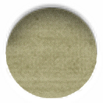
the deadlies
Make 7 small strips of paper
Write the following words: alcohol, drugs, sex, work, money, food, family/friends
Place the strips in a bowl/envelope and mix up
Person A draws out one slip and shares the word
Person B: list 5 ways in which it has had a negative impact on your life. (If the word seems difficult or inapplicable to you, consider this resistance.)
Each repeat several times. If you get the same word twice, do it again. “Very often, it’s the last impact on the final list of an annoying “Oh no, not again” that yields a break, through denial, into clarity.”

Slide 4
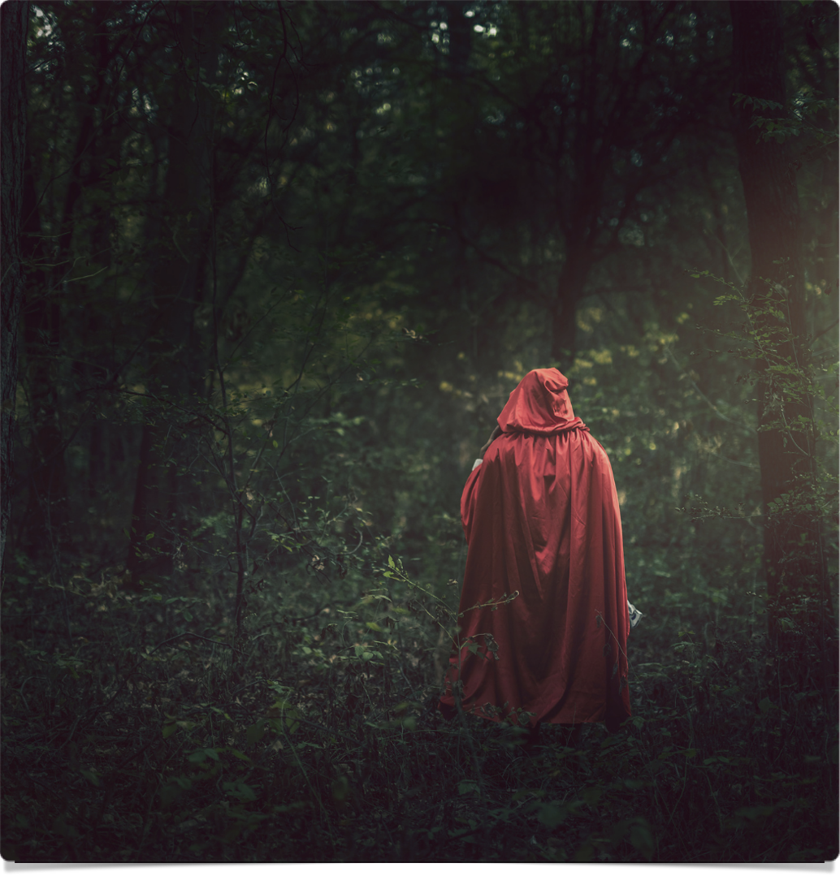
Dangers to the trail
“Every creative person has myriad ways to block creativity.” → we become obsessed with other things in order to avoid engaging in our creativity : eating junk food, drugs, work & busy-ness, painful love, sex, social media
“The minute a creative thought raises its head, it is lopped off by the obsession, which blocks fear and prevents risk.”
“Now, note carefully that food, work, and sex are all good in themselves. It is the abuse of them that makes them creativity issues.“
“Knowing yourself as an artist means acknowledging which of these you abuse when you want to block yourself.”

Slide 5
Dangers to the trail
“We begin to sense our real potential and the wide range of possibilities open to us. That scares us. So we all reach for blocks to slow our growth.”
“If we are honest with ourselves, we all know which blocks are the toxic ones for us. Clue: this is the block we defend as our right. Line up the possibilities. Which one makes you angry to even think about giving up? That explosive one is the one that has caused you the most derailment. Examine it. When asked to name our poison, most of us can.”
“The object of all of this blocking is to alleviate fear. The choice to block is a creative U-turn.”
“It takes grace and courage to admit and surrender our blocking devices. Who wants to? Not while they are still working!”

Slide 6
“Our deepest fear is not that we are inadequate. Our deepest fear is that we are powerful beyond measure. It is our light, not our darkness that most frightens us. We ask ourselves, 'Who am I to be brilliant, gorgeous, talented, fabulous?' Actually, who are you not to be? You are a child of God. Your playing small does not serve the world. There is nothing enlightened about shrinking so that other people won't feel insecure around you. We are all meant to shine, as children do. We were born to make manifest the glory of God that is within us. It's not just in some of us; it's in everyone. And as we let our own light shine, we unconsciously give other people permission to do the same. As we are liberated from our own fear, our presence automatically liberates others.”
~Marianne Williamson

Slide 7
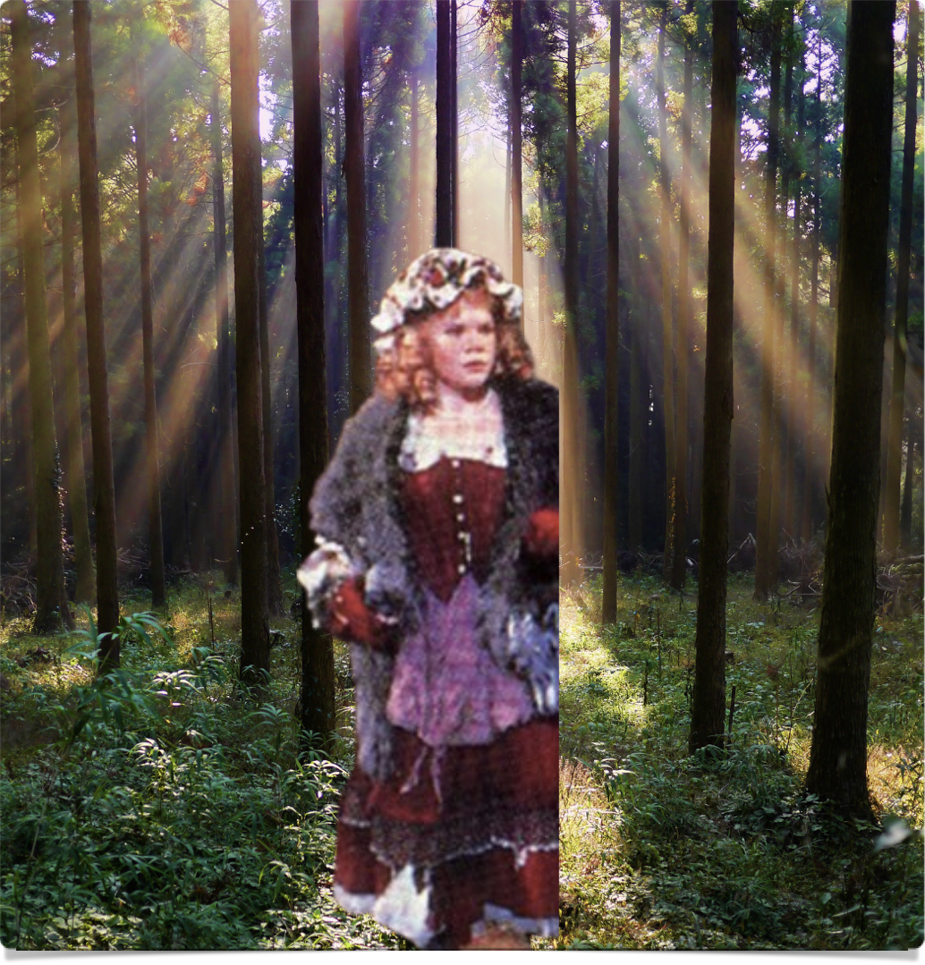
Dangers to the trail
“Rather than paint, write, dance, audition, and see where it takes us, we pick up a block. Blocked, we know who and what we are: unhappy people. Unblocked, we may be something much more threatening—happy.”
“For most of us, happy is terrifying, unfamiliar, out of control, too risky! Is it any wonder we take temporary U-turns?”
“As we become aware of our blocking devices—food, busyness, alcohol, sex, other drugs—we can feel our U-turns as we make them. The blocks will no longer work effectively."
“Over time, we will try—perhaps slowly at first and erratically—to ride out the anxiety and see where we emerge. Anxiety is fuel. We can use it to write with, paint with, work with.”

Slide 8
workaholism quiz
I work outside of office hours: seldom, often, never?
I cancel dates with loved ones to do more work: seldom, often, never?
I postpone outings until the deadline is over: seldom, often, never?
I take work with me on weekends: seldom, often, never?
I take work with me on vacations: seldom, often, never?
I take vacations: seldom, often, never?
My intimates complain I always work: seldom, often, never?
I try to do two things at once: seldom, often, never?
I allow myself free time between projects: seldom, often, never?
I allow myself to achieve closure on tasks: seldom, often, never?
I procrastinate in finishing up the last loose ends: seldom, often, never
I set out to do one job and start on three more at the same time: seldom, often, never?
I work in the evenings during family time: seldom, often, never?
I allow calls to interrupt—and lengthen—my work day: seldom, often, never?
I prioritize my day to include an hour of creative work/play: seldom, often, never?
I place my creative dreams before my work: seldom, often, never?
I fall in with others’ plans and fill my free time with their agendas: seldom, often, never?
I allow myself down time to do nothing: seldom, often, never?
I use the word deadline to describe and rationalize my work load: seldom, often, never?
Going somewhere, even to dinner, with a notebook or my work numbers is something I do: seldom, often, never?

Slide 9
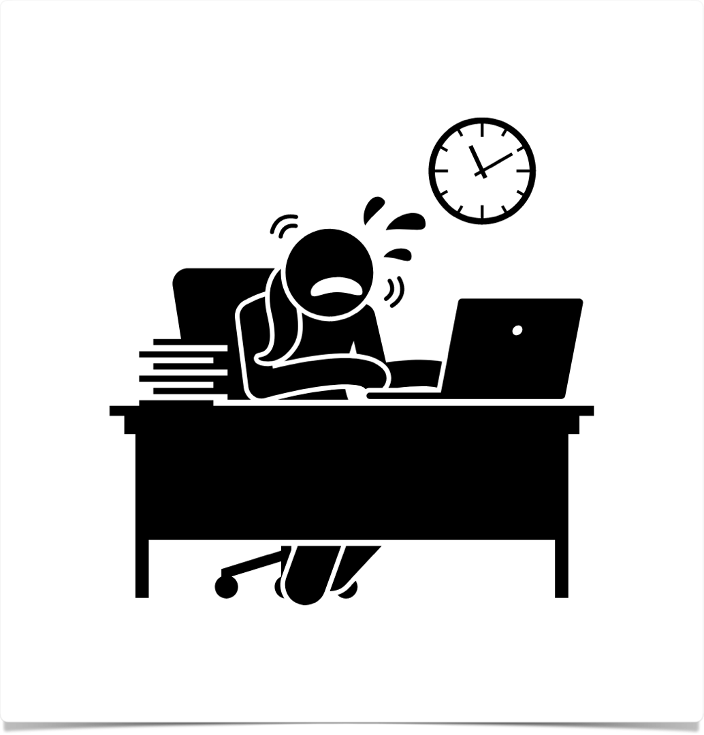
Workaholism
“If people are too busy to write morning pages, or too busy to take an artist date, they are probably too busy to hear the voice of authentic creative urges. To return to the concept of a radio set, the workaholic jams the signals with self-induced static.”
“Play can make a workaholic very nervous. Fun is scary.”
“‘If I had more time, I’d have more fun,’ we like to tell ourselves, but this is seldom the truth. To test the validity of this assertion, ask yourself how much time you allot each week to fun: pure, unadulterated, nonproductive fun?”

Slide 10
Workaholism
“In order to recover our creativity, we must learn to see workaholism as a block instead of a building block.”
“There is a difference between zestful work toward a cherished goal and workaholism. That difference lies less in the hours than it does in the emotional quality of the hours spent. There is a treadmill quality to workaholism.”
"For a workaholic, work is synonymous with worth, and so we are hesitant to jettison any part of it.”
“One way to achieve clarity about our time expenditures is to keep a daily checklist and record of our time spent. Even an hour of creative work/play can go a long way toward offsetting the sense of workaholic desperation that keeps our dreams at bay.”
“Because workaholism is a process addiction (an addiction to a behavior rather than a substance), it is difficult to tell when we are indulging in it… The trick is to define overwork—and this is where we often lie to ourselves, bargaining to hold on to those abusive behaviors that still serve us.”
Post this sign where you will see it: “Workaholism is a block, not a building block.”

Slide 11
truth or truth
Tell the truth. What habit do you have that gets in the way of your creativity?
Tell the truth. What do you think might be a problem? It is.
What do you plan to do about the habit or problem?
What is your payoff in holding on to this block?

Slide 12
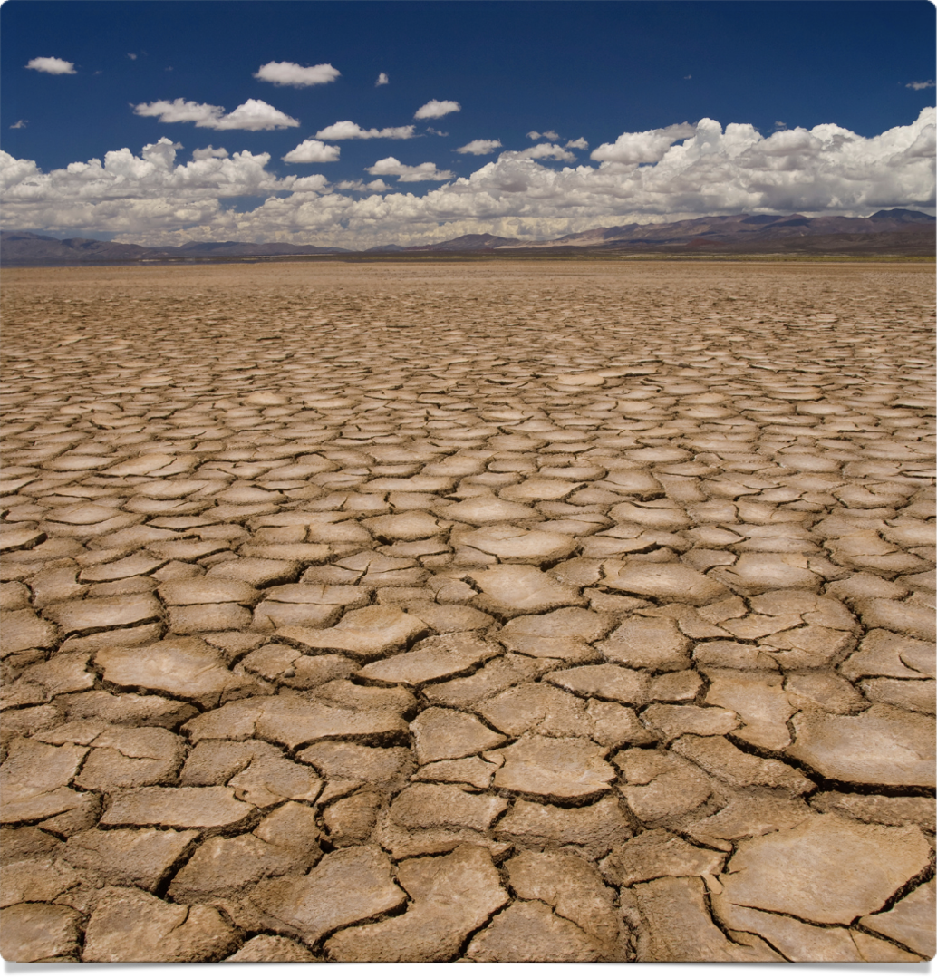
drought
“In any creative life there are dry seasons.”
“Life loses its sweetness; our work feels mechanical, empty, forced. We feel we have nothing to say, and we are tempted to say nothing.”
“These are the times when the morning pages are the most difficult and most valuable.”
“During a drought (during a doubt, I just accurately wrote with a slip of the finger),” we seek water/comfort/solace → use the tool of the morning pages: “To write is to right things.”
“A path will emerge. An insight will be a landmark that shows the way out of the wilderness. Dancer, sculptor, actor, painter, playwright, poet, performance artist, potter, artists all—the morning pages are both our wilderness and our trail.”

Slide 13
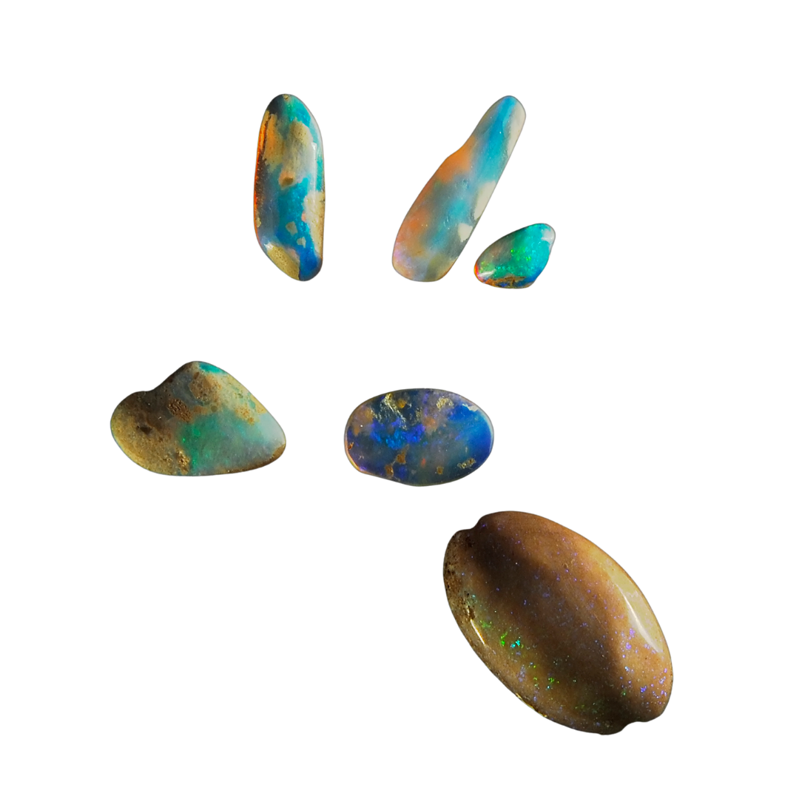
touchstones
Make a quick list of things you love, happiness touchstones for you.
  Eg. River rocks worn smooth, willow trees, cornflowers, chicory, real Italian bread, homemade vegetable soup, the Bo Deans’ music, black beans and rice, the smell of new-mown grass, blue velvet (the cloth and the song), Aunt Minnie’s crumb pie …

Slide 14
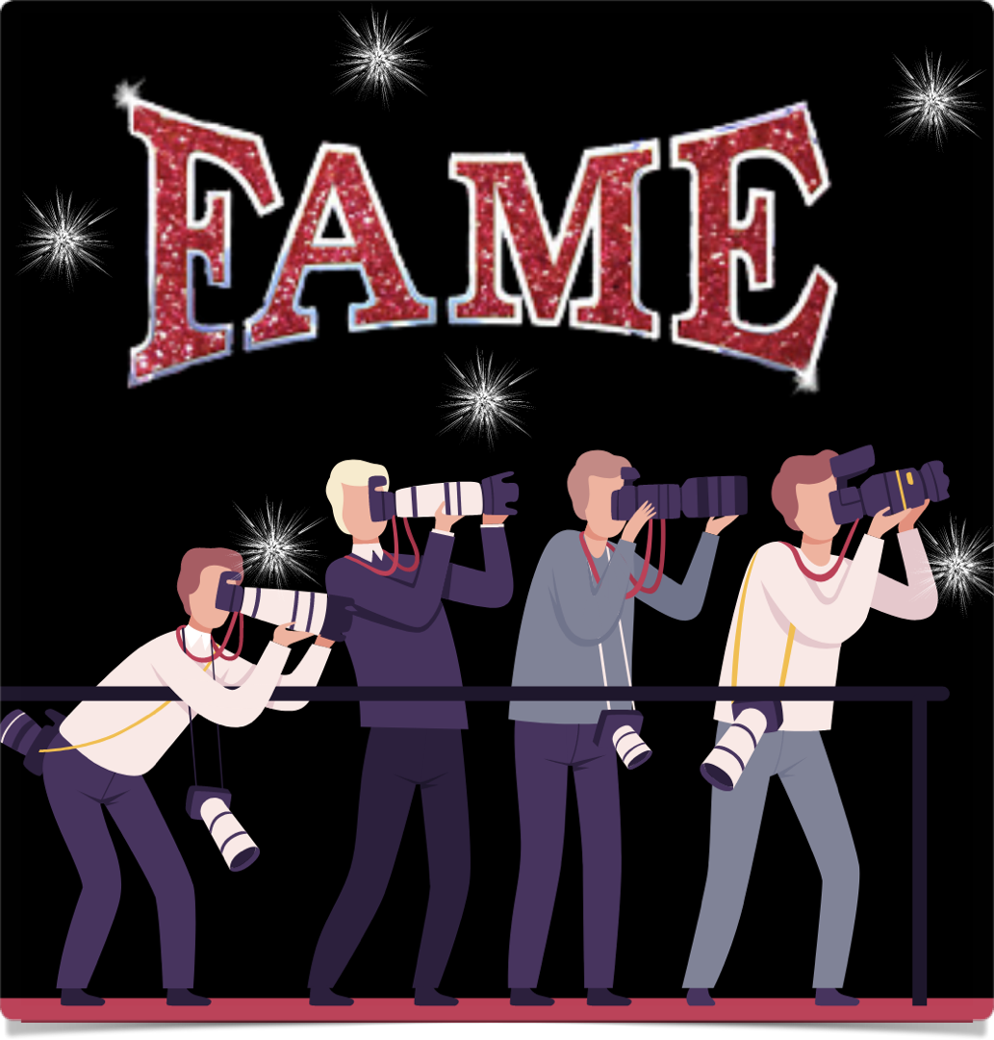
FAME
“Fame encourages us to believe that if it hasn’t happened yet, it won’t happen. Fame is not the same as success, and in our true souls we know that. We know—and have felt—success at the end of a good day’s work. But fame? It is addictive, and it always leaves us hungry.”
“Fame is a spiritual drug. It is often a by-product of our artistic work, but like nuclear waste, it can be a very dangerous by-product. Fame, the desire to attain it, the desire to hold on to it, can produce the ‘How am I doing?’ syndrome. This question is not ‘Is the work going well?’ This question is ‘How does it look to them?’”
“The point of the work is the work. Fame interferes with that perception. Instead of acting being about acting, it becomes about being a famous actor. Instead of writing being about writing, it becomes about being recognized, not just published.”
“We all like credit where credit is due. As artists, we don’t always get it. Yet, focusing on fame—on whether we are getting enough—creates a continual feeling of lack.”
Send yourself a fan letter/postcard — “You’re doing great!” In the long run, fan letters from ourselves—and our creative self—are what we are really after. Fame is really a shortcut for self-approval. Try approving of yourself just as you are—and spoiling yourself rotten with small kid’s pleasures.”
The antidote to the fear of not being loved is “concrete, small, loving actions. We must actively, consciously, consistently, and creatively nurture our artist selves.”

Slide 15
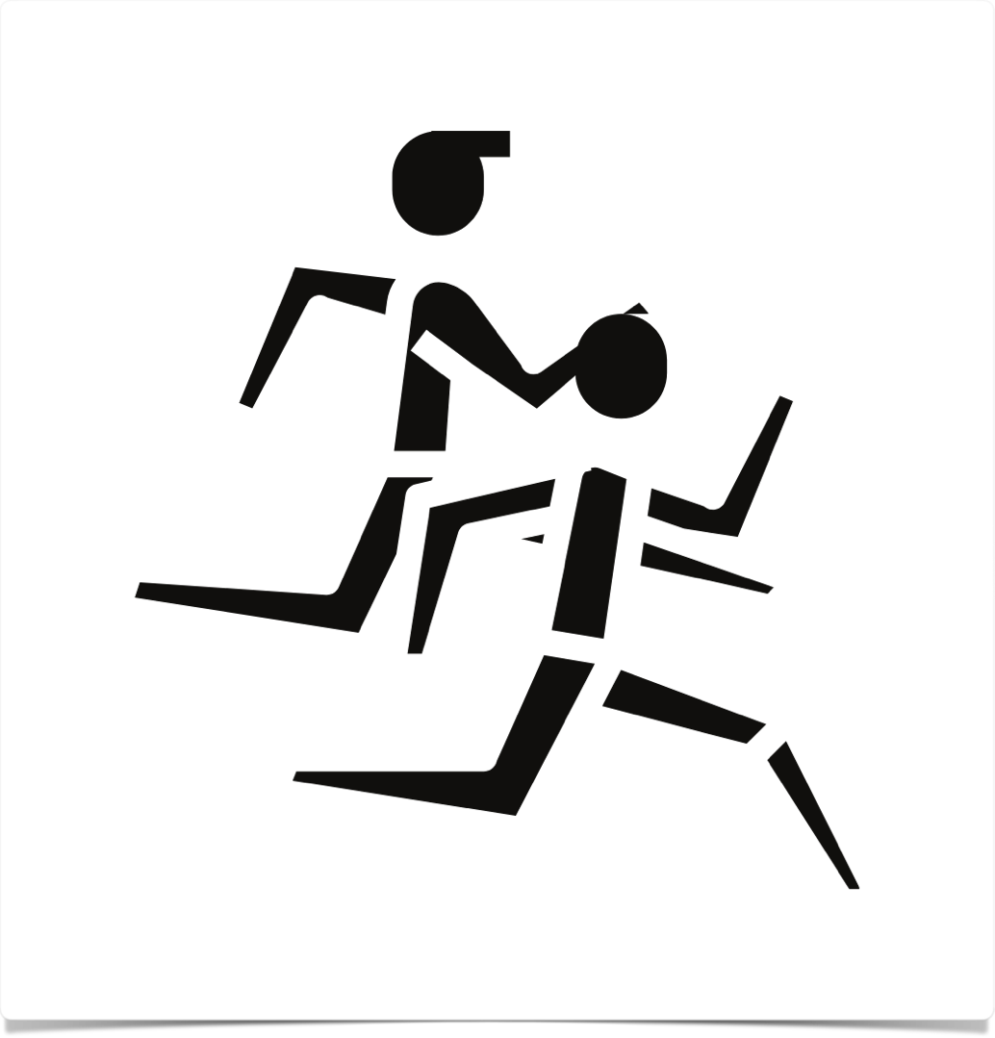
competition
“Competition is another spiritual drug. When we focus on competition we poison our own well, impede our own progress. When we are ogling the accomplishments of others, we take our eye away from our own through line.”
“We ask ourselves the wrong questions, and those wrong questions give us the wrong answers. ‘Why do I have such rotten luck?’ 'Why did he get his movie/article/play out before I got mine out?’ ‘What’s the use?’ ‘What do I have to offer?’ We often ask these questions as we try to talk ourselves out of creating.”
Competitive thinking “asks us to define our own creativity in terms of someone else’s.”
“Whenever you are angered about someone else beating you out, remember this: the footrace mentality is always the ego’s demand to be not just good but also first and best.” — an impossible task!
“All work is influenced by other work. All people are influenced by other people. No man is an island and no piece of art is a continent unto itself.”
Competitive thinking leads to too-early-criticism, not allowing incubation, seeking outside approval, or not doing the work at all
More helpful questions:
  Did I work on my play today?
  Did I make the deadline to mail it off where it needed to go?
  Have I done any networking on the play’s behalf?

Slide 16
week 10 tasks
The Deadlies (strips of paper)
Touchstones
  Post your list where it can console you and remind you of the things you love & that make you happy
  Draw the items, or acquire them. Eg. If you love blue velvet, get a remnant and use it as a runner on a sideboard or dresser, or tack it to the wall and mount images on it. Play a little.
The Awful Truth: continue to work through questions
Setting a Bottom Line
  Using your answers from number 3, try setting a bottom line for yourself
  Eg. If you notice your evenings are typically gobbled by your boss’s extra assignments, then a rule must come into play: no work after six. If you wake at six and could write for an hour if you were not interrupted to look for socks and make breakfast and do ironing, the rules might be “No interrupting Mommy before 7:00 A.M.” If you are working too many jobs and too many hours, you may need to look at your billing. Are you pricing yourself appropriately? Do some footwork. What are others in your field receiving? Raise your prices and lower your work load.

Slide 17
week 10 tasks
Cherishing
  List five small victories
  List three nurturing actions you took for your artist.
  List three actions you could take to comfort your artist.
  Make three nice promises to yourself. Keep them.
  Do one lovely thing for yourself each day this week.

