Slide 1
Week 11
Recovering a Sense of Autonomy

Slide 2
“This week we focus on our artistic autonomy. We examine the ongoing ways in which we must nurture and accept ourselves as artists. We explore the behaviors that can strengthen our spiritual base and, therefore, our creative power. We take a special look at the ways in which success must be handled in order that we not sabotage our freedom.”
-Julia Cameron

Slide 3

acceptance
“I AM AN ARTIST. As an artist, I may need a different mix of stability and flow from other people. I may find that a nine-to-five job steadies me and leaves me freer to create. Or I may find that a nine-to-five drains me of energy and leaves me unable to create. I must experiment with what works for me.”
“An artist’s cash flow is typically erratic. No law says we must be broke all the time, but the odds are good we may be broke some of the time.” → good work won’t sell, market is bad right now, factors out of our control → “Being true to the inner artist often results in work that sells—but not always.”
“I have to free myself from determining my value and the value of my work by my work’s market value. The idea that money validates my credibility is very hard to shake.”
“I must learn that as an artist my credibility lies with me, and my work (and God).”
“I need to create what wants to be created. I cannot plan a career to unfold in a sensible direction dictated by cash flow and marketing strategies. Those things are fine; but too much attention to them can stifle the child within, who gets scared and angered when continually put off. Children, as we all know, do not deal well with ‘Later. Not now.’”
“Since my artist is a child, the natural child within, I must make some concessions to its sense of timing. Some concessions does not mean total irresponsibility.”
“Sometimes I will write badly, draw badly, paint badly, perform badly. I have a right to do that to get to the other side. Creativity is its own reward.”

Slide 4
acceptance
“As an artist, I must be very careful to surround myself with people who nurture my artist—not people who try to overly domesticate it for my own good. Certain friendships will kick off my artistic imagination and others will deaden it.”
"As an artist, my self-respect comes from doing the work. One performance at a time, one gig at a time, one painting at a time.”
“Throughout it all, daily, I show up at the morning pages”
“As an artist, I can literally die from boredom. I kill myself when I fail to nurture my artist child because I am acting like somebody else’s idea of an adult. The more I nurture my artist child, the more adult I am able to appear. Spoiling my artist means it will let me type a business letter. Ignoring my artist means a grinding depression.”
“Creativity is oxygen for our souls.” → when we can’t create “we will react as if we are fighting for our lives— we are.”
“To be an artist is to recognize the particular. To appreciate the peculiar. To allow a sense of play in your relationship to accepted standards. To ask the question “Why?” To be an artist is to risk admitting that much of what is money, property, and prestige strikes you as just a little silly. “
“To be an artist is to acknowledge the astonishing.”
We have been given the gift of creativity. Our use of it is a gift back to the world. “Accepting this bargain is the beginning of true self-acceptance.”

Slide 5

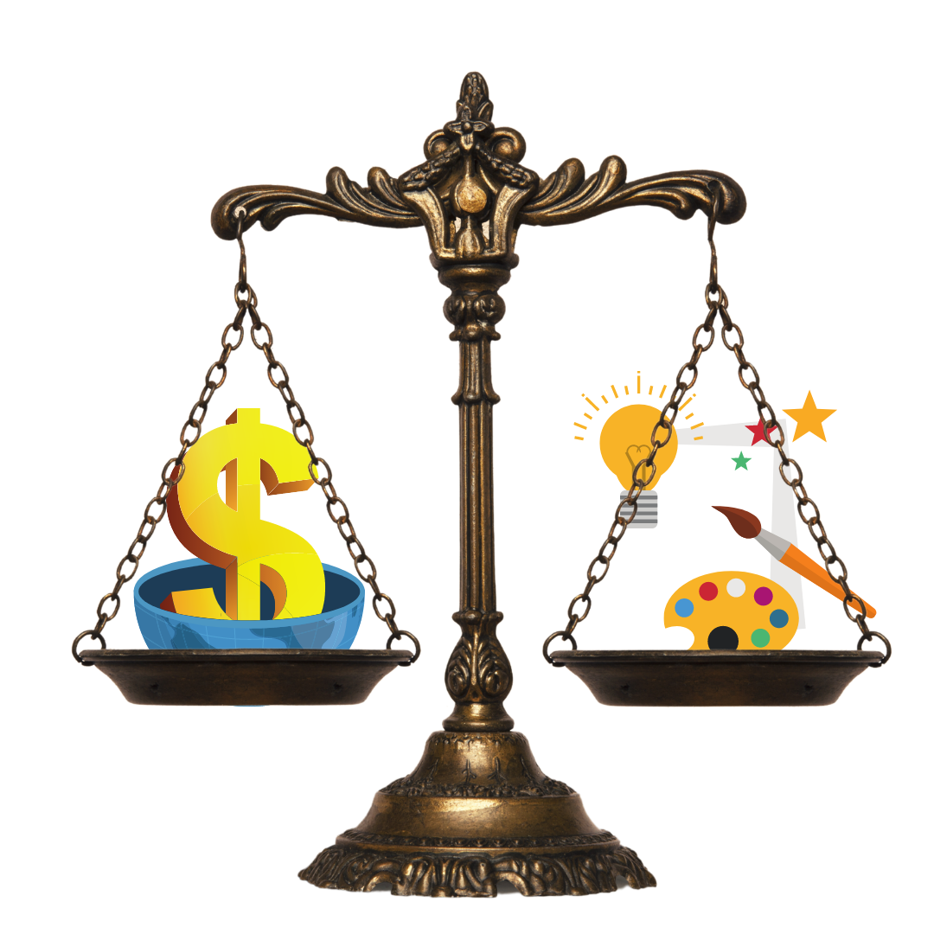
business v creativity

Slide 6


success
“Creativity is an on-going practice. It is not something that can be perfected, finished, and set aside.”
“It is my experience that we reach plateaus of creative attainment only to have a certain restlessness set in. Yes, we are successful. Yes, we have made it, but … In other words, just when we get there, there disappears.”
“This unfinished quality, this restless appetite for further exploration, tests us. We are asked to expand in order that we not contract.”
“The choice is very simple: we can insist on resting on our laurels, or we can begin anew. The stringent requirement of a sustained creative life is the humility to start again, to begin anew.”
“We insist on a straight and narrow when the Artist’s Way is a spiral path. Invested in the outer trappings of a career, we can place that investment above our inner guidance. Deciding to play by the numbers, we lose our commitment to counting ourselves and our own goals worthy.”
“You don’t need to overturn a successful career in order to find creative fulfillment. It is necessary to overturn each day’s schedule slightly to allow for those small adjustments in daily trajectory that, over the long haul, alter the course and the satisfactions of our careers.” → morning pages & artist date!
“Artists can and do responsibly meet the demands of their business partnerships. What is more difficult and more critical is for us as artists to continue to meet the inner demand of our own artistic growth.”
“In short, as success comes to us, we must be vigilant. Any success postulated on a permanent artistic plateau dooms us, and it, to failure.”

Slide 7

The zen of sports
“Most blocked creatives are cerebral beings. We think of all the things we want to do but can’t. Early in recovery, we next think of all the things we want to do but don’t.”
“In order to effect a real recovery, one that lasts, we need to move out of the head and into a body of work. To do this, we must first of all move into the body.”
Take a 20min walk a day; think of it like a moving meditation. “The object is to stretch your mind more than your body, so there doesn’t need to be an emphasis on fitness, although eventual fitness is a likely result.” → walk/run/swim/cycle
“The goal is to connect to a world outside of us, to lose the obsessive self-focus of self-exploration and, simply, explore.”
“As we said before, we learn by going where we have to go. Exercise is often the going that moves us from stagnation to inspiration, from problem to solution, from self-pity to self-respect. We do learn by going.”
Webster’s definition of exercise: “the act of bringing into play or realizing in action”

Slide 8
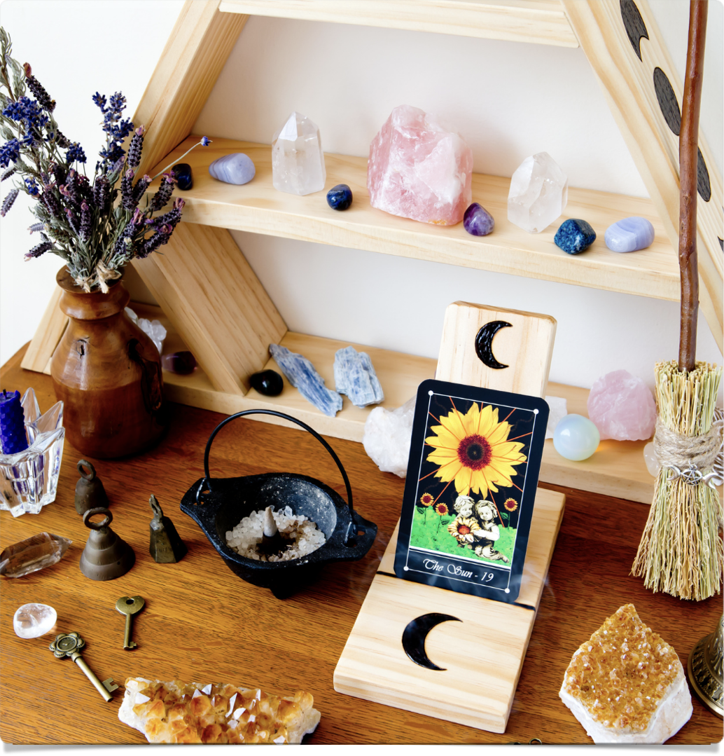
artist’s altar
“Morning pages as meditation.”
“In order to stay easily and happily creative, we need to stay spiritually centered. This is easier to do if we allow ourselves centering rituals.”
“Many blocked creatives grew up in punitively religious homes. For us to stay happily and easily creative, we need to heal from this, becoming spiritually centered through creative rituals of our own. A spiritual room or even a spiritual corner is an excellent way to do this.”
“This haven can be a corner of a room, a nook under the stairs, even a window ledge. It is a reminder and an acknowledgment of the fact that our creator unfolds our creativity.”
“Fill it with things that make you happy. Remember that your artist is fed by images. We need to unlearn our old notion that spirituality and sensuality don’t mix. An artist’s altar should be a sensory experience.”
“Small rituals, self-devised, are good for the soul. Burning incense while reading affirmations or writing them, lighting a candle, dancing to drum music, holding a smooth rock and listening to Gregorian chant—all of these tactile, physical techniques reinforce spiritual growth.”
“Remember, the artist child speaks the language of the soul: music, dance, scent, shells … Your artist’s altar to the creator should be fun to look at, even silly. Remember how much little kids like gaudy stuff. Your artist is a little kid, so …”

Slide 9
do we need “god” or a “higher power” in order to be creative artists?

Slide 10
week 11 tasks
Tape your own voice reading the Basic Principles. (See page 3). Choose a favorite essay from this book and tape that as well. Use this tape for meditation.
Write out, in longhand, your Artist’s Prayer from Week Four. Place it in your wallet.
Buy yourself a special creativity notebook. Number pages one through seven. Give one page each to the following categories: health, possessions, leisure, relationships, creativity, career, and spirituality. With no thought as to practicality, list ten wishes in each area. All right, it’s a lot. Let yourself dream a little here.
Working with the Honest Changes section in Week Four, inventory for yourself the ways you have changed since beginning your recovery.
List five ways you will change as you continue.
List five ways you plan to nurture yourself in the next six months: courses you will take, supplies you will allow yourself, artist’s dates, and vacations just for you.
Take out a piece of paper and plan one week’s nurturing for yourself. This means one concrete, loving action every single day for one week: please binge!
Write and mail an encouraging letter to your inner artist. This sounds silly and feels very, very good to receive. Remember that your artist is a child and loves praise and encouragement and festive plans.
Once more, reexamine your God concept. Does your belief system limit or support your creative expansion? Are you open minded about altering your concept of God?
List ten examples of personal synchronicity that support the possibility of a nurturing creative force

