Slide 1
week 12
Recovering a Sense of Faith

Slide 2
“In this final week, we acknowledge the inherently mysterious spiritual heart of creativity. We address the fact that creativity requires receptivity and profound trust—capacities we have developed through our work in this course. We set our creative aims and take a special look at last-minute sabotage. We renew our commitment to the use of the tools.”
-Julia Cameron

Slide 3


trusting
“Creativity requires faith. Faith requires that we relinquish control.”
“This is frightening, and we resist it. Our resistance to our creativity is a form of self-destruction. We throw up roadblocks on our own path. Why do we do this? In order to maintain an illusion of control.”
“Depression, like anger and anxiety, is resistance, and it creates dis-ease. This manifests itself as sluggishness, confusion, ‘I don’t know …’”
“The truth is, we do know and we know that we know.”
“Each of us has an inner dream that we can unfold if we will just have the courage to admit what it is.”
“This resistance is really very understandable… We have bought the message of our culture: this world is a vale of tears and we are meant to be dutiful and then die. The truth is that we are meant to be bountiful and live.”
“There is a path for each of us. When we are on our right path, we have a surefootedness. We know the next right action—although not necessarily what is just around the bend. By trusting, we learn to trust.”

Slide 4

mystery
“Do not fear mistakes — there are none.” Miles Davis
“Creativity—like human life itself—begins in darkness. We need to acknowledge this. All too often, we think only in terms of light: ‘And then the lightbulb went on and I got it!’'
“Ideas, like stalactites and stalagmites, form in the dark inner cave of consciousness. They form in drips and drops, not by squared-off building blocks. We must learn to wait for an idea to hatch. Or, to use a gardening image, we must learn to not pull our ideas up by the roots to see if they are growing.”
“The creative process is a process of surrender, not control.”
“Mystery is at the heart of creativity. That, and surprise.”
You have to leave the bread in order to let it rise →“ Creativity requires a respectful reticence.” (synonyms for reticence: silence, reserve, restraint)
“Let [your ideas] grow in dark and mystery. Let them form on the roof of our consciousness. Let them hit the page in droplets. Trusting this slow and seemingly random drip, we will be startled one day by the flash of ‘Oh! That’s it!’”

Slide 5

The imagination at play
“We are an ambitious society, and it is often difficult for us to cultivate forms of creativity that do not directly serve us and our career goals.”
"The experience of creative living argues that hobbies are in fact essential to the joyful life.”
“Many hobbies involve a form of artist-brain mulling that leads to enormous creative breakthroughs. When I have screenwriting students stuck at the midpoint of act two, I ask them to please go do their household mending. They usually balk, offended by such a mundane task, but sewing has a nice way of mending up plots. Gardening is another hobby I often assign to creativity students.”
“It is a paradox of creative recovery that we must get serious about taking ourselves lightly.”
“As gray, as controlled, as dreamless as we may strive to be, the fire of our dreams will not stay buried. The embers are always there, stirring in our frozen souls like winter leaves. They won’t go away. They are sneaky. We make a crazy doodle in a boring meeting. We post a silly card on our office board. We nickname the boss something wicked. Plant twice as many flowers as we need.”
“Restive in our lives, we yearn for more, we wish, we chafe. We sing in the car, slam down the phone, make lists, clear closets, sort through shelves. We want to do something but we think it needs to be the right something, by which we mean something important.”
“We are what’s important, and the something that we do can be something festive but small: dead plants go; mismatched socks bite the dust. We are stung by loss, bitten by hope.”

Slide 6
“Your shoes feel worn. You throw them out. There’s a garage sale coming and you are playing host. You buy a first edition, splurge on new sheets. A friend worries once too often about what’s come over you and you take your first vacation in years. The clock is ticking and you’re hearing the beat. You stop by a museum shop, sign your name on a scuba-diving sheet, and commit yourself to Saturday mornings in the deep end. “You’re either losing your mind—or gaining your soul. Life is meant to be an artist date. That’s why we were created..”

Slide 7
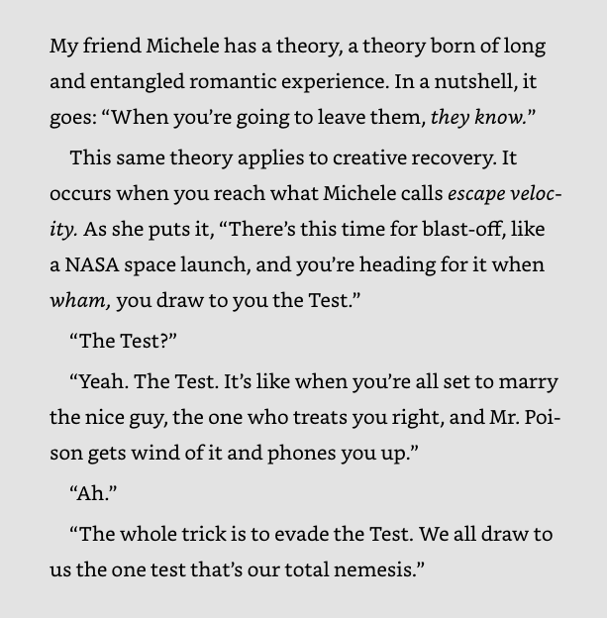

escape velocity

Slide 8
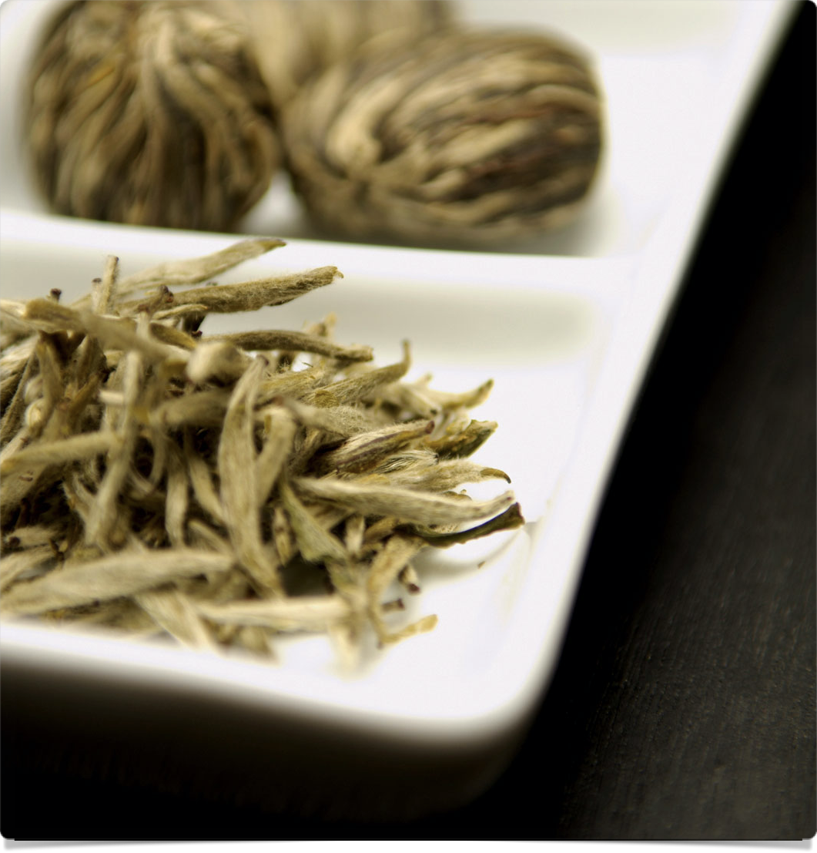
escape velocity
“I thought of all the times I’d been fooled. There was the agent who managed to undo done deals but apologized so prettily…. There was the editor who asked for rewrite upon rewrite until gruel was all that remained, but who always said I wrote brilliantly and was her brightest star. A little flattery can go a long way toward deterring our escape velocity. So can a little cash. More sinister than either is the impact a well-placed doubt can have, particularly a “for your own good, just wanting to make sure you’ve thought about this” doubt—voiced by one of our nearest and dearest.”
“As recovering creatives, many of us find that every time our career heats up we reach for our nearest Wet Blanket.”
“In order to achieve escape velocity, we must learn to keep our own counsel, to move silently among doubters, to voice our plans only among our allies, and to name our allies accurately.”
“Make a list: those friends who will support me. Make another list: those friends who won’t. Name your W.B.’s for what they are—Wet Blankets. Wrap yourself in something else—dry ones. Fluffy heated towels. Do not indulge or tolerate anyone who throws cold water in your direction. Forget good intentions. Forget they didn’t mean it. Remember to count your blessings and your toes. Escape velocity requires the sword of steely intention and the shield of self-determination.”

Slide 9
week 12 tasks
Write down any resistance, angers, and fears you have about going on from here. We all have them.
Take a look at your current areas of procrastination. What are the payoffs in your waiting? Locate the hidden fears. Do a list on paper.
Sneak a peek at Week One, Core Negative Beliefs (see page 30.) Laugh. Yes, the nasty critters are still there.Note your progress. Read yourself the affirmations on pages 36 and 37. Write some affirmations about your continued creativity as you end the course.
Mend any mending.
Repot any pinched and languishing plants.
Select a God jar. A what? A jar, a box, a vase, a container. Something to put your fears, your resentments, your hopes, your dreams, your worries into.
Use your God jar. Start with your fear list from Task 1 above. When worried, remind yourself it’s in the jar—“God’s got it.” Then take the next action.
Now, check how: Honestly, what would you most like to create? Open-minded, what oddball paths would you dare to try? Willing, what appearances are you willing to shed to pursue your dream? 9. List five people you can talk to about your dreams and with whom you feel supported to dream and then plan.
Reread this book. Share it with a friend. Remember that the miracle is one artist sharing with another. Trust God. Trust yourself.

