Slide 1
Chapter one
recovering a sense of safety

Slide 2
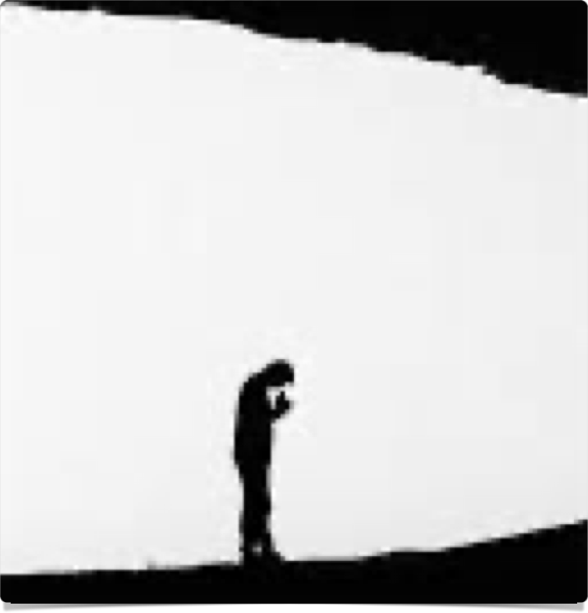

shadow artists
“One of our chief needs as creative beings is support. Unfortunately this can be hard to come by.”
“Timid young artists, adding parental fears to their own, often give up their sunny dreams of artistic careers, settling into the twilight world of could-have-beens and regrets. There, caught between the dream of action and the fear of failure, shadow artists are born.”
Belief that art belongs to other people: being in the shadow of other artists
“In order to move from the realm of shadows into the light of creativity, shadow artists must learn to take themselves seriously. With gentle deliberate effort, they must nurture their artist child. Creativity is play, but for shadow artists, learning to allow themselves to play is hard work.”

Slide 3
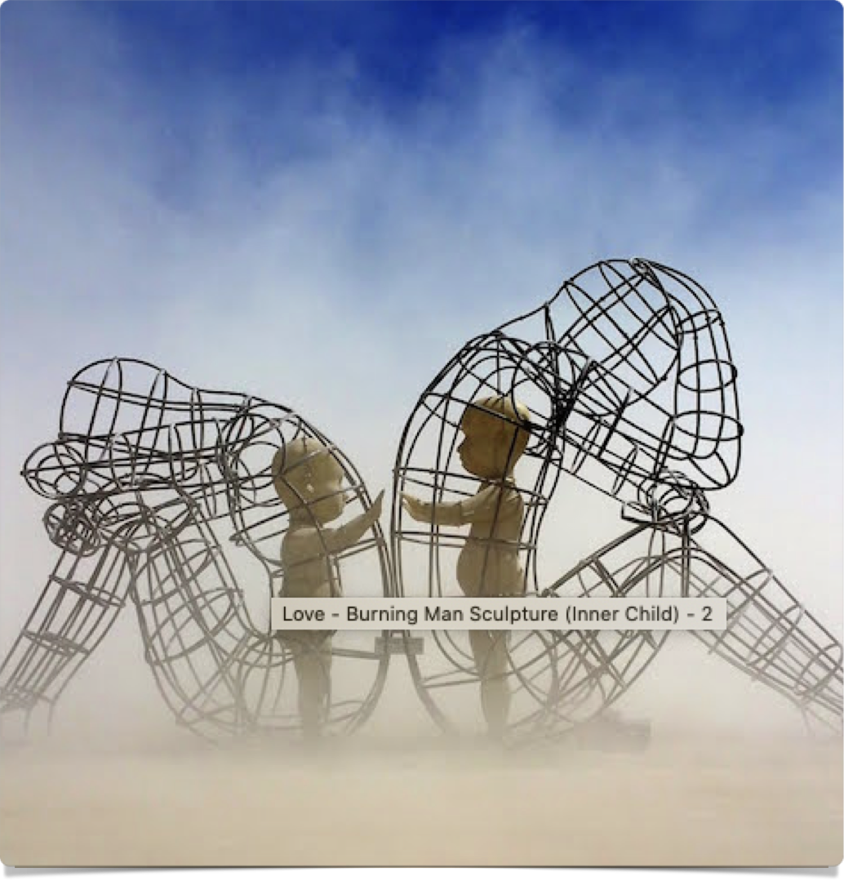
inner child
“Remember, your artist is a child”
“Judging your early artistic efforts is artistic abuse”
“In recovering from our creative blocks, it is necessary to go gently and slowly”
“It is an awkward, tentative, even embarrassing process.”
“Remember that in order to recover as an artist, you must be willing to be a bad artist. Give yourself permission to be a beginner.”
Do you know how old I’ll be by the time I learn to really play the piano/act/write a decent play? The same age you’ll be if you don’t. Let’s start.
Alexander Milov

Slide 4

core negative beliefs
If I’m fully creative, what will it mean? What will happen to me and to others?
Internalized negative beliefs

Slide 5
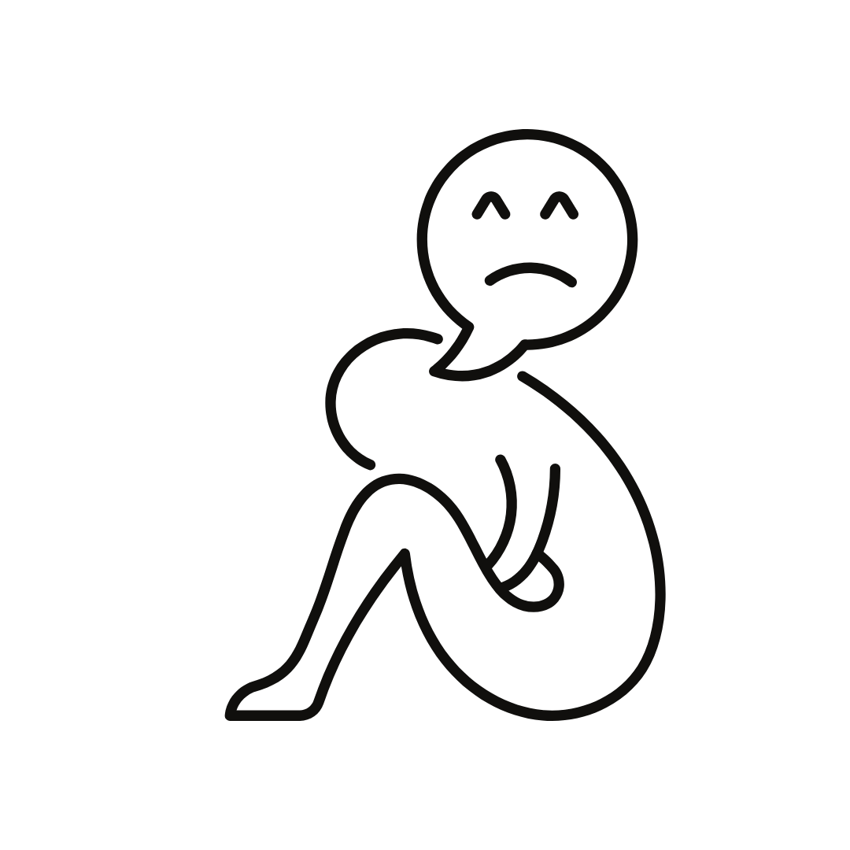
1. Everyone will hate me
2. I will hurt my friends and family
3. I will go crazy
4. I will abandon my friends and family
5. I can’t spell

Slide 6

beliefs are not facts
“None of these core negatives need be true. They come to us from our parents, our religion, our culture, and our fearful friends.”
“You are not dumb, crazy, egomaniacal, grandiose, or silly just because you falsely believe yourself to be.”
“What you are is scared. Core negatives keep you scared.”
“Core negatives…always go for your jugular. They attack your sexuality, your lovability, your intelligent, whatever vulnerability they can latch on to.”

Slide 7
  Negative Beliefs
  artists are:
  drunk
  crazy
  broke
  irresponsible
  loners
  promiscuous
  doomed
  unhappy
  born, not made
  Positive Beliefs
  artists are:
  sober
  sane
  solvent
  responsible
  user-friendly
  faithful
  saved
  happy
  discovered & recovered

Slide 8

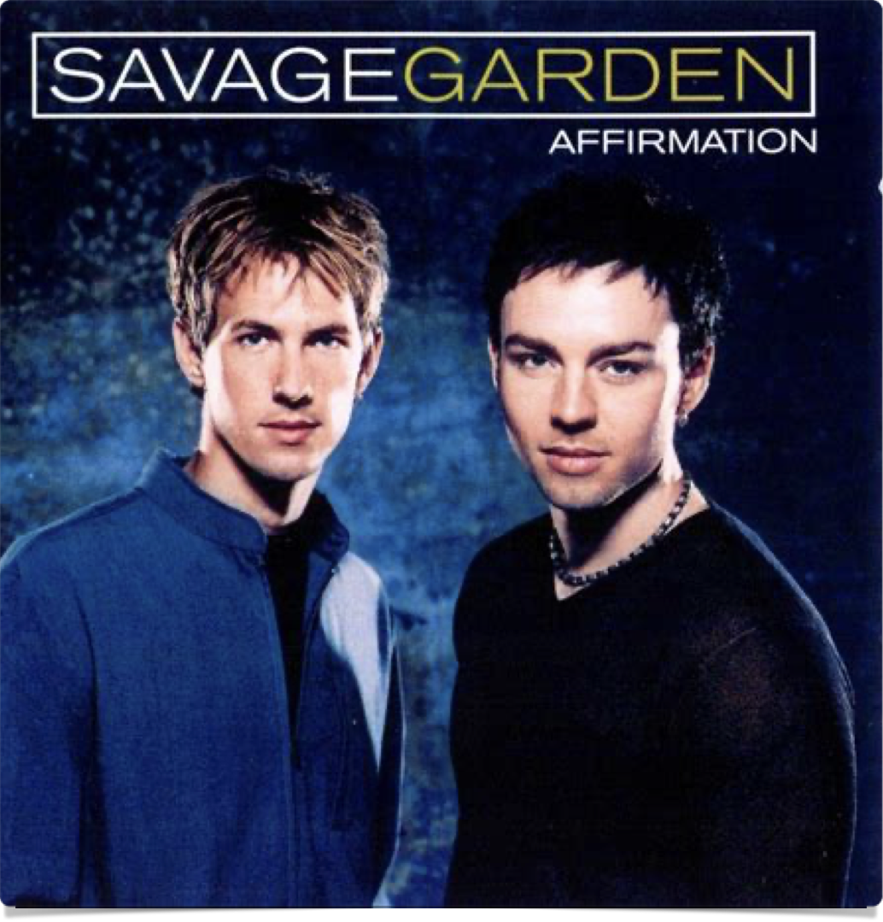
Affirmations
“An affirmation is a positive statement of (positive) belief”
“…if we can become one-tenth as good at positive self-talk as we are at negative self-talk, we will notice an enormous change”.

Slide 9
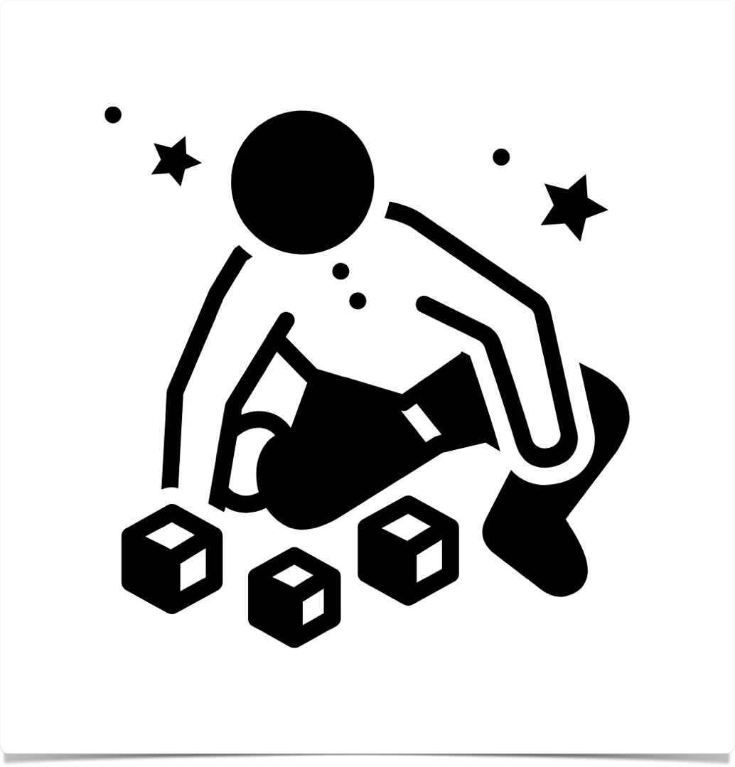
activity time!
Pick one
  “I deserve love,”
  “I deserve fair pay”
  “I deserve a rewarding creative life”
  “I am brilliant and successful artist”
  “I have rich creative talents”
  “I am competent and confident in my creative work”
Write the statement 10x
Listen to the objections or “blurts”

Slide 10
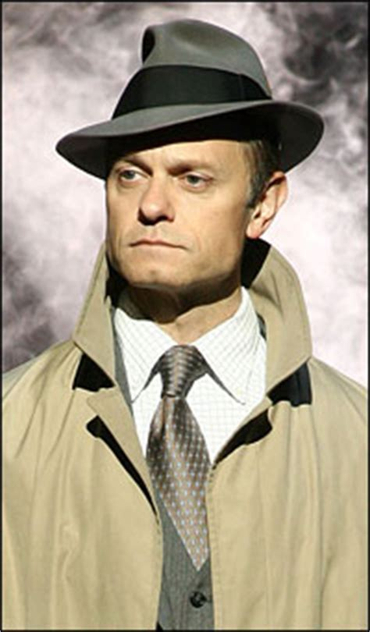
detective work
Write out your negative beliefs or blurts
Where did this belief come from?
    Time travel: breaking life into 5yr increments, & naming biggest influences
Convert into a positive

Slide 11


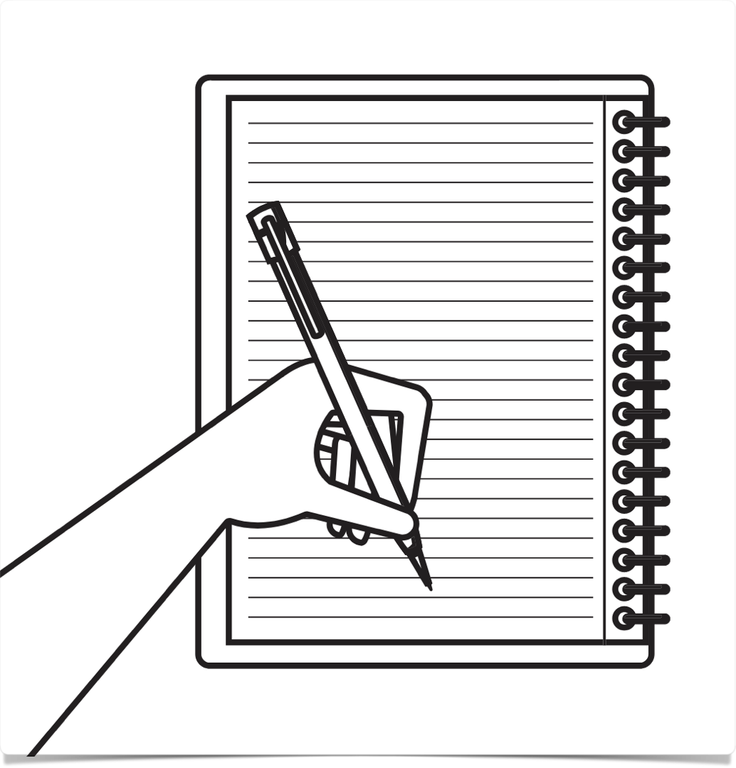


summary
This is not going to be quick & easy
This is a journey
Sacred circle
Morning pages
Artist’s Date

Slide 12
week 1 tasks
Morning pages & affirmations
Artist Date
Time travel & Monster Hall of Fame: list 3 enemies of your creative self-worth
Story from Monster Hall of Fame
Letter to the Editor in Your Defense
Hall of Champions: write out compliments
Write a Thank You Letter
Imaginary Lives
Affirmations and Blurts
Go for a walk

