Slide 1
Artist’s way
2021

Slide 2


what to expect
12 week commitment
We will work through the book together
Read chapter; exercises; share challenges & discoveries

Slide 3

what to expect
“There is no quick fix for instant, pain-free creativity…”
“…creative recovery (or discovery) is a teachable, trackable process”

Slide 4

stages of recovery
Defiance & giddiness
Anger
Grief
Resistance and hope
Bargaining Period: The Creative U-turn
Ego surrender
New sense of self

Slide 5
stages of recovery
“If this sounds like a lot of emotional tumult, it is. When we engage in a creativity recovery, we enter into a withdrawal process from life as we know it.”

Slide 6

the sacred circle
This is a safe place to learn & grow together
“Envy, backbiting, criticism have no place in our midst, nor do ill temper, hostility, sarcasm, chivvying for position.”
“Let there be, always, a place for the artist toddler to try, to falter, to fail, to try again.”
“A believing mirror”: a friend to your creativity, someone who believes in your and your creativity

Slide 7
group rules
Creativity flourishes in a place of safety and acceptance
Creativity grows among friends, withers among enemies
All creative ideas are children who deserve our protection
All creative success requires creative failure
Fulfilling our creativity is a sacred trust

Slide 8
group rules
Violating someone’s creativity violates a sacred trust
Creative feedback must support the creative child, never shame it
Creative feedback must build on strengths, never focus on weaknesses
Success occurs in clusters and is born in generosity
The good of another can never block our own

Slide 9





spiritual electricity
“creator” “artist” “the divine”
the role of the artist
We undertake exercises to achieve alignment with the creative energy of the universe.
synchronicity

Slide 10

“withdrawal”
“Withdrawal is another way of saying detachment or non attachment, which is emblematic of consistent work with any meditation practice.”
“Ordinarily… we think of having a substance removed from us. We give up alcohol, drugs, sugar, fats, caffeine — and we suffer withdrawal. It’s useful to view creative withdrawal a little differently. We ourselves are the substance we withdraw to, not from, as we pull our overextended and misplaced creative energy back into our own core.”

Slide 11

basic principles
Creativity is the natural order of life. Life is energy: pure creative energy
There is an underlying, in-dwelling creative force infusing all of life — including ourselves
When we open ourselves to our creativity, we open ourselves to the creator’s creativity within us and our lives
We are, ourselves, creations. And we, in turn, are meant to continue creativity by being creative ourselves
Creativity is God’s gift to us. Using our creativity is our gift back to God.
The refusal to be creative is self-will and is counter to our true nature
When we open ourselves exploring our creativity, we open ourselves to God: good orderly direction
As we open our creative channel to the creator, many gentle but powerful changes are to be expected
It is safe to open ourselves to greater and greater creativity
Our creative dreams and yearnings come from a divine source. As we move toward our dreams, we move toward our divinity

Slide 12
the non-negotiables
mornings pages & artist date

Slide 13

morning pages
three pages of longhand writing
strictly stream-of-consciousness
there is no wrong way to do morning pages
they are not meant to be art
they are not even meant to be writing
they are the act of moving the hand across the page and writing whatever comes to mind
nobody is allowed to read them except for you (don’t read back for the first 8 weeks or so)
non-negotiable!

Slide 14

morning pages
the censor
You call that writing? You’re a joke!
You can’t spell
You’re too old
You can’t create
You’re not good enough
https://youtu.be/9DDdM66_nSI?t=207

Slide 15
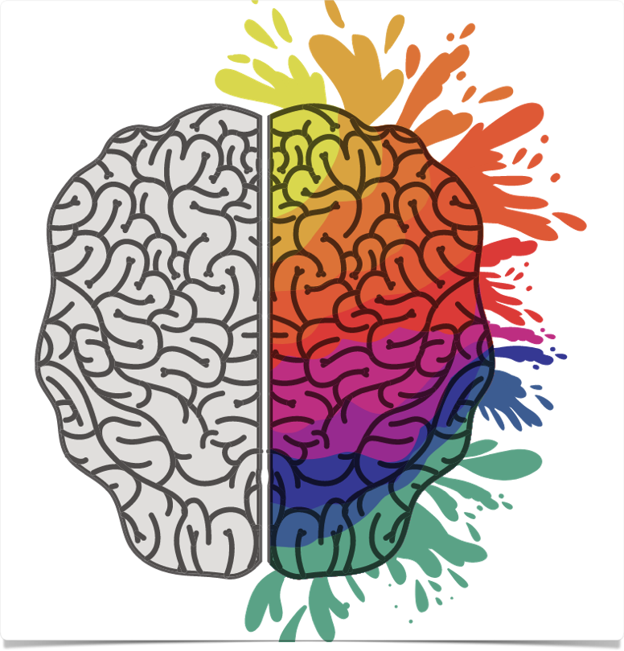
morning pages
Logic brain = survival & censor
Artist brain = creative & holistic
“Morning pages teach logic brain to stand aside and let artist brain play”
A pathway to a strong and clear sense of self

Slide 16

artist date
“A block of time especially set aside and committed to nurturing your creative consciousness, your inner artist”
only for you - “no taggers-on”
“your artist needs to be taken out, pampered, and listened to”
fear = “you are likely to find yourself avoiding your artist date”
fun!

Slide 17

filling the well
“as artist’s we must learn to be self-nourishing. We must become alert enough to consciously replenish our creative resources as we draw on them.”
“…involves the active pursuit of images to refresh our artistic reservoirs. Art is born in attention.”
“We feed [the artist brain] images”
“Think magic. Think delight. Think fun… Do not think what you should do.”
“mystery not mastery”
lighting incense, music, dancing barefoot, cooking, showering, swimming… paying attention to the detail

Slide 18
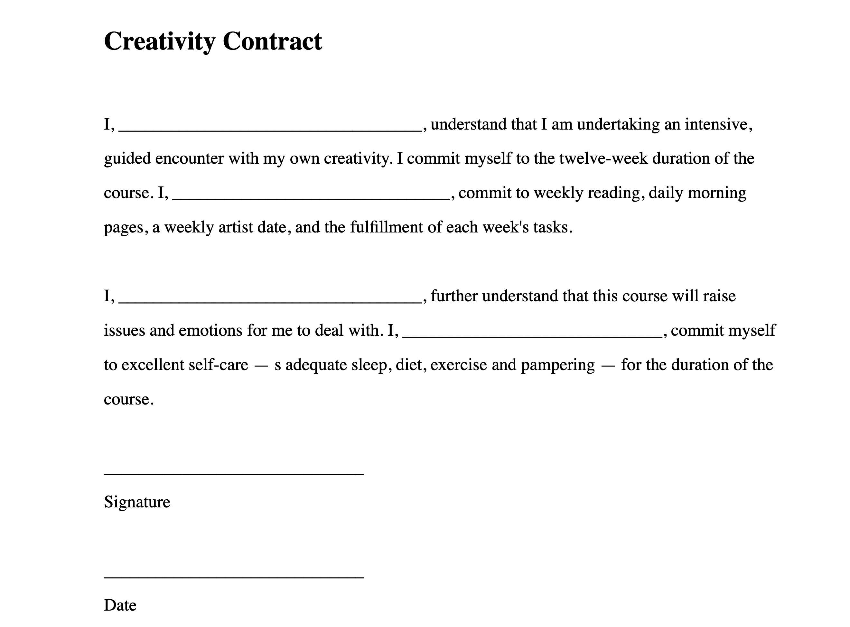

Slide 19
take a break! 😊

