Slide 1
Week 2
Recovering a Sense of Identity

Slide 2

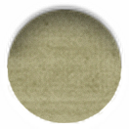
the sacred circle
This is a safe place to learn & grow together
“Envy, backbiting, criticism have no place in our midst, nor do ill temper, hostility, sarcasm, chivvying for position.”
“Let there be, always, a place for the artist toddler to try, to falter, to fail, to try again.”
“A believing mirror”: a friend to your creativity, someone who believes in your and your creativity
“a sacred circle of believing mirrors to potentiate each other’s growth, to mirror a “yes” to each others creativity

Slide 3
Ch 2 summary
Outside Threats
Poisonous Playmates
    blocked friends may find your recovery disturbing & try to stop you in your own growth: fear & jealousy; guilt
    “Be very careful to safeguard your newly recovering artist.”
Crazymakers
    personalities that cause drama
    can exist in any setting, in any art form
    toxic people: make + seek drama, discount your reality, blame others, create chaos
    Inner Threats
“The Secret Doubt: being closed to possibility
    “I like to think of the mind as a room…The room has a door. That door is ever so slightly ajar, and outside we can see a great deal of dazzling light. Out there in the dazzling light are a lot of new ideas that we consider too far-out for us and so we keep them out there… In our ordinary, prerecovery life, when we would hear something weird or threatening, we’d just grab the doorknob and pull the door shut. Fast.”

Slide 4
Ch 2 summary
Paying Attention
    “These days cry out, as never before, for us to pay attention, so we can move through them and get our joy and pride back.” Anne Lamott
    Attention is a way to connect and survive
    Attention is an act of connection
    For some extra reading: “Leonard Bernstein on Cynicism, Instant Gratification, and Why Paying Attention Is a Countercultural Act of Courage and Resistance” https://www.brainpickings.org/2016/10/03/dinner-with-lenny-leonard-bernstein-jonathan-cott/

Slide 5
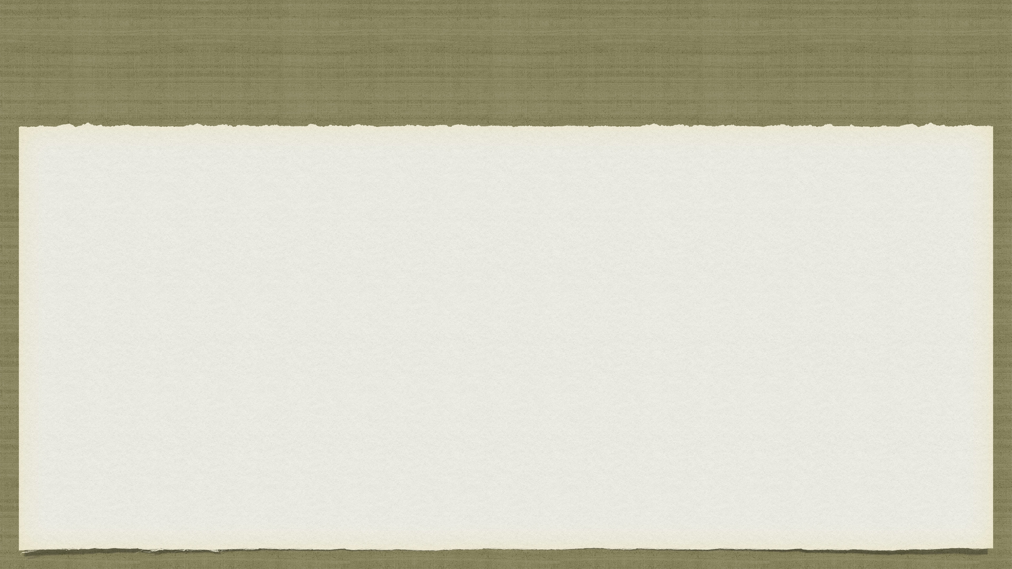
basic principles
Creativity is the natural order of life. Life is energy: pure creative energy
There is an underlying, in-dwelling creative force infusing all of life — including ourselves
When we open ourselves to our creativity, we open ourselves to the creator’s creativity within us and our lives
We are, ourselves, creations. And we, in turn, are meant to continue creativity by being creative ourselves
Creativity is God’s gift to us. Using our creativity is our gift back to God.
The refusal to be creative is self-will and is counter to our true nature
When we open ourselves exploring our creativity, we open ourselves to God: good orderly direction
As we open our creative channel to the creator, many gentle but powerful changes are to be expected
It is safe to open ourselves to greater and greater creativity
Our creative dreams and yearnings come from a divine source. As we move toward our dreams, we move toward our divinity

Slide 6
Week 2 tasks
basic principles
where does your time go?
20 things you enjoy doing
from 20 things, 2 things you’ve avoided. do them.
read affirmations from wk 1.
5+ imaginary lives
life pie
ten tiny changes
make a change a goal
do the change

