Slide 1
Artist’s way
Week 3: Recovering a Sense of Power

Slide 2

today’s agenda
Week 2 check-in
Week 3 summary
Synchronicity
Week 3 Tasks

Slide 3
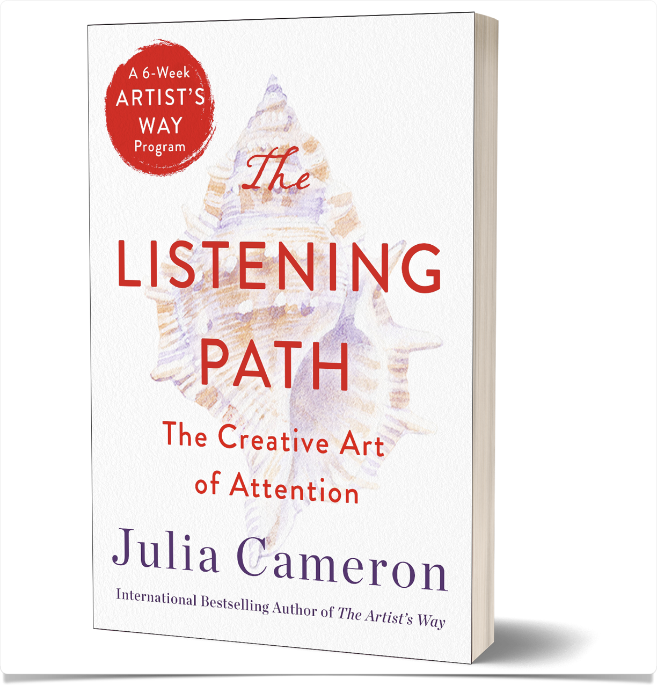
Julia Cameron
3 tools
    morning pages
    artist date
    walking
“simple and repetitive”

Slide 4
Julia Cameron
morning pages
  compel us to action
  compel us to expand
  become more authentic
  make us less lonely
  a witnessing document “This is how you feel”
  3 pages: compel to future

Slide 5
Julia Cameron
artist date
  “enchanting and interesting”
  delight a younger part of yourself
  “festive”
  “please sweet pea, take an artist date”

Slide 6
shame
“Shame is a controlling device. Shaming someone is an attempt to prevent the person from behaving in a way that embarrasses us.”
It asks the question “What will they think of me once they know this?” This is a frightening question, particularly if we have ever been made to feel ashamed for our curiosities and explorations — social, sexual, spiritual.”
“The act of making art exposes a society to itself. Art brings things to light. It illuminates us. It sheds light on our lingering darkness. It casts a beam into the heart of our own darkness and says, “See?”
“But before a wound can heal it must be seen, and this act of exposing the wound to air and light, the artist’s act, is often reacted to with shaming.”
“If a child has ever been made to feel foolish for believing themselves talented, the act of actually finishing a piece of art will be fraught with internal shaming.”

Slide 7
Criticism
“We don’t make art with its eventual criticism foremost in mind, but criticism that asks a question like “How could you?” can make an artist feel like a shamed child.
“Let me be clear. Not all criticism is shaming. In fact, even the most severe criticism when it fairly hits the mark is apt to be greeted by an internal ah-hah! if it shows the artist a new and valid path for work. The criticism that damages is that which disparages, dismisses, ridicules, or condemns. It is frequently vicious but vague and difficult to refute.”
“As artists we must learn to be very self-protective. Does this mean no criticism? No. It means learning where and when to seek out right criticism… when criticism is appropriate and from whom.”
“As artists we cannot control all the criticism we will receive. We cannot make our professional critics more healthy or more loving or more constructive than they are. But we can learn to comfort our artist child over unfair criticism; we can learn to find friends with whom we can safely vent our pain.”
“Art requires a safe hatchery… As artists, we must learn to create our own safe environments.”
“By telling our shame secrets around our art and telling them through our art, we release ourselves and others from darkness. This release is not always welcomed.”

Slide 8
dealing with criticism
Receive the criticism all the way through and get it over with
Jot down notes to yourself on what concepts or phrases bother you
Jot down notes on what concepts or phrases seem useful
Do something very nurturing for yourself — read an old good review or recall a compliment
Remember that even if you have made a truly rotten piece of art, it may be a necessary stepping-stone to your next work. Art matures spasmodically and requires ugly-duckling growth stages

Slide 9
dealing with criticism
Look at the criticism again. Does it remind you of any criticism from your past — particularly shaming childhood criticism? Acknowledge to yourself that the current criticism is triggering grief over a long-standing wound.
Write a letter to the critic — not to be sent, most probably! Defend your work and acknowledge what was helpful, if anything, in the criticism proffered.
Get back on the horse. Make an immediate commitment to do something creative.
Do it. Creativity is the only cure for criticism.

Slide 10
Growth
“Growth is an erratic forward movement: two steps forward, one step back.”
“Remember that and be very gentle with yourself.”
“Easy accomplishes it”
“If you will hew to a practice of writing 3 pages every morning and doing one kind thing for yourself every day, you will begin to notice a slight lightness of heart.”
“Practice being kind to yourself in small, concrete ways.”
“As a creative being you will be more productive when coaxed than when bullied.”

Slide 11
synchronicity
Carl G. Jung (1960), Synchronicity: An Acausal Connecting Principle (Internet Archive)
    “meaningful coincidence”
“Loosely defined as a fortuitous intermeshing of events”; also called serendipity
“the possibility of an intelligent and responsive universe, acting and reacting to our interests.”
“It is my experience that this is the case. I have learned as a rule of thumb, never to ask whether can do something. Say, instead, you are doing it. Then fasten your seatbelt.”
“Leap, and the net will appear.”

Slide 12
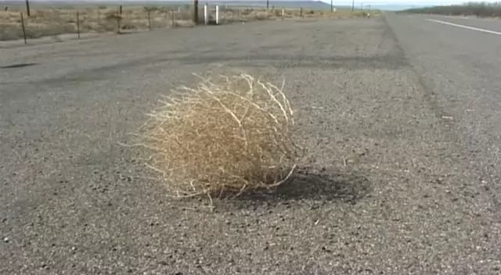

Slide 13
week 3 tasks
Describe your childhood room. What’s your favorite thing about your room right now?
Describe 5 traits you like in yourself as a child.
5 childhood accomplishments. List 5 favorite childhood foods. Buy yourself one this week!
Take a look at your habits. List 3 obvious rotten habits. What’s the payoff in continuing them? List 3 of your subtle foes. what use do these forms of sabotage have?
Make a list of friends who nurture you. Which of their traits serve you well?

Slide 14
week 3 tasks
Call a friend who treats you like you are a really good and bright person who can accomplish things.
Take an hour to follow to your inner compass by doing an artist-brain activity and listening what insights bubble up (morning pages, painting, driving, walking, scrubbing, writing…)
5 people you admire. 5 people you secretly admire. What traits can you cultivate in yourself?
5 dead people you wish you had met. 5 eternity buddies. What traits do you find in these people that you can find in your friends?
Look at 8 & 9. Who “should” you admire? Who does your heart want to admire?

