Slide 1
Week 4
Recovering a Sense of Integrity

Slide 2
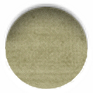
honest changes
“Working with the morning pages, we begin to sort through the differences between our real feelings, which are often secret, and our official feelings, those on the record for public display.”
Public feelings = “I feel okay”, “It’s okay” → “At the root of a successful creative recovery is the commitment to puncture our denial, to stop saying “it’s okay” when it fact it’s something else. The morning pages press us to answer what else.”
Not doing morning pages: not facing what you need to face → “I was to crabby to write them” v “I didn’t write them so I am crabby.”
“Over any considerable period of time, the morning pages perform spiritual chiropractic. They realign our values.”

Slide 3
honest changes
Morning pages show us “I, myself, feel this way… and that way… and this way… No else need agree with me, but this is what I feel.”
Resistance to what the pages are telling us.

Slide 4
kriya
“a Sanskrit word meaning a spiritual emergency or surrender… Perhaps they should be spelled crias because they are cries of the soul as it wrung through changes.”
“Be prepared for bursts of tears and of laughter. A certain giddiness may accompany sudden stabs of loss. Think of yourself as an accident victim walking away from the crash: your old life has crashed and burned; your new life isn’t apparent yet. You may feel yourself to be temporarily without a vehicle. Just keep walking. If this description sounds dramatic, it is only to prepare you for possible emotional pyrotechnics.”
“It is important to know that matter which form your growth takes, there is another kind of change, slower and more subtle, accumulating daily whether you sense its presence or not.”

Slide 5
what does “Kriya” mean
“The Sanskrit root ‘kri’ means ‘action’ or ‘effort.’ And ‘ya’ is the Atman or soul. So its literal translation is some sort of action or effort involving your transcendental Self. “
“Kriyas are involuntary movements that can occur during or outside meditation in the process of a spiritual awakening.”
“The Sanskrit root verb Kri means “to do,” that is, “action.” The word Kriya is derived from the root verb Kri. Hence Kriya literally means “action”
Sources
https://sanskritclassics.com/about_OK.html
https://www.yogapedia.com/definition/5022/kriya
https://elemental.yoga/blog/2018/6/9/what-is-kriya
https://kundalinisymptoms.com/info/kriyas/
https://www.wisdomlib.org/definition/kriya

Slide 6
what is kriya?

Slide 7
affirmations
Continuing to work with affirmations
    “I receive your good willingly”
    “I trust my perceptions”
    “A stronger and clearer me is emerging.”
    “I recover and enjoy my identity.”

Slide 8

buried dreams
5 hobbies that sound fun
5 classes that sound fun
5 things you personally would never do that sound fun
5 skills it would be fun to have
5 things you used to enjoy doing
5 silly things you would like to try once

Slide 9

reading deprivation!
“No reading? That’s right: no reading.”
“Reading depravation is a very powerful tool — and a very frightening one.”
“At least one student always explains to me— pointedly, in no uncertain terms—that he is or she is a very important and busy person with duties and obligations that include reading. This information is inevitably relayed in a withering tone that implies I am an idiot child, an artistic flake, unable to grasp the complexities of an adult’s life.”

Slide 10

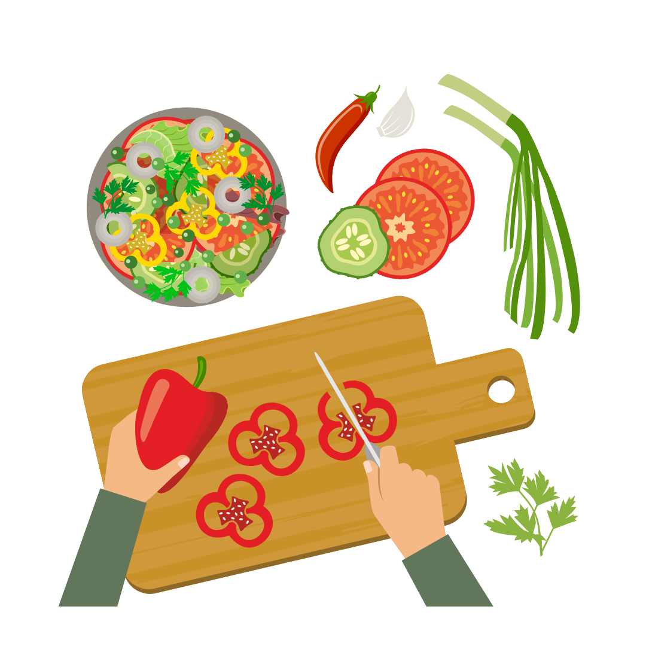

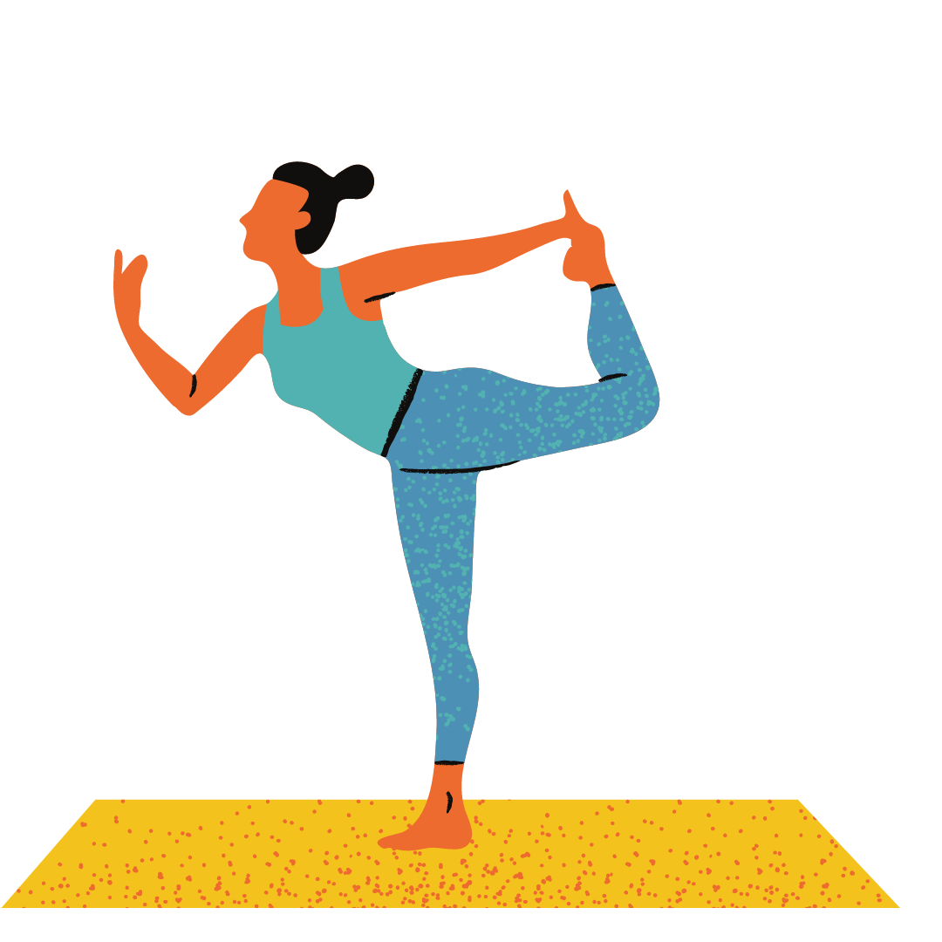




things to do instead
dance
listen to music
sort closets
cook
re-arrange the kitchen
watercolor
work out
make curtains
write letters
meditate
mend
fix your bike

Slide 11
tasks
Describe your ideal environment. Town? Country? Swanky? Cozy? One paragraph. One image, drawn or clipped, that conveys this. What’s your favorite season? Why? Find images/draw it. Place it near your working area.
Describe yourself at 80. What did you do after 50 that you enjoyed? Write a letter from yourself at 80. What would you tell yourself? What interests would you urge yourself to pursue? What dreams would you encourage?
Remember yourself at 8. What did you like to do? What were your favorite things? Write a letter from your 8-year-old self to you now. What would you tell yourself?
Can you make a special/secret room for yourself? Decorate it for fun.
Review your life pie from week 1. Has it changed shape? (Be careful not to expect too much too soon.) List ongoing self nurturing toys you could buy your artist: books on tape, magazine subscription, theatre tickets, a bowling ball

Slide 12
Tasks
Write your own Artist’s Prayer. Use it everyday for a week
Plan a small vacation for yourself: one weekend day. extended artist’s date
Open your closet. Throw out/donate/hand-on one low-self-worth outfit.
Look at one situation in your life that you feel you should change but haven’t yet. What is the payoff for you in staying stuck?
If you break your reading deprivation, write about how you did it. In a tantrum? A slip-up? A binge? How do you feel about it? Why?

