Slide 1
Week 5
Recovering a Sense of Possibility

Slide 2
“This week you are being asked to examine your pay-offs in remaining stuck. You will explore how you curtail your own possibilities by placing limits on the good you can receive. You will examine the cost of settling for appearing good instead of being authentic. You may find yourself thinking about radical changes, no longer ruling out your growth by making others the cause of your constriction.”
Julia Cameron

Slide 3
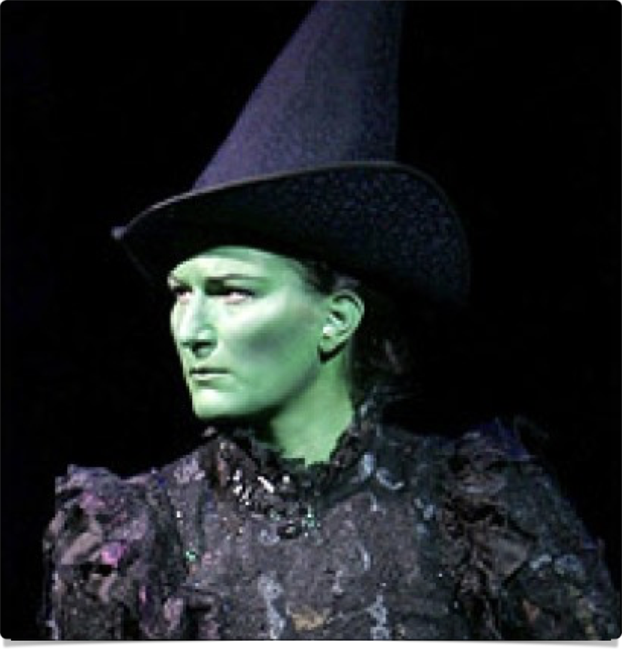

limits
“One of the chief barriers to accepting God’s generosity is our limited notion of what we are in fact able to accomplish.”
“On the one hand, we take ourselves very seriously and don’t want to look like idiots pursuing some patently grandiose scheme. On the other hand, we don’t take ourselves—or God—seriously enough and so we define as grandiose many schemes that, with God’s help, may fall well within our grasp.”

Slide 4
limits
“Some of you may be thinking that this sounds like the magic-wand chapter: I pray and presto! Sometimes, that is how it will feel.”
Clear away the wreckage → learn to accept small pieces of our vision → “then, one day, presto! The vision seems to suddenly be in place.”
“We come to recognize that God is unlimited in supply and that everyone has equal access. This begins to clear up guilt about having or getting too much. Since everyone can draw on the universal supply, we deprive no one with our abundance.”

Slide 5


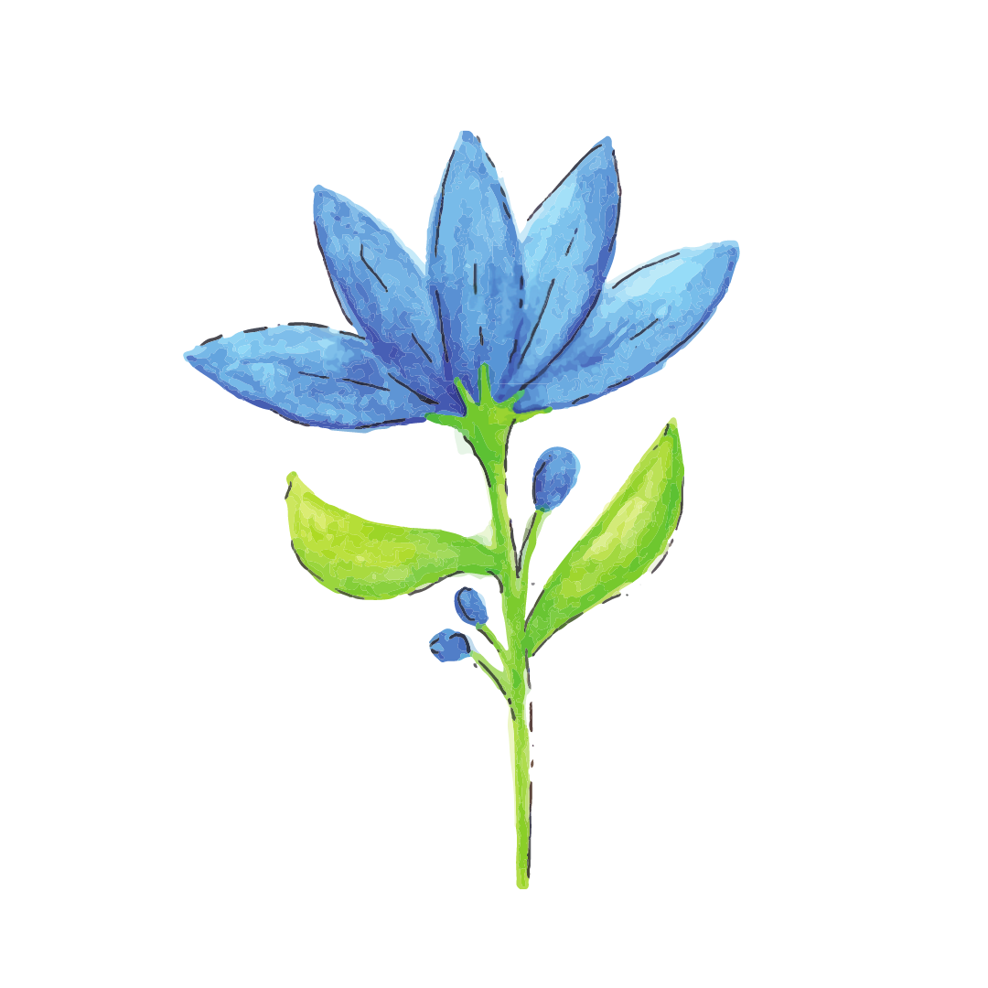




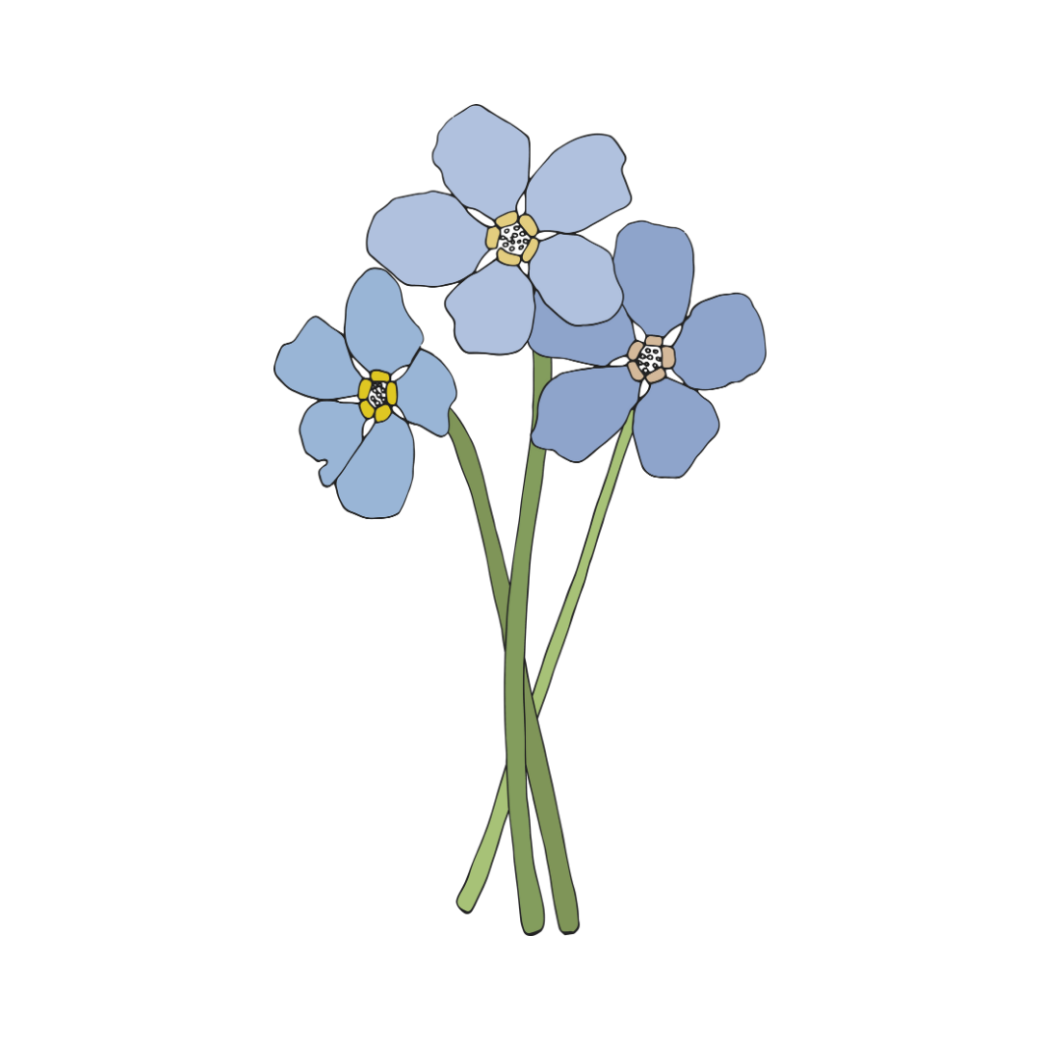



Slide 6
“The desire to be worldly, sophisticated, and smart often blocks our flow. We have ideas and opinions about where our good should come from.”
Getting breaks from “unusual” places
“Any progress is made by leaps of faith, some small and some large.”
    take the first class → more education → a larger workspace → a year off to do the thing → a book/a gallery
“Take the concrete steps necessary to trigger our synchronous good.”

Slide 7
“If this still sounds airy fairy to you, ask yourself bluntly, what next step are you evading. What dream are you discounting as impossible given your resources? What payoff are you getting for remaining stuck at this point in your expansion?”
“God as source” or We Live in an Abundant World

Slide 8
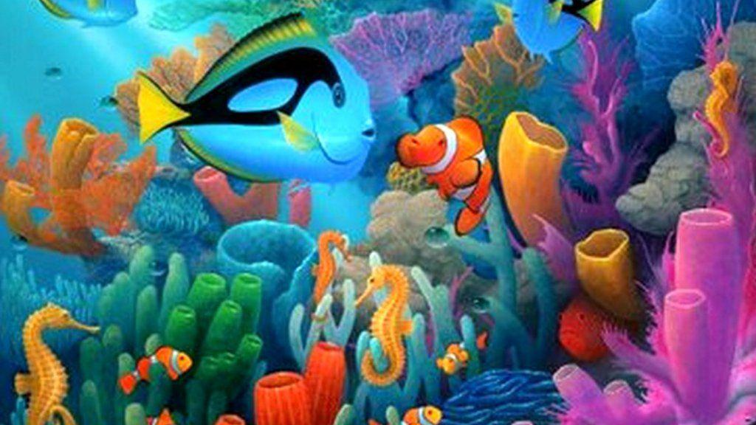

Slide 9
“God as my source is a simple but completely effective plan for living. It removes negative dependency—and anxiety— from our lives by assuring us that God will provide. Our job is to listen for how.”
“One way we listen is by writing morning pages.”
    Ask for help in the evening; listen for answers in the morning
“Be open to all help.”

Slide 10

finding the river
“Recovery is the process of finding the river and saying yes to its flow, rapids and all. We startle ourselves by saying yes instead of no to opportunities.”
Beginning to trust ourselves & find more compassion for ourselves and others
“We are learning to give up idolatry—the worshipful dependency on any person, place, or thing. Instead, we place our dependency on the source itself.”

Slide 11

the virtue map
“An artist must have downtime. Time to do nothing.”
“Defending our right to such time takes courage, conviction, and resiliency.”
“Such time, space, and quiet will strike our family and friends as a withdrawal from them. It is.”
“For an artist, withdrawal is necessary. Without it, the artist in us feels vexed, angry, out of sorts… An artist requires the healing of time alone. Without this period of recharging, our artist becomes depleted.”
“Being caught on the treadmill of virtuous production.”
“Many recovering creatives sabotage themselves most frequently by making nice… Many of us make a virtue out of deprivation.” → “I call this seductive, faux spirituality the Virtue Trap.”

Slide 12

the virtue map
“We strive to be good, to be nice, to be helpful, to be unselfish. We want to be generous, of service, of the world.”
“But what we really want is to be left alone.” → when we can’t, we abandon ourselves
‘Are you self-destructive?’
    are you destructive of yourself?
    are you destructive of your true nature?

Slide 13
what would i try?
What would I try if it weren’t too crazy?
  Sky diving, scuba diving
  Belly dancing, Latin dancing
  Getting my poems published
  Buying a drum set
  Cycling through France
What would I try if it weren’t too selfish?
  Sign up for scuba lessons
  Take the dance class
  Submit once a week
  Buy cousin’s second-hand drum set
  Call my travel agent, check out France

Slide 14
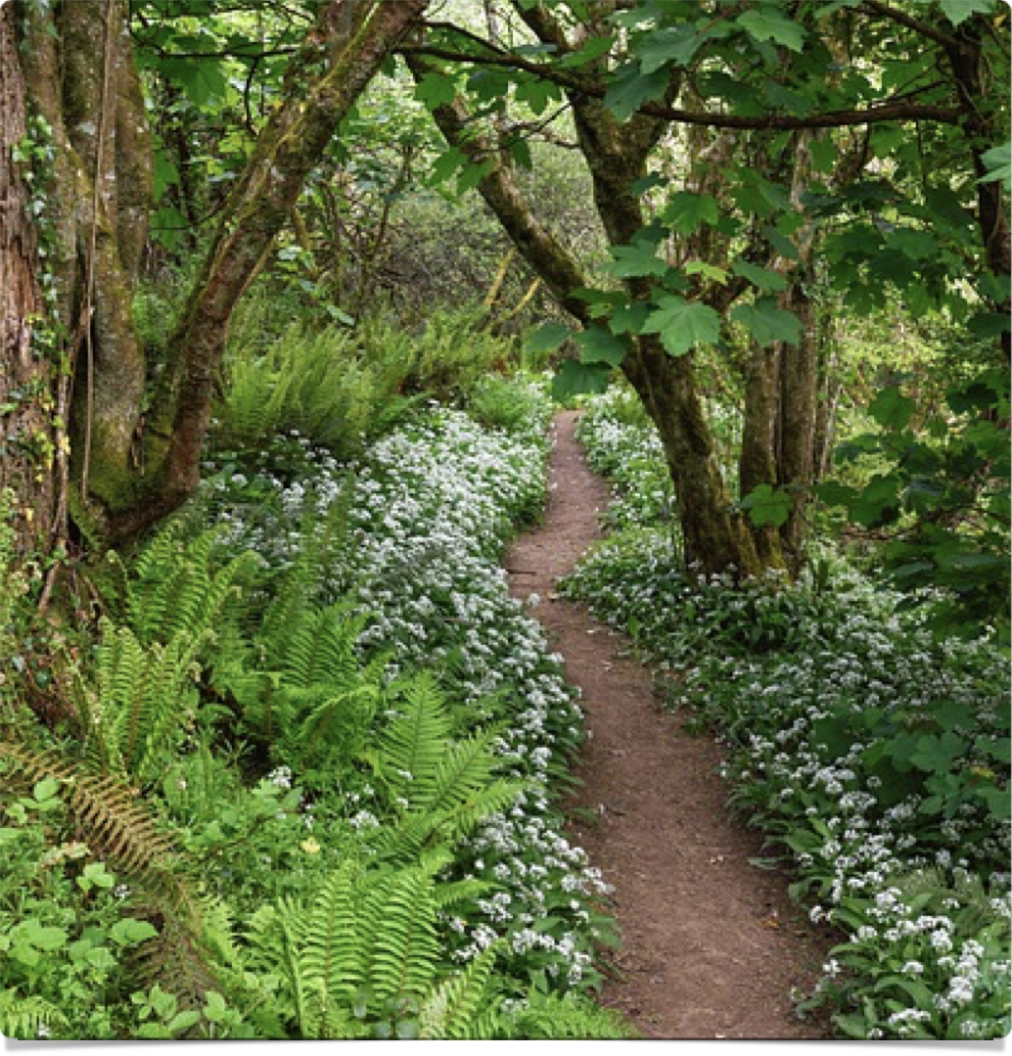
Forbidden joy exercise
List 10 things you love to do but are not allowed to do
(photo by Mark Barnwell)

Slide 15
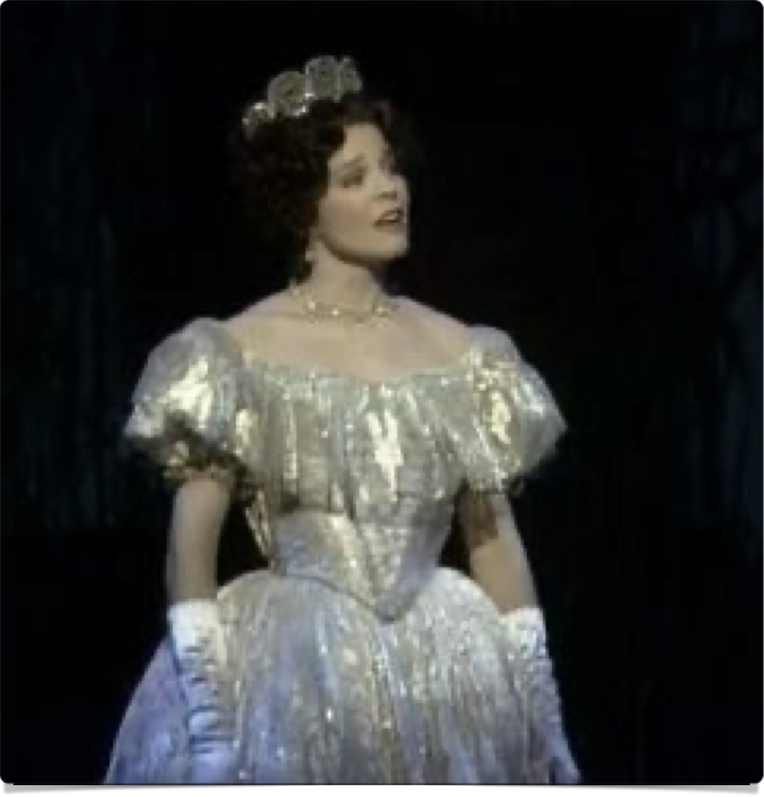
Wish list
I wish __________
9x
10th time: I most especially wish ________

Slide 16
week 5 tasks
The reason I can’t really believe in a supportive God is…. List 5 grievances (God can take it.)
Start an Image File: If I had either faith or money I would try… List 5 desires. Start collecting images over the next week.
5 imaginary lives. Have they changed? Are you doing more parts of them? Images in Image File
If I were 20 and had money… List 5 adventures. Images in Image File
If I were 65 and had money… List 5 post-poned pleased. Images!

Slide 17
week 5 tasks
10 ways I am mean to myself (help to exorcise the negative)
10 items I would like to own but don’t (images!)
Honestly, my favorite creative block is… Draw a cartoon of yourself indulging in it.
My payoff for staying blocked is… (explore in morning pages)
The person I blame for being blocked is (explore in morning pages)

