Slide 1
Week 6
Recovering a Sense of Abundance

Slide 2
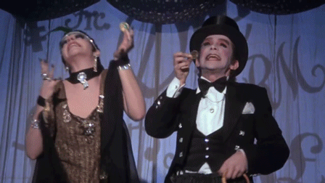

abundance/money
“This week you tackle a major creative block — money. You are asked to really look at your own ideas around God, money, and creative abundance.”
“The essays will explore the ways in which your attitudes limit abundance and luxury in your current life.”
“You will be introduced to counting… a tool for clarity and the right use of funds.”
“This week may feel volatile.”

Slide 3

money madness
People with money are…
Money makes people…
I’d have more money if…
My dad thought money was…
My mom always thought money would…
In my family, money cause…
Money equals…
If I had money, I’d…
If I could afford it, I’d…
If I had some money, I’d…
I’m afraid that if I had money I would…
Money is…
Money causes…
Having money is not…
In order to have more money, I’d need to…
When I have money, I usually…
I think money…
If I weren’t so cheap I’d…
People think money…
Being broke tells me…

Slide 4
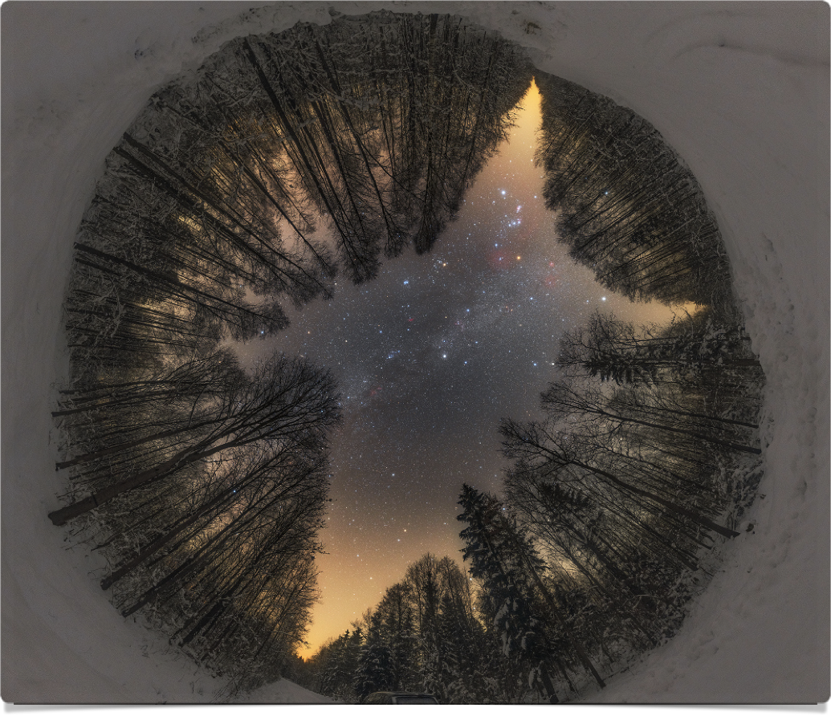
God
giving up to a higher power
good orderly direction
the creator, the architect
higher power
energy

Slide 5
guiding principles
re-written by Tae Phoenix
Life is a manifestation of creative energy that includes cycles of building and destruction.
The innate urge to create is a healthy part of being human.
When we open ourselves to creativity, we embrace vulnerability, intuition, spontaneity and uncertainty. This leads us to greater happiness and peace.
Our lives are a manifestation of creative energy; it benefits us to align our own efforts with that energy for as long as we are able.
Creativity is a precious component of our whole selves. Valuing it is a gift to ourselves and leads to greater self worth.

Slide 6
guiding principles
re-written by Tae Phoenix
re-written by Tae Phoenix
It is our choice which parts of our nature to feed. The refusal to feed our creative nature runs counter to our well being.
When we open ourselves to being creative, we become aware of our ephemerality and yearn to use our time here well.
As we open ourselves to creativity, we will see powerful but subtle adjustments that lead to personal and artistic growth.
It is safe to open ourselves up to creativity, insofar as anything in life is truly ‘safe.’
Our creative dreams and yearnings come from a part of ourselves that we must listen to in order to value all that we are.

Slide 7

luxury
“All too often we become blocked and blame it on our lack of money. This is never an authentic block.”
“The actual block is our feeling of constriction, our sense of powerlessness.”
“Art requires us to empower ourselves with choice. At the most basic level, this means choosing to do self-care.”

Slide 8
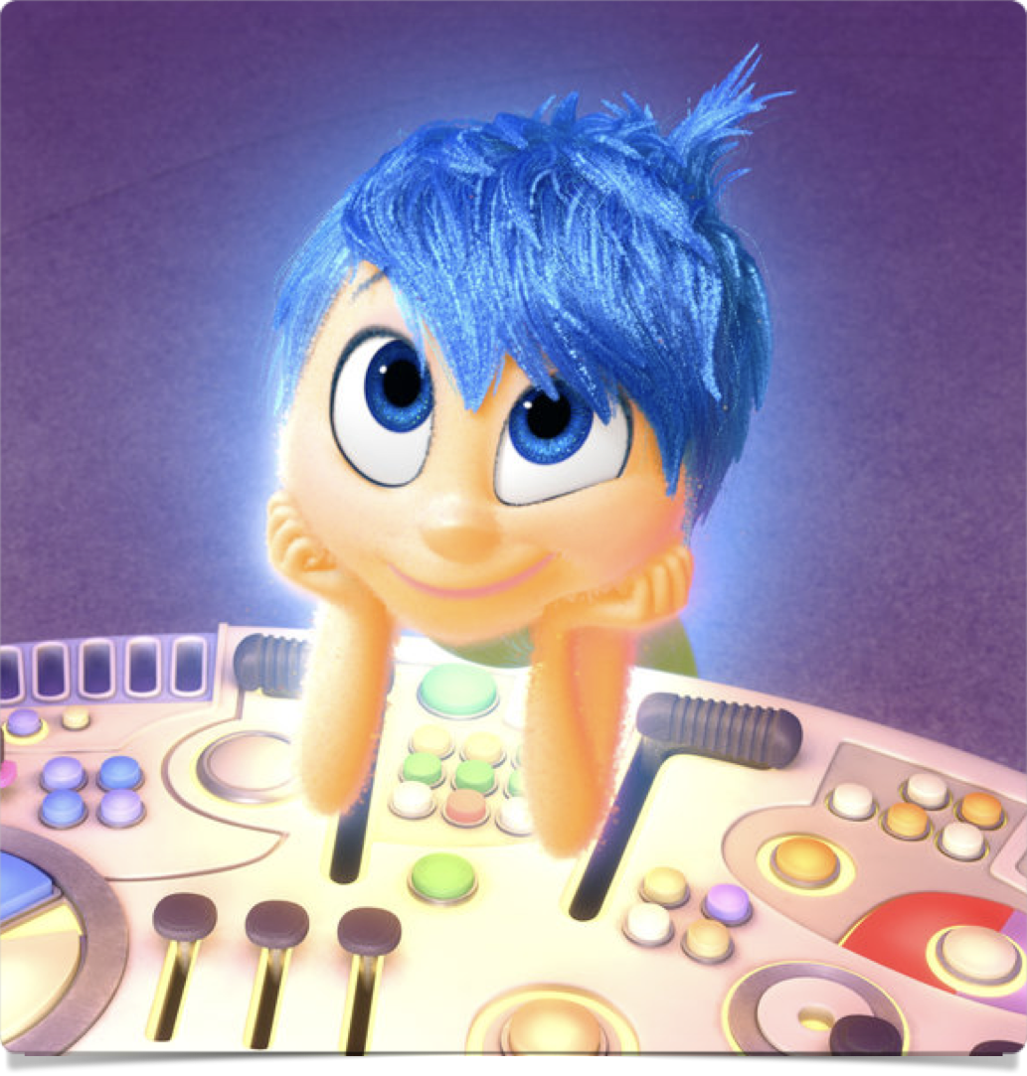
luxury
“Let me be clear that the luxury I am talking about here has nothing to do with penthouse views, designer clothes, zippy foreign sports cars, or first-class travel…”
Luxury = “What gives us true joy?”
    Being aware of Wet Blankets → people who’ll discourage you, talk you down etc
    Also self talk: “It’s silly” → “a defense word our Wet Blanket Adult uses to squelch our artist child… Yes artist dates are silly — that’s the whole point.”
“Creative living requires the luxury of time, which we carve out for ourselves — even if it’s 15min for quick morning pages and a 10min mini-bath after work.”

Slide 9
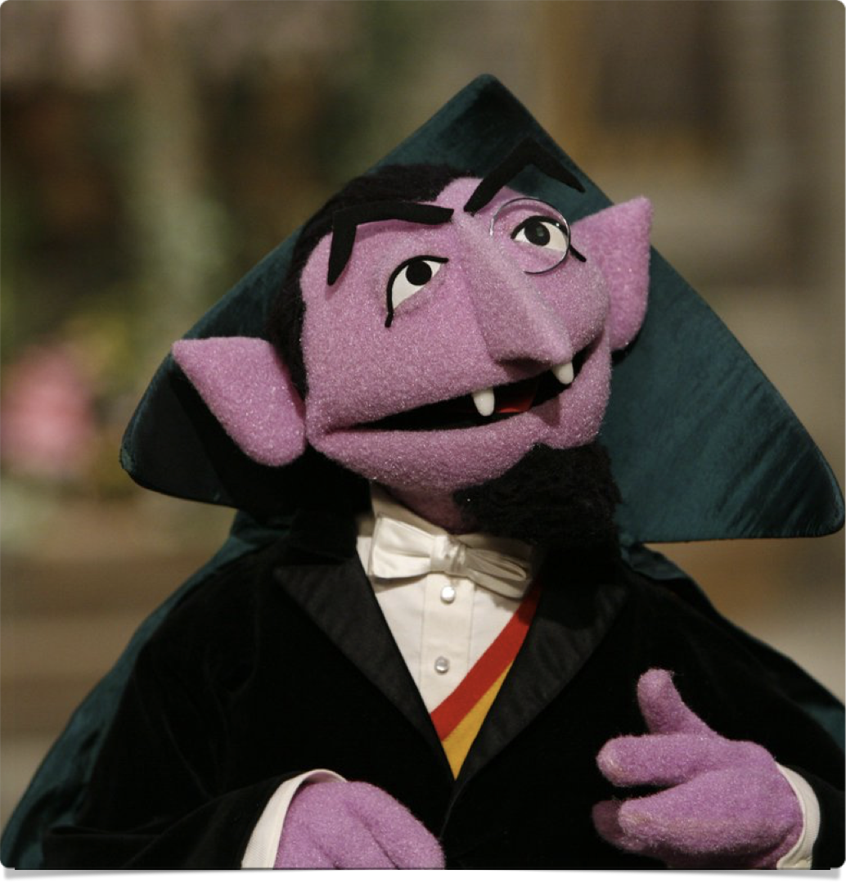
counting
“For the next week you will be discovering how you spend your money.”
Write down every thing you spend, no matter how small.
“Each day… what you bought, what you spent, where your money went, whether it was for groceries, lunch, a cab ride, or a loan to your brother.”
“This is an exercise in self-observation, not self-flagellation.”
“For many of us, counting is a necessary prelude to learning creative luxury.”

Slide 10
week 6 tasks
Find 5 pretty or interesting rocks (something small you can keep in your pocket)
Pick 5 flowers or leaves. You may want to press them. (re-live kindergarten)
Throw out or give away 5 ratty pieces of clothing
Bake something.
Send postcards to 5 friends. (“This is not a good-two-shoes exercise. Send to people you would love to hear from”)

Slide 11
week 6 tasks
Re-read the Basic Principles. Read an Artist’s Prayer (yours or JC’s)
Any new changes in your home environment? Make some.
Acceptance: Any new flow in your life? Practice saying yes to freebies.
Prosperity: any changes in your financial situation or your perspective on it? Any new — even crazy — ideas about what you would love doing? Add to image file!

Slide 12
The Artist’s Prayer
by Julia Cameron
O Great Creator,
We are gathered together in your name
That we may be of greater service to you
And to our fellows.
We offer ourselves to you as instruments.
We open ourselves to your creativity in our lives.
We surrender to you our old ideas.
We welcome your new and more expansive ideas.
We trust that you will lead us.
We trust that it is safe to follow you.
We know you created us and that creativity
Is your nature and our own.
We ask you to unfold our lives
According to your plan, not our low self-worth.
Help us to believe that it is not too late
And that we are not too small or too flawed
To be healed—
By you and through each other—and made whole.
Help us to love one another,
To nurture each other’s unfolding,
To encourage each other’s growth,
And understand each other’s fears.
Help us to know that we are not alone,
That we are loved and lovable.
Help us to create as an act of worship to you.

Slide 13
I will take my rightful place on stage
and I will be myself.
I am not a cosmic orphan.
I have no reason to be timid.
I will respond as I feel;
awkwardly, vulgarly,
but respond.
I will have my throat open,
I will have my heart open,
I will be vulnerable.
I may have anything or everything
the world has to offer, but the thing
I need most, and want most,
is to be myself.
I will admit rejection, admit pain,
admit frustration, admit even pettiness,
admit shame, admit outrage,
admit anything and everything
that happens to me.
The best and most human parts of
me are those I have inhabited
and hidden from the world.
I will work on it.
I will raise my voice.
I will be heard.
The Actor’s Vow
Eliza Kazan

Slide 14
other prayers?

