Slide 1
Week 7
Recovering a Sense of Connection

Slide 2
“We turn this week to the practice of right attitudes for creativity. The emphasis is on your receptive as well as active skills. The essays, exercises, and tasks aim at excavating areas of genuine creative interest as you connect with your personal dreams.”
-Julia Cameron

Slide 3


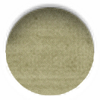
Listening
“The ability to listen is a skill we are honing with both our morning pages and our artist dates.”
“The pages train us to hear past our Censor”
“Art is not about thinking something up. It is about the opposite — getting something down.”
    the idea of pulling something out of thin air v. drawing from the well.
“…we are more the conduit than the creator of what we express.”

Slide 4
Listening
“When I teach screenwriting, I remind my students that their movie already exists in its entirety. Their job is to listen for it, watch it with their mind’s eye, and write it down. The same may be said of all art. If painting and sculptures wait for us, then sonatas wait for us; books, plays, and poems wait for us too. Our job is simply to get them down.”
“To do that, we drop down the well. Some people find it easier to picture the stream of inspiration as being like radio waves of all sorted being broadcast at all times. With practice, we learn to hear the desired frequency on request.”

Slide 5
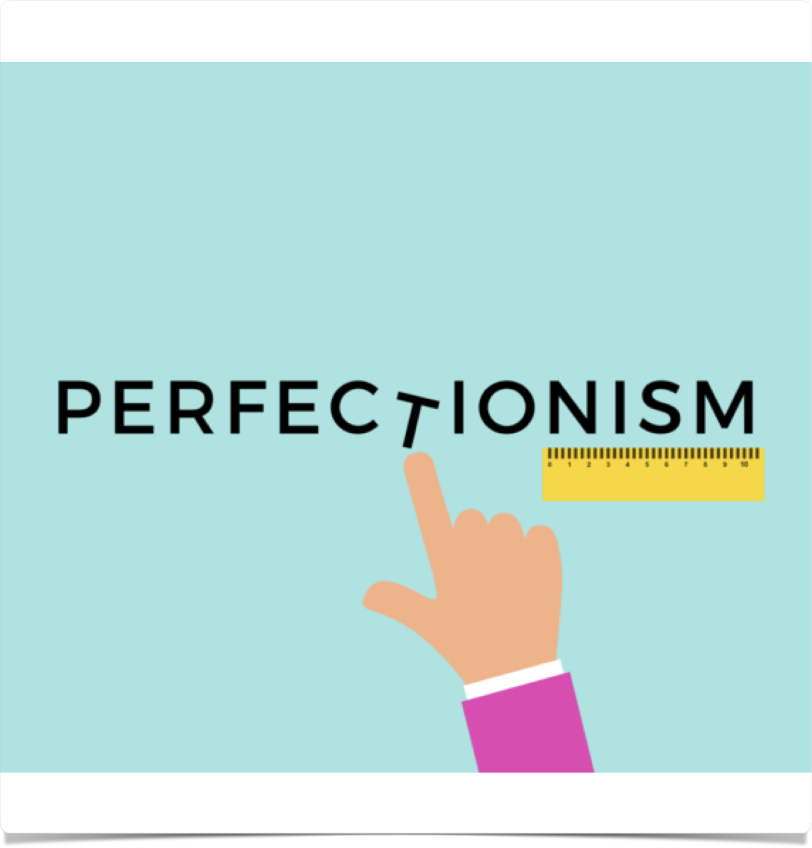
perfectionism
Getting it right; fixing it before I go further; having standards
“Perfectionism has nothing to do with getting getting it right, it has nothing to do with fixing things. It has nothing to do with standards. Perfectionism is a refusal to let yourself move ahead.”
“It is a loop — an obsessive, debilitating closed system that causes you to get stuck in the details of what you are creating and to lose sight of the whole.”
“Do not fear mistakes, there are none.” Miles Davis
The Skills Collective

Slide 6
perfectionism
“The perfectionist fixes one line of a poem over and over — until no lines are right. The perfectionist redraws the chin line on a portrait until the paper tears. The perfectionist writes so many versions of scene one that they never get to the rest of the play. The perfectionist writes, paints, creates with one eye on their audience. Instead of enjoying the process, the perfectionist is constantly grading the results.”
The Skills Collective

Slide 7
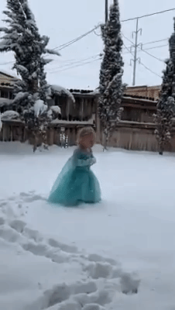
perfectionism
“The perfectionist is never satisfied. The perfectionist never says, ‘This is pretty good. I think I’ll just keep going.’ To the perfectionist, there is always room for improvement.”
We think it’s humility but it’s actually pride/ego
Art is never “finished”, “but at a certain point you let go and call it done. That is a normal part of creativity — letting go.”
The Skills Collective

Slide 8
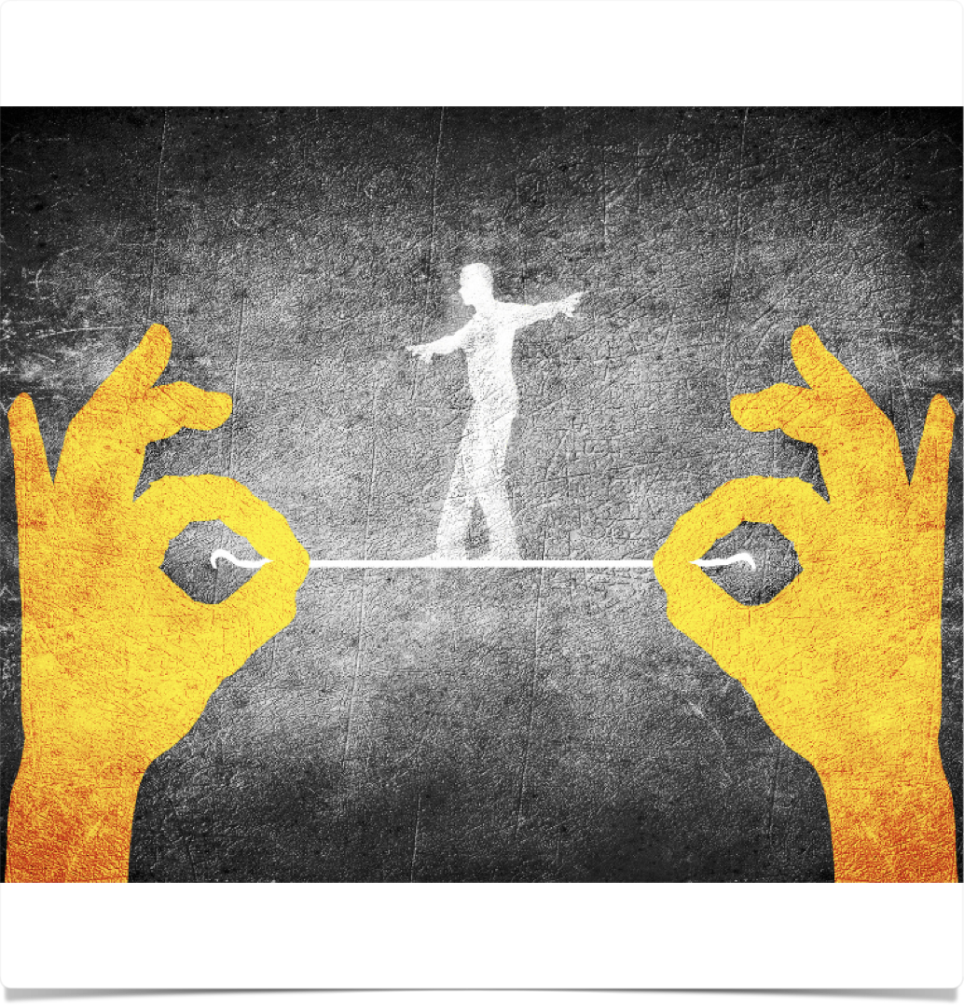
RISK
“Usually when we say we can’t do something, what we mean is that we won’t do something unless we can guarantee that we’ll do it perfectly.”
“The success of creative recovery hinges on our ability to move out of the head and into action. This brings us squarely to risk.”
Fear of looking stupid
“We must break through ‘I can’t because…’ Because I’m too old? Too broke, too shy, too proud? Self-defended? Timorous?”
“As blocked artists, we unrealistically expect and demand success from ourselves and recognition of that success from others.”

Slide 9
If I didn’t have to do it perfectly I would try…

Slide 10
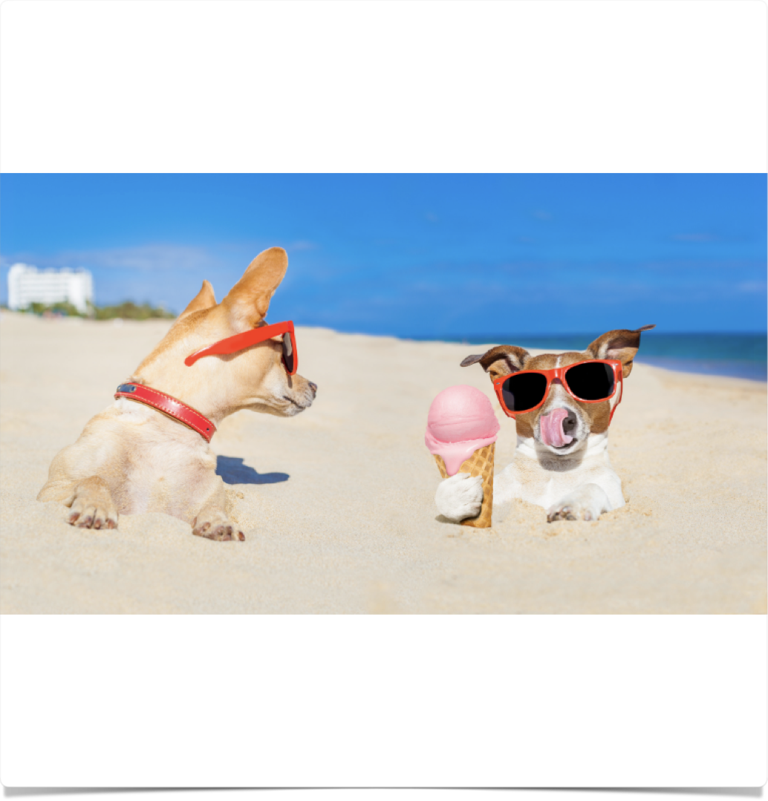
jealousy
“My jealousy roars in the head, tightens the chest, massages my stomach lining with a cold fist as it searches out the best grip.”
“Jealousy is a map. Each of our jealousy maps differs. Each of will probably be surprised by some of the things we discover on our own.”
“Jealousy is always a mask for fear: fear that we aren’t able to get what we want; frustration that somebody else seems to be getting what is rightfully ours even if we are too frightened to reach for it.”
“At its root, jealousy is a stingy emotion. It doesn’t allow for the abundance and multiplicity of the universe. Jealousy tells us there is only room for one — one poet, one painter, one whatever you dream of being.”

Slide 11
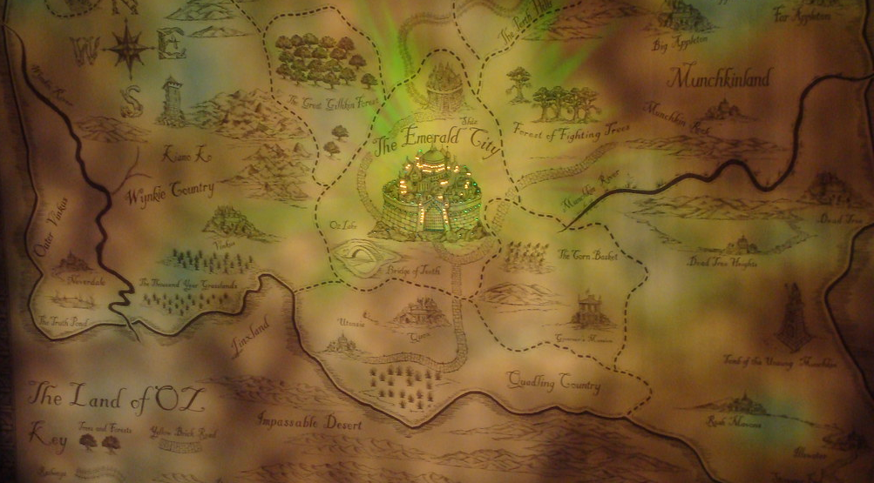

jealousy map
WHO
(whom are you jealous of?)
My sister Libby
My friend Ed
Anne Sexton
WHY
(why are you jealous of them?)
She has a real art studio
Writes good crime novels
Famous poet
ACTION ANTIDOTE
(action towards creative risk)
Fix spare room
Try writing one
Publish long-hoarded poems

Slide 12
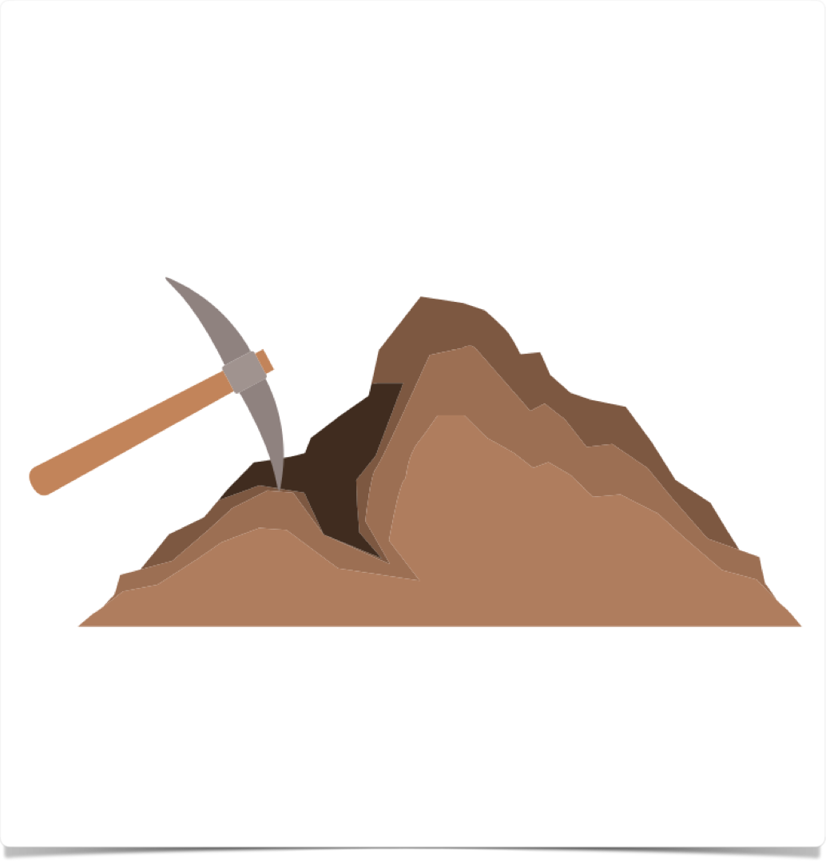
archeology exercise
Sleuth work: “very often, we have buried parts of ourselves that can be uncovered by some digging.”
“Not only will your answers tell you what you missed in the past; they will tell you what you can be doing, now, to comfort and encourage your artist child.”

Slide 13
archeology exercise
As a kid, I missed the chance to…
As a kid, I lacked…
As a kid, I could have used…
As a kid, I dreamed of being…
As a kid, I wanted a…
In my house, we never had enough…
As a kid, I needed more…
I am sorry that I will never again see…
For years, I have missed and wondered about…
I beat myself up about the loss of…

Slide 14
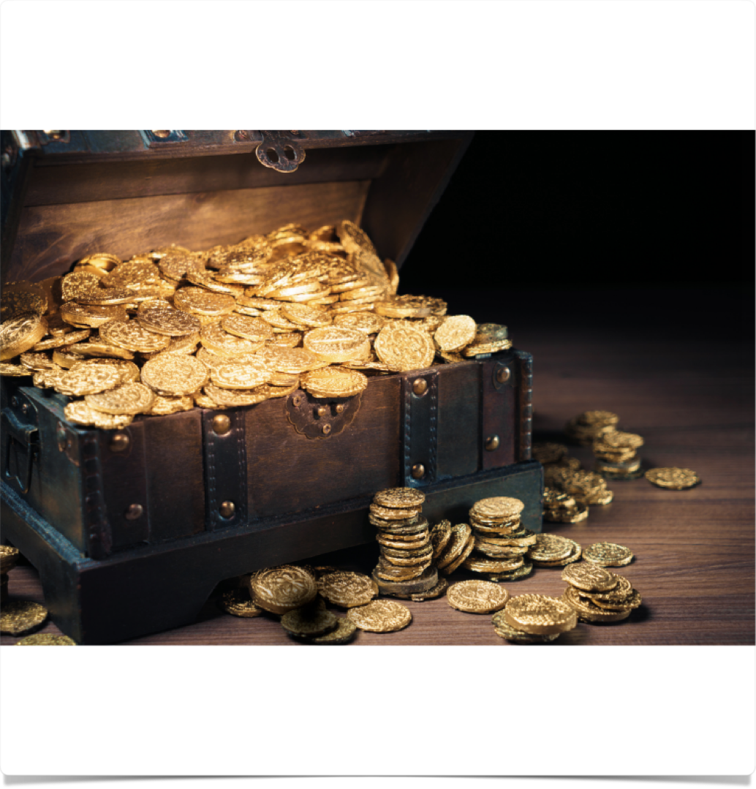
Positive stock
I have a loyal friend in…
One thing I like about my town is…
I think I have nice…
Writing my morning pages has shown me I can…
I am taking a greater interest in…
I believe I am getting better at…
My artist has started to pay more attention to…
My self-care is…
I feel more…
Possibly, my creativity is…

Slide 15
week 7 tasks
Make this phrase a mantra: Treating myself like a precious object will make me strong. Watercolor/crayon/calligraph this phrase. Post it where you will see it. We tend to think being hard on ourselves will make us strong. But it is cherishing ourselves that gives us strength.
Listen to an album for 20min, just for joy. Doodle as you listen. Allow yourself to draw the shapes, emotions, thoughts you hear in the music.
Take yourself into a sacred space — a church, a synagogue, library, grove of trees — and allow yourself to savor the silence and healing solitude. Each of us has a personal idea of what sacred space is. Eg. clock store or aquarium. Experiment.
Create one wonderful smell in your house — with soup, incense, fir branches, candles, — whatever.
Wear your favorite item of clothing for no special occasion.

Slide 16
week 7 tasks
Buy yourself one wonderful pair of socks, one wonderful pair of gloves — one wonderfully comforting self-loving something.
Collect a stack of magazines. For 20min, literally tear through the magazines & collect images that reflect your life or interests. Think it like a pictorial autobiography. Include past/present/future/dreams & images you simply like. Arrange the pictures on some newspaper in a way that pleases you.
Quickly list 5 favorite films. Common denominators? Do you see traces of your cinematic themes in your collage?
Favorite topics to read about. Are these topics in your collage?
Give your collage a place of honor, even a secret place is ok.

