Slide 1
Week 8
Recovering a Sense of Strength

Slide 2
“This week tackles another major creative block: time. You will explore the ways in which you have used your perception of time to preclude taking creative risks. You will identify immediate and practical changes you can make in your current life. You will excavate the early conditioning that may have encouraged you to settle for far less than you desire creatively.”
Julia Cameron

Slide 3
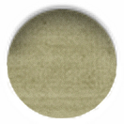
early patterning
“The following questions are aimed at helping you retrieve and decipher your own conditioning.
Some of them may seem not to apply. Write about whatever they trigger for you.”
As a kid, my dad thought my art was… That made me feel…
I remember one time when he…
I felt very… and … about that. I never forgot it.
As a kid, my mother taught me that my daydreaming was…
I remember she’d tell me to snap out of it by reminding me…
The person I remember who believed in me was…
I remember one time when…
I felt… and …. about that. I never forgot it.
The thing that ruined my chance to be an artist was…
The negative lesson I got from that, which was logical but I still believe, is that I can’t… and be an artist
When I was little, I learned that… and … were big sins that I particularly had to watch out for.
I grew up thinking artists were… people.
The teacher who shipwrecked my confidence was…
I was told…
I believed this teacher because…
The mentor who have me a good role model was…
When people say I have talent I think they want to…
The thing is, I am suspicious that…
I just can’t believe that…
If I believe I am really talented, then I am mad as hell at… and … and… and… and….

Slide 4
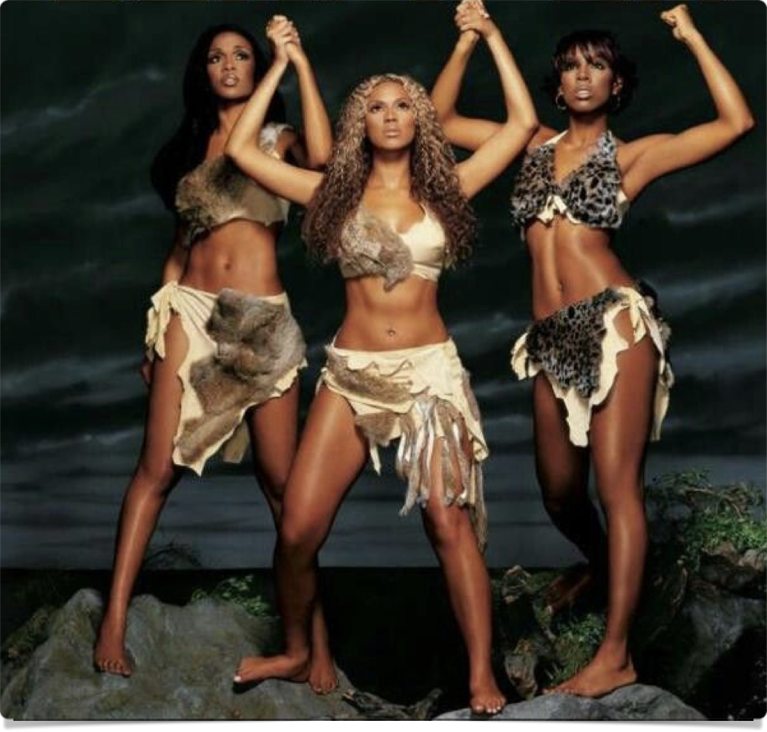
survival
“One of the most difficult tasks an artist must face is a primal one: artistic survival.”
“All artists must learn the art of surviving loss: loss of hope, loss of face, loss of money, loss of self-belief.”
“In addition to our many gains, we inevitably suffer these losses in an artistic career.”
“Artistic losses can be turned into artistic gains and strengths.”
“…in order to move through loss and beyond it, we must acknowledge it and share it. Because artistic losses are seldom openly acknowledged or mourned, they become artistic scar tissue that blocks artistic growth.”

Slide 5

survival
“Perhaps the most damaging form of artistic loss has to do with criticism. The artist within… is seldom hurt by truth… Ah-hah! is often the accompanying inner sound when a well-placed, accurate critical arrow makes it mark.”
“The criticism that damages… is the criticism—well-intentioned or ill—that contains no saving kernel of truth yet has a certain damning plausibility or an unassailable blanket judgement that cannot be rationally refuted.”
The role of teachers in criticism: “There is a sacred trust inherent in the bond between teacher and student.” When the trust is broken, it is a deep betrayal.

Slide 6


the ivory tower
“Creativity cannot be comfortably quantified in intellectual terms. But its very nature, creativity eschews such containment.”
In an academic environment, student work is often only viewed in terms of its shortfalls — “…promising work is met with a volley of should-have-dones, could-have-dones, and might-have-dones, insted of being worked with as it is.”
“For an artist, to become overly cerebral is to become crippled. This is not to say that artists lack rigor; rather, that artistic rigor is grounded differently than intellectual life usually admits.”
Role of teachers: “as taller trees, let us not allow our darker critical powers unfettered play upon the seedling artists in our midst.”
“In order to recover our sense of hope and the courage to create, we must acknowledge and mourn the scars that are blocking us. This process may seem both painstaking and petty, but it is a necessary right of passage.”
“Just as a teenager must gain autonomy from an overbearing parent, so too an artist must regain autonomy from malignant artistic mentors.”

Slide 7

the ivory tower
“Like the career of any athlete, an artist’s life will have its injuries. These go with the game. The trick is to survive them, to learn how to let yourself heal… Give yourself the dignity of admitting your artistic wounds. That is the first step in healing them.”
Self-inflicted wounds: “many times, as artists, we are offered a chance that we balk at, sabotaged by our fear, our low self-worth, or simply our other agendas.”

Slide 8

gain disguised as loss
“Art is at the act of structuring time. ‘Look at it this way,’ a piece of art says. ‘Here’s how I see it.’
“It’s all in the frame.” Eve Babitz
“Every loss must always be viewed as a potential gain; it’s all in the framing.”
“I learned when by loss, to ask the right question: ‘What next?’ instead of ‘Why me?”
“…the key to career resiliency is self-empowerment and choice.”
“non illegitimi carbrundum” = “Don’t let the bastards get you down.”
“When faced with a loss, immediately take one small action to support your artist. Even if all you are doing is buying a bunch of tulips and a sketch pad, your action says, ‘I acknowledge you and your pain. I promise you a future worth having.’”

Slide 9
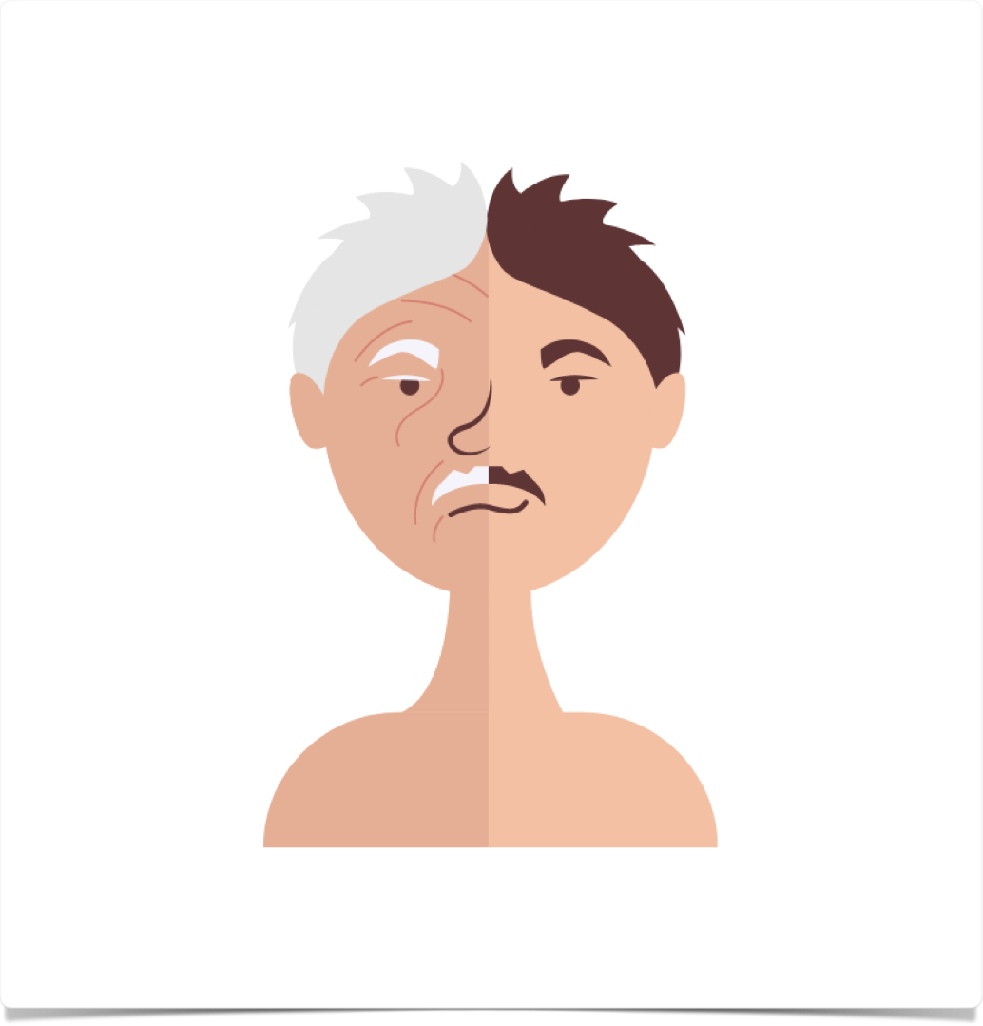
age & Time:
product & Process
Q: Do you know how old I’ll be by the time I learn to play the piano?
A: The same age you’ll be if you don’t.

Slide 10

age & Time:
product & Process
“‘I’m too old for that’ ranks with ‘I don’t have money for it’ as a Great Block Lie we use to prevent further exploration… it’s something we tell ourselves to save ourselves from the emotional cost of the ego deflation involved in being a beginner.”
Conversely — “I’ll wait until I’m retired.”
“Many blocked creatives tell themselves they are both too old and too young to allow themselves to pursue their dreams. Old and dotty, they might try it. Young and foolish, they might try it. In either scenario, being crazy is a prerequisite to creative exploration.”
“We do not want to look crazy. And trying something like that (whatever it is) at our age (whatever it is) would look nuts. Yes, maybe.”

Slide 11
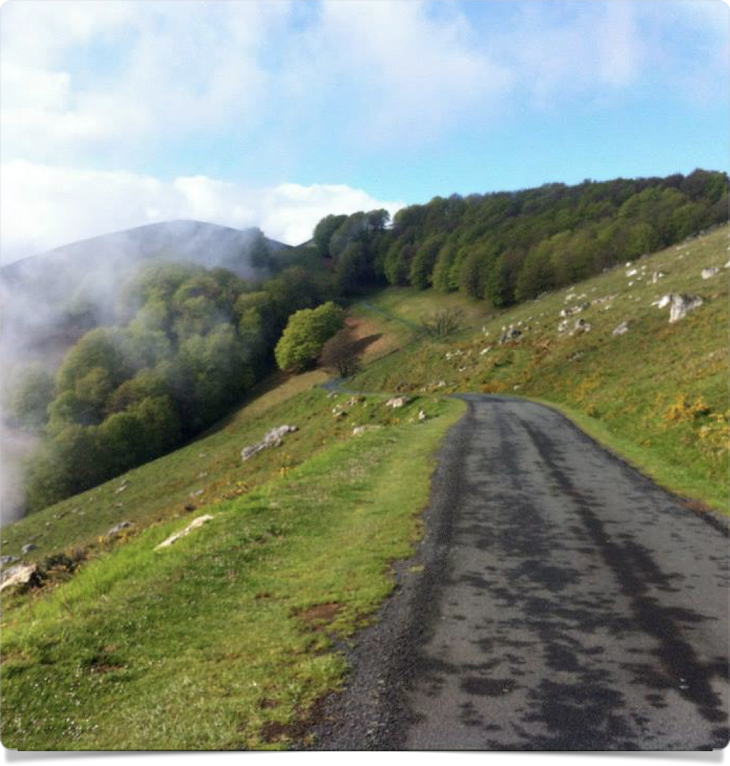
age & Time:
product & Process
Focusing on the length of the journey instead of on the process
“We like to focus on having learned a skill or on having made an artwork. This attention to final form ignores the fact that creativity lies not in the done but in doing.”
“In a sense, no creative act is ever finished. You can’t learn to act because there is always more to learn… This doesn’t mean that the work accomplished is worthless. Far from it. It simply means that doing the work points the way to new and better work to be done.”
“Focused on process, our creative life retains a sense of adventure.”

Slide 12
age & Time:
product & Process
“We inherit the obsession with product and the idea that art produces finished product from our consumer-oriented society. This focus creates a great deal of creative block… Fixated on the need to have something to show for our labors, we often deny our curiosities.”
“Our use of age as a block to creative work interlocks with our toxic finished-product thinking.”
“The beginner’s humility and openness lead to exploration. Exploration leads to accomplishment. All of it begins at the beginning, with the first small and scary step.”

Slide 13

filling the form
“Taking the next small step instead of skipping ahead to a large one for which you may not yet be prepared.”
Eg. to sell a screenplay, first you have to write one. To write one, you need an idea, commit it to paper, write until you have 120 pages.
Filling the form = morning pages!!! Doing the the thing each day.
“Most of the time, the next right thing is something small: washing out your paintbrushes, stopping by the art-supply store and picking up clay… There is always one action you can take for your creativity daily.”
“This daily-action commitment fills the form.”

Slide 14

filling the form
“Blocked creatives like to think they are looking at changing their whole life in one feel swoop. This form of grandiosity is very often its own undoing… Who can concentrate on a first drawing class when they’re obsessing about having to divorce their partner and leave town?”
“Creative people are dramatic, and we use negative drama to scare ourselves out of our creativity with this notion of wholesale and often destructive change. Fantasizing about pursuing our art full-time, we fail to pursue it part-time—or at all.”
“Indulging ourselves in a frantic fantasy of what our life would look like if we were real artists, we fail to see the many small creative changes that we could make at this very moment.”
“No one is asking you to leap. That’s just drama, and, for the purposes of creative recovery, drama belongs on the page or on the canvas or in the clay or in the acting class or in the act of creativity, however small.”
“Creativity requires activity, and this is not good news to most of us. It makes us responsible, and we tend to hate that. You mean I have to do something in order to feel better?”

Slide 15

filling the form
“As a rule of thumb, the odds (thinking about about what could happen) are what we use to procrastinate about doing what comes next. This is our addiction to anxiety in lieu of action.”
“Watch yourself for a week and notice the way you will pick up an anxious thought… and blow off — or at least delay — your next creative action.”
“Filling the form means that we must work with what we have rather than languish in complaints over what we have not.”
“What can you do, right now, in your life as it is currently constituted? Do that thing. Take one small daily action instead of indulging in the big questions.”

Slide 16
affirmations
Select 5 affirmations and work with them this week.
I am a talented person
I have a right to be an artist
I am a good person and a good artist
Creativity is a blessing I accept
My creativity blesses others
My creativity is appreciated
I now treat myself and my creativity more gently
I now treat myself and my creativity more generously
I now share my creativity more openly
I now accept hope
I now act affirmatively
I now accept creative recovery
I now allow myself to heal
I now accept God’s help unfolding my life
I now believe God loves artists

Slide 17
week 8 tasks
Goal search. You may find the following exercise difficult. Allow yourself to do it anyway. If multiple dreams occur to you, do the exercise for each one.
  Name your dream. Write it down.
  Name one concrete goal that signals to you its accomplishment. On your emotional compass, this goal signifies true north
  In a perfect world, where would you like to be in 5 years in relation to your dream and true north?
  In the world we inhabit now, what action can you take, this year, to move you closer?
  What action can you take this month? This week? This day? Right now?
  List your dream. List its true north. Select a role model. Make an action plan. Five years. Three years. One year. One month. One week. Now. Choose an action.
  Resources for goal setting
  SMART Goals - https://www.indeed.com/career-advice/career-development/how-to-write-a-smart-goal
  WOOP My Life - https://woopmylife.org/en/home

Slide 18
week 8 tasks
New childhood: What might you have been if you’d had perfect childhood nurturing? Write a page of this fantasy childhood. What were you given? Can you reparent yourself in that direction now?
Color schemes: Pick a color and write a quick few sentences describing yourself in the first person. (I am silver, high-tech & ethereal, the color of dreams and accomplishment… I feel serene etc)
- What is your favorite color?
- What do you have that is that color?
- What about an entire room?
This is your life and your house.
List 5 things you are not allowed to do. Now do that thing on paper. Write it, draw it, paint it, act it out, collage it. Now put some music on and dance it.

Slide 19
week 8 tasks
Style Search: List 20 things you like to do. For each item:
- Does it cost more or is it free?
- Expensive or cheap?
- Alone or with somebody?
- Job related?
- Physical risk?
- Fast-paced or slow?
- Mind, body, or spiritual?
Ideal Day: Plan a perfect day in your life as it is now constituted, using the information gleaned from Style Search
Ideal Ideal Day: Play a perfect day in your life as you wish it were constituted. There are no restrictions. Allow yourself to be and to have whatever your heart desires. Your ideal environment, job, home, circle of friends, intimate relationship, stature in your art form, — your wildest dreams.
Choose one festive aspect from your ideal day. Allow yourself to live it. You may not be able to move to Rome yet, but even in a still-grungy apartment you can enjoy a homemade cappuccino and a croissant.

