Slide 1
Week 9
Recovering a Sense of Compassion

Slide 2
This week finds us facing the internal blocks to creativity. It may be tempting to abandon ship at this point. Don’t! We will explore and acknowledge the emotional difficulties that beset us in the past as we made creative efforts. We will undertake healing the shame of past failures. We will gain in compassion as we reparent the frightened artist child who yearns for creative accomplishment. We will learn tools to dismantle emotional blocks and support renewed risk.
-Julia Cameron

Slide 3
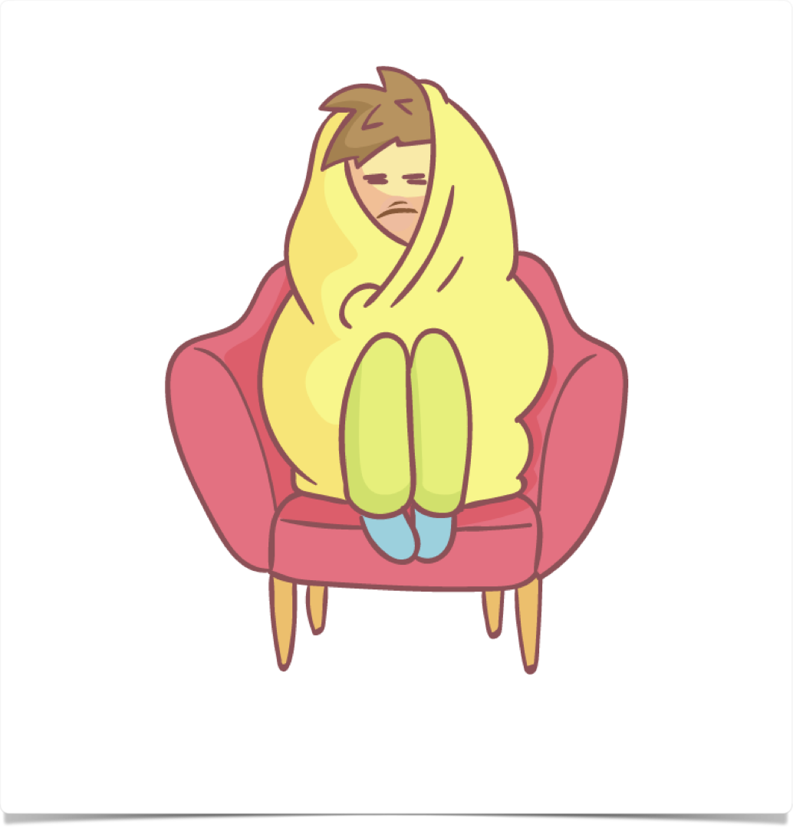

Fear
“One of the most important tasks in artistic recovery is learning to call things—and ourselves—by the right names. Most of us have spent years using the wrong names for our behaviors. We have wanted to create and we have been unable to create and we have called that inability laziness. This is not merely inaccurate. It is cruel.”
“Accuracy and compassion serve us far better. Blocked artists are not lazy. They are blocked.”
“One of the most important tasks in artistic recovery is learning to call things—and ourselves—by the right names. Most of us have spent years using the wrong names for our behaviors. We have wanted to create and we have been unable to create and we have called that inability laziness. This is not merely inaccurate. It is cruel.”
“Accuracy and compassion serve us far better. Blocked artists are not lazy. They are blocked.”

Slide 4
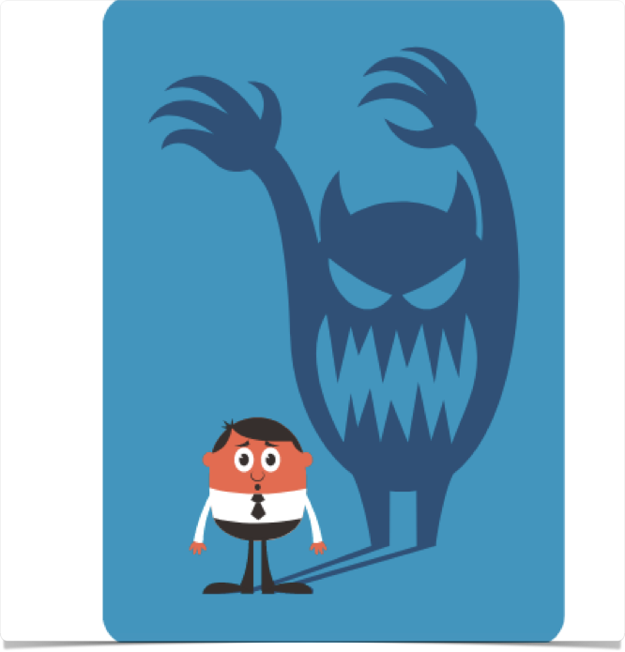
Fear
“The blocked artist does not know how to begin with baby steps. Instead, the blocked artist thinks in terms of great big scary impossible tasks: a novel, a feature film, a one-person show, an opera. When these large tasks are not accomplished, or even begun, the blocked artist calls that laziness. Do not call the inability to start laziness. Call it fear.”
“Do not call the inability to start laziness. Call it fear.”
What are the fears? Success, failure, abandonment → all stemming from childhood realities
“Most blocked artists tried to become artists against either their parents’ good wishes or their parents’ good judgment…You’d better not just be an artist. You better be a great artist if you’re going to hurt your parents so much….”

Slide 5

Fear
“The need to be a great artist makes it hard to be an artist.”
“The need to produce a great work of art makes it hard to produce any art at all.”
Finding it hard to start, doesn’t mean you shouldn’t start at all
You will need help: from supportive friends & yourself

Slide 6


Fear
Give yourself permission to start small and take baby steps
Reward yourself when you take those steps
Do not call procrastination laziness, call it fear
Use love for your artist to cure its fear. Stop yelling at yourself, be nice, call fear by its right name.

Slide 7

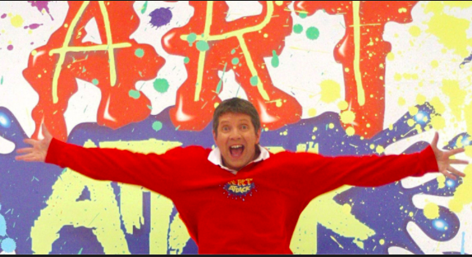
enthusiasm
We often hear “It must take so much discipline to be an artist.”
Discipline is short-lived & rooted in self-admiration. It’s like a battery, useful but short-life.
“Over any extended period of time, being an artist requires enthusiasm more than discipline. Enthusiasm is not an emotional state. It is a spiritual commitment, a loving surrender to our creative process, a loving recognition of all the creativity around us.”
https://youtu.be/kvr8iU0sen4
enthusiasm - derived from Greek + Latin: “filled with God”; also from “inspire” — “spirare”: to breathe
“Enthusiasm is grounded in play, not work”
“Far from being a brain numbed soldier [requiring strict discipline], our artist is actually our child within, our inner playmate.”

Slide 8

enthusiasm
What about the discipline of morning pages?
  "True, our artist may rise at dawn to greet the typewriter or easel in the morning stillness. But this event has more to do with a child’s love of secret adventure than with ironclad discipline.”
“Treating work as play. Paint is great gooey stuff. Sixty sharpened pencils are fun… Work space as a play space.”
Art is a process. The process is meant to be fun!

Slide 9

creative U-Turns
“Recovering from artist’s block, like recovering from any major illness or injury, requires a commitment to health.”
“Those of us addicted to sympathy in the place of creativity can become increasingly threatened as we become increasingly functional. Many recovering artists become so threatened that they make U-turns and sabotage themselves.”
“An artistic U-turn arrives on a sudden wave of indifference. We greet our newly minted product or our delightful process with ‘Aw, what does it matter anyhow? It’s just a start. Everybody else is so much further ahead…’”
“Yes, and they will stay that way if we stop working.”
“We are now on the road and the road is scary.”

Slide 10
creative U-Turns
What it looks like:
  screenwriter has an agent interested who suggests a few changes. writer doesn’t make the changes.
  performance artist gets a space to workshop new material, receives mixed feedback, stops working on the material
  actor is asked to get head shots by a prestigious agent and check back in. doesn’t get head shots, doesn’t check in
  painter is invited to a group show, theirs is first. they pick a fight with the gallery director.
  poet reads poems at a local open mic night. gets good feedback. instead of continuing at this level and gaining strength, goes straight to a slam, loses, stops reading publicly altogether
  a fledgling photographer is encouraged by her teacher. student botches developing one roll of film, and quits, claiming it was boring

Slide 11

creative U-Turns
“In dealing with our creative U-turns, we must first of all extend ourselves some sympathy.”
“Creativity is scary, and in all careers there are U-turns.”
double shame: our fear and our reaction to it
“A successful creative career is always built on successful creative failures. The trick is to survive them.”
Have compassion. Creative U-turns are always born from fear—fear of success or fear of failure. It doesn’t really matter which. The net result is the same.

Slide 12
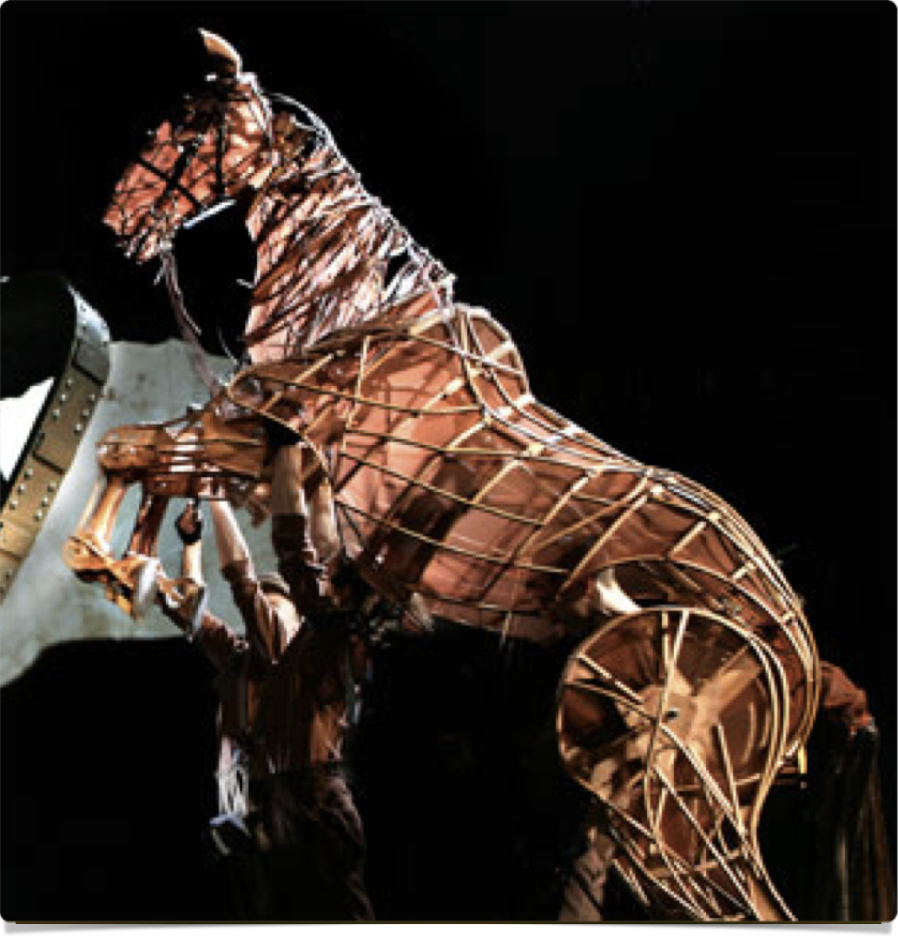
Recovering from a u-turn
“Have compassion. We must first admit that it exists. Yes, I did react negatively to fear and pain. Yes, I do need help.”
“Think of your talent as a young and skittish horse that you are bringing along. This horse is very talented but it is also young, nervous, and inexperienced. It will make mistakes, be frightened by obstacles it hasn’t seen before. It may even bolt, try to throw you off, feign lameness. Your job, as the creative jockey, is to keep your horse moving forward and to coax it into finishing the course.”
“One trick a seasoned jockey uses is to place a green horse in the slipstream of an older, steadier, and more seasoned horse.”
    Who do I know who has an agent? Ask them how they got one.
    Who has done a re-write? How did they do it?
    Who has survived a savage review? How did they heal?
Who can I ask for help about this U-turn? Then start asking.

Slide 13

blasting through blocks
“In order to work freely on a project, an artist must be at least functionally free of resentment (anger) and resistance (fear).”
  “Remember, your artist is a creative child. It sulks, throws tantrums, holds grudges, harbors irrational fears. Like most children, it is afraid of the dark, the bogeyman, and any adventure that isn’t safely scary. As your artist’s parent and guardian, its big brother, warrior, and companion, it falls to you to convince your artist it is safe to come out and (work) play.”

Slide 14
blasting through blocks
“Beginning any new project, it’s a good idea to ask your artist a few simple questions.”
    List any resentments (anger) you have in connection with this project. It does not matter how petty, picky, or irrational these resentments may appear to your adult self. To your artist child they are real big deals: grudges.
    Ask your artist to list any and all fears about the projected piece of work and/or anyone connected to it. Can be as “dumb as a two-year-olds”! Eg. I’m afraid the work will be good & they won’t know it, I’m afraid I’ll never finish, I’m afraid my ideas are cliched etc
    Ask yourself if that is all. Have you left out any itsy fear? Have you suppressed any “stupid” anger? Get it on the page.
    Ask yourself what you stand to gain by not doing this piece of work.
    Make your deal. The deal is: “Okay, Creative Force, you take care of the quality, I’ll take care of the quantity.” Sign your deal and post it.

Slide 15
Week 9 tasks
Read your morning pages!
  Take 2 differently colored highlighters: one to highlight insights, another to highlight actions needed needed.
  Do not judge your pages or yourself. This is very important. Yes, they will be boring. Yes, they may be painful. Consider them a map. Take them as information, not an indictment.
  Take Stock: Who have you consistently been complaining about? What have you procrastinated on? What blessedly have you allowed yourself to change or accept?
  Acknowledge: The pages have allowed us to vent without self-destruction, to plan without interference, to complain without an audience, to dream without restriction, to know our own minds.
  Give yourself credit for undertaking them. Give them credit for the changes and growth they have fostered.

Slide 16
Week 9 tasks
Visualizing (continuation of goal setting)
  Spend time filling in the juicy details that would really make the experience wonderful for you.
  Name your goal: I am ______________ (present tense, describe yourself doing it at the height of your powers! This is your ideal scene.)
  Read it aloud to yourself
  Post it above your work area
  Read it aloud, daily!
  Collect images of yourself and combine them with your magazine collages

Slide 17
Week 9 tasks
Priorities
  List your creative goals for the year
  List your creative goals for the months
  List your creative goals for the week
Creative U-Turns
  name one of yours; name 3 more; name one that just kills you
  Forgive yourself. Forgive yourself for all failures of nerve, timing, and initiative. Devise a personalized list of affirmations to help you do better in the future.
  Choose one creative U-turn. Retrieve it. Mend it.
Choose an artist totem. It might be a doll, a stuffed animal, a carved figuring, or a wind-up toy. The point is to choose something you immediately feel a protective fondness toward. Give your totem a place of honor and then honor it by not beating up on your artist child.

