Slide 1
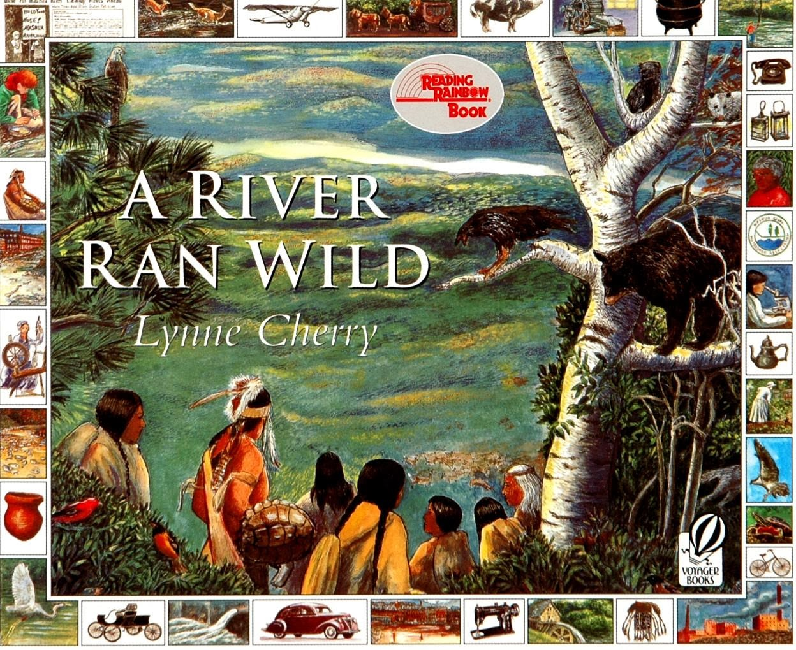


Dr. Deborah Kozdras dkozdras@usf.edu
Dr. Sherry Moser smoser@usf.edu

Slide 2
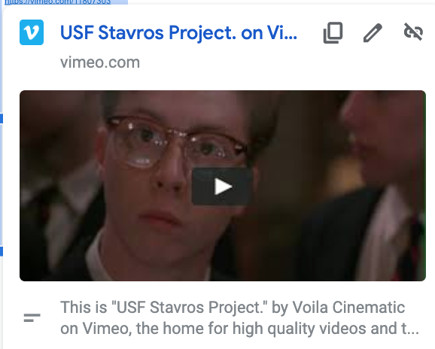
Giving Time, Talent, Treasures
https://vimeo.com/11807303

Slide 3

Financial Literacy Standards and Activities
https://sunnymoney.weebly.com/disney/what-does-beauty-and-the-beast-teach-about-charity

Slide 4
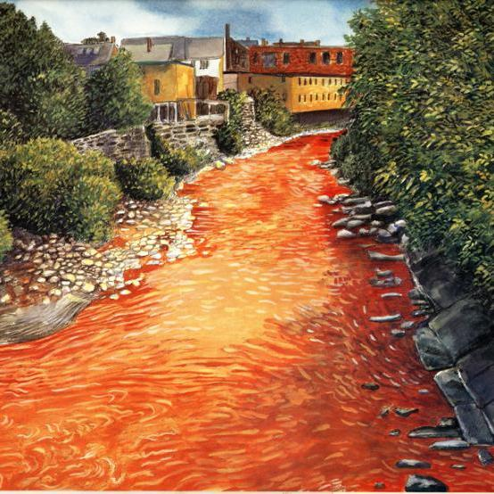

From CSI to ESI: Who killed the river?
What do you see? | What do you think? | What questions do you have?

Slide 5
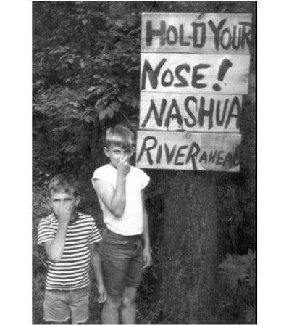
Step 1
Becoming a Detective
•As a detective, your job will be to explore the following documents to determine who or what killed the Nashua River.
•The Nashua River is located in northern Massachusetts.
In the 1960's, the Nashua River's pollution could be smelled long before reaching the river's banks.
(NRWA Archives)

Slide 6
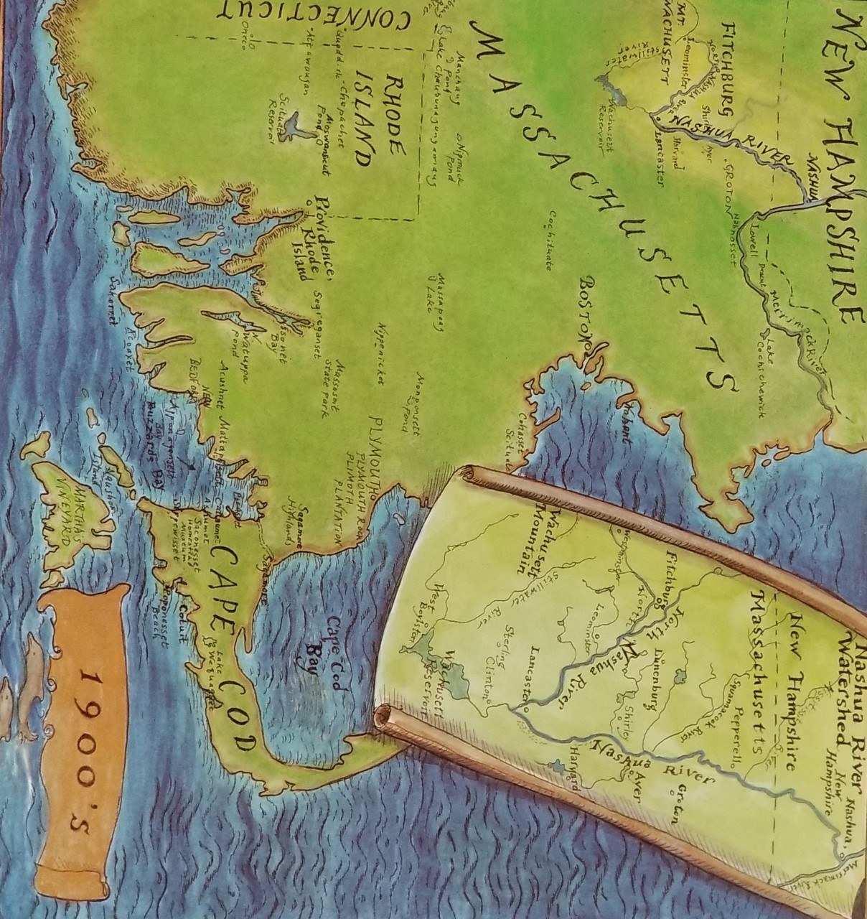
Nashua River
https://earth.google.com/web/@42.71564655,-71.51303715,65.69118264a,34181.23914254d,35y,0h,0t,0r/data=ChMaEQoJL20vMDQ1cjNyGAIgASgC
Notes:
Introduce the book, show the map. Use link to Google Earth to show location. Point out the timeline on the map pages.

Slide 7
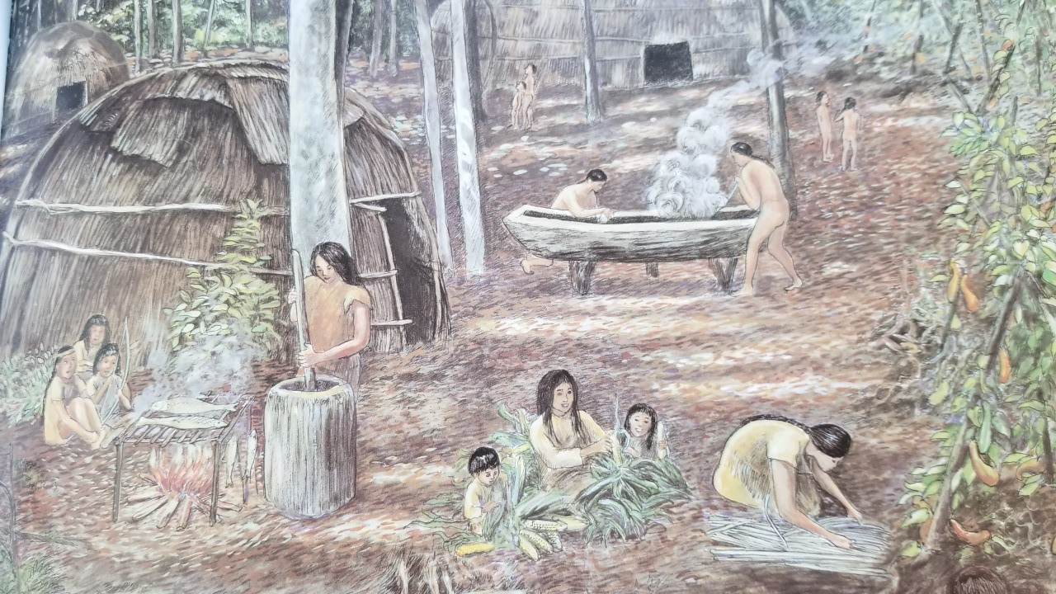
Step 2: Investigating the Evidence:
The Nashaway were a tribe of Algonquian Indians inhabiting the upstream portions of the Nashua River valley in what is now the northern half of Worcester County, Massachusetts near Mount Wachusett.

Slide 8
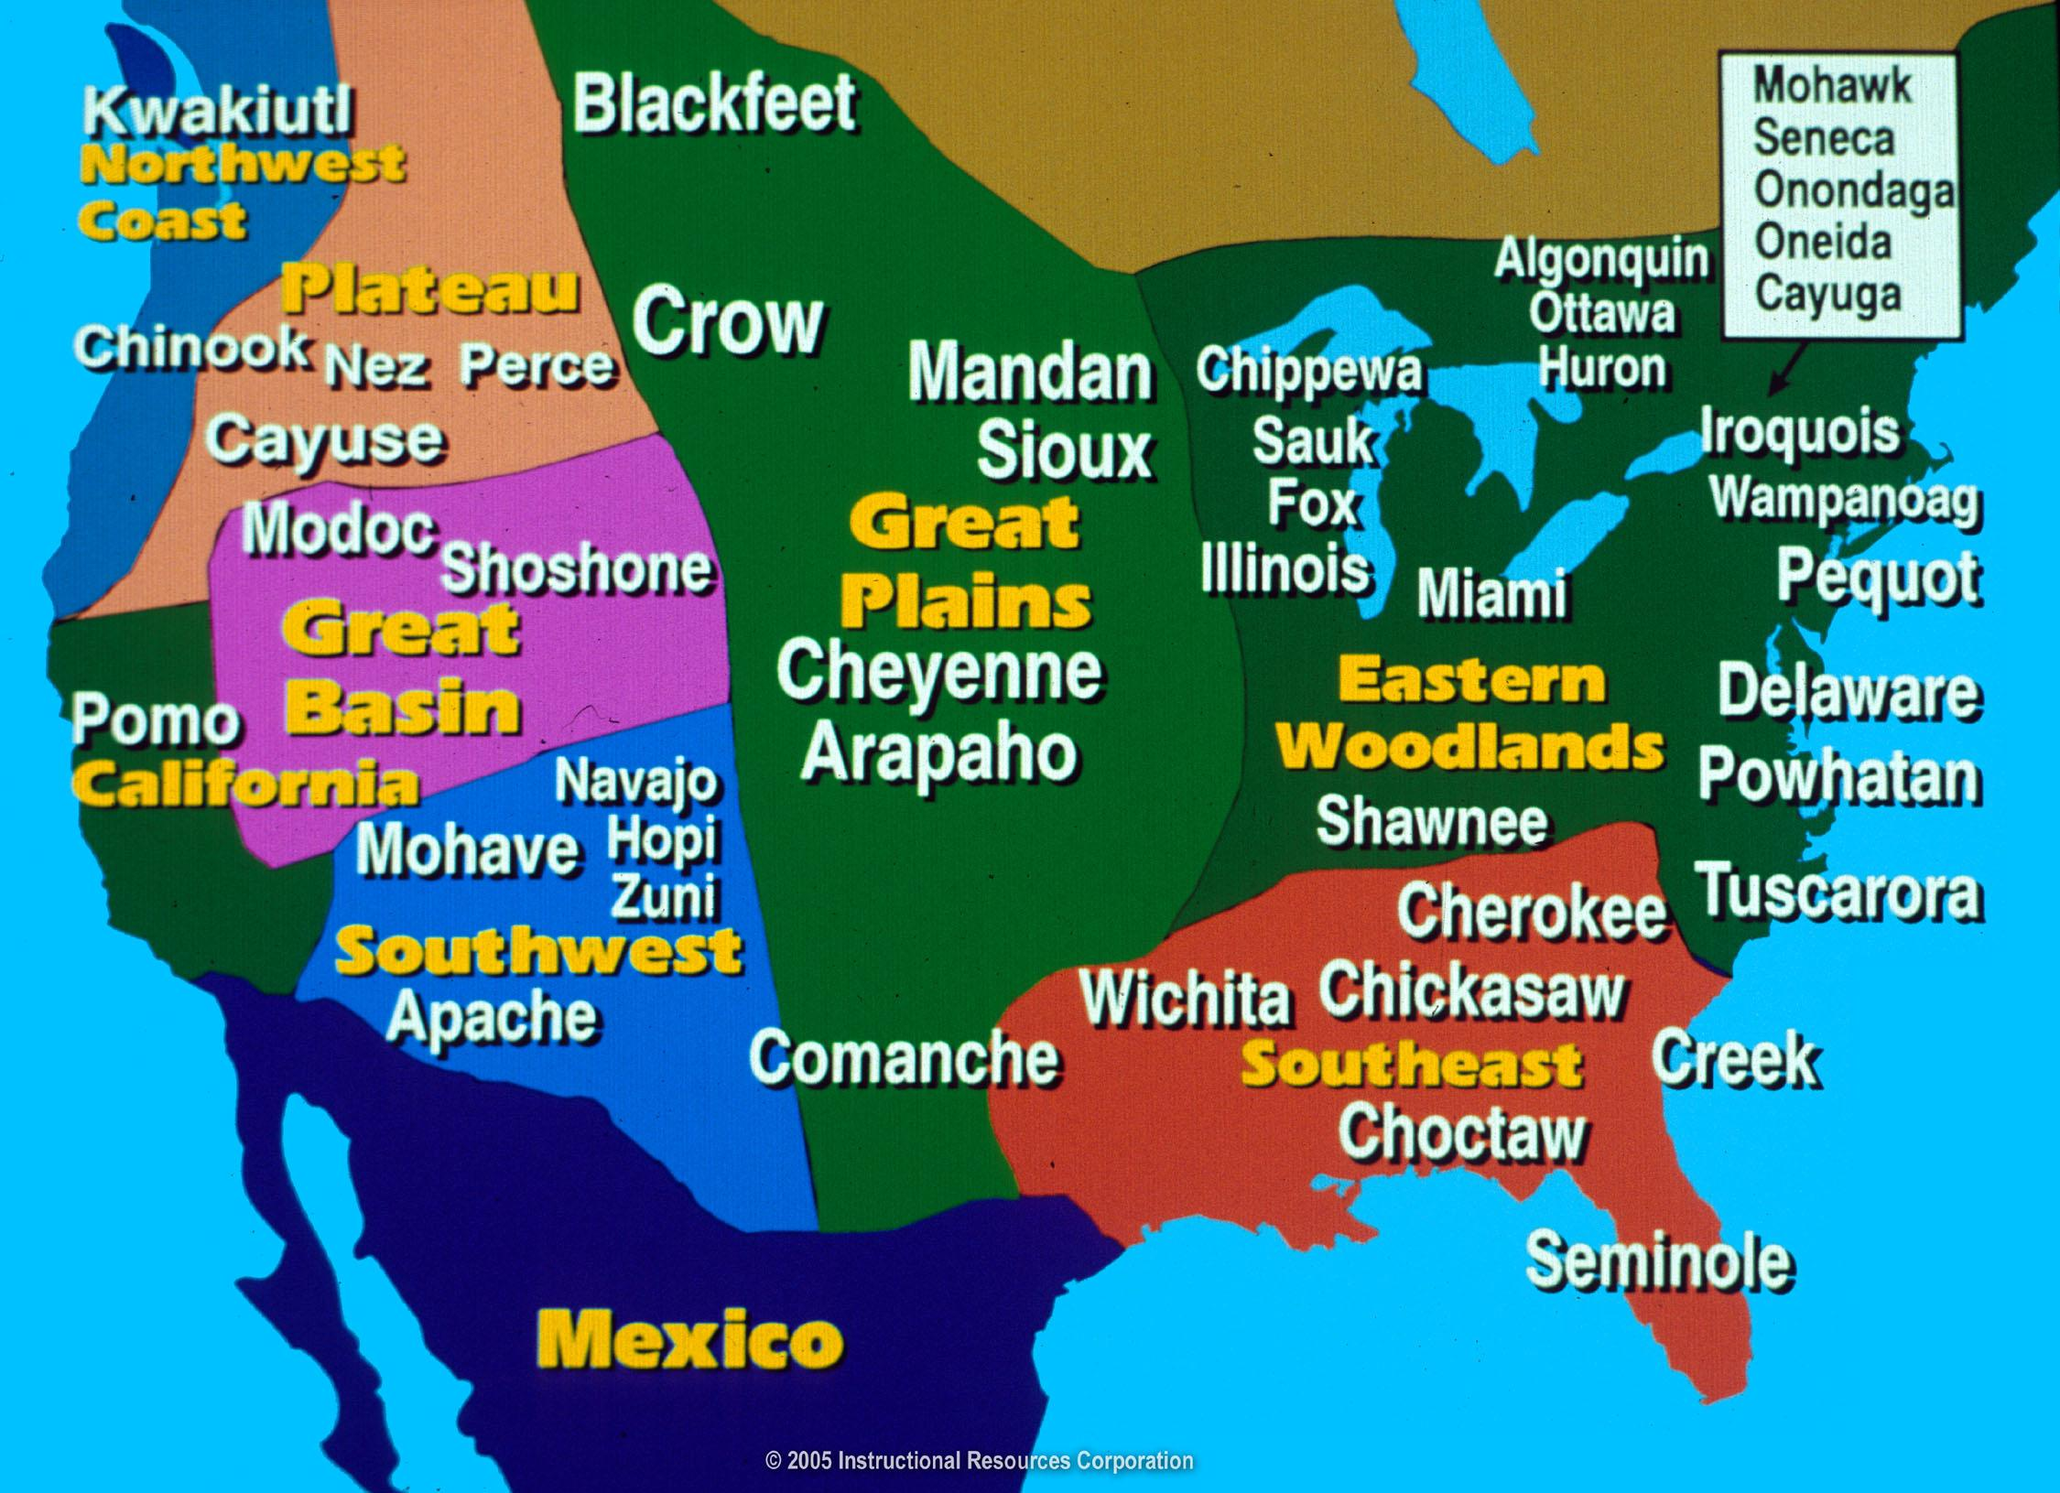
Extra Activity: Investigate Native American Tribes
https://www.history.com/topics/native-american-history/native-american-cultures

Slide 9
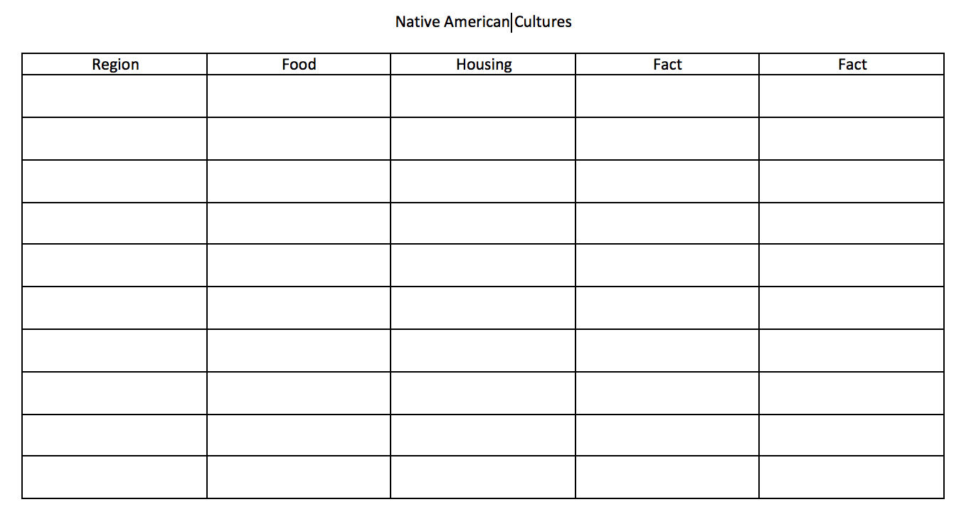
Extra Activity: Investigate Native American Tribes

Slide 10
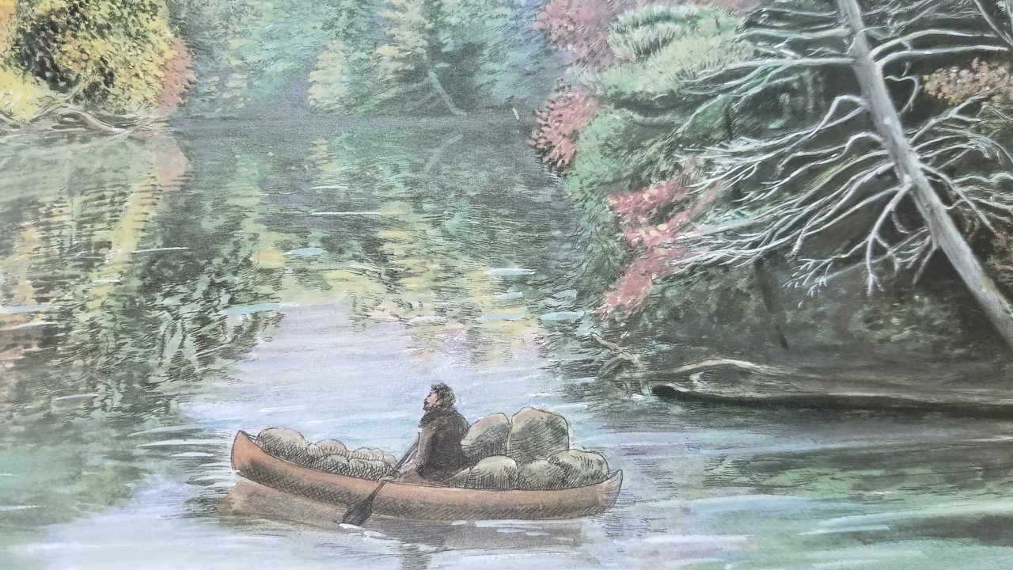
The fur trade in North America began during the 1500s when Europeans explored the eastern coast. Native Americans traded furs, deer hides, and meat for iron tools, wool blankets, colorful cloth, and guns.

Slide 11
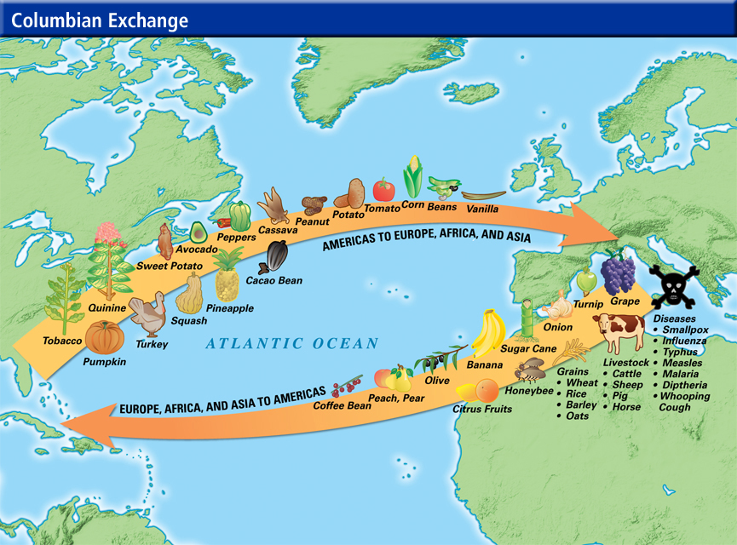
Extra Activity: Investigate Early Colonial Trade
https://www.southamptonschools.org/site/handlers/filedownload.ashx?moduleinstanceid=1227&dataid=23681&FileName=Columbian%20Exchange.pdf

Slide 12
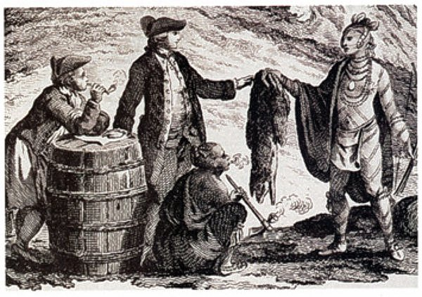
Extra Activity: Investigate Early Colonial Trade
https://www.khanacademy.org/humanities/us-history/precontact-and-early-colonial-era/old-and-new-worlds-collide/a/environmental-and-health-effects-of-contact

Slide 13
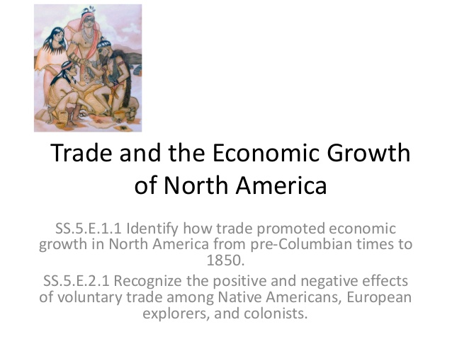
Extra Activity: Investigate Early Trade
https://sunnymoney.weebly.com/5.html

Slide 14
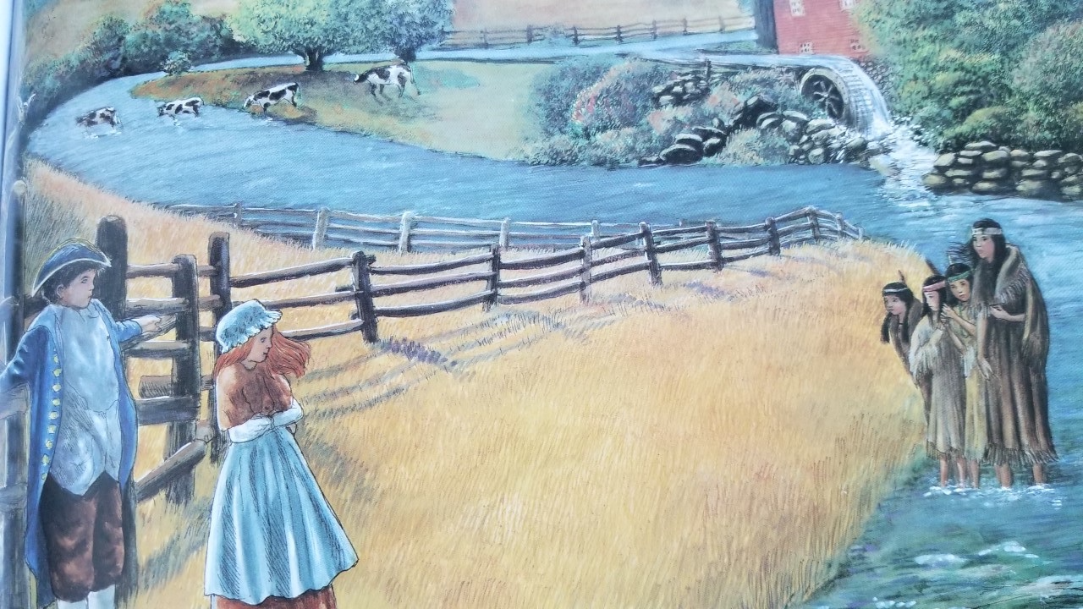
The growth of settlements along the Nashua led to fights between settlers and Indians. Settlers fenced land and cut down forests. They hunted and killed more animals than needed for survival in order to sell pelts to be sent to England.

Slide 15
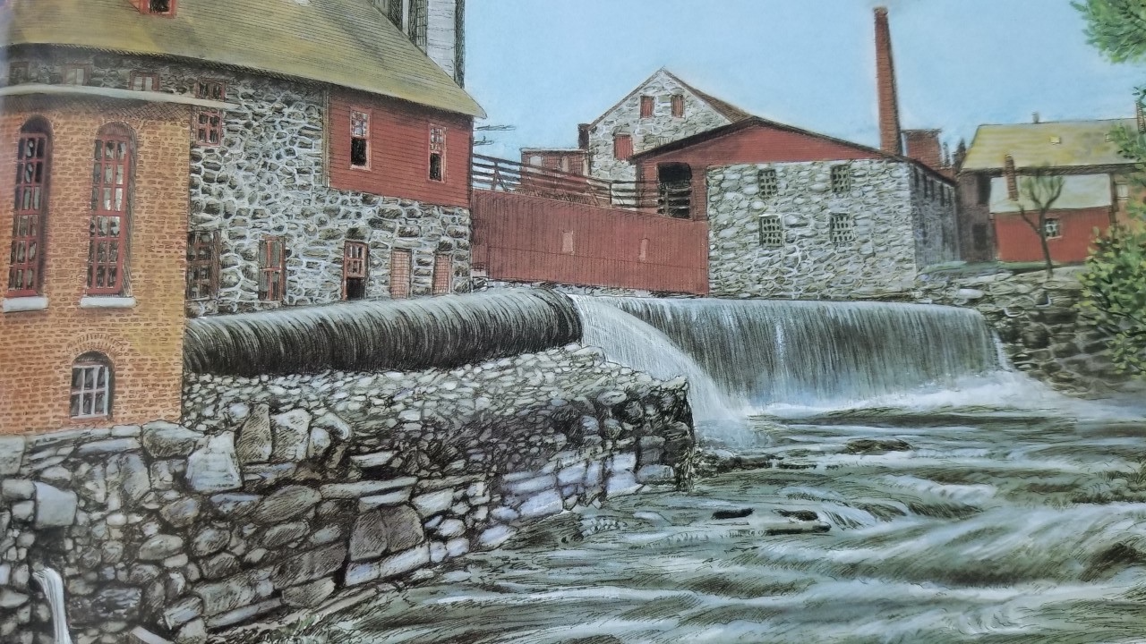
The Industrial Revolution impacted settlements in North American into the 19th century. America’s economy grew as new industries formed. New machines for making cloth and paper dumped their waste into the Nashua River.

Slide 16
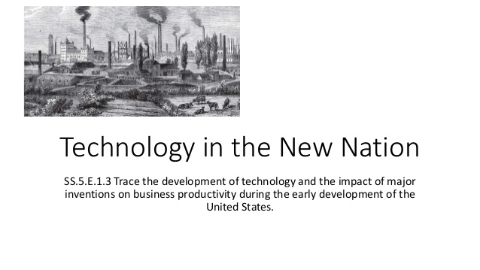

Extra Activity: Technology and Development of the Market Economy
https://sunnymoney.weebly.com/5.html

Slide 17
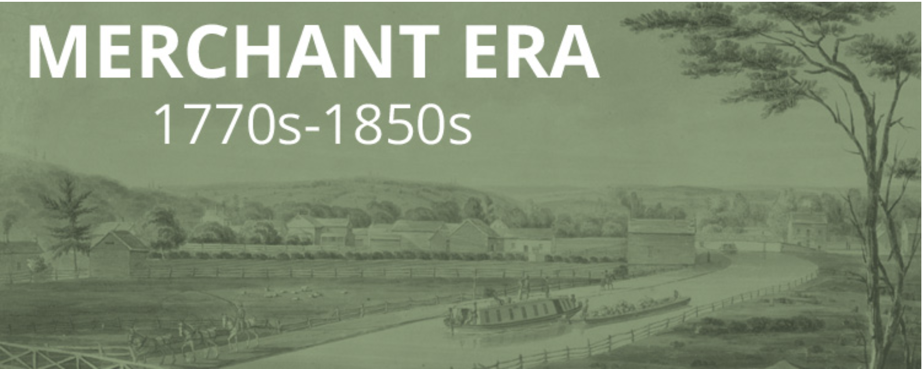


Extra Activity: Technology and Development of the Market Economy
https://americanhistory.si.edu/american-enterprise-exhibition

Slide 18
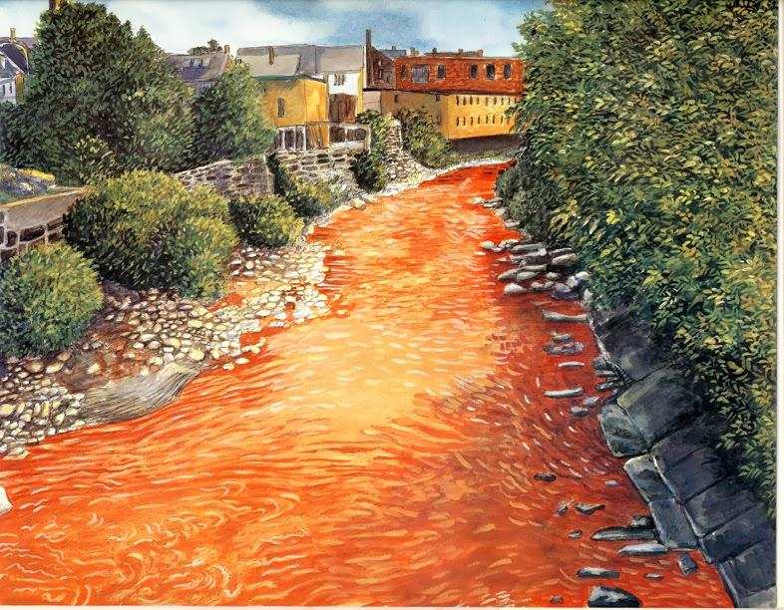
The polluting of the Nashua River caused it to run more slowly. Over time, pulp clogged the river, fish died and the dark and dirty river smelled bad. Birds no longer came to the river.

Slide 19
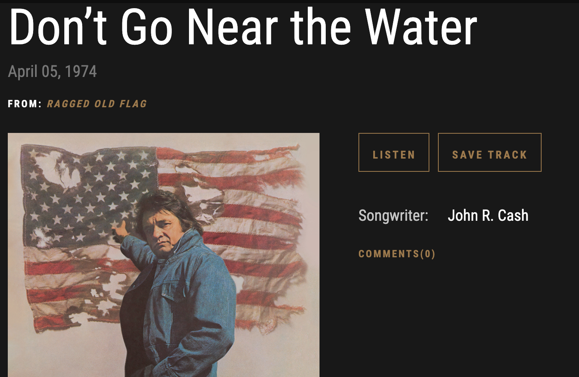
https://www.johnnycash.com/track/dont-go-near-the-water-4/

Slide 20
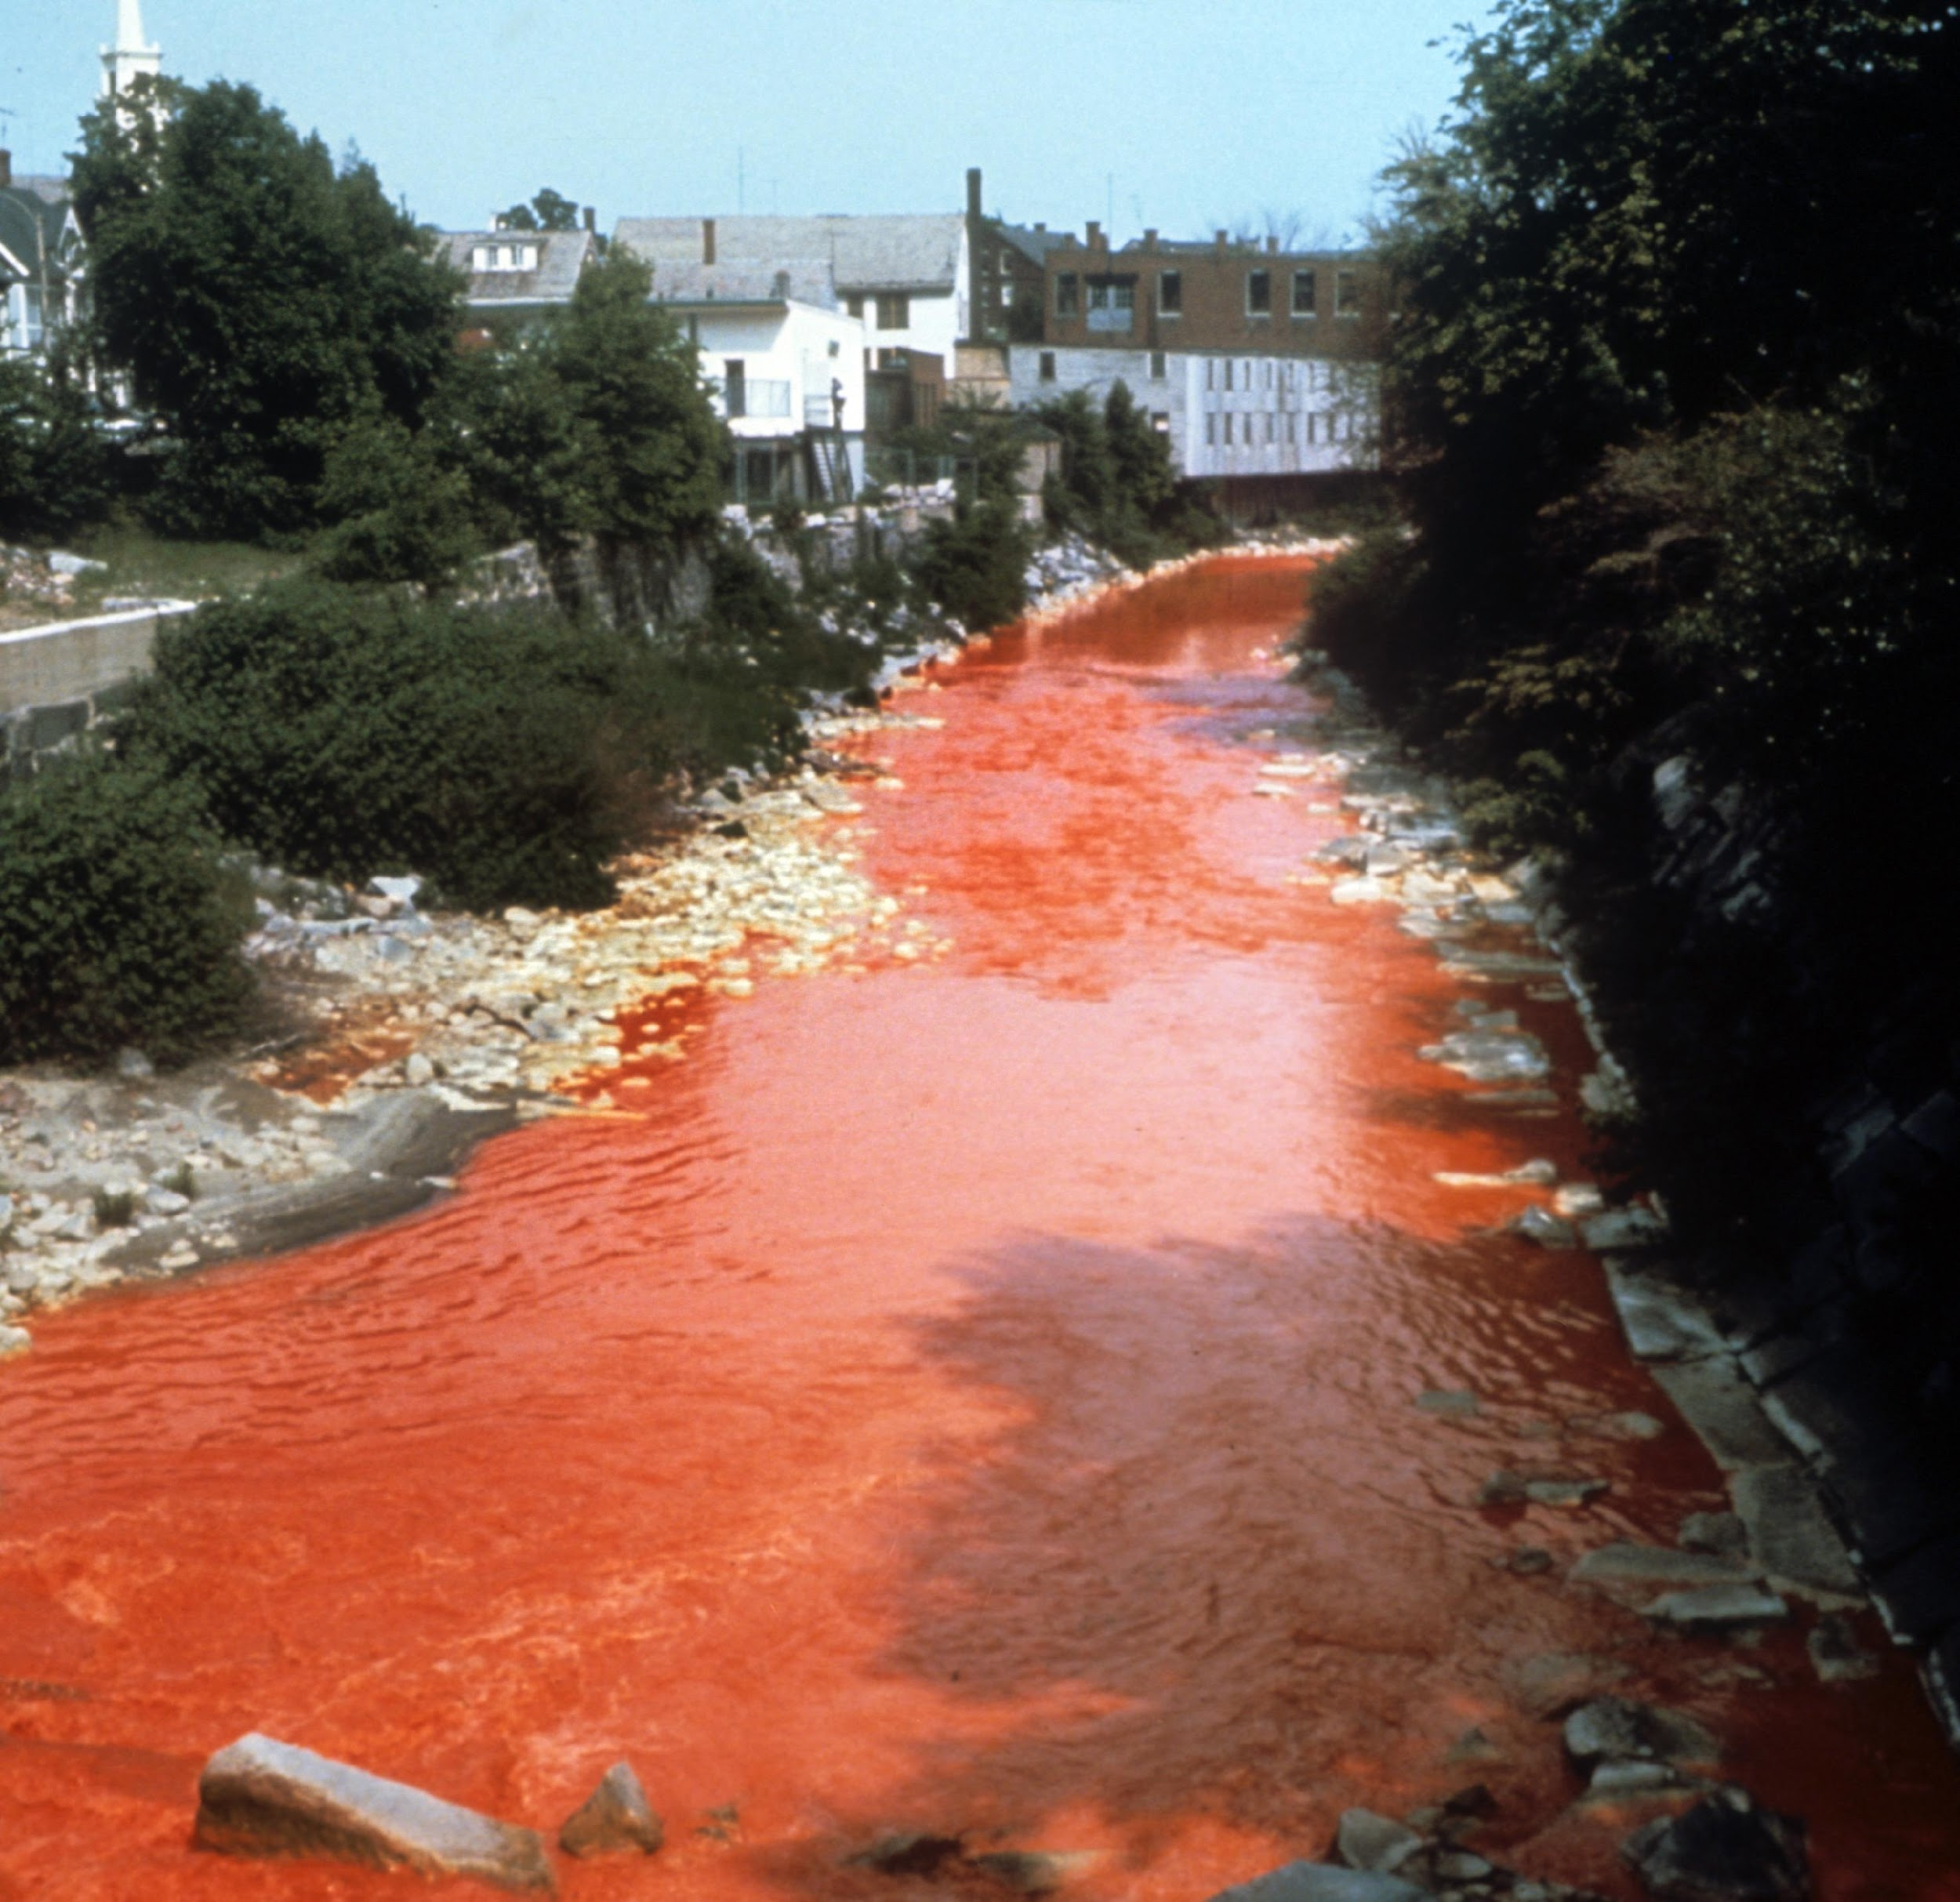
Nashua River, 1962
https://umngeniriverwalk.wordpress.com/2014/12/04/how-a-housewife-transformed-an-open-sewer-into-a-swimmable-river/
https://www.epa.gov/laws-regulations/summary-clean-water-act
http://freedomsway.org/national-rivers-month-marion-stoddart/

Slide 21
Investigate evidence in the next ten slides
Descriptive Questions:
Who, What, When, Where
Analytical Questions:
How, Why

Slide 22
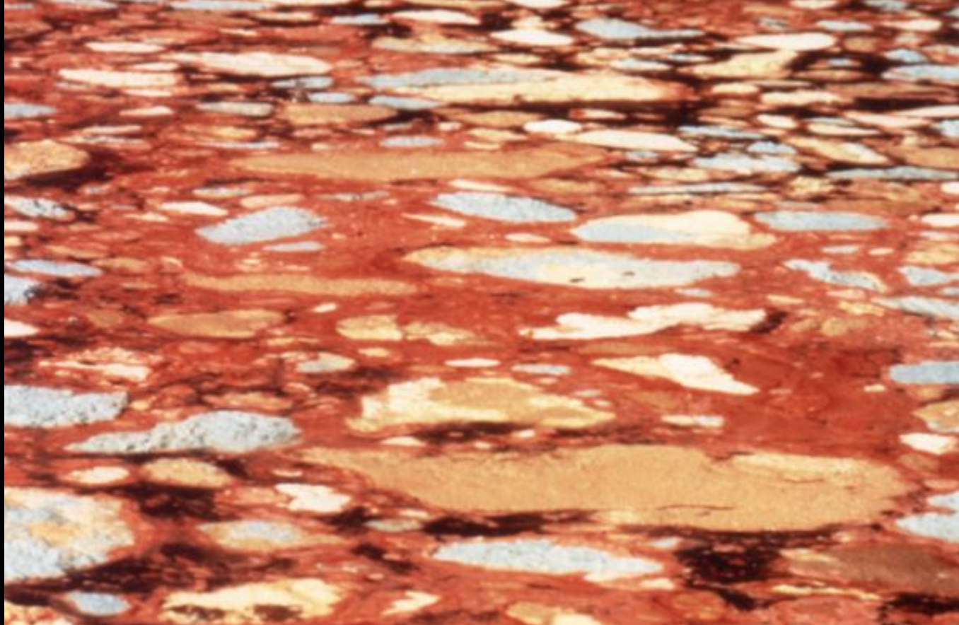
Exhibit 1: A mat of paper sludge from local mills floating on the Nashua River in the 1960's
(NRWA Archives)

Slide 23
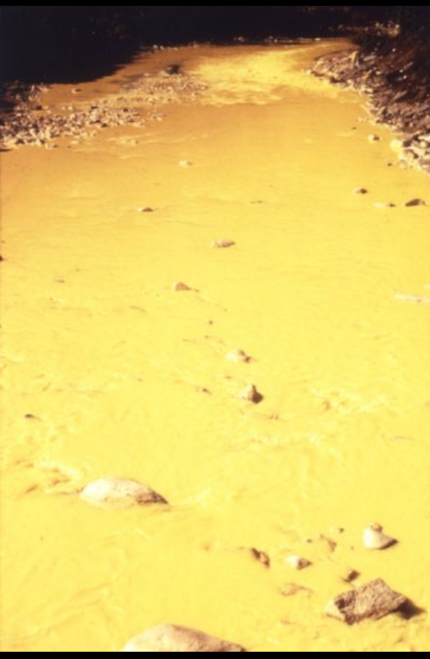
Exhibit 2: Yellow dye pollutes the Nashua River in the 1960's
(NRWA Archives)

Slide 24
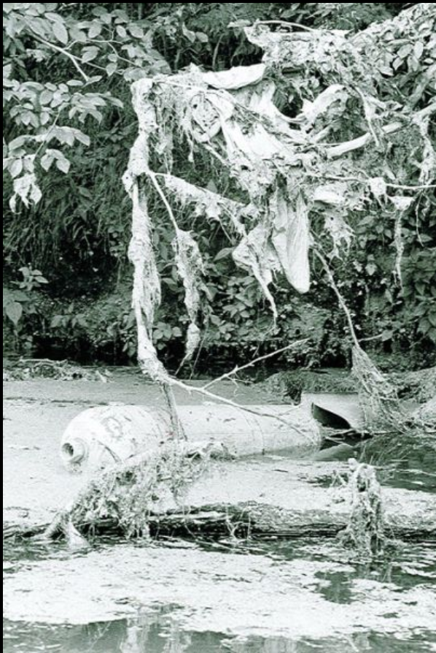
Exhibit 3: Trash and paper sludge lining the Nashua River in the 1960's.
(NRWA Archives)

Slide 25
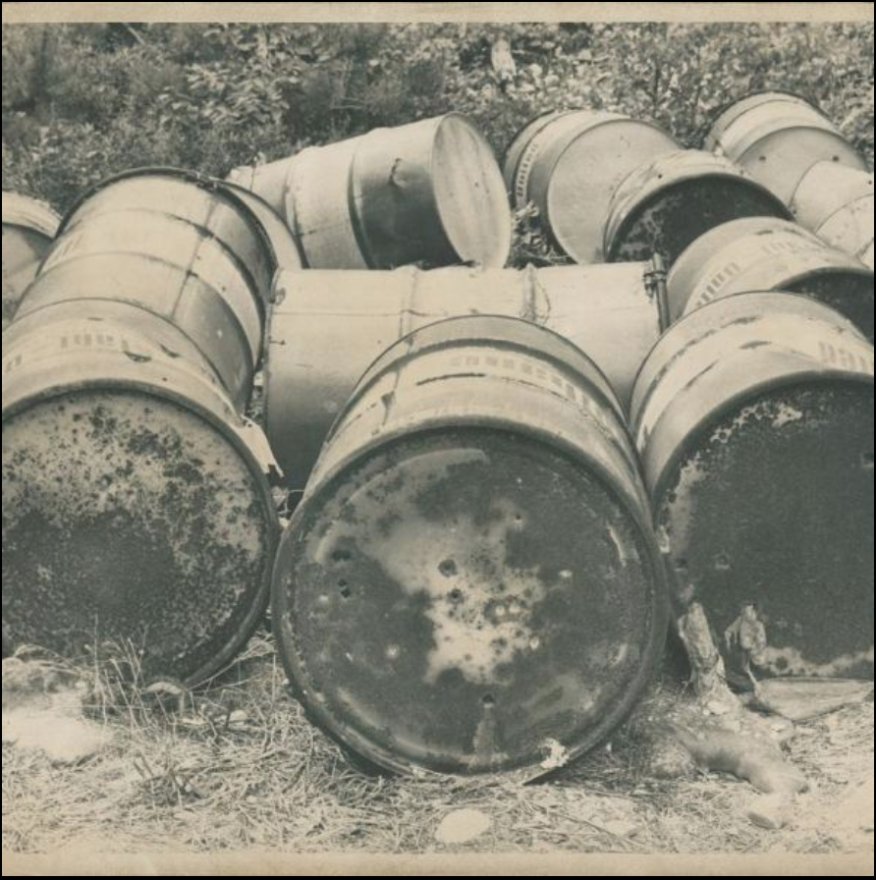
Exhibit 4: Drums of liquids dumped at the river's edge.

Slide 26
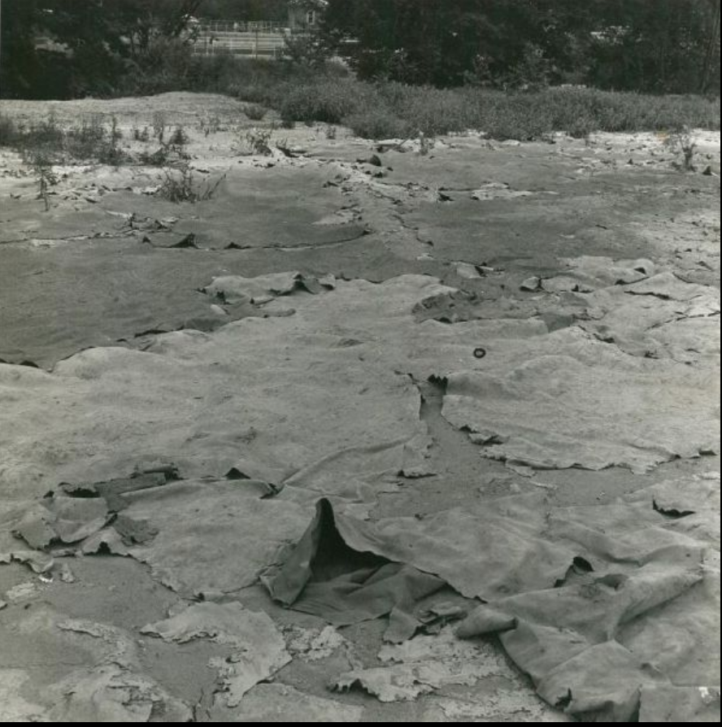
Exhibit 5: Paper mill refuse, Nashua River flood plain, Leominster, MA
(Photo by Jack Swedberg)

Slide 27
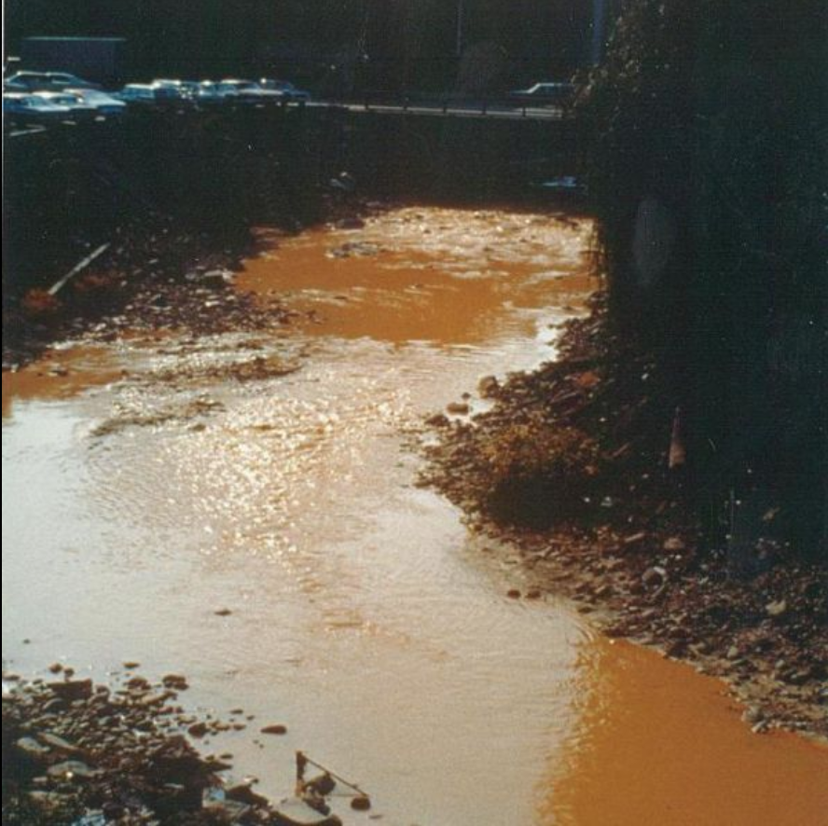
Exhibit 6: Downstream from a factory.

Slide 28
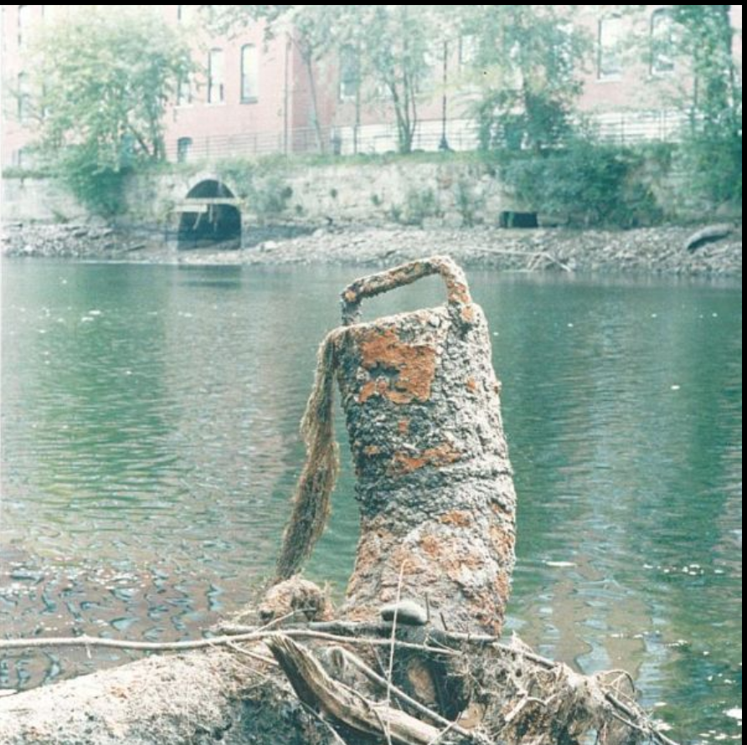
Exhibit 7: Exposed pipe.

Slide 29
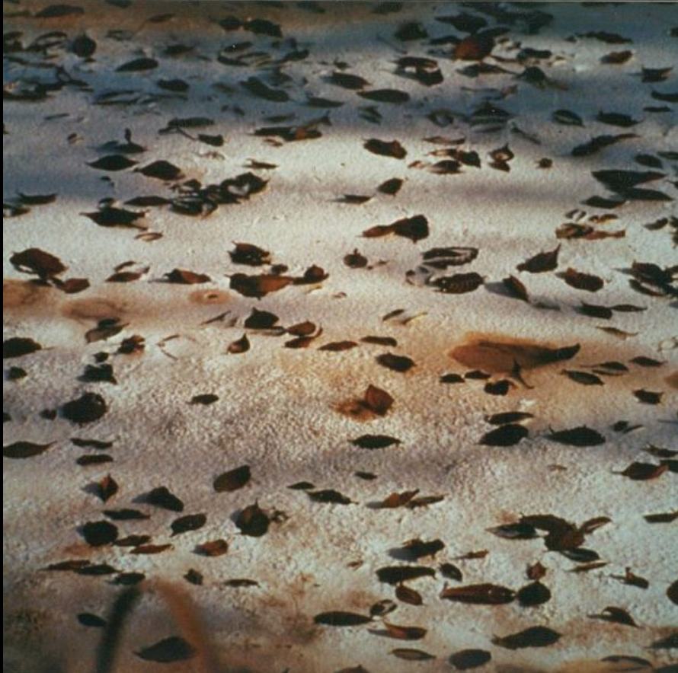
Exhibit 8: Thick sludge from industry waste.

Slide 30
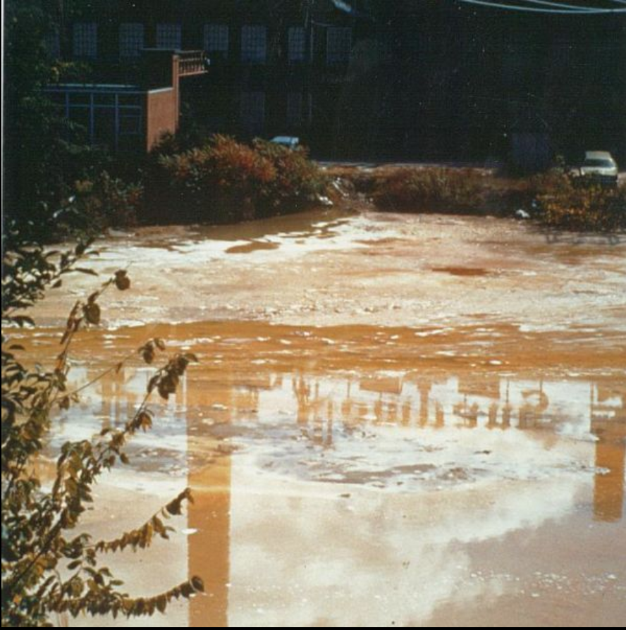
Exhibit 9: Downstream from a paper mill.

Slide 31
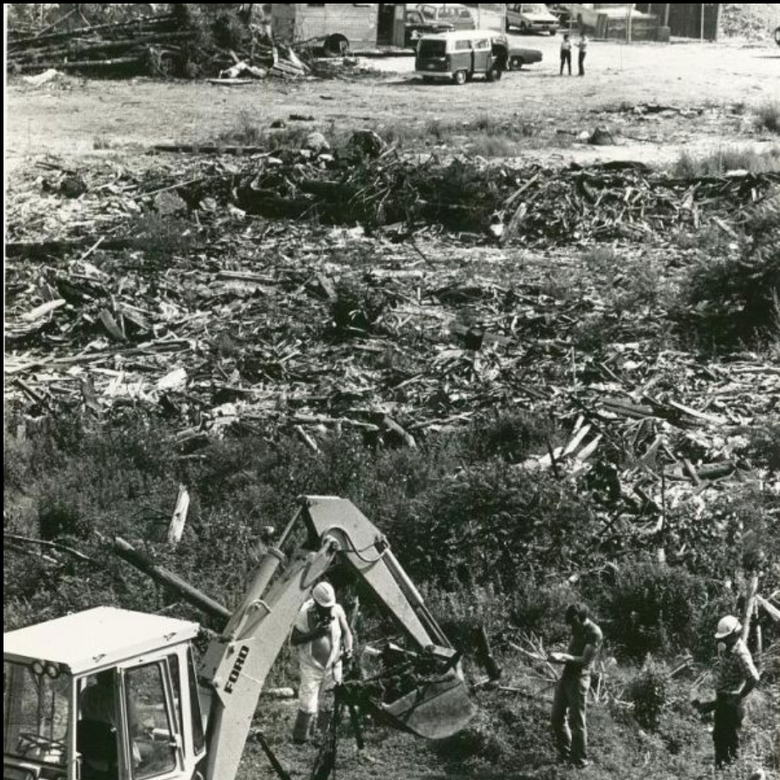
Hazardous waste dump off Gilson Rd., Nashua, NH, 1980.

Slide 32
Cracking The Case
Found Poetry Template
What___________________________________________
When___________________________________________
Where__________________________________________
Who____________________________________________
How____________________________________________
Why____________________________________________
What if . . ._______________
________________________
Who Killed the River?
Based on your analysis of the documents and citing evidence to support your answer, please write a paragraph/found poetry answering: Who/What killed the river?

Slide 33
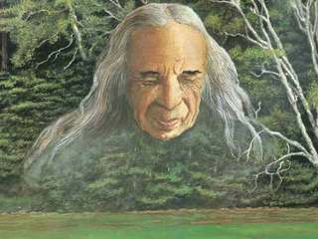
Who will save the river?

Slide 34
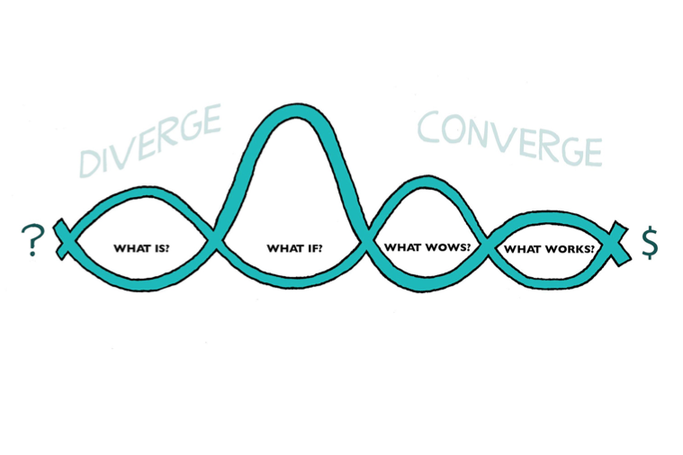
Entrepreneurial (Design) Thinking

Slide 35
What___________________________________________
When___________________________________________
Where__________________________________________
Who____________________________________________
How____________________________________________
Why____________________________________________

Slide 36

Refuse
Reduce
Reuse
Recycle
Repurpose
Reimagine
Redesign
Rewrite

Slide 37
What Wows? Make a Pitch that Wows!
1.Start with a question or story. Did you ever(problem)
2.Who are you? We are (name of company)
3.What are you creating? We are here to tell you about
4.Who do you help? What is the solution?
5.Create a persuasive slogan.

Slide 38
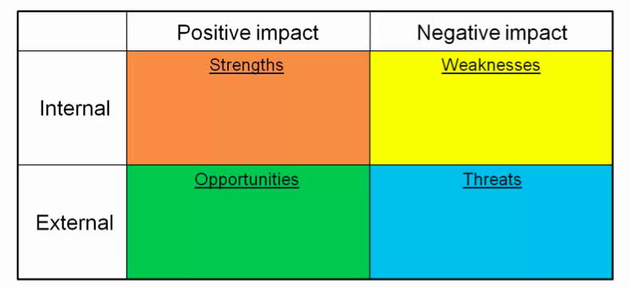
What Works?
Students evaluate pitches with SWOT

Slide 39
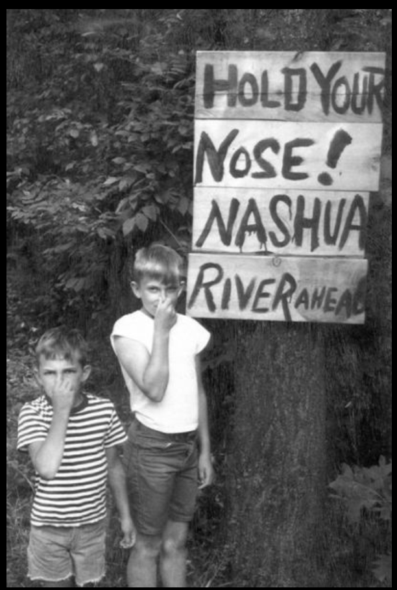
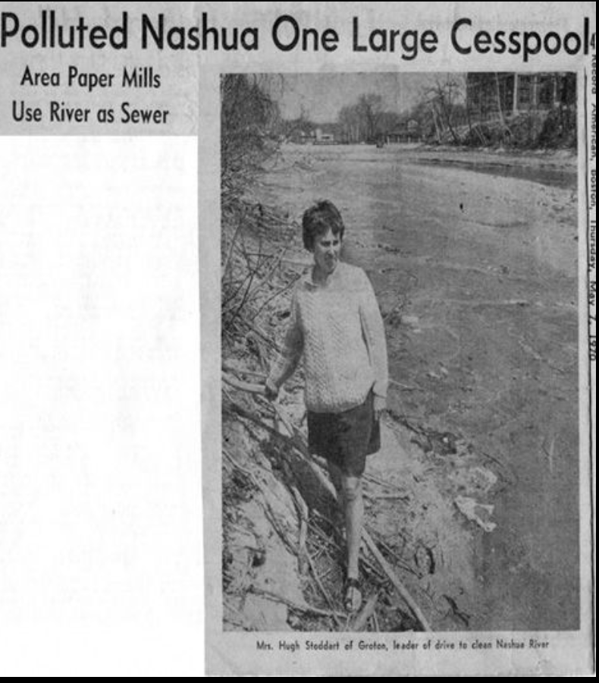
In the 1960's, the Nashua River's pollution could be smelled long before reaching the river's banks.
(NRWA Archives)
Marion Stoddart led the movement to restore the highly polluted Nashua River.
(NRWA Archives)

Slide 40

Who Saved the River?
In 1965, the U. S. Congress passed the first Clean Water Act. The next year, Marion Stoddart coordinated a successful citizen campaign that led to the passage of the Massachusetts Clean Water Act of 1966.
https://www.youtube.com/watch?v=OQ3j4_HQJ4o

Slide 41
Stakeholder Decision-making
Stakeholders | How will they be affected by improvements in water quality | is the effect + or - | Is the interest of the shareholder related to: People, Planet, and/or Profit | Importance of stakeholder interest 1 very 2 somewhat 3 not

Slide 42
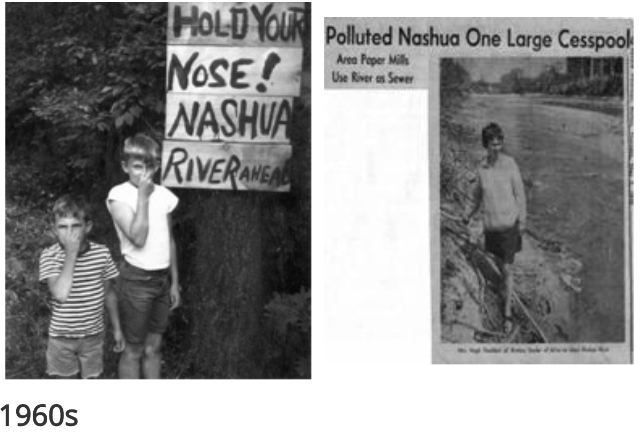
NRWA Historical Highlights
The restoration of the Nashua River launched the Nashua River Watershed Association into an international spotlight, a prime example of collaboration to accomplish a goal for the betterment of all society. The Association’s leadership and approach to protecting natural resources through a watershed approach, protecting both land and water throughout the region, continues to be recognized by federal, state, and local governmental leaders, as well as by leaders in the fields of environmental protection and environmental education.

Slide 43
1960s
Nashua River Clean-up Committee (NRCC) formed by Marion Stoddart and others
US Congress passed Clean Water Act in 1965
The North Nashua River in 1966 reached a septic condition and would not support life except for sludge worms
Petition and signatures and a bottle of dirty Nashua River waters presented to Massachusetts Governor Volpe and legislators
Secretary of the Interior Stewart Udall, Senator Ted Kennedy, Governor Volpe, and Lt. Governor Richardson visited the Nashua River and met with citizens
Massachusetts Clean Water Act signed into law
NRCC successfully pushed to raise the River Classification from “U”, unsuitable for the transportation of waste, to “B-“, suitable for all uses including fishing, swimming, and boating

Slide 44
1969-1979 Part 1
Nashua River Watershed Association founded on October 16, 1969
Petition with 13,000 signatures sent to President Nixon, Governors Sargent and Peterson, Congressmen and Legislators seeking assurance that federal monies be appropriated to help with the construction of waste water treatment plants
Nashua River selected for the $15 million River Basin Demonstration Project (Nashua River Program) by the New England Region Commission
Mine Falls Canal Park purchased by the City of Nashua with Land and Water Conservation Grant
Nashua River Watershed Association’s office established at Fort Devens with donated space and staff time
Hydrology and Water Resources Study of the Nashua River watershed completed and published
First Plan for the Nashua River watershed published
$1 million of the Model River Demonstration Project money spent to construct major sewer interceptors in Nashua, NH

Slide 45
1969-1979 Part 2
US Environmental Protection Agency (EPA) formed. Goal set that all US waters be fishable and swimmable by 1983
Squannacook-Nissitissit Sanctuary Act passed in 1975
The US Fish & Wildlife’s Oxbow National Wildlife Refuge established in 1974
West Fitchburg and East Fitchburg Treatment plants began operation
Squannacook Task Force organized
Project CURB (Clean Up Our River Banks) and the Groton Conservation Commission coordinated effort and established the Petapawag Canoe Launch site
Pepperell Treatment Plant began operations
Bolton Flats Wildlife Area established in 1977
Lancaster Greenway Committee helped assemble the 412 acres of the Cook Conservation Area
Lane-Comerford Conservation Area acquired in 1979 for wildlife habitat to mitigate the loss of flood plain with construction of I-90
First Nashua River Canoe Guide published and first Canoe Race held
The first state-owned Tree Farm in the nation, J. Harry Rich State Forest in Groton, acquired by Department of Environmental Management in1981, with efforts from Rich Tree Farm Task Force

Slide 46
1979-1989 Part 3
NRWA Office relocated to Main Street in Fitchburg after 11 years at Fort Devens
Nashua River Greenway Management Plan and the Squannacook and Stillwater River Protection Plans completed. All three rivers designated by the Commonwealth as Scenic Rivers
Acid Rain Monitoring (ARM) began in 1983 and the NRWA was district coordinator for the statewide volunteer effort
NRWA received the Environmental Merit Award from the Environmental Protection Agency (EPA) in 1984
Dam in Mine Falls Park in Nashua converted to hydroelectric dam with fish lift
United Nations honored NRWA Founder Marion Stoddart, naming her to the “Global 500 Roll of Honor”
Clinton Wastewater Treatment Plant started construction, Leominster Wastewater Facility completed and Ayer Wastewater Treatment Plant began advanced treatment
Metropolitan District Commission (MDC) began acquisition program in 1986 in Wachusett subwatershed
Monoosnoc Brook Greenway Project began with public and private partnership of the city, state, and Searstown developers brought together by NRWA
The Stillwater Task Force established in 1988

Slide 47
1989-1999 Part 1
Prevent Pointless Pollution Program began alerting citizens to non-point sources of pollution and their prevention
Clinton Wastewater Treatment Facility completed
Children’s book about the Nashua River and its environmental history, A River Ran Wild by Lynne Cherry, published in 1992. It went on to win numerous awards including ABA’s Pick of the List, NCSS-CBC Notable Children’s Trade Book in the Field of Social Studies, and selection as a PBS Reading Rainbow book
New Hampshire Shorelands Protection Act passed in 1991
National Geographic visited the NRWA in 1992 and featured a story on the restoration of the Nashua River in its special Water issue devoted to fresh water in North America
NRWA began its volunteer water quality monitoring program in 1992
Governor William Weld helped celebrate the official opening of the NRWA’s River Resource Center in Groton, purchased in 1993
Environmental Education began at the River Resource Center and watershed curriculum was developed and taught in schools throughout the watershed

Slide 48
1989-1999 Part 2
Fort Devens closed as US Army Base. NRWA helped develop Re-Use Plan
The 1995 to 2020 Vision for the Nashua River Watershed was published
12,900 acres in the Nashua River watershed’s heartland designated as the Central Nashua River Valley Area of Critical Environmental Concern (ACEC)
Restoration of riverbank in Howard Park helped by the Squannacook Task Force, Town of Townsend, AmeriCorps, and NRWA volunteers
Massachusetts State Legislature passed the Rivers Protection Act on July 31, 1996. The Rivers Act provides protection for over 9,000 miles of riverfront in Massachusetts
NRWA’s Communities Connected by Water program was initiated
NRWA had key role in developing the Massachusetts Watershed Initiative, which became widely acclaimed as a model for protecting and restoring the nation’s waterways
NRWA launched its first website

Slide 49
1999-2009 Part 1
Both the cities of Fitchburg, Massachusetts and Nashua, New Hampshire drafted community development plans that make the Nashua River the focal point of their urban riverfront revitalization
In 2000, the Massachusetts Riverways Program presented the Fitchburg Stream Team with an Adopt-a-Stream award for its work to protect riverside greenways along the North Nashua River in Fitchburg
“River Classroom” canoe-based environmental education program, originally developed by Nashoba Paddler, transferred to the NRWA in 2001. NRWA now puts 1,800 students on the river each year
Squannassit and Petapawag Areas of Critical Environmental Concern (ACEC) designated in 2002, the two largest ACECs in the Commonwealth to date, with Squannassit covering 37,450 acres and Petapawag covering 25,630 acres in the communities of Ashby, Ayer, Dunstable, Groton, Harvard, Lancaster, Lunenburg, Pepperell, Shirley, Townsend, and Tyngsboro
The Squannacook-Nissitissit Rivers combined sub-basin served as one of four sites nationally to merit a Source Water Stewardship Project, brought to the watershed by Trust for Public Land with their funding from the federal Environmental Protection Agency

Slide 50
1999-2009 part 2
Nashua River Watershed Five Year Action Plan 2003 to 2007 drafted by the NRWA in partnership with the Massachusetts Watershed Initiative’s Team in the Nashua River watershed
265-acre Pepperell Springs property on Gulf Brook, a tributary to the Nissitissit River, which is a major tributary to the Nashua River, successfully preserved by a coalition of partners including Pepperell residents, the Trust for Public Land (TPL), the Nashoba Conservation Trust, the Nissitissit River Land Trust, and the Town of Pepperell. Key funding of $1.383 million came from a Forest Legacy Program grant. NRWA co-chaired the Pepperell Springs Preservation Project
“Fund for the Future” capacity- building program began
NRWA’s partnership with the J.R. Briggs Elementary School in Ashburnham chosen as one of the five schools in Massachusetts to implement a "Environment in an Integrating Context" curriculum
NRWA and three partner organizations, Beaver Brook Association, New England Forestry Foundation, and the Trust for Public Land, awarded a multi-year Targeted Watershed Initiative grant of $770,192 by the U.S. Environmental Protection Agency – one of only fourteen awarded nationwide in 2004—for the NRWA’s "Protecting Today's Water for Tomorrow" project to proactively combat threats to drinking water in the Squannacook-Nissitissit sub-basin

Slide 51
1999-2009 part 3
By 2009, NRWA worked on seven Forest Legacy projects (two of which were multi-tract) which will protect over 3,000 acres with a federal contribution of nearly $8 million
The Nashua River Rail Trail completed and opened for public use
Education staff and programs, River Classroom and Scientist-in-Residence won multiple awards for “Excellence in Environmental Education” from the MA Executive Office of Environmental Affairs
Protection of 360-acre Surrenden Farm in Groton protected ¾ miles of Nashua River greenway as a result of a partnership project led by the Trust for Public Land, the Groton Conservation Trust, and others
Electronic cataloguing of the contents of the Bill Farnsworth Conservation Clearinghouse began in 2007
NRWA’s Smart Growth Circuit Rider worked with the Massachusetts towns of Ashby, Groton, Pepperell, and Townsend, and the New Hampshire towns of Mason, Greenville, New Ipswich, Hollis, and Brookline on writing or revising bylaws, ordinances, and town plans for the purpose of better protecting water resources

Slide 52
1999-2009 part 4
1,162 students participate in Monoosnoc Brook Poster Contest at MBGP "Environmental Art & Music Festival" at Fall Brook Elementary School in 2008
Devens Open Space and Recreation Plan 2008 to 2013 drafted by NRWA
USDA awarded NRWA a Forest Innovation Grant to apply strategies learned from the EPA Targeted Watershed Initiative grant to 11 towns and lands in the southern portion of the watershed
In 2008, the NRWA began managing a multi-year project to eradicate invasive water chestnuts from the Pepperell Pond impoundment of the Nashua River under a grant from the MA Department of Conservation and Recreation to the Town of Pepperell
EIC program that began at one school with 2 teachers in a single grade grew to include all teachers in grades 1 through 5 at J.R. Briggs Elementary in Ashburnham, and expanded to Fall Brook Elementary in Leominster
Over 1 mile of the Squannacook and Nashua Rivers’ frontage at their confluence in Shirley was permanently protected

Slide 53
1999-2009 part 5
Fitchburg protected two riverfront properties by creating parks, the 2-acre downtown Riverfront Park and the Steamline Trail Park which protects ¾ mile of North Nashua River frontage. In 2009, the City permanently protected a third riverfront property, with a proposal to create Gateway Park, with grant funding from the Executive Office of Energy & Environmental Affairs. Active partners in that project included Mayor Lisa Wong and the City of Fitchburg, the Fitchburg Greenway Committee, the Nashua River Watershed Association, the North Central Charter Essential School, and particularly the North County Land Trust and The Trustees of Reservations
ExtraMile Design produces a documentary biography on NRWA founder Marion Stoddart called Work of 1000
“Nashua River Greenway” Forest Legacy Area, the largest such area of the half dozen in Massachusetts (over 420,000 eligible acres), designated as eligible for the Forest Legacy Program, a partnership between participating States and the USDA Forest Service focused on identifying and helping to protect environmentally important forests from conversion to non-forest uses

Slide 54
2009-today
National Geographic’s Written in Water: Messages of Hope for Earth’s Most Precious Resource (2010) contains an essay on the Nashua River cleanup by Marion Stoddart
NRWA’s Volunteer Water Quality Monitoring program began its 20th consecutive year in 2012. The Commonwealth of Massachusetts uses NRWA’s monitoring data to create its MA Water Quality Assessment Report, and the State of New Hampshire uses NRWA’s data in its Volunteer River Assessment Program
NRWA providing environmental education programs to over 10,000 children and adults each year
Bio-control project using Galerucella beetles to control invasive purple loosestrife in watershed wetlands begins

Slide 55
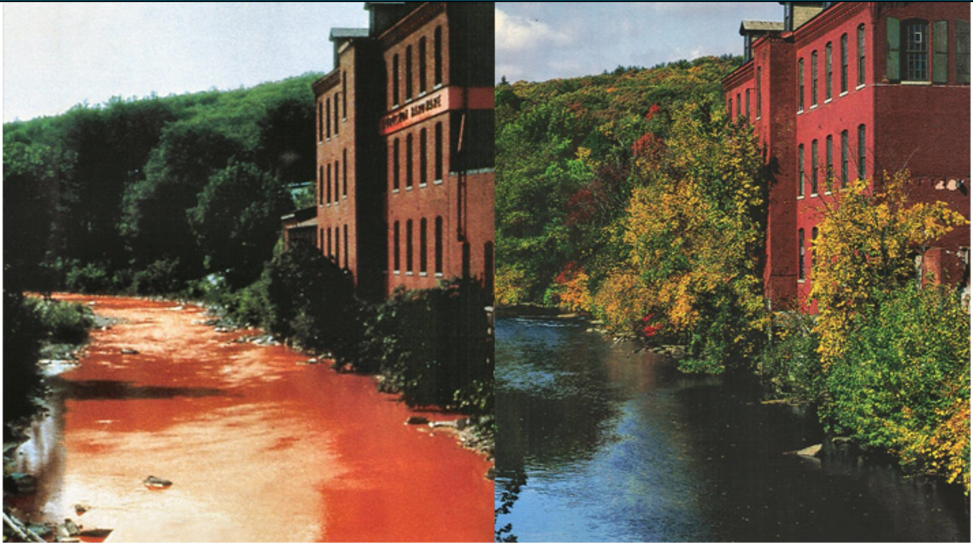
https://ejatlas.org/print/nashua-river-pollution-usa

Slide 56
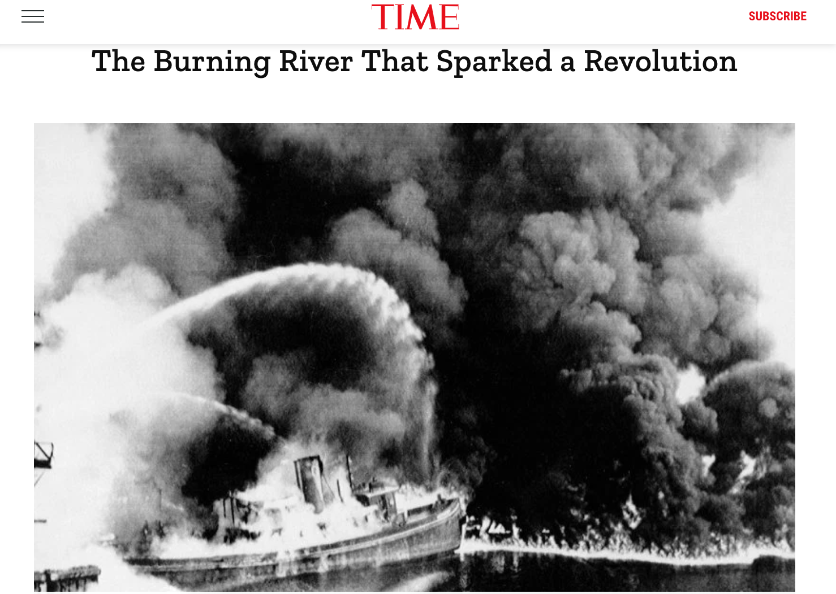
That other river . . .

Slide 57
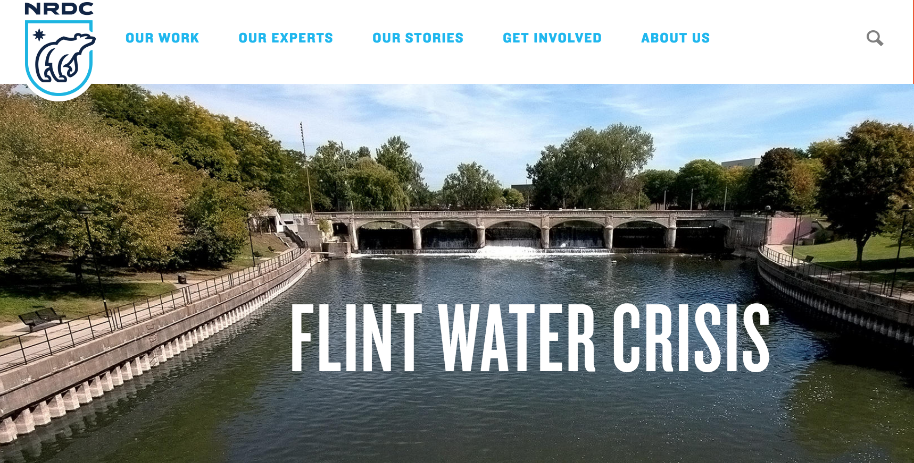
https://www.nrdc.org/flint
Notes:
National Resources Defense Council: Another example of how communities can be harmed by river pollution.

Slide 58
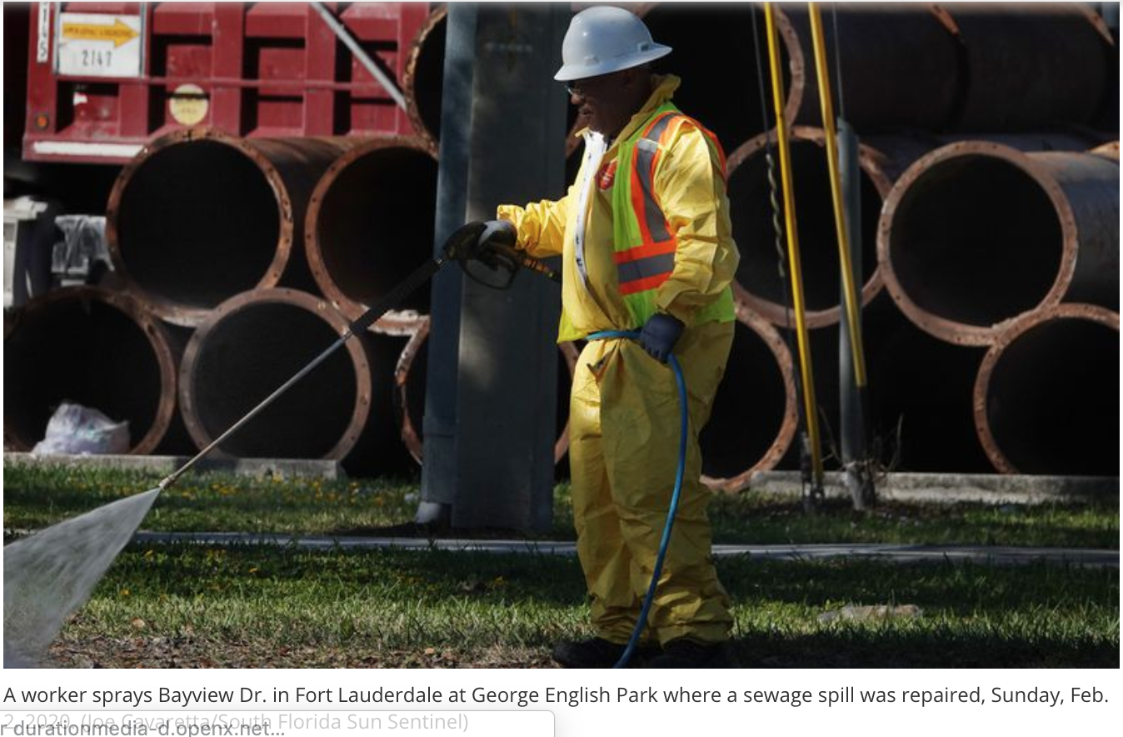
Sewage in the Sunny South
https://www.sun-sentinel.com/local/broward/fort-lauderdale/fl-ne-fort-lauderdale-january-sewage-day-2-20200131-nj3kzdggojayzgdsbkegruc2yi-story.html
https://www.nbcnews.com/news/us-news/more-211-million-gallons-sewage-fort-lauderdale-s-waterways-n1137916
https://www.sun-sentinel.com/local/broward/fort-lauderdale/fl-ne-sewage-spill-george-english-park-20200202-hwms2zm62rd7pd4s5kluxhfa64-story.html

Slide 59

https://kids-clerk.house.gov/grade-school/lesson.html?intID=17
https://www.ducksters.com/history/us_government/how_laws_are_made.php
https://www.youtube.com/watch?v=Otbml6WIQPo

Slide 60
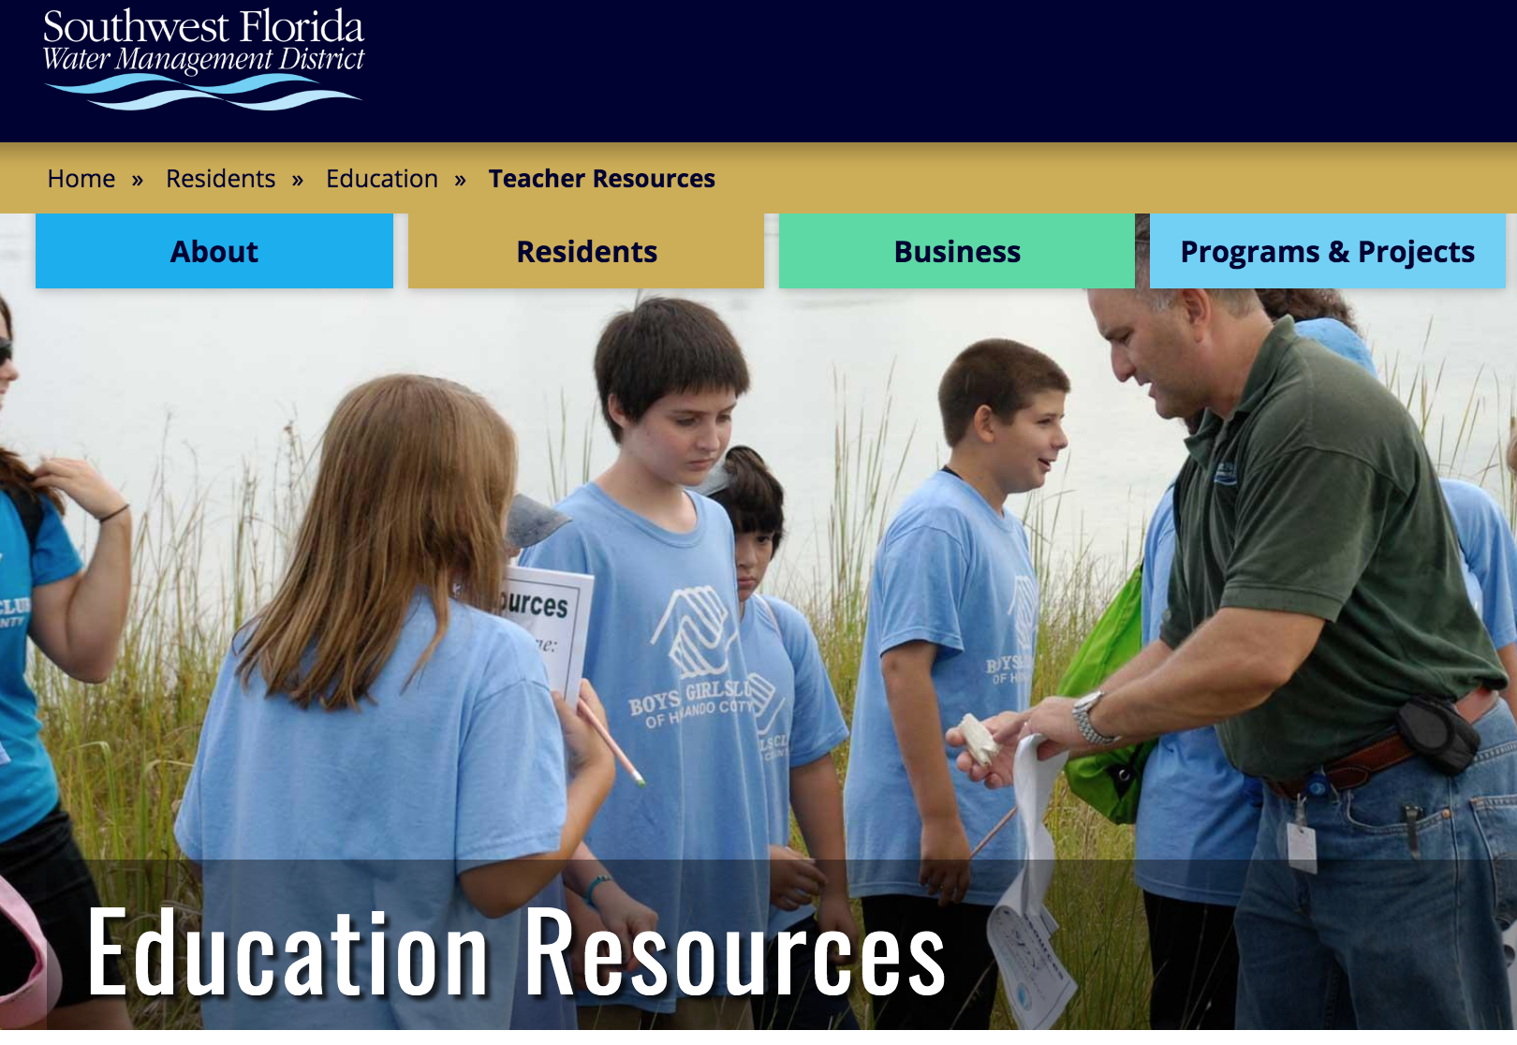
https://www.swfwmd.state.fl.us/residents/education/teacher-resources

Slide 61
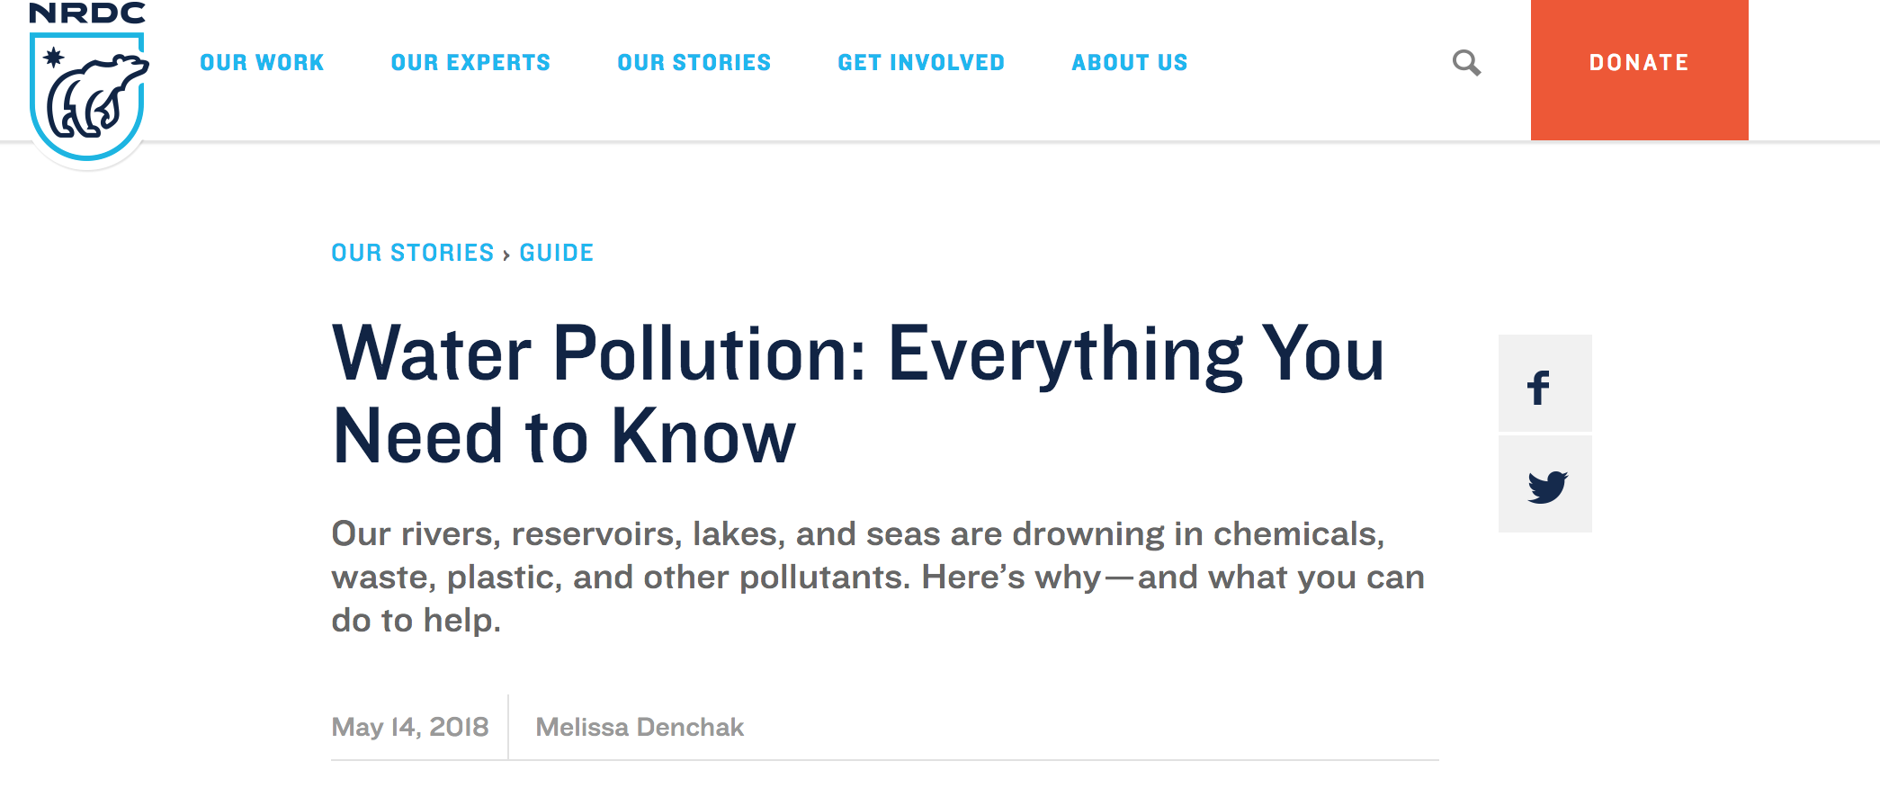
https://www.nrdc.org/stories/water-pollution-everything-you-need-know

Slide 62

https://www.youngvoicesfortheplanet.com/

Slide 63
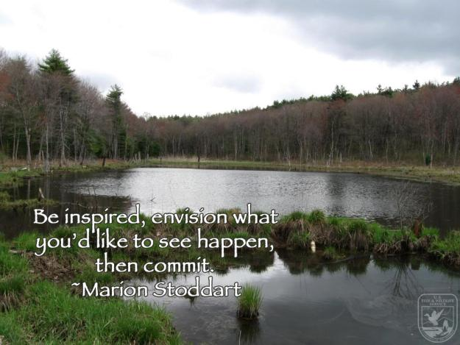

Slide 64
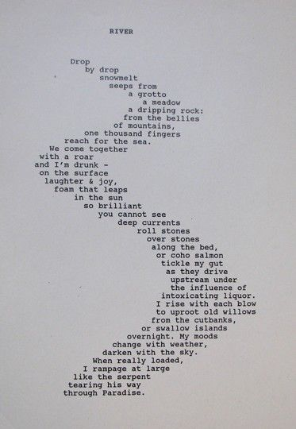
Using Rivers to Explore Poetry
https://www.poemhunter.com/poems/river/
https://hellopoetry.com/words/river/
https://interestingliterature.com/2018/01/31/10-of-the-best-poems-about-rivers-and-streams/

Slide 65
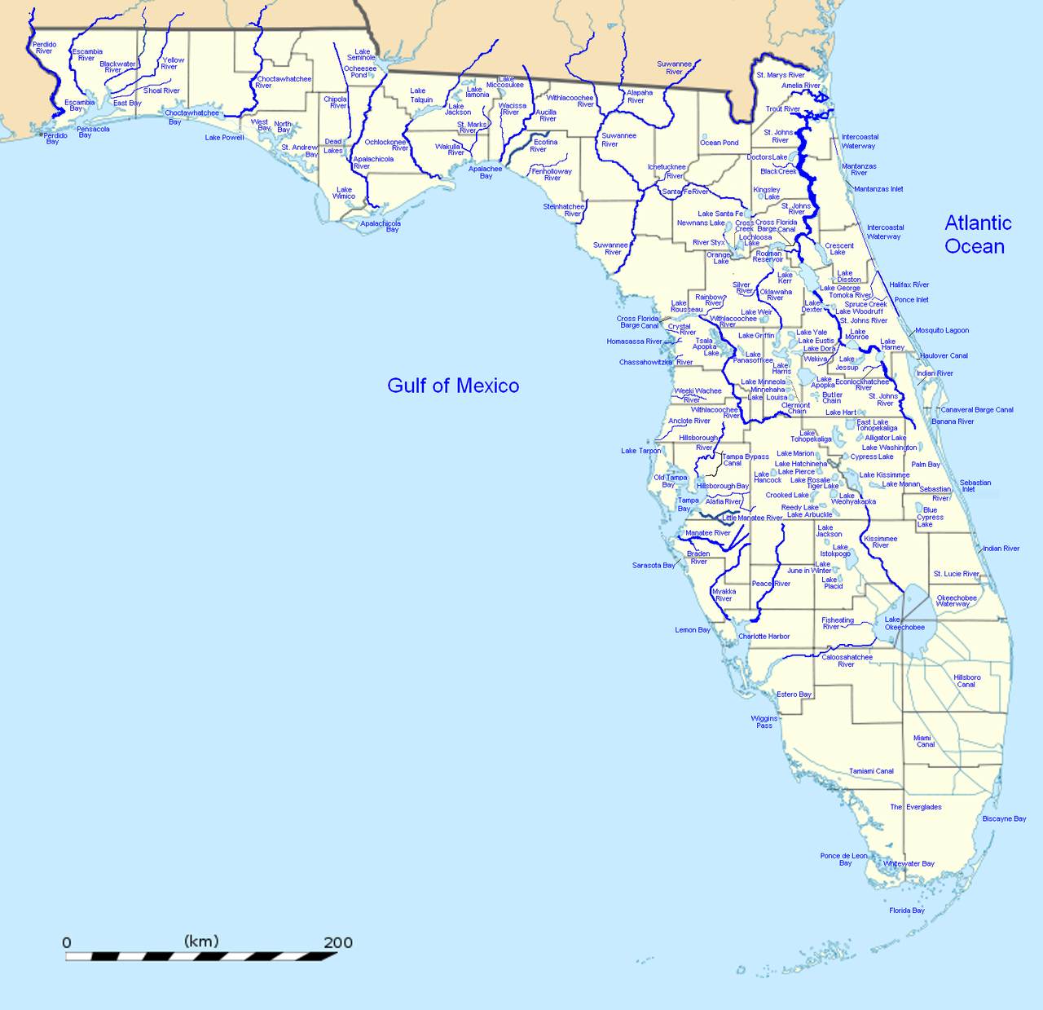
https://en.wikipedia.org/wiki/List_of_rivers_of_Florida
Peace River
Where is it located?
How long is it?
Types of wildlife?
Interesting fact
Interesting fact

Slide 66
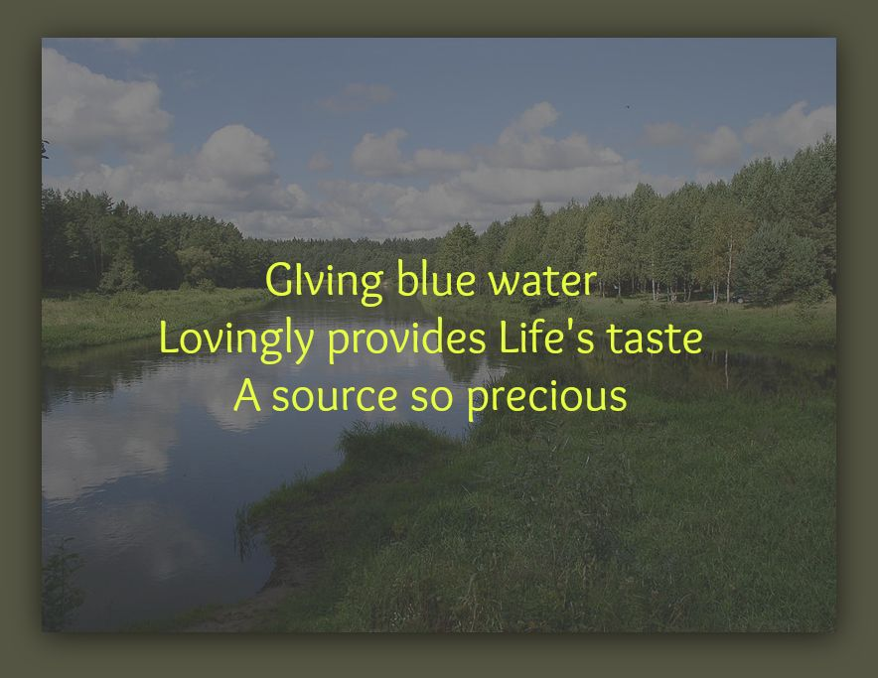
https://www.poemofquotes.com/articles/poetry_forms.php
http://www.readwritethink.org/search/?resource_type=16&type=28

Slide 67
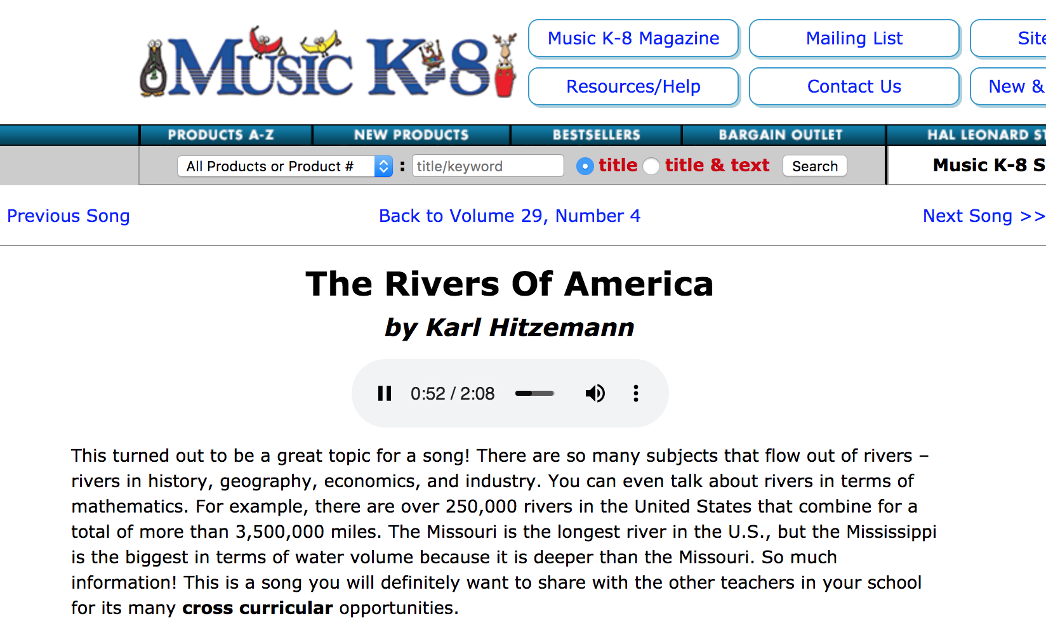

https://www.musick8.com/html/current_tune.php?numbering=144&songorder=12
https://www.songsforteaching.com/science/physicalscience/whyriversflow.php

Slide 68

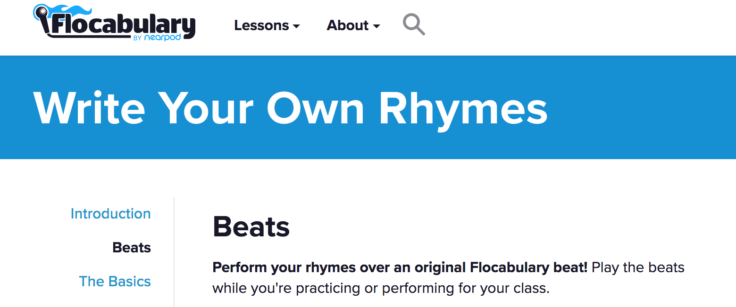
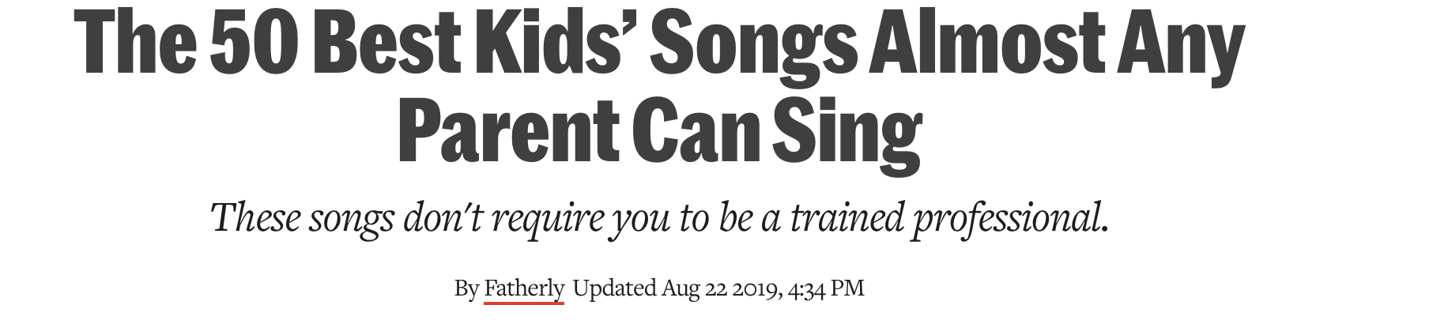
https://www.flocabulary.com/warp/beats/
https://customserenade.com/songwriting-for-kids/
https://www.fatherly.com/play/the-50-best-kids-songs-almost-any-parent-can-sing/

Slide 69


https://www.artandwriting.org/what-we-do/the-awards/how-to-enter/

Slide 70

https://www.startwithabook.org/summer-reading-learning/oceans-rivers-and-ponds

Slide 71

https://www.floridastateparks.org/

Slide 72
Links to Readworks Articles
https://www.readworks.org/article/Rivers/10c19751-880a-4f31-b006-a3b20cc3ee03#!articleTab:content/contentSection:f74dede7-15fe-4f07-a4dd-a6406b3c631b/
https://www.readworks.org/article/World-Rivers/4b1cdb12-897b-407e-8925-de9365bb7783#!articleTab:content/contentSection:817b52cb-e908-4600-b1f1-369cdbaa3693/
https://www.readworks.org/article/Explorers-of-North-America/3201287c-8093-4ef5-a6aa-d357b83fc7e8#!articleTab:content/contentSection:1522ffa8-2a5a-430e-9ed0-5265a299e0ae/
https://www.readworks.org/article/Pollution-and-Conservation/8dce5855-f219-4e23-9831-86314ab55bbf#!articleTab:content/contentSection:1a513032-2877-49fe-a9f2-d04cc05a671e/
https://www.readworks.org/article/Protecting-Water-and-Watery-Habitats/116d70e6-0c8c-438a-91bc-431c50e9242f#!articleTab:content/contentSection:55d03a3c-b40c-47d8-90dc-44ec97ee367f/
https://www.readworks.org/article/Justice-for-the-Fish/414eb426-b92e-45af-842e-c8270d161598#!articleTab:content/

