Slide 1

Three Branches Rap
https://www.youtube.com/watch?v=ZCB8EOY5d48

Slide 2

Checks & Balances
The Economics of our Branches of Government

Slide 3
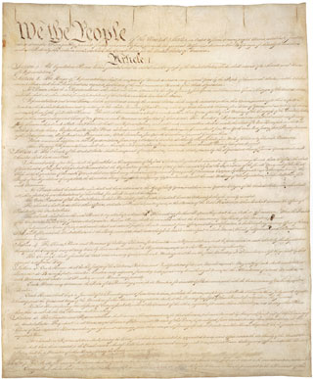

6 Big Ideas of the Constitution
https://www.archives.gov/legislative/resources/education/constitution
This lesson engages students in a study of the Constitution to learn the significance of "Six Big Ideas" contained in it. Students analyze the text of the Constitution in a variety of ways, examine primary sources to identify their relationship to its central ideas and debate the core constitutional principles as they relate to today's political issues.

Slide 4
What is the Significance of the Six Big Ideas in the Constitution and for Americans Today?
Six Big Ideas
Limited government
Republicanism
Checks and balances
Federalism
Separations of powers
Popular sovereignty
https://www.dummies.com/education/politics-government/the-7-articles-of-the-us-constitution/

Slide 5
Orientation to the Constitution
Mapping the text
  4487 words in the Constitution
    Preamble 52
    Article I 2266
    Article II 1023
    Article III 375
    Article IV 328
    Article V 143
    Article VI 154
    Article VII 146

Slide 6
Orientation to the Constitution
Mapping the text Handout 1
  4487 words in the Constitution
  How much of the Constitution is dedicated to each structure of power?
  Class discussion
    What are some general reflections we can make about the Constitution?
    Which topics received the most attention in the Constitution?
    Does the map suggest hypotheses about the relative importance to the Founders of the powers of the new government?
    To what extent do the powers of each branch of government displayed in the map match how the federal government works today?

Slide 7
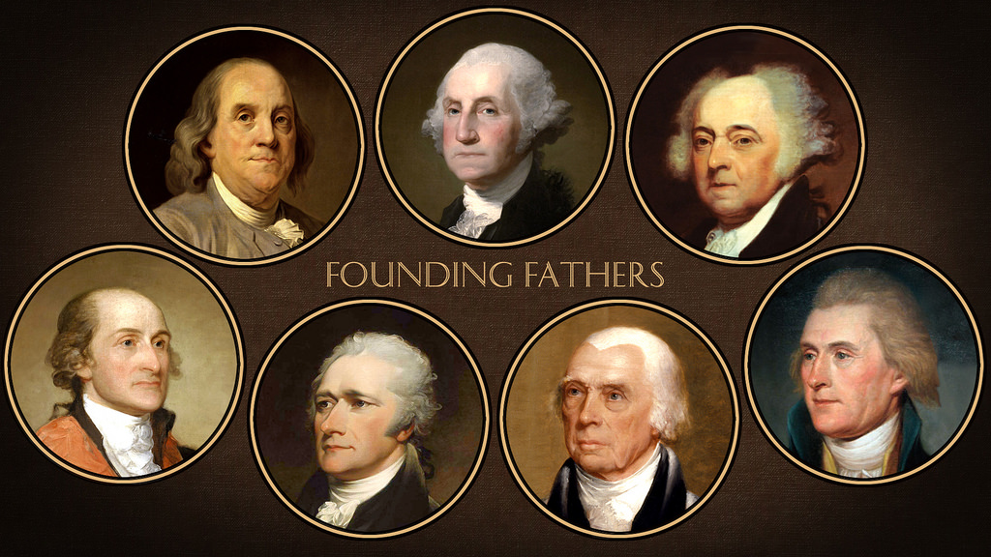
Introducing the Founders
Studying the Founders can aid in understanding the government they created.
  https://constitutioncenter.org/learn/educational-resources/founding-fathers
http://teachingamericanhistory.org/convention/intro/
Founders Social Network Handout 2
  Each student completes a Founding Fathers profile.
  After completion, students browse other profiles to determine the most likely ‘friends’ their Founder would choose.

Slide 8
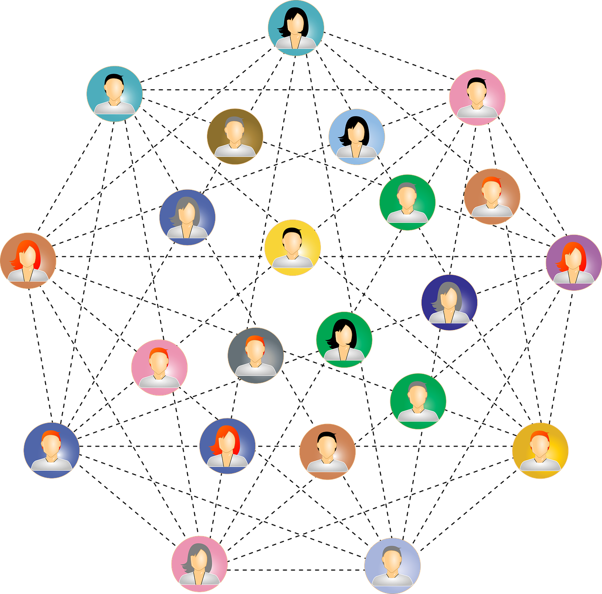
What Other Social Networks?
Talk with your table:
  What other social networks could be adapted for this task?
  What might those tasks involve?

Slide 9
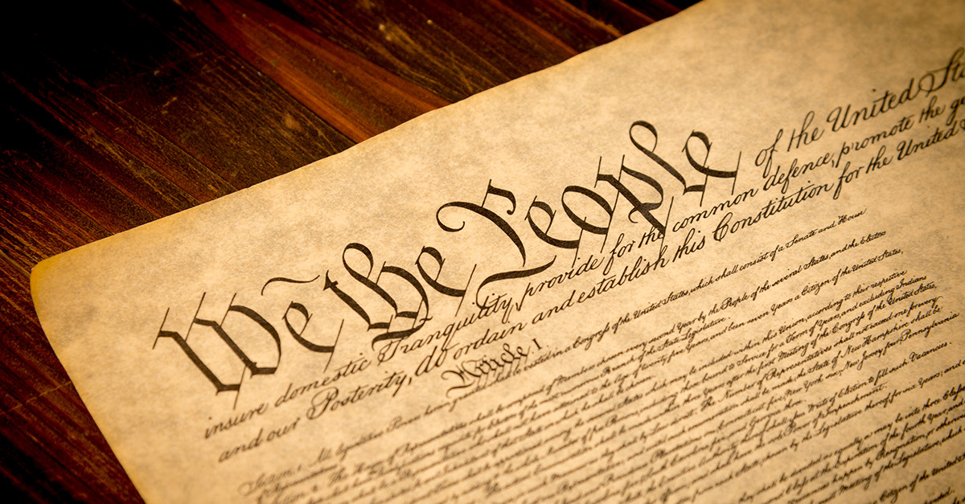
Outlining the Constitution
Outlining the Constitutions Six Big Ideas Handout 3
  Divide students into 6 groups.
  Provide a copy of the Constitution.
  Analyze the text to find two examples for the group’s Big Idea.
    Article/Section/Clause
    Quote
    Paraphrase
http://www.government-and-constitution.org/us-constitution/7-principles-of-the-constitution.htm

Slide 10
Additional Resources for the
Six Big Ideas
Limited government https://study.com/academy/lesson/constitutional-provisions-for-limited-government.html
Republicanism https://www.usconstitution.net/xconst_A4Sec4.html
Check and Balances https://www.usconstitution.net/consttop_cnb.html
Federalism https://www.usconstitution.net/consttop_fedr.html
Separation of Powers https://www.usconstitution.net/consttop_sepp.html
Popular Sovereignty http://www.government-and-constitution.org/united-states-government/popular-sovereignty.htm

Slide 11
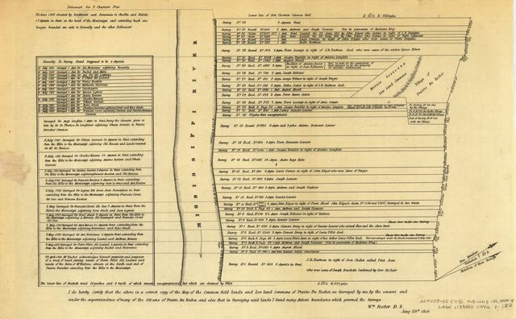
Analyzing Primary Sources to
Relate the Six Big Ideas
Student pairs receive a primary sources for the documents list.
  https://catalog.archives.gov/search
Analyze the document in search of one of the six big ideas.
  https://catalog.archives.gov/OpaAPI/media/306501/content/arcmedia/media/images/26/1/26-0051a.gif
Post the documents, along with others related to the same ideas, in groups.
Students share three clues from the document that supported their decisions.
  Some documents could fall under more than one idea.

Slide 12
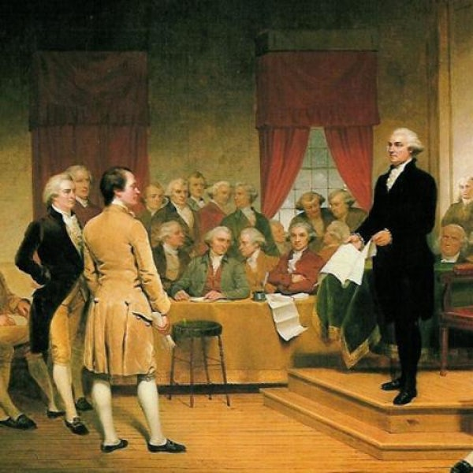
Debating the Six Big Ideas in America Today
Assign debate questions to teams
  Sides A and B
Use Handout 4 to guide notetaking and preparation.
Ratification: The People Debate the Constitution, 1787 - 1788
By Pauline Maier

Slide 13


Economics of the U.S. Constitution
https://www.americanbar.org/content/dam/aba/publishing/insights_law_society/Economics_Constitution.authcheckdam.pdf

Slide 14
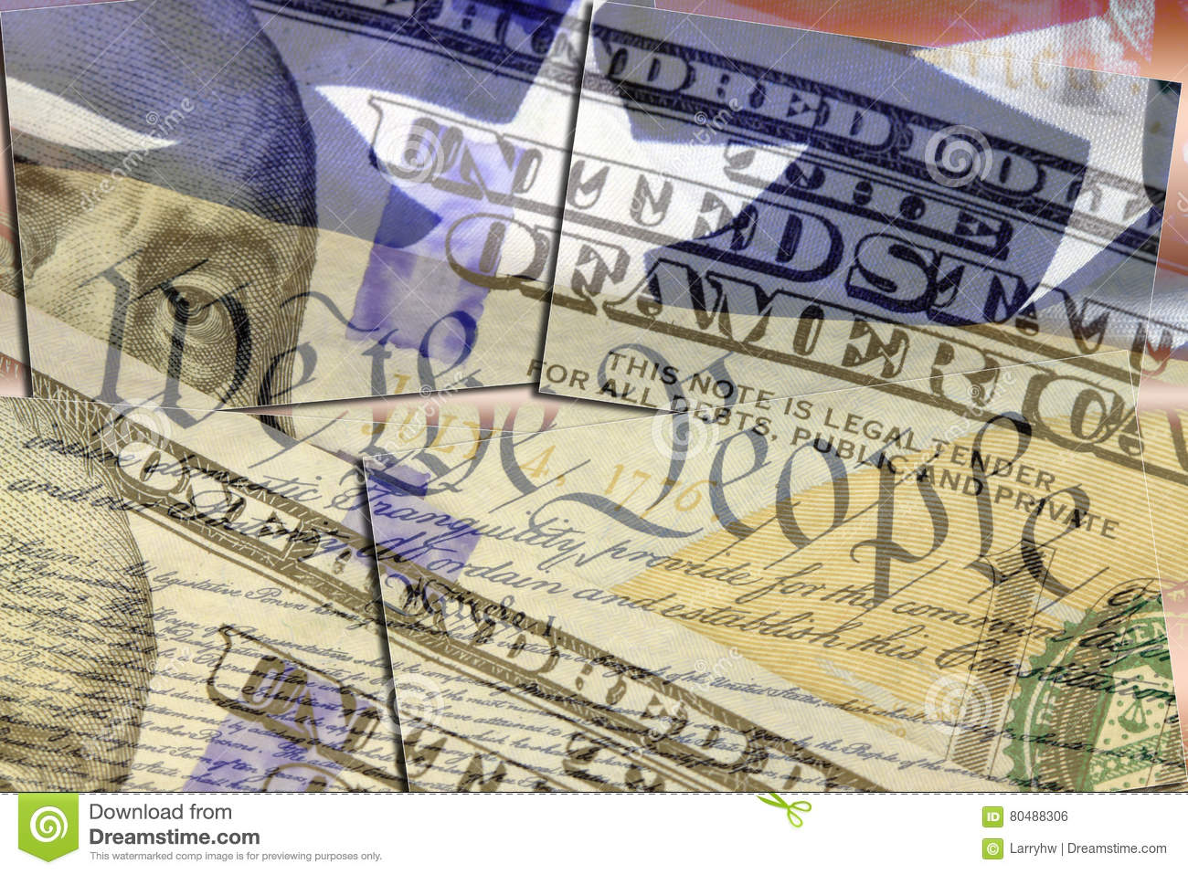
Objectives
Recognize that the U.S. Constitution is an economic as well as a political document.
Identify the institutions of a market economy featured in the U.S. Constitution.

Slide 15
Lesson Description
Students discuss why the American economy grew in the period following the American Revolution. After reading an essay by Douglass North and examining the U.S. Constitution, they identify the economic features of the Constitution.

Slide 16
Economic Issues Faced by the
New Nation pg. 161
Debt
Power to tax
Currencies
Tariff wars
Why did the U.S. economy grow and prosper in the period after the American Revolution? Why didn’t the U.S. collapse into squabbles over taxes and trade as so often happened in Europe?

Slide 17
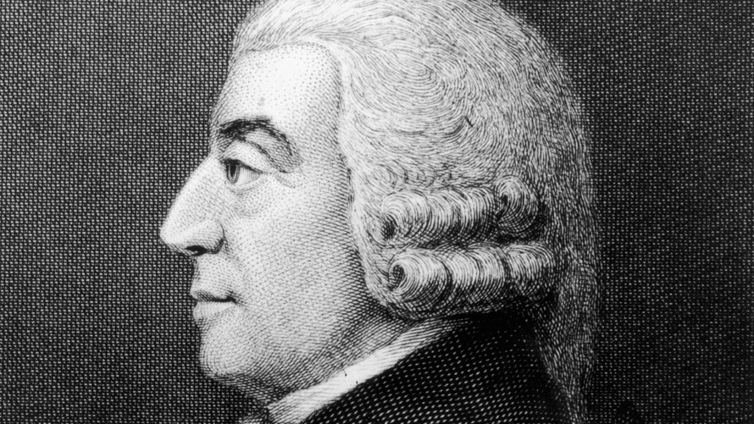
Adam Smith
Adam Smith (1723-1790) was a Scottish philosopher and economist who is best known as the author of An Inquiry into the Nature and Causes of the Wealth Of Nations (1776), one of the most influential books ever written.
https://www.adamsmith.org/about-adam-smith

Slide 18
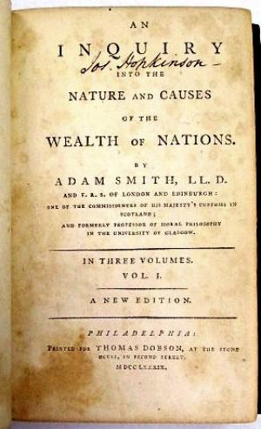
Key points from The Wealth of Nations
Regulations on commerce are ill-founded and counter-productive (market economy vs. mercantilism).
Productive capacity rests on the division of labor (specialization) and the accumulation of capital.
A country’s future income depends upon this capital accumulation.
Supply and demand determine production and costs.
Competition and free exchange are under threat from the monopolies, tax preferences, controls, and other privileges that producers extract from the government authorities.
Government itself must be limited.

Slide 19
The Economics of the U.S.
Constitution
Essay by Douglas C. North pp. 70-71
  How did the Constitution come to be written as it is?
  Whose interests were served by the document?
  What does is say?
  How important was it at the time and for subsequent generations?
  What are the lessons to be learned with respect to calling a new constitutional convention to rewrite it?

Slide 20
Examination of the Economic Features of the Constitution pg. 162-163
Provide a copy of the U.S. Constitution.
Use Handout 2 to
  answer questions about the Constitution
  cite where the answer is found in the Constitution

Slide 21
Closure – Review Key Points of the Lesson
Did the ideas of Adam Smith influence the writers of the Constitution? Explain.
The message of the writers of the Constitution was that people should earn wealth on their own and not look to government to provide it for them. How did the constitution make it difficult to redistribute wealth?
What specific economic powers does the Constitution confer on the federal government?

Slide 22
Essay Question
The American colonies had been established during a period of mercantilism. This is an economic system that stresses providing special favors from government to people in business. For example, the government of Great Britain granted trade monopolies to certain groups and provided subsidies to encourage the production of certain goods. The colonies often benefited from these mercantilistic practices. What influenced the writers of the Constitution to resist mercantilism?

Slide 23
What Are The Economic Functions of Government?

Slide 24
Government’s Role In the Economy
Maintain the legal and social framework
Maintain competition
Provide public goods and services
Correct for externalities
Stabilize the economy
Redistribute Income

Slide 25
Objectives
Students will be able to:
Classify government economic activities according to the six economic functions of government.
Analyze governmental economic actions withing the liberal/conservative framework

Slide 26
What are Economic Functions of Government?
What are some economic activities of local, state, and national governments?
What might happen if our government expanded its current roles and activities?

Slide 27
Government Rules and Regulations
What are some rules and regulations imposed by our government?
Why are some things unregulated?
Should all problem areas be regulated? Why or why not?

Slide 28
Economist’s View of Economic
Functions of Government
Maintain the legal and social framework
Maintain competition
Provide public goods and services
Correct for externalities
Stabilize the economy
Redistribute Income

Slide 29
Economist’s View of Economic
Functions of Government
Maintain the legal and social framework
  Define and enforce property rights
  Establish a monetary system
Maintain competition
  Create and enforce antitrust laws and regulate national monopolies
Provide public goods and services
  Public goods and services are those that markets will not provide in sufficient quantities.

Slide 30
Economist’s View of Economic
Functions of Government
Correct for externalities (by-products of production or consumption)
  Reduce negative externalities
  Encourage increased production of goods and services that have positive externalities
Stabilize the economy
  Reduce unemployment and inflation, and promote economic growth
Redistribute Income
  Redistribute income from people who have higher incomes to those with lower incomes

Slide 31
What’s In The News?
Which economic function of government is referenced in each headline?

Slide 32
What Role Should Government
Play in the Economy?
Conservative and liberal views
    What are the specific arguments of each view?
Suppose a U.S. senator proposed legislation that increases taxes for higher-income taxpayers in order to provide more funds for public education.
  Which view?
A Congressional leader argues that there should be a constitutional amendment that limits the size of the federal government.
  Which view?

Slide 33

Econ Edlink
Roles of Government https://www.econedlink.org/resources/roles-of-government-video-and-quiz/
Roles of Government in Fiscal Policy https://www.econedlink.org/resources/the-role-of-government-the-federal-government-and-fiscal-policy/

Slide 34
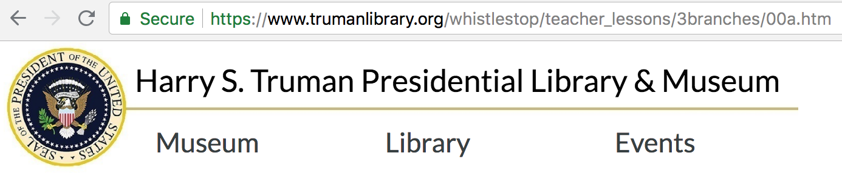
Truman Library - Branches of Government
https://www.trumanlibrary.org/whistlestop/teacher_lessons/3branches/00a.htm

Slide 35
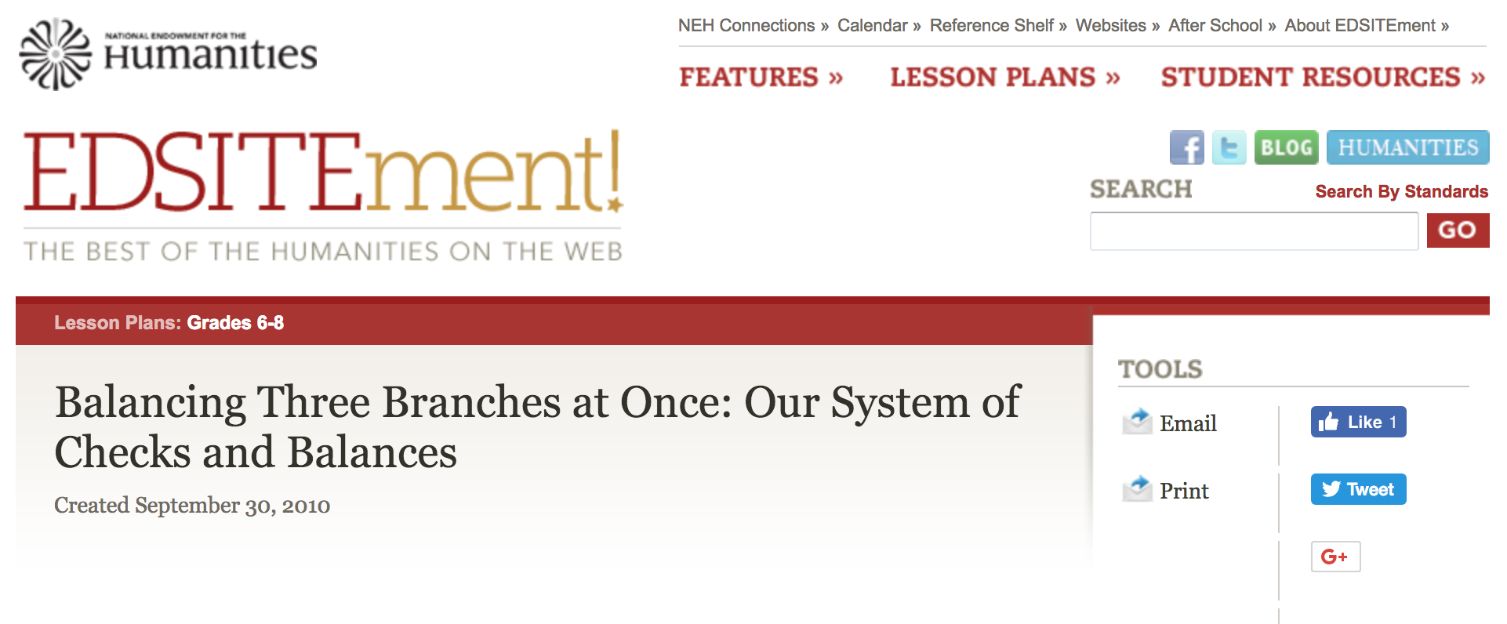
Edsitement Checks and Balances
https://edsitement.neh.gov/lesson-plan/balancing-three-branches-once-our-system-checks-and-balances

Slide 36

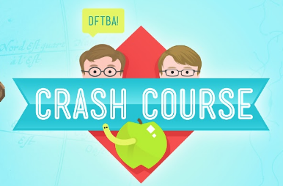
Separation of Powers, Checks & Balances
Kahn Academy
https://www.khanacademy.org/humanities/ap-us-government-and-politics/foundations-of-american-democracy/principles-of-american-government/v/separation-of-powers-and-checks-and-balances
Crash Course
https://www.youtube.com/watch?time_continue=1&v=0bf3CwYCxXw

Slide 37

Flocabulary Branches of Government
https://www.flocabulary.com/unit/3-branches-of-government/
https://www.flocabulary.com/warp/intro/
https://www.flocabulary.com/warp/beats/

Slide 38

Thank you!!
Sherry Moser
smoser@usf.edu
https://usfstavrosresources.weebly.com/

