Slide 1


Tampabay.com/nie

Slide 2


Newspaper in Education (NIE)
The Tampa Bay Times NIE program is a cooperative effort between schools and the Times to promote the use of newspapers in print and electronic form as educational resources.
The goal of NIE is to build future, life-long readers, productive citizens and critical thinkers.

Slide 3

Times NIE services
The Tampa Bay Times Newspaper in Education program provides free resources to Citrus, Hernando, Hillsborough, Manatee, Pasco and Pinellas counties.
  The TBT NIE provides newspapers, electronic licenses and curriculum guides to classrooms around Tampa Bay each year
  TBT NIE hosts teacher workshops
  TBT NIE provides teachers with free lesson plans in print and online – www.tampabay.com/nie.

Slide 4

2017-2018 school year
.

Slide 5
Developing daily habits
Using the newspaper in your classroom and NIE curriculum on a regular basis helps students develop daily reading habits that they will carry through their lives.
The Times provides a vital link to the real world for students who too often do not realize the value of their academic programs. The study of today's critical issues, events and people helps students understand the past and see a role for themselves in their future world.

Slide 6

Informational text
According to Scholastic magazine, “Informational text is a type of nonfiction — a very important type. Nonfiction includes any text that is factual. (Or, by some definitions, any type of literature that is factual, which would exclude texts such as menus and street signs.) Informational text differs from other types of nonfiction in purpose, features, and format.”

Slide 7
The newspaper is the ultimate informational text.
The newspaper also meets these specific characteristics. It is a logical resource for information about the natural, social and political world.
  Conveys information about the natural or social world
  Is written from someone who knows information to someone who doesn’t
  Has specialized features such as headings and technical vocabulary.

Slide 8
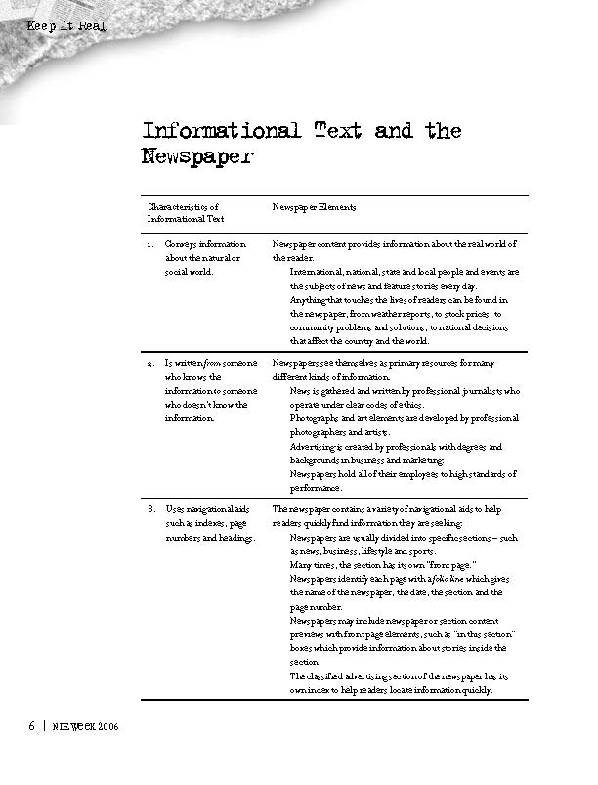
Keep it Real
Keep it Real

Slide 9
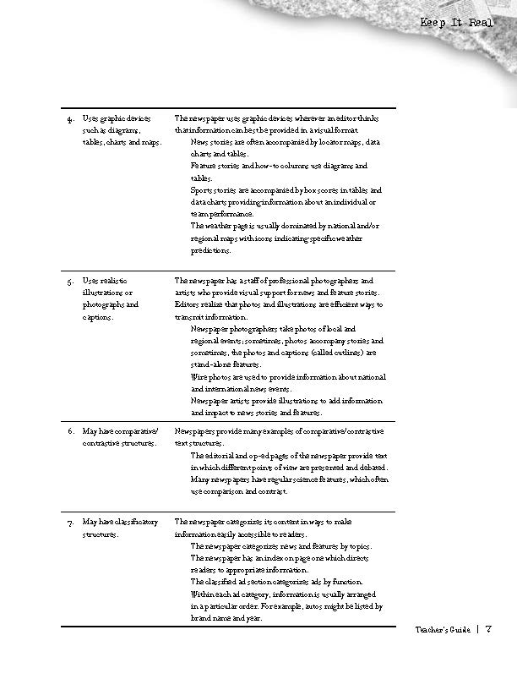
Keep it Real

Slide 10
“All our reporters have an editor who supervises them. The number of reporters an editor supervises varies but generally it’s between four and seven people. When a reporter writes a story, their editor reads it thoroughly, asks questions, edits for grammar, spelling, clarity and facts, often asking a reporter where they got a piece of information and questioning something if it seems not to make sense. They check names, dates or other facts as well. After the supervising editor finishes the story, it is sent to the copy desk, where at least one copy editor and sometimes two will also read the story, checking facts (such as names, places, math) and raising questions if something seems amiss or suspicious in a story. That’s the process that we go through for most routine stories.
“If the story is highly complex or significant, or we plan to run it on the front page, especially the Sunday front page, it will almost always go through additional layers of editing. The first editor’s supervisor might read it, and on many occasions. I will review the story or our executive editor will. Stories that are running on the Sunday front page (our most read addition) are always read by an assistant managing editor and either me or the executive editor.
“The process is somewhat compressed when breaking news is published online. If the story is one that is ongoing and developing -- someone has just been arrested on a murder charge – the reporter will write the article and we have an editor read it before publication. Sometimes that is not their supervising editor but another trusted editor who is free at the moment the story needs to be published. After the story goes online, it is updated throughout the day by the reporter, re-edited by their editor and then when the story is not going to be updated any more before print publication, it goes through the editing process above, where it gets a final read from the assigning editor and goes to be read by the copy desk.”
-- Jennifer Orsi, managing editor Tampa Bay Times

Slide 11

Using the Digital Edition
You and your students can read the Tampa Bay Times, just as it appears in the printed edition, from the convenience of your computer, phone, tablet or electronic reading device.
  Classwork
  Homework
  Research
  Writing models
  Grammar and math exercises

Slide 12
Convenient
The digital edition can be accessed on any computer or electronic device with Internet access. You and your students can download the android and iTunes apps for more convenience.
If you are using the digital edition for a class lesson, one computer, license and projector is all you need. Online writing prompts are available on our tampabay.com/nie website as well.

Slide 13

Digital edition
Cool features
Access
You can access all seven editions in all counties.
E-Mail
E-Mail Articles to your friends or family.
Print
Save or print the articles you want to keep.
Search
Search for past articles.
E-mail
E-mail notification for research and projects.

Slide 14
Digital Edition: Special Features
The digital edition can be accessed on any computer or electronic device with Internet access. However, not all special features are available on the apps. If you would like to use the translation, audio, print and archive features, you will need to log in using a computer.

Slide 15
Accessing the Digital Edition
  Teachers, students, and parents should use the same user name and password:
    Go to tampbay.com/nie
    Click log in here
    Enter user name
    Enter password
    Select preferred edition
    Click remember me box
    Click Log in

Slide 16
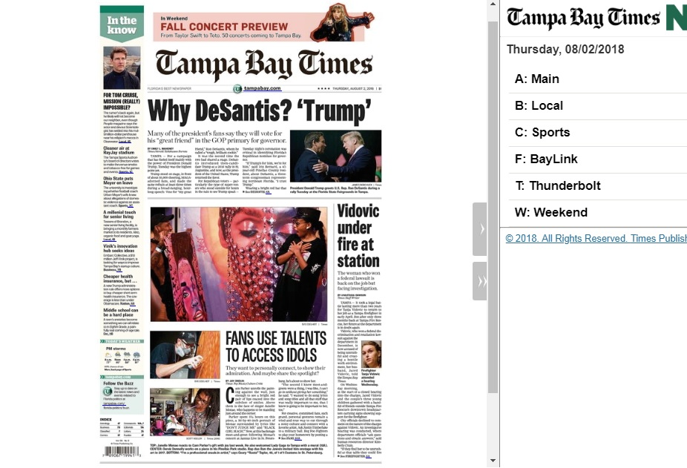

Slide 17
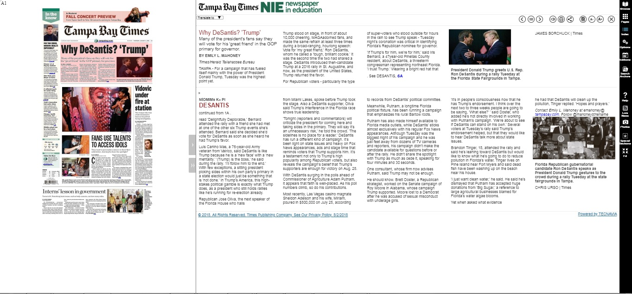

Slide 18
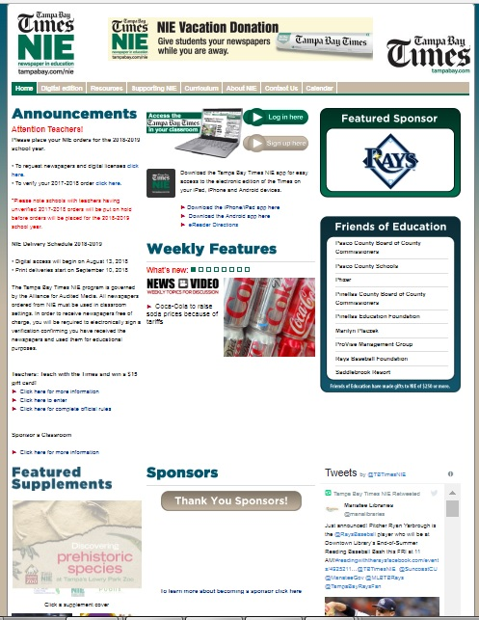
Tampabay.
com/nie

Slide 19
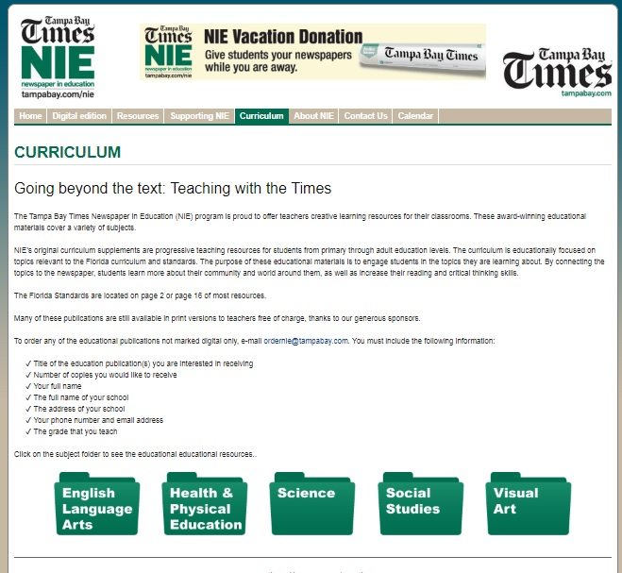
Curriculum Supplements

Slide 20





Cross-curricula

Slide 21
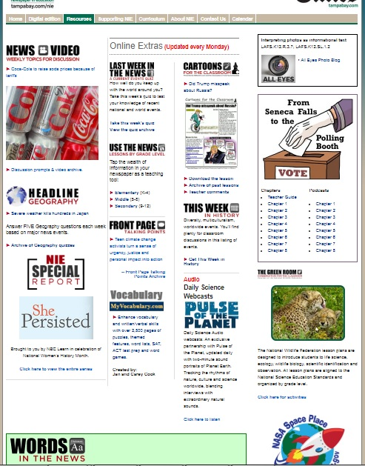
Resources

Slide 22
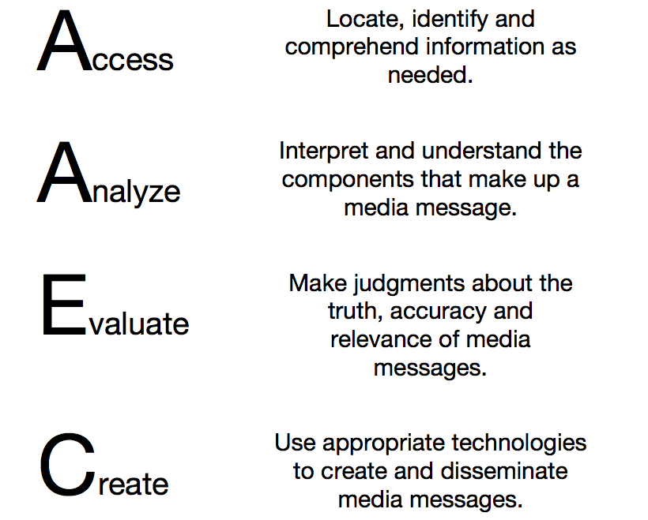
Media Process: From Reading to Writing

Slide 23
American Press Institute:
Critical questions for interpreting media
Type: What kind of content is this?
Source: Who and what are the sources cited and why should I believe them?
Evidence: What’s the evidence and how was it vetted?
Interpretation: Is the main point of the piece proven by the evidence?
Completeness: What’s missing?
Knowledge: Am I learning every day what I need?

Slide 24


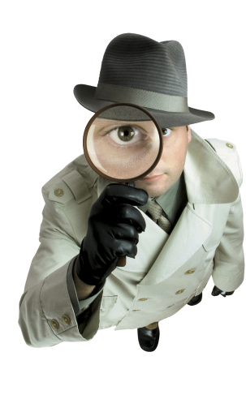
Read like a detective.
Write like a reporter.

Slide 25
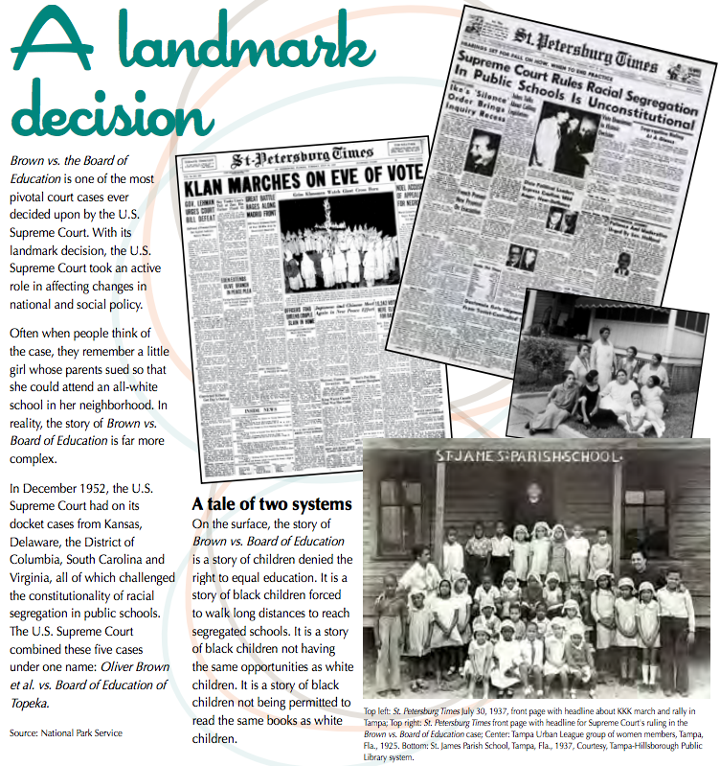
Read like a detective
Essential Question:
Why is Brown vs. Education a Landmark Decision? (pp. 8-9)
Text dependent questions
What is the basis of the Brown vs. Education case? (R1, R8)
By reading through the text, what can you infer the definition of a “landmark decision” is? (R4, R2)
Based on this text, predict how schools in your area would look, had the Supreme Court not ruled against segregation in 1954? (R1, R3, R8)

Slide 26
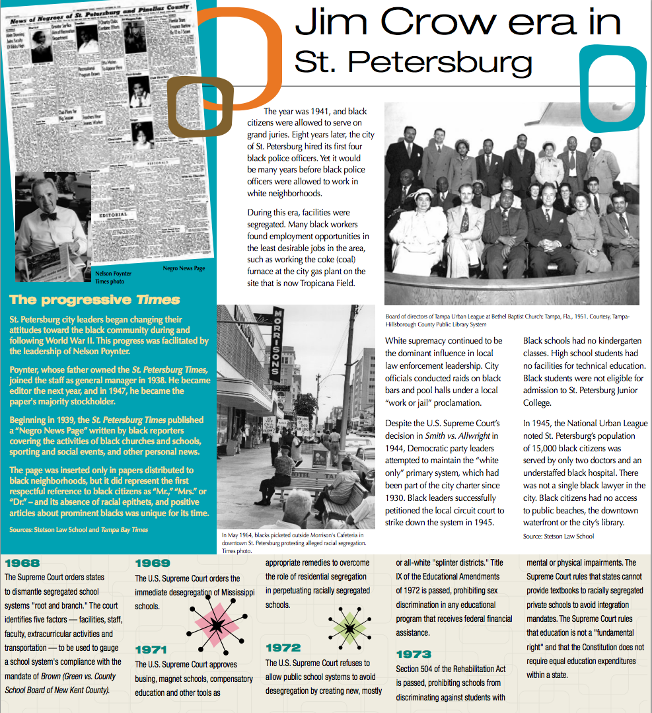
Write like a reporter
What was the impact of the Jim Crow era in Tampa Bay?
Text dependent questions
What are the social implications during this era? (R1, R8)
What are the economic implications during this era? (R1, R8)
What are political implications? (R1, R8)
What are the ethical implications? (R1, R8)

Slide 27
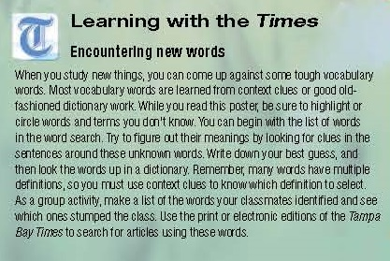
Learning new words

Slide 28
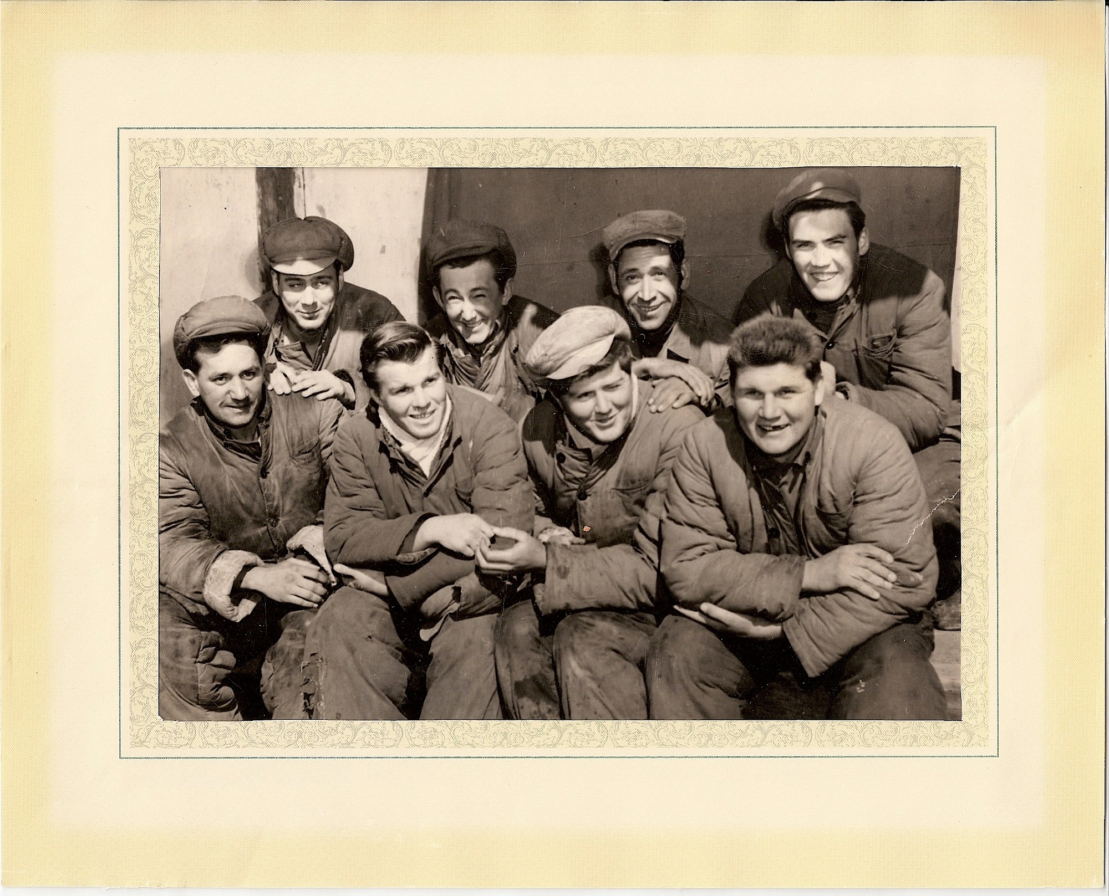
Interpreting images & graphics

Slide 29
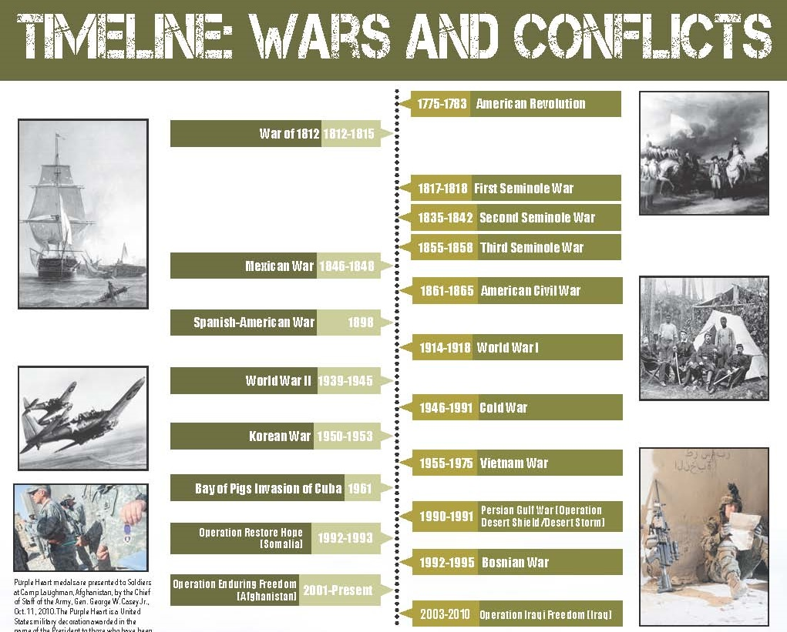
Interpreting timelines

Slide 30
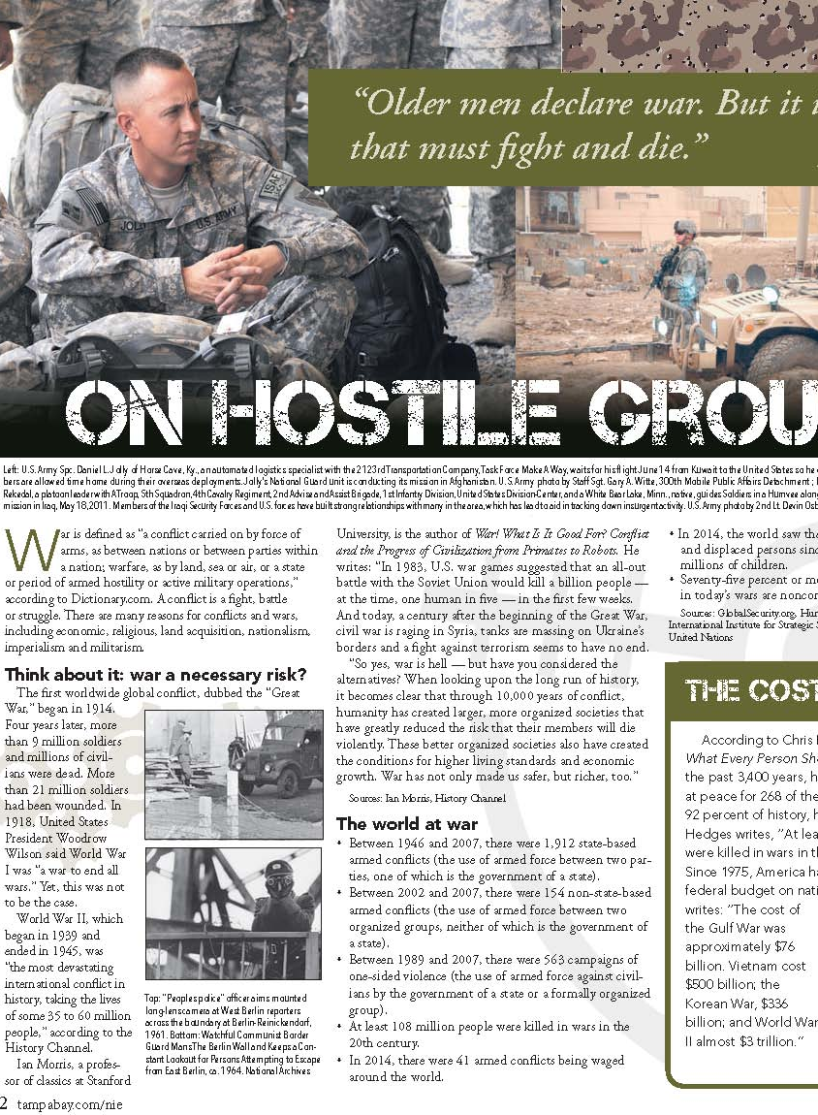
Read like a reporter. Write like a detective. Determine evidence and claims.
What evidence does author provide?
What claims does author make implicitly?
Using the evidence, create an argument.

Slide 31
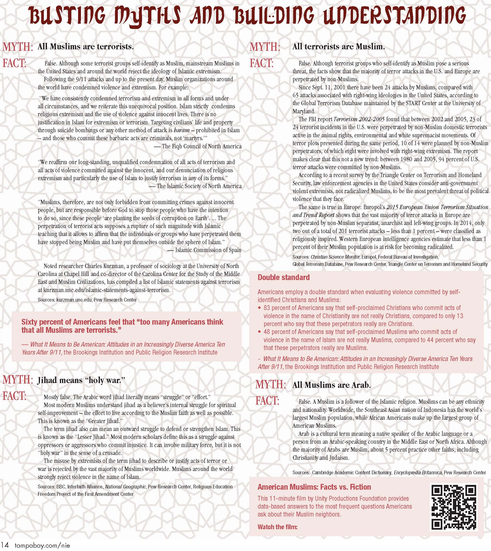
Fact, opinion, myths, reality

Slide 32

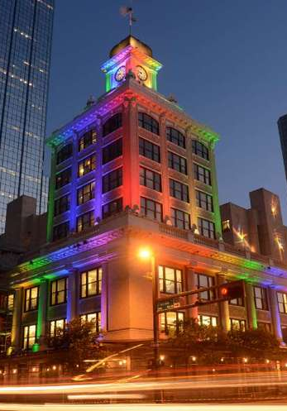
Interpreting photos … All Eyes
tampabay.com/photo-gallery

Slide 33


Interpreting photos … All Eyes
tampabay.com/photo-gallery

Slide 34

Interpreting photos … All Eyesing photos … All Eyes
tampabay.com/photo-gallery

Slide 35
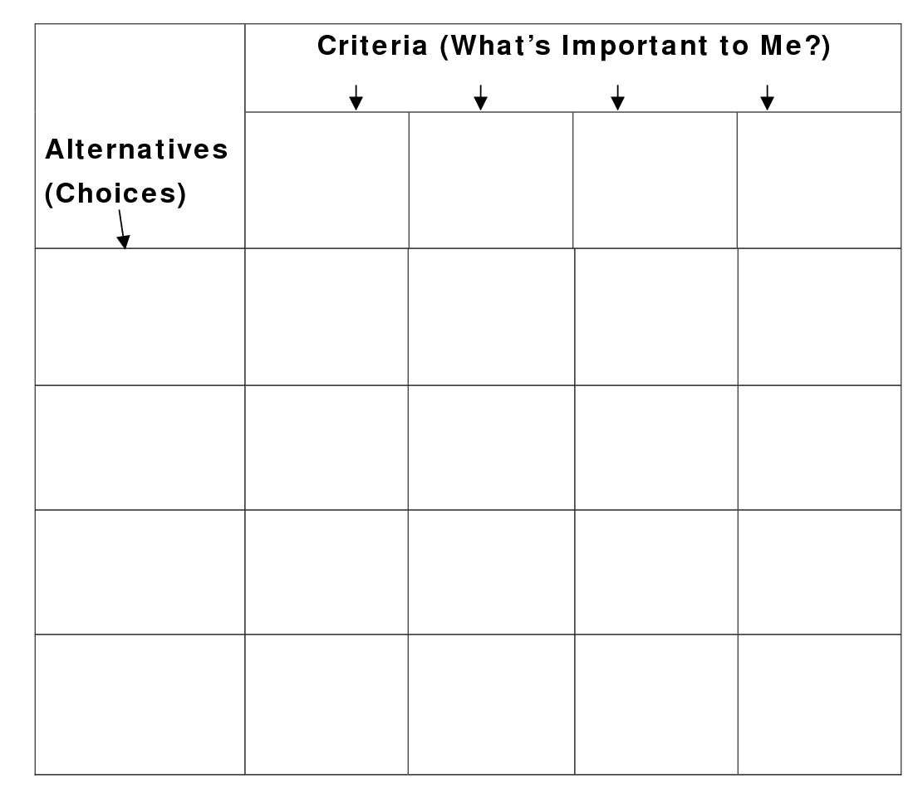
Social-Cultural
Economic
Ethical
Health

Slide 36
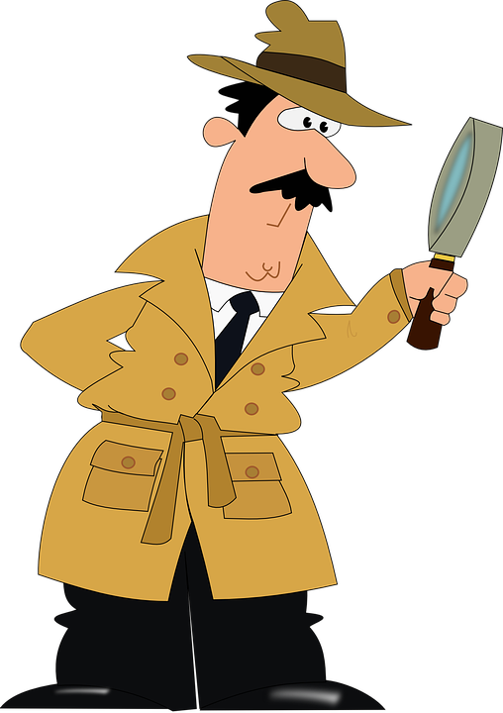
We all need to be news detectives…

Slide 37
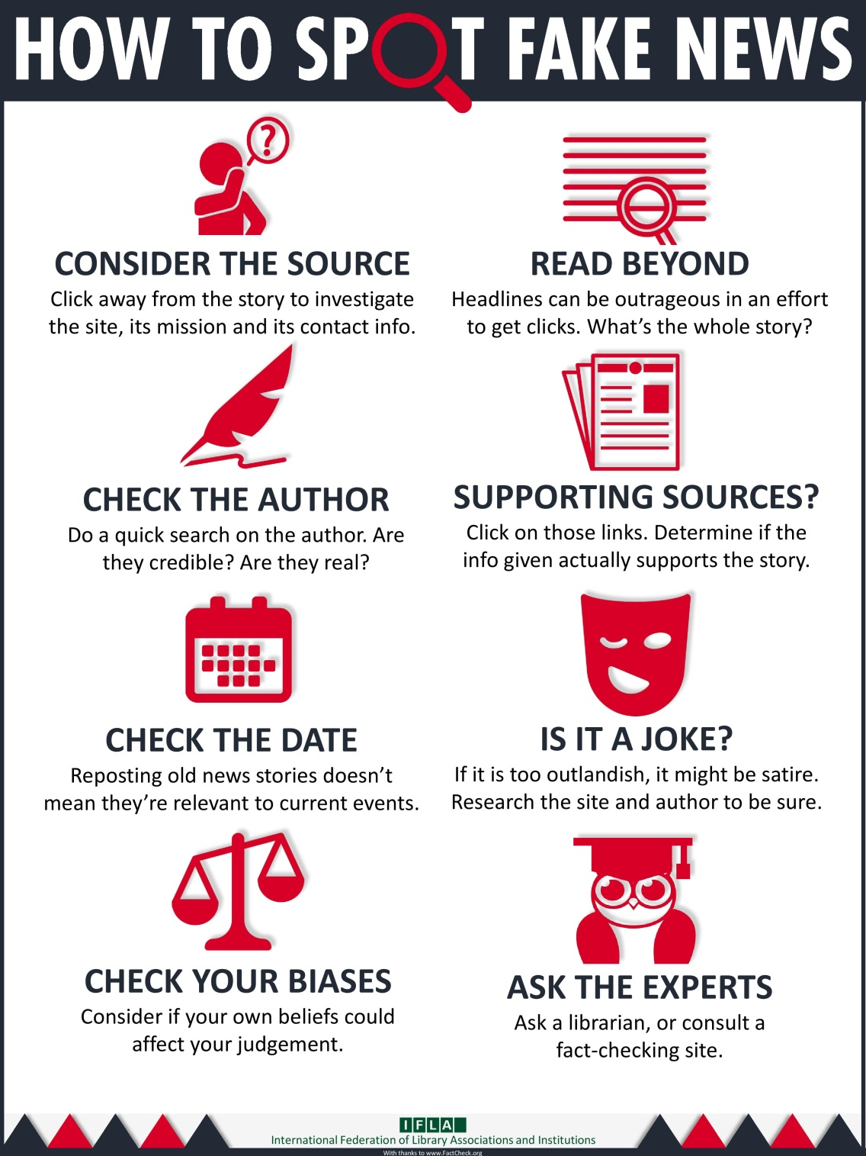
Notes:
What's wrong with fake news?
Why should you care about whether or not your news is real or fake?
You deserve the truth. You are smart enough to make up your own mind - as long as you have the real facts in front of you. You have every right to be insulted when you read fake news, because you are in essence being treated like an idiot.
Fake news destroys your credibility. If your arguments are built on bad information, it will be much more difficult for people to believe you in the future.
Fake news can hurt you, and a lot of other people. Purveyors of fake and misleading medical advice like Mercola.com and NaturalNews.com help perpetuate myths like HIV and AIDS aren't related, or that vaccines cause autism. These sites are heavily visited and their lies are dangerous.
Real news can benefit you. If you want to buy stock in a company, you want to read accurate articles about that company so you can invest wisely. If you are planning on voting in an election, you want to read as much good information on a candidate so you can vote for the person who best represents your ideas and beliefs. Fake news will not help you make money or make the world a better place, but real news can.

Slide 38
Key Questions to Ask:
Who made the message?
Who is the target audience (how do you know)?
Who paid for this? Or who gets paid if you read or respond to this message?
Who might benefit or be harmed by this?
What important info is left out or missing?
Is this credible (and what makes you think so)?
Is the main point proven by verifiable evidence?

Slide 39
Identify the source!
Look for a byline – who wrote it?
  Is this a real person? More importantly, are they credible?

Slide 40
Identify the source!
Look for a byline – who wrote it?
Is this a real person? More importantly, are they credible?
Who owns the webpage?

Slide 41
Identify the source!
Look for a byline – who wrote it?
Is this a real person? More importantly, are they credible?
Who owns the webpage?
Who originally wrote or said the information being referenced?

Slide 42
Identify the source!
Look for a byline – who wrote it?
Is this a real person? More importantly, are they credible?
Who owns the webpage?
Who originally wrote or said the information being referenced?
Who took the photo/video images?
Are they timely? Have they been changed/edited?
(TIP: Using a reverse image search on Google can give you an idea of whether the image is real.)

Slide 43
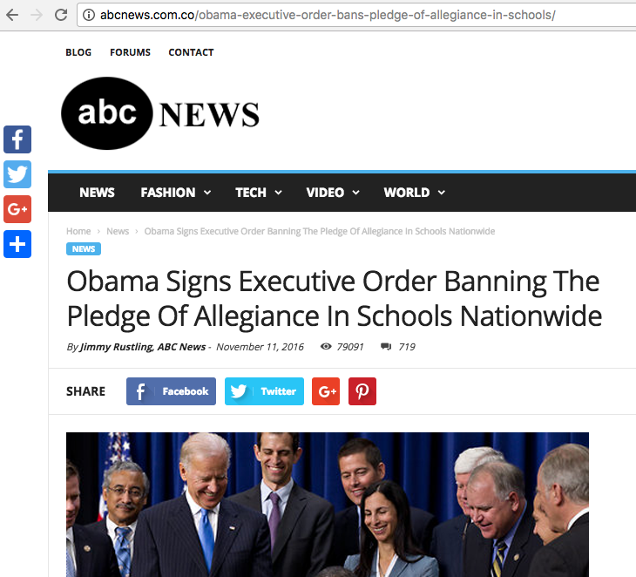
Double check
the URL

Slide 44




Sites that get paid to do this leg work for you:
FACT CHECKING
FactCheck.org
Politifacts.com
Washington Post Fact Checker
Snopes.com
USAFacts.org (beta)
Allsides

Slide 45





FACT CHECKING - Continued
OpenSecrets.org
Poynter.org
Factitious
OpenSources.co
TinEye
SBrowning.com - WhoWhatWhen
Notes:
OpenSecrets.org - Nonpartisan, independent and nonprofit, the Center for Responsive Politics is the nation's premier research group tracking money in U.S. politics and its effect on elections and public policy.
Poynter - founded the International Fact-Checking Network in 2015 and is the leading convener, teacher and community-builder for fact-checkers around the world.
Facticious - http://factitious.augamestudio.com/#/
OpenSources.co - document created by Melissa Zimdars, assistant professor of communication and media at Merrimack College in North Andover, MA because she saw her students referencing questionable sources, she created and shared this document with them of how to think about sources, as well as a list of misleading, satirical and fake sites.
TinEye - Search by image and find where that image appears onlineSearch by image and find where that image appears online
WhoWhatWhen -WhoWhatWhen is a database of key people and events from 1000 A.D. to the present. Create graphic timelines of periods in history and of the lives of individuals. - The database consists of famous people and famous events. People entries consist of the name, short description, which category they were famous for, and birth and death dates. No detailed biographical info is in this database, but this site will provide links to popular web search engines which will give you in depth information about each person or event. While people from all over the globe are included, there is a definite "American" slant to the entries. Dates go from around 1000 AD to the present. Only people with a known year of birth and death are entered. Famous composers, scientists, political figures, writers, etc... make up most of the entries before 1900. After that, a lot of "popular culture" figures are in the database.
Nonpartisan, independent and nonprofit, the Center for Responsive Politics is the nation's premier research group tracking money in U.S. politics and its effect on elections and public policy. Nonpartisan, independent and nonprofit, the Center for Responsive Politics is the nation's premier research group tracking money in U.S. politics and its effect on elections and public policy.

Slide 46

Jodi Pushkin, manager
jpushkin@tampabay.com
Office: 727-893-8961
Website for NIE: tampabay.com/nie
Twitter: Twitter.com/TBTimesNIE

