Slide 1
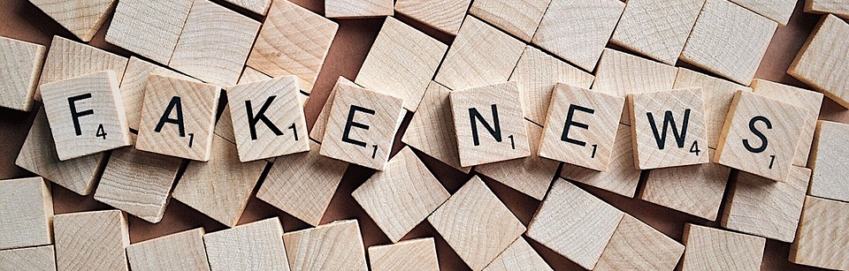


Deborah Kozdras:
dkozdras@usf.edu
USF Stavros Center
Jodi B. Pushkin jpushkin@tampabay.com
Tampa Bay Times NIE
http://tinyurl.com/fakenewsworkshop
Thank-you to State Farm for generously sponsoring this workshop.

Slide 2
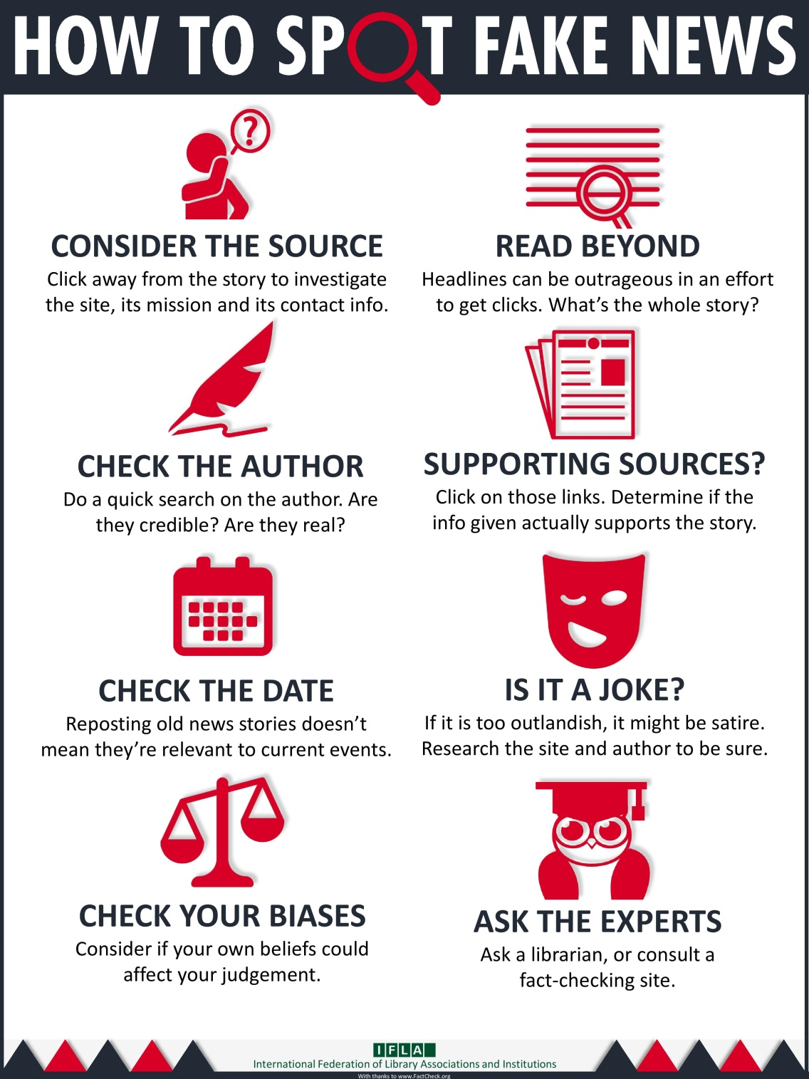
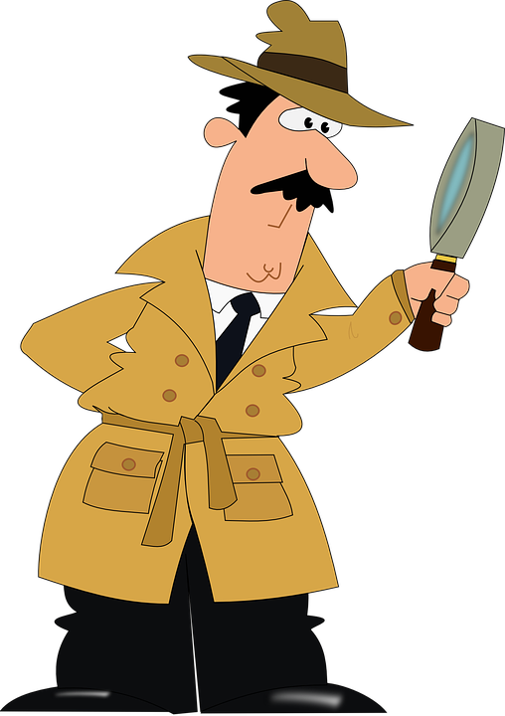
Notes:
What's wrong with fake news?
Why should you care about whether or not your news is real or fake?
You deserve the truth. You are smart enough to make up your own mind - as long as you have the real facts in front of you. You have every right to be insulted when you read fake news, because you are in essence being treated like an idiot.
Fake news destroys your credibility. If your arguments are built on bad information, it will be much more difficult for people to believe you in the future.
Fake news can hurt you, and a lot of other people. Purveyors of fake and misleading medical advice like Mercola.com and NaturalNews.com help perpetuate myths like HIV and AIDS aren't related, or that vaccines cause autism. These sites are heavily visited and their lies are dangerous.
Real news can benefit you. If you want to buy stock in a company, you want to read accurate articles about that company so you can invest wisely. If you are planning on voting in an election, you want to read as much good information on a candidate so you can vote for the person who best represents your ideas and beliefs. Fake news will not help you make money or make the world a better place, but real news can.

Slide 3
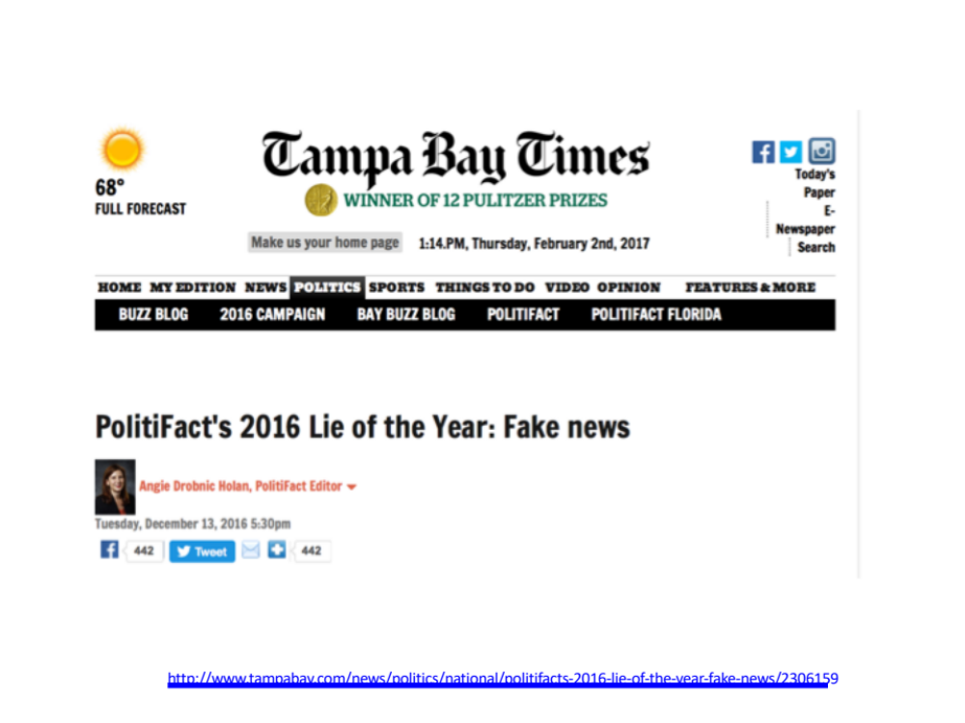
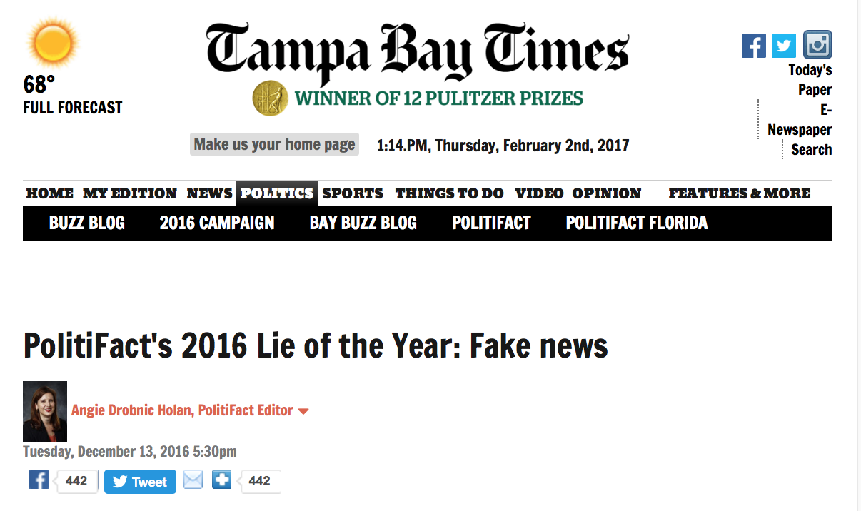
http://www.tampabay.com/news/politics/national/politifacts-2016-lie-of-the-year-fake-news/2306159

Slide 4
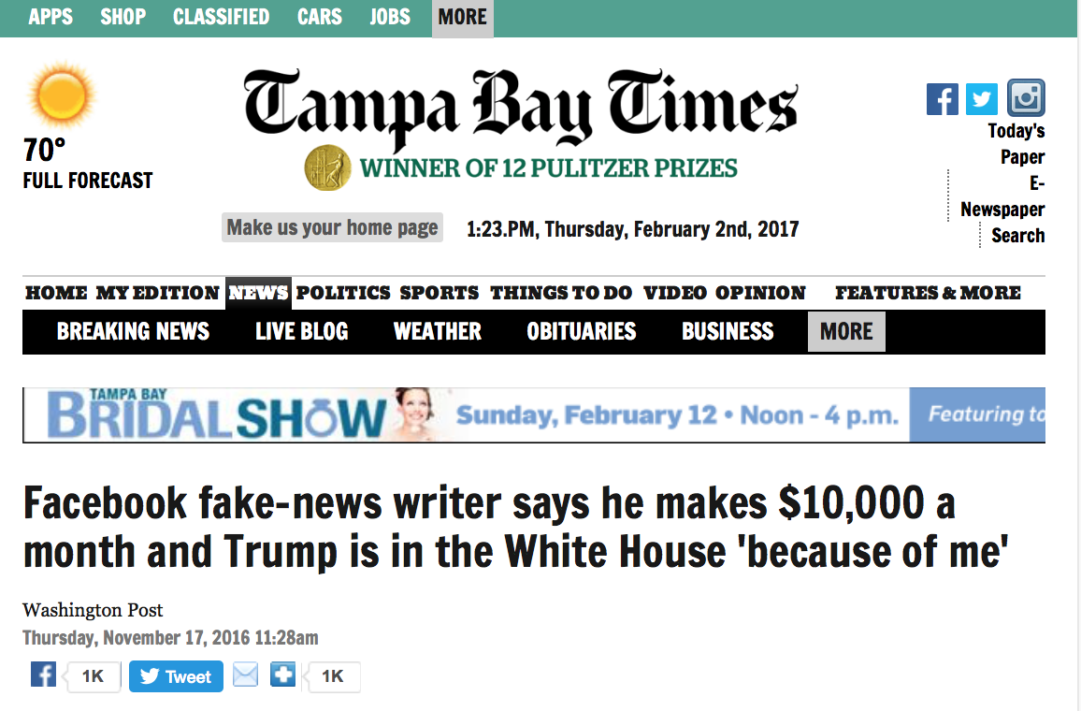

Economics: Why Do They Do It?
Notes:
Other fake news had less convoluted origins. Paul Horner runs a string of websites, some looking deceptively like mainstream news organizations. He created a post that said protesters at Trump rallies were paid $3,500 to disrupt the rally as a dirty tricks plot. He told the Washington Post he knew it wasn't true but wrote it as a parody that could make him money if people actually believed it. "I just wanted to make fun of that insane belief, but it took off," he said.
What happened next is classic: Trump himself repeated the claim about paid protesters at a rally.

Slide 5

The Economics of Why They Do It
Monetary Benefits + Psychological Benefits
>
Psychological Costs of Committing the Crime
+
Monetary Opportunity Costs
Probability of arrests and convictions
(Expected Penalty Effect)
http://wmcyberintrusion.info/wp-content/uploads/2017/11/FakeNews2017.pdf

Slide 6
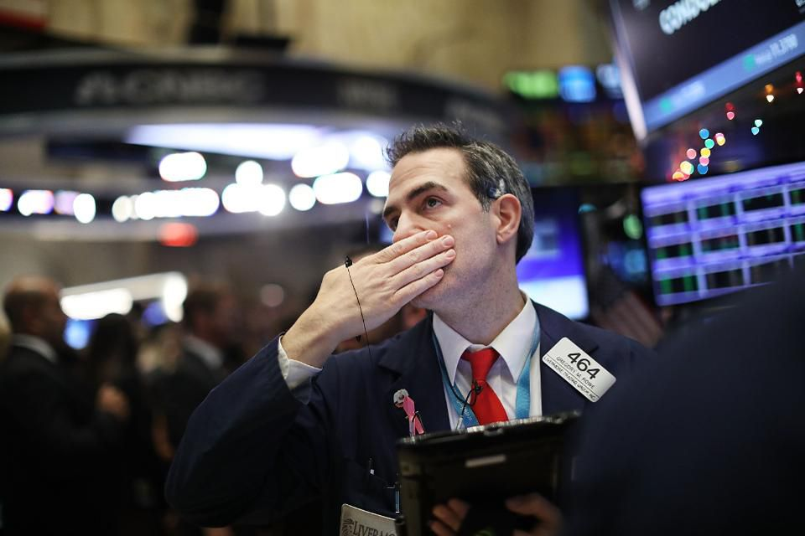
How can fake news impact the stock market?
“Did you hear what the CEO of XYZ Corp said about those widgets in Mexico? For the markets, what is "fake news"? It's rumors, and misinformation sometimes used to move the price of a security. It's not new. Some tech firms are working on detection mechanisms that will score a news articles reliability to help those who rely on the news to make investment decisions.”

Slide 7
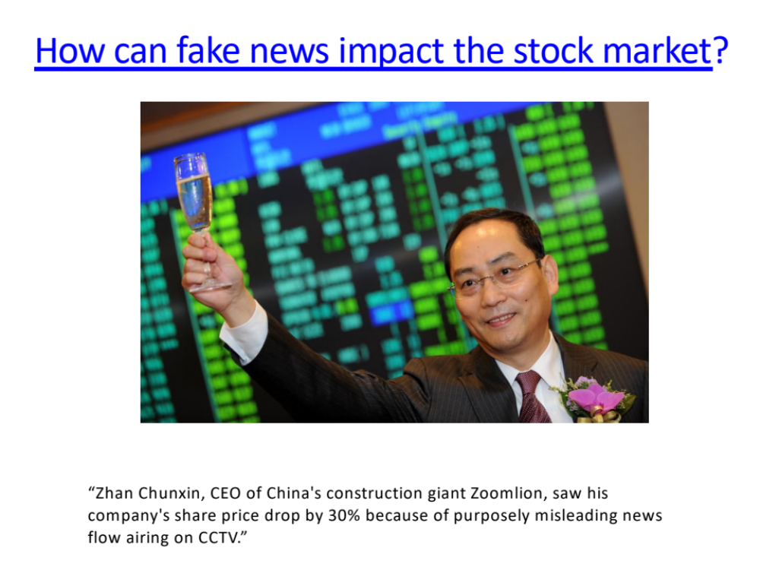
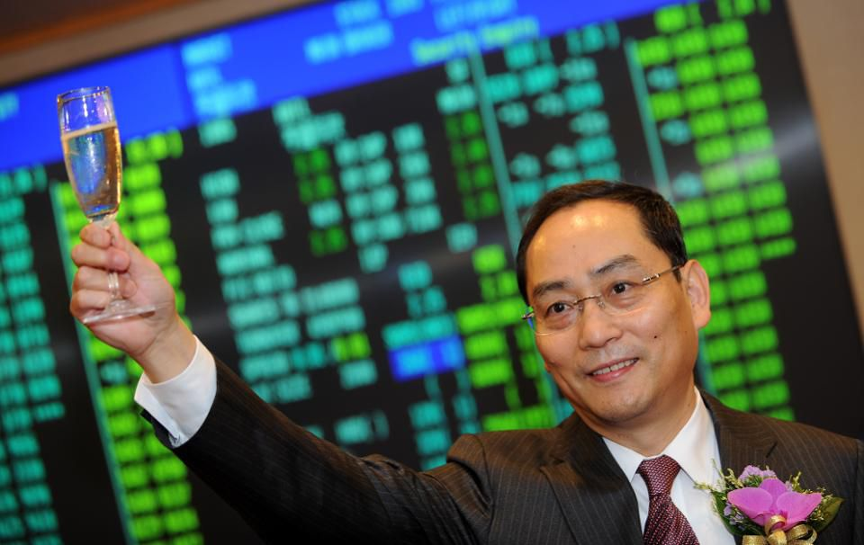
How can fake news impact the stock market?
“Zhan Chunxin, CEO of China's construction giant Zoomlion, saw his company's share price drop by 30% because of purposely misleading news flow airing on CCTV.”

Slide 8
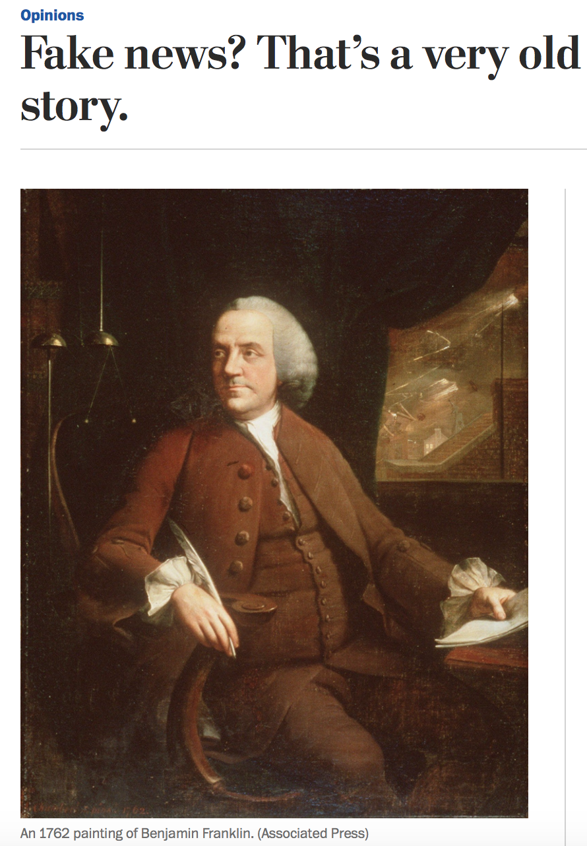
https://www.washingtonpost.com/opinions/fake-news-thats-a-very-old-story/2016/11/25/c8b1f3d4-b330-11e6-8616-52b15787add0_story.html?utm_term=.de1971e180cc

Slide 9
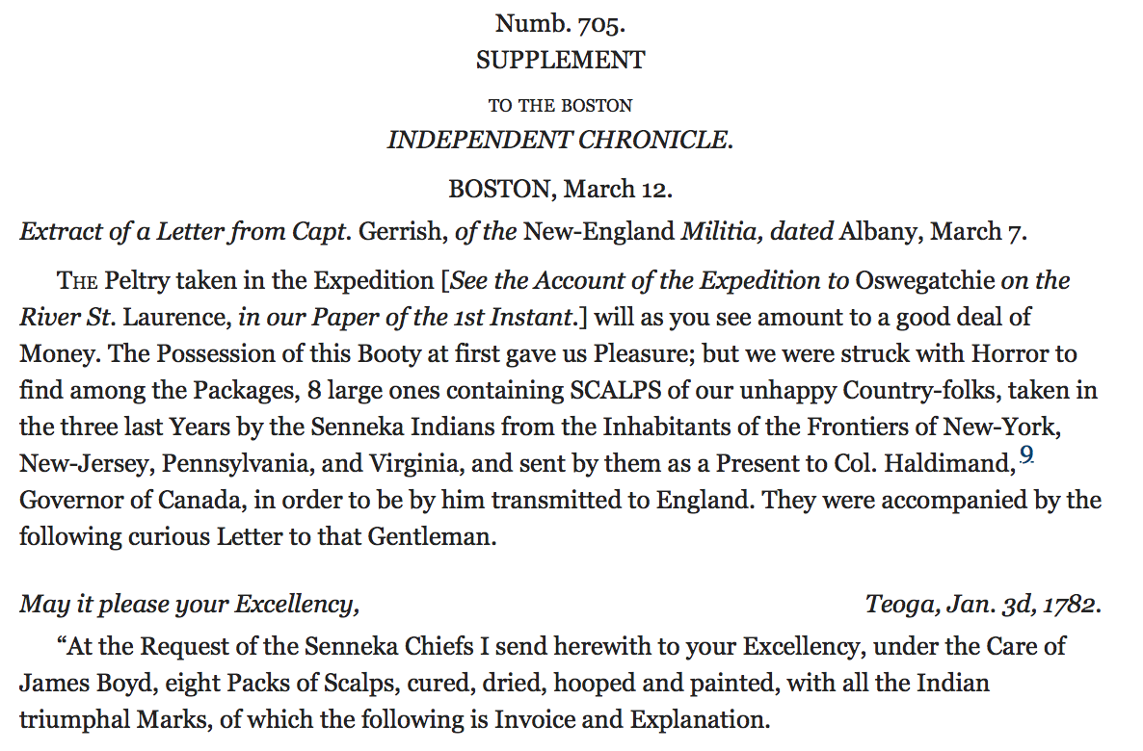
https://founders.archives.gov/documents/Franklin/01-37-02-0132

Slide 10
Wrote to a friend (Richard Price) about the power of the news . . .
The ancient Roman and Greek Orators could only speak to the Number of Citizens capable of being assembled within the Reach of their Voice: Their Writings had little Effect because the Bulk of the People could not read. Now by the Press we can speak to Nations; and good Books & well written Pamphlets have great and general Influence. The Facility with which the same Truths may be repeatedly enforc’d by placing them daily in different Lights, in Newspapers which are every where read, gives a great Chance of establishing them. And we now find that it is not only right to strike while the Iron is hot, but that it is very practicable to heat it by continual Striking.—
https://founders.archives.gov/documents/Franklin/01-37-02-0299

Slide 11
Unicorns on the Moon?
From the Italian version of The Great Moon Hoax. Leopoldo Galluzzo, Altre scoverte fatte nella luna dal Sigr. Herschel (Other lunar discoveries from Signor Herschel), Napoli, 1836 (Smithsonian Institution Libraries)
https://www.smithsonianmag.com/smithsonian-institution/great-moon-hoax-was-simply-sign-its-time-180955761/
Notes:
Traditionally, media hoaxes have often been perpetuated for mercenary reasons. The most notable early instance of fake news came in 1835, when credible New York newspaper The Sun published a story announcing the discovery of life on the Moon. Over a series of six articles, the newspaper reported a British astronomer had developed a powerful new telescope that had revealed life on the Moon. The articles were allegedly sourced from a fictitious scientific journal and described entire alien eco-systems in sensational detail. Unicorns, hairy human-like beings, oceans and temples were all seriously reported, with the story concluding after the Sun's rays reportedly destroyed the special telescope and burned the astronomer's observatory to the ground. The circulation of The Sun hit an all-time high due to the articles and it reportedly took weeks before the story was declared a hoax, one which the newspaper never even issued a retraction over. It was clear that fake news worked.

Slide 12
Yellow Journalism & the Yellow Kid:
Spanish-American War, 1890’s, & Hearst vs. Pulitzer
https://cartoons.osu.edu/digital_albums/yellowkid/1895/1895.htm

Slide 13
From Yellow Journalism to Click Bait
R.F. Outcault

Slide 15
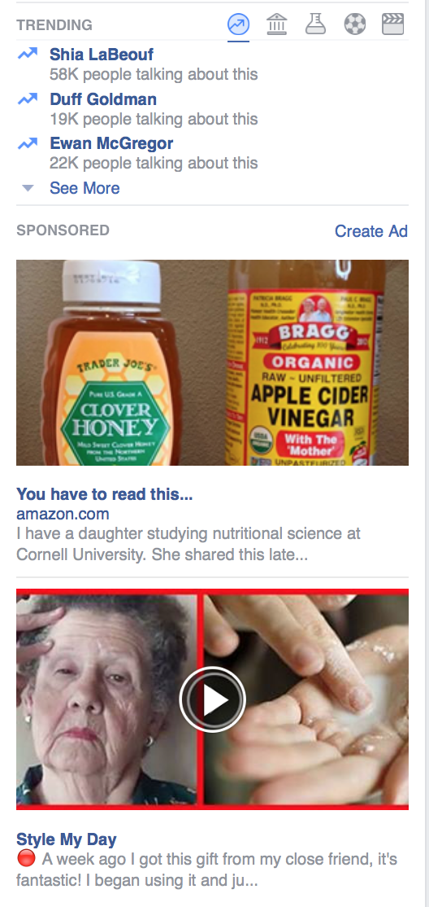
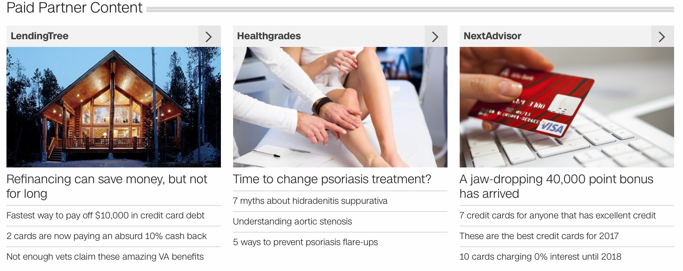
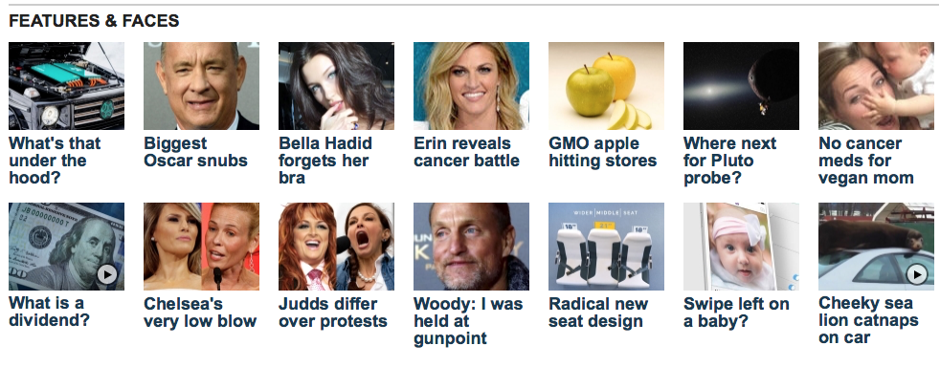
Click Bait

Slide 16
Can we always ignore it?

Slide 17
Why do we get hooked into spreading dubious claims?
What happens when we are surfing the net?
What happens when we surf our news feeds?
What happens when we surf Facebook?

Slide 18
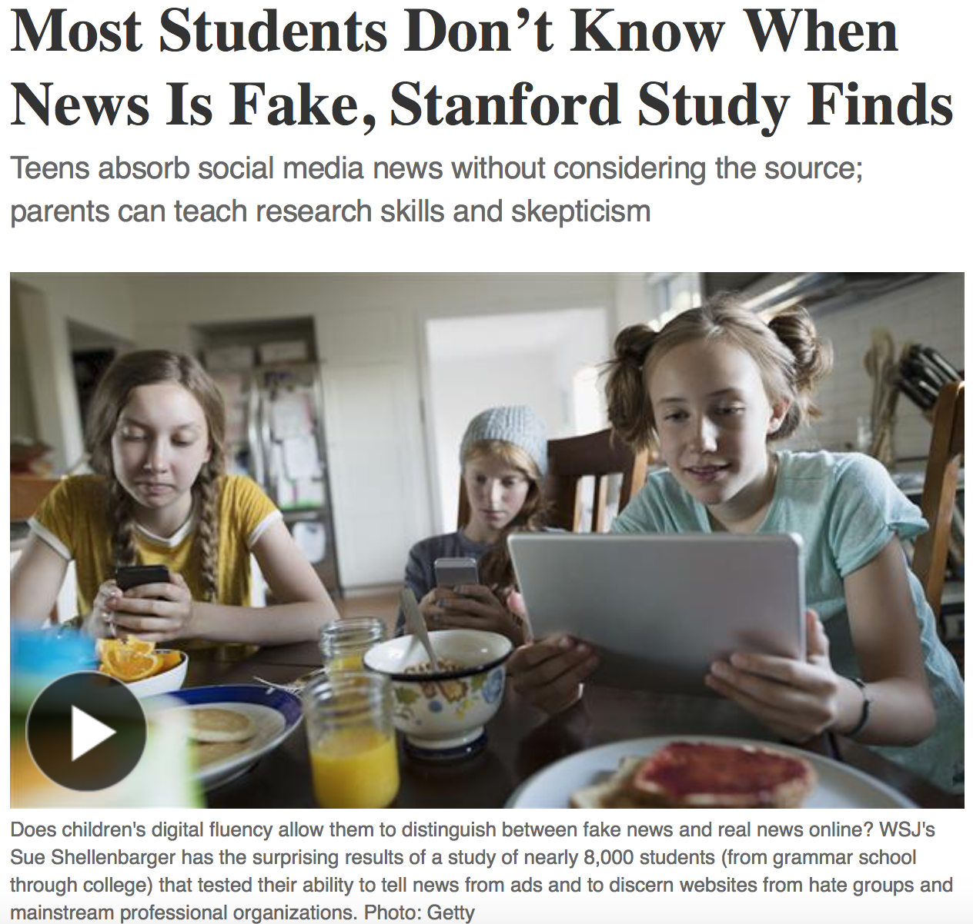

Read T

Slide 19
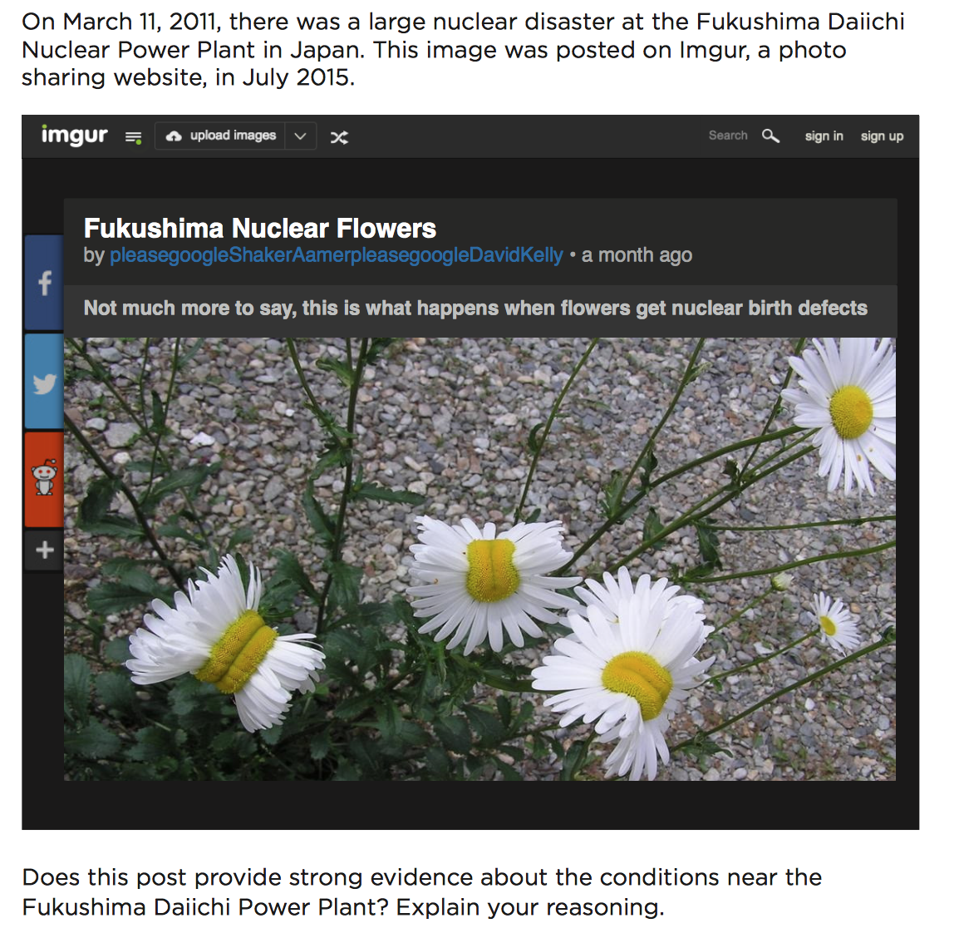
Stanford SHEG: Evaluating Evidence

Slide 20

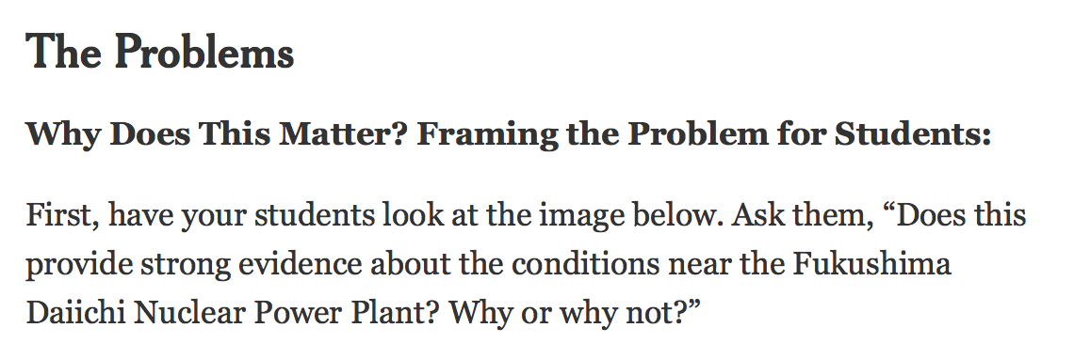
Findings
Nearly four in 10 high school students believed, based on the headline, that this photograph of deformed daisies provided strong evidence of toxic conditions near the Fukushima Daiichi nuclear plant in Japan, even though no source or location was given for the photo.

Slide 21
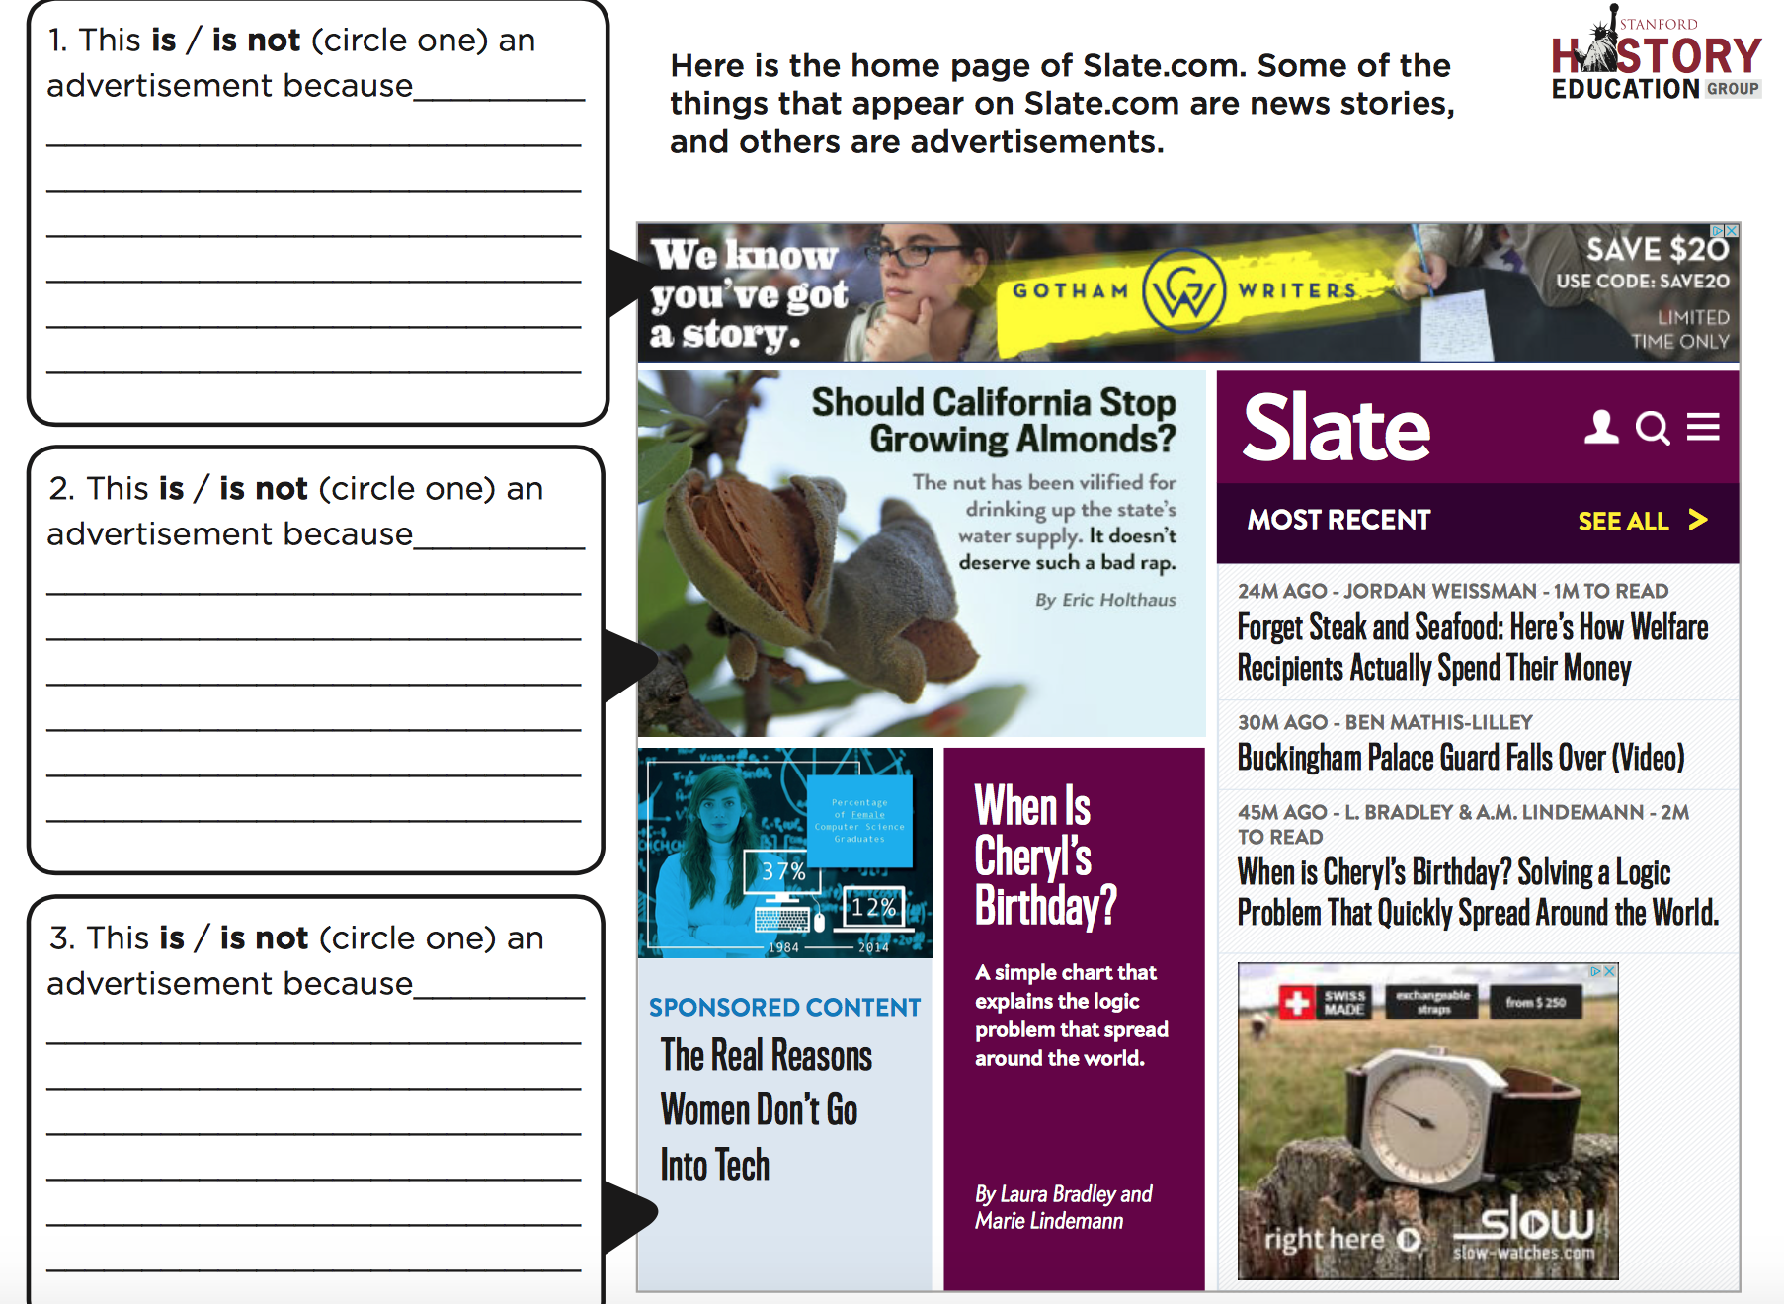
Stanford SHEG Project: Home Page Analysis
https://sheg.stanford.edu/upload/V3LessonPlans/Executive%20Summary%2011.21.16.pdf

Slide 22
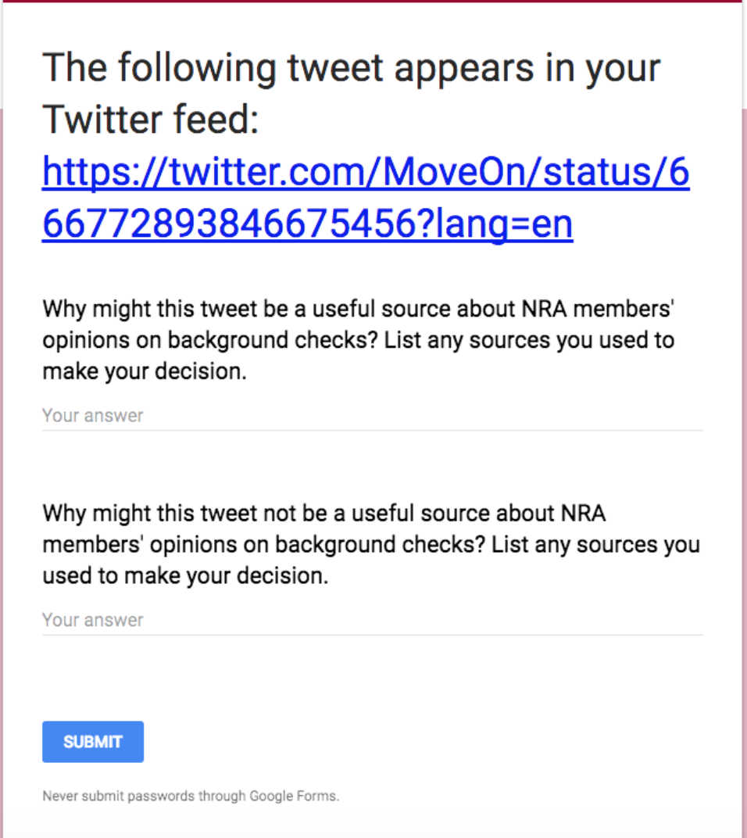
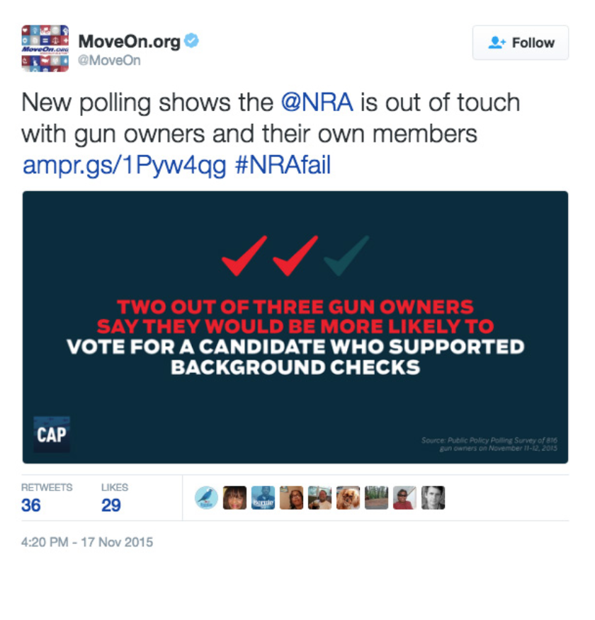
Stanford SHEG: Claims on Social Media

Slide 23
Beyond the Checklist . . . Lateral Literacy
http://www.kappanonline.org/breakstone-need-new-approach-teaching-digital-literacy/
Notes:
The most prominent digital literacy organizations in the United States and Canada instruct students to evaluate the trustworthiness of online sources using checklists of 10 to 30 questions. (Common Sense Media, the News Literacy Project, Canada’s Media Smarts, the University of Rhode Island’s Media Education Lab, and the American Library Association all disseminate website evaluation checklists.) Such lists include questions like: Is a contact person provided? Are the sources of information identified? Is the website a .com (supposedly bad) or a .org (supposedly good)?

Slide 24
What Fact Checkers Do
https://www.politifact.com/truth-o-meter/article/2018/feb/12/principles-truth-o-meter-politifacts-methodology-i/

Slide 25
Politifact’s Fact Checking Process
Uses on-the-record interviews
Publishes a list of sources with every fact-check.
Attempts to contact the person, website or organization
Emphasizes primary sources and original documentation.
In cases where PolitiFact must cite news reports from other media that rely on unnamed or unattributed sources we note that we cannot independently verify their reporting.

Slide 26

American Press Institute:
Critical questions for interpreting media
Type: What kind of content is this?
Source: Who and what are the sources cited and why should I believe them?
Evidence: What’s the evidence and how was it vetted?
Interpretation: Is the main point of the piece proven by the evidence?
Completeness: What’s missing?
Knowledge: Am I learning every day what I need?

Slide 27
“All our reporters have an editor who supervises them. The number of reporters an editor supervises varies but generally it’s between four and seven people. When a reporter writes a story, their editor reads it thoroughly, asks questions, edits for grammar, spelling, clarity and facts, often asking a reporter where they got a piece of information and questioning something if it seems not to make sense. They check names, dates or other facts as well. After the supervising editor finishes the story, it is sent to the copy desk, where at least one copy editor and sometimes two will also read the story, checking facts (such as names, places, math) and raising questions if something seems amiss or suspicious in a story. That’s the process that we go through for most routine stories.
“If the story is highly complex or significant, or we plan to run it on the front page, especially the Sunday front page, it will almost always go through additional layers of editing. The first editor’s supervisor might read it, and on many occasions. I will review the story or our executive editor will. Stories that are running on the Sunday front page (our most read addition) are always read by an assistant managing editor and either me or the executive editor.
“The process is somewhat compressed when breaking news is published online. If the story is one that is ongoing and developing -- someone has just been arrested on a murder charge – the reporter will write the article and we have an editor read it before publication. Sometimes that is not their supervising editor but another trusted editor who is free at the moment the story needs to be published. After the story goes online, it is updated throughout the day by the reporter, re-edited by their editor and then when the story is not going to be updated any more before print publication, it goes through the editing process above, where it gets a final read from the assigning editor and goes to be read by the copy desk.”
-- Jennifer Orsi, managing editor Tampa Bay Times

Slide 28

We all need to be news detectives…

Slide 29

Key Questions to Ask:
Who made the message?
Who is the target audience (how do you know)?
Who paid for this? Or who gets paid if you read or respond to this message?
Who might benefit or be harmed by this?
What important info is left out or missing?
Is this credible (and what makes you think so)?
Is the main point proven by verifiable evidence?

Slide 30
Identify the source!
Look for a byline – who wrote it?
  Is this a real person? More importantly, are they credible?

Slide 31
Identify the source!
Look for a byline – who wrote it?
Is this a real person? More importantly, are they credible?
Who owns the webpage?

Slide 32
Identify the source!
Look for a byline – who wrote it?
Is this a real person? More importantly, are they credible?
Who owns the webpage?
Who originally wrote or said the information being referenced?

Slide 33
Identify the source!
Look for a byline – who wrote it?
Is this a real person? More importantly, are they credible?
Who owns the webpage?
Who originally wrote or said the information being referenced?
Who took the photo/video images?
Are they timely? Have they been changed/edited?
(TIP: Using a reverse image search on Google can give you an idea of whether the image is real.)

Slide 34
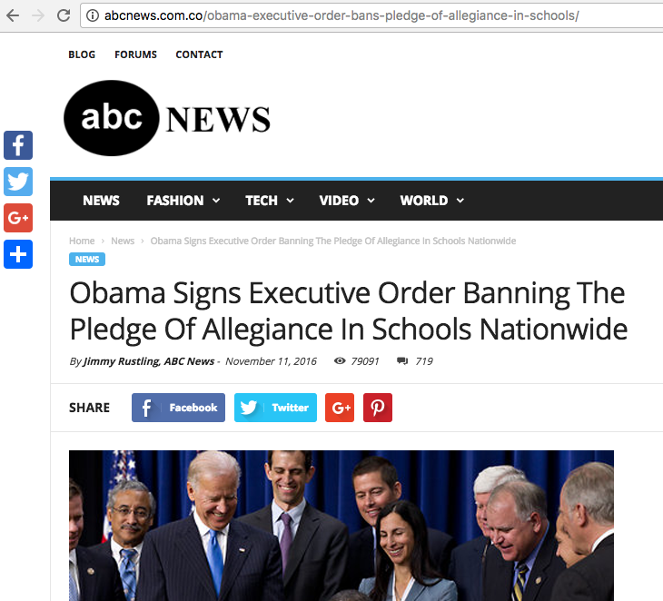
Double check
the URL

Slide 35




Sites that get paid to do this leg work for you:
FACT CHECKING
FactCheck.org
Politifacts.com
Washington Post Fact Checker
Snopes.com
USAFacts.org (beta)
Allsides

Slide 36





FACT CHECKING - Continued
OpenSecrets.org
Poynter.org
Factitious
OpenSources.co
TinEye
SBrowning.com - WhoWhatWhen
Notes:
OpenSecrets.org - Nonpartisan, independent and nonprofit, the Center for Responsive Politics is the nation's premier research group tracking money in U.S. politics and its effect on elections and public policy.
Poynter - founded the International Fact-Checking Network in 2015 and is the leading convener, teacher and community-builder for fact-checkers around the world.
Facticious - http://factitious.augamestudio.com/#/
OpenSources.co - document created by Melissa Zimdars, assistant professor of communication and media at Merrimack College in North Andover, MA because she saw her students referencing questionable sources, she created and shared this document with them of how to think about sources, as well as a list of misleading, satirical and fake sites.
TinEye - Search by image and find where that image appears onlineSearch by image and find where that image appears online
WhoWhatWhen -WhoWhatWhen is a database of key people and events from 1000 A.D. to the present. Create graphic timelines of periods in history and of the lives of individuals. - The database consists of famous people and famous events. People entries consist of the name, short description, which category they were famous for, and birth and death dates. No detailed biographical info is in this database, but this site will provide links to popular web search engines which will give you in depth information about each person or event. While people from all over the globe are included, there is a definite "American" slant to the entries. Dates go from around 1000 AD to the present. Only people with a known year of birth and death are entered. Famous composers, scientists, political figures, writers, etc... make up most of the entries before 1900. After that, a lot of "popular culture" figures are in the database.
Nonpartisan, independent and nonprofit, the Center for Responsive Politics is the nation's premier research group tracking money in U.S. politics and its effect on elections and public policy. Nonpartisan, independent and nonprofit, the Center for Responsive Politics is the nation's premier research group tracking money in U.S. politics and its effect on elections and public policy.

Slide 37

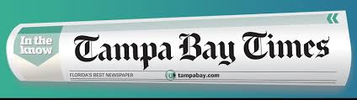
Tampabay.com/nie

Slide 38
Times NIE services
The Tampa Bay Times Newspaper in Education program provides free resources to Citrus, Hernando, Hillsborough, Manatee, Pasco and Pinellas counties.
  The TBT NIE provides newspapers, electronic licenses and curriculum guides to classrooms around Tampa Bay each year
  TBT NIE hosts teacher workshops
  TBT NIE provides teachers with free lesson plans in print and online – www.tampabay.com/nie.

Slide 39

Using the Digital Edition
You and your students can read the Tampa Bay Times, just as it appears in the printed edition, from the convenience of your computer, phone, tablet or electronic reading device.
  Classwork
  Homework
  Research
  Writing models
  Grammar and math exercises

Slide 40
Accessing the Digital Edition
  Teachers, students, and parents should use the same user name and password:
    Go to tampbay.com/nie
    Click log in here
    Enter user name
    Enter password
    Select preferred edition
    Click remember me box
    Click Log in

Slide 41
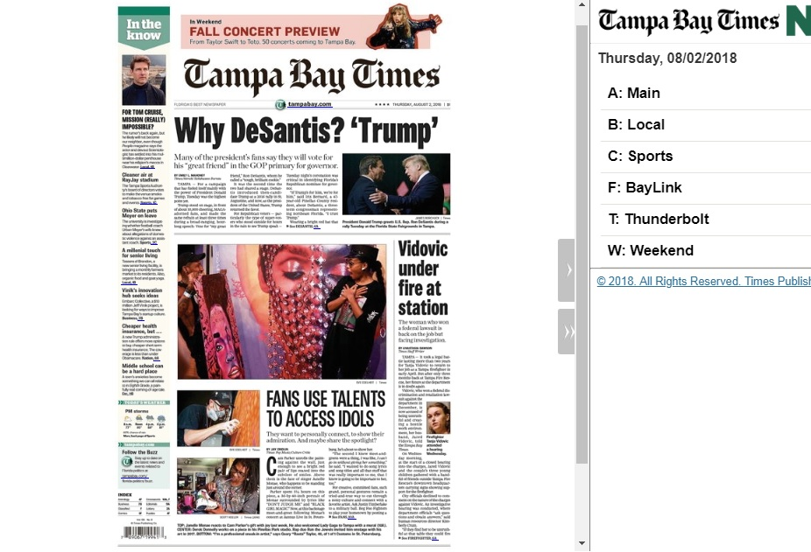

Slide 42
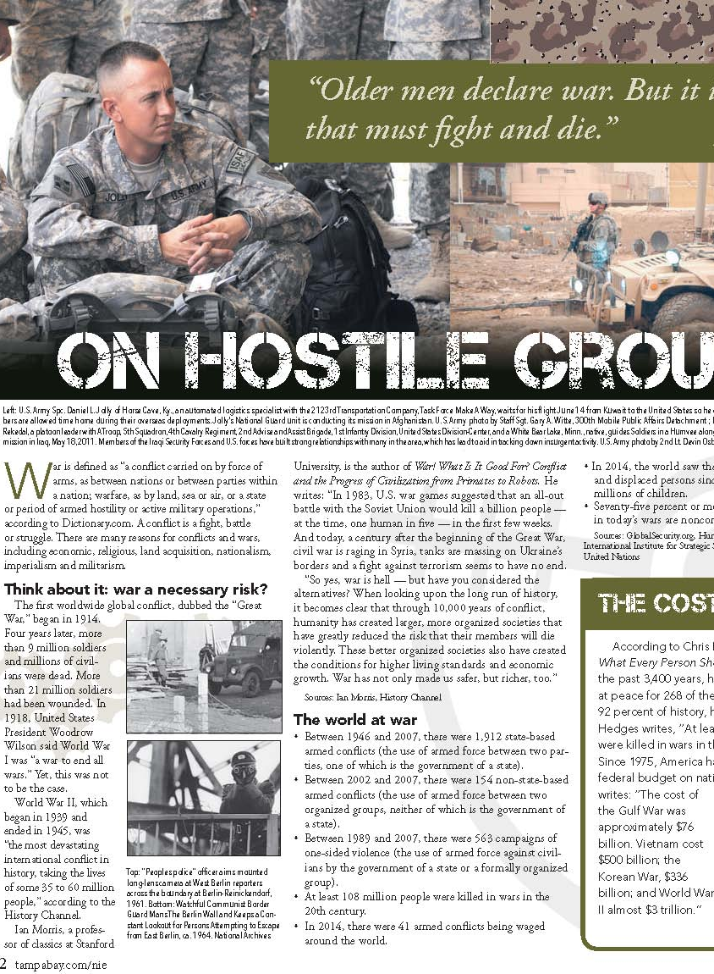
Read like a reporter. Write like a detective. Determine evidence and claims.
What evidence does author provide?
What claims does author make implicitly?
Using the evidence, create an argument.

Slide 43
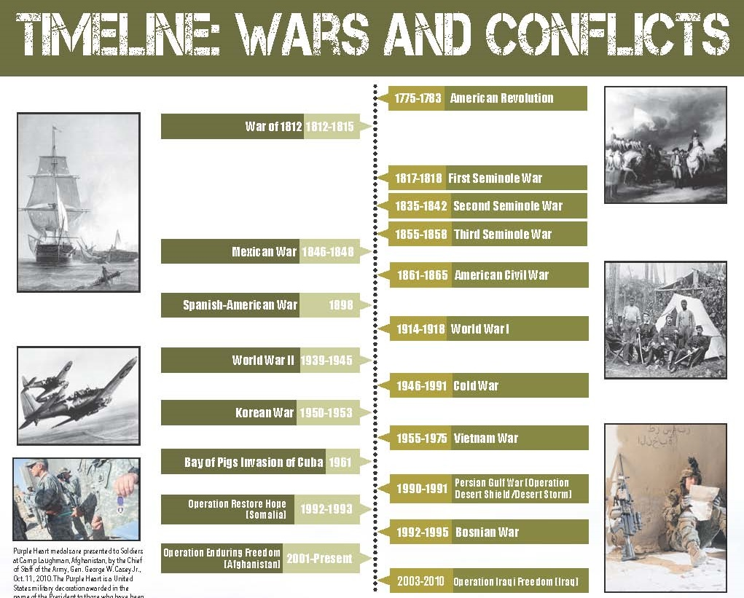
Interpreting timelines

Slide 44
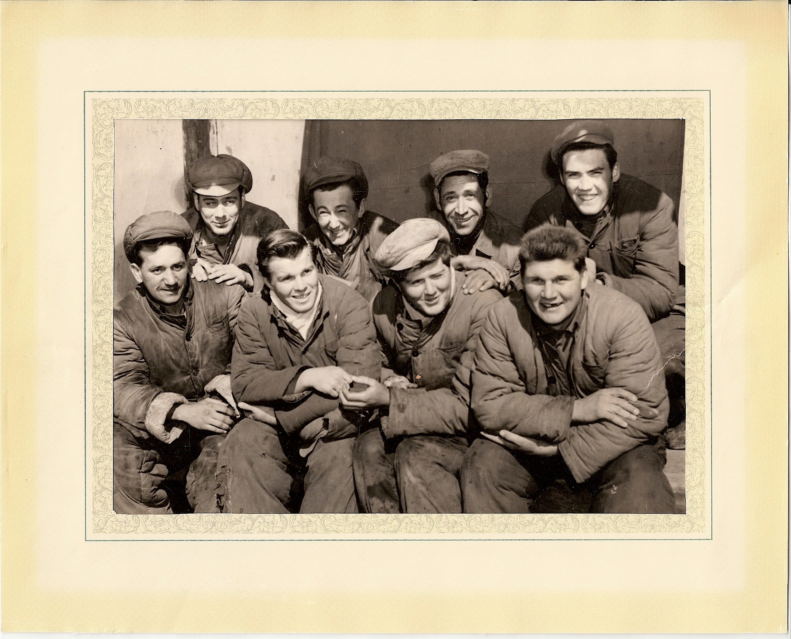
Interpreting images & graphics

Slide 45

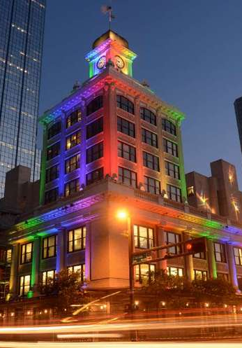
Interpreting photos … All Eyes
tampabay.com/photo-gallery

Slide 46

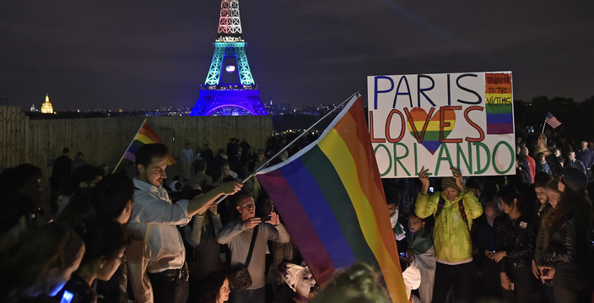
Interpreting photos … All Eyes
tampabay.com/photo-gallery

Slide 47

Jodi Pushkin, manager
jpushkin@tampabay.com
Office: 727-893-8961
Website for NIE: tampabay.com/nie
Twitter: Twitter.com/TBTimesNIE
Facebook.com/TBTNIE

