Slide 1
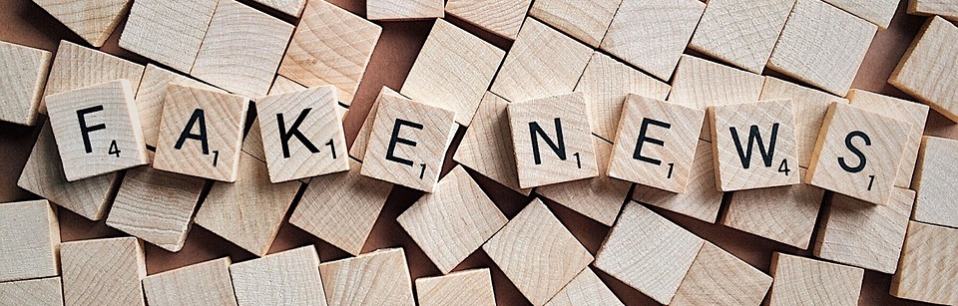

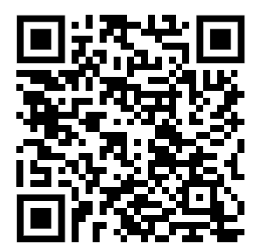
International Literacy Association Conference, October 2019
Deborah Kozdras, USF Stavros Center
James Welsh, Florida Center for Instructional Technology
Jenifer Jasinski Schneider, USF Literacy Studies
tinyurl.com/ILAfakenews

Slide 2
Fake News in a Post Truth Era
"In a culture like ours, long accustomed to splitting and dividing all things as a means of control, it is sometimes a bit of a shock to be reminded that, in operational and practical fact, the medium is the message. This is merely to say that the personal and social consequences of any medium - that is, of any extension of ourselves - result from the new scale that is introduced into our affairs by each extension of ourselves, or by any new technology."
(McLuhan, 1964, p. 7)

Slide 3
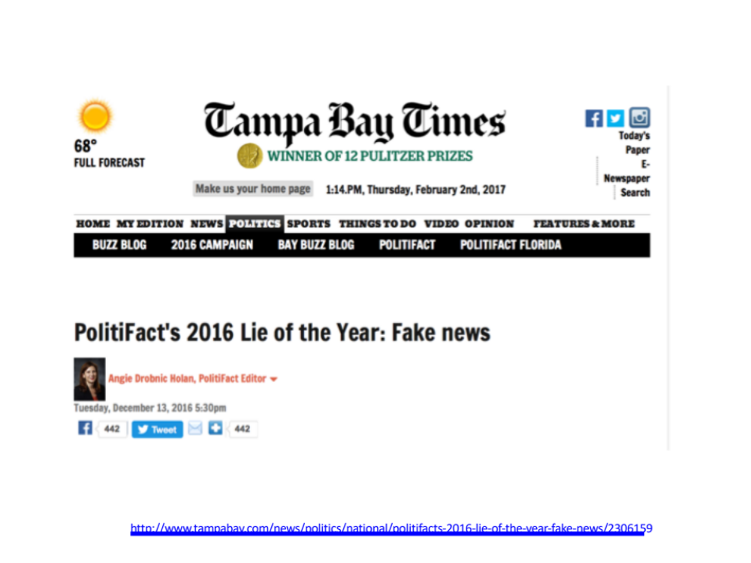
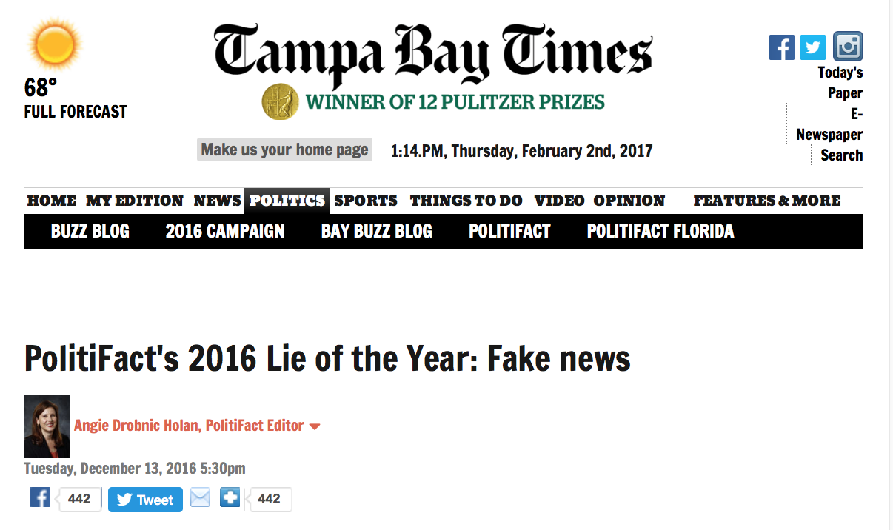
http://www.tampabay.com/news/politics/national/politifacts-2016-lie-of-the-year-fake-news/2306159

Slide 4
Why do we get hooked into spreading dubious claims?
What happens when we are surfing the net?
What happens when we surf our news feeds?
What happens when we surf Facebook?

Slide 5
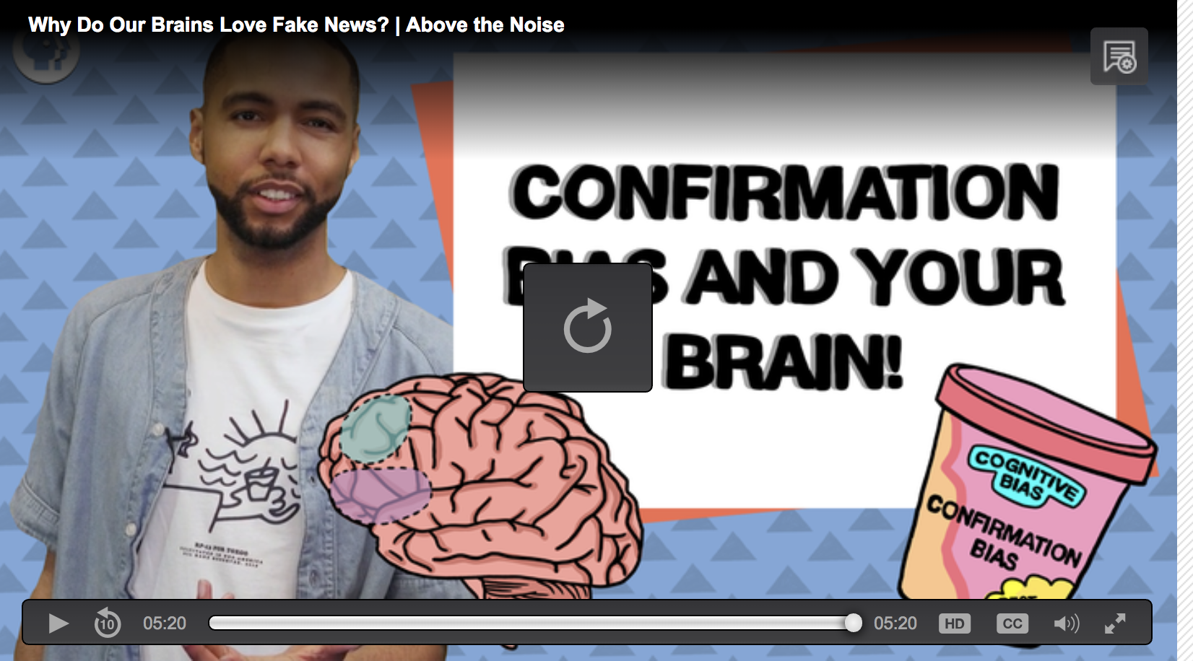
Recognize Your Biases
https://www.pbslearningmedia.org/resource/bias-brain-kqed/why-do-our-brains-love-fake-news-above-the-noise/?#.W4BO_dPwZBx

Slide 6
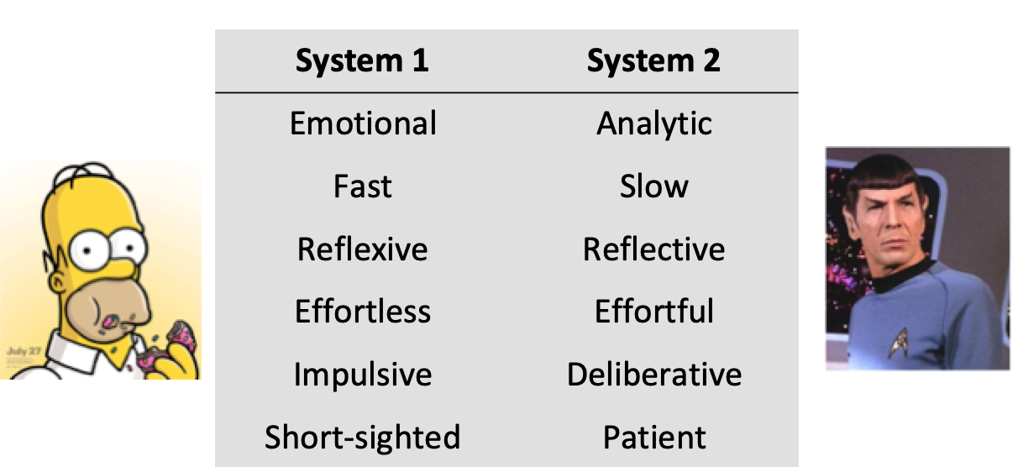
Thinking Fast and Slow by Daniel Kahneman
Doesn’t realize bias
Doesn’t always recognize own cognitive biases

Slide 8
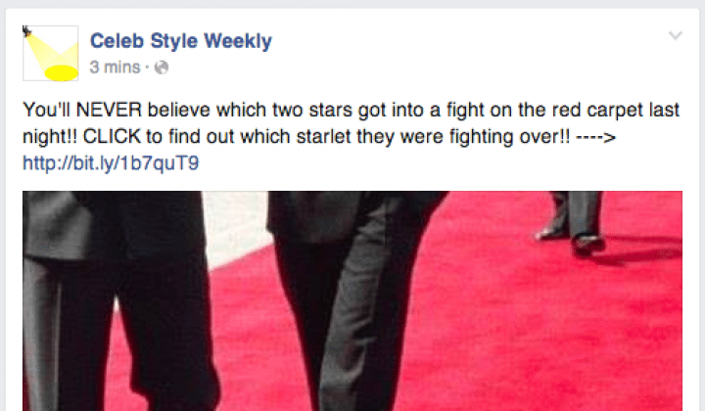

Slide 9
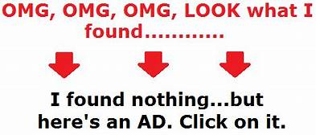

Slide 10
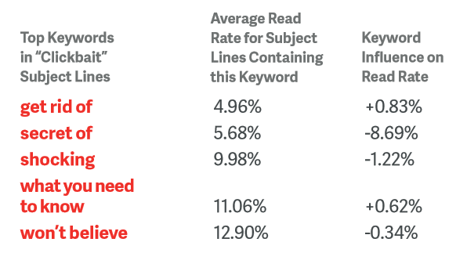
Literacy Lessons

Slide 11
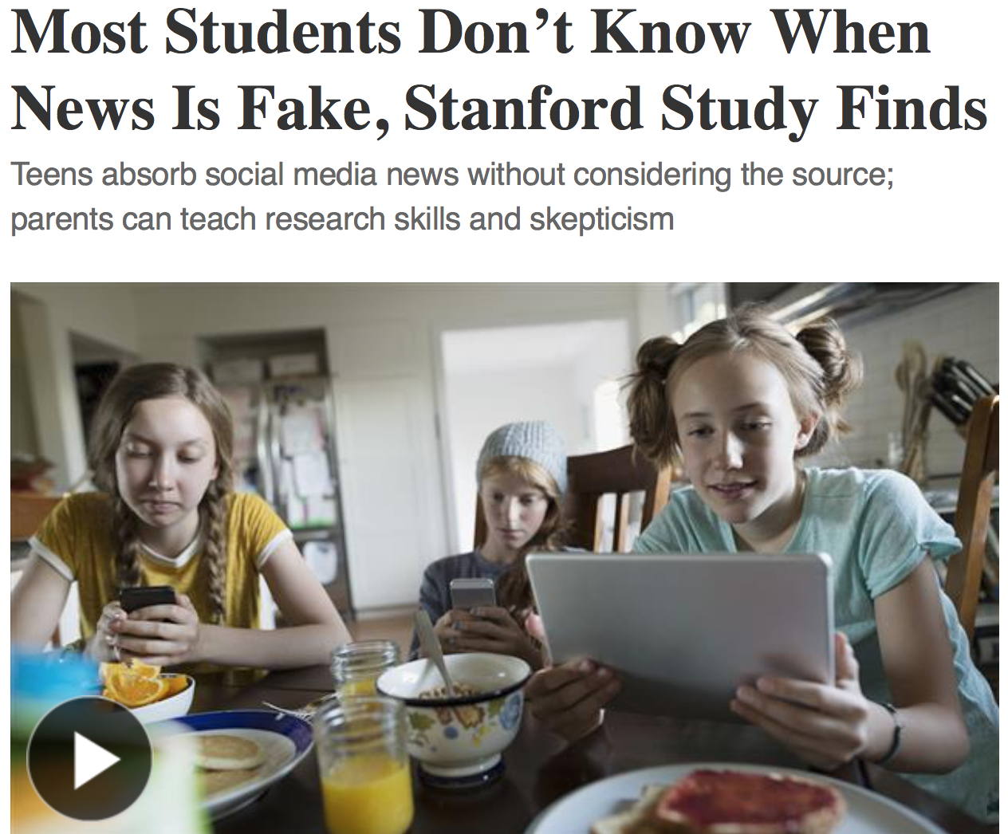

Read T

Slide 12
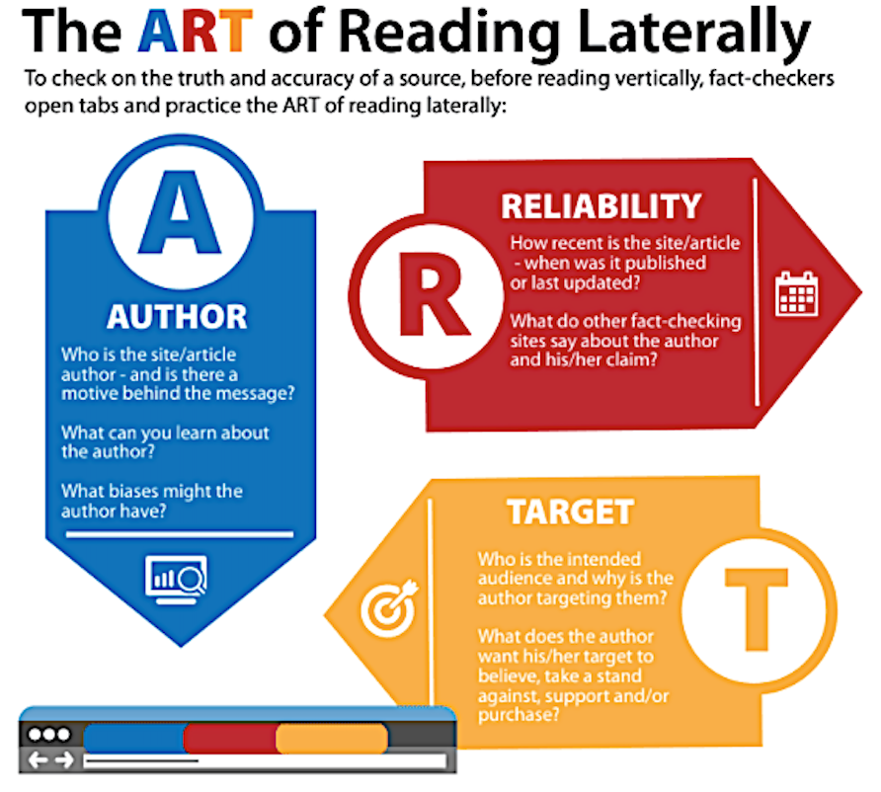

Slide 13
Fact Checking and Lateral Literacy
Use on-the-record interviews
Publish a list of sources with every fact-check.
Attempt to contact the person, website or organization
Emphasize primary sources and original documentation.
https://www.politifact.com/truth-o-meter/article/2018/feb/12/principles-truth-o-meter-politifacts-methodology-i/

Slide 14




Sites that get paid to do this leg work for you:
FACT CHECKING
FactCheck.org
Politifacts.com
Washington Post Fact Checker
Snopes.com
USAFacts.org (beta)
Allsides

Slide 15




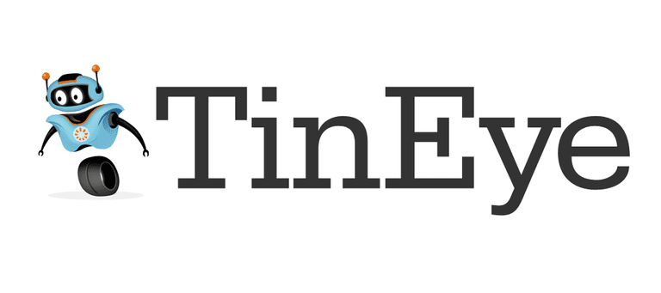
FACT CHECKING - Continued
OpenSecrets.org
Poynter.org
Factitious
OpenSources.co
TinEye
SBrowning.com - WhoWhatWhen
Notes:
OpenSecrets.org - Nonpartisan, independent and nonprofit, the Center for Responsive Politics is the nation's premier research group tracking money in U.S. politics and its effect on elections and public policy.
Poynter - founded the International Fact-Checking Network in 2015 and is the leading convener, teacher and community-builder for fact-checkers around the world.
Facticious - http://factitious.augamestudio.com/#/
OpenSources.co - document created by Melissa Zimdars, assistant professor of communication and media at Merrimack College in North Andover, MA because she saw her students referencing questionable sources, she created and shared this document with them of how to think about sources, as well as a list of misleading, satirical and fake sites.
TinEye - Search by image and find where that image appears onlineSearch by image and find where that image appears online
WhoWhatWhen -WhoWhatWhen is a database of key people and events from 1000 A.D. to the present. Create graphic timelines of periods in history and of the lives of individuals. - The database consists of famous people and famous events. People entries consist of the name, short description, which category they were famous for, and birth and death dates. No detailed biographical info is in this database, but this site will provide links to popular web search engines which will give you in depth information about each person or event. While people from all over the globe are included, there is a definite "American" slant to the entries. Dates go from around 1000 AD to the present. Only people with a known year of birth and death are entered. Famous composers, scientists, political figures, writers, etc... make up most of the entries before 1900. After that, a lot of "popular culture" figures are in the database.
Nonpartisan, independent and nonprofit, the Center for Responsive Politics is the nation's premier research group tracking money in U.S. politics and its effect on elections and public policy. Nonpartisan, independent and nonprofit, the Center for Responsive Politics is the nation's premier research group tracking money in U.S. politics and its effect on elections and public policy.

Slide 16

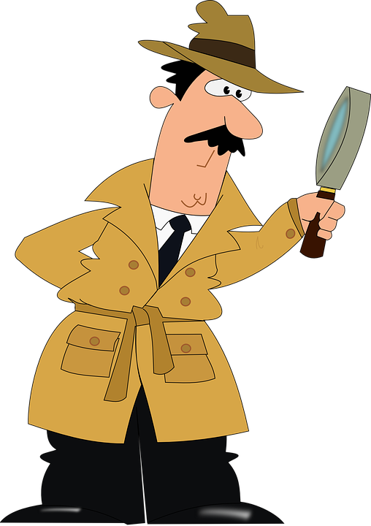
We all need to be news detectives…

Slide 17
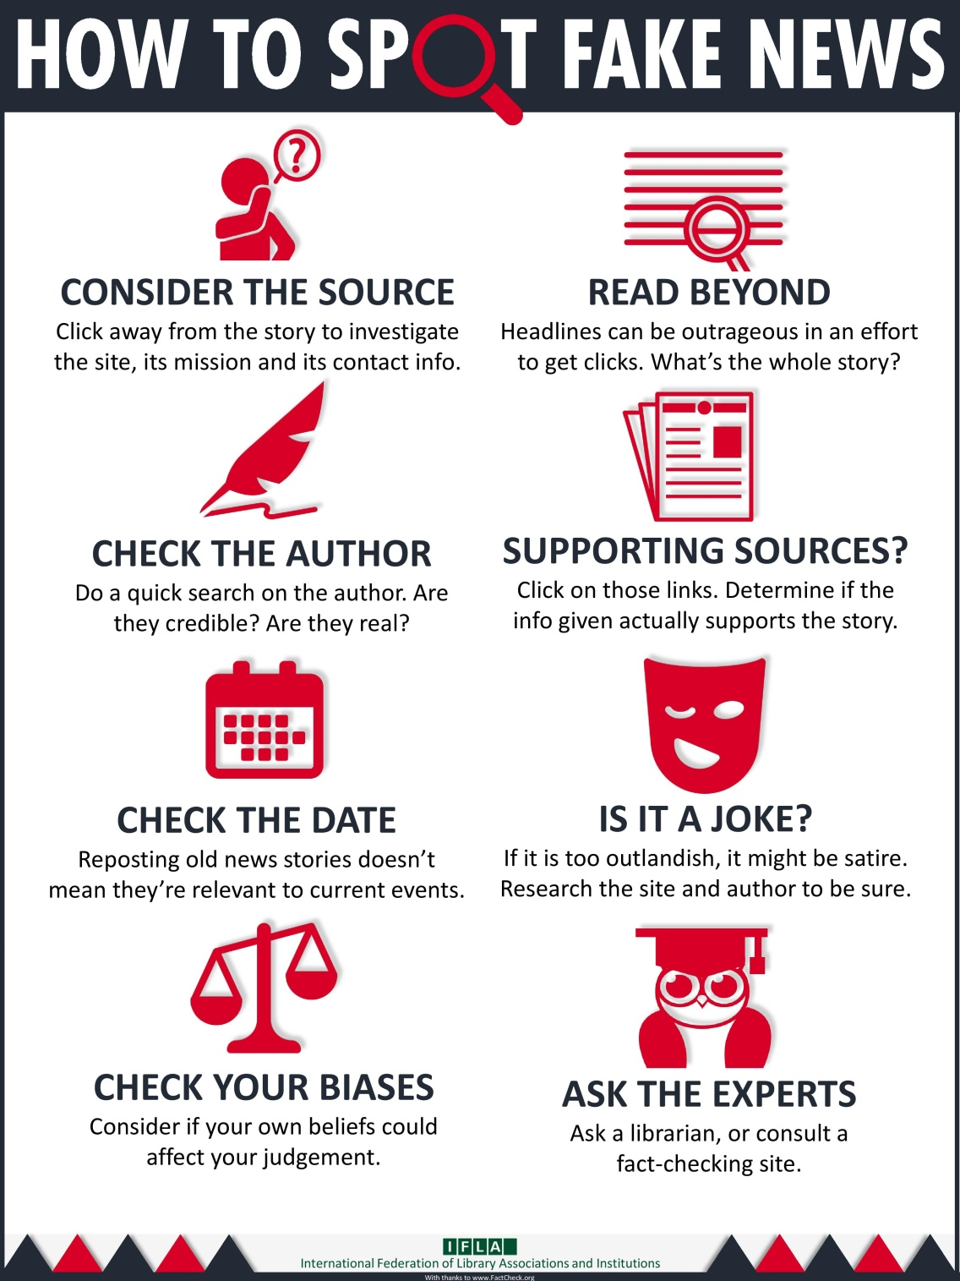
Notes:
What's wrong with fake news?
Why should you care about whether or not your news is real or fake?
You deserve the truth. You are smart enough to make up your own mind - as long as you have the real facts in front of you. You have every right to be insulted when you read fake news, because you are in essence being treated like an idiot.
Fake news destroys your credibility. If your arguments are built on bad information, it will be much more difficult for people to believe you in the future.
Fake news can hurt you, and a lot of other people. Purveyors of fake and misleading medical advice like Mercola.com and NaturalNews.com help perpetuate myths like HIV and AIDS aren't related, or that vaccines cause autism. These sites are heavily visited and their lies are dangerous.
Real news can benefit you. If you want to buy stock in a company, you want to read accurate articles about that company so you can invest wisely. If you are planning on voting in an election, you want to read as much good information on a candidate so you can vote for the person who best represents your ideas and beliefs. Fake news will not help you make money or make the world a better place, but real news can.

Slide 18

Key Questions to Ask:
Who made the message?
Who is the target audience (how do you know)?
Who paid for this? Or who gets paid if you read or respond to this message?
Who might benefit or be harmed by this?
What important info is left out or missing?
Is this credible (and what makes you think so)?
Is the main point proven by verifiable evidence?

Slide 19
Identify the source!
Look for a byline – who wrote it?
  Is this a real person? More importantly, are they credible?

Slide 20
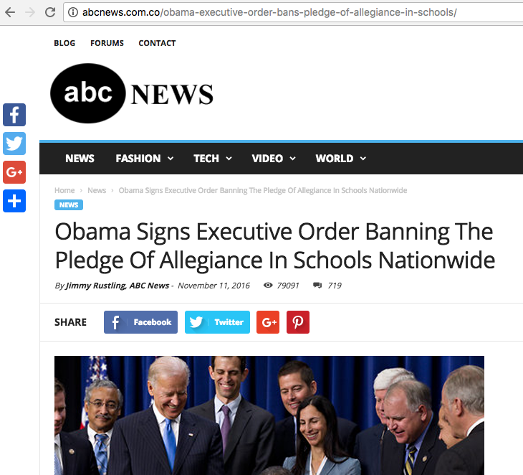

Slide 21
Double check
the URL

Slide 22

Identify the source!
Look for a byline – who wrote it?
Is this a real person? More important, are they credible?
Who owns the webpage?
Who originally wrote or said the information being referenced?
Who took the photo/video images?
Are they timely? Have they been changed/edited?
(TIP: Using a reverse image search on Google can give you an idea of whether the image is real.)

Slide 23
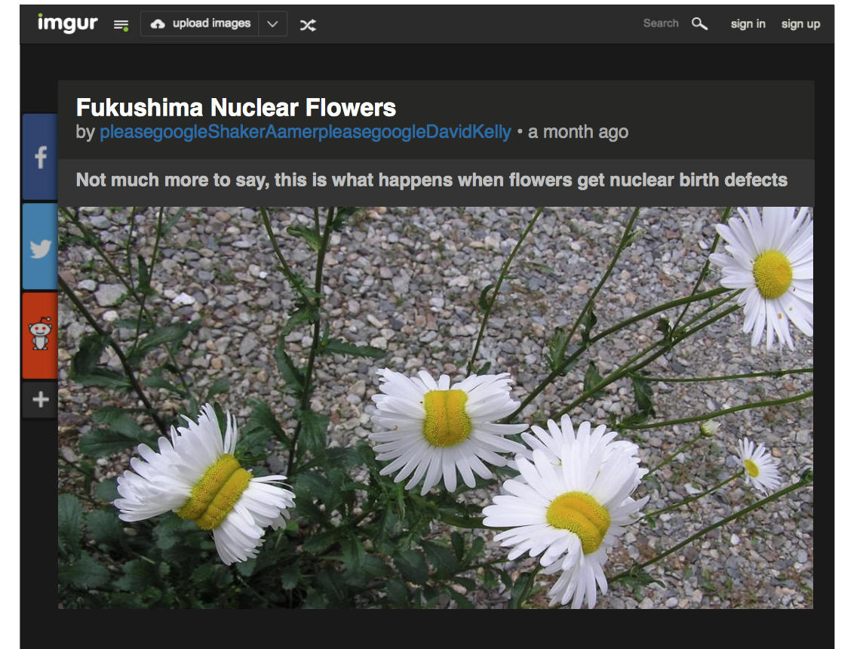
Does this image present strong evidence for toxic conditions near the
Fukushima nuclear plant in Japan?
Notes:
Nearly four in 10 high school students believed, based on the headline, that this photograph of deformed daisies provided strong evidence of toxic conditions near the Fukushima Daiichi nuclear plant in Japan, even though no source or location was given for the photo.

Slide 24
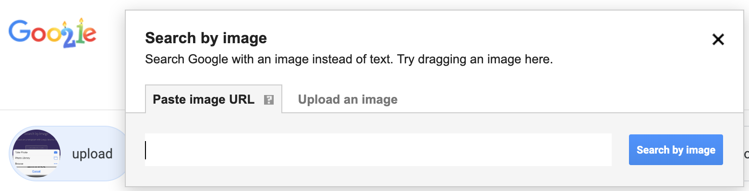
Reverse Image Search

Slide 25
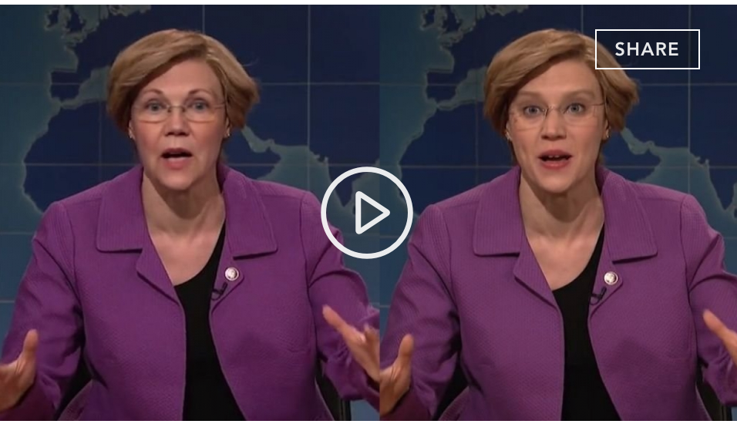
What About Deepfakes?

Slide 26

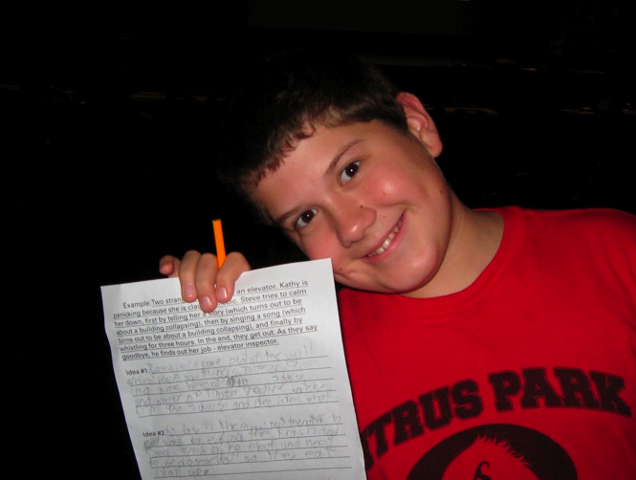

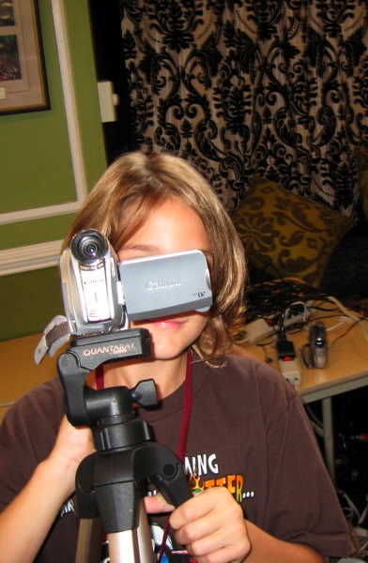
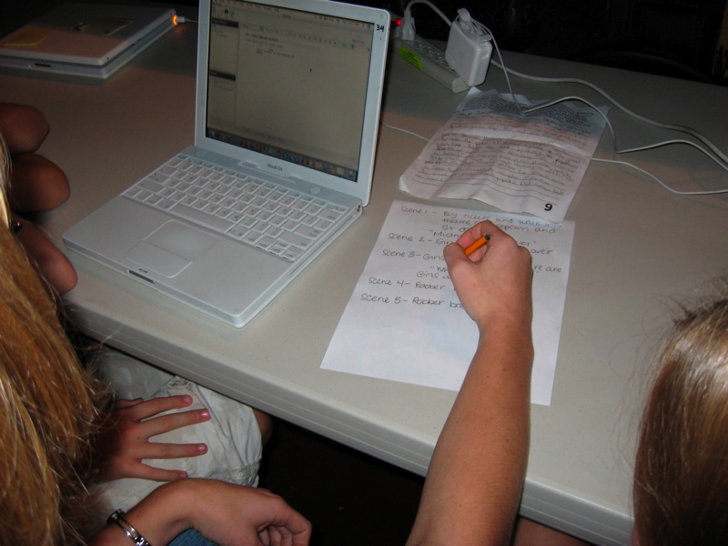
Multimedia Text Producer Strategies:
Slow Literacies by Deconstructing and Reconstructing Films
Notes:
The place where this happens is in movie camp.
We’re just going to talk about one context here.

Slide 27
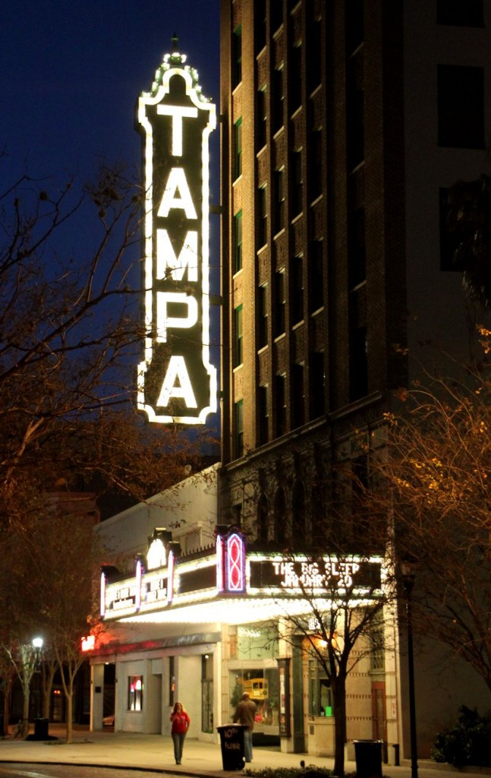
Context

Slide 28
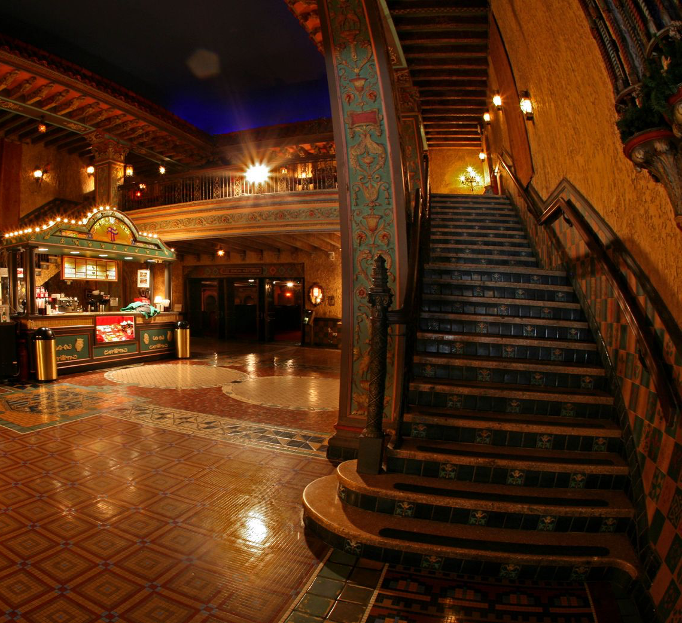
Historic Tampa Theatre & USF & FCIT
Camp began in 2004 - Research 2007-current
Instructional space for Film camp for students 8-17

Slide 29
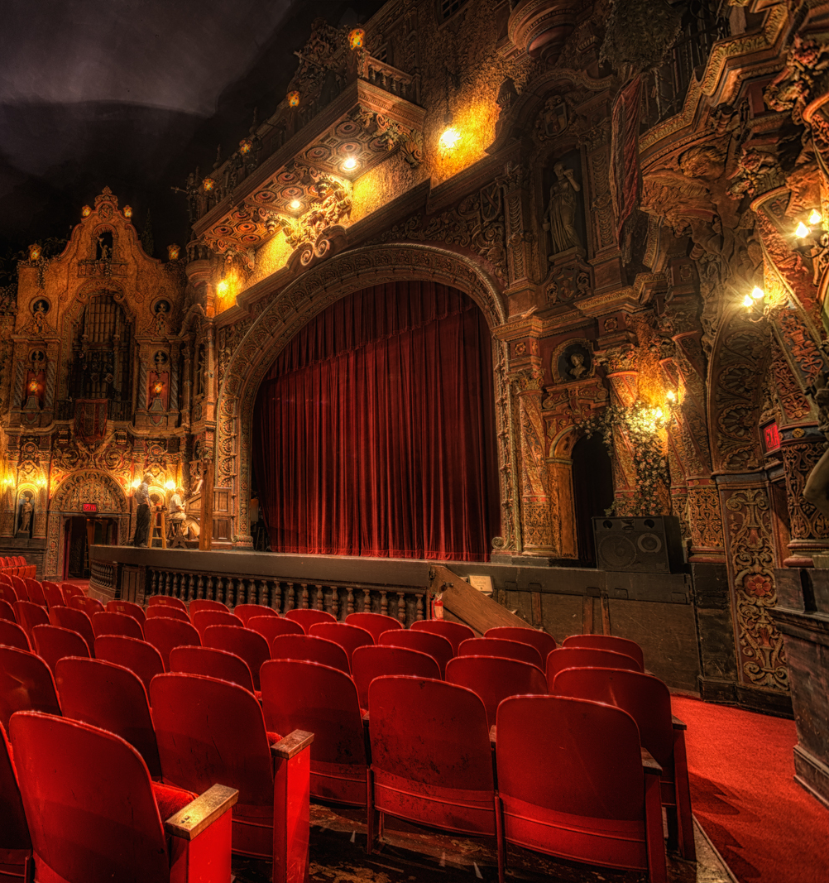
Camp meets for 8 sessions of one week of half days
Each group consists of 1 counselor and 4 students
Learn about “movie magic”
Notes:
Each group produces a film within a week
Because the movie conteint is student controlled, instruction can fous on movie-making strategies
(film deconstruction)

Slide 30
Fast & Slow Literacy
SURFACE (FAST)
DEEP (SLOW)
Surface-level and deep-level reading are possible, regardless of mode (e.g. text, film, music, visual art).
Surface-level reading involves fast thinking — quick judgements based on partial information through a terministic (Burke) screen.
Deep-level reading involves slow thinking — applying critical literacy strategies, seeking out implied meanings, intricate structures, biases, contradictions, motivations, omissions, manipulations, etc.

Slide 31
Literature/Reading
surface-level reading
SURFACE (FAST)
DEEP (SLOW)
literary
analysis
part of K-12
curriculum
Every K-12 student is exposed to literary analysis concepts and exercises.
These strategies include examining symbolism, themes, author’s purpose, and the role of genre.
These strategies don’t include shots, lighting, music, mise en scene, or other “movie magic” strategies.
Notes:
Literary analysis is one way we teach slow thinking with alphabetic text.
What often happens in film classes (when they exist), curriculum tends to use literary strategies, not filmic. They do theme, plot, character – which all apply – but they don’t address shots, lighting, music, mise en scene, which film camp does

Slide 32
Digital Media
surface-level reading
SURFACE (FAST)
DEEP (SLOW)
media/film
analysis
absent from
K-12 curriculum
Most K-12 students have no exposure to comparable analysis strategies for digital media.
Analysis of multimodal content is increasingly important because of widespread adoption of multimodal texts in public discourse, the relative complexity of multiple modes, and the speed with which new content is produced.
Notes:
We suggest that these competencies can be acquired while making movies.

Slide 33
Film Camp Context
campers bring memes
more critical understanding of digital media
SURFACE (FAST)
deconstruction
reconstruction
DEEP (SLOW)
Identify essential components, approximate within constraints
In the context of film camp, students bring in ideas for content (memes), then learn to de-construct, analyze content, then attempt to re-construct memes within their movies.
This deconstruction/reconstruction process follows a FAST-SLOW-FAST pattern that allows development of a more critical understanding of digital media.
Notes:
Campers bring in memes – pieces of pop culture, iconic intertextual moments, characters, (as Ecco (1985) calls them Magic Intertextal Frames then
In the camp context, they are coached in methods of deconstruction, an essential first step toward being able to reproduce approximations of those memes within their own work.

Slide 34
However…
This happens all the time, every day.
If we help the kids label this as a valuable, transferrable, literacy strategy, they can deploy it in other contexts, literacy situations.
If we apply this lesson to K-12 contexts, schools can get with the program, rather than actively working against it.
How does this apply to ”reading” fake/fact?
Notes:
However, we didn’t create this. It happens every day, all over the world. If we don’t help students pluck it out and label it and recognize it as a transferable multimedia strategy, then it’s less likely to be used across media platforms and critically.

Slide 35
Back to Fake vs. Fact
Students should be treated to this kind of instruction.
On a national level, we need to re-examine the lessons from our 2016 election, vis a vis media messages shaped by our biases
On a global level, the relations between nations are tremendously impacted so slow multimedia literacies are essential.

Slide 36
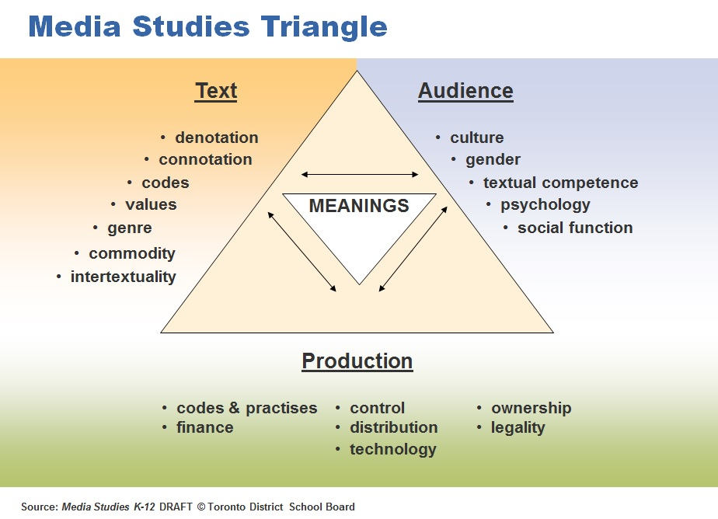
How was it produced?

