Slide 1

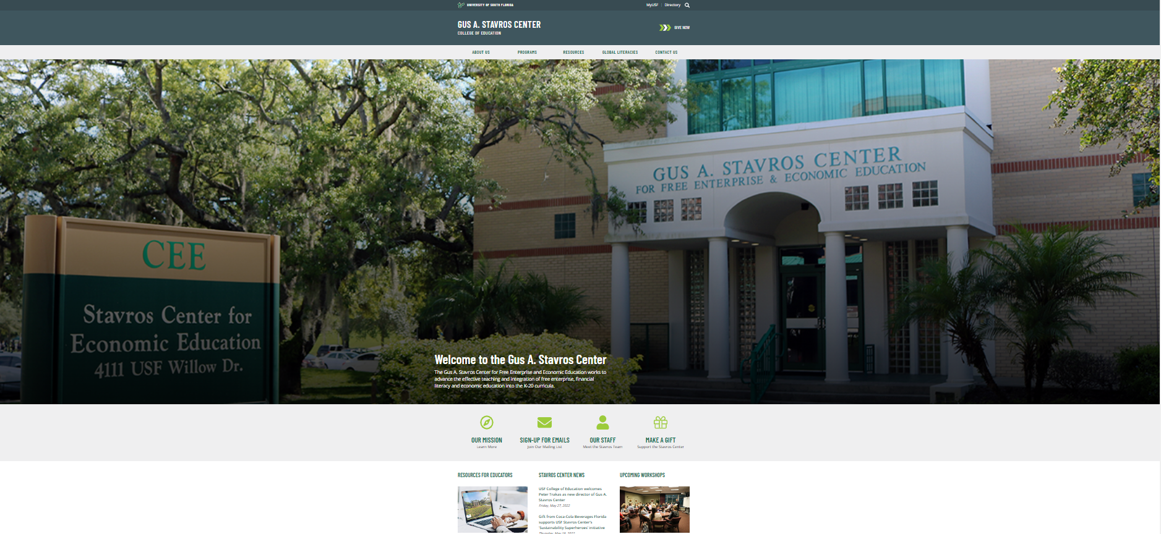

April 4, 2023
Fight fraud and secure your digital footprint by managing your
personal information wisely.
5:30-6:00 Dinner
6:00-7:00 Workshop
7:00 Short Break
7:10 Resume Workshop
8:15 Wrap Up and Close
Sponsored by:

Slide 2
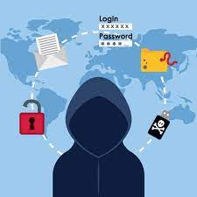
Fight fraud and secure your digital footprint by managing your personal information wisely.
  Understand problems that can occur when an individual is a victim of identity theft.
  Describe the conditions under which individuals should and should not disclose their Social Security number, account numbers, or other sensitive personal information.
  Recommend actions a victim of identity theft should take to limit losses and restore personal security.

Slide 3
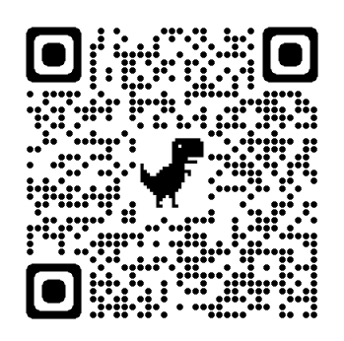

What do you know?
Quiz:
https://forms.gle/eeEaVaD76wjE9RGU9
DOJ Identity Theft Quiz Resource Link

Slide 4
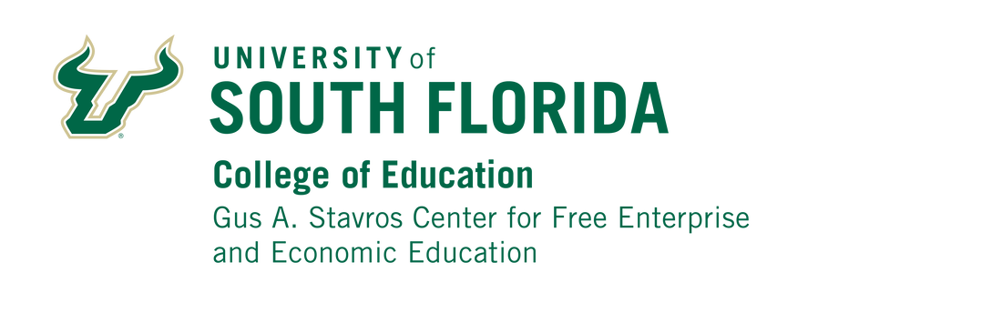
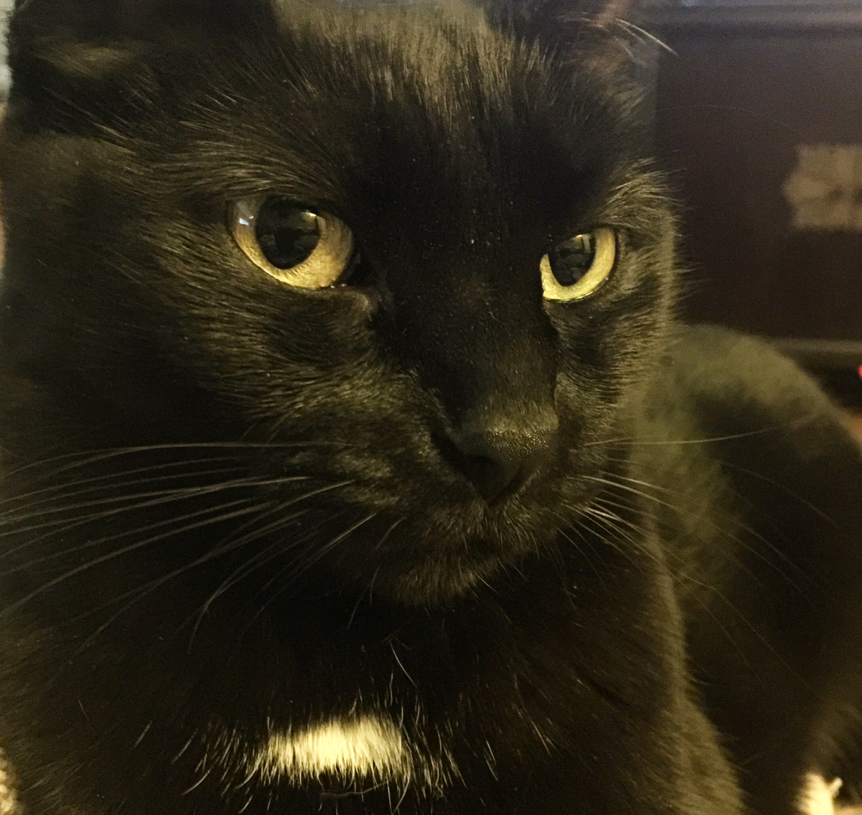
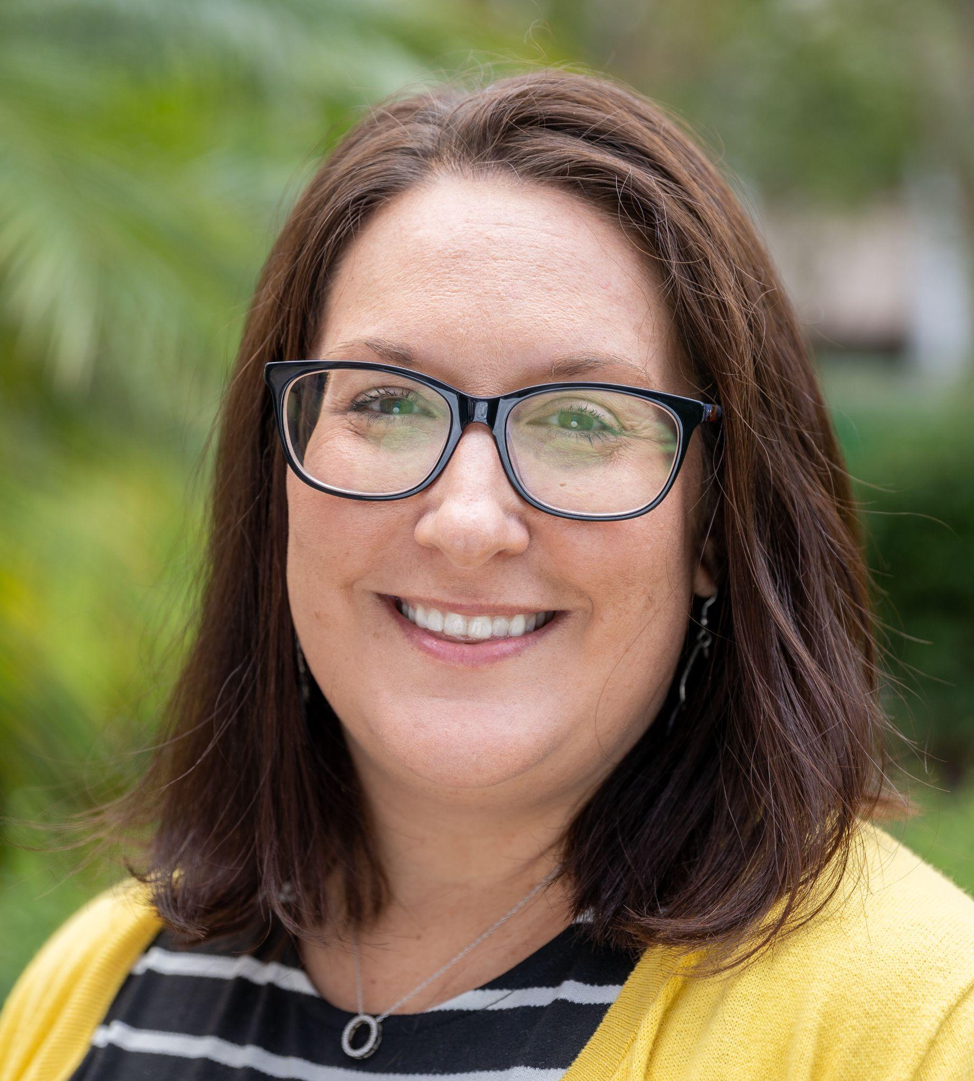


Your Presenters:
Jodi Pushkin
Writer, manager, 23 years
Newspaper in Education Manager
Tampa Bay Times
Teacher, 33 years
Jpushkin@tampabay.com
Brittany Sampson
Teacher, 21 years
Lakeland Senior
High School
Polk County Public Schools
Bsampson@usf.edu

Slide 5
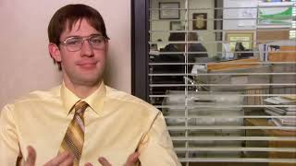
"Identity Theft is No Joke"
"Product Recall" (Season 3, Episode 20)
The Office

Slide 6
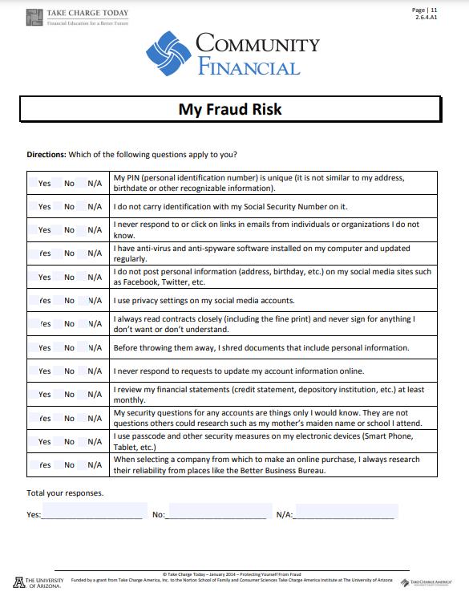
My Fraud Risk
https://www.cfcu.org/files/cfcu18/1/file/YouthMonth/MyFraudRisk.pdf

Slide 7

https://www.nbcnews.com/nightly-news/video/consumer-alert-identity-theft-jumped-16-percent-in-past-year-867979331624?v=raila&

Slide 8


What is Identity Theft?
Identity theft is the crime of obtaining the personal or financial information of another person to use their identity to commit fraud, such as making unauthorized transactions or purchases.
Identity theft is committed in many different ways and its victims are typically left with damage to their credit, finances, and reputation.
https://www.investopedia.com/terms/i/identitytheft.asp

Slide 9
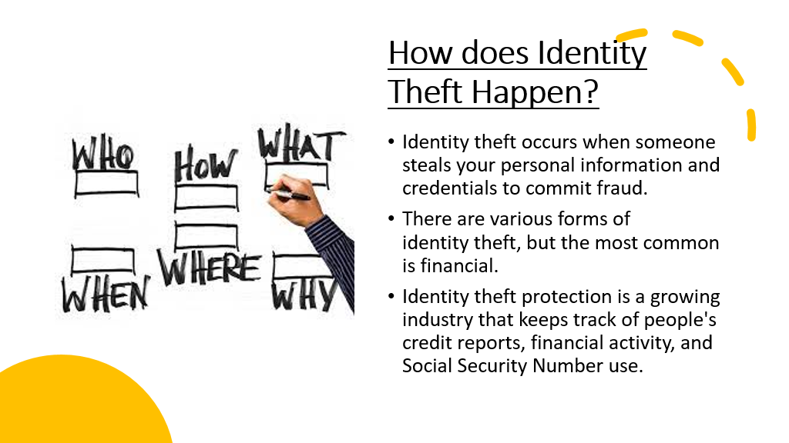
How does Identity Theft Happen?
Identity theft occurs when someone steals your personal information and credentials to commit fraud.
There are various forms of identity theft, but the most common is financial.
Identity theft protection is a growing industry that keeps track of people's credit reports, financial activity, and Social Security Number use.

Slide 10

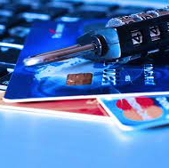
Fraud
Arrests for crimes not committed
Damaged financial security
Tarnished credit reports
Compromised health

Slide 11
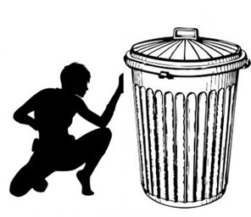
How Does it Happen?
When someone steals your personal information such as your:
  Bank Account Number
  Social Security Number
  Credit Card Information
  Driver's License
Some identity thieves sift through trash bins looking for credit card and bank statements.
More high-tech methods involve accessing corporate databases to steal lists of customer information.

Slide 12
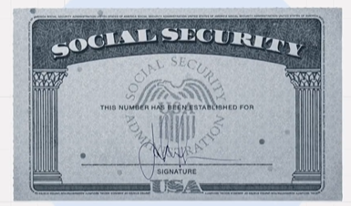
What Is a SSN?
Facts To Know About Social Security Numbers
A Social Security number (SSN) refers to a numerical identifier assigned to US citizens and other residents to track income and determine benefits.
The original intention of the SSN was to track earnings and provide benefits.
The SSN was created in 1936 as part of The New Deal to provide for retirement and disability benefits.
Today, it is used for additional purposes, such as identifying individuals for tax purposes and tracking credit reports.
Individuals in the US are asked to provide their SSN to obtain credit, open bank accounts, obtain government benefits, make major purchases, and more.
https://www.investopedia.com/terms/s/ssn.asp

Slide 13
Other Reasons You May Need a SSN
To open a back account or other financial account.
To apply for a federal loan.
To apply for unemployment.
As an identifier on tax returns.
To get a driver's license.
To obtain a passport.
When enrolling in Medicare.

Slide 14

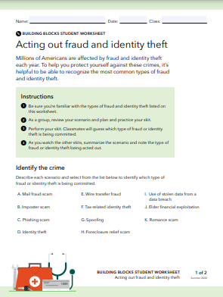
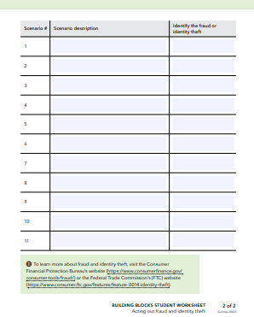
Resource Links
Acting out fraud and identity theft Teacher Overview
Acting out fraud and identity theft Lesson Plan
Acting out fraud and identity theft Student Worksheet

Slide 15
Acting Out Fraud
Big idea:
Fraud and identity theft hurt millions of Americans every year.

Slide 16
1. You receive an email that encourages you to click a link and enter personal information, including your Social Security number and bank account number. The email looks official, but the sender’s email address seems odd. TYPE OF FRAUD: Phishing scam
2. You contact the IRS to ask for more time to file your taxes, but you find out that someone has already filed a tax return in your name. TYPE OF FRAUD: Tax-related identity theft
3. You receive a letter from an unknown company with a message that you’ve won a cash prize. To claim your prize, you’ll need to send them your bank account information so they can deposit the money into your account. The company then uses your bank account information to take money from you. TYPE OF FRAUD: Mail fraud scam
4. Your caller ID shows that a local number associated with the high school in your town is calling you. You answer and the person calling says they’re raising money for a local sports tournament. You soon realize the caller is not actually with the school. TYPE OF FRAUD: Spoofing
5. You get a call from someone raising money for a charity. They ask you to wire money immediately because they have a critical and urgent humanitarian need. They get annoyed when you ask them for more information. TYPE OF FRAUD: Wire transfer fraud

Slide 17
6. You get a call from someone claiming to be with the sheriff’s office. They say they need your personal information to update their neighborhood records. You quickly recognize they’re not actually who they claim to be. TYPE OF FRAUD: Imposter scam
7. Someone pretending to be you used your name and personal information to borrow money to purchase a car. TYPE OF FRAUD: Identity theft
8. Your grandmother has a neighbor who has gained her trust but has been secretly taking money from her bank account. TYPE OF FRAUD: Elder financial exploitation
9. A hacker stole information from your credit card company, including your personal data, and used it to charge purchases. TYPE OF FRAUD: Use of stolen data from a data breach
10. You receive a letter saying that your house is in foreclosure and will be taken by the bank unless you mail a check and your personal information immediately. You know you’ve been paying your mortgage on time. TYPE OF FRAUD: Foreclosure relief scam
11. You have a friend you met through a social media app. You have not met in person, but you know it is true love. You have so much in common, and they look great in their pics. They ask you to do them a favor and send them $250 for a new outfit they can’t wait for you to see them in. TYPE OF FRAUD: Romance scam

Slide 18
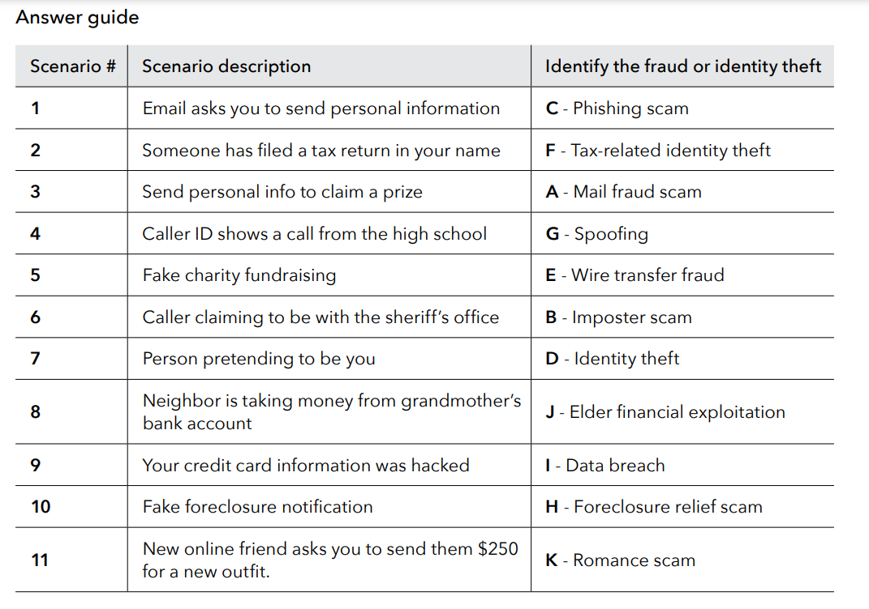

Slide 19
Different Kinds of Fraud
Identity Theft occurs when someone uses your personal information, such as your name, Social Security number, or credit card number, without your permission to commit fraud or other crimes. The Federal Trade Commission (FTC) estimates that as many as 9 million Americans have their identities stolen each year. You should review your credit report and credit card statements often to verify that you made the charges shown.
Phishing is when fraudsters looking for ways to get your personal or financial information use the Internet. These scam artists send email or pop-up messages that might alert you to a problem with your account or state that you have a refund waiting. Some of these messages appear to come from legitimate companies.
Business and Investment Fraud - Investment or business fraud schemes will try to lure you in with the promise of low- or no-risk investments. Scammers often ask for upfront cash in exchange for guaranteed future returns. There is no such thing as a guaranteed return on investment. It's a scam.
Business email compromise (BEC)—also known as email account compromise (EAC)—is one of the most financially damaging online crimes. It exploits the fact that so many of us rely on email to conduct business—both personal and professional. In a BEC scam, criminals send an email message that appears to come from a known source making a legitimate request, like in these examples:
  A vendor your company regularly deals with sends an invoice with an updated mailing address.
  A company CEO asks her assistant to purchase dozens of gift cards to send out as employee rewards. She asks for the serial numbers so she can email them out right away.
  A homebuyer receives a message from his title company with instructions on how to wire his down payment.

Slide 20
Unethical schemes
Charity and Disaster Fraud -- Charity fraud schemes seek donations for organizations that do little or no work—instead, the money goes to the fake charity’s creator. While these scams can happen at any time, they are especially prevalent after high-profile disasters. Criminals often use tragedies to exploit you and others who want to help. Charity fraud scams can come to you in many forms: emails, social media posts, crowdfunding platforms, cold calls, etc. Always use caution and do your research when you're looking to donate to charitable causes.
After a natural disaster or other emergency, unethical contractors and other scammers may commit insurance fraud, re-victimizing people whose homes or businesses have been damaged. Sometimes these fraudsters even pretend to be affiliated with the government, when they are not. If you need any post-disaster repairs, do your research before hiring any contractor.

Slide 21
Advance Fee Fraud
Advance fee fraud, also called upfront fee fraud, is any scam that, in exchange for a fee,
  Promises to send you money, products, or services;
  Offers you the opportunity to participate in a special deal;
  Asks for your assistance in removing funds from a country in political turmoil; or
  Asks for your assistance to help law enforcement catch thieves.

Slide 22

Debt Collection Scam
Most debt collectors will contact you to collect on legitimate debts you owe. But there are scammers who pose as debt collectors to get you to pay for debts you don't owe or ones you’ve already paid. Don’t provide any personal financial information until you can verify the debt.

Slide 23
Debt Elimination Scam
Debt Elimination Fraud -- Unlike legitimate companies who work with debtors to help them responsibly repay their debts, debt elimination scammers promise to make you debt free in exchange for a modest upfront or membership fee that they simply pocket. Victims pulled in by these schemes will certainly lose that fee, but they may also lose property, incur additional debt, damage their credit rating, risk identity theft, or face legal action. Avoid doing business with any company that guarantees they can settle your debts, especially those that charge up-front fees before performing any services. Instead, you can work with a free or nonprofit credit counseling program that can help you work with your creditors

Slide 24
Mortgage Modification Scam
Foreclosure relief or mortgage loan modification scams are schemes to take your money or your house, often by making a false promise of saving you from foreclosure. Scammers may ask you to pay upfront fees for their service, guarantee a loan modification, or ask you to sign over the title of your property, or sign paperwork you don’t understand. If you are having trouble making payments on your mortgage, a HUD-approved housing counseling agency can help you assess your options and avoid scams. If you think you may have been a victim of a foreclosure relief scam, you may also want to consult an attorney.

Slide 25
Imposter Scams
Grandparent scams -- If you get a call from someone who sounds like a grandchild or relative asking you to wire or transfer money or send gift cards to help them out of trouble, it could be a scam.
Imposter scammers try to convince you to send money by pretending to be someone you know or trust like a sheriff; local, state, or federal government employee; or charity organization. Remember, caller ID can be faked. You can always call the organization or government agency and ask if the person works for them before giving any money.

Slide 26
Mail Fraud
Mail fraud letters look real but the promises are fake. A common warning sign is a letter asking you to send money or personal information now in order to receive something of value later. Examples of mail fraud might include notices of prizes, sweepstakes winnings, vacations, and other offers to claim valuable items. The USPS has identified common postal or mail fraud schemes . If you’re a victim of mail fraud, you can file a complaint through the U.S. Postal Inspection Service .

Slide 27
Money Mule Scam
A money mule is someone who receives and moves money that came from victims of fraud. While some money mules know they’re assisting with criminal activity, others are unaware that their actions are helping fraudsters. Money mules may be recruited through online job or social media posts that promise easy money for little effort. They may also agree to help a love interest who they’ve met online or over the phone, by sending or receiving money, as part of a romance scam. Don’t agree to receive or send money or packages for people you either don’t know or haven’t met. Also, be aware of jobs that promise easy money.

Slide 28
Nigerian Scam
Nigerian Fraud -- This fraud combines identify theft and advance fee fraud. Scammers posing as government officials contact victims asking for help in transferring millions of dollars out of Nigeria in exchange for a percentage of the funds. They convince victims to provide their bank name and account numbers and other identifying information and to send checks to pay for bribes or legal fees. Perpetrators may also use the personal information received to drain victims' accounts and credit cards.

Slide 29
Money transfer Fraud
Con artists use money transfers to steal people’s money. If someone you don’t know asks you to send money to them, it should be a red flag. Scammers also use mobile payment services to trick people into sending money or merchandise without holding up their end of the deal. For example, a scammer may sell you concert or sports tickets but then never actually give them to you. Or a scammer might purchase an item from you, appear to send a payment, and then cancel it before it reaches your bank account.
Using mobile payment services with family, friends, and others you know and trust is the safest way to protect your money. You should also be cautious when people you do know ask you to send them money. Before you send money, verify that they are the ones requesting it.
Never send money to someone you don’t know. If you think you made a money transfer to a scammer, contact your bank or the company you used to send the money immediately and alert them that there may have been a mistake.

Slide 30
Mortgage Closing Scams
Mortgage closing scams target homebuyers who are nearing the closing date on their mortgage loan. The scammer attempts to steal the homebuyer's closing funds—for example, their down payment and closing costs—by sending the homebuyer an email posing as the homebuyer's real estate agent or settlement agent (title company, escrow officer, or attorney). These schemes are often complex and appear as legitimate conversations with your real estate or settlement agent. When you’re about to close on your home, take several steps, including identifying trusted individuals to confirm the process and payment instructions and writing down their names and contact information so you can reach out to them directly

Slide 31
Prize Scams
In a lottery or prize scam, the scammers may call or email to tell you that you’ve won a prize through a lottery or sweepstakes and then ask you to pay an upfront payment for fees and taxes. In some cases, they may claim to be from a federal government agency. Avoid providing any personal or financial information, including credit cards or Social Security numbers, to anyone you don’t know. Also, never make an upfront payment for a promised prize, especially if they demand immediate payment.

Slide 32
Romance Scam
A romance scam is when a new love interest tricks you into falling for them when they just want your money. Romance scams start in a few different ways, usually online. Scammers may also spend time getting to know you and developing trust before asking you for a loan or for access to your finances. Be smart about who you connect with and what information you share online. Don’t share sensitive personal information, such as bank account or credit card numbers or a Social Security number, with a new love connection.

Slide 33
Resources for Fraud
Consumer Financial Protection Bureau
  Common types of fraud
  Fraud and scam basics
Office of the Comptroller and Currency

Slide 34
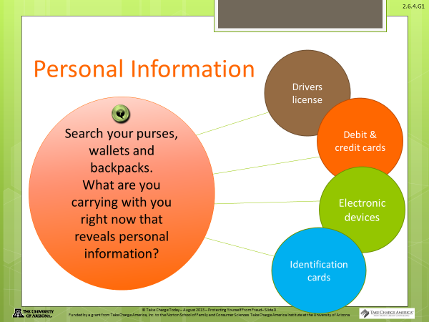

Slide 35

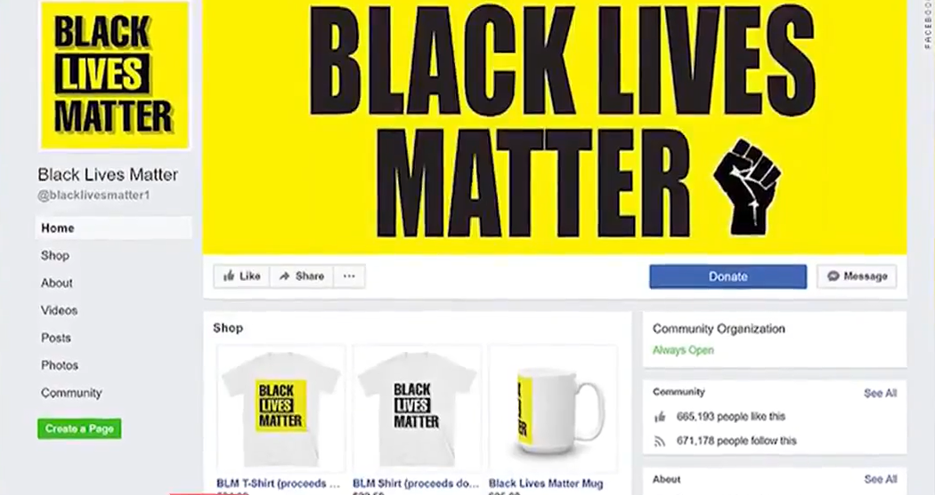
Real Life Scams:
CriticialCommons.org "FB: Black Lives Matter Scam"

Slide 36

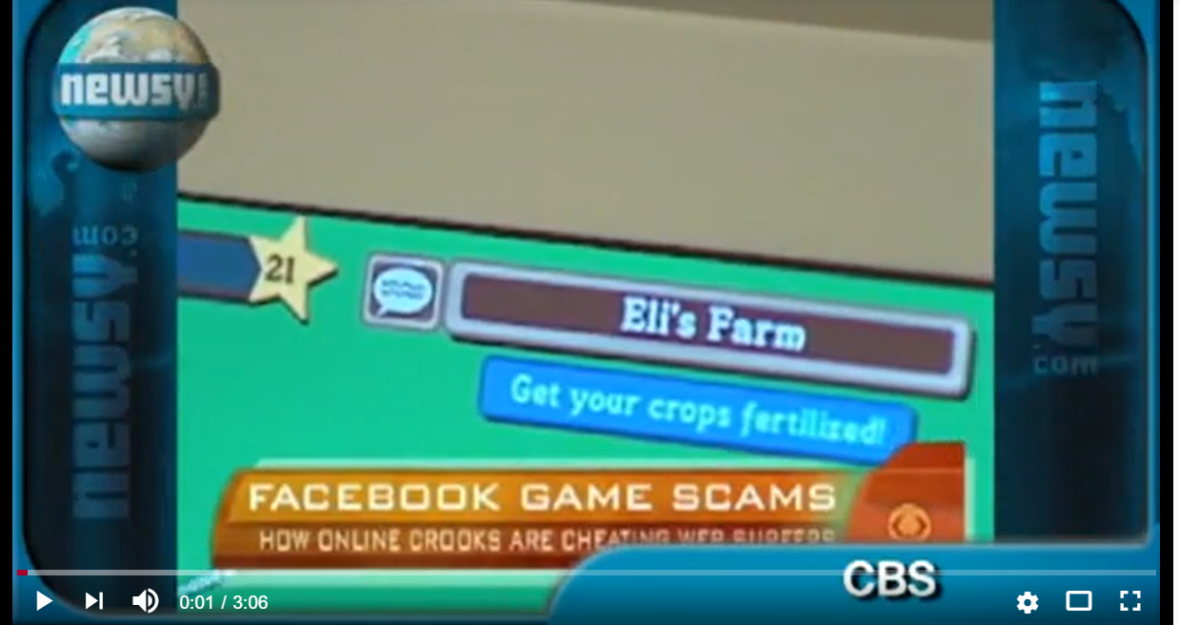
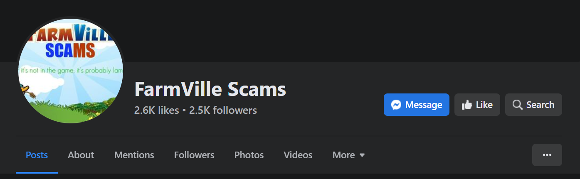
Real Life Scams:
Farmville Scam Expose

Slide 37
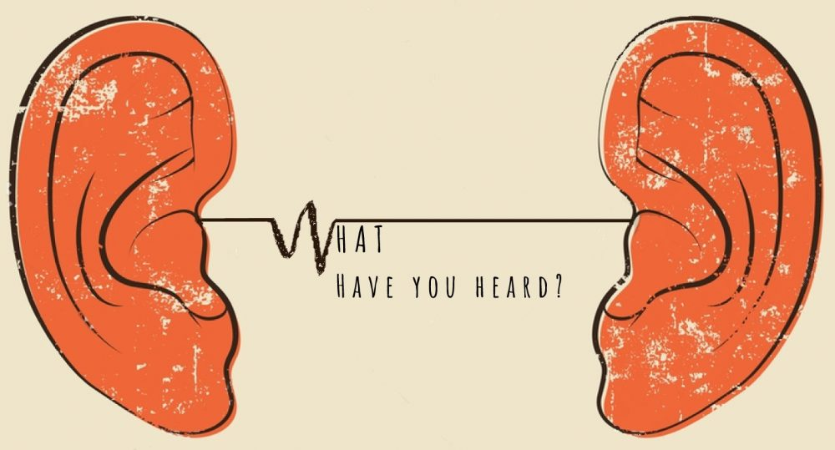
Real Life Scams:
What have you heard?

Slide 38
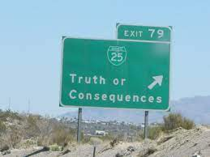
What can a thief do with my personal information?
An identity thief can use your name and information to:
  buy things with your credit cards
  get new credit cards
  open a phone, electricity, or gas account
  steal your tax refund
  get medical care
  pretend to be you if they are arrested

Slide 39
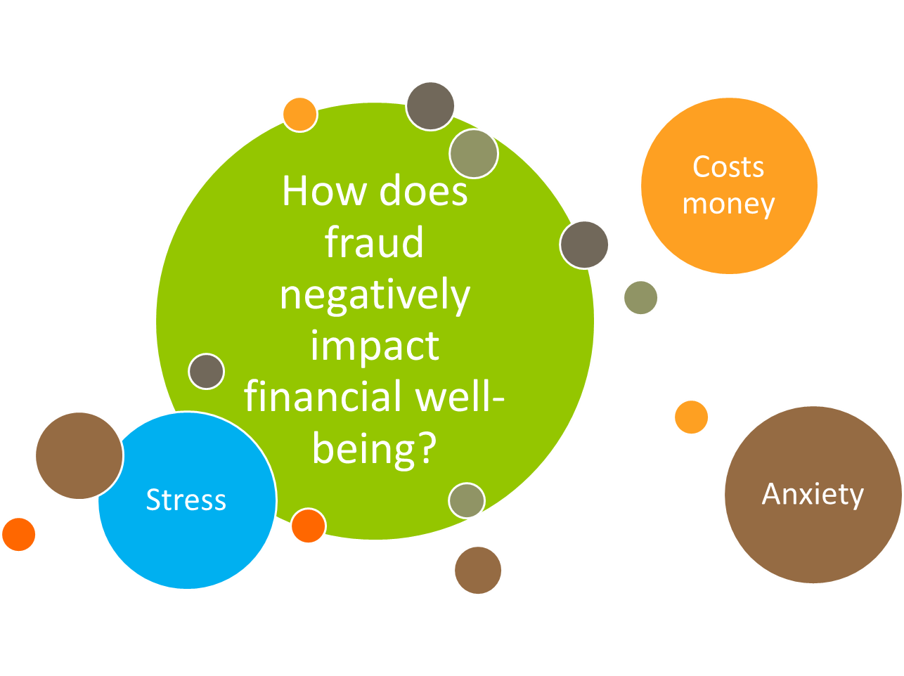

Slide 40
Impact on Me?
Why should I care if someone steals my identity?
You will be responsible for what the thief does while using your personal information. You might have to pay for what the thief buys. This is true even if you do not know about the bills.
How can that happen?
A thief might get a credit card using your name.
He changes the address.
The bills go to him, but he never pays them.
That means the credit card company thinks you are not paying the bills.
That will hurt your credit.
Identity Theft
Effect
Effect
Consequence
Consequence
Consequence
Consequence

Slide 41
Can I protect myself from identity theft?
You can lower your risk. Every time you shop in a store, you:
  watch your wallet
  are careful with your credit card or debit card
  do not tell people your PIN number
When you shop online, you can:
  use passwords that people cannot guess
  shop on secure websites. They have an address that starts with “https”
  not put personal information on computers in public spaces, like the library
  have security software on your own computer
Protect
Identity
Protect
Protect

Slide 42
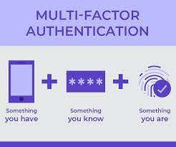
How can I protect my identity?
Protect your personal information. That helps you protect your identity. Here are some things you can do:
At home:
  keep your financial records, Social Security and Medicare cards in a safe place
  shred papers that have your personal or medical information
  take mail out of your mailbox as soon as you can
As you do business:
  only give your Social Security number if you must. Ask if you can use another kind of identification
  do not give your personal information to someone who calls you or emails you
On the computer:
  use passwords that are not easy to guess. Use numbers and symbols when you can
  do not respond to emails or other messages that ask for personal information
  do not put personal information on a computer in a public place, like the library

Slide 43

How to Protect Yourself?
Tips to Fight Identity Theft:
Never provide personal financial information, including your Social Security number, account numbers or passwords, over the phone or the Internet if you did not initiate the contact. Never click on the link provided in an email you believe is fraudulent. It may contain a virus that can contaminate your computer.
Do not be intimidated by an email or caller who suggests dire consequences if you do not immediately provide or verify financial information. If you believe the contact is legitimate, go to the company's Website by typing in the site address directly or using a page you have previously bookmarked, instead of a link provided in the email.
If you fall victim to an attack, act immediately to protect yourself. Alert your financial institution. Place fraud alerts on your credit files. Monitor your credit files and account statements closely.
Report suspicious emails or calls to the Federal Trade Commission or by calling 1-877-IDTHEFT.

Slide 44
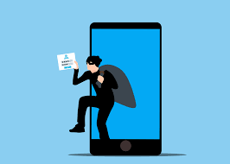
Now What?
How do I know if someone steals my identity?
Sometimes, you can tell if someone steals your identity.
  Read your bills. Do you see charges for things you did not buy?
  Watch your bank account statement. Are there withdrawals you did not make? Are there changes you do not expect?
  Check your mail. Did you stop getting a bill? Or did you start getting a new bill you do not know about?
  Get your credit report. Are there accounts or other information you do not recognize?
  If you answer yes to any of these questions, someone might have stolen your identity.

Slide 45

What to do after your identity has been compromised?
Contact
Contact the credit reporting agencies to make sure they are aware of the issue; have a security or fraud alert attached to your credit report.
Contact
Contact the Social Security Administration to notify it of fraudulent use of your number, or the potential for it if the number was stolen/lost.
File
File a police report on an actual theft of your card or use of your SSN.
Monitor
Monitor your credit reports for any unauthorized use of existing credit accounts or the unauthorized opening of new accounts.

Slide 46
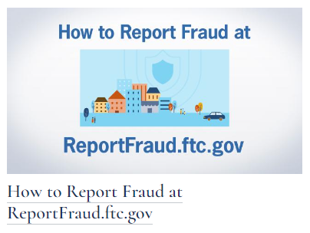
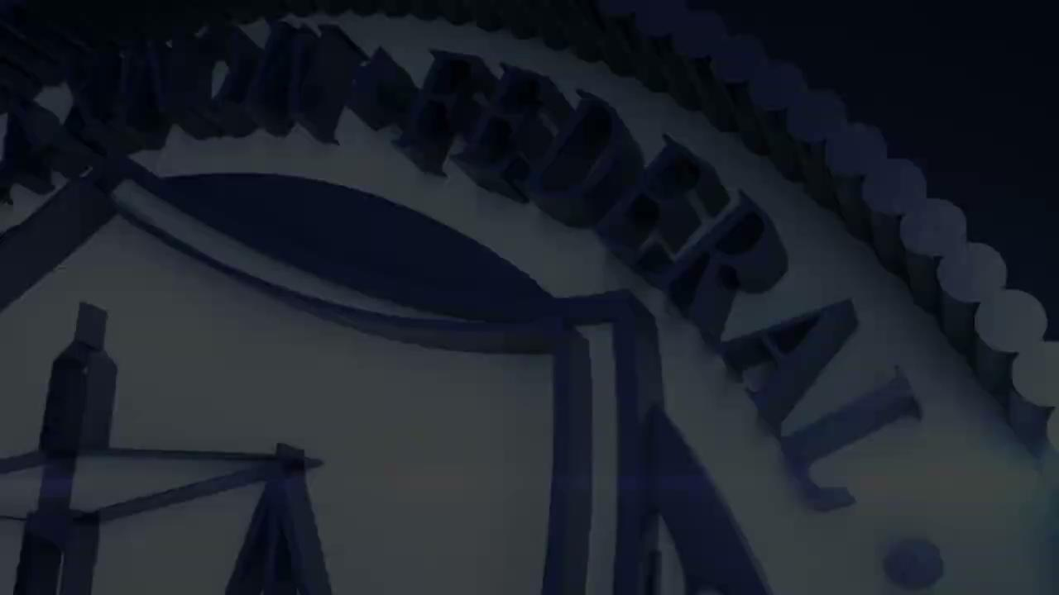
Contact the FTC
https://consumer.ftc.gov/sites/default/files/videos/downloads/video-0212_howtoreportfraud.ftc_.gov_1080p_3mbps.mp4
https://consumer.ftc.gov/

Slide 47

Can you guess?
Losses from identity theft cost Americans ____________.
$4.2 billion $5.8 billion $10 billion $100 billion
The FTC received _______ fraud and identity theft reports
200,000 2 million 5.7 million 9.1 million
___________ identity theft cases were reported to the FTC
800 thousand 900 thousand 1 million 1.4 million
$2.8 billion of losses were from _____________________
imposter scams consumer online shopping social media
$392 million of losses were from consumer online shopping
imposter scams consumer online shopping social media

Slide 48

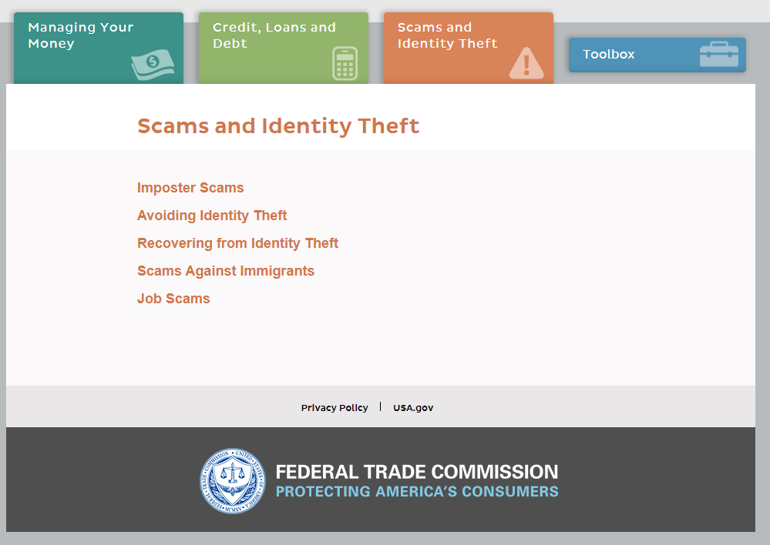
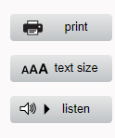
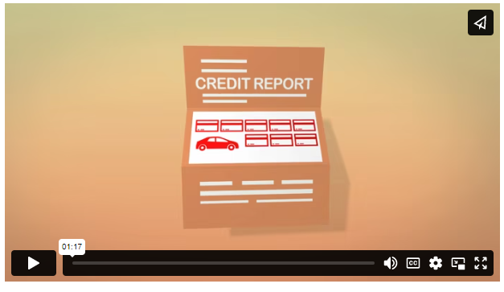
Student Research Activities
https://consumer.gov/scams-identity-theft/avoiding-identity-theft

Slide 49
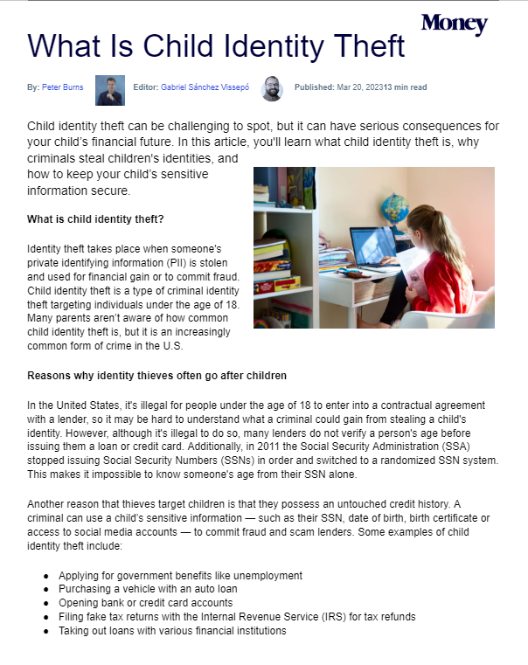
What is Child Identity Theft?
Reading Comprehension
What is Child Identity Theft: Money Magazine Article <google doc>
Design a poster to educate families about child identity theft.

Slide 50

Using the News
The Tampa Bay Times Newspaper in Education program provides newspapers in digital and print format to teachers at no cost to teachers, schools, or families.
Using the newspaper in your classroom every day will increase students' reading skills and knowledge of the world around them.

Slide 51
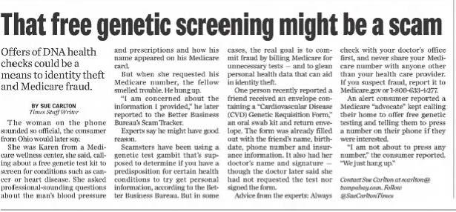

Slide 52
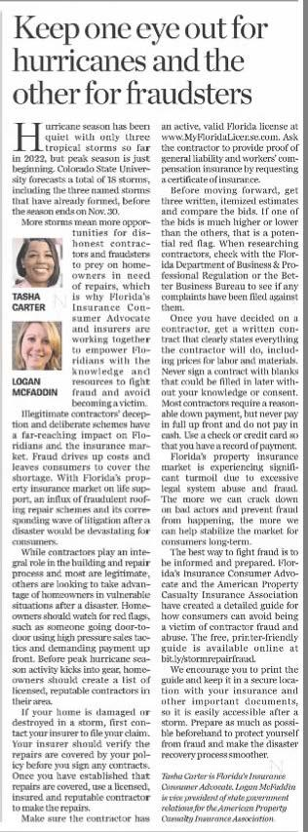
Keep an eye out for fraudsters
https://drive.google.com/file/d/1rQ12kGS6TbKHy_KJV0Uks1ec5Loh7wHA/view?usp=sharing

Slide 53
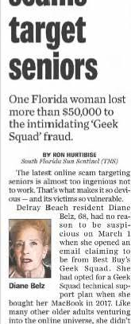
Geek Squad fraud
Tech help scams target seniors

Slide 54
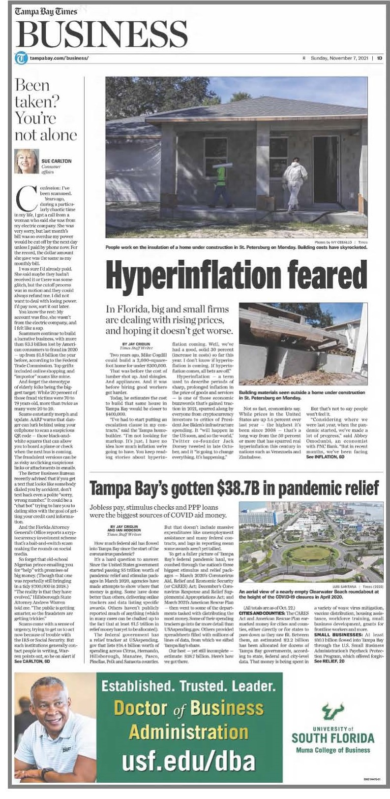
Debt Scam
Been taken? You're not alone

Slide 55
Email Scam
Florida charter school principal resigns after sending check to scammer posing as Elon Musk

Slide 56

Resources
In addition to the newspaper, NIE offers curriculum, updated weekly on our website.
  FBI warns about thieves using QR codes to steal your data
  What is Crypto and Why did it Crash?
  Go Fund Me Magic

Slide 57
Teaching Different Kinds of Fraud:
Infographic/ Cartoon
Read articles.
Compare/ Contrast
Poster to Create Awareness in City Hall
Do and Don't List

Slide 58


Spam... spam... spam....

Slide 59
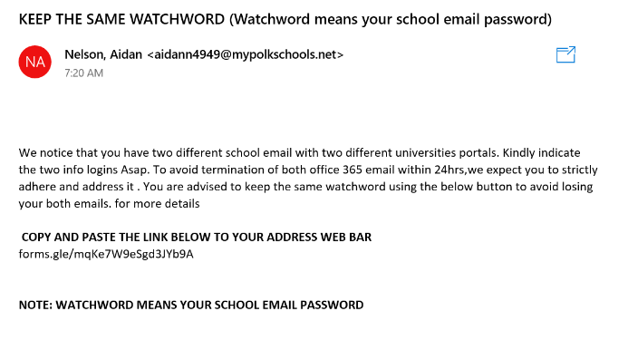
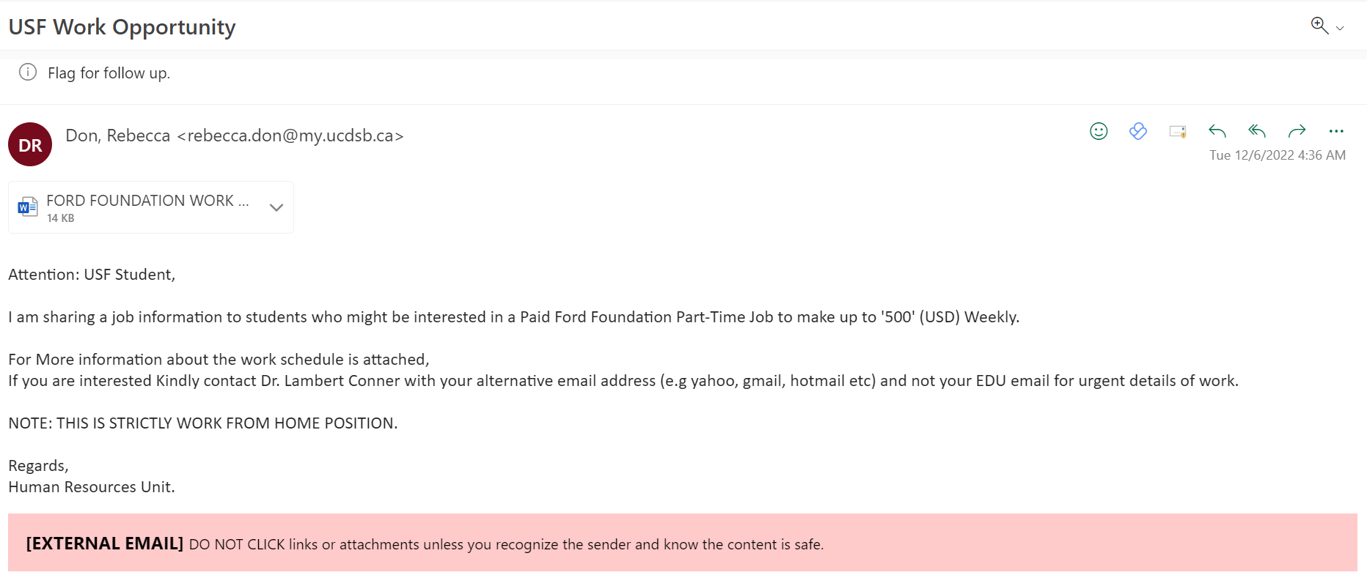
Spam... spam... spam....

Slide 60
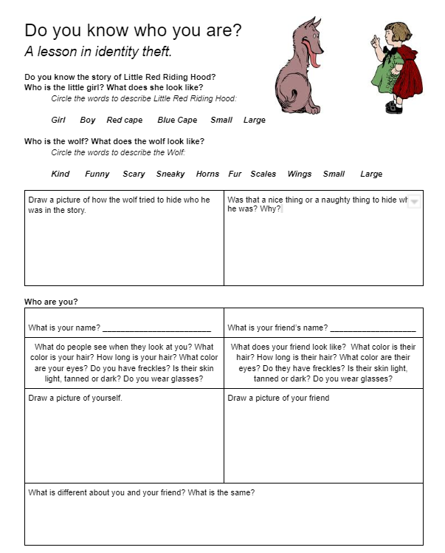
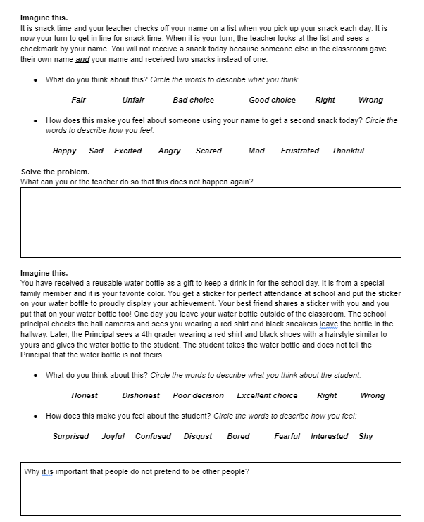

Elementary K-2: Identity Theft
https://docs.google.com/document/d/1A2r3OIgebVbj7LeWOrtuTEVjGZIjayg3ed9fM-XS42Q/edit?usp=sharing

Slide 61
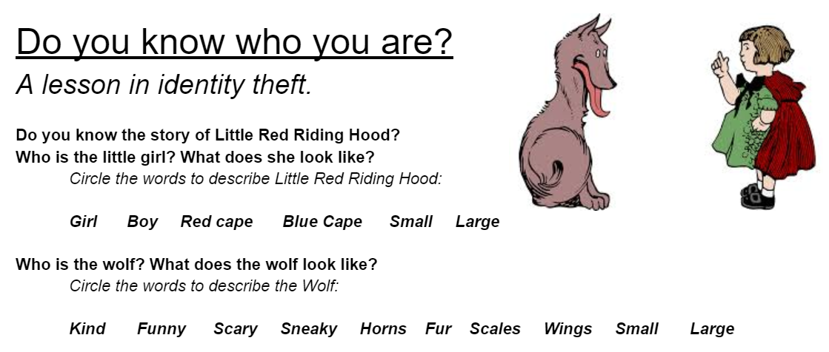

Slide 62
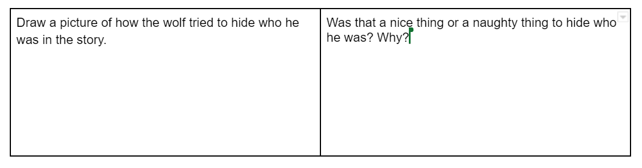
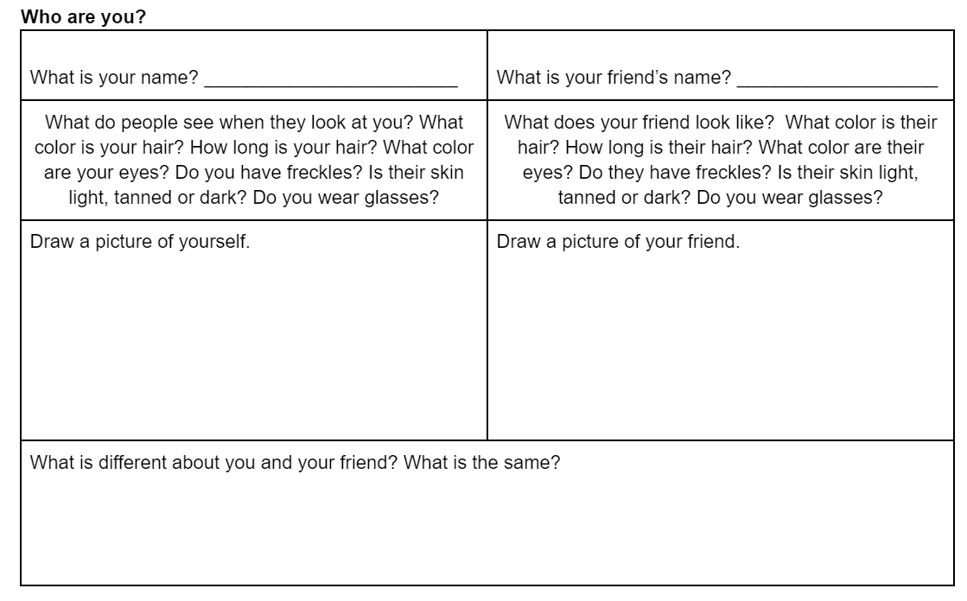

Slide 63
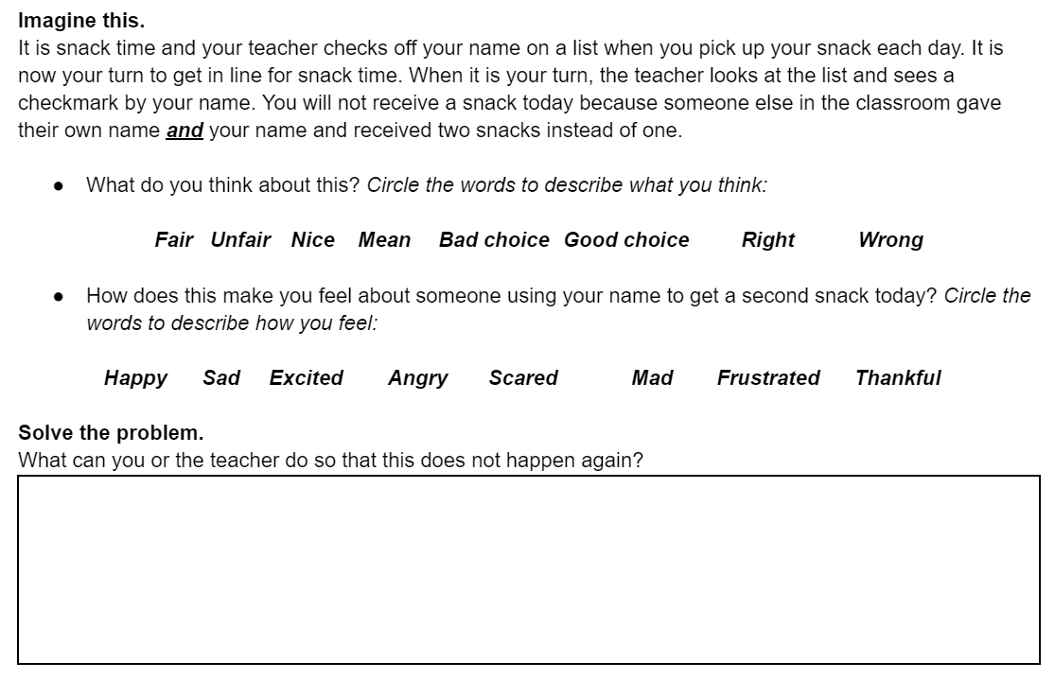

Slide 64
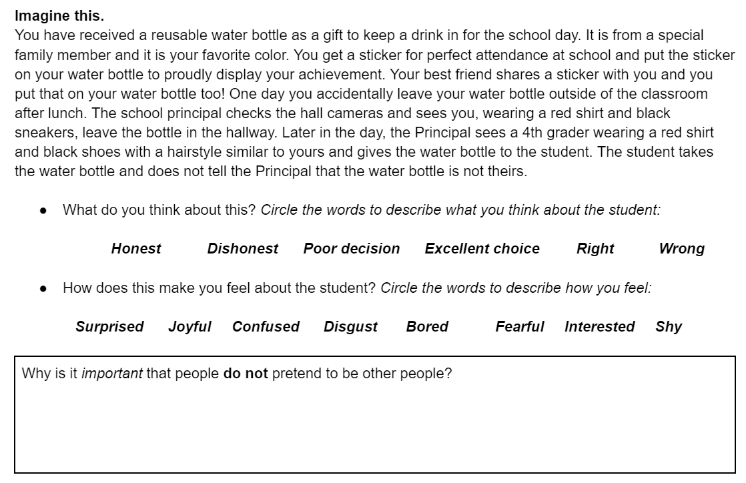

Slide 65

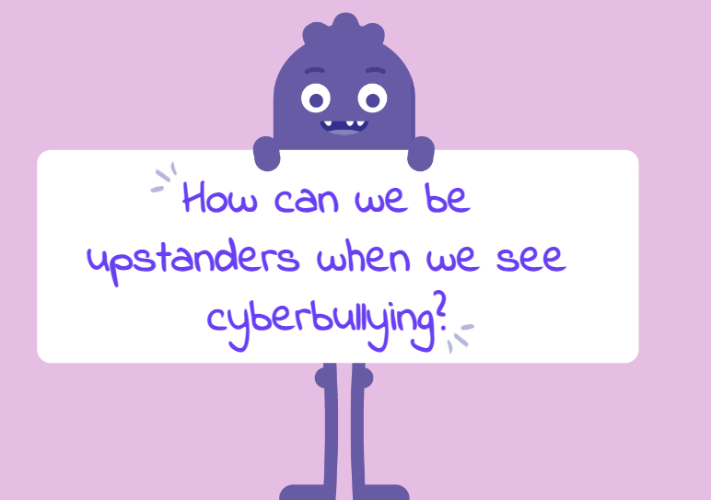
Elementary 3-5: Super Digital Citizen
Learning Objectives:
Reflect on the characteristics that make someone an upstanding digital citizen.
Recognize what cyberbullying is.
Show ways to be an upstander by creating a digital citizenship superhero comic strip.
Super Digital Citizen Lesson Link

Slide 66
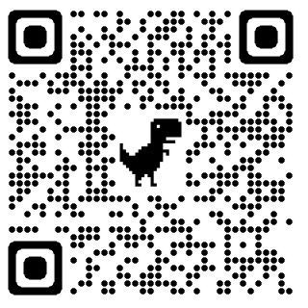
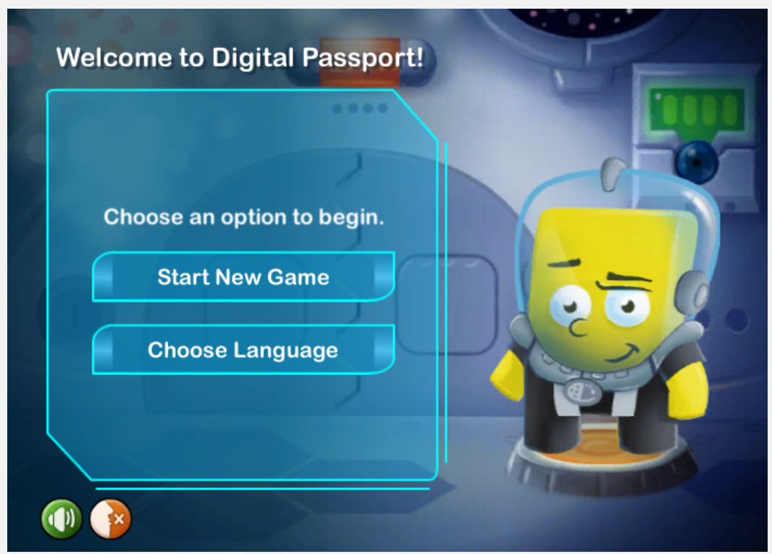
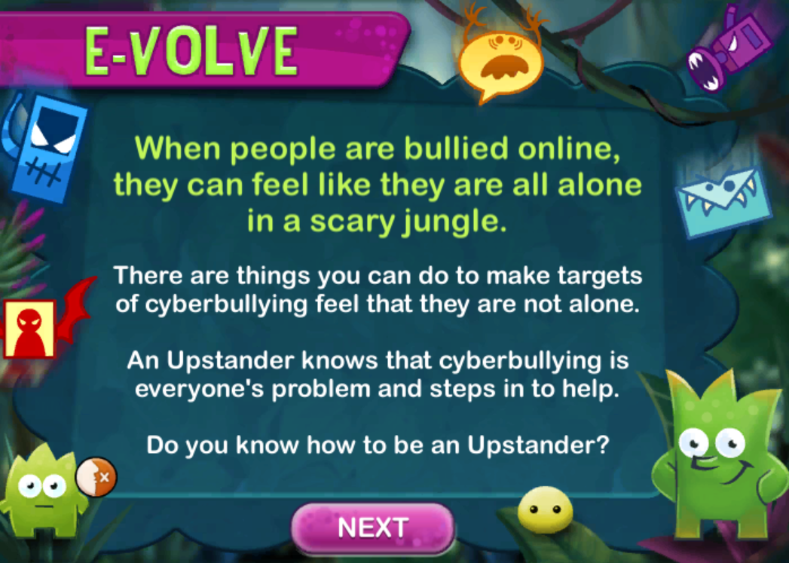
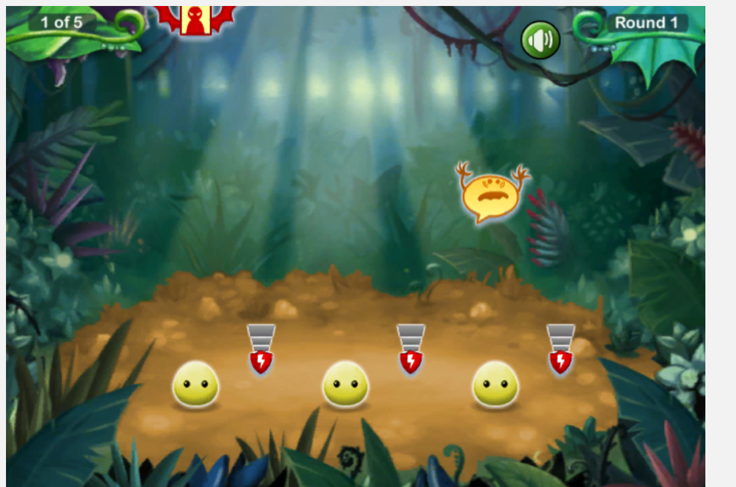
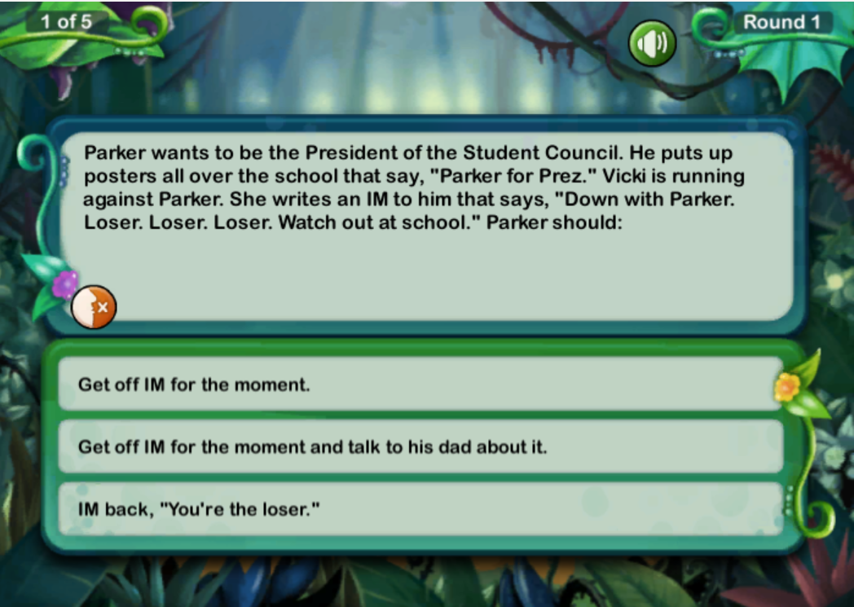
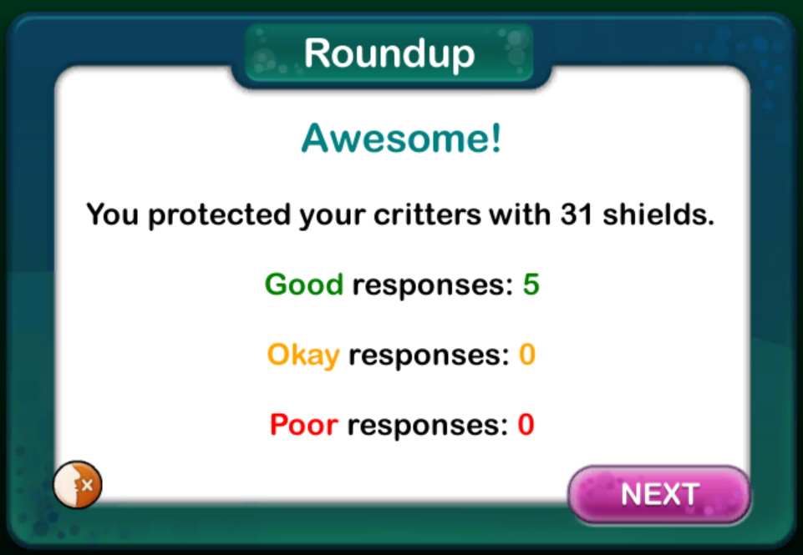
Game:
https://www.digitalpassport.org/evolve.html

Slide 67


Elementary 3-5: Super Digital Citizen
Super Digital Citizenship- Video Link
Digital Citizen Superhero Student Handout
What Would a Super Digital Citizen Hero Do? Handout
Lesson Quiz
Take Home Family Activity
Classroom Friendly Websites and Apps for Making Comics <per Common Sense Edu>

Slide 68




"Be A Super Digital Citizen"
Super Digital Citizen Pennant Templates
Common Sense Education Lesson Link
Be A Digital Citizen Lesson Plan - Grade 4
Common Core ELA
L.4.4, L.4.5, L.4.6, RF.4.4, RF.4.4a, RI.4.10, RI.4.4, RI.4.7, SL.4.1a, SL.4.1b, SL.4.1c, SL.4.1d, SL.4.4, SL.4.5, SL.4.6, W.4.10, W.4.4

Slide 69

Middle: 6-8 Who Are You Online?
Students hear from teens about the benefits and drawbacks of presenting themselves differently (or even anonymously) to others online and consider what it means to "be yourself" in digital spaces.
Discuss:
What reasons do people have for creating and using fake social media accounts (e.g., finstas)?
What are some of the results of having and using these accounts?
How do you present yourself online?
Who Are You Online? Lesson Plan - Grade 6
Quick Activity Link
Common Core ELA
L.6.1, L.6.2, L.6.3, L.6.4, L.6.6, SL.6.1, SL.6.1a, SL.6.1b, SL.6.1c, SL.6.1d, SL.6.2, SL.6.3, SL.6.4, SL.6.6, W.6.1, W.6.1a, W.6.1b, W.6.1c, W.6.10, W.6.4, W.6.8, L.6.2.B, L.6.3.A, L.6.3.B

Slide 70





Game:
Welcome to Anywhere Game: Digital Citizenship
Digital Compass by Common Sense Education teaches students the fundamentals of digital citizenship through a choose-your-own-path interactive game, designed for grades 6–8.

Slide 71

Middle: 6-8 Who Are You Online?
Who Are You Online Presentation Slides
Presenting Yourself Online Video Link
Finsta Debate Activity (Are Fake Accounts ok?)
Family Activity/ Discussion
Lesson Quiz
Students hear from teens about the benefits and drawbacks of presenting themselves differently (or even anonymously) to others online and consider what it means to "be yourself" in digital spaces.
Discuss:
What reasons do people have for creating and using fake social media accounts (e.g., finstas)?
What are some of the results of having and using these accounts?
How do you present yourself online?

Slide 72


InfoGraphics!!!
ThalesGroup.com
How would you use infographics in your classroom?

Slide 73




How Do You Safeguard Money from Scammers?
How Do You Safeguard Money from Scammer? <USF Blog Post>
  Safeguard From Scammers <Student Guide Google Doc>
  Power Company Warns of Scam TBT - Corresponding Article
https://np1.nearpod.com/sharePresentation.php?code=08b40639f5df5889f9d5b42e77495176-1&oc=user-created&utm_source=link

Slide 74





How Does a Data Breach Impact Me?
USF Blog Post Link
Student Guide: How does a Data Breach Impact Me? <google doc>
Capital One Data Breach <NIE PDF>

Slide 75
Additional USF Blog Posts:
Identity Theft is Taxing
  Corresponding TBT news article: Identity Theft-Related Tax Fruad Remains the Top Scam
Identity Theft: Who is at Risk?
  Corresponding TBT news article: How to Protect Your Kids from Identity Theft

Slide 76

"Protect" Lessons:
https://floridafinancialliteracy.weebly.com/protect.html

Slide 77
Additional Links to Consequences of Identity Theft
https://consumer.georgia.gov/consumer-topics/identity-theft-emotional-impact#:~:text=Victims%20of%20identity%20theft%20will,the%20ability%20to%20trust%20again.
https://www.aura.com/learn/dangers-of-identity-theft
https://www.ojp.gov/feature/identity-theft/overview
https://www.credit.com/blog/surprising-ways-identity-theft-can-hurt-you-85080/
https://www.pcmag.com/how-to/5-ways-identity-theft-can-ruin-your-life

Slide 78
https://www.justice.gov/criminal-fraud/identity-theft/identity-theft-and-identity-fraud
https://mpdc.dc.gov/page/examples-identity-theft
https://consumer.ftc.gov/articles/what-know-about-identity-theft
https://nearpod.com/t/social-studies/6th/a-cyber-privacy-parable-L80925841&oc=lesson-library&utm_source=link
https://np1.nearpod.com/sharePresentation.php?code=01214a47dd1ea5434a885a772ebc60d7-1&oc=lesson-library&utm_source=link
https://newsela.com/read/faceapp-safety/id/54622/
https://newsela.com/read/deleted-posts-facebook/id/48338/

Slide 79
Identity Theft Video Resources:
https://www.youtube.com/watch?v=TpHnr7sg9d0
https://www.youtube.com/watch?v=fjodt2JnWT8
https://www.youtube.com/watch?v=kDFeSUUwRnA
https://www.fraudweek.com/

Slide 80

QR Code to Resources:

Slide 81

Financial Literacy
Standards Covered
Personal Financial Literacy Standards

Slide 82
Financial Literacy Standards Covered: High School
SS.912.FL.6.9 https://www.cpalms.org/PreviewStandard/Preview/8606
Explain that loss of assets, wealth, and future opportunities can occur if an individual’s personal information is obtained by others through identity theft and then used fraudulently, and that by managing their personal information and choosing the environment in which it is revealed, individuals can accept, reduce, and insure against the risk of loss due to identity theft.
  Remarks
    Describe problems that can occur when an individual is a victim of identity theft.
    Give specific examples of how online transactions, online banking, email scams, and telemarketing calls can make consumers vulnerable to identity theft.
    Describe the conditions under which individuals should and should not disclose their Social Security number, account numbers, or other sensitive personal information.

Slide 83
Financial Literacy Standards Covered: High School
SS.912.FL.6.10 https://www.cpalms.org/Public/PreviewStandard/Preview/8607
Compare federal and state regulations that provide some remedies and assistance for victims of identity theft.
  Remarks
    Recommend actions a victim of identity theft should take to limit losses and restore personal security.

Slide 84
Financial Literacy Standards Covered: Middle School
SS.8.FL.6.7 https://www.cpalms.org/PreviewStandard/Preview/8612
Discuss that one method to cope with unexpected losses is to save for emergencies.
  Remarks
    Give examples of events for which emergency savings could offset financial losses.

Slide 85
Financial Literacy Standards Covered: Elementary School
SS.4.FL.6.4 https://www.cpalms.org/PreviewStandard/Preview/8519
Discuss that one method to cope with unexpected losses is to save for emergencies.
  Remarks
    Give examples of events for which emergency savings could offset financial losses.

Slide 86
Additional Standards Covered
LAFS.1112.SL.1.2 Integrate multiple sources of information presented in diverse formats and media (e.g., visually, quantitatively, orally) in order to make informed decisions and solve problems, evaluating the credibility and accuracy of each source and noting any discrepancies among the data.

Slide 87



Slide 88











Slide 89






Slide 90



Stavros Center Resources

Slide 91




