Slide 1
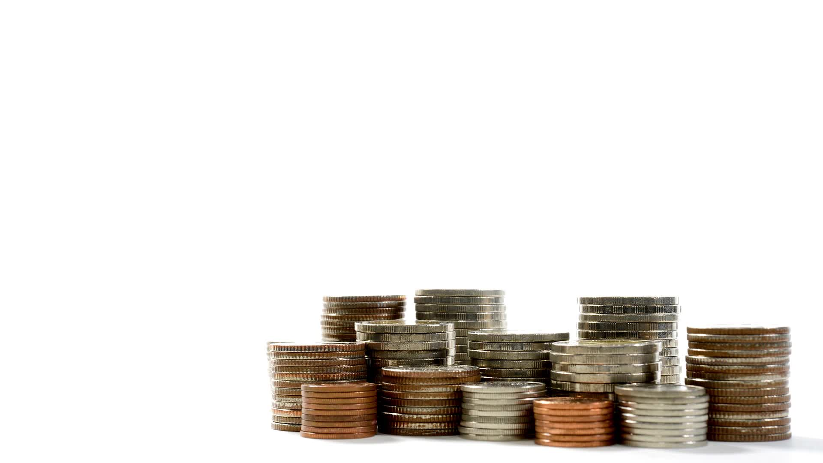
Money and Banking for Elementary Students
Stavros Center for Economic Education
Christine Angel Danger
November 2024

Slide 2
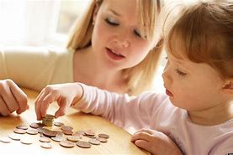
A review of financial-literacy education programs for children and adolescents - Aisa Amagir, Wim Groot, Henriëtte Maassen van den Brink, Arie Wilschut, 2018
Financial education can be defined as teaching which is intended to lead to financial literacy in the wider sense indicated by the OECD (2014). The ultimate goal of financial education is to empower and motivate people to change their financial behavior, for example, to induce them to make well-considered financial decisions. Therefore, we distinguish three components in our definition of financial literacy:
1. Knowledge and understanding. To know how to behave, it is necessary to be informed adequately about the domain referring to the intended behavior. However, the effect of knowledge on changes in behavior is relatively limited (Hilgert et al., 2003; Perry and Morris, 2005). Therefore, two other aspects must be taken into account.
2. Skills and behavior. To be able to change one’s behavior, it is necessary to master the operational skills which refer to the domain, for example, how to deal with budgeting.
3. Attitudes and confidence. To be able to apply something outside the context in which it has been learnt, it is necessary to have self-efficacy (Bandura, 1997, 2006), and develop the necessary motivation in order to do so.
In sum, our definition comprises knowing what to do, the skills to be able to perform these actions, and the inclination to carry them out.
(Organisation for Economic Co-operation and Development (OECD)

Slide 3
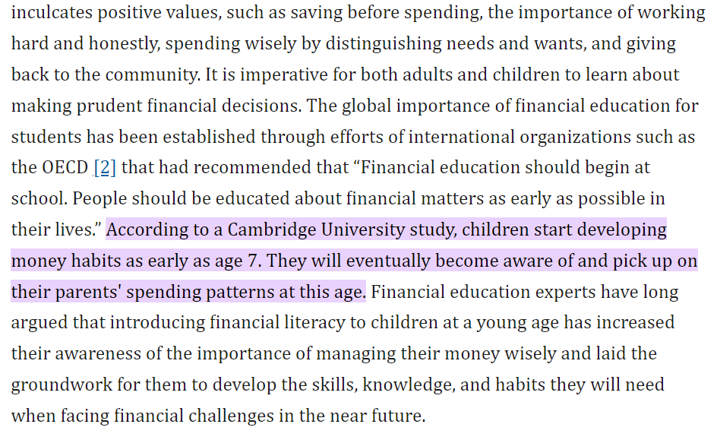
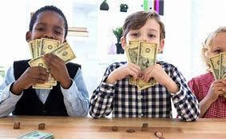
Children's understanding of financial literacy and parents' choice of financial knowledge learning methods in Malaysia - PMC

Slide 4
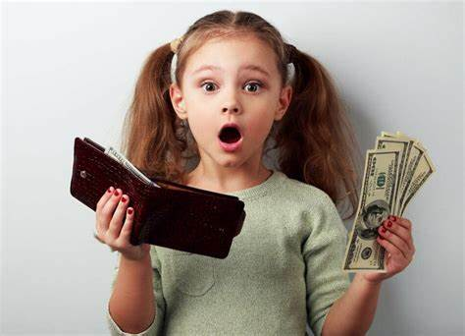
The importance of financial literacy and its impact on financial wellbeing | Journal of Financial Literacy and Wellbeing | Cambridge Core
This is the definition of financial literacy from the team of experts who worked on this (PISA) assessmentFootnote⁸:
“Financial literacy is knowledge and understanding of financial concepts and risks, as well as the skills and attitudes to apply such knowledge and understanding in order to make effective decisions across a range of financial contexts, to improve the financial wellbeing of individuals and society, and to enable participation in economic life.” ( OECD 2019b)
…we have found that several rich countries do not have high levels of youth financial literacy. For example, both the United States and some European countries, such as Italy, France, and Spain, ranked at the OECD average or below the average on the 2012 financial literacy scale.

Slide 5
Recognize
SS.K.E.1.2 Recognize that United States currency comes in different forms.
Recognize
Recognize
SS.1.E.1.1 Recognize that money is a method of exchanging goods and services.
Distinguish
SS.1.E.1.3 Distinguish between examples of goods and services.
Distinguish
SS.1.E.1.4 Distinguish people as buyers, sellers, and producers of goods and services.
Recognize
SS.2.E.1.2 Recognize that people supply goods and services based on consumer demands.
Explain
SS.2.E.1.4 Explain the personal benefits and costs involved in saving and spending.
SS.K.E.1.3 Recognize that people work to earn money to buy things they need or want.

Slide 6
SS.3.E.1.2 List the characteristics of money.
SS.3.E.1.3 Recognize that buyers and sellers interact to exchange goods and services through the use of trade or money.
SS.4.FL.3.5 Explain that when people deposit money into a bank (or other financial institution), the bank may pay them interest. Banks attract savings by paying interest. People also deposit money into banks because banks are safe places to keep their savings.
SS.4.FL.1.4 People can earn interest income from letting other people borrow their money. Explain why banks and financial institutions pay people interest when they deposit their money at those institutions.

Slide 7

Vocabulary
Producer
Consumer
Goods
Services
Work
Pay
Currency
Bank
Earn
Interest

Slide 8
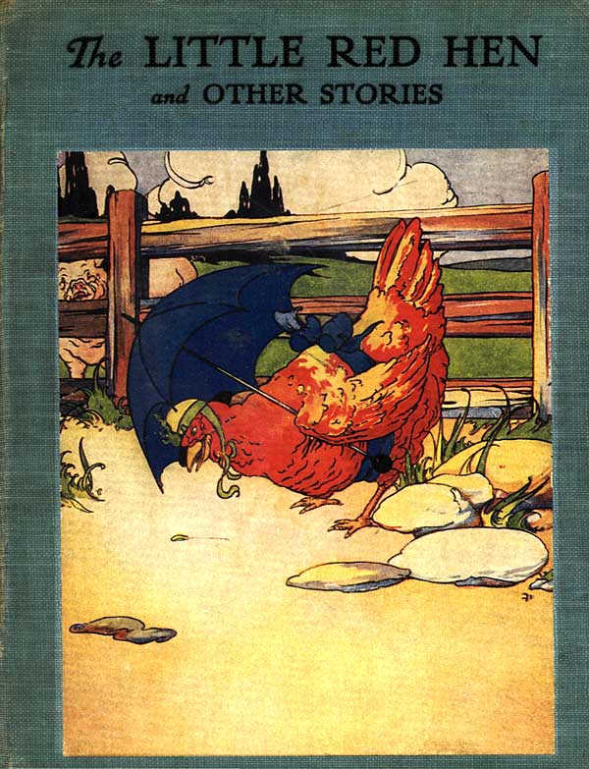
The Project Gutenberg eBook of The Little Red Hen, by Florence White Williams
Have you ever worked hard as a producer on a project and found that no one would help you? Then when you got it all done, suddenly everyone wanted to participate, or consume your goods? You have something in common with the Little Red Hen! You can download a free copy of the original Little Red Hen at Project Gutenburg
Check out the lesson that was published on EconEdLink: The Little Red Hen is a Producer and a Consumer for more engaging activities to use with the book!

Slide 9
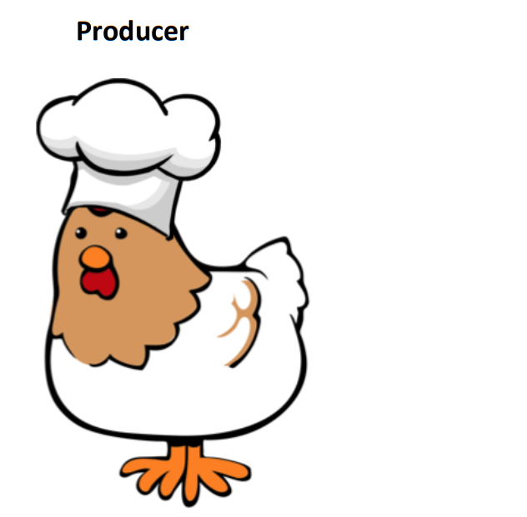
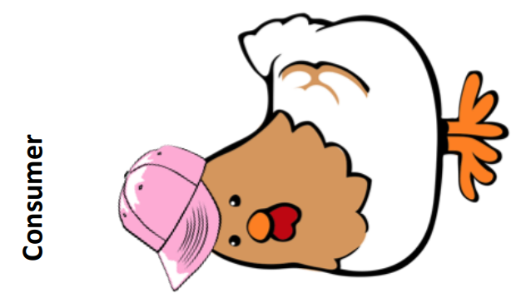
I make bread and pizza.
A consumer is a person who uses goods and services to satisfy their personal needs and not for resale or in the production of other goods and services.
What types of things might this consumer buy from this producer?
A producer is a person or firm who use resources to make goods and services.
What might this character might produce?

Slide 10
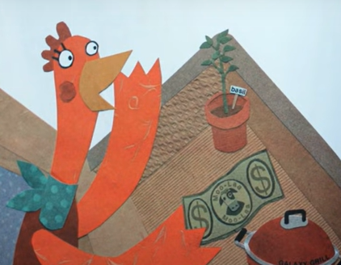
Introduce Little Red Hen Makes a Pizza by reading the title and author.
Ask students the following questions:
What they think the story will be about?
Who do you think will be the producer?
Who do you think will be the consumer?
Distribute copies of Little Red Hen with Consumer and Producer Hats and give a copy to each student. Instruct students to fold the page in half so that the producer is on one side and the consumer on the other. As the students are watching the video or reading the book, students are to hold up and show the producer (hen with pizza hat) when the little red hen is acting as a producer and to show the consumer when she is acting as a consumer. Read the story or show the video as a whole class activity. Obtain a copy of the The Little Red Hen Makes a Pizza, available on Amazon. As an alternative, use the YouTube video The Little Red Hen Makes a Pizza Read-a-loud.

Slide 11


Slide 12
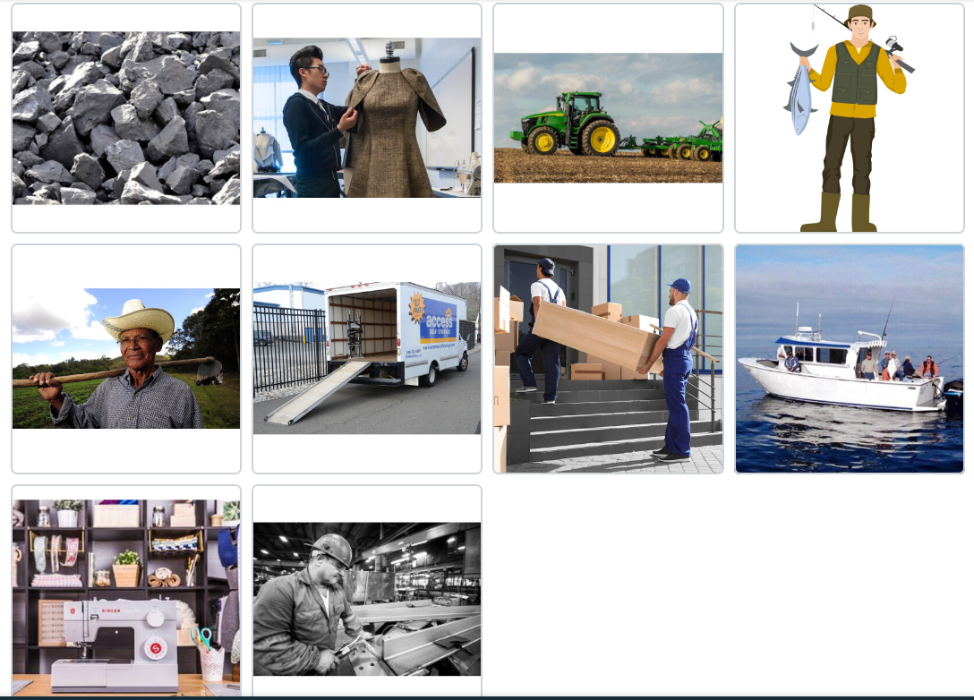
EconEdLink - The Little Red Hen is a Producer and a Consumer
Group Activity
Ask students to recall the times when the Little Red Hen was a producer. Ask the class:
What was she doing?
What resources did she use?
Project the EconEdLink interactive Producers Use Resources Interactive and say the following: Just like the Little Red Hen, these producers use resources to do their jobs. Use the interactive as a large group activity where students link the producers to the resources they use to do their jobs. Assign each group one of the producers. In small groups, the students describe how a producer would interact with a consumer in the real world by answering the following questions:
What does the producer do?
What good or service does the producer provide?
Who would consume this good or service?
Show how the producer and consumer would interact.

Slide 13
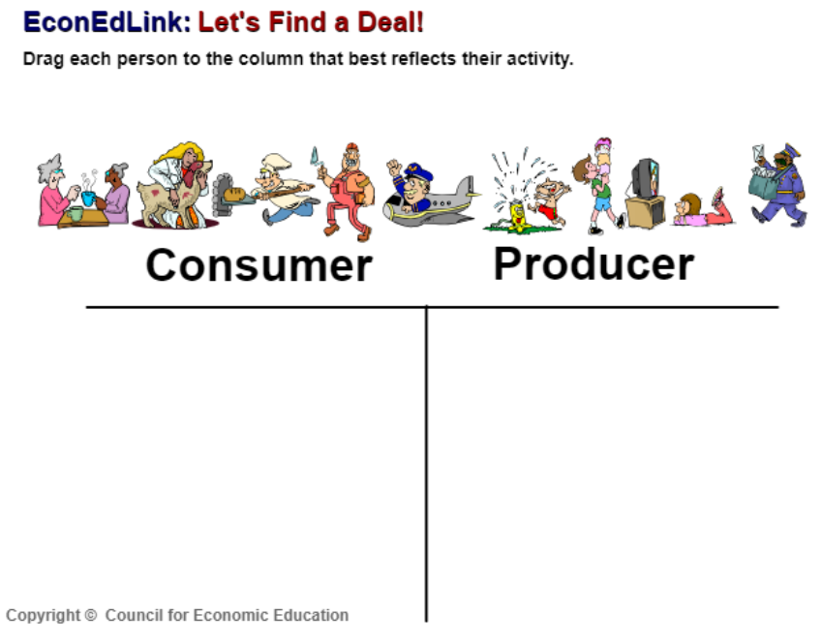
EconEdLink - The Little Red Hen is a Producer and a Consumer
Individual Activity
Project the activity Let’s Find a Deal. Assign students to a computer. Have students complete the activity and print their answers. Have students provide a short explanation of why each person they selected belongs in the consumers column or the producers column.

Slide 14
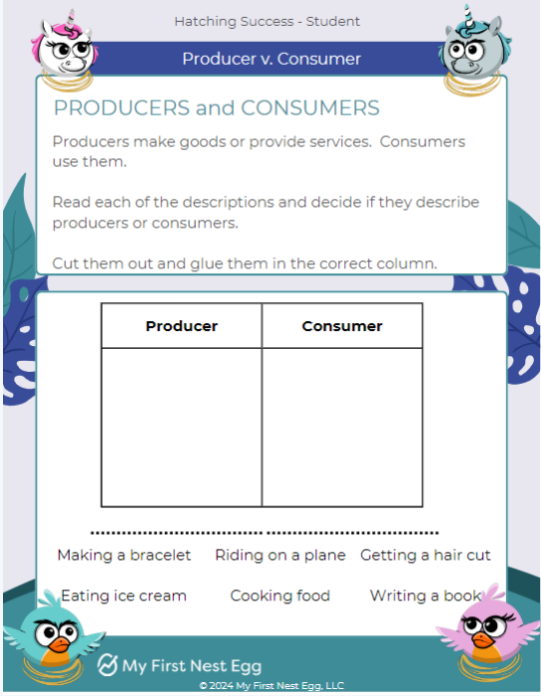
Teacher Resources - My First Nest Egg

Slide 15
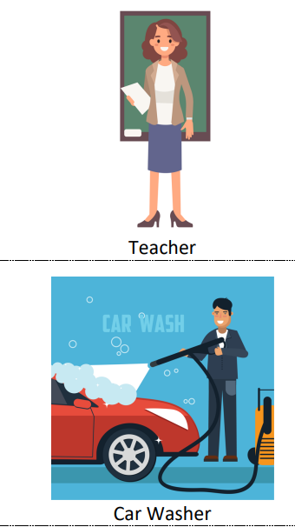
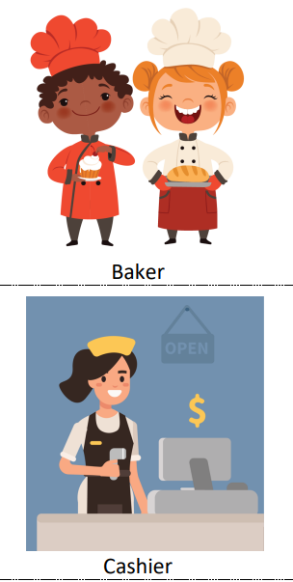
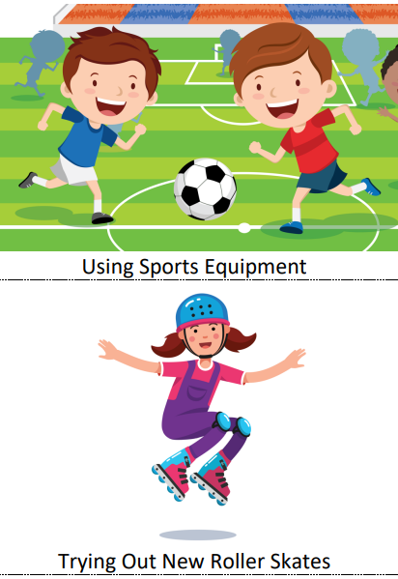
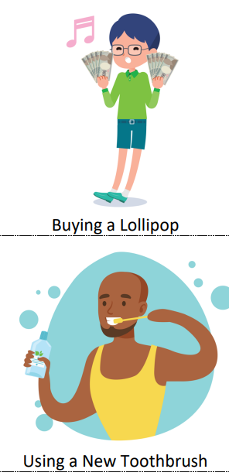
EconEdLink - The Little Red Hen is a Producer and a Consumer
Assessment
Students can either work in small groups or individually. Using the Act It Out Cards, students pull a card. If they are working in small groups, they discuss the following guiding questions and use these to act out a real world scenario using the following guiding questions:
What is the person doing?
Is the person a consumer or a producer?
If the person is a consumer, are they buying a good or service? If the person is a producer, what resources does the person need to do their job
How would this producer/consumer interact with a consumer/producer in the real world.
As a group of students enacts a scenario, the rest of the class has to guess what they are doing and how the consumers and producers interact to trade goods and services. Alternatively, as an individual activity, students pick a card and draw/write answers to the guiding questions above.

Slide 16
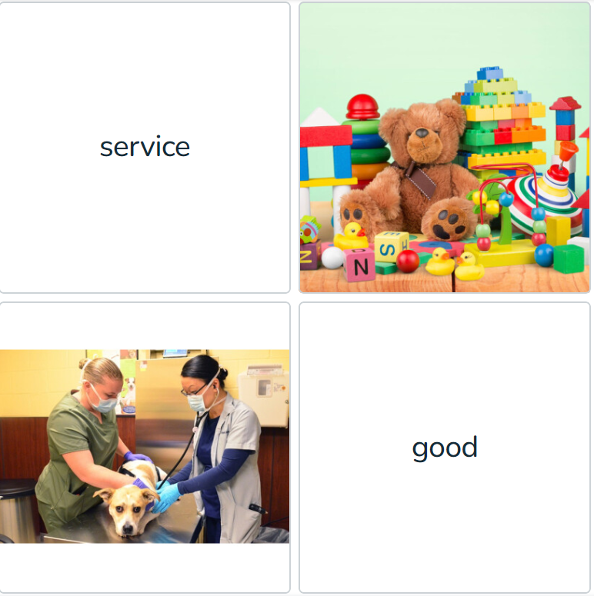
EconEdLink - The Little Red Hen is a Producer and a Consumer
Use the EconEdLink Goods and Services Interactive with students. Tell students that producers make products (goods) and they also do things (services) for people. After completing the activity, students discuss how the producers provide goods and services to people.

Slide 17
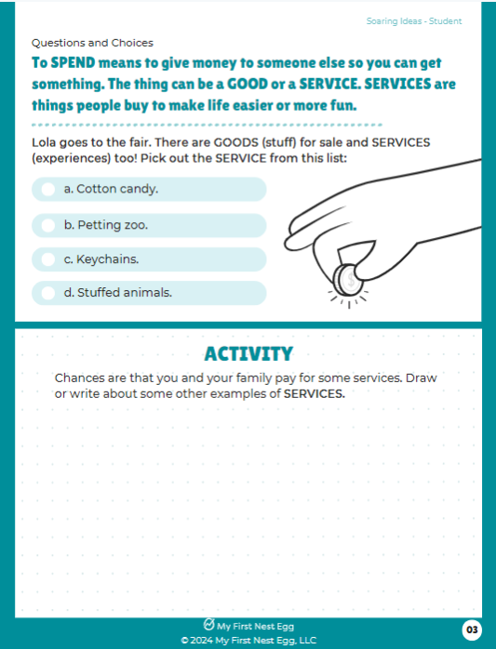
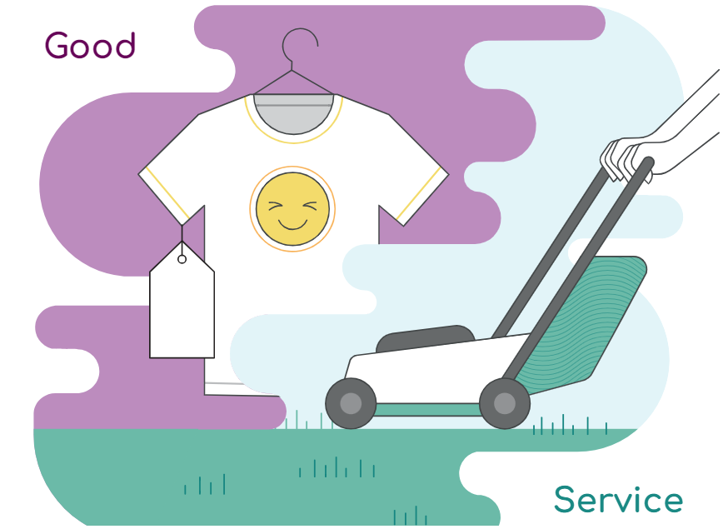
Teacher Resources - My First Nest Egg
The Things We Buy
There are two ways people spend money: They buy goods or pay for services. Goods are things like t-shirts, pencils, or notebooks (just like what's for sale in the school store). Services are when you pay someone to do something for you. For example, grown-ups might pay someone to mow the lawn or cut their hair. Both of these are services.
https://www.econlowdown.org/resource-gallery/currency_academy

Slide 18
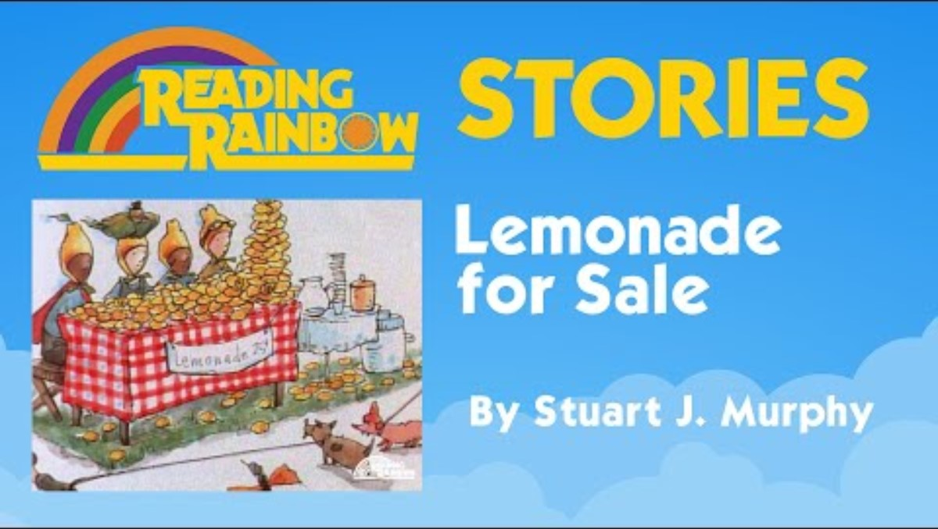
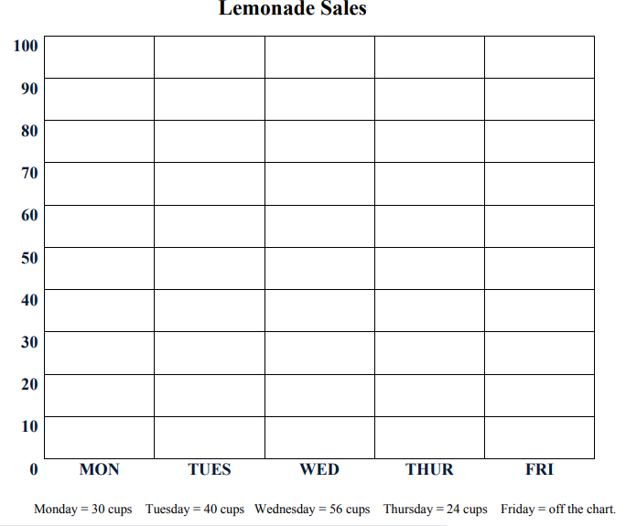
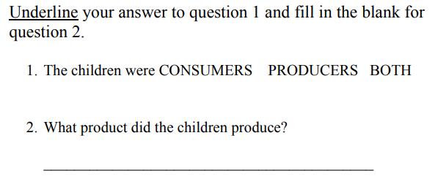
Lemonade For Sale: Lesson Plan
This literature-based lesson incorporates the economic concepts of producer, consumer, and productive resources through active exploration. Students listen to a story about children who produce and sell lemonade to raise money for their clubhouse. They produce a product and classify the resources used in production as natural resources, capital resources (goods), or human resources. The extension activities integrate mathematics and language arts as students graph the lemonade sales and create an advertisement for lemonade.

Slide 19
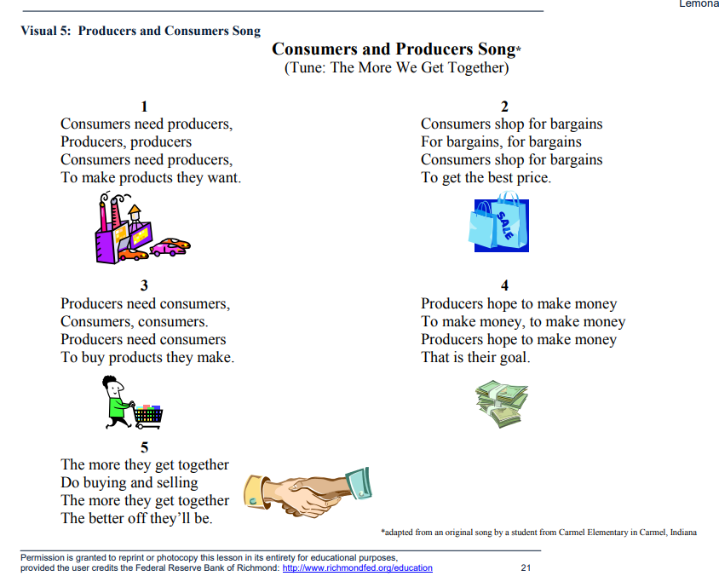
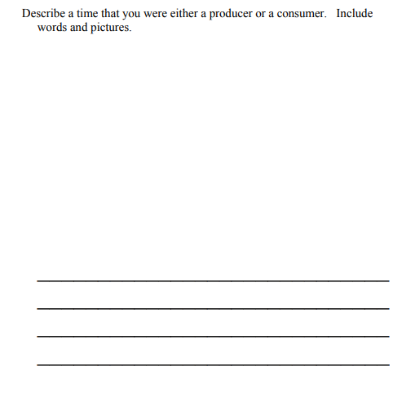
Lemonade For Sale: Lesson Plan

Slide 20
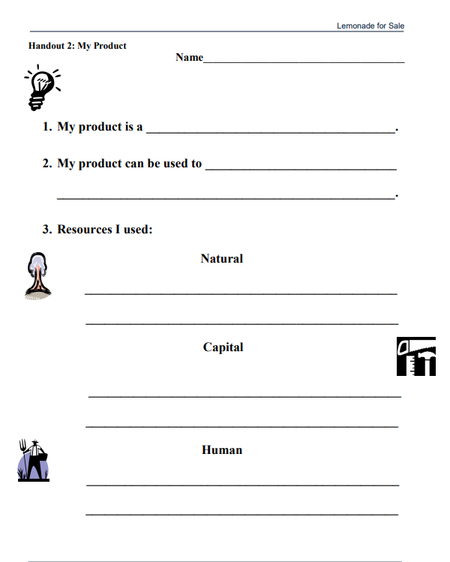
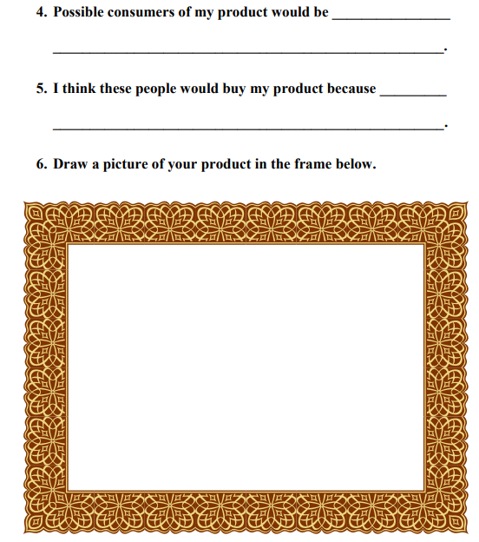

Slide 21
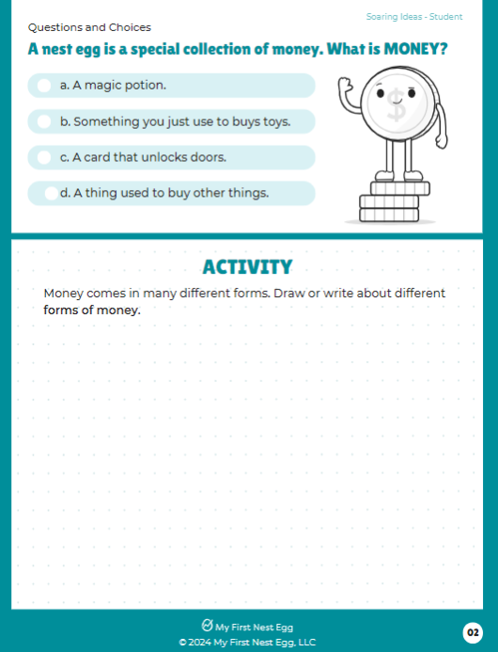
Teacher Resources - My First Nest Egg

Slide 22

https://www.econlowdown.org/resource-gallery/explore-economics-what-makes-something-useful-as-money

Slide 23

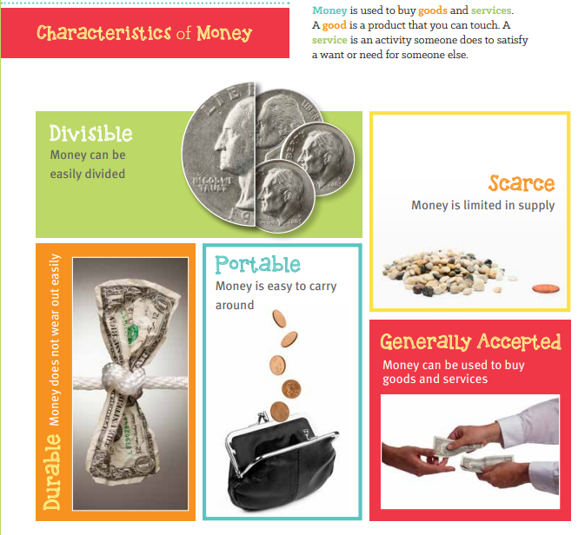
My Money Student Workbook

Slide 24
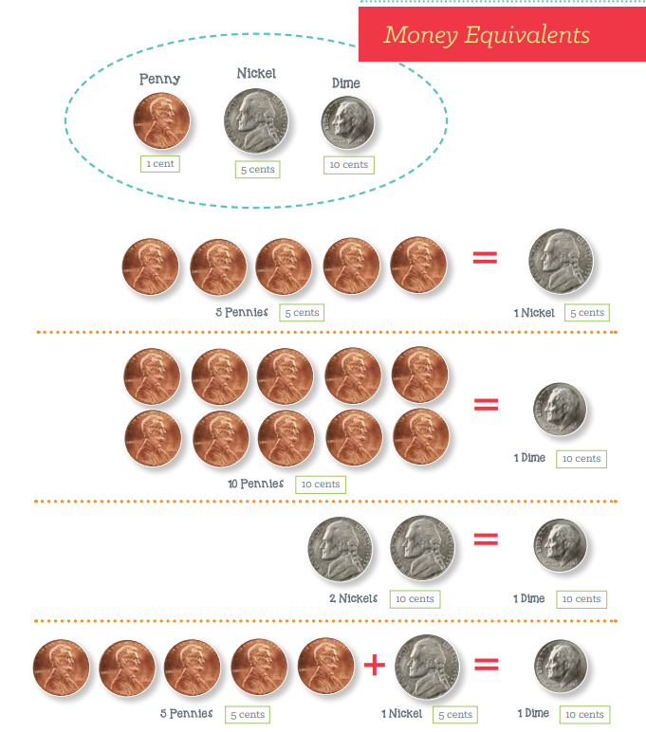
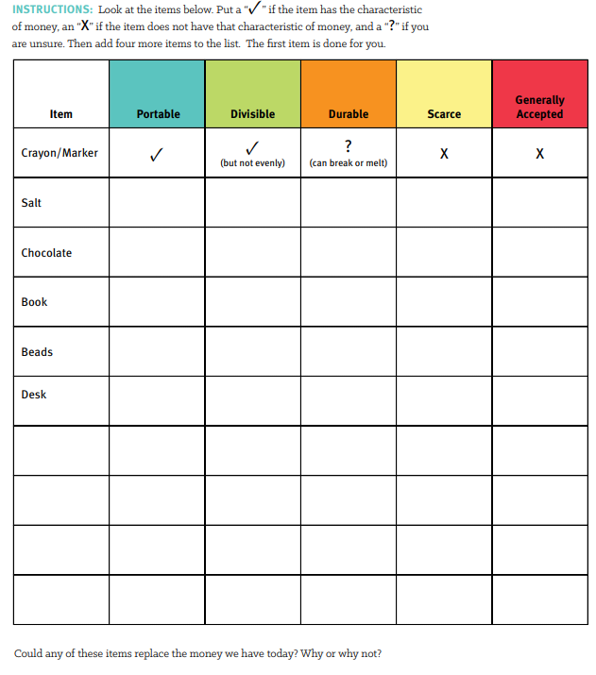

Slide 25
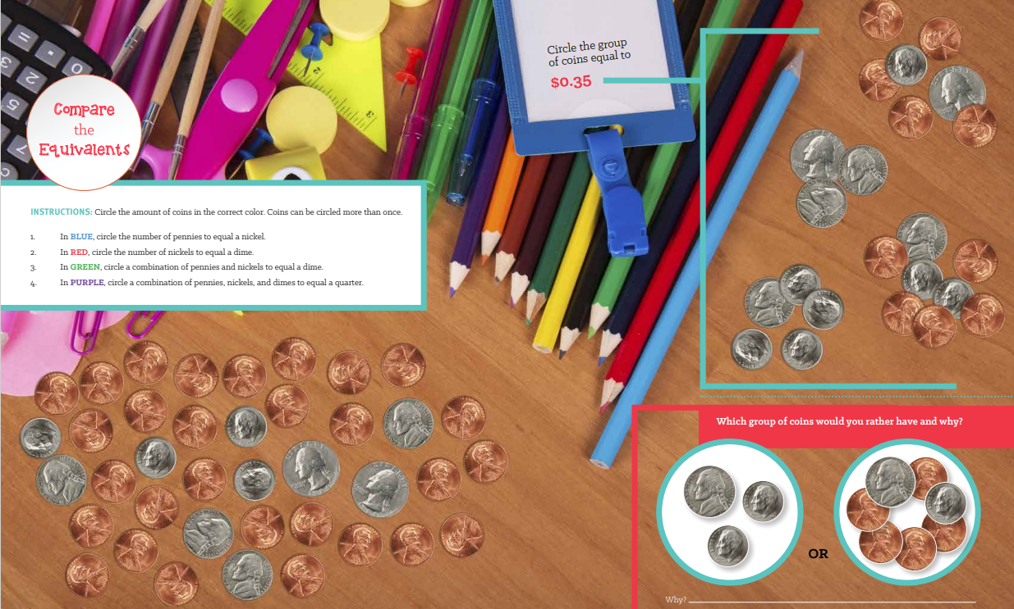

Slide 26
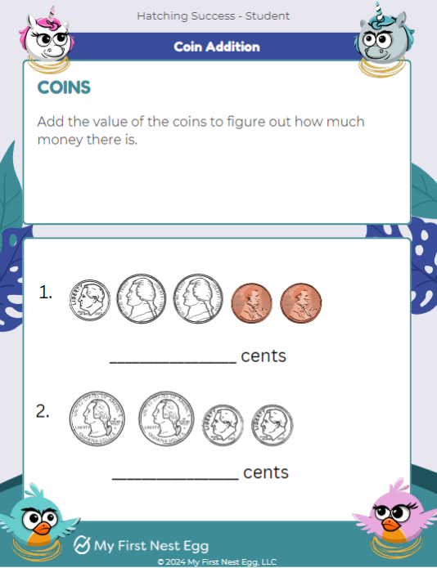
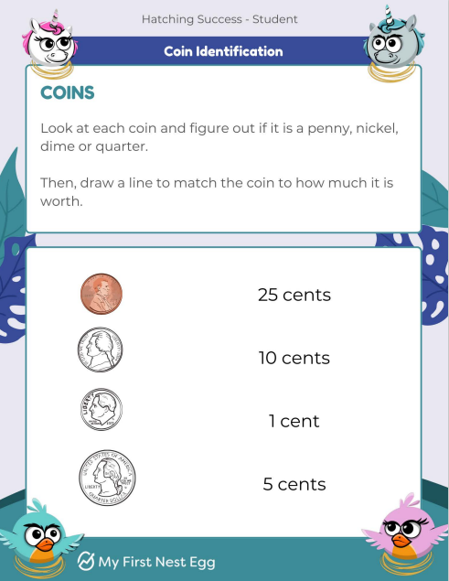
Teacher Resources - My First Nest Egg

Slide 27
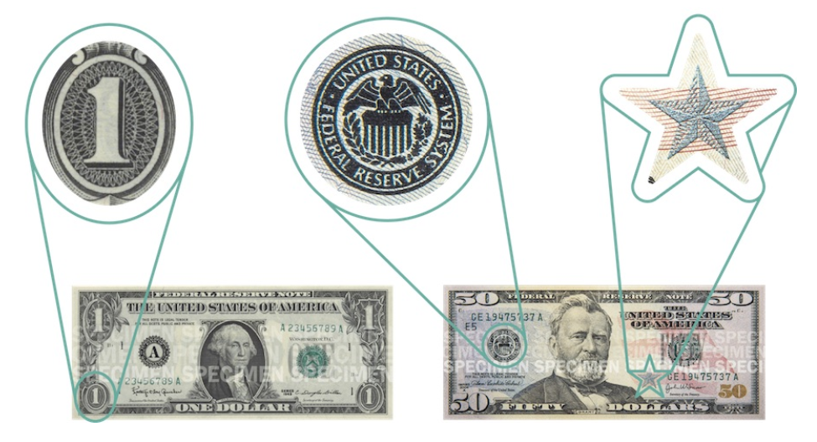
https://www.econlowdown.org/resource-gallery/currency_academy
Shapes
Have you ever noticed that all bills are exactly the same-sized rectangle? They must all be the exact same size to pass inspection. Speaking of shapes, you can also find ovals, stars, and circles in the art on bills.

Slide 28
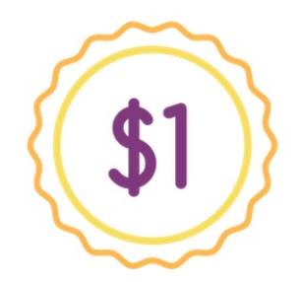
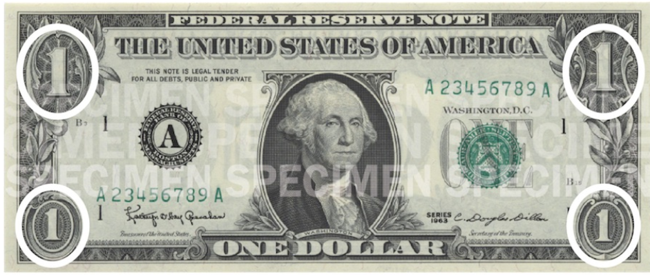
Currency
Before you can use currency in any store, you must know which bills you have. The easiest way to figure that out is by looking at the numbers in the corners. Those numbers tell you the value of the bill. Remember, value just means how much something is worth.
For example, if there is a "1" in the corners of your bill, then you are holding a $1 bill. Whenever you see the $ symbol in front of a number, it just means the dollar value.

Slide 29
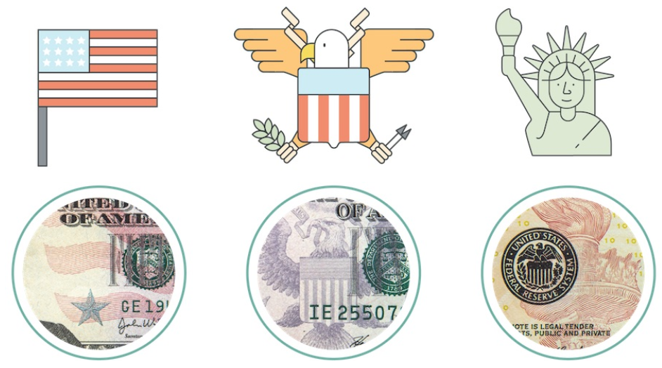
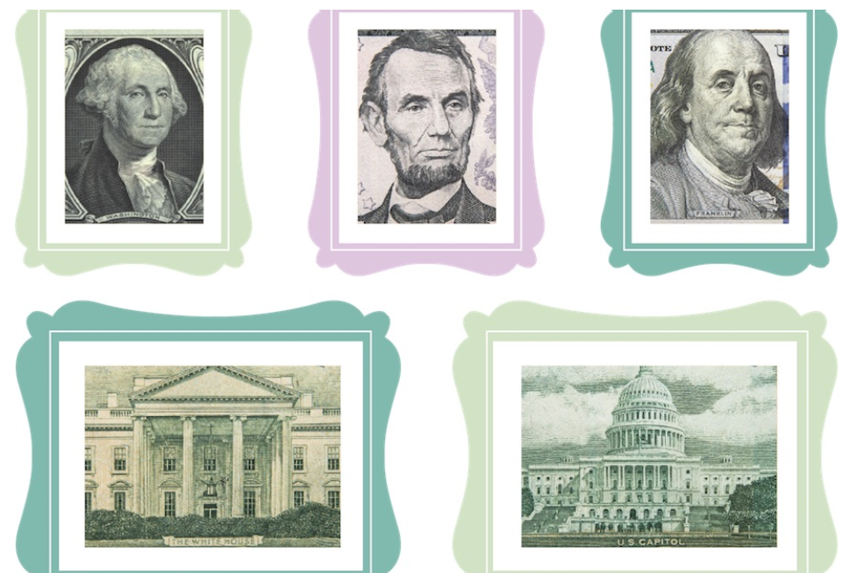
Symbols
America has a lot of important symbols from history built into the artwork on the bills. For example, you will see stars and stripes from the American flag, Bald Eagles, and even the Statue of Liberty.
Pictures
Every bill has a drawing of a statesman from history on the front. A statesman is a well-known person whose work has shaped the direction of the country. This can be a president or someone who ran an important part of the government. Drawings of famous buildings are also on bills, like the White House and the Capitol building in Washington, DC.

Slide 30
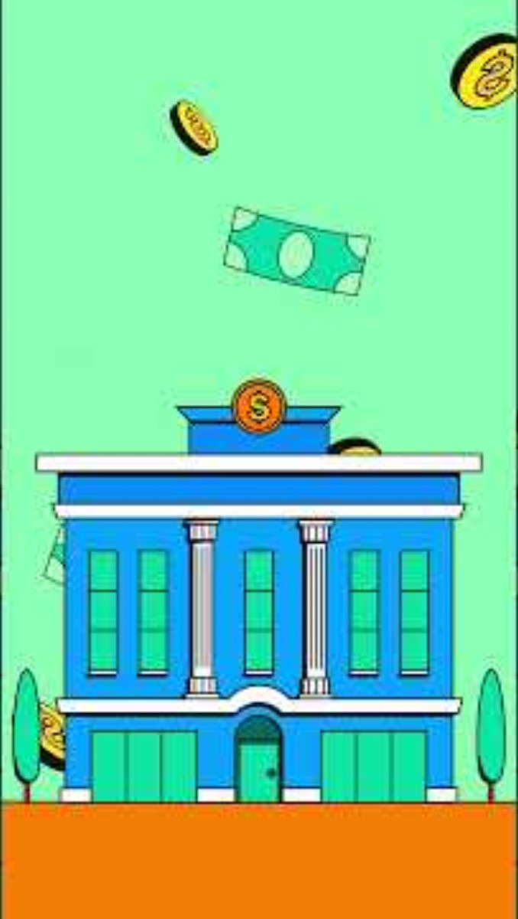
Greenlight for Classrooms Lesson Library
Lesson objectives
Students will understand the basics of banks and credit unions, including how financial institutions pay interest to depositors and collect interest from borrowers.
Students will be able to describe the advantages of saving money in an account at a financial institution rather than keeping the money at home.
Compare and contrast different types of financial institutions, including banks and credit unions, and their products and services| d Explain the importance of federal deposit insurance, and NCUA.
Earning interest - Details - Kahoot!

Slide 31
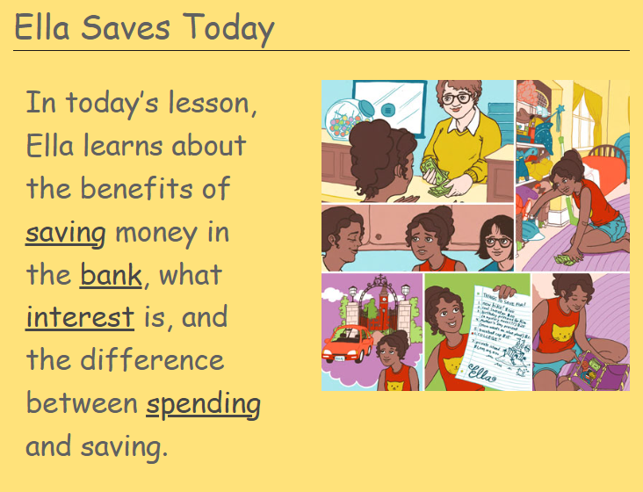
https://www.econlowdown.org/resource-gallery/ella_saves_today
Young children are not likely to think past their piggy banks when it comes to safe places to set money aside for those special items. In this short module, your students will learn that a bank account offers security and a return on their savings.

Slide 32
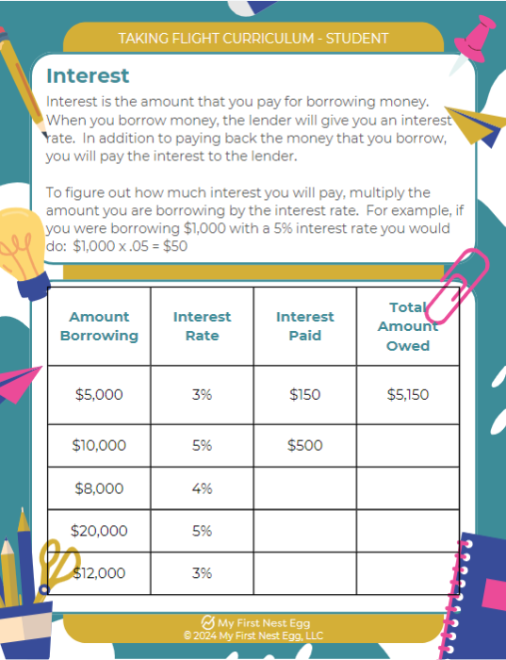
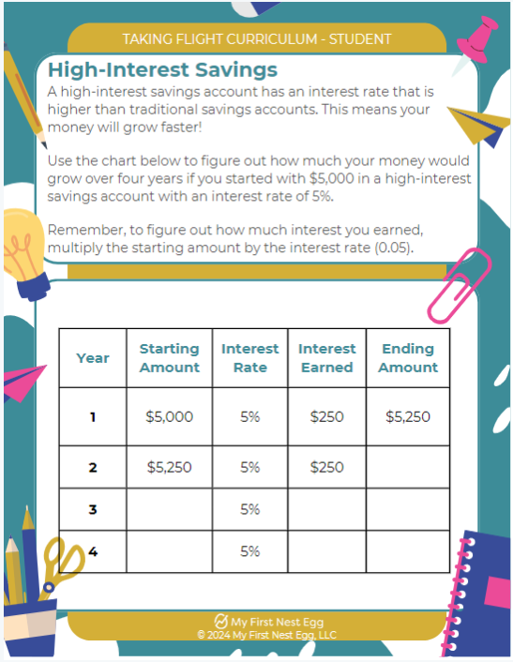
Teacher Resources - My First Nest Egg

Slide 33
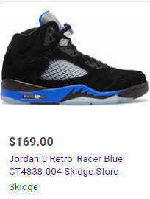

Renting Nike Air Jordan shoes from Rent-A-Center typically costs $19.99 per week. If you decide to purchase them after renting, the total cost can vary. For example, the Air Jordan 5 Racer Blues would cost $375 to buy outright through Rent-A-Center. If you continue renting them for a year, the total cost would be $1,050

Slide 34
Amount Borrowing | Interest Rate | Interest Paid | Total Amount Owed
$169 | 21%
$169 | 32%
$169 | 447%
$169 | 680%
$169 | 767%
Most credit card companies will calculate credit card interest daily based on the current balance on your card. To calculate this daily interest rate yourself, divide your APR by 365 and then multiply by your current balance. It is important to keep in mind that some companies may charge different interest rates depending on how the balance was incurred: by making purchases, by transferring balances or by making cash advances.
How long would it take to save to buy these $169 shoes if you saved $20 per month?
How long would it take to buy them if you saved $20 per week?

Slide 35
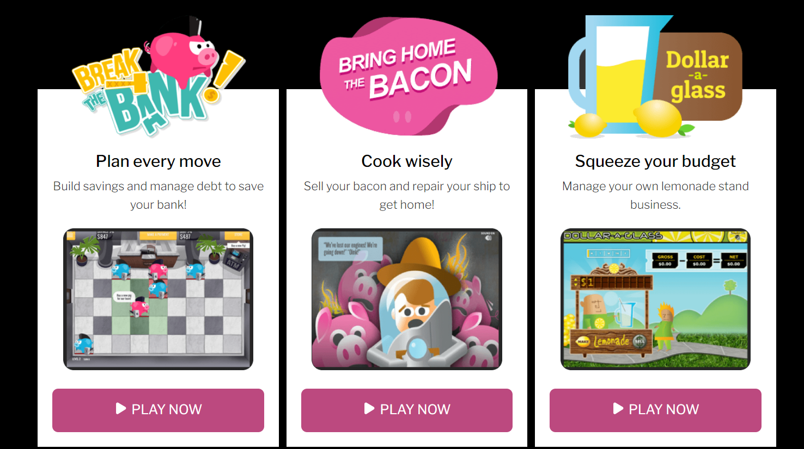
Games - Biz Kids

