Slide 1

Spending and Saving Money
Once Upon a Dime
Virtual Series Part 2
Christine Angel Danger
November 2024

Slide 2
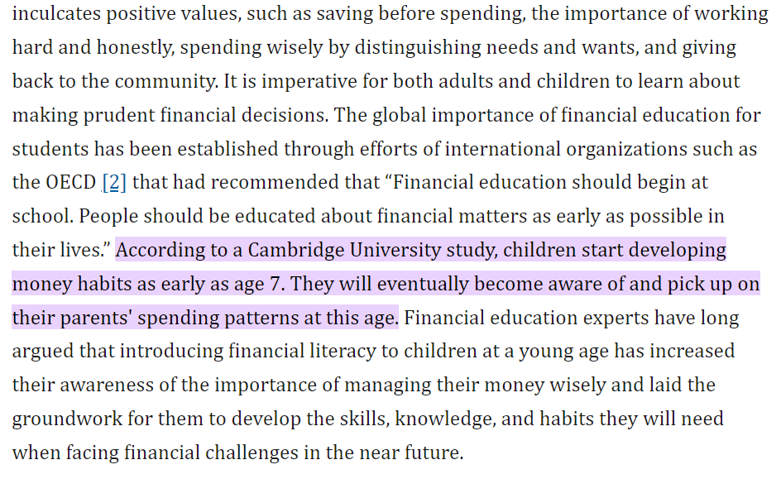
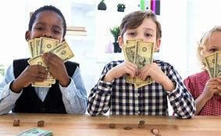
Children's understanding of financial literacy and parents' choice of financial knowledge learning methods in Malaysia - PMC

Slide 3
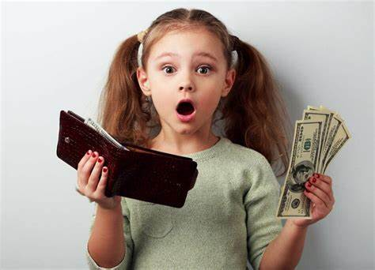
The importance of financial literacy and its impact on financial wellbeing | Journal of Financial Literacy and Wellbeing | Cambridge Core
This is the definition of financial literacy from the team of experts who worked on this (PISA) assessmentFootnote⁸:
“Financial literacy is knowledge and understanding of financial concepts and risks, as well as the skills and attitudes to apply such knowledge and understanding in order to make effective decisions across a range of financial contexts, to improve the financial wellbeing of individuals and society, and to enable participation in economic life.” ( OECD 2019b)
…we have found that several rich countries do not have high levels of youth financial literacy. For example, both the United States and some European countries, such as Italy, France, and Spain, ranked at the OECD average or below the average on the 2012 financial literacy scale.

Slide 4
Recognize
SS.K.E.1.3 Recognize that people work to earn money to buy things they need or want.
Recognize
SS.1.E.1.1 Recognize that money is a method of exchanging goods and services.
Define
SS.1.E.1.2 Define opportunity costs as giving up one thing for another.
Distinguish
SS.1.E.1.3 Distinguish between examples of goods and services.
Distinguish
SS.1.E.1.4 Distinguish people as buyers, sellers, and producers of goods and services.
Recognize
SS.1.E.1.5 Recognize the importance of saving money for future purchases.
Identify
SS.1.E.1.6 Identify that people need to make choices because of scarce resources.
Recognize
SS.2.E.1.1 Recognize that people make choices because of limited resources.
Explain
SS.2.E.1.4 Explain the personal benefits and costs involved in saving and spending.
Recognize
SS.3.E.1.3 Recognize that buyers and sellers interact to exchange goods and services through the use of trade or money.

Slide 5
SS.4.FL.1.2 People earn an income when they are hired by an employer to work at a job.
Explain why employers are willing to pay people to do their work.
SS.4.FL.2.4 Discuss that whenever people buy something, they incur an opportunity cost. Opportunity cost is the value of the next best alternative that is given up when a person makes a choice.
SS.4.FL.2.7 Planning for spending can help people make informed choices. Develop a budget plan for spending, saving, and managing income.
SS.4.FL.3.1 Identify ways that income is saved, spent on goods and services, or used to pay taxes.
SS.4.FL.3.2 Explain that when people save money, they give up the opportunity to buy things now in order to buy things later.
SS.4.FL.3.3 Identify ways that people can choose to save money in many places for example, at home in a piggy bank or at a commercial bank,...
SS.4.FL.3.4 Identify savings goals people set as incentives to save. One savings goal might be to buy goods and services in the future.
SS.4.FL.3.5 Explain that when people deposit money into a bank (or other financial institution), the bank may pay them interest. Banks attract savings by paying interest. People also deposit money into banks because banks are safe places to keep their savings.

Slide 6

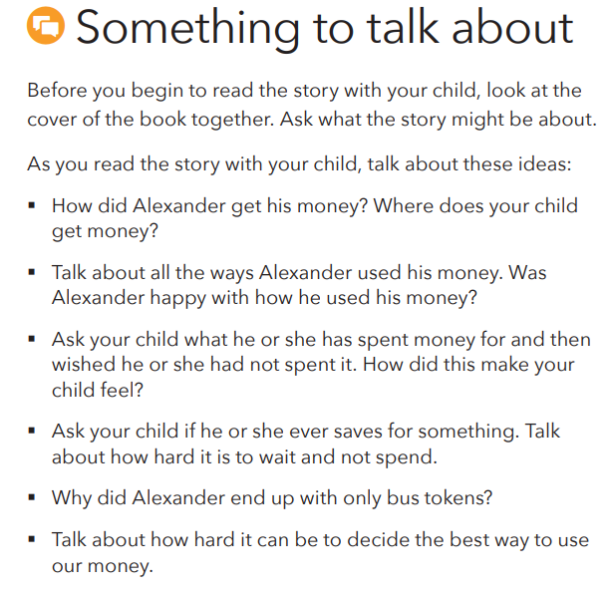
Money as You Grow Bookshelf for Parents and Caregivers from Consumer Financial Protection Bureau
Savings | Savings Goal | Spending | Opportunity Cost
How might the story be different if Alexander had a SMART goal?
Money as You Grow Bookshelf for parents and caregivers | Consumer Financial Protection Bureau

Slide 7


Slide 8
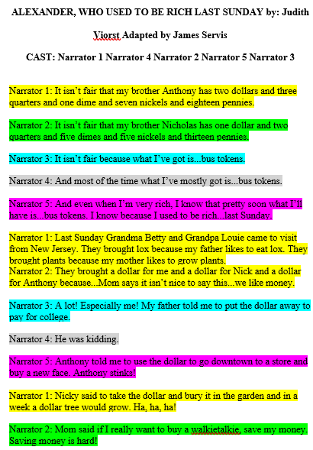
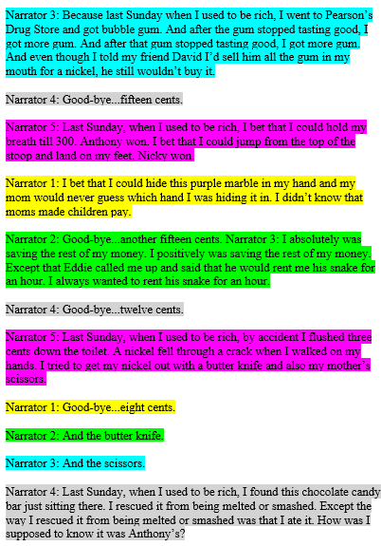
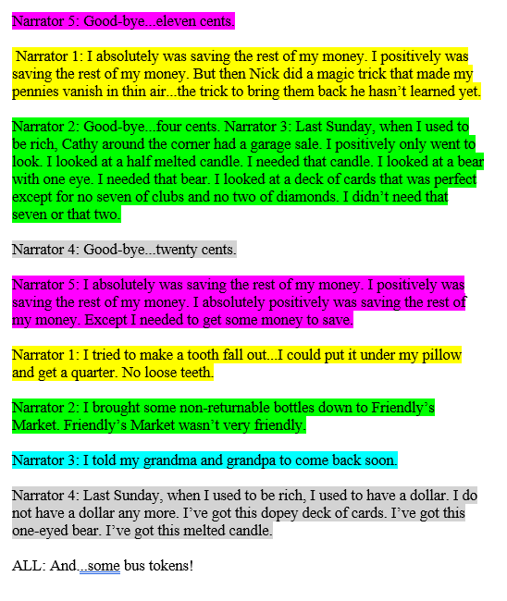
Reader’s Theater for Five Students

Slide 9
What is saving? (Keeping some of your money to buy things in the future; not spending)
Do you save? (Answers will vary.)
What is a savings goal? (A good or service you want to buy in the future)
What is your savings goal? (Answers will vary.)
Why is it hard to save? (Answers will vary but may include the following: There are many things to buy that tempt you to spend. You have to wait to get something in the future. If you spend, you get something now.)
What is spending? (Using some or all of your money to buy things you want now)
What is opportunity cost? (The next-best thing that is given up when a choice is made)
When people choose to spend, what is their opportunity cost—what do they give up? (Buying things in the future)
When people choose to save, what is their opportunity cost—what do they give up? (Buying things today)

Slide 10
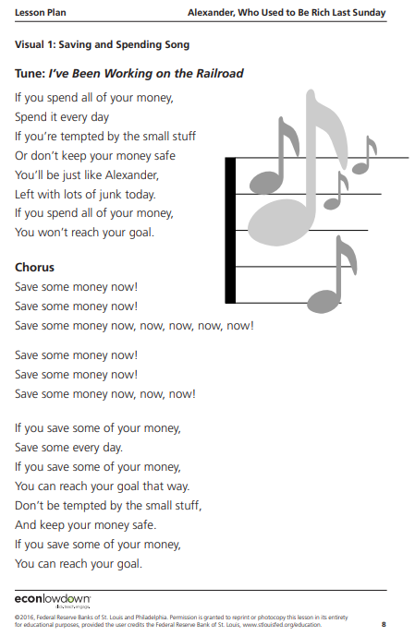
Sing a song about saving:
This activity will help your child learn about saving money. First, sing the lyrics below to the tune of “Row, Row, Row Your Boat.” Then, sing the song together.
Save, save, save money / At home or in a bank / When you meet your future goals /
It’s saving you should thank!

Slide 11
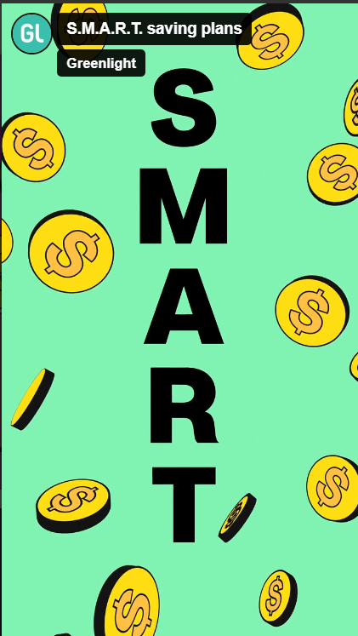
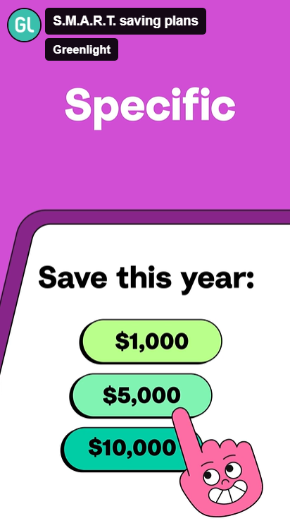
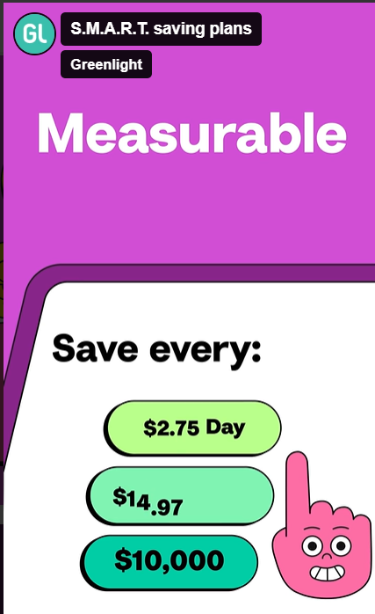
Greenlight for Classrooms: Free financial literacy lesson plans
Notes:
Making a savings plan is SMART. Make your savings goals specific. What are you saving for and how much will you save? Make it measurable. When and how will you get money and how much of it will you save each time?

Slide 12
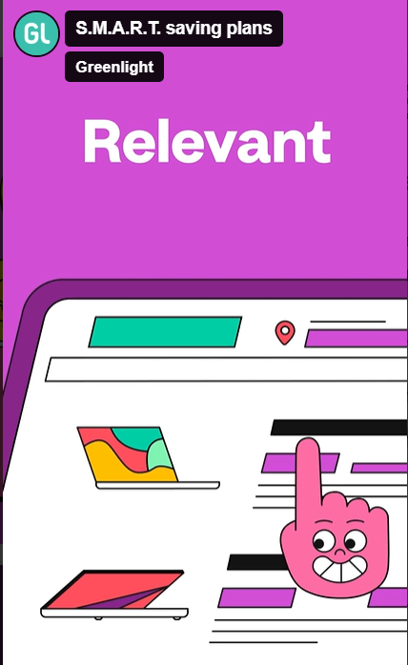
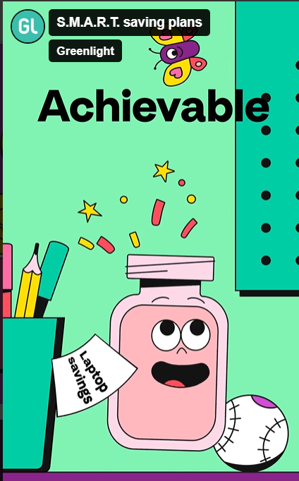
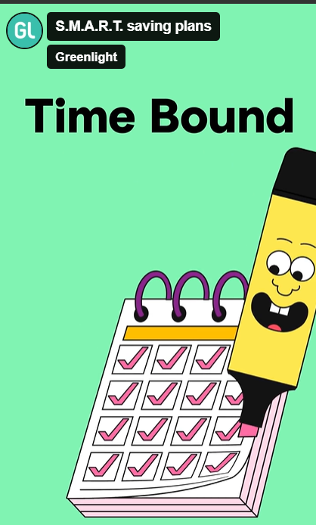
Notes:
Make it relevant, this should be what you want! Make it achievable. This should be a goal you know you can actually reach. Keep it timebound. Keep track of your progress.

Slide 13
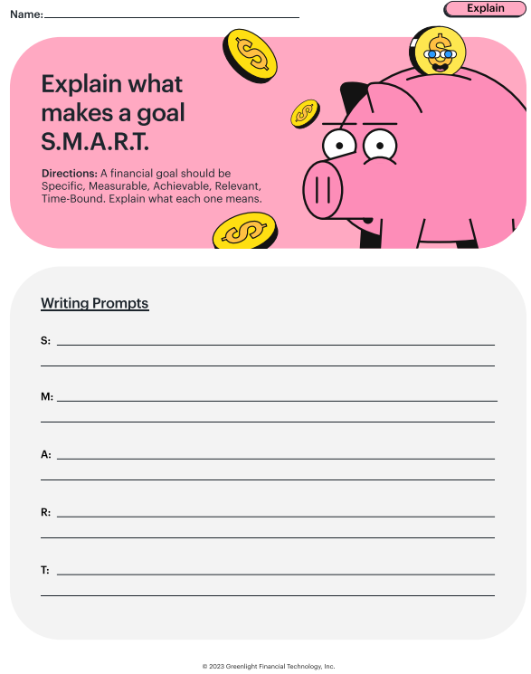
Why do people save?
What are some examples of purchases you may want to save for?
What are some smaller things you like to buy that do not cost much money?
Why might money goals be more successful if the specific details are measurable?
Why is it important to have a money goal that is relevant and important to you?
Brainstorm your personal goals for spending and saving, then create a savings plan.

Slide 14
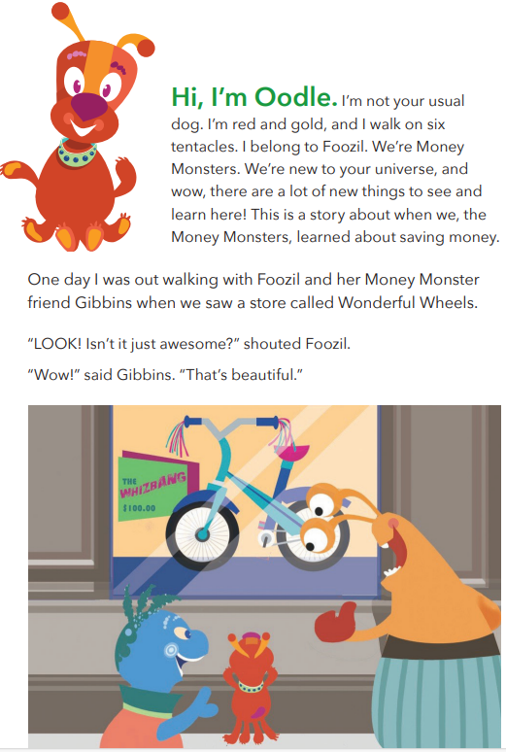
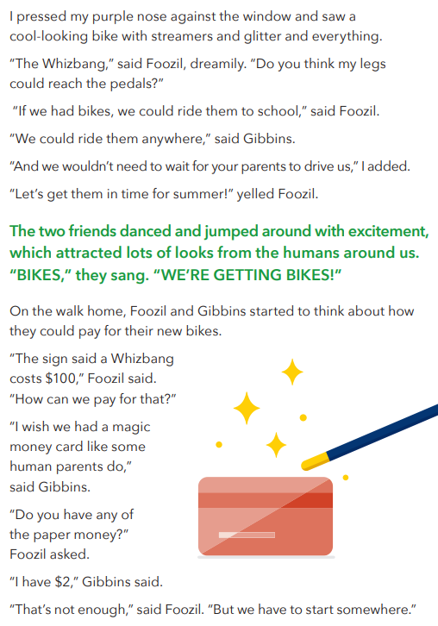

Slide 15
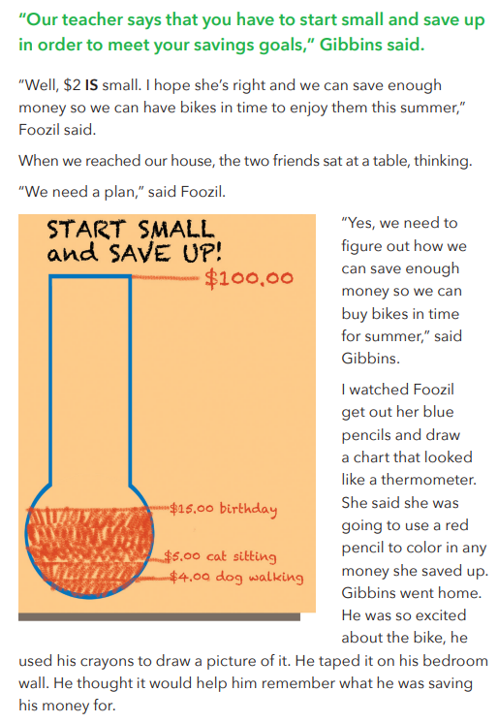
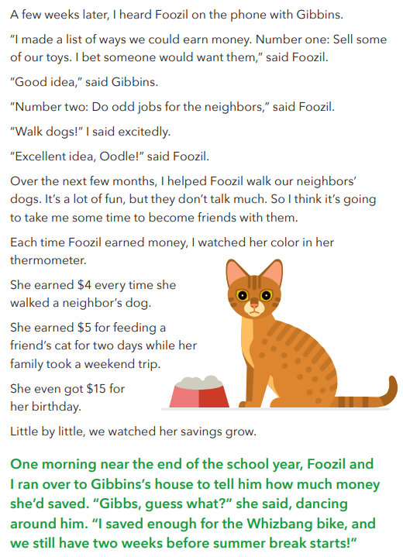

Slide 16
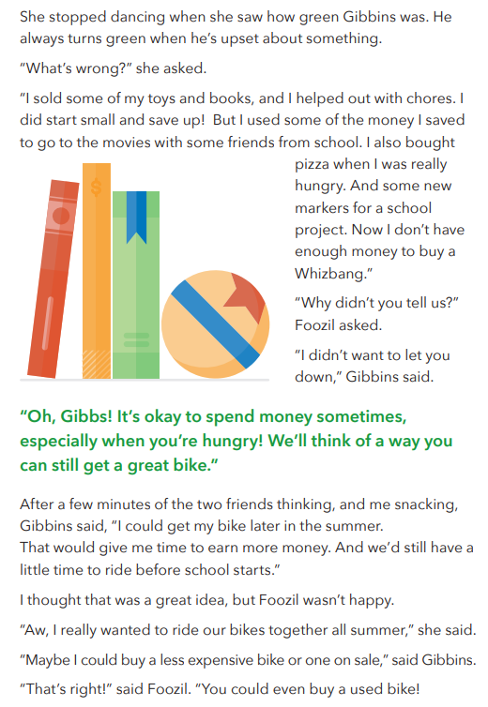
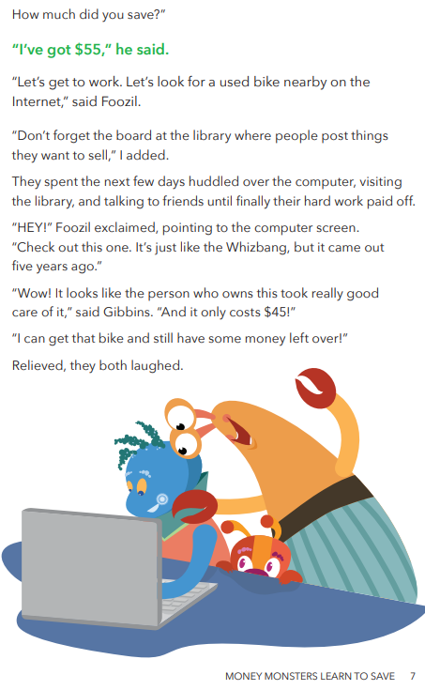

Slide 17
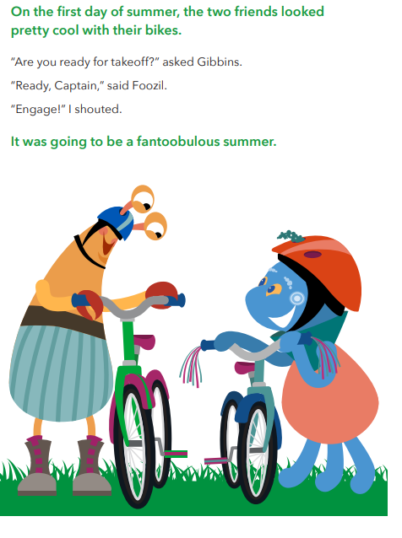
What did Foozil and Gibbins want to buy?
How did Foozil earn money?
What did Gibbins do to earn money? § How long do you think it took them to save enough money to buy their bikes?
Has our family saved money for something special?
What is one thing we could save for as a family?
How hard or easy would it be for us to save for that goal?

Slide 18
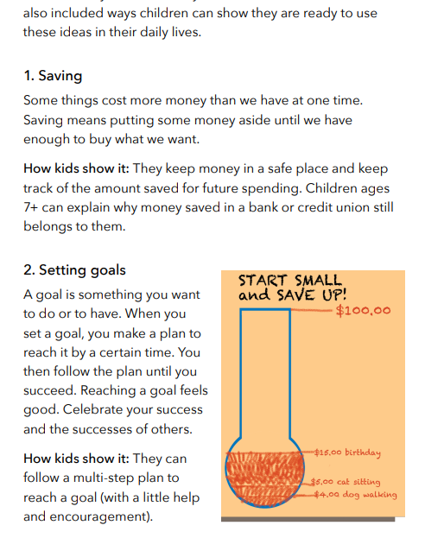

Meet the Money Monsters! | Consumer Financial Protection Bureau

Slide 19

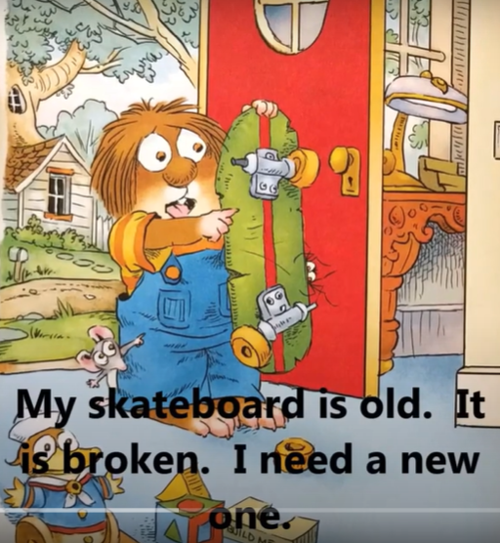
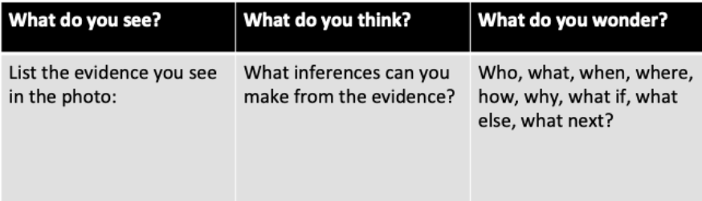
What do you see on the cover?
Based on what you see, what do you think the story will be about?
What questions do you have?

Slide 20
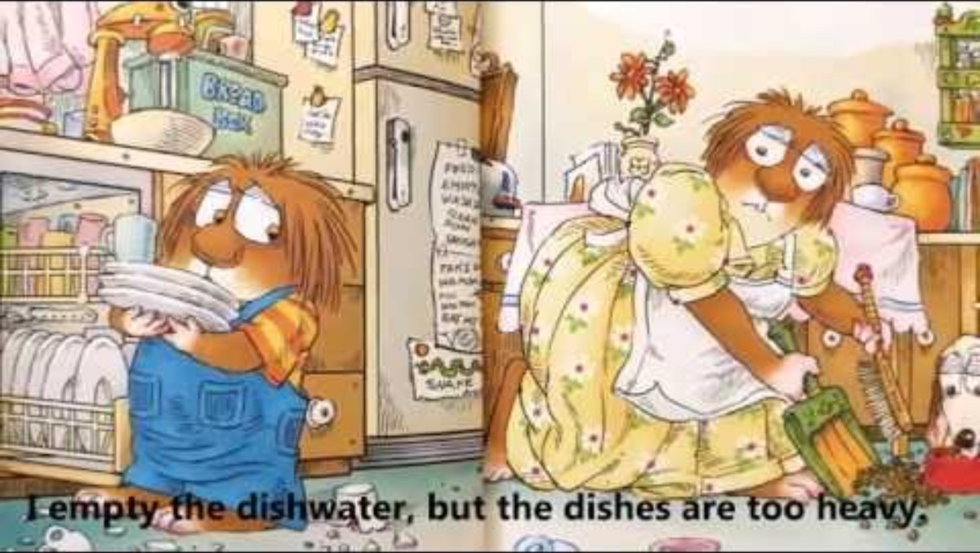
https://youtu.be/8g4DBTMfE9I

Slide 21

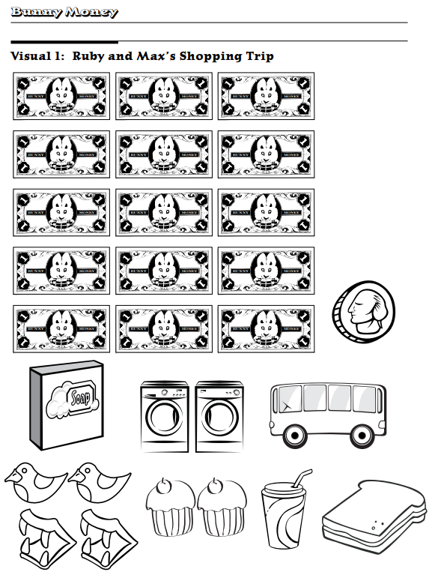
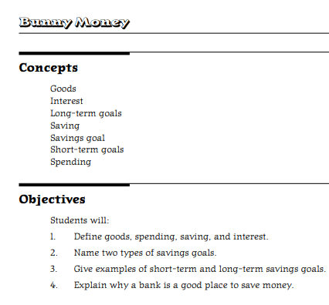
My Money | Richmond Fed

Slide 22
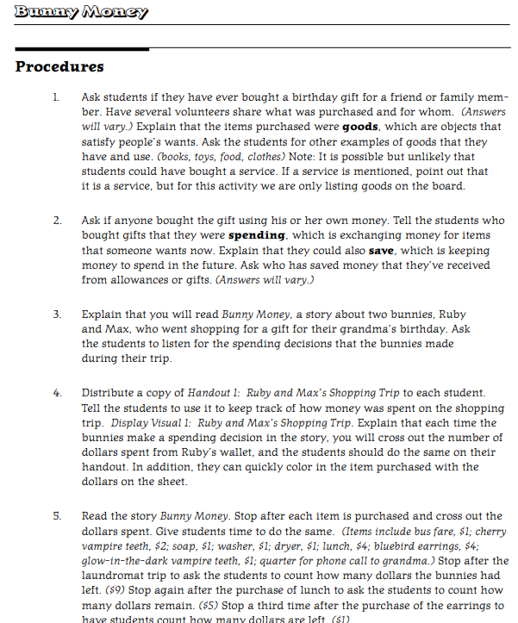
Goods
Interest
Long-term goals
Saving
Savings goal
Short-term goals
Spending
Define goods, spending, saving, and interest.
Name two types of savings goals.
Give examples of short-term and long-term savings goals.
Explain why a bank is a good place to save money

Slide 23


Slide 24
How many dollars had Ruby saved and put in her wallet for the shopping trip? ($15 — Students may need to count all the dollars crossed out to get this total.)
What did Ruby plan to purchase? (a music box with skating ballerinas)
• Why didn’t Ruby buy the music box? (It cost $100; she didn’t have enough money.)
• How did Max spend some of Ruby’s money? (He bought cherry and glow-in-the-dark vampire teeth; he went to the Laundromat to clean cherry syrup off his clothes; he ate a peanut butter and jelly sandwich, two coconut cupcakes, and a banana shake for lunch.)
• Why was Ruby upset with Max? (His mess from the cherry vampire teeth cost her $3 at the Laundromat, and he spent her last dollar on glow-in-the-dark vampire teeth.)
• How did Ruby and Max get home from the shopping trip? (Ruby used Max’s lucky quarter to call Grandma to pick them up.)
• Do you think Max made smart spending decisions? Why or why not?
© 2011 Federal Reserve Banks of St. Louis, Philadelphia, and Kansas City Permission is granted to reprint or photocopy this lesson in its entirety for educational purposes, provided the user credits the Federal Reserve Banks of St. Louis: www.stlouisfed.org/education and Philadelphia: www.philadelphiafed.org/education

Slide 25
Remind students that Ruby didn’t buy the music box for Grandma because she hadn’t saved enough money. Tell them that it is helpful to have a goal in order to save. Describe a savings goal as a good or service that people want in the future. When you work toward a savings goal, it keeps you from spending your money now, so you will have enough saved to purchase your goal item in the future.
Ask students if they think Ruby could save enough money to purchase the music box in a short amount of time (soon) or a longer amount of time (later). (Since the music box cost $100, it would probably take a longer amount of time to save the money.) Explain that they can set two types of savings goals: short-term goals for goods you want to buy in the next few months or long-term goals for goods you want to buy in a year or longer. Tell them that long-term goals can be set for many years later, when they are a teenager or even a grown-up.
Tell students that you need their help in deciding whether certain savings goals would be short-term or long-term goals. Choose two students to wear the name tags from Handout 2: Name Tags, “Short-Term” and “Long-Term.” Both students should stand in front of the room facing the class. Hand each one the appropriate pocket folder or portfolio, labeled either “Short-Term Goals” or “Long-Term Goals.”

Slide 26
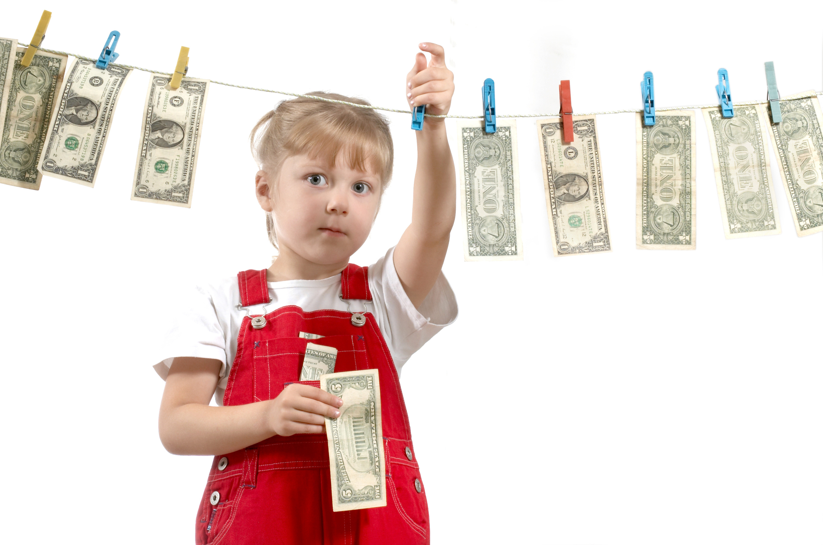
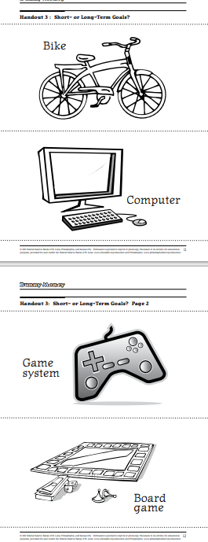






Goal Setting
Short Term
Long Term

Slide 27
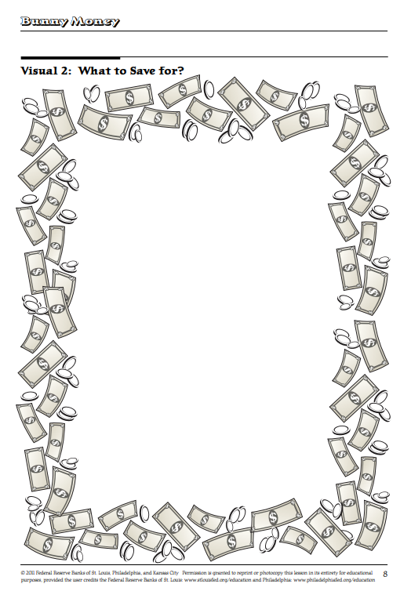
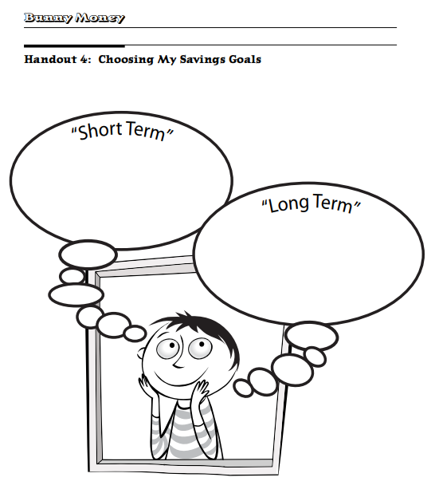

Slide 28
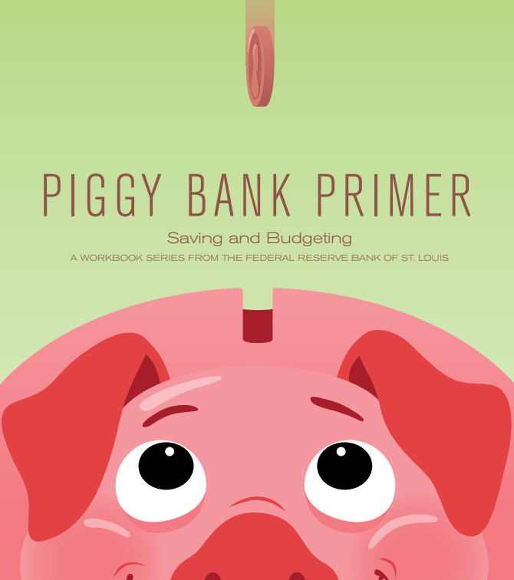
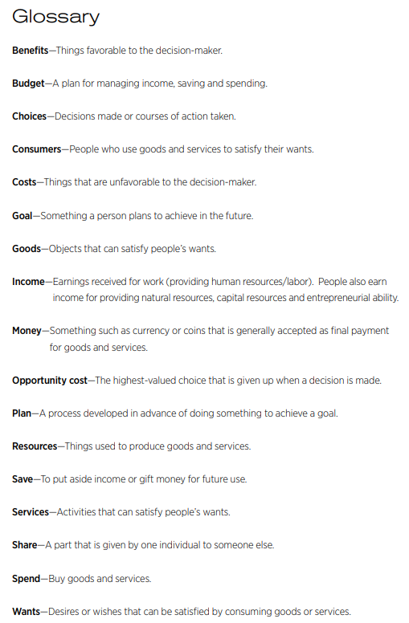
My Money | Richmond Fed

Slide 29
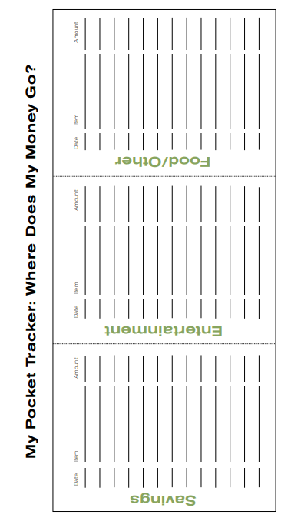
My Money | Richmond Fed

Slide 30
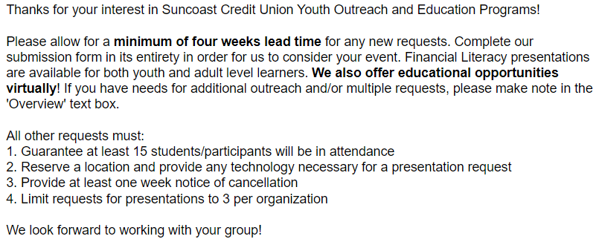

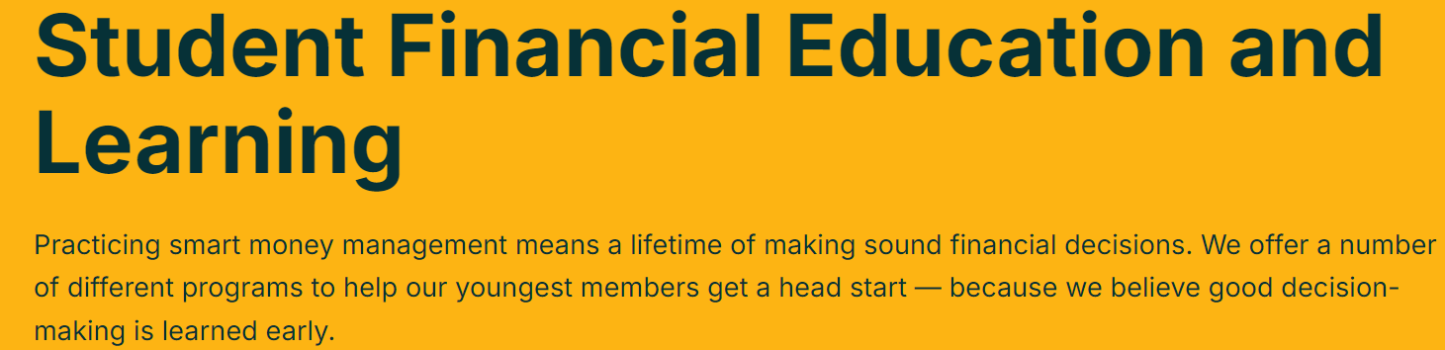
Youth Outreach - Suncoast Credit Union Sponsorship Submission
Adult Financial Literacy Education
mPower eLearning
Youth Outreach

Slide 31
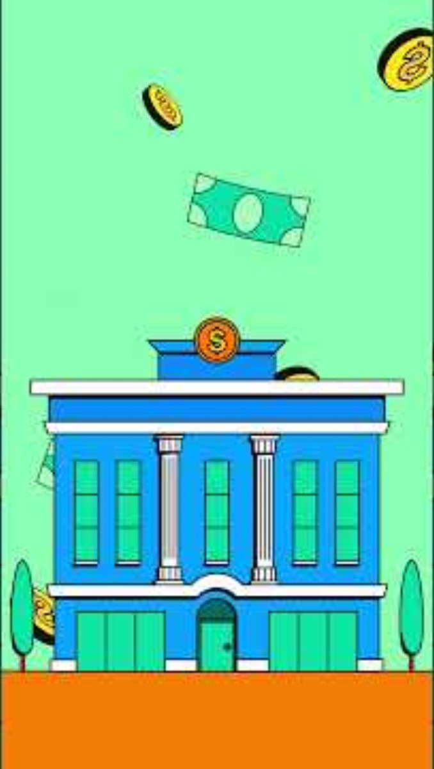
Greenlight for Classrooms Lesson Library
Where to save
Students will watch the video “Where to save” and discuss the following concepts covered:
What are some benefits of saving money in a bank or a credit union?
Why might someone save money with a certificate of deposit (CD)?
What are important factors to consider when deciding where to save your money?

Slide 32

Greenlight for Classrooms Lesson Library
FDIC
Students will watch the video “FDIC” and discuss the following concepts covered:
Before saving your money at a bank, why would it be important to check if it is FDIC insured?
Why do you think there are different insurers for banks and credit unions?
What are some examples of financial assets that aren’t covered by FDIC?
Banks & credit unions - Details - Kahoot!

Slide 33
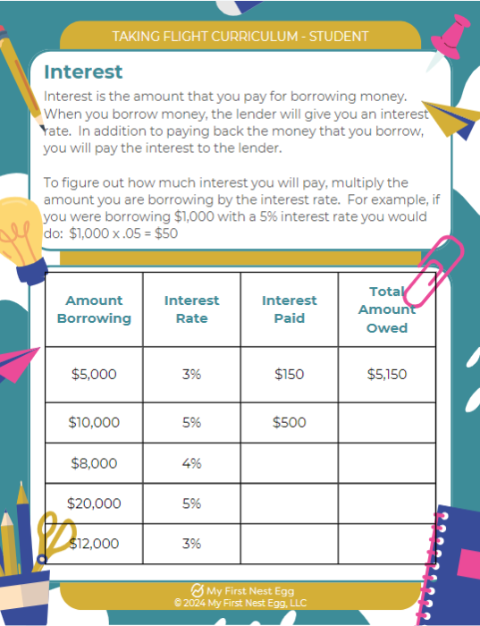
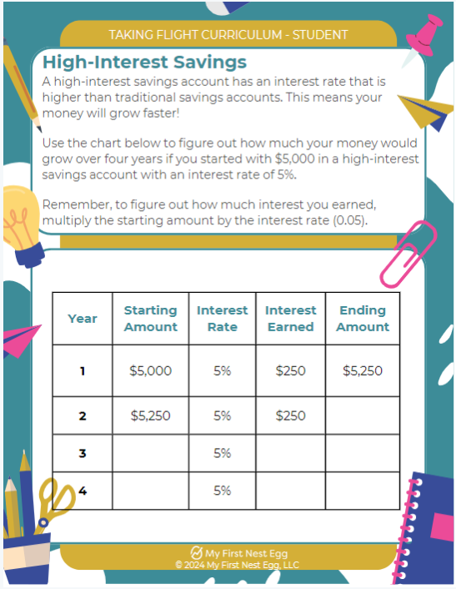
Teacher Resources - My First Nest Egg

Slide 34
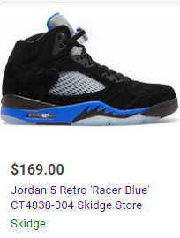

Renting Nike Air Jordan shoes from Rent-A-Center typically costs $19.99 per week. If you decide to purchase them after renting, the total cost can vary. For example, the Air Jordan 5 Racer Blues would cost $375 to buy outright through Rent-A-Center. If you continue renting them for a year, the total cost would be $1,050

Slide 35
Amount Borrowing | Interest Rate | Interest Paid | Total Amount Owed
$169 | 21%
$169 | 32%
$169 | 447%
$169 | 680%
$169 | 767%
Most credit card companies will calculate credit card interest daily based on the current balance on your card. To calculate this daily interest rate yourself, divide your APR by 365 and then multiply by your current balance. It is important to keep in mind that some companies may charge different interest rates depending on how the balance was incurred: by making purchases, by transferring balances or by making cash advances.
How long would it take to save to buy these $169 shoes if you saved $20 per month?
How long would it take to buy them if you saved $20 per week?

Slide 36
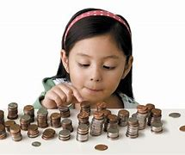
Money as You Grow Bookshelf for parents and caregivers | Consumer Financial Protection Bureau
Build your child’s money skills while you read
English
Español
It's important to you to get the most out of reading time with your child. Money as You Grow Bookshelf lets you build on the time you may already spend reading together, and helps you bring money topics to life through storytime.

Slide 37
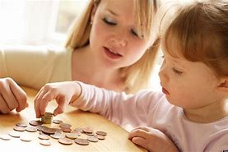
A review of financial-literacy education programs for children and adolescents - Aisa Amagir, Wim Groot, Henriëtte Maassen van den Brink, Arie Wilschut, 2018
Financial education can be defined as teaching which is intended to lead to financial literacy in the wider sense indicated by the OECD (2014). The ultimate goal of financial education is to empower and motivate people to change their financial behavior, for example, to induce them to make well-considered financial decisions. Therefore, we distinguish three components in our definition of financial literacy:
1. Knowledge and understanding. To know how to behave, it is necessary to be informed adequately about the domain referring to the intended behavior. However, the effect of knowledge on changes in behavior is relatively limited (Hilgert et al., 2003; Perry and Morris, 2005). Therefore, two other aspects must be taken into account.
2. Skills and behavior. To be able to change one’s behavior, it is necessary to master the operational skills which refer to the domain, for example, how to deal with budgeting.
3. Attitudes and confidence. To be able to apply something outside the context in which it has been learnt, it is necessary to have self-efficacy (Bandura, 1997, 2006), and develop the necessary motivation in order to do so.
In sum, our definition comprises knowing what to do, the skills to be able to perform these actions, and the inclination to carry them out.
(Organisation for Economic Co-operation and Development (OECD)

