Slide 1



Hunger by the Numbers
Christine Angel Danger M.Ed. NBCT
Lisa Lawson
USF Stavros Center

Slide 2

#cokegivesback

Slide 3


Kahoot!
Join at www.kahoot.it
or with the Kahoot! app
Start a game
“There are people in the world so hungry, that God cannot appear to them except in the form of bread.” –Mahatma Gandhi
Notes:
5:50

Slide 4
CONTENTS
1. The Global and Local Hunger Crisis
2. SDG 2
3. Food Waste
4. Solutions
5. Ties to Standards / Lesson Ideas

Slide 5
Key Terms+
Composting—Composting is the natural process of recycling organic matter, such as leaves and food scraps, into a fertilizer that can enrich soil and plants.³
Culling—Culling is the removal of products based on quality or appearance criteria, including specifications for size, color, weight, and blemishes.⁴
Food Insecurity—Lacking the means to get sufficient food for each person in a household to live a healthy lifestyle.⁵
Food Miles—Food miles are the distance food is transported from the time it is produced or harvested until it reaches the consumer. ⁶
Food Supply Chain—A food supply chain refers to the processes that describe how food goes from the farm to the table. These processes include production, processing, distribution, consumption, and disposal.⁷
Every step of the supply chain requires human or natural resources.⁸
Food Waste—Edible food that is available for human consumption but is not consumed.⁹
Hunger—A sensation of discomfort due to the lack of food.¹⁰
Leachate—Leachate is a contaminated liquid that is generated as water percolates through a solid waste disposal site.¹¹
SS Footnotes - Jayden Davis (squarespace.com)

Slide 6
“35 million people in the U.S. are hungry or don’t know where their next meal is coming from, and 13 million of them are children. If another country were doing this to our children, we’d be at war.” – Jeff Bridges
01
The Local and Global Hunger Crisis
Notes:
6:05

Slide 7

Notes:
https://youtu.be/cYpemn-5lTU?si=la3CzKdzhDP3ZXPw

Slide 8
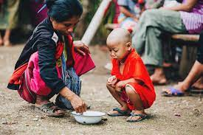
A Global Problem
According to the UN’s World Food Programme, 870 million people in the world do not have enough to eat (1 in 8 people!). Poor nutrition causes nearly half (45%) of deaths in children under five – 3.1 million children each year.

Slide 9
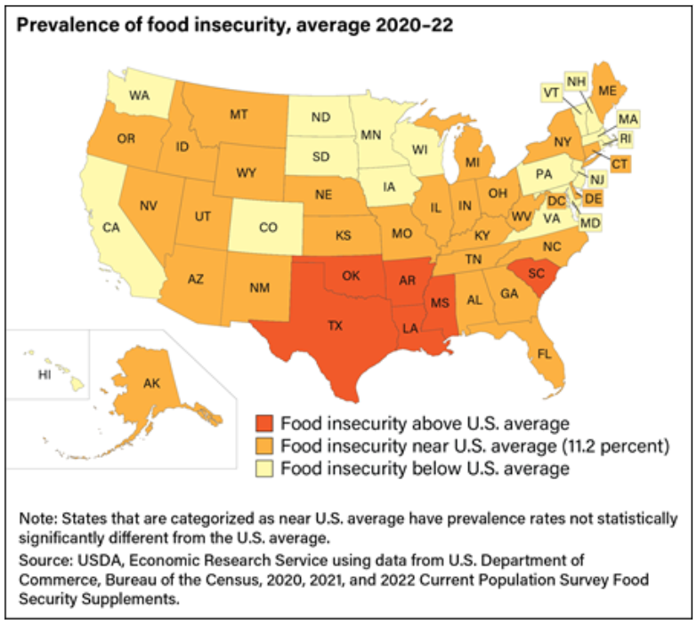
How Many People in the U.S. Lived in Food-insecure Households In 2022?
44.2 million people lived in food-insecure households.
11.7 million adults lived in households with very low food security.
7.3 million children lived in food-insecure households in which children, along with adults, were food insecure.
2023: Over 1 in 6 U.S. households with children (17.3 percent) experience food insecurity, an increase of 40 percent compared to 2021.
Food Insecurity—Lacking the means to get sufficient food for each person in a household to live a healthy lifestyle.⁵
Notes:
SS Footnotes - Jayden Davis (squarespace.com)

Slide 10
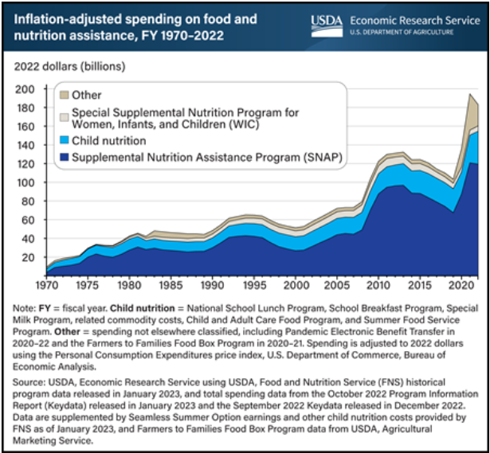
Federal spending on USDA’s food and nutrition assistance programs totaled $183.0 billion in fiscal year 2022.
Notes:
USDA ERS - Charts of Note

Slide 11


Slide 12
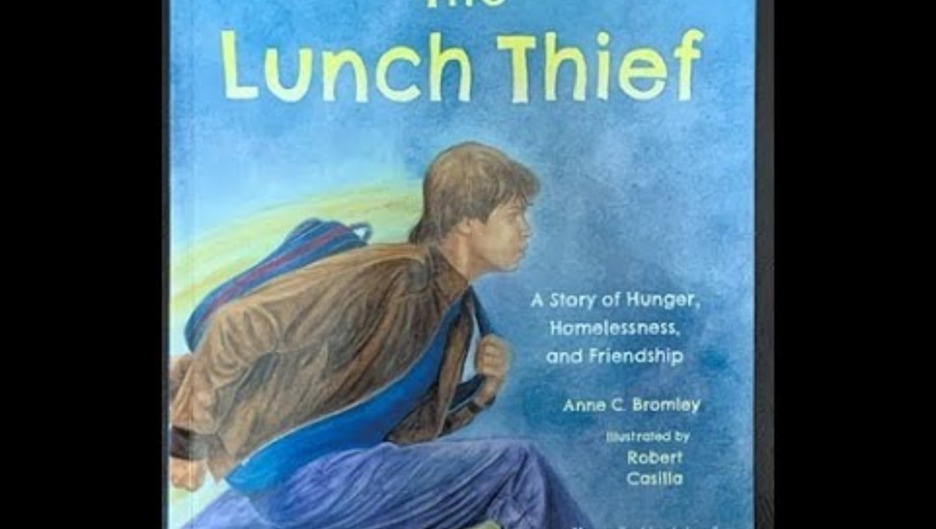

Slide 13

The Global Hunger Crisis - Causes
Conflict is still the biggest driver of hunger, with 70 percent of the world's hungry people living in areas afflicted by war and violence.
.
The climate crisis is one of the leading causes of the steep rise in global hunger. Climate shocks destroy crops and livelihoods, and undermine people’s ability to feed themselves
High fertilizer prices could turn the current food affordability crisis into a food availability crisis, with production of corn, rice, soybean and wheat all falling since 2022.
Global fertilizer prices have climbed even faster than food prices, which remain at a
ten-year high themselves. A global food crisis | World Food Programme (wfp.org)

Slide 14
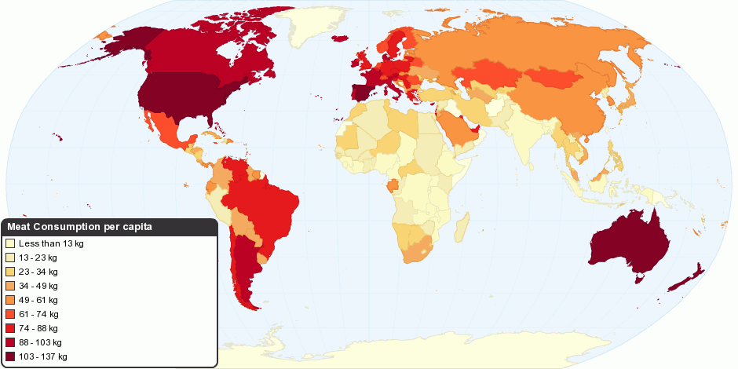
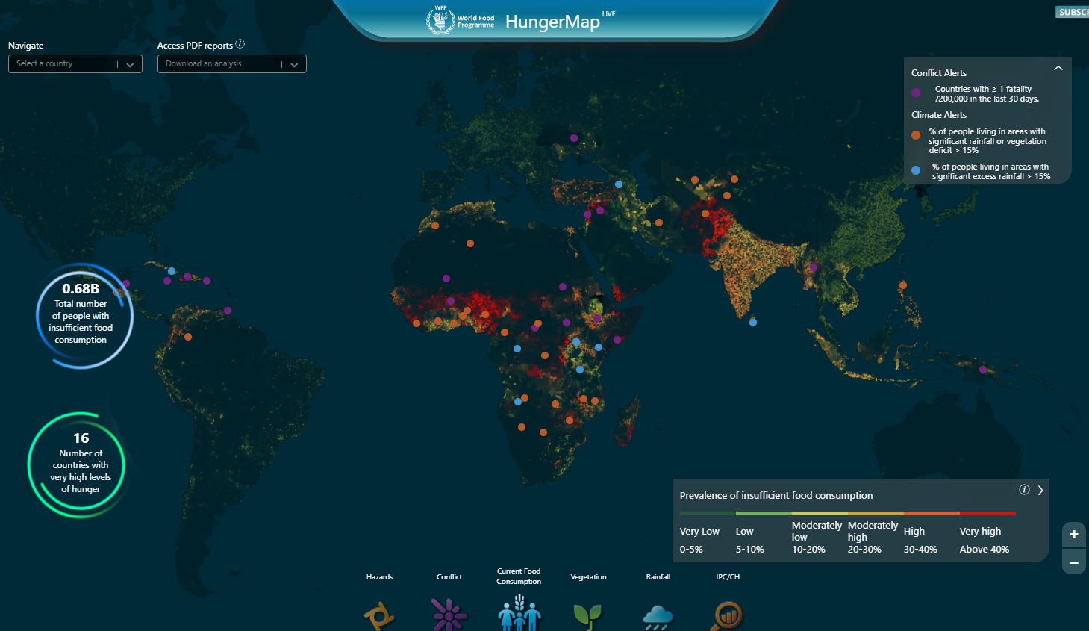
40 maps that explain
food in America
World Hunger Map
https://www.vox.com/a/explain-food-america
HungerMap LIVE (wfp.org)

Slide 15
Top Ten Causes Of World Hunger:
Hunger Is Not Caused By Scarcity
The hunger problem is not simple. For instance, in 2012, Holt-Giménez et al. found that there is enough food to feed 1.5 times the size of the world population. However, most industrially-produced grain crops go to biofuels, (to power vehicles), and confined animal feedlots rather than people. Furthermore, they found that hunger is due to poverty and inequality, not scarcity.
Poverty: Poverty and hunger exist in a vicious cycle. Malnutrition leads to underdevelopment, lack of abilities and unemplo yment.
Food shortages: Droughts or disease-carrying organisms and pests can lead to crop failures, often causing food shortages.
War and conflict: These are among the leading contributors to world hunger. They cause population displacement and lack of access to food sources and production.
Climate change: With extreme climatic events, crops fail drastically. This factor has the potential to drive a hundred million people into poverty.
Poor nutrition: Without a variety of food sources for adequate nutrition human health suffers.
Poor public policy: A country’s poor infrastructure and lack of investments in agriculture can lead to extreme poverty and hunger.
Economy: A country’s economic resilience and stability has a direct effect on its nutritional resilience. Working towards economic stability has a ripple effect on all the items in this list.
Food waste: Lack of food storage or poor distribution can cause this. As a result, food, and other valuable resources such as water and soil are wasted.
Gender inequality: Female farmers are often responsible for many agricultural activities, and food production in poor countries. Despite this, they tend to be underrepresented at decision making forums.
Forced migration: Refugees fleeing conflict often live in areas with inadequate food supply. Droughts in their homelands also add to this.
7 Ways to Achieve Zero Hunger - THRIVE blog (strive2thrive.earth)

Slide 16



Does your school have a way to provide food assistance to students?
Yes | No | Not Sure
Notes:
Discuss
AT 6:30

Slide 17

Notes:
When people are hungry or malnourished they cannot learn or work well.

Slide 18

“Malnutrition is the single largest contributor to disease in the world.” – Food and Agriculture Organization of the United Nations
02
Sustainable Development
Goal 2

Slide 19
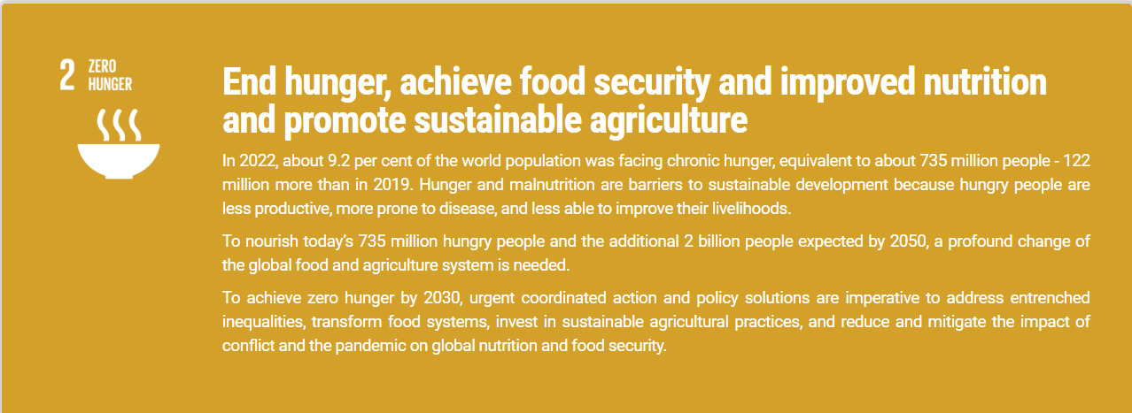
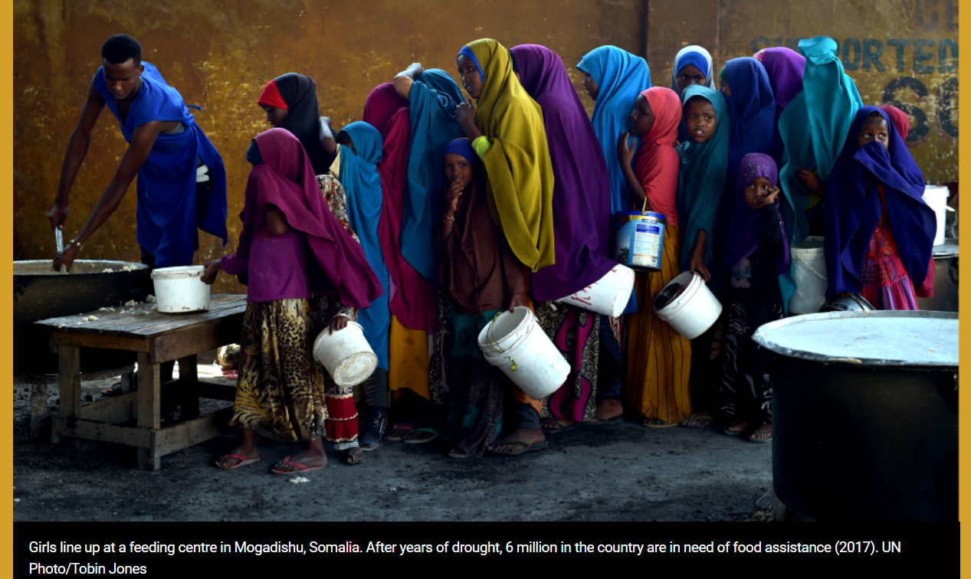
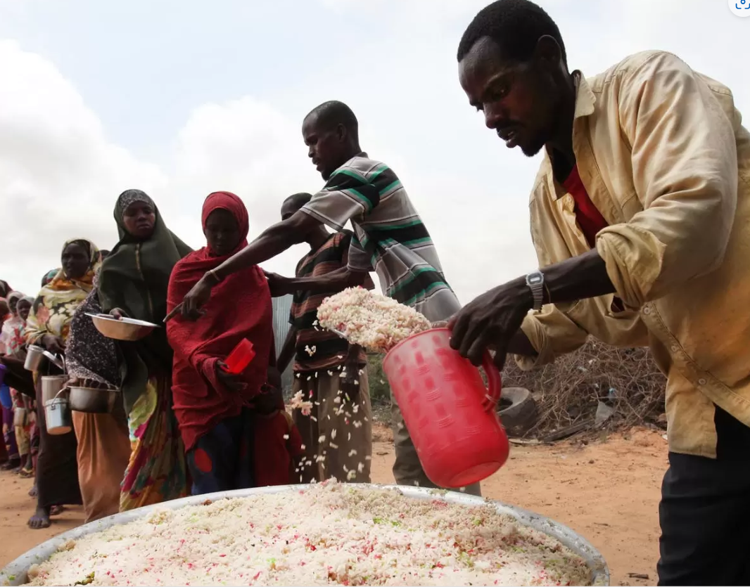
The Global Hunger Crisis

Slide 20
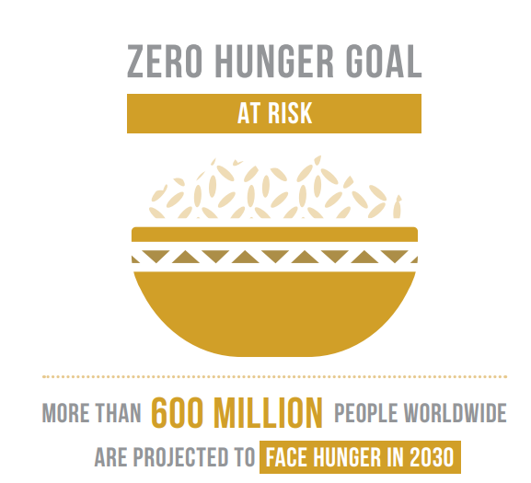
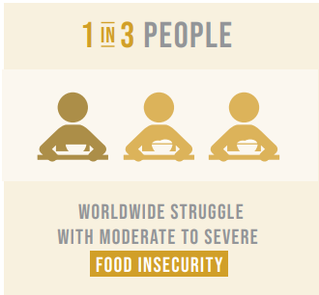
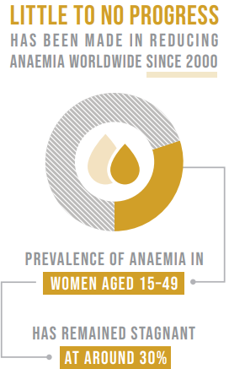
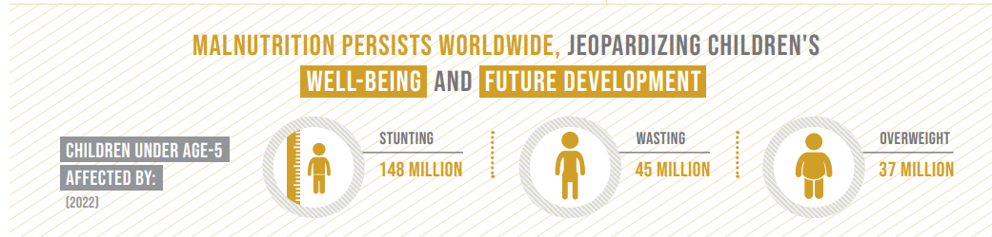
Goal 2: Zero Hunger - United Nations Sustainable Development

Slide 21
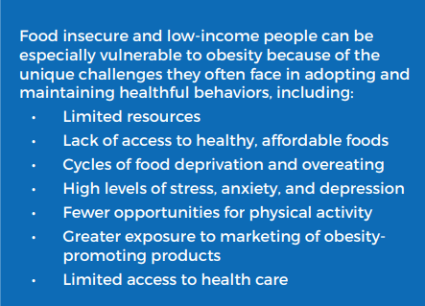
Food-insecure people are more prone to obesity. Not having a grocery store close by (and limited transportation) forces people to shop at places that sell mostly packaged and prepared foods – higher in calories, but lower in nutrition.
Approximately 39.5 million people, which accounts for 12.8% of the U.S. population, reside in low-income and low-access areas—commonly referred to as food deserts. These areas lack convenient options for securing affordable and healthy foods, especially fresh fruits and vegetables. Food deserts disproportionately affect high-poverty regions, creating everyday hurdles that can make it harder for kids, families, and communities to grow healthy and strong.
frac_brief_understanding_the_connections.pdf

Slide 22
Eradicating Hunger
Strategy | United Nations' Zero Hunger Challenge | Global Food Security Program
Objectives | End hunger, improve food security, and nutrition | Enhance agricultural productivity, sustainably use natural resources, and strengthen resilience to climate change
Progress | Progress has been made, but challenges persist | Collaborative efforts have seen some success in improving food access and security

Slide 23
03
Food Waste
“There are genuinely sufficient resources in the world to ensure that no one, nowhere, at no time, should go hungry.” – Ed Asner

Slide 24
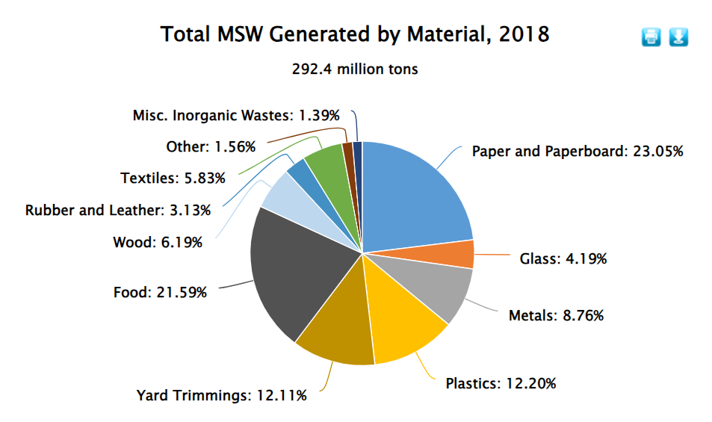

Slide 25
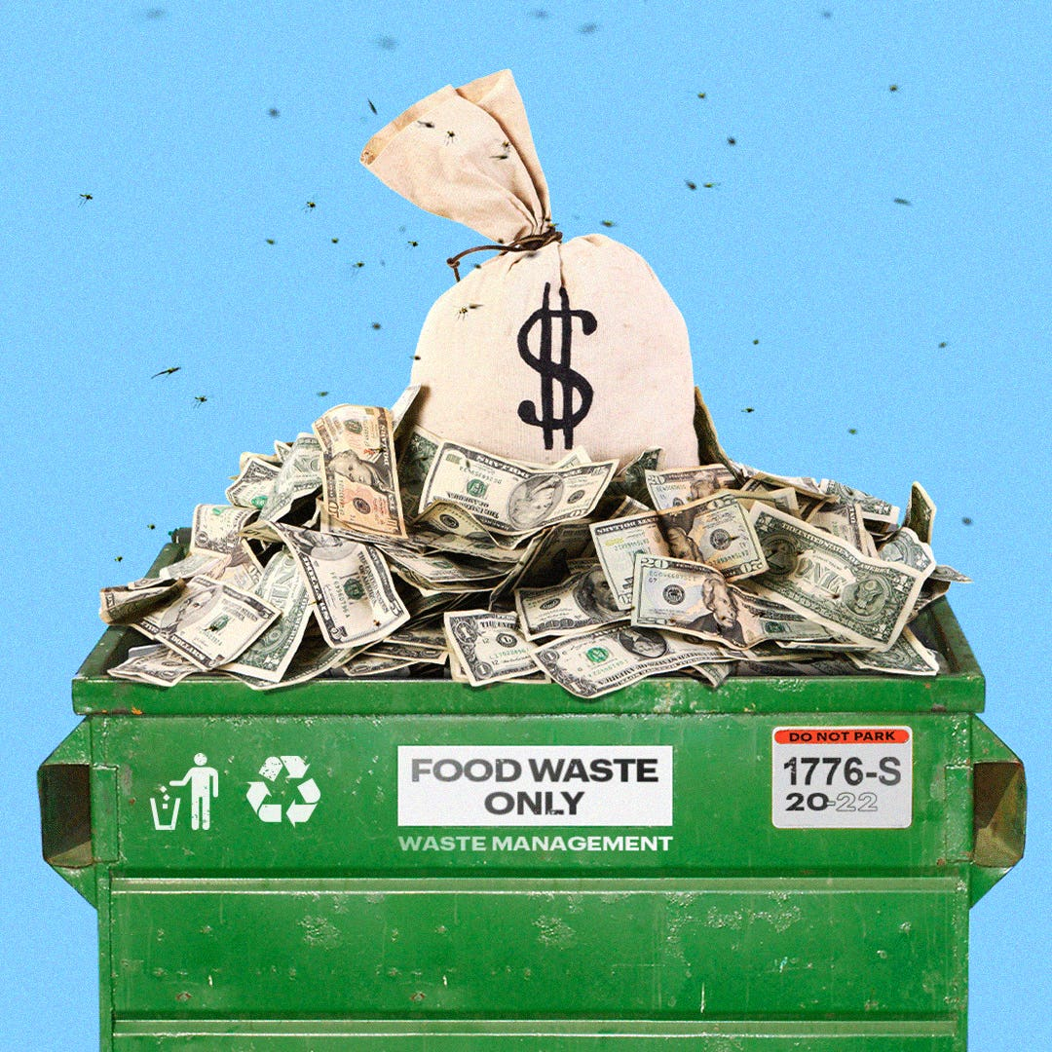
The average grocery store throws away between $5,000 and $10, 000 worth of food weekly.
There’s a powerful disincentive to improving and eradicating the problem. Since throwing out food cuts into corporate profits, the Internal Revenue Service classifies it as tax deductible.
$140.8 BILLION
Was spent on waste management in 2022.
21.59% of that waste was food waste.
We spent over 6.5 BILLION DOLLARS to dispose of food waste in 2022.
Food Waste Costs U.S. Taxpayers Billions Of Dollars A Year (forbes.com)

Slide 26
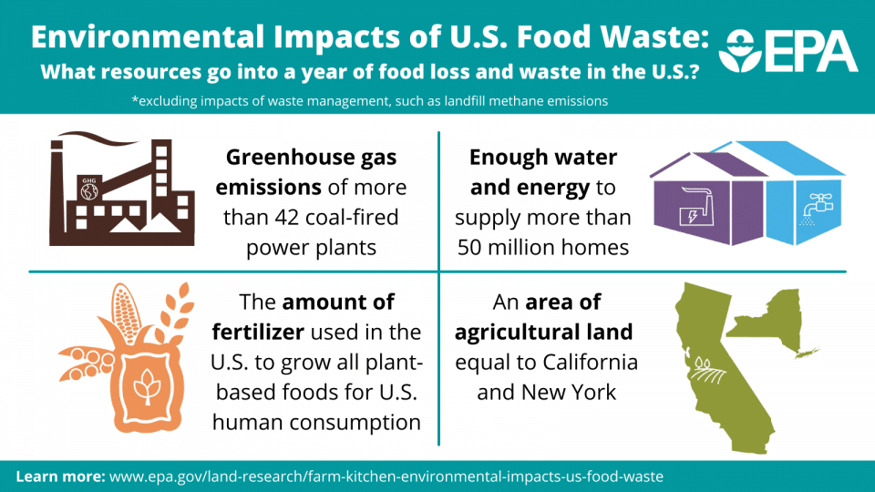

Slide 27
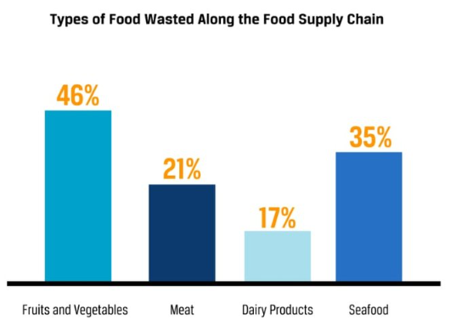
Americans produce billions of pounds of food waste every year, affecting the environment and economy in which they live. The average American throws out more than 400 lbs. (181 kg.) of food annually, which translates to 30%–40% of the total US food supply. ^{1, 2} Wasted food ranks as the number one material in US landfills, accounting for 24.1% of all municipal solid waste.²⁶
Issues that exacerbate the problem include:
unsustainable practices within the food supply chain
high aesthetic standards for produce (size, shape, color)
uninformed consumer behavior
Negative consequences of food waste include:
increased greenhouse gas emissions
wasted and compromised water supplies
economic losses
Redistributing unwanted or unsold food to organizations like food banks and churches not only reduces food waste but curbs food insecurity in the US.
Household composting diverts food from landfills, thereby mitigating greenhouse gas emissions.
SS Footnotes - Jayden Davis (squarespace.com)
Notes:
1. Dana Gunders and Jonathan Bloom, Wasted: How America is Losing Up to 40% of Its Food From Farm to Fork to Landfill (NRDC, August 2017), 4, https://www.nrdc.org/sites/default/files/wasted-2017-report.pdf. 2. “Food Waste FAQs,” US Department of Agriculture, Accessed October 21, 2021, https://www.usda.gov/foodwaste/faqs

Slide 28
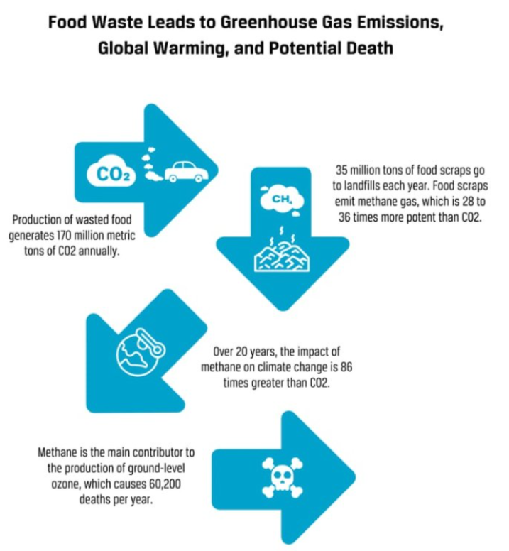
Wasted food left to rot in landfills also increases greenhouse gas emissions.¹²⁴
According to the Environmental Protection Agency, only 2.6 million tons of food scraps were composted in 2018, compared to 35 million tons that went into landfills.¹²⁵
SS Footnotes - Jayden Davis (squarespace.com)
Notes:
5 compost

Slide 29
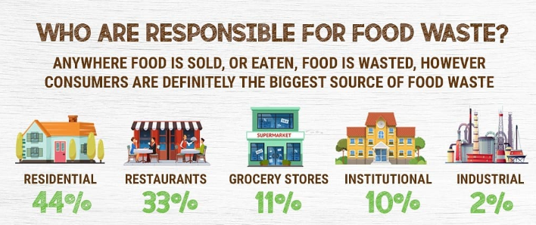
Concerning efforts to prevent food waste and loss, the US is ranked number 22 among 35 high-income countries—number 1 referring to a country at the forefront of food sustainability initiatives and number 35 referring to a country with the poorest practices.
Who is responsible for Food loss or Food waste? (avristech.com)

Slide 30
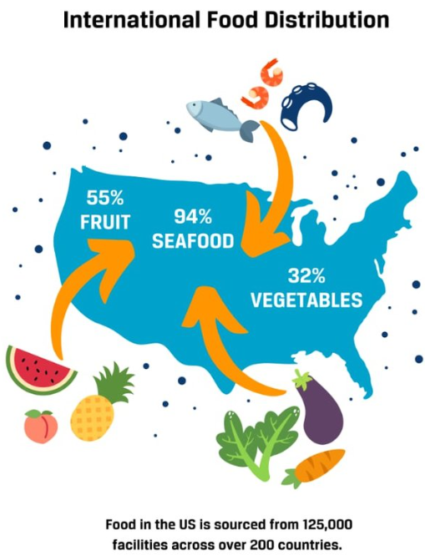
Studies estimate that processed food in the United States now travels over 1,300 miles on average, and fresh produce travels over 1,500 miles before reaching grocery stores and restaurants.⁷⁹ Lengthy transport times and distances lead to more damage during transportation and reduced shelf life.⁸⁰
^{Local Options Include:}
Where To Buy - Florida Fresh Meat Company
Market | Tampa, FL | Good Earth Meat & Seafood (goodearthmeatandseafood.com)
Tampa Farmers Markets - A Guide to Tampa Area Farmers Markets (tampabaydatenightguide.com)
SS Footnotes - Jayden Davis (squarespace.com)

Slide 31
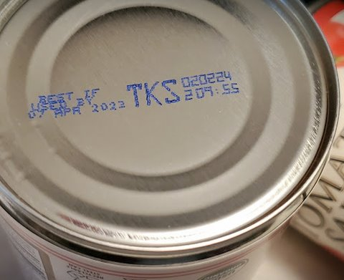
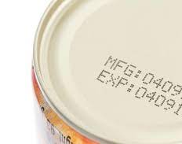
What are Food Product Dates?
Many consumers misunderstand the purpose and meaning of the date labels that often appear on packaged foods. Confusion over date labeling accounts for an estimated 20 percent of consumer food waste.
Except for infant formula, manufacturers are not required by Federal law or regulation to place quality-based date labels on packaged food.
There are no uniform or universally accepted descriptions used on food labels for open dating (calendar dates) in the United States.

Slide 32
Solutions
Ending Hunger
04
“If we can conquer space, we can conquer childhood hunger.” – Buzz Aldrin

Slide 33
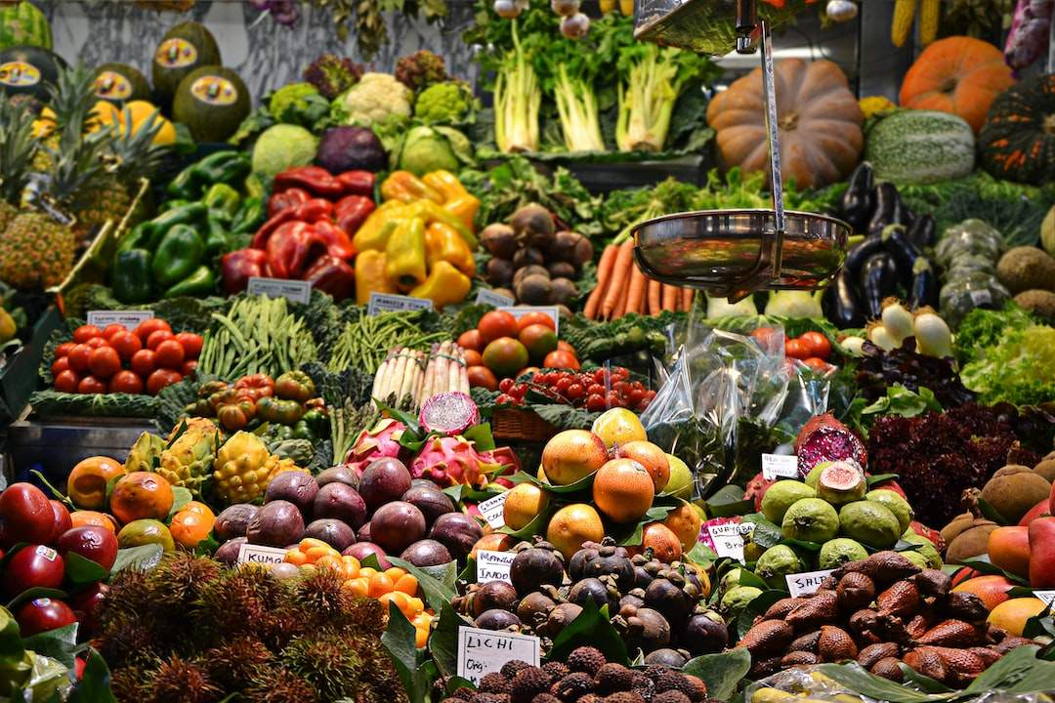
Governmental Efforts
Food Distribution Policies:
To ensure fair and equitable distribution of food resources.
Legislation:
Enacting laws that protect vulnerable populations and promote sustainable farming practices.
International Collaboration:
Engaging in international agreements to address global hunger and food security.
Investment in Infrastructure:
Building essential infrastructure to support food production and distribution.

Slide 34
Local Governance
Community Food Banks:
Establishing local food banks and distribution networks to support those in need.
Urban Agriculture Programs:
Encouraging urban farming to improve access to fresh produce in densely populated areas.
Public-Private Partnerships:
Collaborating with local businesses to invest in food security and poverty reduction programs.
Advocacy and Awareness:
Local government can play a role in raising awareness and advocating for food security initiatives.

Slide 35
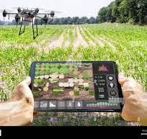
Impact of Agricultural Technology
Farmers no longer have to apply water, fertilizers, and pesticides uniformly across entire fields. Instead, they can use the minimum quantities required and target very specific areas, or even treat individual plants differently. Benefits include:
Higher crop productivity
Decreased use of water, fertilizer, and pesticides, which in turn keeps food prices down
Reduced impact on natural ecosystems
Less runoff of chemicals into rivers and groundwater
Increased worker safety
Notes:
1.

Slide 36
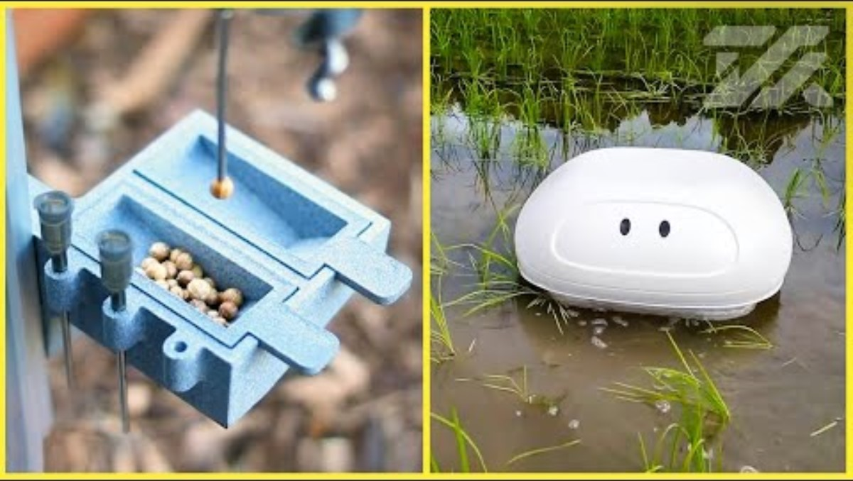

Slide 37
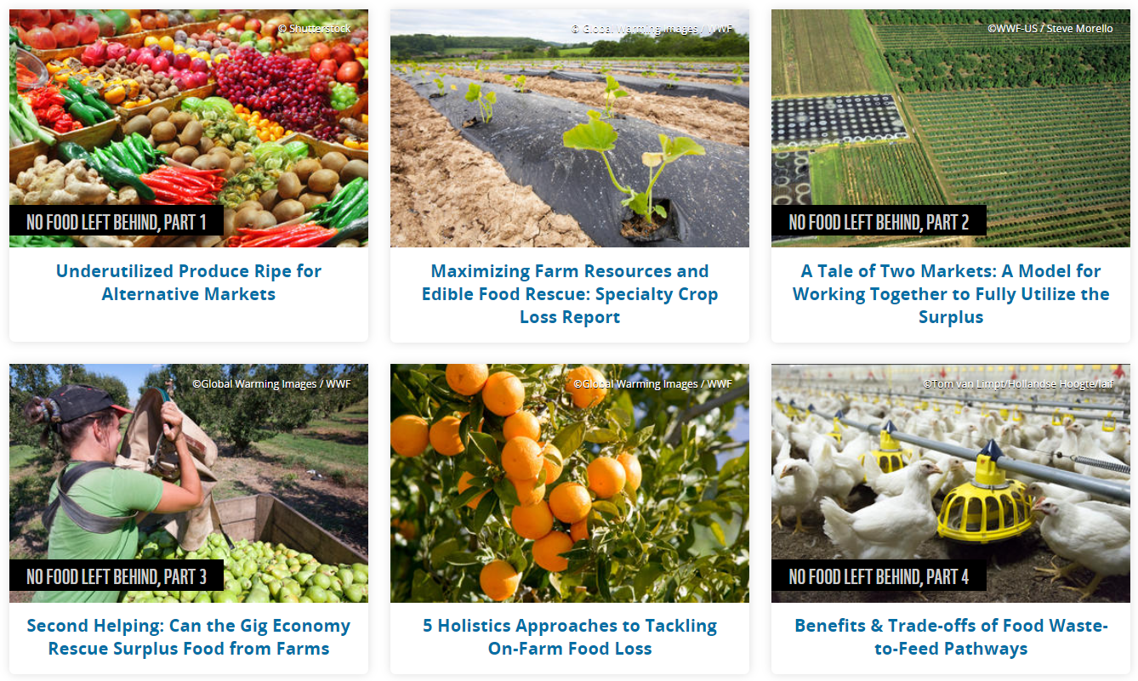
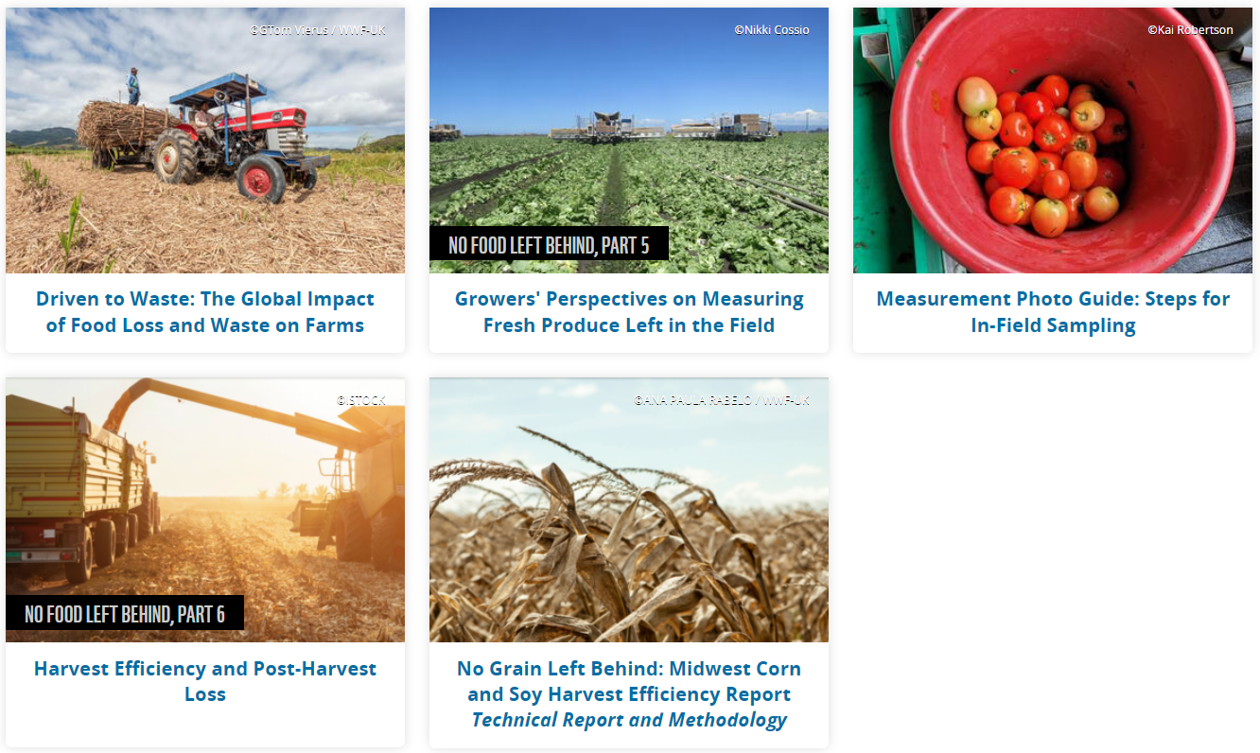

No Food Left Behind | Pages | WWF (worldwildlife.org)
An estimated 10 million tons of crops grown on farms each year never gets harvested or makes it past the farm gate—about a third of what’s grown. This loss happens because of labor shortages, cosmetic imperfections, weather events and more, and it makes up about 16% of total US food loss and waste.
Notes:
1 source reduction

Slide 38
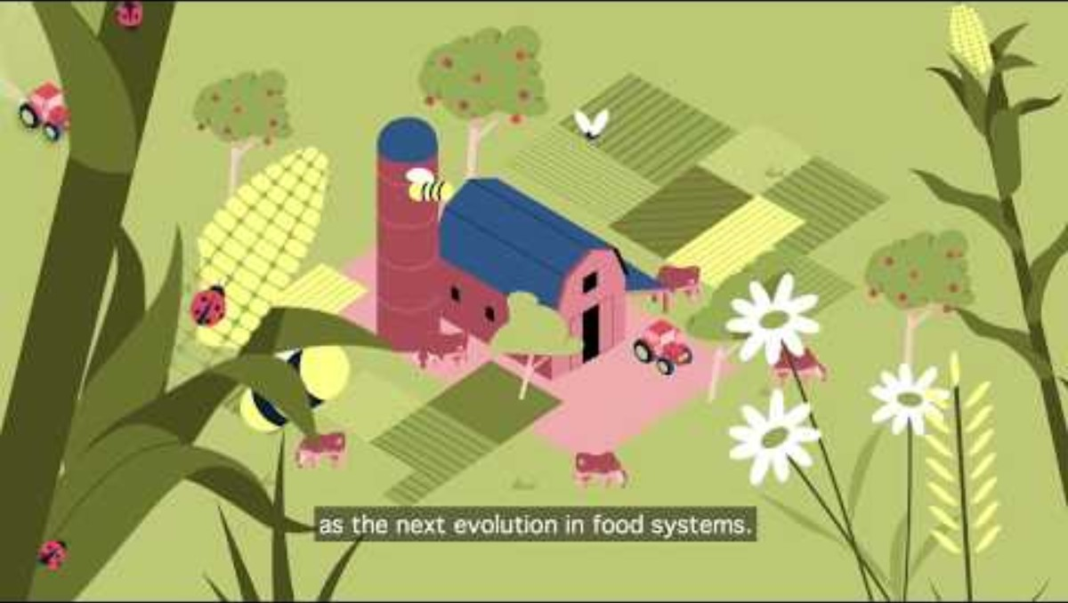
Notes:
Agroecology

Slide 39
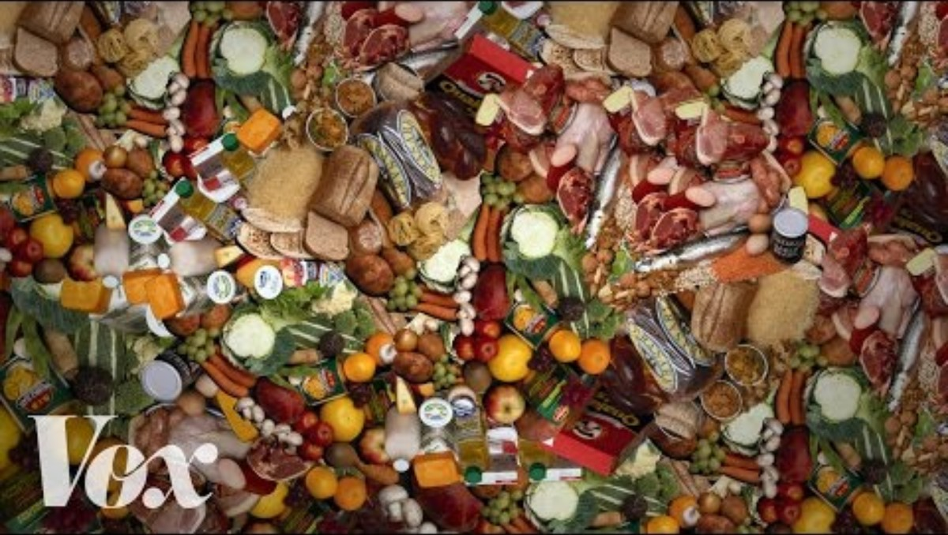

Slide 40
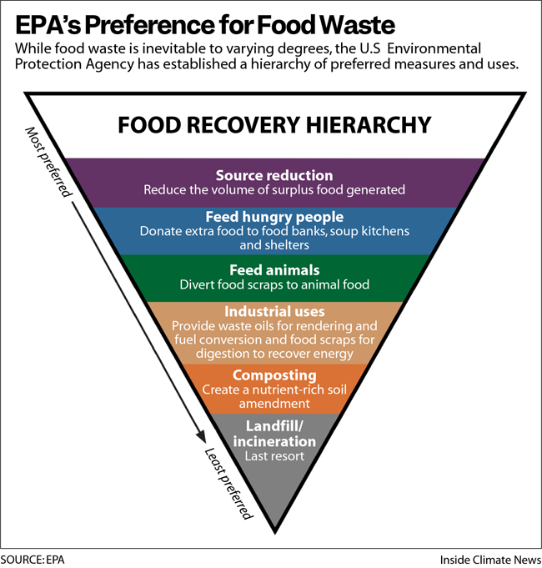
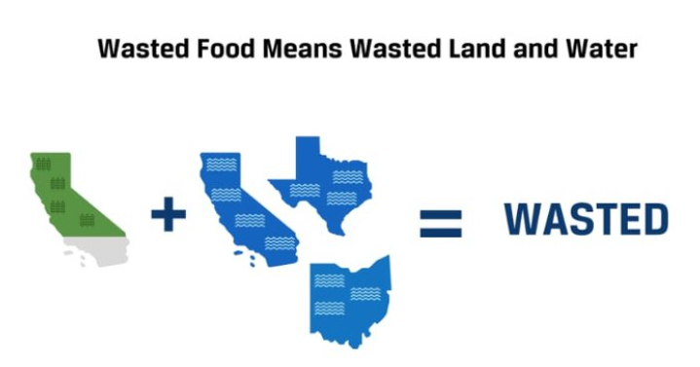
Reduce Waste

Slide 41
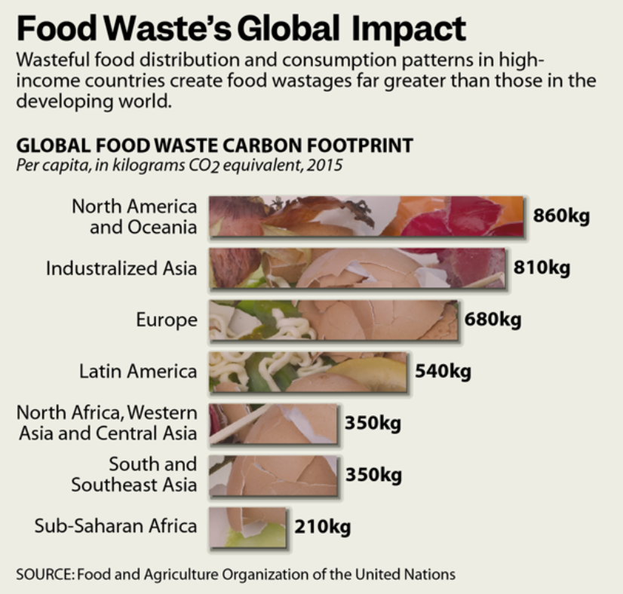

Slide 42
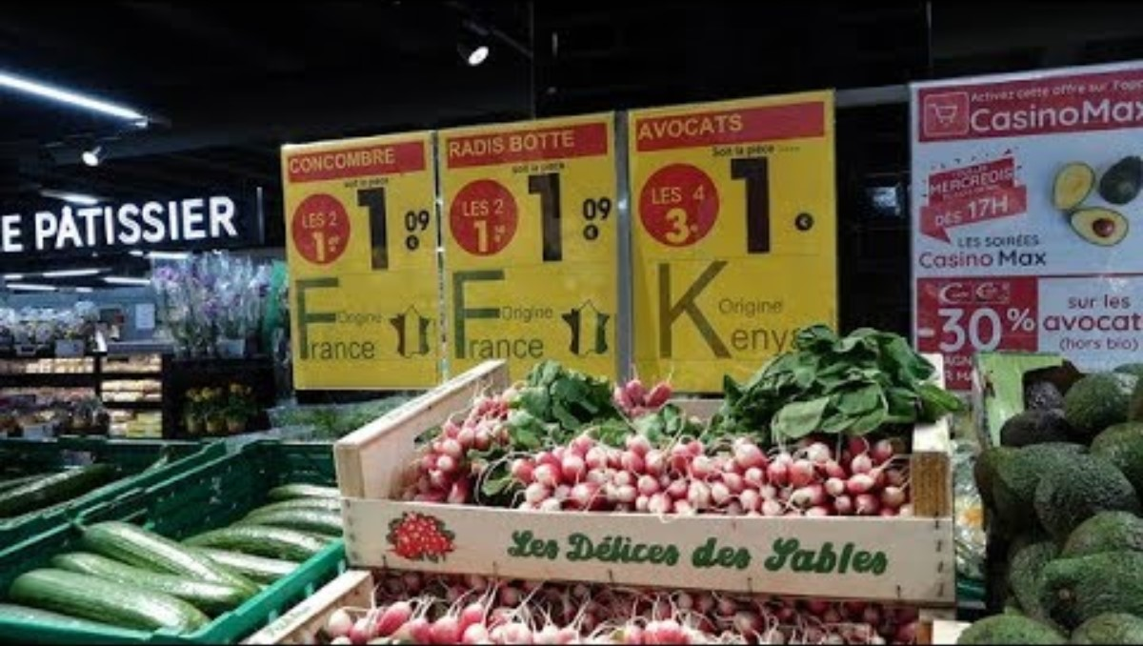

Slide 43
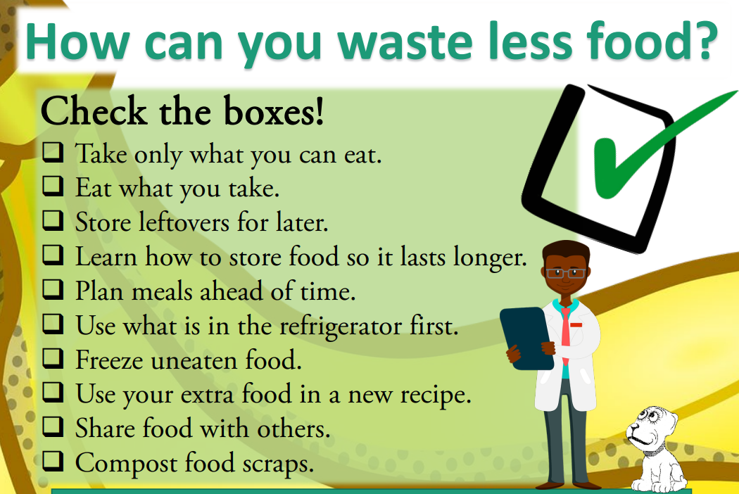
Food is too good to waste! (epa.gov)
Notes:
1

Slide 44
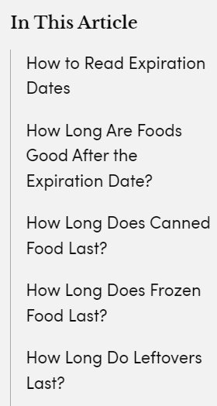

Is It Safe to Eat Food Past the Expiration Date? Here's What You Should Know
Don’t Through Out Good Food
Food Expiration Date Guidelines Plus Easy-to-Read Chart (realsimple.com)

Slide 45



Where to Learn How Best to Store Perishables and How Long They Will Keep Safely
The FoodKeeper, developed cooperatively by the U.S. Department of Agriculture, Cornell University and the Food Marketing Institute, is a complete guide to how long virtually every food available in the United States will keep in the pantry, in the refrigerator, and in the freezer.
The Fresh Fruits section, for example, covers apples (3 weeks in the pantry, 4 – 6 weeks in the fridge, and — only if cooked — 8 months in the freezer) to pomegranates (2 – 5 days pantry, 1 – 3 months fridge, and 10 – 12 months freezer).
Mobile apps: Android
Apple devices: Apple
Notes:
1

Slide 46
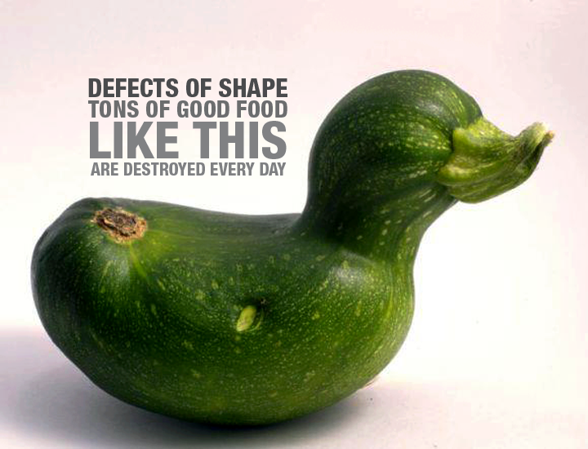

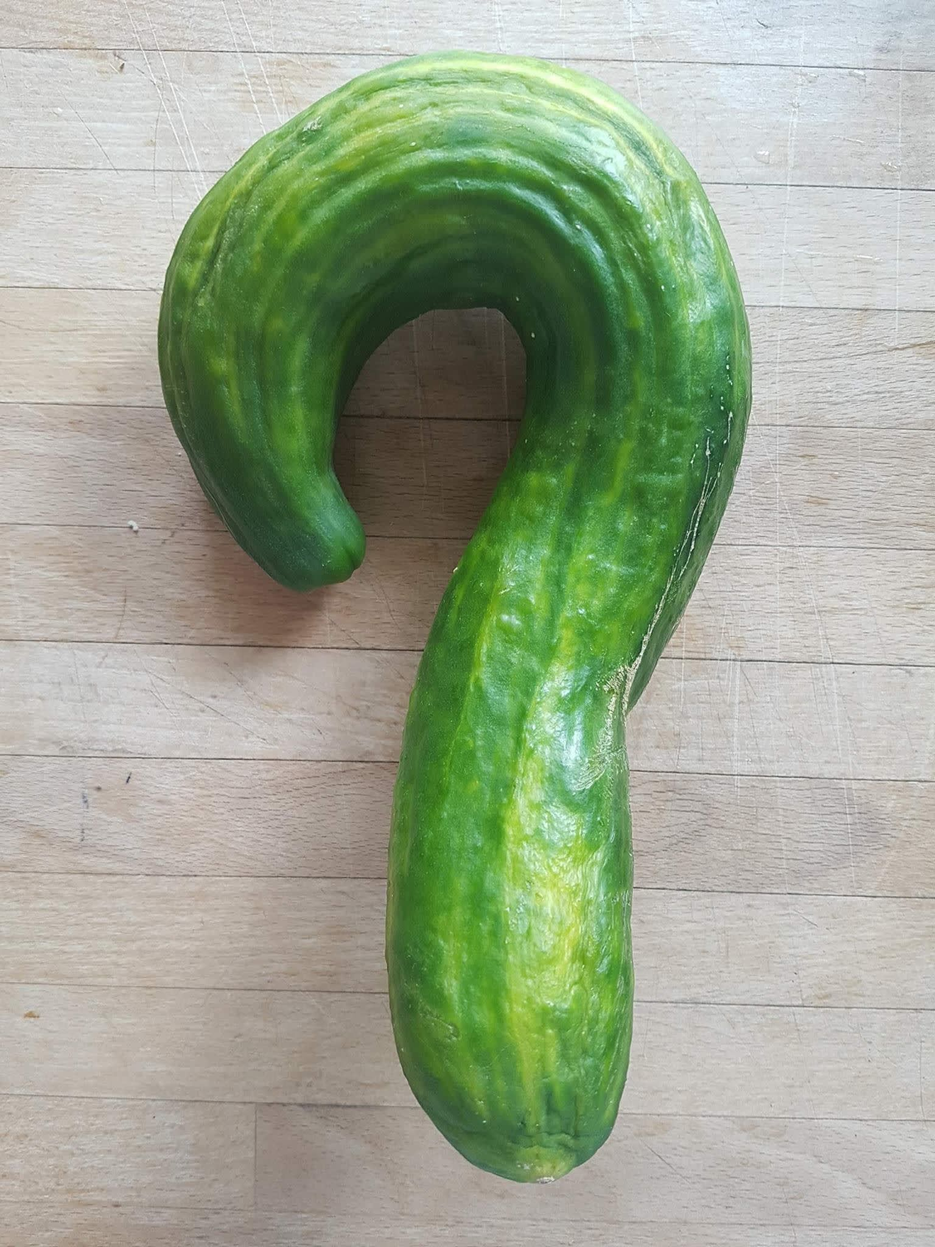
Eat Imperfect Food
Notes:
1. Source Reduction

Slide 47
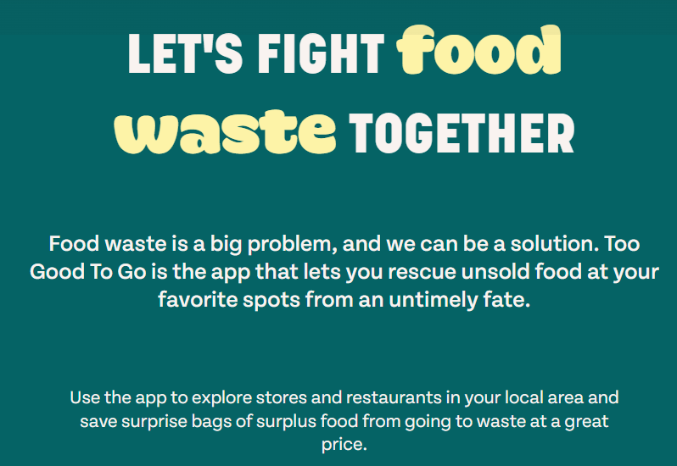
Find Food - Feeding Tampa Bay
Publix and Walmart donate expired food to Feeding America
https://www.feedingamerica.org/
Save Food - Help The Planet - Too Good To Go
Notes:
1

Slide 48
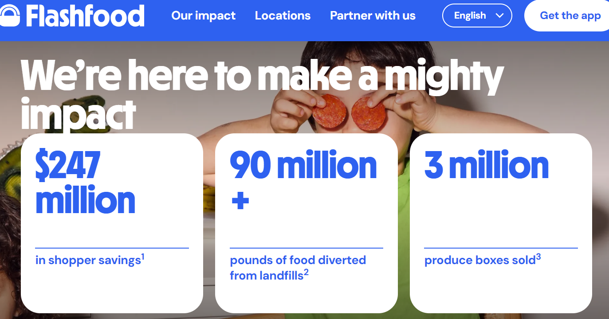
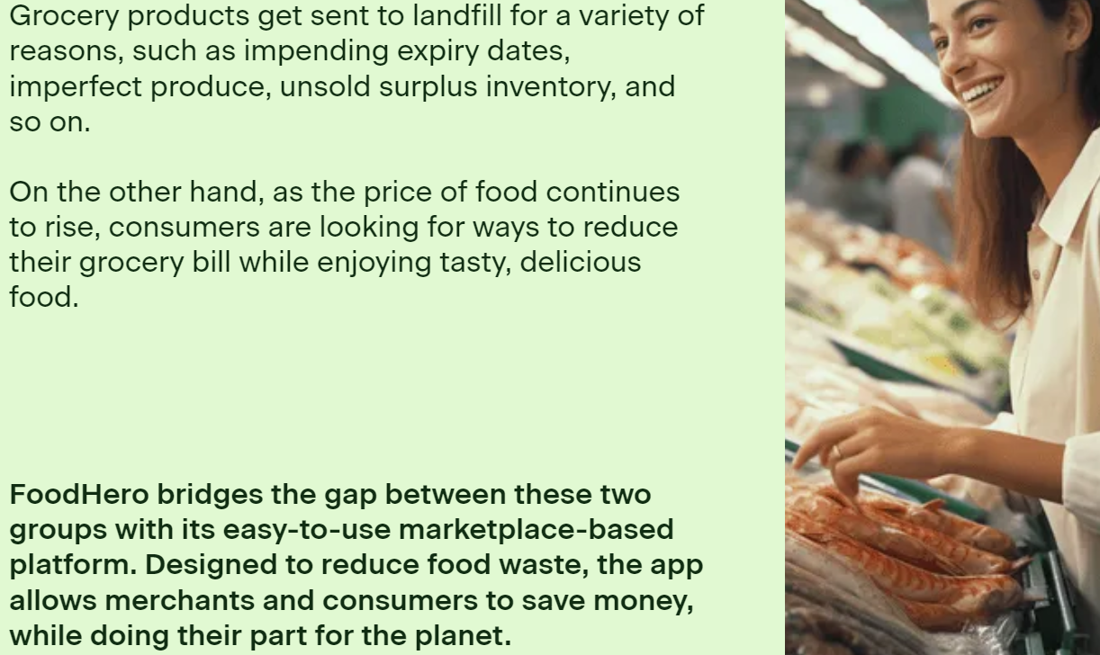
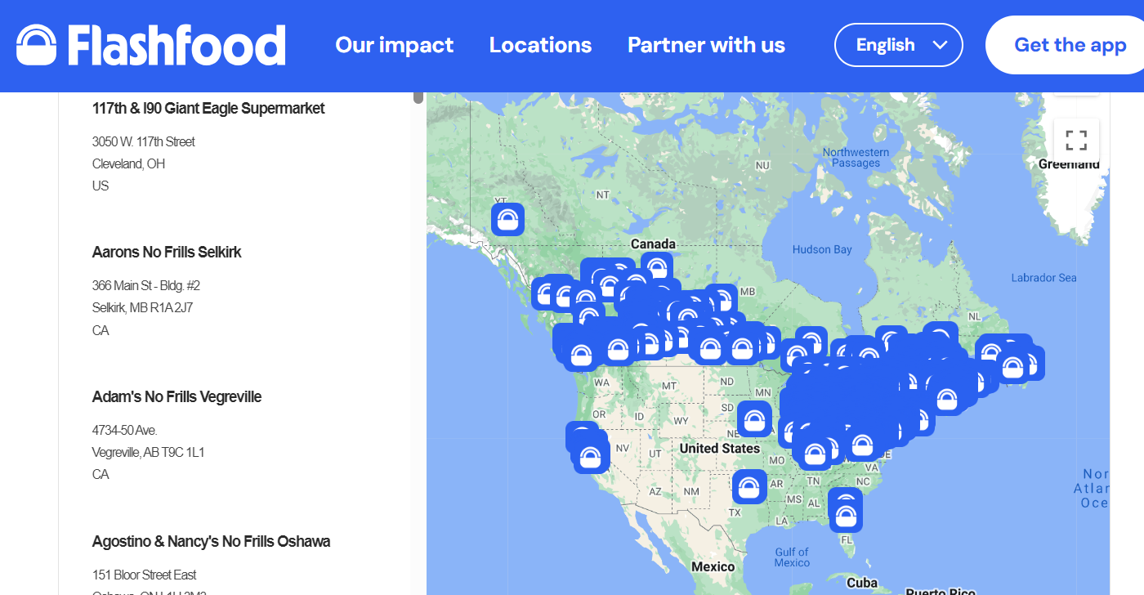
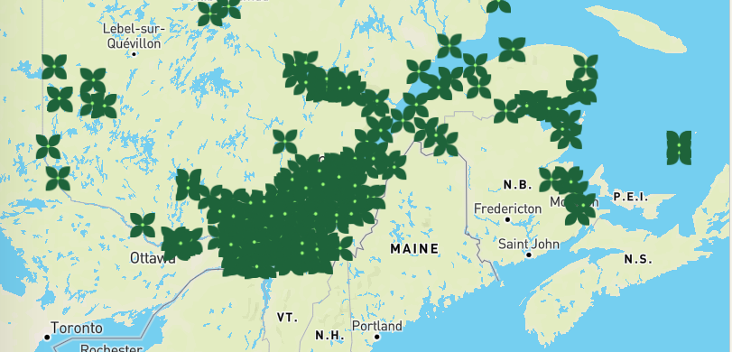
Notes:
Flashfood | Our impact
Why FoodHero? To Reduce Food Waste, Save Money & the Planet

Slide 49

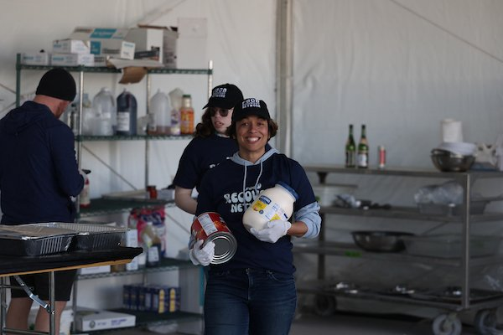
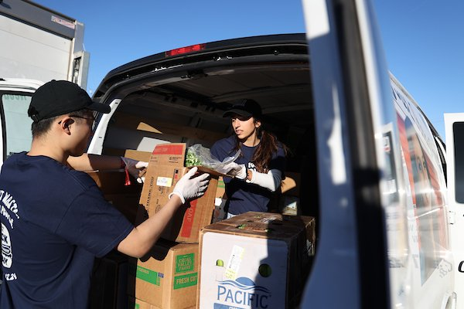
Food Recovery Network
192 campuses in 44 states and the District of Columbia. 16.3 million pounds recovered. 13.6 million meals donated. Over 7200 Metric Tons of CO2 emissions prevented.
On Sunday, February 11, 2024, six volunteers, including FRN alumni and local students from the University of Nevada, Las Vegas, joined FRN staff at the Players Tailgate just across the street from Allegiant Stadium to recover surplus food—both raw, fresh foods and prepared meals—and transport it for donation to The Just One Project, a nonprofit organization dedicated to fighting food insecurity in southern Nevada.
Our efforts resulted in an incredible 3,994 pounds of surplus food delivered safely to our nonprofit partner, where it’ll go to produce thousands of quality meals to feed people experiencing hunger.
Notes:
2

Slide 50

Kiran Sridhar, a remarkable 16-year-old, was deeply moved by the long lines of people waiting for food at a local shelter during his school community service project. Fueled by empathy and determination, he founded the “Waste No Food” platform—a brilliant solution to combat hunger.
Waste No Food operates as a “shared economy” platform, connecting surplus food from numerous restaurants and grocery stores in the Bay Area directly with shelters serving the hungry and homeless. Kiran’s innovative app bridges the distribution gap between donors and recipients, ensuring that excess food reaches those in need within seconds.
When you don’t know where your next meal is coming from, it becomes all-consuming. Kiran’s initiative demonstrates how a single individual can make a significant impact in the fight against hunger. His dedication and vision inspire us all to take action and contribute to a world where no one goes to bed hungry.

Slide 51
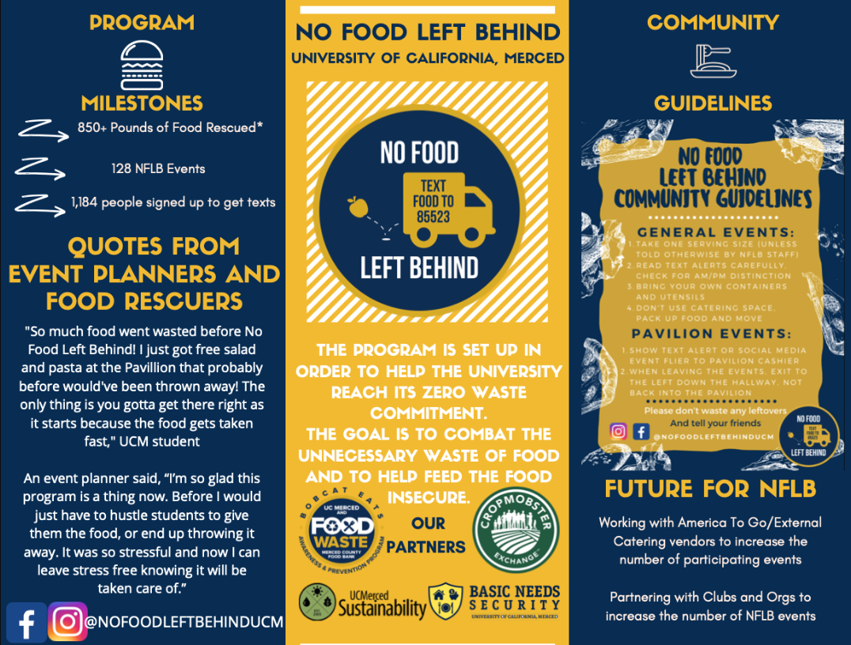
No Food Left Behind is a free text messaging service that connects students, staff and faculty at the University of California, Merced to events that might have food leftover. People are encouraged to bring Tupperware to these events to collect any remaining food which simultaneously reduces food waste and food insecurity.
No Food Left Behind: A free text service to reduce food insecurity and food waste - AASHE Campus Sustainability Hub
Notes:
2

Slide 52

We are the boots on the ground, the local experts who make finding help easier. There are more than 200 211 agencies across the United States, each with a team of compassionate, highly trained community specialists who are available to help you access the best local resources and services to address any need.
The 211 network in the United States responds to more than 21 million requests for help every year. Most calls, web chats, and text messages are from people looking for help meeting basic needs like housing, food, transportation, and health care.
The Federal Communications Commission (FCC) designated 211 as the 3-digit number for information and referrals to social services and other assistance in 2000. The 211 service is provided by more than 200 local organizations that are committed to serving their communities. Many different kinds of organizations operate the 211 service, including United Ways, Goodwill, Community Action Partnerships, and local crisis centers.

Slide 53
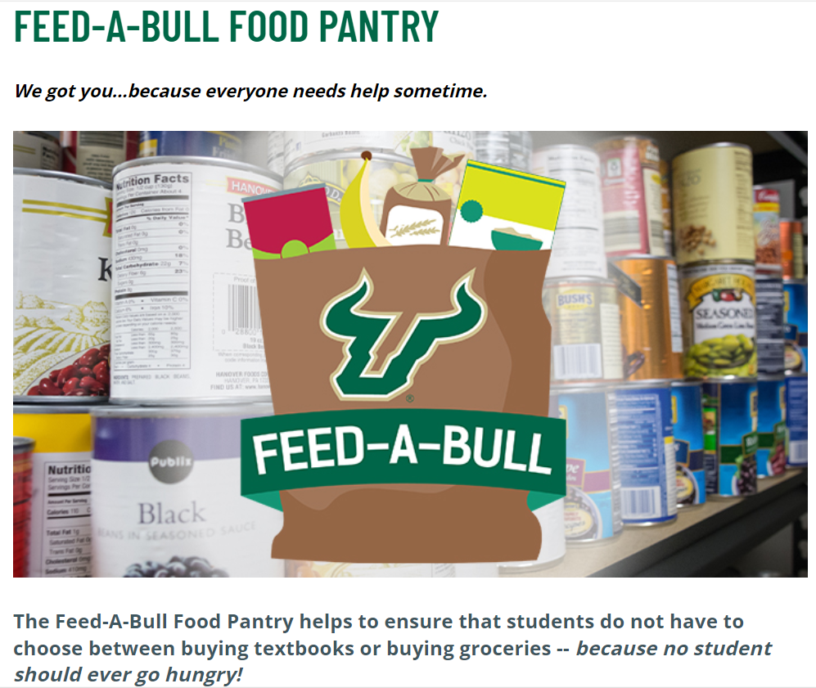
48% of college students in America are food insecure
ABOUT THE PANTRY
Feed-A-Bull, an initiative spearheaded by Student Health & Wellness Center and Feeding Tampa Bay, strives to alleviate food hardship and hunger among all enrolled USF students by providing supplemental food, nutrition education and resources to any student in need -- whatever their situation -- in order to ensure their academic success at USF.
The confidential pantry was created as a response to the knowledge that approximately 30 percent of students face food insecurity while attending the university for a variety of reasons, and supplemental food assistance may allow these students to focus on their studies.
Notes:
Some 48% of college students in America are food insecure. A new study published by Temple University and the Wisconsin HOPE Lab highlights some staggering stats: 36 percent of college students say they are food insecure. It’s more prevalent among college students of color, up to 57 percent

Slide 54
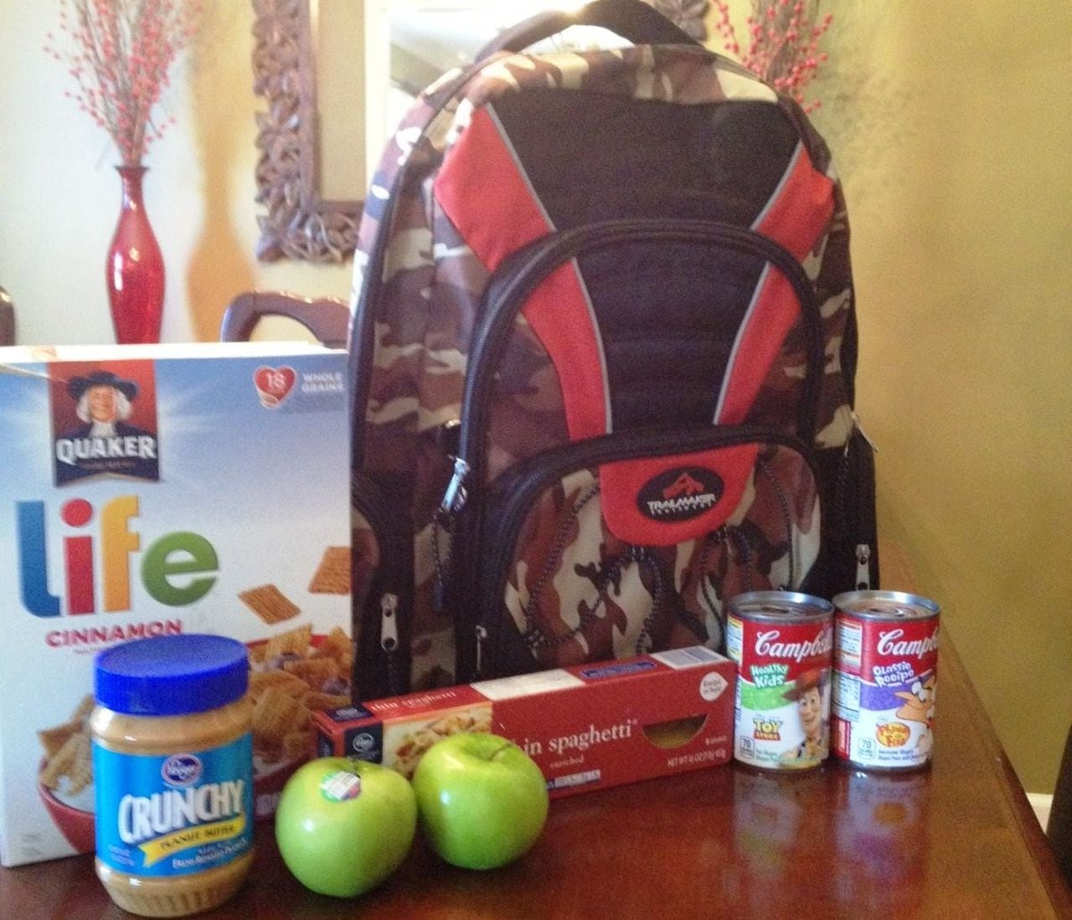
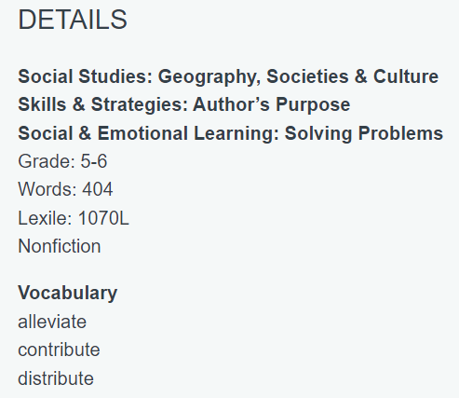
Backpacks to Fight Hunger, Voice Reading Passage (readworks.org)
BackPack Program | Feeding America
Notes:
BackPack Program | Feeding America

Slide 55
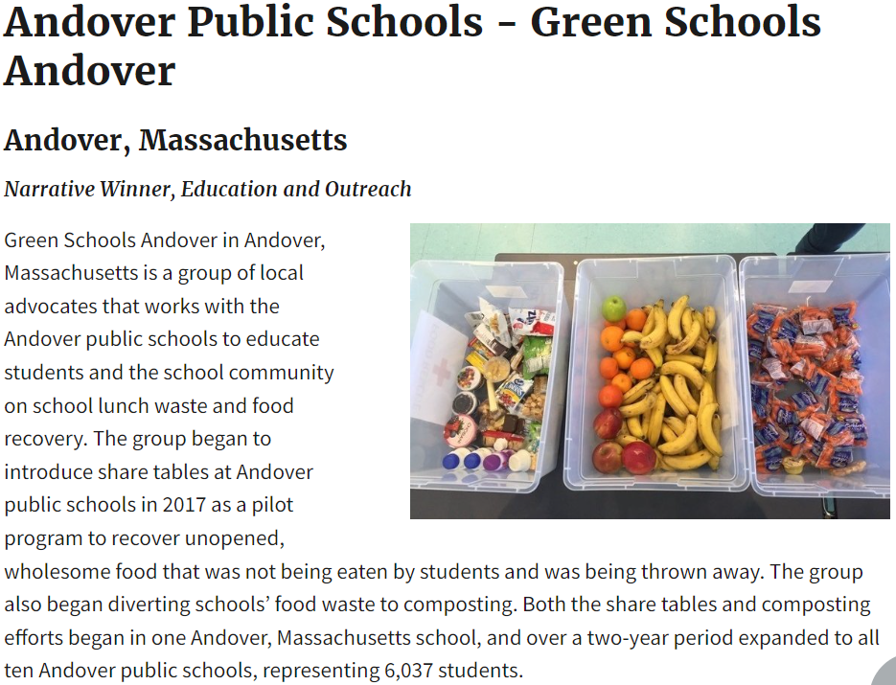
Success Stories in Reducing Waste | US EPA
About the 2018 Food Recovery Challenge National Award Winners | US EPA

Slide 56


In addition to the waste reduction strategy, which also included goals like the elimination of styrofoam cafeteria trays and the establishment of “robust recycling programs” for all schools, the school district’s other primary aim is to “create a supportive culture for food waste reduction and diversion.”
It’s “a really transformative experience for students and one that could kind of affect their choices both in school cafeterias and at home,” Rosenthal said.
In Baltimore Schools, Cutting Food Waste as a Lesson in Climate Awareness and Environmental Literacy - Inside Climate News

Slide 57


Food waste for livestock feeding: Feasibility, safety, and sustainability implications - ScienceDirect
Recovering consumption-stage food waste for animal feeding is a viable solution that simultaneously addresses the issues of waste management, food security, resource conservation, and pollution and climate-change mitigation.
Farmer recycles food waste from local supermarket

Slide 58

Insects grown on food waste are safe to use in animal feed - All About Feed
Black soldier fly larvae, house fly larvae, mealworms and small mealworms that are grown on food waste can – under certain conditions – be safely used as an ingredient for animal feed. This is the conclusion of a study by the Risk Assessment & Research Office (BuRO) of the Dutch Food and Consumer Product Safety Authority (NVWA).

Slide 59



Composting
Composting is the natural process of recycling organic matter, like leaves and food waste, into a fertilizer that can enrich soil and plants.¹⁶⁹ Individuals can compost food waste such as fruits and vegetables, eggshells, tea bags, nut shells, and coffee grounds.¹⁷⁰ The four basic ingredients for compost are “greens” from grass clippings and food scraps, “browns” from dead leaves and twigs, water, and air.¹⁷¹ The green materials provide nitrogen, which is essential for plant and animal growth, and the brown materials supply carbon, which is a food source for decomposers.¹⁷² For every 1 part green material, there should be 2–4 parts brown material.¹⁷³
The EPA estimates that in 2018, 2.6 million tons of food was composted. That’s only 4.1% of wasted food.
Notes:
5

Slide 60
Ties to Standards / Lesson Ideas
05
“Working at the Food Bank with my kids is an eye-opener. The face of hunger isn’t the bum on the street drinking Sterno; it’s the working poor. They don’t look any different, they don’t behave any differently, they’re not really any less educated. They are incredibly less privileged, and that’s it.” – Mario Batali

Slide 61


Slide 62

How You Can Teach Students About World Hunger (wfpusa.org)
Fight hunger by playing a game! This is an easy one: visit www.freerice.com and start answering trivia questions. For every question you get right, sponsors donate the cash equivalent of 10 grains of rice – filling empty plates around the world…for free!

Slide 63
Science standards taught using a school garden:
Kindergarten: characteristics of real plants vs. fake or fictional plants in books, observe how plants are alike and different.
1st grade : Make observations of living things using 5 senses, identify the major parts of a plant including leaf, stem, root, and flower; differentiate between living and nonliving things, observe that plant closely resemble their parents, plants need air, water, light, and space.
2nd grade: compare and contrast the basic needs for survival that all living things have, recognize habitats, observe and describe life cycles of plants.
3rd grade: classify flowering and nonflowering plants into major groups by their characteristics, such as those that produce seeds and those that produce spores, describe how animals and plants respond to changing seasons, recognize that plants use energy from the sun, air, and water to make their own food, describe structures in plants and their roles in food production, support, water and nutrient transport, and reproduction, investigate how plants respond to stimuli such as light and gravity.
4th grade: compare seasonal changes in Florida to those in other regions, explain that animals cannot make their own food but when they eat plants the energy is transferred, trace the flow of energy from the sun through the food chain, recognize the ways plants and animals can impact the environment, identify processes of sexual reproduction in flowering plants, compare and contrast the major life cycle stages of plants and animals.
5th grade: Describe how environmental changes affect the survival of plants and animals, compare the structures and systems of plants to those of humans, compare and contrast how adaptations of plants and animals enable them to survive in different environments.

Slide 64


About - Nourish: Food + Community (nourishlife.org)
Videos - Nourish: Food + Community (nourishlife.org)

Slide 65


Slide 66

The Good Garden – How One Family Went From Hunger to Having Enough

Slide 67


Slide 68
Speaking of roots, millions are being poured into urban farming programs and infrastructure aimed at combating food insecurity in East St. Louis and the surrounding area. Rising next to the JJK Center and the Lansdowne UP offices is a 100-meter passive solar greenhouse, which will be the first of its kind in the U.S. It will have the capacity to produce 30,000 pounds of food per year, with an energy bill of a few dollars a day.
This effort is part of the Jackie Joyner-Kersee Food, Agriculture, Nutrition (FAN) Innovation Center, which is a collaboration between the JJK Foundation, the University of Illinois Urbana-Champaign, the Donald Danforth Plant Science Center and Lansdowne UP.
The dynamic partnership provides educational and professional development programming in agriculture, STEAM, food innovation, nutrition, physical activity and entrepreneurialism to youth and community members.
They Built New Housing in East St. Louis. Now They Need People to Buy Into Their Vision (riverfronttimes.com)

Slide 69


Slide 70

Florida Agriculture in the Classroom 🍊 (faitc.org)

Slide 71


Gardening for Nutrition Archives - Florida Agriculture in the Classroom (faitc.org)

Slide 72





Narrative Texts
Notes:
We seek to inspire children to want to learn and to take an interest in the world around them. We want to empower them to be make choices that benefit their futures. A combination of fiction and non fiction texts inspires and informs.

Slide 73
  What resources does Bear have?
  What resources does Hare have?
  We can call Hare an entrepreneur? What does that mean?
  Does Hare’s original deal with Bear sound like a good deal for both parties? Why or why not?
  What resources do Hare and his family need to grow the garden?
  How does Hare continue to outwit Bear?
  What are the different parts of Hare’s garden ecosystem?
  What lessons did both Bear and Hare learn?
Notes:
We help teachers to ask questions that will cause students to think and make connections.

Slide 74




tFlorida Gardening Calendar - Solutions for Your Life - University of Florida, Institute of Food and Agricultural Sciences - UF/IFAS (ufl.edu)
FLORIDA GARDENING CALENDAR
The Gardening Calendar gives Florida gardeners a monthly guide for what to plant and do in their gardens and includes links to useful gardening websites, all based on University of Florida research and expertise.
Three different editions of the Gardening Calendar provide specific tips for each of Florida’s climate zones--North, Central, and South.

Slide 75

Notes:
https://youtu.be/-zsv_vImOr8

Slide 76






Plan-It-Map-It.pdf (faitc.org)
Gardening for Grades

Slide 77


Slide 78






Slide 79

Notes:
https://youtu.be/uxXF1hkrT0c

Slide 80



Slide 81




Slide 82



The UF/IFAS extension for Hillsborough County offers workshops on rain barrels and composting. If you attend the workshop (cost is $10), you get the rain barrel or compost bin for free!
Rain Barrels - Hillsborough County - University of Florida, Institute of Food and Agricultural Sciences - UF/IFAS (ufl.edu)
Composting - Hillsborough County - University of Florida, Institute of Food and Agricultural Sciences - UF/IFAS (ufl.edu)

Slide 83


Slide 84

THANKS !
Please complete the survey.
THE END

