Slide 1

Teach Like A
Rockstar!
The Economics
of the Music Industry!

Slide 2

Tonight’s Rockstar Lineup:
5:30-6:00- Dinner and Documentary
6:00-6:30 - ROCK CONCERT
6:30-6:45 - Working Intermission
6:45-7:15 - Meet Gooding
7:15-8:15 - Rockin’ Resources for your students
8:15 - Closing remarks, survey, questions

Slide 3

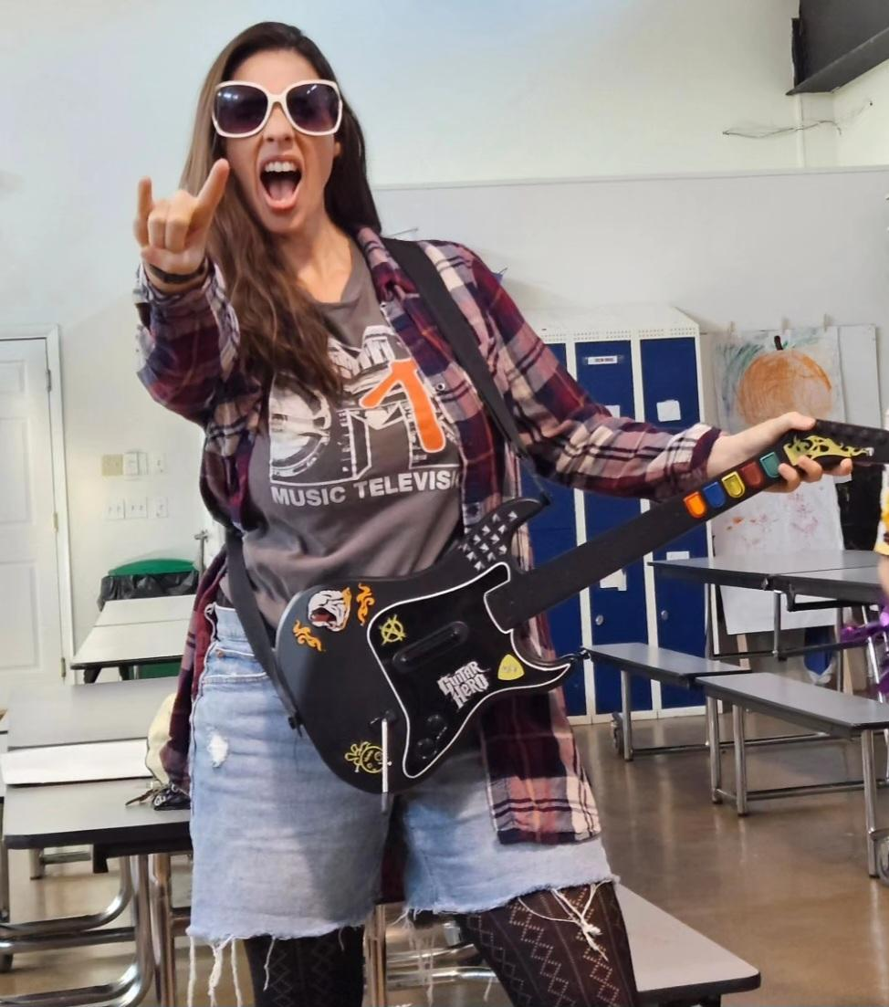
OUR TEACHERS
Angel Danger
Kara Windish
Hillsborough County District Academic Coach
26 years teaching
Master Teacher Mentor at Stavros since 2016
Learning Gate Community School
18th year teaching
3 years with Stavros

Slide 4
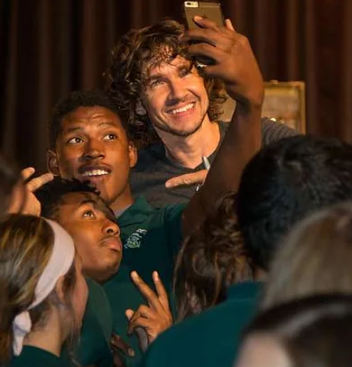


…And Special Guest
GOODING is an American musician and songwriter known for his “heart on his sleeve” live performances and for touring relentlessly through 48 states, the UK, and Canada with well over 2,000 shows under his belt. As a solo artist, he has written, recorded, produced, engineered, and mixed over 20 solo records - including the upcoming album The Forgotten Plains, out Fall 2023 - and 120 additional records for his film/tv publishing company Kingdom 2, earning over 1,000 sync placements making him one of the most prolific and most-licensed independent artists working today.
.

Slide 5

Funding the Future!
Funding the Future is a nonprofit organization that teaches teens vital financial principles by organizing live musical performances at schools across the nation and creating a dialogue around financial literacy between students and musicians.

Slide 6
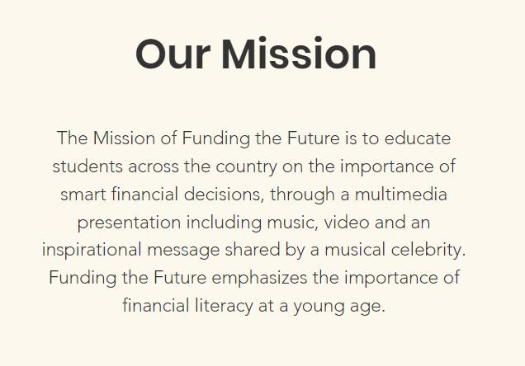
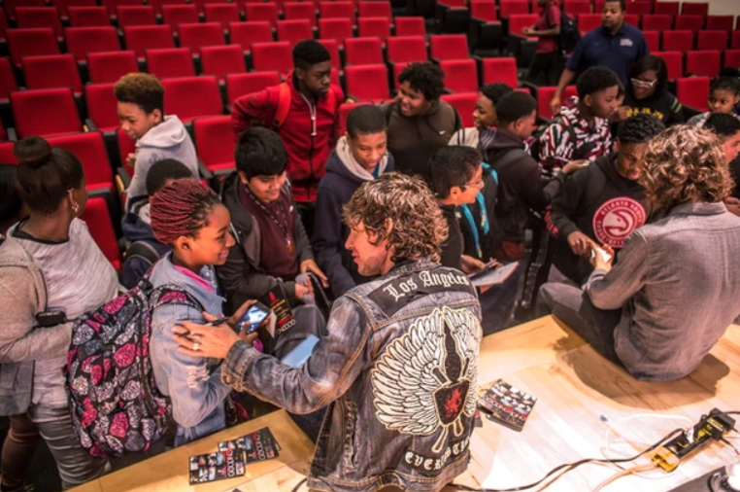
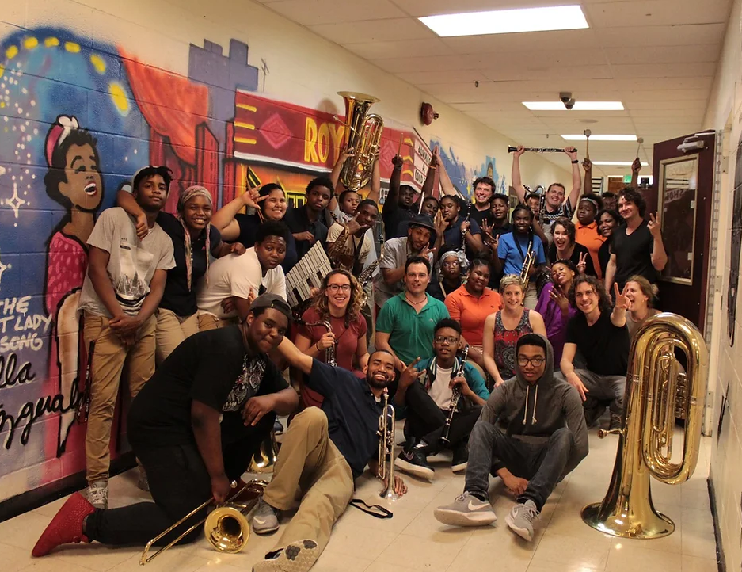
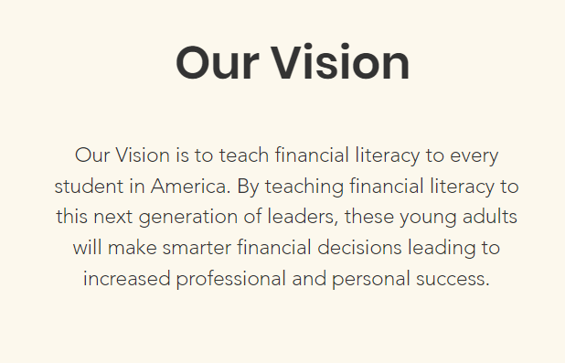

Slide 7

Funding the Future | About

Slide 8
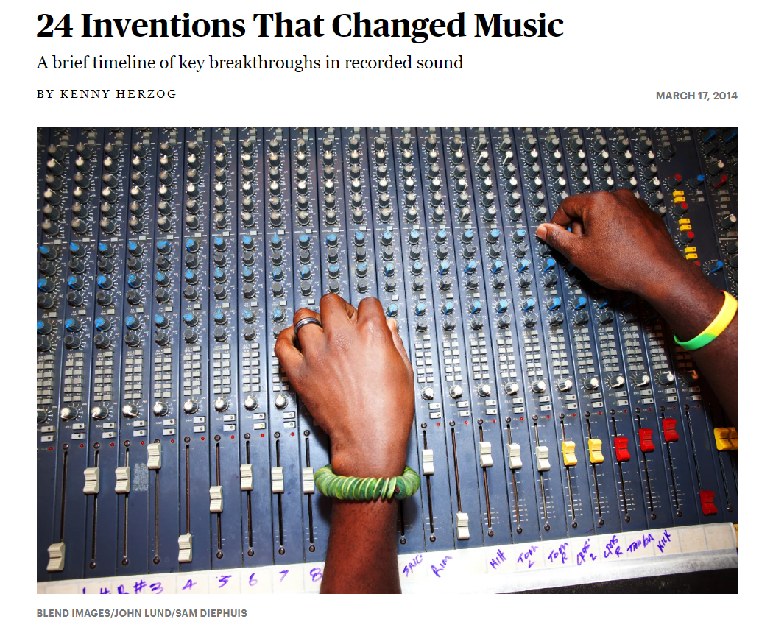
Check out this article and fill in the corresponding worksheet about inventions through time involving the music industry.
The QR code to the article is at the top of the worksheet.

Slide 9
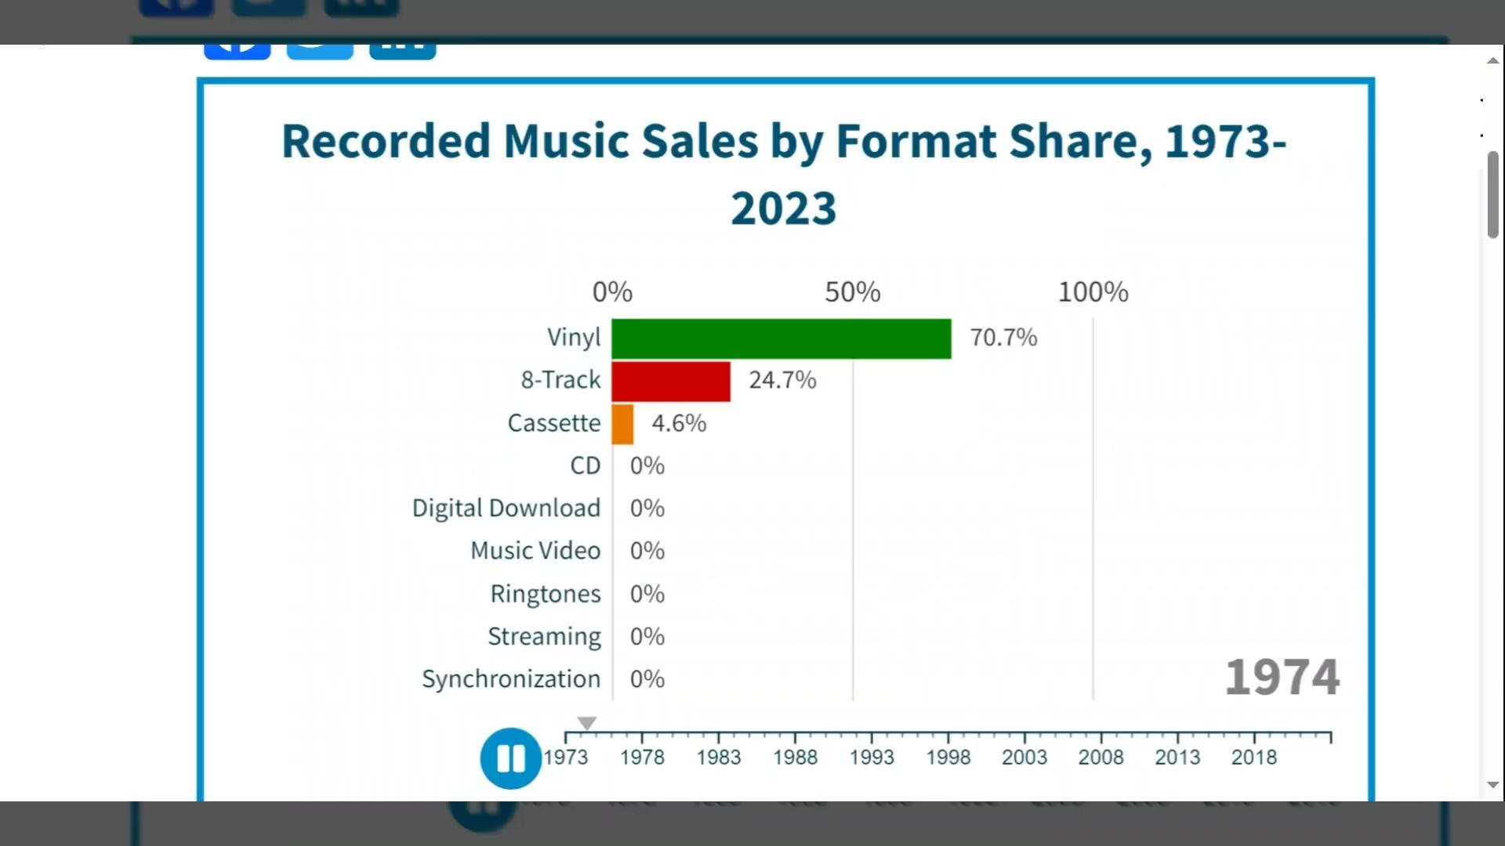
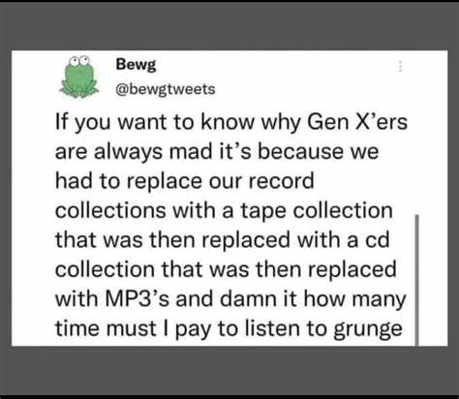
Animated Chart of the Day: Recorded Music Sales by Format Share, 1973 to 2022 | American Enterprise Institute - AEI

Slide 10
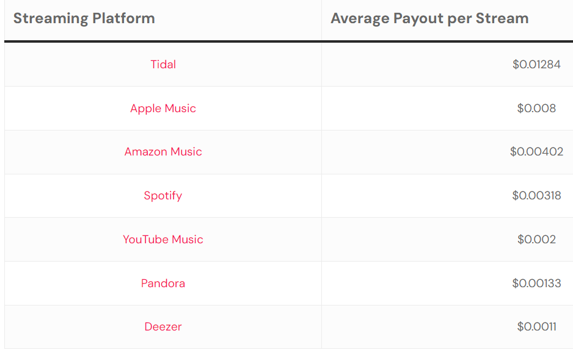
Music Streaming Payouts Comparison: A Guide for Musicians — VIRPP
If your song is streamed a million times on Spotify, you can earn approximately $3,180. Similarly, a million streams on Apple Music could earn you around $8,000.
However, it’s important to remember that these are gross figures. In most cases, the net amount that reaches the artist can be considerably lower, as it’s typically subject to deductions.

Slide 11
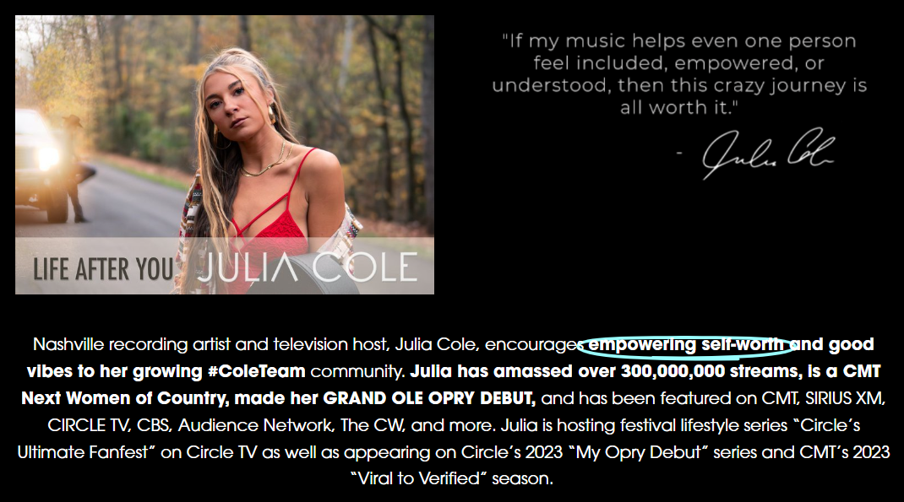
Elementary/
Middle School

Slide 12
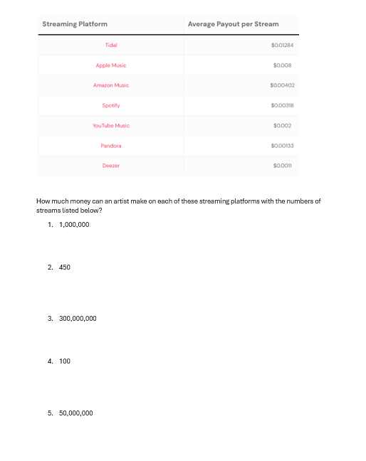

Slide 13

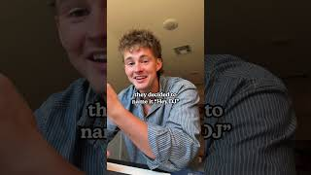
Ai Created Songs

Slide 14
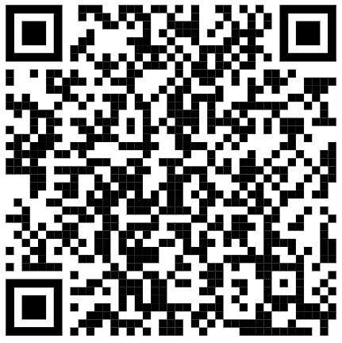

AI and the Music Industry
https://www.billboard.com/pro/how-ai-entrepreneurs-changing-music-industry-guest-column/

Slide 15
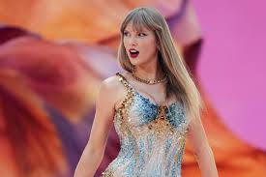

SWIFT-ONOMICS

Slide 16
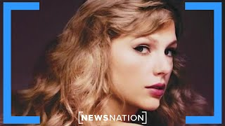

Slide 17
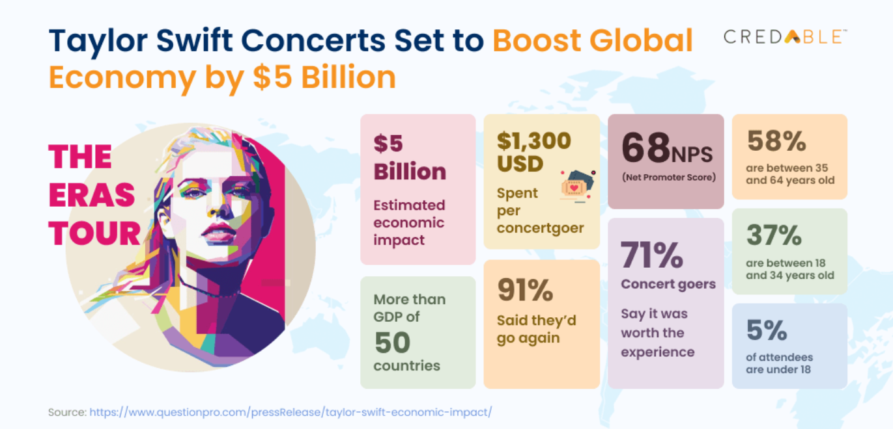
https://www.credable.in/insights-by-credable/business-insights/the-impact-of-taylor-swifts-the-eras-tour-on-global-economies/

Slide 18
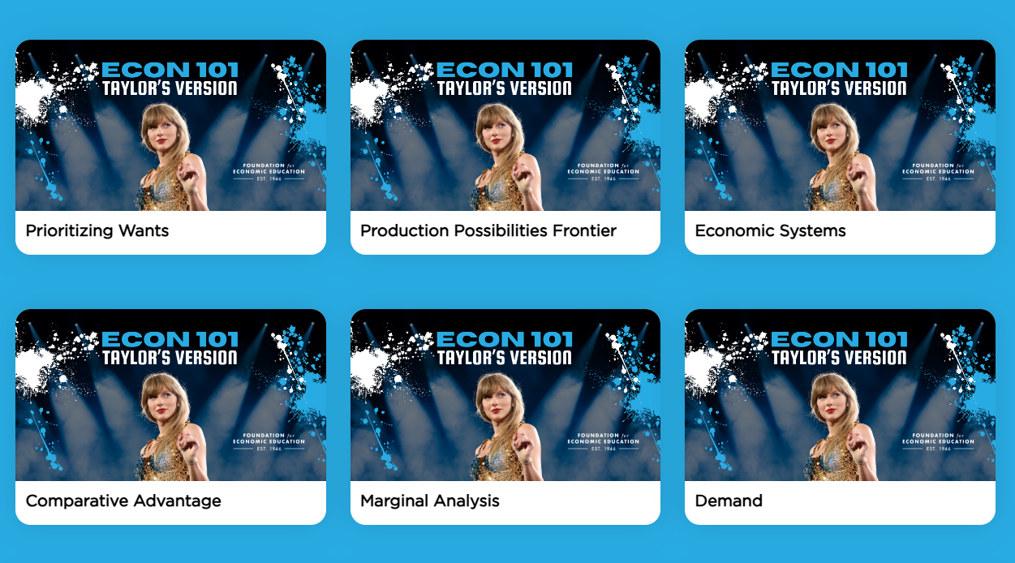
High School and AP Level Resources
https://teachers.fee.org/courses/taylor

Slide 19

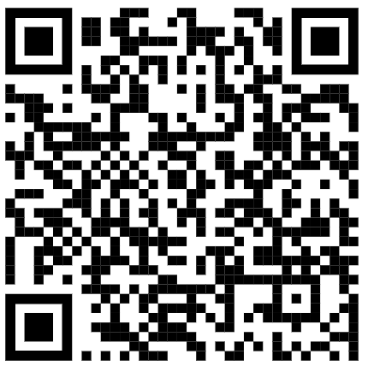
What is Ticketmaster?
https://www.mondayeconomist.com/p/ticketmaster?__s=o9beirmkekw1zm015jcz

Slide 20
Music Projects!
This can be tailored to your curriculum, or use the personal finance standards presented here!

Slide 21
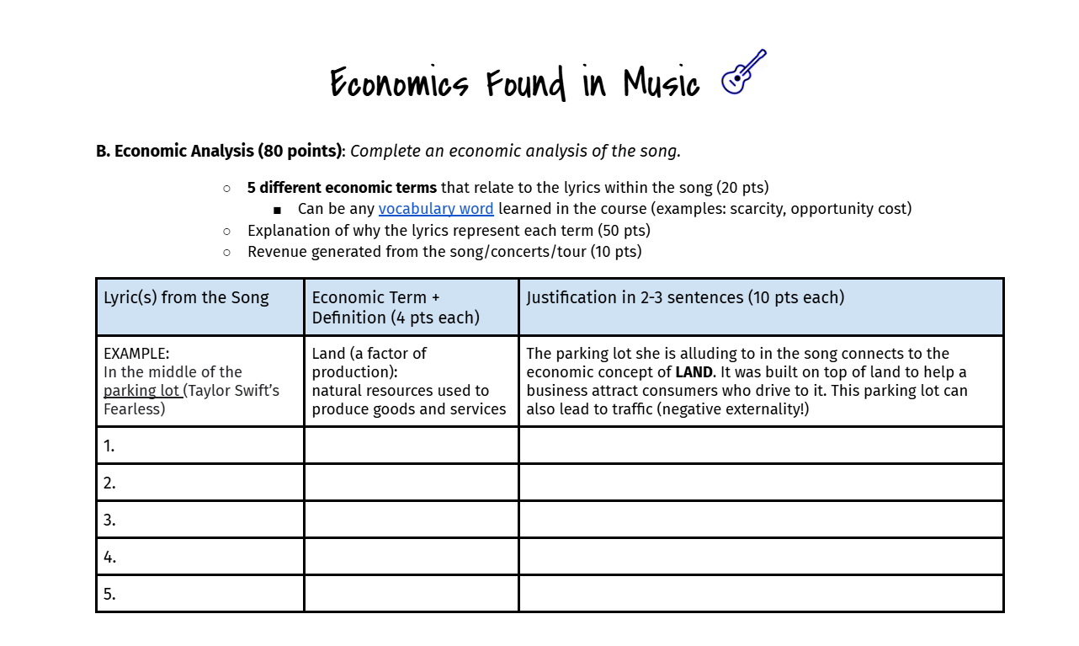
Economic Analysis of a Song:

Slide 22


Slide 23
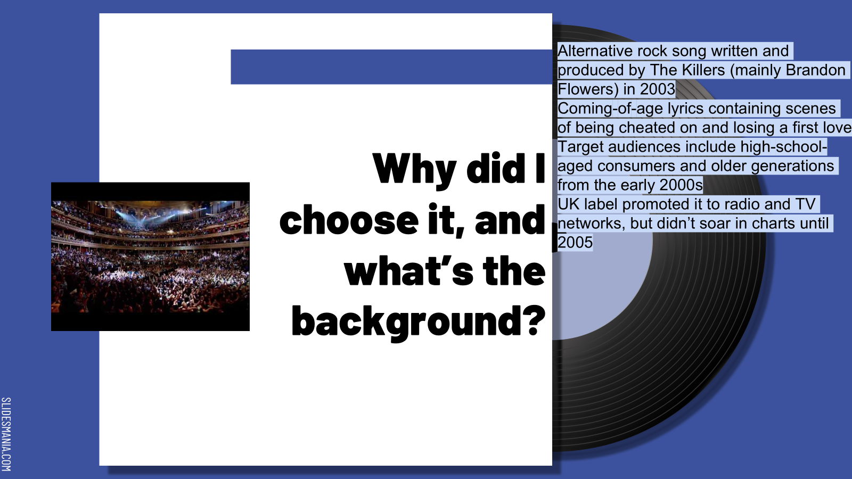

Slide 24
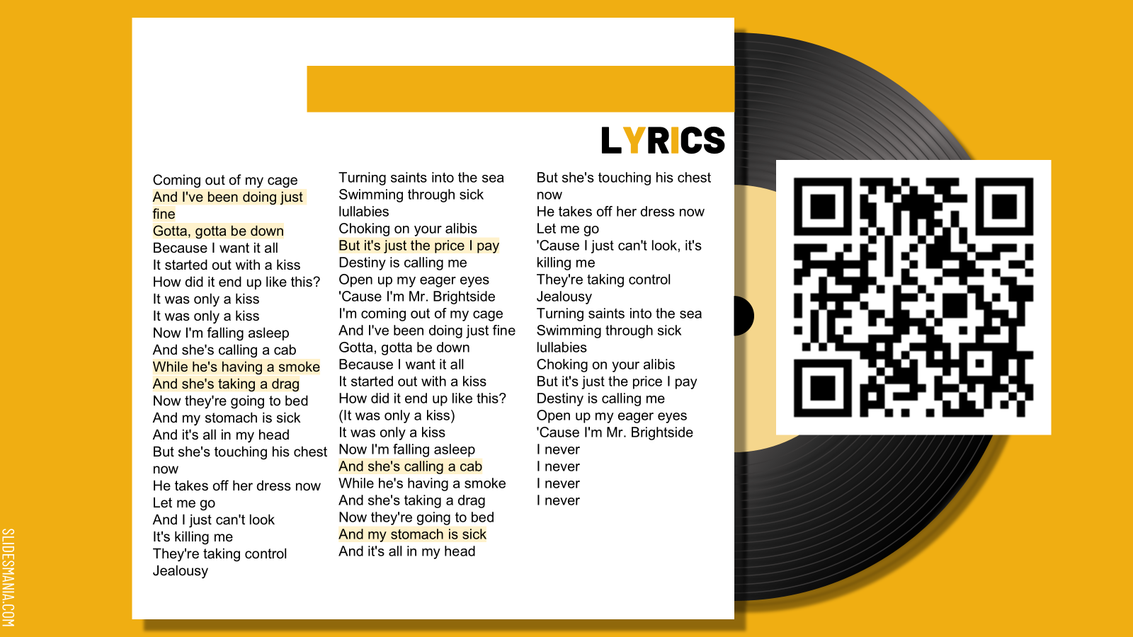

Slide 25
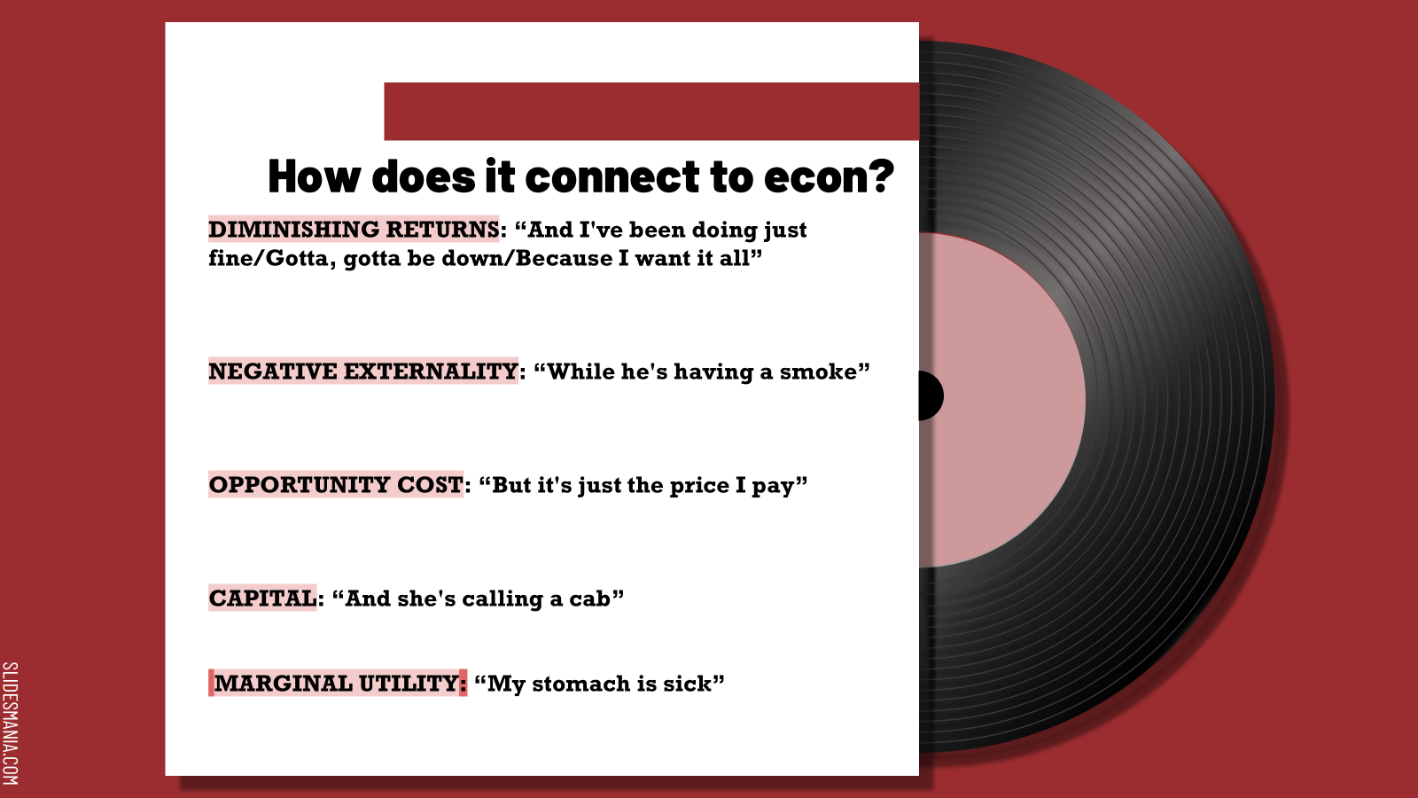

Slide 26
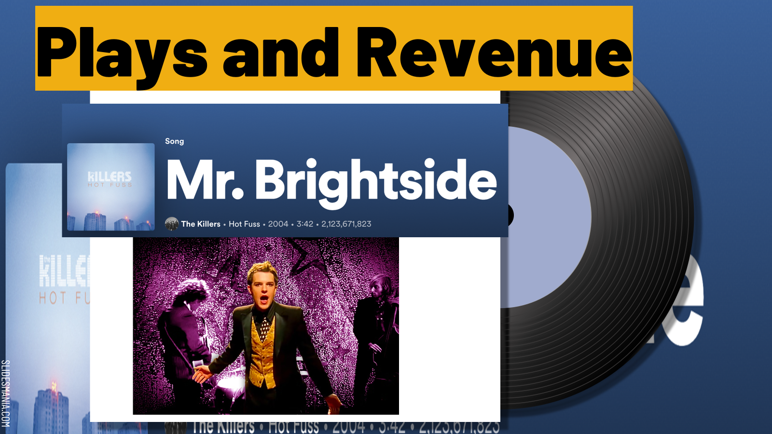
2,123,671,823 streams X $0 .002= $4,247,343

Slide 27
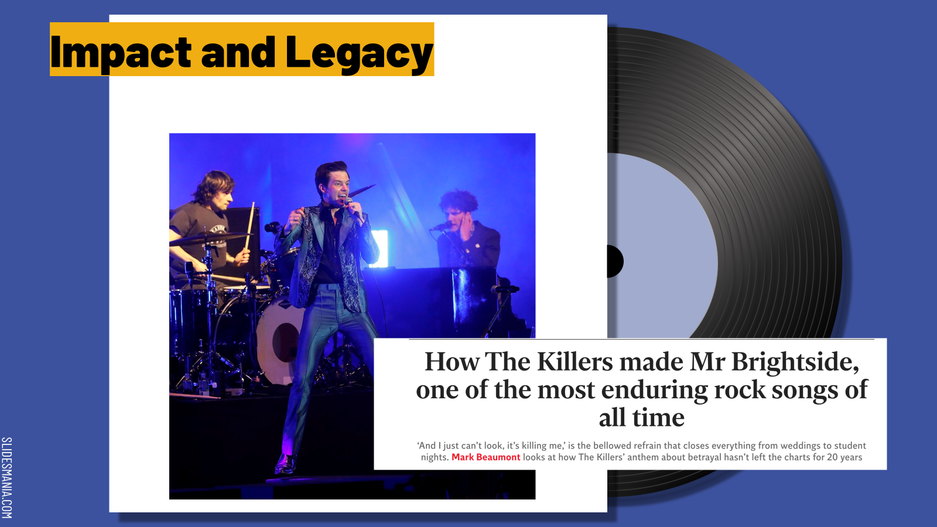

Slide 28
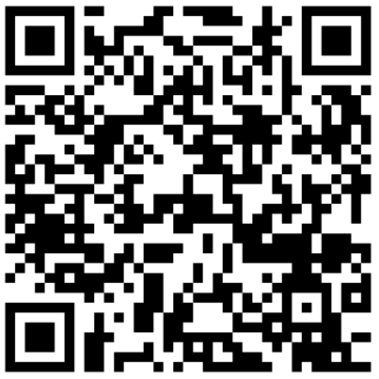
THANKS!
Please complete the survey

Slide 29

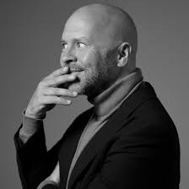
Everyone gets a book!

