Slide 1
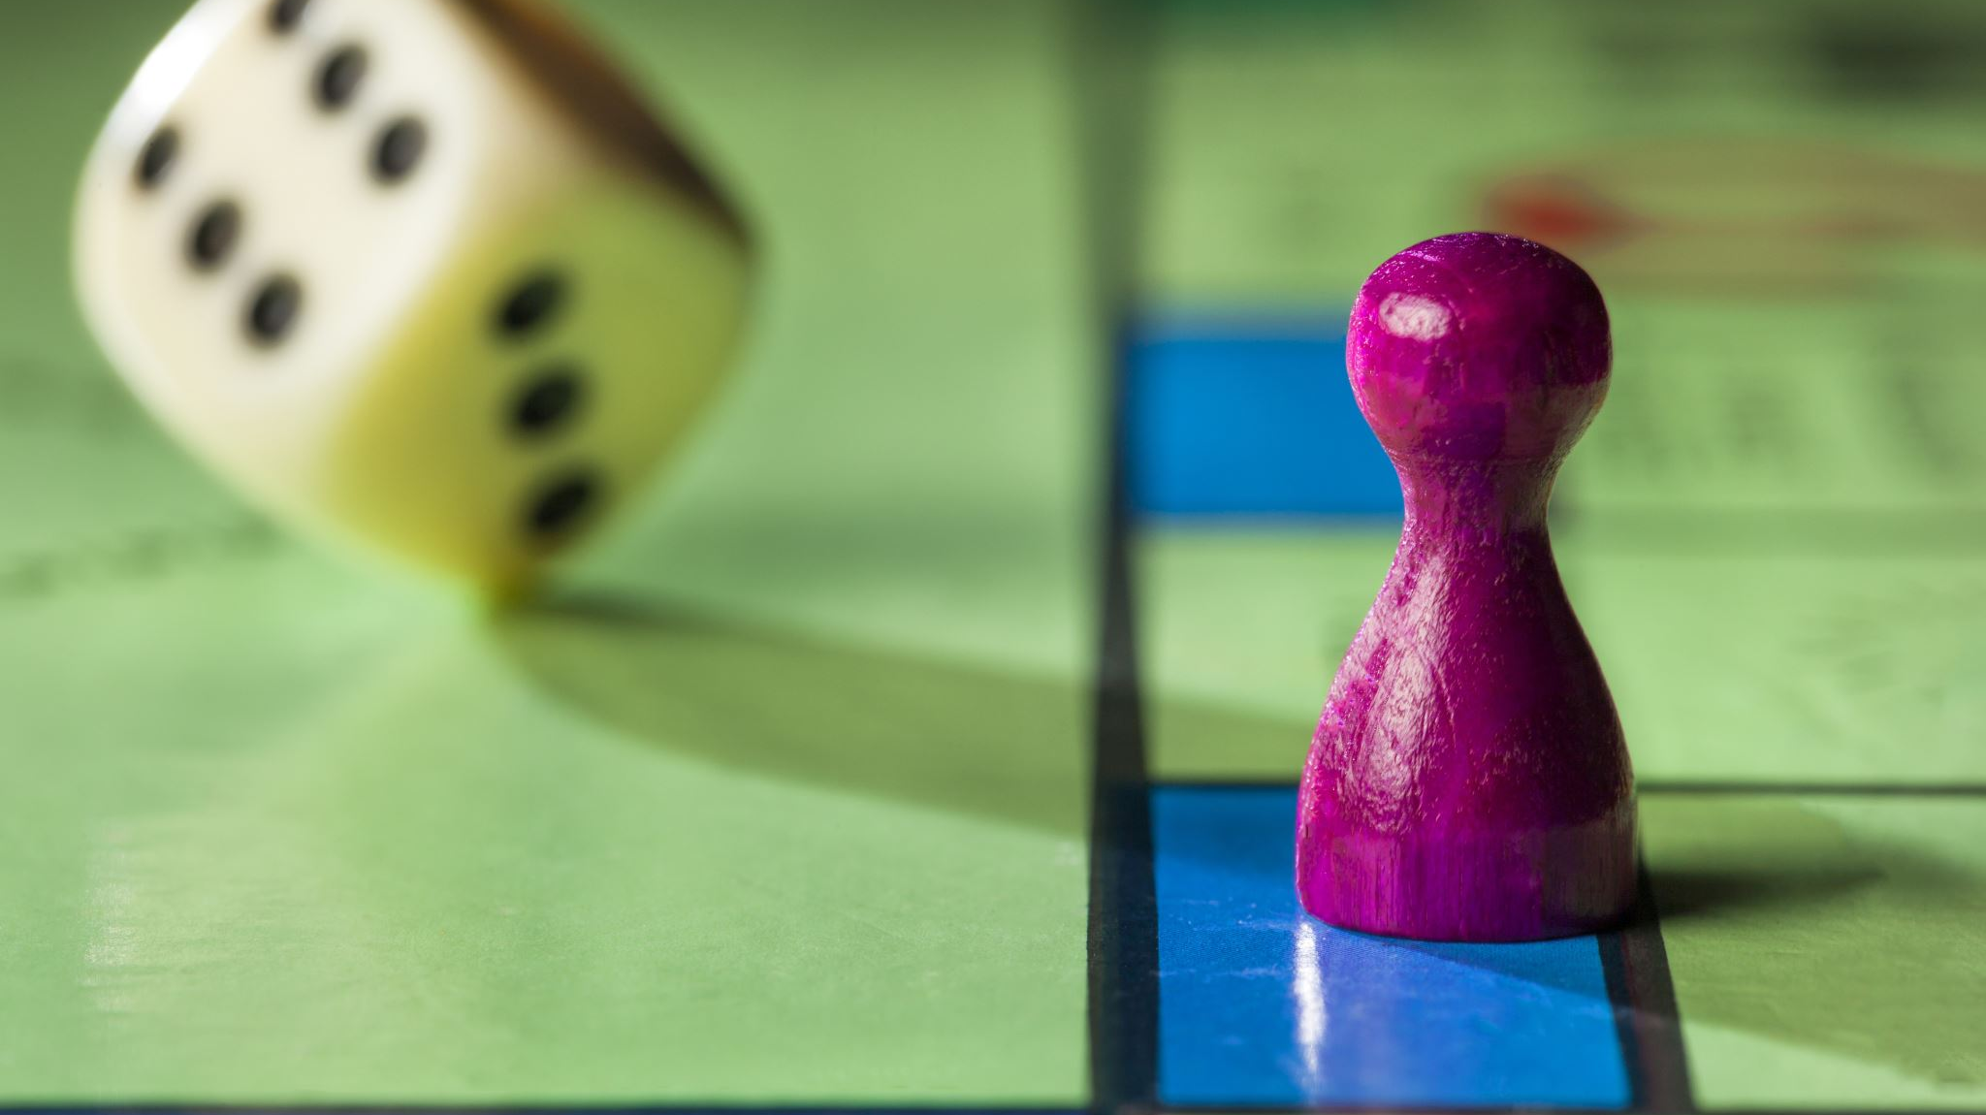
Wants vs, Needs
Once Upon a Dime
Stavros Center for Economic Education
Christine Angel Danger

Slide 2

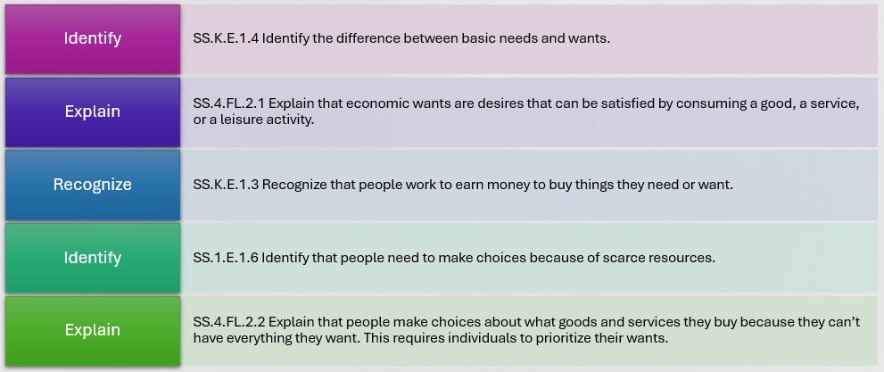
Identify
SS.K.E.1.4 Identify the difference between basic needs and wants.
Explain
SS.4.FL.2.1 Explain that economic wants are desires that can be satisfied by consuming a good, a service, or a leisure activity.
Recognize
SS.K.E.1.3 Recognize that people work to earn money to buy things they need or want.
Identify
SS.1.E.1.6 Identify that people need to make choices because of scarce resources.
Explain
SS.4.FL.2.2 Explain that people make choices about what goods and services they buy because they can’t have everything they want. This requires individuals to prioritize their wants.

Slide 3
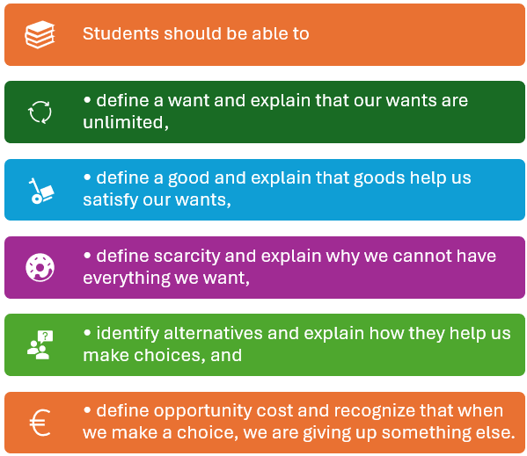
Objectives
Students should be able to
• define a want and explain that our wants are unlimited,
• define a good and explain that goods help us satisfy our wants,
• define scarcity and explain why we cannot have everything we want,
• identify alternatives and explain how they help us make choices, and
• define opportunity cost and recognize that when we make a choice, we are giving up something else.

Slide 4
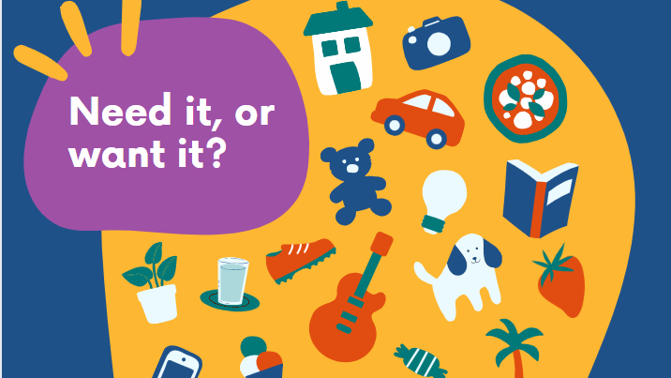

Slide 5


Originally publishedJanuary 1, 2007
AuthorMaribeth Boelts
GenrePicture Books · Childrens · Realistic Fiction · Poverty · Fiction · School · Cultural · Family · Social Issues · Kids
AwardsCharlotte Zolotow Award
Lily Learns about Wants and Needs (Cloverleaf Books ™ ― Money Basics) Paperback – August 1, 2013
by Lisa Bullard (Author), Christine M. Schneider (Illustrator)

Slide 6


Slide 7
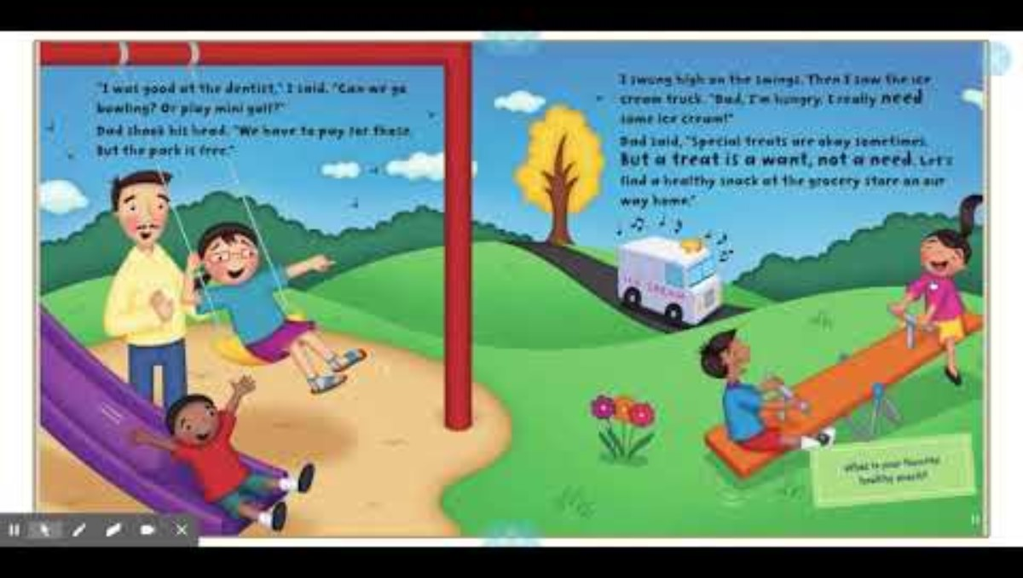
https://youtu.be/dVAxj5zX4zQ?si=Ld9K7rETh9rx523e

Slide 8


Slide 9
I’m thirsty.
Want | Good
Notes:
Procedure 1. Introduce the lesson by telling the students you are thirsty and want something to drink. Ask the class how you can satisfy this want. List the different types of drinks they name on the board. 2. Write the word want on the board. Explain that a want is a desire that can be satisfied by consuming a good or a service. Ask the class “What was my want?” (Something to drink) 3. Write the word good on the board. Explain that a good is an object that satisfies a person’s wants. Ask the class “What good could satisfy my want?” (Any of the drinks named) 4. Tell the students they are going to hear a story about two little bears that had several wants. Read the story The Berenstain Bears Get the Gimmies once with the students just listening to the story. 5. After the story, list the following on the board and ask the students to listen for the listed wants when you read the story again:

Slide 10
Read the story again.
Want | Good
Candy Entertainment Toys Presents Rewards for good behavior | Gummy Gumballs, Chewy Chompers Ride on Bucking the Frog Rubber cat toy Puzzle, top Book about dinosaurs, box of crayons
Notes:
Procedure 1. Introduce the lesson by telling the students you are thirsty and want something to drink. Ask the class how you can satisfy this want. List the different types of drinks they name on the board. 2. Write the word want on the board. Explain that a want is a desire that can be satisfied by consuming a good or a service. Ask the class “What was my want?” (Something to drink) 3. Write the word good on the board. Explain that a good is an object that satisfies a person’s wants. Ask the class “What good could satisfy my want?” (Any of the drinks named) 4. Tell the students they are going to hear a story about two little bears that had several wants. Read the story The Berenstain Bears Get the Gimmies once with the students just listening to the story. 5. After the story, list the following on the board and ask the students to listen for the listed wants when you read the story again:

Slide 11
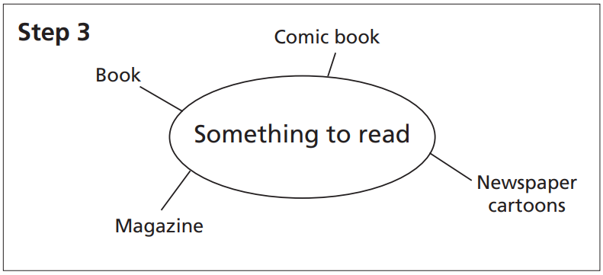
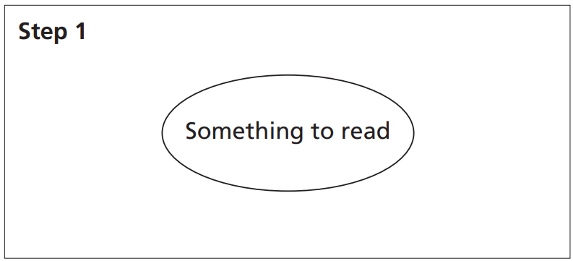
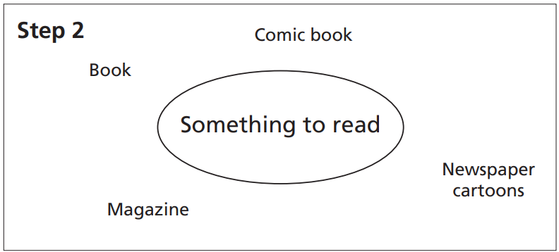
Make a Word Web
Notes:
Instruct the pairs to do the following, allowing time for students to complete each step before moving to the next:
• Draw a circle in the center of the paper and write the want on their card in the circle. (Point to Step 1 on Visual 1 as an example.)
• Around the circle, write examples of goods that could satisfy the want. (Point to Step 2 on Visual 1 as an example.)
• Connect the goods to the want, making a word web. (Point to Step 3 on Visual 1 as an example.)
• Share the completed word web with the class.
Ask students if they can have everything they want? (No). Why not? (There is not enough time, money, or goods.) Tell students that this problem is called scarcity. Scarcity means we can’t have everything we want. Write the word scarcity on the board.

Slide 12
Choices Alternatives
Your wants are unlimited, so you have to make choices.
A choice is a decision made between two or more alternatives.
An alternative is a possible choice you can make.

Slide 13
Stella has one hour of free time before dinner to either watch TV or play outside with friends.
What is Stella’s problem?
2. What is scarce?
Notes:
1. What is Stella’s problem? (She has only one hour of free time.) 2. What is scarce? (Time)

Slide 14
Malaki has one piece of paper to use for a craft project. He wants to either make a paper airplane or draw a picture for his mother
What is Malaki’s problem?
2. What is scarce?
Notes:
. What is Malaki’s problem? (He has only one piece of paper.) 2. What is scarce? (Paper)

Slide 15
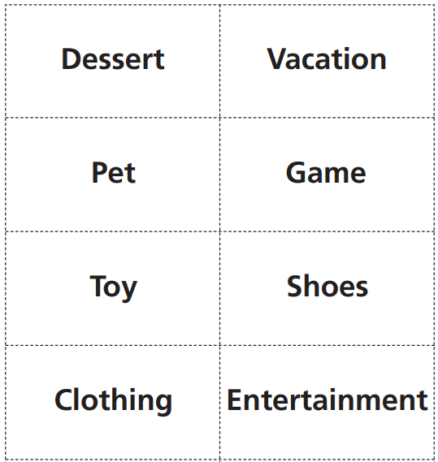
Opportunity Cost
Who | Want | Choice Taken 1st choice | Opportunity Cost 2nd choice
Opportunity cost is whatever must be given up in order to obtain something else. In other words, it is your second choice.
Notes:
Tell the students that opportunity cost is whatever must be given up in order to obtain something else. In other words, it is your second choice.
sing examples from the board, point out some of the student pairs’ actual opportunity costs. (For example, “The opportunity cost of Ting and George choosing ice cream for dessert was the cake.”) Then, call on individual students and ask them what the opportunity cost is for a given pair of students on the board. (For example, “What is Sarah and Jose’s opportunity cost for the vacation to Disney World?” [A vacation to the beach.])

Slide 16
Vocabulary
What do you call a desire or wish to have something?
• What do we use to satisfy our wants?
• Because resources are scarce, what must we do?
• When you choose one thing over another, what is given up is a cost to you.
Notes:
What do you call a desire or wish to have something? (A want)
• What do we use to satisfy our wants? (Goods)
• Because resources are scarce, what must we do?
(We have to decide what we want; we must make choices.)
• When you choose one thing over another, what is given up is a cost to you. What is this type of cost called? (Opportunity cost)

Slide 17
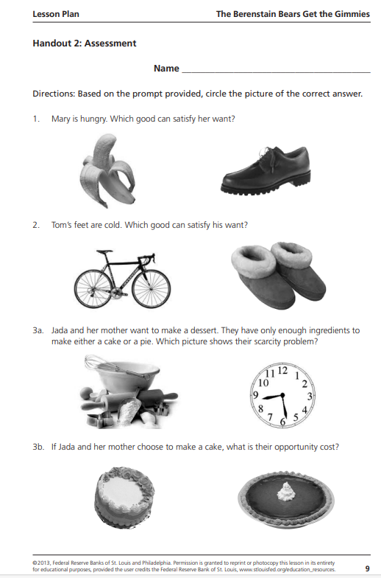
Assessment

Slide 18
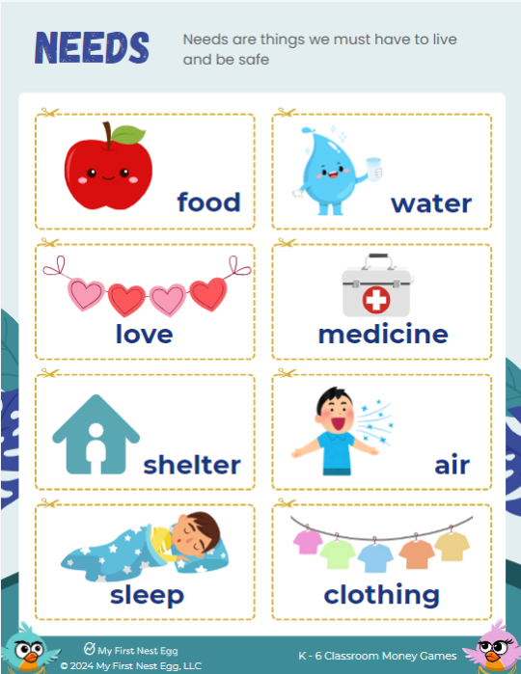
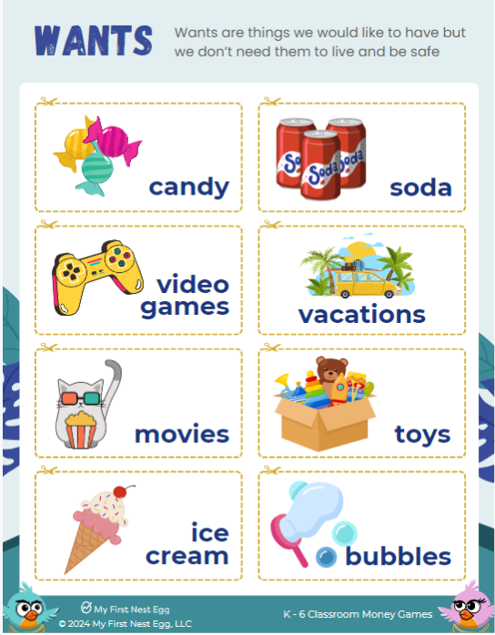
Teachers - My First Nest Egg

Slide 19
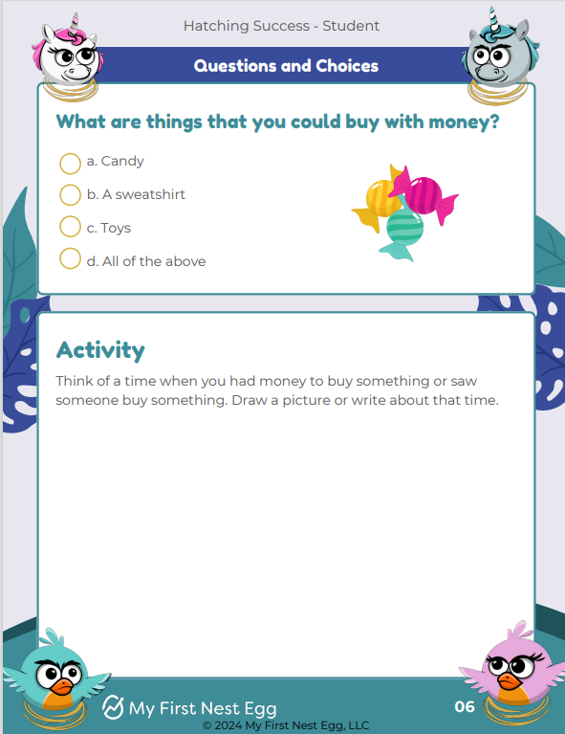
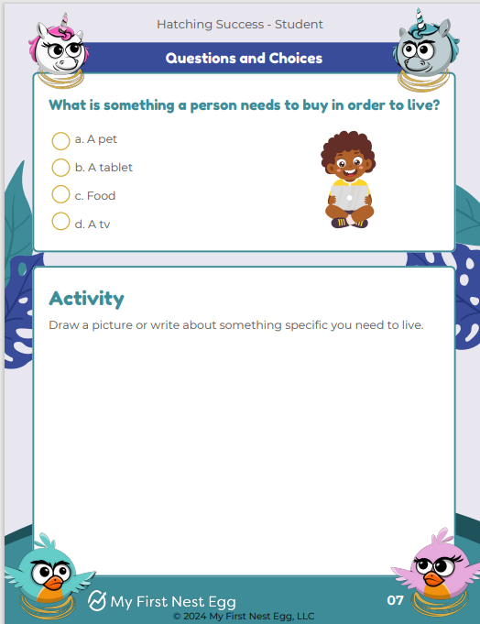
Notes:
D is the correct answer! There are many things you can buy with money - from the pencils we use to the clothes we wear.
C is the correct answer! People need many things to live, like food, water, clothing and shelter.

Slide 20
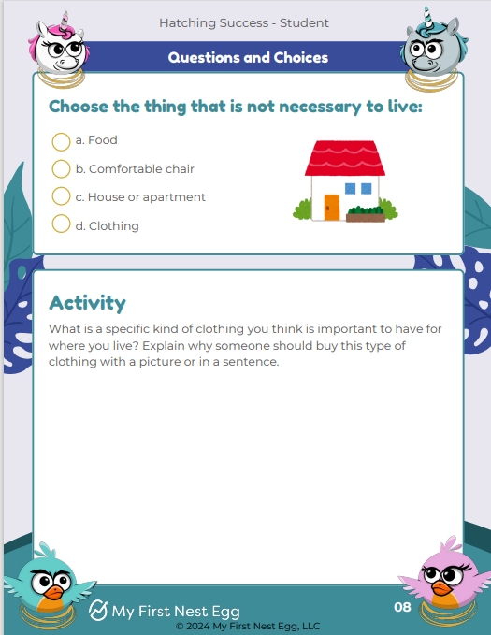
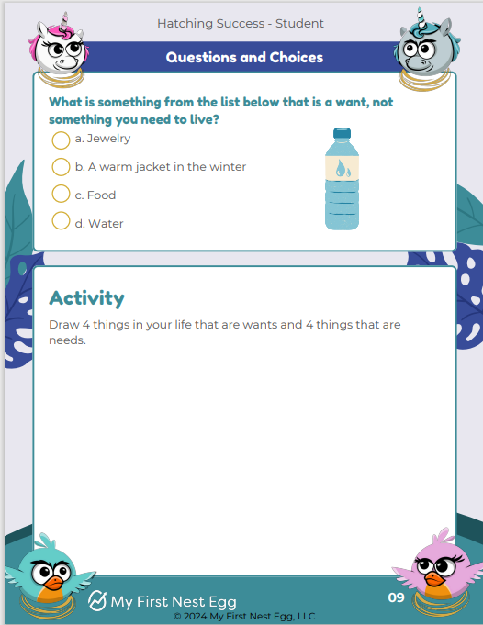
Notes:
B is the correct answer! Although a comfortable chair is nice, it is not necessary in order to live. Everyone needs food, clothing, water and shelter.
A is the correct answer! A need is something we have to have in order to live, while a want is something we would love to have, but isn’t necessary for living.

Slide 21
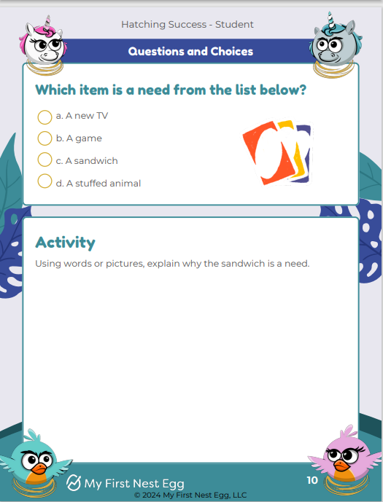
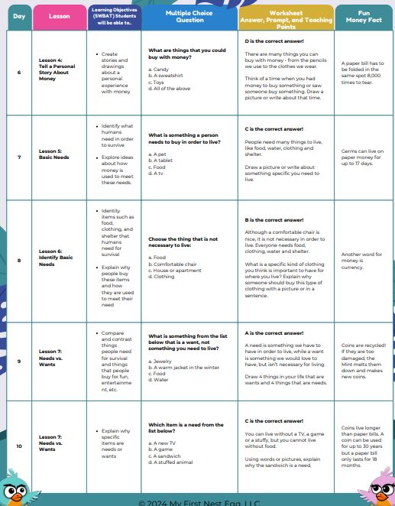
Notes:
C is the correct answer! You can live without a TV, a game or a stuffy, but you cannot live without food.

