Slide 1
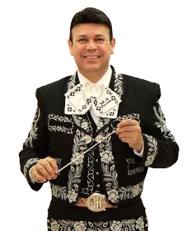

2016 Unity Conference
Arts Education
Menudo Breakfast
Maestro Jose Hernandez
September 11, 2016
Hilton San Diego Del Mar, CA

Slide 2
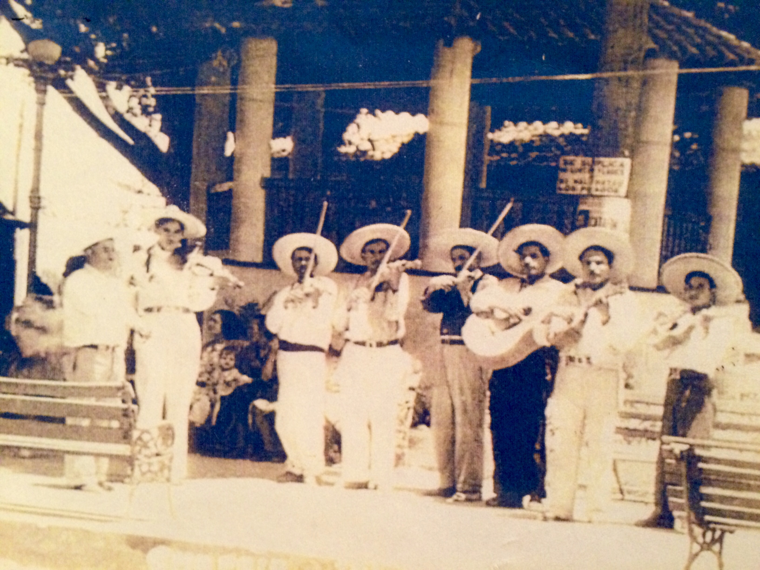
September 11, 2016
Hilton San Diego Del Mar, CA

Slide 3
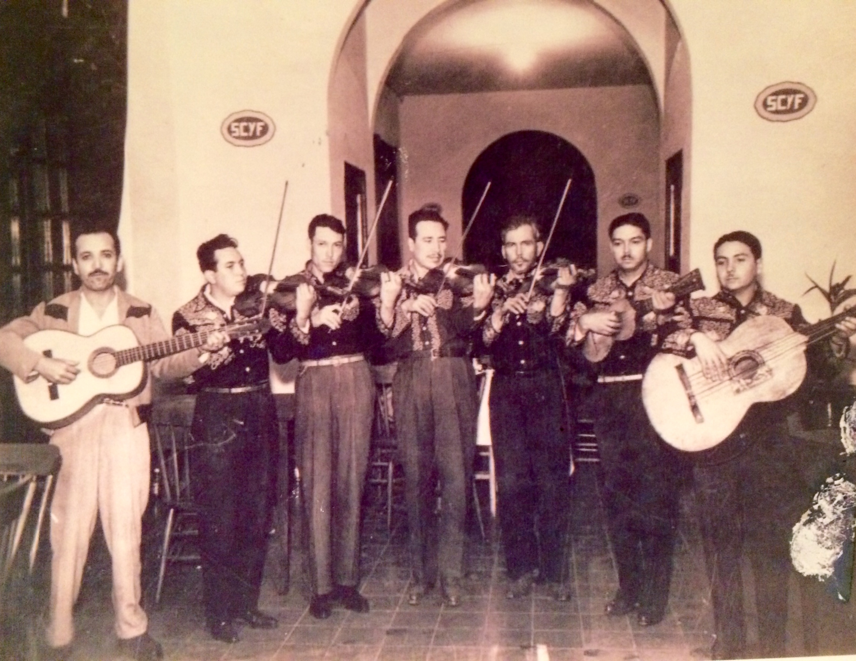
September 11, 2016
Hilton San Diego Del Mar, CA

Slide 4
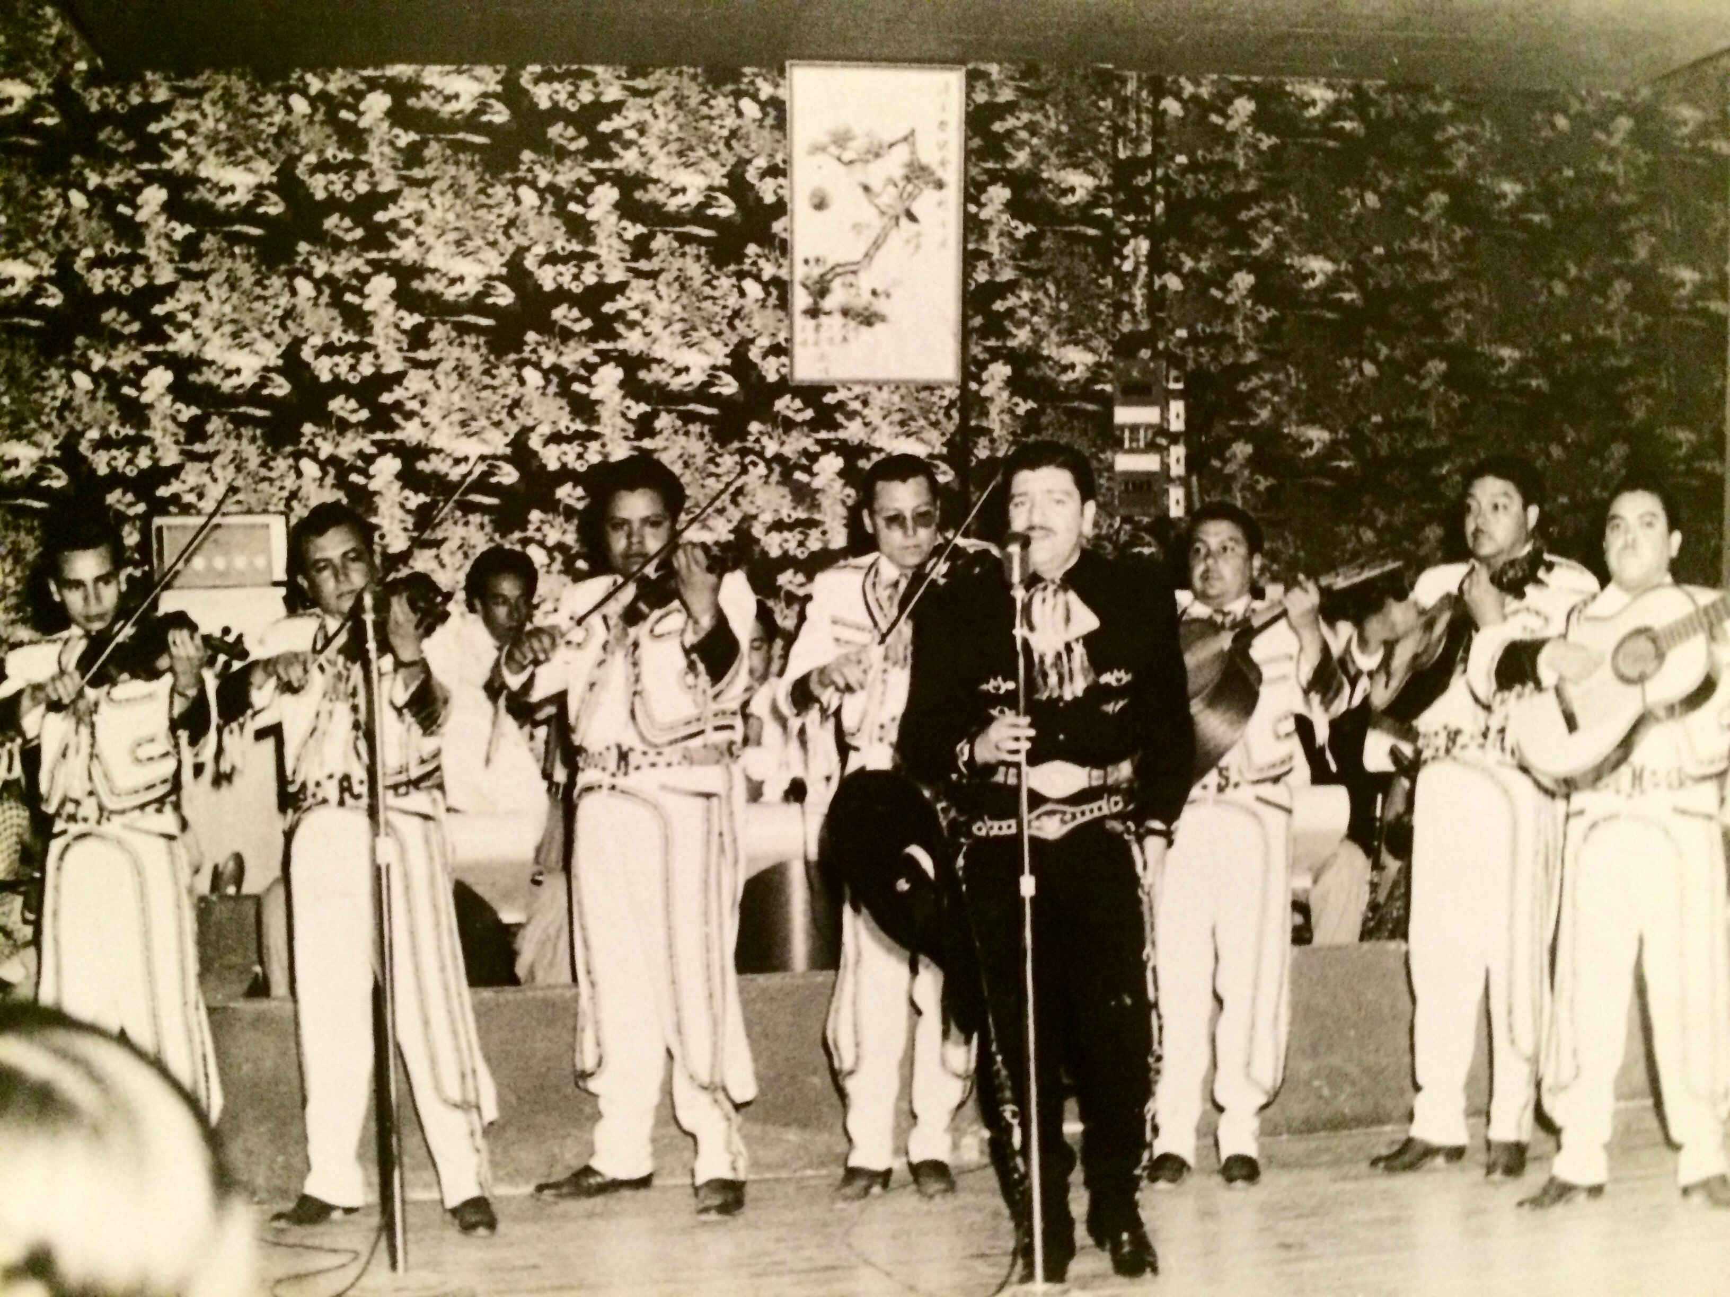
September 11, 2016
Hilton San Diego Del Mar, CA

Slide 5
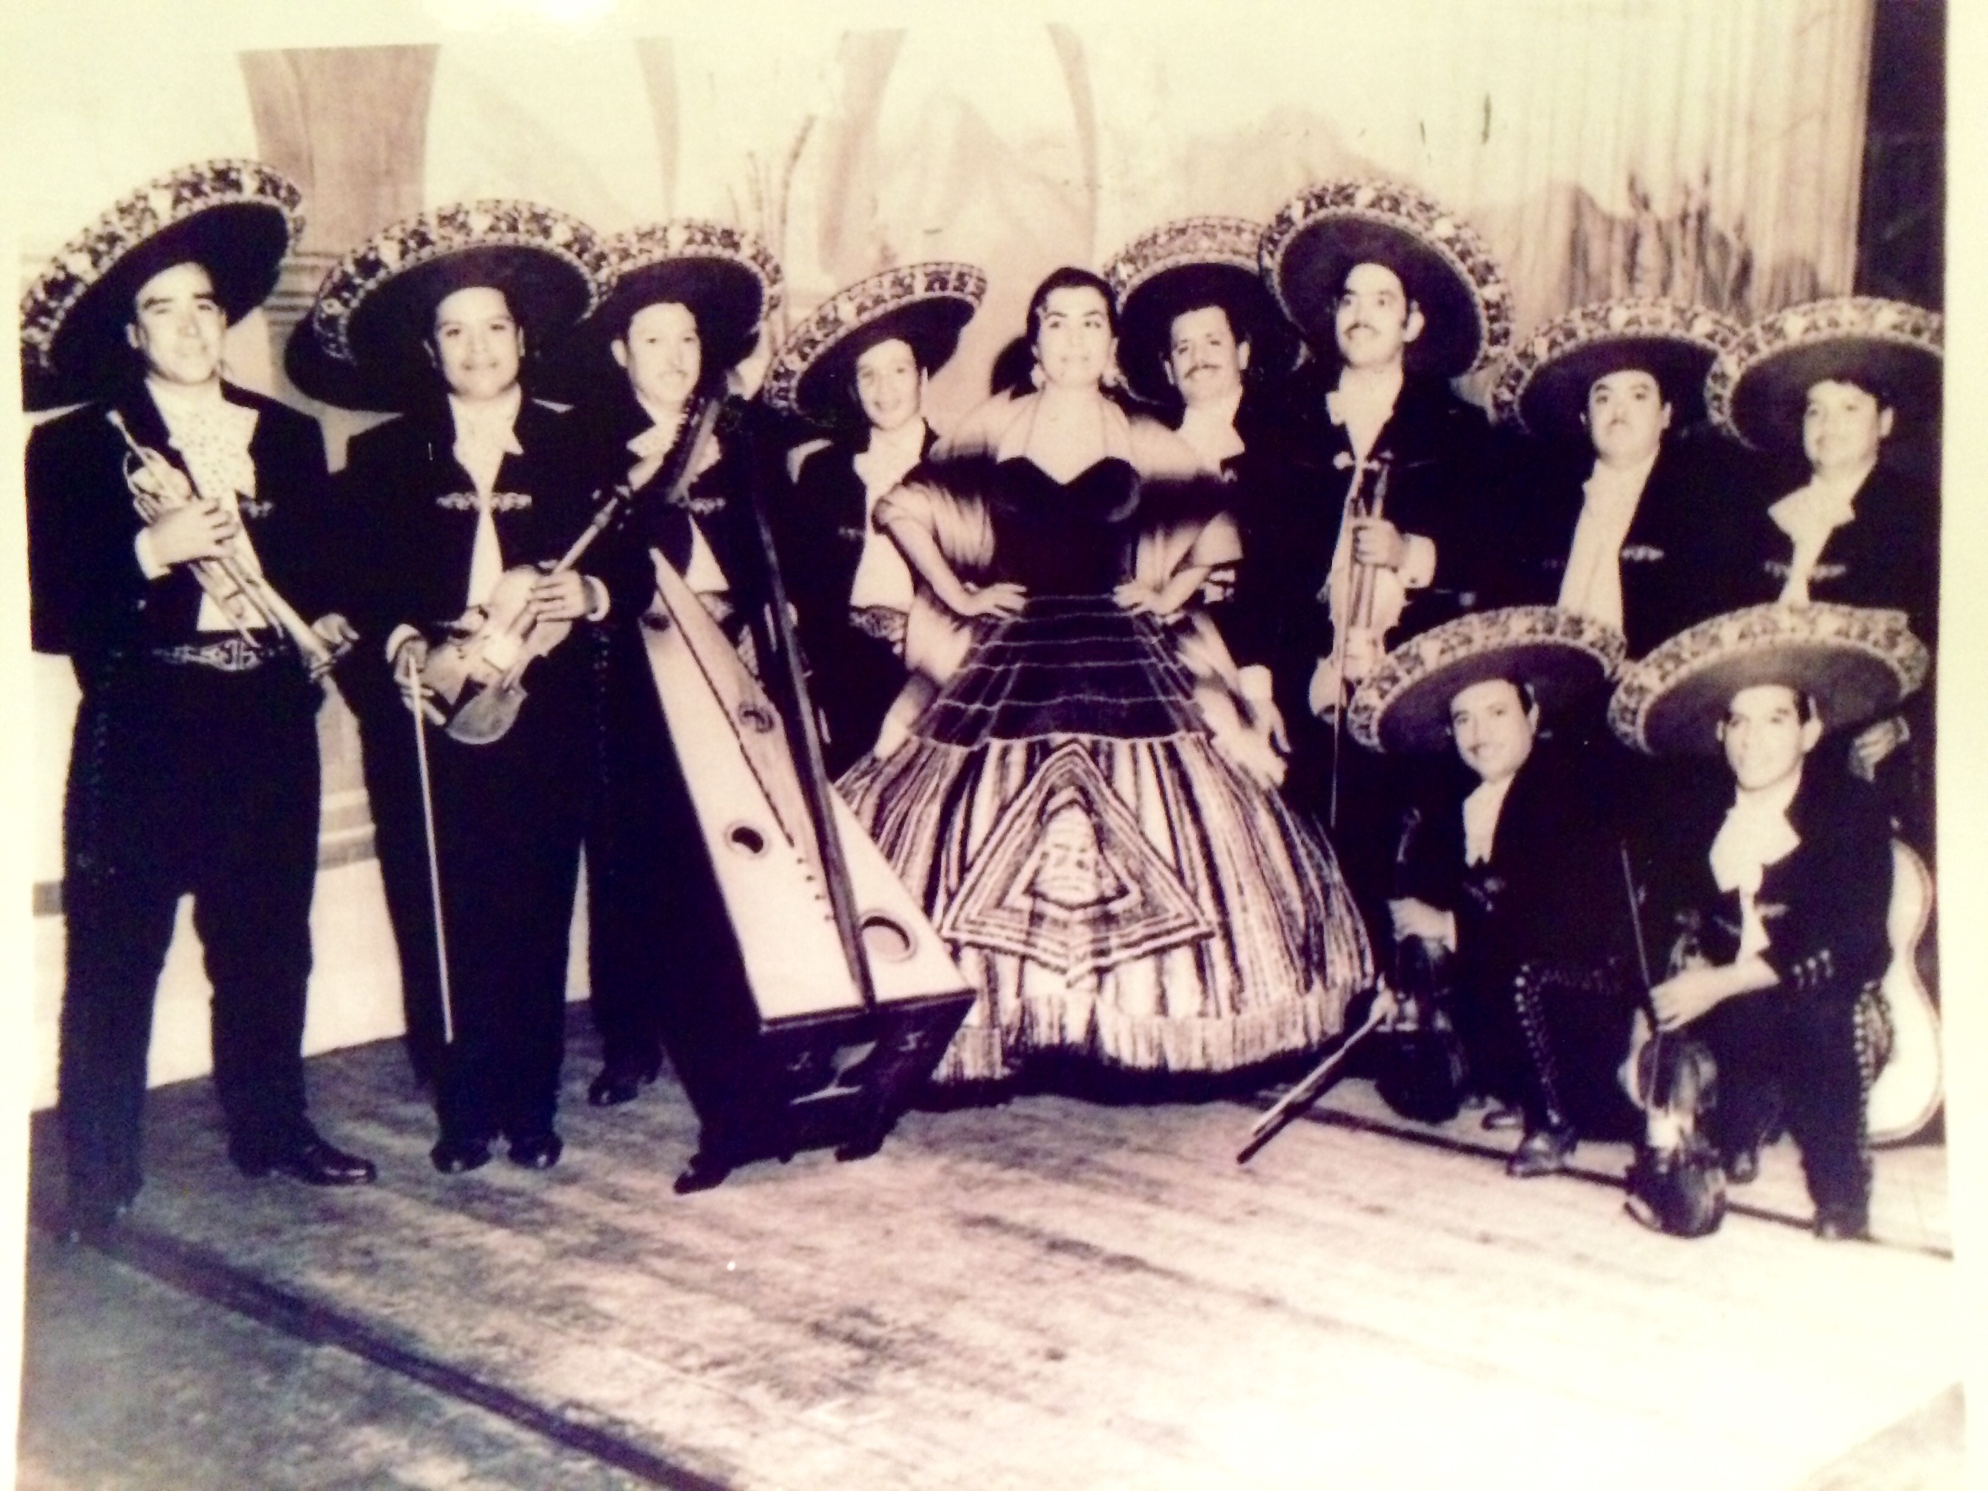
September 11, 2016
Hilton San Diego Del Mar, CA

Slide 6
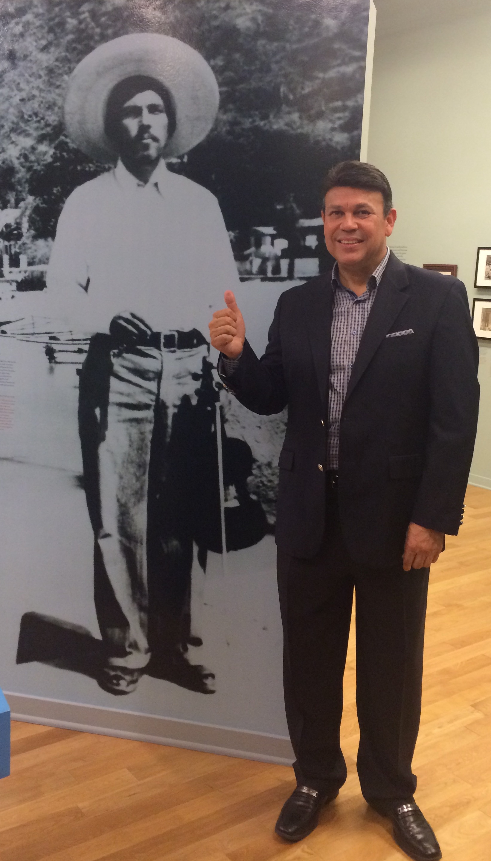
Grandfather,
Jose Hernandez

Slide 7
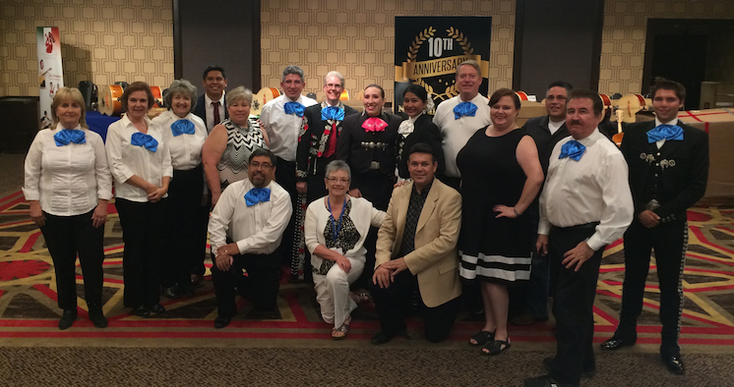
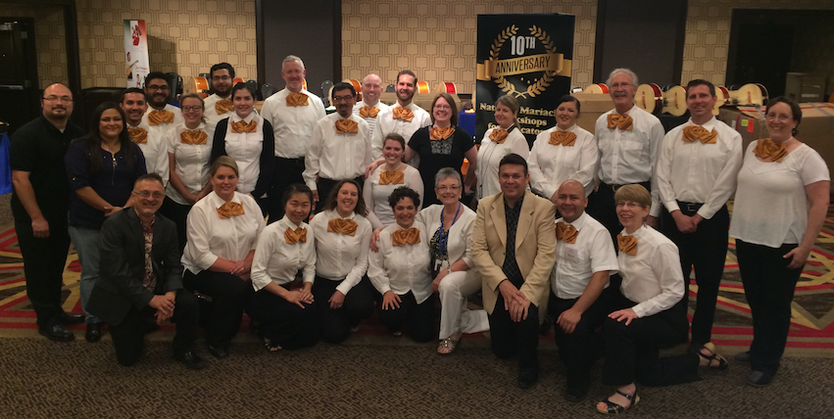
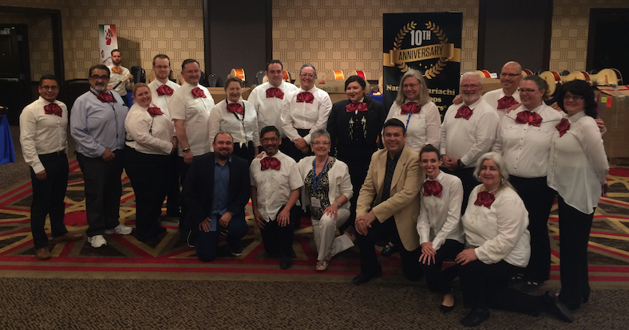
And Now, Paying It Forward
Teaching Pedagogy to Teachers

Slide 8
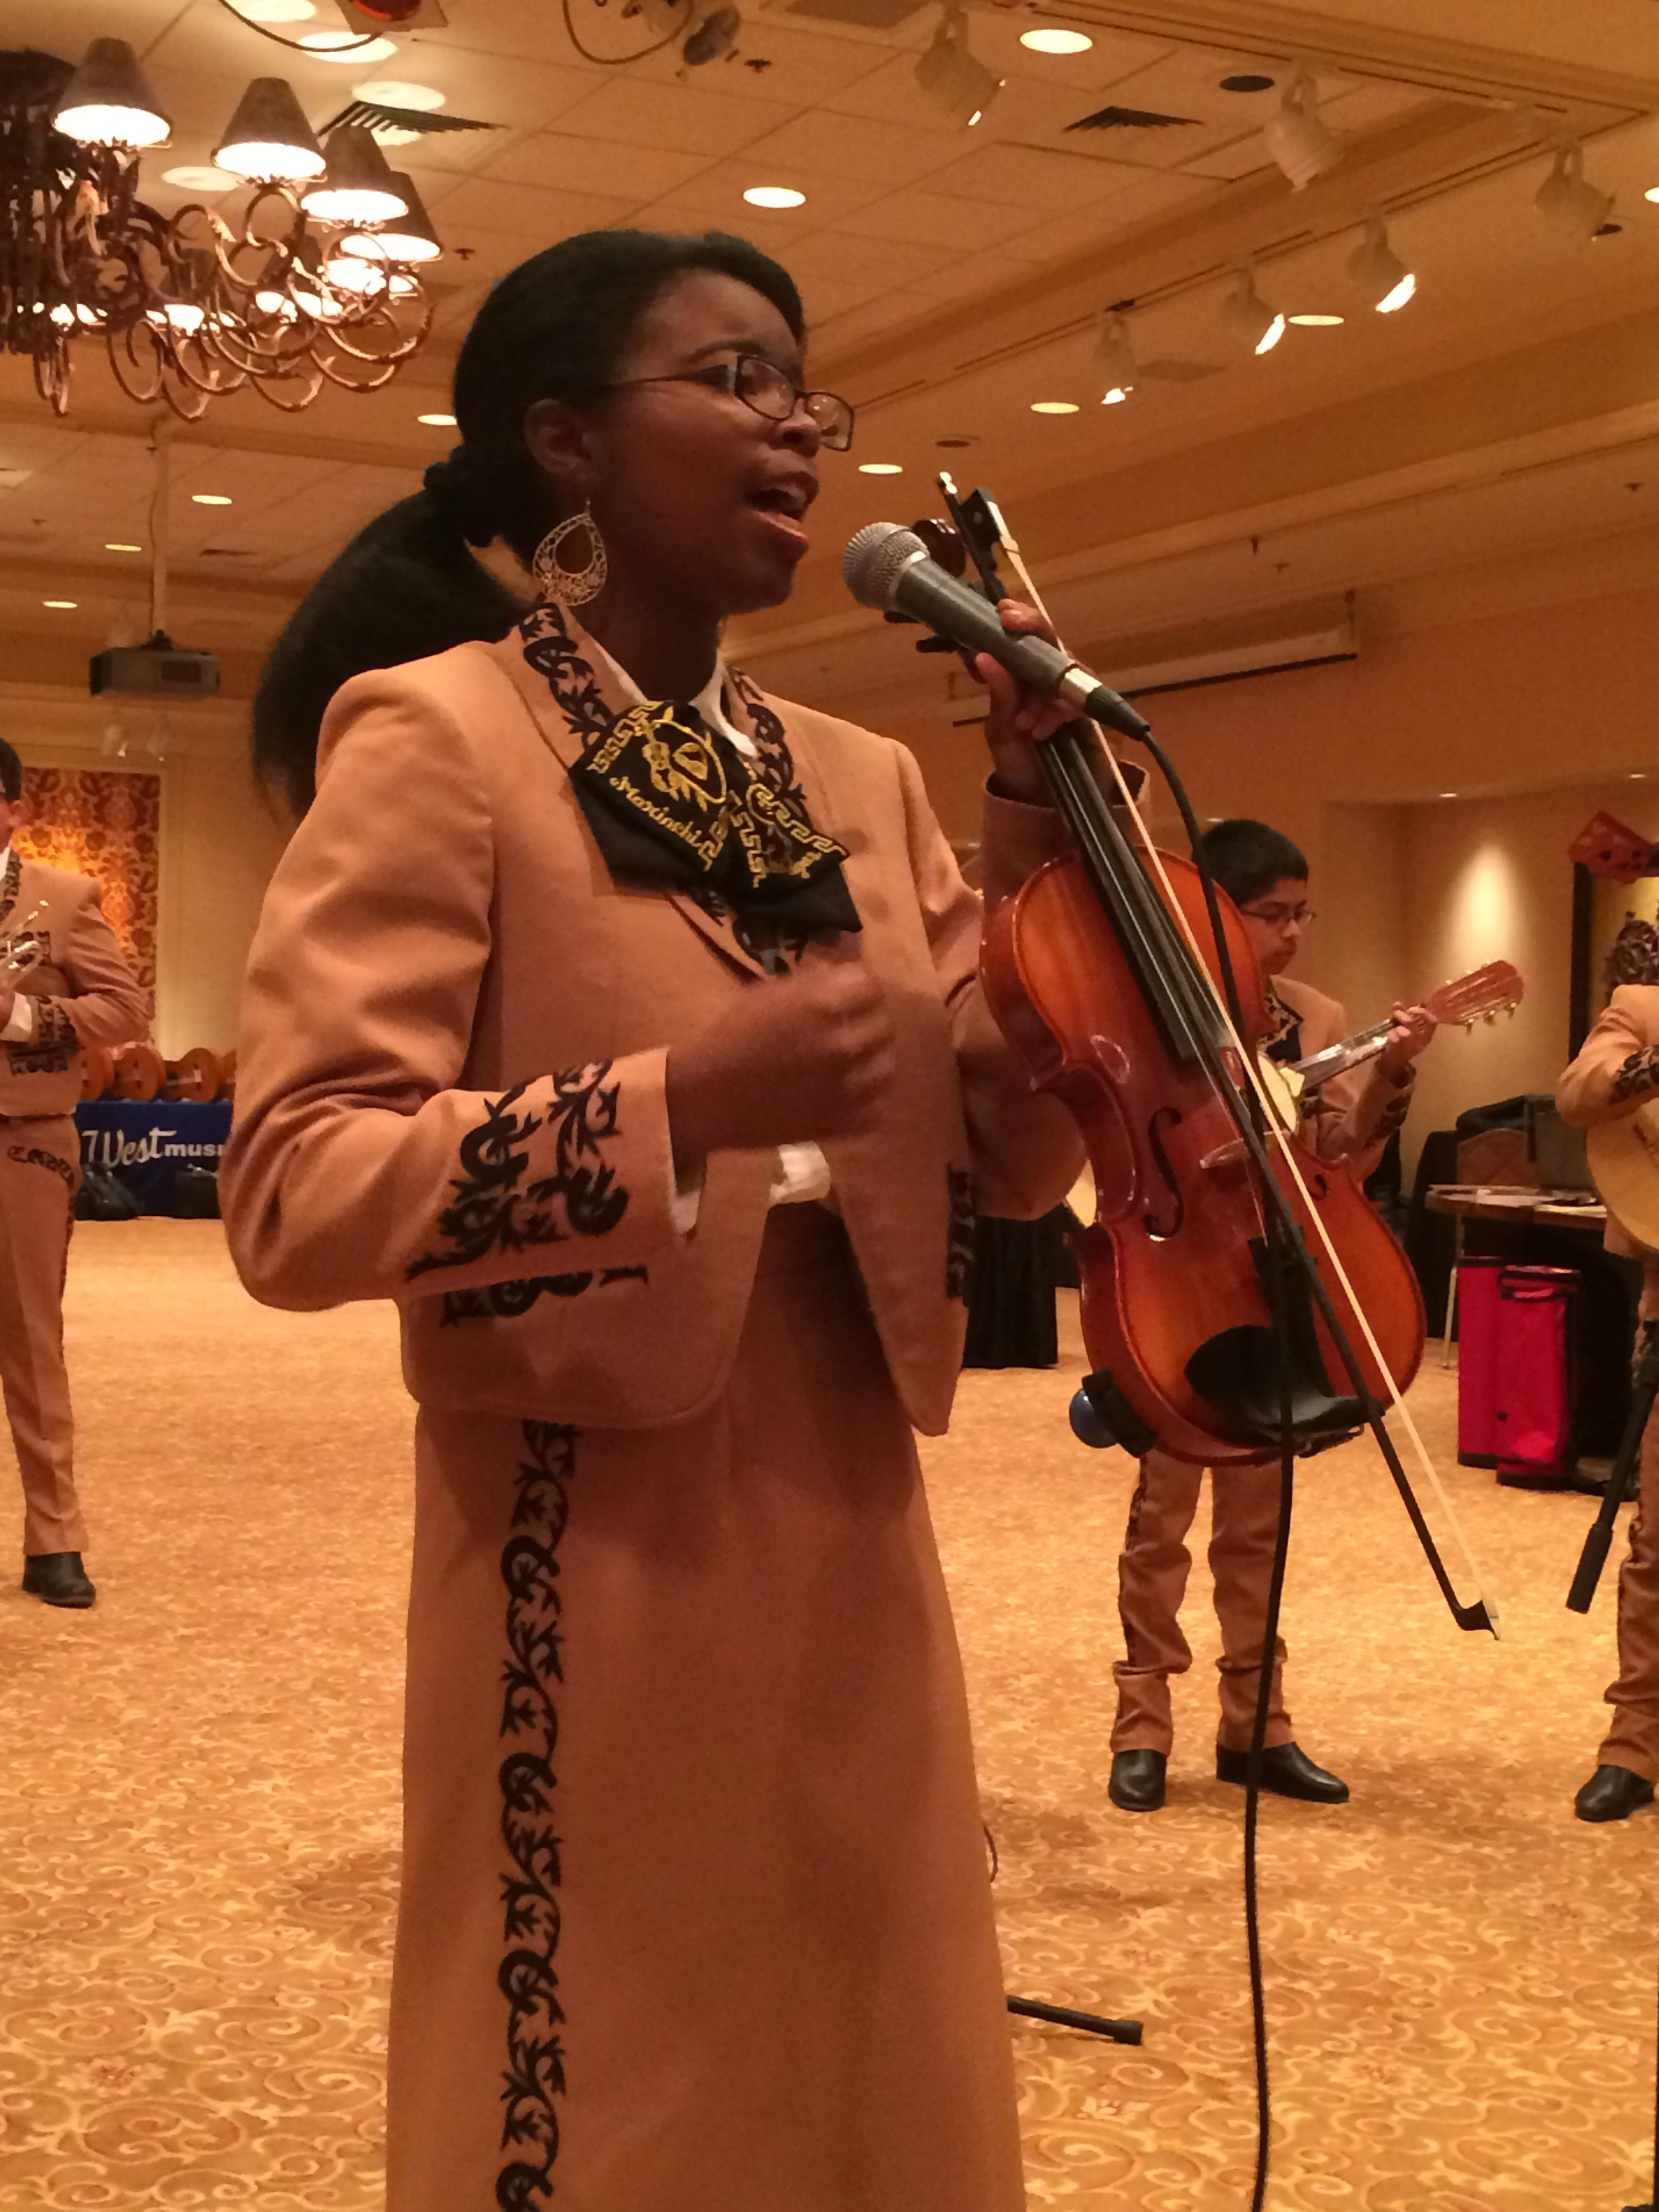
From Zero to Mariachi!
2016 Unity Conference
Arts Education
Menudo Breakfast
Jose Hernandez and Marcia Neel
Music Education Consultants, Inc.
September 11, 2016
Hilton San Diego Del Mar, CA

Slide 9
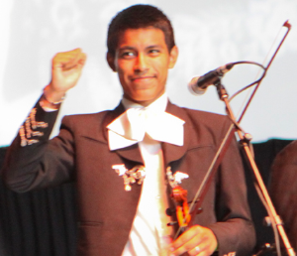
Benefits of a School Mariachi Program
Involves More Students in Music
Helps keep students in school
Uses multiple intelligences
Teaches life-long skills
Provides opportunities for students to serve as role
models to younger students
Increases student self-esteem and self-confidence
Provides effective bridge to parental involvement
Celebrates/Recognizes culture and heritage
Creates a school “Mosaic of Musical Experiences”
Allows for entry-level music experiences at any time

Slide 10
Benefits of a School Mariachi Program
Involves More Students in Music
Helps keep students in school
Uses multiple intelligences
Teaches life-long skills
Provides opportunities for students to serve as role
models to younger students
Increases student self-esteem and self-confidence
Provides effective bridge to parental involvement
Celebrates/Recognizes culture and heritage
Creates a school “Mosaic of Musical Experiences”
Allows for entry-level music experiences at any time
It’s Fun!

Slide 11

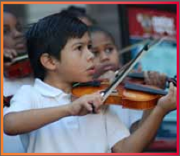
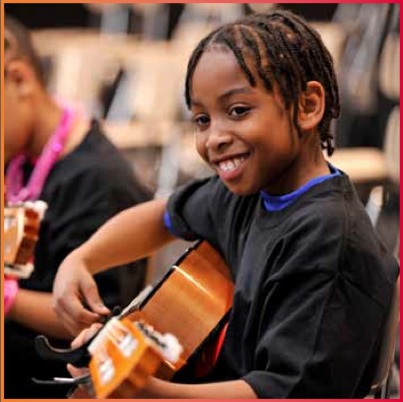
Prelude:
Music Makes Us Baseline Research Report
Becky J. A. Eason, Ph.D.
Center for Public Partnerships & Research
The University of Kansas
Christopher M. Johnson, Ph.D.
Music Research Institute
The University of Kansas
musicmakesus.org/resources/research

Slide 12
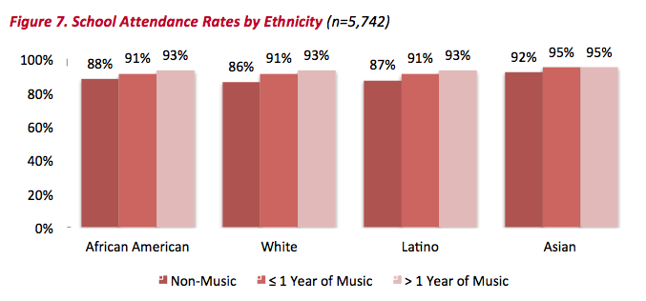
Findings: Attendance Rates

Slide 13
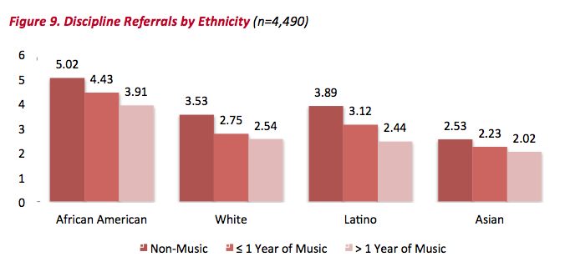
Findings: Discipline Referrals

Slide 14
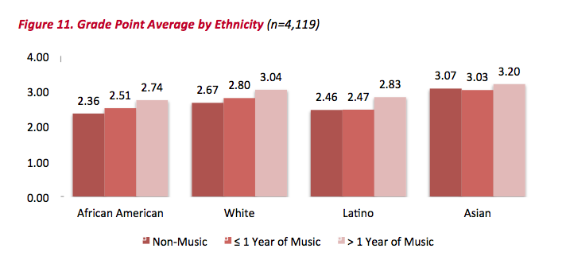
Findings: Grade Point Average

Slide 15
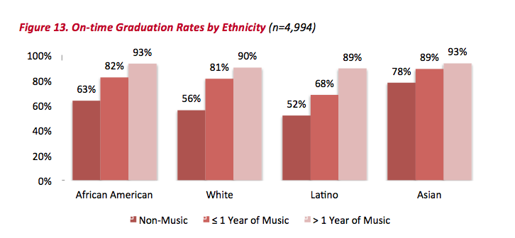
Findings: On Time Graduation Rates

Slide 16
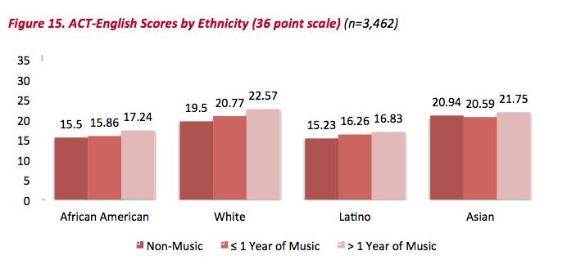
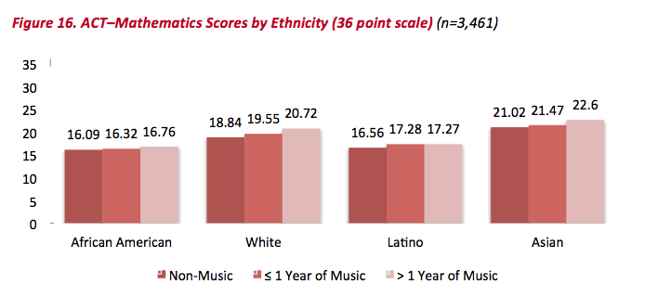
Findings: ACT Scores

Slide 17
Summary: What Was Learned?
The MORE a student participates in
MUSIC,
the more POSITIVE
the BENEFITS become.

Slide 18
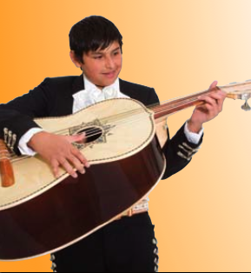
Implementation: During the School Day
Methodology: Same as Band or Orchestra
1. Articulate between HS (2) & MS (2-3)
2. Year 1: Start simply with only 2 classes
a. Beg. Trumpet/Violin (Melodia)
b. Beg. Guitar/Vihuela/Guitarron (Armonia)
3. Schedule classes to meet daily
4. Use a structured standards-
based curriculum that
focuses on literacy

Slide 19
Implementation: During the School Day
Methodology: Same as Band or Orchestra
1. Articulate between HS (3) & MS (3)
2. Year 2: Add Beg Mariachi Ensemble
3. Continue with offering
a. Beg Trumpet/Violin (Melodia)
b. Beg Guitar/Vihuela/Guitarron (Armonia)

Slide 20
Implementation: During the School Day
Methodology: Same as Band or Orchestra
1. Split HS (4-5) & MS (4-5)
2. Year 3: Add Int Mariachi Ensemble
3. Continue with offering
a. Beg Trumpet/Violin (Melodia)
b. Beg Guitar/Vihuela/Guitarron (Armonia)
c. Beg Mariachi Enemble

Slide 21
Implementation: After School Program
Methodology: Same as Band or Orchestra
1. Organize by instrument type:
Armonia and Melodia classes
2. Rehearse classes every other day
3. Provide guided practice on alternate
day
4. Conduct full ensemble
rehearsal on Fridays with
increases as appropriate

Slide 22
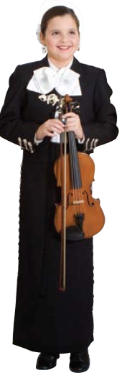
Year 2: After School Program
Methodology: Same as Band or Orchestra
Maintain what was implemented and:
1. Add two level-specific ensemble classes
2. Rehearse above classes twice
weekly alternating days with
guided practice classes
3. Conduct full ensemble rehearsal
on Fridays with increases as
appropriate

Slide 23
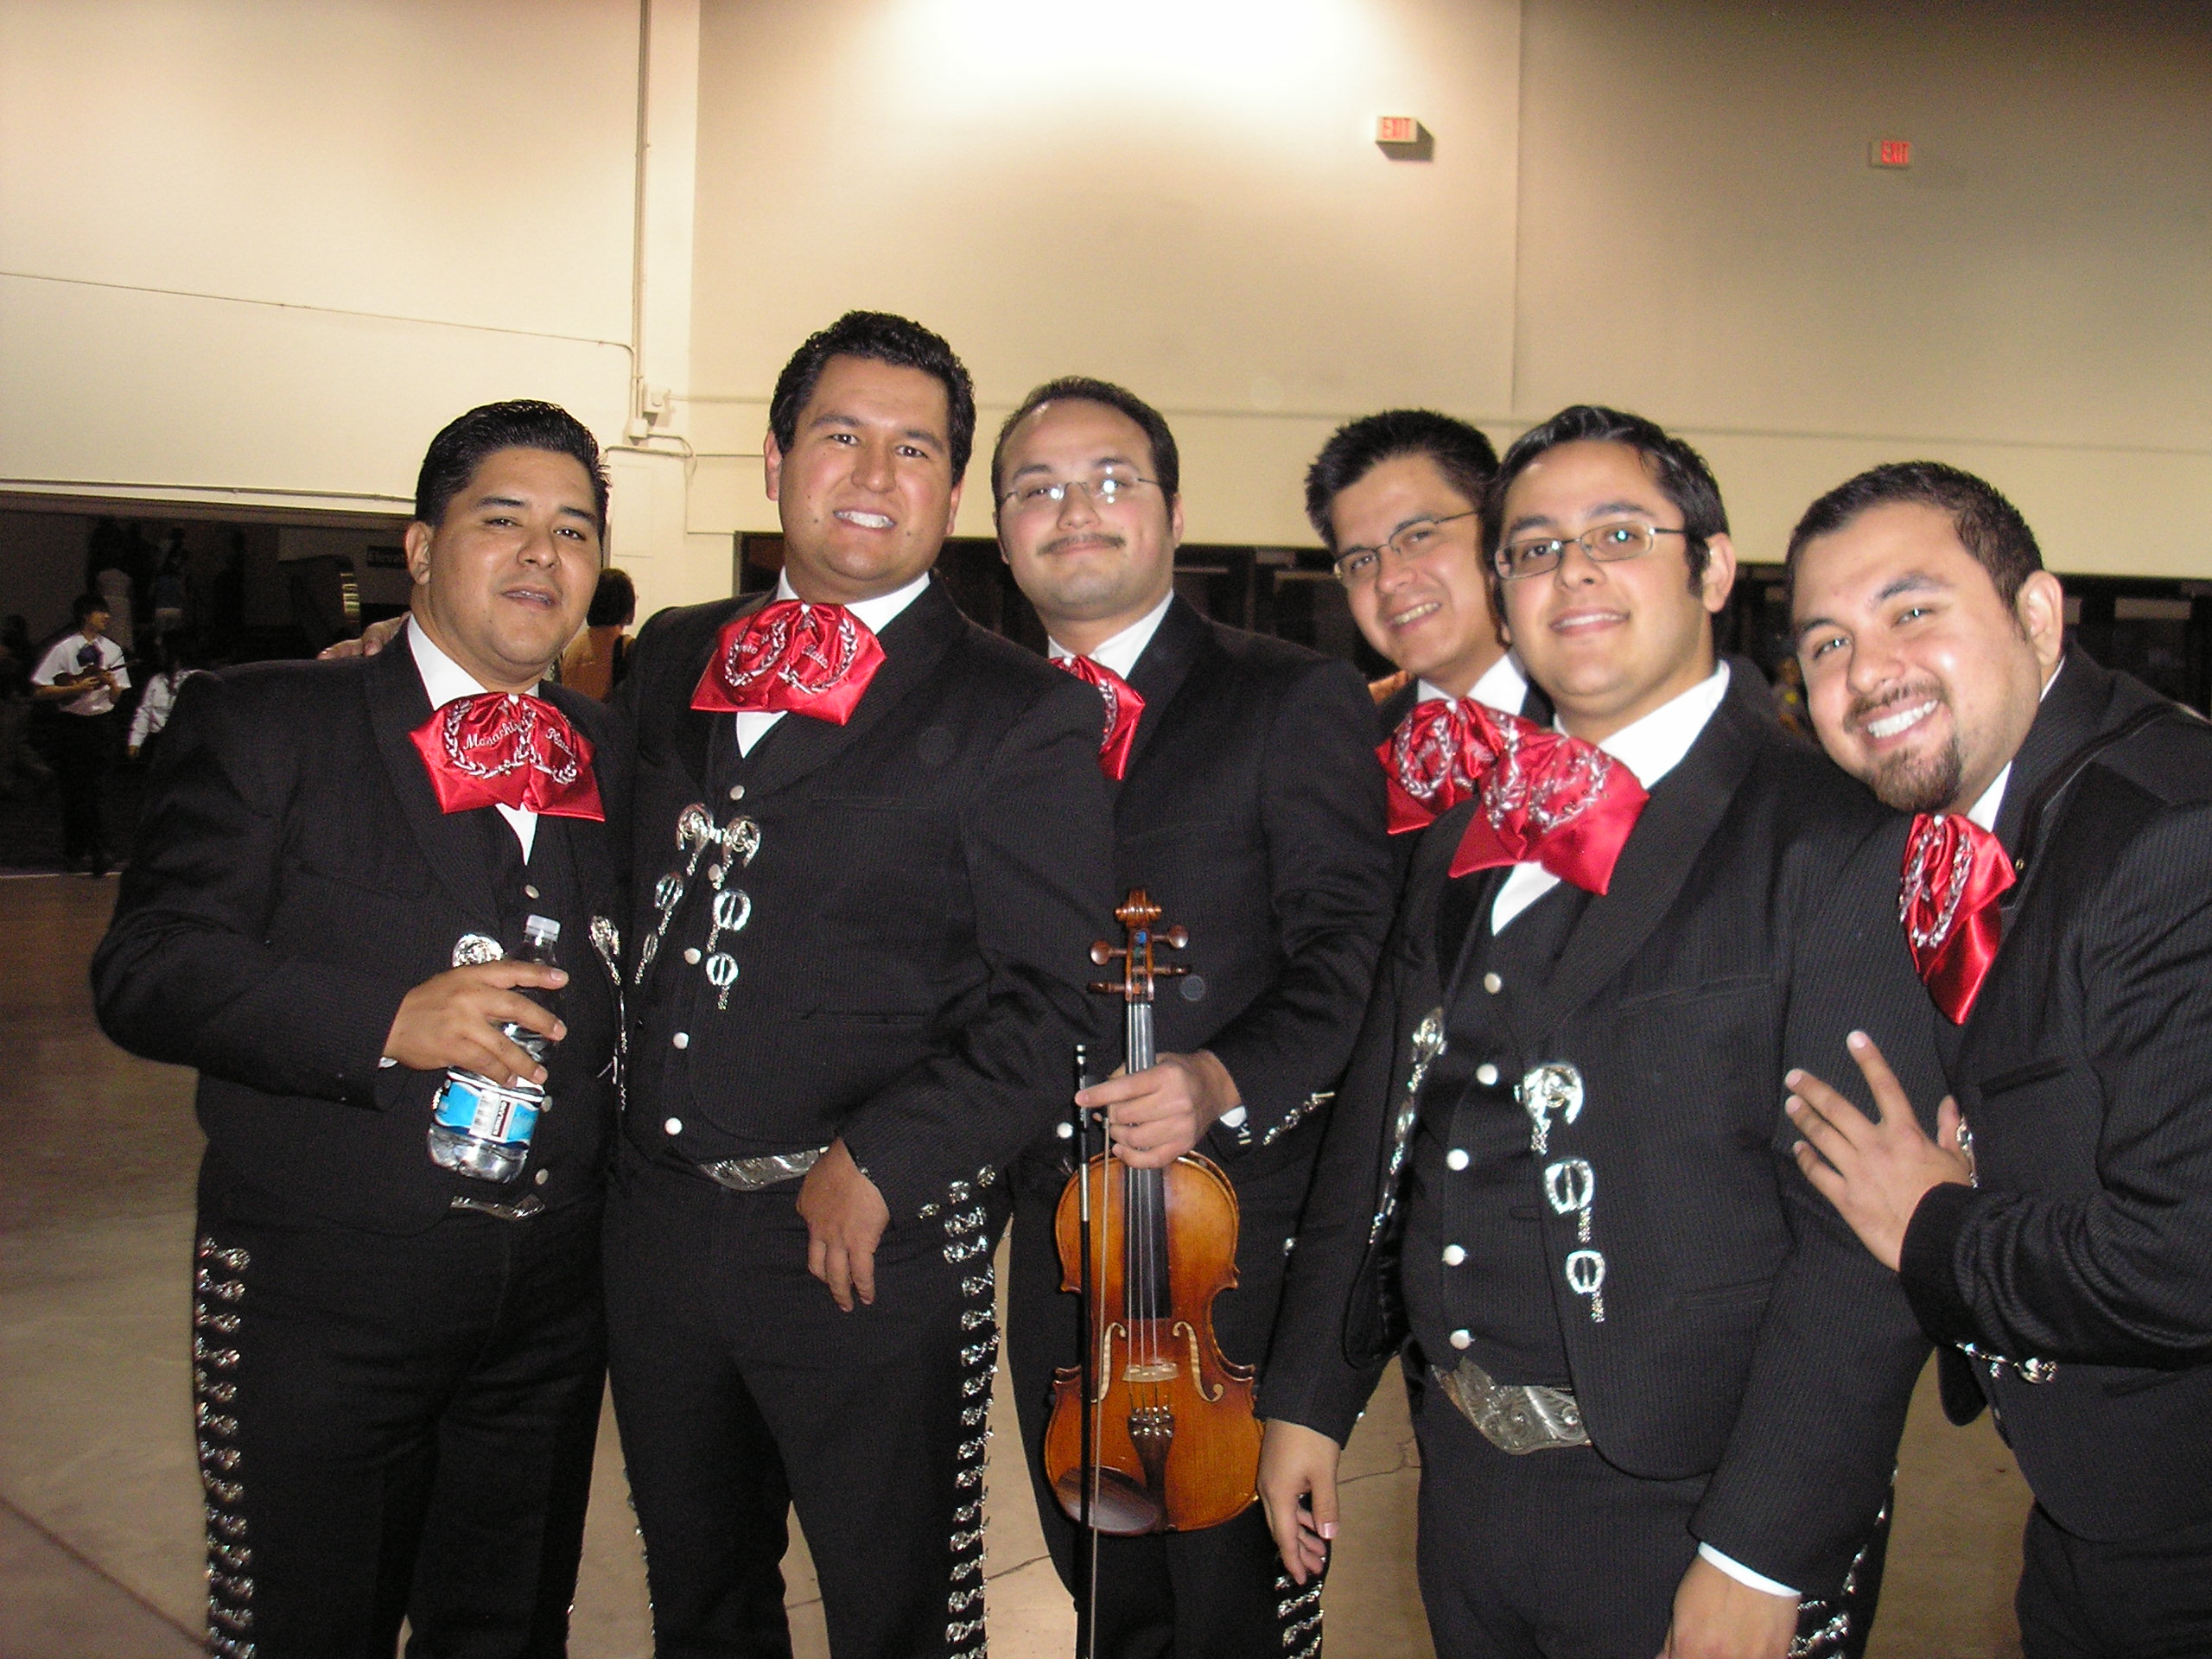
Implementation: Budget Considerations
1. Staff

Slide 24
Implementation: Budget Considerations
Staffing: In-school
To Start:
1 Itinerant teacher split between
high school and middle school

Slide 25
Implementation: Budget Considerations
Staffing: After-school
1 Teacher
1 Assistant for guided practice days
  Other district faculty/staff
  University student
  Community member
  Graduated music student
  Peer coaching?

Slide 26
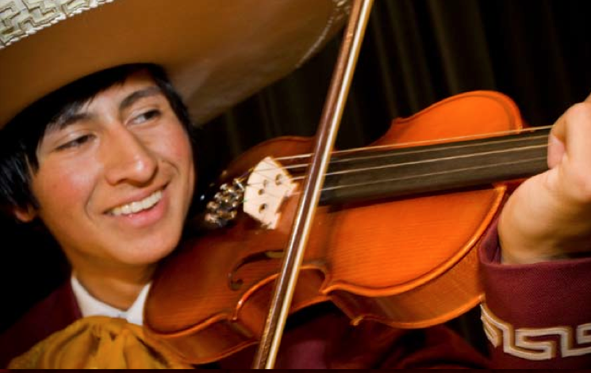
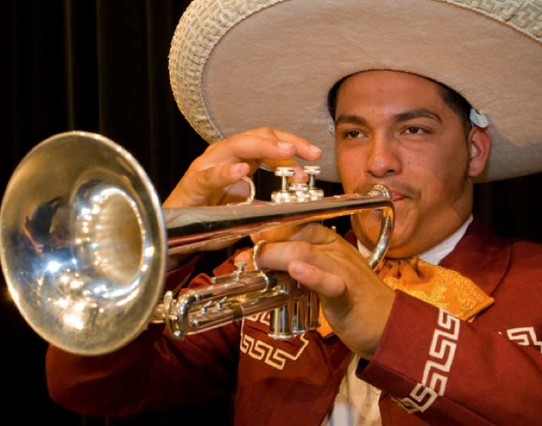
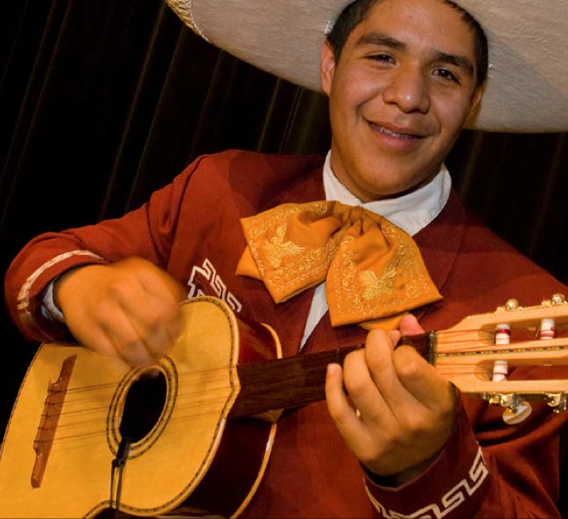
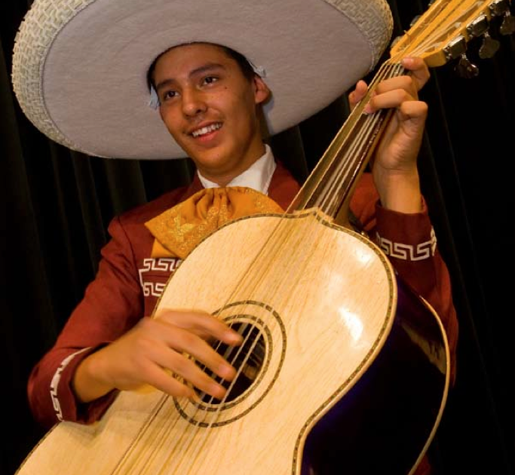
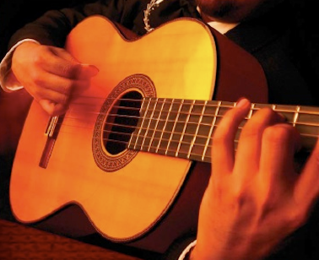
Implementation: Budget Considerations
2. Instruments

Slide 27
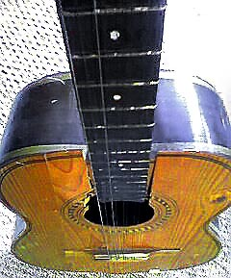

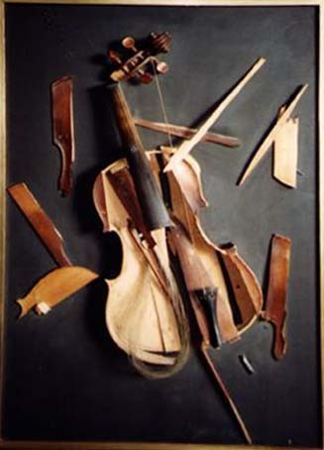
Implementation: Budget Considerations
2. Instruments: Know Your Vendor!!!!!
ALWAYS buy from a Reputable Dealer!!!

Slide 28

Implementation: Budget Considerations
2. Instruments: Know Your Vendor!!!!!
ALWAYS buy from a Reputable Dealer!!!

Slide 29
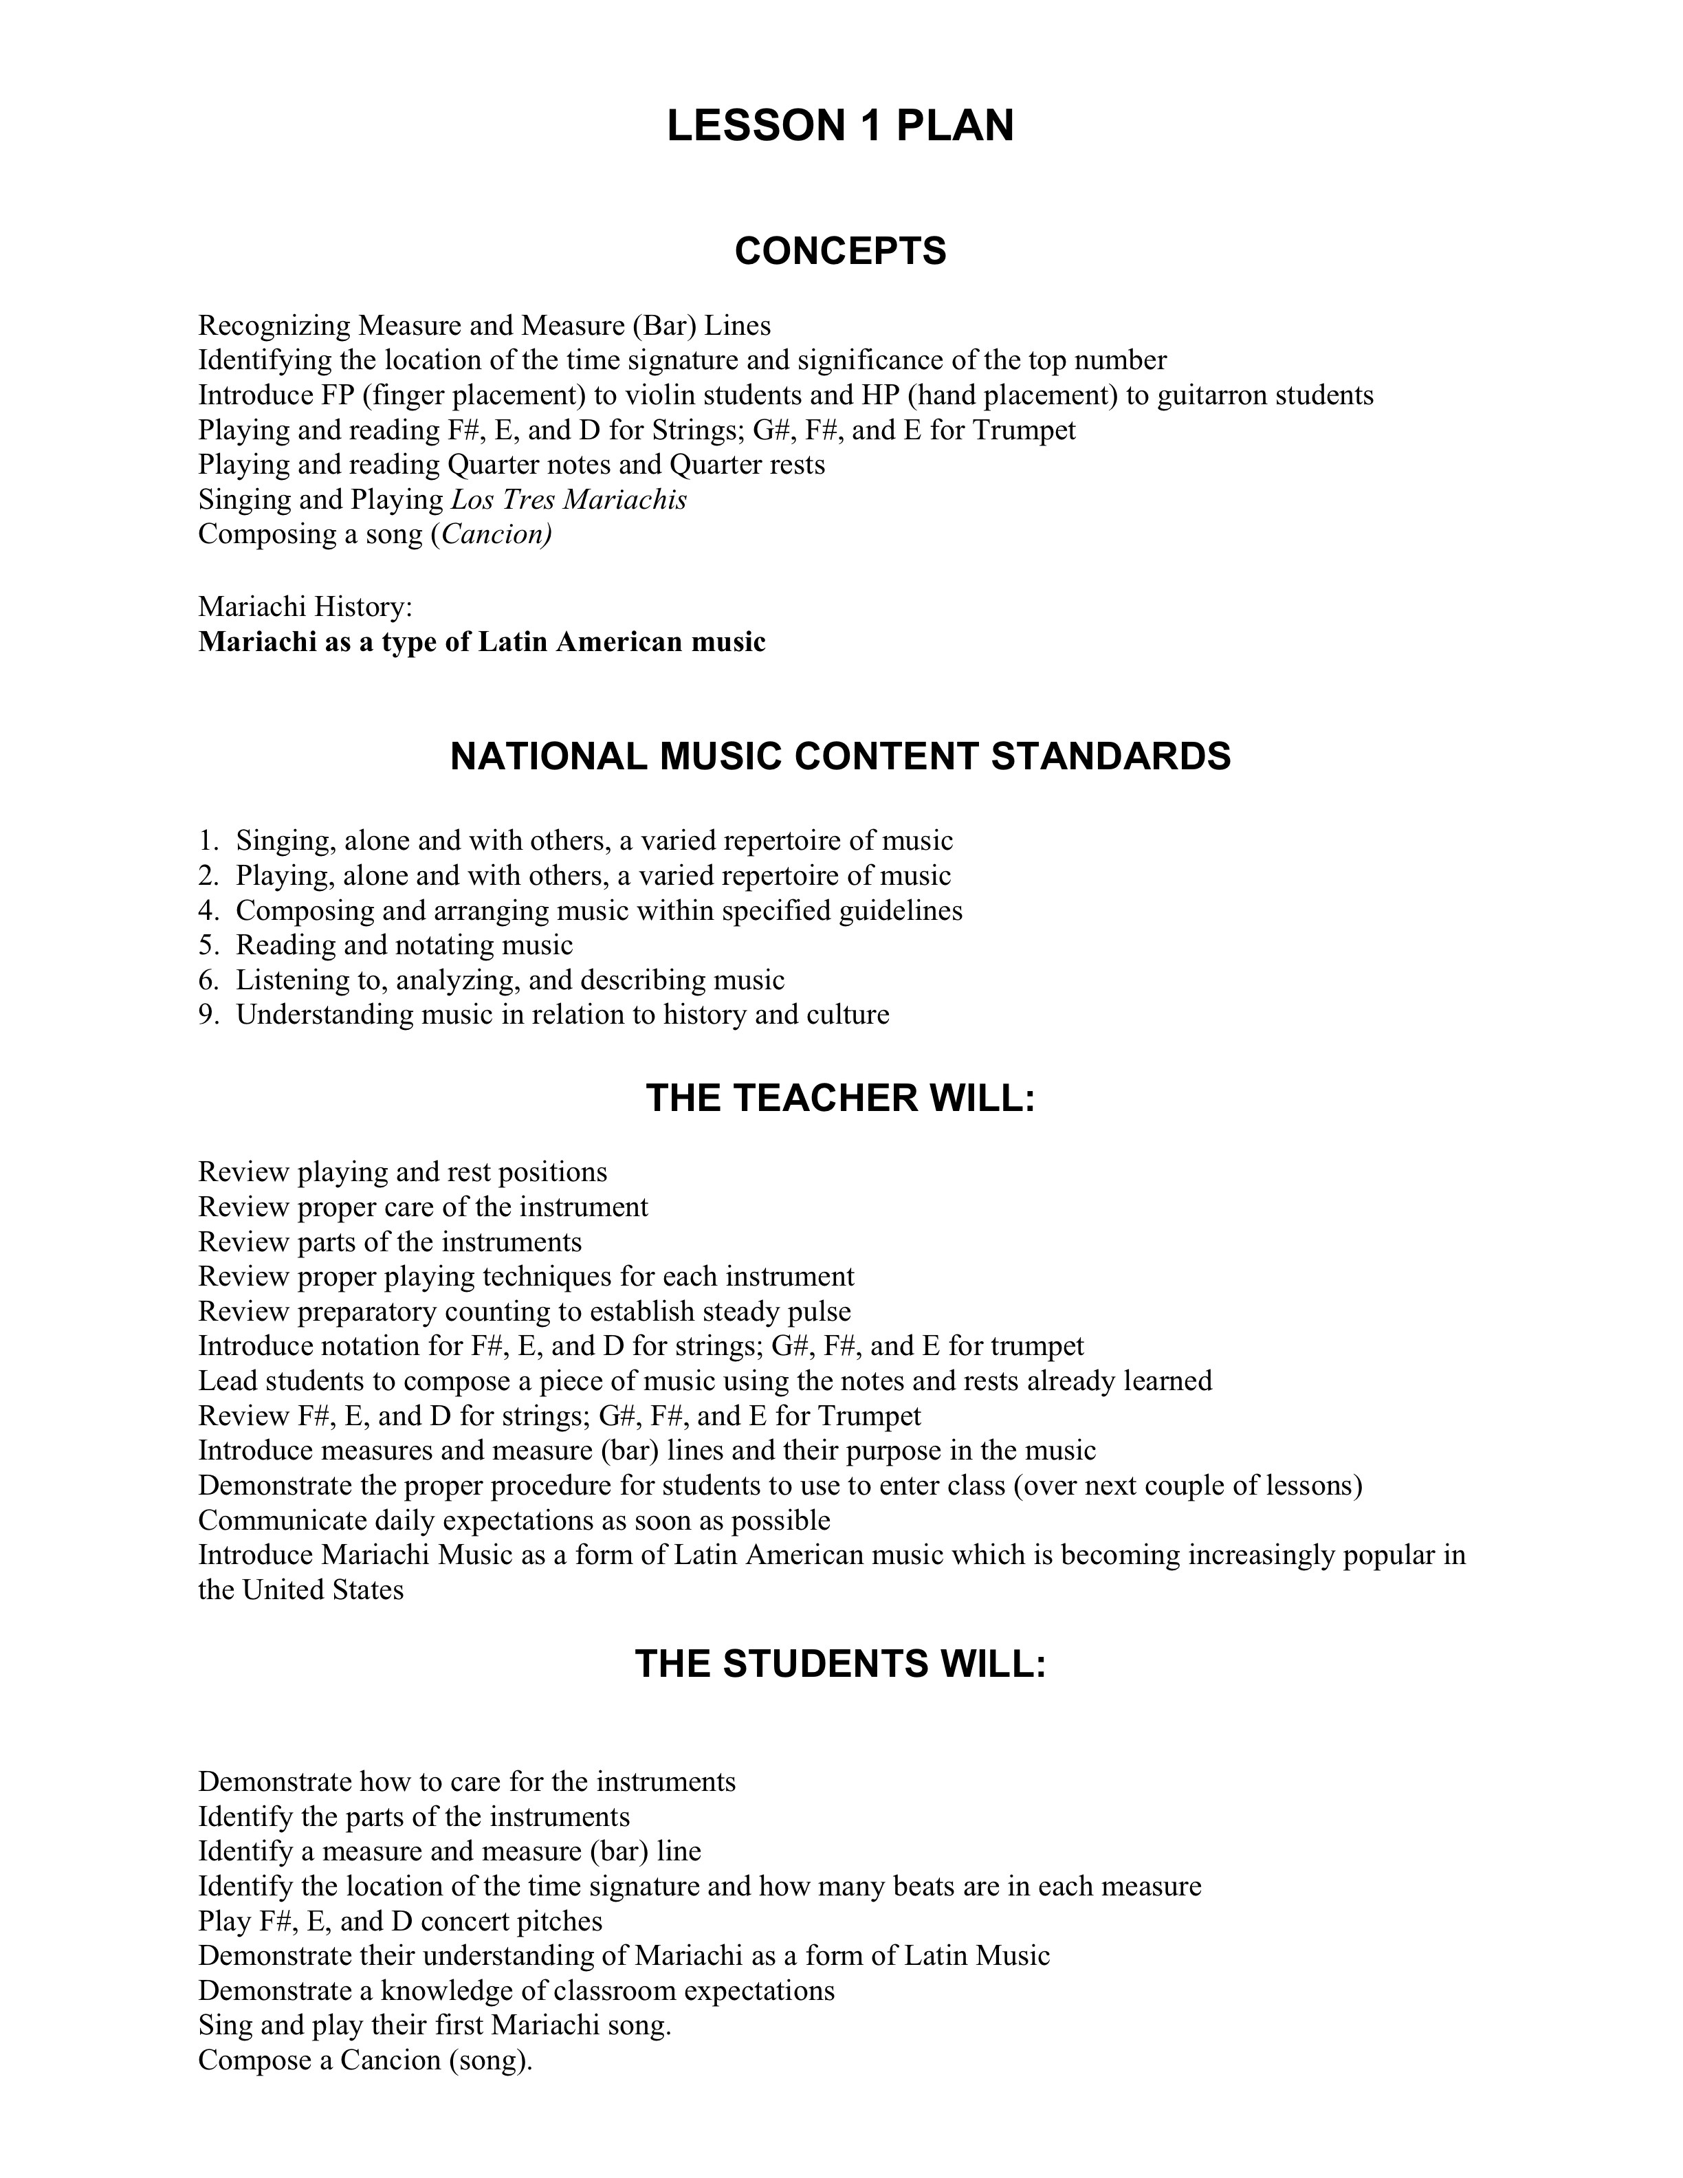
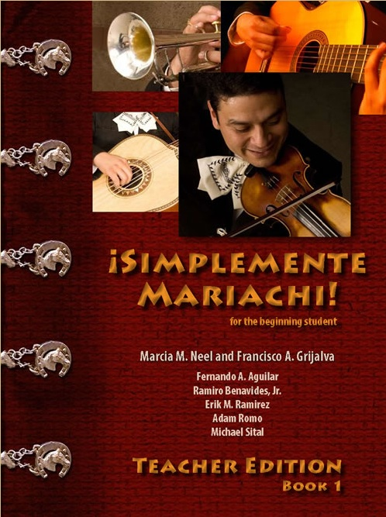
Implementation: Budget Considerations
3. Textbooks, Music and Materials

Slide 30





Implementation: Budget Considerations
3. Textbooks, Music and Materials
Arranged by
Jose Hernandez

Slide 31
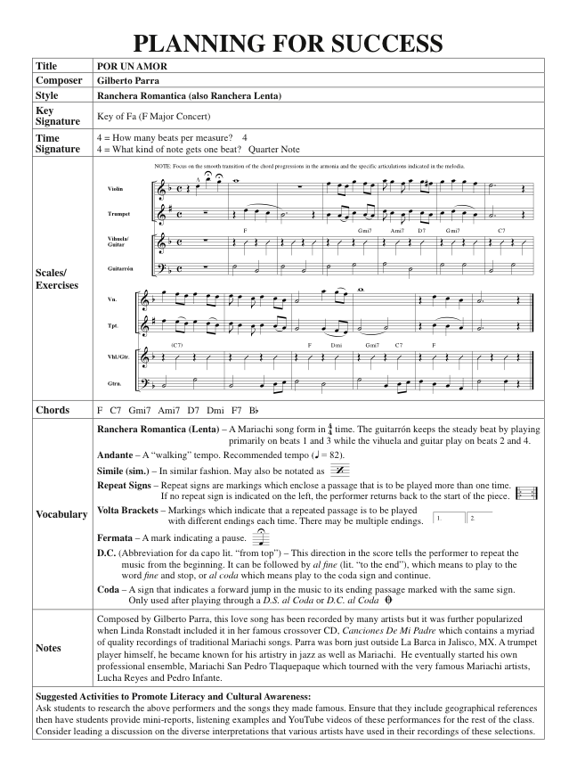

Slide 32
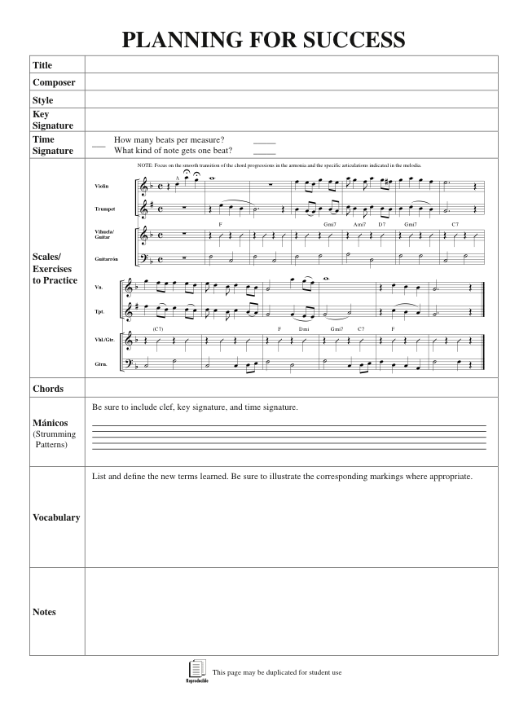

Slide 33


Implementation: Budget Considerations
3. Textbooks, Music and Materials
Arranged by
Jose Hernandez
Traditional Mexican Songs for the
Elementary Music Class
La Sandunga
Noche de
Paz

Slide 34
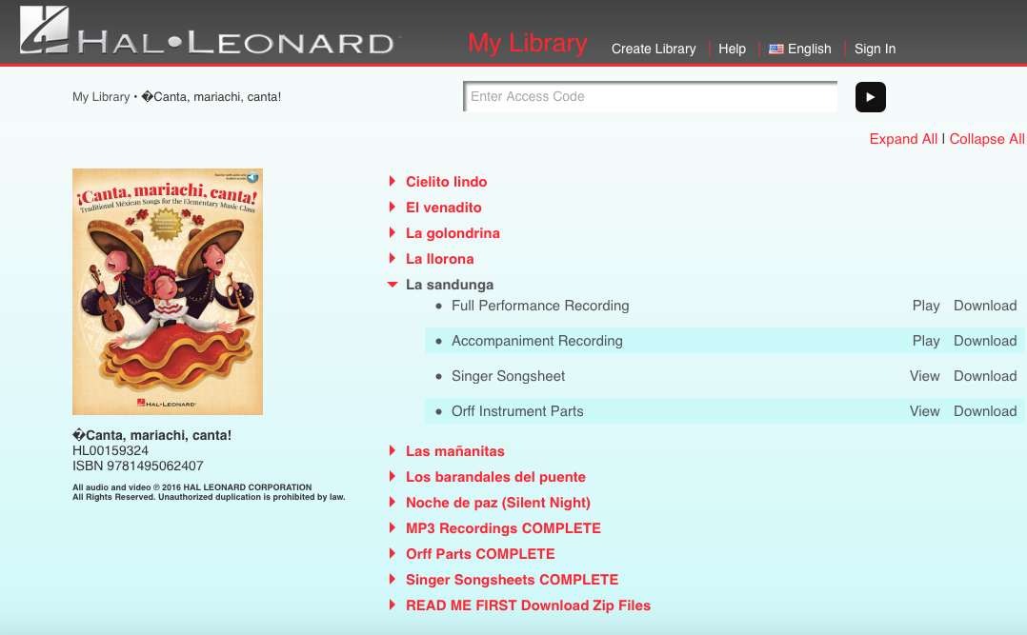
Implementation: Budget Considerations
3. Textbooks, Music and Materials

Slide 35



Implementation: Budget Considerations
3. Textbooks, Music and Materials

Slide 36
Implementation: Budget Considerations
4. Supplies
Sets of Violin Strings
Shoulder Rests
Sets of Guitar Strings
Heavy Gauge Guitar Picks
Classical Guitar/Vihuela Straps
Sets of Vihuela Strings
Finger Picks for Vihuelas
Sets of Guitarron Strings
Bottles of Valve Oil
Bass Guitar Straps

Slide 37
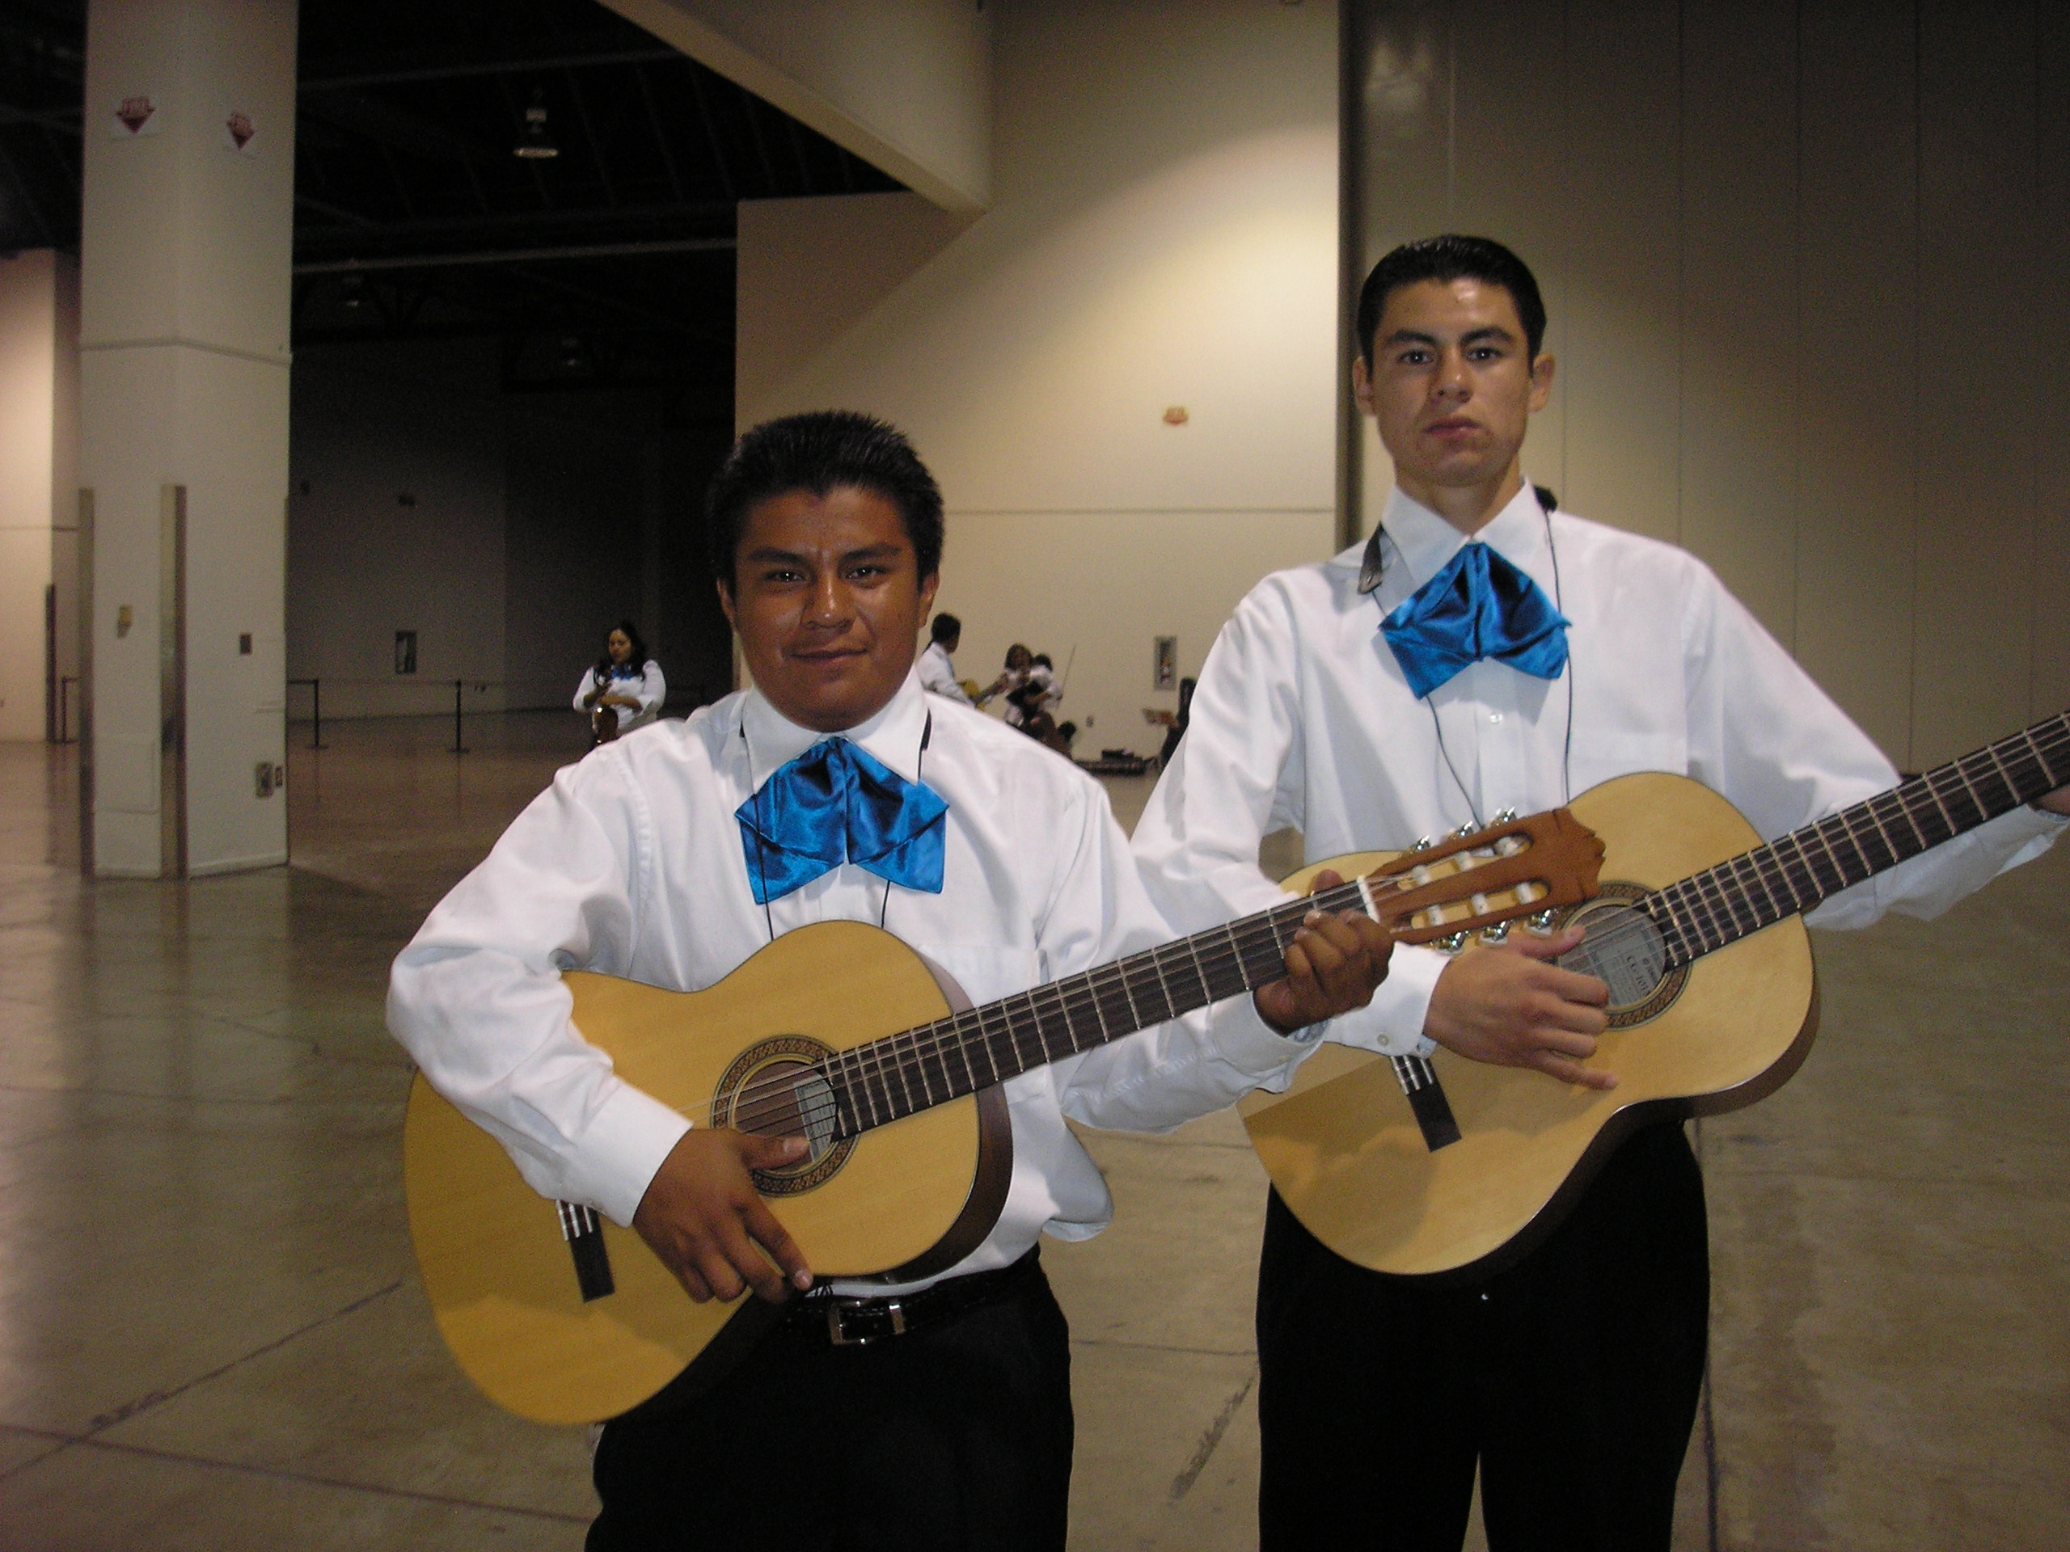
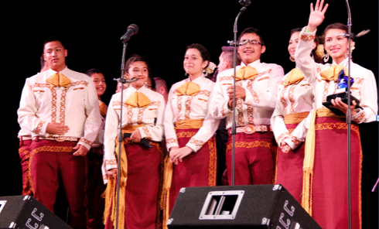
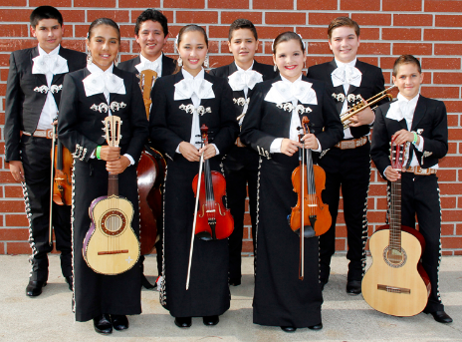
Implementation: Budget Considerations
5. Uniforms
a. White shirt and black pant with basic moño (tie)
b. Vaquero Uniform
(Ranch/Cowboy)
Decorative pant/skirt
& shirt with
coordinating moño
c. Traje de Gala
(Full Mariachi Suit)
Decorative jacket
with pant/skirt
& coordinating moño.

Slide 38
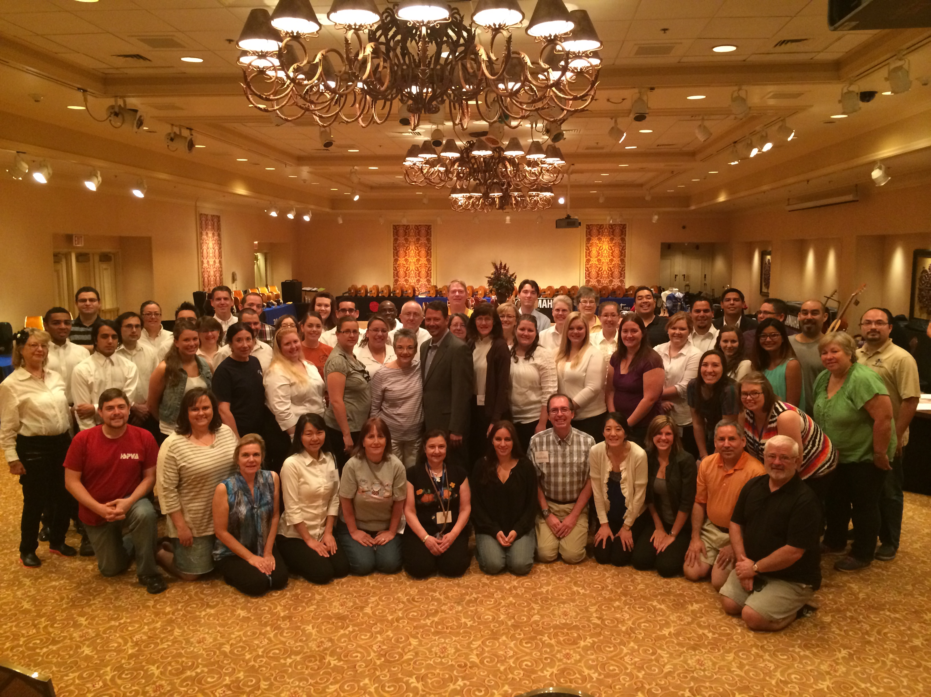
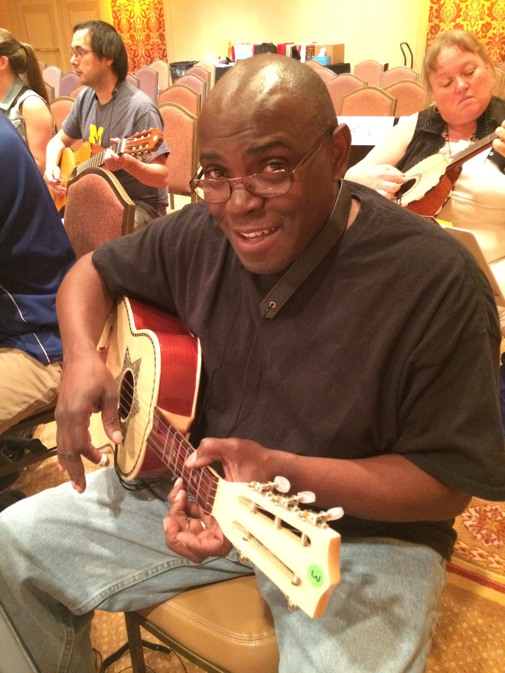
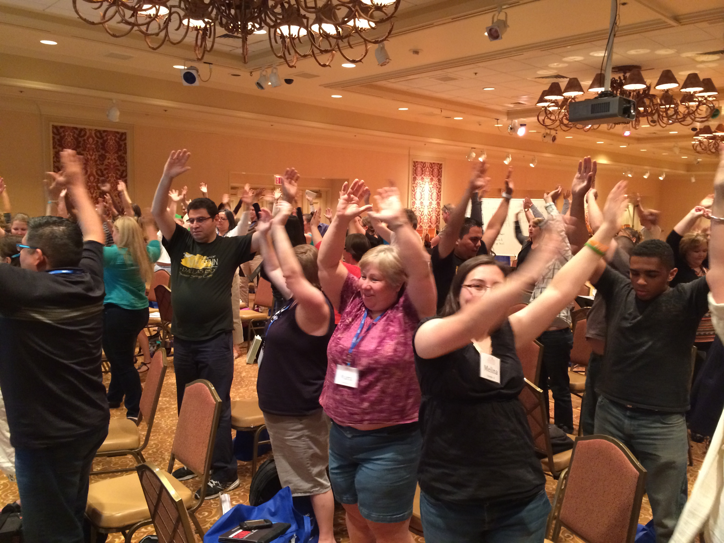
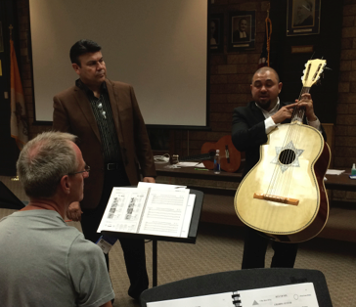
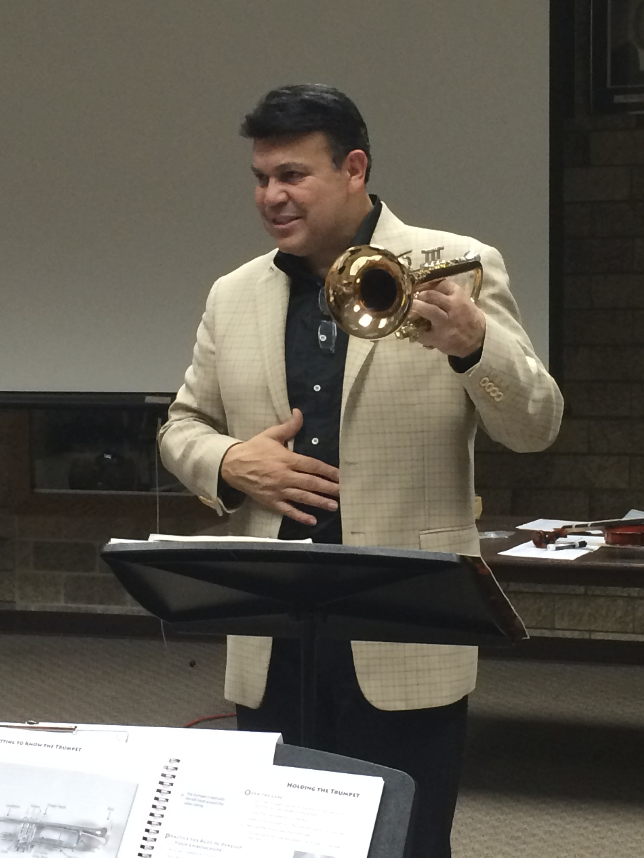
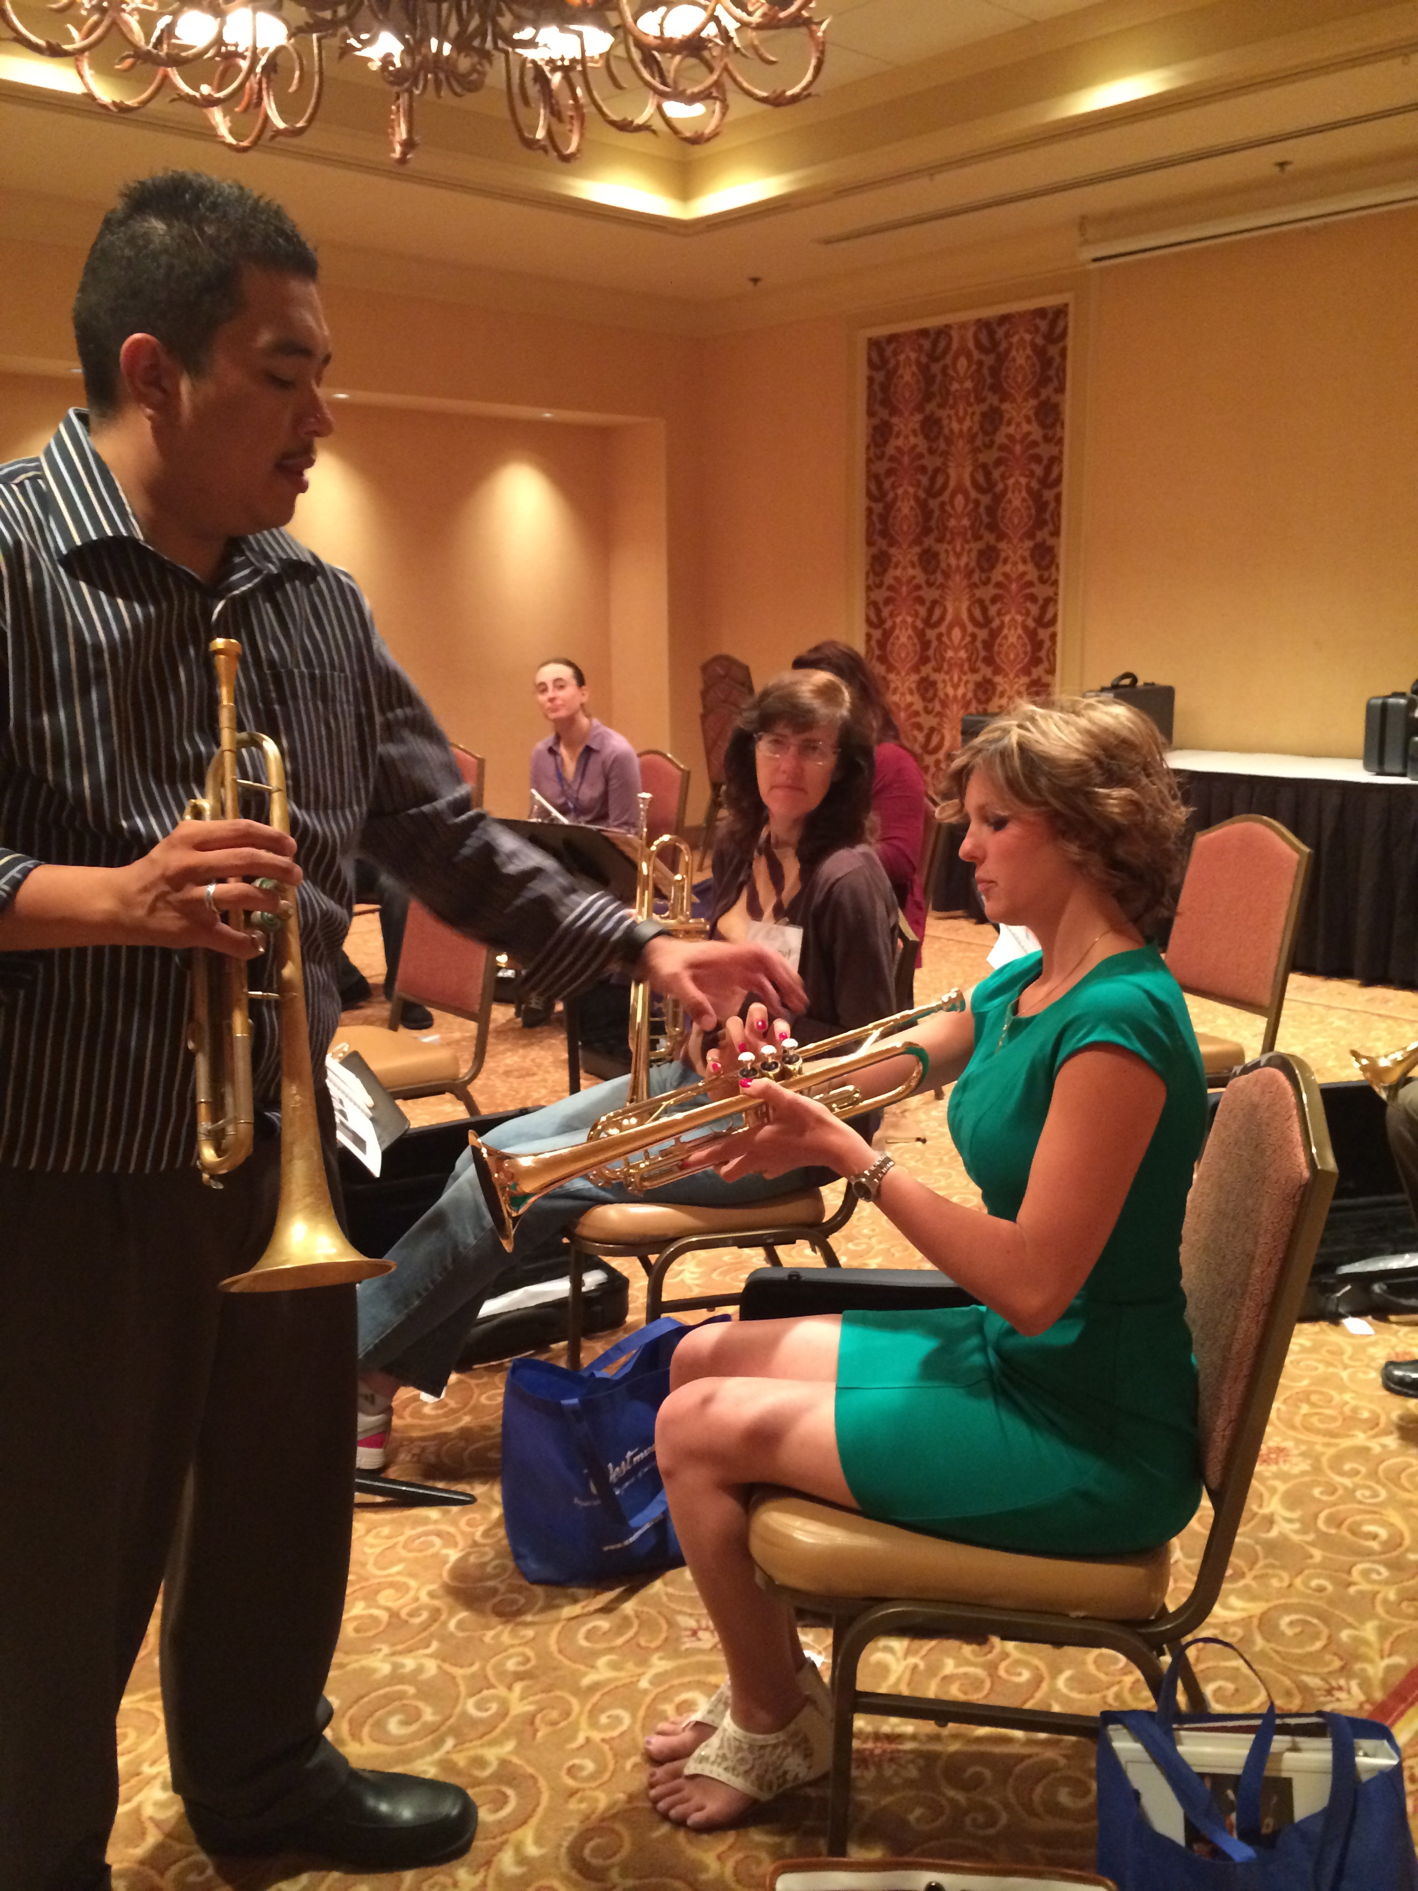
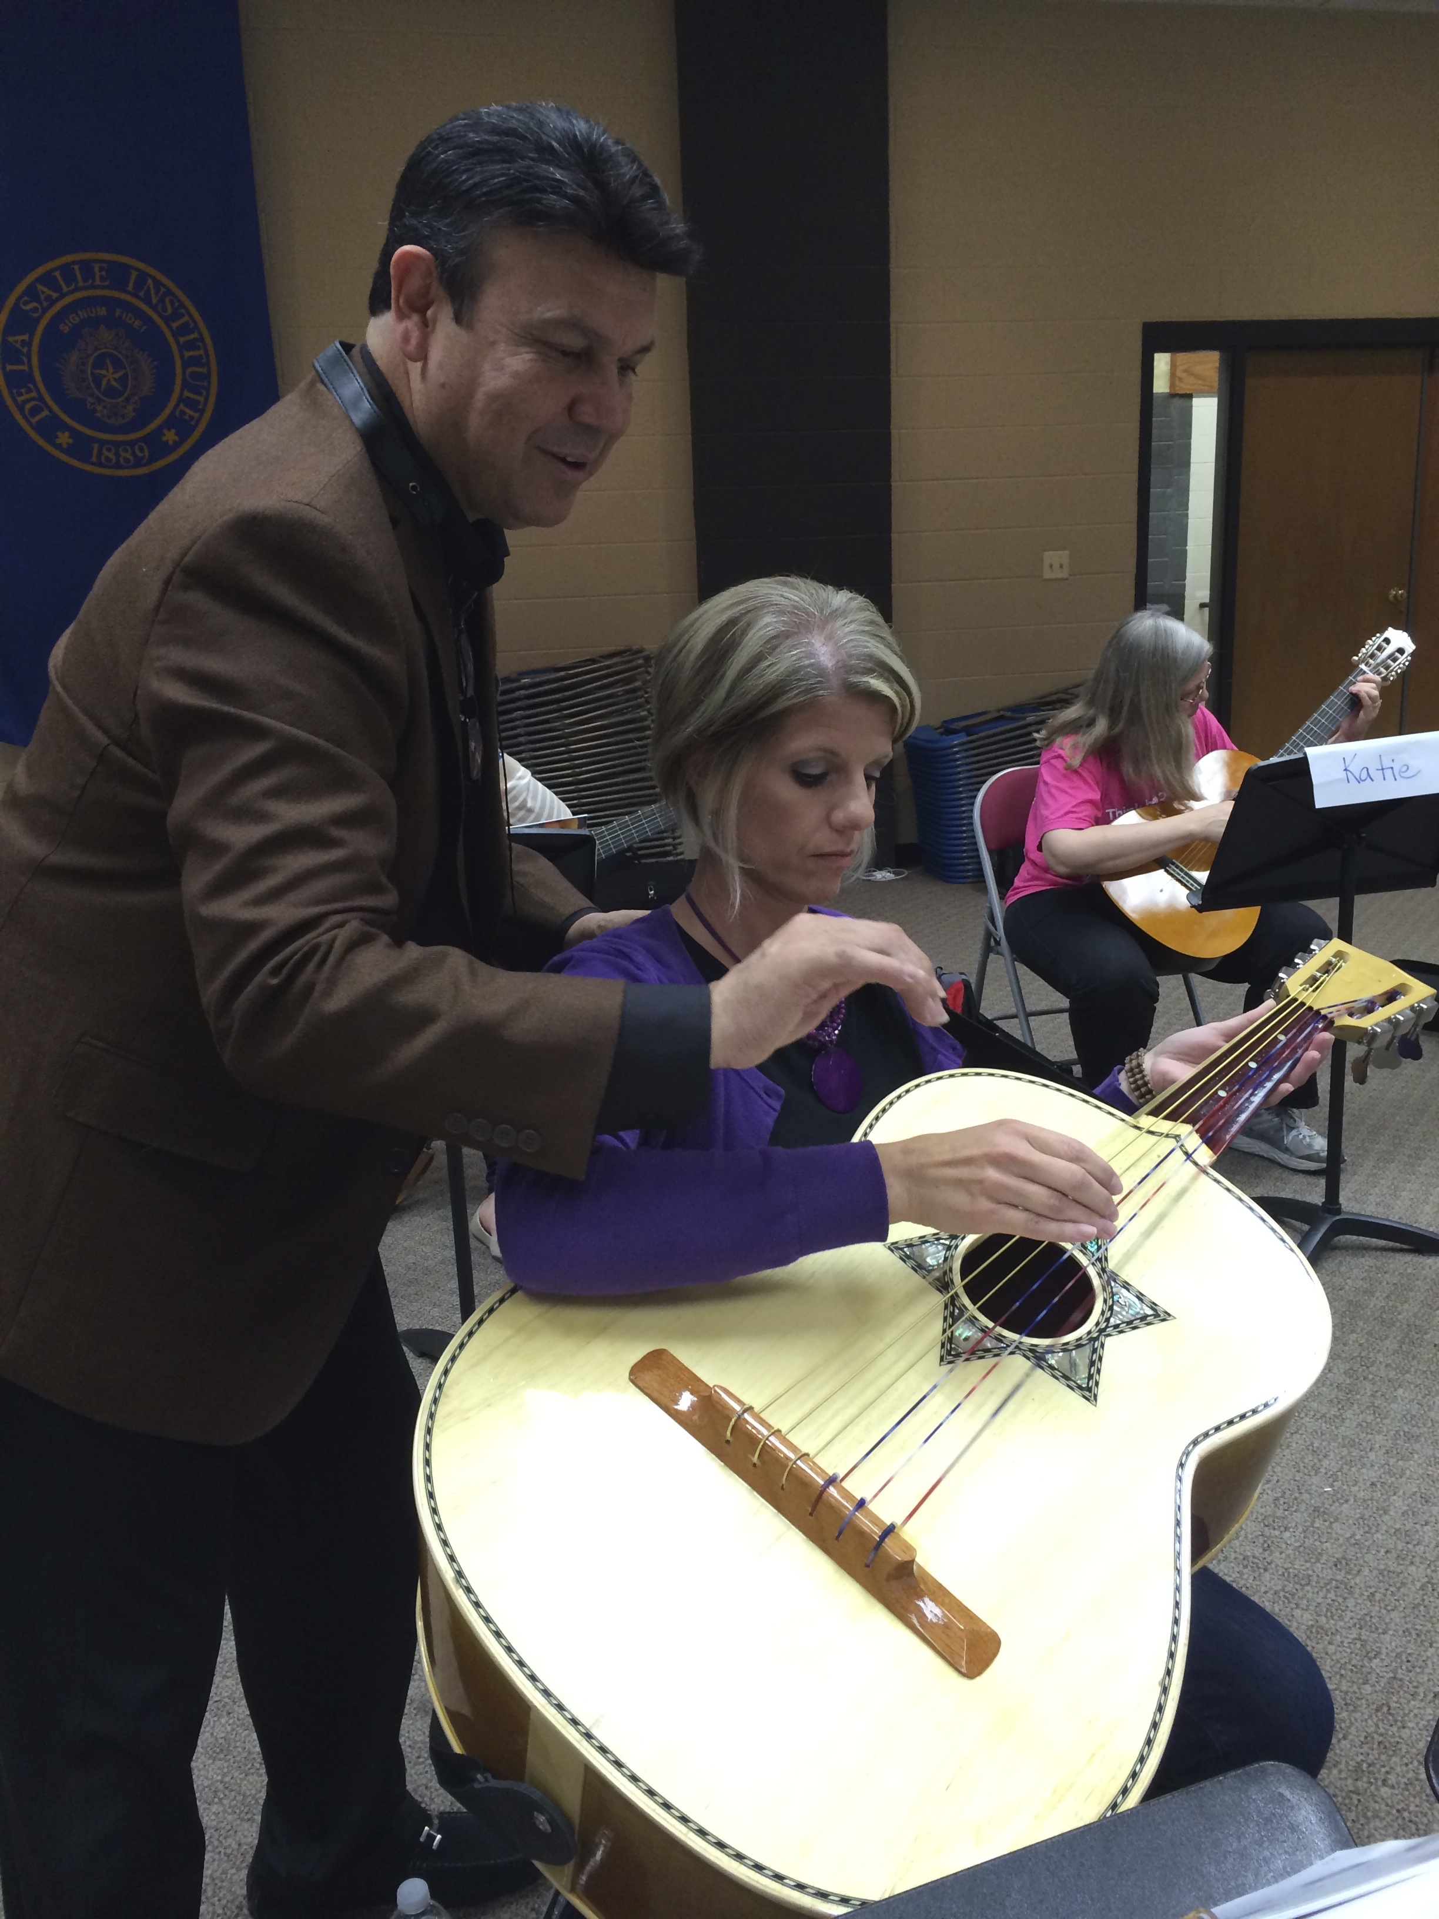
Implementation: Budget Considerations
6. Professional Development

Slide 39
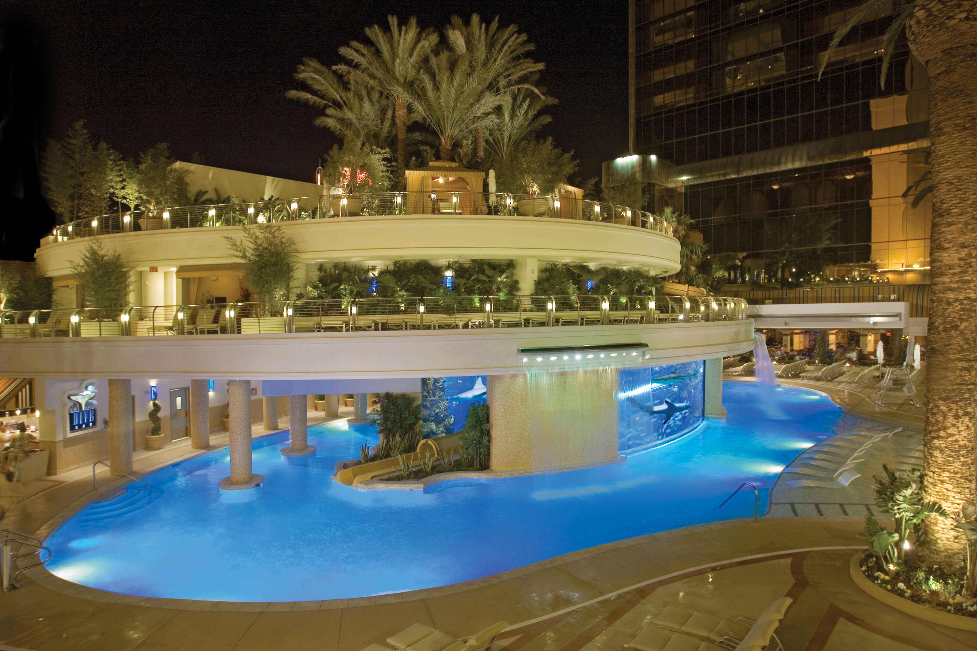

The Fabulous Golden Nugget
Hotel and Casino Las Vegas
National Mariachi Workshops
for Educators®
3 Graduate Credits Available
June 26-30, 2017
www.musicedconsultants.net/
2017-mariachi-workshops

Slide 40
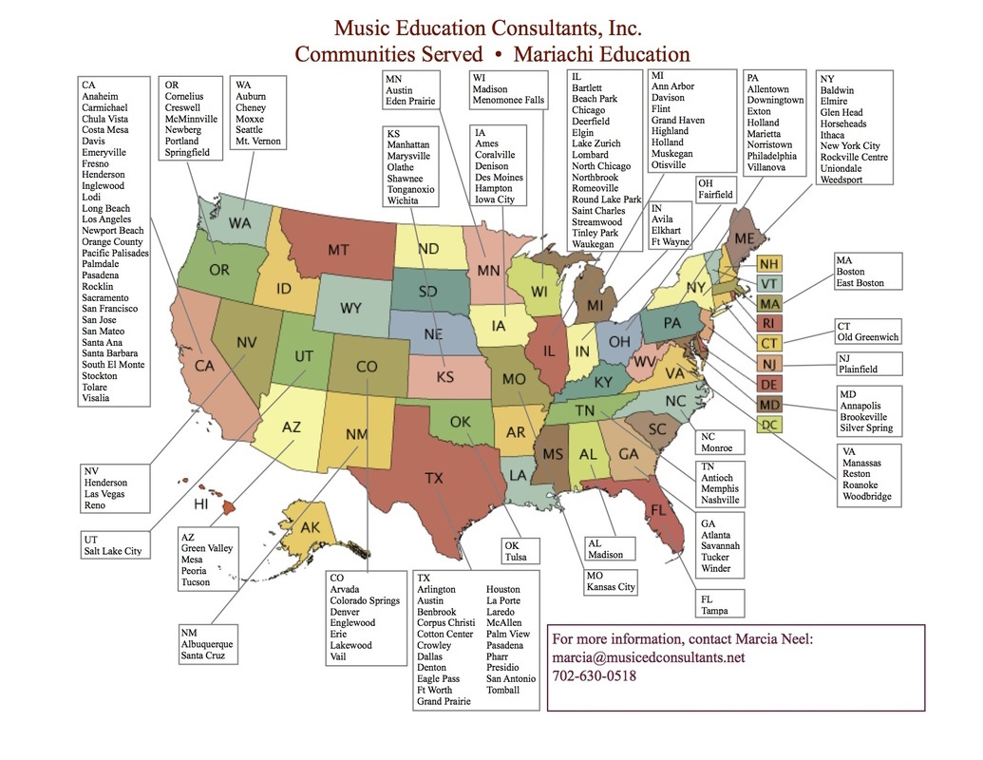

Slide 41

Implementation: Budget Considerations
7. Student Workshops

Slide 42
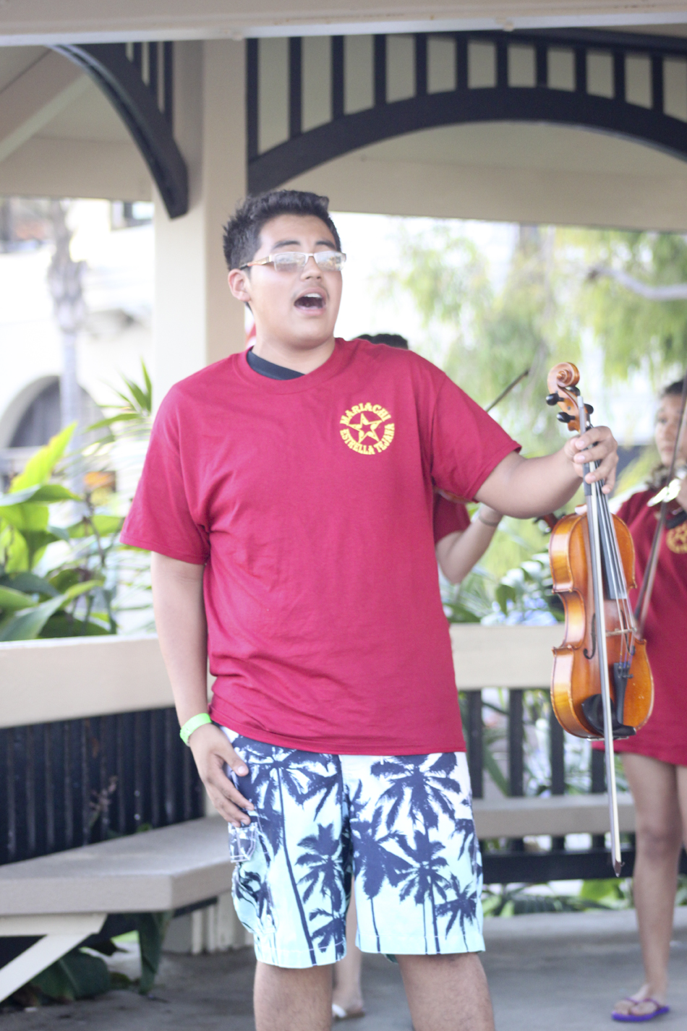
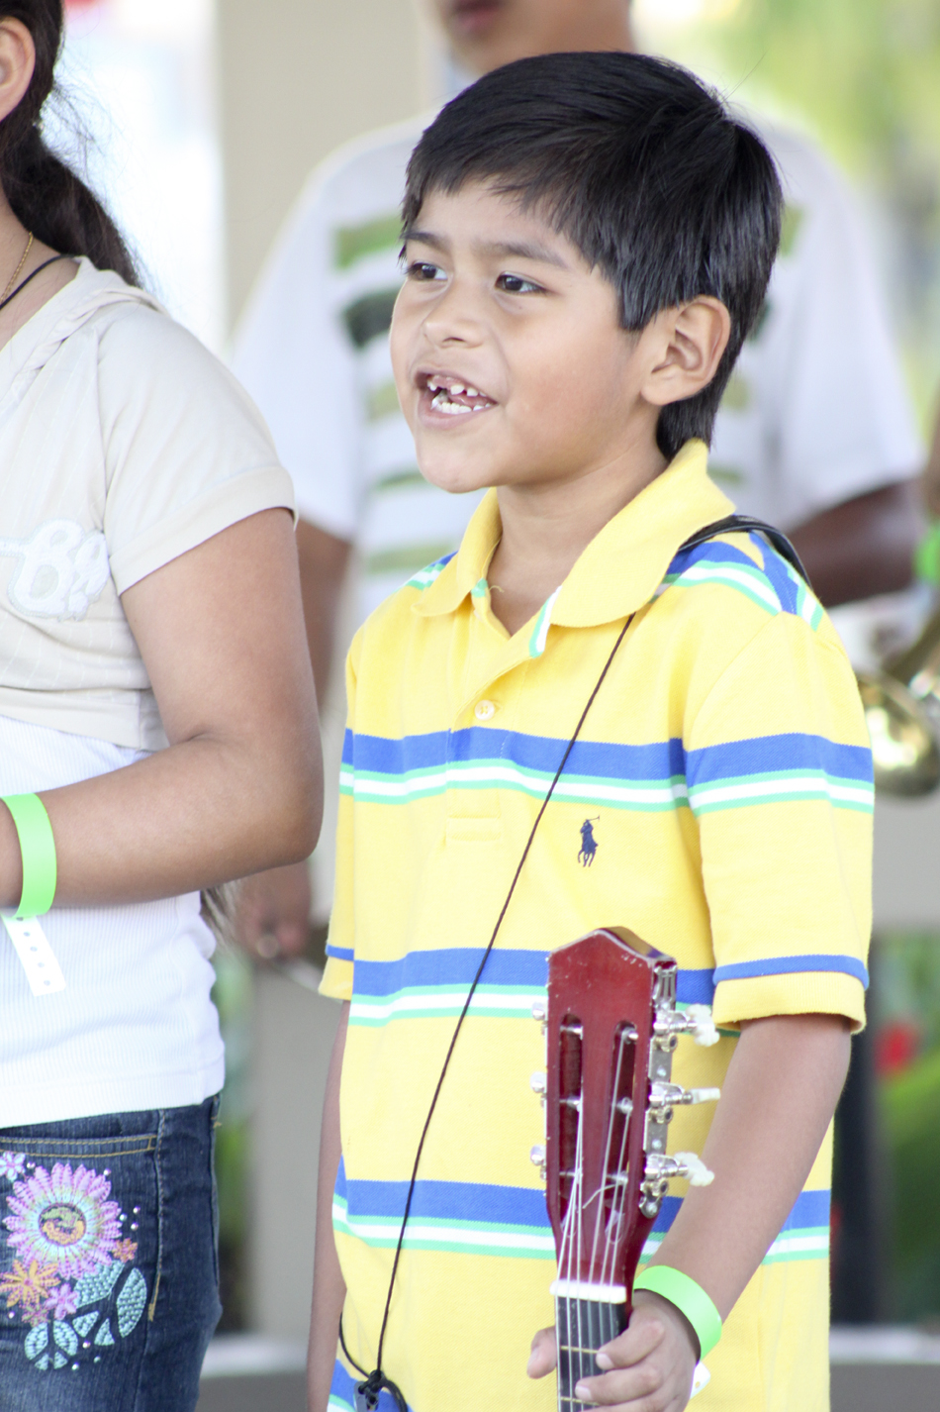

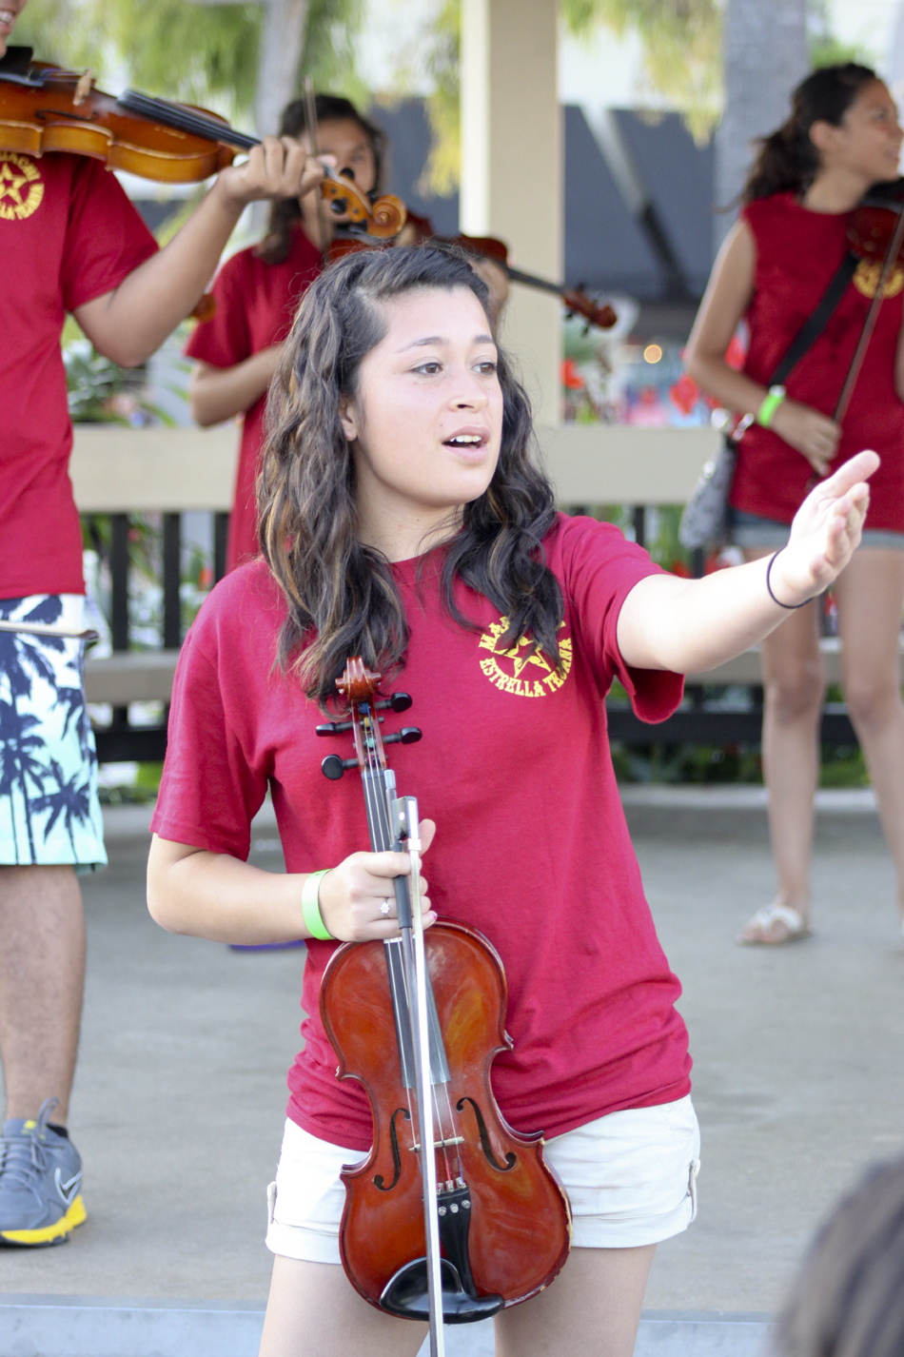
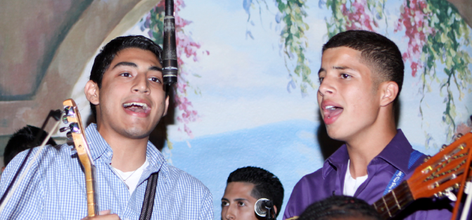
ALL AGES
EVERYONE SINGS!

Slide 43

Bailey Middle School Mariachi Program – Year Two

Slide 44


Presentation and Materials posted at:
www.musicedconsultants.net/conference-materials
Q & A
Jose Hernandez
@JoseSoldeMexico
Marcia Neel
@MusicEdConsult
marcia@musicedconsultants.net

Slide 45

Got QR Scanner? Sign up for e-news
www.musicedconsultants.net/sign-up-for-e-news

Slide 46

Thank You, CLSBA

