Slide 1
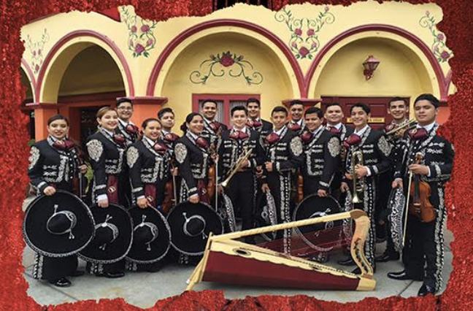
2017 Western Division Leadership Conference
From Zero to Mariachi!
Marcia Neel
Music Education Consultants, Inc.
June 14, 2017
Golden Nugget Hotel -- Las Vegas, NV

Slide 2
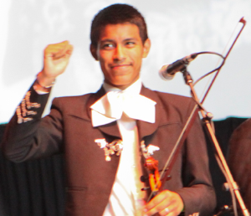
Benefits of a School Mariachi Program
Involves More Students in Music
Helps keep students in school
Uses multiple intelligences
Teaches life-long skills
Provides opportunities for students to serve as role
models to younger students
Increases student self-esteem and self-confidence
Provides effective bridge to parental involvement
Celebrates/Recognizes culture and heritage
Creates a school “Mosaic of Musical Experiences”
Allows for entry-level music experiences at any time

Slide 3
Benefits of a School Mariachi Program
Involves More Students in Music
Helps keep students in school
Uses multiple intelligences
Teaches life-long skills
Provides opportunities for students to serve as role
models to younger students
Increases student self-esteem and self-confidence
Provides effective bridge to parental involvement
Celebrates/Recognizes culture and heritage
Creates a school “Mosaic of Musical Experiences”
Allows for entry-level music experiences at any time
It’s Fun!

Slide 4
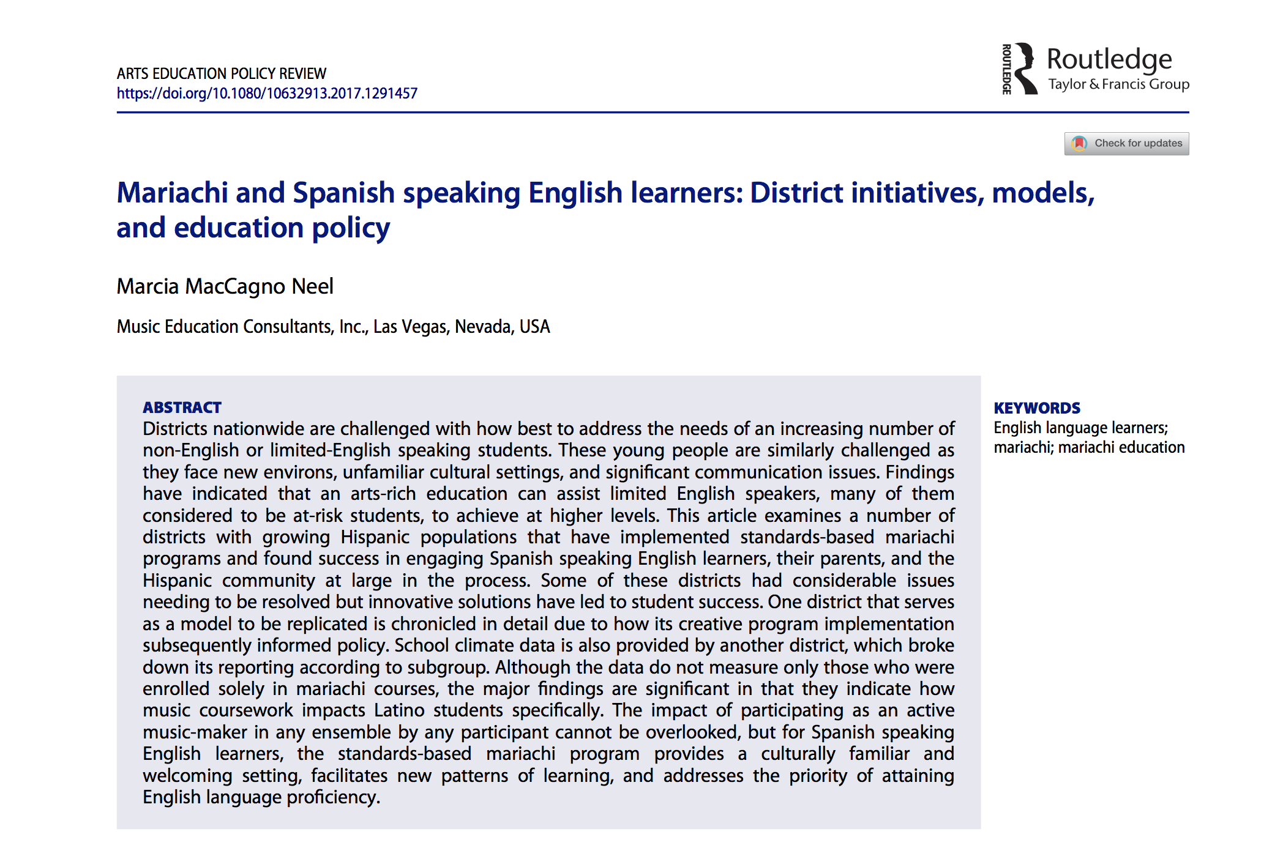
https://doi.org/10.1080/10632913.2017.1291457

Slide 5

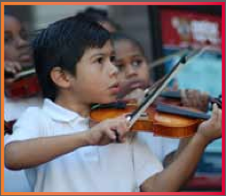
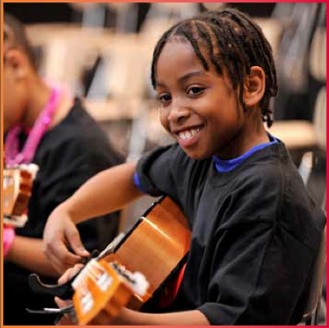
Prelude:
Music Makes Us Baseline Research Report
Becky J. A. Eason, Ph.D.
Center for Public Partnerships & Research
The University of Kansas
Christopher M. Johnson, Ph.D.
Music Research Institute
The University of Kansas
musicmakesus.org/resources/research

Slide 6
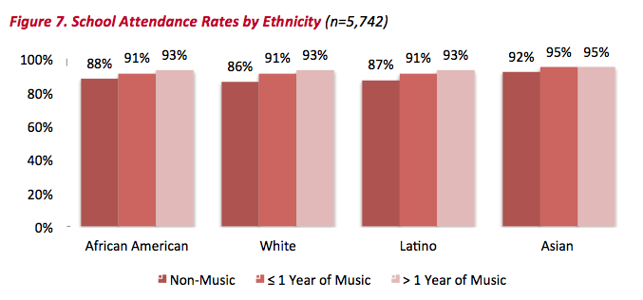
Findings: Attendance Rates

Slide 7
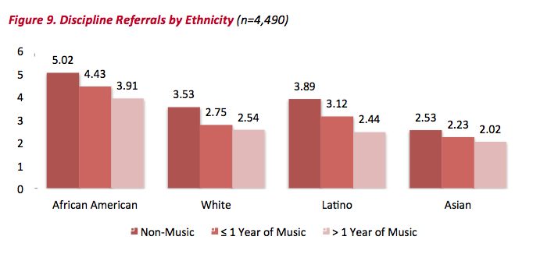
Findings: Discipline Referrals

Slide 8
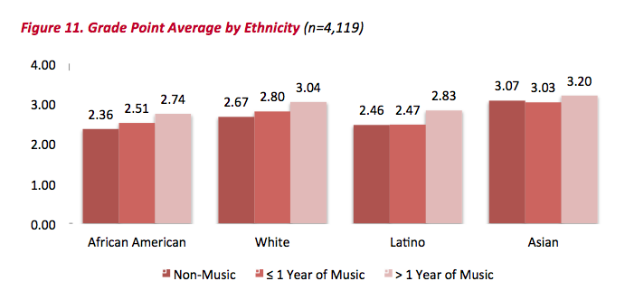
Findings: Grade Point Average

Slide 9
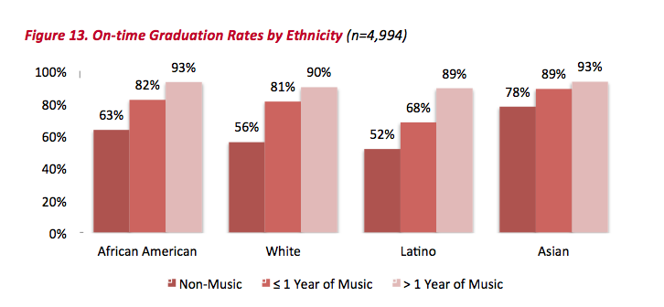
Findings: On Time Graduation Rates

Slide 10
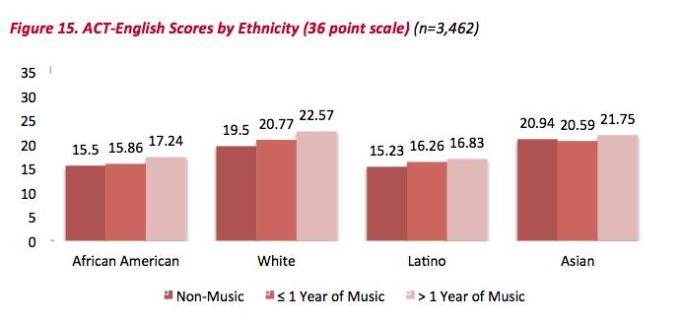
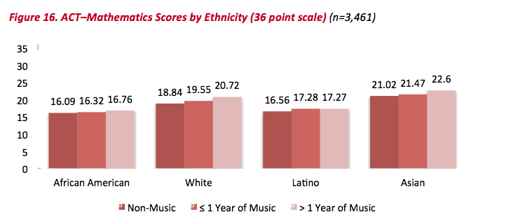
Findings: ACT Scores

Slide 11
Summary: What Was Learned?
The MORE a student participates in
MUSIC,
the more POSITIVE
the BENEFITS become.

Slide 12
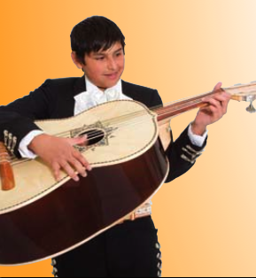
Implementation: During the School Day
Methodology: Same as Band or Orchestra
1. Articulate between HS (2) & MS (2-3)
2. Year 1: Start simply with only 2 classes
a. Beg. Trumpet/Violin (Melodia)
b. Beg. Guitar/Vihuela/Guitarron (Armonia)
3. Schedule classes to meet daily
4. Use a structured, standards-
based curriculum that
focuses on literacy

Slide 13
Implementation: After School Program
Methodology: Same as Band or Orchestra
1. Organize by instrument type:
Armonia and Melodia classes
2. Rehearse classes every other day
3. Provide guided practice on alternate
day with assistant
4. Conduct full ensemble
rehearsal on Fridays with
increases as appropriate

Slide 14
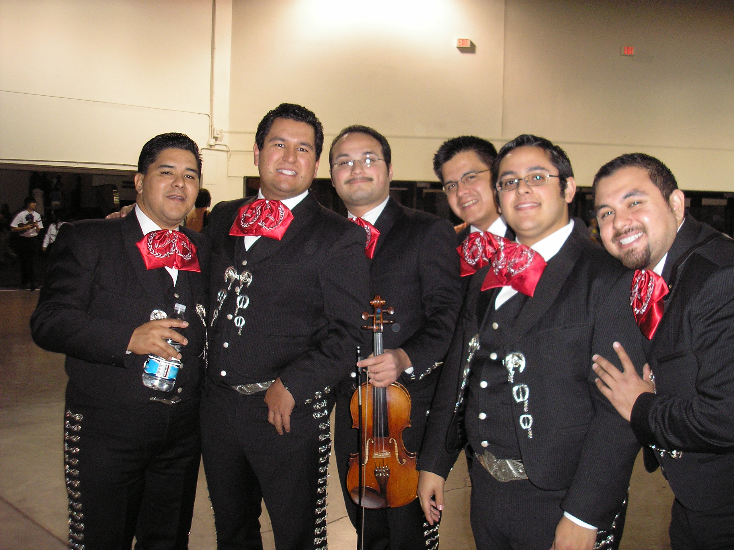
Implementation: Budget Considerations
1. Staff

Slide 15
Implementation: Budget Considerations
Staffing: In-school
To Start:
1 Itinerant teacher split between high school and middle school
2 Assign a class to current music educator(s) already on staff.

Slide 16
Implementation: Budget Considerations
Staffing: After-school
1 Teacher
1 Assistant for guided practice days
  Other district faculty/staff
  University student
  Community member
  Graduated music student
  Peer coaching?

Slide 17
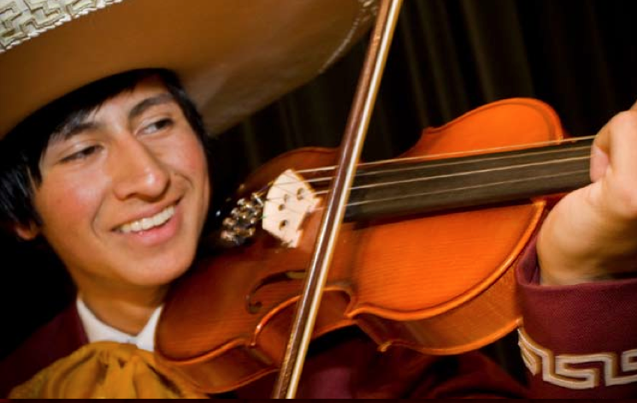
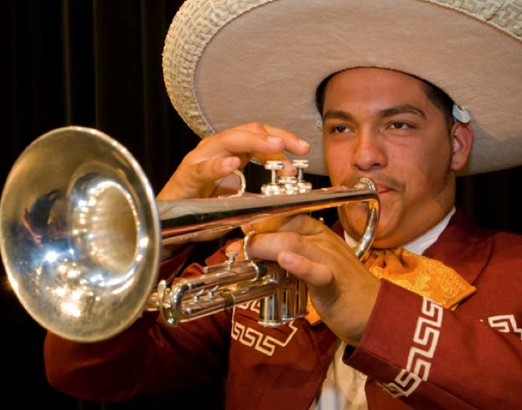
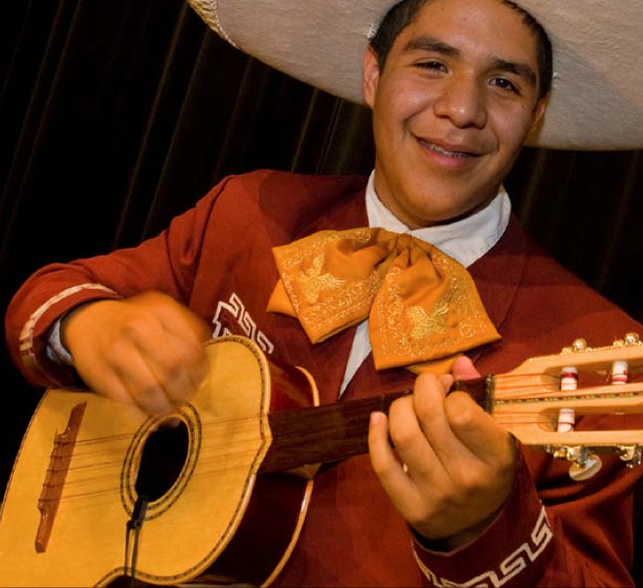
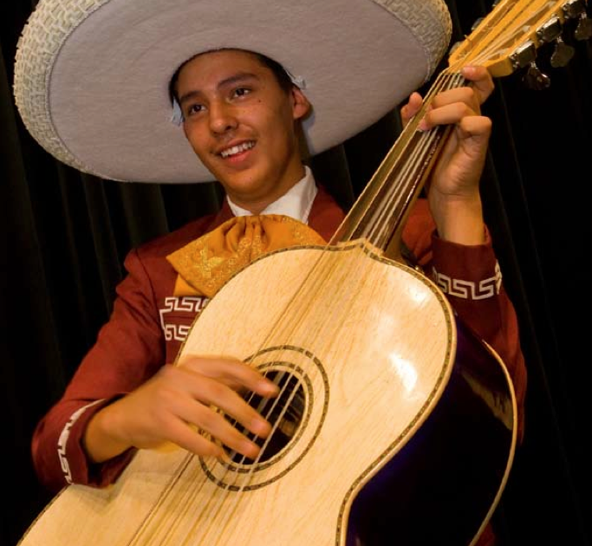
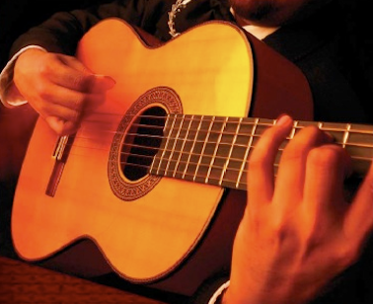
Implementation: Budget Considerations
2. Instruments

Slide 18
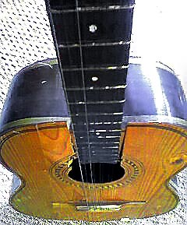

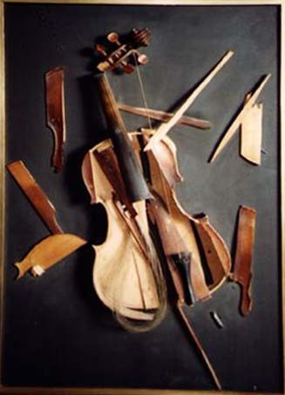
Implementation: Budget Considerations
2. Instruments: Know Your Vendor!!!!!
ALWAYS buy from a Reputable Dealer!!!

Slide 19

Implementation: Budget Considerations
2. Instruments: Know Your Vendor!!!!!
ALWAYS buy from a Reputable Dealer!!!

Slide 20
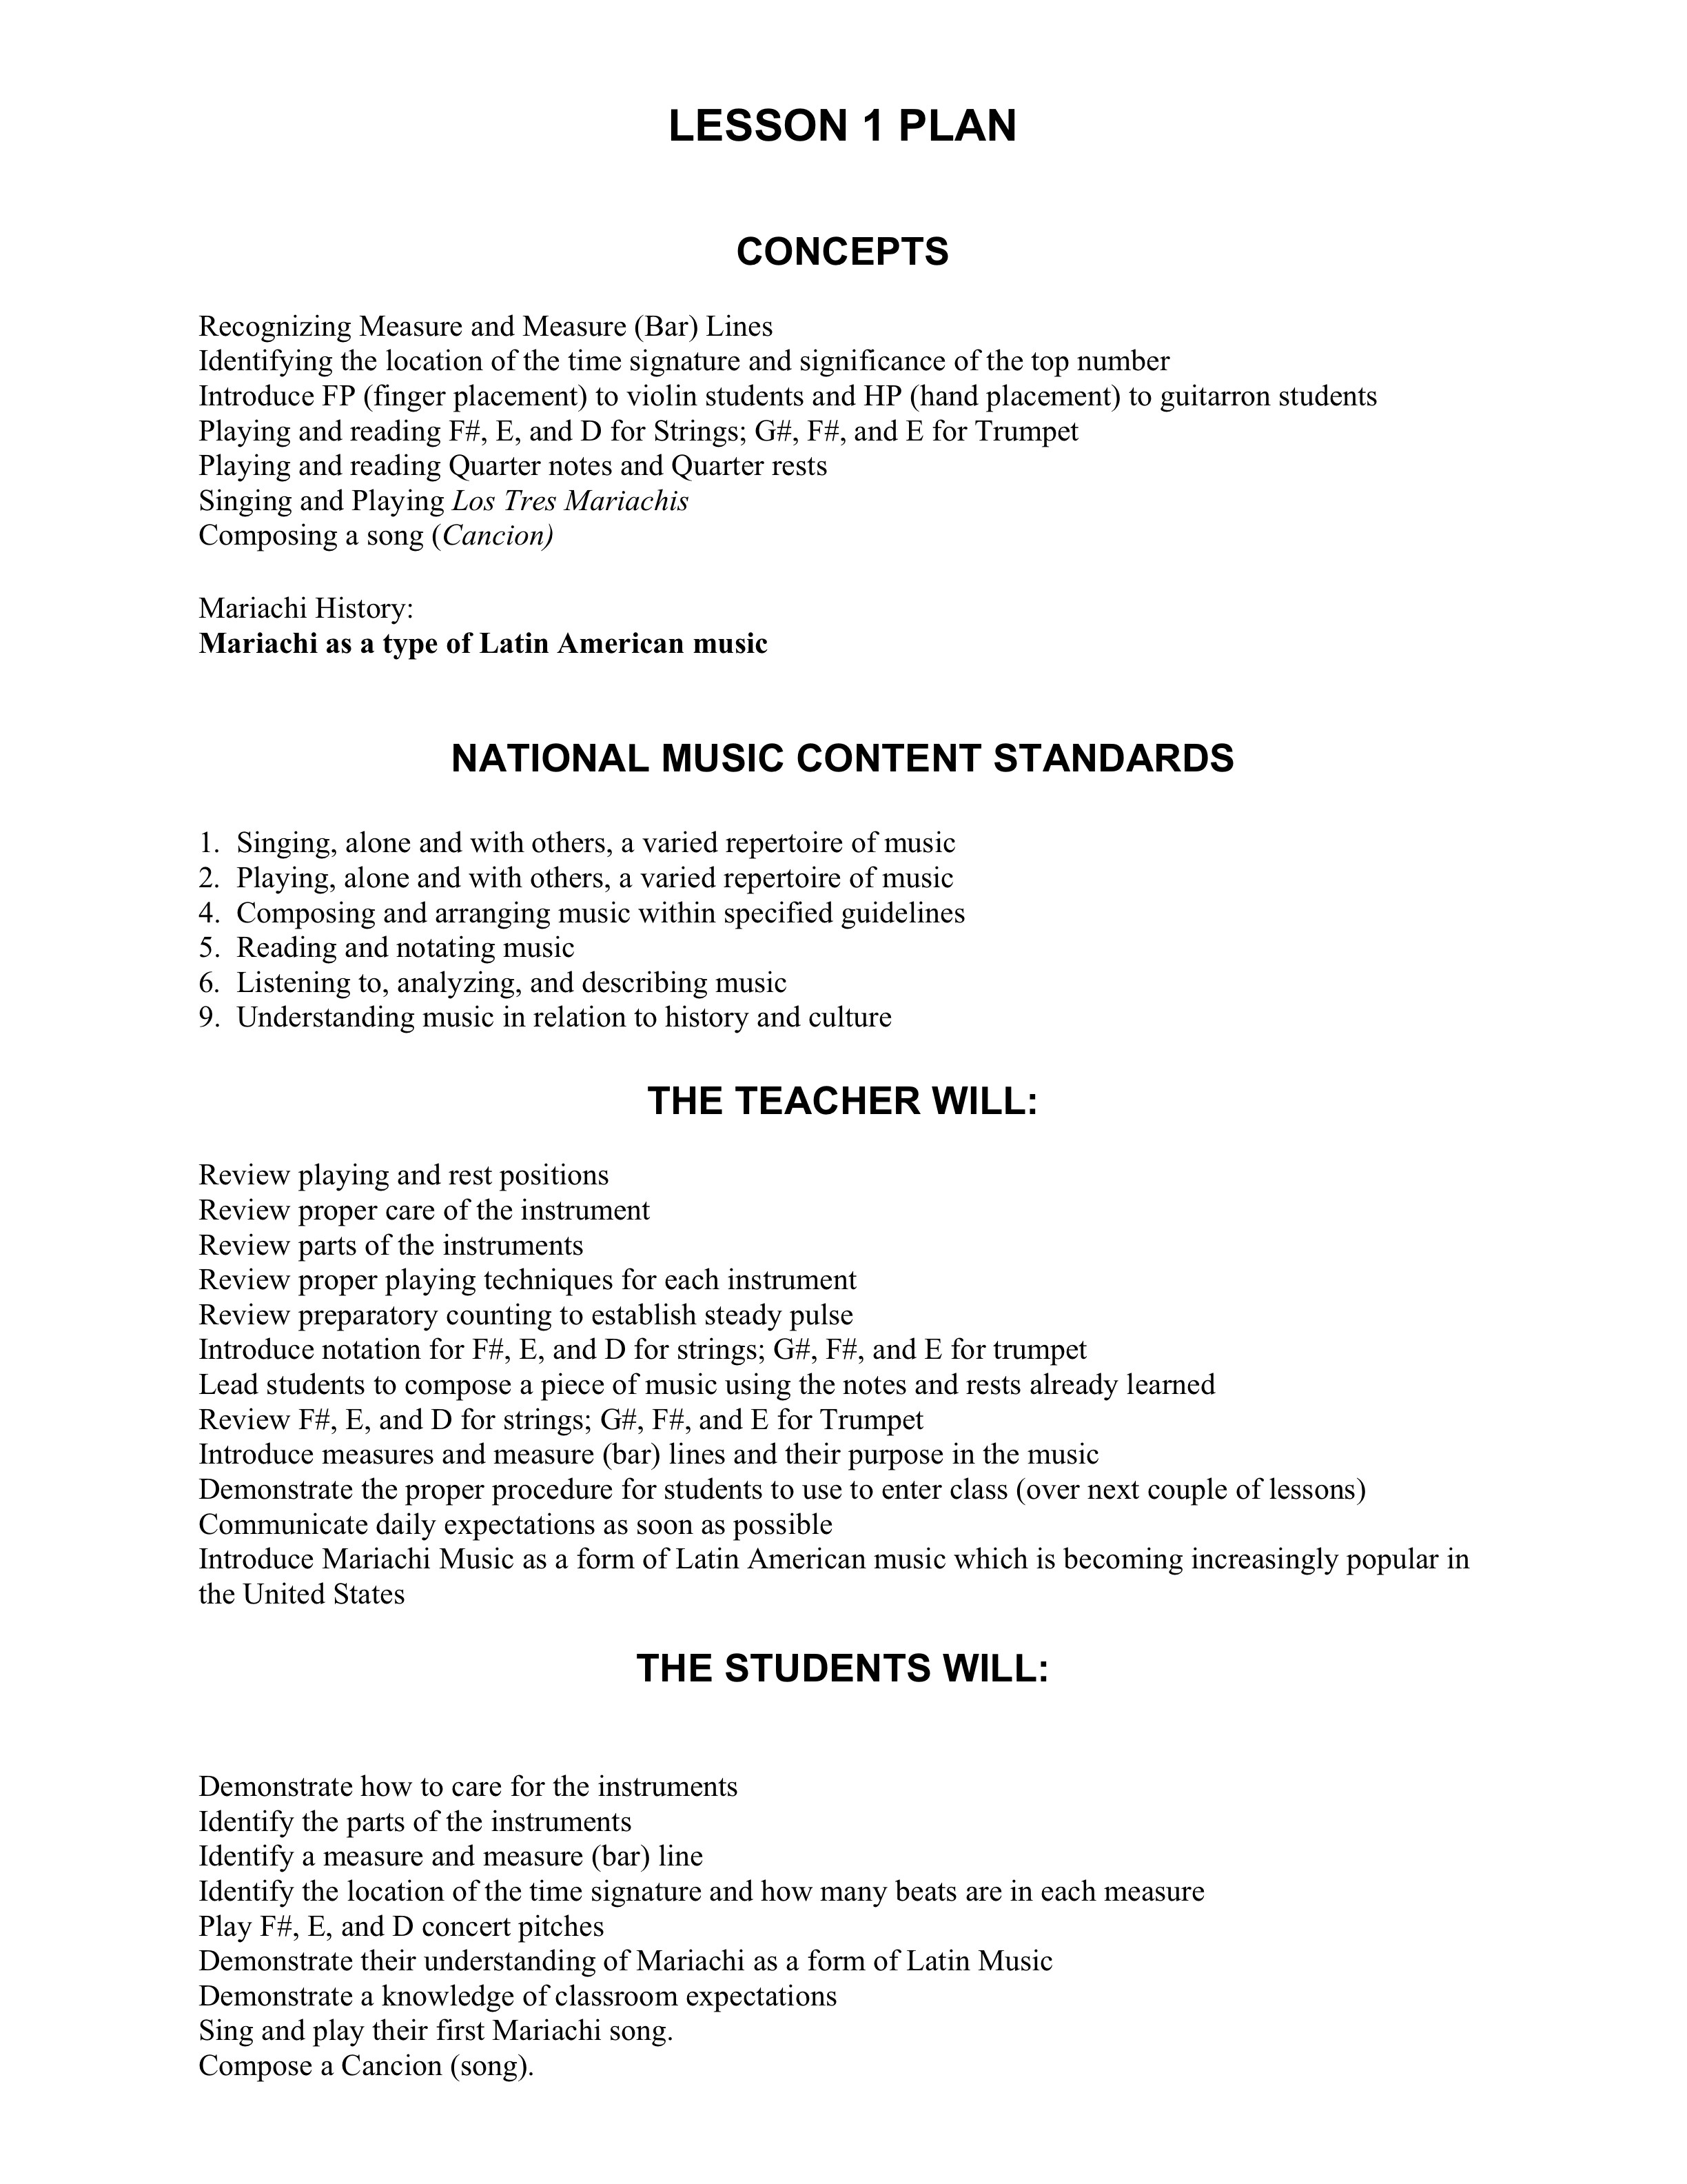
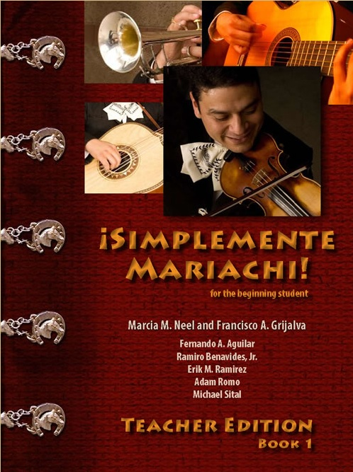
Implementation: Budget Considerations
3. Textbooks, Music and Materials

Slide 21





Implementation: Budget Considerations
3. Textbooks, Music and Materials
Arranged by
Jose Hernandez

Slide 22
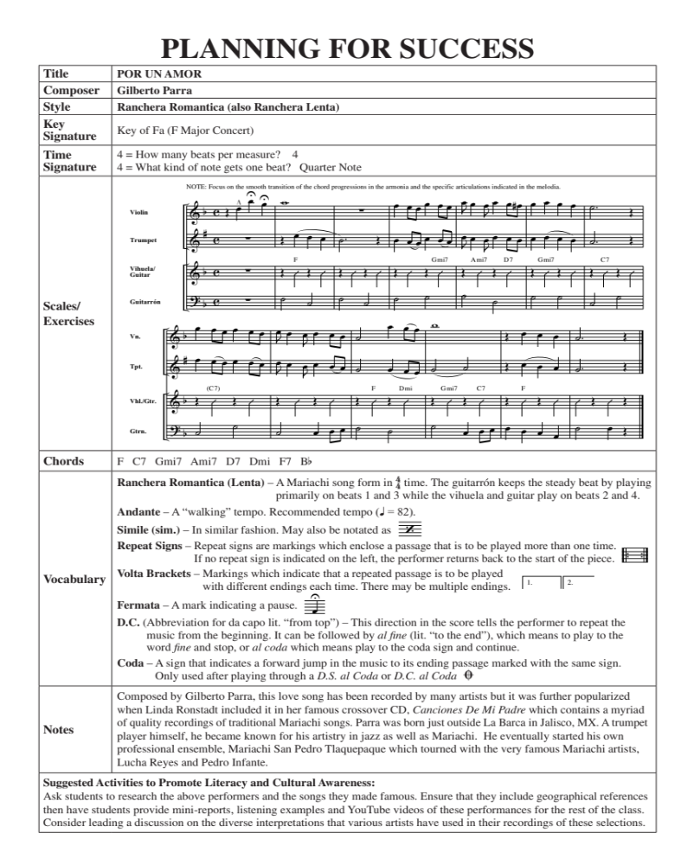

Slide 23
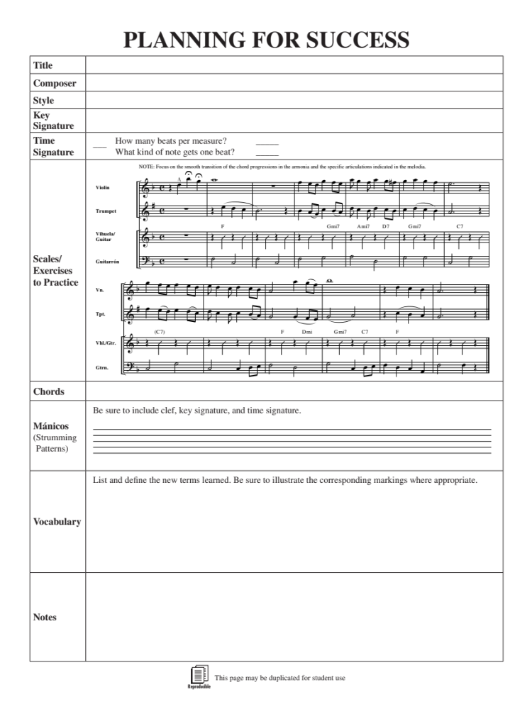

Slide 24
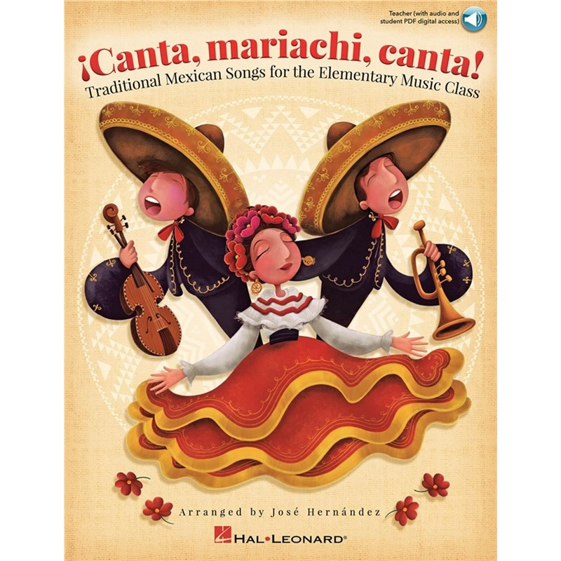

Implementation: Budget Considerations
3. Textbooks, Music and Materials
Arranged by
Jose Hernandez
Traditional Mexican Songs for the
Elementary Music Class
Cielito
Lindo
Noche de
Paz

Slide 25
Implementation: Budget Considerations
3. Textbooks, Music and Materials
Arranged by
Jose Hernandez
Traditional Mexican Songs for the
Elementary Music Class
Cielito
Lindo
Noche de
Paz

Slide 26
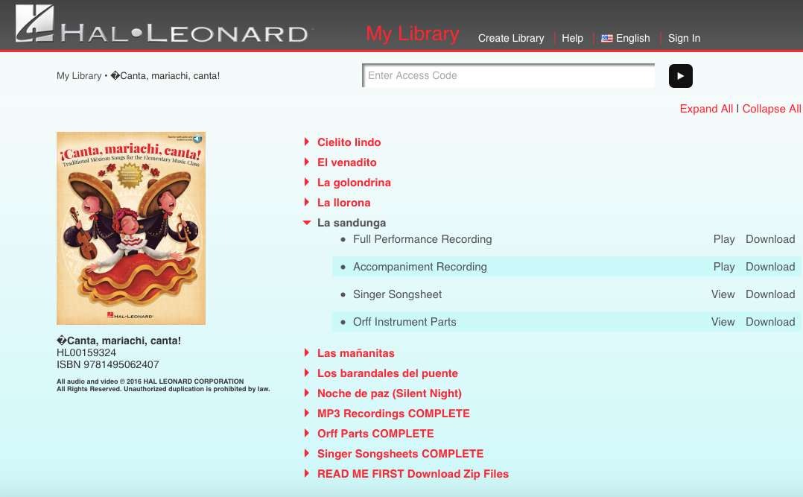
Implementation: Budget Considerations
3. Textbooks, Music and Materials

Slide 27
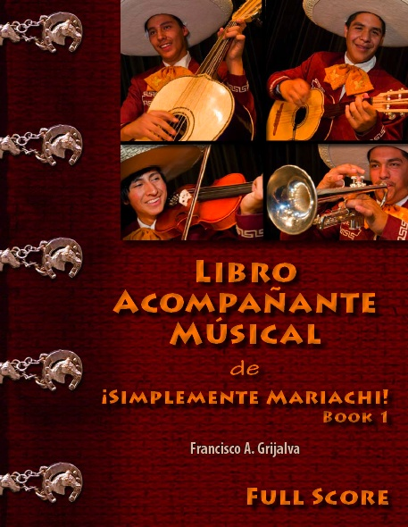


Implementation: Budget Considerations
3. Textbooks, Music and Materials

Slide 28
Implementation: Budget Considerations
4. Supplies
Sets of Violin Strings
Shoulder Rests
Sets of Guitar Strings
Heavy Gauge Guitar Picks
Classical Guitar/Vihuela Straps
Sets of Vihuela Strings
Finger Picks for Vihuelas
Sets of Guitarron Strings
Bottles of Valve Oil
Bass Guitar Straps

Slide 29
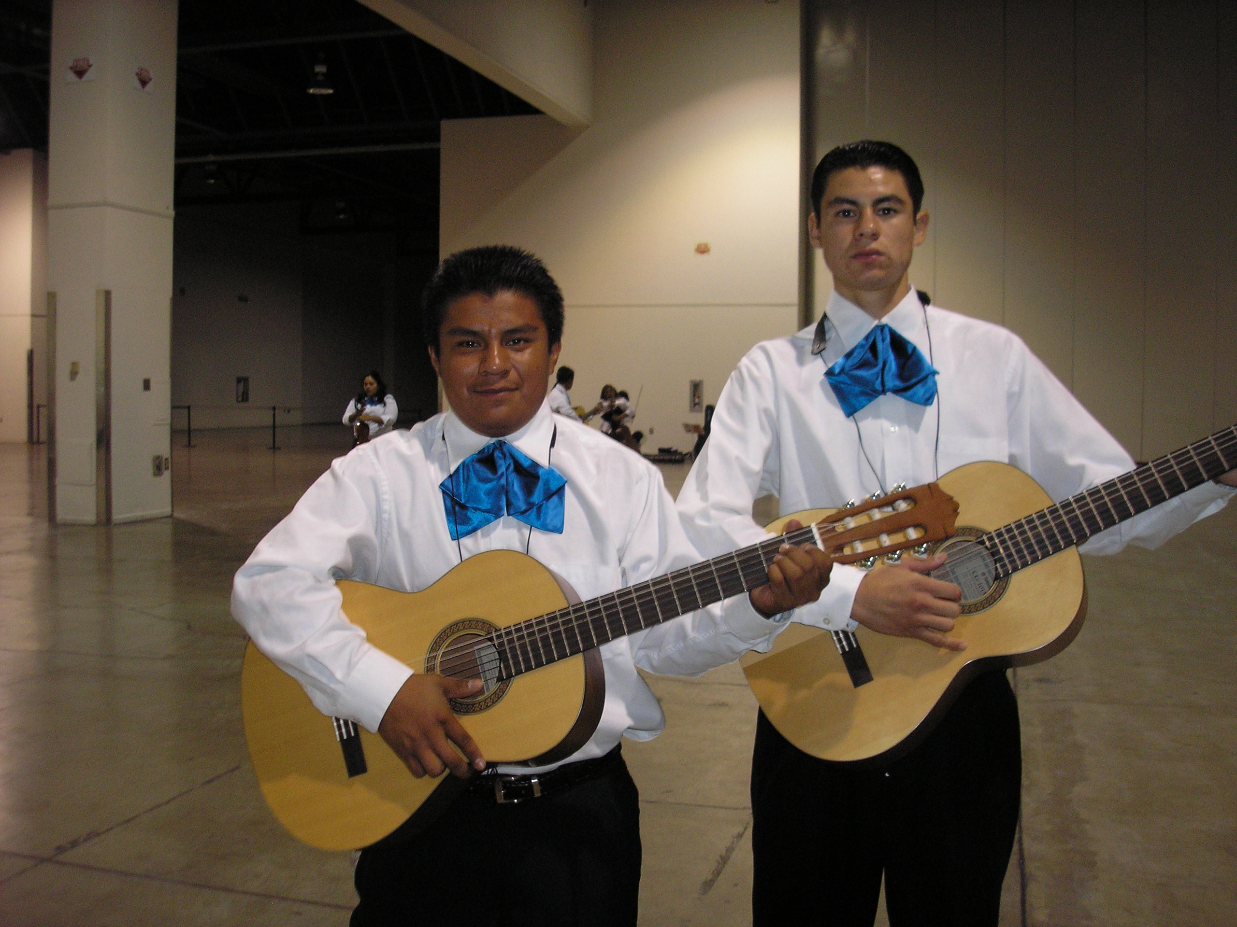
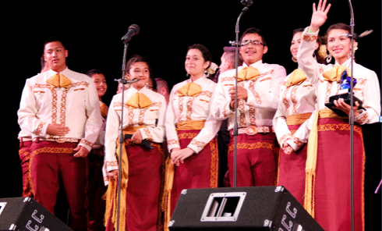
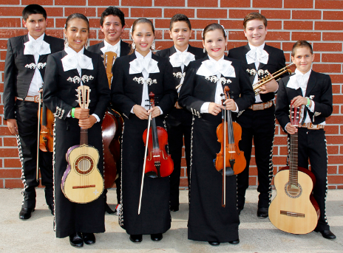
Implementation: Budget Considerations
5. Uniforms
a. White shirt and black pant with basic moño (tie)
b. Vaquero Uniform
(Ranch/Cowboy)
Decorative pant/skirt
& shirt with
coordinating moño
c. Traje de Gala
(Full Mariachi Suit)
Decorative jacket
with pant/skirt
& coordinating moño.

Slide 30
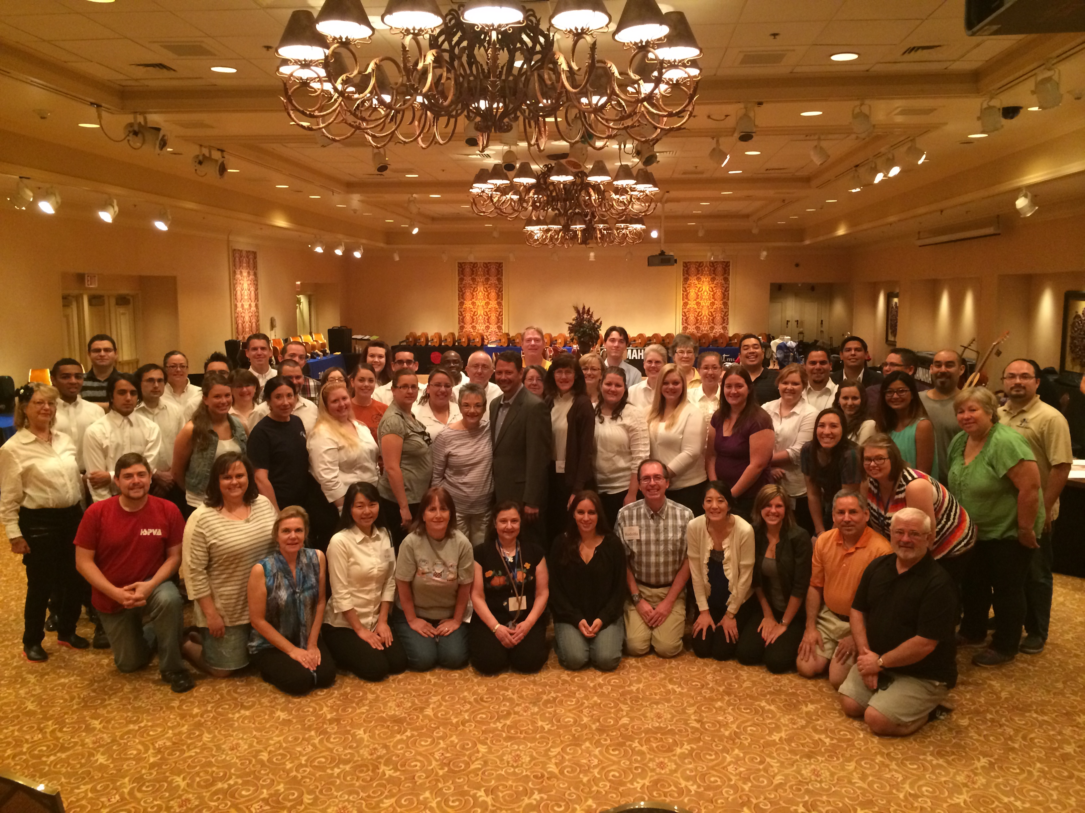
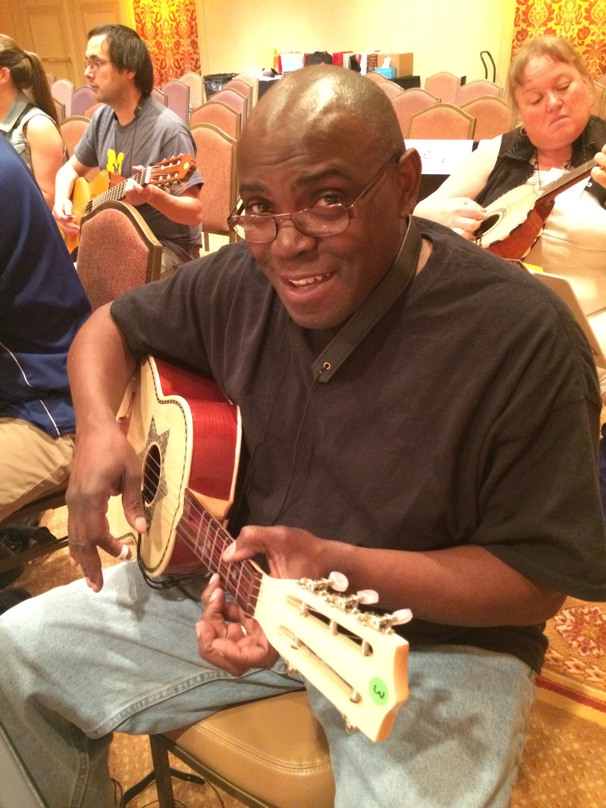
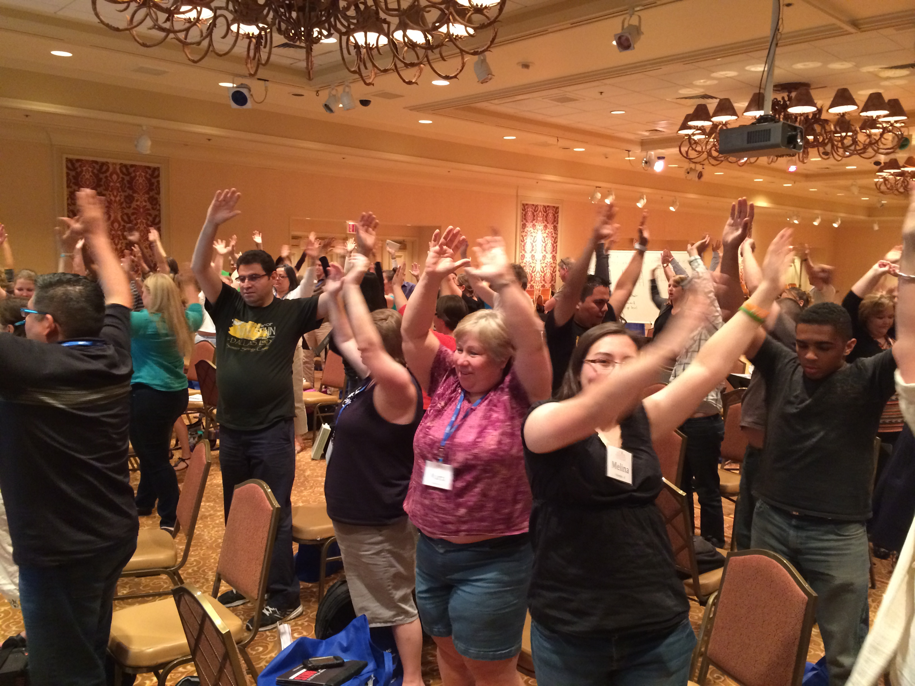
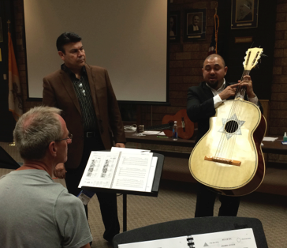
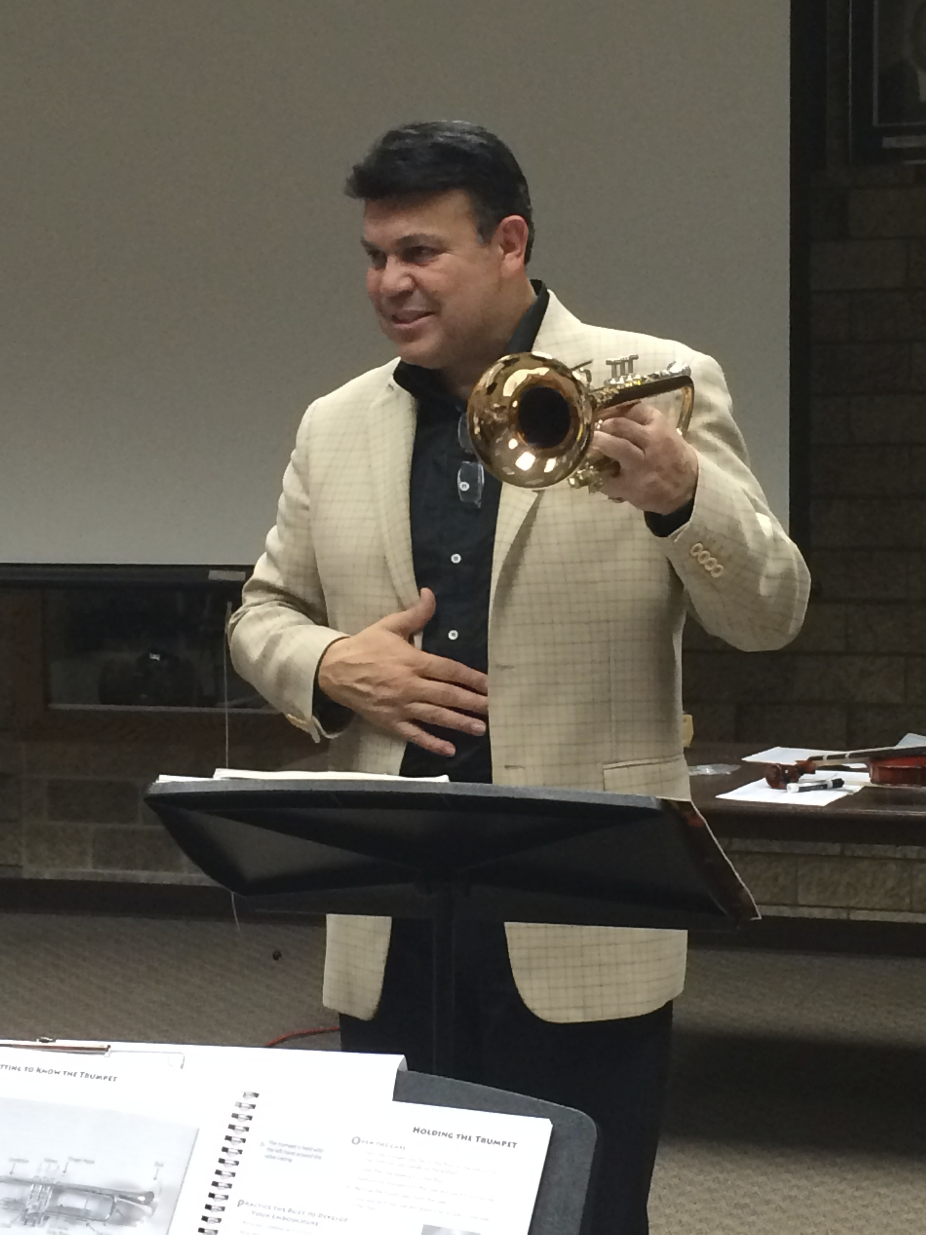
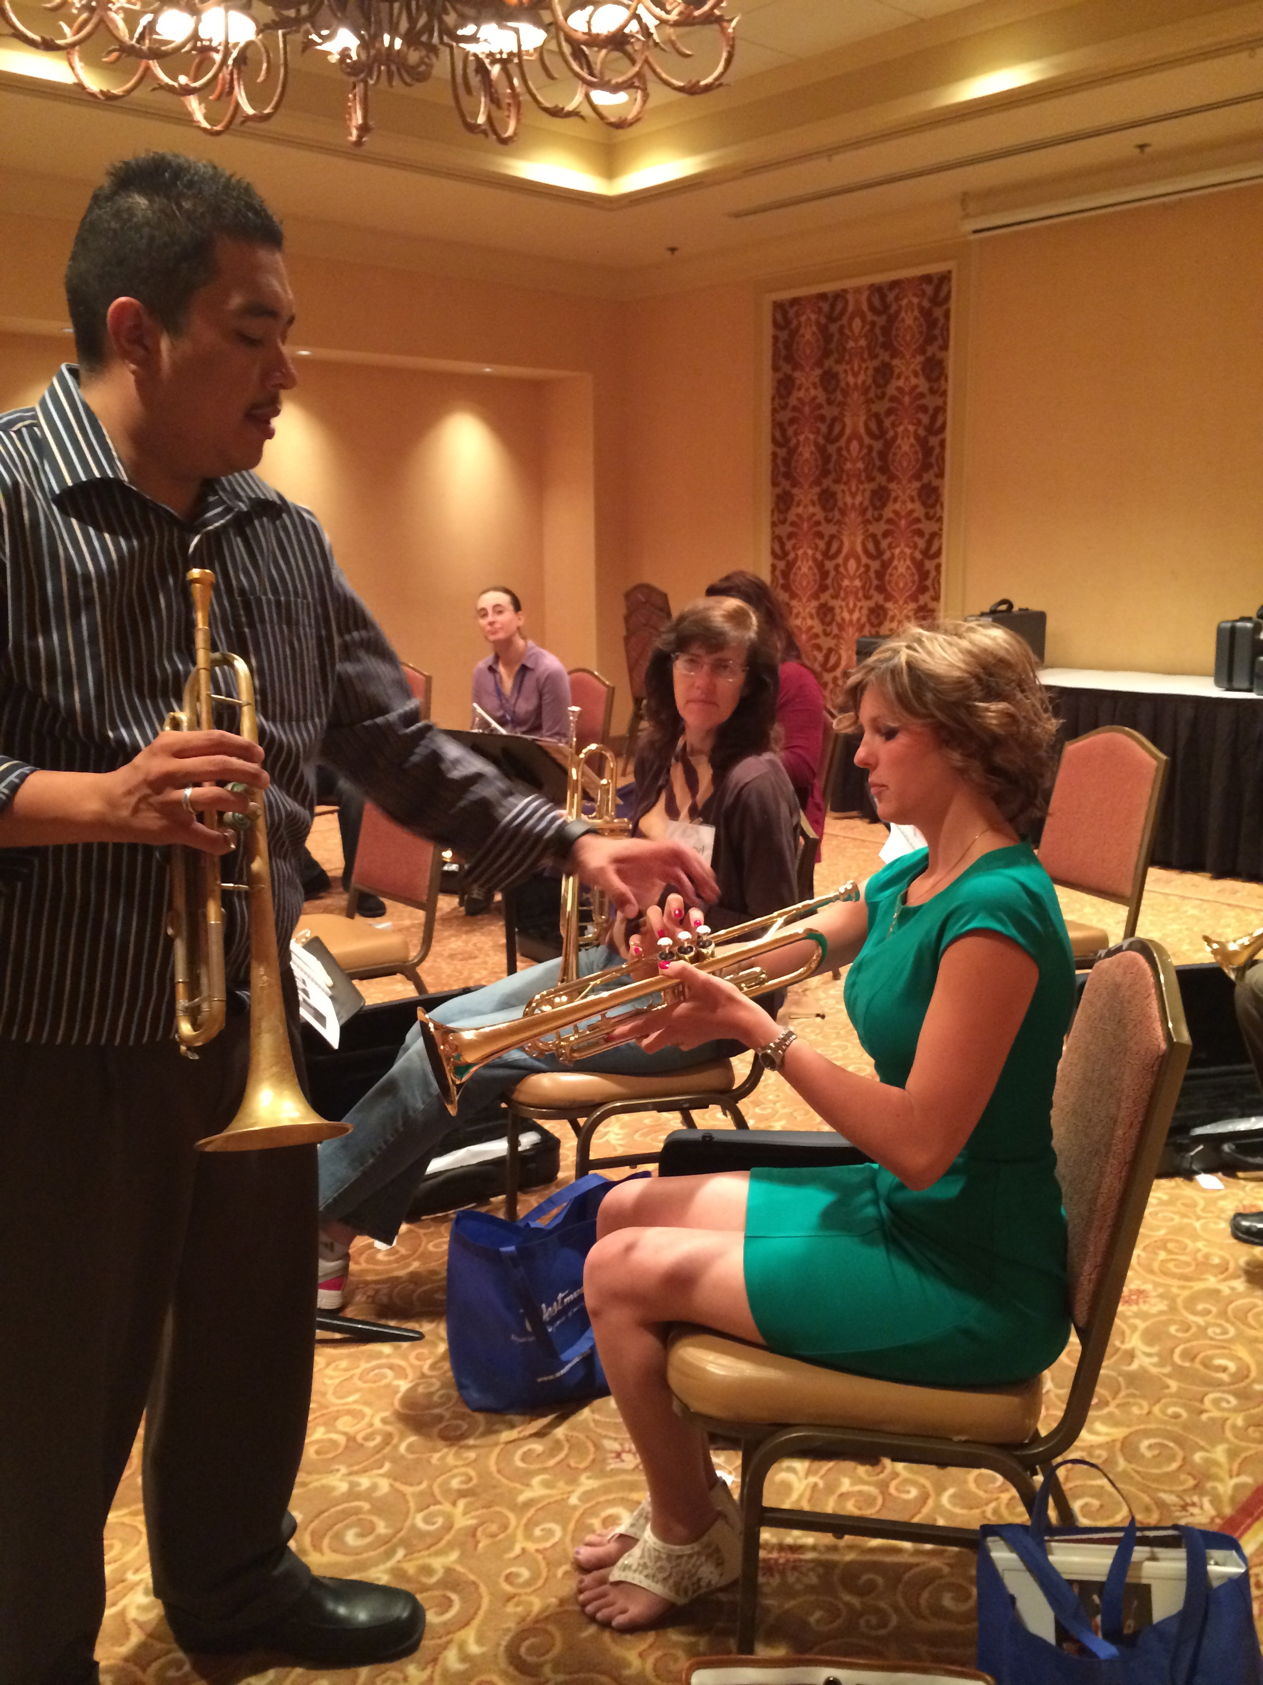
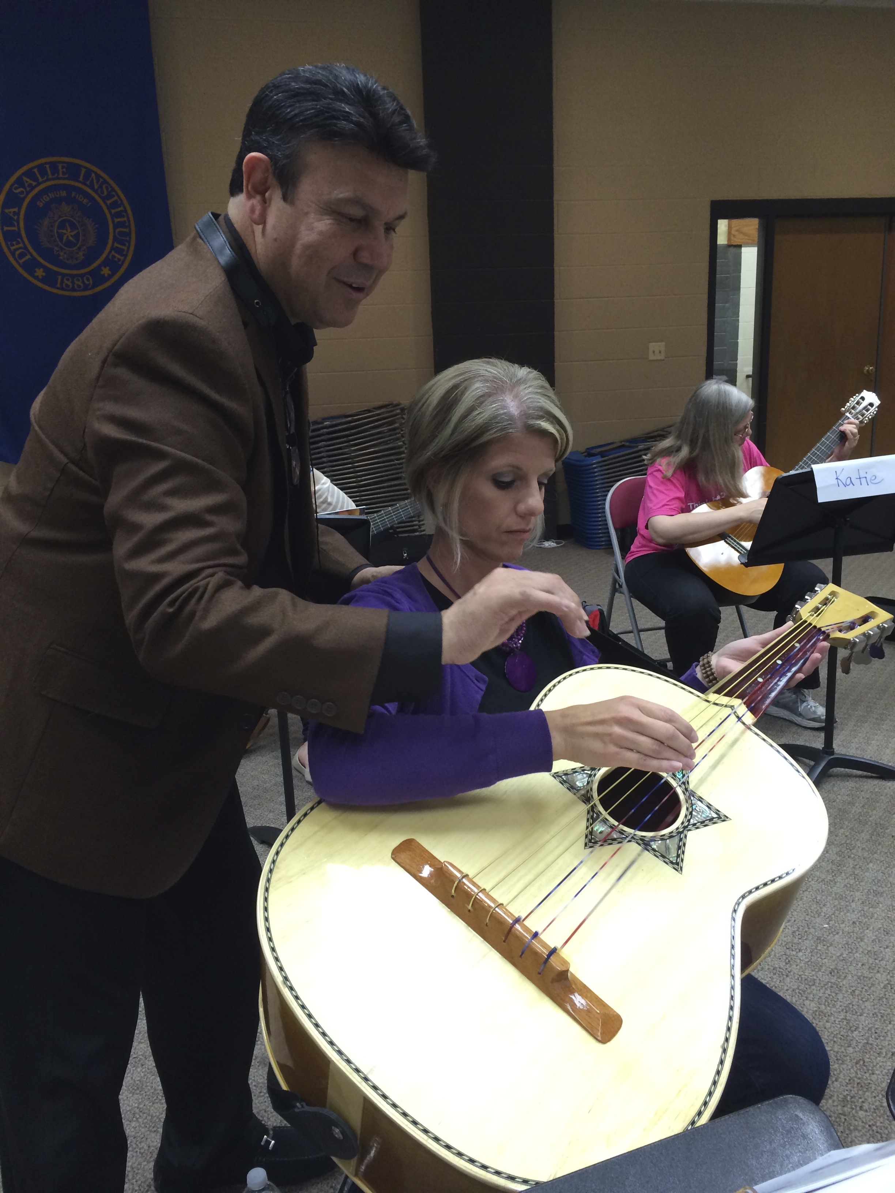
Implementation: Budget Considerations
6. Professional Development

Slide 31
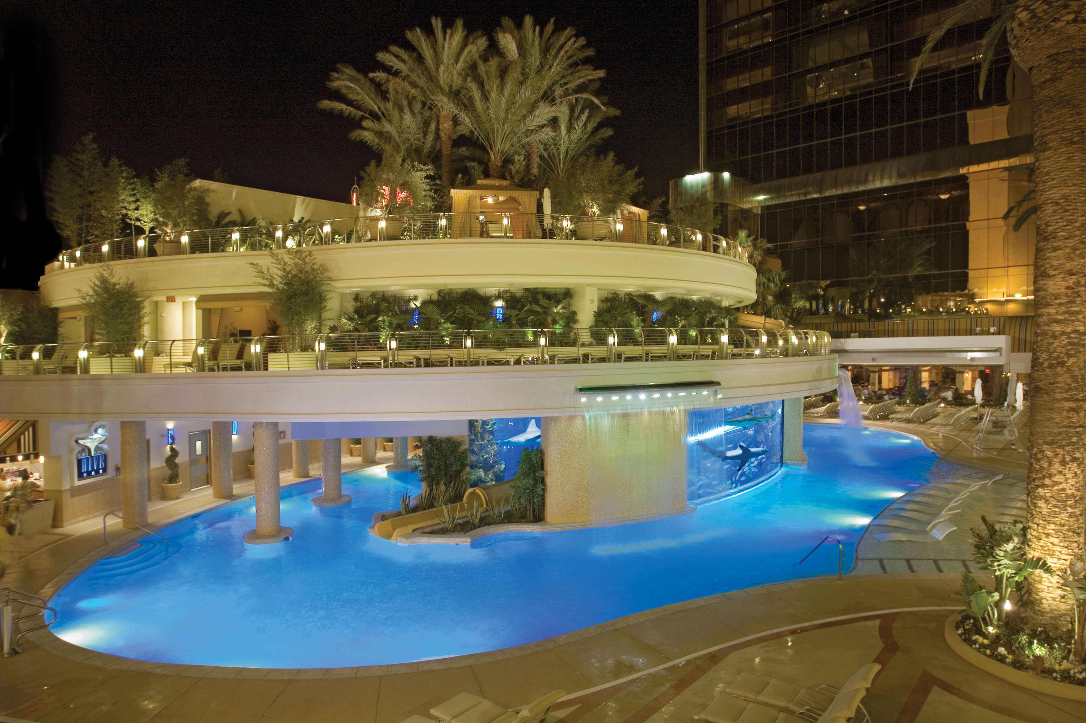
The Fabulous Golden Nugget
Hotel and Casino Las Vegas
National Mariachi Workshops
for Educators®
3 Graduate Credits Available
June 26-30, 2017
www.musicedconsultants.net/
2017-mariachi-workshops

Slide 32
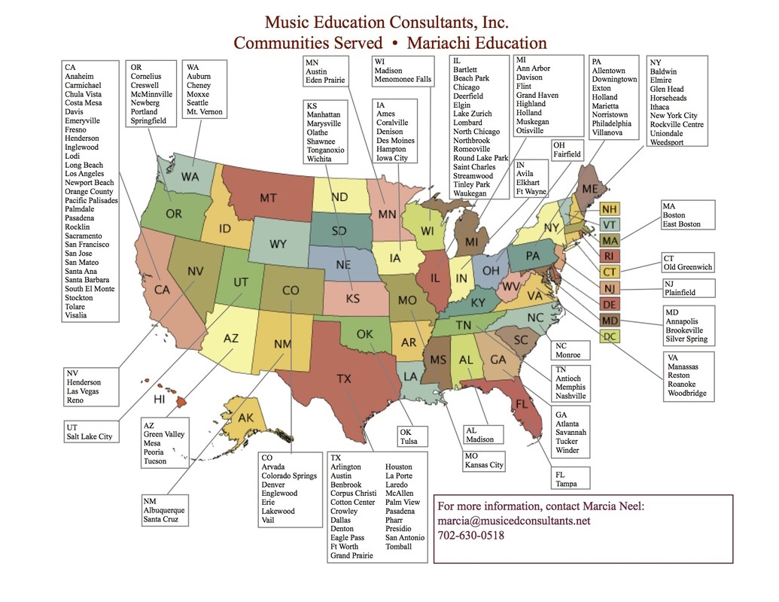

Slide 33

Implementation: Budget Considerations
7. Student Workshops

Slide 34
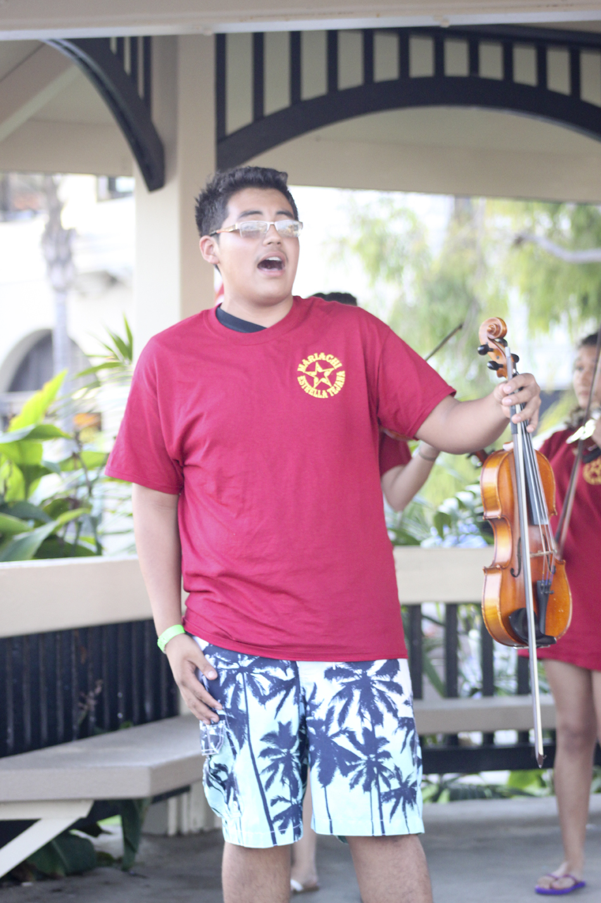
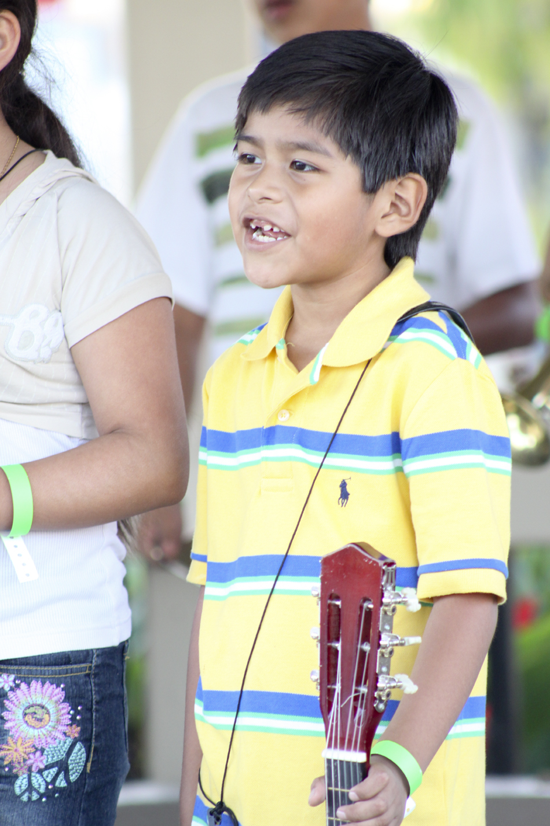

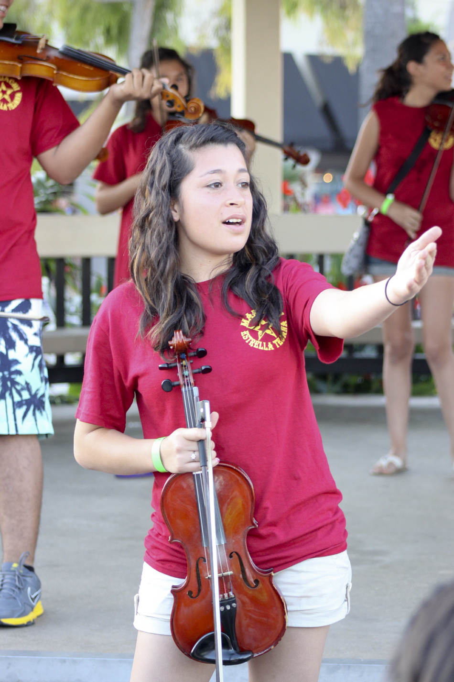
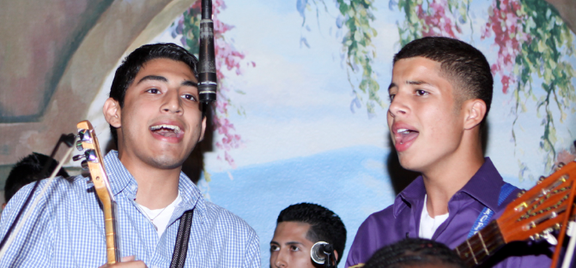
ALL AGES
EVERYONE SINGS!

Slide 35

Bailey Middle School Mariachi Program – Year Two

Slide 36

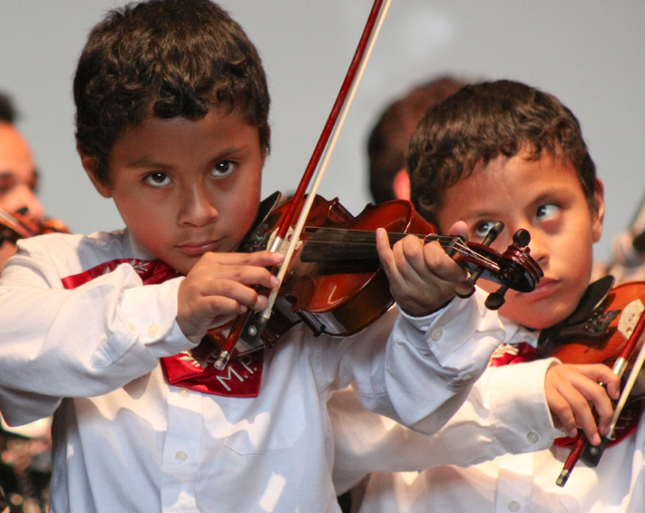

Presentation and Materials posted at:
www.musicedconsultants.net/conference-materials
Q & A
Marcia Neel
@MusicEdConsult
marcia@musicedconsultants.net

Slide 37
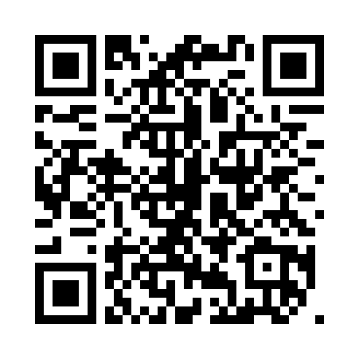
Got QR Scanner? Sign up for e-news
www.musicedconsultants.net/sign-up-for-e-news

