Slide 1
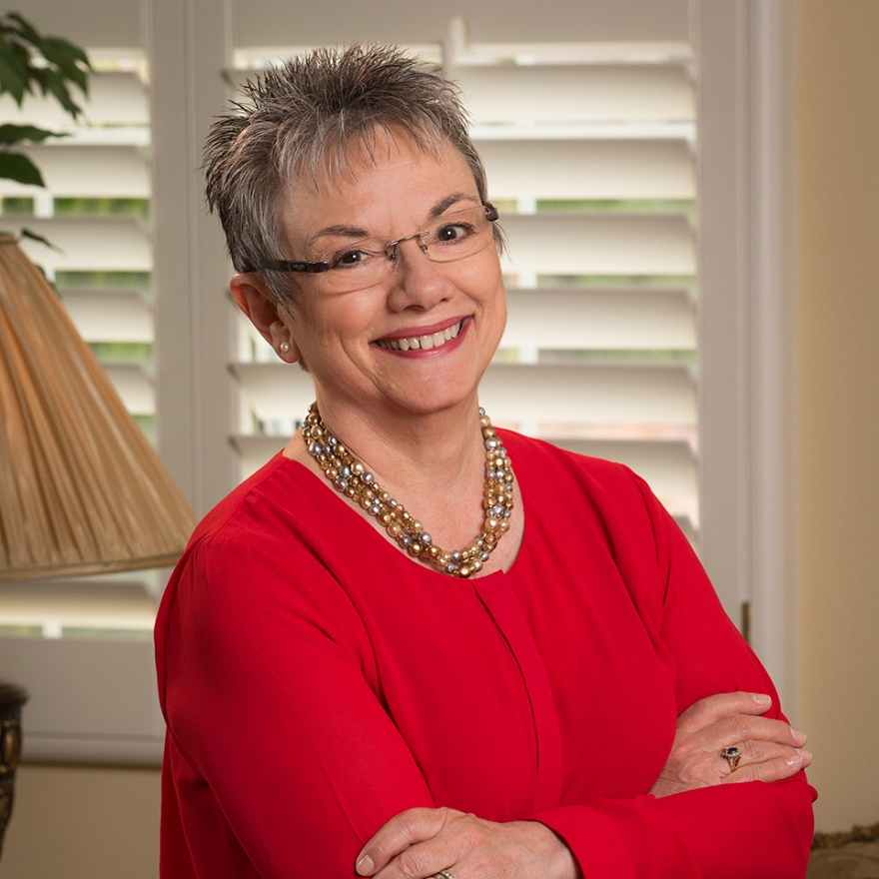


Marcia Neel
Master Educator
  Crossing Over to the
  Other Side of the Podium:
  Lessons in Body Language

Slide 2
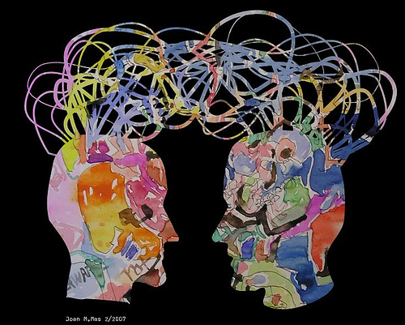
Communication
  Ability to listen
  effectively
  Ability to express
  thoughts effectively
  with others –
  both verbally and
  non-verbally

Slide 3
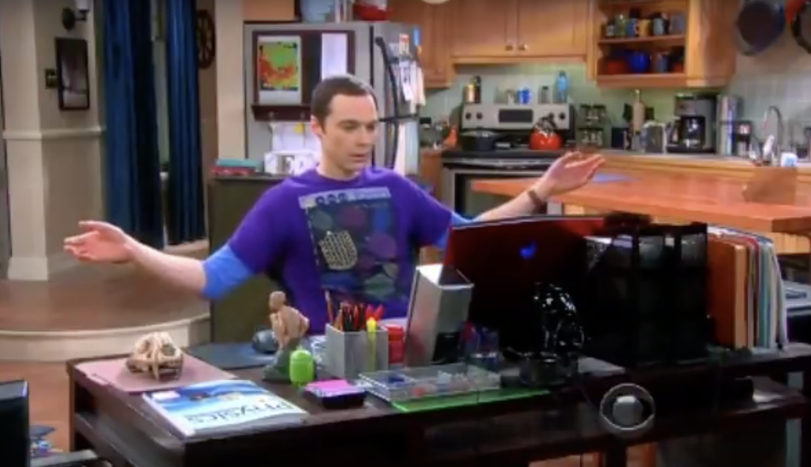
Big Bang Body Language

Slide 4

Big Bang Body Language

Slide 5

Body Language: The ultimate truth
about who you are and what you think.
The Bad News. . .
You Tell on Yourself!

Slide 6

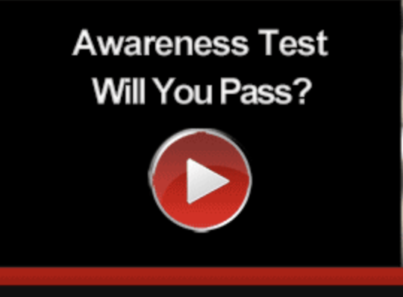
Body Language
The ultimate truth about who you are and what you think

Slide 7

What am I Thinking?

Slide 8

What am I Thinking?

Slide 9

What am I Thinking?

Slide 10

What am I Thinking?

Slide 11

Notice a Common Element?

Slide 12
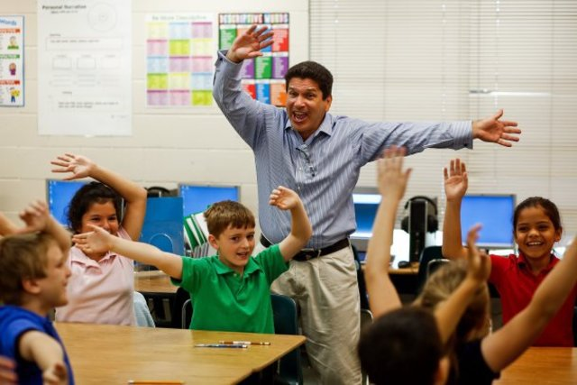
How am I feeling?

Slide 13
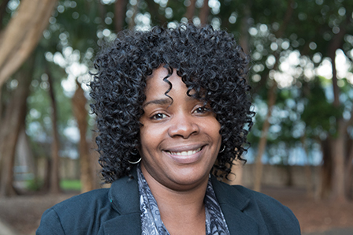
How am I feeling?

Slide 14

How am I feeling?

Slide 15

How am I feeling?

Slide 16
What are the common facial elements?

Slide 17

How am I making you feel right now?

Slide 18

How am I making you feel right now?

Slide 19

How am I making you feel right now?

Slide 20
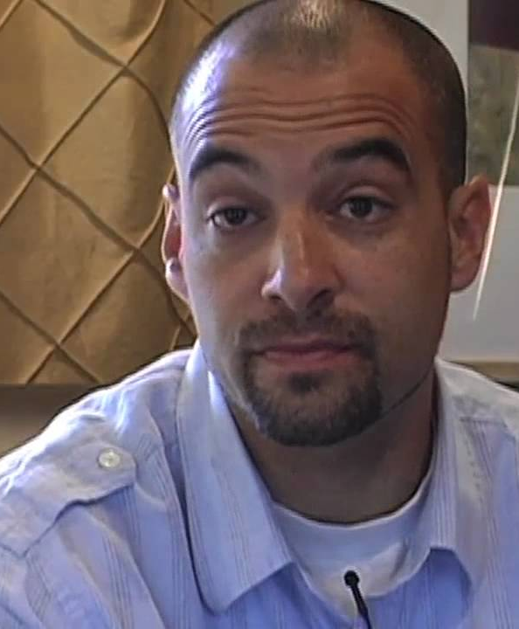
How am I making you feel right now?

Slide 21

How am I making you feel right now?

Slide 22

How am I making you feel right now?

Slide 23

Using Purposeful Body Language
Command authority in the classroom by:
Speaking with purpose which helps to produce the desired result
Using a loud, clear and enthusiastic voice to convey confidence

Slide 24
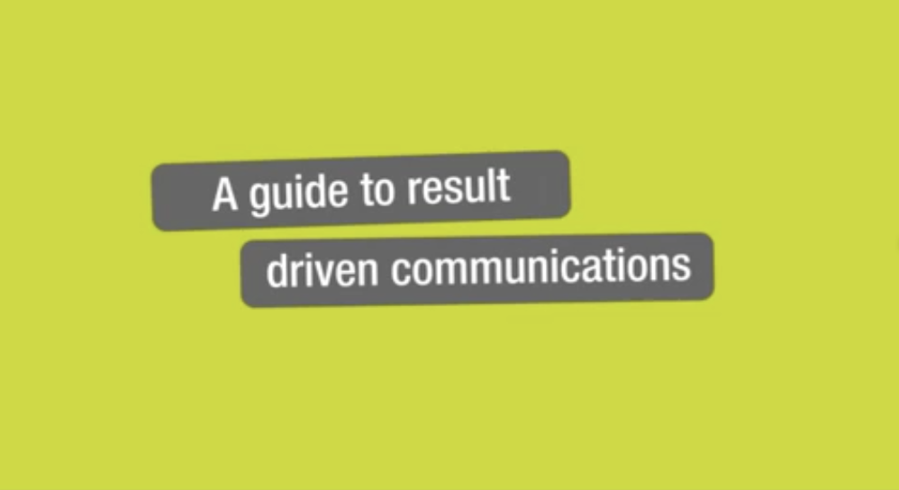
Result-driven Communication
Precise communication at the right place
and the right time is a guarantee for success.

Slide 25

Result-driven Communication
Precise communication at the right place
and the right time is a guarantee for success.

Slide 26

Using a loud, clear and enthusiastic voice conveys confidence

Slide 27
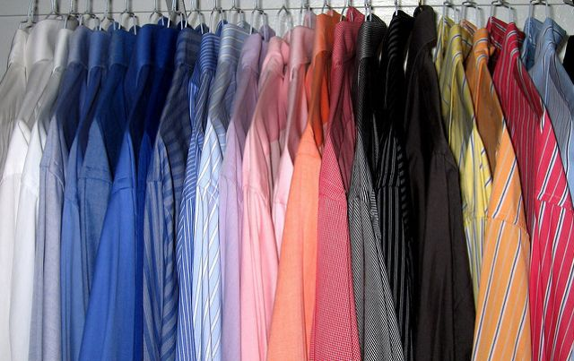
Using Purposeful Body Language
Command authority in the classroom by:
Looking professional
What do clothes have to do with it?
Clothes aren’t actions!
…or are they?

Slide 28
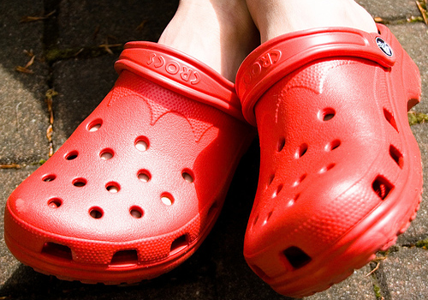
CROCKS
NEVER EVER WEAR. . .
Crocks are for the beach – NOT the classroom

Slide 29
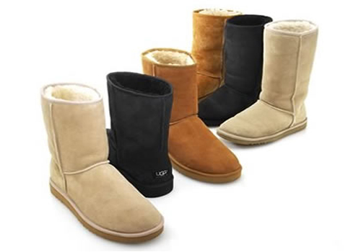
UGGS
NEVER EVER WEAR. . .
Uggs are just glorified slippers. Slippers are PJs.
Would you wear PJs to conduct your ensemble?

Slide 30

SWEATS
NEVER EVER WEAR. . .
Sweats scream, “I’m lazy! Please fire me!”

Slide 31
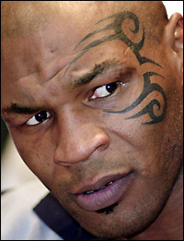
FACE TATOOS
NEVER EVER WEAR. . .
Just. . .don’t. . .do. . .it!

Slide 32

NEVER EVER WEAR. . .
MESSAGE T’s
Unless it’s promoting your
school or music ed program

Slide 33
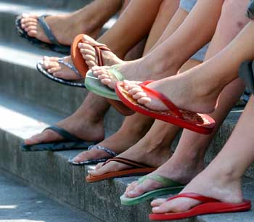
FLIP-FLOPS
NEVER EVER WEAR. . .
Dressy sandals or casual loafers are fine!

Slide 34
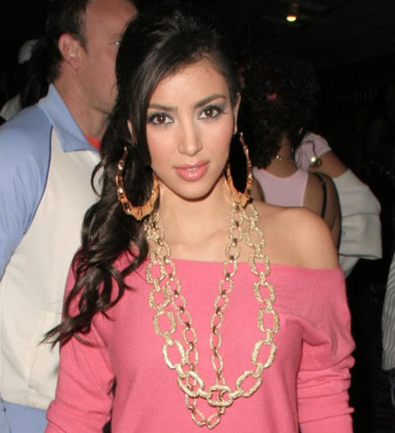
TOO MUCH JEWELRY
NEVER EVER WEAR. . .
Loud, clanky jewelry could create unwanted percussion!

Slide 35

ANYTHING TOO
REVEALING!
NEVER EVER WEAR. . .
School is not the place to show off your abs
or your extra cellulite

Slide 36
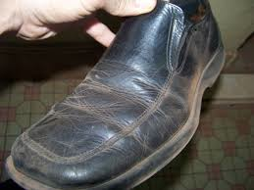
DIRTY SHOES
NEVER EVER WEAR. . .
Get some polish and clean them to a high shine.

Slide 37

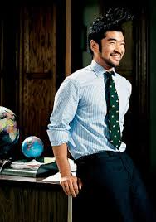
YOU ARE A PROFESSIONAL!
DRESS LIKE ONE!
Students, parents, and administrators
take you more seriously when you
come to work dressed as a professional.

Slide 38
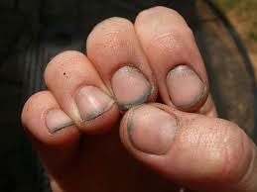
PERSONAL GROOMING. . .
NAILS
Dirty nails say, “I don’t care enough about myself to take care of myself.”

Slide 39
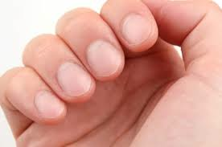
NAILS
PERSONAL GROOMING. . .
Yes—I took a shower this morning!

Slide 40
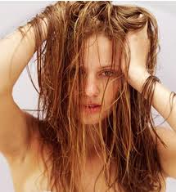
HAIR
PERSONAL GROOMING. . .
Greasy hair means that you got up late which means that you are
ill-prepared to teach today.

Slide 41
MAKE-UP
PERSONAL GROOMING. . .
Heavy make-up says,
“It’s all about me! Notice me!”

Slide 42
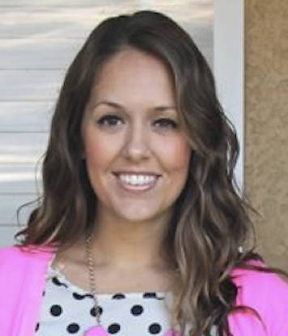
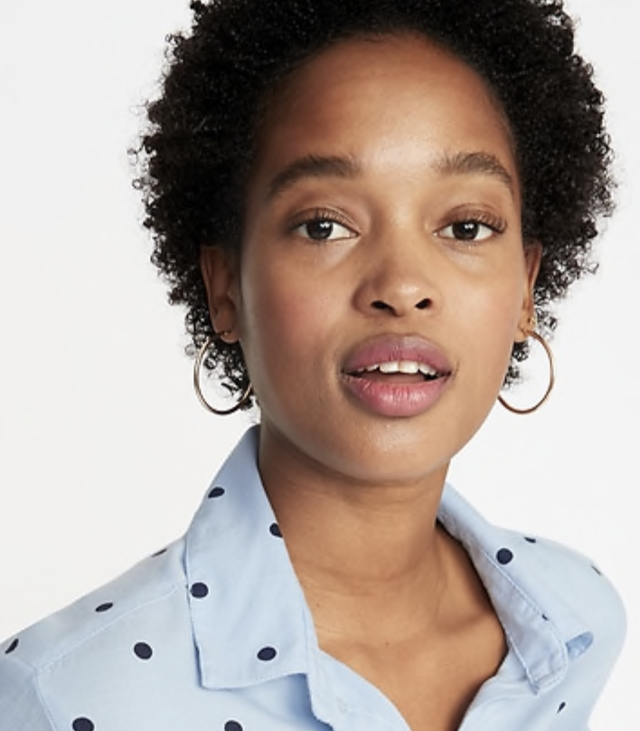

PERSONAL GROOMING. . .
Make-up should look like it’s barely there.

Slide 43
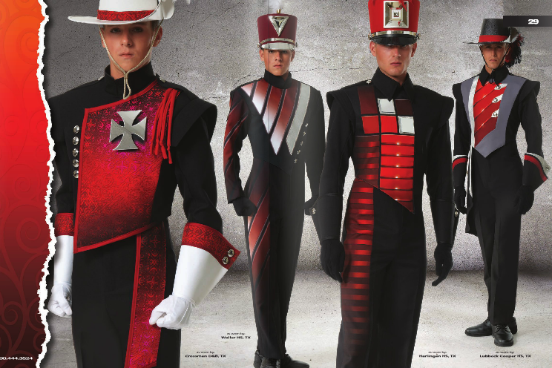
The “look” of your students determines their brand so choose wisely.

Slide 44
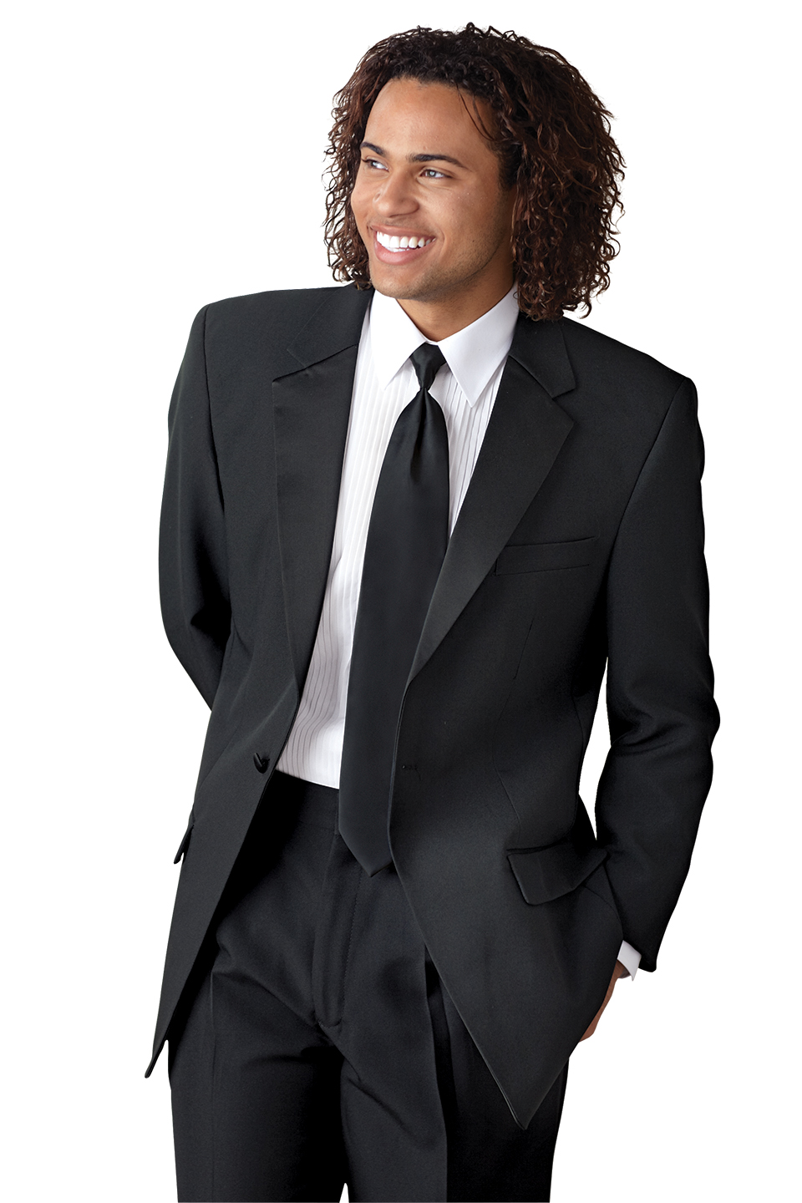
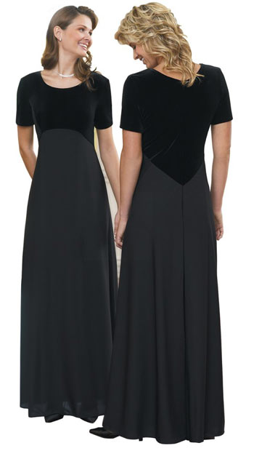
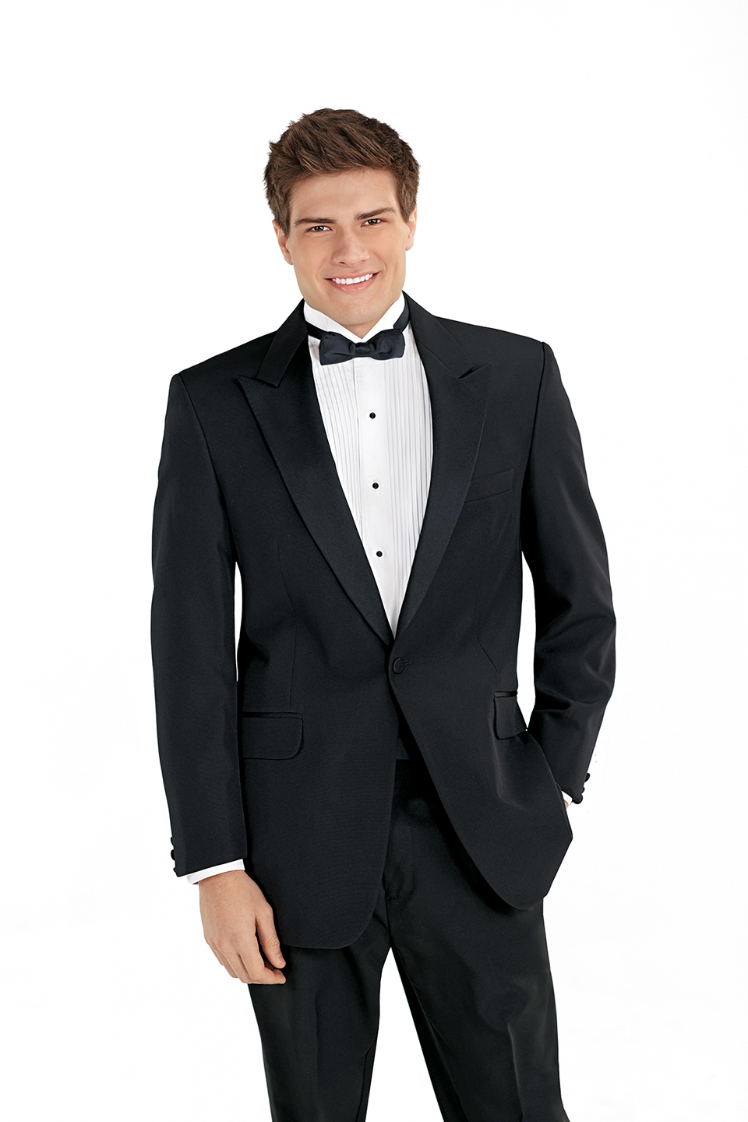
The “look” of your students determines their brand so choose wisely.

Slide 45
YOUR “LOOK” REVEALS TWO ITEMS:
1. How much you care about yourself
(self-respect)
2. How much you care about others
(mutual respect)
Looking good!
What a great way to show students how much you care!

Slide 46


What are the similarities and
what do they convey?

Slide 47
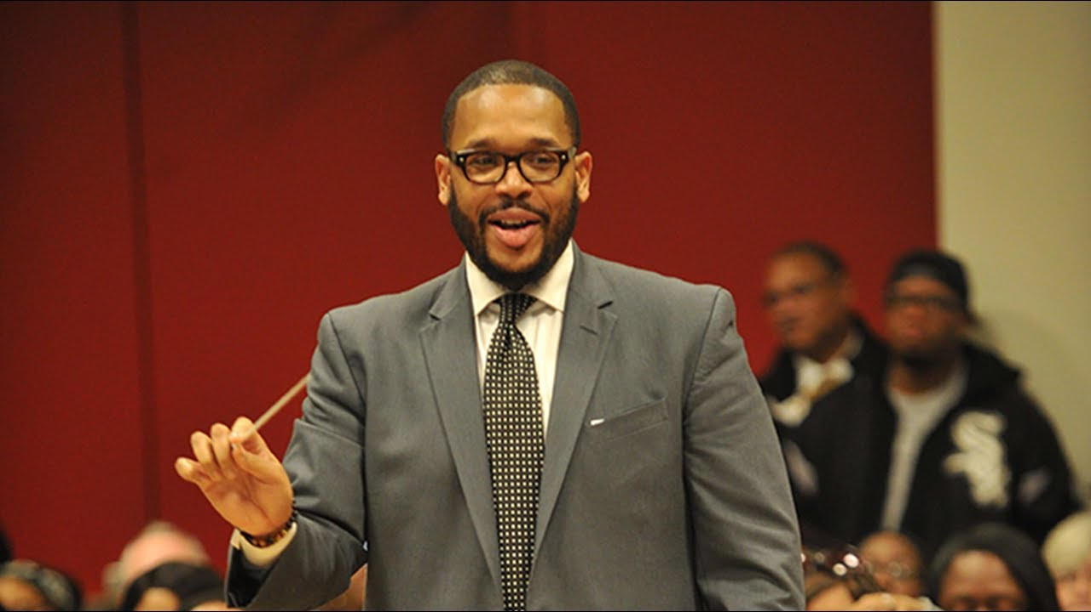
Using Purposeful Body Language
Command authority in the classroom by:
Demonstrating good posture—slouching conveys a negative attitude or lack of interest or respect.

Slide 48
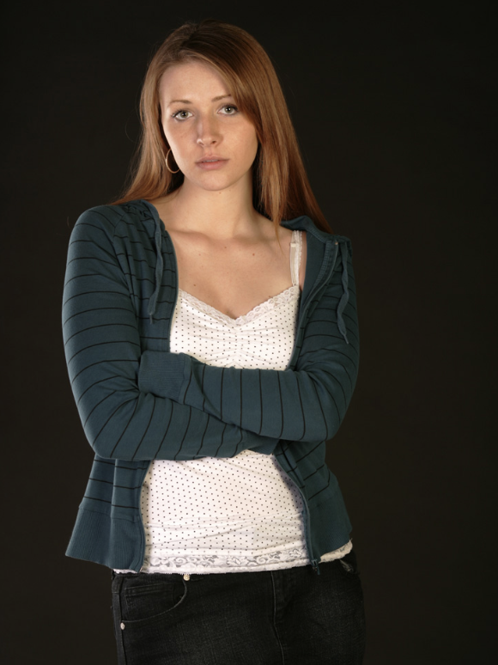
What are they telling us?

Slide 49
Using Purposeful Body Language
Command authority in the
Keeping arms unfolded which shows an openness to receive
Showing open palms
when possible
Using fluid gestures
which promote a calm
classroom by:
atmosphere

Slide 50



Slide 51
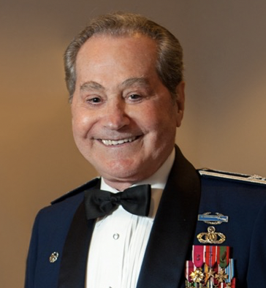
Using Purposeful Body Language
Command authority in the classroom by:
Standing in front of desks and other obstructions to promote trust.
Conducting without a
music stand to promote
trust and respect.
Colonel Arnald Gabriel
Conductor Emeritus of the U.S. Air Force Band

Slide 52
Using Purposeful Body Language
Command authority in the classroom by:
Moving around the room to show that you care about all of your students.
Becoming more aware of your facial expressions which will promote a more positive learning climate.

Slide 53
Using Purposeful Body Language
Command authority in the classroom by:
Smiling and nodding when students “get it” to give them a sense of well-being.
Walking throughout the school with a pleasant facial expression to show that you are approachable.

Slide 54
Body Language: The ultimate truth
about who you are and what you think.
The Bad News. . .
You Tell on Yourself!

Slide 55
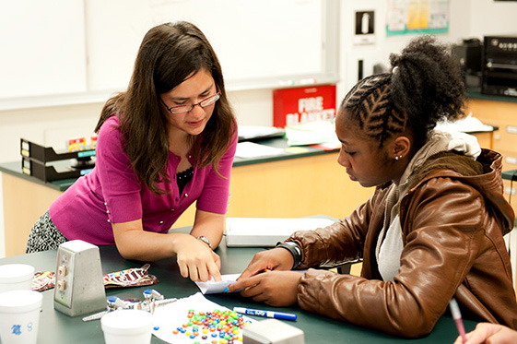
Body Language: The ultimate truth
about who you are and what you think
The Good News. . .
Knowing about Body Language Will Help You Understand
Your Students Better

Slide 56
Using Purposeful Body Language
Your Personal Checklist:
Knowing your purpose
Being overly prepared
Succeeding at less than 100%
Reflecting
Knowing that you can be better tomorrow than you are today
Fin

Slide 57

Master Educator Program
Our mission is to provide inspiring professional development opportunities and artistic music collaborations for music educators at the local, state and national levels.
www.musicedconsultants.net/conference-materials
marcia@musicedconsultants.net

