Slide 1

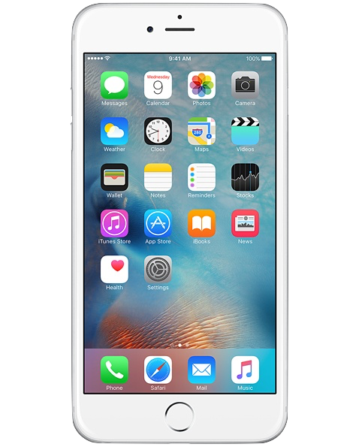
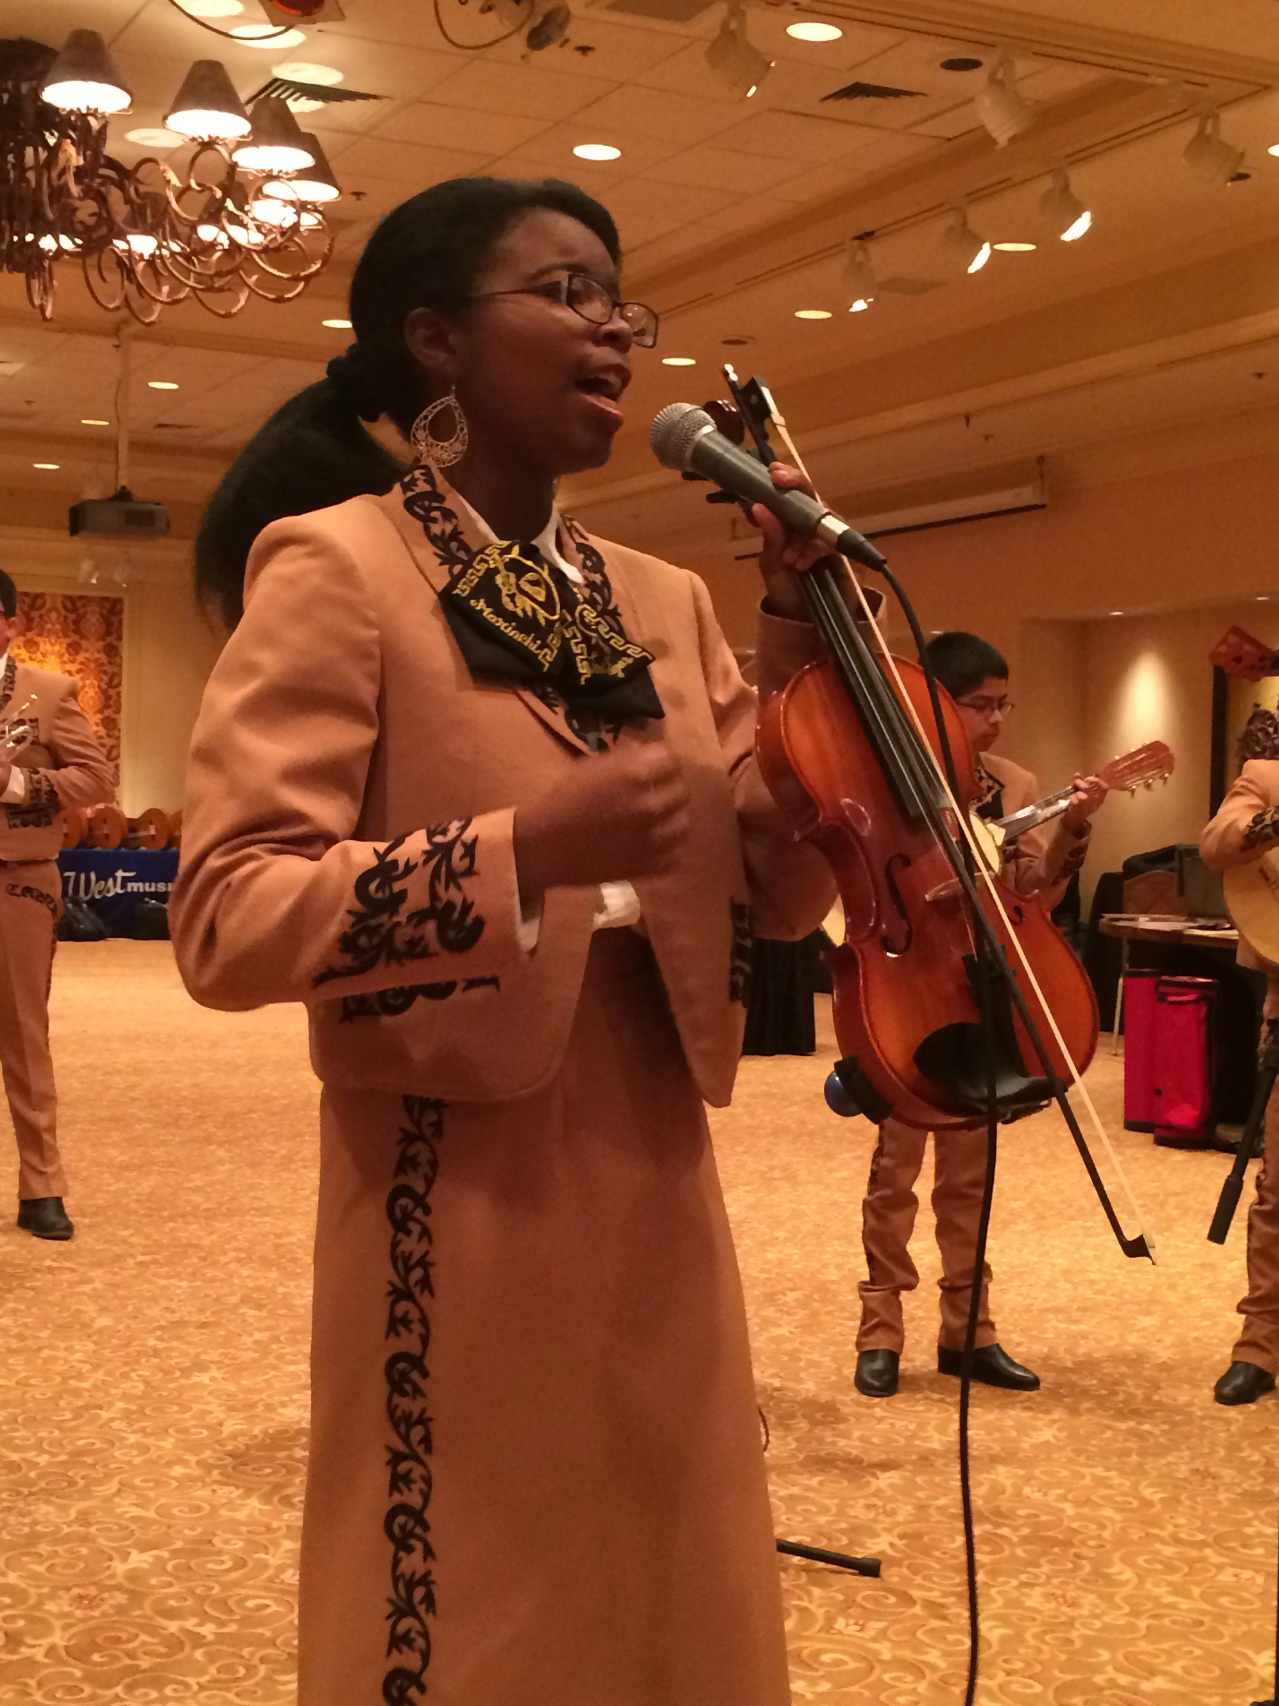

¡Viva el Mariachi!
An SFUSD Case Study
Sofia Fojas,
SFUSD
José Hernández
Mariachi Sol de Mexico
Marcia Neel
Music Education Consultants, Inc.
Will be posted online at:
www.musicedconsultants.net/conference-materials
S

Slide 2
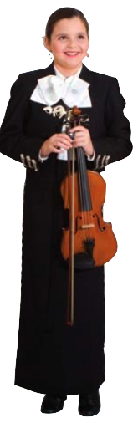
Today’s Session
Why Mariachi?
Mariachi as a Strategy for
Equity in Urban Education
Mariachi as a Legitimate
Course of Study
Staffing
Professional Development:
Easy to Learn and Fun to
Teach!
S

Slide 3
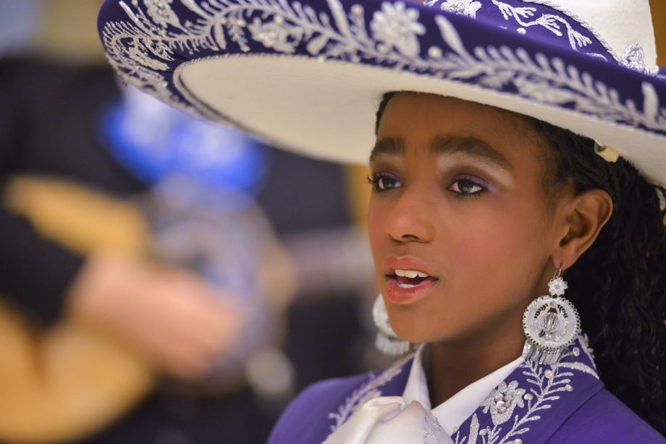
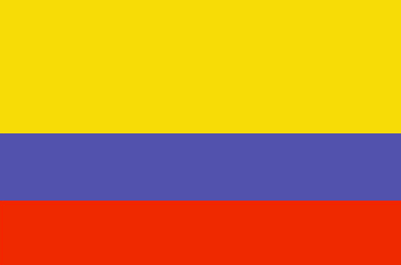


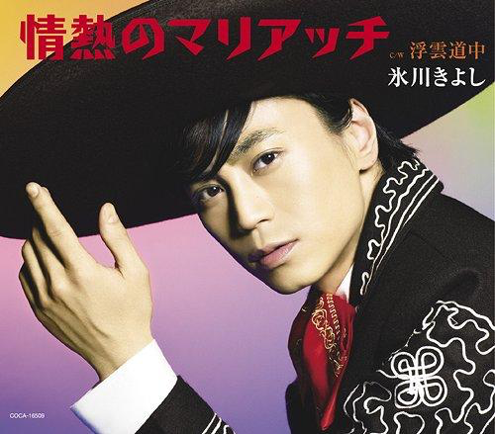
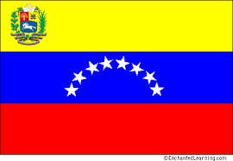
Why Mariachi? Mariachi is Universal!
Columbia
Peru
Anani Rhames
Australia
Hikawa Kiyoshi
Venezuela
J

Slide 4
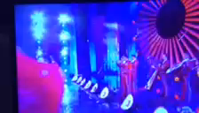
Why Mariachi?
Mariachi crosses ALL genres!
Sol de Mexico performs from
Nutcracker Suite
J

Slide 5
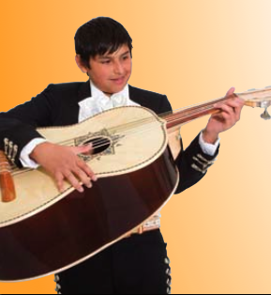
Why Mariachi?
Social Justice
The Arts are for ALL!
M

Slide 6
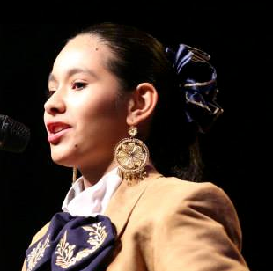
Why Mariachi?
. . .Richard Carranza
Involves more students
in Music Education
Provides an entry-level
music experience anytime
Helps keep students in school
Serves as an effective bridge to parental involvement
Celebrates/recognizes culture and heritage
M

Slide 7
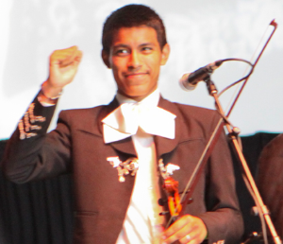
Additional Benefits of
School Mariachi Programs
Uses multiple intelligences
Teaches life-long skills
Increases student self-esteem
and self-confidence
Provides opportunities for students to serve as role models to younger students
Creates a school “Mosaic of Musical Experiences”

Slide 8
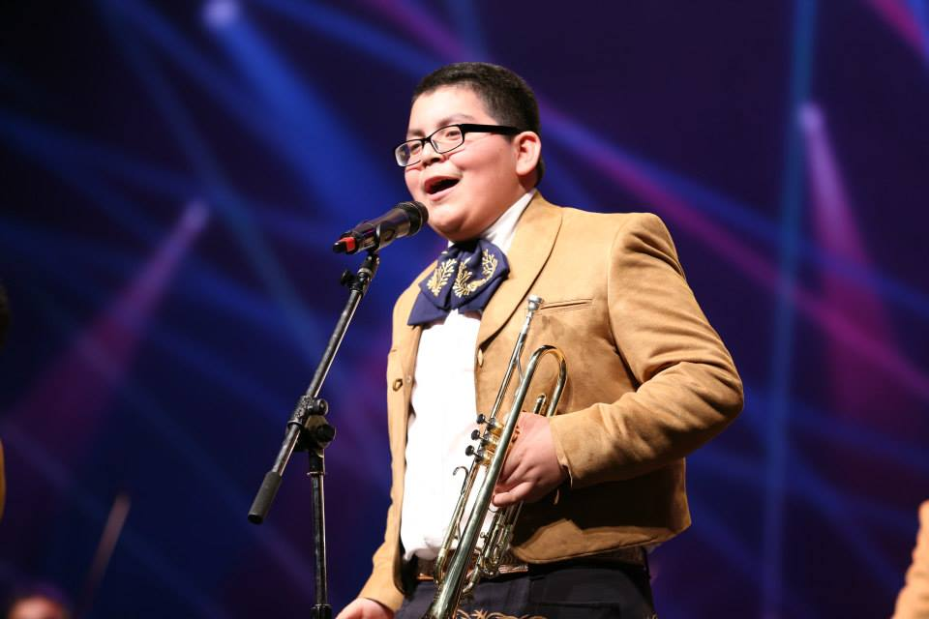
And. . .It’s FUN!

Slide 9
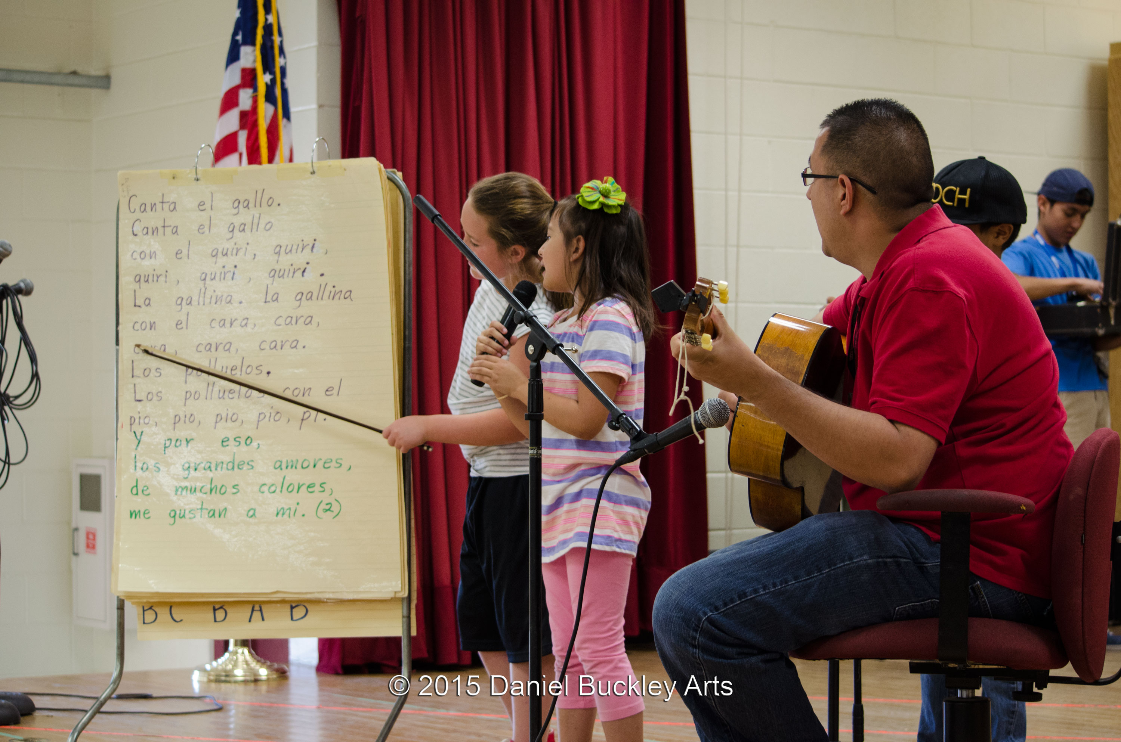
Mariachi and Bilingualism
M

Slide 10
Mariachi and Bilingualism
1. Mariachi is inherently tied to Mexico
and is recognized as such by students
2. Songs are performed in Spanish but
instruction is delivered in English
3. Students equate Spanish musical terms
with corresponding words in English.
Ex: Golpe, Sale
4. Social bonding develops quickly-inherent
to music ensembles

Slide 11
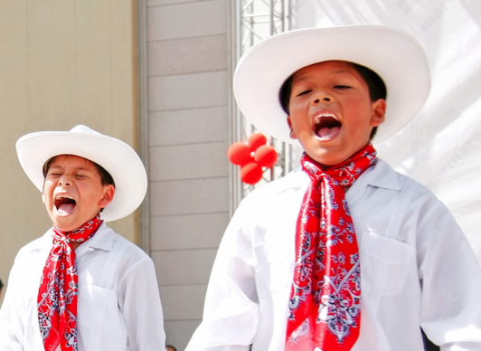
Mariachi and Bilingualism
5. Mariachi transcends generations
“Old People’s Music?”
“Concert Madness?”
“Relevant?”
“Sounds of Home!”

Slide 12

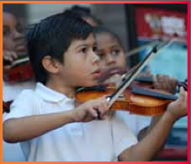
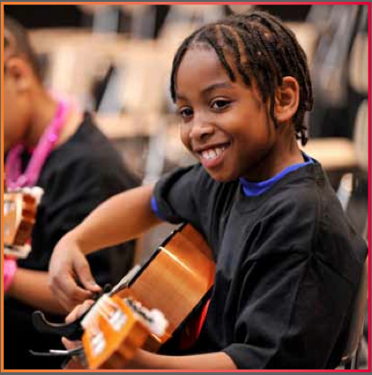
Prelude:
Music Makes Us Baseline Research Report
Becky J. A. Eason, Ph.D.
Center for Public Partnerships & Research
The University of Kansas
Christopher M. Johnson, Ph.D.
Music Research Institute
The University of Kansas
musicmakesus.org/resources/research

Slide 13
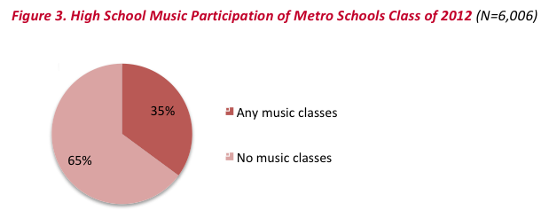
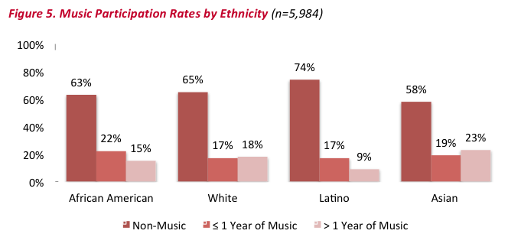
Music Participation Rates by Ethnicity

Slide 14
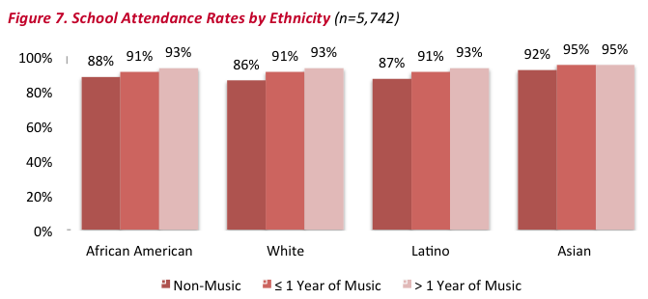
School Attendance Rates by Ethnicity

Slide 15
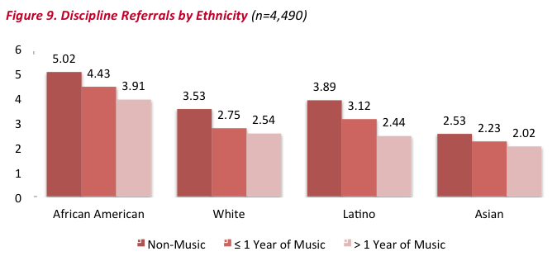
Discipline Referrals by Ethnicity

Slide 16
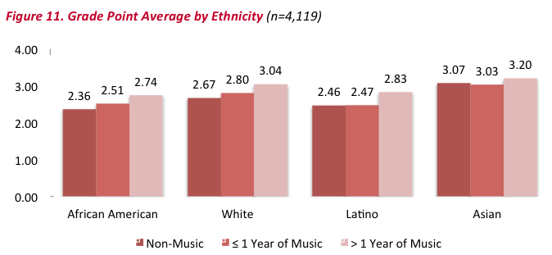
GPA by Ethnicity

Slide 17
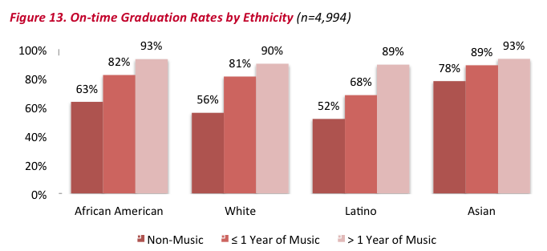
On-time Graduation Rates by Ethnicity

Slide 18
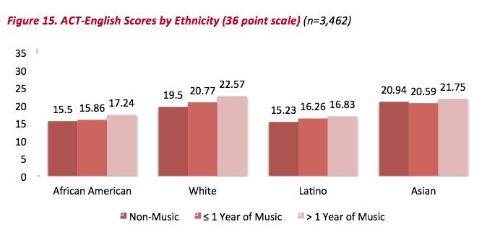
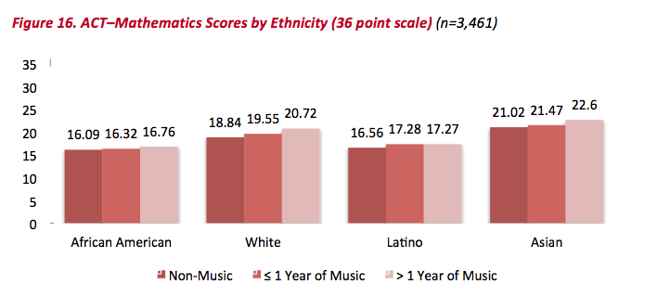
ACT: English and Math by Ethnicity

Slide 19
Summary: What Was Learned?
The MORE a student
participates in MUSIC,
the more POSITIVE
the BENEFITS become.

Slide 20
Clark County School District
1990 Enrollment:
121,918
2000 Enrollment:
231,125
2015 Enrollment:
314,643
43.4% Latino
2002 Mariachi Enrollment
265
_____________
2015 Mariachi Enrollment
4,765
_____________

Slide 21

A Standards-based Curricular Approach
to Performance Understanding
M

Slide 22
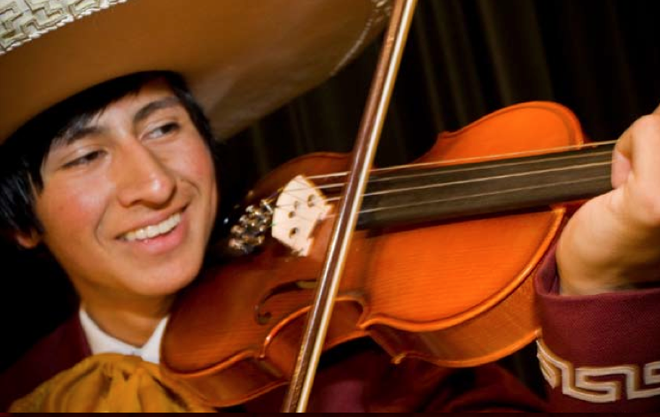
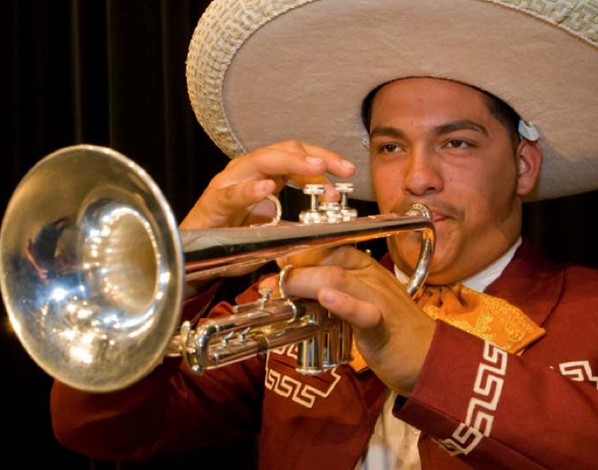
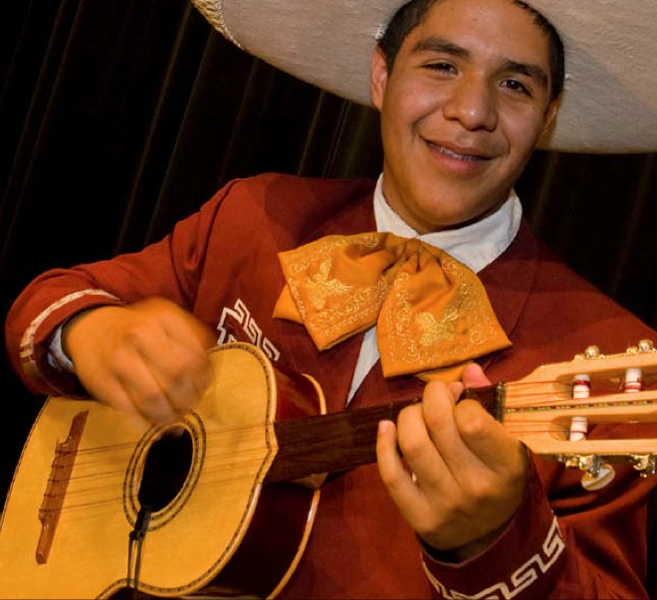
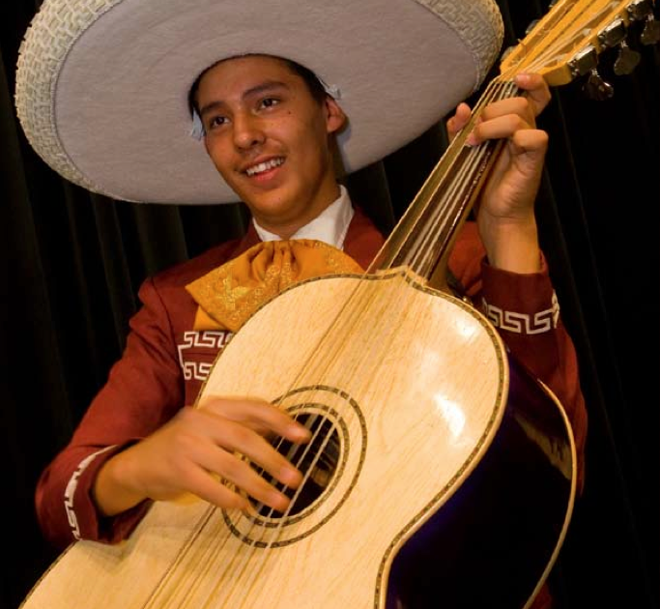
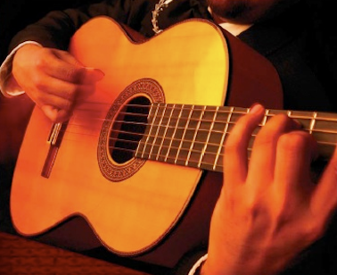
What is taught in Mariachi?
S

Slide 23

What is taught in Mariachi?
Visual and Performing Arts:
Music Content Standards

Slide 24
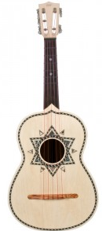

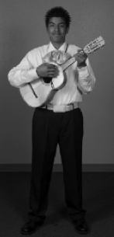
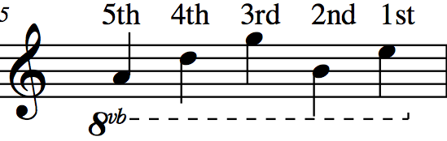
Characteristic Instruments: The Vihuela
A
D
G
B
E
5
4
3
2
1

Slide 25
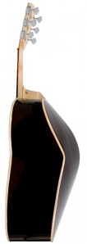
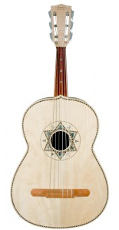
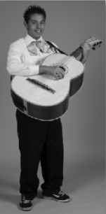
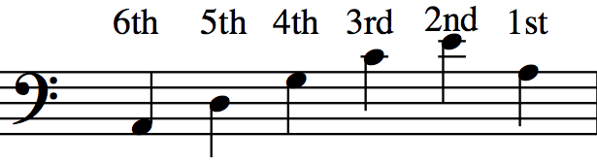
Characteristic Instruments: The Guitarron
A
D
G
C
E
A
T
Written Range: Sounds Octave Lower
6
5
4
3
2
1

Slide 26
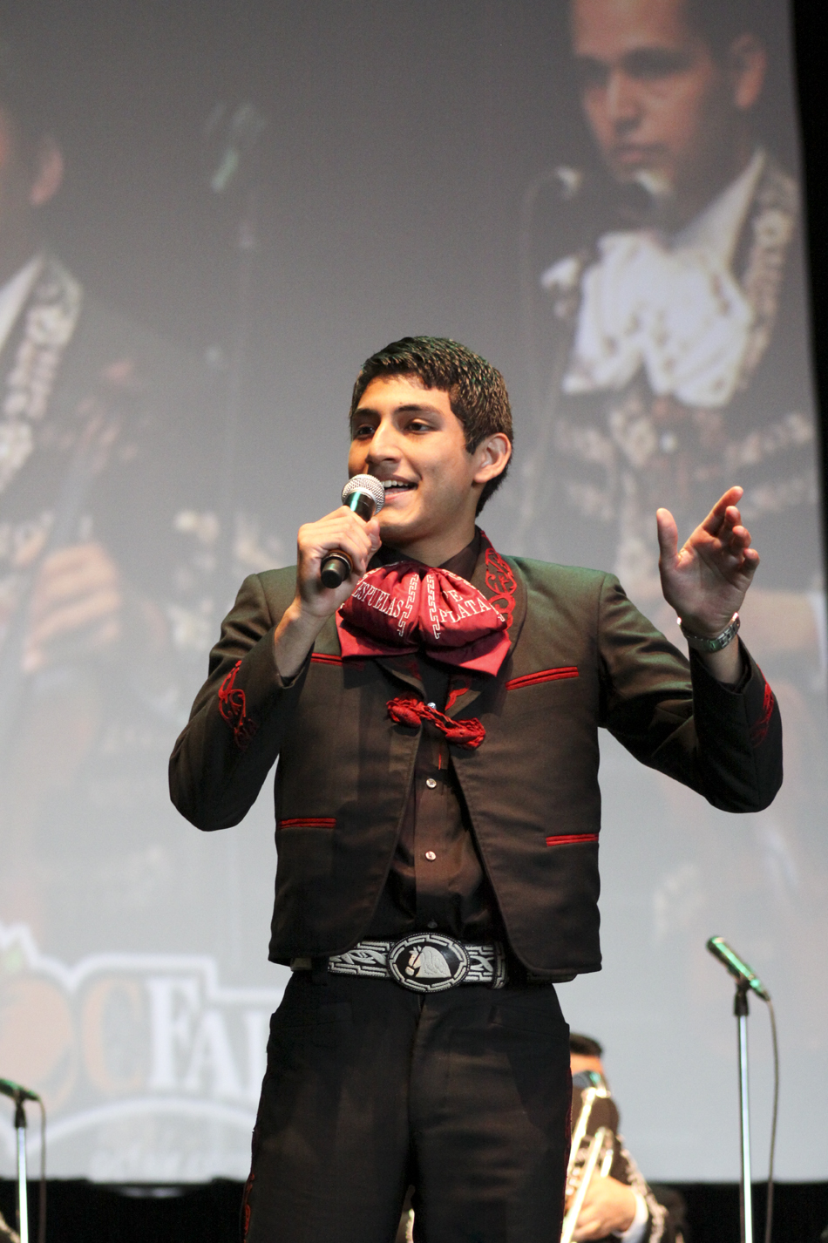
New Terms
1. Melodia
Violin, Trumpet
Vocal
2. Armonia:
The Rhythm Section
Guitar, Vihuela
Guitarron
3. Mánico
Strumming Pattern
Notes:
26

Slide 27
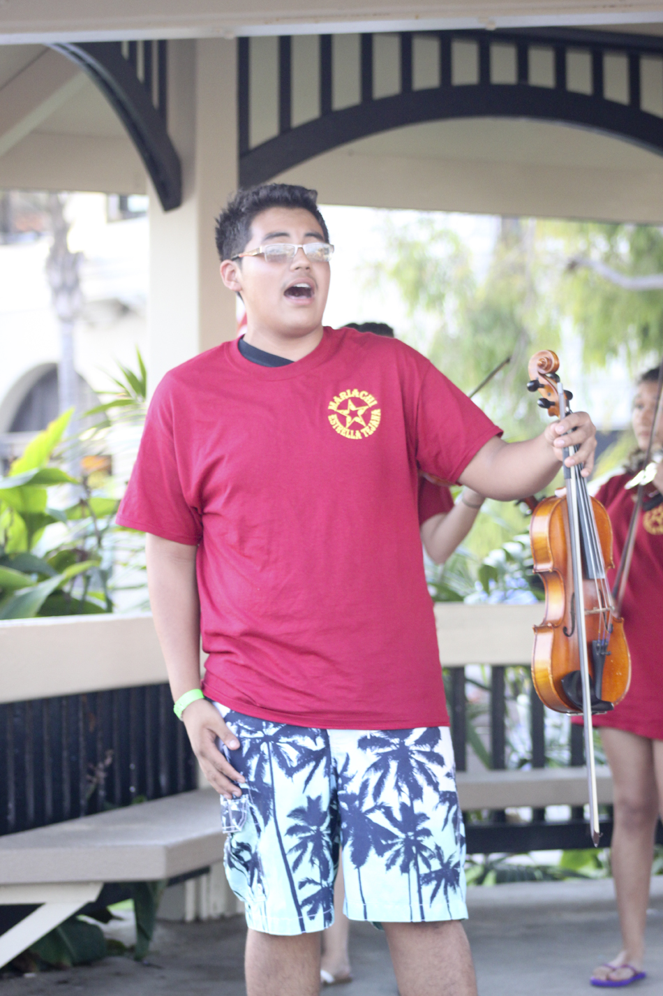
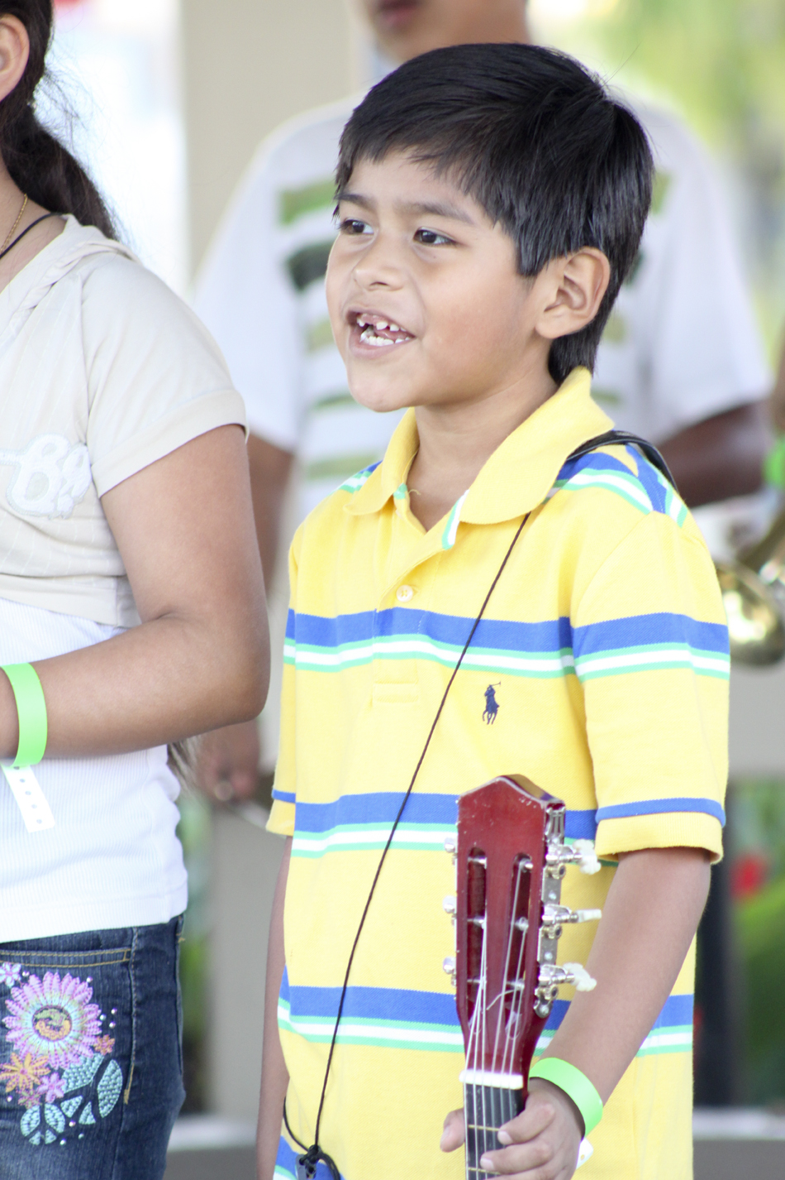
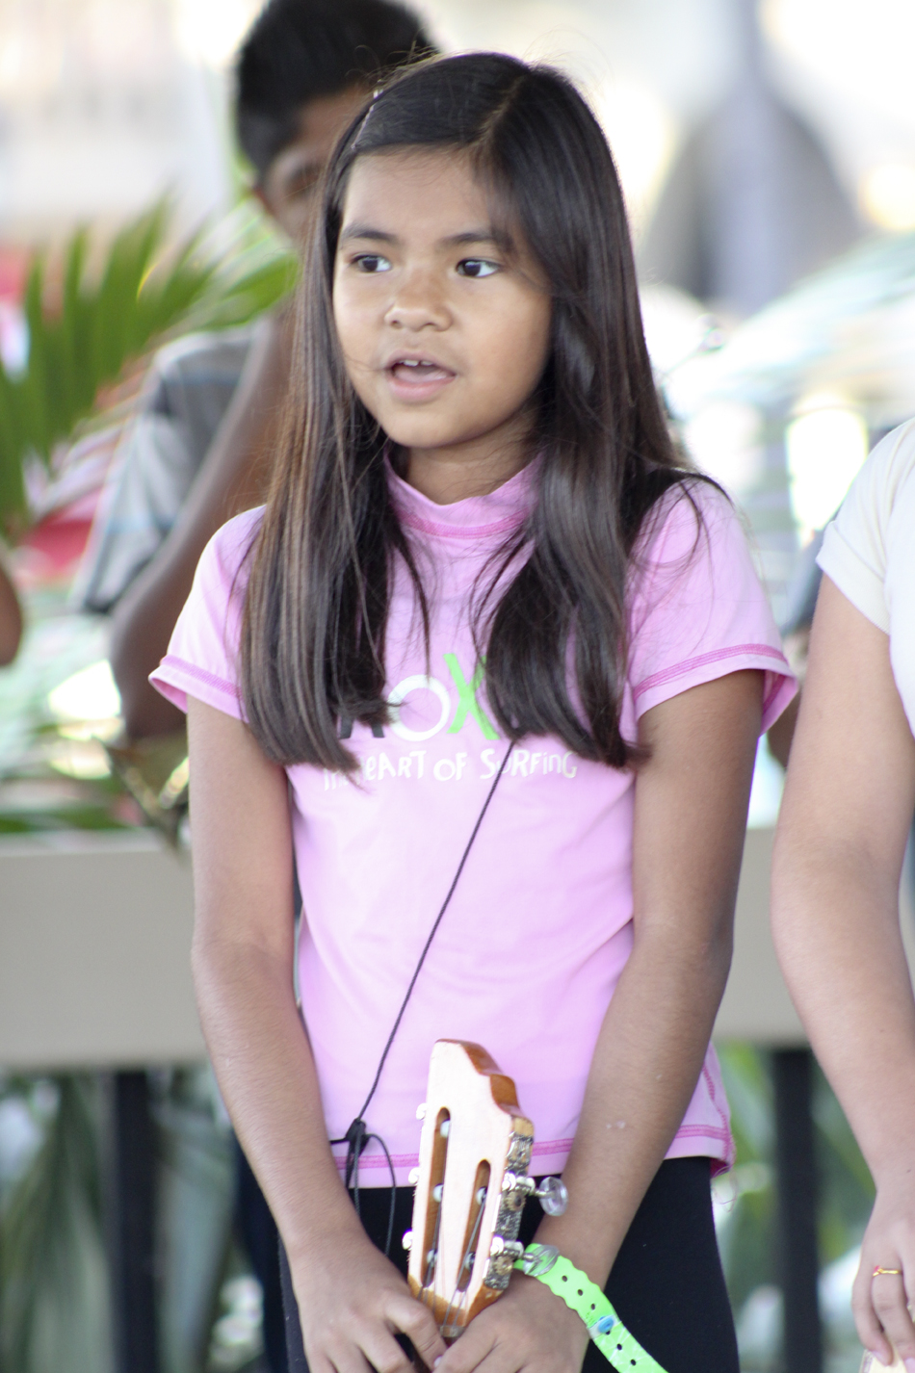
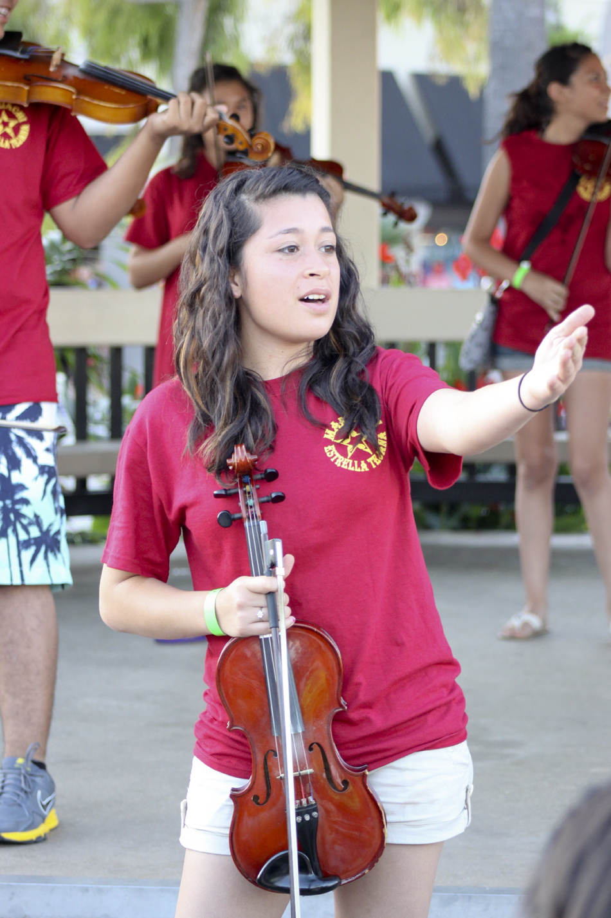
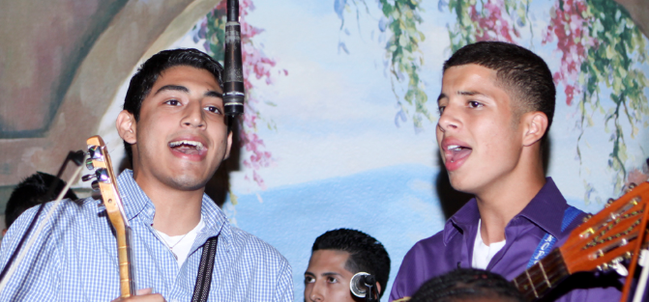
ALL AGES
EVERYONE SINGS!

Slide 28

How do we get started?
Nuts and Bolts

Slide 29
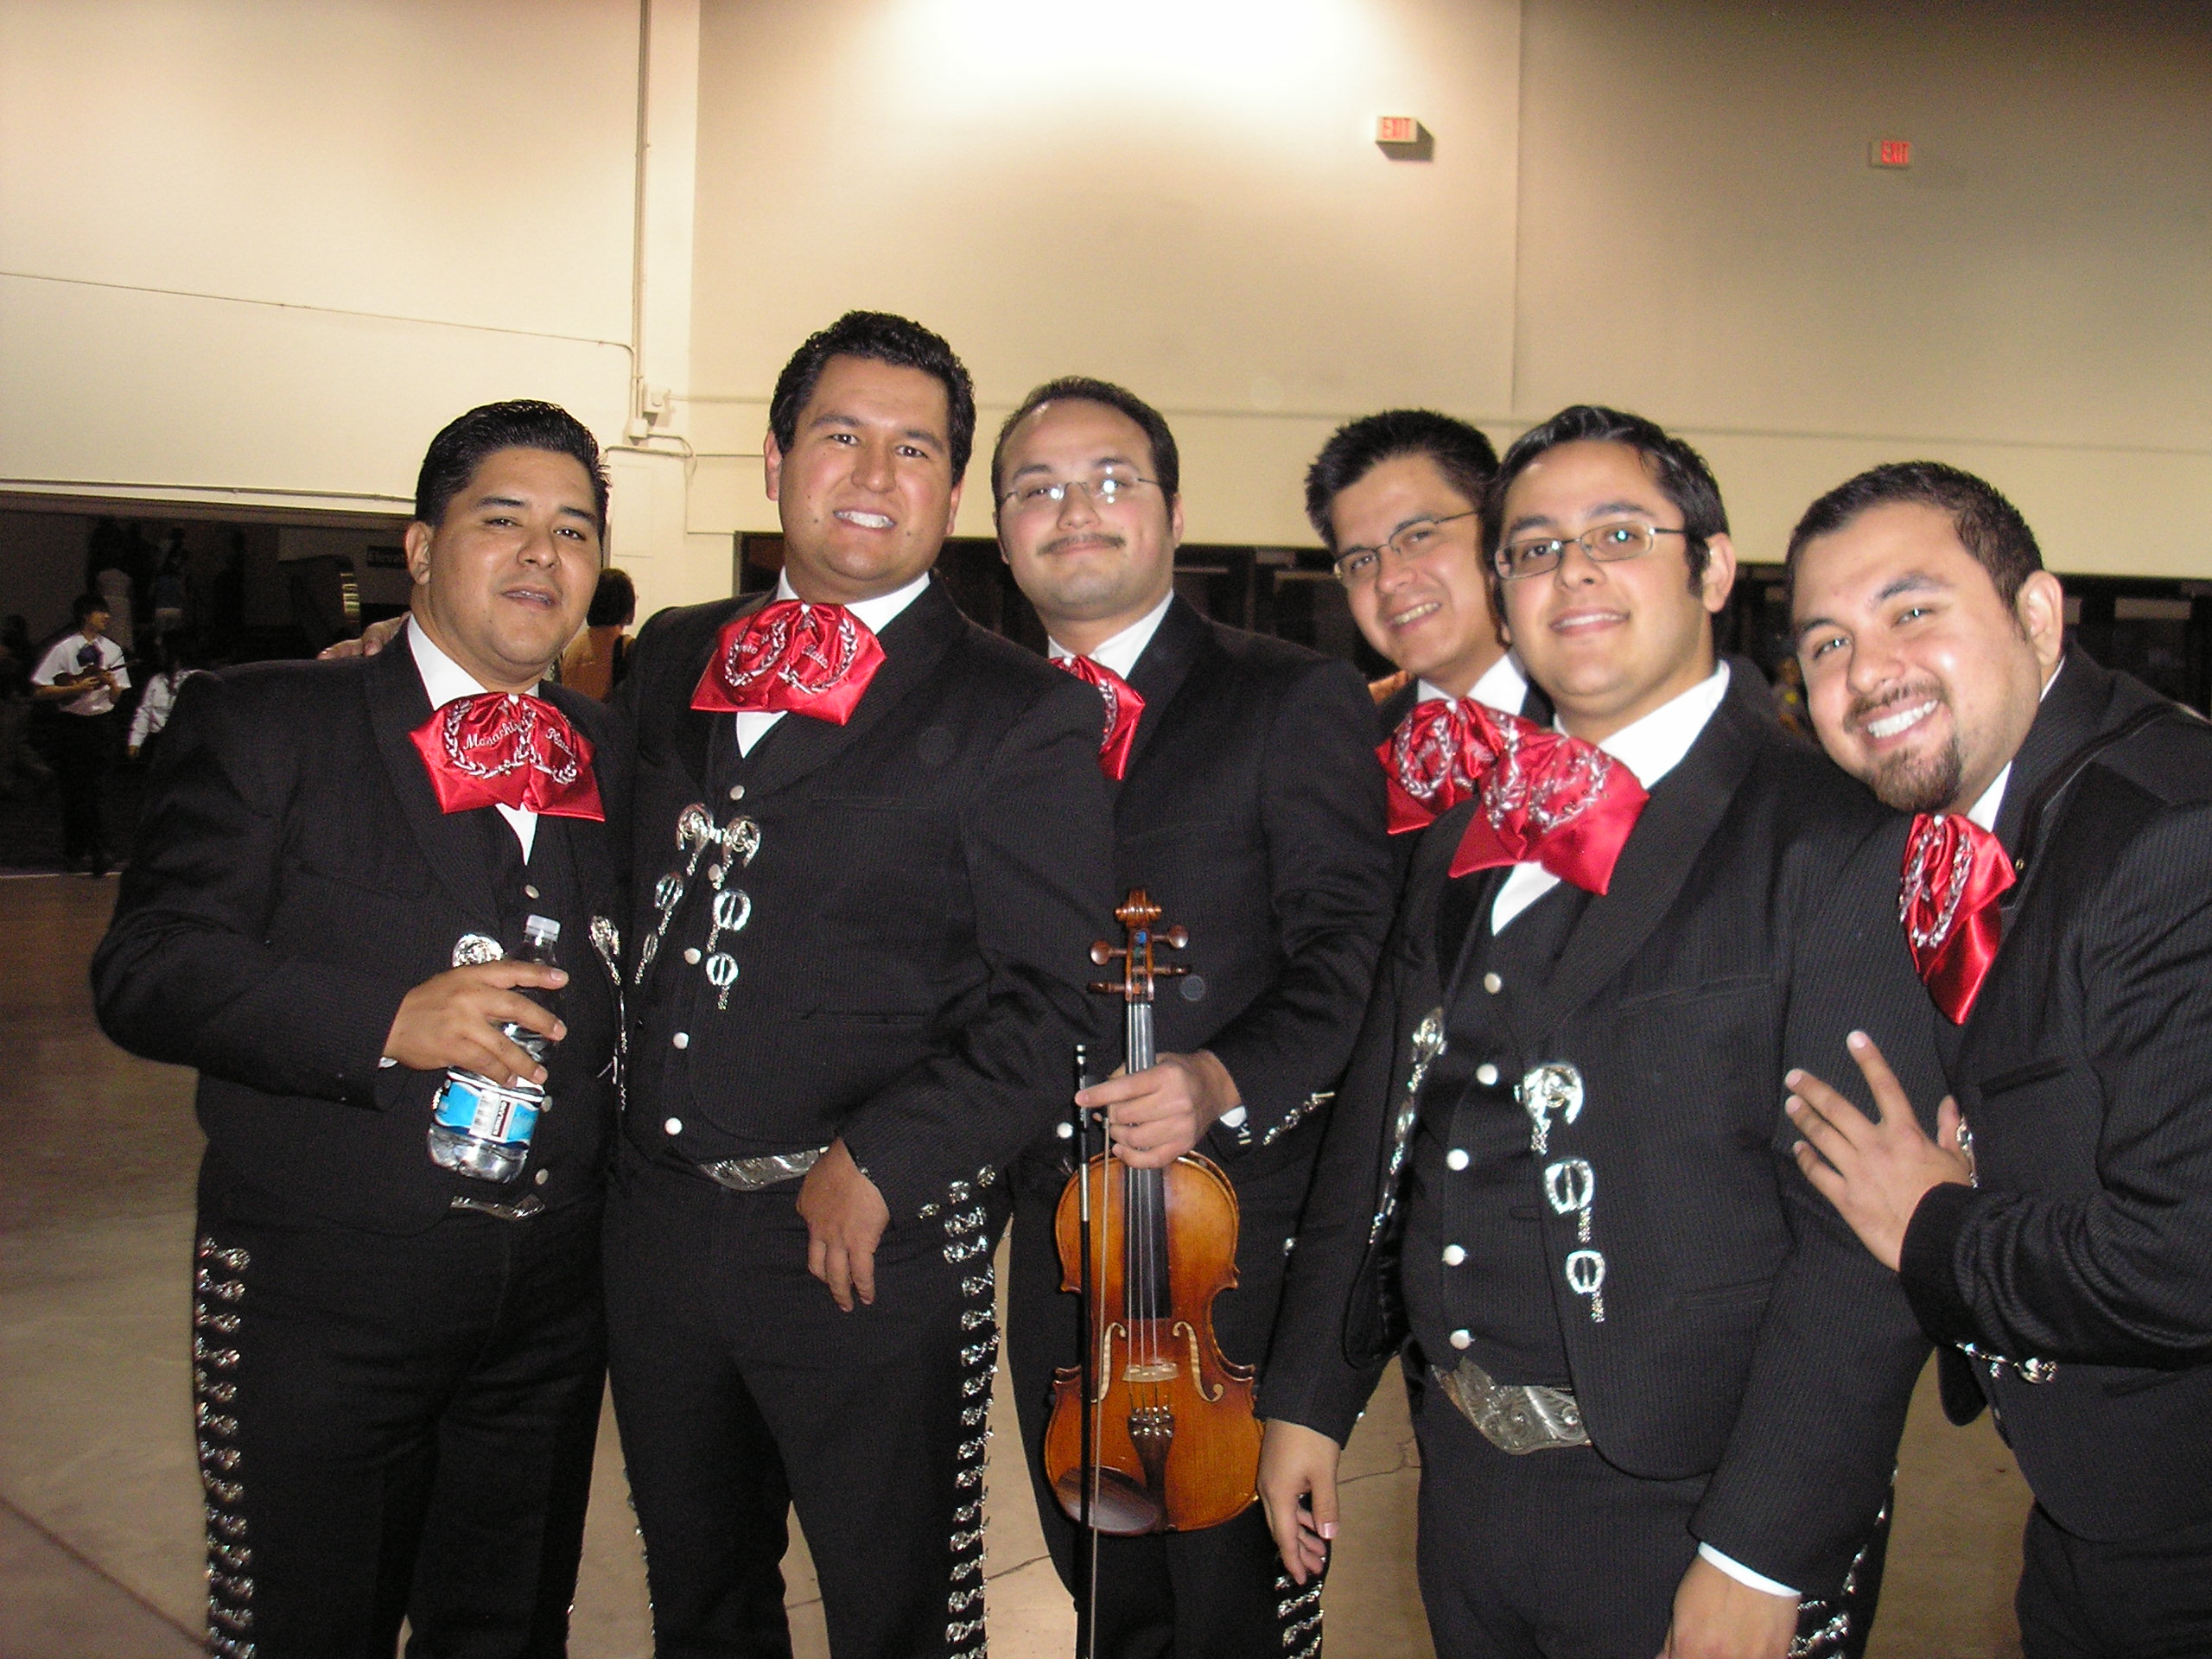
Who can teach it?

Slide 30
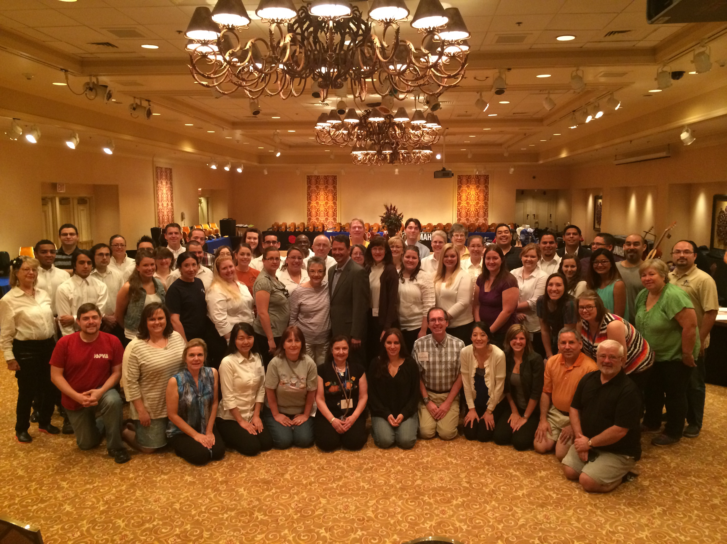
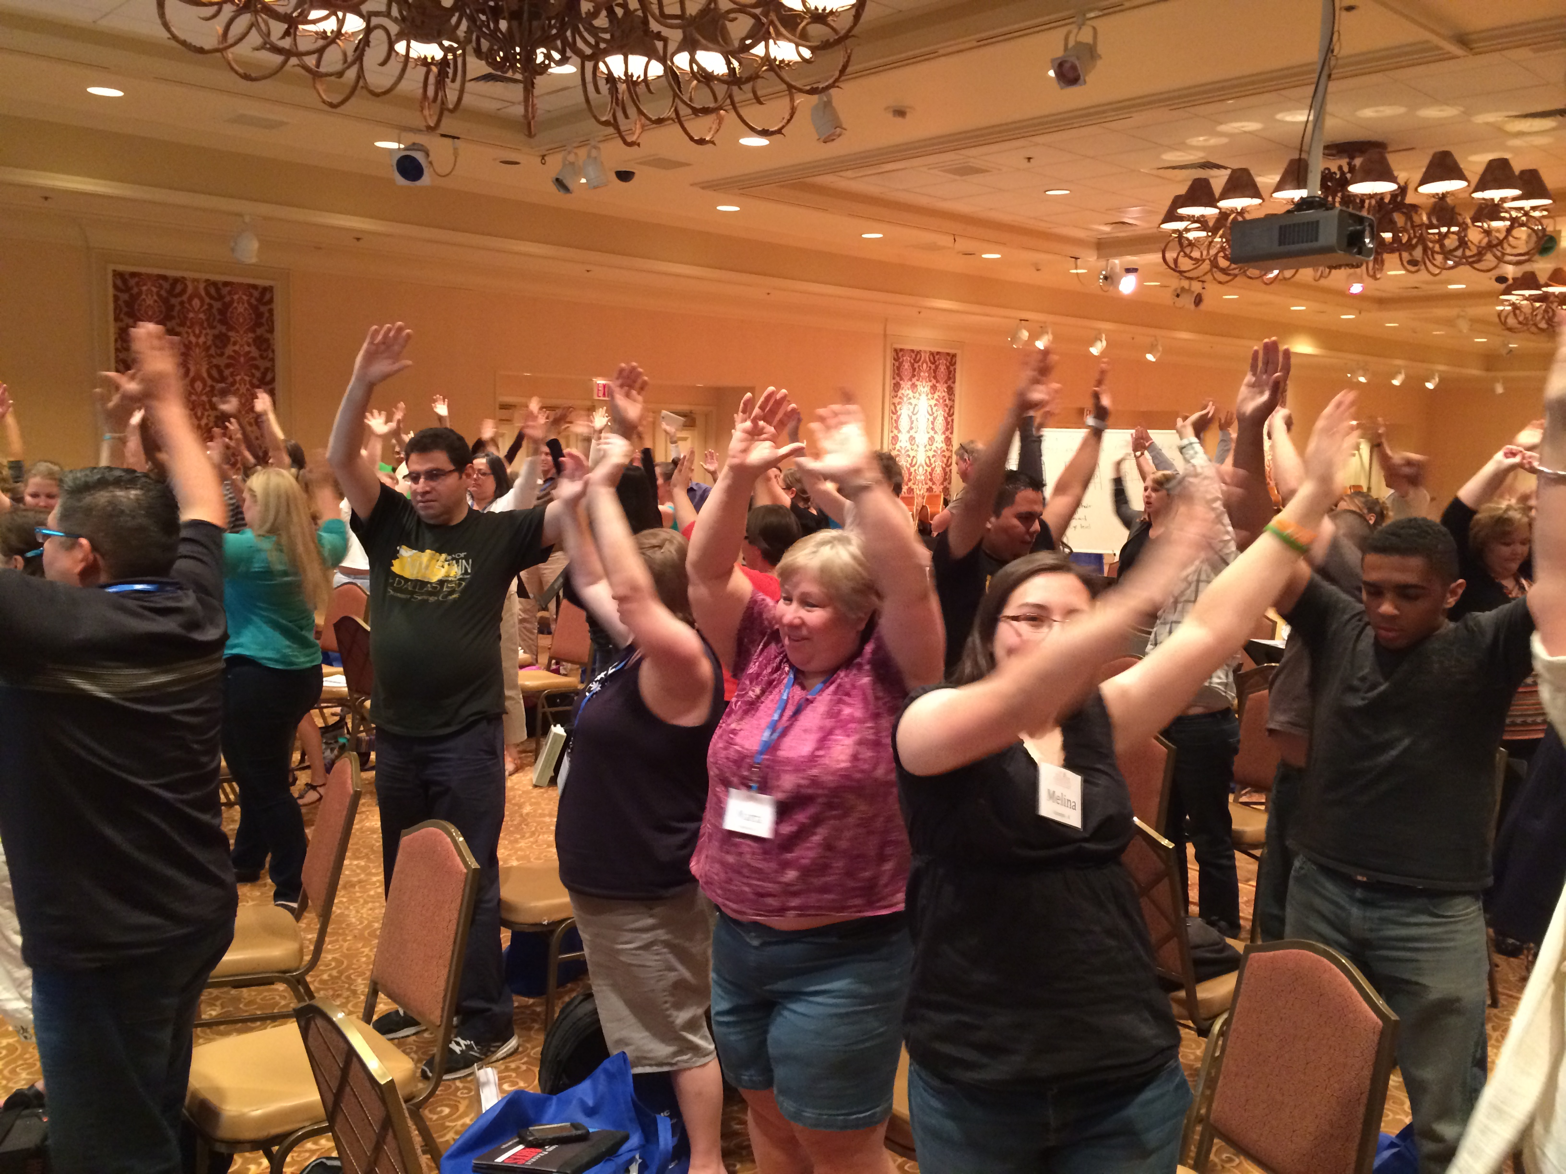
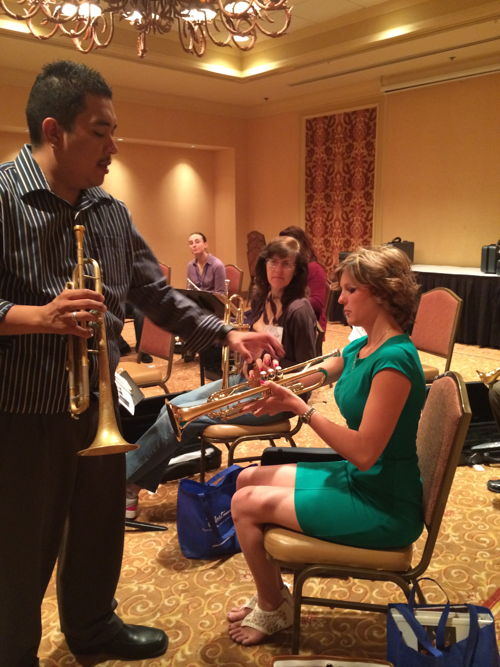
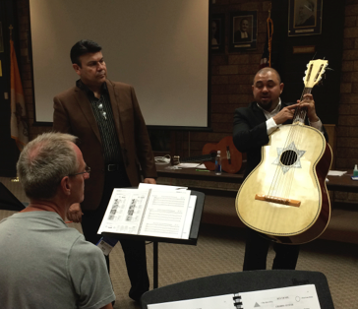
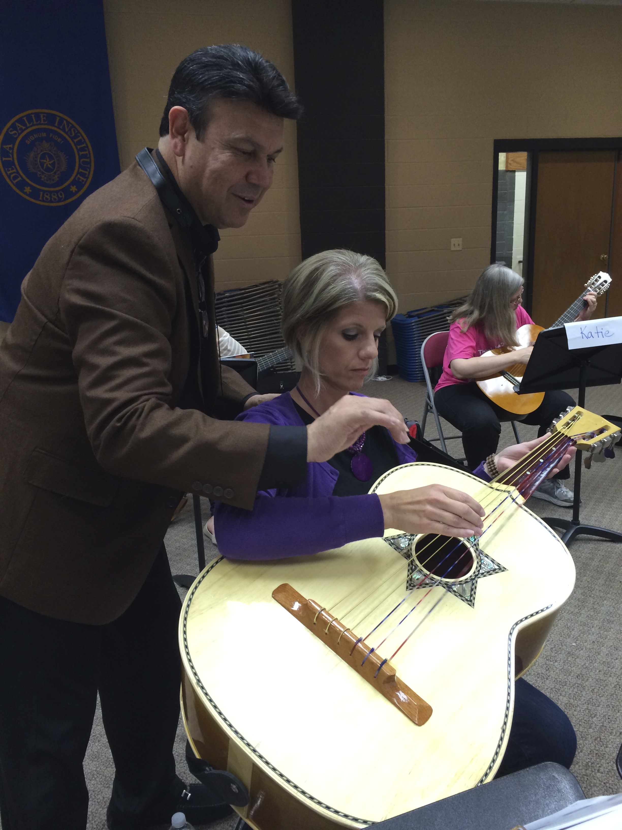
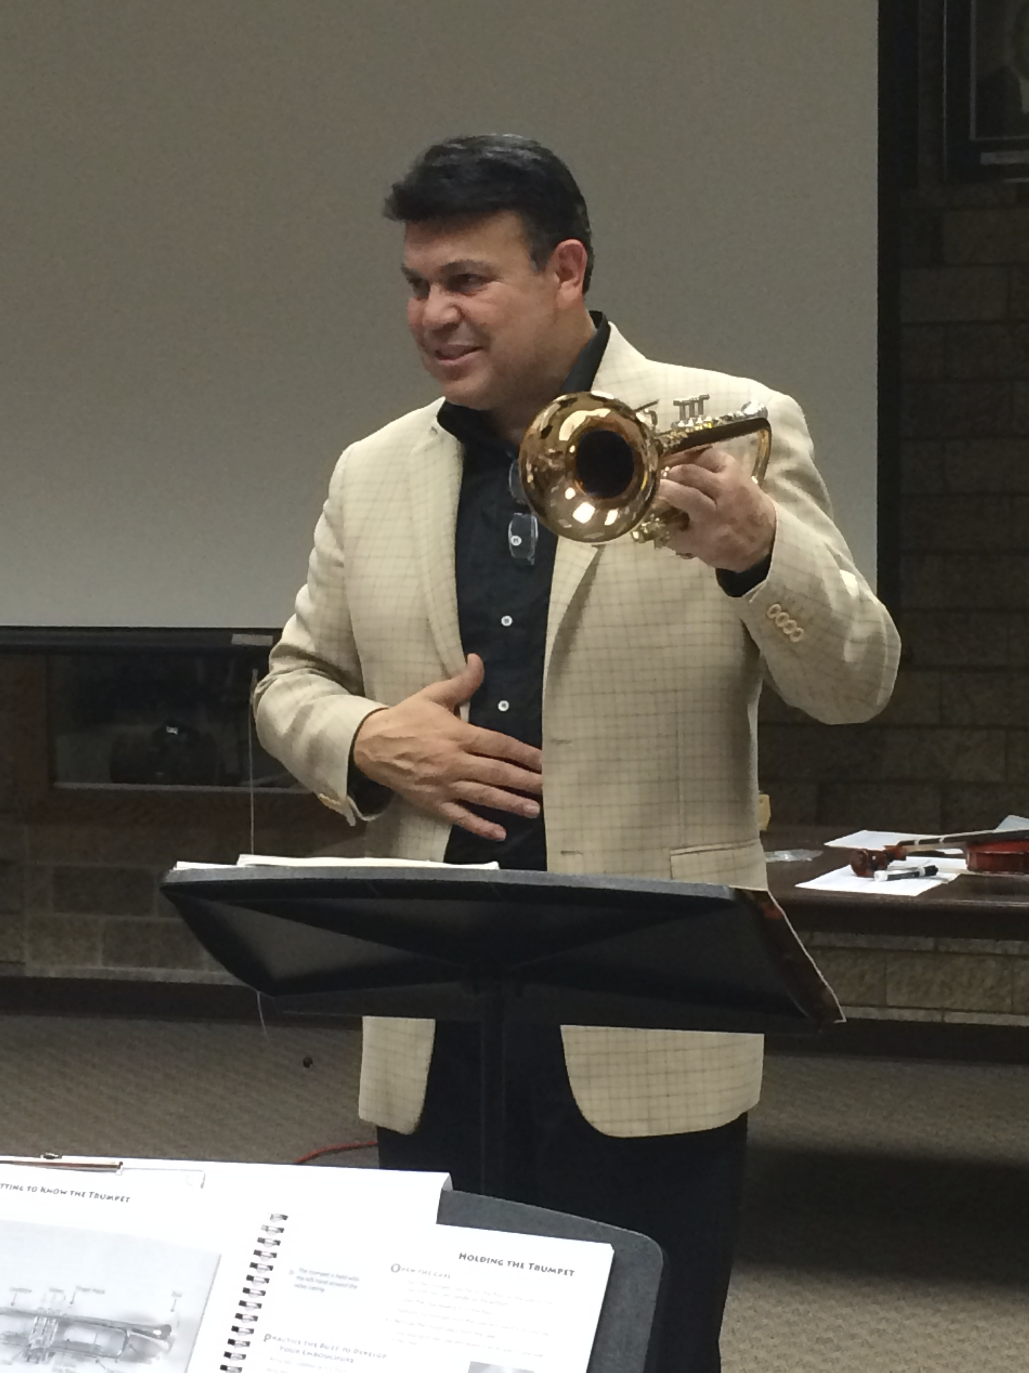
Anyone Who Has the Desire to Learn!
National Mariachi Workshops for Educators

Slide 31
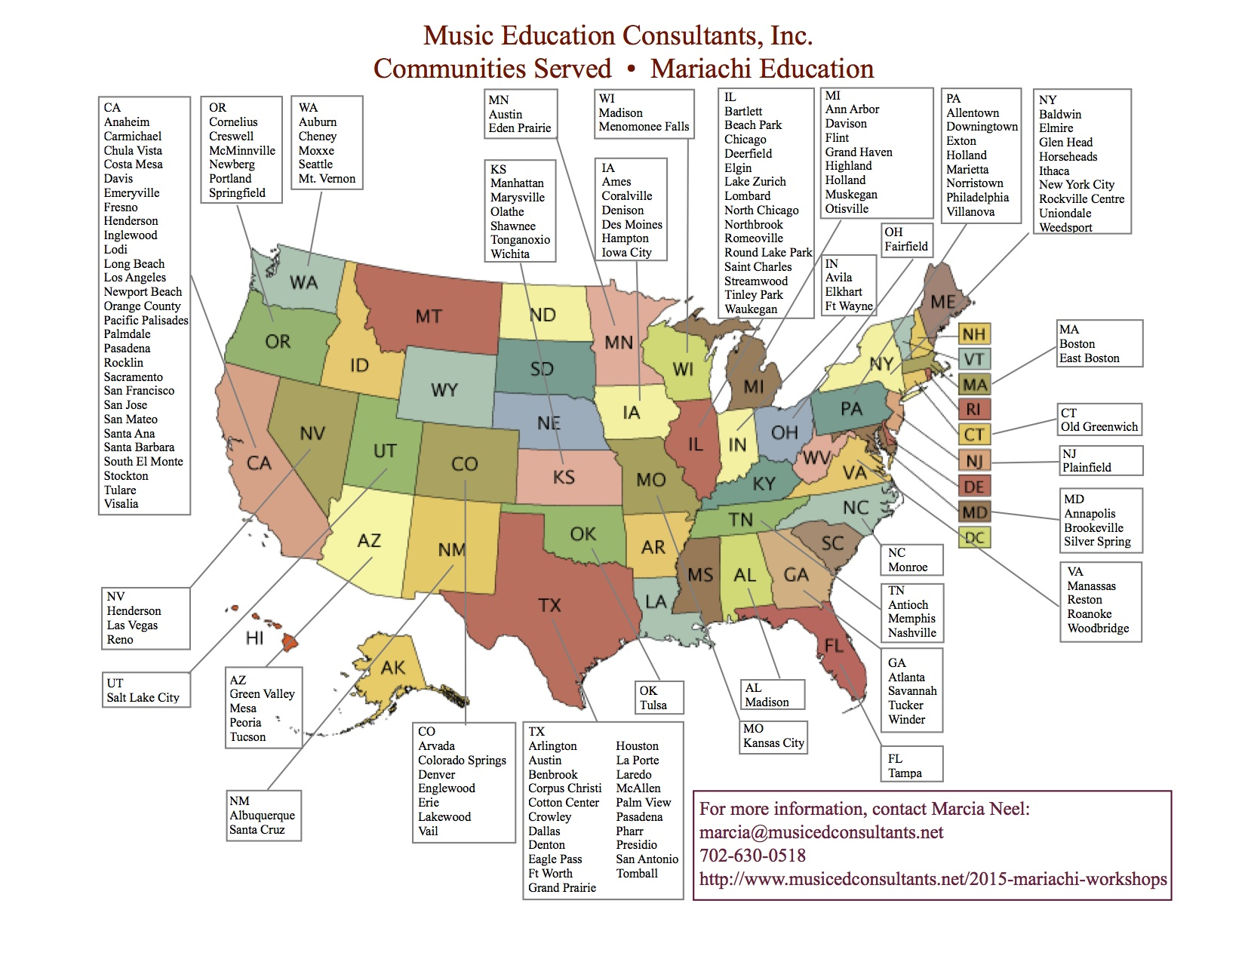
Budget Considerations
6. Professional Development

Slide 32
The Joy of Music-making!
De Colores
De colores,
De colores se visten los campos en la primavera.
De colores,
De colores son los pajarillos que vienen de afuera.
De colores,
De colores es el arco iris que vemos lucir.
Y por eso los grandes amores de muchos colores
Me gustan a mi
Y por eso los grandes amores de muchos colores
Me gustan a mi.
J

Slide 33
The Joy of Music-making!
De Colores
Canta el gallo,
Canta el gallo con el quiri, quiri, quiri, quiri, quiri.
La gallina,
La gallina con el cara, cara, cara, cara, cara.
Los polluelos,
Los polluelos con el pio, pio, pio, pio, pi
Y por eso los grandes amores de muchos colores
Me gustan a mi
Y por eso los grandes amores de muchos colores
Me gustan a mi.

Slide 34

Bailey Middle School Mariachi Program – Year Two

Slide 35

Q & A
Contact: Sofia Fojas at FojasS@sfusd.edu
Will be posted online at:
www.musicedconsultants.net/conference-materials

