Slide 1
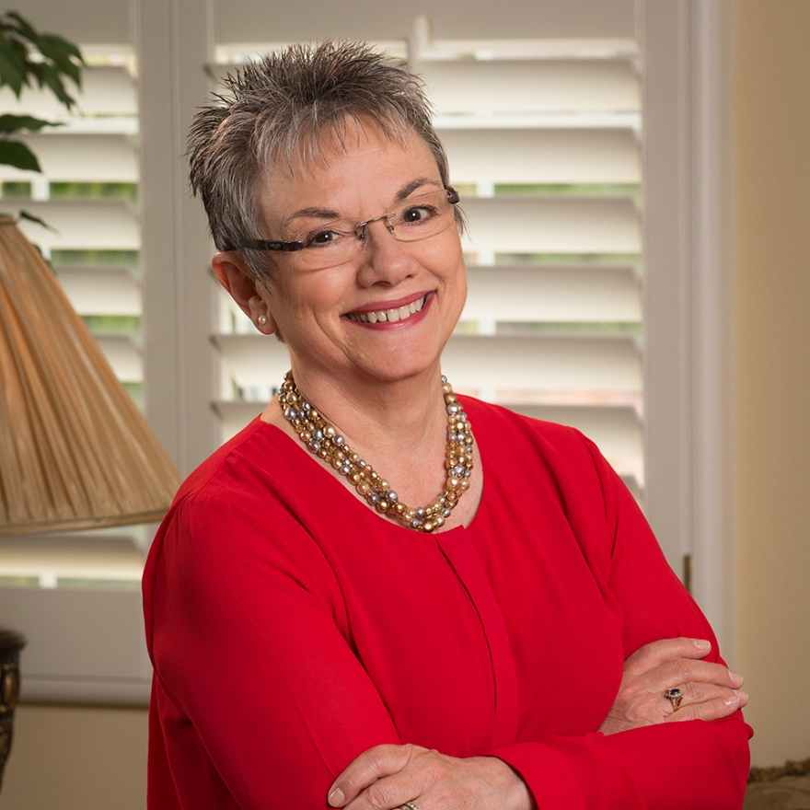


Marcia Neel
Master Educator
Arkansas Bandmasters
Association

Slide 2
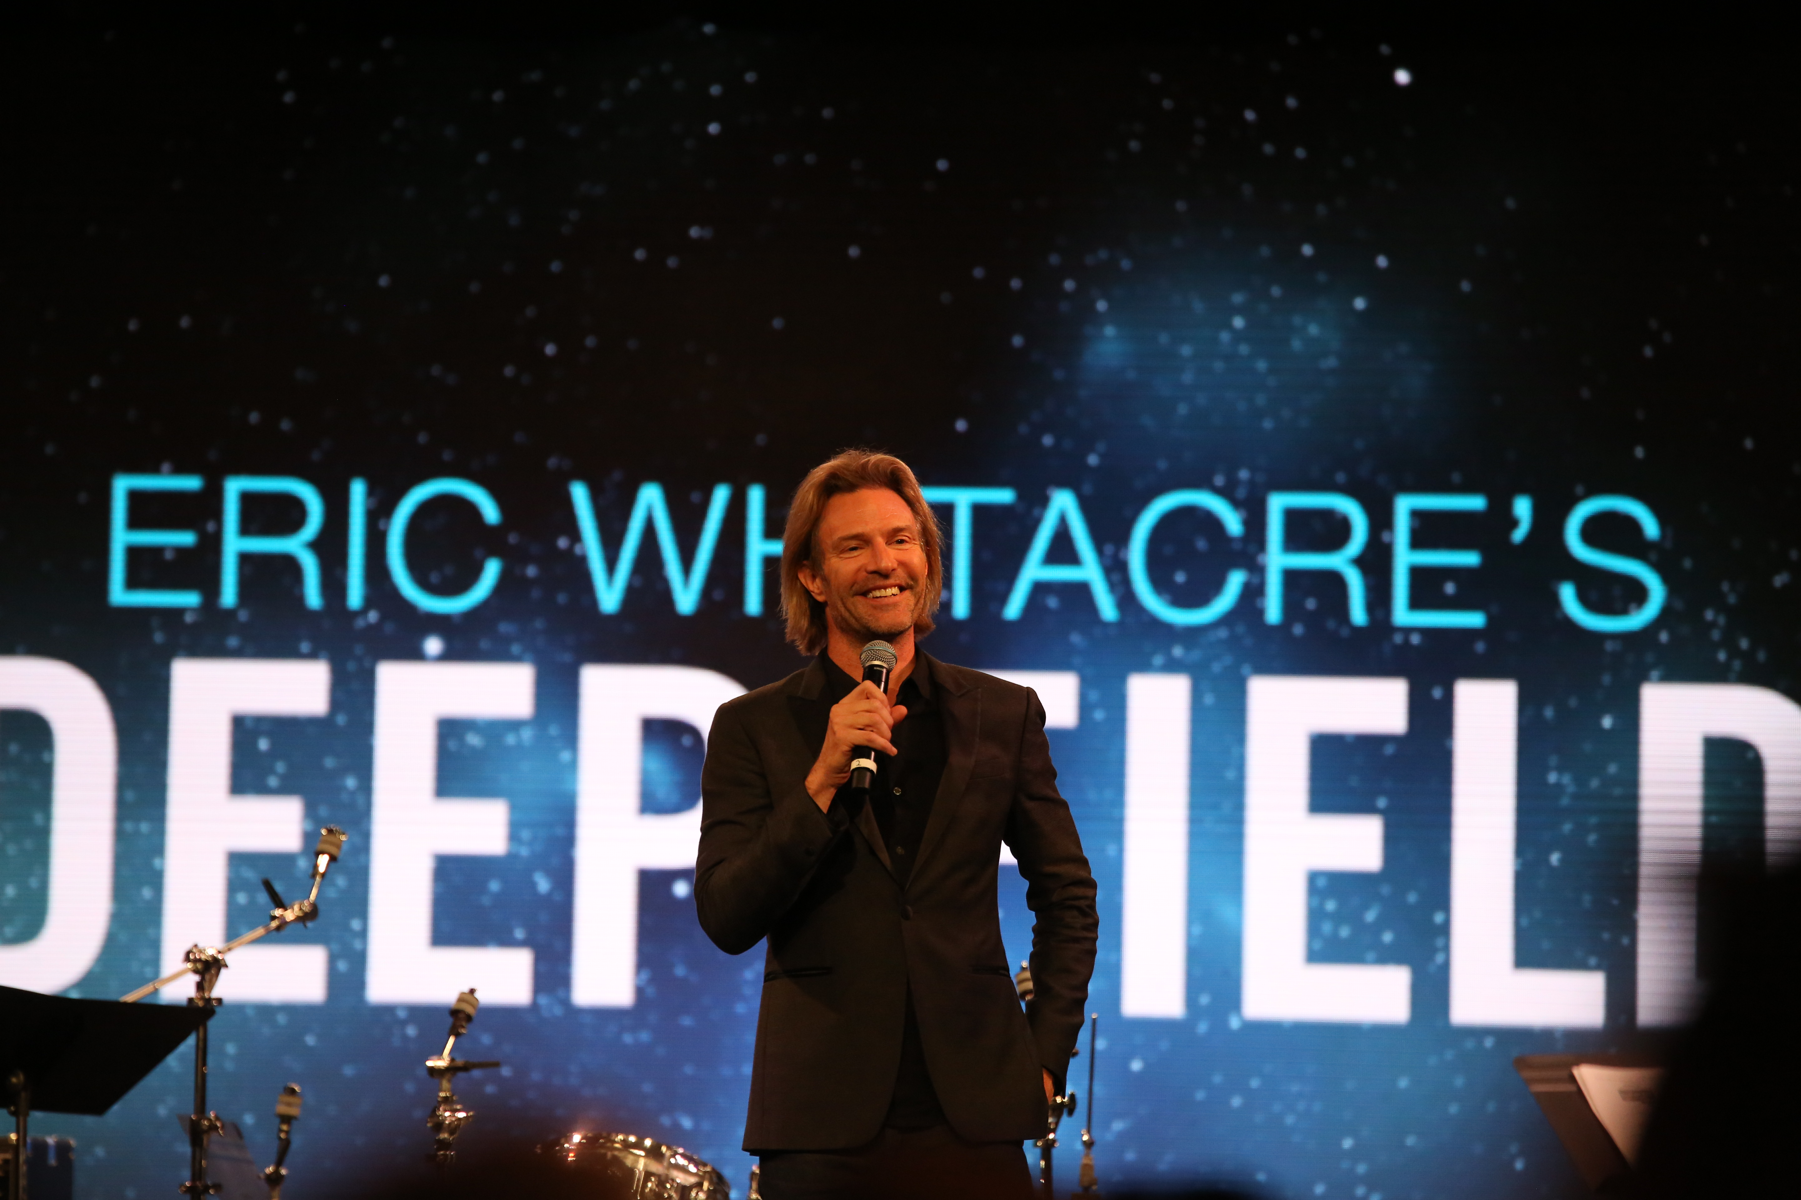

Slide 3

From: Paradise Lost
Exstasis: All I Want to do is Fly

Slide 4


Slide 5
But for Music Education…

Slide 6


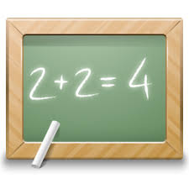
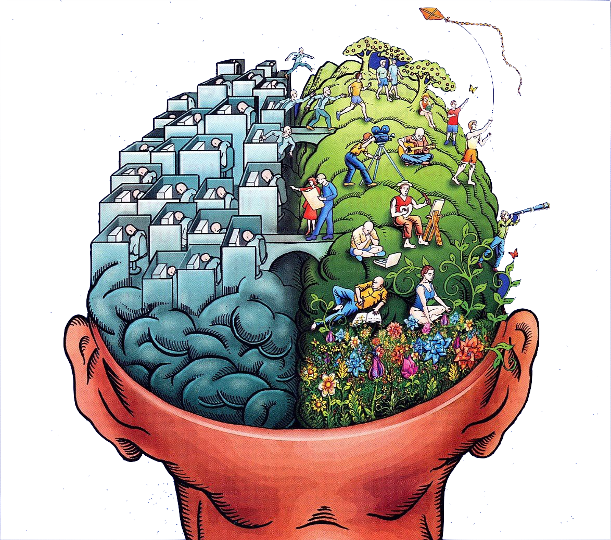
School is. . .
Impressionistic
Expressionistic
Music is. . .

Slide 7

The expressive 5 C’s which are
life-changing:
Creativity
Critical Thinking
Collaboration
Confidence
Communication
Therefore. . .

Slide 8
The Music Skills Practice Room is. . .

Slide 9
The Music Skills Practice Room is. . .
The Life Skills Practice Room

Slide 10
The Life Skills Practice Room
1. Creativity (Innovation). . .
  Ability to create new and more
  worthwhile ideas and to create something that we don’t even know that we need

Slide 11
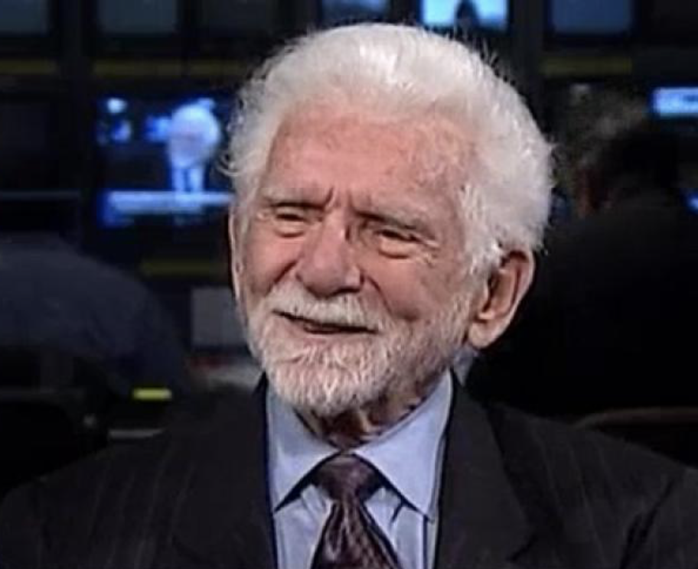
The Life Skills Practice Room
Creative Thinker

Slide 12
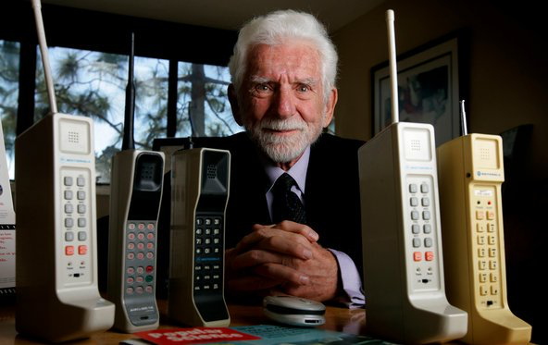
The Life Skills Practice Room
Creative Thinker
Martin Cooper

Slide 13

The Life Skills Practice Room
2. Critical Thinking. . .
  Ability to reason effectively and
  solve problems.

Slide 14
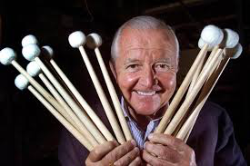
The Life Skills Practice Room
Problem Solver:

Slide 15
The Life Skills Practice Room
Vic Firth was inspired to design a
higher-quality mallet than the
“warped utensils and implements
not specifically designed for
percussionists” while
playing timpani with the
Boston Symphony Orchestra.

Slide 16
The Life Skills Practice Room
3. Collaboration (Teamwork). . .
  Ability to work creatively, effectively and respectfully
  with ALL

Slide 17
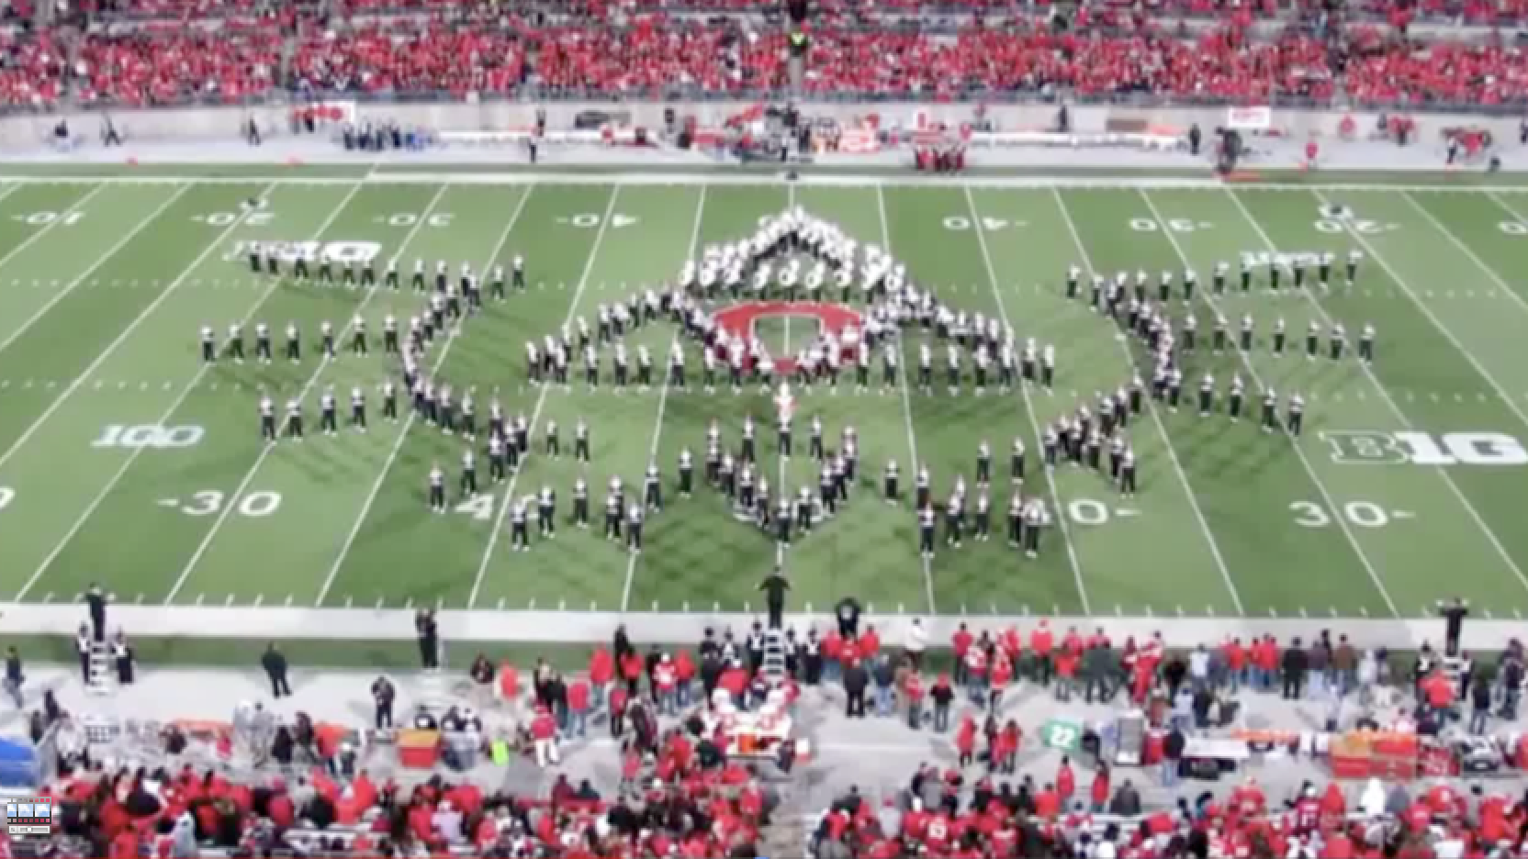
The Life Skills Practice Room
The Ohio State University Marching Band

Slide 18
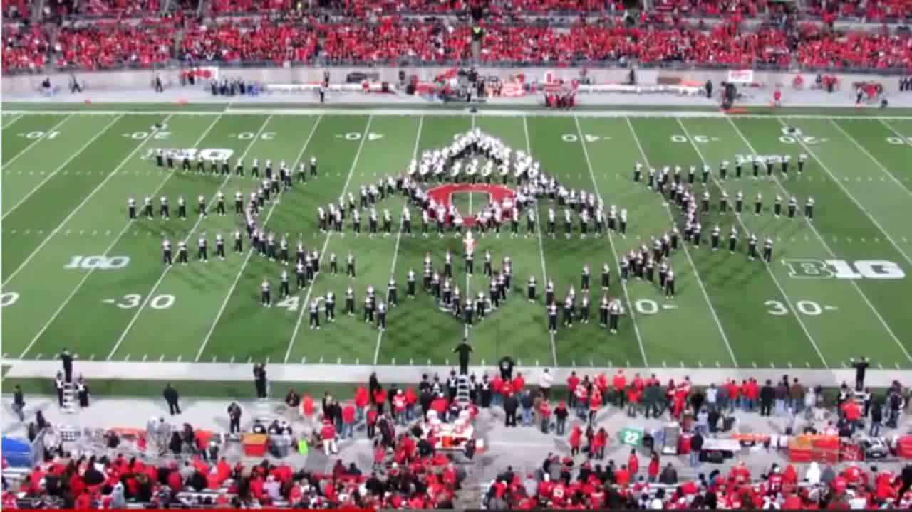
The Life Skills Practice Room
The Ohio State University Marching Band

Slide 19
The Life Skills Practice Room
4. Confidence. . .
  Ability to handle EVERY
  CIRCUMSTANCE and grow from it

Slide 20
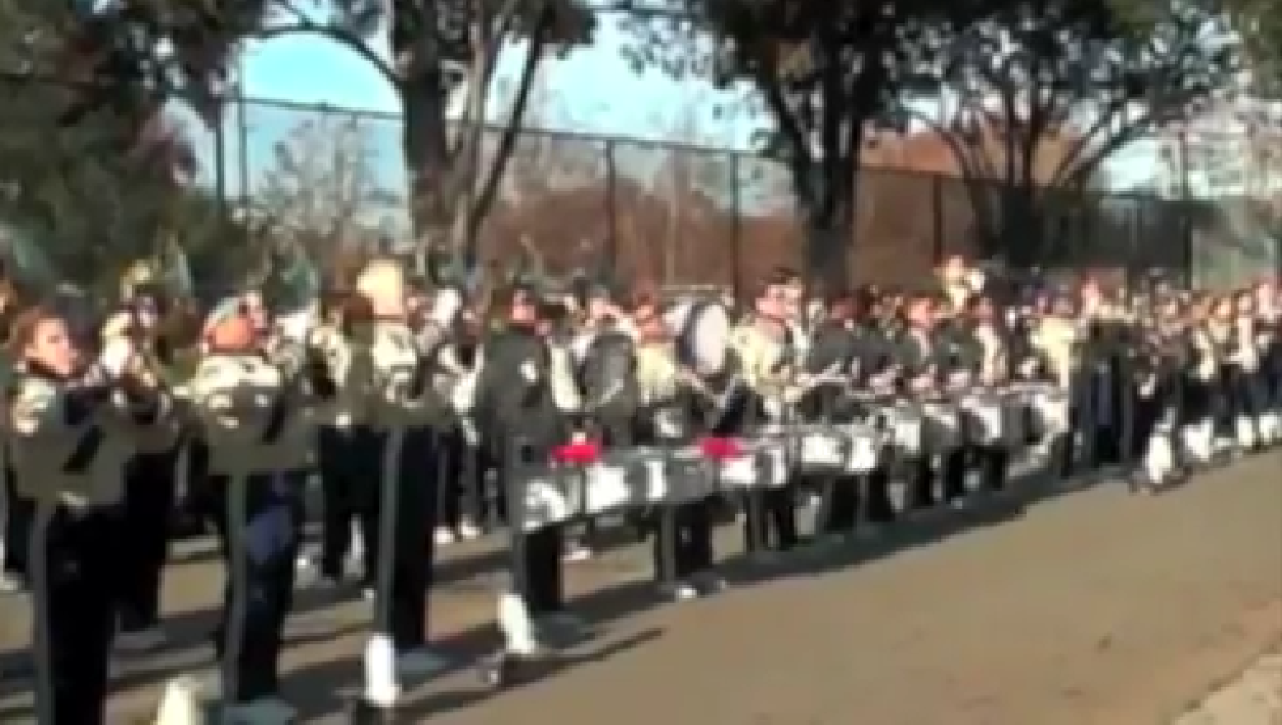
The Life Skills Practice Room

Slide 21

The Life Skills Practice Room

Slide 22
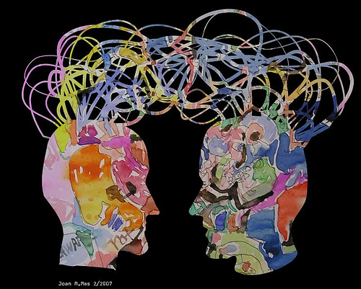
The Life Skills Practice Room
5. Communication. . .
  Ability to listen
  and express thoughts
  effectively

Slide 23
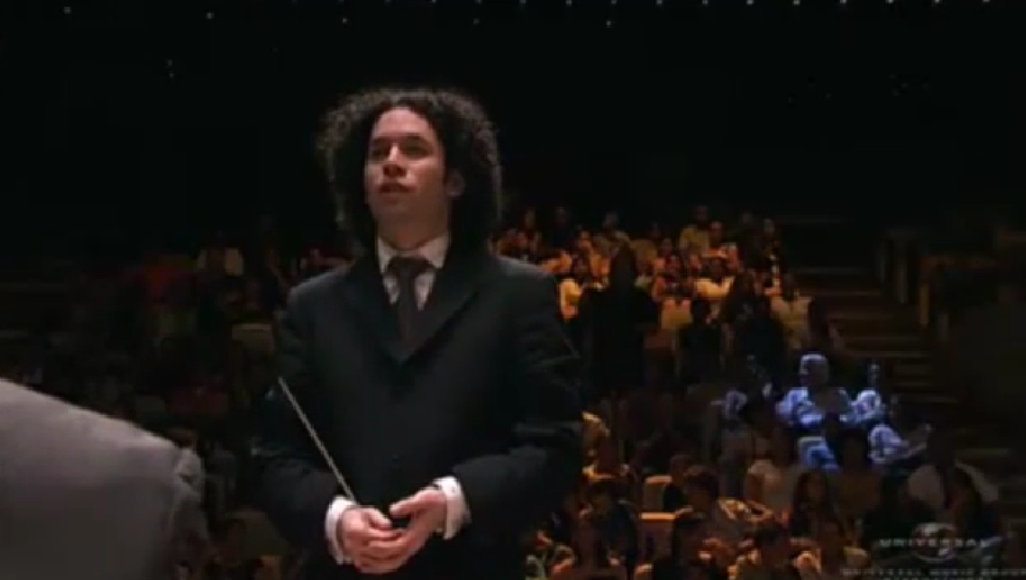
Communication
Maestro Gustavo Dudamel

Slide 24

Communication
Simón Bolivar School Orchestra, Venezuela

Slide 25

One Goal

Slide 26
One Goal
Ensure continued,
active music-making.
#MSFQ

Slide 27

Really?

Slide 28

We offer a path to Success
We provide meaningful, lifelong Memories
We provide opportunities for authentic learning through Action
We teach mutual and self- Respect
We teach students to Trust

Slide 29
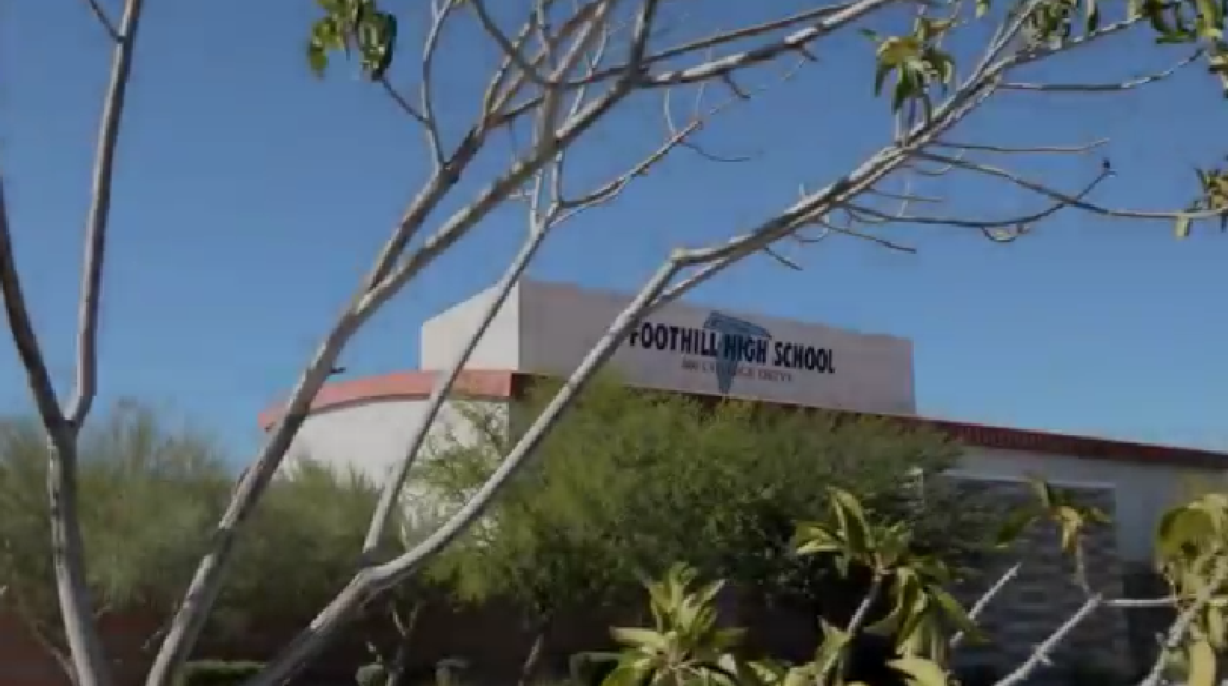
There is a Place…where kids are S.M.A.R.T.

Slide 30

There is a Place…where kids are S.M.A.R.T.

Slide 31

Master Educator Program
Our mission is to provide inspiring professional development opportunities and artistic music collaborations for music educators at the local, state and national levels.

