Slide 1

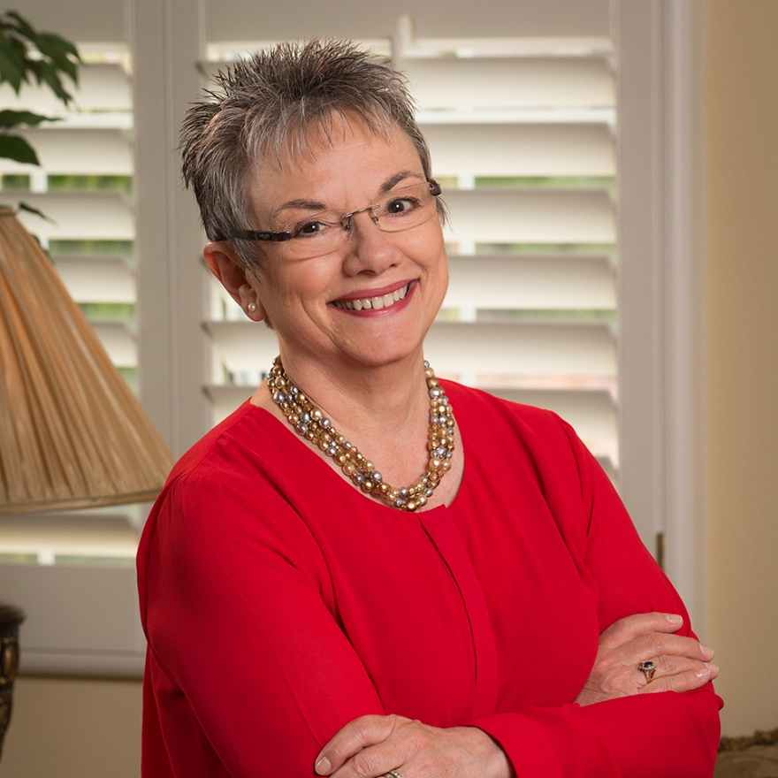



Marcia Neel
Master Educator
Making an Advocate of Your Principal:
10 Things to Do “Monday”
October 3, 2018
www.musiceducationconsultants.net/conference-materials

Slide 2
The Two Querries…
What Do Principals
Really Think?
2. What Have You Done to
Make an Advocate out of
Your Principal?

Slide 3
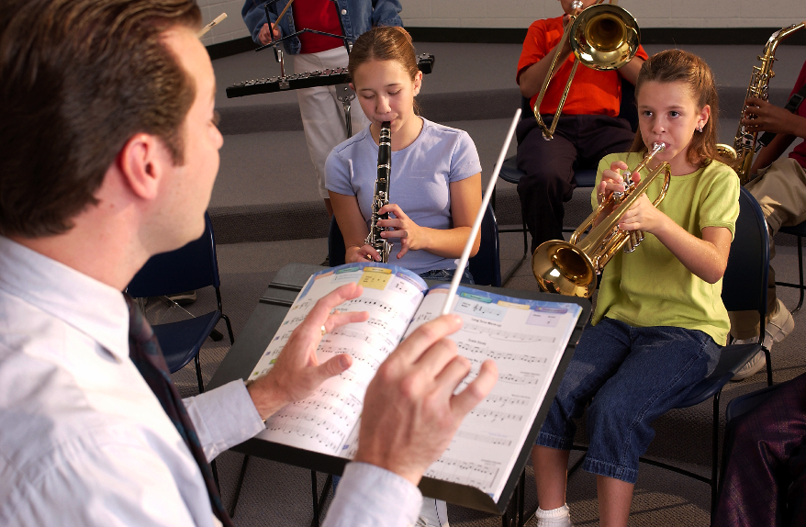
1. What I love best about my music teacher is
that he/she is. . . (here we go!)
Caring
Dedicated
Passionate
Committed
Success-oriented
Organized
Dynamic
Positive
A Team Player/Builder
with Students, Staff and Parents

Slide 4
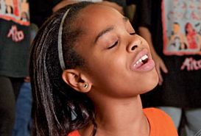
1. What I love best about my music teacher is
that he/she is. . . (cont.)
Communicative
Encouraging
Flexible
Professional
Creative
Talented (Performer)
Intense (In a Good Way)
Effective with Pedagogy

Slide 5
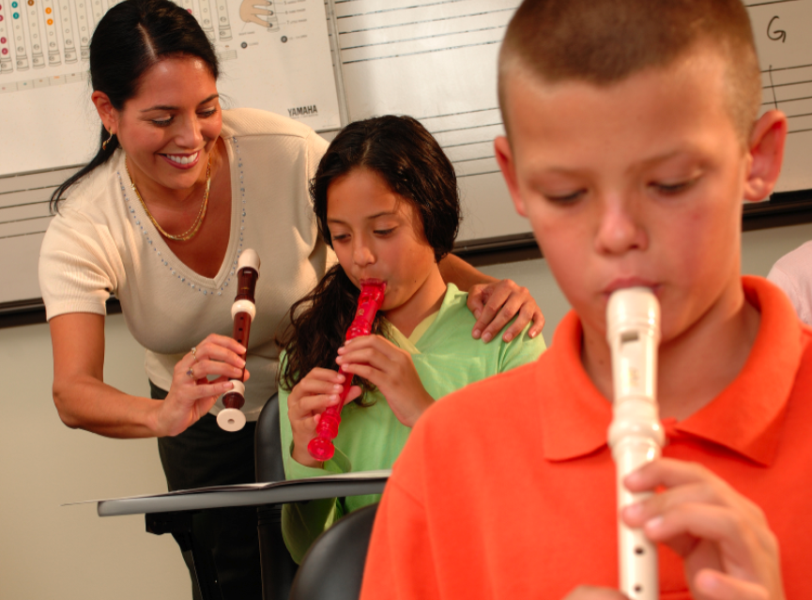
1. What I love best about my music teacher is
that he/she is. . . (cont.)
Responsible
Collegial
Motivational
Inspirational
Helpful
Content-oriented
A Music Advocate (Recruiter)
Demanding (Of Self and Students)

Slide 6
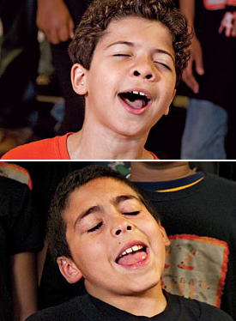
2. To improve the music program, I would ask my music teachers to. . .
Communicate ! Communicate! Communicate!
Coordinate/Collaborate with Colleagues
Articulate with Feeder Schools More
Recruit/Retain More
Focus on Building Group Identity
Promote More
Perform More

Slide 7
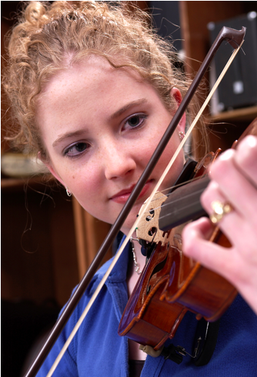
2. To improve the music program, I would ask my music teachers to. . .
Help Administrators to Help Them
(esp: Class Sizes and
Program Building)
Extend Learning Into the Community
Develop More Partnerships
Incorporate School-wide Objectives
Assess Their Own Programs More
Often

Slide 8
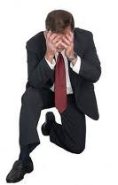
3. What troubles me most is that he/she is not. . .
Passionate
Considerate of the “Big Picture”
Communicative
Demanding Enough
Managing the Classroom Well
Lesson-planning Effectively
Even-tempered
A Team Player
Organized

Slide 9
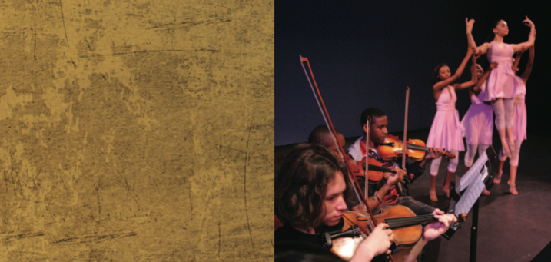


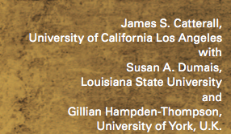
What Have You Done to Make an Advocate Out of Your Principal?
“I communicate and keep my principal informed.”

Slide 10

“I communicate and keep my principal informed.”

Slide 11
I always have small ensembles READY to perform
I invite her (and faculty) to PERFORM in the Holiday Concert
I copy him on all correspondence
I communicate music advocacy information
I took him golfing
. . .He Won!!!!

Slide 12
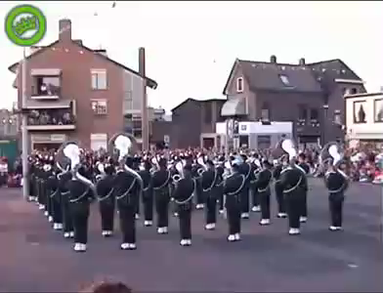
Sometimes Though -- It Seems As If Principals TRY To Trip Us UP!

Slide 13
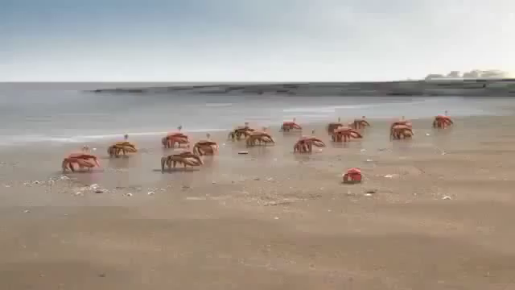
BUT. . .It’s Really a Team Effort!

Slide 14
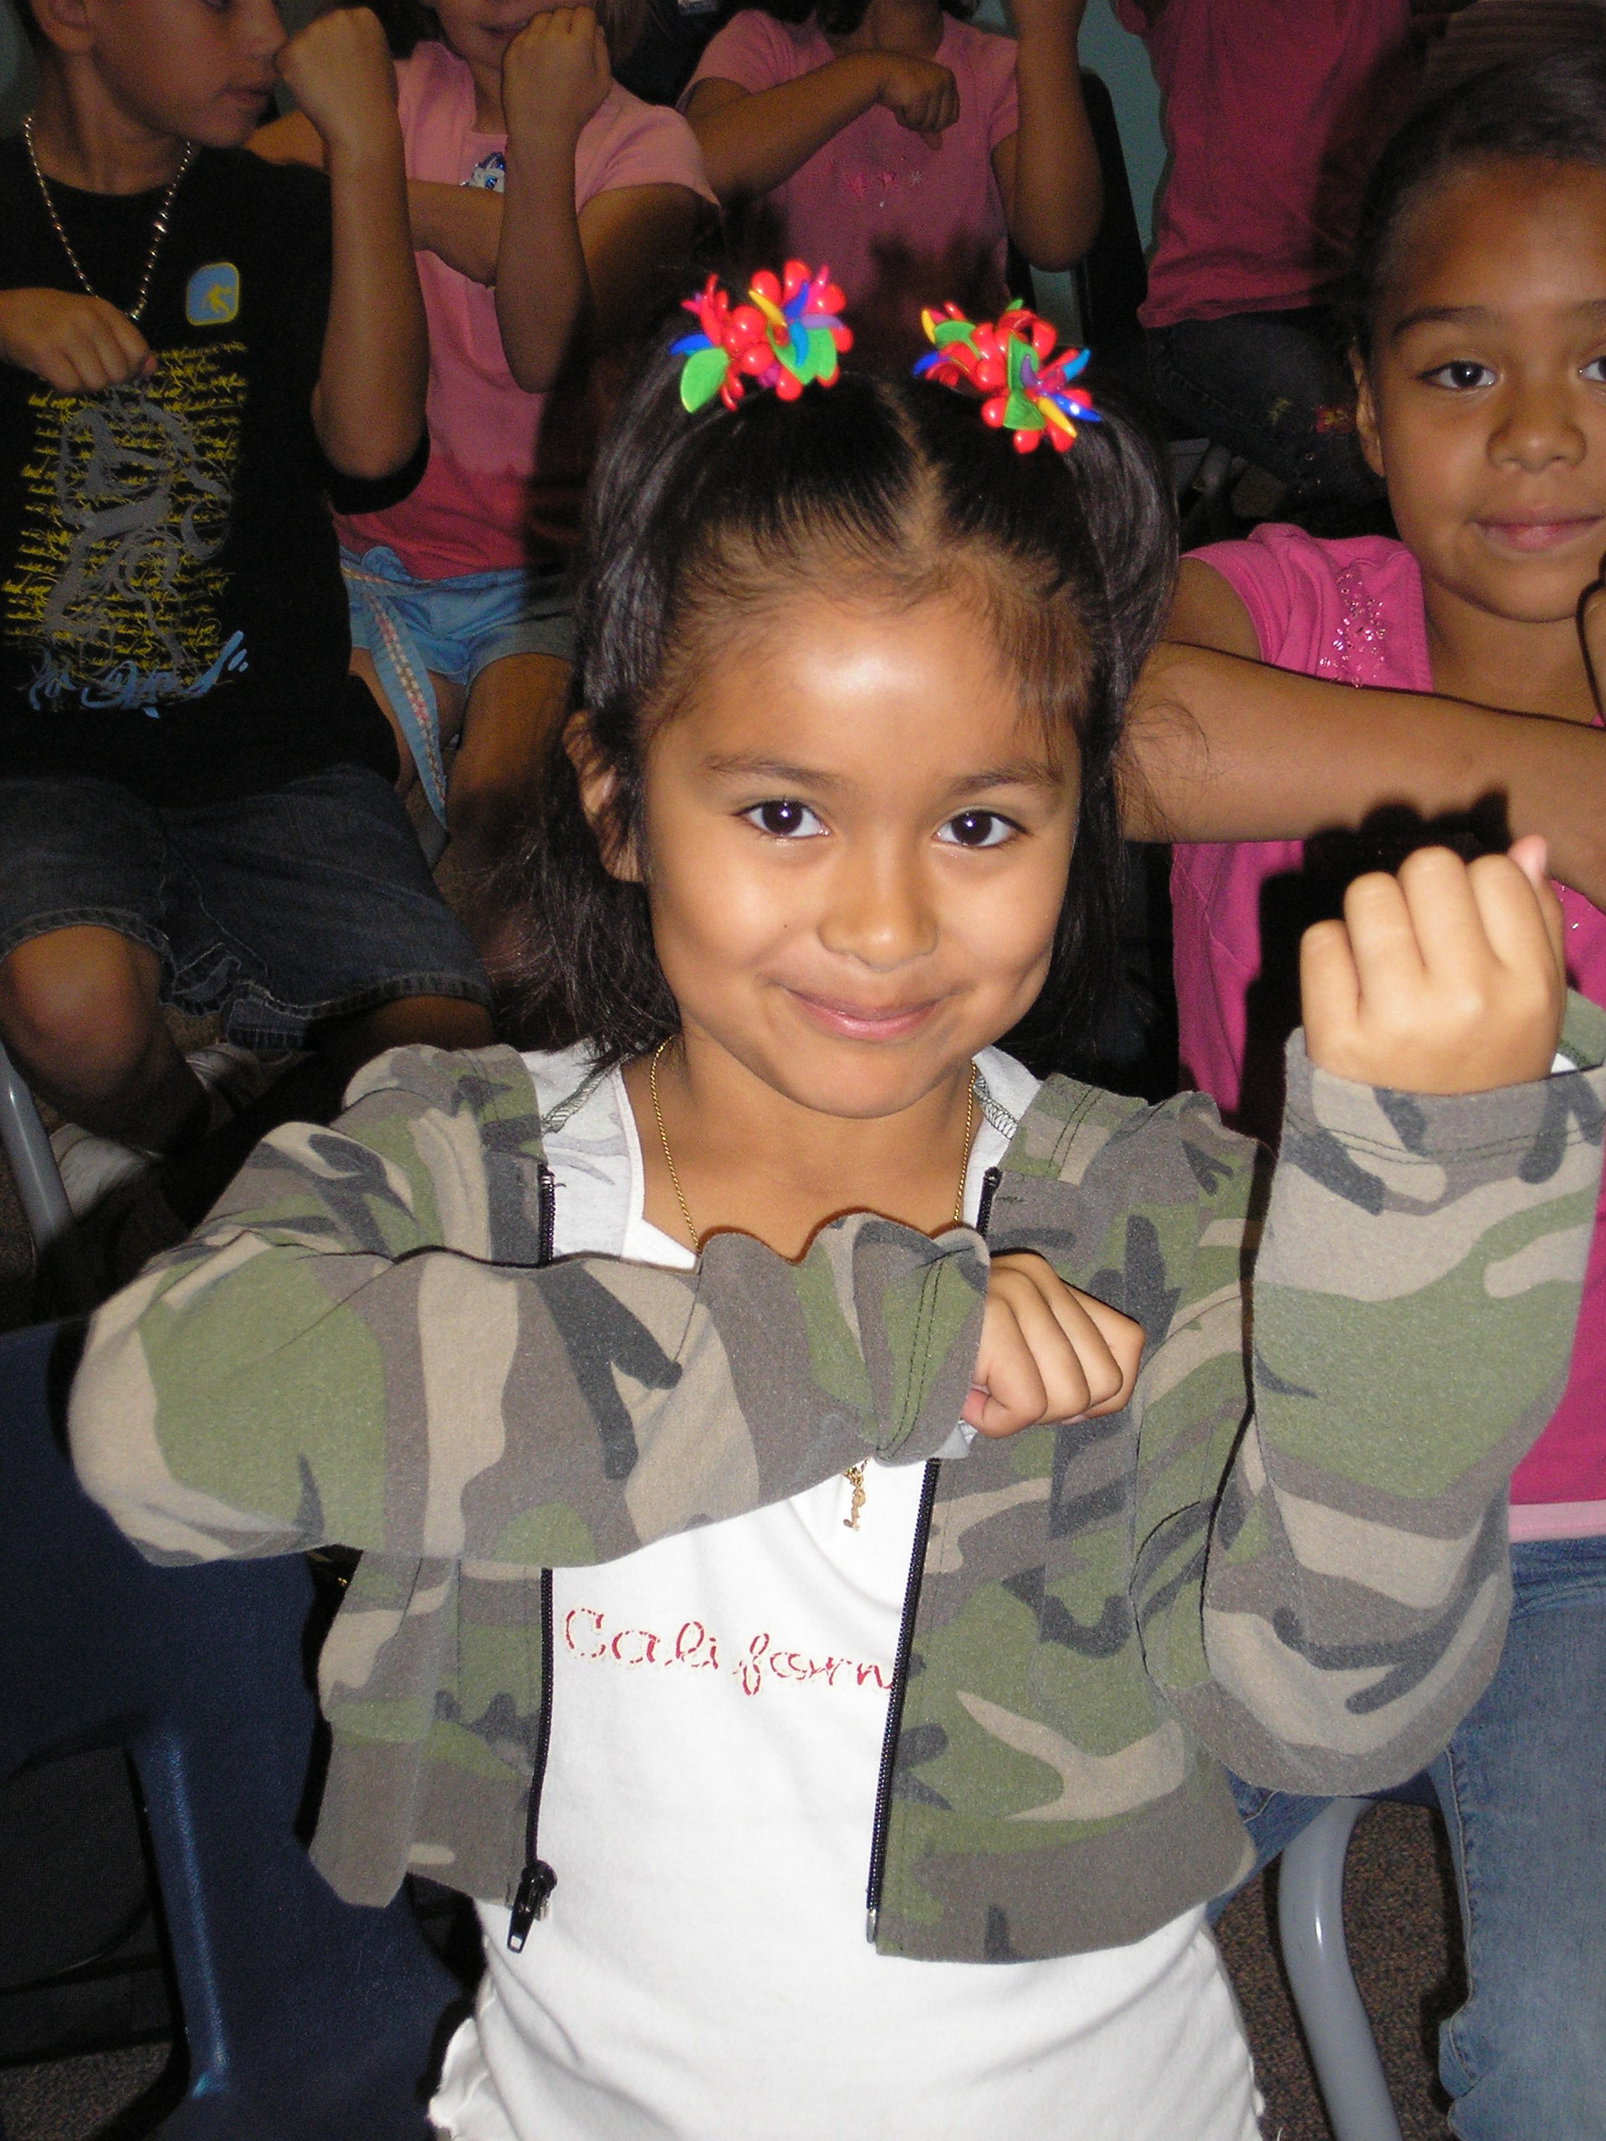
1. Engage Your Principal Directly
Come on down. . .
“Help me give out
instruments to the kids!”

Slide 15
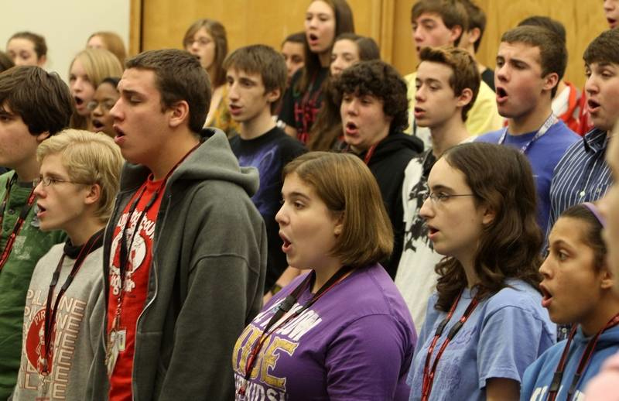
1. Engage Your Principal Directly
Come on down. . .
“I need an audience to help the students prepare for…”

Slide 16
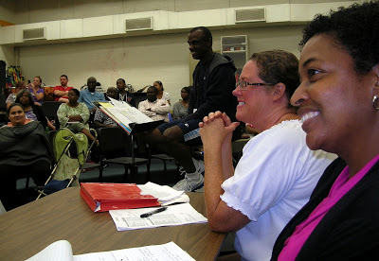
1. Engage Your Principal Directly
Come on down. . .
“Could you give a presentation to the Booster Parents?”

Slide 17
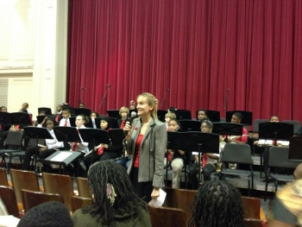
1. Engage Your Principal Directly
Come on down. . .
“Could you provide Opening Remarks at our upcoming concert?”
Praise your administrator in front of the
parents for their support.
Have students present a signed, framed print.

Slide 18
2. Ask your students to complete:
“Music makes the difference because. . .” then use their responses.
“…when you’re sad and then you play music, it cheers you up. Music will always be there for you.”
“…it makes me feel free and like nobody is judging me.”

Slide 19
Music makes the difference because…
“…it helps me express my feelings into something other than words.”
“…it’s a perfect way to tell and show how you feel.”

Slide 20
Music makes the difference because…
“…hearing music helps me work and helps me be the person I want to be.”
“…it gives you a feeling; a feeling that makes you think you can do anything whether it’s doing chores, finishing your homework, or even reaching your goals in life.”

Slide 21
Music makes the difference because…
Use their responses. . .
a. In your upcoming concert programs/newsletters
  b. In your school newspaper’s “music corner” (Don’t have a “music corner?” You know what to do!)
  c. As copy for making banners/posters to display around the school
  d. As copy for recruitment fliers and posters at feeder schools
  e. As copy for CMEA publications
  f. As copy for a publication about your school’s FANTASTIC music program

Slide 22
3. Retrieve information about the value of studying music - quote it in any of the above outlets but especially on recruitment information! Share with your supervisor.
Resources:
bit.ly/MusicEdFacts
supportmusic.com
MusicAchievementCouncil.org

Slide 23

4. Recruit 24/7

Slide 24
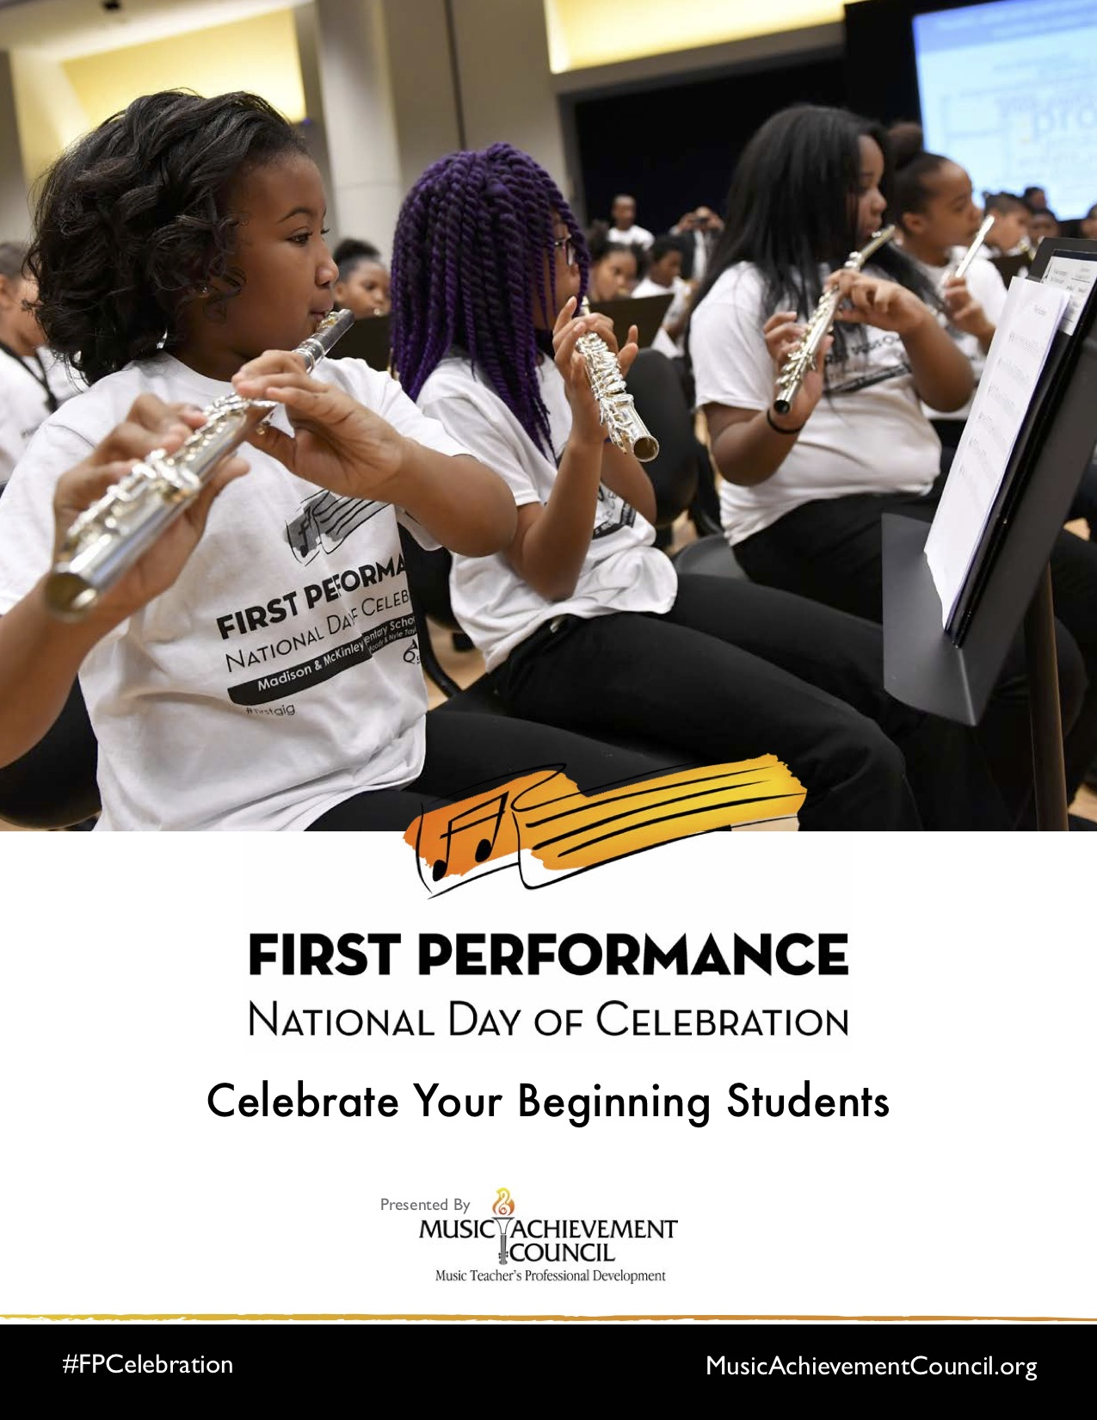
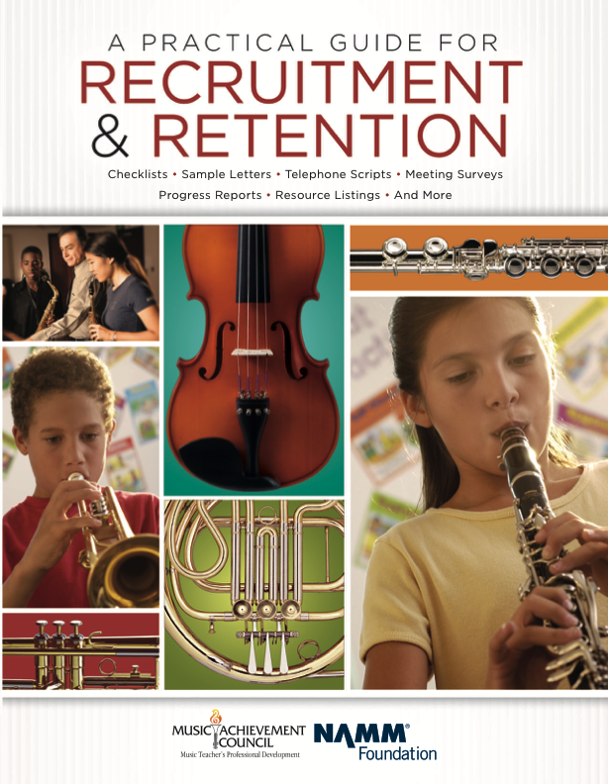
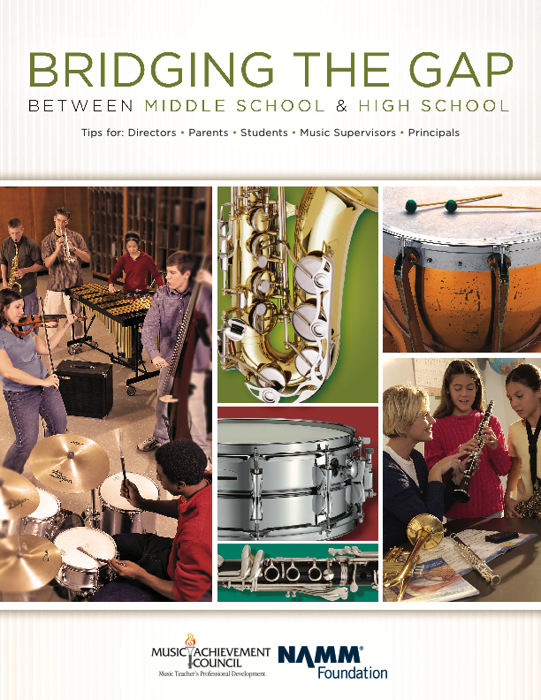
4. Recruit 24/7
Free Materials from the Music Achievement Council

Slide 25
5. In your next concert program, include an insert designating each attendee as a member of the newly-formed Mozart Middle School Coalition for Music Education/Music Boosters Club/Committee to Promote Music Education
  a. To help make the program better for those they love
  b. To help establish the program as a school-wide entity using a positive approach
  d. To feel invested -- i.e. “buy-in”
  continued. . .

Slide 26
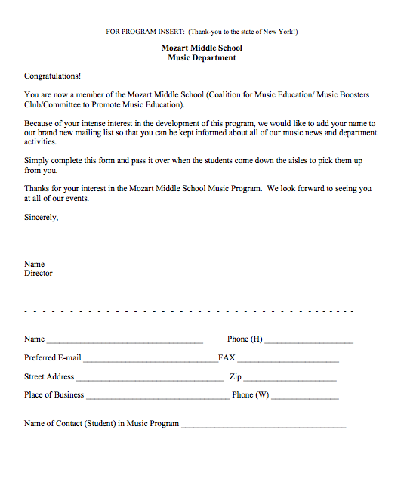
  Parents are the ones who have the most important interest at hand. It is THEIR child’s music education.
    They can become your voice if needed.

Slide 27


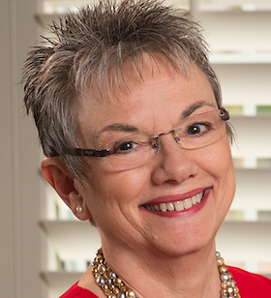


6. Let the Information Come Directly to YOU!!!
Get on Twitter and start following!!!
@NAfME
@MaryLNAMM
@MusicEdConsult
@MusicAchCouncil
@EricWhitacre

Slide 28
7. Arrange for a performance for the principal’s meeting, school board, city council, state legislature, etc.
They will appreciate the “good news” for a change.
BE READY!!!!!!!!
PERFORM WELL!!!!

Slide 29





8. Create a website, Twitter Account, etc. and communicate, communicate, communicate. Share the GOOD NEWS!!!!

Slide 30
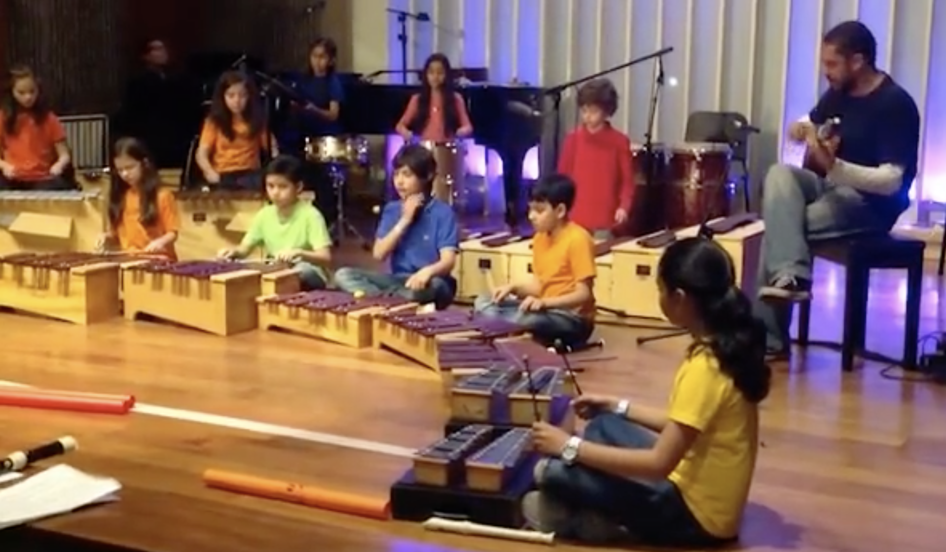
Website Videos Could Include:
Student Performances: with Permission

Slide 31

Website Videos Could Include:
Student Performances: with Permission

Slide 32
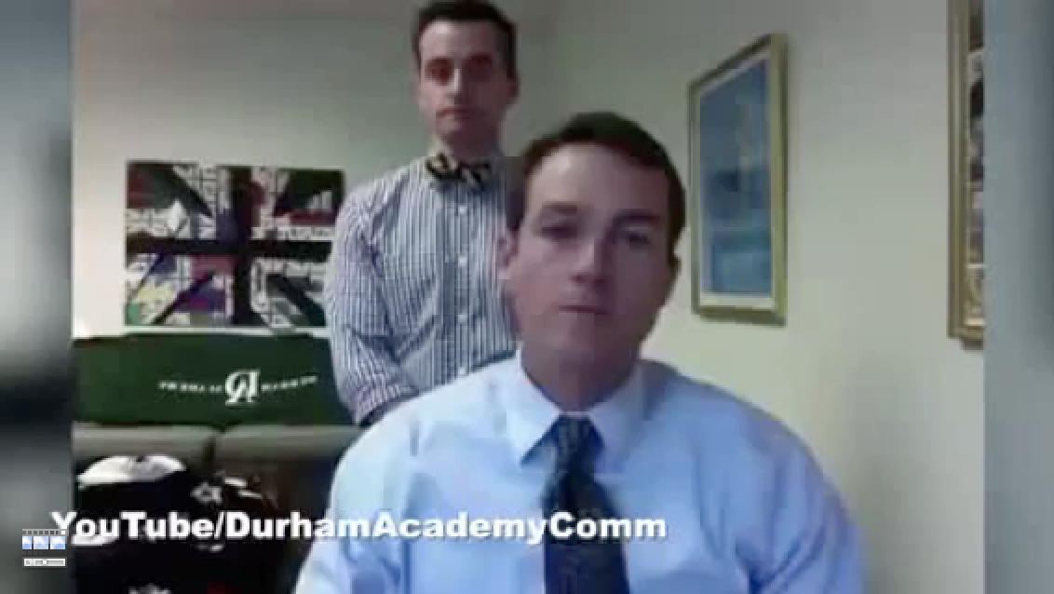
Website Videos Could Include:
School Announcements

Slide 33
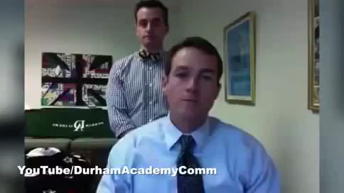
Website Videos Could Include:
School Announcements

Slide 34
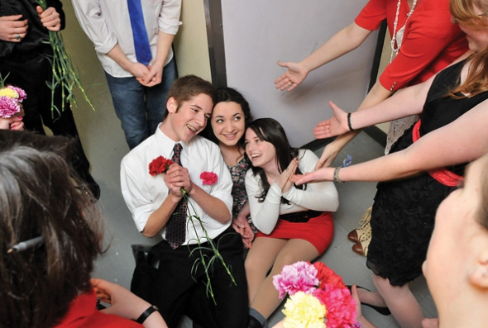
9. Come up with a clever version of a “Happy Birthday” song to serenade your school staff on their special day. THEY WILL LOVE YOU FOR IT! Give away FREEBIES!
Insert Serenade Photo

Slide 35
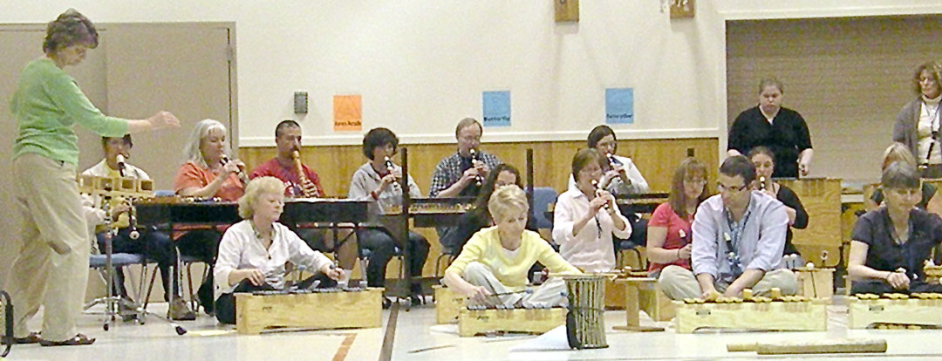
10. Offer to conduct an inservice at your school. Your teachers will LOVE it and your principal will enjoy the collaborative team building that will result.

Slide 36
Remember. . .Your principal needs YOU!
Be an active, involved member of the faculty.
Take part in as many school activities as you can.
Volunteer to help when needed.
Organize faculty functions, school food drives, etc. (at least one each semester)
Ask how you/your program can help build school spirit.

Slide 37
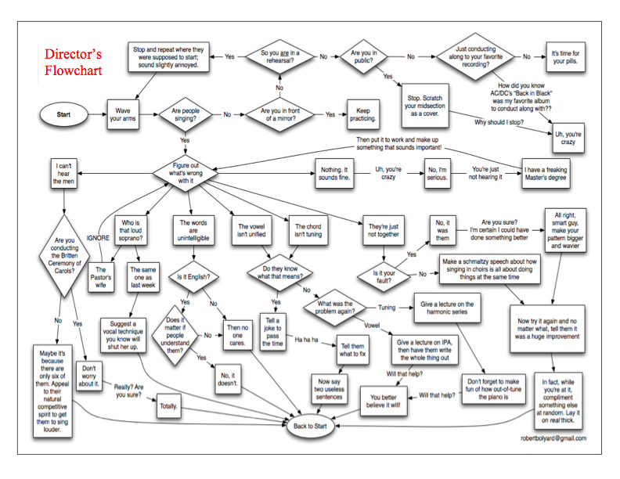
How Can I Do It All?

Slide 38
How Can I Do It All?
Stay Focused
on the “Why!”
We are ALL in this
for the Kids!

Slide 39
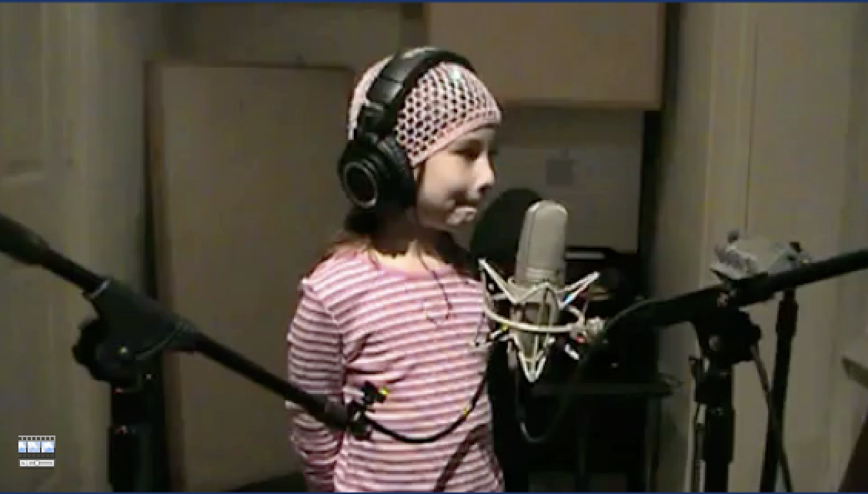
Aren’t each of them worth it?

Slide 40
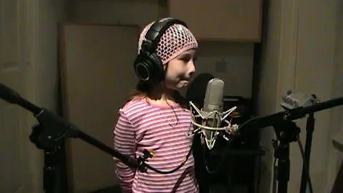
Aren’t each of them worth it?

Slide 41

Session posted online at:
www.musiceducationconsultants.net/conference-materials
Master Educator Program
Our mission is to provide inspiring professional development opportunities and artistic music collaborations for music educators at the local, state and national levels.

Slide 42
Session posted online at:
www.musiceducationconsultants.net/conference-materials
Master Educator Program
Our mission is to provide inspiring professional development opportunities and artistic music collaborations for music educators at the local, state and national levels.

