Slide 1

DID YOU KNOW . . .
The Music Achievement Council (MAC) is an action-oriented, non-profit organization whose sole
purpose is to enable more students to begin and continue in instrumental music programs.
www.musicachievementcouncil.org

Slide 2

DID YOU KNOW . . .
96 percent of public school principals
believe that participating in music
education encourages and motivates
students to stay in school longer.
(Harris Poll)
www.musicachievementcouncil.org

Slide 3
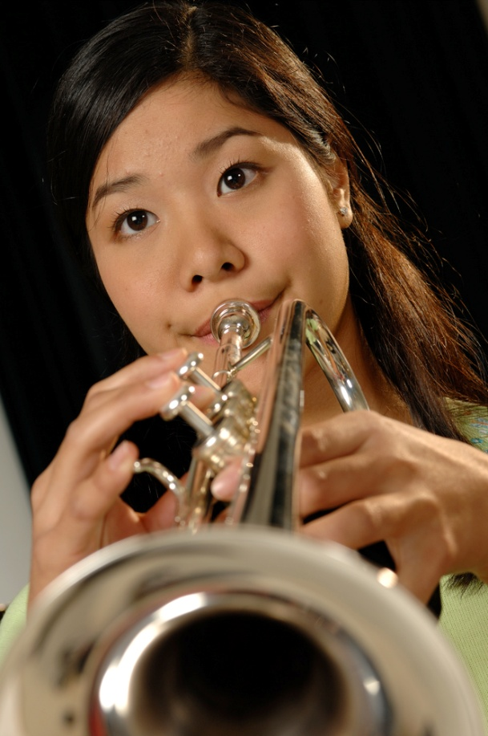
DID YOU KNOW . . .
An interactive poll confirms that music education at an early age greatly increases the likelihood that a child will grow up to seek higher education and ultimately even earn a higher salary. (2007 Harris Poll)
www.musicachievementcouncil.org

Slide 4

THE MESSAGE IS. . .
If you want to be a CEO, College President, or
even a Rock Star,
TAKE MUSIC!
www.musicachievementcouncil.org

Slide 5

THE MESSAGE IS. . .
If you want to be a CEO, College President, or
even a Rock Star,
TAKE MUSIC!
www.musicachievementcouncil.org

Slide 6



THE MESSAGE IS. . .
If you want to be a CEO, College President, or
even a Rock Star,
TAKE MUSIC!
www.musicachievementcouncil.org

Slide 7
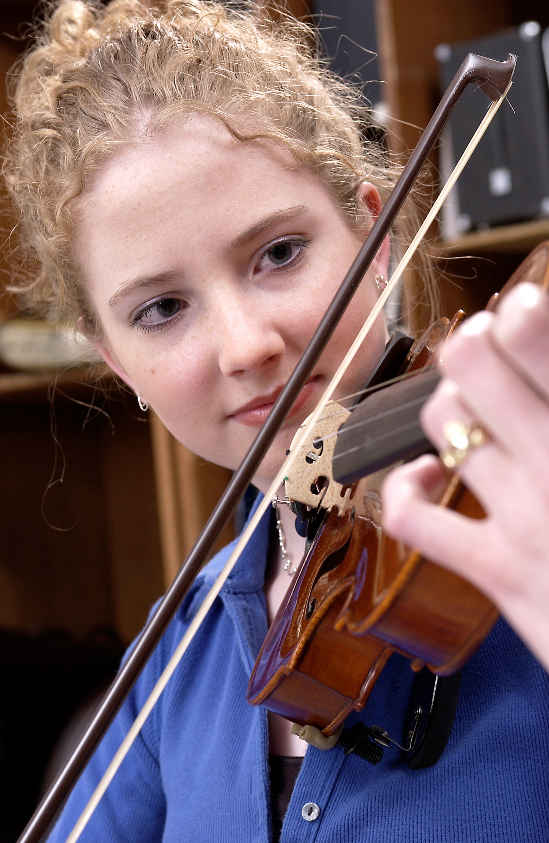
DID YOU KNOW . . .
82 percent of Americans who don’t currently play an instrument wish they had learned to play one. (Gallup Poll)
www.musicachievementcouncil.org

Slide 8
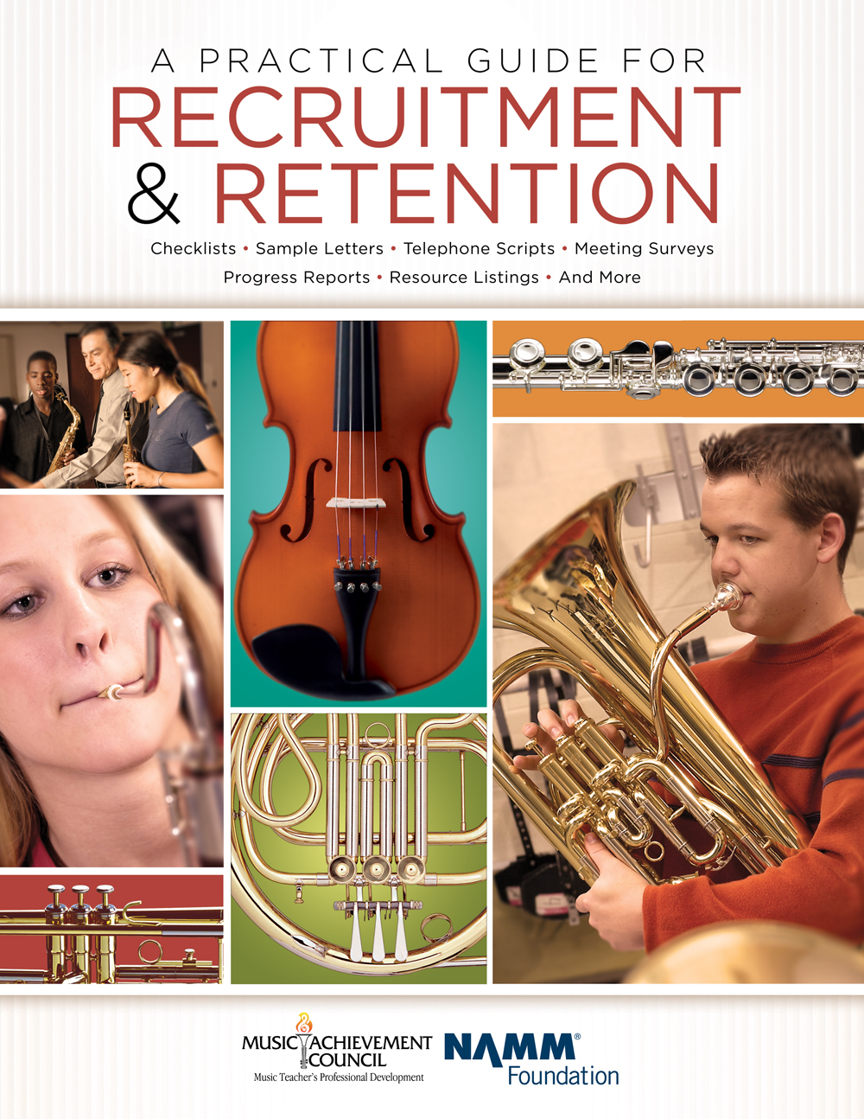
DID YOU KNOW . . .
All of today’s session attendees will receive FREE COPIES of:
A Practical Guide for Recruitment and Retention
www.musicachievementcouncil.org

Slide 9
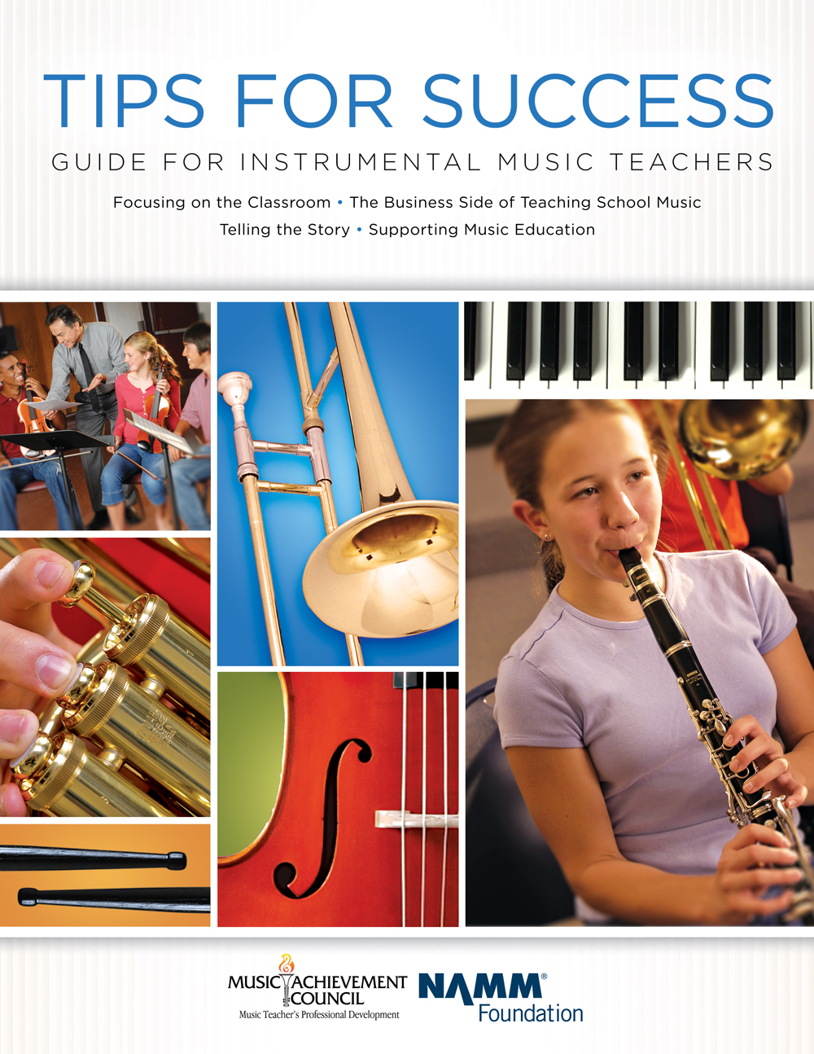
DID YOU KNOW . . .
All of today’s session attendees will receive FREE COPIES of:
Tips for Success:
A Guide for Instrumental Music Teachers
www.musicachievementcouncil.org

Slide 10
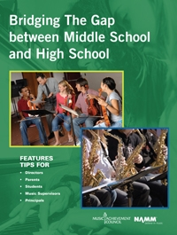
DID YOU KNOW . . .
All of today’s session attendees will receive FREE COPIES of:
Bridging the Gap between
Middle School and High School
www.musicachievementcouncil.org

Slide 11
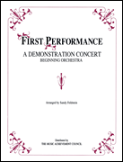
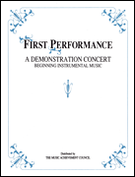
DID YOU KNOW . . .
First Performance Demo Concert for Band and/or Orchestra features sheet music, parts, sample letters, programs and student certificates for beginning ensembles. Students can perform a composition in seven short weeks with the materials provided!
www.musicachievementcouncil.org

Slide 12
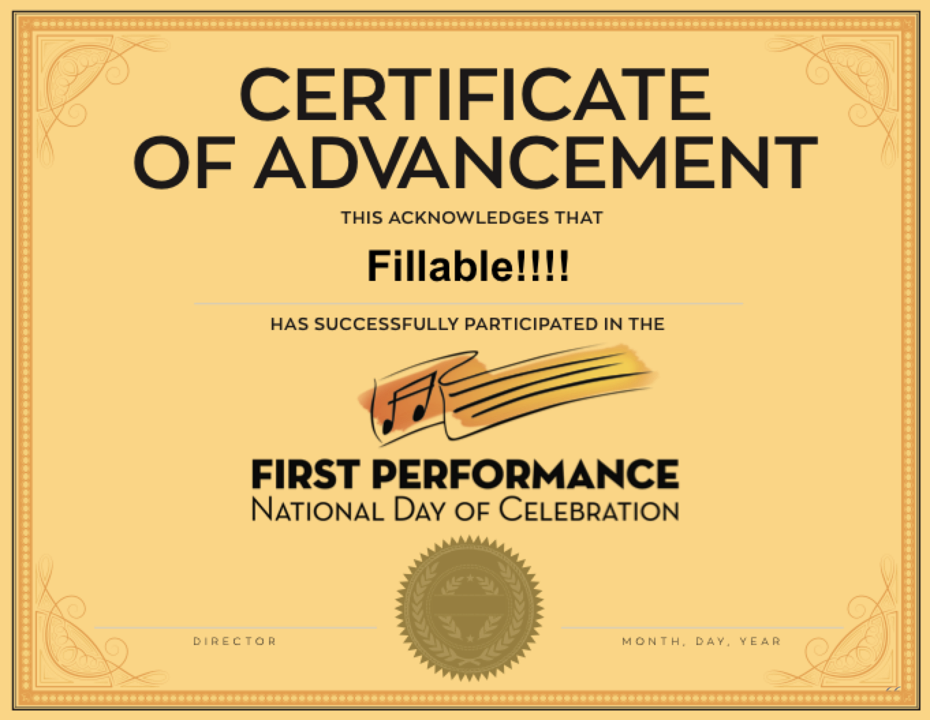
DID YOU KNOW . . .
The First Performance National Day of Celebration is held on the 3rd Thursday of November annually to recognize the achievements of your Beginning instrumental students?
www.musicachievementcouncil.org

Slide 13
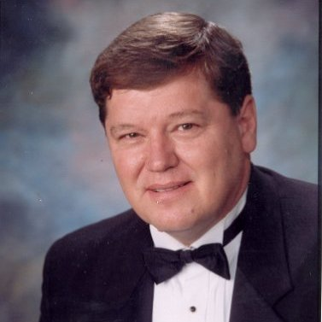
DID YOU KNOW . . .
Three of these publications are provided online at no charge by the Music Achievement Council.
They are based on real world strategies shared by the profession’s most successful music educators.
Greg Bimm

Slide 14
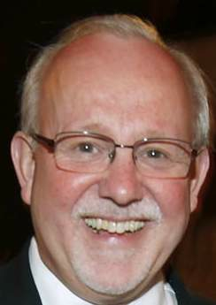
DID YOU KNOW . . .
Three of these publications are provided online at no charge by the Music Achievement Council.
They are based on real world strategies shared by the profession’s most successful music educators.
Charlie Menghini

Slide 15
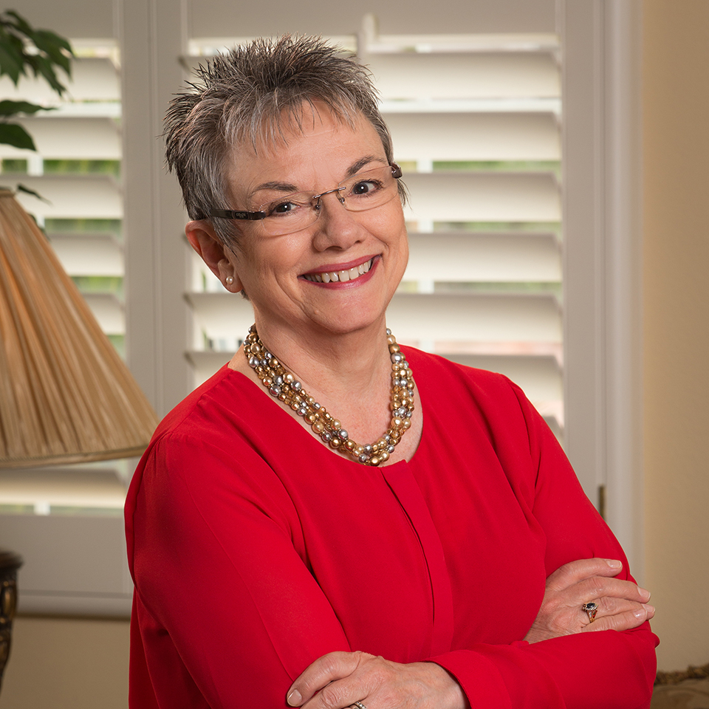
DID YOU KNOW . . .
Three of these publications are provided online at no charge by the Music Achievement Council.
They are based on real world strategies shared by the profession’s most successful music educators.
Marcia Neel

Slide 16
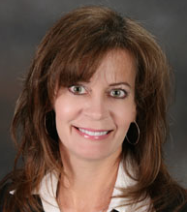
DID YOU KNOW . . .
Three of these publications are provided online at no charge by the Music Achievement Council.
They are based on real world strategies shared by the profession’s most successful music educators.
Terry Shade

Slide 17
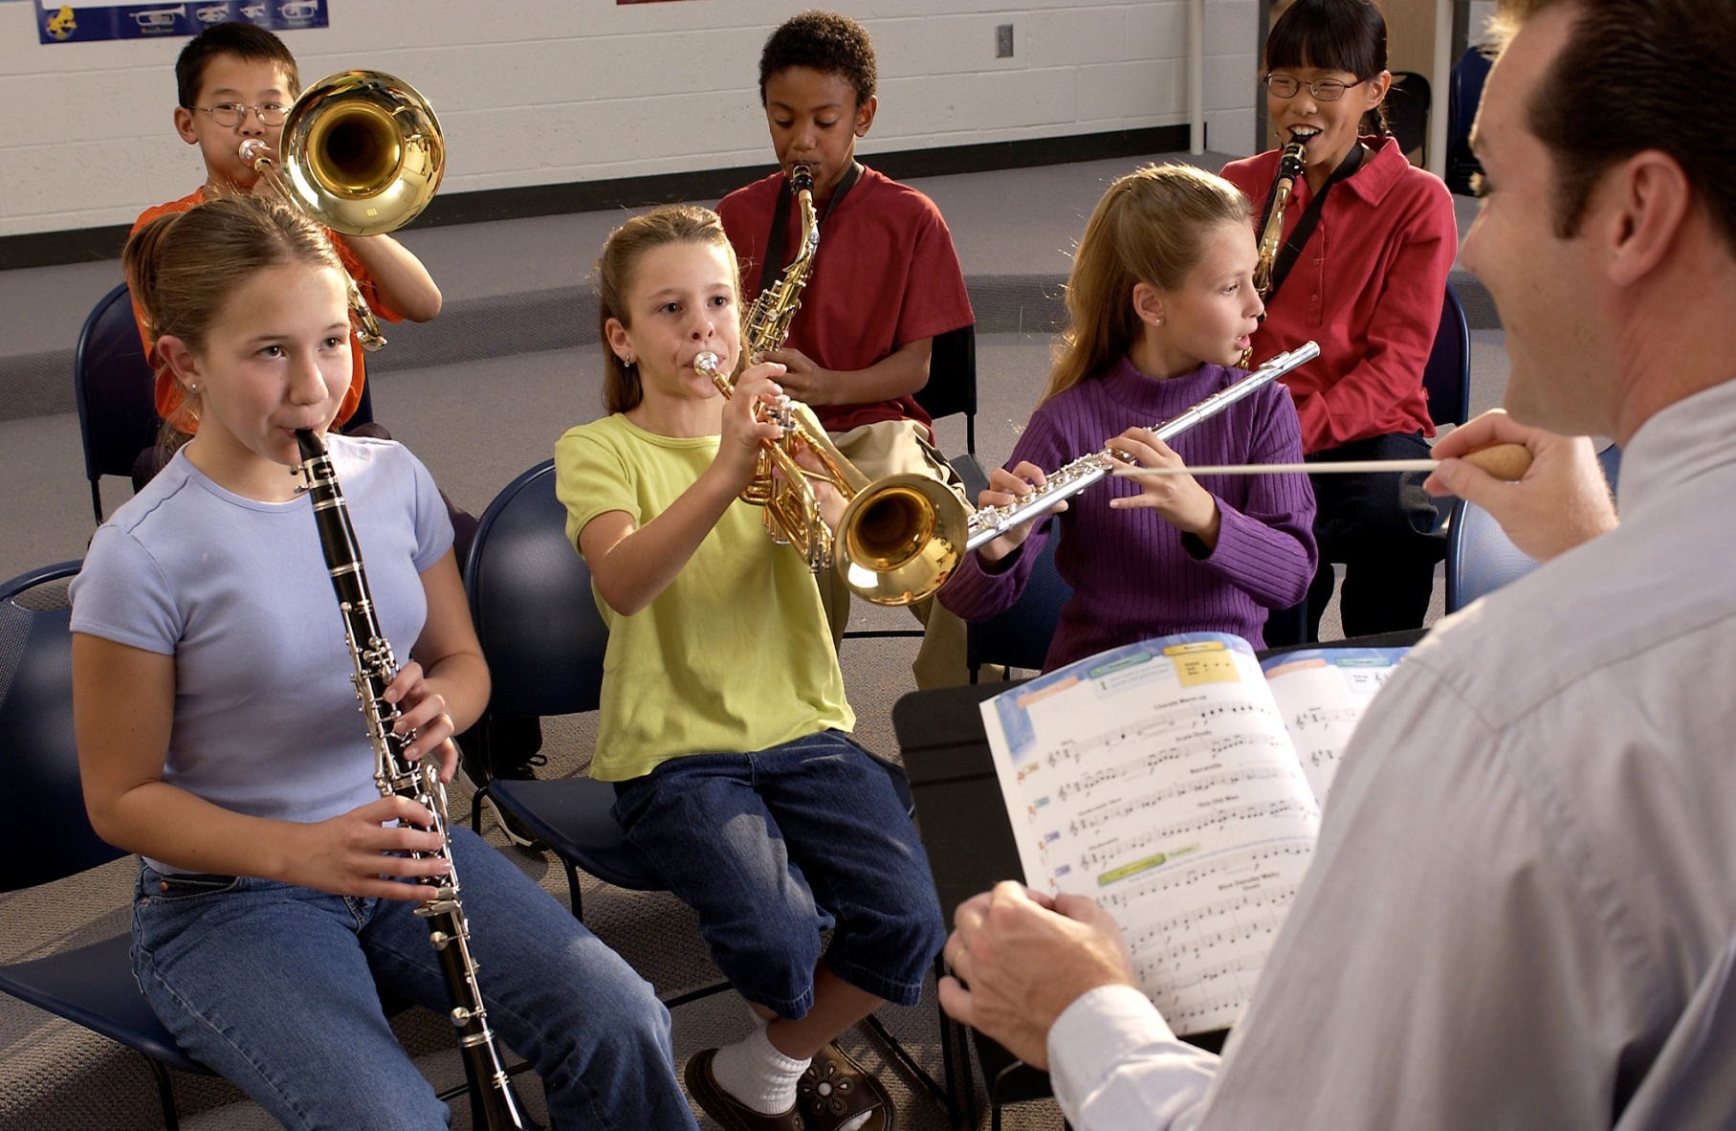

DID YOU KNOW . . .
www.musicachievementcouncil.org

Slide 18
DID YOU KNOW . . .
Music making has been scientifically proven to:
Exercise the brain
Inspire creativity
Increase productivity
Fight memory loss
Reduce stress
Lower blood pressure
Build confidence
Stave off depression

Slide 19

DID YOU KNOW . . .
Metropolitan Nashville Public Schools found that ATTENDANCE RATES ROSE with increased study in music.
No Music:
< 1 Year of Music:
> 1 Year of Music:
87% Attendance
91% Attendance
93% Attendance

Slide 20
DID YOU KNOW . . .
Metropolitan Nashville Public Schools found that DISCIPLINE REPORTS FELL with increased study in music.
No Music:
< 1 Year of Music:
> 1 Year of Music:
4.34 over 4 years
3.75 over 4 years
3.23 over 4 years

Slide 21
DID YOU KNOW . . .
Metropolitan Nashville Public Schools found that GPAs ROSE with increased study in music.
No Music:
< 1 Year of Music:
> 1 Year of Music:
2.51 Average
2.61 Average
2.89 Average

Slide 22
DID YOU KNOW . . .
Metropolitan Nashville Public Schools found that GRADUATION RATES ROSE with increased study in music.
No Music:
< 1 Year of Music:
> 1 Year of Music:
60% Average
81% Average
91% Average

Slide 23
DID YOU KNOW . . .
Metropolitan Nashville Public Schools found that ACT SCORES ROSE with increased study in music.
No Music:
< 1 Year of Music:
> 1 Year of Music:
16.95 Eng, 17.20 Math
17.64 Eng, 17.62 Math
19.58 Eng, 18.67 Math

Slide 24
WHAT WAS LEARNED?
The MORE a student participates in MUSIC,
the more POSITIVE these BENEFITS become.

Slide 25
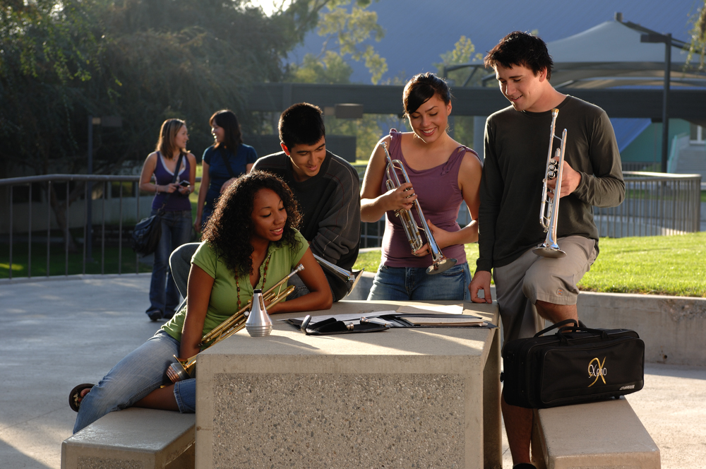
FAMOUS QUOTES. . .
Music has the power of producing a
certain effect on the moral character of
of the soul.
. . . Aristotle

Slide 26
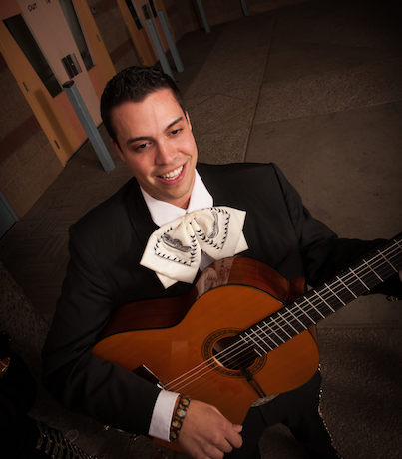
FAMOUS QUOTES. . .
Music furnishes a delightful recreation
for the hours of respite from the cares of the day, and lasts us through life.
. . . Thomas Jefferson

Slide 27






Bridging the Gap Between
Middle School High School
Marcia Neel
PPT, Session, and Videos will be Posted Online at:
www.MusicEdConsultants.net/conference-materials
www.MusicAchievementCouncil.org

Slide 28

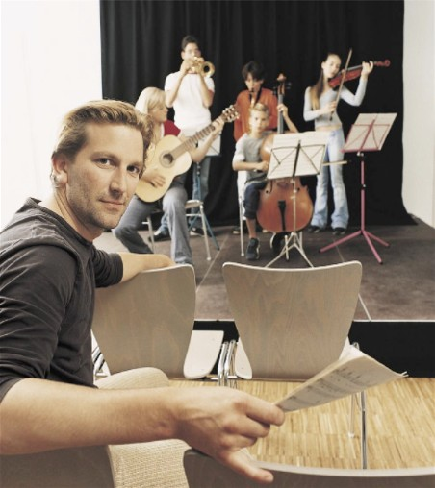
Today’s Session: Bridging the Gap Between Middle and High School
WE WANT (TO KEEP) YOU!
The WHAT
The WHY
The HOW

Slide 29

WHAT Other Teachers Think I Do!

Slide 30
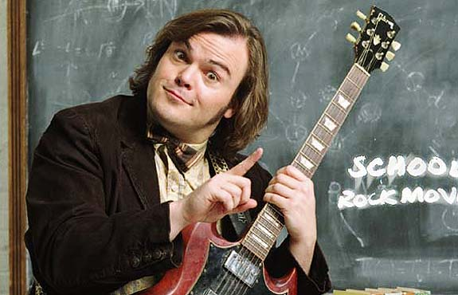
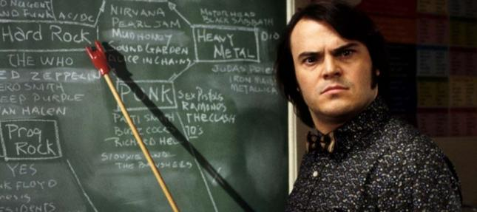
WHAT the Kids Think I Do!

Slide 31

WHAT Society Thinks I Do!

Slide 32
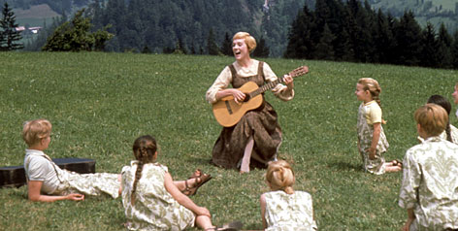
WHAT My Mom Thinks I Do!

Slide 33
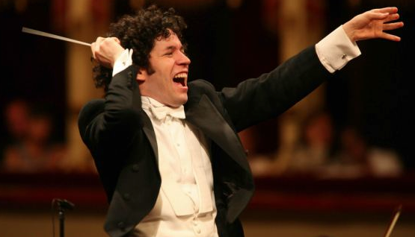
WHAT I Think I Do!

Slide 34



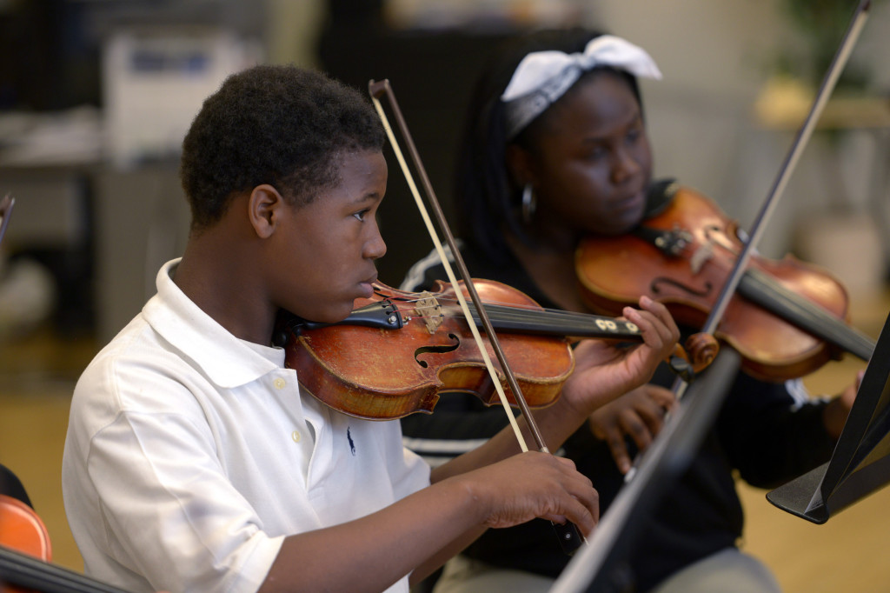
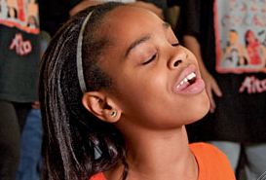
WHAT I Really Get to Do!
Facilitate Success and Fulfillment
www.musicachievementcouncil.org

Slide 35
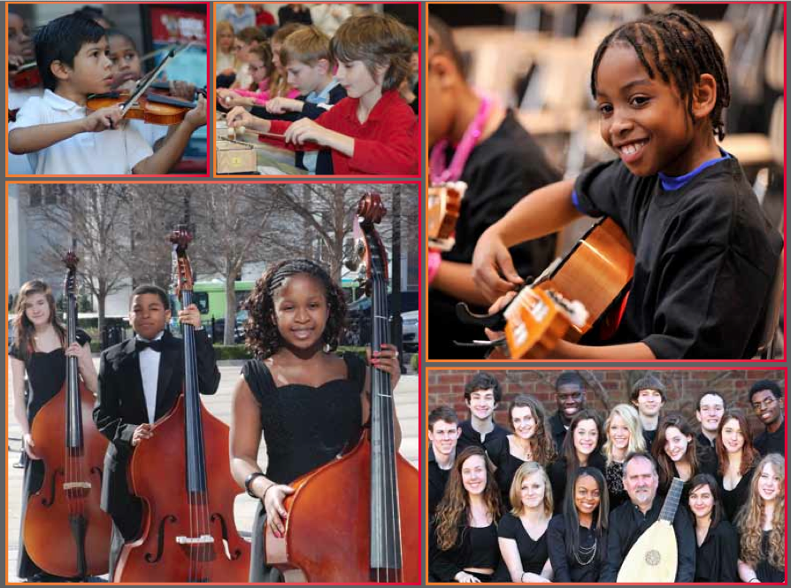

The WHY of Staying in Music
Music Makes Us
Baseline Research Report
http://musicmakesus.org/resources/research

Slide 36
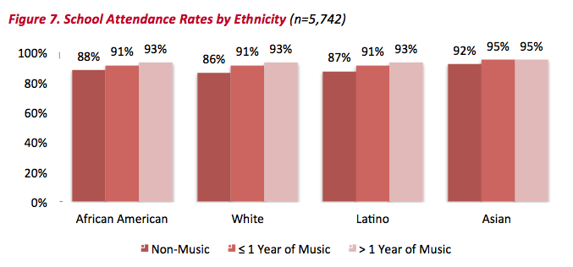
The WHY of Staying in Music
ATTENDANCE RATES
http://musicmakesus.org/resources/research

Slide 37
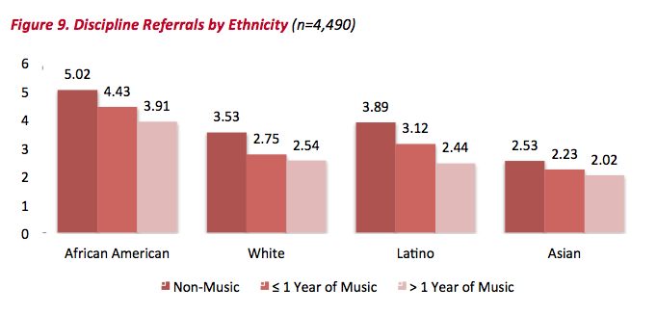
The WHY of Staying in Music
DISCIPLINE REFERRALS
http://musicmakesus.org/resources/research

Slide 38
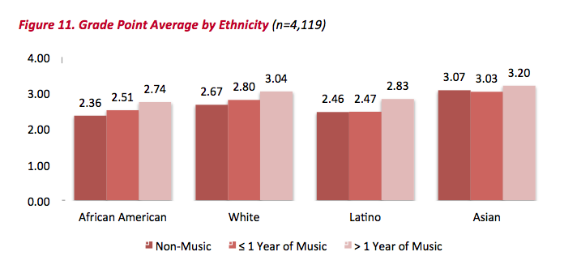
The WHY of Staying in Music
GPAS
http://musicmakesus.org/resources/research

Slide 39
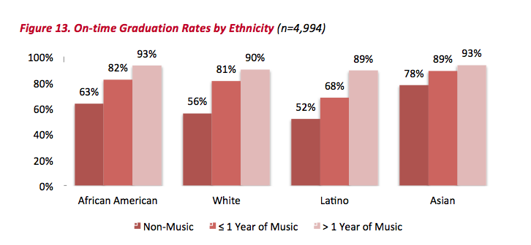
The WHY of Staying in Music
ON-TIME GRADUATION RATES
http://musicmakesus.org/resources/research

Slide 40
The WHY of Staying in Music
SUMMARY: What Was Learned?
“The more a student participates
in music, the more positive
these benefits become.”
http://musicmakesus.org/resources/research

Slide 41
The HOW of Staying in Music
STRATEGIES TO BRIDGE THE GAP
What Music Educators Can Do
What HS/MS Parents Can Do
What HS/MS Students Can Do
What HS/MS Principals Can Do
What Music Supervisors Can Do

Slide 42
The HOW of Staying in Music
STRATEGIES TO BRIDGE THE GAP
What Music Educators Can Do
Work as a district-wide
Music Education TEAM with one goal:
To ensure continued,
active music-making.

Slide 43
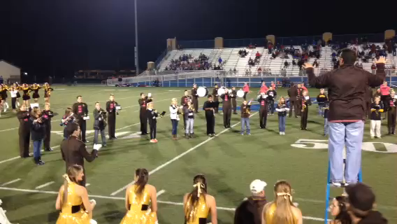
The HOW of Staying in Music
Build the vision EARLY!
www.musicachievementcouncil.org
Notes:
43

Slide 44
The HOW of Staying in Music
Build the vision EARLY!
www.musicachievementcouncil.org
Notes:
44

Slide 45
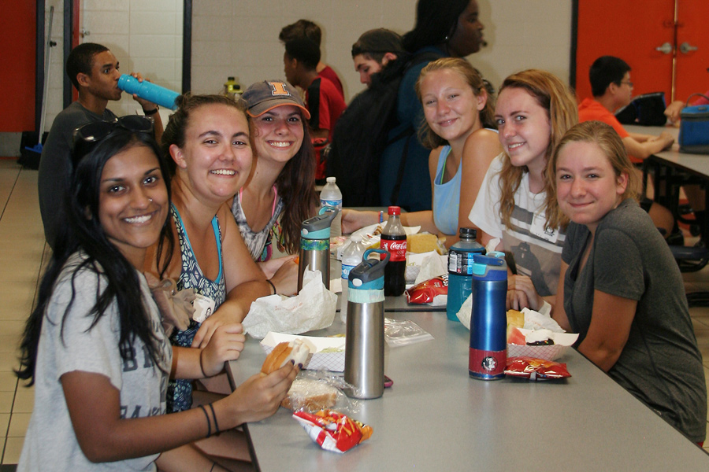
The Partnership Halftime Show:
Pre-game Activities
Have beginners join the high school students in a pre-game pizza party.

Slide 46
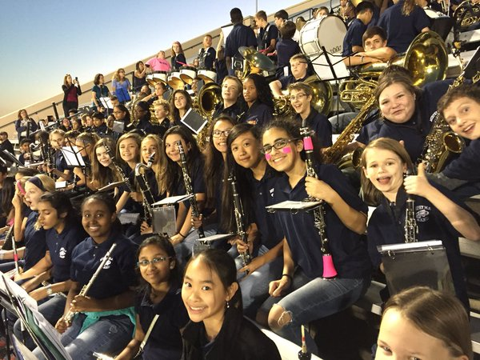
The Partnership Halftime Show:
Pre-game Activities
Have beginners join the high school students in a pre-game pizza party.
Have beginners sit/play with HS band at game.

Slide 47

The Partnership Halftime Show:
Pre-game Activities
Have beginners join the high school students in a pre-game pizza party.
Have beginners sit/play with HS band at game.
Have high school boosters host a middle school parent reception and invite principals to speak.

Slide 48

The Partnership Halftime Show:
Pre-game Activities
Have beginners join the high school students in a pre-game pizza party.
Have beginners sit/play with HS band at game.
Have high school boosters host a middle school parent reception and invite principals to speak.
Provide VIP seating in the stands for parents.

Slide 49
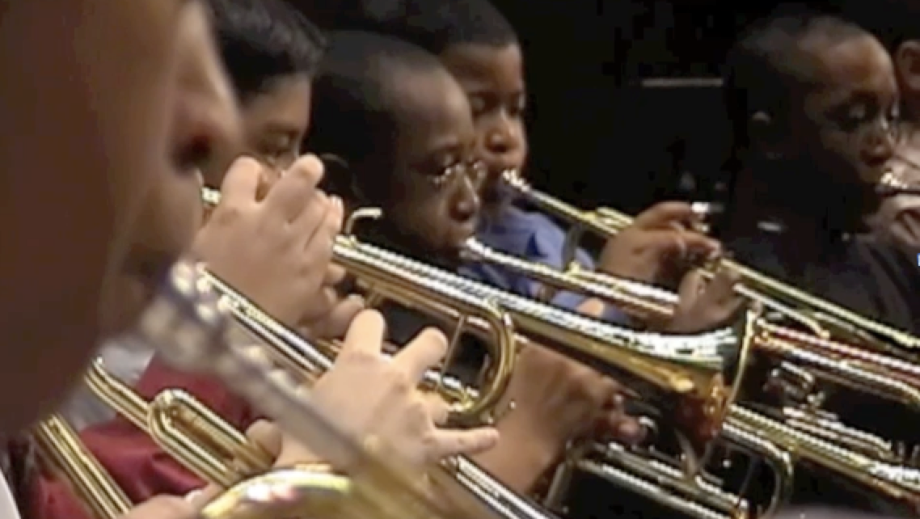
The HOW of Staying in Music
First Performance National
Day of Celebration!

Slide 50
The HOW of Staying in Music
First Performance National
Day of Celebration!

Slide 51
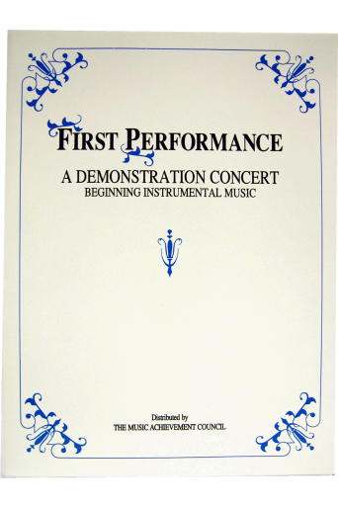
Why Does First Performance DoC Work?
The timing of the performance
  Parents want to hear their kids play
  Student interest soars and they learn to love performing
Students practice more prior to a performance
Retention rate increases
The audience will be large … enthusiastic … and will arrive early -- lots of quality time with those who care most about the outcome -- the parents!

Slide 52

Parents will be amazed! Most have no idea how much their child has learned based on what they hear at home!

Slide 53

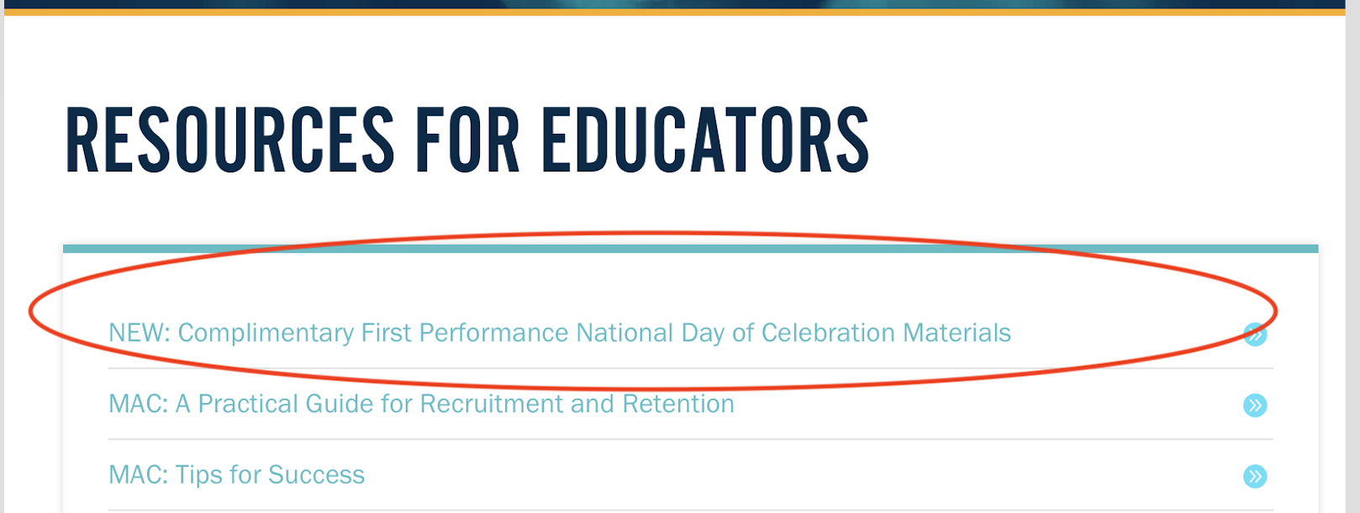
Complimentary Download www.musicachievementcouncil.org
. . .Use Your Own Method Book Music

Slide 54
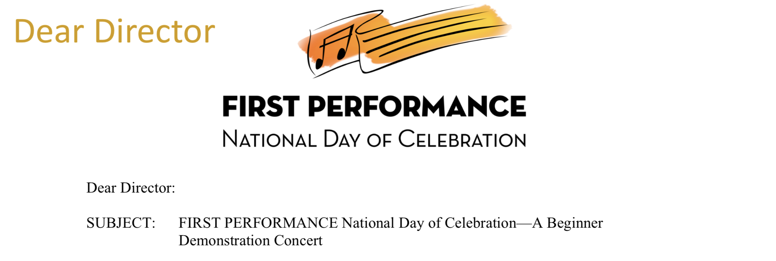
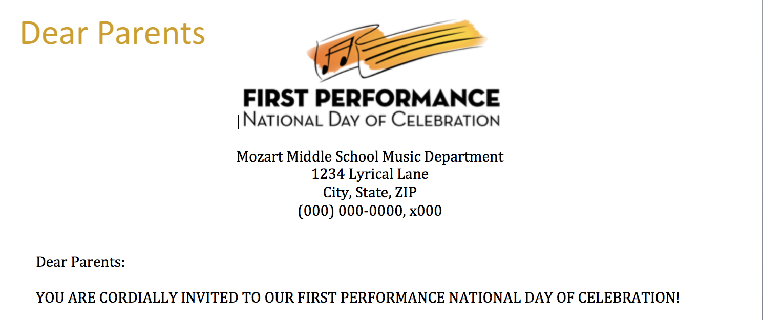
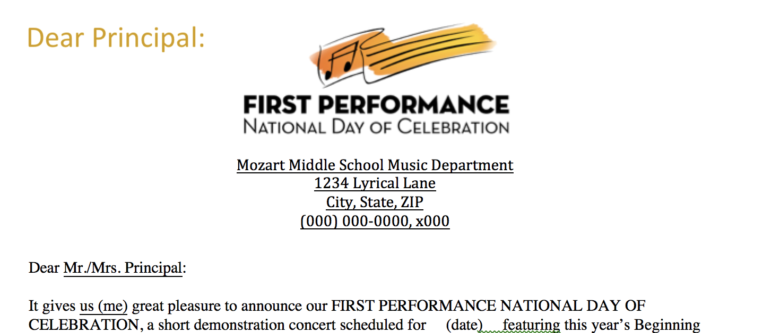
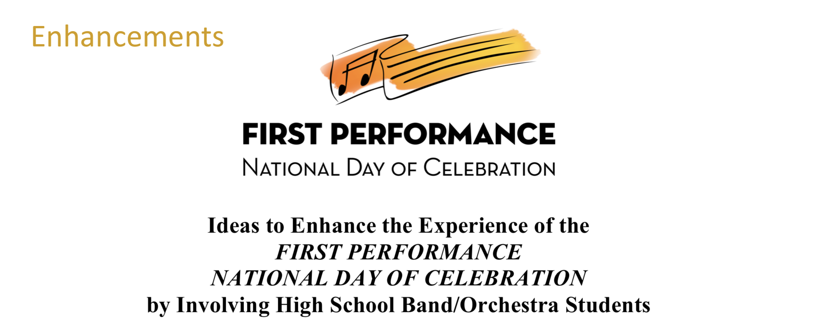

www.musicachievementcouncil.org
What’s Included:

Slide 55
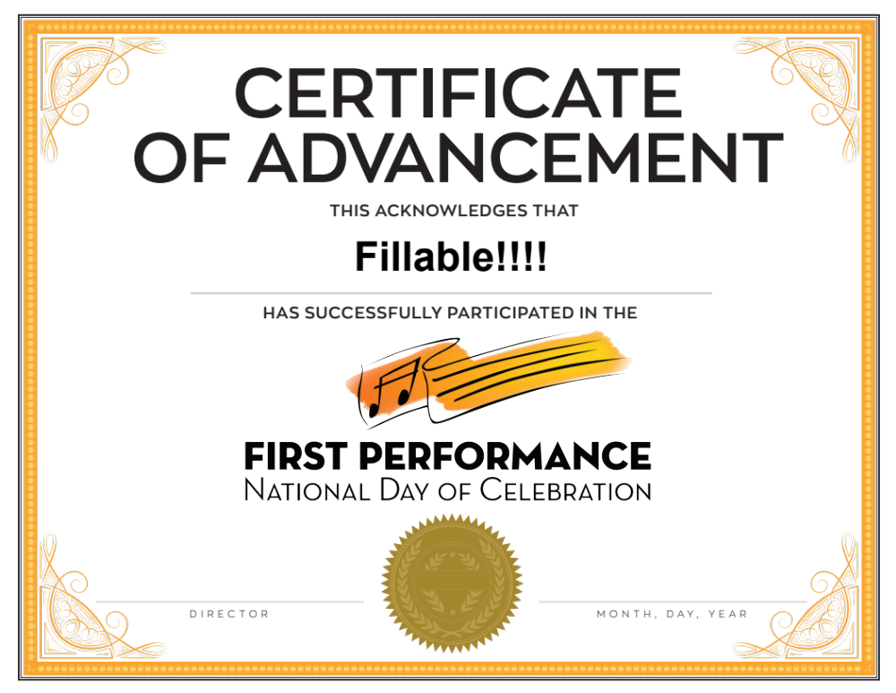

Slide 56
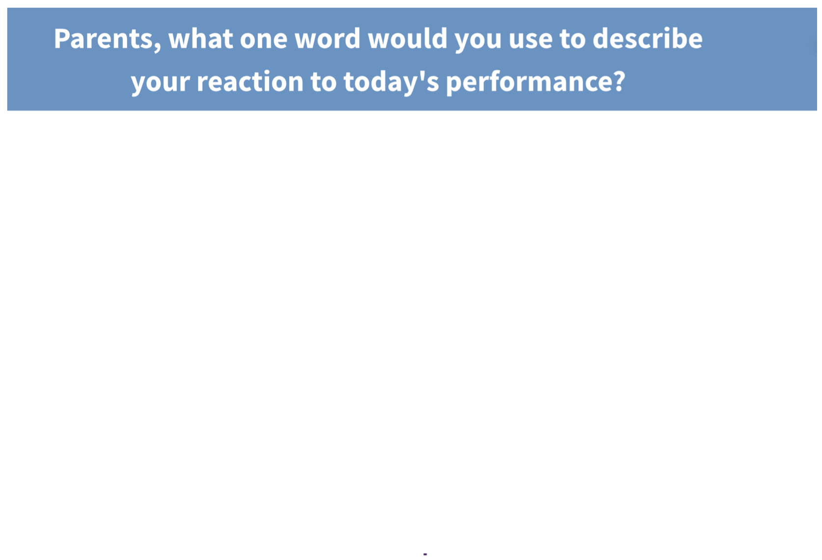
Response from LIVE at the 2017 Midwest Clinic

Slide 57
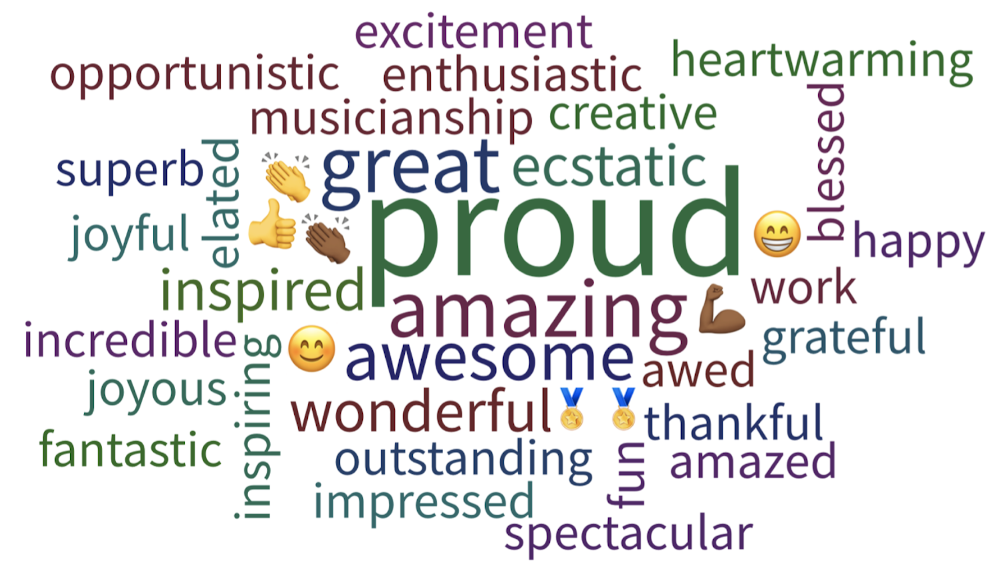
Response from LIVE at the 2017 Midwest Clinic

Slide 58
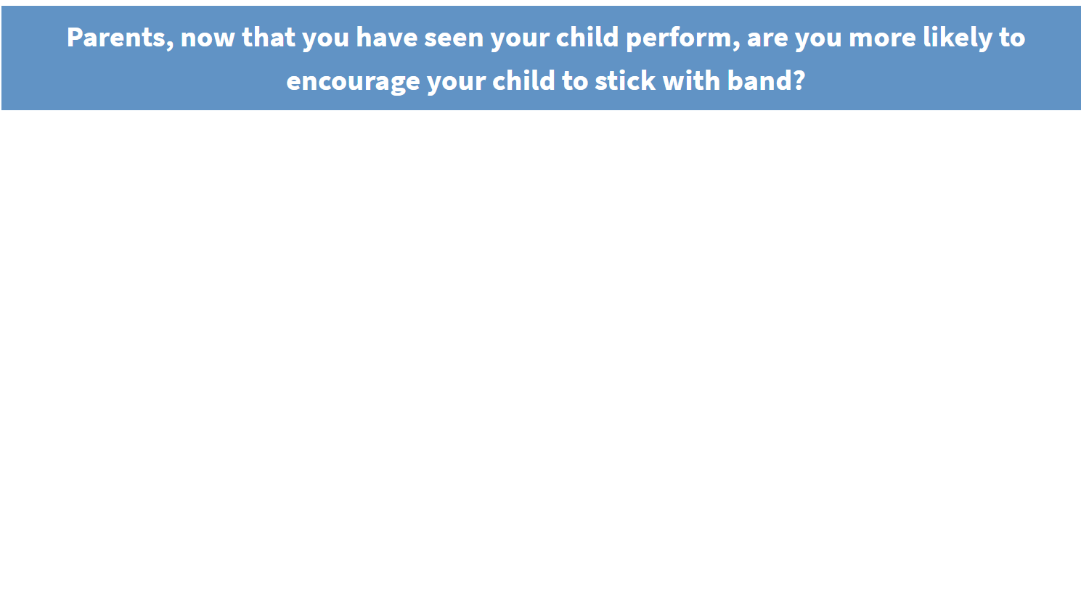
Response from LIVE at the 2017 Midwest Clinic

Slide 59
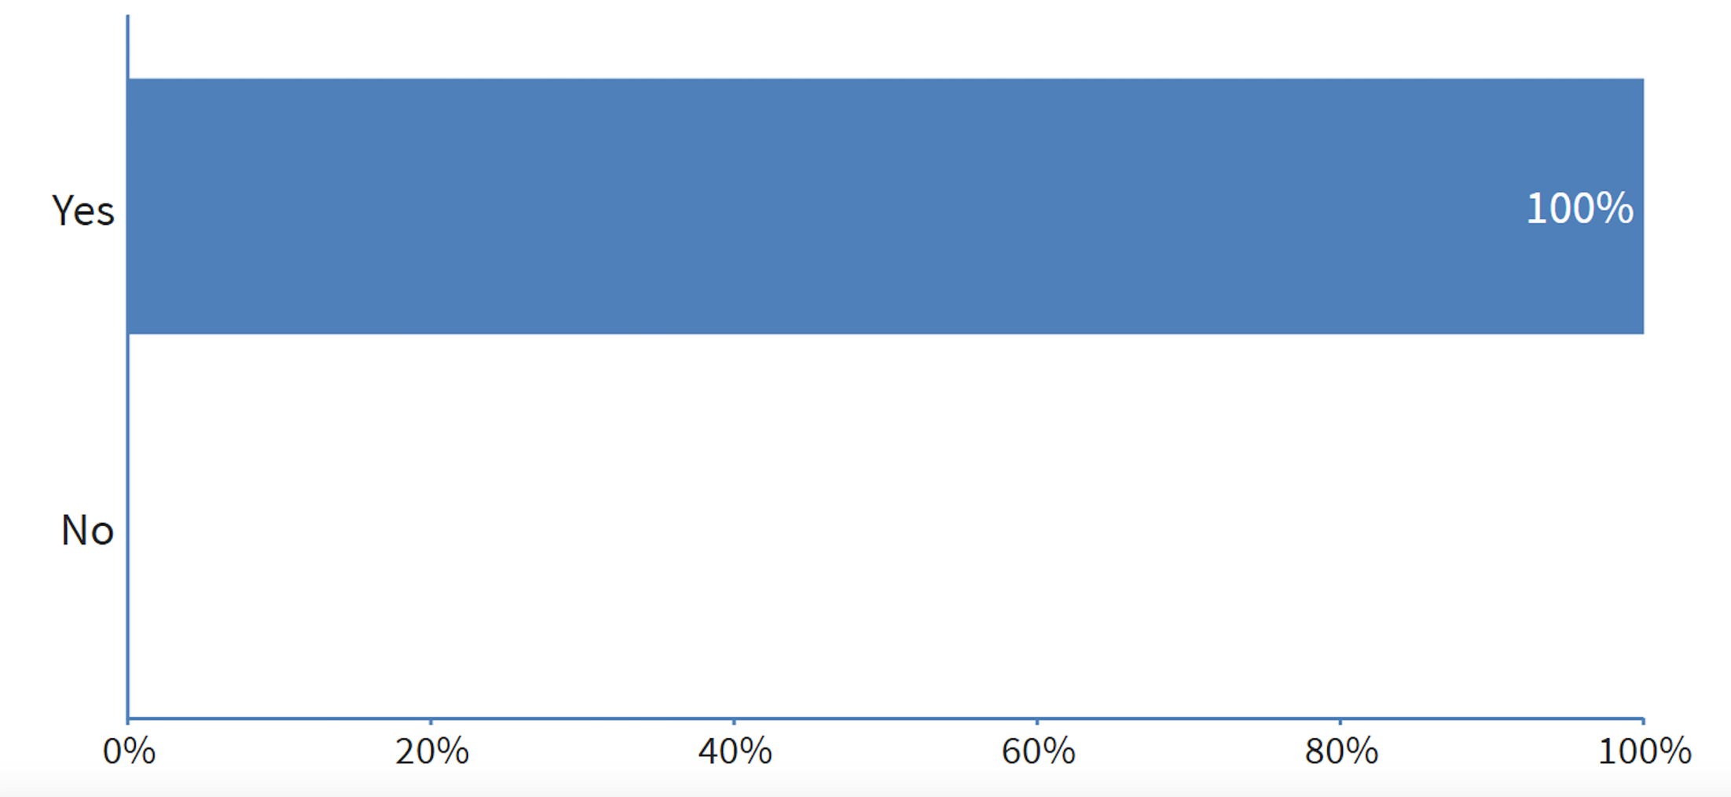
Response from LIVE at the 2017 Midwest Clinic

Slide 60

Schedule your 2018 Program NOW!
Join us on the 3rd Thursday in November
Download Your FREE Materials at:
www.musicachievementcouncil.org

Slide 61
The HOW of Staying in Music
What HS/MS Parents Can Do:
Engage Parents Early

Slide 62
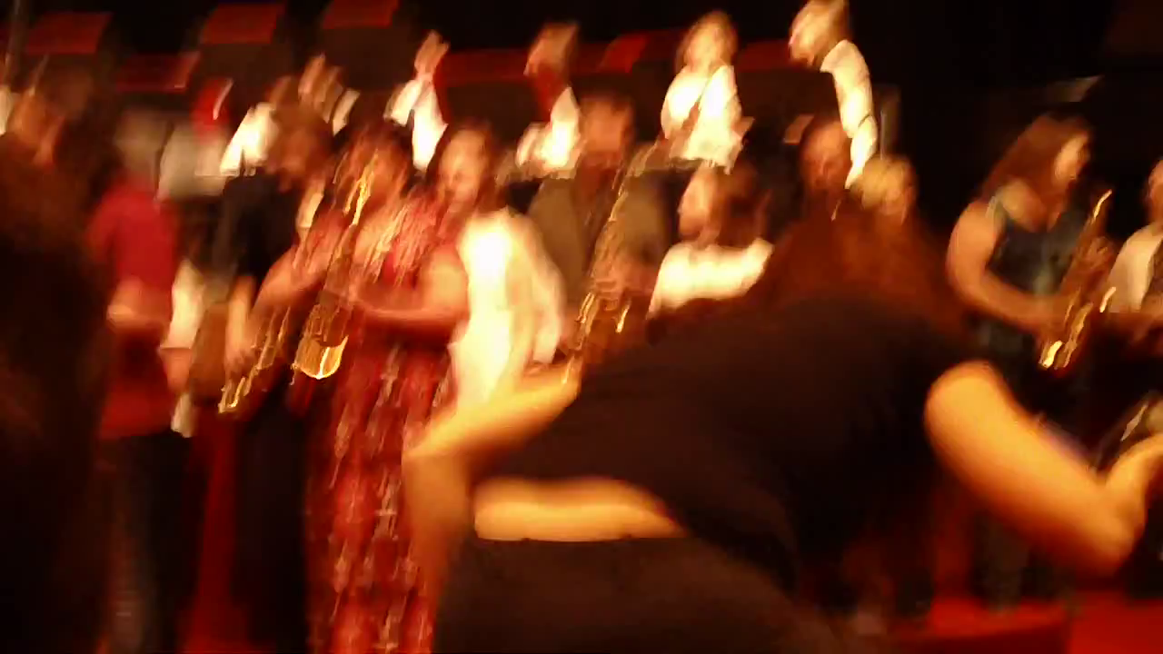
The HOW of Staying in Music
Engage Parents EARLY—The Parent Band!

Slide 63
The HOW of Staying in Music
Engage Parents EARLY—The Parent Band!

Slide 64
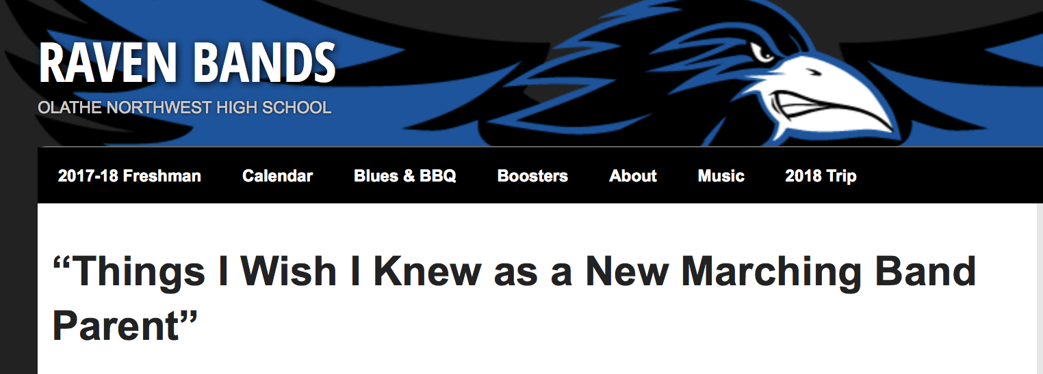
The HOW of Staying in Music
Have Parents Teach Parents

Slide 65
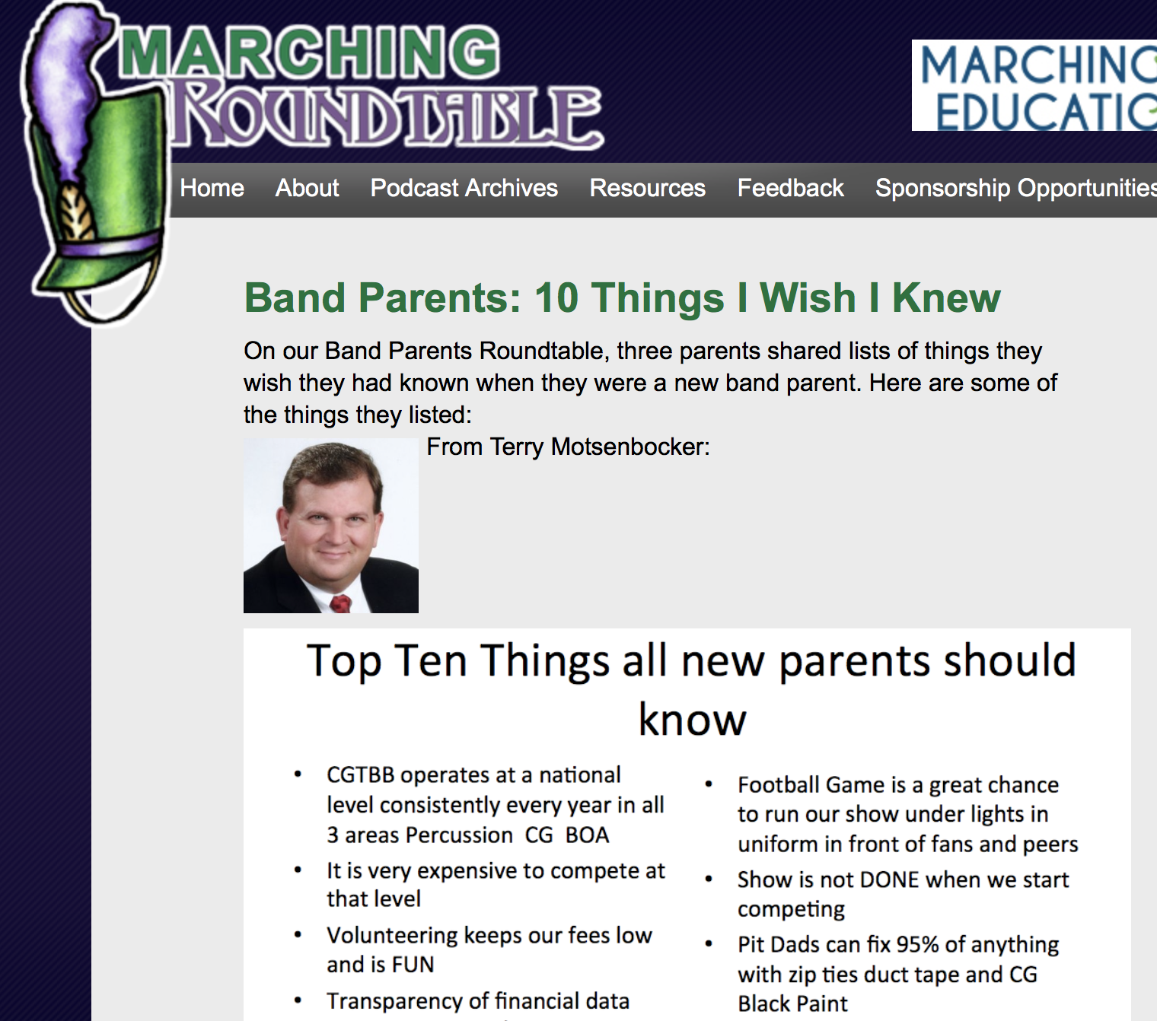
The HOW of Staying in Music
Have Parents Teach Parents

Slide 66
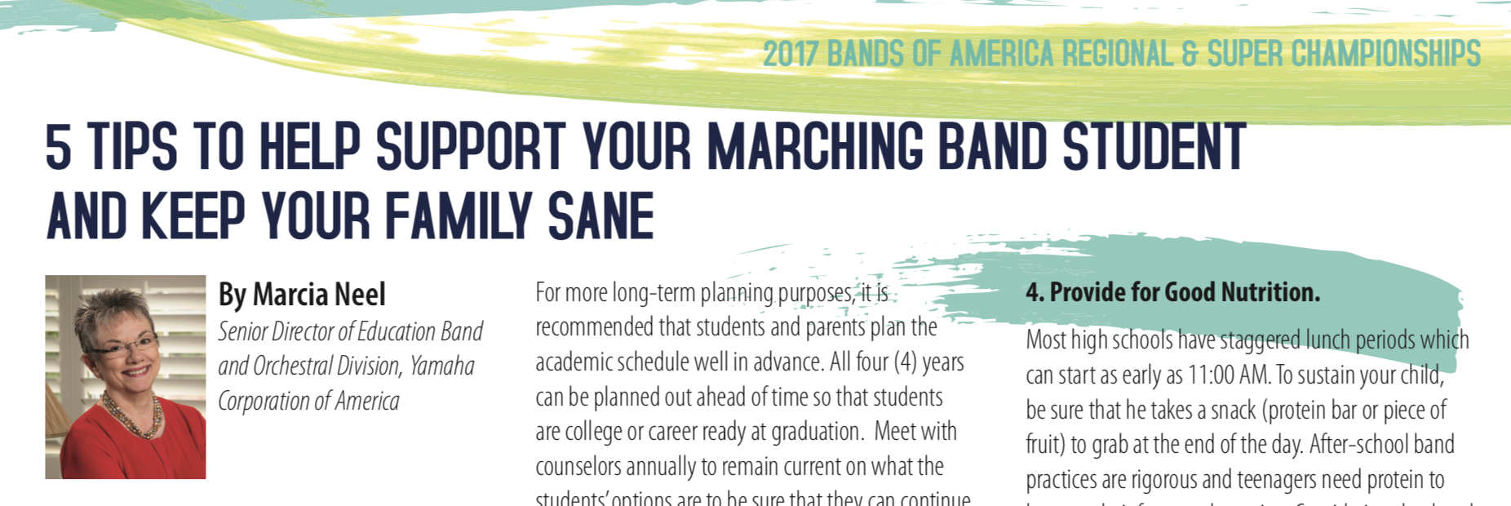
The HOW of Staying in Music
Have Parents Teach Parents

Slide 67
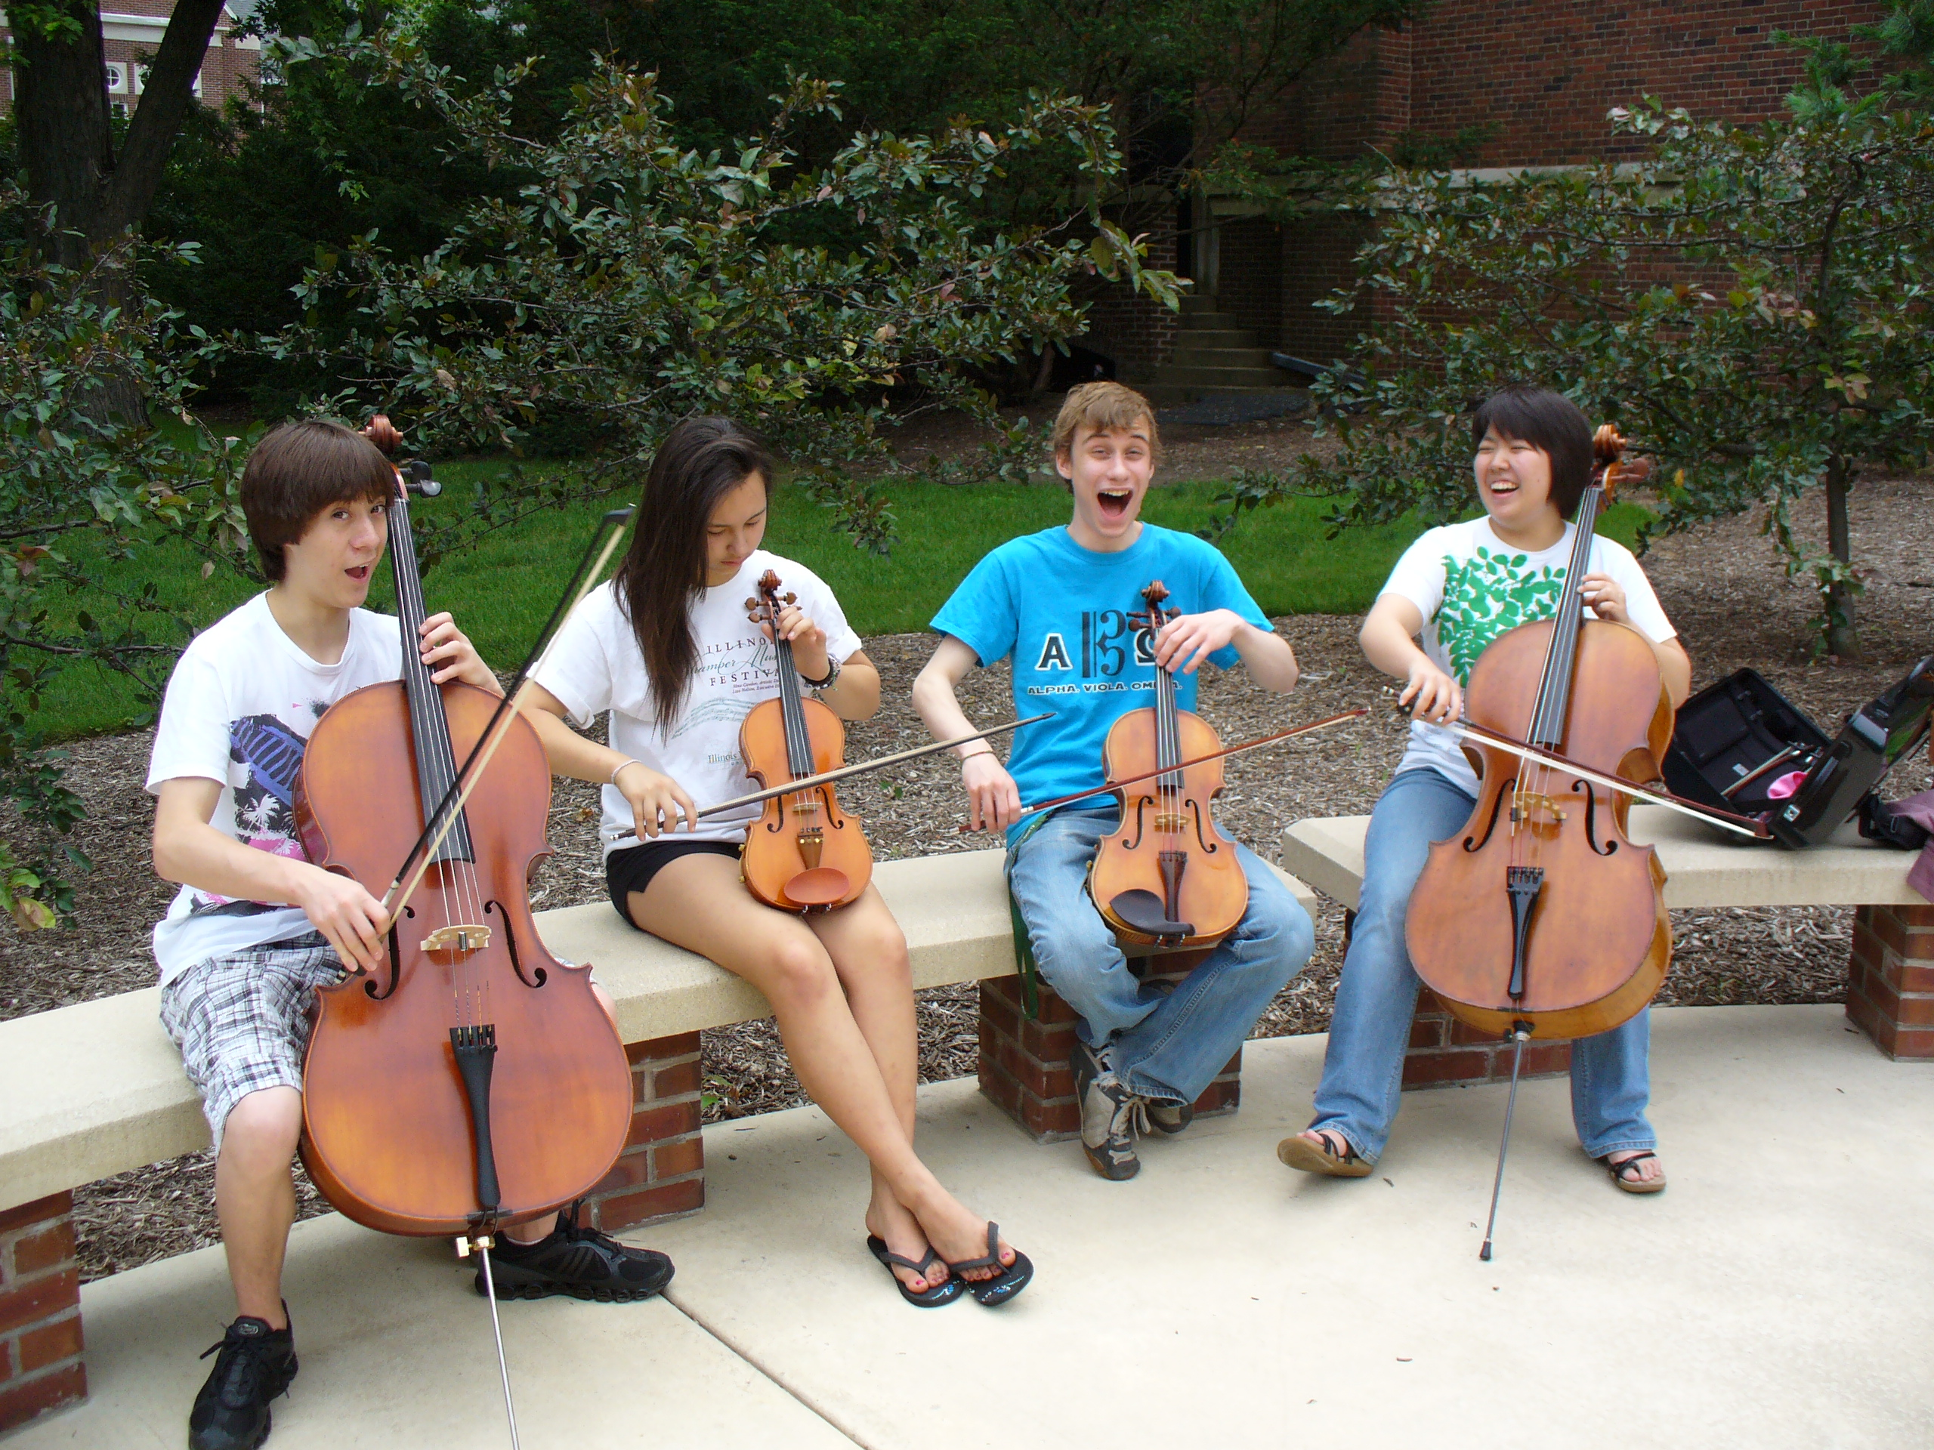
The HOW of Staying in Music
What HS/MS Students Can Do:
1. Serve as “Intern Instructors” for FREE Summer Lesson Program for beginning students.

Slide 68
The HOW of Staying in Music
What HS/MS Students Can Do:
1. Serve as “Intern Instructors” for FREE Summer Lesson Program for beginning (at-risk) students.
2. Participate ACTIVELY in ALL retention
efforts – give “testimonials”

Slide 69


The HOW of Staying in Music
Have Students Give “Testimonials”

Slide 70
The HOW of Staying in Music
Have Students Give “Testimonials”

Slide 71
The HOW of Staying in Music
What HS/MS Students Can Do:
Serve as “Intern Instructors” for Summer
Lesson Program for beginning students
2. Participate ACTIVELY in ALL recruitment efforts – give “testimonials”
3. Remain engaged with former programs
A. Mentor upcoming students. . .Give back!
B. Coach upcoming students. retention
C. Serve that program: Usher, sell refreshments

Slide 72
The HOW of Staying in Music
What HS/MS Students Can Do:
Serve as “Intern Instructors” for Summer
Lesson Program for beginning students
2. Participate ACTIVELY in ALL recruitment efforts – give “testimonials”
3. Remain engaged with former programs
Write letters of invitation (Big Bro/Sis)
and congratulations as appropriate

Slide 73

The HOW of Staying in Music
What HS/MS Students Can Do:
4. Write letters of invitation (Big Bro/Sis)
and congratulations as appropriate
  “Congratulations!
  You have been chosen to
  play (insert instrument)
  in the (name of school) band!”
  Giving a “Golden Invitation” to
  band/orchestra makes them feel special!”

Slide 74
The HOW of Staying in Music
What HS/MS Students Can Do:
Serve as “Intern Instructors” for Summer
Lesson Program for beginning students
2. Participate ACTIVELY in ALL recruitment efforts – give “testimonials”
3. Remain engaged with former programs
Write letters of invitation (Big Bro/Sis)
and congratulations as appropriate
5. Send musical greeting cards

Slide 75
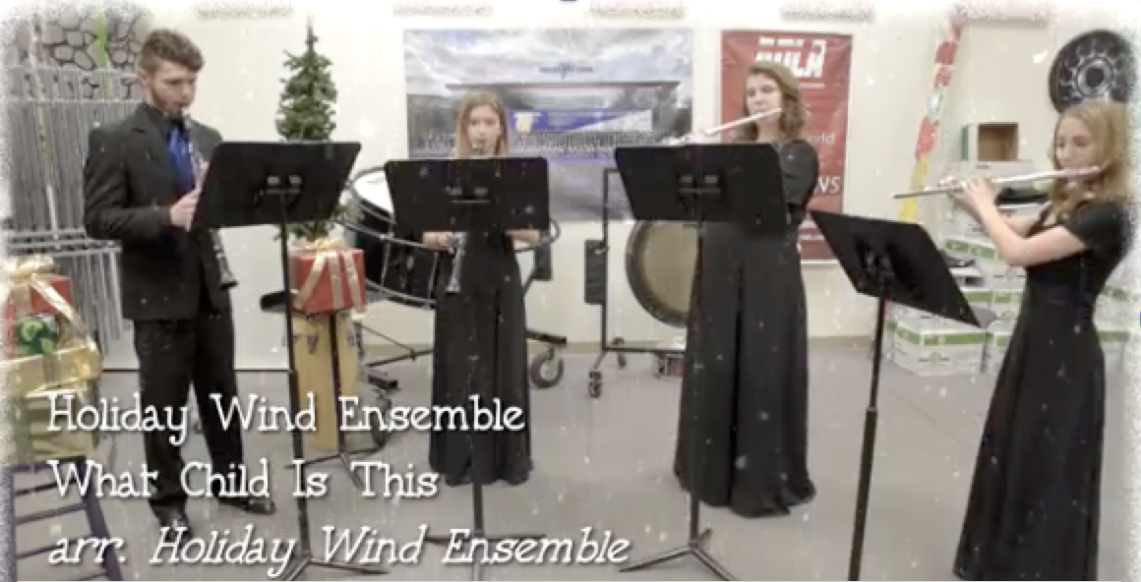
The HOW of Staying in Music
What HS/MS Students Can Do:
Foothill High School AP Music Theory Card

Slide 76

The HOW of Staying in Music
What HS/MS Students Can Do:
Foothill High School AP Music Theory Card

Slide 77
The HOW of Staying in Music
What HS/MS Principals Can Do:
1. Help facilitate recruitment assemblies/
events/activities at feeder schools
2. Work with feeder principals on
scheduling
3. Create joint presentation for (feeder)
parents
4. Provide opening remarks at each other’s
concerts

Slide 78
The HOW of Staying in Music
What Music Supervisors Can Do:
1. Ensure that faculty sees itself as part of
one, K–12 Music Program –
build purpose and unity!

Slide 79
The HOW of Staying in Music
What Music Supervisors Can Do:
2. Track articulation/achievement data
1. Ensure that faculty sees itself as part of
one, K–12 Music Program –
build purpose and unity!

Slide 80
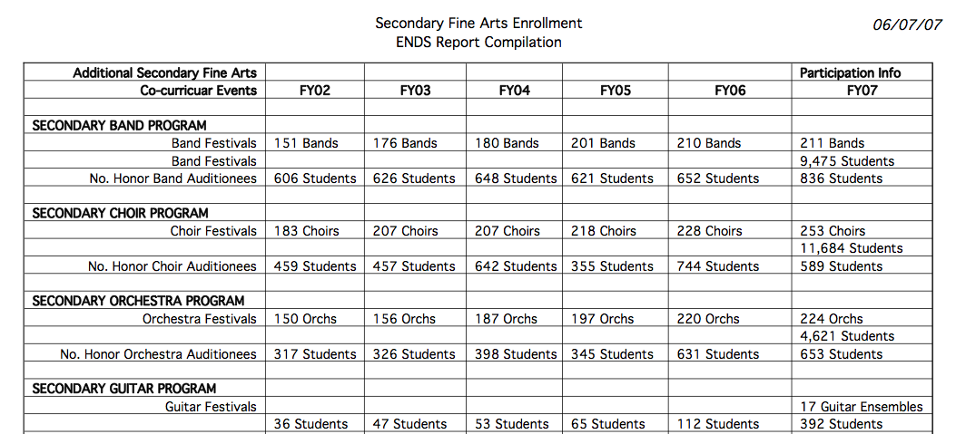
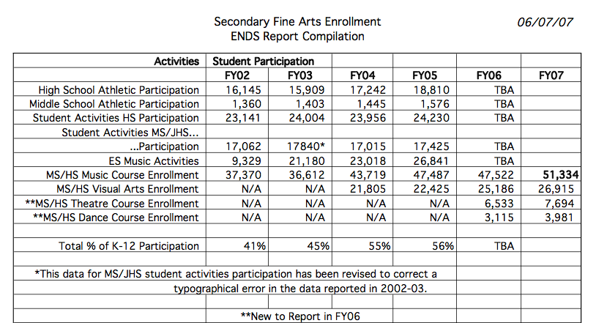


Slide 81
The HOW of Staying in Music
What Music Supervisors Can Do:
1. Ensure that faculty sees itself as part of
one, K–12 Music Program –
build purpose and unity!
2. Track articulation data
3. Provide sample student schedules

Slide 82
The HOW of Staying in Music
What Music Supervisors Can Do:
3. Provide sample student schedules
Wind Symphony
Algebra I
Biology
AP English
Music Theory
Orchestra
Jazz Band
Geometry
Chemistry
Chamber Ensemble
Algebra II
Algebra XV
Calculus

Slide 83
The HOW of Staying in Music
What Music Supervisors Can Do:
1. Ensure that faculty sees itself as part of
one, K–12 Music Program –
build purpose and unity!
2. Track articulation data
3. Provide sample student schedules
4. Ensure that students receive quality
learning opportunities and experiences

Slide 84
The HOW of Staying in Music
What Music Supervisors Can Do:
4. Ensure that students receive quality
learning opportunities and experiences
Honor Band Opportunities
Solo and Ensemble Festivals
Large Group Festivals

Slide 85

A GREAT EXAMPLE: Foothill HS
“There is a place. . .”

Slide 86
A GREAT EXAMPLE: Foothill HS
“There is a place. . .”

Slide 87

Got SMART Phone? www.musicedconsultants.net/conference-materials
Notes:
87

Slide 88














Thanks to these Quality Companies!
@MusicEdConsult @MusicAchCouncil
www.musicachievementcouncil.org
Notes:
www.musiceducationconsultants.net/mmea2010
88

Slide 89
Thanks to these Quality Companies!
@MusicEdConsult @MusicAchCouncil
www.musicachievementcouncil.org
Notes:
www.musiceducationconsultants.net/mmea2010
89

