Slide 1

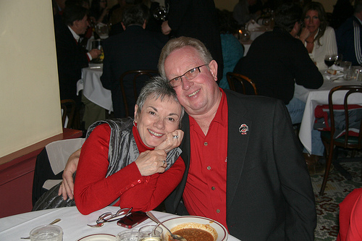
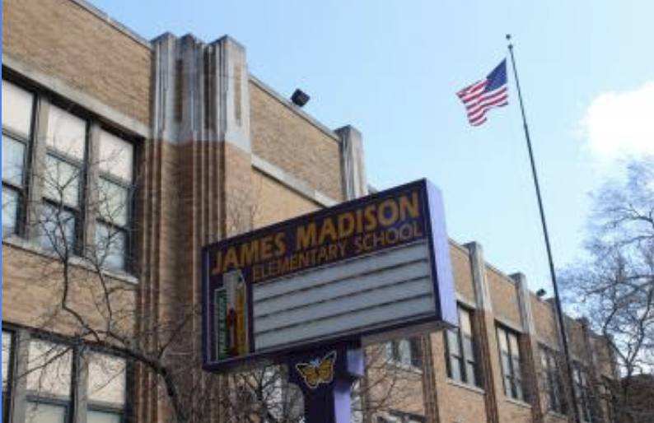
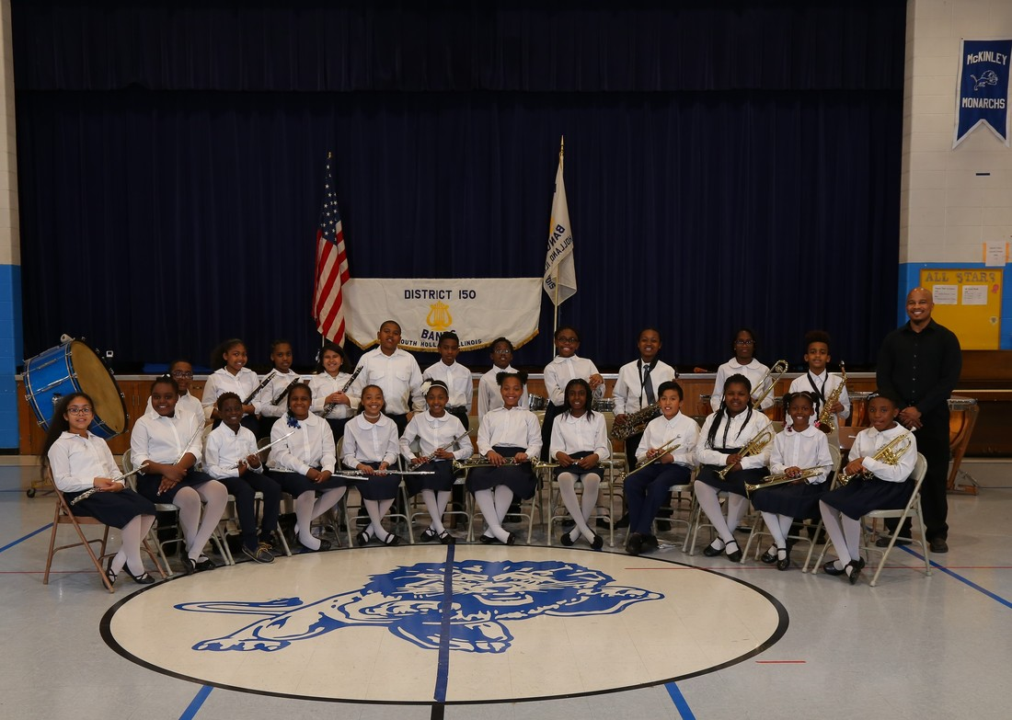
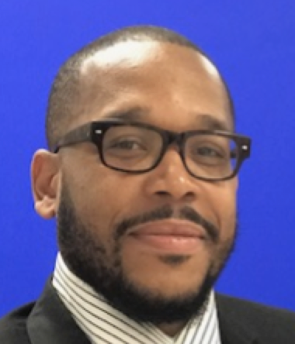
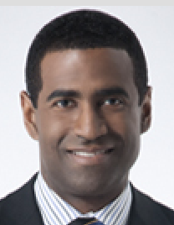
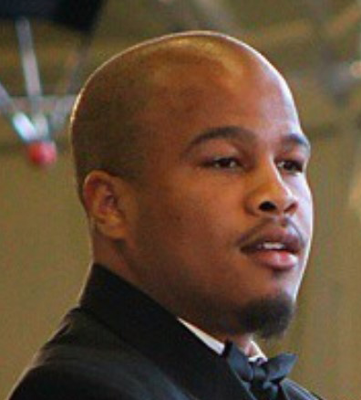
Madison Elementary School McKinley Junior High School
Beginning Band Beginning Band
Mario Moody Derrick Young Nyle Taylor
Director Host Director

Slide 2
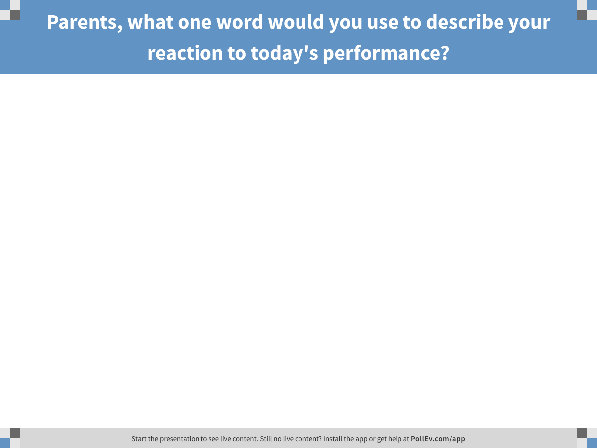
Notes:
Parents, what one word would you use to describe your reaction to today's performance?
https://www.polleverywhere.com/free_text_polls/6R1FuKsPv4YxtMe

Slide 3
Who: Beginning Instrumental Programs
What: Director Letter
Parent Letter
Principal Letter
Script
Fillable Certificate of “Advancement”

Slide 4
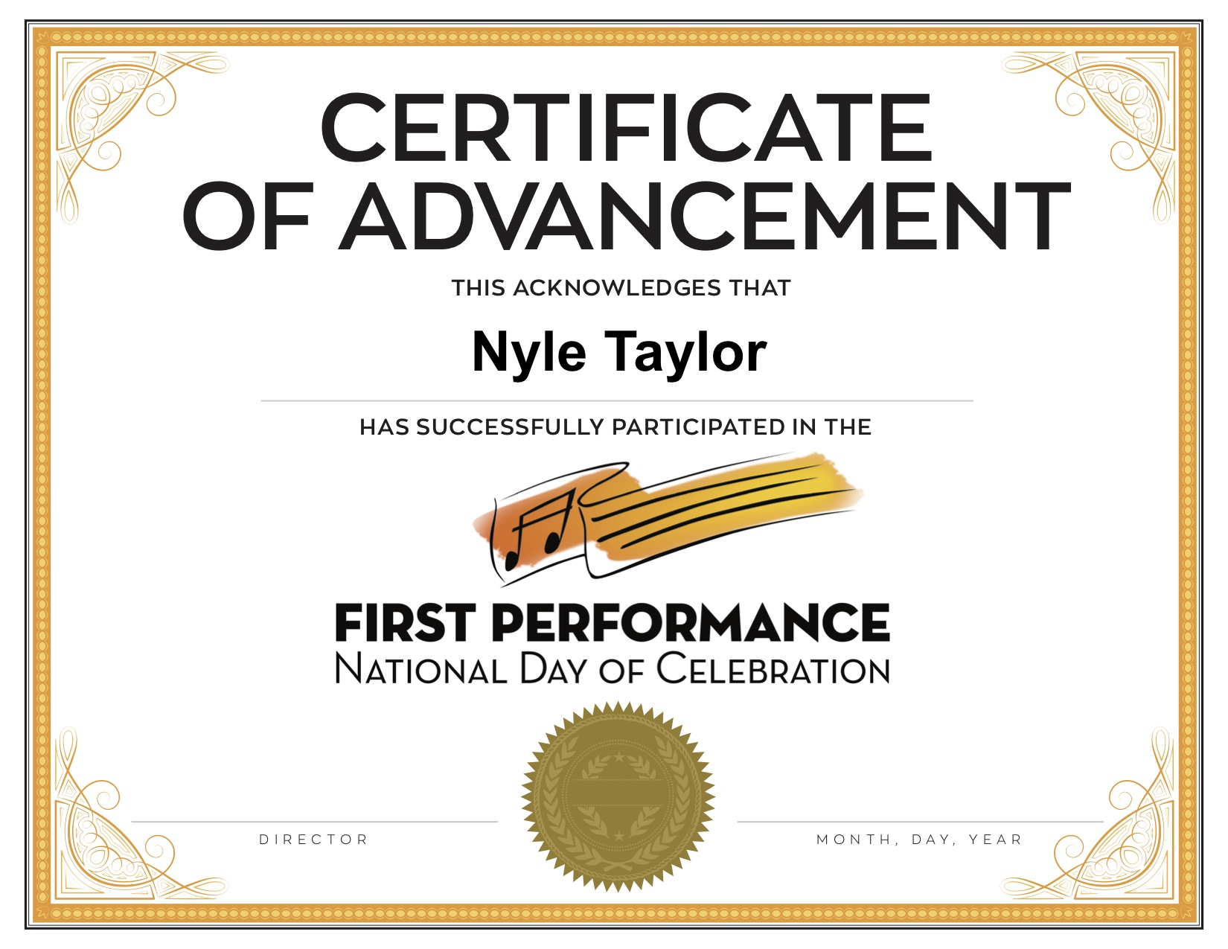


Slide 5
When: 3rd Thursday of November Annually
Why: To Increase Retention
How: www.musicachievementcouncil.org
http://bit.ly/firstgigMAC
Panel: Questions, Ideas

Slide 6
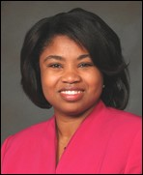
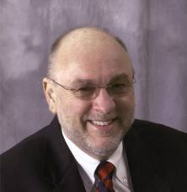
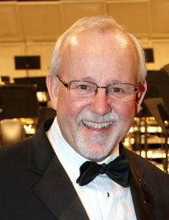
Teresa Hill Tim Lautzenheiser Charlie Menghini
Superintendent SD 151 Attitude Concepts for Today VanderCook President, Ret.
Mario Moody Nyle Taylor
Madison Elementary School Director McKinley Elementary School Director

Slide 7
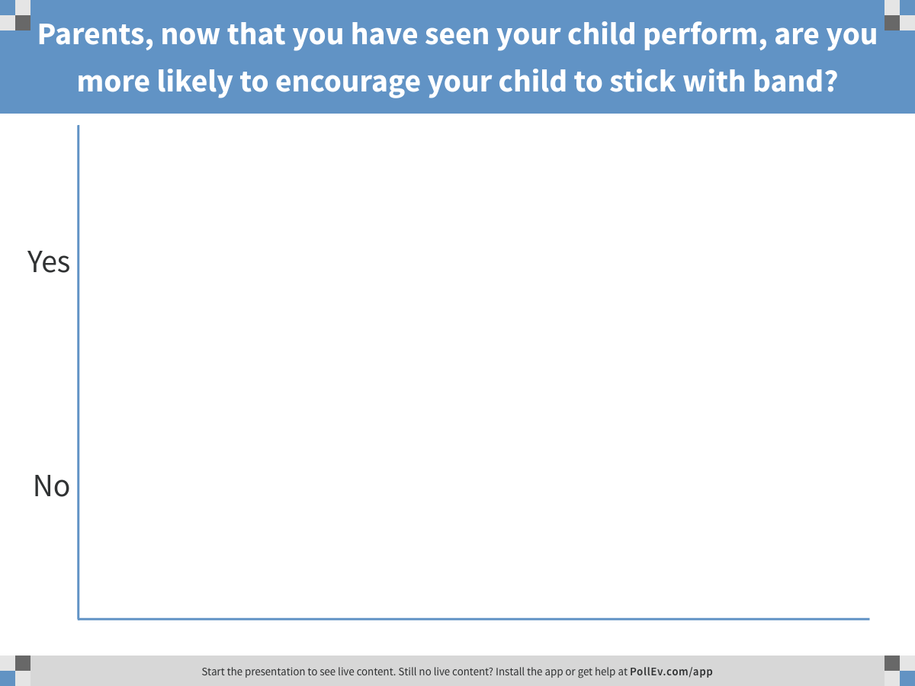
Notes:
Parents, now that you have seen your child perform, are you more likely to encourage your child to stick with band?
https://www.polleverywhere.com/multiple_choice_polls/gLxFirjIo5vaOCe

Slide 8












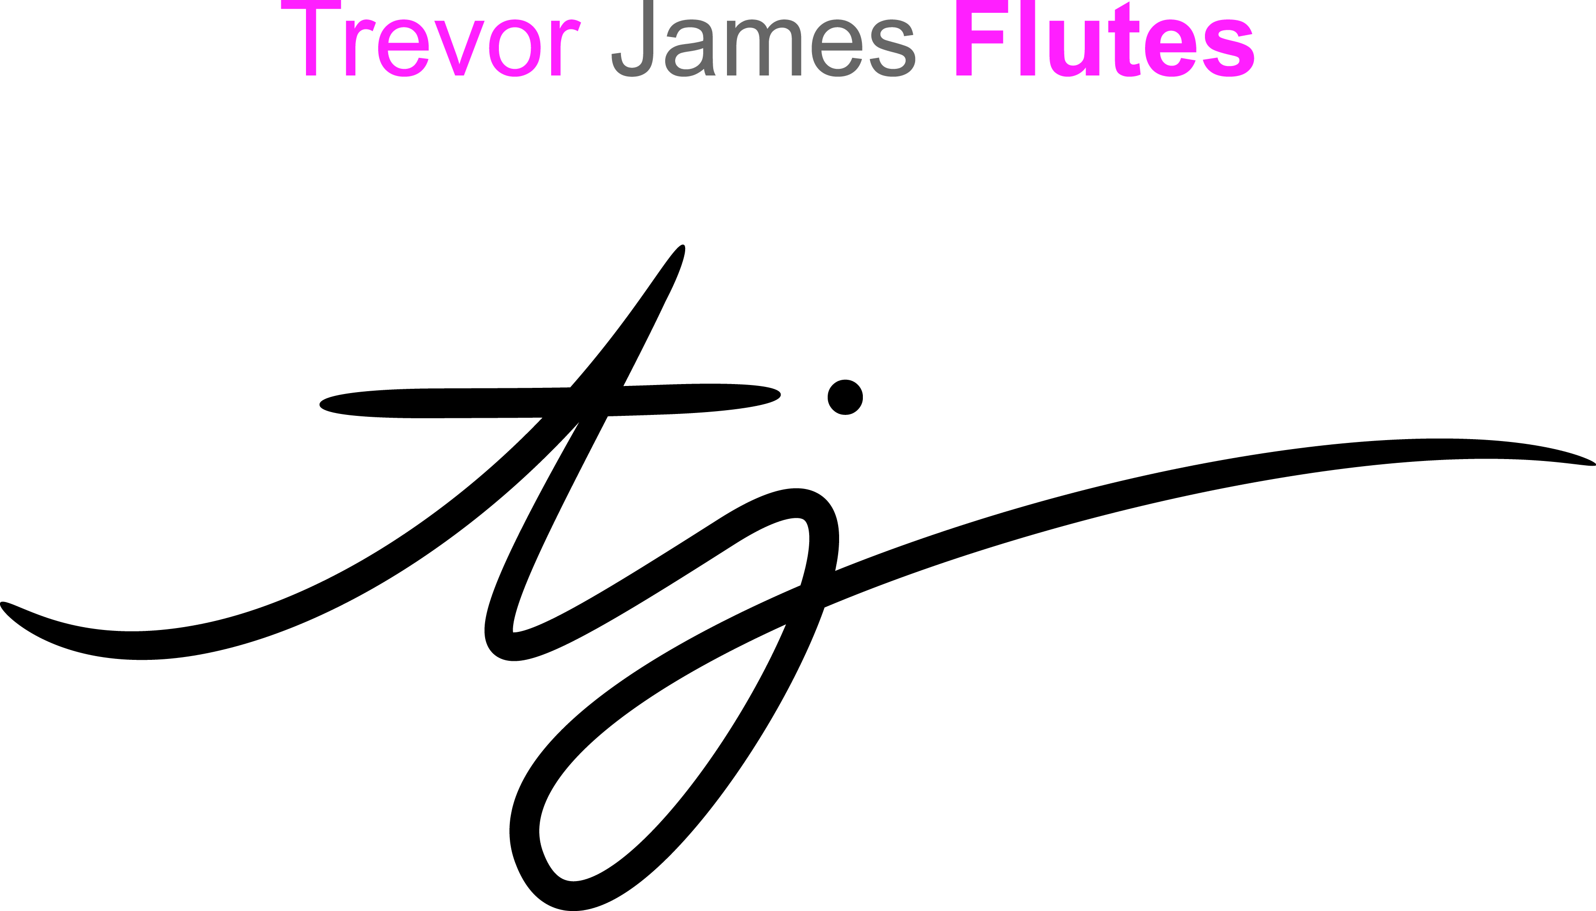


@FirstGigMAC @MusicEdConsult
Thanks also to these Quality Companies!
www.musicachievementcouncil.org
Notes:
www.musiceducationconsultants.net/mmea2010
8

