Slide 1


Analogy of the Band Director’s Job. . .the C.E.O. Approach
MARCIA NEEL
2018 IBA Conference May 11, 2018 10:00 AM

Slide 2
Google:
What does a band director do?
Band directors are responsible for leading orchestras or other musical groups during musical performances or recording sessions.
Band directors select musical arrangements and practice arrangements.
In order to have a career as a band director, a minimum of a bachelor’s degree in music is usually required.

Slide 3
All of this is ALSO Your Job!
Accountant
Politician
Architect
Psychologist
Author
Public Relations Executive
Career Planner
Quality Assurance Executive
Financial Planner
Sales Executive
Travel Agent
Magician

Slide 4
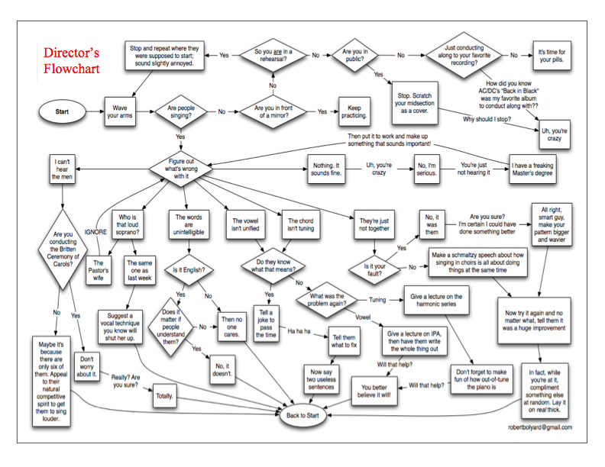
In Reality. . . The Director’s Flowchart

Slide 5
Corporate
Structure:
Setting the Climate and
Empowering Others to Lead!

Slide 6

Structure:
Getting Down to Business as CEO
C.E.O. directors work with students in a business-like, professional manner so that they perceive that they have a job to do, understand how to perform that job, and know how to perform it well.
Thus. . .

Slide 7





Structure:
Getting Down to Business as CEO
. . .C.E.O. directors ensure that each department (section) is provided with the leaders required to motivate the entire team to perform well so that the company can function at its very best to produce a profit – the inspired musical performance.

Slide 8
The Story of
Oscar Muñoz, CEO
United Airlines

Slide 9

Job 1: Untangle the Mess that was United Airlines
Prior CEO Jeffrey Smisek: 42% Job Approval Rating from Employees on Glassdoor.com
CEO Oscar Muñoz?
96% Job Approval Rating

Slide 10

What were his secrets?
Established the Primary Goal:
Regain the Trust of United’s Employees
Listen, learn then provide feedback from what they say.
Always support your team! (Not always easy)
Separate personal views from company views.
Show compassion but be principled & profitable.
Swing easy—Understand who you are and be yourself.

Slide 11
Thinktank: Questions, Answers, and Stories
10 Qualities of CEOs
As Seen in the
Bandroom Setting

Slide 12
Thinktank: Questions, Answers, and Stories
10 Qualities of CEOs as Seen in the Bandroom
It is the Vision of the CEO that dictates the future of the company. What is the vision for the band program?
2. CEOs show a greater sense of purpose and passion for what they do. Their energy is boundless! Why is this and how can this have an effect on the program overall? the school?
3. The CEO listens to the organization’s team members then makes decisions accordingly. Why is this important? What is the ultimate result and how does it impact the band?

Slide 13
Thinktank: Questions, Answers, and Stories
10 Qualities of CEOs in the Bandroom
4. The smartest CEOs are vulnerable, curious and always trying to learn. Why would vulnerability and curiosity be of value?
5. CEOs build relationships and foster a collaborative climate. In what ways do these qualities provide impact?
6. Successful CEOs remain organized in their approach to solving problems within the business. What is your touchstone when it comes to problem-solving?

Slide 14
Thinktank: Questions, Answers, and Stories
10 Qualities of CEOs in the Bandroom
7. Top CEOs know how to communicate in neutral language that is easily understandable so that effective action can be taken and conflict avoided. How does this come into play in our situation?
8. Impactful CEOs think outside the box. What advantage could this provide?
9. Successful CEOs take risks. In what way can this quality be applied?

Slide 15
Thinktank: Questions, Answers, and Stories
10 Qualities of CEOs in the Bandroom
The best CEOs exhibit traits that cultivate trust:
Maintain integrity
Show respect for all as equals
Maintain Confidences
Openly communicate vision and values
Demonstrate Compassion
Focus on shared goals rather than personal agendas
Listen with an Open Mind
Do the right thing regardless of personal risk
The beauty is that in demonstrating these traits to others,
they will be demonstrated to each other as well as back to you in return.

Slide 16
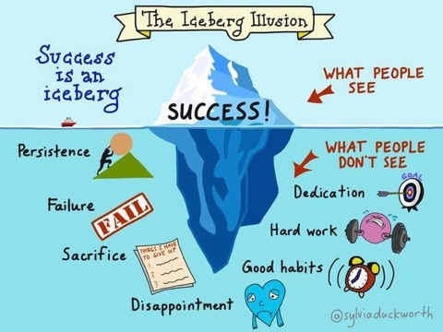

Slide 17
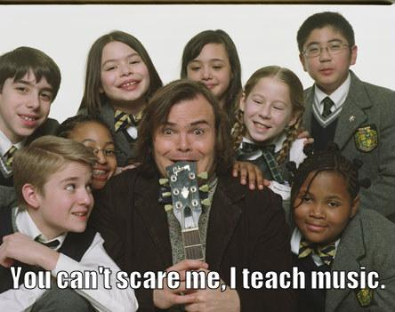

Slide 18

What is Your Personal Job 1 as C.E.O.?

Slide 19


This session & materials will be posted online at:
www.musicedconsultants.net/conference-materials
Thank You!!!!!

