Slide 1
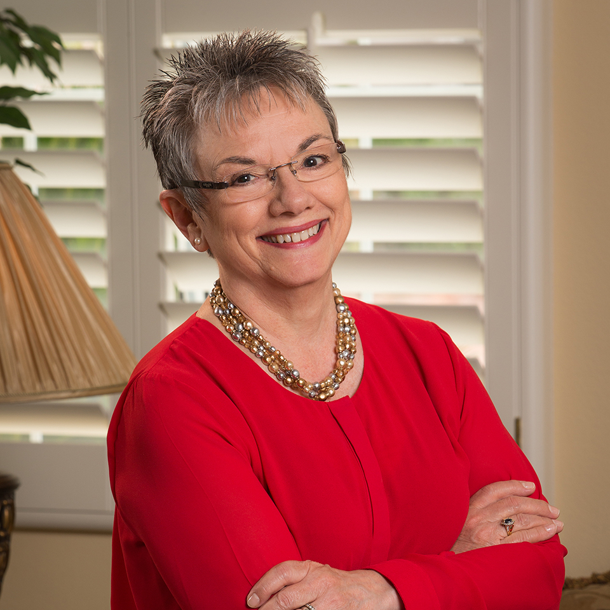



Marcia Neel
Master Educator
But for Music Education. . .

Slide 2
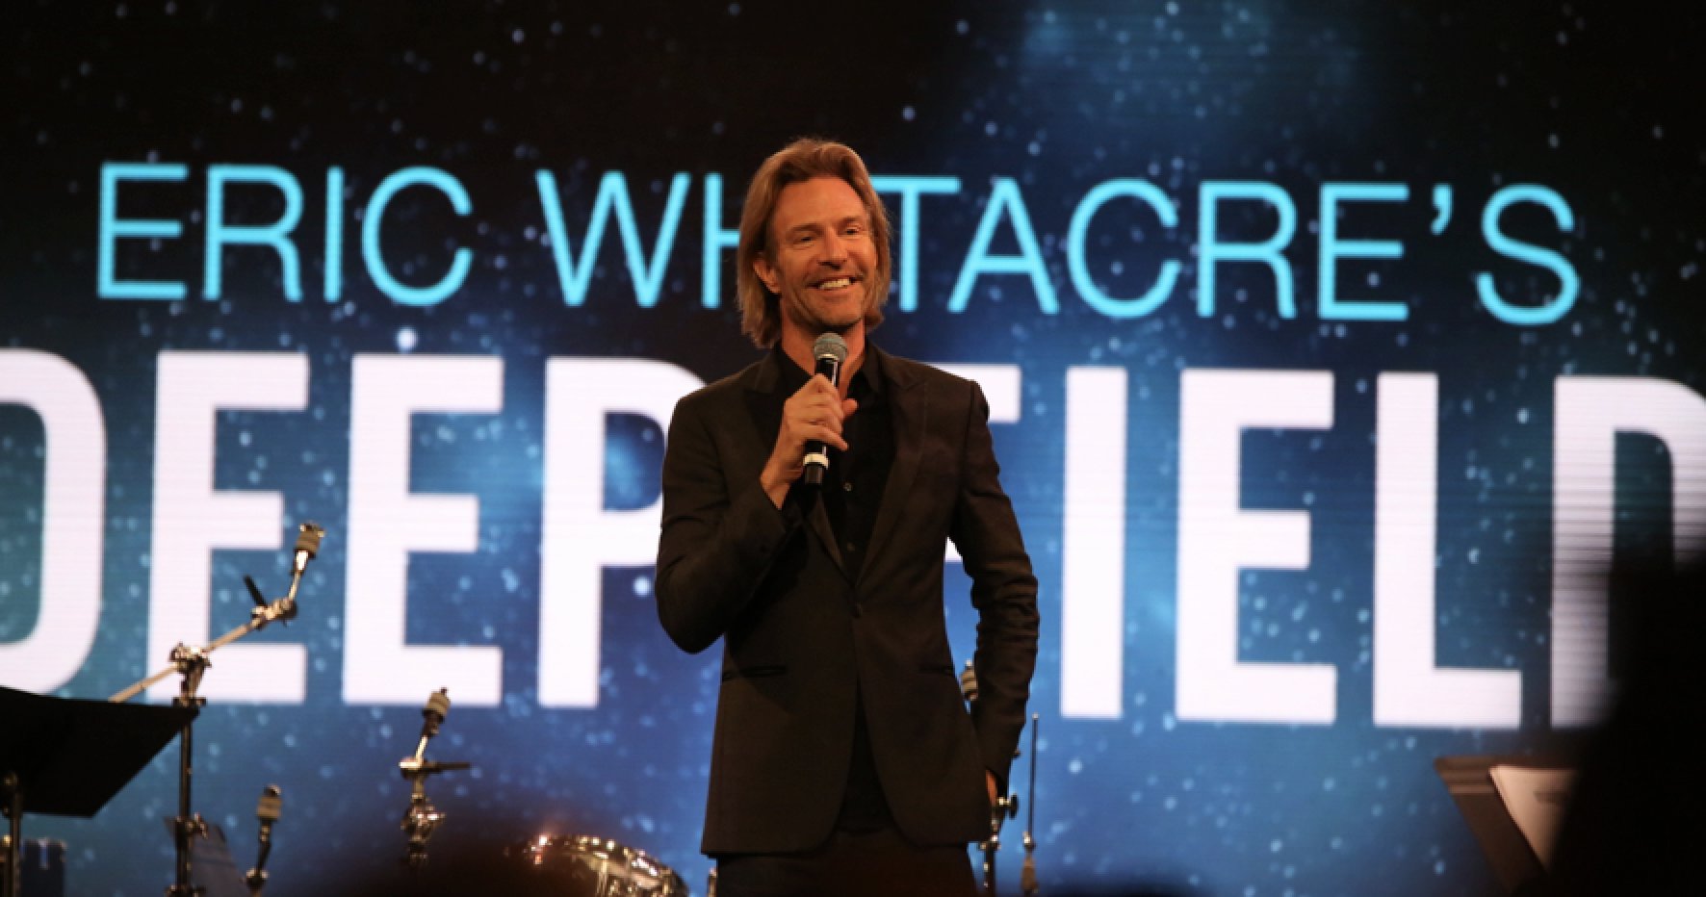

Slide 3

From: Paradise Lost
Exstasis: All I Want to do is Fly

Slide 4


Slide 5
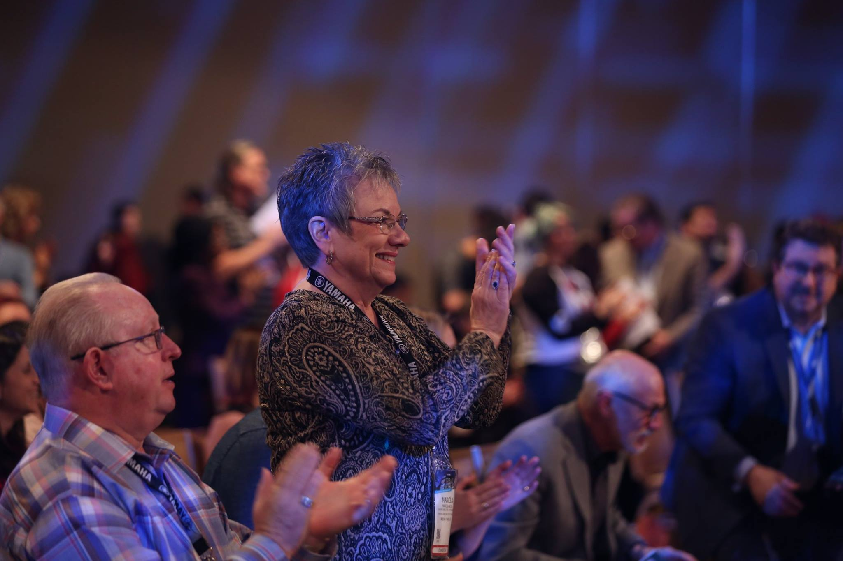

Slide 6
Why?

Slide 7
School is. . .
Impressionistic
vs
Expressionistic
Music is. . .

Slide 8

Music-making can help prepare
young people for their futures.
Creativity
Critical Thinking
Collaboration
Confidence
Communication
Therefore. . .

Slide 9
The Music Skills Practice Room is. . .
The Life Skills Practice Room

Slide 10
The Life Skills Practice Room
1. Creativity (Innovation). . .
  Ability to create new and more
  worthwhile ideas and to work
  creatively with others.
  Create something that we don’t even know that we need!

Slide 11
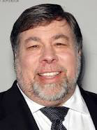
The Life Skills Practice Room
Creative Thinkers

Slide 12
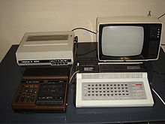
The Life Skills Practice Room
Creative Thinkers
Steve Wozniak

Slide 13

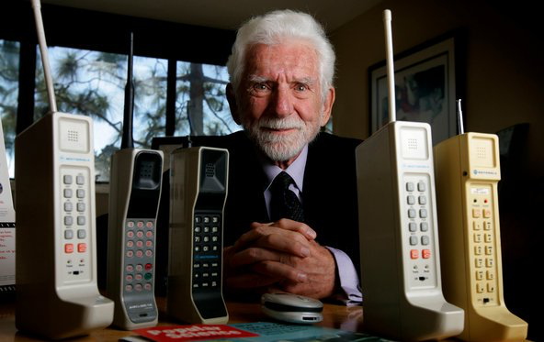
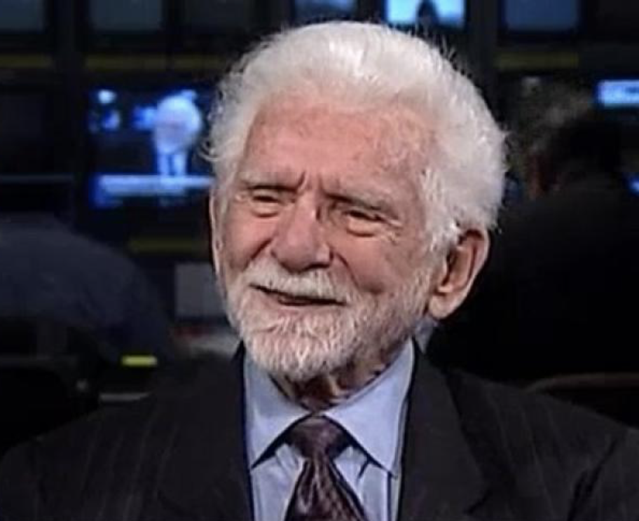
The Life Skills Practice Room
Creative Thinkers

Slide 14
The Life Skills Practice Room
Creative Thinkers
Martin Cooper

Slide 15
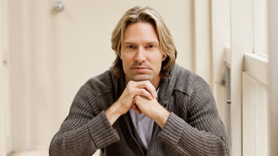
The Life Skills Practice Room
Creative Thinkers

Slide 16

The Life Skills Practice Room
Creative Thinkers
Whitacre’s Virtual Choir 1
Sings Lux Arumque

Slide 17

The Life Skills Practice Room
2. Critical Thinking. . .
  Ability to reason effectively and
  solve problems.

Slide 18
The Life Skills Practice Room
Problem-Solving
EX: A student’s solution to getting
people to turn off their phones during a performance:

Slide 19
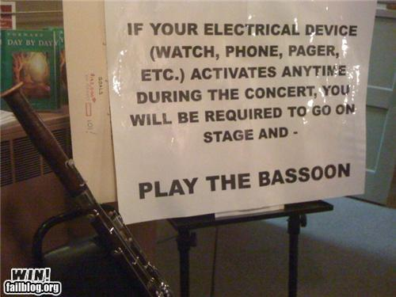

Slide 20
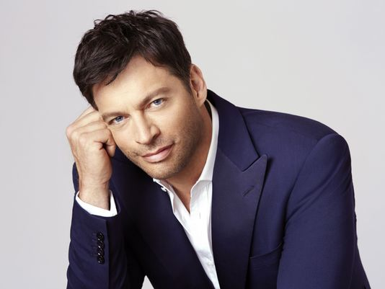
The Life Skills Practice Room
Problem Solvers:

Slide 21
The Life Skills Practice Room
Harry Connick, Jr. holds a
patent for a digital sheet
music, touch-screen system
that coordinates musical
displays for musicians in
an orchestra. No need to
print revised parts!

Slide 22
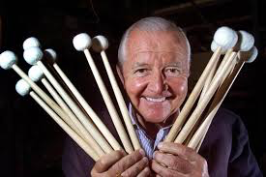
The Life Skills Practice Room
Problem Solvers:

Slide 23
The Life Skills Practice Room
Vic Firth was inspired to design a
higher-quality mallet than the
“warped utensils and implements
not specifically designed for
percussionists” while
playing timpani with the
Boston Symphony Orchestra.

Slide 24
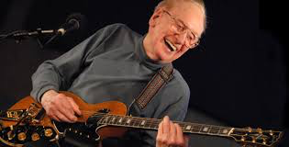
The Life Skills Practice Room
Problem Solvers:

Slide 25
The Life Skills Practice Room
Les Paul invented the
solid body guitar because his audience at the BBQ joint
where he performed
couldn’t hear him play.

Slide 26
The Life Skills Practice Room
3. Collaboration (Teamwork). . .
  Ability to work effectively and respectfully with ALL

Slide 27
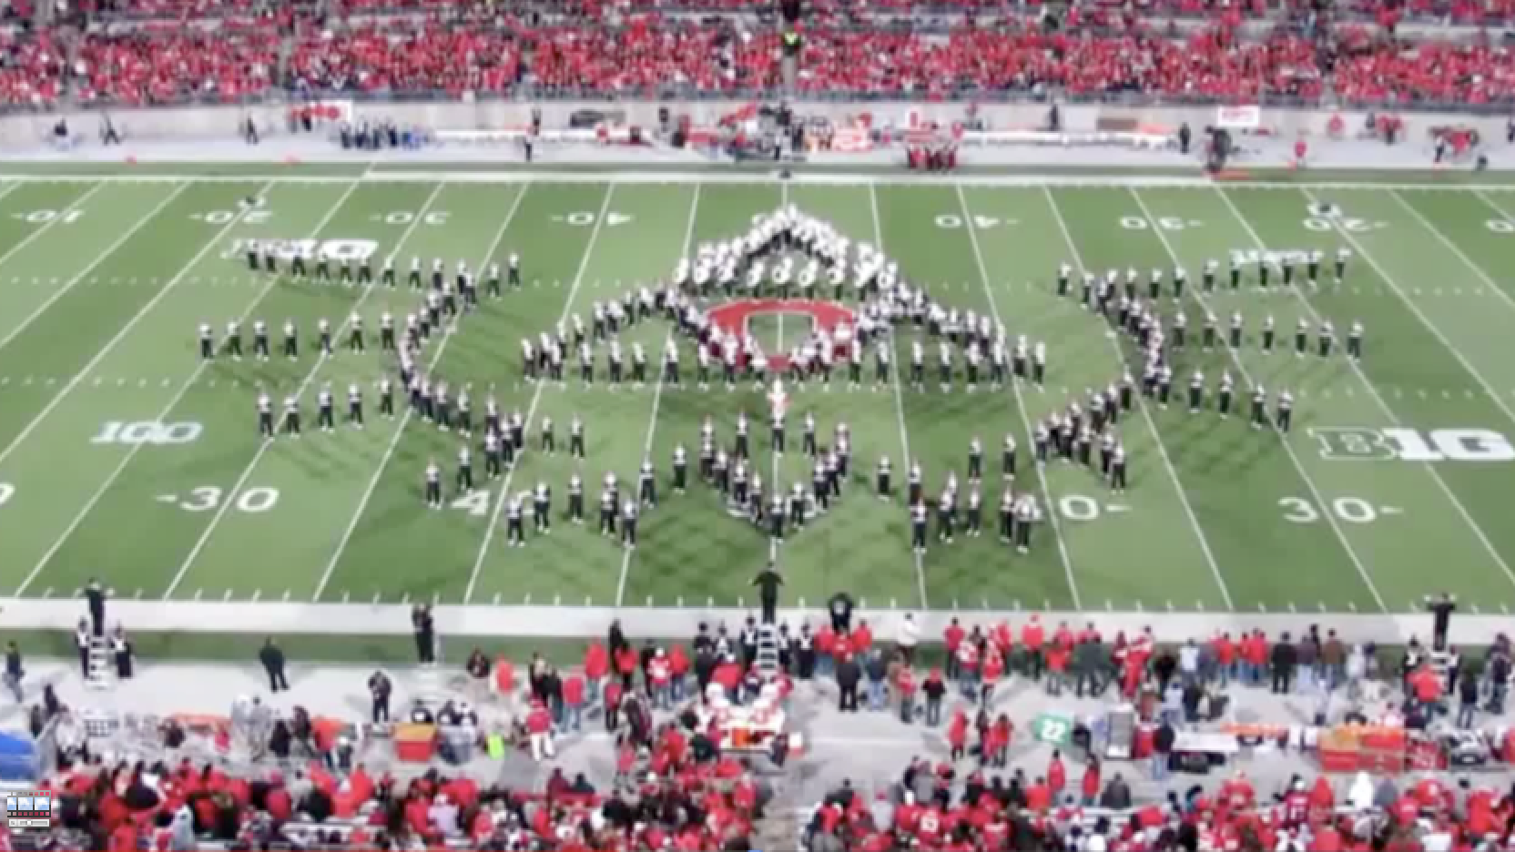
The Life Skills Practice Room
Ohio State University Marching Band

Slide 28
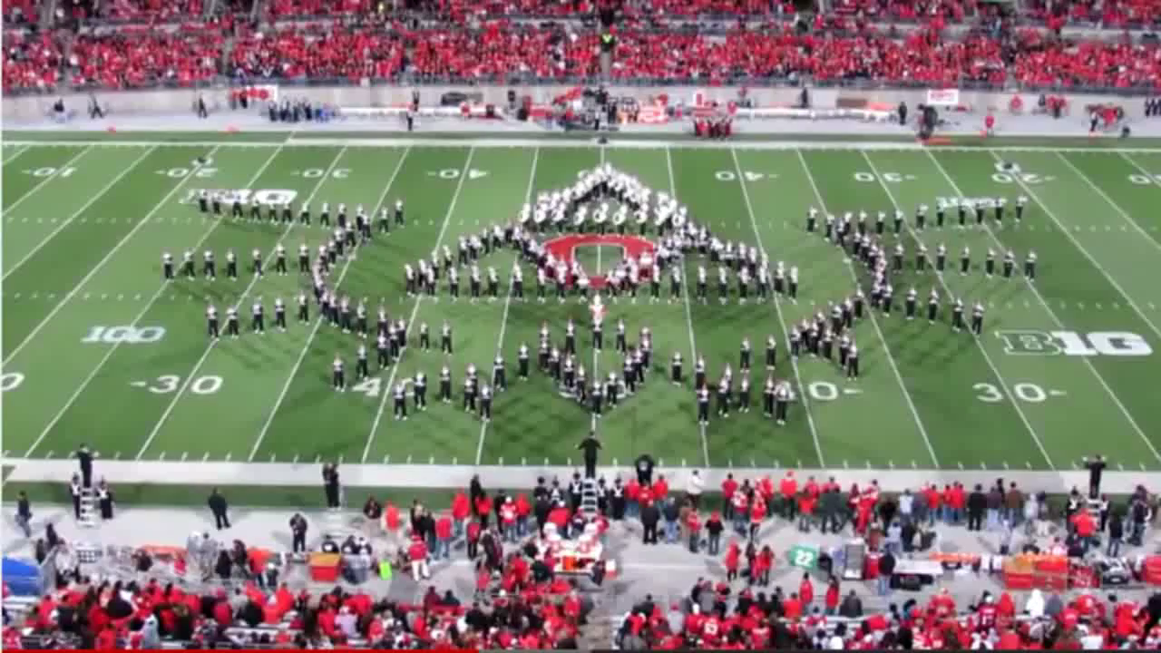
The Life Skills Practice Room
Ohio State University Marching Band

Slide 29
The Life Skills Practice Room
4. Confidence. . .
  Ability to handle EVERY
  CIRCUMSTANCE and grow from it.

Slide 30
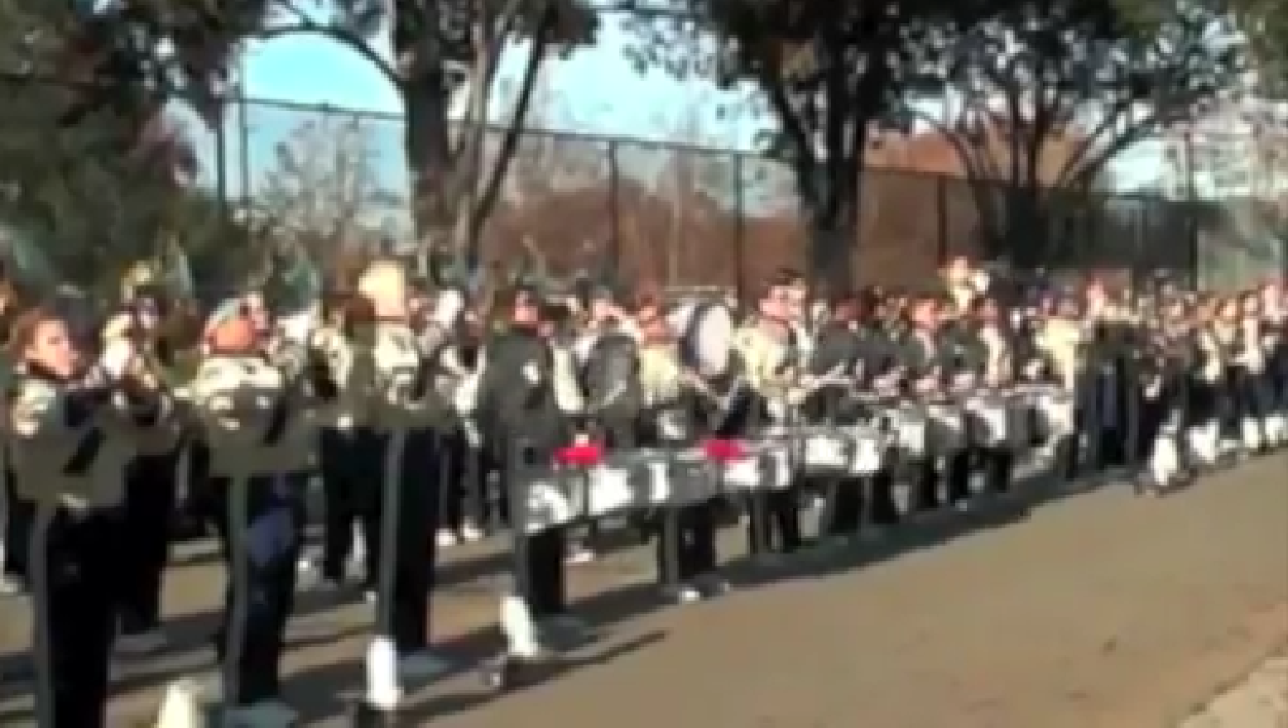
The Life Skills Practice Room

Slide 31

The Life Skills Practice Room

Slide 32
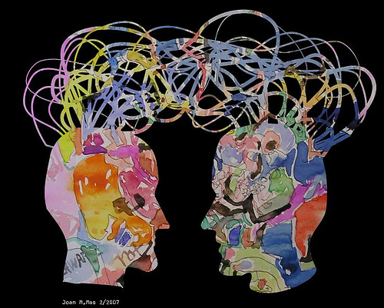
The Life Skills Practice Room
5. Communication. . .
  Ability to listen
  and express thoughts
  effectively

Slide 33
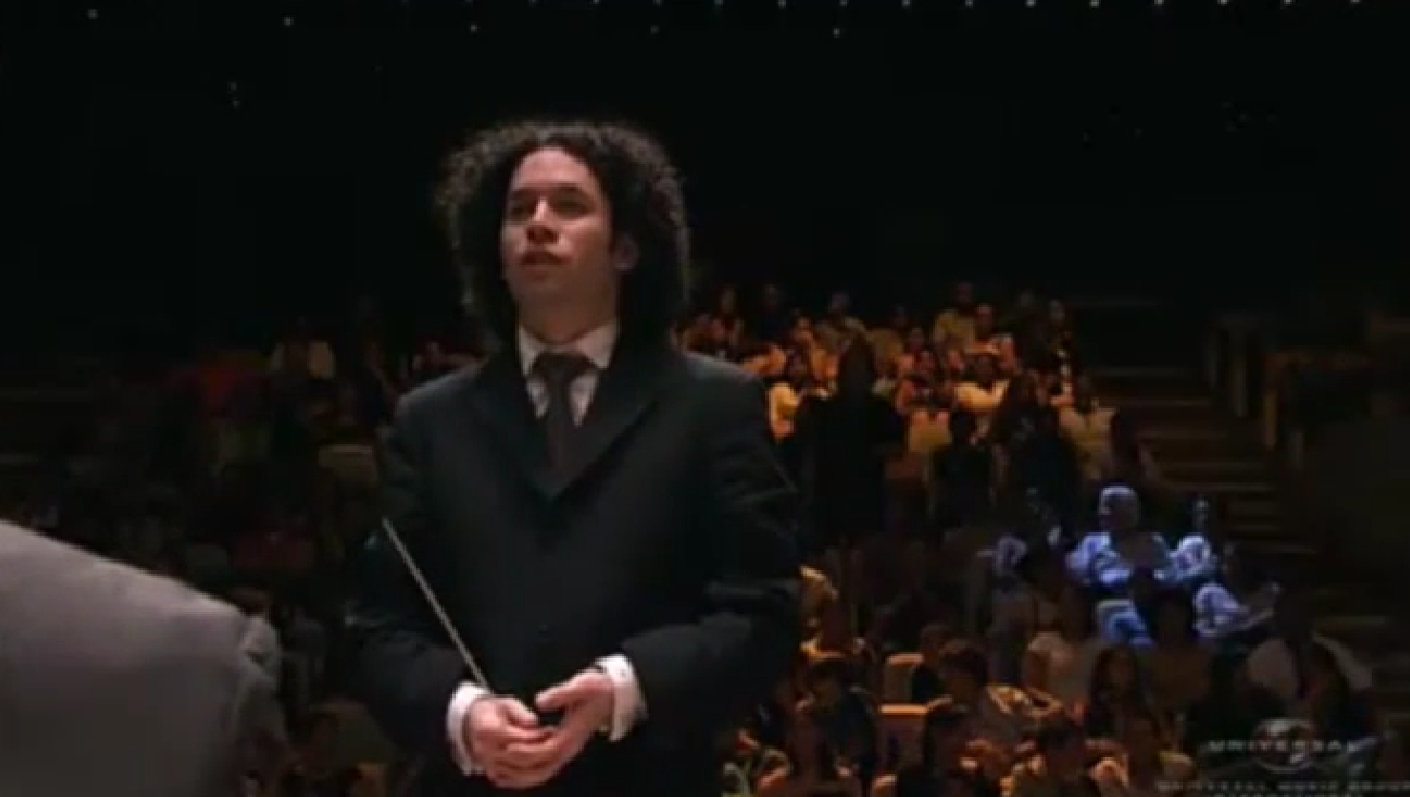
Communication
Maestro Gustavo Dudamel

Slide 34

Communication
Simón Bolivar School Orchestra, Venezuela

Slide 35
Parents
Teachers
“ONE IS TOO SMALL A
NUMBER TO ACHIEVE
SOMETHING GREAT”
Principals
Custodians
How can we ALL come together?
Support Staff
Dealers
Community

Slide 36

Focus on One Goal

Slide 37
Focus on One Goal
Ensure continued,
active music-making.

Slide 38


Slide 39

We offer a path to Success
We provide meaningful, lifelong Memories
We foster expression through Art
We teach mutual Respect
We exemplify the meaning of Trust

Slide 40
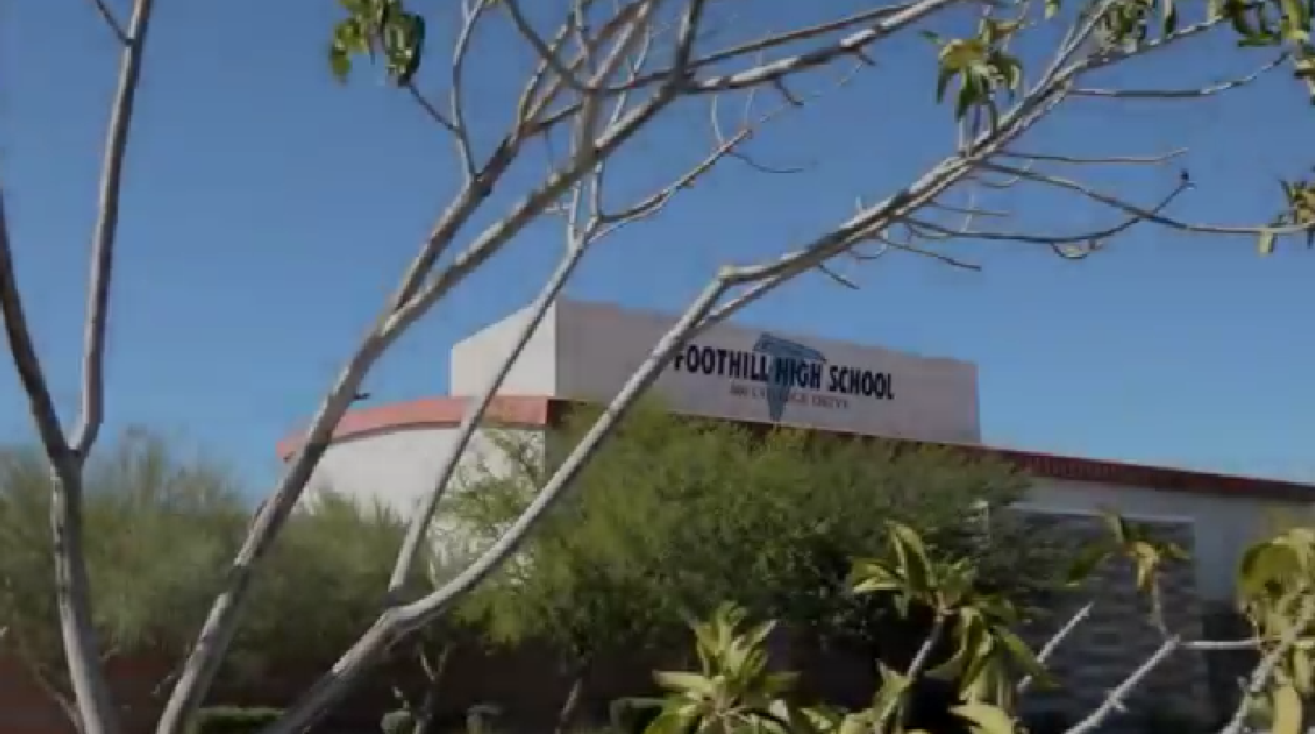
There is a Place…where kids are S.M.A.R.T.

Slide 41

There is a Place…where kids are S.M.A.R.T.

Slide 42



Join Our Music Education Community
Yamaha.io/YME_marcia

