Slide 1


Making an Advocate of Your Principal:
10 Things to Do “Monday”
Marcia Neel
marcia@musicedconsultants.net
www.musiceducationconsultants.net/conference-materials

Slide 2
The Two Querries…
What Do Principals Really Think?
2.What Have You Done to Make an Advocate out of Your Principal?

Slide 3
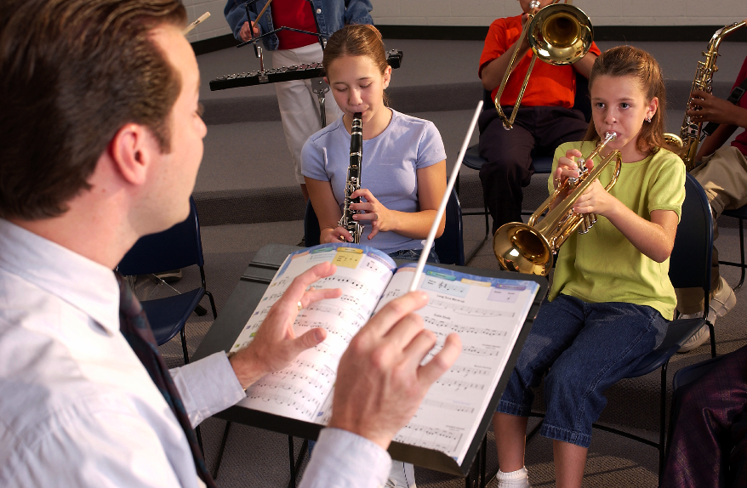
1. What I love best about my music teacher is
that he/she is. . .(here we go!)
Caring
Dedicated
Passionate
Committed
Success-oriented
Organized
Dynamic
Positive
A Team Player/Builder
with Students, Staff and Parents

Slide 4
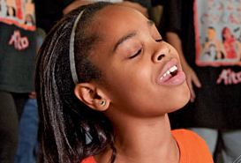
1. What I love best about my music teacher is
that he/she is. . . (cont.)
Communicative
Encouraging
Flexible
Professional
Creative
Talented (Performer)
Intense (In a Good Way)
Effective with Pedagogy

Slide 5
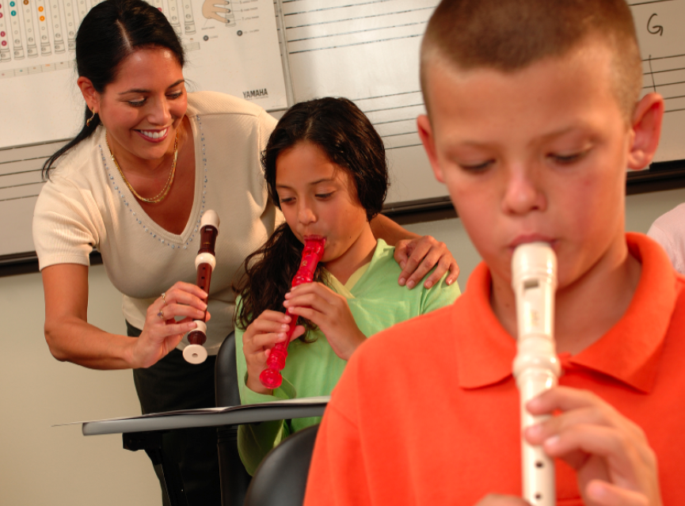
1. What I love best about my music teacher is
that he/she is. . . (cont.)
Responsible
Collegial
Motivational
Inspirational
Helpful
Content-oriented
A Music Advocate (Recruiter)
Demanding (Of Self and Students)

Slide 6
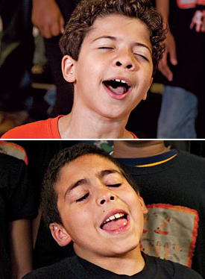
2. To improve the music program, I would ask my music teachers to. . .
Communicate ! Communicate! Communicate!
Coordinate/Collaborate with Colleagues
Articulate with Feeder Schools More
Recruit/Retain More
Focus on Building Group Identity
Promote More
Perform More

Slide 7
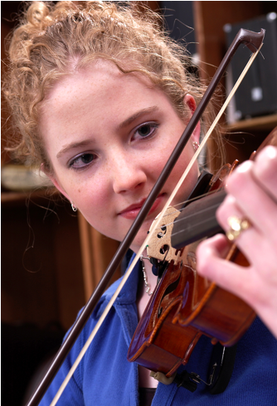
2. To improve the music program, I would ask my music teachers to. . .(cont.)
Help Administrators to Help Them
(esp: Class Sizes and
Program Building)
Extend Learning Into the
Community
Develop More Partnerships
Incorporate School-wide
Objectives
Assess Their Own Programs More
Often

Slide 8

3. What troubles me most is that he/she is not. . .
Passionate
Considerate of the Big Picture
Communicative
Demanding Enough
Managing the Classroom Well
Lesson-planning Effectively
Even-tempered
A Team Player
Organized

Slide 9



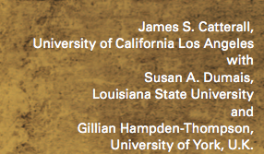
What Have You Done to Make an
Advocate Out of Your Principal?
“I communicate and keep my principal informed.”

Slide 10

“I communicate and keep my principal informed.”

Slide 11
What Have You Done to Make an
Advocate Out of Your Principal? (Con’t.)
Always Have Small Ensembles READY to Perform
Invite Her (and Faculty) to PERFORM in the Holiday Concert
Copy Him on All Correspondence
Communicate Music Advocacy Information
Take him Golfing
. . .He wins a lot!!!!!

Slide 12
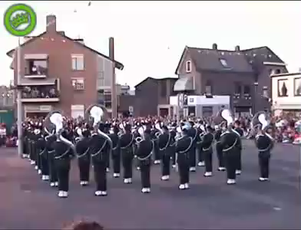
Sometimes Though -- It Seems As If Principals TRY To Trip Us UP!

Slide 13
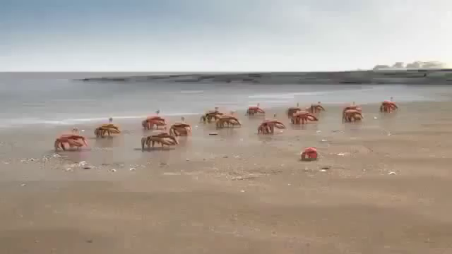
BUT. . .It Really Takes Team Effort!

Slide 14
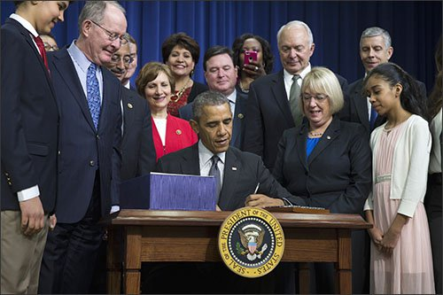
1. Help Your Principal Understand
ESSA: Every Student Succeeds Act

Slide 15


ESSA: So What’s New?
It ends the Federal School Improvement Strategies

Slide 16


ESSA: So What’s New?
Accountability is moving from Federal to State level.
NCLB was top-down, one-size fits all approach to struggling schools,
ESSA offers the flexibility to find the best local solutions—while also ensuring that students are making progress.

Slide 17

ESSA: So What’s New?
Accountability is moving from Federal to State level.
ESSA, while encouraging rigorous and challenging state academic standards on which the state’s accountability system is built, does not require Common Core

Slide 18

ESSA: So What’s New?
Ends Federal Goal of 100% Proficiency by 2014
It ends the requirement that all schools that don’t meet goals for any subgroup of students are automatically identified as failing.
But wait. . .
there’s more!

Slide 19
ESSA Terms to Look for:
“Well-rounded,” “Music,” “Arts”
The “Well-Rounded Education” provision (previously known as “Core Academic Subjects”) is a section (Sec. 8002) within ESSA that lists courses, activities, and programming in subjects deemed critical when providing students a broad and enriched educational experience. The provision includes “music” and “arts,” which articulates the importance of music and arts as a part of every child’s education.

Slide 20
ESSA
Why is this important for ME?
  A New and Clear Intent to Support Our Nation’s
  Schools Through a Well-Rounded Education
  2. Enumeration of Music and Arts as a Well-Rounded Subject
  3. Requirements for Well-Rounded Education: Schools will now be able to assess their ability to provide a well-rounded education and address deficiencies using federal funds.

Slide 21
ESSA
Why is this important for ME?
  4. Flexibility of Title I funds to provide supplemental funds for well-rounded education (ergo, Music and Arts Education)
  5. More Professional Development for Music and Arts Educators through Title II funding
  6. Flexible Accountability Systems—not just tests!
  7. Protection from “Pull Outs” (we keep hoping!)

Slide 22
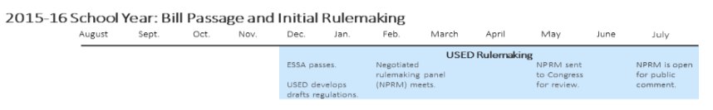
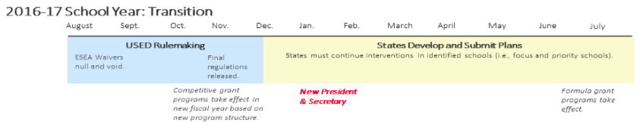
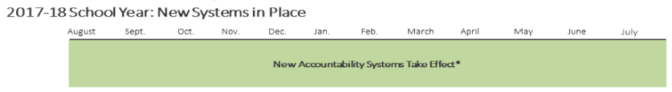
ESSA Timeline
Credit: Foundation for Excellence in Education

Slide 23
So What Should I Do? Next Steps
  Become familiar with ESSA (Handout)
  Everything ESSA on NAfME Website
  2. Meet with your Music and Arts Dept Team
  Plan Needs Assessment?
  Schedule a meeting with your Principal
  4. SERVE! Your principal does not know
  your needs

Slide 24
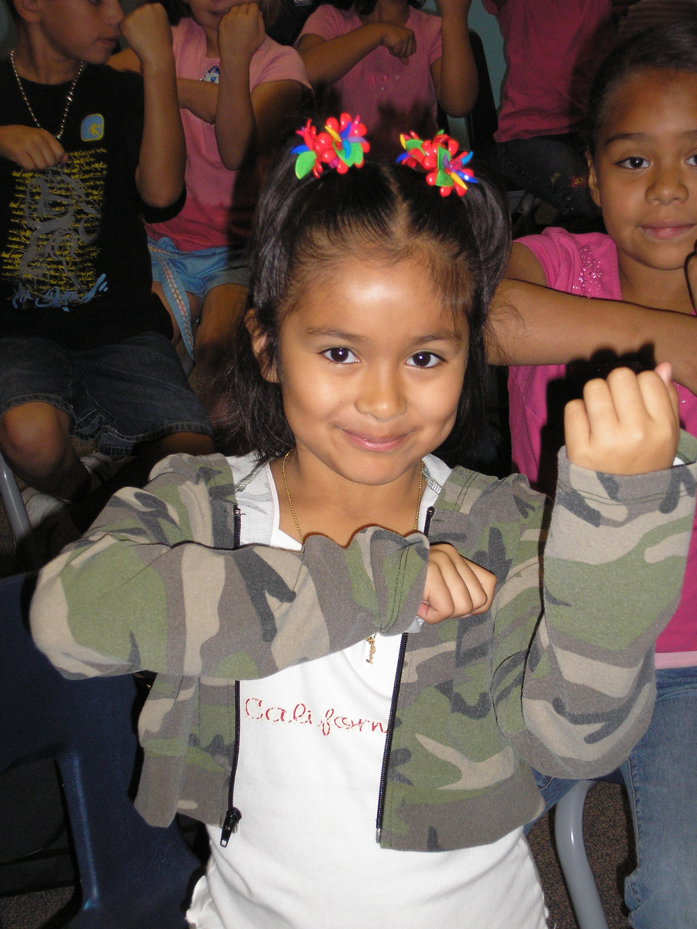
2. Engage Your Principal Directly
Come on down. . .
“Help me give out
instruments to the kids!”

Slide 25
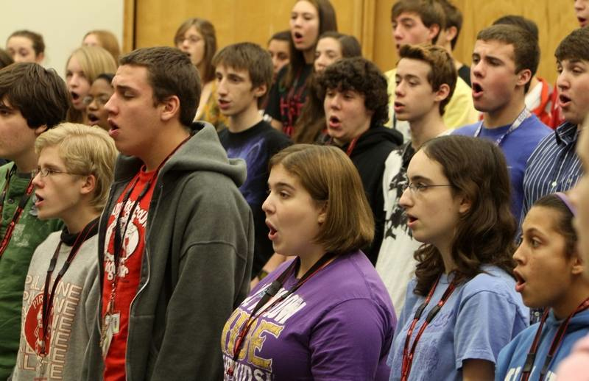
2. Engage Your Principal Directly
Come on down. . .
“I need an audience to help the students prepare for…”

Slide 26
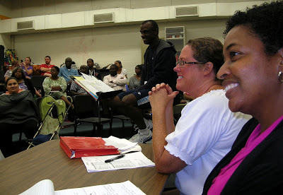
2. Engage Your Principal Directly
Come on down. . .
“Could you give a presentation to the Booster Parents?”

Slide 27
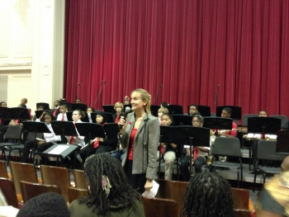
2. Engage Your Principal Directly
Come on down. . .
“Could you provide Opening Remarks at our upcoming concert?”
Praise your administrator in front of the
parents for their support.
Have students present a signed, framed print.

Slide 28
3. Ask your students to complete the sentence, “Music makes the difference because. . .” then use their responses.
“…when you’re sad and then you play music, it cheers you up. Music will always be there for you.”
“…it makes me feel free and like nobody is judging me.”

Slide 29
Music makes the difference because…Use their responses. . .
a. In your upcoming concert programs/newsletters
  b. In your school newspaper’s “music corner” (Don’t have a “music corner?” You know what to do!)
  c. As copy for making banners/posters to display around the school
  d. As copy for recruitment fliers and posters at feeder schools
  e. As copy for MMEA publications
  f. As copy for a publication about your school’s FANTASTIC music program

Slide 30
4. Retrieve information about the value of studying music - quote it in any of the above outlets but especially on recruitment information! Share with your supervisor.
Resources:
NAfME.org
bit.ly/MusicEdFacts
supportmusic.com

Slide 31

5. Recruit 24/7

Slide 32
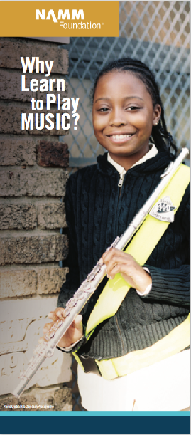


5. Recruit 24/7 – FREE COPIES
of assorted brochures available from:
NAMMFoundation.org

Slide 33
6. In your next concert program, include an insert designating each attendee as a member of the newly-formed Mozart Middle School Coalition for Music Education/Music Boosters Club/Committee to Promote Music Education
  a. To help make the program better for those they love
  b. To help establish the program as a school-wide entity using a positive approach
  d. To feel invested -- i.e. “buy-in”
  continued. . .

Slide 34
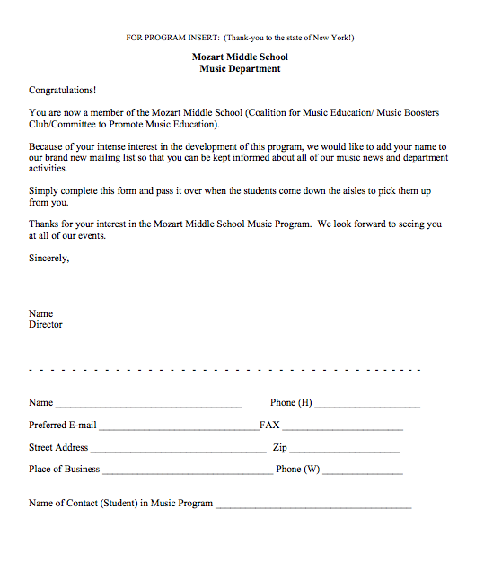
  Parents are the ones who have the most important interest at hand. It is THEIR child’s music education.
    They can become your voice if needed.

Slide 35


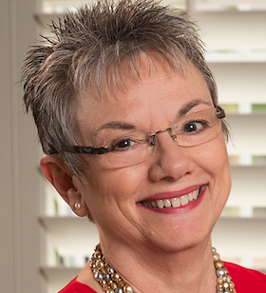


7. Let the Information Come Directly to YOU!!!
Get on Twitter and start following!!!
@NAfME
@MaryLNAMM
@MusicEdConsult
@MusicAchCouncil
@EricWhitacre

Slide 36
8. Arrange for a performance for the principal’s meeting, school board, city council, state legislature, etc. They will appreciate the “good news” for a change.
BE READY!!!!!!!!
PERFORM WELL!!!!

Slide 37





9. Create a website, Twitter Account, etc. and communicate, communicate, communicate. Share the GOOD NEWS!!!!

Slide 38
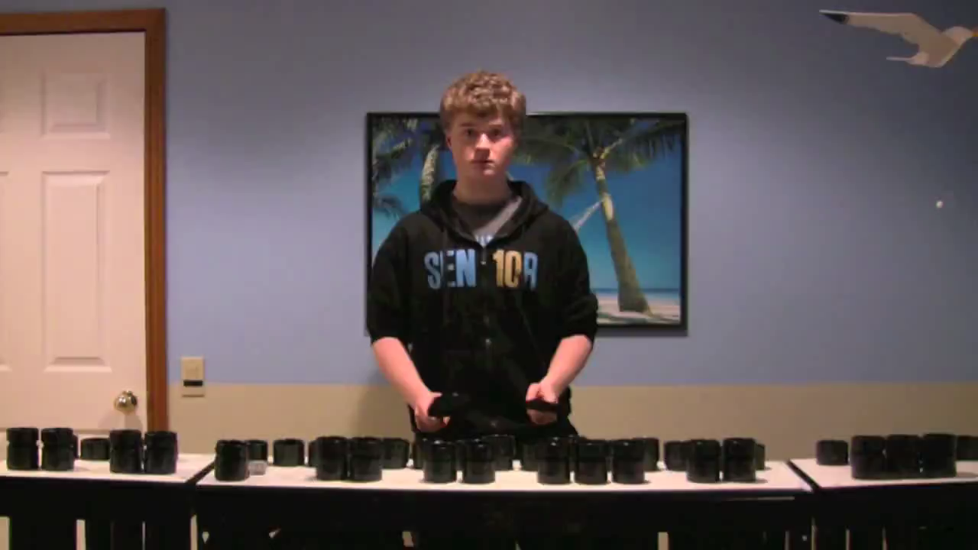
Website Videos Could Include:
Student Projects: with Permission

Slide 39

Website Videos Could Include:
Student Produced Videos!

Slide 40
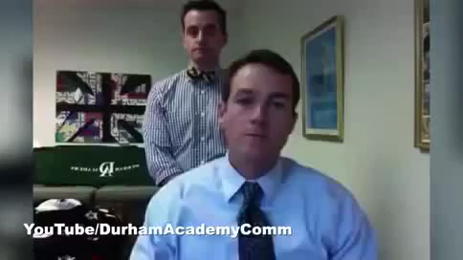
Website Videos Could Include:
School Announcements

Slide 41
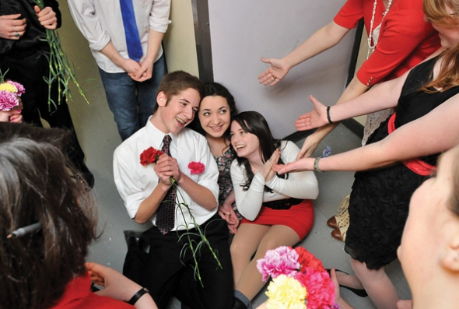
11. Come up with a clever version of a “Happy Birthday” song to serenade your school staff on their special day. THEY WILL LOVE YOU FOR IT! Give away FREEBIES!
Insert Serenade Photo

Slide 42
Remember. . .Your principal needs YOU!
Be an active, involved member of the faculty.
Take part in as many school activities as you can.
Volunteer to help when needed.
Organize faculty functions, school food drives, etc. (at least one each semester)
Ask how you/your program can help build school spirit.

Slide 43
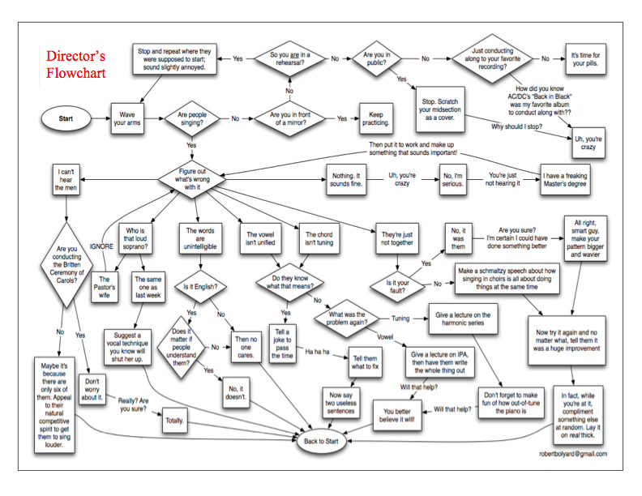
How Can I Do It All?

Slide 44
How Can I Do It All?
Stay Focused
on the “Why!”
We are ALL in this
for the Kids!

Slide 45


Thank-You!
Posted at:
www.musicedconsultants.net/conference-materials

