Slide 1

DID YOU KNOW . . .
The Music Achievement Council (MAC) is an action-oriented, non-profit organization whose sole
purpose is to enable more students to begin and continue in instrumental music programs.
www.musicachievementcouncil.org

Slide 2
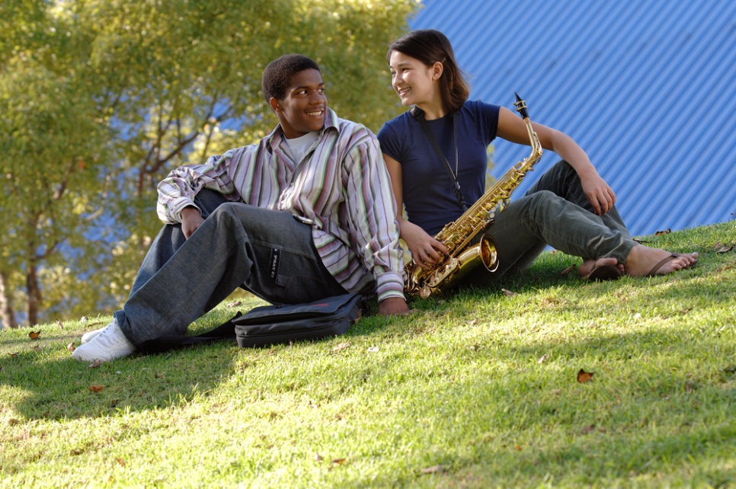
DID YOU KNOW . . .
96 percent of public school principals
believe that participating in music
education encourages and motivates
students to stay in school longer.
(Harris Poll)
www.musicachievementcouncil.org

Slide 3
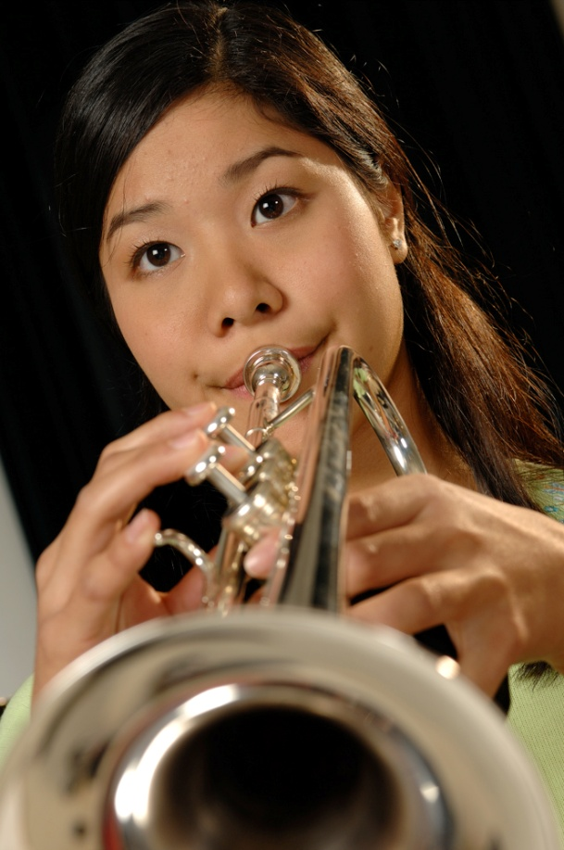
DID YOU KNOW . . .
An interactive poll confirms that music education at an early age greatly increases the likelihood that a child will grow up to seek higher education and ultimately even earn a higher salary. (2007 Harris Poll)
www.musicachievementcouncil.org

Slide 4
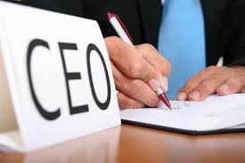
THE MESSAGE IS. . .
If you want to be a CEO, College President,
or even a Rock Star,
TAKE MUSIC!
www.musicachievementcouncil.org

Slide 5

THE MESSAGE IS. . .
If you want to be a CEO, College President,
or even a Rock Star,
TAKE MUSIC!
www.musicachievementcouncil.org

Slide 6
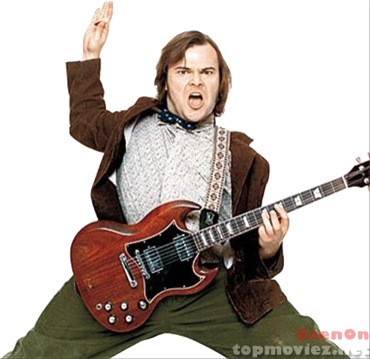


THE MESSAGE IS. . .
If you want to be a CEO, College President,
or even a Rock Star,
TAKE MUSIC!
www.musicachievementcouncil.org

Slide 7
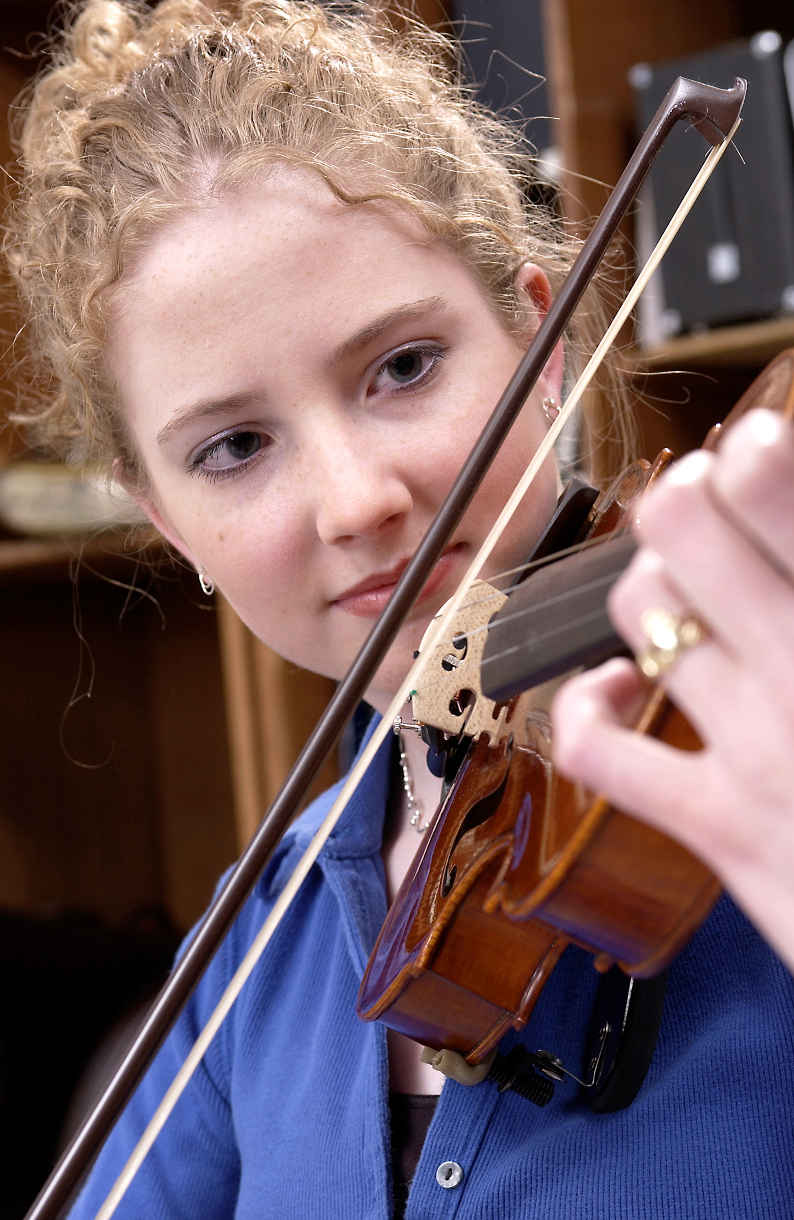
DID YOU KNOW . . .
82 percent of Americans who don’t currently play an instrument wish they had learned to play one. (Gallup Poll)
www.musicachievementcouncil.org

Slide 8
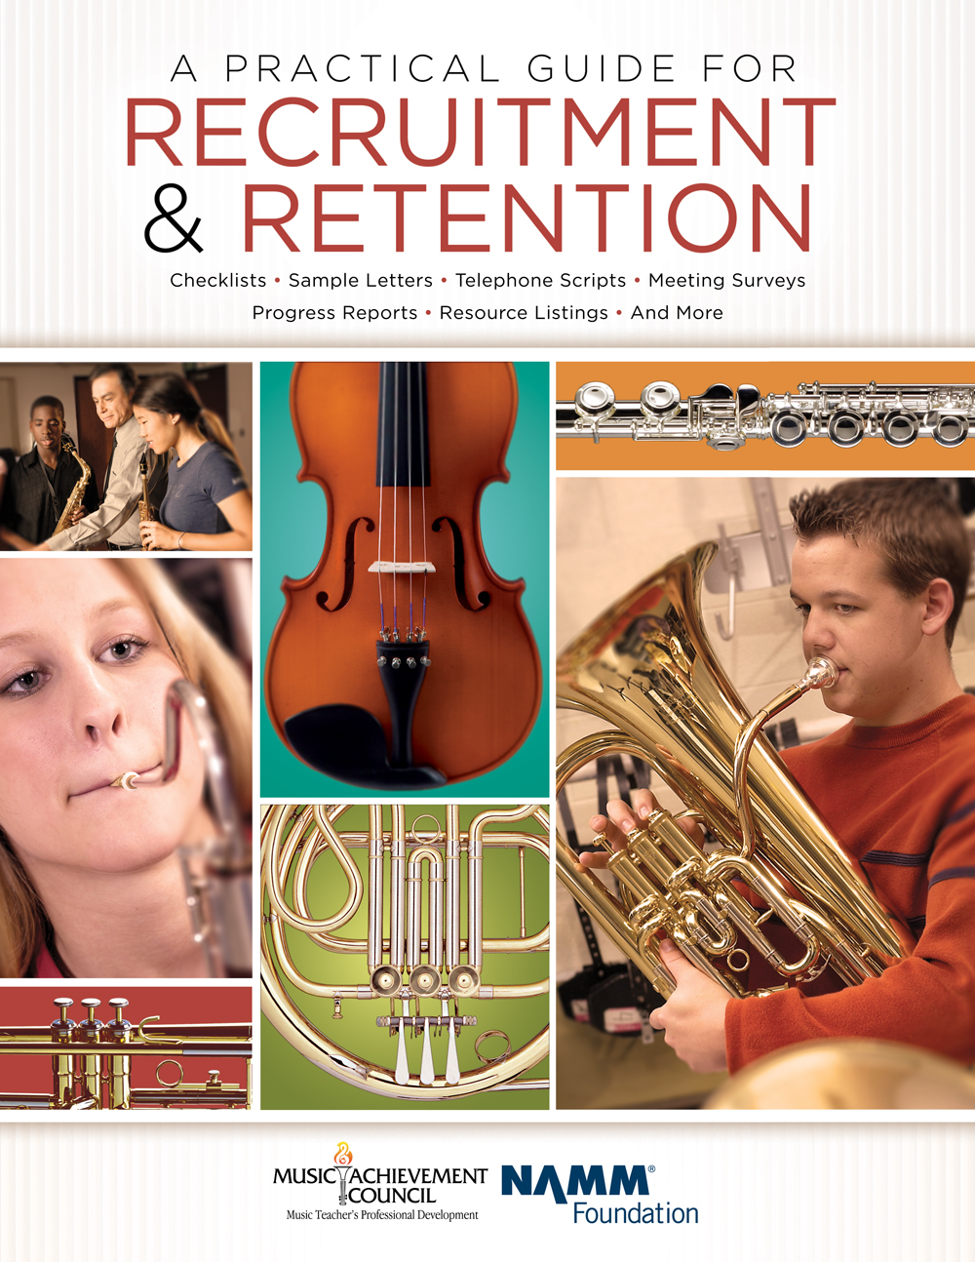
DID YOU KNOW . . .
All of our MAC session attendees receive FREE COPIES of:
A Practical Guide for Recruitment and Retention
www.musicachievementcouncil.org

Slide 9
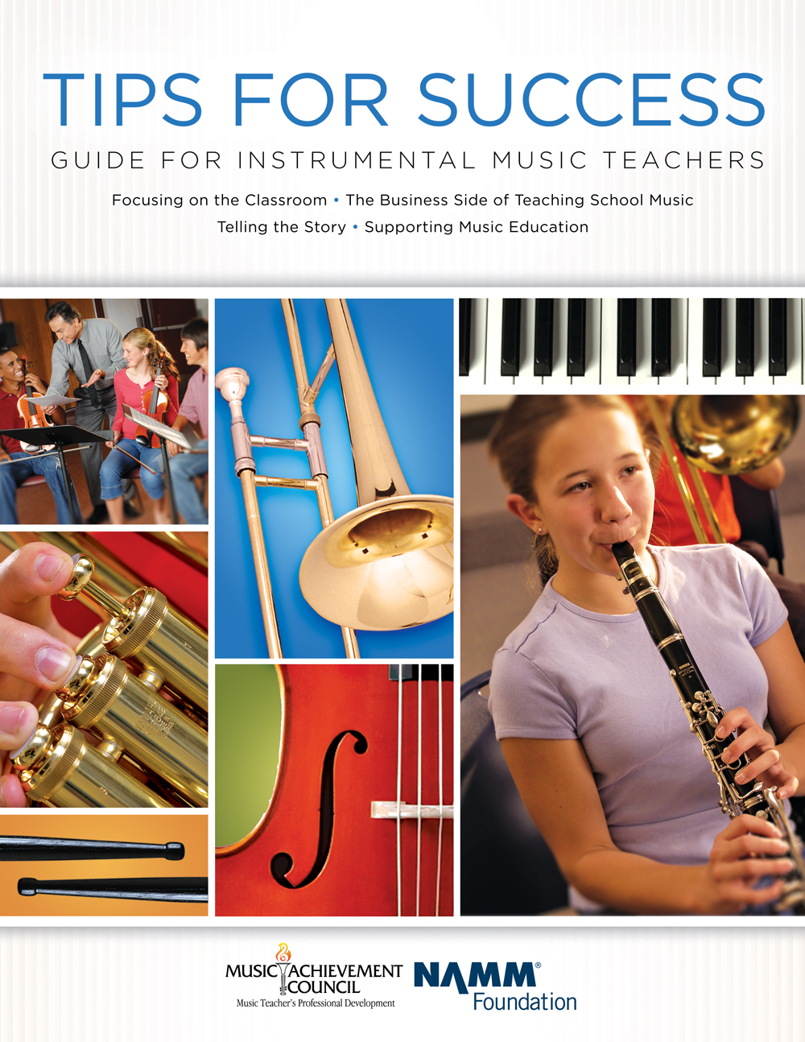
DID YOU KNOW . . .
All of our MAC session attendees receive FREE COPIES of:
Tips for Success:
A Guide for Instrumental Music Teachers
www.musicachievementcouncil.org

Slide 10
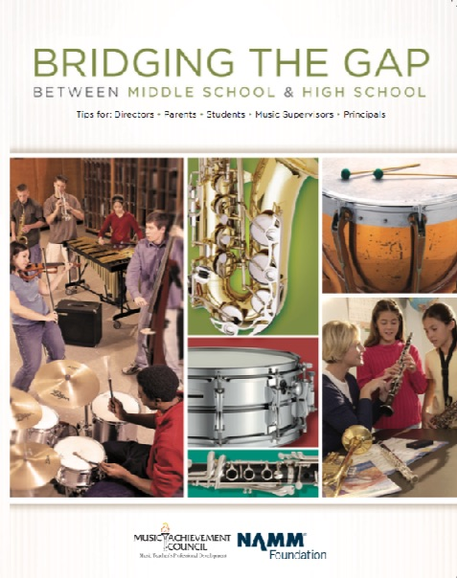
DID YOU KNOW . . .
All of our MAC session attendees receive FREE COPIES of:
Bridging the Gap between
Middle School and High School
www.musicachievementcouncil.org

Slide 11
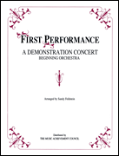
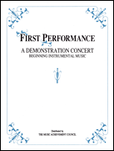
DID YOU KNOW . . .
The First Performance Demo Concert for Band and/or Orchestra features sheet music, parts, sample letters, programs and student certificates for beginning ensembles. Students can perform a composition in seven short weeks with the materials provided!
www.musicachievementcouncil.org

Slide 12
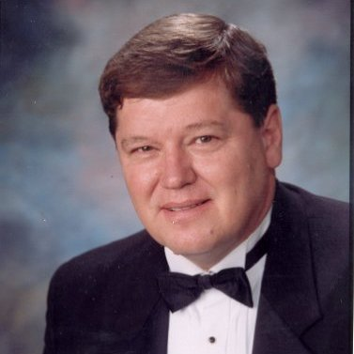
DID YOU KNOW . . .
Three of these publications are provided online at no charge by the Music Achievement Council.
Greg Bimm
They are based on real world strategies shared by the profession’s most successful music educators.

Slide 13
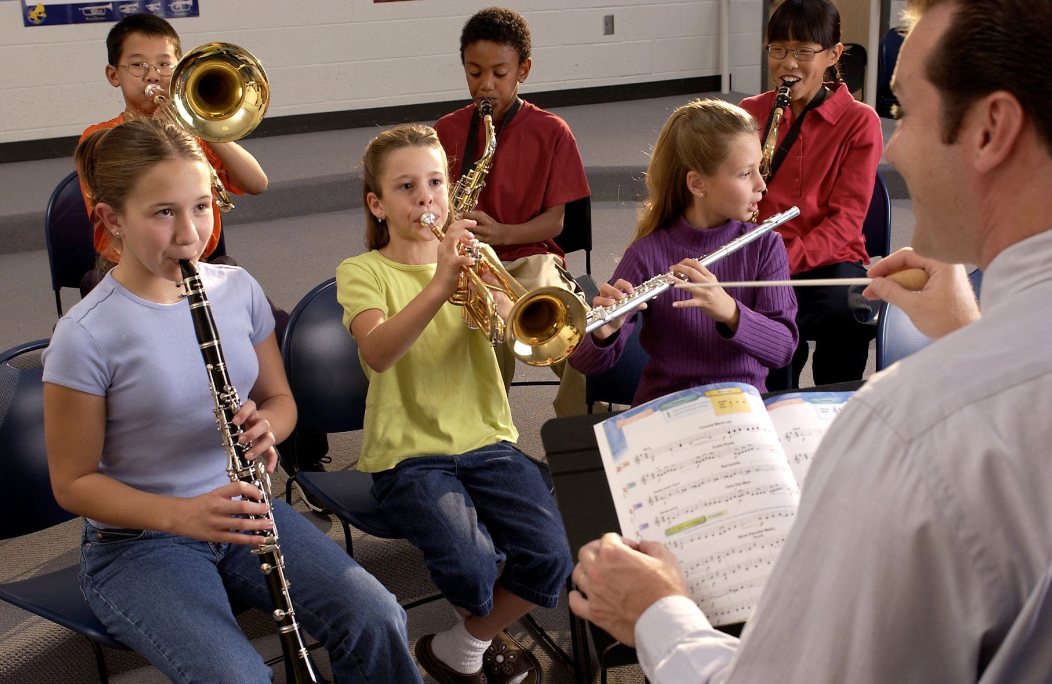

DID YOU KNOW . . .
www.musicachievementcouncil.org

Slide 14
DID YOU KNOW . . .
Music making has been scientifically proven to:
Exercise the brain
Inspire creativity
Increase productivity
Fight memory loss
Reduce stress
Lower blood pressure
Build confidence
Stave off depression

Slide 15

DID YOU KNOW . . .
Metropolitan Nashville Public Schools found that ATTENDANCE RATES ROSE with increased study in music.
No Music:
< 1 Year of Music:
> 1 Year of Music:
87% Attendance
91% Attendance
93% Attendance

Slide 16
DID YOU KNOW . . .
Metropolitan Nashville Public Schools found that DISCIPLINE REPORTS FELL with increased study in music.
No Music:
< 1 Year of Music:
> 1 Year of Music:
4.34 over 4 years
3.75 over 4 years
3.23 over 4 years

Slide 17
DID YOU KNOW . . .
Metropolitan Nashville Public Schools found that GPAs ROSE with increased study in music.
No Music:
< 1 Year of Music:
> 1 Year of Music:
2.51 Average
2.61 Average
2.89 Average

Slide 18
DID YOU KNOW . . .
Metropolitan Nashville Public Schools found that GRADUATION RATES ROSE with increased study in music.
No Music:
< 1 Year of Music:
> 1 Year of Music:
60% Average
81% Average
91% Average

Slide 19
DID YOU KNOW . . .
Metropolitan Nashville Public Schools found that ACT SCORES ROSE with increased study in music.
No Music:
< 1 Year of Music:
> 1 Year of Music:
16.95 Eng, 17.20 Math
17.64 Eng, 17.62 Math
19.58 Eng, 18.67 Math

Slide 20
WHAT WAS LEARNED?
The MORE a student participates in MUSIC,
the more POSITIVE these BENEFITS become.

Slide 21
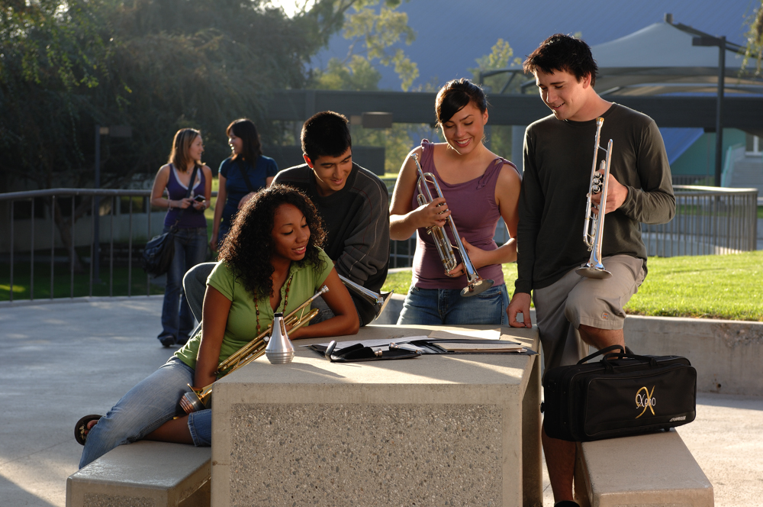
FAMOUS QUOTES. . .
Music has the power of producing a
certain effect on the moral character of
of the soul.
. . . Aristotle

Slide 22
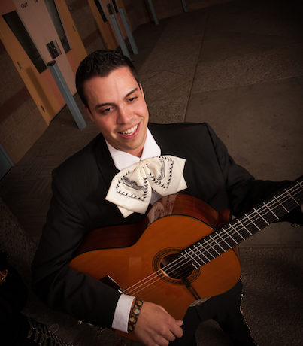
FAMOUS QUOTES. . .
Music furnishes a delightful recreation
for the hours of respite from the cares of the day, and lasts us through life.
. . . Thomas Jefferson

Slide 23

MAC Update:
What Music Education Needs from You!

Slide 24
Promoting “our”
Message

Slide 25

Recruitment and Retention
WE WANT YOU!

Slide 26
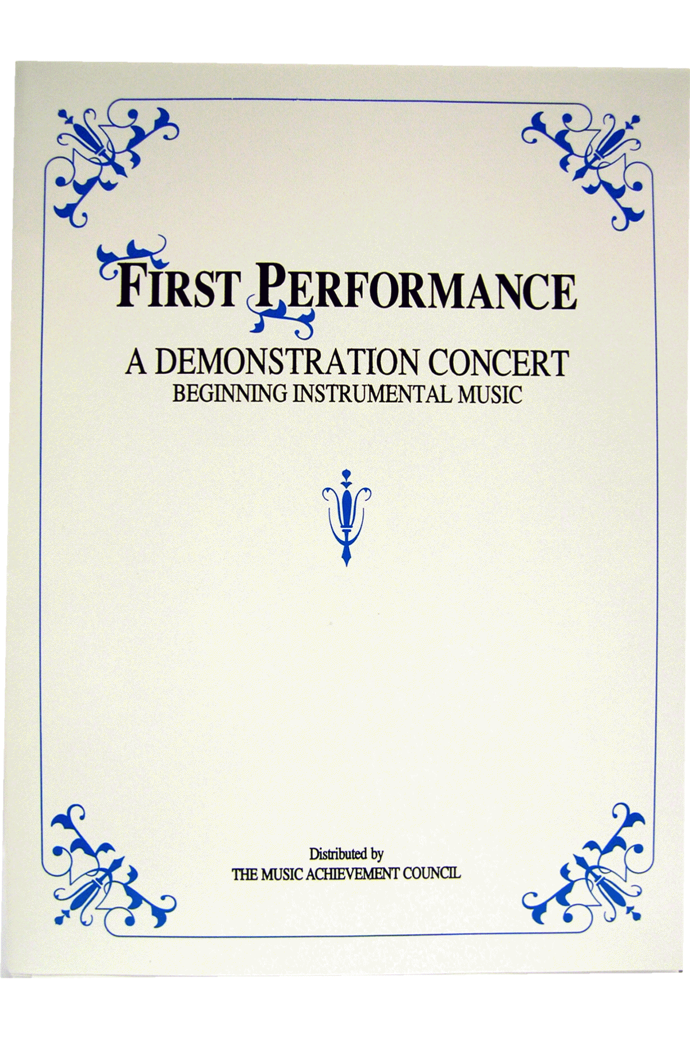
Build the vision EARLY — Elementary
GET ‘EM FIRED UP!
Give a
First Performance
Concert
with Your Beginners!
Involve Experienced Players!

Slide 27

Build the vision EARLY — Elementary
First Performance Concert
Involve Experienced Players!

Slide 28
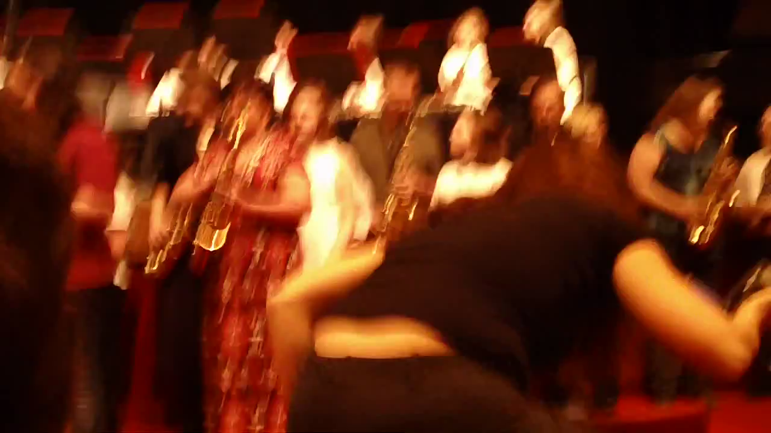
Engage the Parents

Slide 29
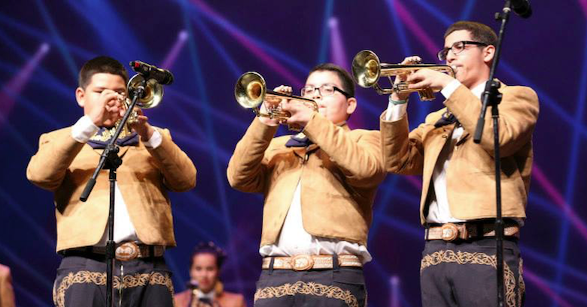
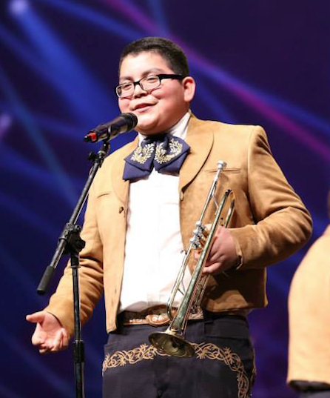
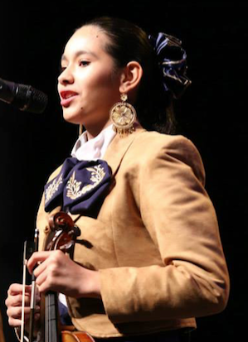
Broaden Your Base!

Slide 30
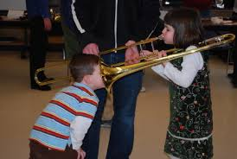
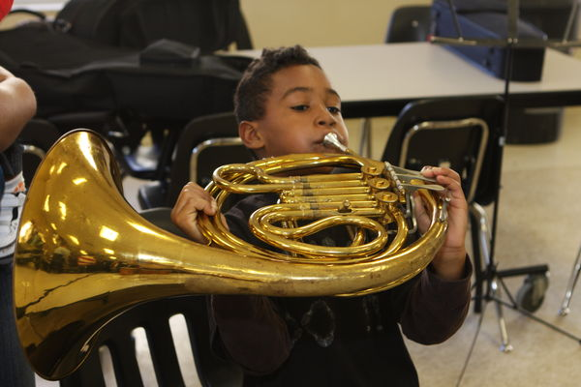
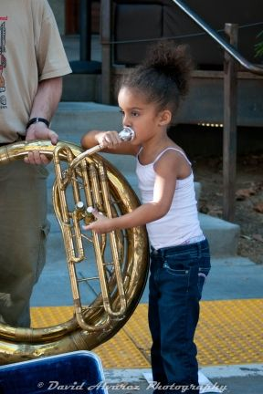
Focusing on the Classroom
Recruit: Attract Students Year-Round
Instrument demos/petting zoos

Slide 31

Retain: Keep the students you have!

Slide 32

Choosing a Music Dealer
Dealers Support Our Programs by. . .
Providing advocacy materials & recruiting help
Providing regular service calls
Ensuring competitive prices
Offering lease programs for new instruments
Providing folders, posters, calendars, nametags. . .
Serving as a partner to help develop our programs
All YOU have to do is ask!!!

Slide 33
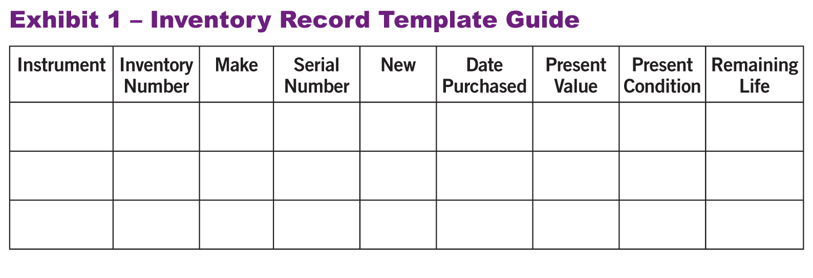
Instrument Replacement: The 5-Year Plan
1. Evaluate the instruments/equipment. Create an Inventory Record Guide
HINT: Know your school’s Fiscal Policies!

Slide 34
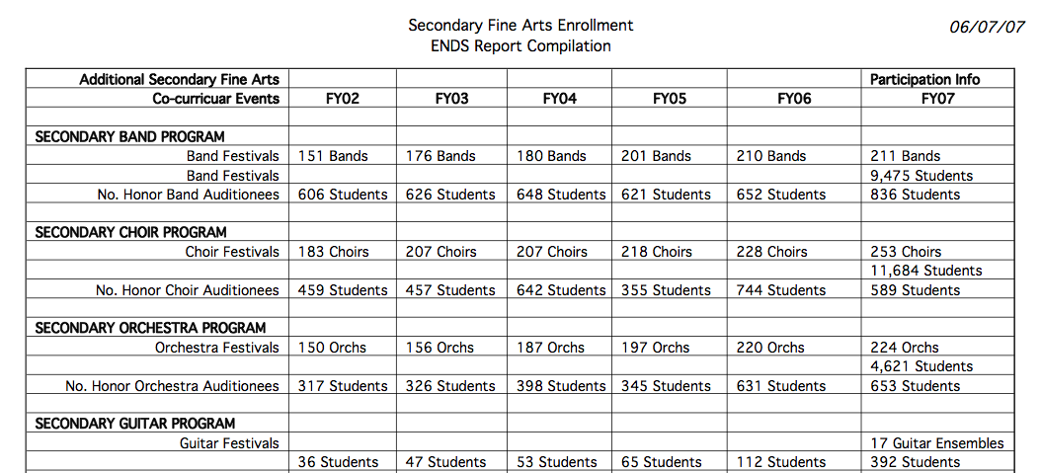
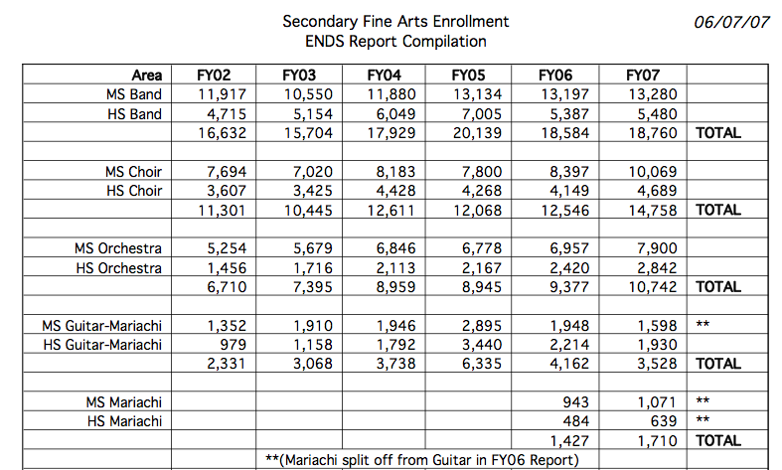
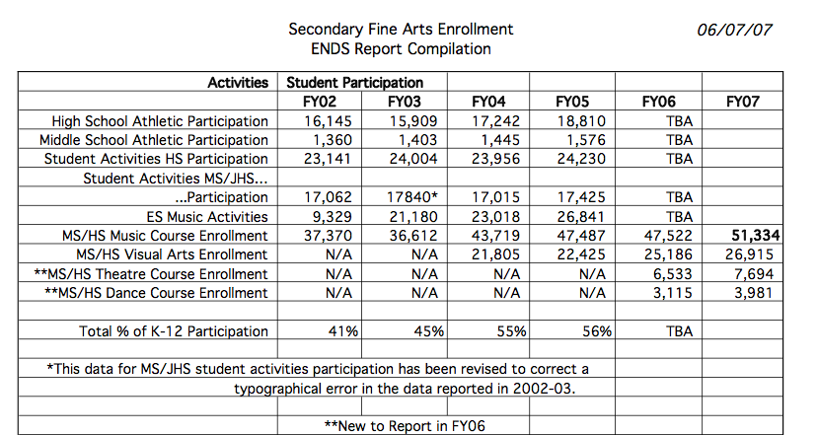
Telling the Story: DATA! DATA! DATA!
Notes:
Produced by the Music Achievement Council
34

Slide 35

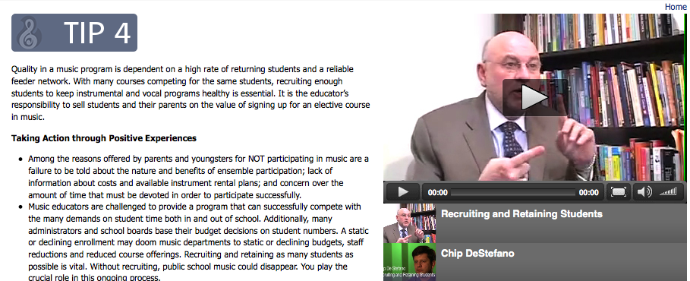
“Tips for Success” Resource Materials
Helpful Videos!
www.MusicAchievementCouncil.org
Notes:
Produced by the Music Achievement Council
35

Slide 36
How Can You Help?
Co-sponsor a state MEA session
Provide copies of “First Performance” to your local schools
Provide professional development
sessions for your teachers
Notes:
36

Slide 37
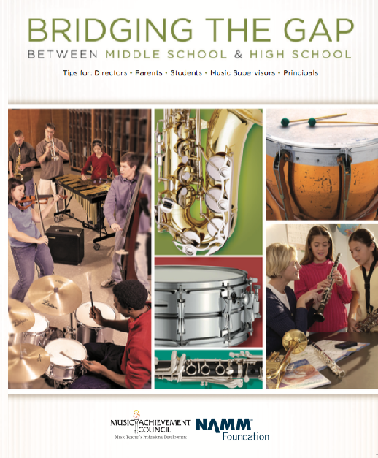
Share our Materials
MusicAchievementCouncil.org
Notes:
37

Slide 38
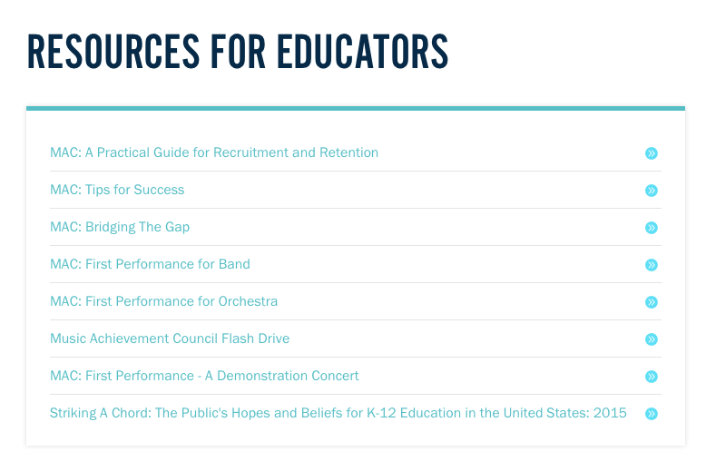
Share our Materials
MusicAchievementCouncil.org
Notes:
38

Slide 39







OMEA
January 29, 2016 2:30 PM CC 201
You CAN Successfully Recruit and Retain
Even MORE Students!
Marcia Neel
Bill Harvey
John Yehling
Rick Dustin
Renier Fee
Jerry Pellegrino
www.musicachievementcouncil.org

Slide 40








2016 IMEA January 28, 2016
Bridging the Gap Between
Middle School and High School
Marcia Neel
Peter Ellman
Russ Bullis
Beth Houlihan
Paul Bauer
Randy Wood
Randy King
George Quinlan
Robin Walenta

Slide 41









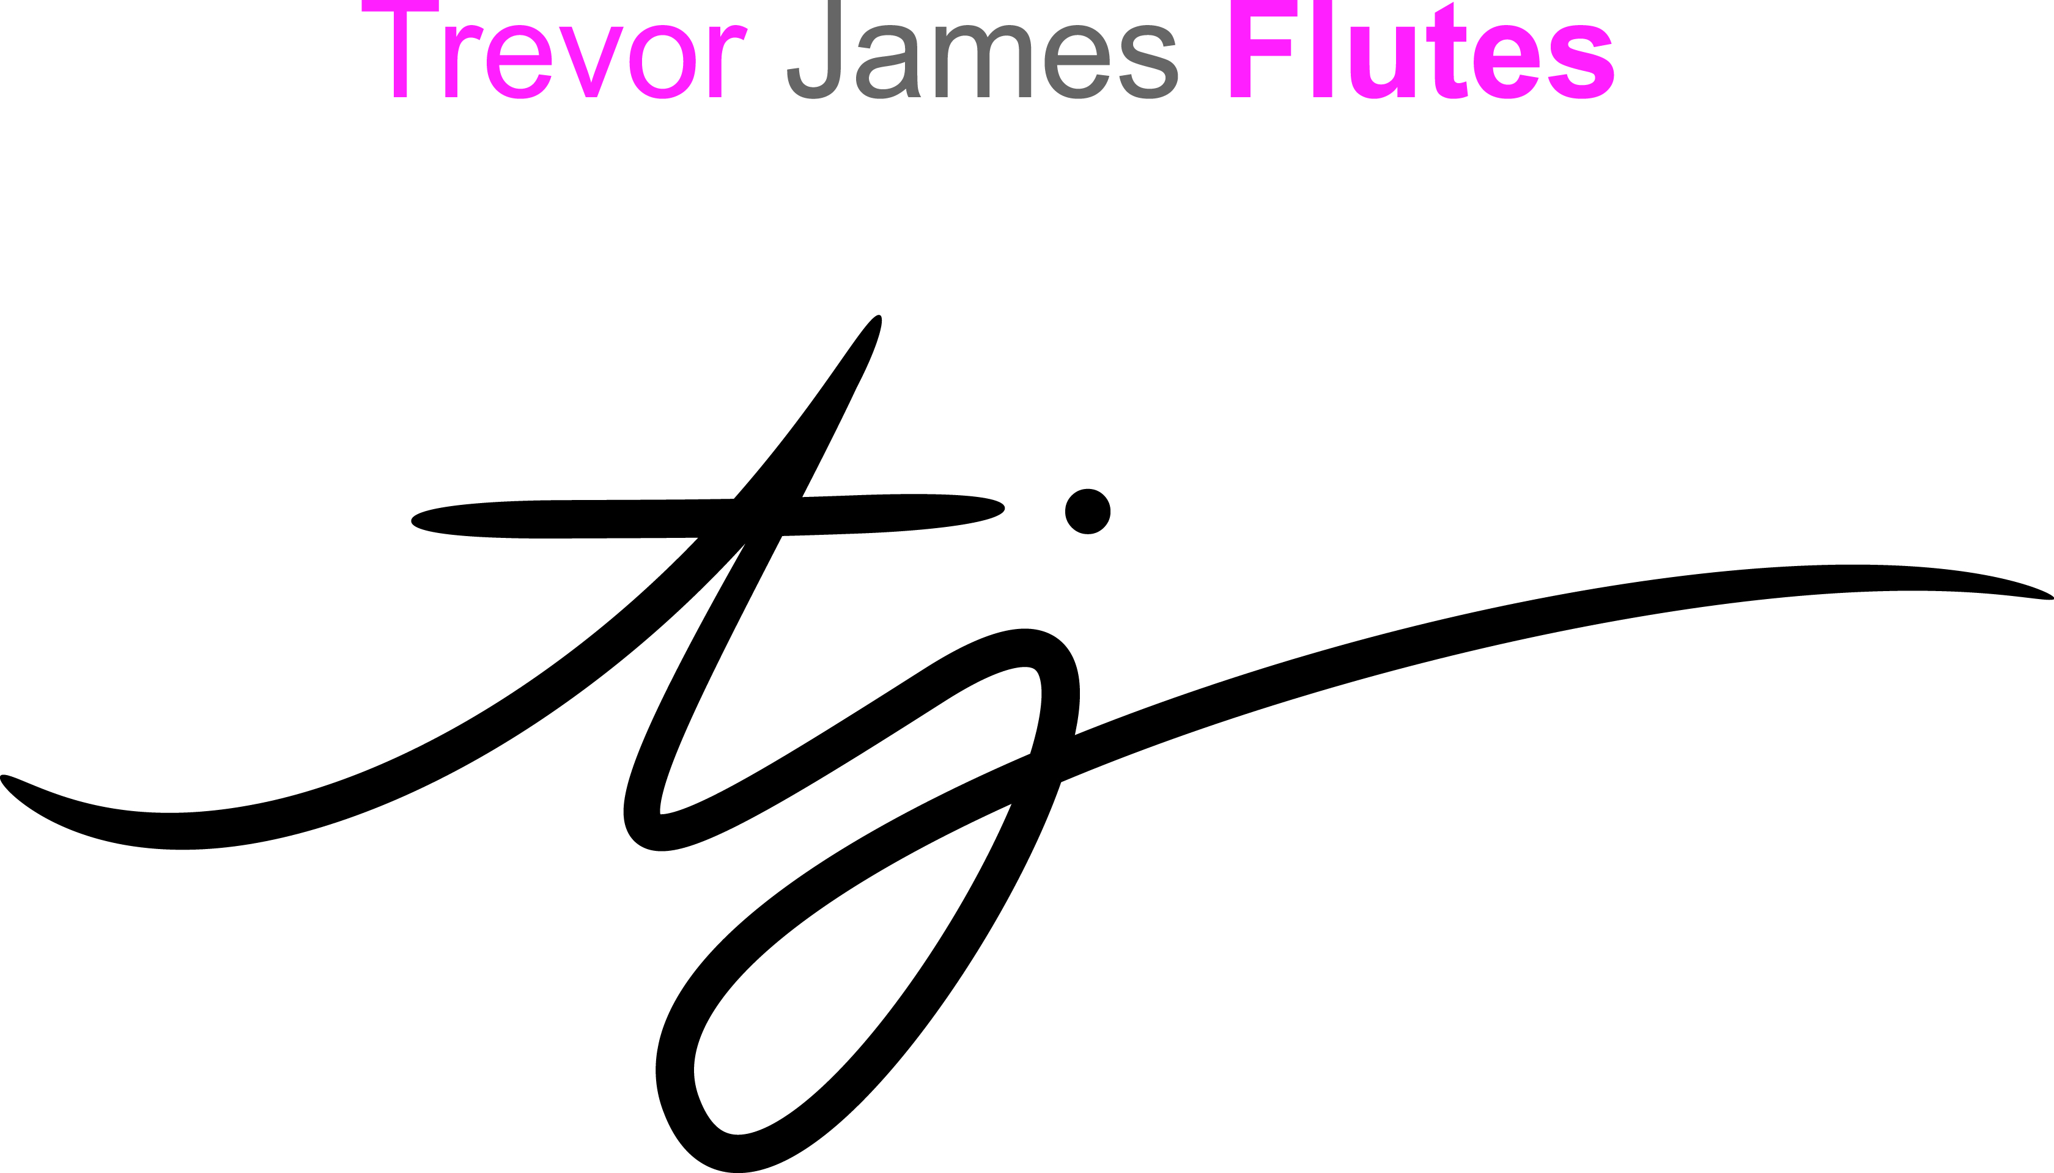



www.MusicAchievementCouncil.org
@MusicAchCouncil and @MusicEdConsult
Thanks also to our Wonderful Corporate Partners!
Notes:
www.musiceducationconsultants.net/mmea2010
41

Slide 42
The Impact of MAC Sessions
I want to thank you. I had so many ideas in
sitting through your workshop on Recruitment
for my beginning band program. Your ideas have
stuck with me-now 5 months later. My students
are completely enjoying playing "Happy Birthday"
music all over our building.

Slide 43
The Impact of MAC Sessions
Thank you for the dynamic presentation and very useful information and resources. I appreciated the energy and passion you brought to the session- especially given the fact that it was the late session on a Saturday afternoon. :) And, it was topped off when I was selected as the winner of one of the door prizes which I read on my flight home.
Thanks again for the valuable learning experience.

Slide 44
The Impact of MAC Sessions
Thanks so much for the session. I am truly grateful. Again I am honest when I say this, I learned and took away so much from your positive attitude and ideas.. Don't stop what your doing!!
Thanks!!!!!!

Slide 45
The Impact of MAC Sessions
Thanks for a great presentation in Providence! I am sharing your ideas with my colleagues and putting them into action with my own groups!
I want you to know that I absolutely loved your presentation....I thought it was fantastic! There was so much that I got out of it...
Just wanted to say that your session was one of the very best I've ever attended (and I've been in this business 37 years!). Thank you so much for sharing your insights, energy, and enthusiasm. It's deeply appreciated.

Slide 46
The Impact of MAC Sessions
Thank you for a wonderful session. I ended up at dinner that night with one of the attendees from another state. We couldn't stop talking about how great, yet easy, the ideas were and what a big shot of adrenaline the presentation was. I expected the teachers to get a lot out of the session, but was surprised at how many take-aways I left with as a vendor. We love what we do and this was a wonderful reminder of just how important it is and in how many ways we can help our school programs. Terri Viveiros, President
Robert’s Musical Instruments

Slide 47

“There Is a Place. . .”
Foothill High School
Notes:
Produced by the Music Achievement Council
47

