Slide 1

DID YOU KNOW . . .
The Music Achievement Council (MAC) is an action-oriented, non-profit organization whose sole
purpose is to enable more students to begin and continue in instrumental music programs.
www.musicachievementcouncil.org

Slide 2

DID YOU KNOW . . .
96 percent of public school principals
believe that participating in music
education encourages and motivates
students to stay in school longer.
(Harris Poll)
www.musicachievementcouncil.org

Slide 3
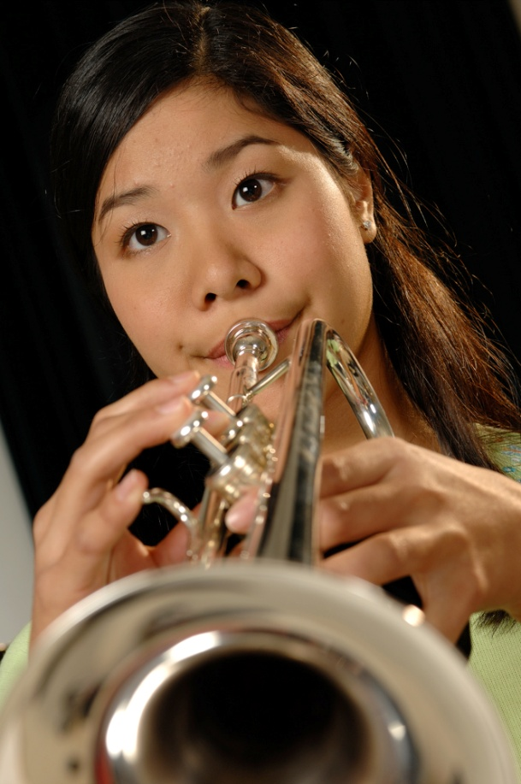
DID YOU KNOW . . .
An interactive poll confirms that music education at an early age greatly increases the likelihood that a child will grow up to seek higher education and ultimately even earn a higher salary. (2007 Harris Poll)
www.musicachievementcouncil.org

Slide 4

THE MESSAGE IS. . .
If you want to be a CEO, College President, or
even a Rock Star,
TAKE MUSIC!
www.musicachievementcouncil.org

Slide 5

THE MESSAGE IS. . .
If you want to be a CEO, College President, or
even a Rock Star,
TAKE MUSIC!
www.musicachievementcouncil.org

Slide 6
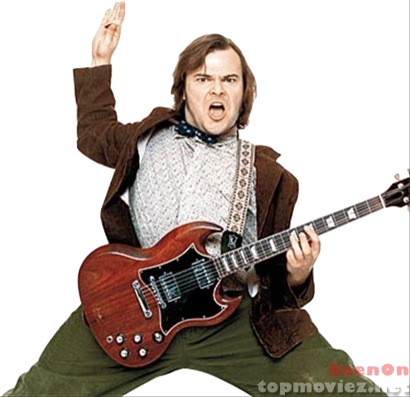


THE MESSAGE IS. . .
If you want to be a CEO, College President, or
even a Rock Star,
TAKE MUSIC!
www.musicachievementcouncil.org

Slide 7
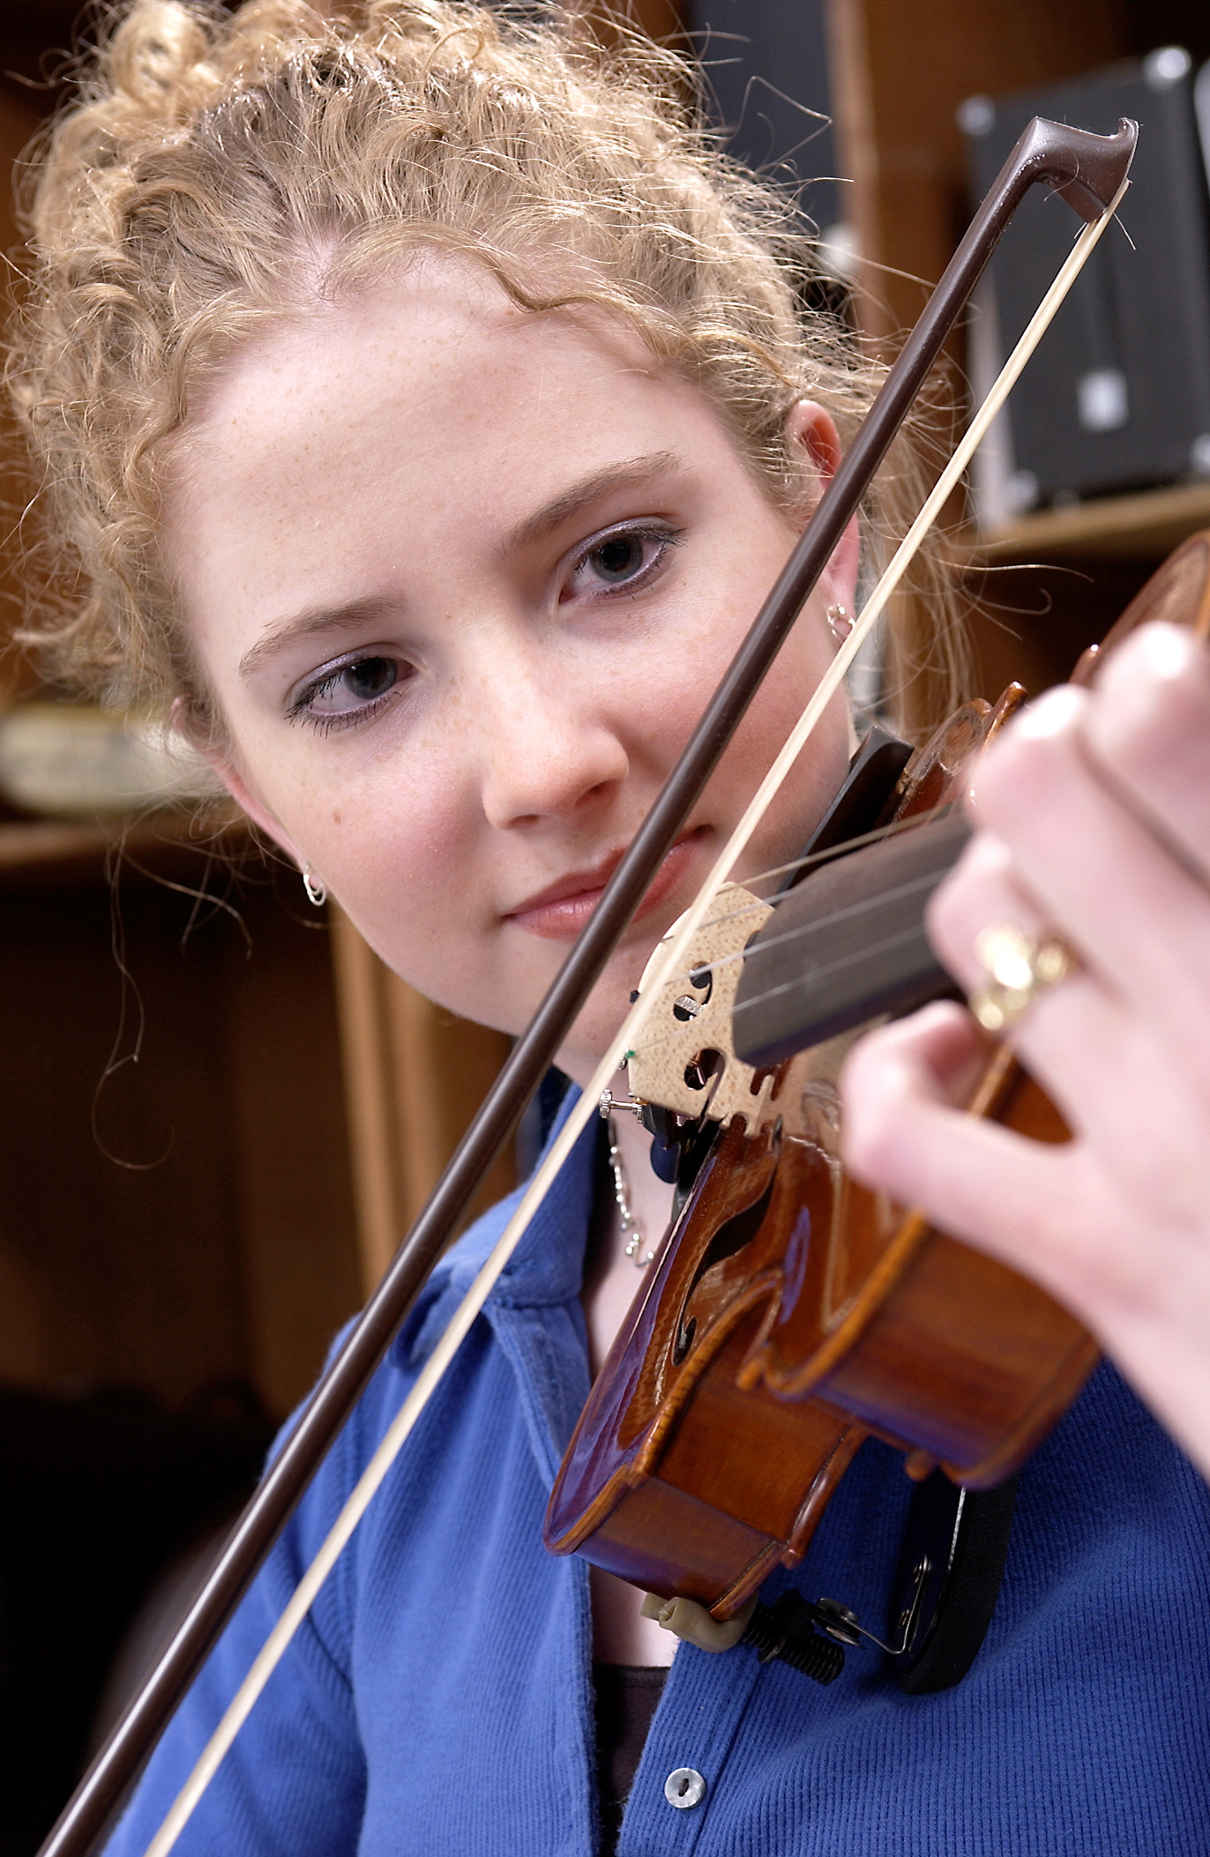
DID YOU KNOW . . .
82 percent of Americans who don’t currently play an instrument wish they had learned to play one. (Gallup Poll)
www.musicachievementcouncil.org

Slide 8
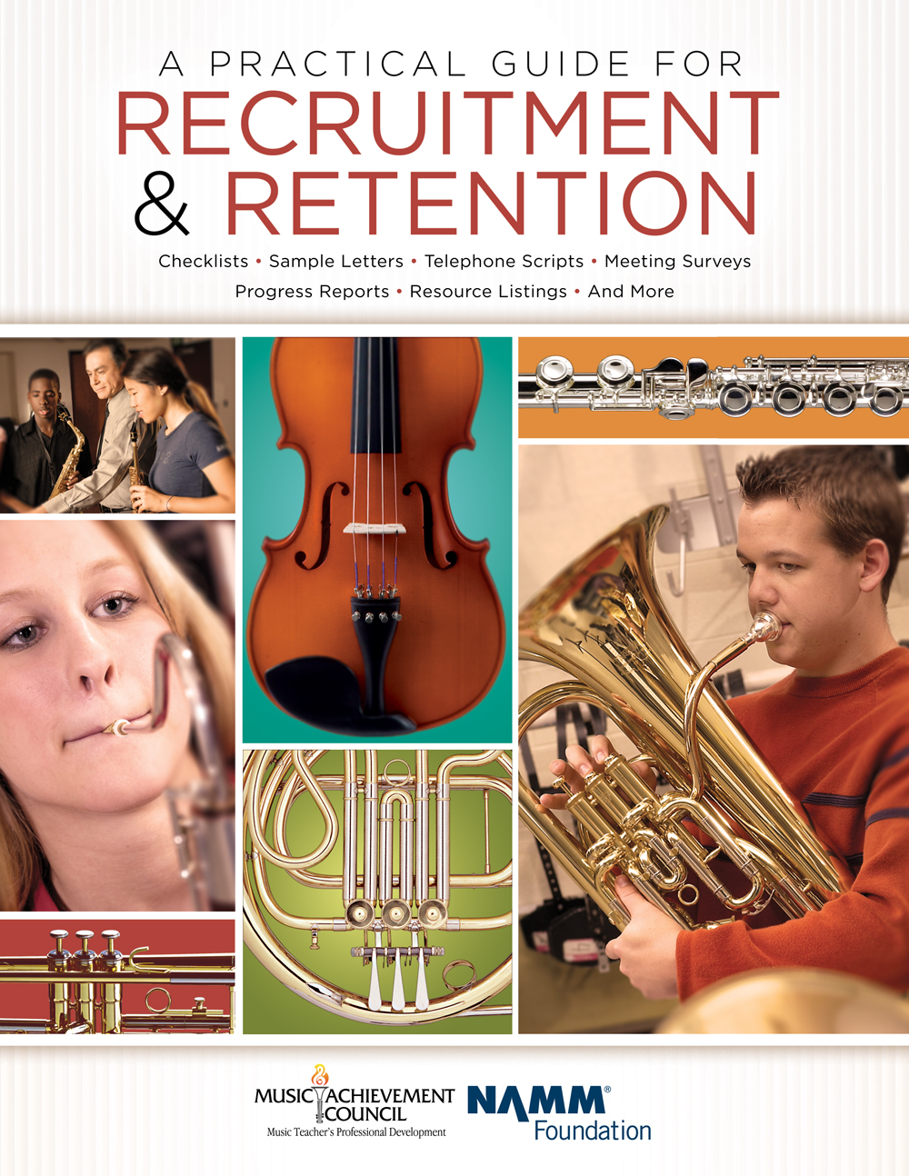
DID YOU KNOW . . .
All of today’s session attendees will receive FREE COPIES of:
A Practical Guide for Recruitment and Retention
www.musicachievementcouncil.org

Slide 9
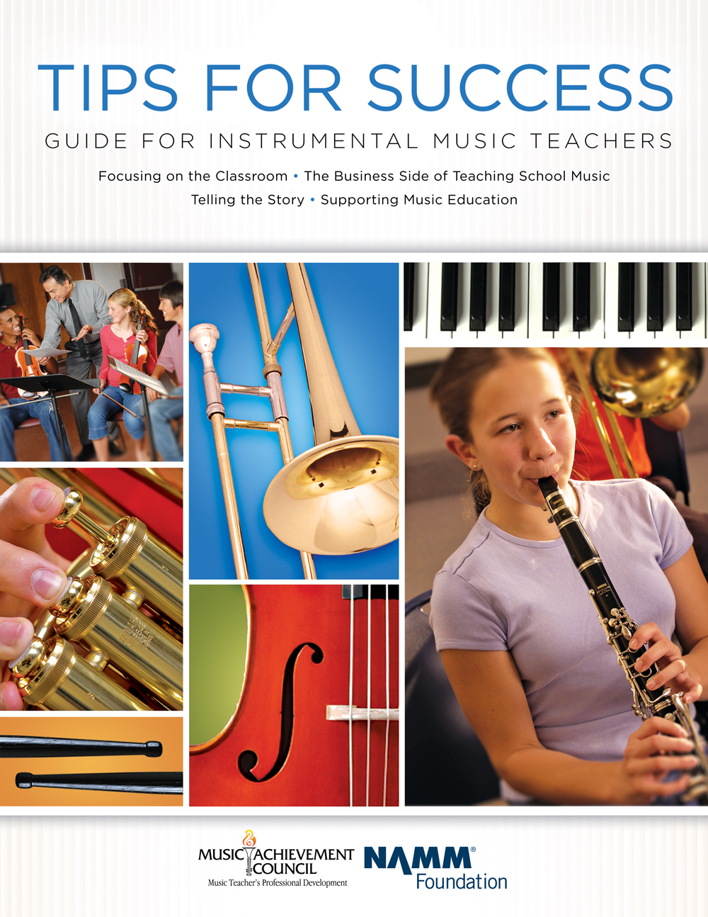
DID YOU KNOW . . .
All of today’s session attendees will receive FREE COPIES of:
Tips for Success:
A Guide for Instrumental Music Teachers
www.musicachievementcouncil.org

Slide 10
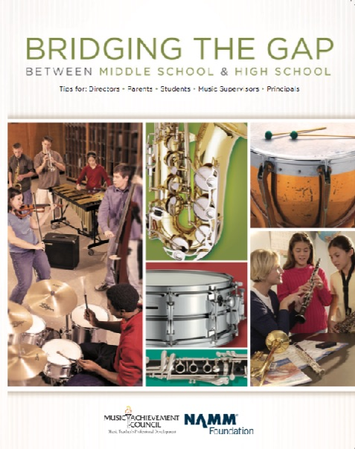
DID YOU KNOW . . .
All of today’s session attendees will receive FREE COPIES of:
Bridging the Gap between
Middle School and High School
www.musicachievementcouncil.org

Slide 11
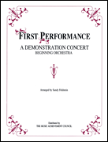
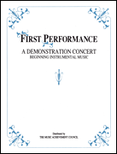
DID YOU KNOW . . .
The First Performance Demo Concert for Band and/or Orchestra features sheet music, parts, sample letters, programs and student certificates for beginning ensembles. Students can perform a composition in seven short weeks with the materials provided!
www.musicachievementcouncil.org

Slide 12
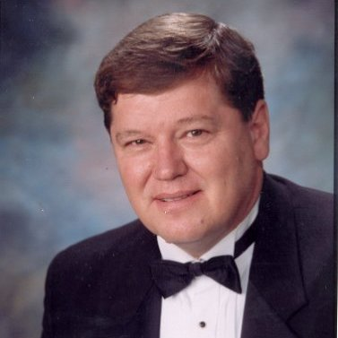
DID YOU KNOW . . .
Three of these publications are provided online at no charge by the Music Achievement Council.
Greg Bimm
They are based on real world strategies shared by the profession’s most successful music educators.

Slide 13
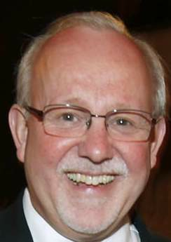
DID YOU KNOW . . .
Three of these publications are provided online at no charge by the Music Achievement Council.
Charlie Menghini
They are based on real world strategies shared by the profession’s most successful music educators.

Slide 14
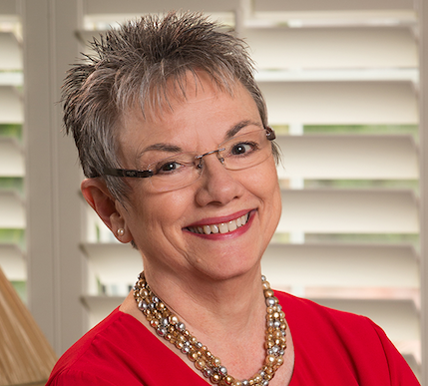
DID YOU KNOW . . .
Three of these publications are provided online at no charge by the Music Achievement Council.
Marcia Neel
They are based on real world strategies shared by the profession’s most successful music educators.

Slide 15
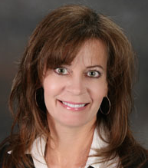
DID YOU KNOW . . .
Three of these publications are provided online at no charge by the Music Achievement Council.
Terry Shade
They are based on real world strategies shared by the profession’s most successful music educators.

Slide 16
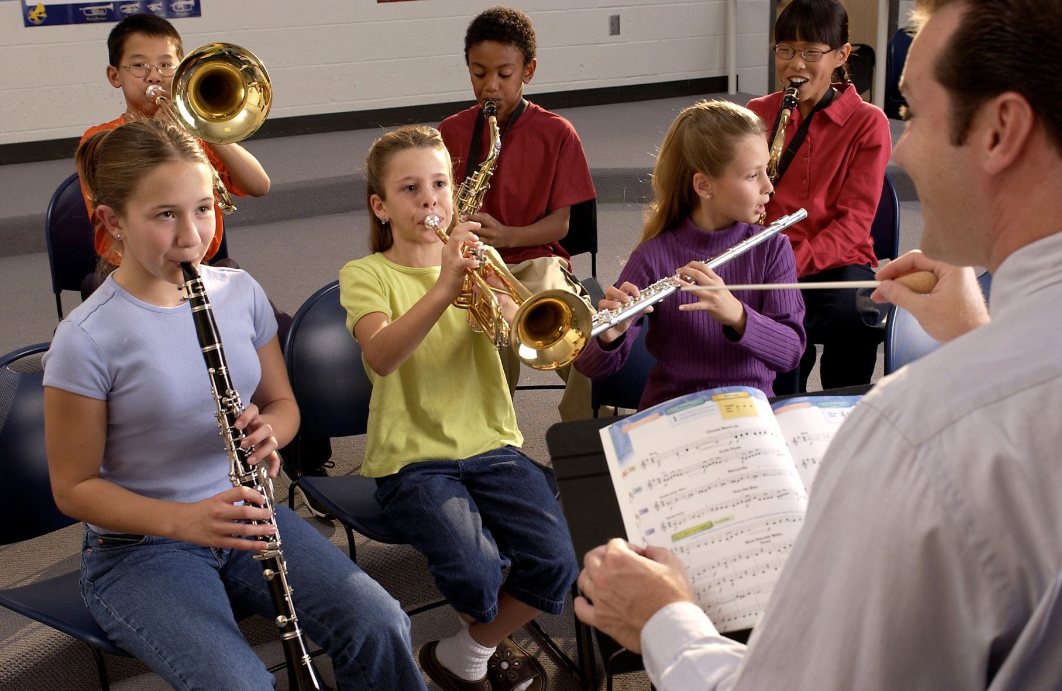

DID YOU KNOW . . .
www.musicachievementcouncil.org

Slide 17
DID YOU KNOW . . .
Music making has been scientifically proven to:
Exercise the brain
Inspire creativity
Increase productivity
Fight memory loss
Reduce stress
Lower blood pressure
Build confidence
Stave off depression

Slide 18

DID YOU KNOW . . .
Metropolitan Nashville Public Schools found that ATTENDANCE RATES ROSE with increased study in music.
No Music:
< 1 Year of Music:
> 1 Year of Music:
87% Attendance
91% Attendance
93% Attendance

Slide 19
DID YOU KNOW . . .
Metropolitan Nashville Public Schools found that DISCIPLINE REPORTS FELL with increased study in music.
No Music:
< 1 Year of Music:
> 1 Year of Music:
4.34 over 4 years
3.75 over 4 years
3.23 over 4 years

Slide 20
DID YOU KNOW . . .
Metropolitan Nashville Public Schools found that GPAs ROSE with increased study in music.
No Music:
< 1 Year of Music:
> 1 Year of Music:
2.51 Average
2.61 Average
2.89 Average

Slide 21
DID YOU KNOW . . .
Metropolitan Nashville Public Schools found that GRADUATION RATES ROSE with increased study in music.
No Music:
< 1 Year of Music:
> 1 Year of Music:
60% Average
81% Average
91% Average

Slide 22
DID YOU KNOW . . .
Metropolitan Nashville Public Schools found that ACT SCORES ROSE with increased study in music.
No Music:
< 1 Year of Music:
> 1 Year of Music:
16.95 Eng, 17.20 Math
17.64 Eng, 17.62 Math
19.58 Eng, 18.67 Math

Slide 23
WHAT WAS LEARNED?
The MORE a student participates in MUSIC,
the more POSITIVE these BENEFITS become.

Slide 24
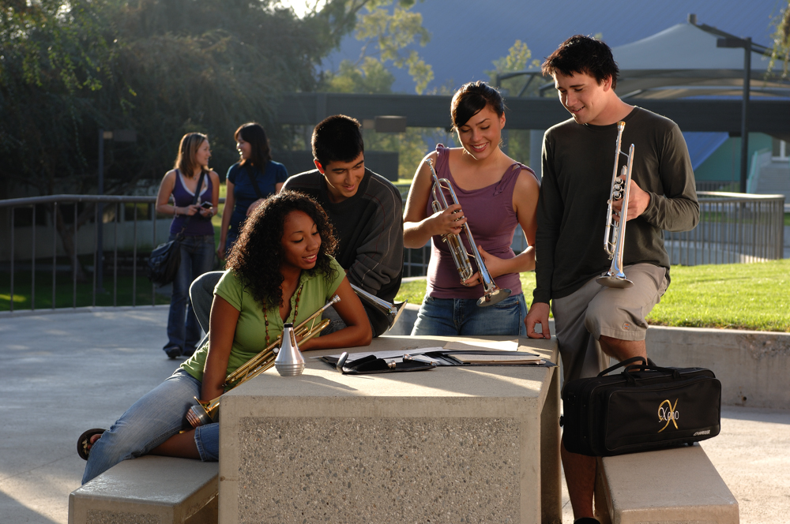
FAMOUS QUOTES. . .
Music has the power of producing a
certain effect on the moral character of
of the soul.
. . . Aristotle

Slide 25
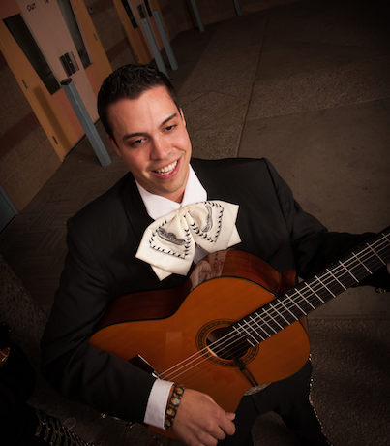
FAMOUS QUOTES. . .
Music furnishes a delightful recreation
for the hours of respite from the cares of the day, and lasts us through life.
. . . Thomas Jefferson

Slide 26




You CAN Successfully Recruit and Retain
Even MORE Students!
Marcia Neel
Paul Thomsen
Mark Bobnick
November 18, 2016 8:00 AM
PPT, Session, and Videos will be Posted Online at:
www.MusicEdConsultants.net/conference-materials
www.MusicAchievementCouncil.org

Slide 27
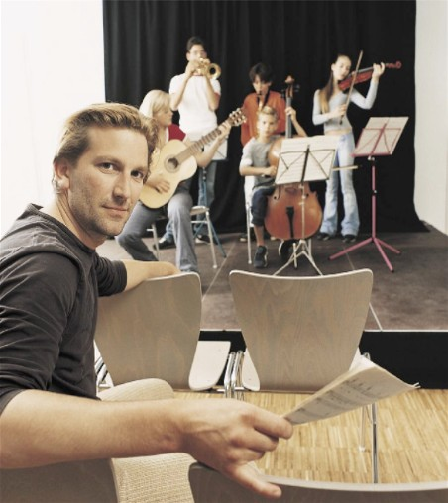
Today’s Session
Tips for Recruiting Students
Tips for Retaining Students
First Performance Concert

Slide 28
Materials Available for You to Use. . . A Year-Round Planner
12 pages of proven methods
10 pages of sample forms
Guidelines for directors

Slide 29
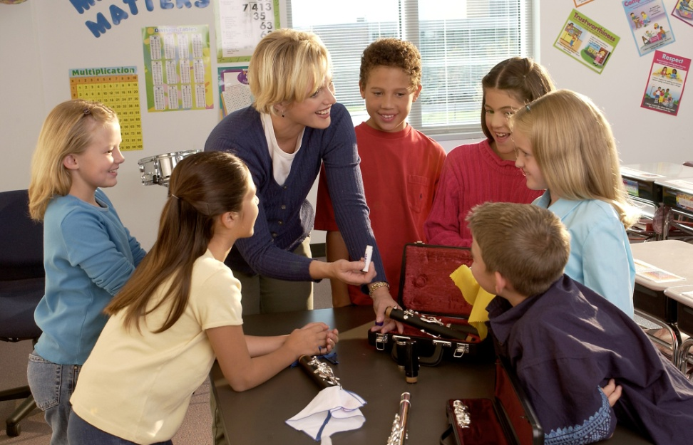
Fundamental Beliefs of
Effective Recruiters
Every student will be interested
All students will have an equal opportunity to succeed
Music is an integral part of their total education
Every student is eagerly welcome-- regardless of talent or ability
Students want to play because it looks like fun

Slide 30
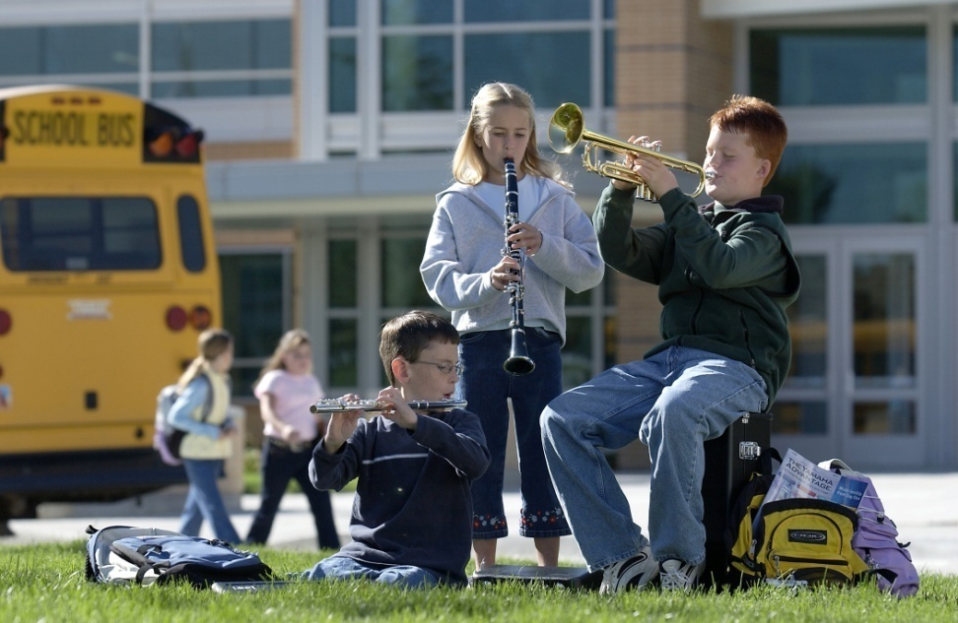
Key Steps in Recruiting:
Attracting Students. . .
Foster student interest through visibility
Inform parents of benefits of music
Build and nurture support among administration & classroom teachers

Slide 31
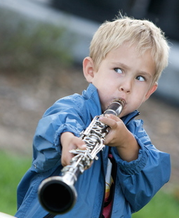
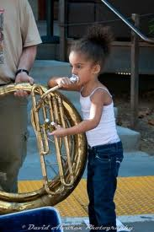
Key Steps in Recruiting
Recruiting is a YEAR-ROUND process including:
REGULAR visits with feeder programs/teachers
EFFECTIVE PR: Bulletin boards, school newsletters, PTA and school announcements, concert programs
Mass concerts with feeder programs
INCLUDING recorder classes
Recruitment meetings with
students and parents—REACH OUT!
Instrument demos/petting zoos
Follow-ups – SHOW UP FOR EVERYTHING!
www.musicachievementcouncil.org
Notes:
31

Slide 32
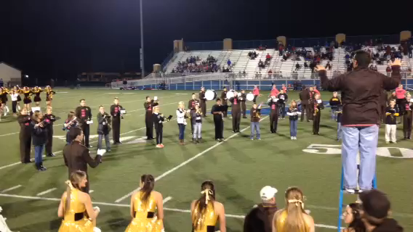
Key Steps in Recruiting:
Engage Students Early. . .
www.musicachievementcouncil.org
Notes:
32

Slide 33
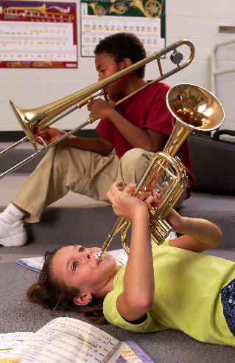
Key Steps in Recruiting:
What’s Really Important. . .
Ensure HIGH quality and fulfillment at each rehearsal
Your ENTHUSIASM matters
Be friendly, approachable
Students have big dreams of success—give it to them!
It’s never to early to recruit
Learning can be FUN! SMILE!
www.musicachievementcouncil.org
Notes:
33

Slide 34
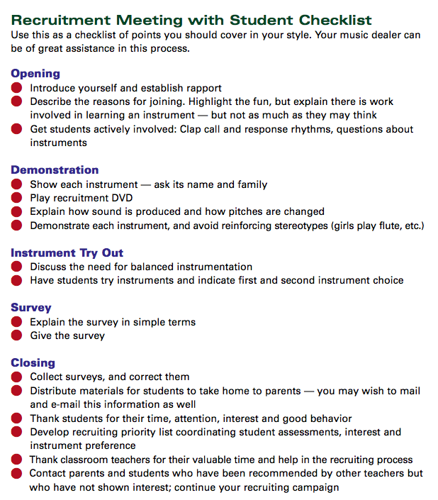
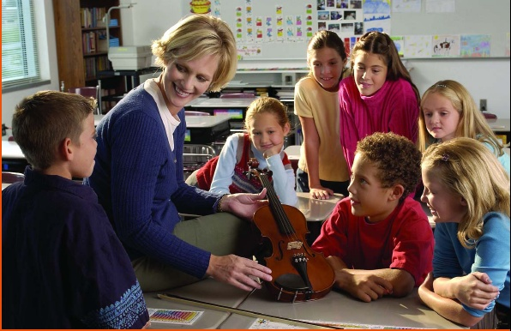

Key Steps in Recruiting: Plan Way Ahead
  Meet with feeder/classroom teachers to identify future instrumentalists
  Select recruitment materials: DVDs, posters, surveys, forms, pamphlets, PR items
  Enlist dealer help well in advance--let them know what you need

Slide 35

Presentation Day/Aptitude Survey
  Best in classroom setting
  Show up unannounced
  Never ask, “how many want to be
  in the band, choir, orchestra. . .”
  Instead, ask for a show of hands, “how
  many of you want to try an instrument?”
  Keep presentation short (30 minutes)
  BE ENTHUSIASTIC!!!!! SMILE!!!!!
Notes:
35

Slide 36

Follow-up idea #1 from:
Jeff Scott & Emily Wilkinson, ALMEA
  “Congratulations!
  You have been chosen to
  play (insert instrument)
  in the (name of school) band!”
  Giving a “Golden Invitation” to band makes
  them feel special!”
www.musicachievementcouncil.org
Notes:
36

Slide 37
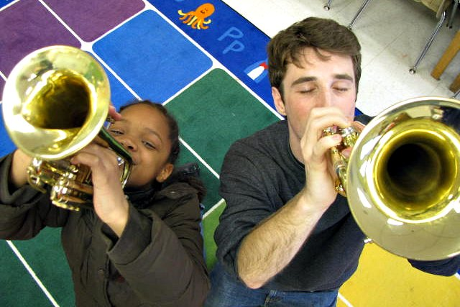
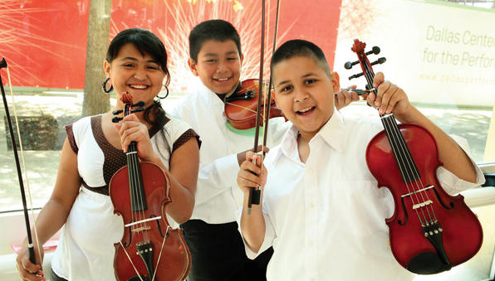
Follow-up idea from:
Chris Crone, PAMEA
Make the time to have each 4th grader touch, hold, and play three instruments of their choice and then send a personal letter home with each student letting the parents know which instrument their child had success on. . .your instrumental numbers go through the roof!”
Notes:
37

Slide 38

Engage Parent Support
Recruitment Letters
  Keep them simple, upbeat and informational
  Emphasize rewards, details, your expectations
  RSVP form
Initial Meeting
  Involve current parents
  Explain rental program
  Provide advocacy materials
Best Ambassador is an Excited Child

Slide 39
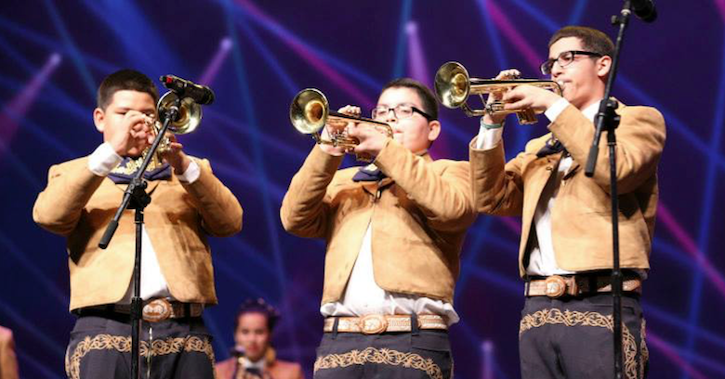
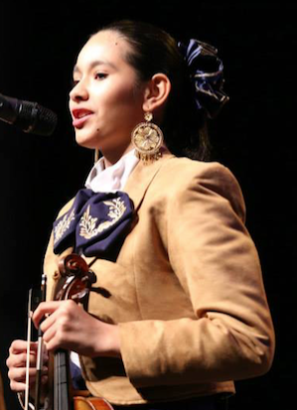
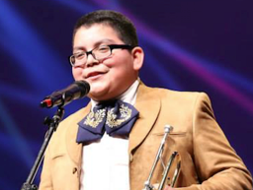
Increase Your Base

Slide 40

Bailey MS Mariachi Program – Year 2

Slide 41

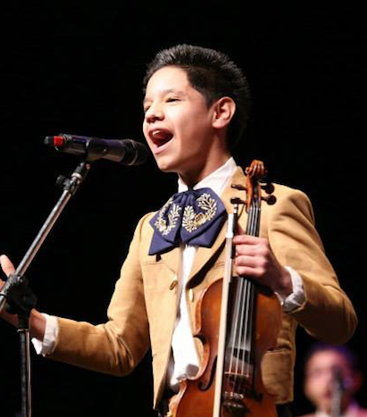

National Mariachi Workshops for Educators®
June 26 - 30, 2017
www. musicedconsultants.net/2017-mariachi-workshops

Slide 42
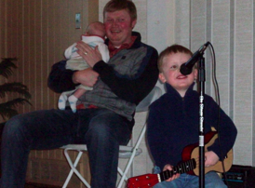
Teach the Parents Too. . .
They don’t know what NORMAL is!
  Teach PARENTS how to support their child’s practicing
www.musicachievementcouncil.org
Notes:
www.musiceducationconsultants.net/mmea2010
42

Slide 43
Teach the Parents Too. . .
They don’t know what NORMAL is!
  Teach PARENTS how to support their child’s practicing
  Give PARENTS ideas of how to keep their children motivated
www.musicachievementcouncil.org
Notes:
www.musiceducationconsultants.net/mmea2010
43

Slide 44
Teach the Parents Too. . .
They don’t know what NORMAL is!
  Teach PARENTS how to support their child’s practicing
  Give PARENTS ideas of how to keep their children motivated
  Encourage PARENTS to play an active role in the learning process and to become involved
www.musicachievementcouncil.org
Notes:
www.musiceducationconsultants.net/mmea2010
44

Slide 45
Teach the Parents Too. . .
They don’t know what NORMAL is!
  Teach PARENTS how to support their child’s practicing
  Give PARENTS ideas of how to keep their children motivated
  Encourage PARENTS to play an active role in the learning process and to become involved
  Communicate with Parents REGULARLY to keep them engaged
Notes:
www.musiceducationconsultants.net/mmea2010
45

Slide 46
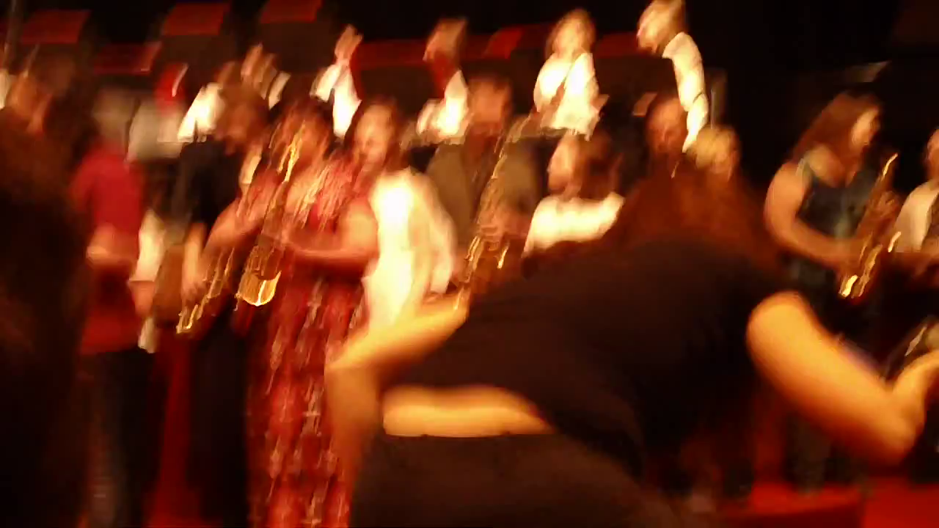
Engage Parent Support…Directly!
The Parent Band – REALLY FUN!
Notes:
www.musiceducationconsultants.net/mmea2010
46

Slide 47
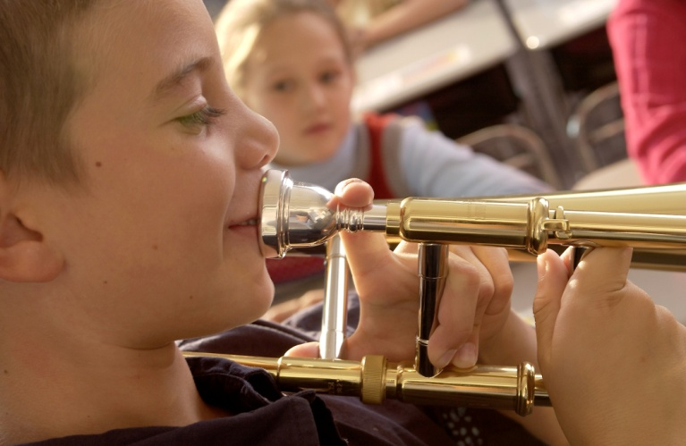
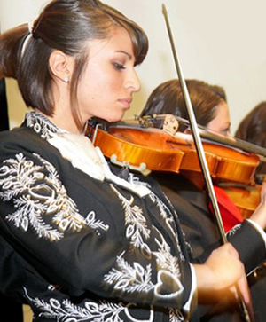
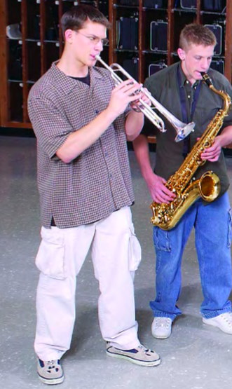
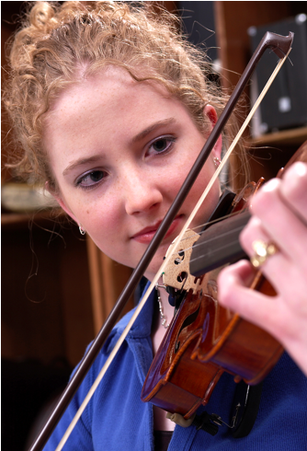
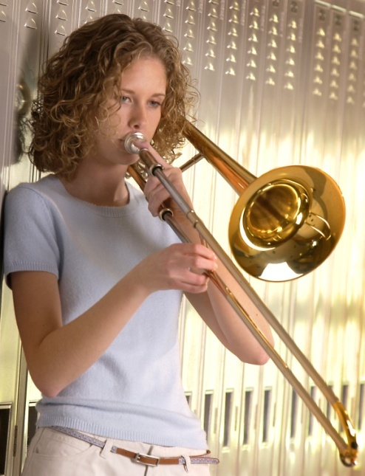
Keeping Your New Recruits

Slide 48

Keeping Your New Recruits
Why Do Kids Stay? Let’s Ask THEM!

Slide 49
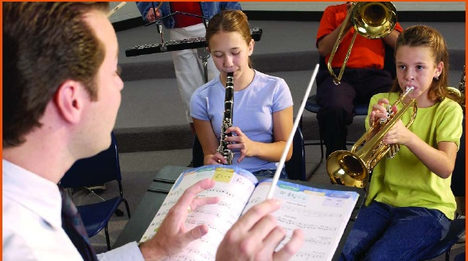

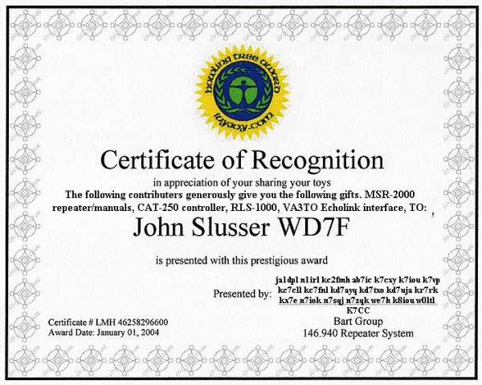
Retention: Keys to Success
Provide a satisfying experience from the day they receive their instruments
Build appreciation for the ensemble
Give recognition and reinforcement

Slide 50
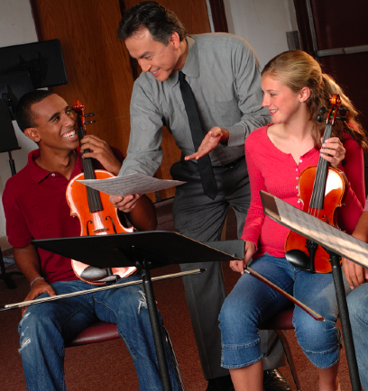
Actions That Help Retain Students
Developing group pride
Improving communication with parents
Evaluating yourself continually “What else?”
Understanding each student as an individual
Being positive and enthusiastic
Providing engaging lessons at each rehearsal
www.musicachievementcouncil.org
Notes:
50

Slide 51

Common Reasons for Drop-outs?
The first disappointment
Notes:
51

Slide 52
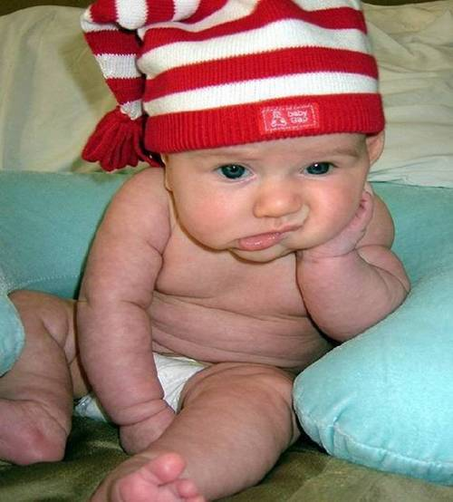
Common Reasons for Drop-outs?
The first disappointment
Lost interest
Notes:
52

Slide 53
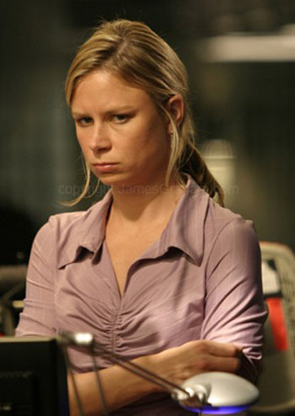
Common Reasons for Drop-outs?
The first disappointment
Lost interest
Didn’t like the teacher
Notes:
53

Slide 54

Common Reasons for Drop-outs?
The first disappointment
Lost interest
Didn’t like the teacher
Conflicts
Notes:
54

Slide 55
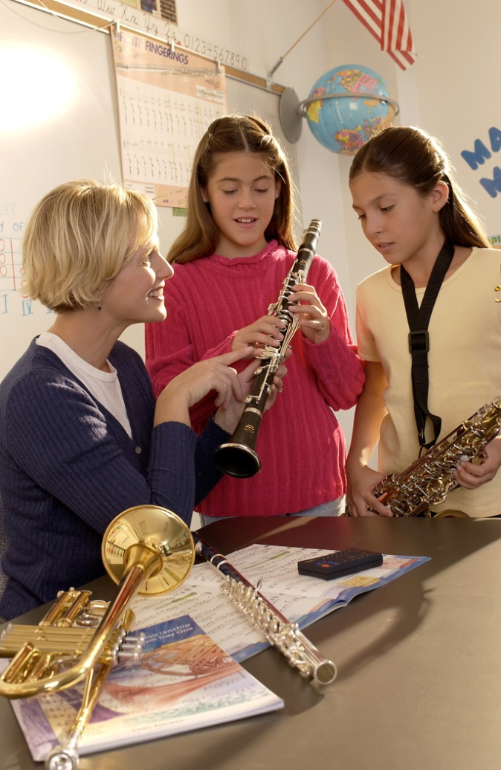
What Can You Do?
Talk to the student
  Probe for real reason they want to quit
  Show interest
Check their instrument
Talk with the parents
Iowa Bandmasters Exit Survey online

Slide 56

Why Should Students Continue?
Tell Your OWN Story: Foothill HS
www.musicachievementcouncil.org
Notes:
56

Slide 57

What If …
Students saw immediate success?
Parents heard their kids play their first performance just 6-7 weeks after they started?
Learning to play was really fun?

Slide 58
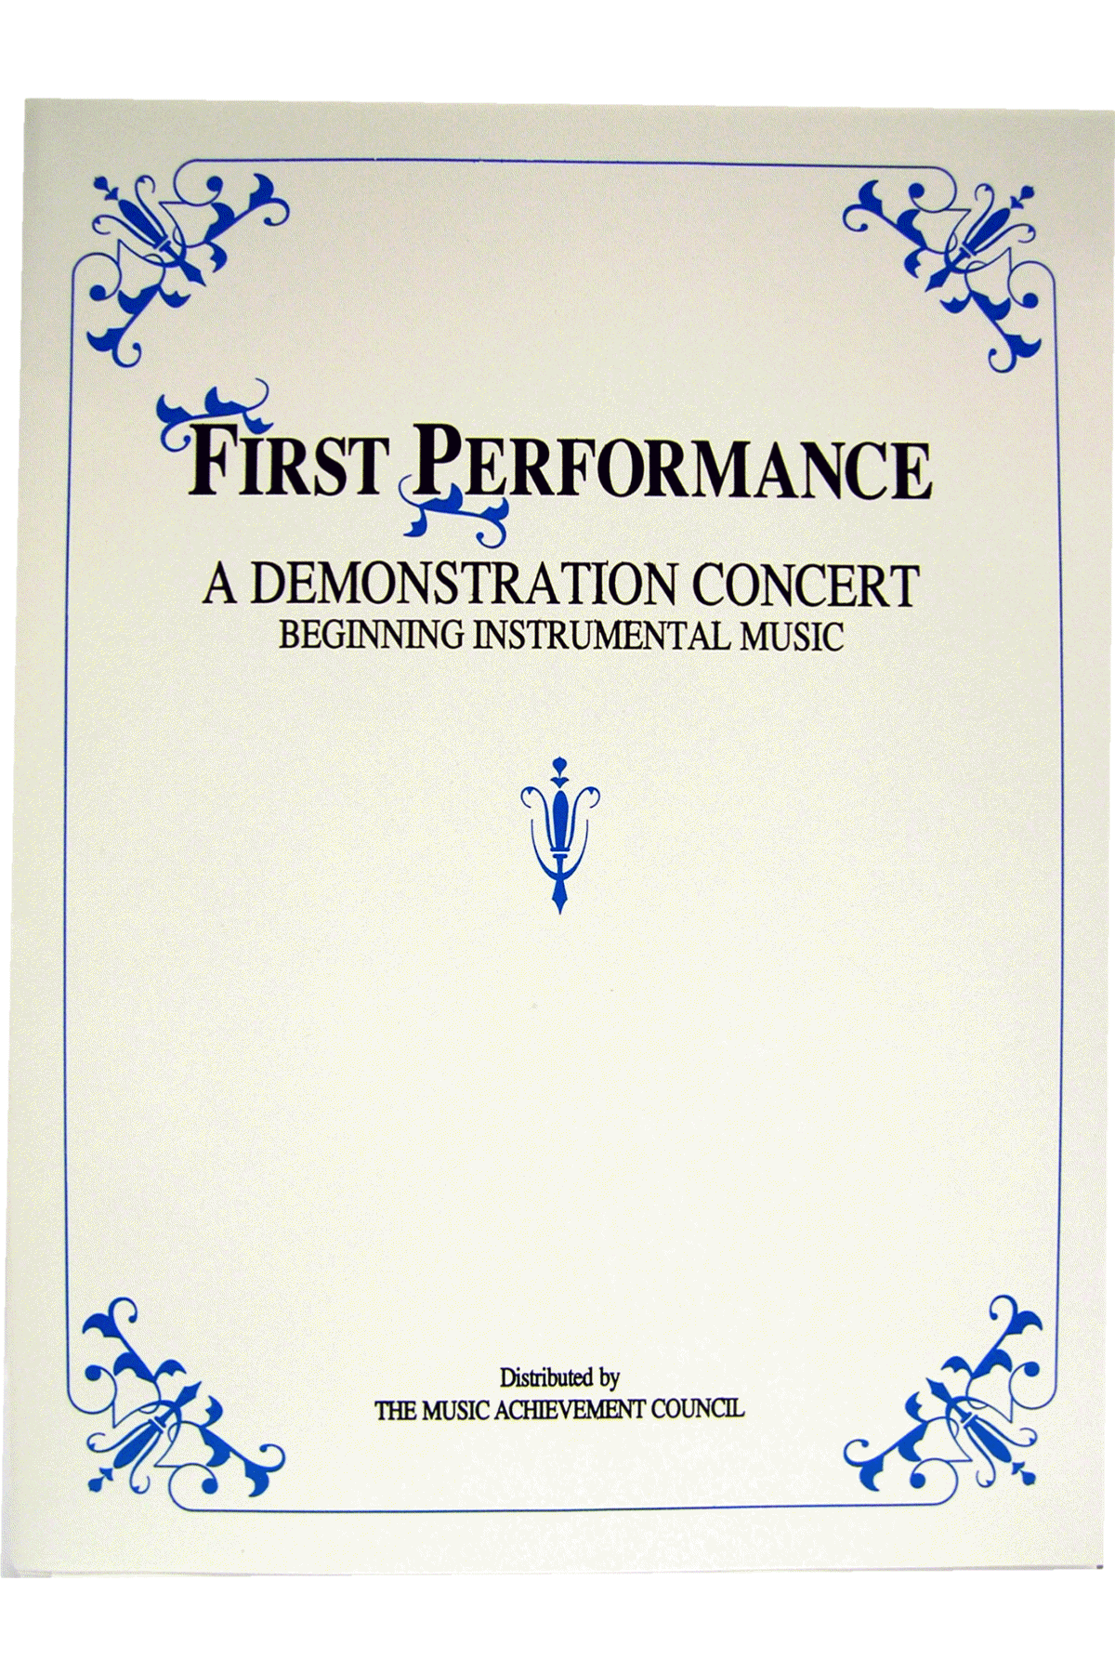
First Performance Concert!
A scripted demonstration of what your students have learned

Slide 59
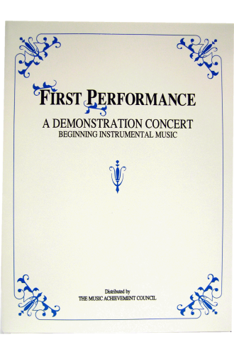
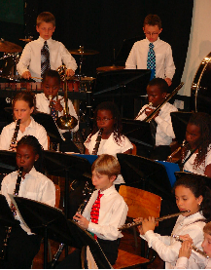
First Performance Demonstration Concert for Band or Orchestra
Schedule 6-8 weeks after the first class
Complete “turn-key” package
May be the best performance in terms of excitement and audience!

Slide 60

First Performance Demonstration

Slide 61
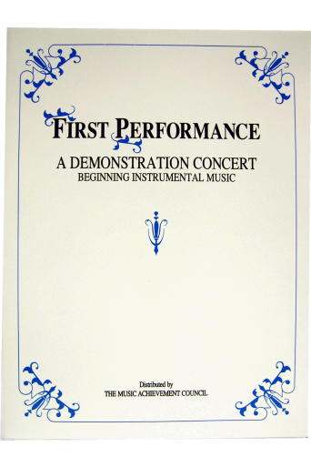
Why Does First Performance Work?
The timing of the performance
  Parents want to hear their kids play
  Student interest soars and they learn to love performing
Students practice more prior to a performance
It works with any group … any schedule … any situation … and any method book
The audience will be large … enthusiastic … and will arrive early -- lots of quality time with those who care most about the outcome -- the parents!

Slide 62
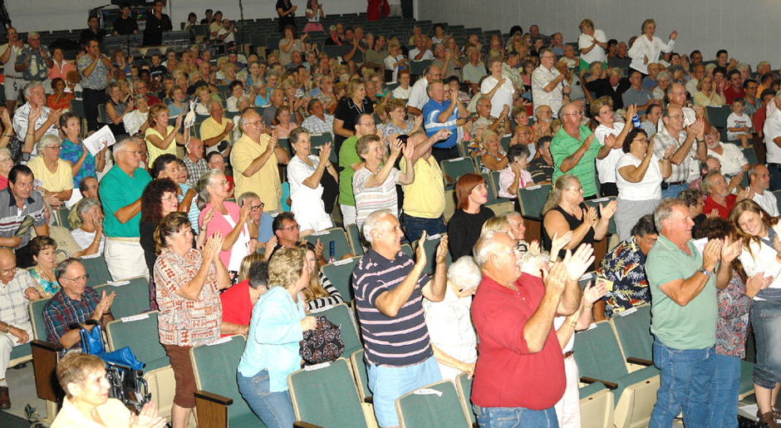
Parents will be amazed! Most have no idea how much their child has learned based on what they hear at home!

Slide 63
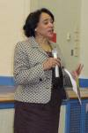
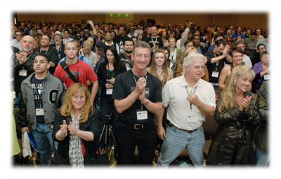
Students enjoy the satisfaction of a performance after good preparation – the process starts early
Many schools have the principal serve as the narrator -- GREAT PR!
The sound of
applause is
infectious
Available at Hal Leonard or through your Local Dealer

Slide 64

Put the Date on Your Calendar!
Schedule First Performance Concert NOW!

Slide 65

M.A.C. Wants to Help. . .
Check Out All of Our Online Resources
www.MusicAchievementCouncil.org
and at BandDirector.com
Notes:
65

Slide 66

Got SMART Phone?
www.nafme.org/my-classroom/
music-achievement-council-resources-educators/
Notes:
66

Slide 67

Got SMART Phone?
musicedconsultants.net/conference-materials
Notes:
67

Slide 68













www.MusicAchievementCouncil.org
@MusicAchCouncil and @MusicEdConsult
Posted at: www.musicedconsultants.net/conference-materials
Thanks also to these Quality Companies!
Notes:
www.musiceducationconsultants.net/mmea2010
68

Slide 69
www.MusicAchievementCouncil.org
@MusicAchCouncil and @MusicEdConsult
Posted at: www.musicedconsultants.net/conference-materials
Thanks also to these Quality Companies!
Notes:
www.musiceducationconsultants.net/mmea2010
69

