Slide 1

DID YOU KNOW . . .
The Music Achievement Council (MAC) is an action-oriented, non-profit organization whose sole
purpose is to enable more students to begin and continue in instrumental music programs.
www.musicachievementcouncil.org

Slide 2

DID YOU KNOW . . .
96 percent of public school principals
believe that participating in music
education encourages and motivates
students to stay in school longer.
(Harris Poll)
www.musicachievementcouncil.org

Slide 3
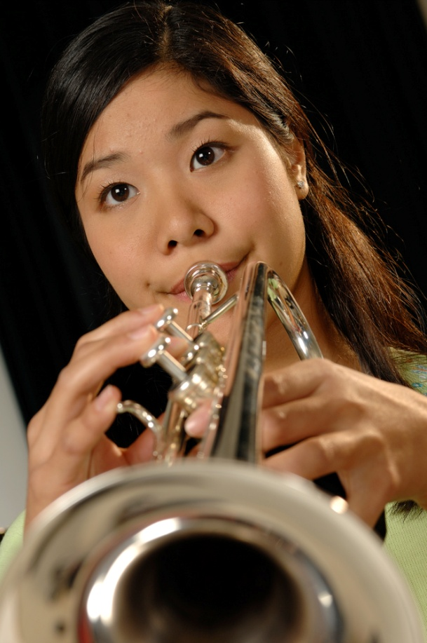
DID YOU KNOW . . .
An interactive poll confirms that music education at an early age greatly increases the likelihood that a child will grow up to seek higher education and ultimately even earn a higher salary. (2007 Harris Poll)
www.musicachievementcouncil.org

Slide 4

THE MESSAGE IS. . .
If you want to be a CEO, College President, or
even a Rock Star,
TAKE MUSIC!
www.musicachievementcouncil.org

Slide 5

THE MESSAGE IS. . .
If you want to be a CEO, College President, or
even a Rock Star,
TAKE MUSIC!
www.musicachievementcouncil.org

Slide 6
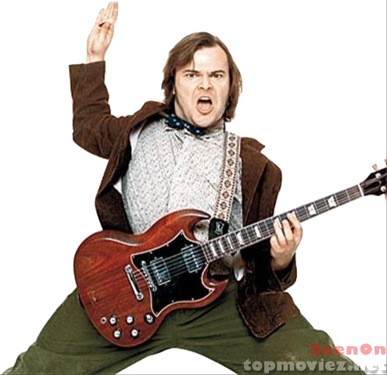


THE MESSAGE IS. . .
If you want to be a CEO, College President, or
even a Rock Star,
TAKE MUSIC!
www.musicachievementcouncil.org

Slide 7
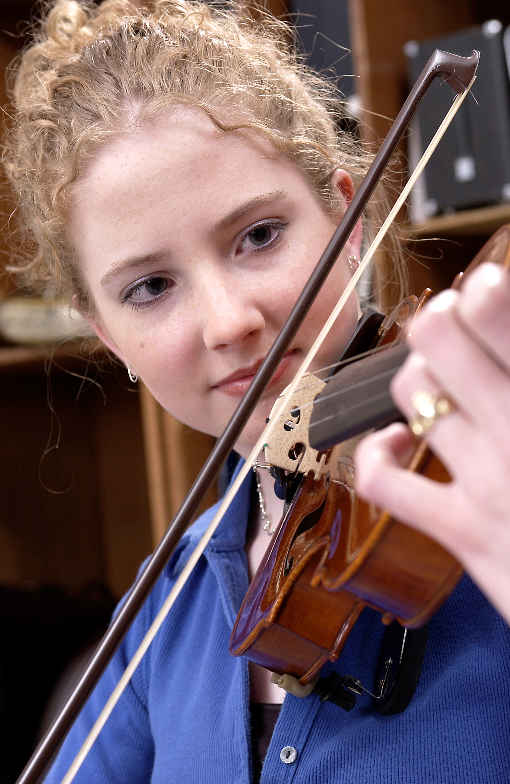
DID YOU KNOW . . .
82 percent of Americans who don’t currently play an instrument wish they had learned to play one. (Gallup Poll)
www.musicachievementcouncil.org

Slide 8
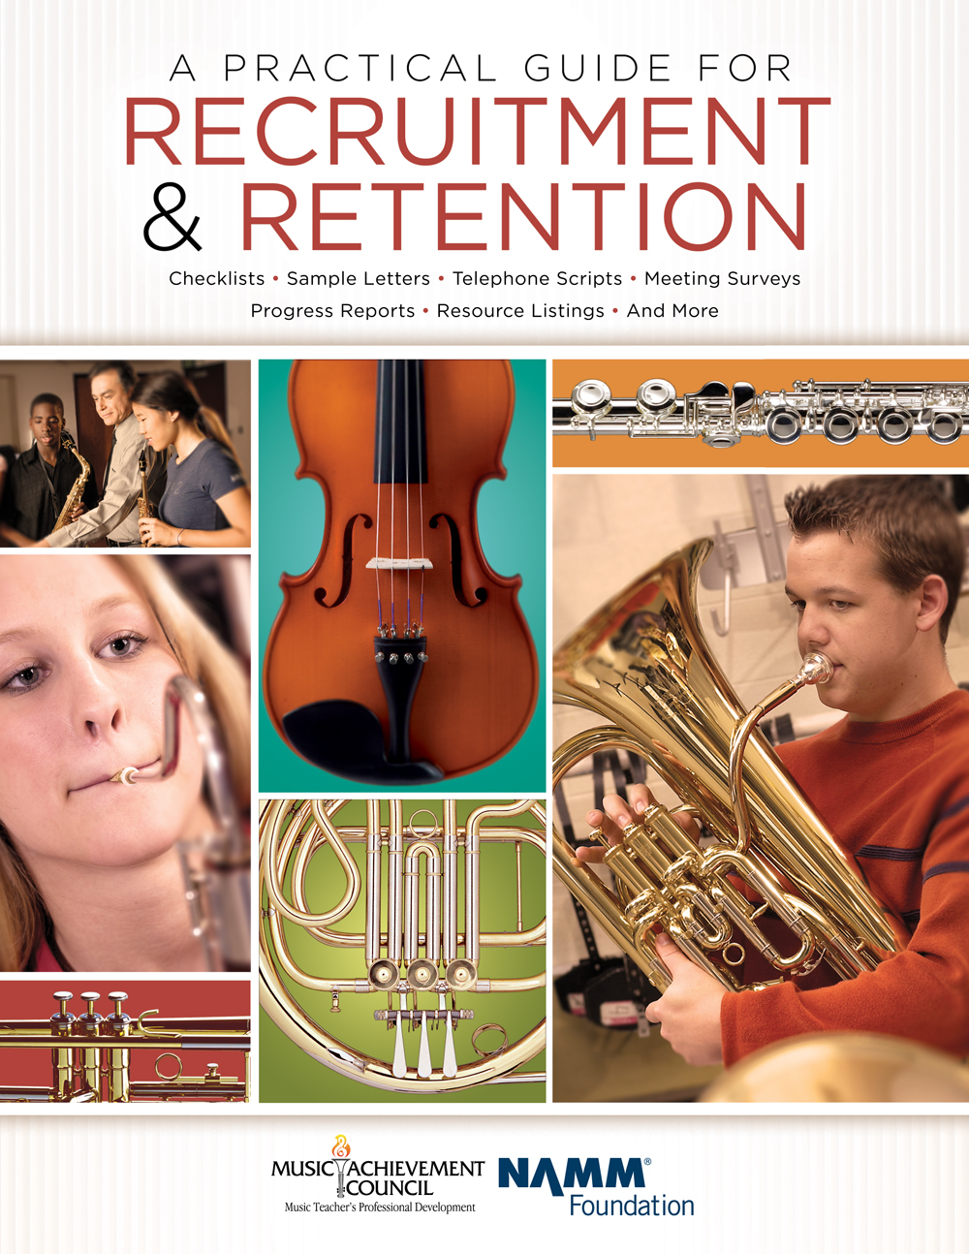
DID YOU KNOW . . .
All of today’s session attendees will receive FREE COPIES of:
A Practical Guide for Recruitment and Retention
www.musicachievementcouncil.org

Slide 9
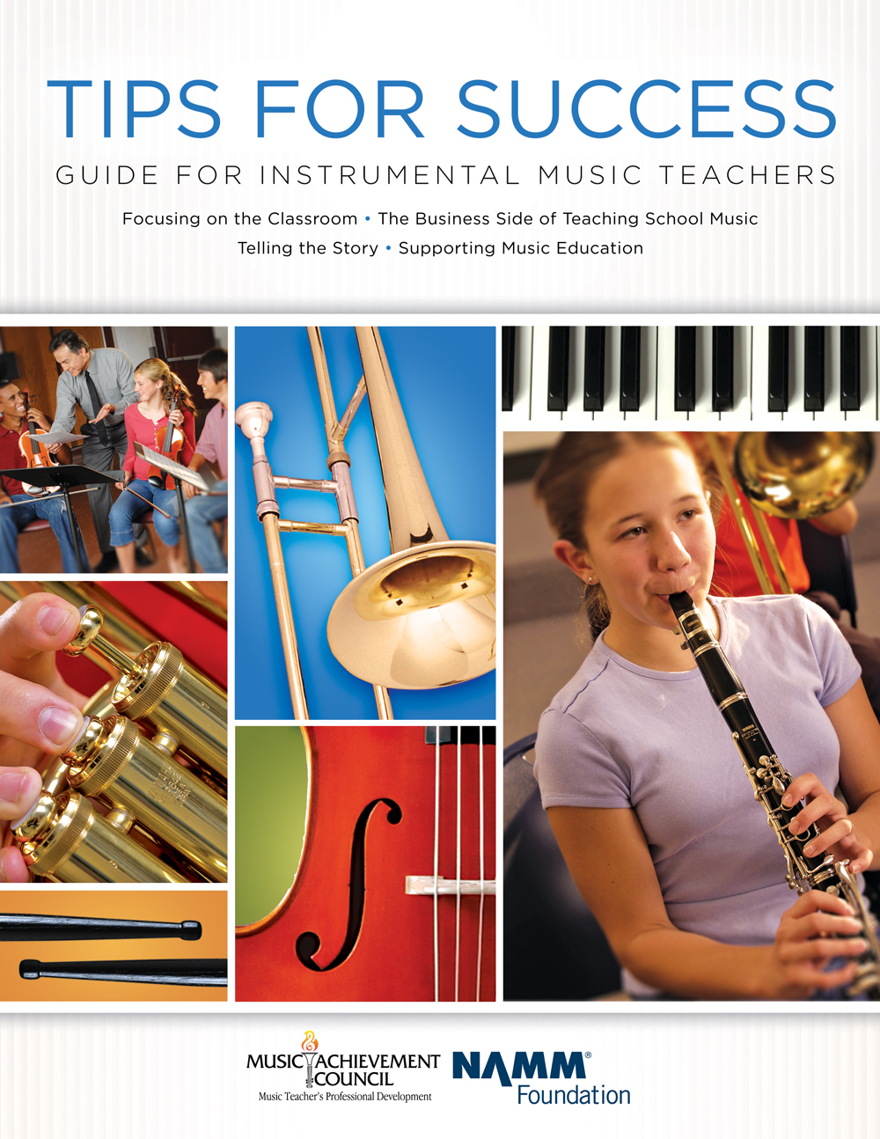
DID YOU KNOW . . .
All of today’s session attendees will receive FREE COPIES of:
Tips for Success:
A Guide for Instrumental Music Teachers
www.musicachievementcouncil.org

Slide 10
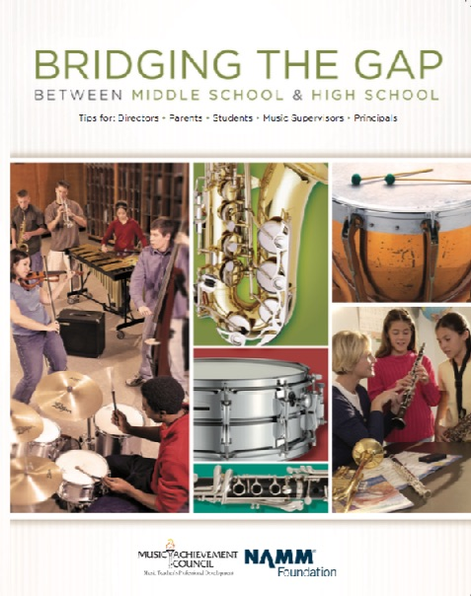
DID YOU KNOW . . .
All of today’s session attendees will receive FREE COPIES of:
Bridging the Gap between
Middle School and High School
www.musicachievementcouncil.org

Slide 11
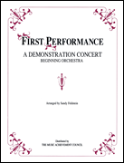
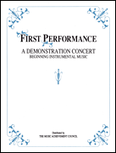
DID YOU KNOW . . .
The First Performance Demo Concert for Band and/or Orchestra features sheet music, parts, sample letters, programs and student certificates for beginning ensembles. Students can perform a composition in seven short weeks with the materials provided!
www.musicachievementcouncil.org

Slide 12
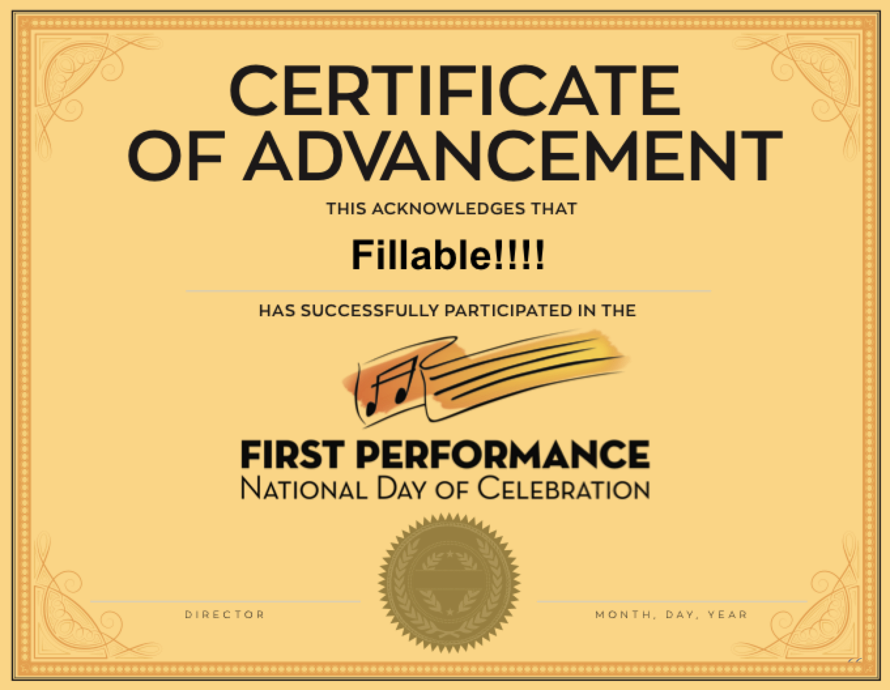
DID YOU KNOW . . .
The First Performance National Day of Celebration is held on the 3rd Thursday of November annually to recognize the achievements of your Beginning instrumental students?
www.musicachievementcouncil.org

Slide 13
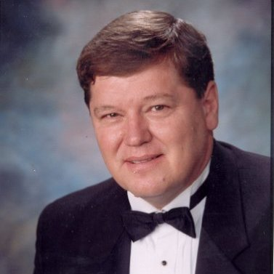
DID YOU KNOW . . .
Most of these publications are provided online at no charge by the Music Achievement Council.
Greg Bimm
They are based on real world strategies shared by the profession’s most successful music educators.

Slide 14
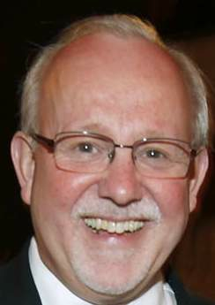
DID YOU KNOW . . .
Most of these publications are provided online at no charge by the Music Achievement Council.
Charlie Menghini
They are based on real world strategies shared by the profession’s most successful music educators.

Slide 15
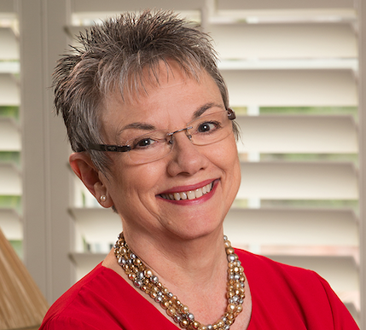
DID YOU KNOW . . .
Most of these publications are provided online at no charge by the Music Achievement Council.
Marcia Neel
They are based on real world strategies shared by the profession’s most successful music educators.

Slide 16
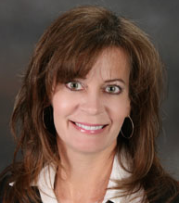
DID YOU KNOW . . .
Most of these publications are provided online at no charge by the Music Achievement Council.
Terry Shade
They are based on real world strategies shared by the profession’s most successful music educators.

Slide 17
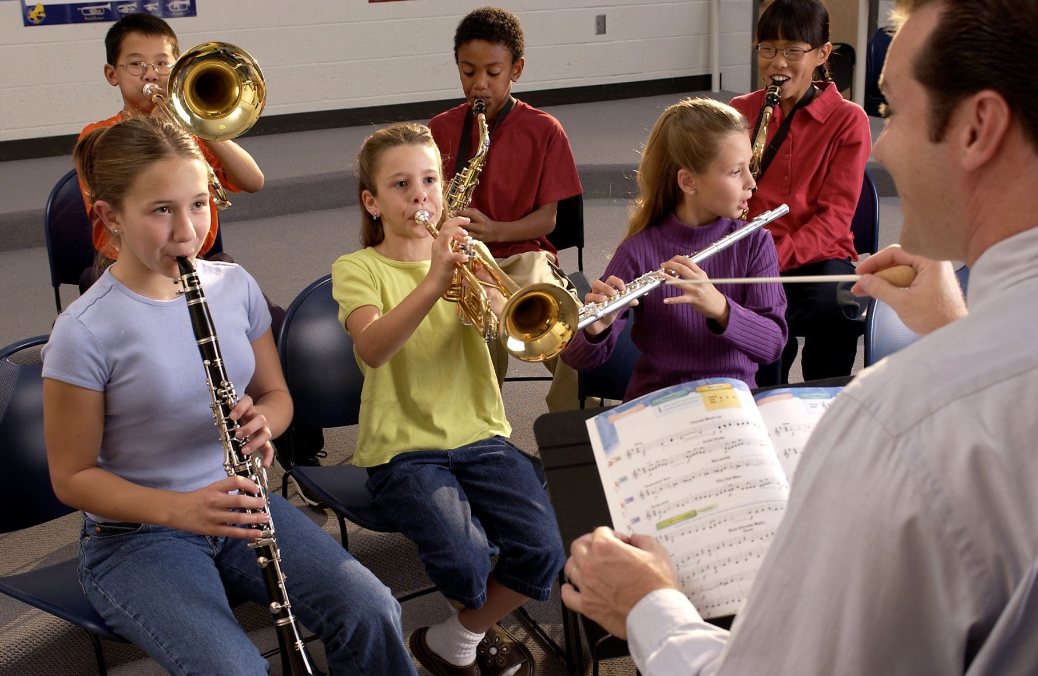

DID YOU KNOW . . .
www.musicachievementcouncil.org

Slide 18
DID YOU KNOW . . .
Music making has been scientifically proven to:
Exercise the brain
Inspire creativity
Increase productivity
Fight memory loss
Reduce stress
Lower blood pressure
Build confidence
Stave off depression

Slide 19

DID YOU KNOW . . .
Metropolitan Nashville Public Schools found that ATTENDANCE RATES ROSE with increased study in music.
No Music:
< 1 Year of Music:
> 1 Year of Music:
87% Attendance
91% Attendance
93% Attendance

Slide 20
DID YOU KNOW . . .
Metropolitan Nashville Public Schools found that DISCIPLINE REPORTS FELL with increased study in music.
No Music:
< 1 Year of Music:
> 1 Year of Music:
4.34 over 4 years
3.75 over 4 years
3.23 over 4 years

Slide 21
DID YOU KNOW . . .
Metropolitan Nashville Public Schools found that GPAs ROSE with increased study in music.
No Music:
< 1 Year of Music:
> 1 Year of Music:
2.51 Average
2.61 Average
2.89 Average

Slide 22
DID YOU KNOW . . .
Metropolitan Nashville Public Schools found that GRADUATION RATES ROSE with increased study in music.
No Music:
< 1 Year of Music:
> 1 Year of Music:
60% Average
81% Average
91% Average

Slide 23
DID YOU KNOW . . .
Metropolitan Nashville Public Schools found that ACT SCORES ROSE with increased study in music.
No Music:
< 1 Year of Music:
> 1 Year of Music:
16.95 Eng, 17.20 Math
17.64 Eng, 17.62 Math
19.58 Eng, 18.67 Math

Slide 24
WHAT WAS LEARNED?
The MORE a student participates in MUSIC,
the more POSITIVE these BENEFITS become.

Slide 25
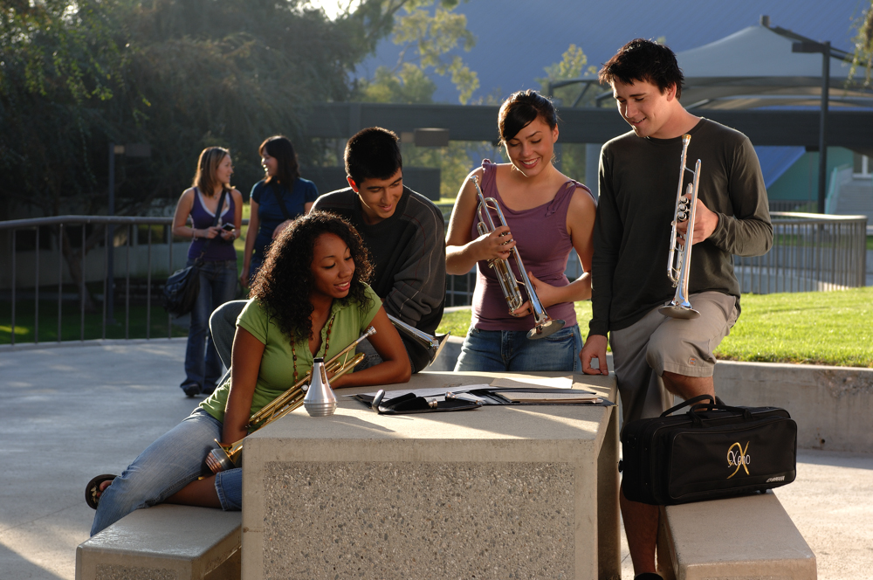
FAMOUS QUOTES. . .
Music has the power of producing a
certain effect on the moral character of
of the soul.
. . . Aristotle

Slide 26
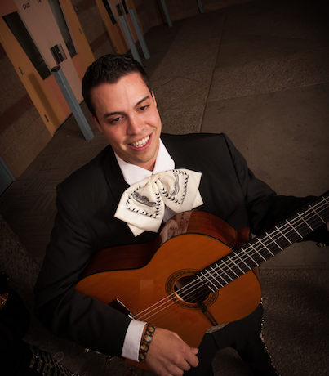
FAMOUS QUOTES. . .
Music furnishes a delightful recreation
for the hours of respite from the cares of the day, and lasts us through life.
. . . Thomas Jefferson

Slide 27


You CAN Successfully Recruit and Retain
Even MORE Students!
Marcia Neel
September 14, 2019
Posted Online at:
www.MusicEdConsultants.net/conference-materials
marcia@musicedconsultants.net @MusicEdConsult on Twitter

Slide 28
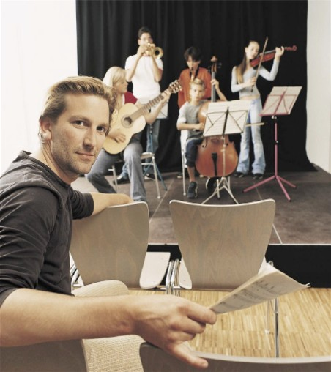
Today’s Session
Tips for Recruiting Students
Tips for Retaining Students
First Performance National Day of Celebration

Slide 29

I. RECRUITING

Slide 30
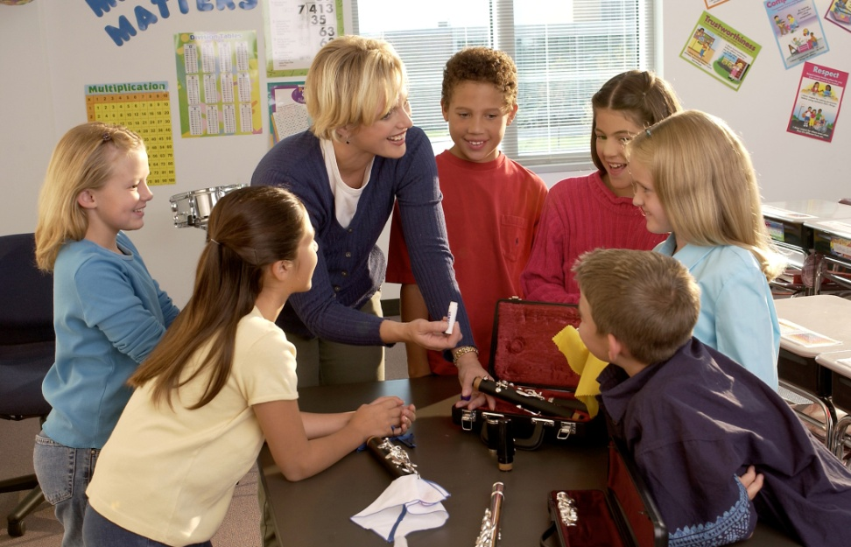
The Four (4) Fundamental Beliefs of
Effective Recruiters
It’s All About Equity
1. Every student will be interested and welcomed.
2. All students will have an equal opportunity to succeed.
3. Music is an integral part of every student’s total education.
4. All students want to play because it looks like fun!

Slide 31
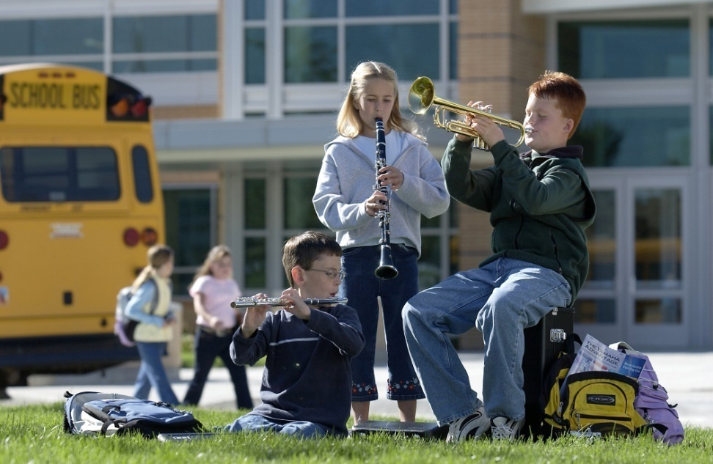
Key Steps in Recruiting:
Attracting Students. . .
Visibility fosters student interest
Informing parents of the benefits of music makes THEM smarter
Building and nurturing support among administration & classroom teachers contributes positively to overall school climate.

Slide 32
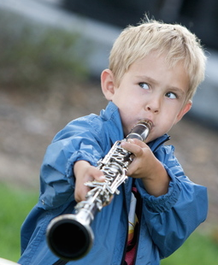
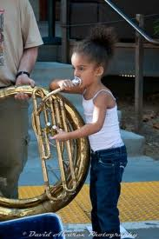
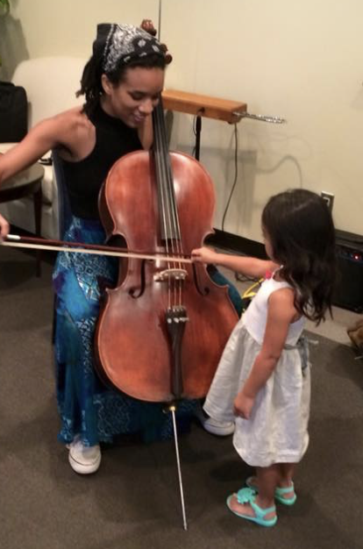
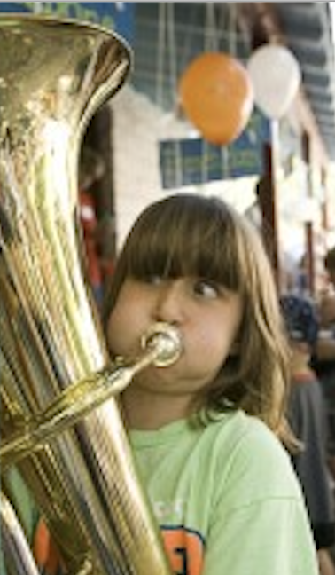
Key Steps in Recruiting
Recruiting is a YEAR-ROUND process including:
Instrument demos/petting zoos with your current students
Regular visits with feeder programs/teachers (Exchange Days)
Mass Concerts with feeder programs including recorder classes
Follow-ups – Show Up for Everything!
www.musicachievementcouncil.org
Notes:
32

Slide 33

Follow-up idea #1 from:
Jeff Scott & Emily Wilkinson, ALMEA
  “Congratulations!
  You have been chosen to
  play (insert instrument)
  in the (name of school) band!”
  Extending an “Invitation” makes
  them feel special!”
www.musicachievementcouncil.org
Notes:
33

Slide 34
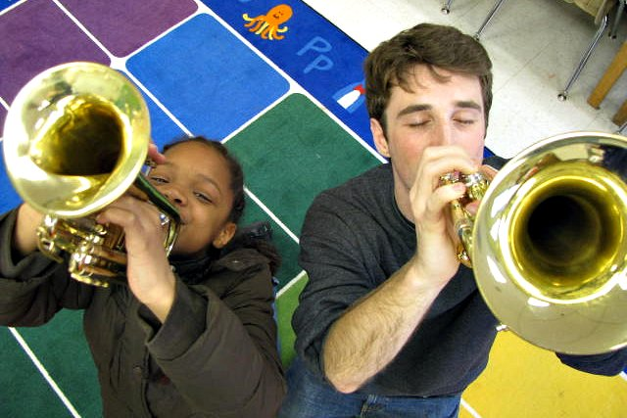
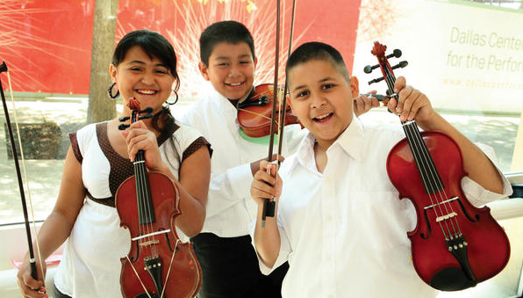
Follow-up idea #2 from:
Chris Crone, PAMEA
Have each 4th grader touch, hold, and play three instruments of choice
Send a personal letter home letting parents know which instrument their child experienced successfully
“Watch numbers go through the roof!”
Notes:
34

Slide 35
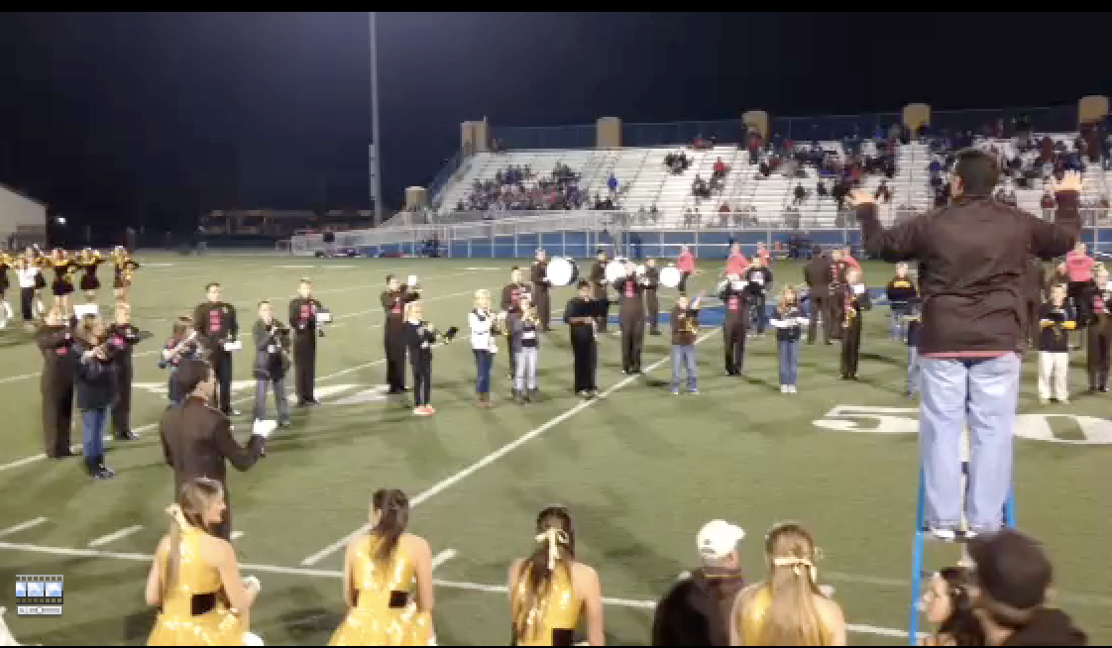
Key Steps in Recruiting:
Engage Students Early. . .2-Note Show!
www.musicachievementcouncil.org
Notes:
35

Slide 36
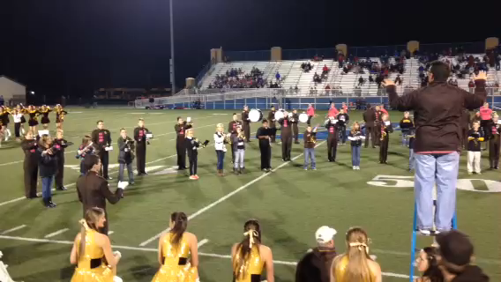
Key Steps in Recruiting:
Engage Students Early. . .2-Note Show!
www.musicachievementcouncil.org
Notes:
36

Slide 37
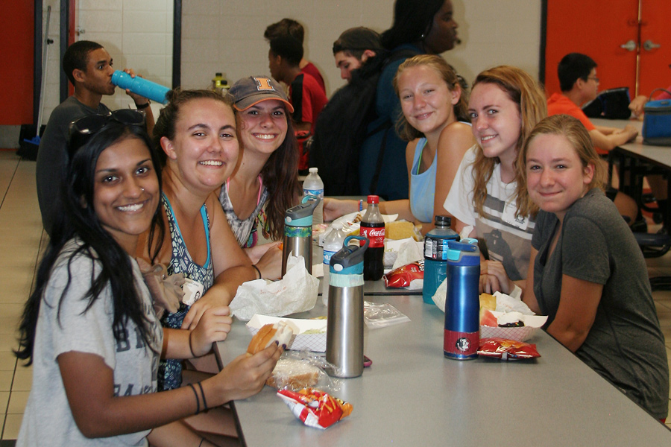
The Partnership Halftime Show:
Pre-game Activities
HS students invite beginners to join the high school students in a pre-game pizza party.

Slide 38
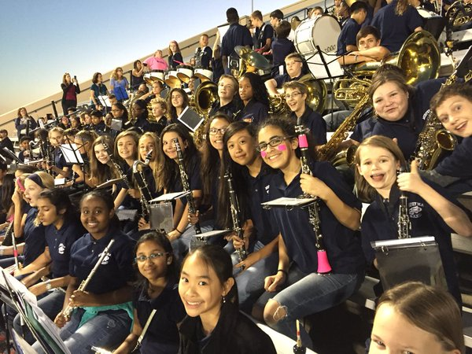
The Partnership Halftime Show:
Pre-game Activities
HS students invite beginners to join the high school students in a pre-game pizza party.
HS students invite beginners to sit/play with HS band at game.

Slide 39

The Partnership Halftime Show:
Pre-game Activities
HS students invite beginners to join the high school students in a pre-game pizza party.
HS students invite beginners to sit/play with HS band at game.
Encourage high school boosters to host a middle school parent reception and invite both principals to speak.

Slide 40


The Partnership Halftime Show:
Pre-game Activities
HS students invite beginners to join the high school students in a pre-game pizza party.
HS students invite beginners to sit/play with HS band at game.
Encourage high school boosters to host a middle school parent reception and invite both principals to speak.
4. Ensure VIP seating/treatment in the stands for parents.

Slide 41

Engage with Prospective Parents
Best Ambassador is an Excited Child
Recruitment Info
  Emphasize rewards, benefits
  Maintain accessibility to parents and don’t give up!
Initial Meeting: Involve
  Current parents
  Current student
  Current administrator

Slide 42

Engage with
Prospective Parents
Can your child read this?
We can help change your
child’s future!
Provide advocacy
information –
and teasers?
Sign up for
Music!

Slide 43
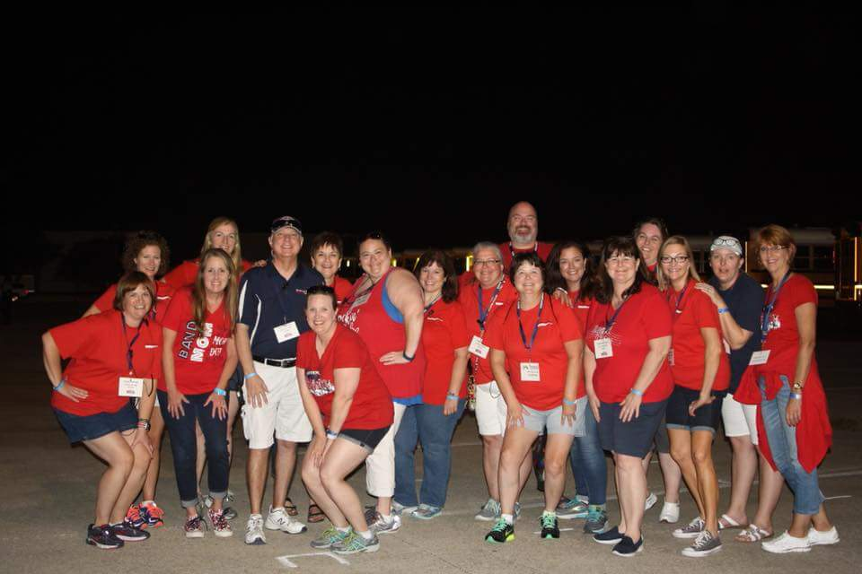
Students don’t quit if their parents
remain involved ACTIVELY in the program!
Lean on your parents—They want to help!

Slide 44
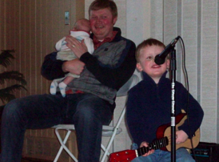
Teach the Parents Too. . .
They don’t know what NORMAL is!
  Teach PARENTS how to support their child’s practicing
Notes:
www.musiceducationconsultants.net/mmea2010
44

Slide 45
Teach the Parents Too. . .
They don’t know what NORMAL is!
  Teach PARENTS how to support their child’s practicing
  Give PARENTS ideas of how to motivate their children
Notes:
www.musiceducationconsultants.net/mmea2010
45

Slide 46
Teach the Parents Too. . .
They don’t know what NORMAL is!
  Teach PARENTS how to support their child’s practicing
  Give PARENTS ideas of how to motivate their children
  Encourage PARENTS to play an active role in the learning process and to become involved
Notes:
www.musiceducationconsultants.net/mmea2010
46

Slide 47
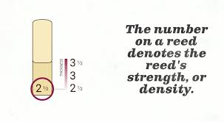
Teach the Parents Too. . .
They don’t know what NORMAL is!
https://www.schoolmusiconline.com/central-music-highlights/2017/10/10/tips-for-beginning-band-parents-music-stands
Notes:
www.musiceducationconsultants.net/mmea2010
47

Slide 48

Teach the Parents Too. . .
They don’t know what NORMAL is!
https://www.schoolmusiconline.com/central-music-highlights/2017/10/10/tips-for-beginning-band-parents-music-stands
Notes:
www.musiceducationconsultants.net/mmea2010
48

Slide 49
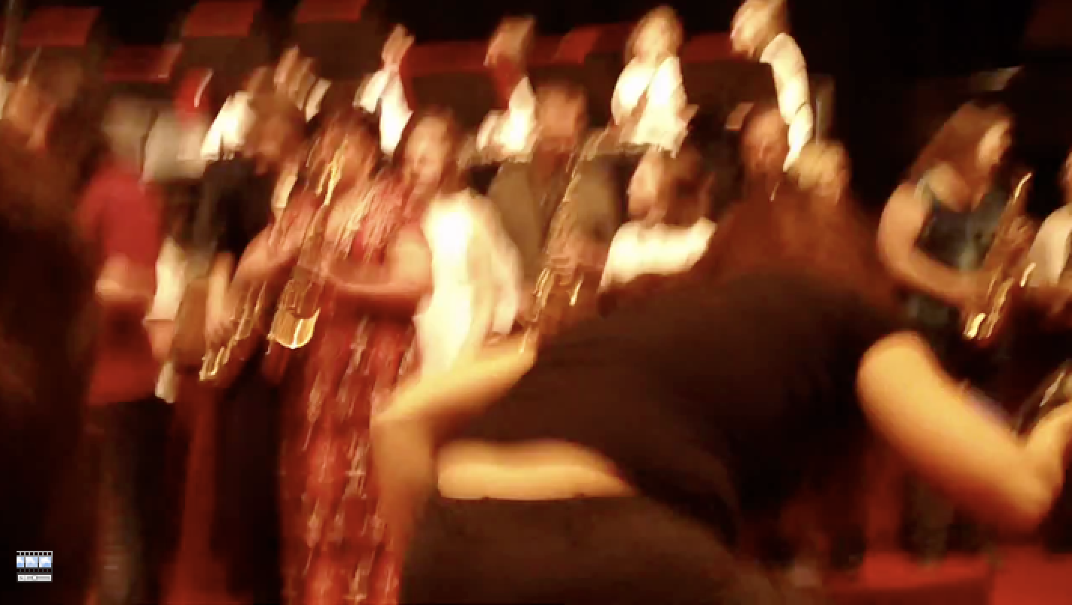
Engage Parent Support…Directly!
The Parent Band – REALLY FUN!
Notes:
www.musiceducationconsultants.net/mmea2010
49

Slide 50
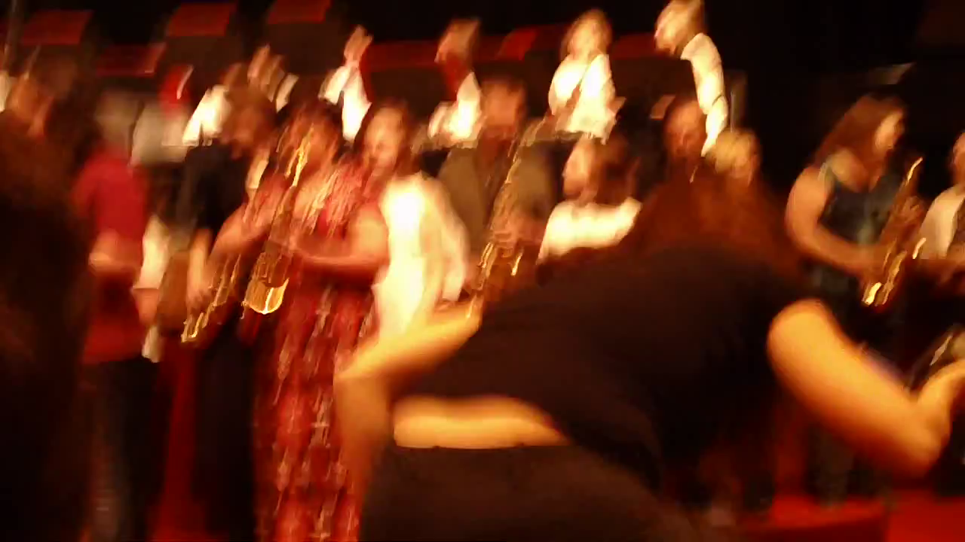
Engage Parent Support…Directly!
The Parent Band – REALLY FUN!
Notes:
www.musiceducationconsultants.net/mmea2010
50

Slide 51
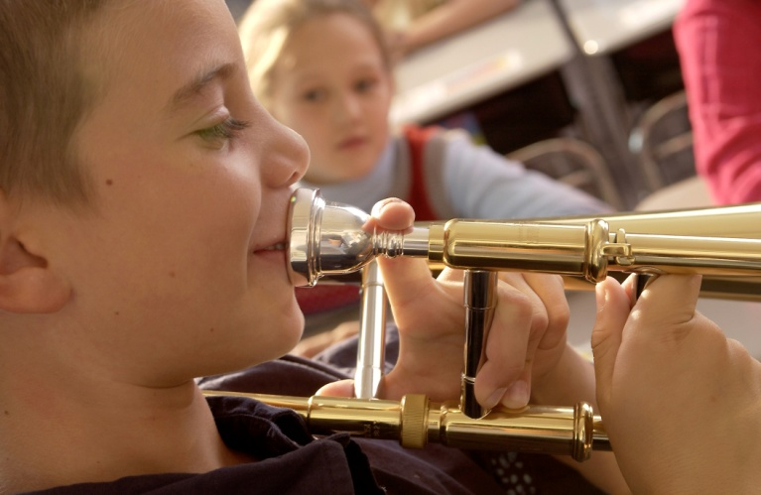
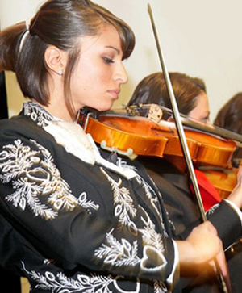
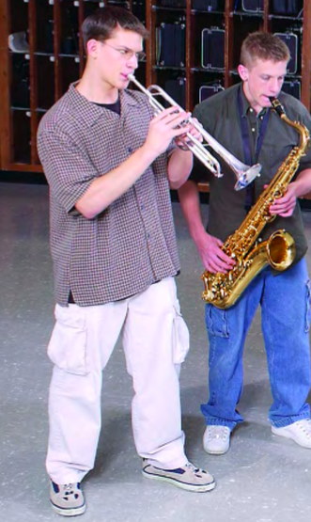
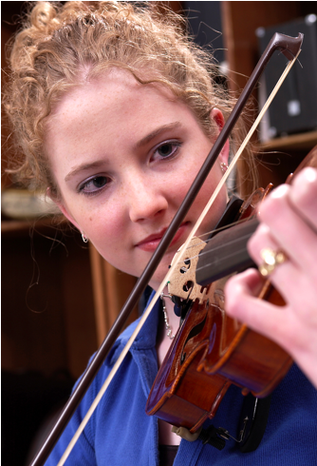
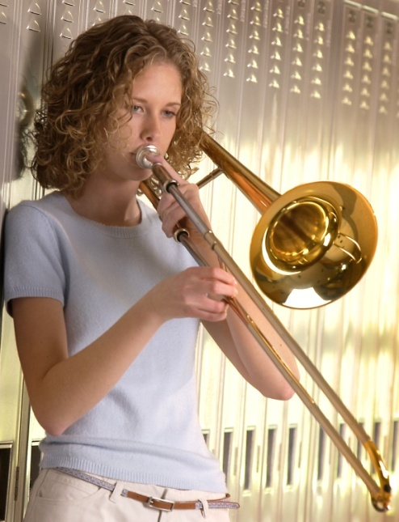
II. RETAINING

Slide 52

Keeping Your New Recruits
Why Do Kids Stay? Let’s Ask THEM!

Slide 53

Keeping Your New Recruits
Why Do Kids Stay? Let’s Ask THEM!

Slide 54


Consider More Effective Scheduling Models
Vertical Alignment
HS Band Director
also
teaches
Beginning ES/MS Band

Slide 55
Consider More Effective Scheduling Models
Vertical Alignment
HS Band
also
teaches
Beginning ES/MS Band
Director

Slide 56

Common Reasons for Drop-outs?
The first disappointment
Notes:
56

Slide 57
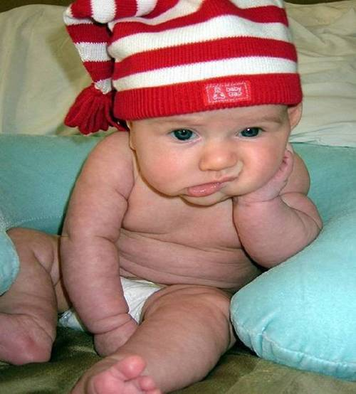
Common Reasons for Drop-outs?
The first disappointment
Lost interest
Notes:
57

Slide 58
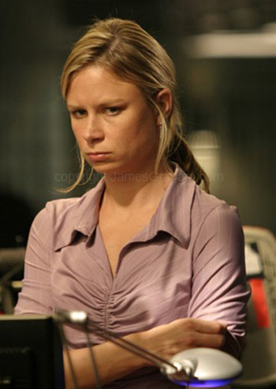
Common Reasons for Drop-outs?
The first disappointment
Lost interest
Didn’t like the teacher
Notes:
58

Slide 59

Common Reasons for Drop-outs?
The first disappointment
Lost interest
Didn’t like the teacher
Conflicts
Notes:
59

Slide 60
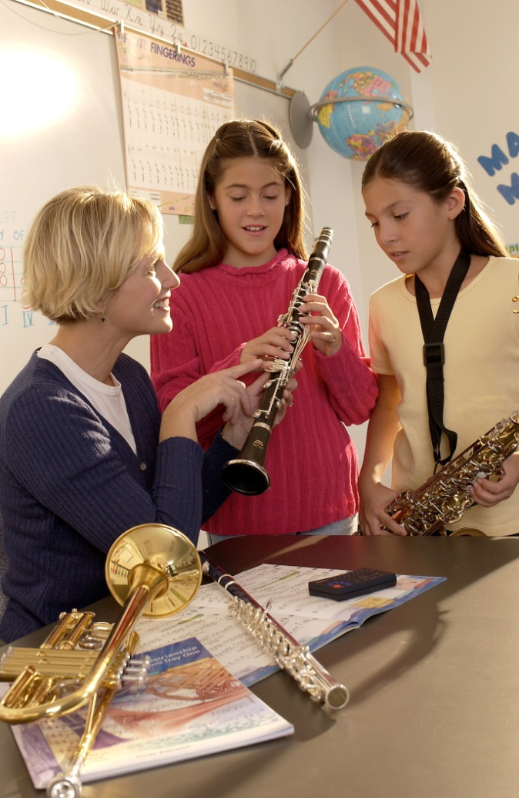
What Can You Do?
Talk to the student
  Probe for real reason they want to quit
Check their instrument
Talk with the parents
Iowa Bandmasters Assn Exit Survey

Slide 61
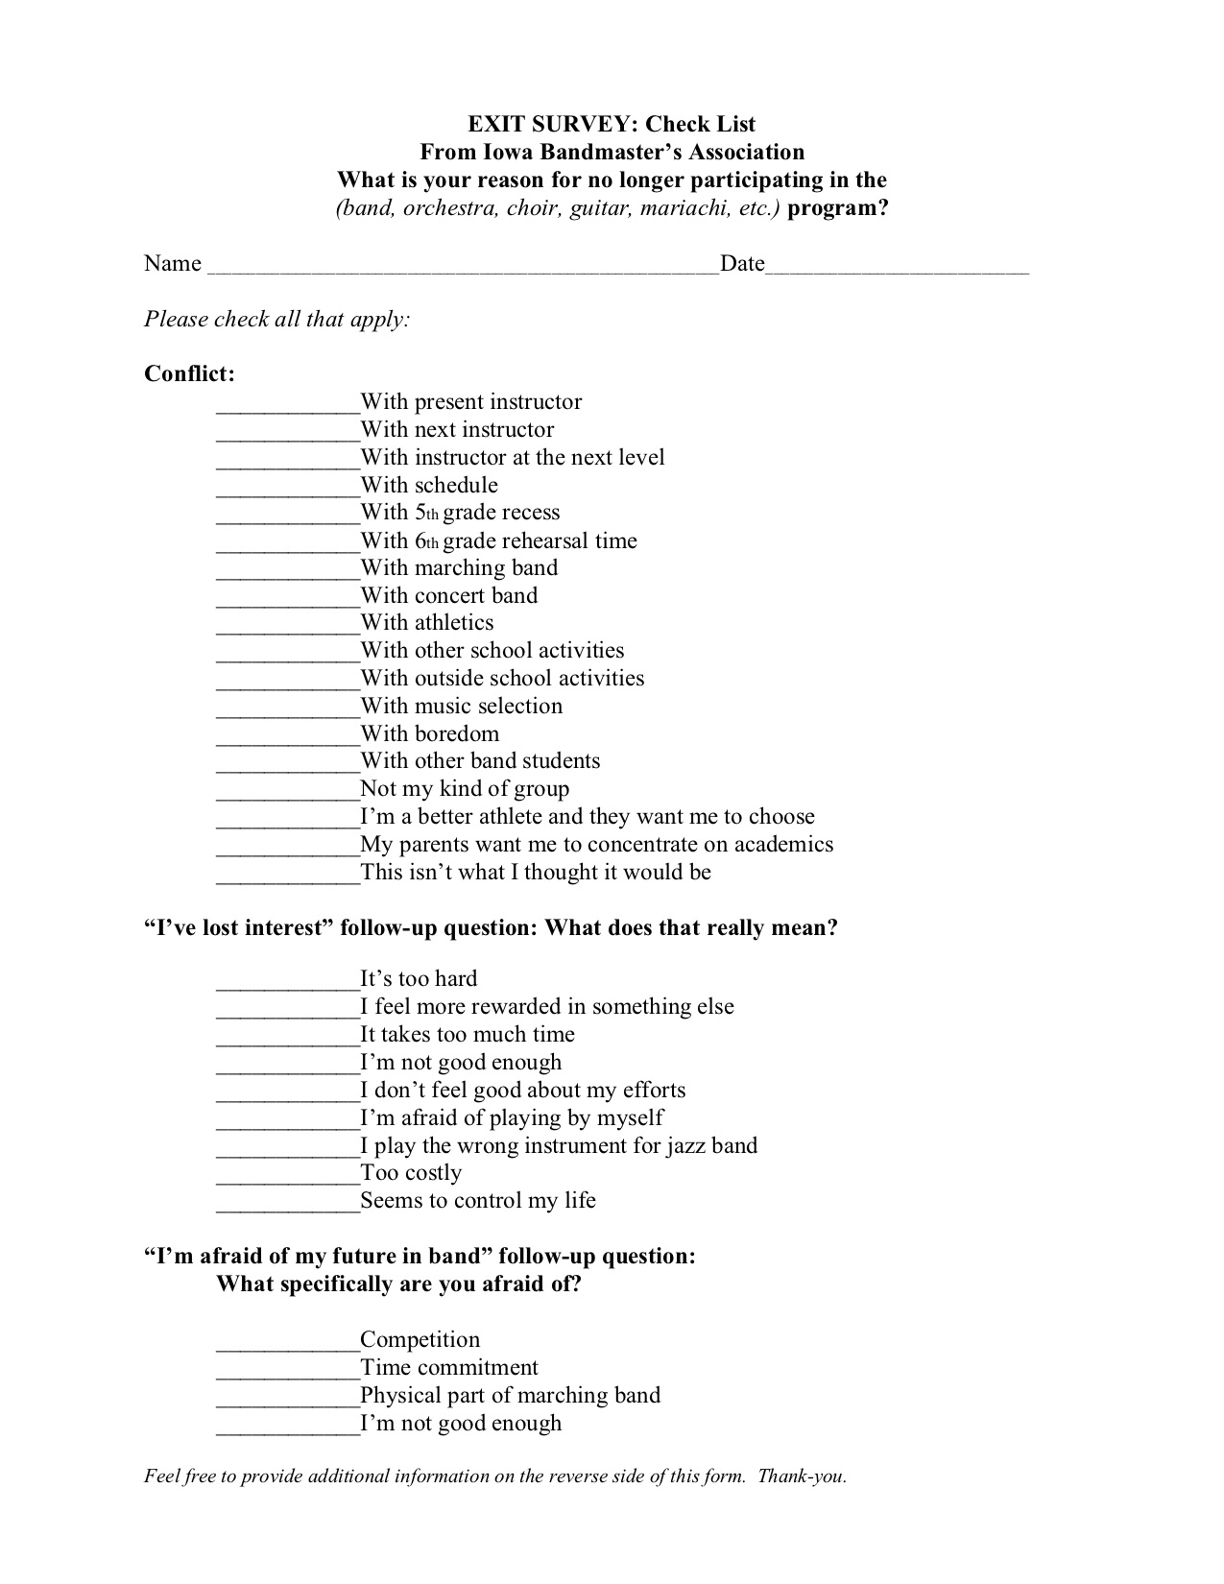

Slide 62




III.

Slide 63
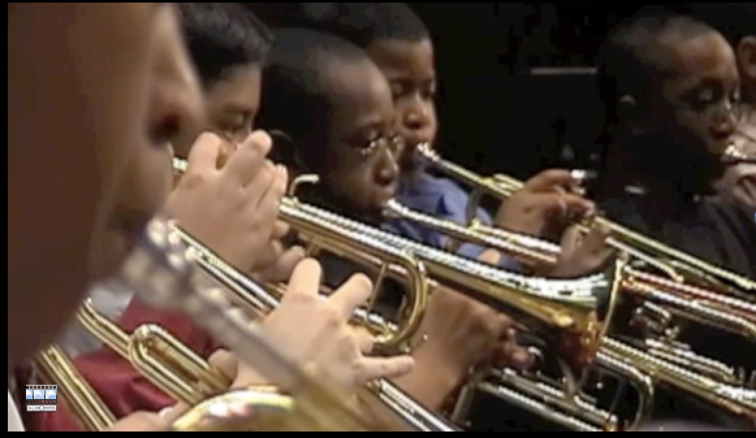
First Performance
National Day of Celebration
3rd Thursday of November Annually

Slide 64

First Performance
National Day of Celebration
3rd Thursday of November Annually

Slide 65
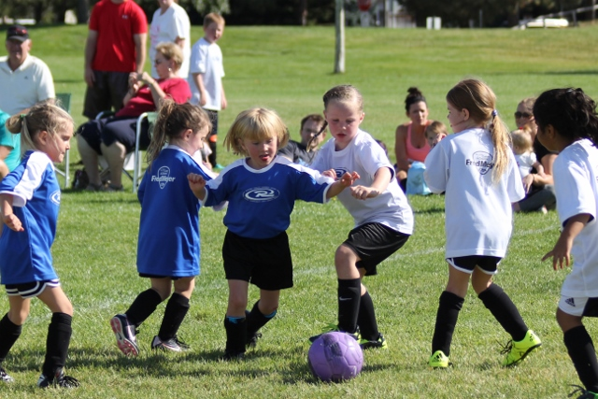

Slide 66
The Results:
  Reduces Beginner Dropout
  Provides Short-Range Achievement
  Goals
  Encourages Engagement with
  Parents
  Strengthens Administrative Support
  Celebrates Musical Accomplishments
  of Beginners

Slide 67
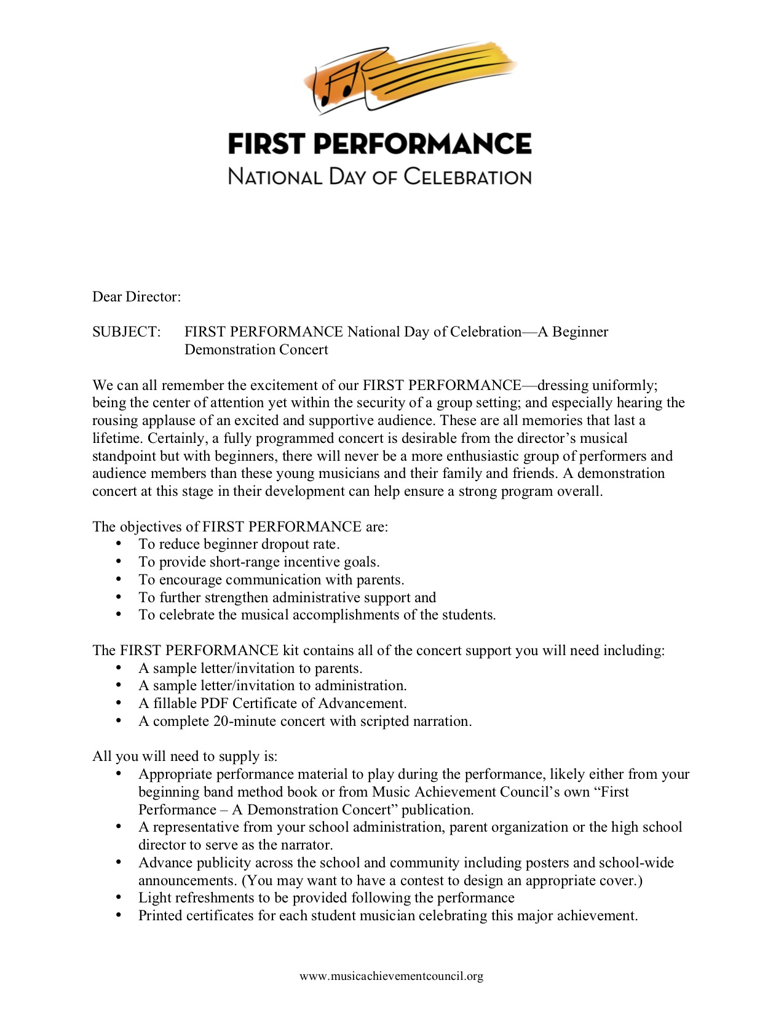
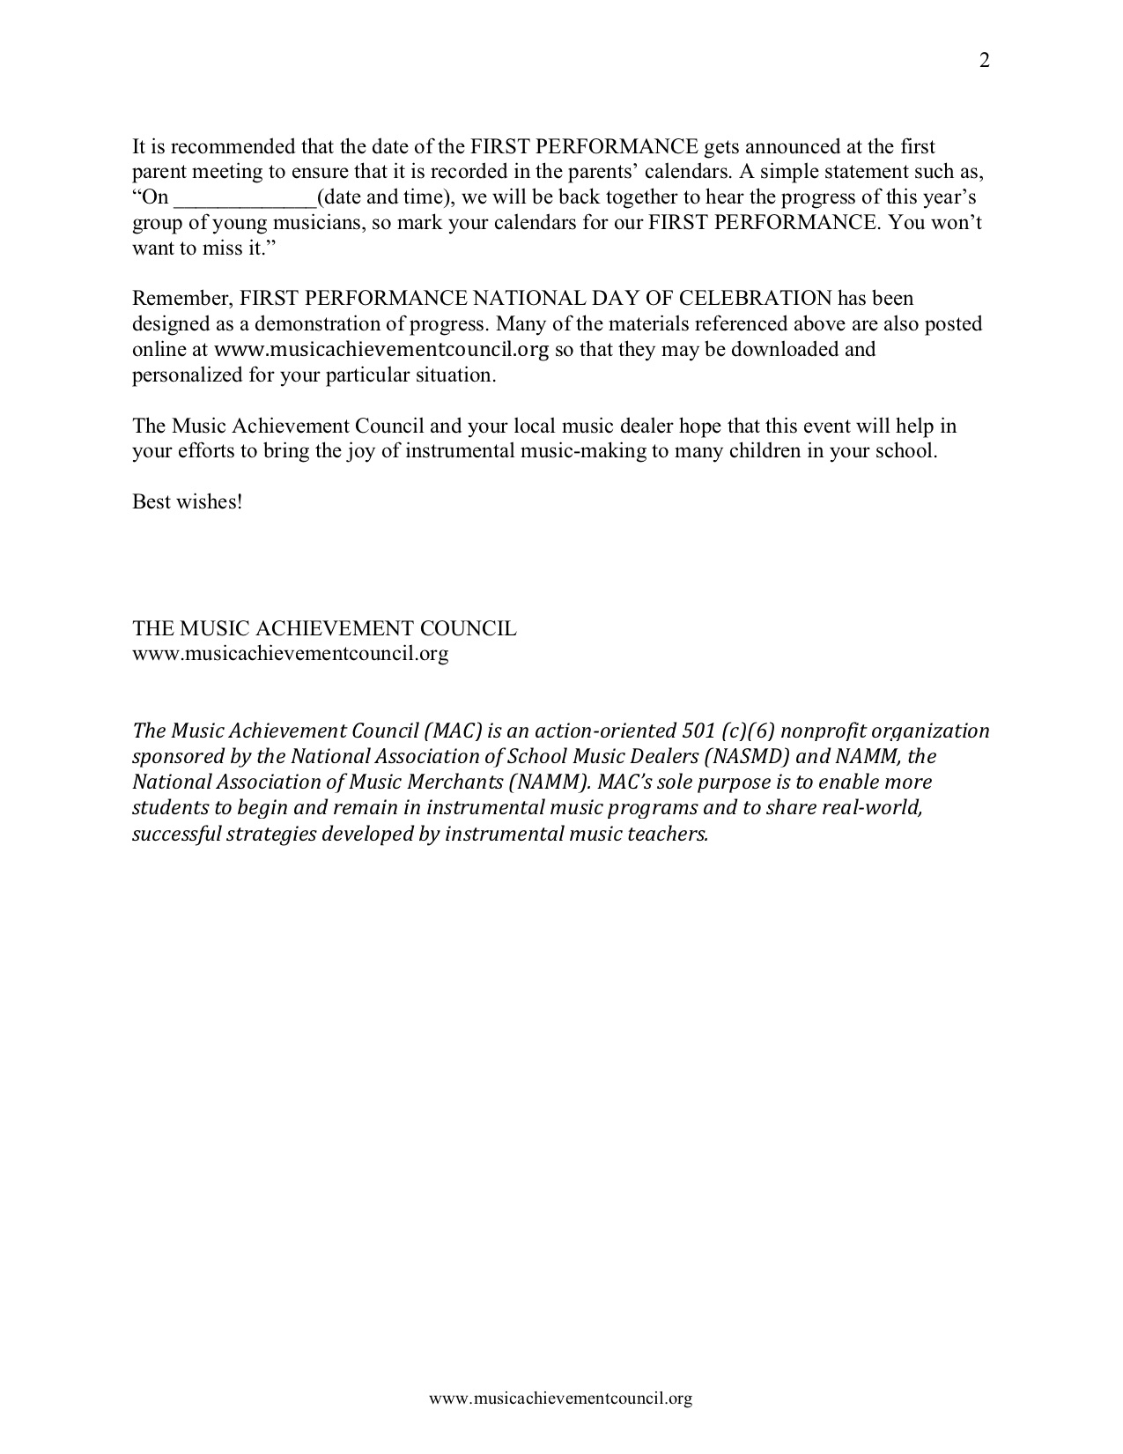
What’s Included?
a. Director Letter with Full Set of Instructions

Slide 68
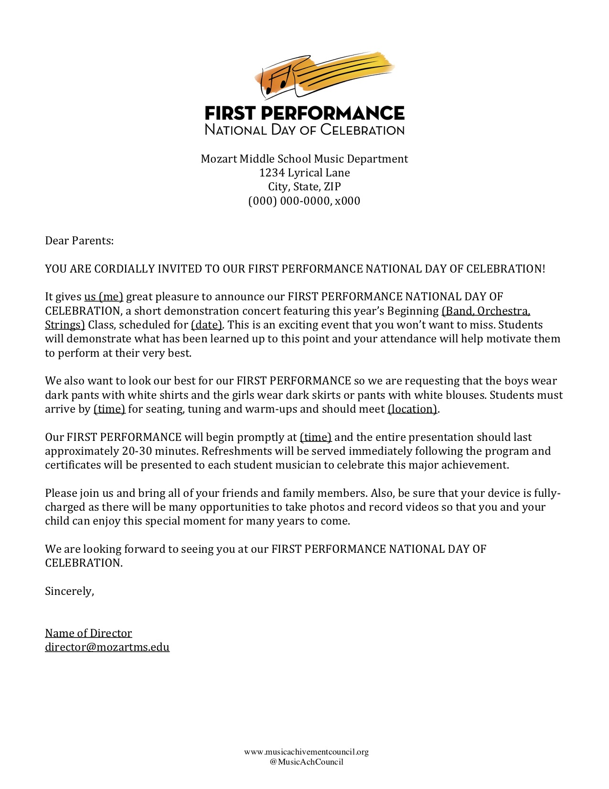
What’s Included?
b. Customizable Letter of Invitation to Parents

Slide 69
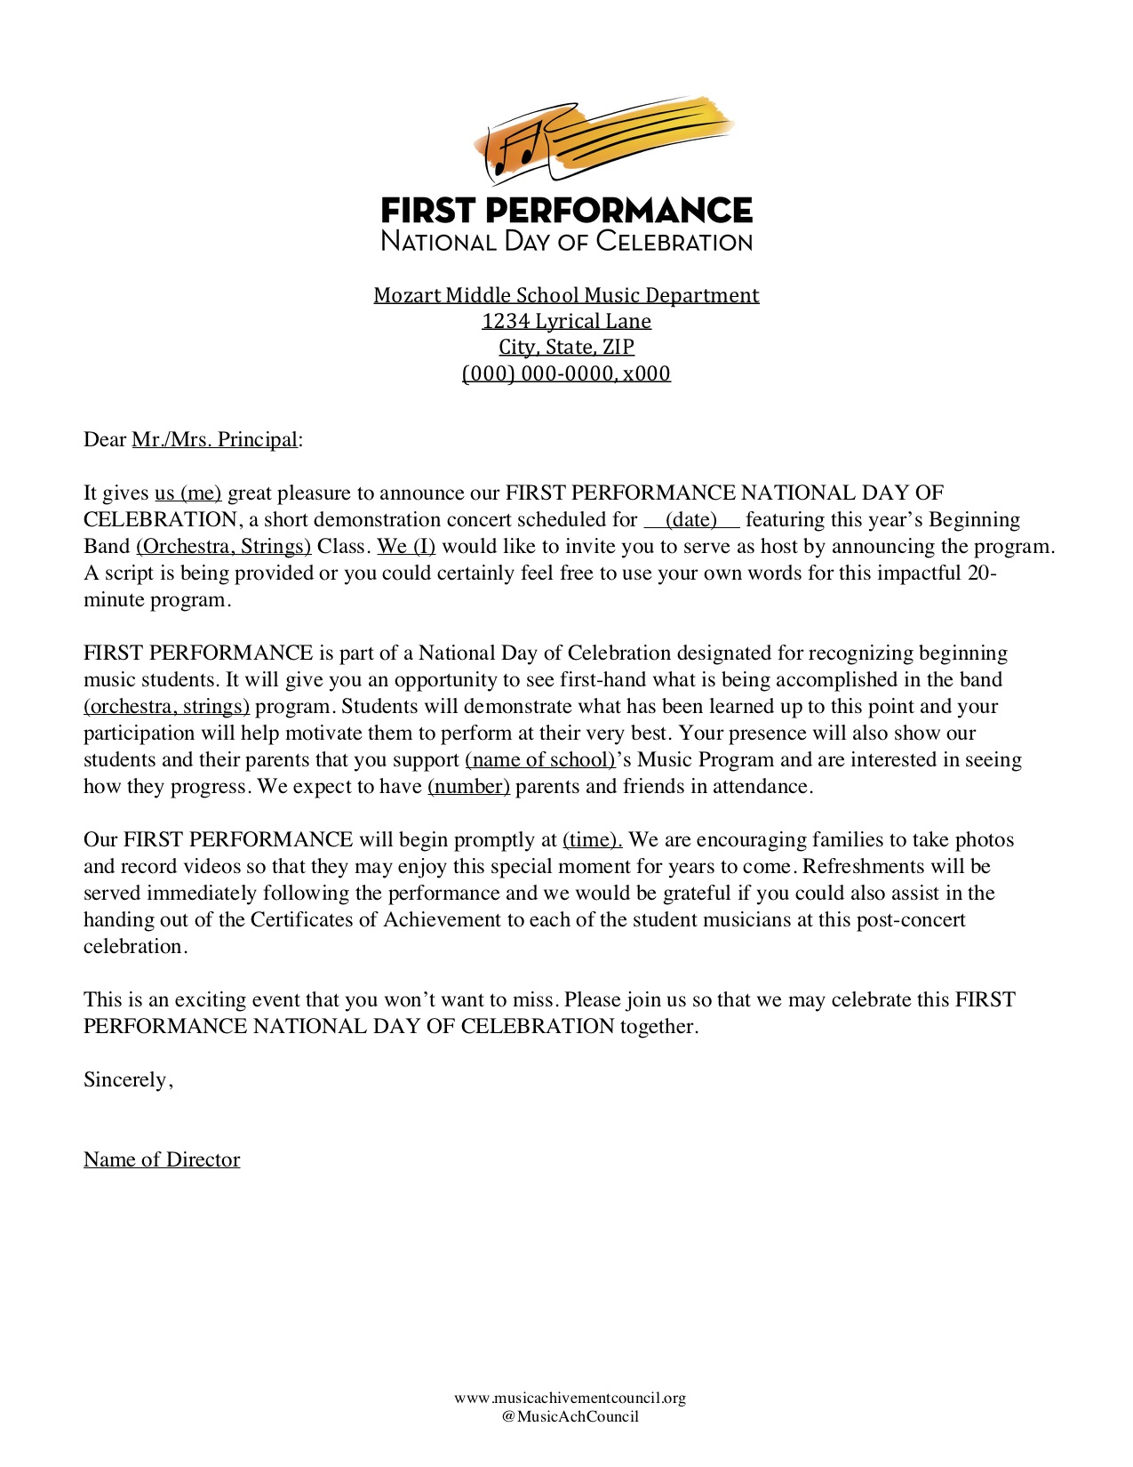
What’s Included?
c. Customizable Letter of Invitation to Principal

Slide 70
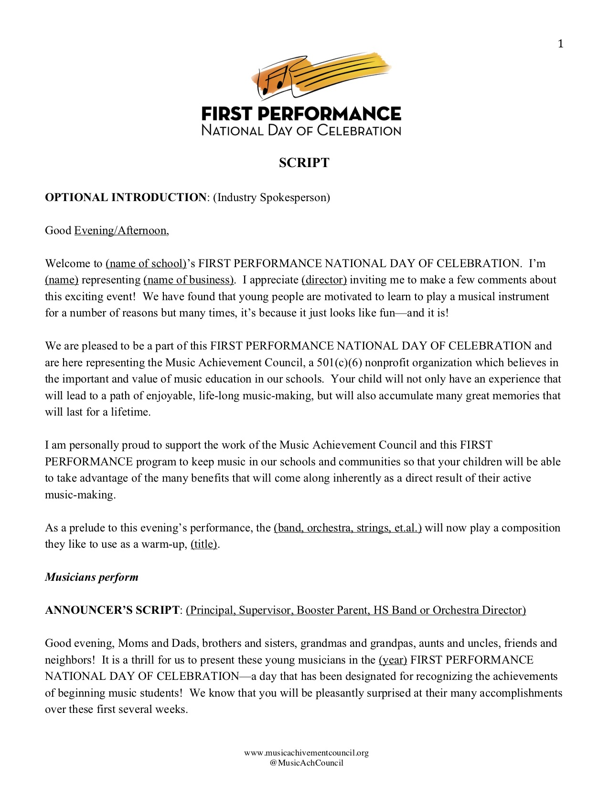


What’s Included?
d. Customizable Script to Make It Your Own!

Slide 71

What’s Included?
e. Press Release Template

Slide 72

What’s Included?
f. Certificate of Advancement

Slide 73

What’s Included?
g. Ideas to Enhance the Experience

Slide 74

What’s Included?
h. Certificate of Music Ed Leadership for
High School Student Participants

Slide 75

What’s Included?
i. #FPCelebration Toolkit

Slide 76





Music
To Use?
Available for
Band or Orchestra at
Local Music Dealers
or online via
Hal Leonard

Slide 77
Why Does this Program Work?
The timing of the performance
  Parents want to hear their kids
  play
  Student interest soars and they
  learn to love performing
Students practice more prior to a performance
The audience will be large and enthusiastic!

Slide 78


Why Does this Program Work?
Administrators get involved! Many schools have the principal serve as the narrator -- GREAT PR!
The sound of
applause is
infectious

Slide 79

Response from F.P. LIVE at the 2017 Midwest Clinic
Consider Using: Poll Everywhere

Slide 80

Response from F.P. LIVE at the 2017 Midwest Clinic

Slide 81

Response from F.P. LIVE at the 2017 Midwest Clinic

Slide 82

Response from F.P. LIVE at the 2017 Midwest Clinic

Slide 83




Response from Mario Moody, Director

Slide 84
Response from Mario Moody, Director
The experience of having our 1st year students perform after only 8 weeks has had a profound impact not only on their confidence and expectations for themselves moving forward, it has challenged me to continually grow by making myself vulnerable and aware of how it feels to be a “beginner." I can relate better to any feelings of apprehension they may feel plus our rehearsals are more effective because my students truly understand that every practice counts.

Slide 85
It’s all FREE to Download!
MusicAchievementCouncil.org
Use Smart Phones to Share
Student Success Stories
http://bit.ly/BegMus

Slide 86



Your Enthusiasm is what Matters!

Slide 87


Additional M.A.C. Resources
www.MusicAchievementCouncil.org
Notes:
87

Slide 88











Thanks to our Sustaining Sponsors!
Notes:
www.musiceducationconsultants.net/mmea2010
88

Slide 89

Complimentary Recruitment and Retention Materials
MusicAchievementCouncil.org
This PPT and Videos will be Posted at:
MusicEdConsultants.net/conference-materials
Contact Information
Marcia Neel
marcia@musicedconsultants.net
@MusicEdConsult on Twitter
702.361.3553

