Slide 1





Making an Advocate Out of Your Principal:
10 Things to do “on Monday”
and then some!!!!!
Marcia Neel
February 2, 2019

Slide 2
The Two Querries…
What Do Principals Really Think?
2.What Have You Done to Make an Advocate out of Your Principal?

Slide 3
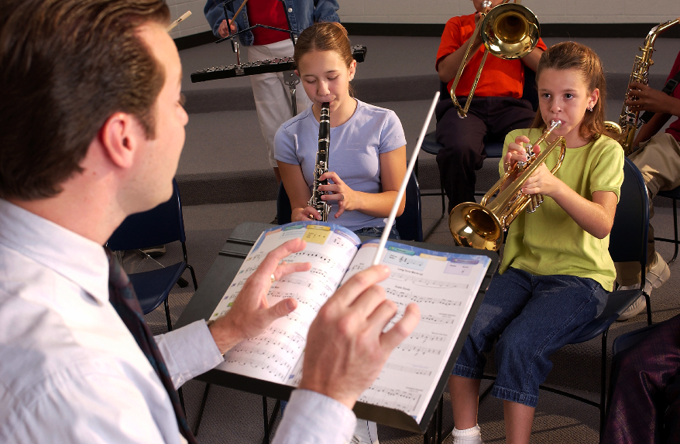
1. What I love best about my music teacher is
that he/she is. . .(here we go!)
Caring
Dedicated
Passionate
Committed
Success-oriented
Organized
Dynamic
Positive
A Team Player/Builder
with Students, Staff and Parents

Slide 4
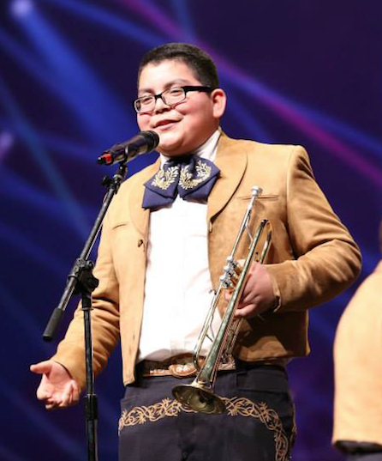
1. What I love best about my music teacher is
that he/she is. . . (cont.)
Communicative
Encouraging
Flexible
Professional
Creative
Talented (Performer)
Intense (In a Good Way)
Effective with Pedagogy

Slide 5
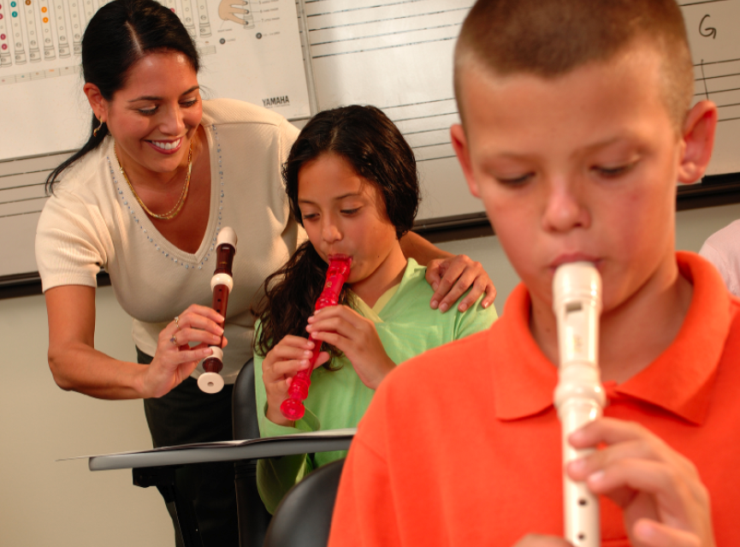
1. What I love best about my music teacher is
that he/she is. . . (cont.)
Responsible
Collegial
Motivational
Inspirational
Helpful
Content-oriented
A Music Advocate (Recruiter)
Demanding (Of Self and Students)

Slide 6
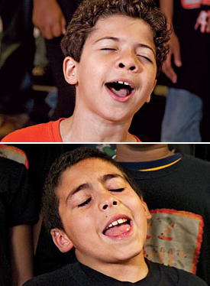
2. To improve the music program, I would ask my music teachers to. . .
Communicate ! Communicate! Communicate!
Coordinate/Collaborate with Colleagues
Articulate with Feeder Schools More
Recruit/Retain More
Focus on Building Group Identity
Promote More
Perform More

Slide 7
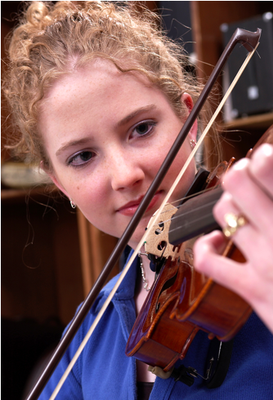
2. To improve the music program, I would ask my music teachers to. . .(cont.)
Help Administrators to Help Them
(esp: Class Sizes and
Program Building)
Extend Learning Into the Community
Develop More Partnerships
Incorporate School-wide Objectives
Assess Their Own Programs More
Often

Slide 8

3. What troubles me most is that he/she is not. . .
Passionate
Considerate of the “Big Picture”
Communicative
Demanding Enough
Managing the Classroom Well
Lesson-planning Effectively
Even-tempered
A Team Player
Organized

Slide 9



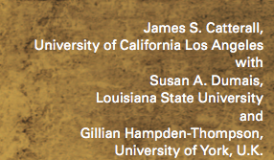
What Have You Done to Make an Advocate Out of Your Principal?
“I communicate and keep my principal informed.”

Slide 10

“I communicate and keep my principal informed.”

Slide 11
Always Have Small Ensembles READY to Perform
Invite Her (and Faculty) to PERFORM in the Holiday Concert
Copy Him on All Correspondence
Communicate Music Advocacy Information
Took him Golfing
. . .He Won!!!!

Slide 12
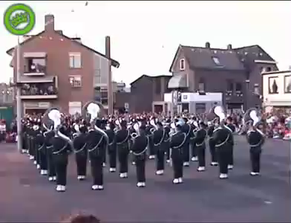
Sometimes Though -- It Seems As If Principals TRY To Trip Us UP!

Slide 13
Sometimes Though -- It Seems As If Principals TRY To Trip Us UP!

Slide 14
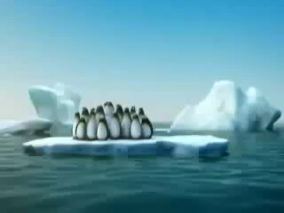
In order to survive,
we must ALL be on the same TEAM!

Slide 15
In order to survive,
we must ALL be on the same TEAM!

Slide 16
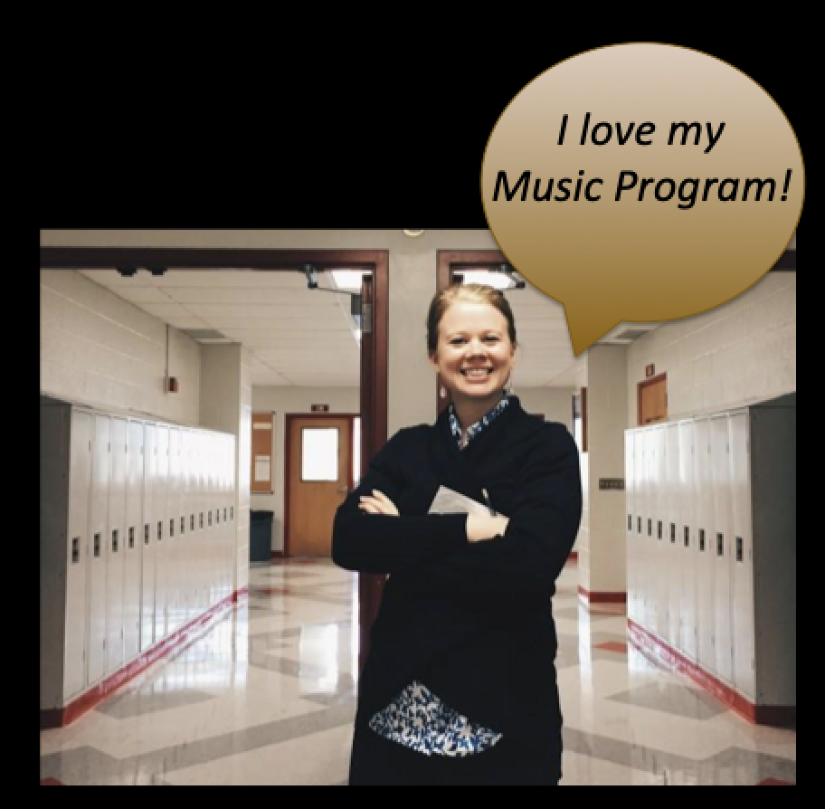



1. Speak the language of your principal but teach them as well.

Slide 17
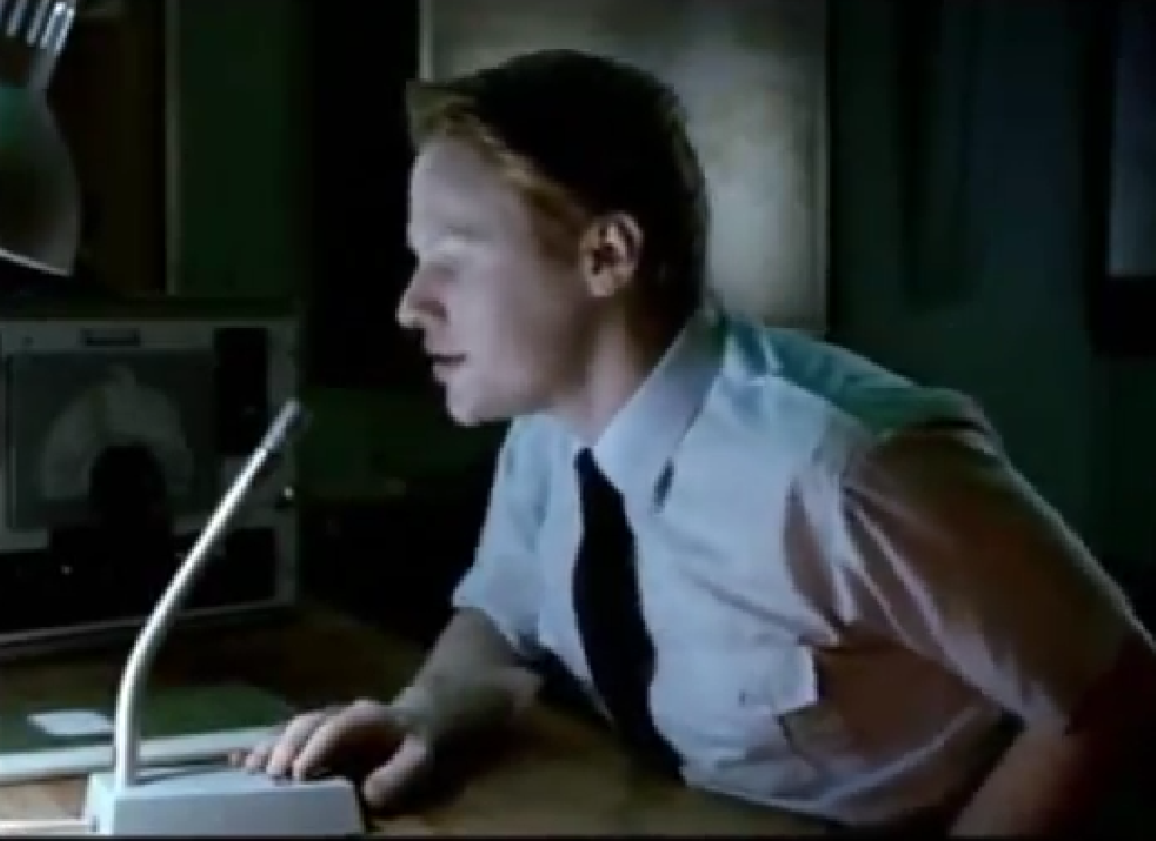
1. Speak the language of your principal but teach them as well.

Slide 18

1. Speak the language of your principal but teach them as well.

Slide 19


Slide 20


Slide 21
ESSA and Some Terms to Look for:
“Well-rounded,” “Music,” “Arts”
The “Well-Rounded Education” provision lists
courses deemed critical when providing students
a broad and enriched educational experience.
It includes “music” and “arts,” which articulates
the importance of music as a part of every child’s
education.

Slide 22


ESSA: So What’s Really New?
Another Education Law du Jour?
It ends the Federal School Improvement Strategies

Slide 23
ESSA: So What’s Really New?
6 Big Deal Items!
  A New and Clear Intent to Support Our Nation’s
  Schools Through a Well-Rounded Education
  2. Enumeration of Music as a Well-Rounded Subject
  3. Flexibility of Title I funds to support a
well-rounded education (ergo, Music Education)

Slide 24
ESSA: So What’s Really New?
6 Big Deal Items!
  4. Increased Funding/Professional Development for Music Educators through Title IV funding
  5. Flexible Accountability Systems
  6. Protection from “Pull Outs” (well. . .sort of)

Slide 25
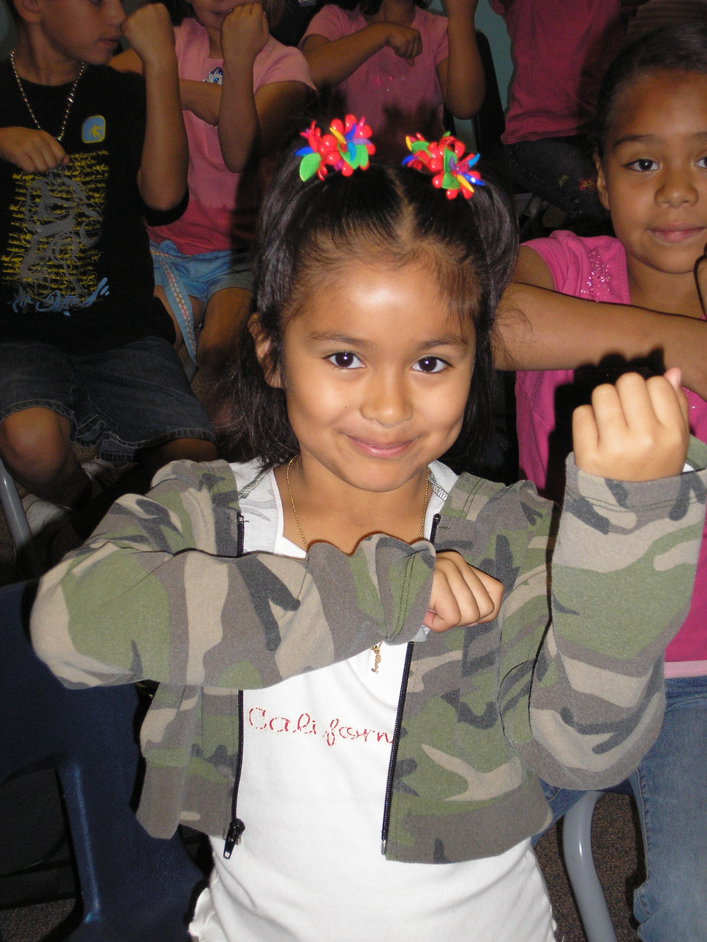
2. Engage Your Principal Directly
Come on down. . .
“Help me give out
instruments to the kids!”

Slide 26
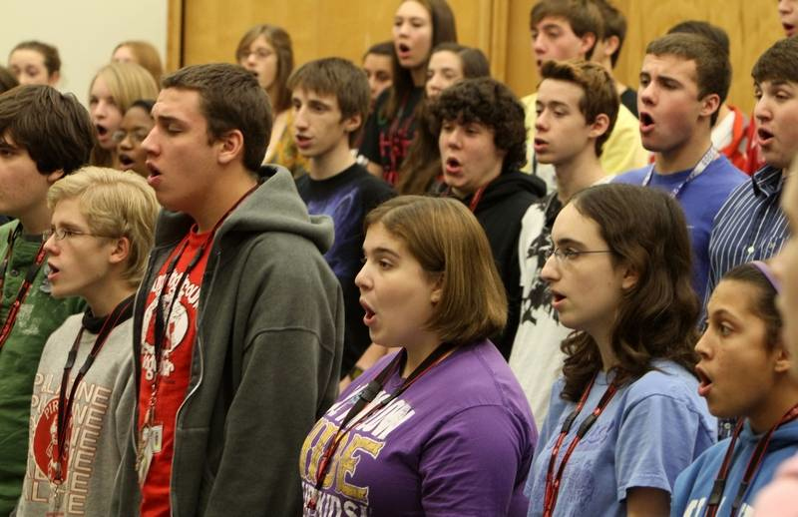
2. Engage Your Principal Directly
Come on down. . .
“I need an audience to help the students prepare for…”

Slide 27
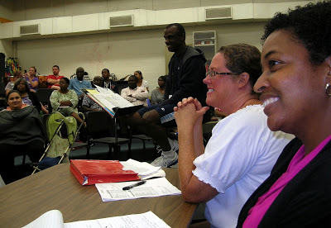
2. Engage Your Principal Directly
Come on down. . .
“Could you give a presentation to the Booster Parents?”

Slide 28
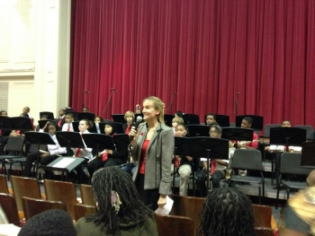
2. Engage Your Principal Directly
Come on down. . .
“Could you provide Opening Remarks at our upcoming concert?”
Praise your administrator in front of the
parents for their support.
Have students present a signed, framed print.

Slide 29
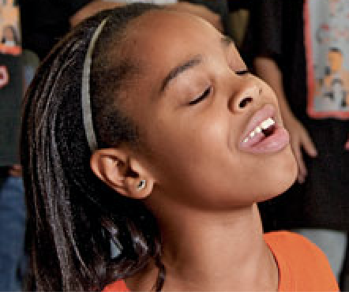
3. Ask your students to complete the sentence, “Music makes the difference because. . .” then use their responses.
“…when you’re sad and then you hear music, it will cheer you up. And when you’re down, it will make you get up from where you are and start dancing. Music will always be there for you.”

Slide 30
“Music makes the difference because. . .”
“…it makes me feel free and like nobody is judging me.”
“…it’s a perfect way to tell and show how you feel.”
“…hearing music helps me work and helps me be the person I want to be.”

Slide 31
“Music makes the difference because. . .”
Use their responses. . .
a. In your upcoming concert programs
  b. In your school newspaper’s “music corner” (Don’t have a “music corner?” You know what to do!)
  c. As copy for recruitment fliers and posters at feeder schools
  d. As copy for MMEA publications
  e. As copy for a publication about your school’s FANTASTIC music program

Slide 32
4. Retrieve information about the value of studying music - quote it in any of the above outlets but especially on recruitment information! Share with your supervisor.
A few Recommended Resources:
musiced.nafme.org/resources
supportmusic.com
bit.ly/MusicEdFacts

Slide 33

5. Recruit 24/7

Slide 34



5. Recruit 24/7 – Keep Music Education Strong
GREAT FOR PARENT NIGHTS!!!!!
Recently Revised to include the Very Latest Research and Statistics on the Benefits of Music Education.
FREE COPIES of assorted brochures available from
NAMMFoundation.org

Slide 35
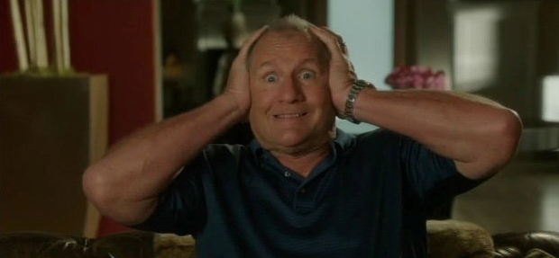
6. Expand: Broaden Your Base
OMG! Does this mean that I have to Learn Something New???

Slide 36

6. Expand: Broaden Your Base
We Have the Power!!!
The Joy of Music-Making
1. Broaden the base
2. Teach so that students will be able to go on and DO music without us
3. Acknowledge and honor ALL music

Slide 37
6. Expand: Broaden Your Base
A. Consider Who We Are Teaching
Do our programs reflect our demographic?
Are we maximing the kids and music relationship?
Do we really need more kids in conservatories?

Slide 38
6. Expand: Broaden Your Base
B. Maximize the “Kids and Music” Relationship
OLD SCHOOL:
If students wanted to be musicians, they had to play an instrument and take lessons
NEW:
If provided with an opportunity to study music through the exploration of the power of music in their lives, our classes would be overflowing

Slide 39
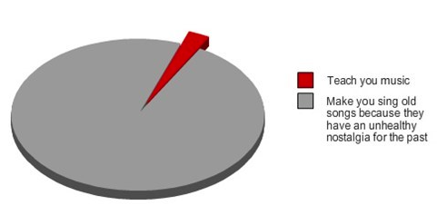
OLD: What Music Teachers Do

Slide 40
6. Expand: Broaden Your Base
C. “De-mythalize” Classical Music
Address Student Interests/Needs/Cultural Backgrounds
Guitar Steel Drum
Drumming Bluegrass
Music Technology Gospel Music
Mariachi Hip Hop
Song Writing Ukelele Ensembles???

Slide 41
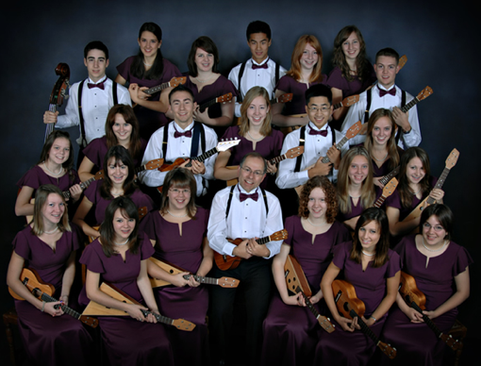
Langley HS Ukelele Ensemble
from B.C. Canada

Slide 42
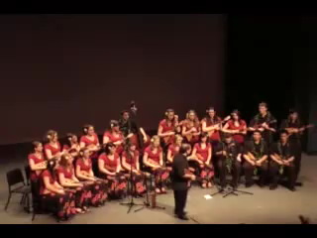
Langley HS Ukelele Ensemble
from B.C. Canada

Slide 43
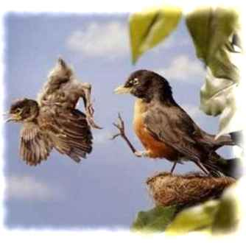
Ideas to Teach So That
Students Can Go On Without Us!
A. Use conceptual teaching methods
    Give them the tools
B. Teach fulfillment
    Instill them with passion for music
C. Allow students to experience your joys of music-making
    Give them the power

Slide 44
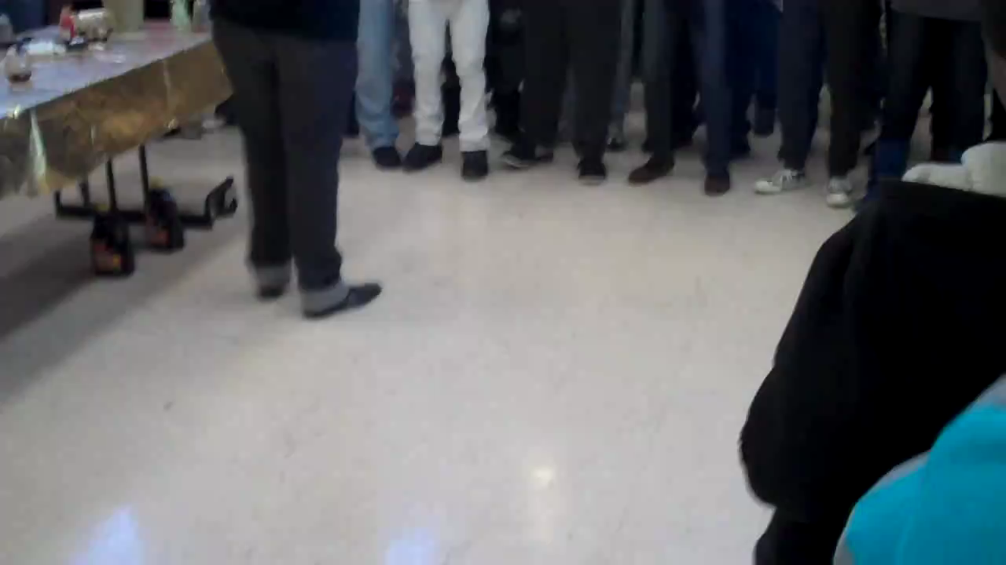
Go On and DO Music Without Us!
Cleveland Hgts HS Gospel Choir

Slide 45
Go On and DO Music Without Us!
Cleveland Hgts HS Gospel Choir

Slide 46
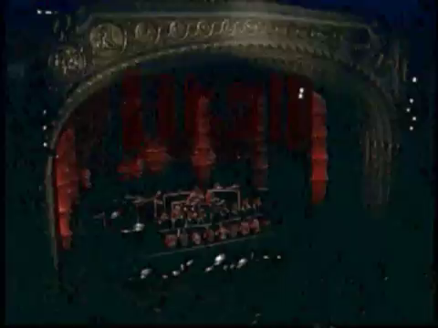
Tucson High School
Steel Drum Ensemble

Slide 47
Tucson High School
Steel Drum Ensemble

Slide 48
Pablo Casals
Each second we live is a new and unique moment in the universe, a moment that never was before and will never be again.
And what do we teach our children in school?
We teach them that two and two make four and that Paris is the capital of France.
We should also teach them who they are.

Slide 49


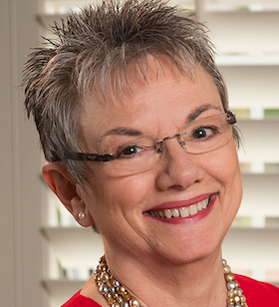


7. Stay up-to-date! Let the Information Come Directly to YOU!!!
Get on Twitter and start following!!!
@NAfME
@MaryLNAMM
@MusicEdConsult
@MusicAchCouncil
@EricWhitacre

Slide 50
8. Arrange for a performance for the principals’ meetings, school board, city council, state legislature, etc.
They will appreciate the “good news” for a change.
BE READY!!!!!!!!
PERFORM WELL!!!!

Slide 51

9. Create a website, Twitter Account, etc. and communicate, communicate, communicate.
Share the GOOD NEWS!!!!

Slide 52
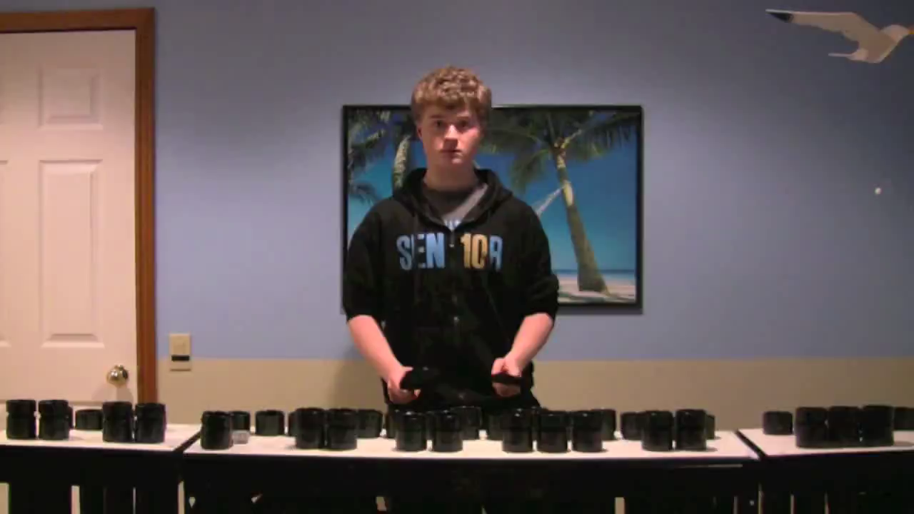
Website Videos Could Include:
Student Projects: with Permission

Slide 53
Website Videos Could Include:
Student Projects: with Permission

Slide 54
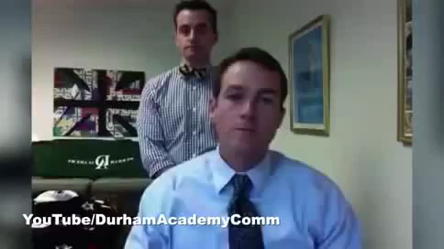
Website Videos Could Include:
School Announcements

Slide 55
Website Videos Could Include:
School Announcements

Slide 56

Website Videos Could Include:
Performance Videos

Slide 57

Website Videos Could Include:
Performance Videos

Slide 58
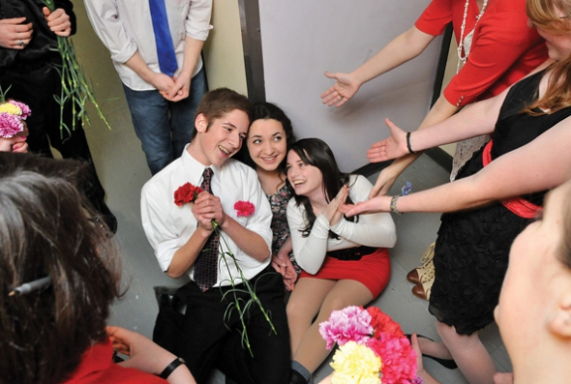
11. Come up with a clever version of a “Happy Birthday” song to serenade your school staff on their special day.
THEY WILL LOVE YOU FOR IT! Give away FREEBIES!
Insert Serenade Photo

Slide 59
Remember. . .Your principal needs YOU!
Be an active, involved member of the faculty.
Take part in as many school activities as you can.
Volunteer to help when needed.
Organize faculty functions, school food drives, etc. (at least one each semester)
Ask how you/your program can help build school spirit.

Slide 60
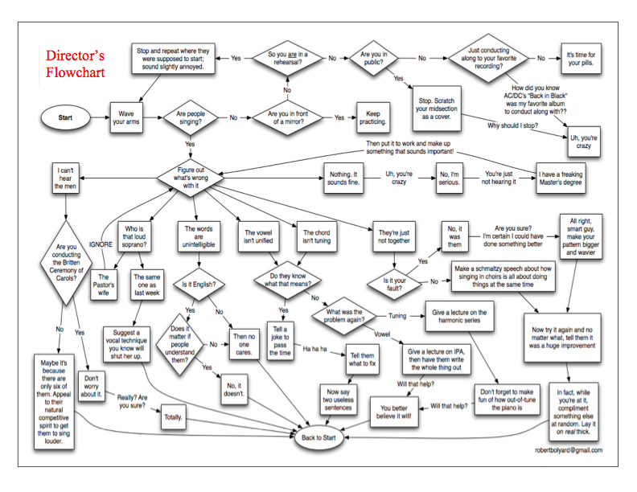
How Can I Do It All?

Slide 61
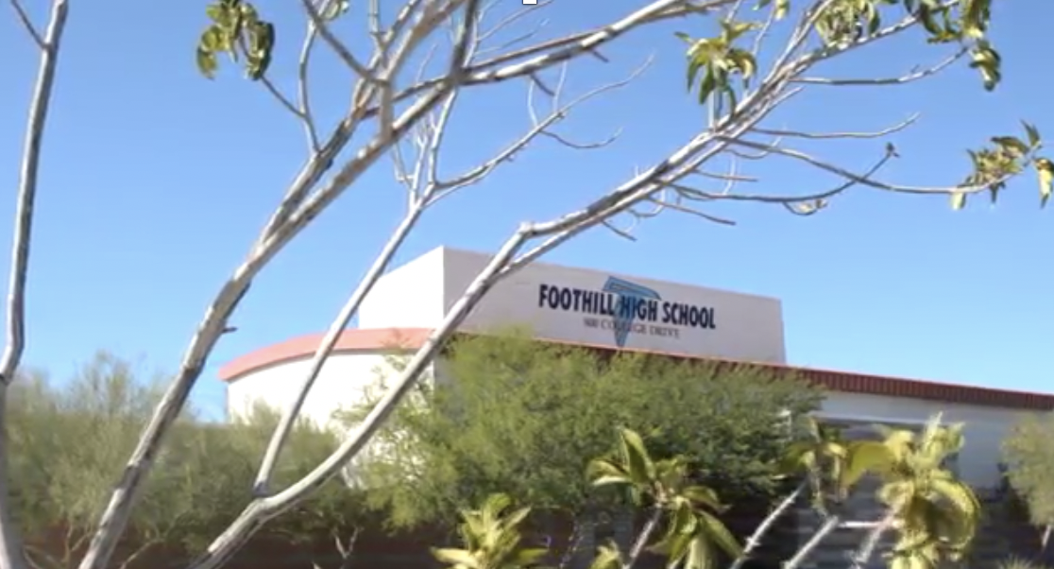
Create A Special Place!
Your Principal Will Love You!

Slide 62

Create A Special Place!
Your Principal Will Love You!

Slide 63

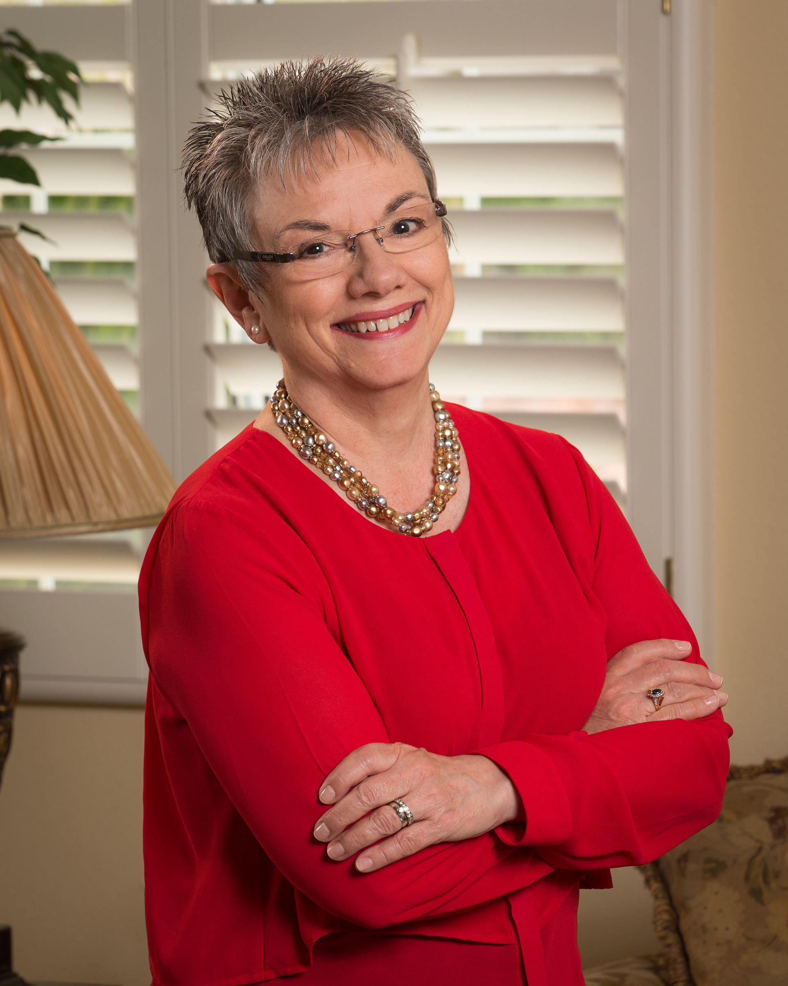
Thank You!
Contact Information:
Posted:
www.musicedconsultants.net/conference-materials
marcia@musicedconsultants.net
@MusicEdConsult on Twitter

