Slide 1



TIPS for Success!
Secrets Revealed From the Very Best!
Marcia Neel
2015 LAMEA
Russ Bullis
Donna Koneska
Fred Zeagler
www.MusicAchievementCouncil.org

Slide 2
Consider the Education/Training Needed for These Careers
All of this is YOUR Job! How is it going?
Accountant
Politician
Architect
Psychologist
Author
Public Relations Executive
Career Planner
Quality Assurance Executive
Financial Planner
Sales Executive
Travel Agent
Magician

Slide 3
1. Focusing on the
Classroom

Slide 4

Focusing on the Classroom
What does a Music Educator Do?
Teach (Standards-based)
Communicate
Share Love of Music
Communicate
Prepare Quality Lessons
Communicate
Assess Student Progress
Communicate
Notes:
Produced by the Music Achievement Council
4

Slide 5

Result-driven Communication

Slide 6

Focusing on the Classroom
Recruitment and Retention
WE WANT YOU!

Slide 7

Focusing on the Classroom
Recruit: Attract Students Year-Round
Foster student interest through visibility
Inform parents of benefits of music
Build and nurture support among administration & classroom teachers

Slide 8
Focusing on the Classroom
Recruit: Attract Students Year-Round
Regular visits with feeder programs/teachers
Mass concerts with feeder programs
including recorder classes
Recruitment meetings with
students and parents—REACH OUT!
Instrument demos/petting zoos

Slide 9
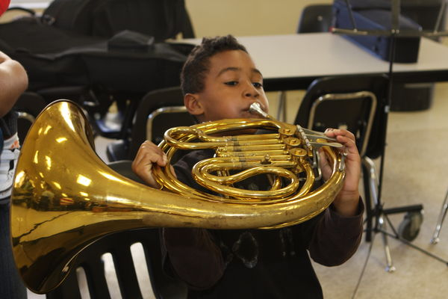
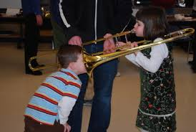
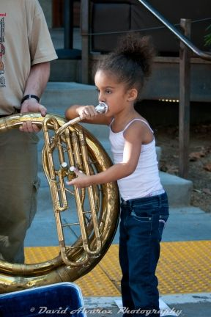
Focusing on the Classroom
Recruit: Attract Students Year-Round
Instrument demos/petting zoos

Slide 10
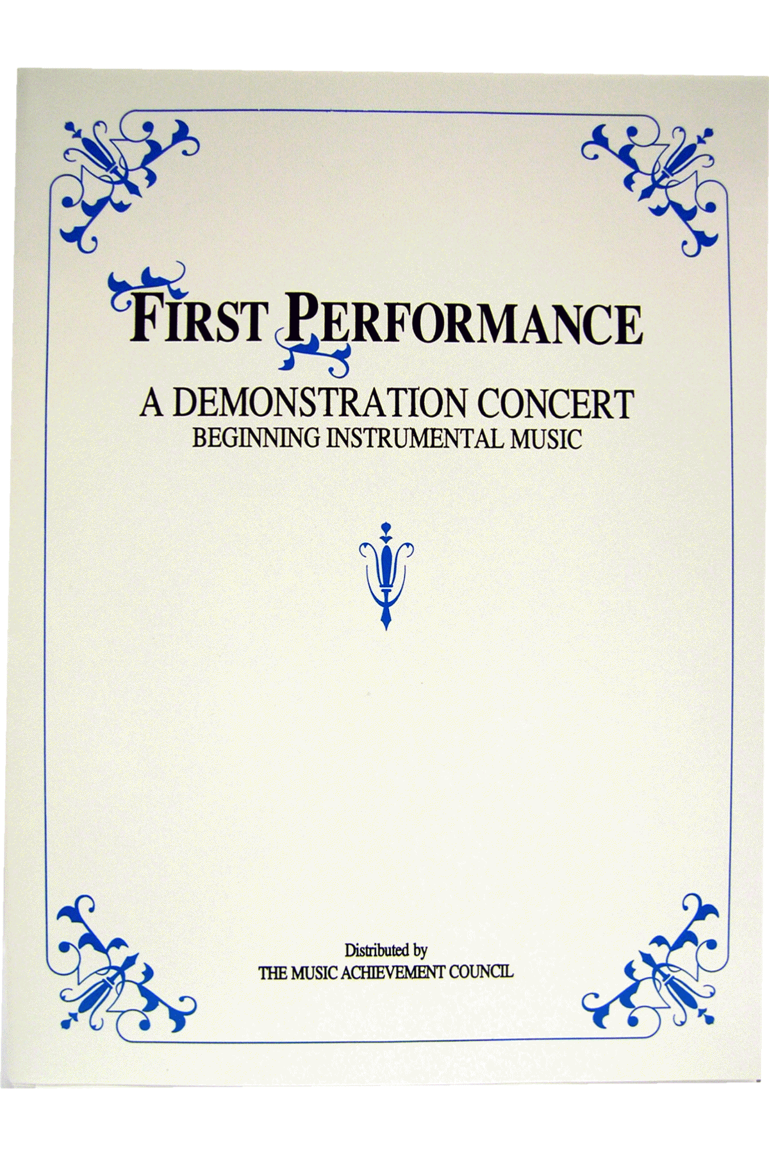
Focusing on the Classroom
Build the vision EARLY — Elementary
GET ‘EM FIRED UP!
Give a
First Performance
Concert
With Your Beginners!
Involve Experienced Players!

Slide 11

Focusing on the Classroom
First Performance Demo Concert
Build the vision EARLY — Elementary

Slide 12
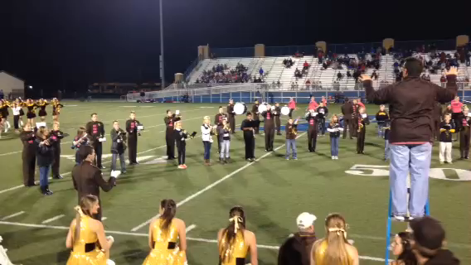
Focusing on the Classroom
Recruitment and Retention
Build the vision EARLY — Elementary

Slide 13
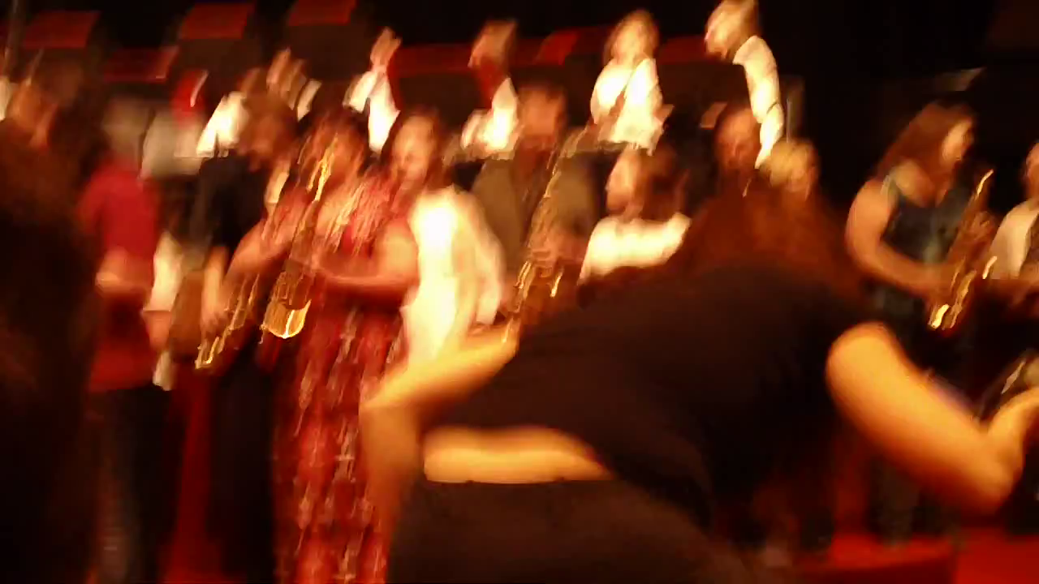
Focusing on the Classroom
Recruitment and Retention
Build the vision EARLY—Elementary Parents

Slide 14

“13 Reasons They Stay in Band”

Slide 15
2. The Business Side of
Teaching

Slide 16
The Business Side of Teaching
Working with Administrators/Faculty
Celebrate your faculty!
Include the principal & faculty in concerts to discover the joy of music-making
Keep all informed of activities/events & THANK THEM OUTWARDLY for their support.
Sign up to chaperone a dance, cover a class, attend a game and/or serve on committees
Notes:
Produced by the Music Achievement Council
16

Slide 17

The Business Side of Teaching
Choosing a Music Dealer
Dealers Support Our Programs by. . .
Providing advocacy materials & recruiting help
Providing regular service calls
Ensuring competitive prices
Offering lease programs for new instruments
Providing folders, posters, calendars, nametags. . .
Serving as a partner to help develop our programs
All YOU have to do is ask!!!

Slide 18
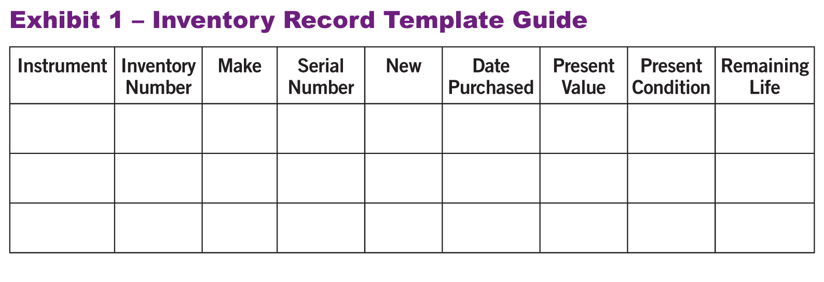
The Business Side of Teaching
Instrument Replacement: The 5-Year Plan
1. Evaluate the instruments/equipment. Create an Inventory Record Guide
HINT: Know your school’s Fiscal Policies!

Slide 19
The Business Side of Teaching
Instrument Replacement Plan
Prioritize a list that should be replaced within 5 years. Estimate probable growth of program
Write up a complete 5-YEAR PLAN that begins
with a clear explanation. Provide the plan to
your supervising administrator.
Keep Your Rationale STUDENT-CENTERED
Notes:
Produced by the Music Achievement Council
19

Slide 20
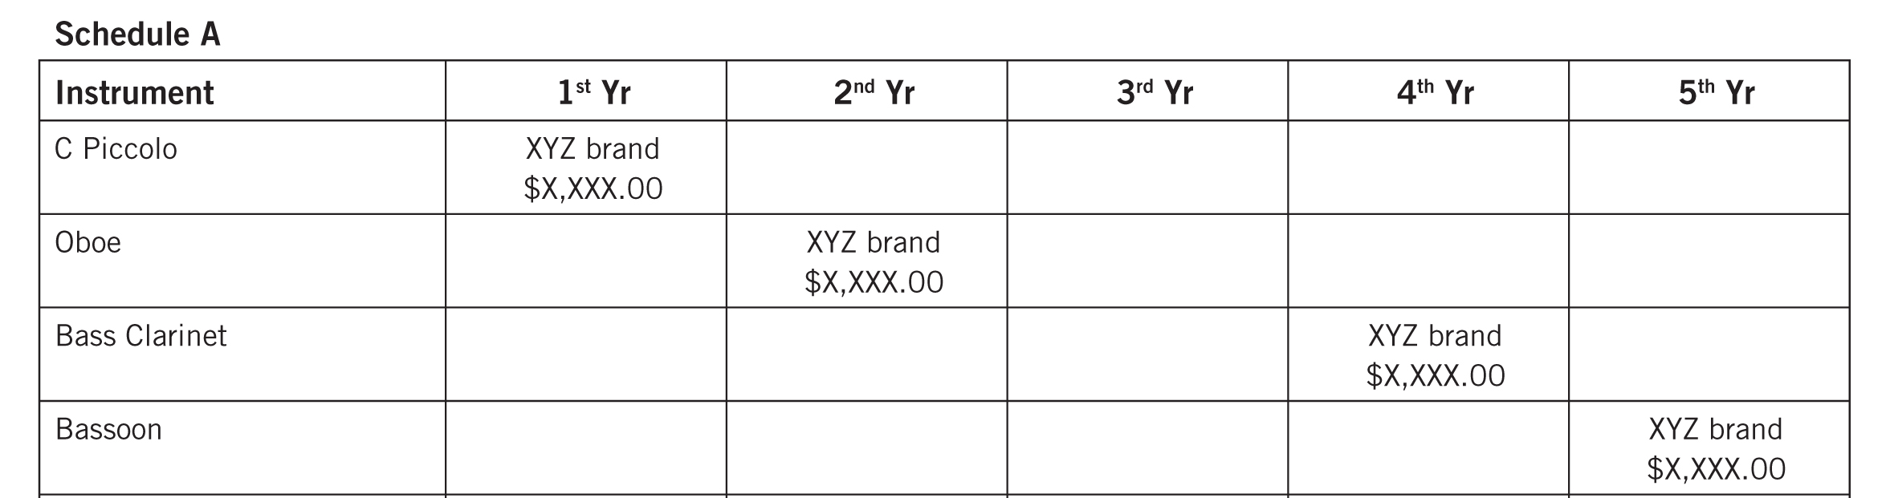
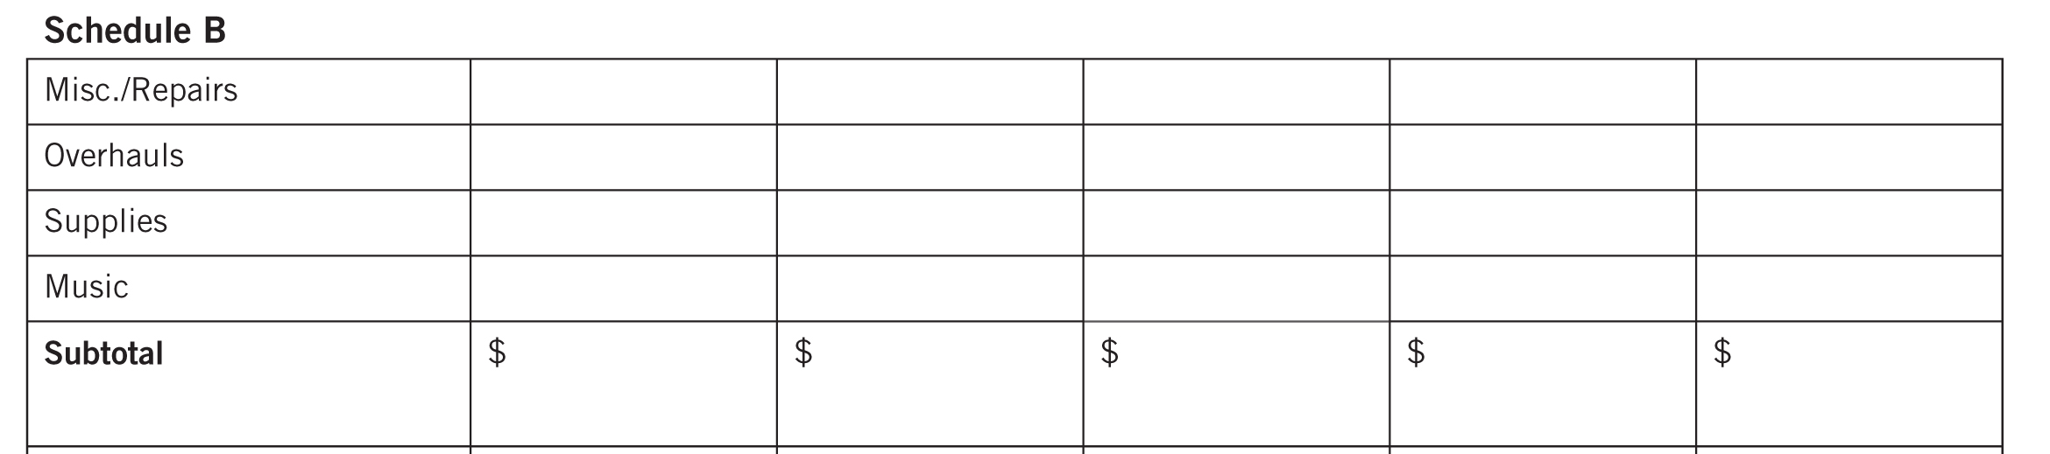
The Business Side of Teaching
Instrument Replacement Plan
Sample Forms to Use to Develop Your Plan. . .

Slide 21
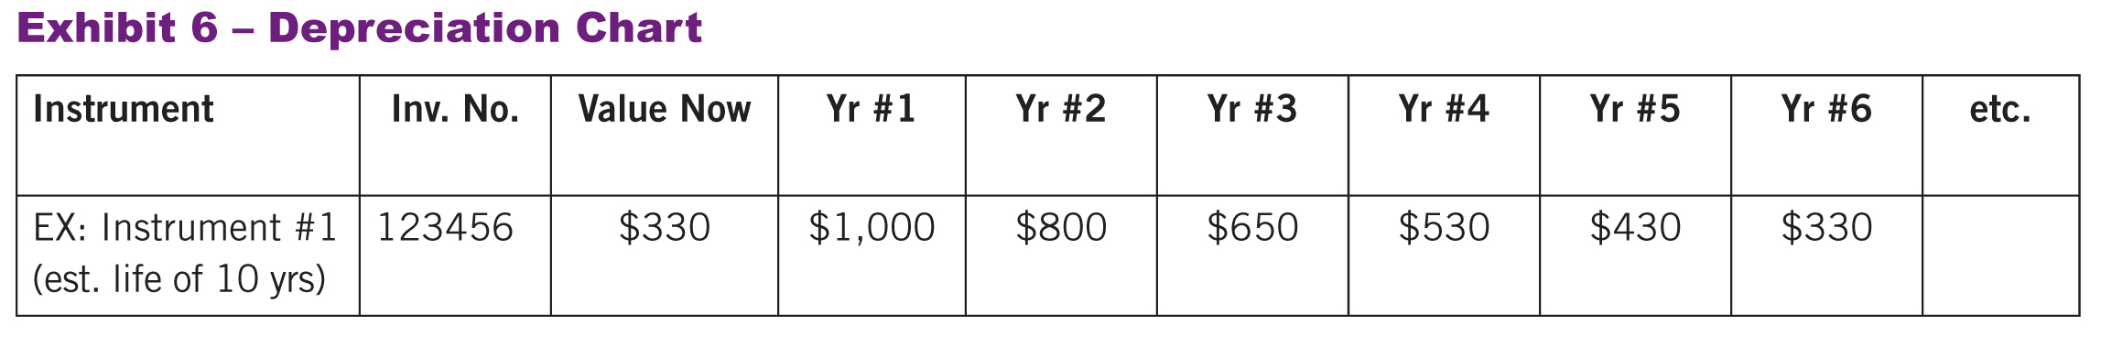
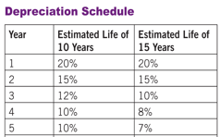
The Business Side of Teaching
Instrument Replacement Plan
Maintain a Depreciation Chart.

Slide 22

3. Telling
The Story

Slide 23
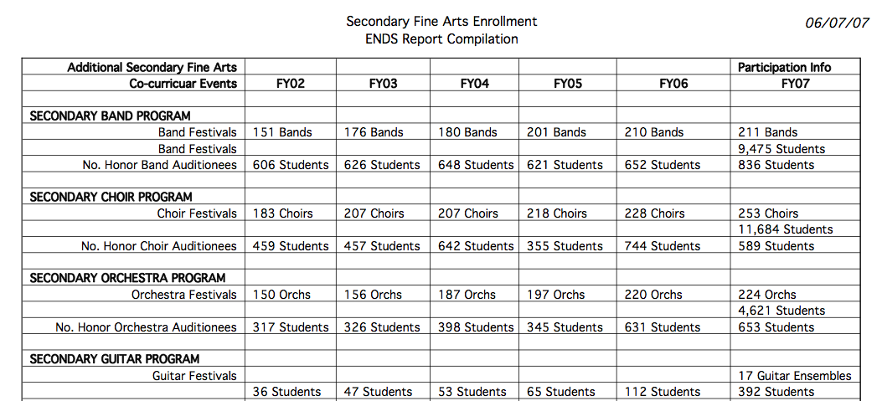
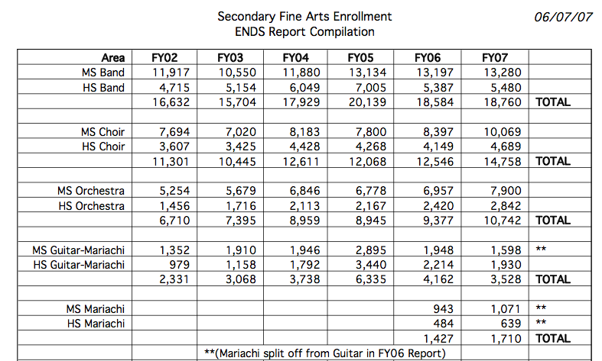
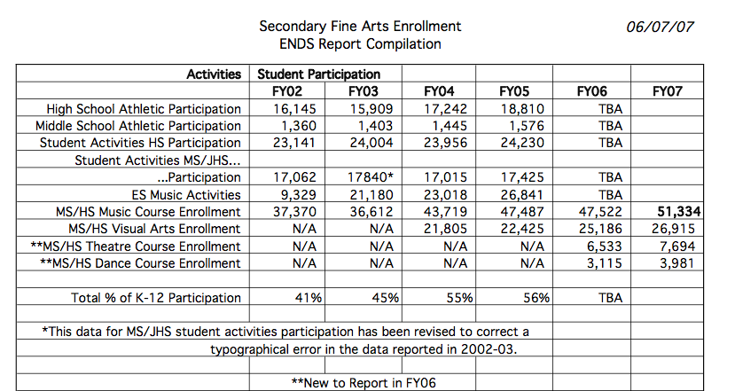
Telling the Story: DATA! DATA! DATA!
Notes:
Produced by the Music Achievement Council
23

Slide 24

Telling the Story
Great Ways to Get Out Your Message
Have students tell their
stories. Music Makes
the Difference Because. . .
Profile Your Students:
Student Artist of the
Week/Month.
Create a Snapshot Video.
Notes:
Produced by the Music Achievement Council
24

Slide 25

Telling the Story
Snapshot Video: Foothill High School
Notes:
Produced by the Music Achievement Council
25

Slide 26

4. Supporting
Music Education
www.MusicAchievementCouncil.org

Slide 27

Supporting Music Education
GIVE BACK: Help Others Succeed!
Recruit new, quality music
educators to your school
district and help them get
started
Offer to help with the
interviewing process
Offer to develop a
Mentoring Program or
serve as a mentor

Slide 28
Supporting Music Education
GIVE BACK: Help Others Succeed!
Have a Local University?
Offer to have Music Ed students observe
your classes
Allow Music Ed students to teach sectionals
Attend university concerts and encourage
your students to attend
Take student teachers and “be gentle!”
Notes:
Produced by the Music Achievement Council
28

Slide 29
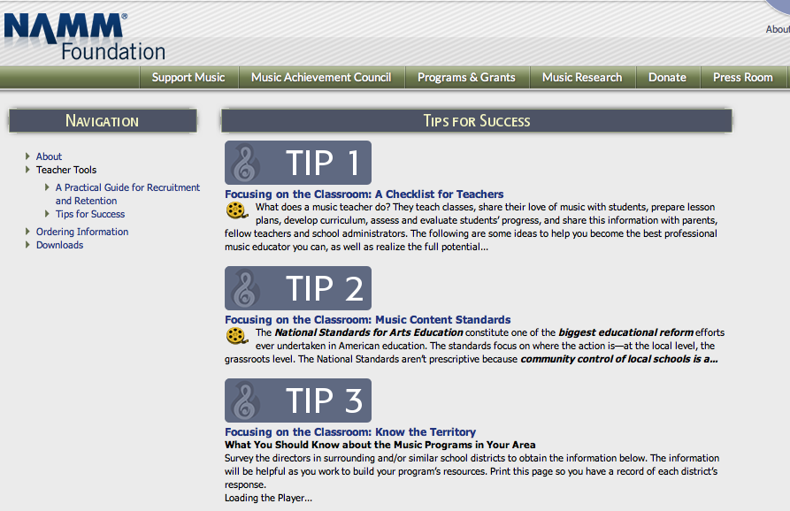
“Tips for Success” Resource Materials
www.MusicAchievementCouncil.org
Notes:
Produced by the Music Achievement Council
29

Slide 30
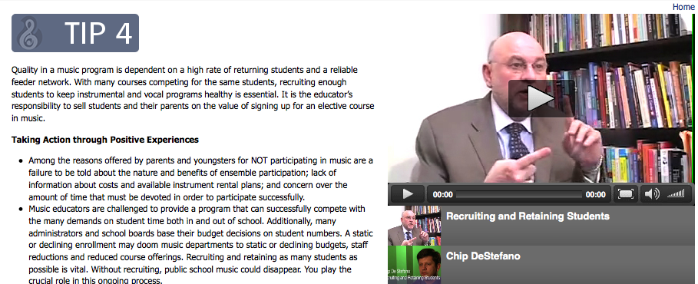
“Tips for Success” Resource Materials
Helpful Videos!
www.MusicAchievementCouncil.org
Notes:
Produced by the Music Achievement Council
30

Slide 31
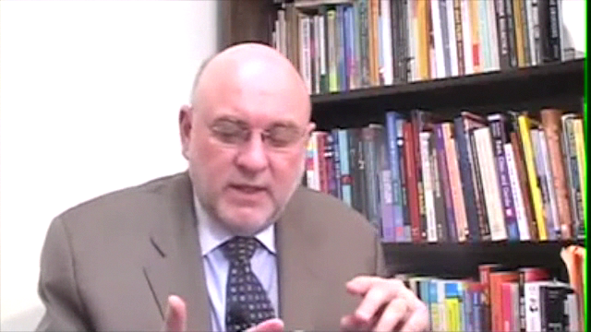
“Tips for Success” Resource Materials
Dr. Tim Says It All!
www.MusicAchievementCouncil.org
Notes:
Produced by the Music Achievement Council
31

Slide 32
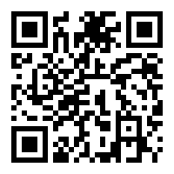
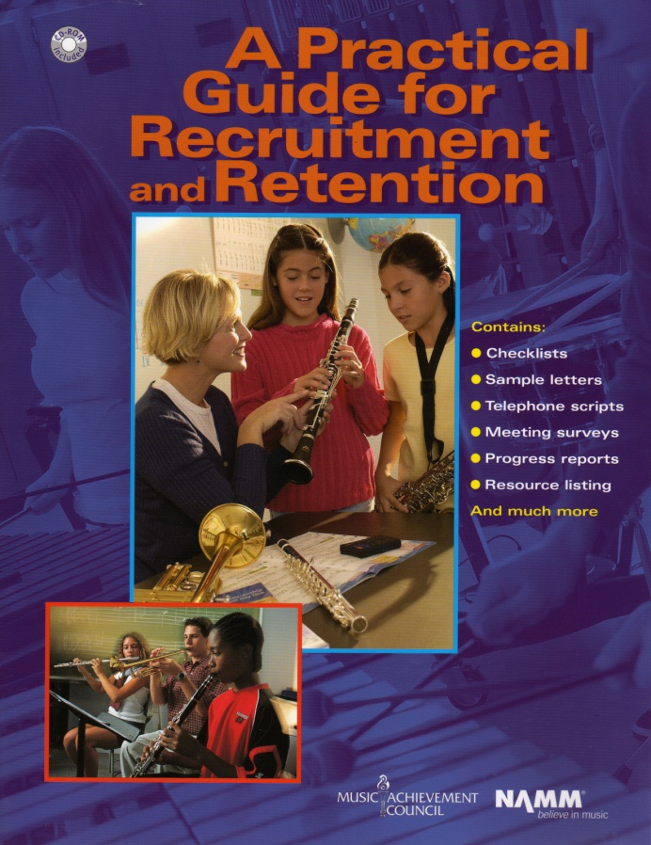


Got Smart Phone?
www.MusicAchievementCouncil.org
marcia@musicedconsultants.net
Notes:
Produced by the Music Achievement Council
32

Slide 33












THANK YOU!!!!!
Notes:
Produced by the Music Achievement Council
33

Slide 34
THANK YOU!!!!!
Notes:
Produced by the Music Achievement Council
34

