Slide 1

Tulsa Public Schools Professional Development
Engage, Excite and Enrich:
Rediscovering the Joy of
Music-Making
Marcia Neel
April 27-28, 2017
marcia@musicedconsultants.net
musiceducationconsultants.net

Slide 2

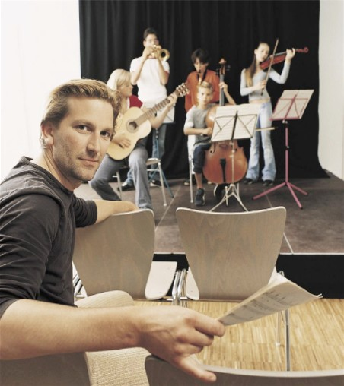
Today’s Session
Rediscovering the Joy of Music-Making!
The WHAT
The WHY
The HOW

Slide 3

WHAT Other Teachers Think I Do!

Slide 4
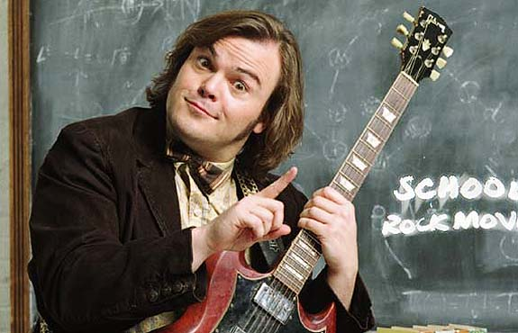
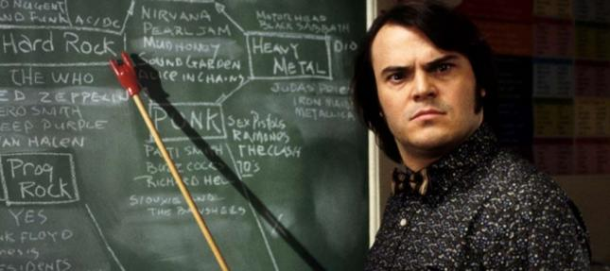
WHAT the Kids (I Don’t Teach) Think I Do!

Slide 5

WHAT Society Thinks I Do!

Slide 6
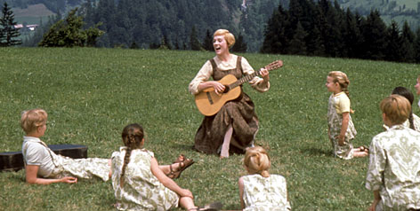
WHAT My Mom Thinks I Do!

Slide 7
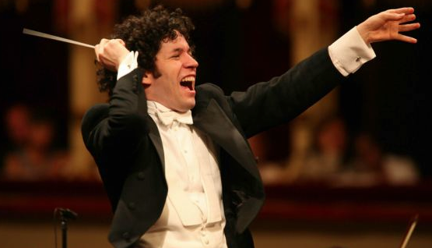
WHAT I Think I Do!

Slide 8
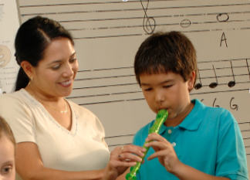
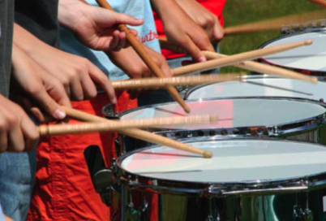

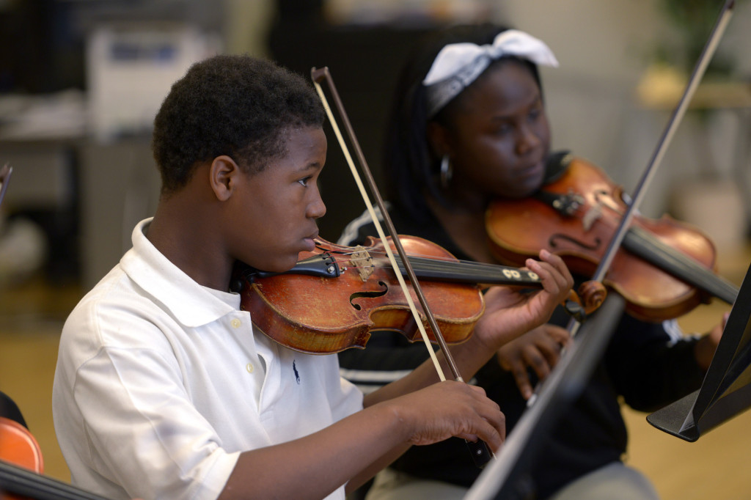
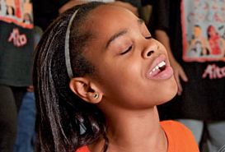
WHAT I Really Get to Do!
Facilitate Success and Fulfillment

Slide 9

The Why
RECENT FINDINGS
Prelude:
Music Makes Us
Baseline Research Report
http://musicmakesus.org/resources/research

Slide 10
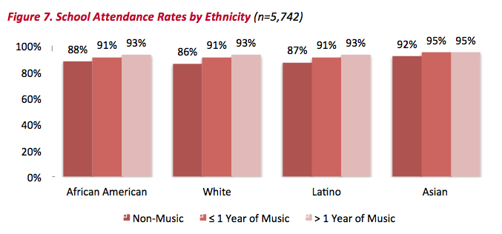
The WHY
ATTENDANCE RATES
http://musicmakesus.org/resources/research

Slide 11
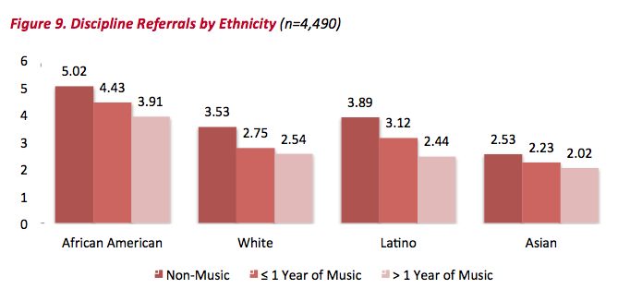
The WHY
DISCIPLINE REFERRALS
http://musicmakesus.org/resources/research

Slide 12
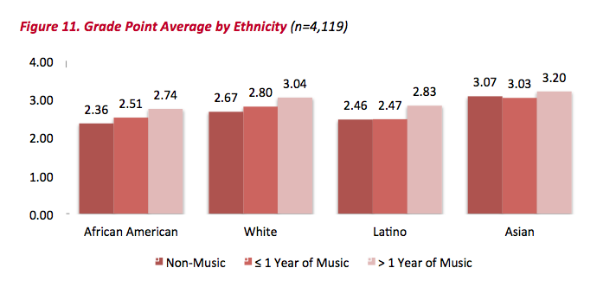
The WHY
GPA
http://musicmakesus.org/resources/research

Slide 13
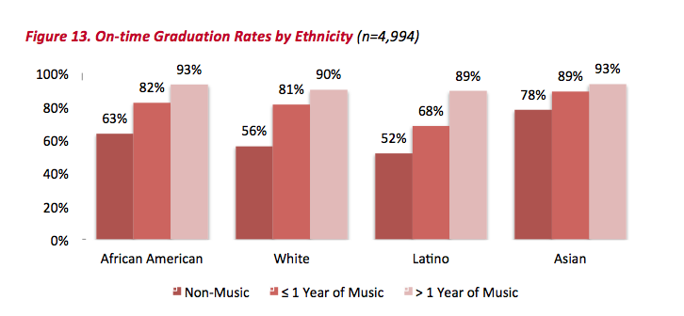
The WHY
ON-TIME GRADUATION RATES
http://musicmakesus.org/resources/research

Slide 14
The WHY
SUMMARY: What Was Learned?
“The more a student participates
in music, the more positive
these benefits become.”
http://musicmakesus.org/resources/research

Slide 15

So HOW is it that
Music Can Be So Impactful?
A couple of examples. . .

Slide 16

Example: Impacted Student
Jason Collier
https://youtu.be/Qw1CZ6Biqdw

Slide 17
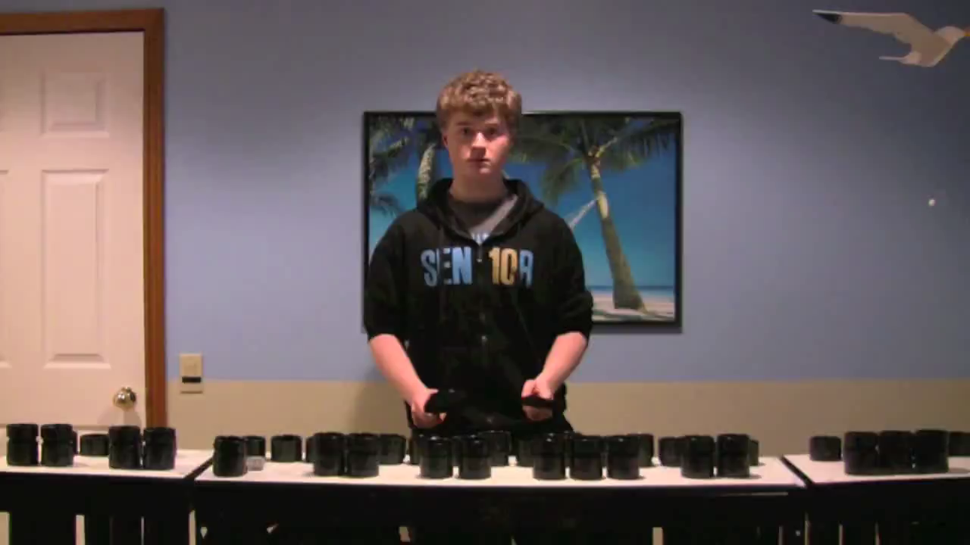
Example: Impacted Student
Senior Project
https://youtu.be/II_znS7pbRE

Slide 18
How do we get them there?

Slide 19

How do we get them there?
FIRST, we C.A.R.E.

Slide 20
C.A.R.E.
1. We Communicate a Unified Message

Slide 21

Ever had trouble getting someone to
understand what you’re trying to say?
https://youtu.be/H8xNj8mfcCU

Slide 22
What is the message of your program and
is everyone “on board?”
Every student is interested and contributes
All students experience success
Every student is eagerly welcome regardless of talent or ability
We are FAMILY!

Slide 23
C.A.R.E.
2. We generate the proper Attitudes toward Music Education

Slide 24
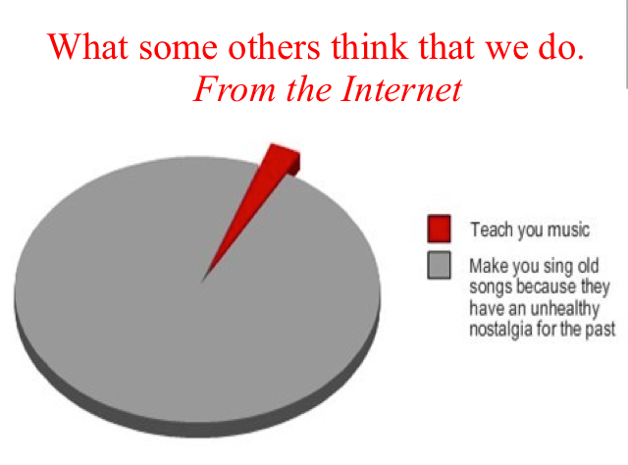

Slide 25
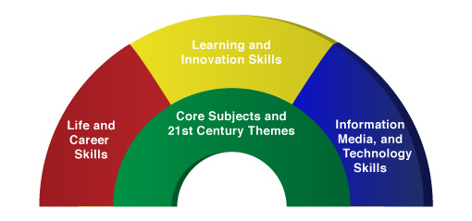

Promulgate the Correct Attitude!
We’re so much more than what it seems!
A focus on these 5 C’s is essential
to prepare students for the 21st Century.
Critical Thinking
Communication
Collaboration
Creativity
Confidence
Therefore. . .

Slide 26
The Music Skills Practice Room is. . .
The Life Skills Practice Room
1. Critical Thinking. . .
  Ability to reason effectively and solve
  problems creatively

Slide 27
The Music Skills Practice Room is. . .
The Life Skills Practice Room
Problem Solving:
Ability to solve problems.
EX: Having a problem getting
people to turn off their phones and
beepers at your concerts? See how one student found a creative solution!

Slide 28
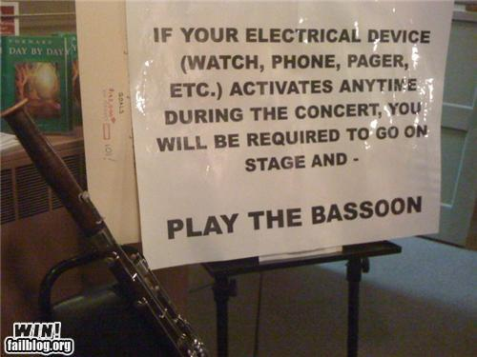
The Music Skills Practice Room is. . .
The Life Skills Practice Room

Slide 29
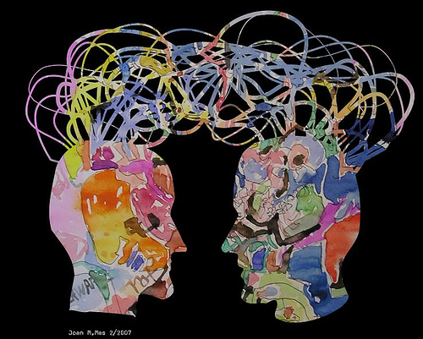
2. Communication. . .
  Ability to listen
  effectively
  Ability to express
  thoughts effectively
  with others –
  both verbally and non-verbally
  Have you tried. . . .
  Result-driven Communication?

Slide 30

2. Communication
Precise, result-driven communication at the right place and the right time is a guarantee for success.
https://www.youtube.com/watch?v=6nPXRAvY5Zo

Slide 31
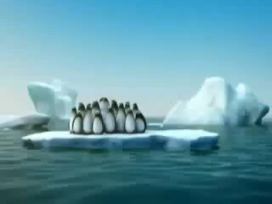
The Music Skills Practice Room is. . .
The Life Skills Practice Room
3. Collaboration
Effective when EVERYONE does their job.
https://youtu.be/FIya6xaWDWo

Slide 32
The Music Skills Practice Room is. . .
The Life Skills Practice Room
4. Creativity. . .
  Ability to create new and more worthwhile ideas and to work creatively with others.

Slide 33

The Music Skills Practice Room is. . .
The Life Skills Practice Room
Creativity: New, Worthwhile Ideas

Slide 34
The Music Skills Practice Room is. . .
The Life Skills Practice Room
5. Confidence. . .
  Ability to handle EVERY CIRCUMSTANCE and grow from it

Slide 35

The Music Skills Practice Room is. . .
The Life Skills Practice Room
Confidence: Ability to handle EVERY CIRCUMSTANCE
https://www.youtube.com/watch?v=rVvaX6n3ClM

Slide 36
C.A.R.E.
3. We guarantee group Responsibility toward the agreed-upon Purpose

Slide 37
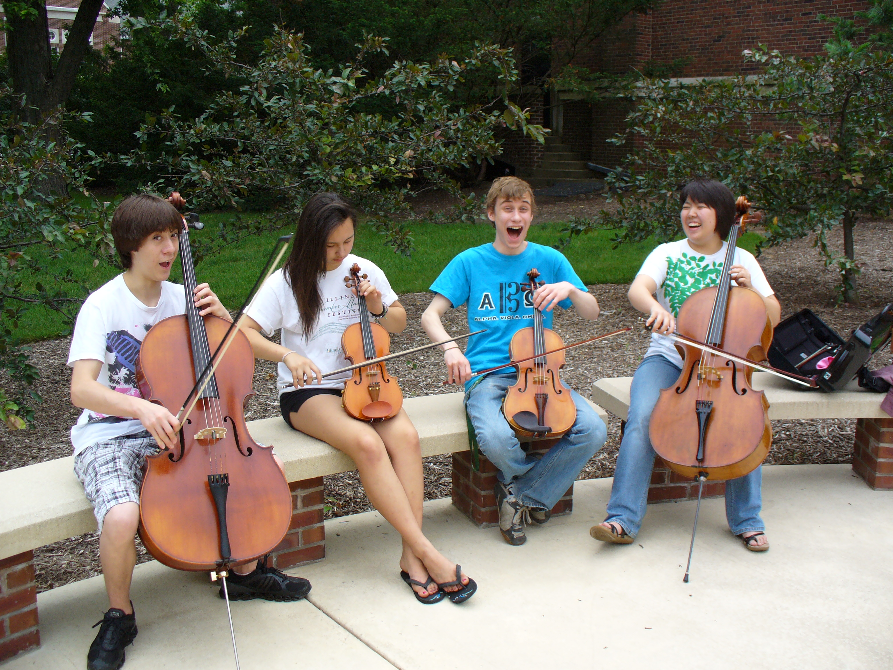
Inclusion and Tolerance:
Success through Music for ALL
Have students. . .
Serve as “intern instructor” for Summer Lesson Program for Beginning Students

Slide 38

Inclusion and Tolerance:
Success through Music for ALL
Have students. . .
Write letters of invitation and congratulations
Invitation to the
Choir, Band or Orchestra Program
Congratulations on your Solo & Ensemble Festival Performance

Slide 39
Inclusion and Tolerance:
Success through Music for ALL
Have students. . .
Send musical greeting cards to former teachers, family members, etc.

Slide 40

Send musical greeting cards to former teachers, family members, etc.

Slide 41
Inclusion and Tolerance:
Success through Music for ALL
Have students. . .
Participate ACTIVELY in all recruitment efforts—give testimonials!

Slide 42

Participate ACTIVELY in all recruitment efforts—give testimonials!

Slide 43
Inclusion and Tolerance:
Success through Music for ALL
Every student is interested and contributes
All students experience success
Every student is eagerly welcome regardless of talent or ability
We are FAMILY!

Slide 44

Inclusion and Tolerance:
Success through Music for ALL
United Sound

Slide 45
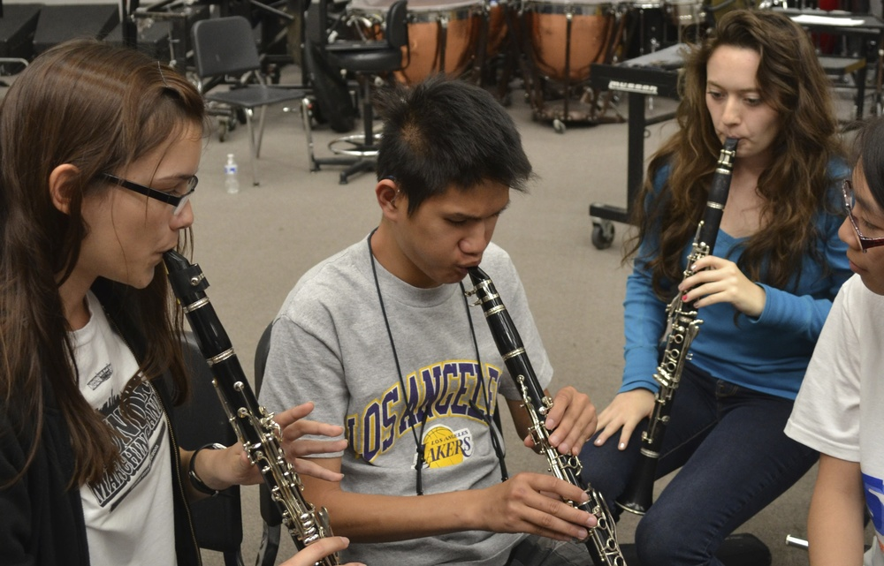
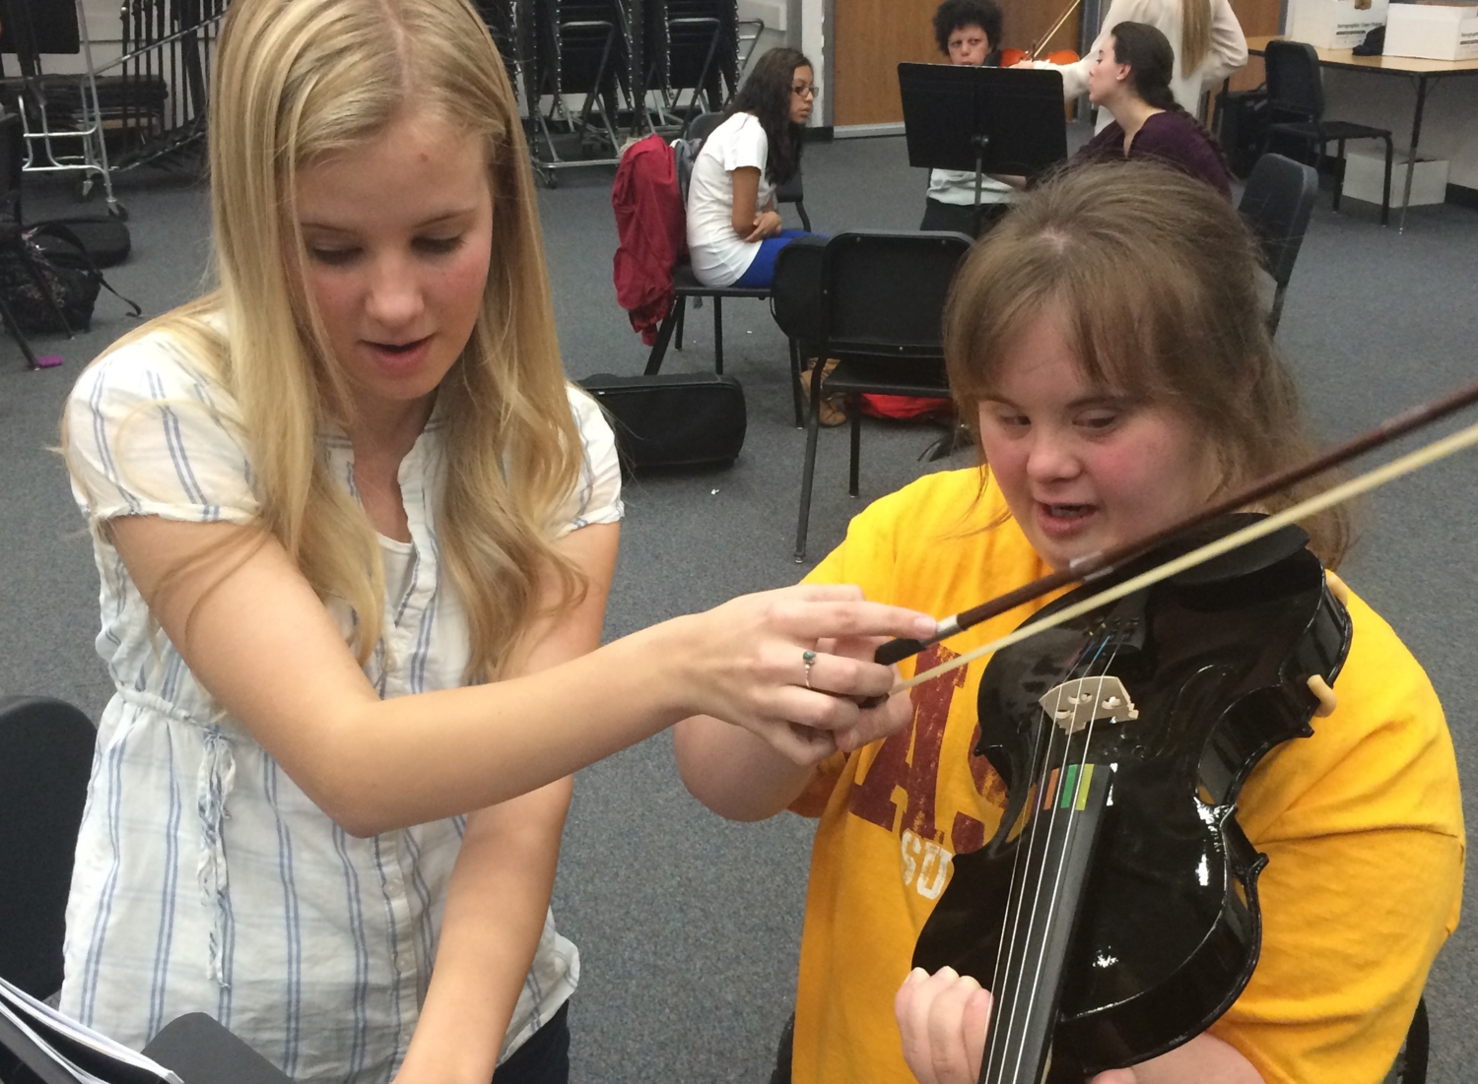
Inclusion and Tolerance:
Success through Music for ALL
United Sound

Slide 46
C.A.R.E.
4. We ensure Excellence
for the right REASON—
the Joy of Music-making!

Slide 47

Excellence for the RIGHT REASON
The Simón Bolivár HS Youth Orch

Slide 48

Instill the Vision EARLY – ELEMENTARY!
First Performance

Slide 49
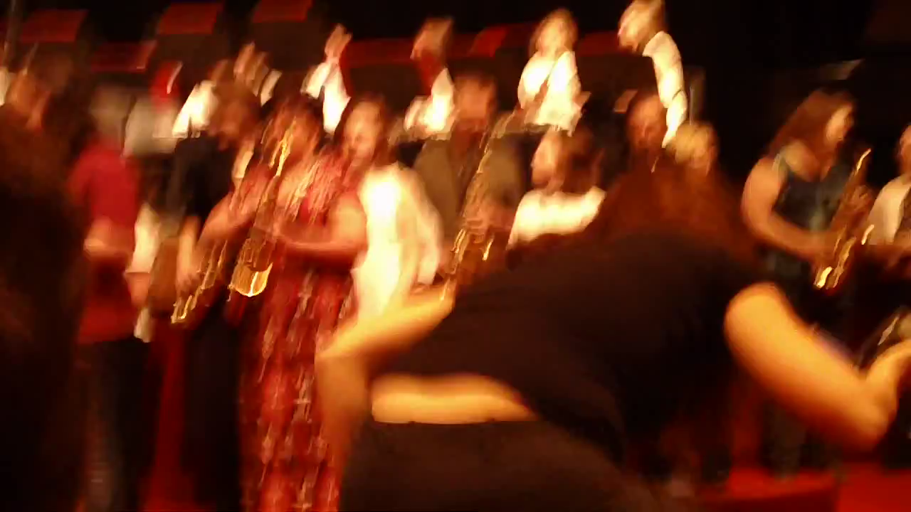
Engage Parents EARLY—The Parent Band!

Slide 50
Ensuring Excellence
Approaching Rehearsals
It’s very simple:
Through the teaching of SKILLS,
students discover their PASSION for
and JOY of active
MUSIC-MAKING

Slide 51
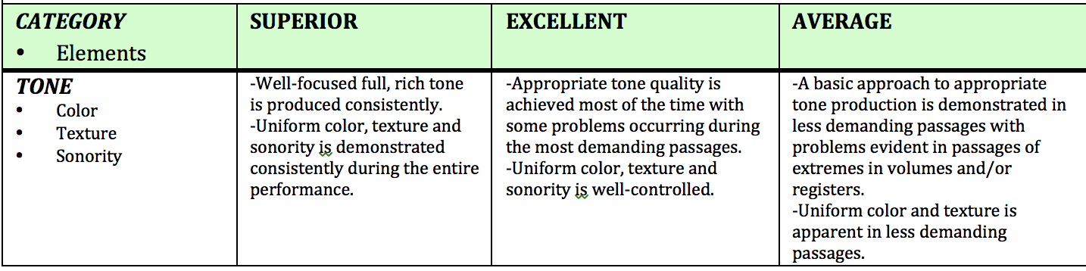
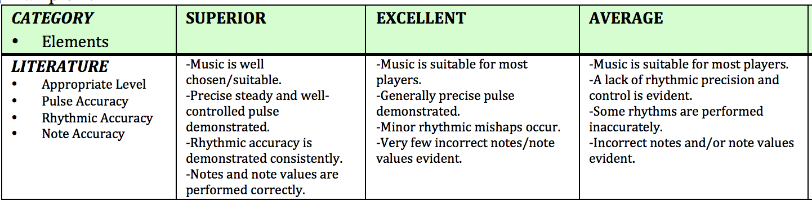
Defining Excellence Ensures Excellence
Skills-based Teaching

Slide 52
So. . .Do We C.A.R.E.?
With GREAT THANKS to Dr. Tim!
1. Communicate a Unified Message
2. Generate the Proper Attitudes toward Music Education
3. Guarantee Group Responsibility Toward the Agreed-upon Purpose
4. Ensure Excellence

Slide 53
One final bit of inspiration. . .
The “Message” of the Foothill HS Band

Slide 54
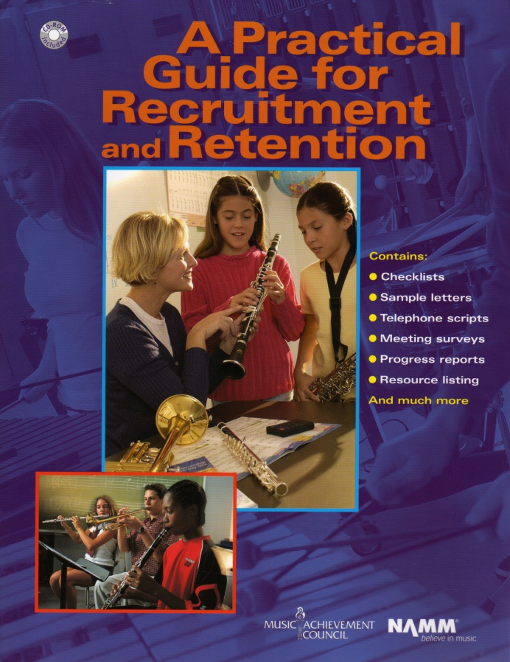
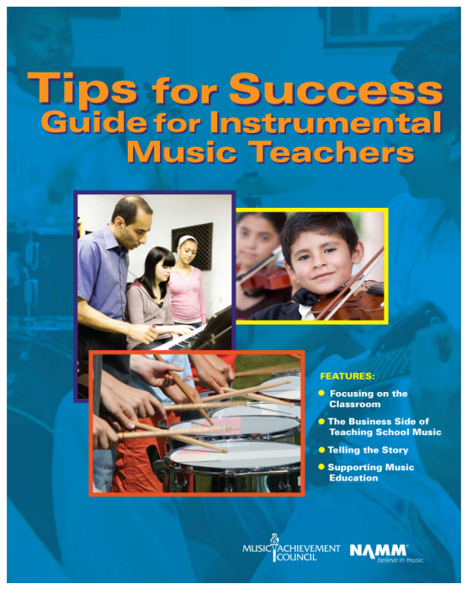
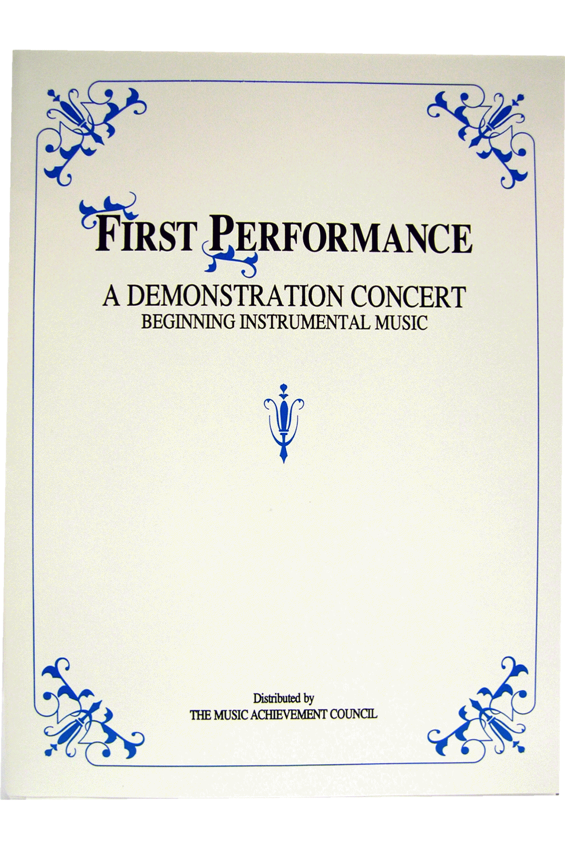
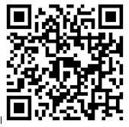
Got SMART Phone?
www.musicedconsultants.net/conference-materials
www.musicachievementcouncil.org

Slide 55

Got Smart Phone?
marcia@musicedconsultants.net
@MusicEdConsult
On Twitter
Thank You!
All materials are posted:
www.musicedconsultants.net/conference-materials

