Slide 1



Marcia Neel
Master Educator
Interviewing:
The Rules of the Road

Slide 2
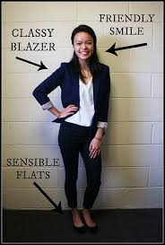
Interviewing:
The Rules of the Road
1. Making a great impression
Professional Attire

Slide 3
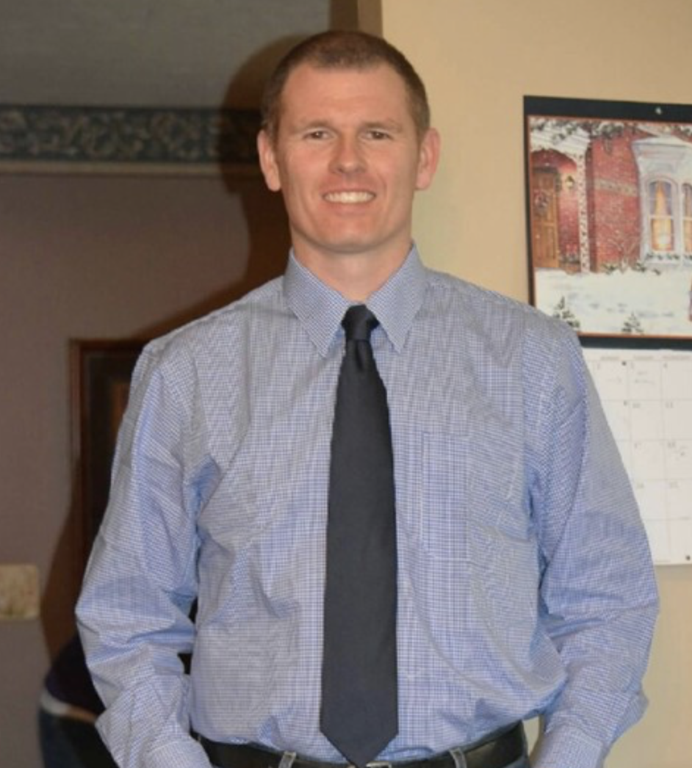
Interviewing:
The Rules of the Road
1. Making a great impression
Professional Attire
Pressed Shirt

Slide 4

Interviewing:
The Rules of the Road
1. Making a great impression
Professional Attire
Pressed Shirt
Suit

Slide 5
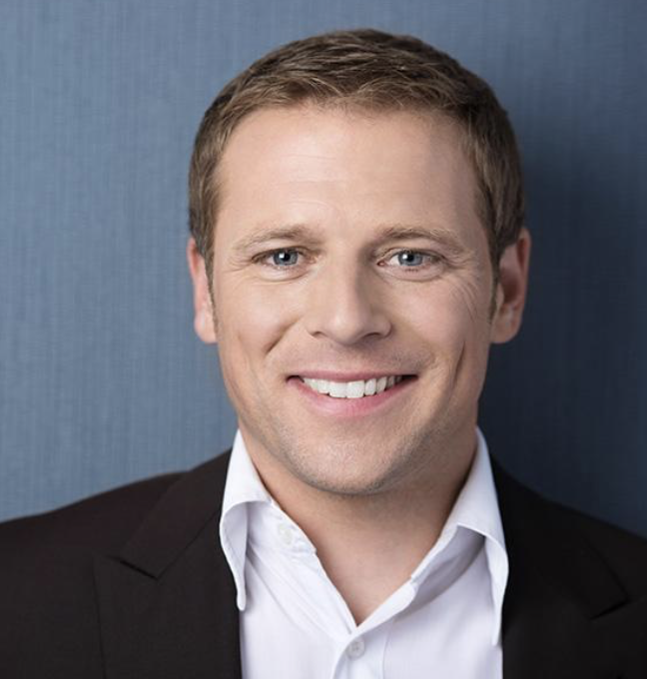
Interviewing:
The Rules of the Road
1. Making a great impression
Professional Attire
Pressed Shirt
Suit
Open Collar

Slide 6



Interviewing:
The Rules of the Road
1. Making a great impression
Confident Handshake and Eye Contact with a Smile

Slide 7

Interviewing:
The Rules of the Road
1. Making a great impression
Engaged Posture
Lean In Slightly
Slow down
your breathing
Gesture
for emphasis

Slide 8
Interviewing:
The Rules of the Road
1. Making a great impression
Tell me about yourself: Prepare your bullet points.
Who you are. Lead with what’s most recent. I’m a graduate from UT Martin, etc. Start strong and grab attention.
Why you’re qualified. 2-4 points. What relevant experience would make the interviewer take notice—i.e. not just what “anyone” would have done. Accomplishments? Proof of performance? Unique skill sets?

Slide 9
Interviewing:
The Rules of the Road
1. Making a great impression
Tell me about yourself: Prepare your bullet points.
C. Why you’re here. This is your chance to express
your enthusiasm for the job. Use 1-2 sentences.
Goal is to wrap up your pitch.
PREPARE YOUR ELEVATOR PITCH!

Slide 10
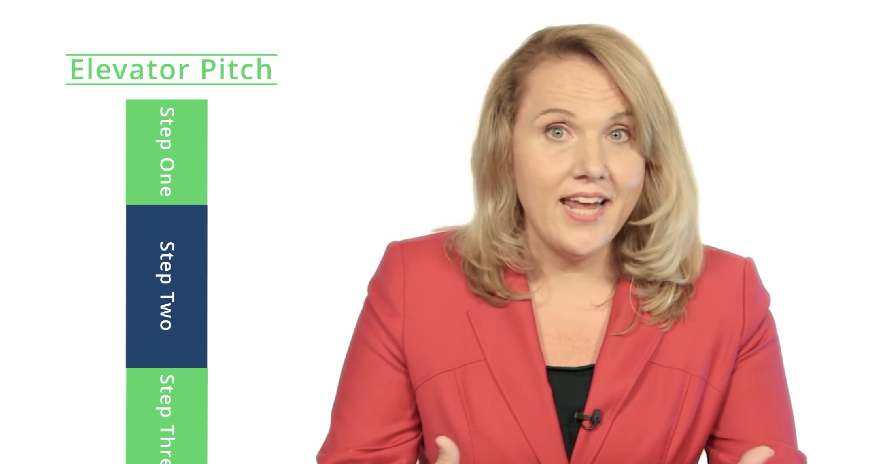
Interviewing:
The Rules of the Road
1. Making a great impression
Tell me about yourself: Prepare your bullet points.
C. Why you’re here. This is your chance to express
your enthusiasm for the job. 1-2 sentences.
Goal is to wrap up your pitch.

Slide 11
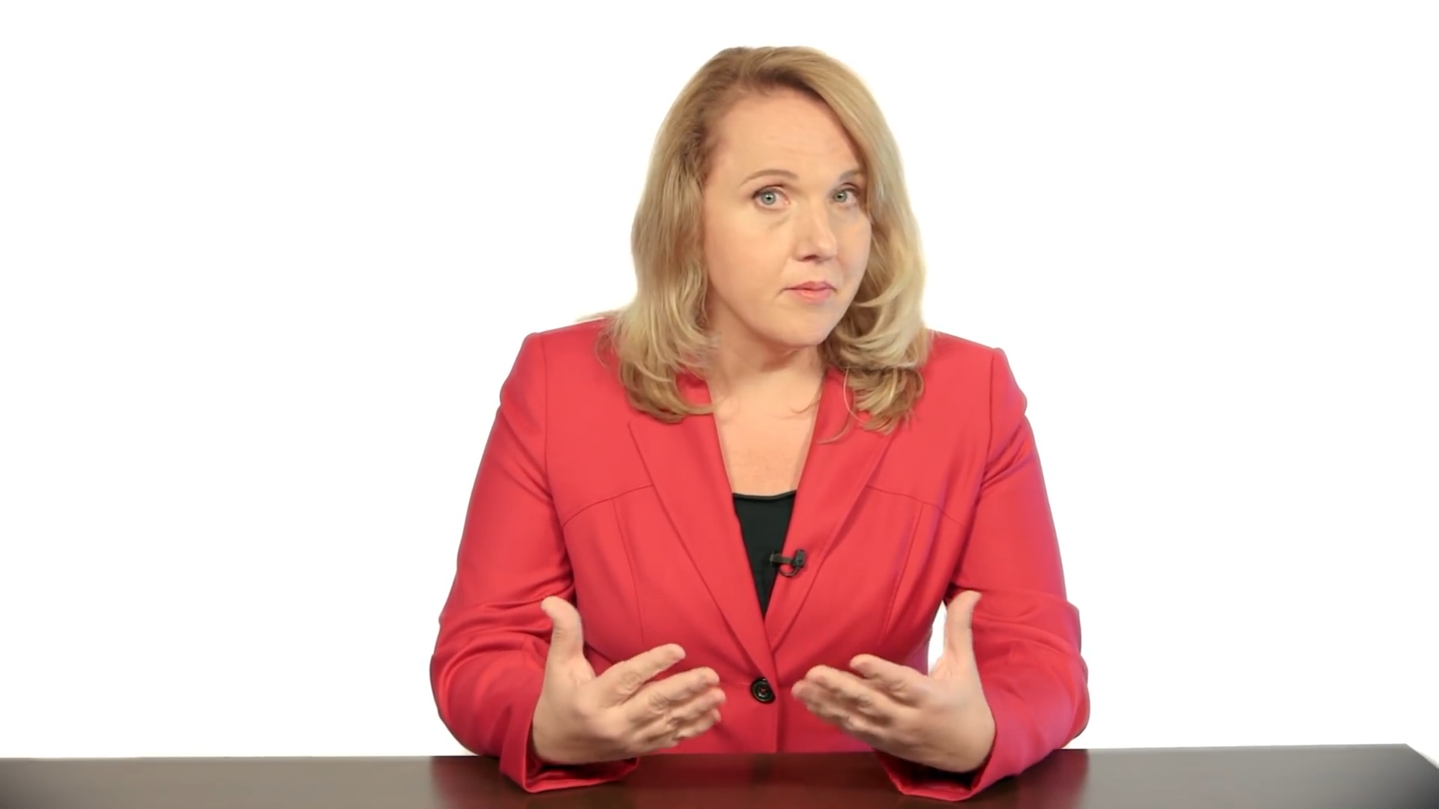
Interviewing:
The Rules of the Road

Slide 12

Interviewing:
The Rules of the Road
1. Making a great impression
Tell me about yourself: Prepare your bullet points.

Slide 13

Interviewing:
The Rules of the Road

Slide 14

Interviewing:
The Rules of the Road
2. Be Prepared: Items to Bring
Completed Application—Printed Copy
Transcripts to Date
Placement File or 3 Letters of
Recommendation
Resume—Sample Posted Online
Portfolio—Authentic and Digital

Slide 15
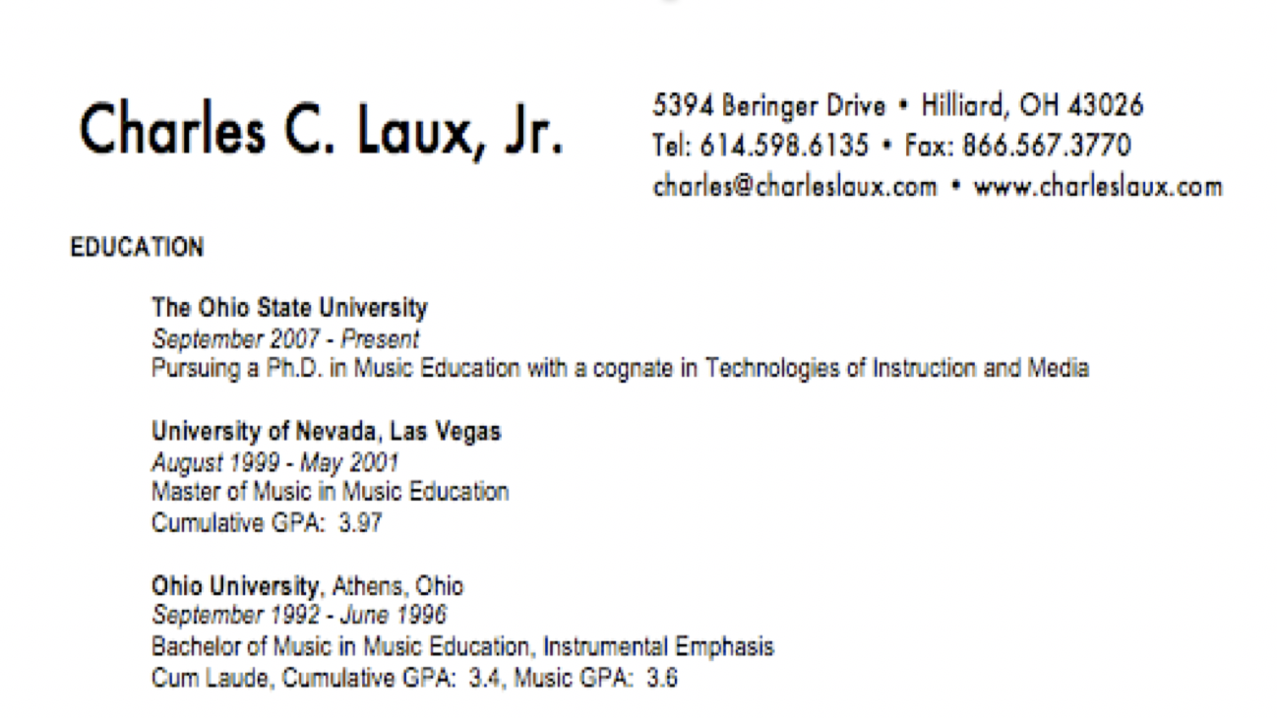
Interviewing:
The Rules of the Road
2. Be Prepared: Items to Bring
Resume: Education

Slide 16
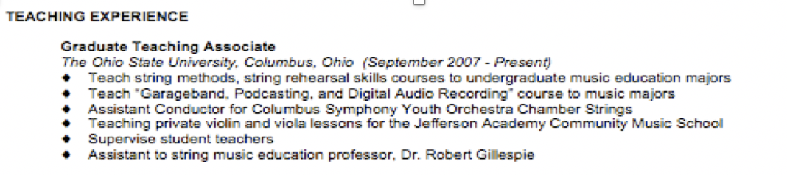

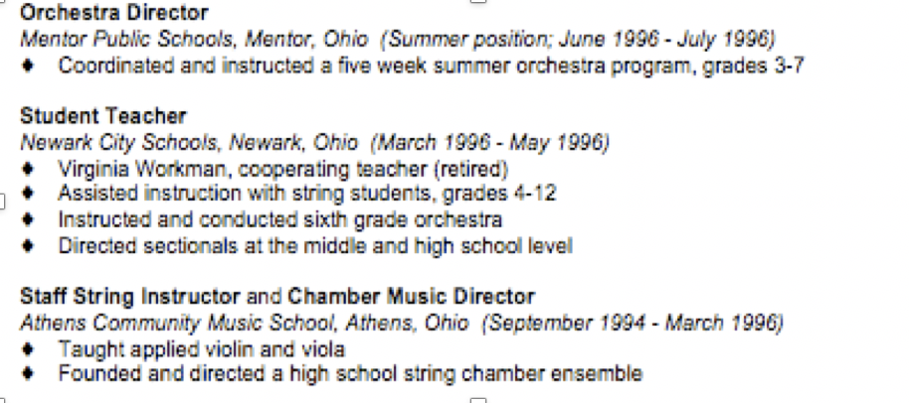
Interviewing:
The Rules of the Road
2. Be Prepared: Items to Bring
Resume: Experience

Slide 17
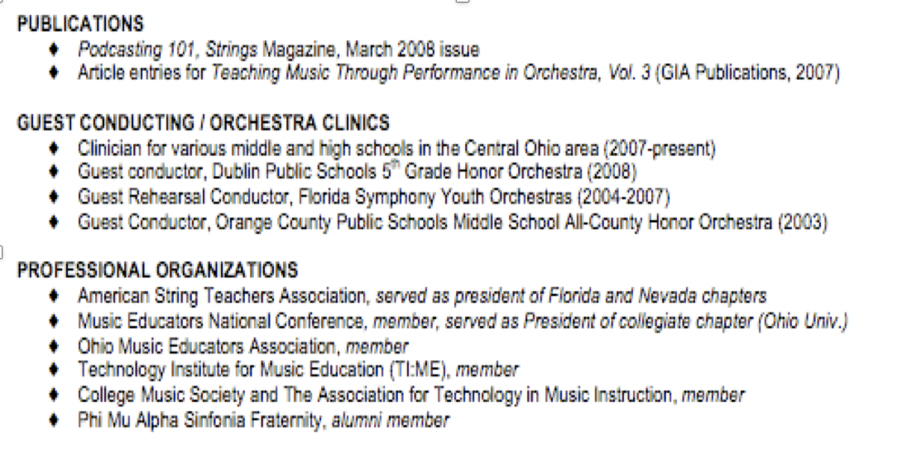
Interviewing:
The Rules of the Road
2. Be Prepared: Items to Bring
Resume: Leadership

Slide 18
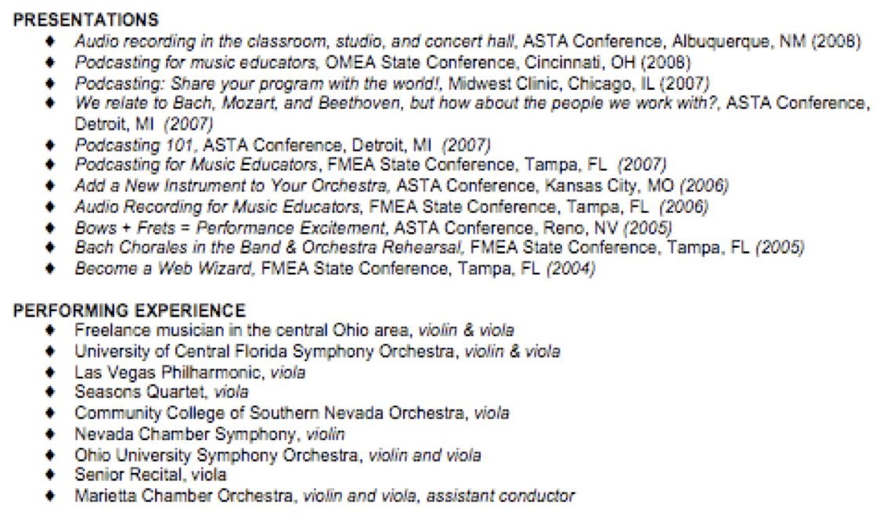
Interviewing:
The Rules of the Road
2. Be Prepared: Items to Bring
Resume: Important Presentations/Performances

Slide 19
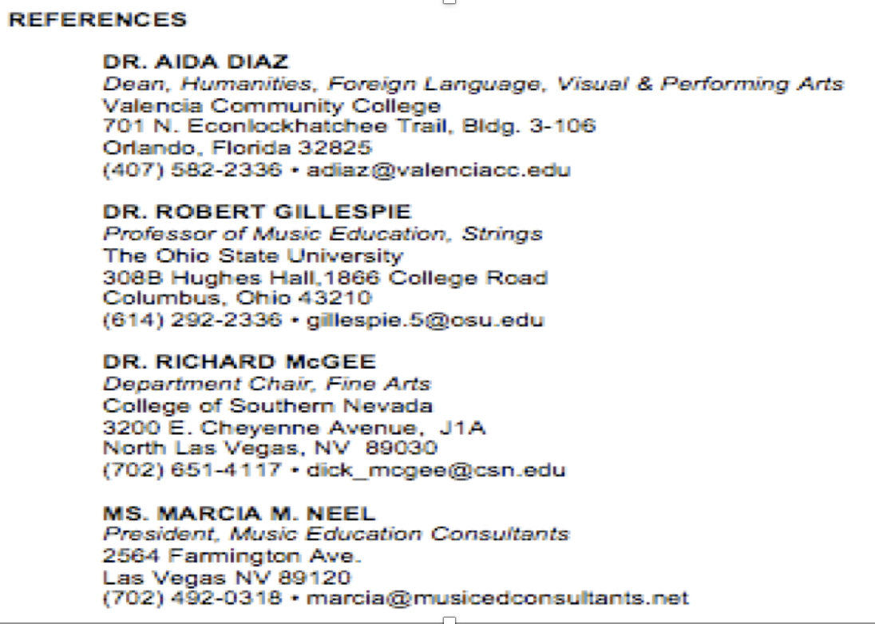
Interviewing:
The Rules of the Road
2. Be Prepared: Items to Bring
Resume: References

Slide 20
Interviewing:
The Rules of the Road
3. Do Your Homework Early
Find out everything you can about the school/district
  Mission Statement?
  Curriculum?
  Courses offered?
  Feeder Program?
  Parent Boosters?
Visit the local programs
Attend concerts at that school

Slide 21
Interviewing:
The Rules of the Road
4. Do Mock Interviews
Sample Questions:
Tell me about yourself
What is your major instrument?
Describe your proficiency on all other
instruments including strings?
What do you consider to be typical problems
for beginning wind/brass/percussion
students?

Slide 22
Interviewing:
The Rules of the Road
4. Do Mock Interviews
Sample Questions:
Describe your high school and college/university background and training.
How have these experiences prepared you to
be a band/string/choir director?
6. Describe you ability to develop and chart a
marching band show.
What are your Jazz Band pedagogical skills and
describe how you teach improvisation.

Slide 23
Interviewing:
The Rules of the Road
4. Do Mock Interviews
Sample Questions:
Describe your expectations regarding
performance?
What are your instructional objectives?
What are some of your considerations in
choosing literature for your ensembles?
11. What classroom management strategies do
you you and how will you handle behaviour
issues?

Slide 24
Interviewing:
The Rules of the Road
4. Do Mock Interviews
Sample Questions:
12. What strategies will you use to recruit
students to your program?
13. Describe what an observer might see in a
typical, daily rehearsal?
14. Please provide an example of a standards-
based lesson.

Slide 25
Interviewing:
The Rules of the Road
4. Do Mock Interviews
Sample Questions:
15. In your opinion, what constitutes a superior,
meaningful performance?
16. What are your expectations regarding fund-
raising?
17. What are some of the non-musical
responsibilities that you have to your students?
18. What are your plans for professional
development?

Slide 26

Interviewing:
The Rules of the Road
5. Put Yourself in My Place

Slide 27

Master Educator Program
Our mission is to provide inspiring professional development opportunities and artistic music collaborations for music educators at the local, state and national levels.

