Slide 1
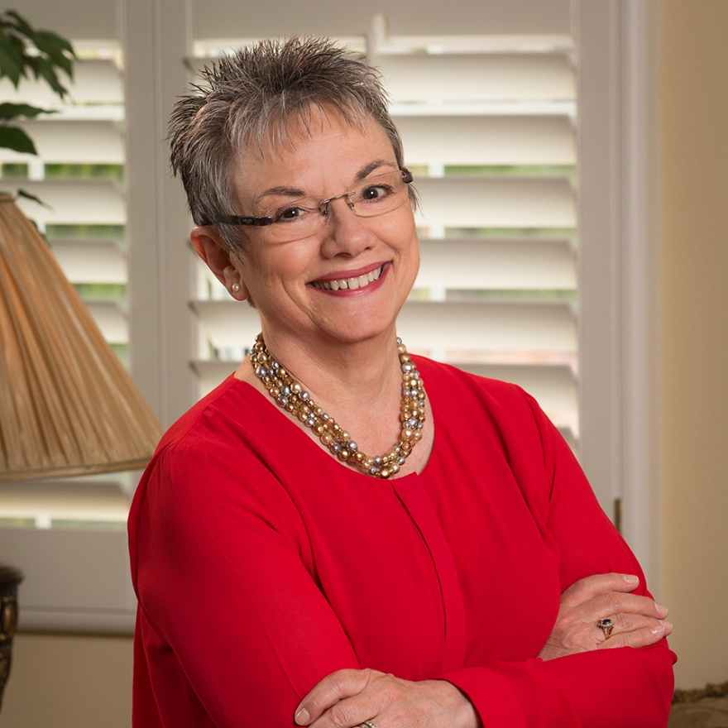


Marcia Neel
Master Educator
One Small Step for YOU!
One GIANT Leap for Music Ed!

Slide 2
Letter to My Younger Self

Slide 3
Letter to My Younger Self
Aware of Impact
Create Opportunities for Students
Empower Students
Teaching Empathy
Leave Ego at the Door - Bring Your Confidence
Gain and Use New Skills
Build Relationships
Make Time for Yourself
Ask For Help
Slowdown - Let Students Process
Tell Stories About Yourself
Find Your Voice - What Works For You
Never Make Assumptions

Slide 4
Letter to My Younger Self
Let Them Know When They Do Things Right
Individual Learning Styles
Learn Their Individual Discipline Style
Be Overly Prepared
Develop and Nurture Your Music Program
Classroom Management
Delegate
Don’t Lose Your Musicality
Impact of Parent Involvement (Sell Them)
Being Intentional
Focus On the Positive
Embrace Mistakes

Slide 5
Letter to My Younger Self
Develop Support System at School
(Music Teachers Are Often Isolated)
Set Limits in the Classroom
Make Students Feel Appreciated
Don’t Reinvent the Wheel
Strengthening Relationships
Teacher Is Not Their Friend
(You Have Six Weeks to Develop Expectations)
Make Connections With Students
Figure Out What Works For You
Don’t Bring Work Emotions Home
Be Up Front With Your Inadequacies

Slide 6
Letter to My Younger Self
Don’t Be Insincere About Your Own Ability
Be Prepared
It’s Students AND Us
Be Proactive About Relationships
Surround Yourself With Knowledgable and Inspiring People
Choose Great Mentors
Don’t Take Yourself So Damn Seriously

Slide 7
What did you love best about
your music teacher?
Choose ONE word!

Slide 8
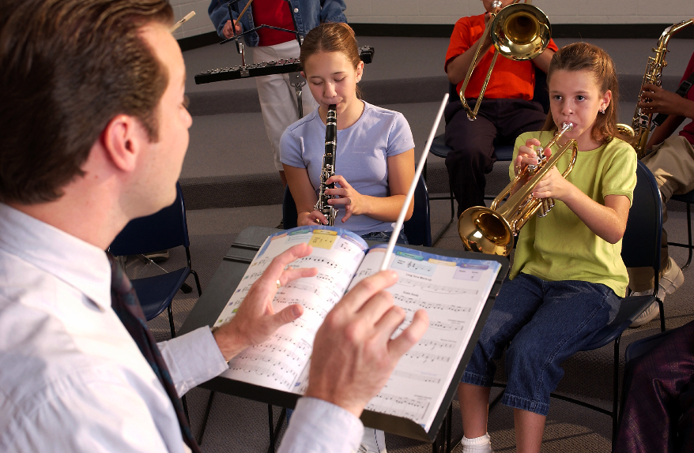
What I loved best about my music teacher
is that he/she was. . .
Caring
Dedicated
Passionate
Committed
Success-oriented
Organized
Dynamic
Positive
A Team Player/Builder
with Students, Staff and Parents

Slide 9
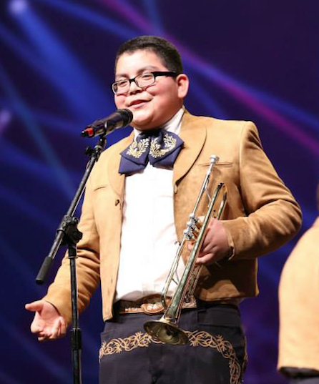
What I loved best about my music teacher
is that he/she was. . .
Communicative
Encouraging
Flexible
Professional
Creative
Talented (Performer)
Intense (In a Good Way)
Effective with Pedagogy

Slide 10
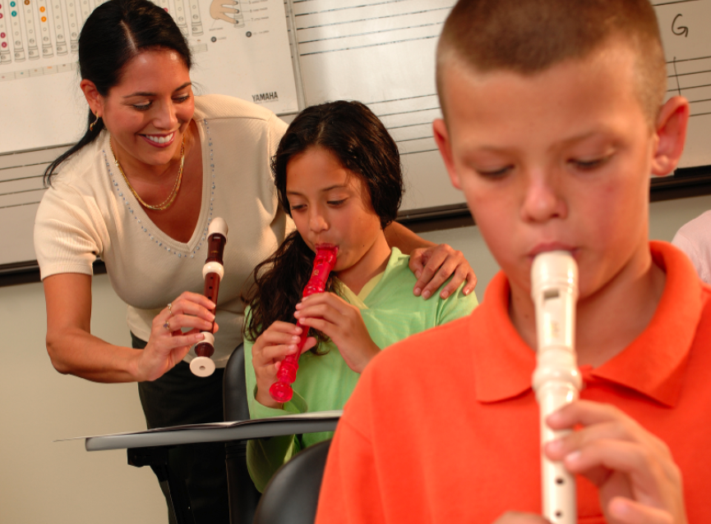
What I loved best about my music teacher
is that he/she was. . .
Responsible
Collegial
Motivational
Inspirational
Helpful
Content-oriented
A Music Advocate (Recruiter)
Demanding (Of Self and Students)

Slide 11
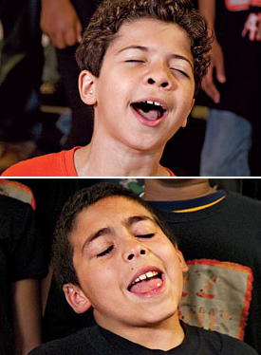
Response of Principals when asked,
To improve the music program,
I would ask my music teachers to. . .
Communicate ! Communicate! Communicate!
Coordinate/Collaborate with
Colleagues
Articulate with Feeder Schools More
Recruit/Retain More
Focus on Building Group Identity
Promote More
Perform More

Slide 12
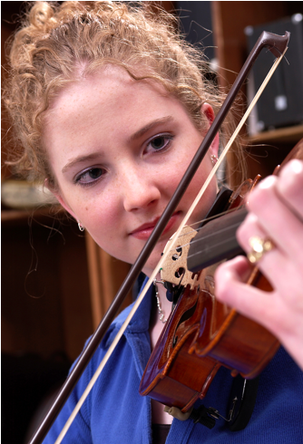
Response of Principals when asked,
To improve the music program,
I would ask my music teachers to. . .
Help Administrators to Help Them
(esp: Class Sizes and Program Building)
Extend Learning Into the Community
Develop More Partnerships
Incorporate School-wide Objectives
Assess Their Own Programs More
Often

Slide 13
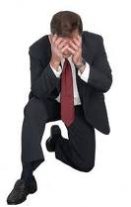
Response of Principals when asked,
What troubles me most is that he/she is not. . .
Passionate
Considerate of the “Big Picture”
Communicative
Demanding Enough
Managing the Classroom Well
Lesson-planning Effectively
Even-tempered
A Team Player
Organized

Slide 14
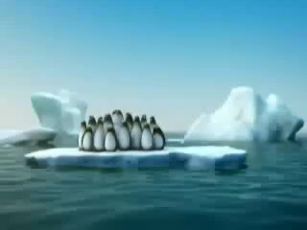
In order to survive,
use the TEAM Approach!

Slide 15
In order to survive,
use the TEAM Approach!

Slide 16
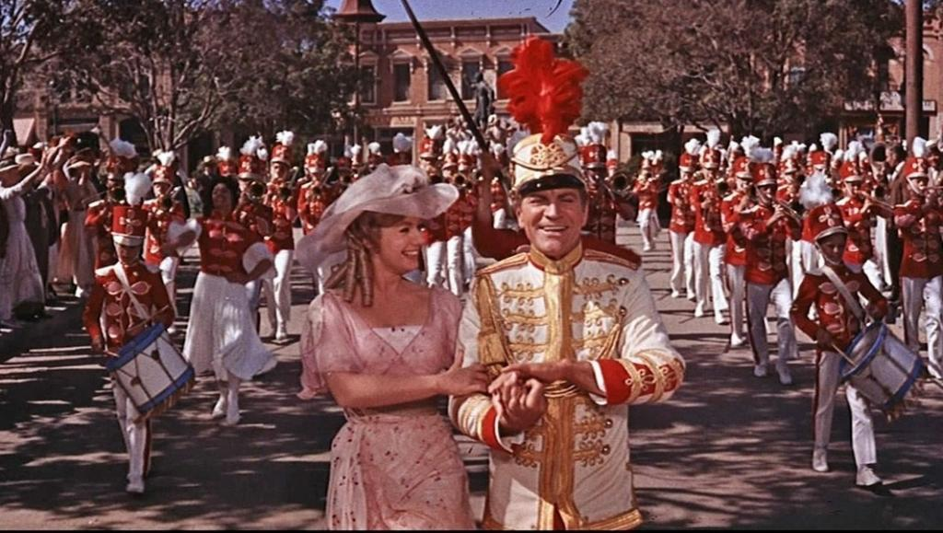
8 Steps to Becoming
the “Professor Harold Hill” of Your School

Slide 17
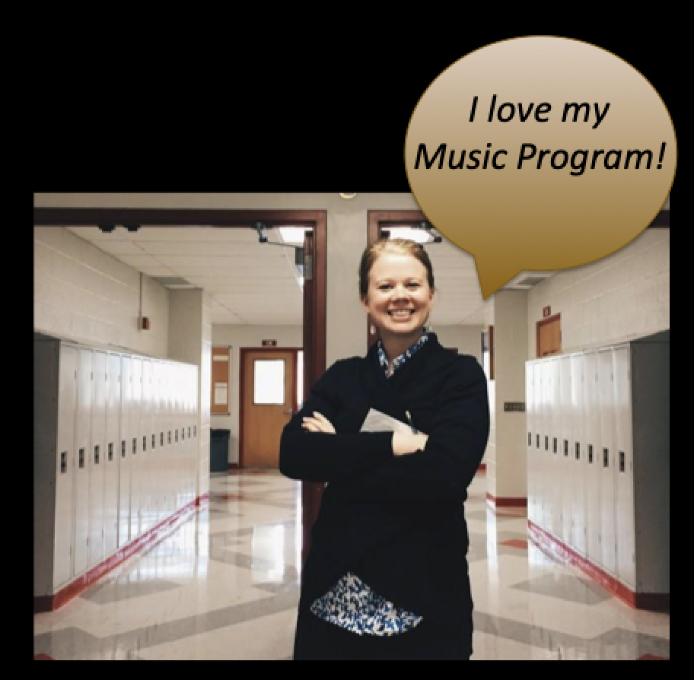



1. Speak the language of your principals
but know that they are also your students

Slide 18
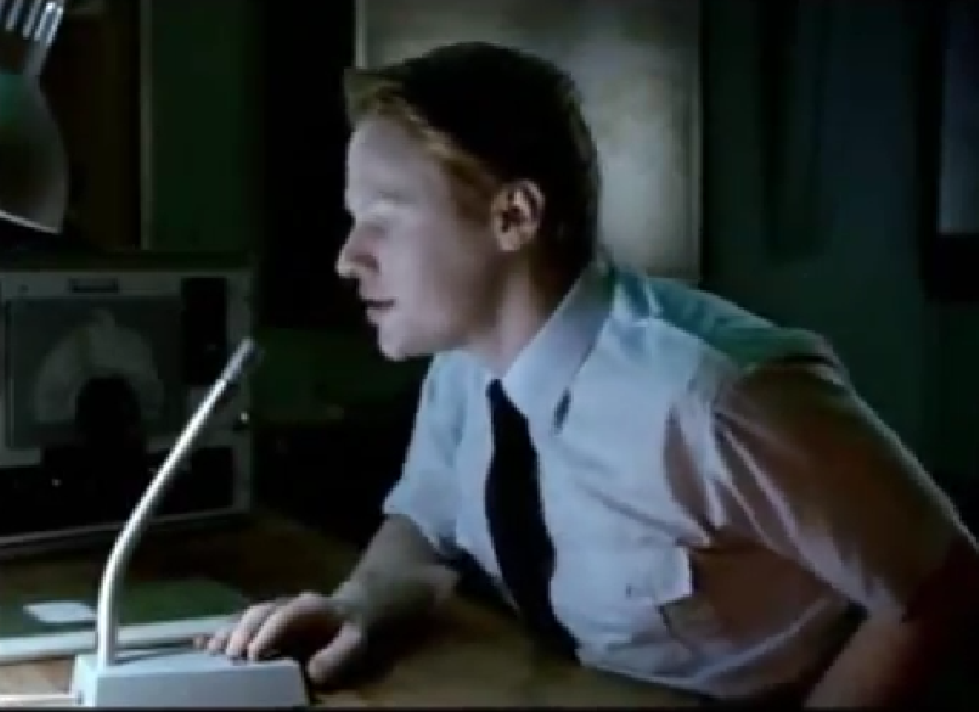
1. Speak the language of your principals
but know that they are also your students

Slide 19

1. Speak the language of your principals
but know that they are also your students

Slide 20
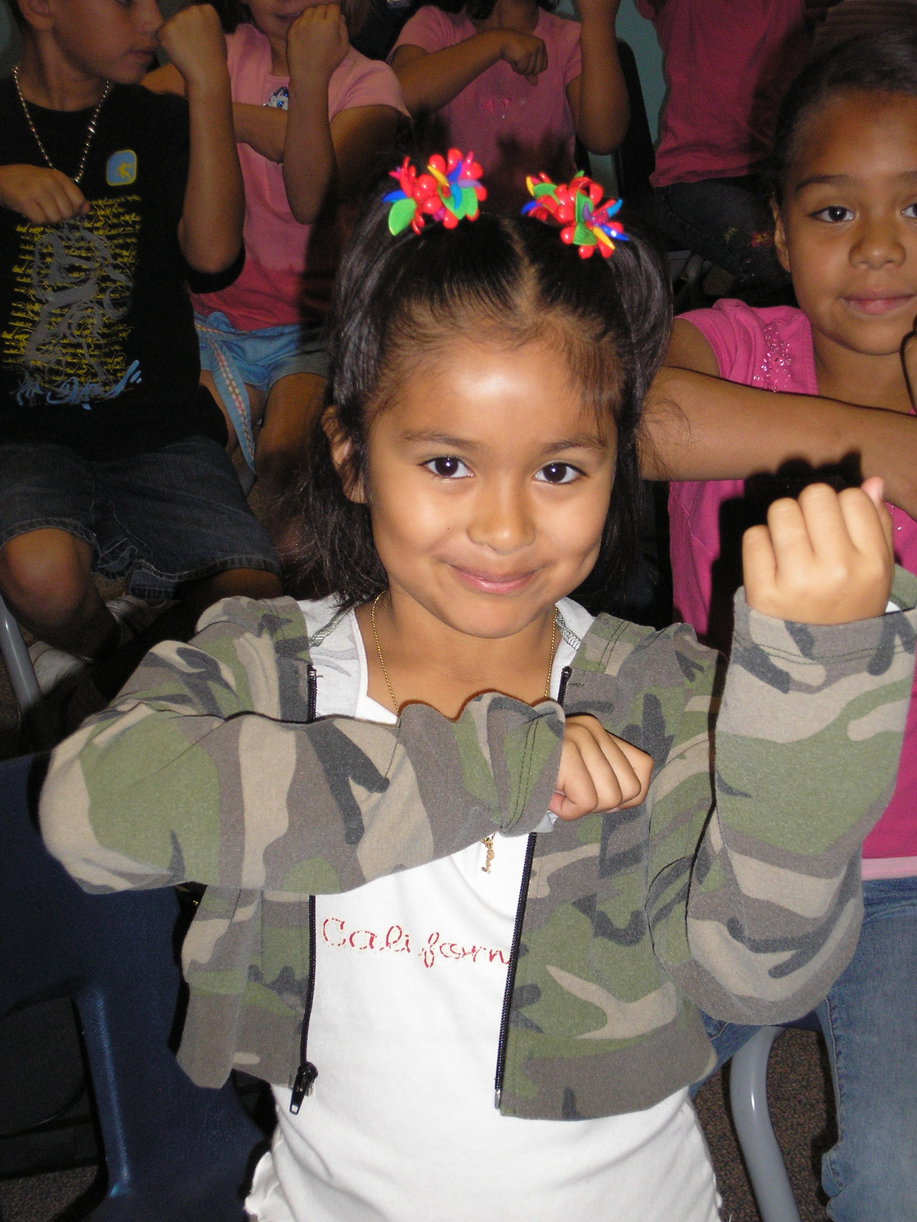
2. Engage Your Principals Directly:
Ask for their help
Come on down. . .
“Could you help me give out instruments to the kids?”

Slide 21
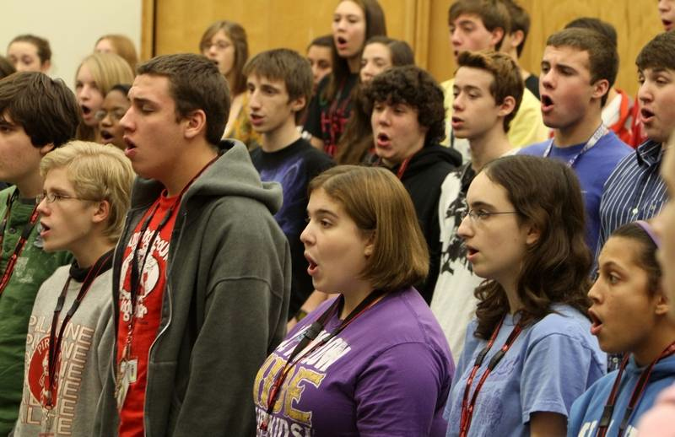
2. Engage Your Principals Directly:
Ask for their help
Come on down. . .
“Could you please come listen to the kids? I need an audience to help the students prepare for…”

Slide 22
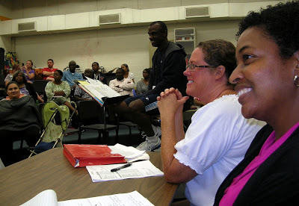
2. Engage Your Principals Directly:
Ask for their help
Come on down. . .
“Could you give a presentation to the Booster Parents?”

Slide 23
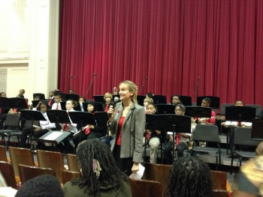
2. Engage Your Principals Directly:
Ask for their help
Come on down. . .
“Could you provide Opening Remarks at our upcoming concert?”
Praise your administrator in front of the
parents for their support.
Have students present a signed, framed print.

Slide 24


3. Make Time to Reflect with Your Students
What am I really getting out of all of this?

Slide 25
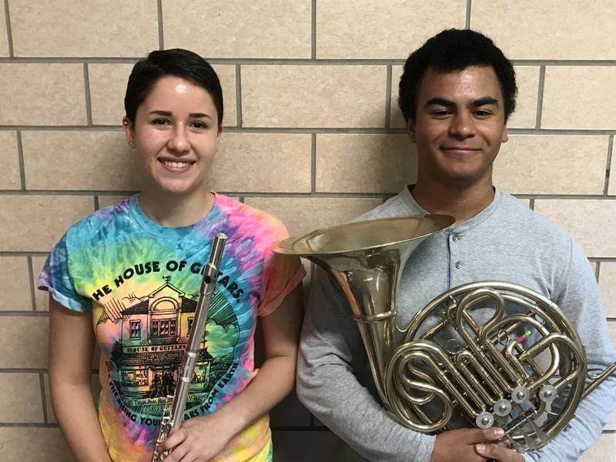

3. Make Time to Reflect with Your Students
Making New Friends!

Slide 26
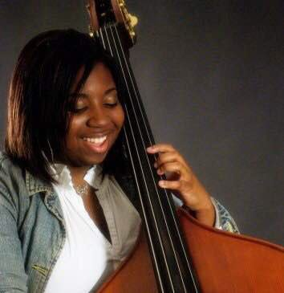
3. Make Time to Reflect with Your Students
The Joy of Making Music!

Slide 27
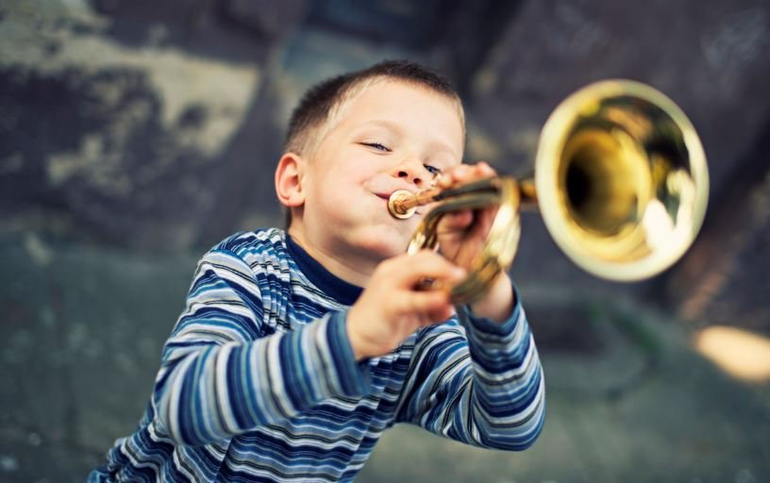
3. Make Time to Reflect with Your Students
It’s Fun!

Slide 28
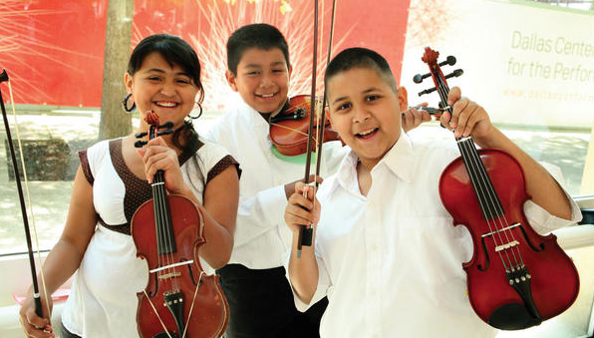
3. Make Time to Reflect with Your Students
It Gives Us a Unified Purpose!

Slide 29
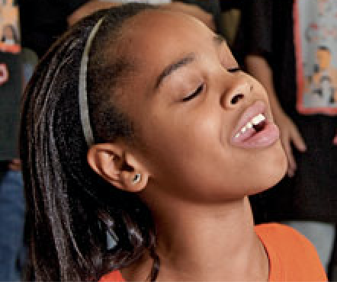
3. Make Time to Reflect with Your Students
Ask them to complete the sentence,
“Music makes the difference because. . .”
“…when you’re sad and then you hear music, it will cheer you up. And when you’re down, it will make you get up from where you are and start dancing. Music will always be there for you.”

Slide 30
3. Make Time to Reflect with Your Students
Ask them to complete the sentence,
“Music makes the difference because. . .”
“…it makes me feel free and like nobody is judging me.”
“…it’s a perfect way to tell and show how you feel.”
“…hearing music helps me work and helps me be the person I want to be.”

Slide 31
3. Make Time to Reflect with Your Students
Ask them to complete the sentence,
“Music makes the difference because. . .”
Share their responses. . .
a. In your concert programs
  b In your school newspaper’s “music corner”
  c. As copy for recruitment fliers and posters at feeder schools
  d. As copy for a publication about your school’s FANTASTIC music program

Slide 32
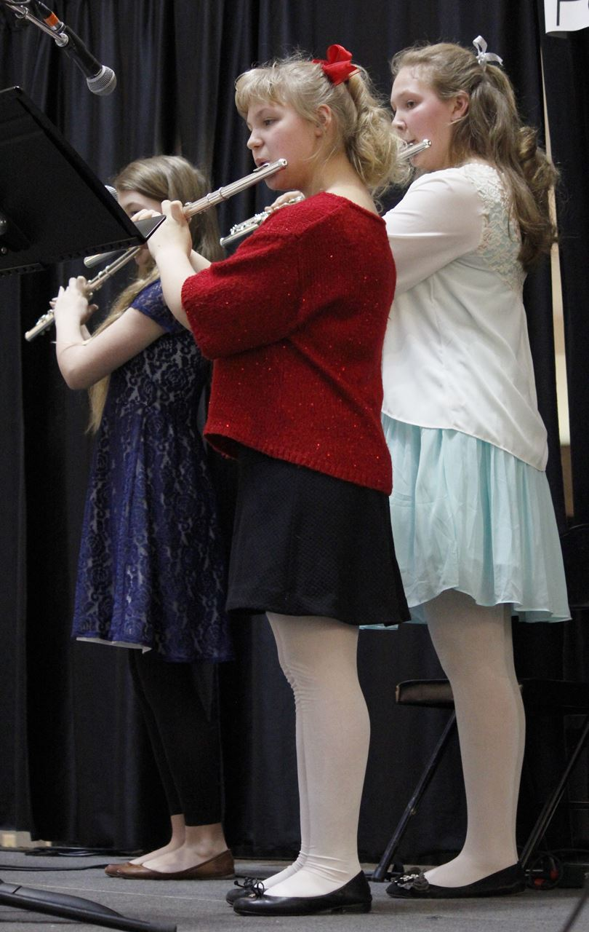
4. Be an advocate for your program.
Don’t be the best kept secret in your school!
Arrange for a performance for the principals’ meetings, school board, city council, state legislature, etc.
They will appreciate the “good news” for a change.
BE READY!!!!!!!!
PERFORM WELL!!!!

Slide 33
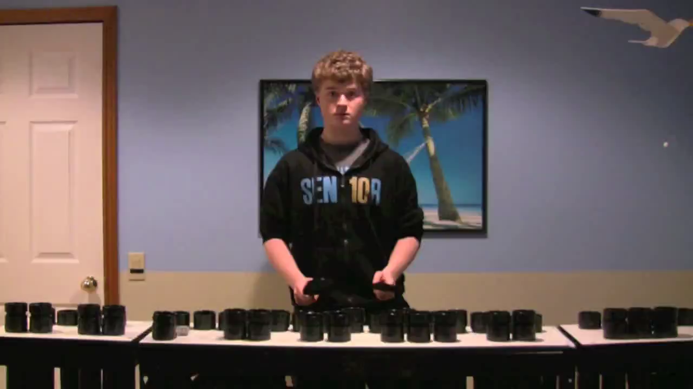
4. Be an advocate for your program.
Don’t be the best kept secret in your school!
Got website?

Slide 34
4. Be an advocate for your program.
Don’t be the best kept secret in your school!
Got website?

Slide 35
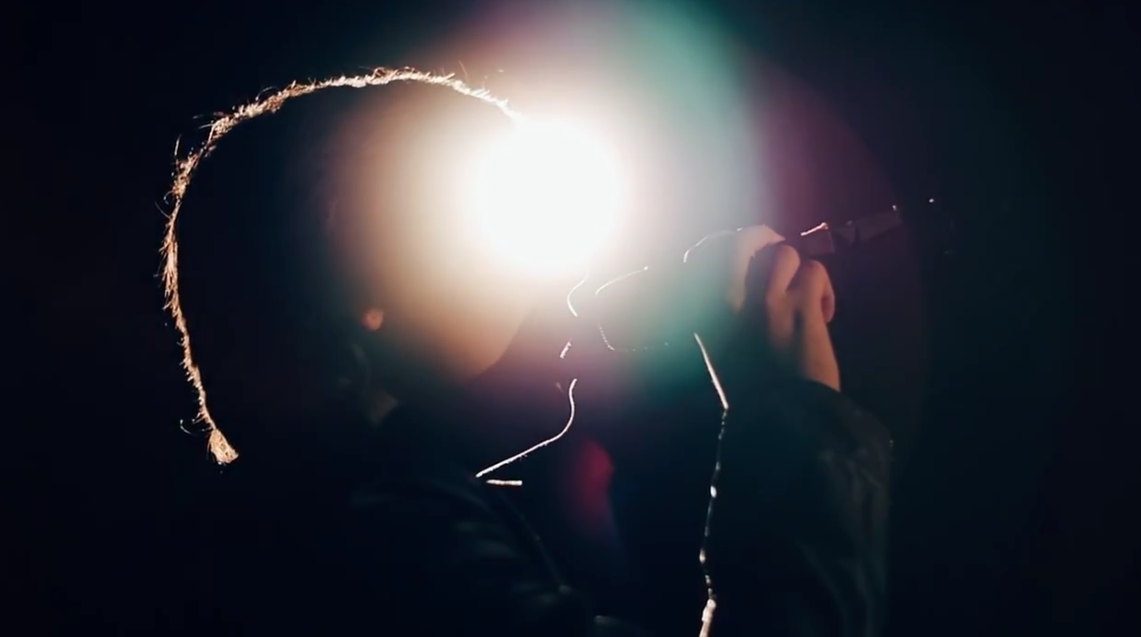
4. Be an advocate for your program.
Don’t be the best kept secret in your school!
Got website?

Slide 36

4. Be an advocate for your program.
Don’t be the best kept secret in your school!
Got website?

Slide 37
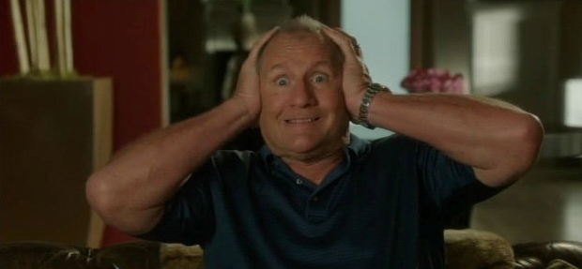
5. Be Flexible: Expand Your Program
OMG! Does this mean that I have to Learn Something New???

Slide 38

5. Be Flexible: Expand Your Program
We Have the Power!!!
The Joy of Music-Making
a. Broaden your base

Slide 39
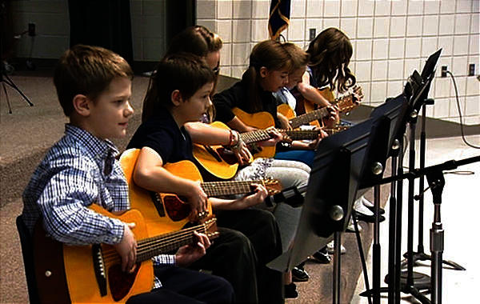
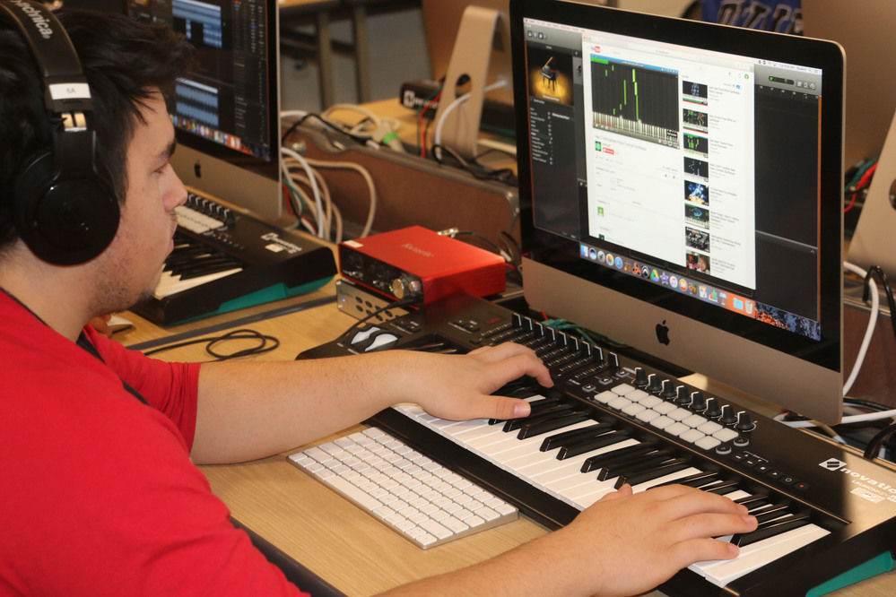
5. Be Flexible: Expand Your Program
We Have the Power!!!
The Joy of Music-Making
a. Broaden your base
b. Teach so that students will be able to go on and DO music without us

Slide 40
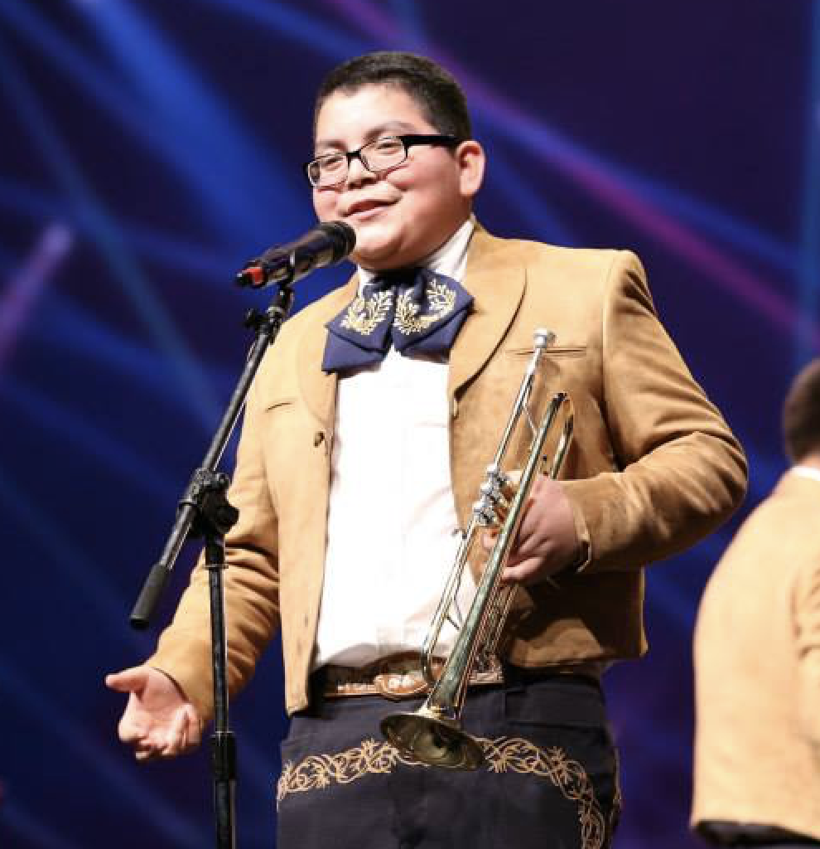
5. Be Flexible: Expand Your Program
We Have the Power!!!
The Joy of Music-Making
a. Broaden the base
b. Teach so that students will be able to go on and DO music without us
c. Acknowledge and honor ALL music

Slide 41
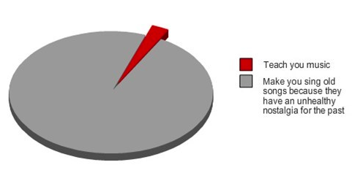
OLD: What Music Teachers Do

Slide 42

NEW: Address Student Interests/Needs/Cultural Backgrounds
Guitar Steel Drum
Drumming Bluegrass
Music Technology Gospel Music
Mariachi Hip Hop
Song Writing Ukelele Ensembles???

Slide 43
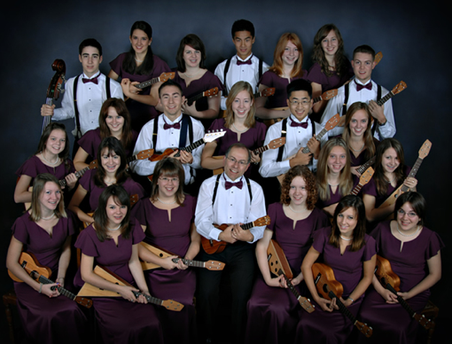
Langley HS Ukelele Ensemble
from B.C. Canada

Slide 44
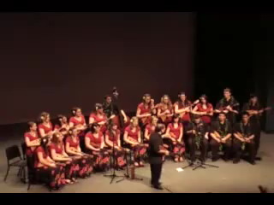
Langley HS Ukelele Ensemble
from B.C. Canada

Slide 45
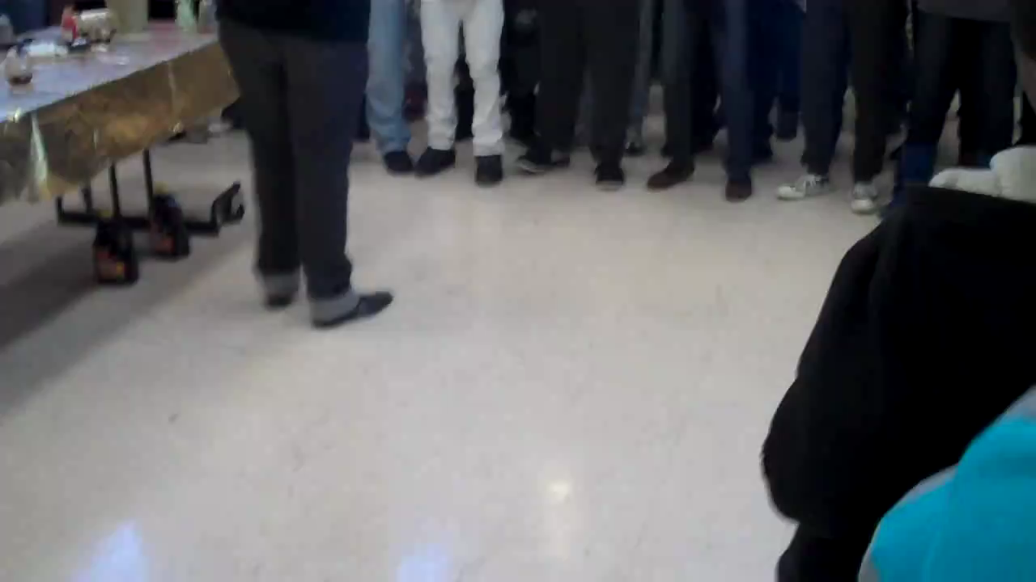
Cleveland Heights HS Gospel Choir

Slide 46
Cleveland Heights HS Gospel Choir

Slide 47
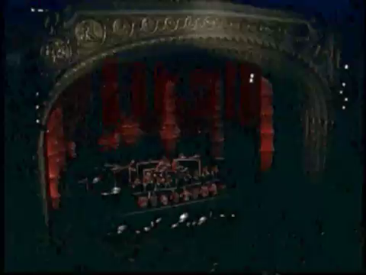
Tucson High School Steel Drum Ensemble

Slide 48
Tucson High School Steel Drum Ensemble

Slide 49
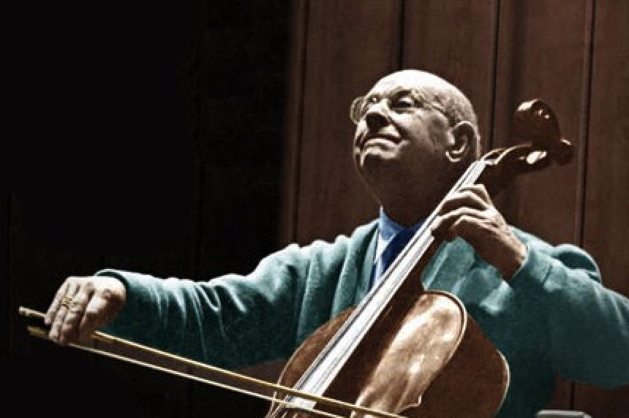
Pablo Casals
Each second we live is a new and unique moment in the universe, a moment that never was before and will never be again.
And what do we teach our children in school?
We teach them that two and two make four and that Paris is the capital of France.
We should also teach them who they are.

Slide 50
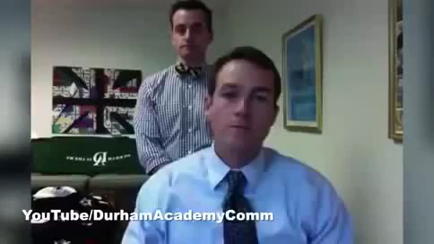
6. Be Creative in Problem-Solving
Don’t Take Yourself Too Seriously

Slide 51
6. Be Creative in Problem-Solving
Don’t Take Yourself Too Seriously

Slide 52
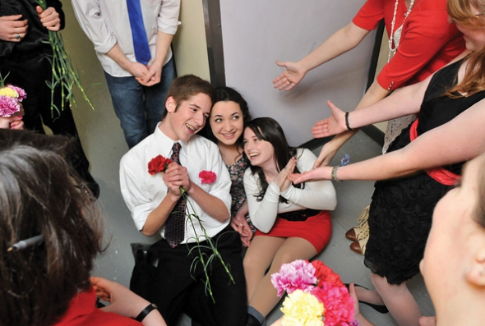
6. Be Creative in Problem-Solving
Don’t Take Yourself Too Seriously
Insert Serenade Photo

Slide 53

7. Recruit 24/7

Slide 54
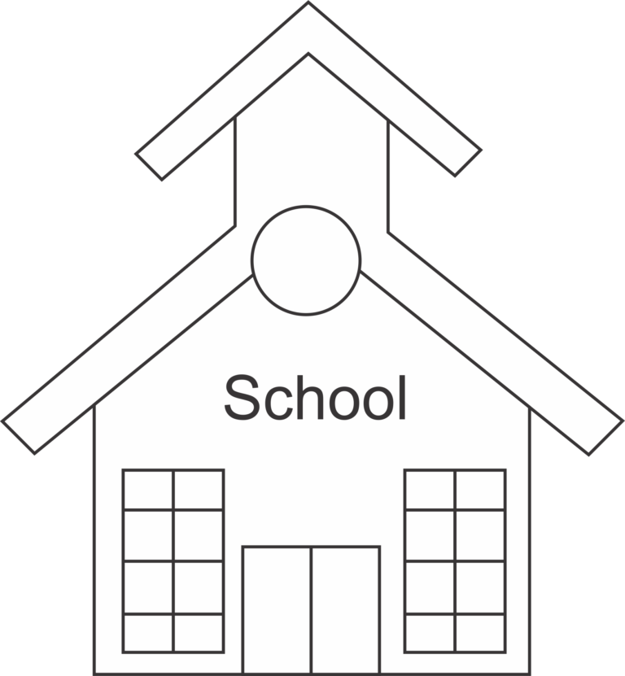
Remember. . .Your school needs YOU!
Be an active, involved member of the faculty.
Take part in as many school activities as you can.
Volunteer to help when needed.
Organize faculty functions, school food drives, etc. (at least one each semester)
Ask how you/your program can help build school spirit.

Slide 55
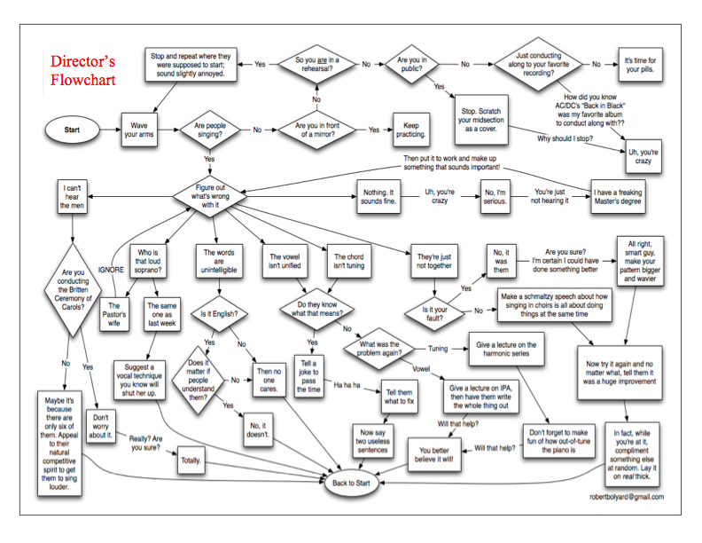
How Can I Do It All?

Slide 56
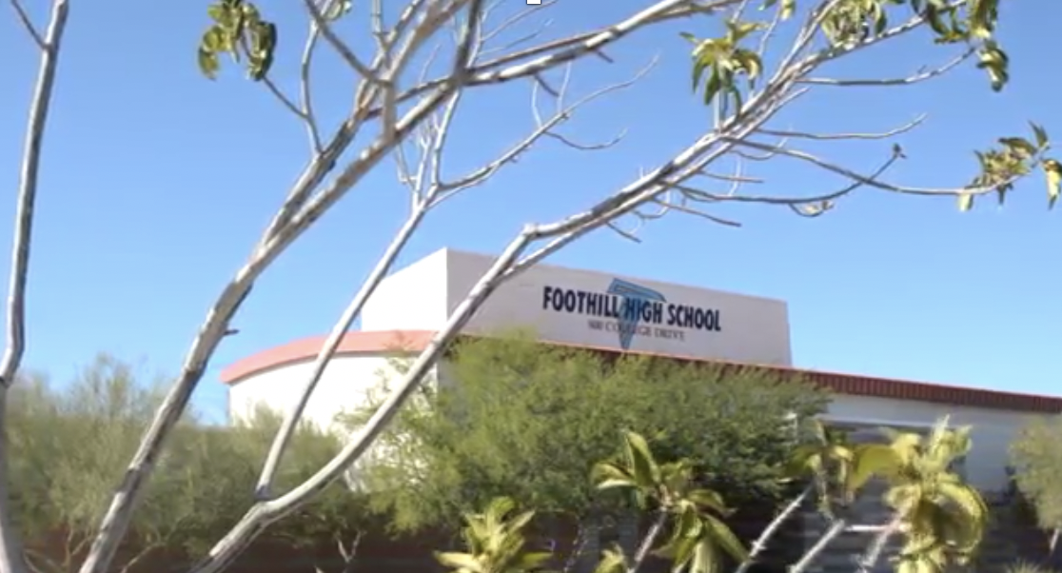
8. Create A Special Place!
EVERYONE Will Love You!

Slide 57

8. Create A Special Place!
EVERYONE Will Love You!

Slide 58
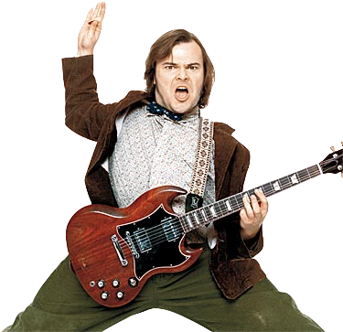
Your Enthusiasm Matters!

Slide 59

One Small Step Across that Stage

Slide 60
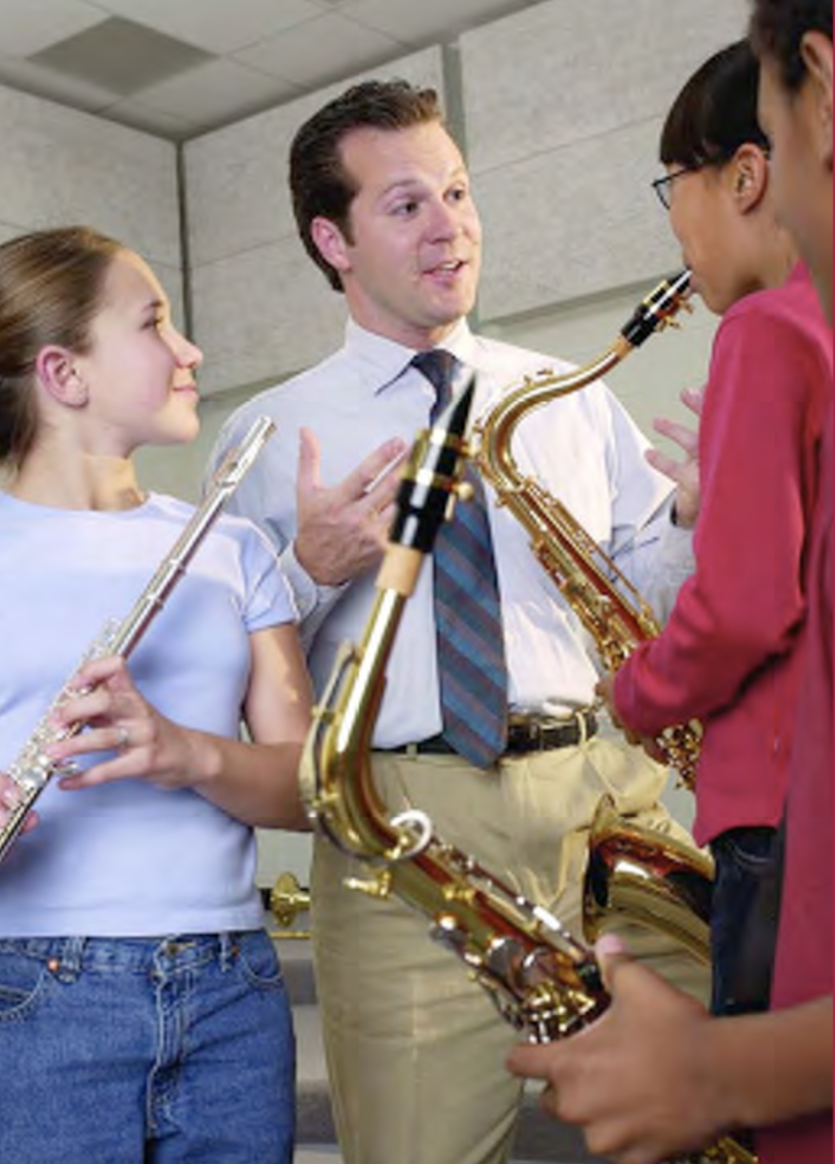
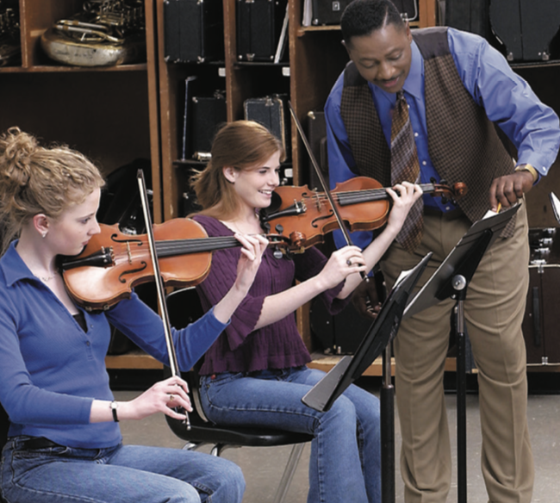
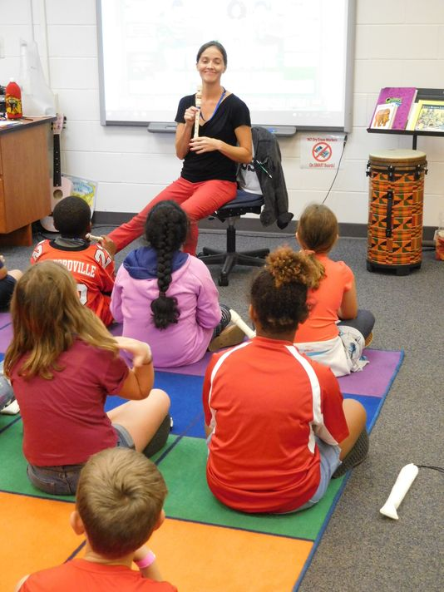
One GIANT Leap for Music Ed
YOU WILL be Changing Lives!!!!!

Slide 61

Master Educator Program
Our mission is to provide inspiring professional development opportunities and artistic music collaborations for music educators at the local, state and national levels.

