Slide 1
The Spirit's Global
Economic Halo Effect:
A North American Grounded Theory and
a Global Question
Jamé Bolds, Ph.D. Candidate, Stellenbosch
CEO, Pathmakers Foundation
Wednesday, 28 October | 2:30 pm
Notes:
Thank the convener, Dr. Antipas Harris, and the Cambridge Centre for Christianity Worldwide. One sentence on who I am: a pastor and development economist finishing a PhD in practical theology at Stellenbosch, under Prof. Nadine Bowers Du Toit. Then go straight to the question. No credentials slide.

Slide 2
What is the Holy Spirit doing in the world?
"If your organization runs any public ministry work: a pantry, a daycare, a workforce program, raise your hand…
Did it start with the leading of the Spirit, or with a practical need?
Notes:
[About 1 minute. 2:30 slot: get hands up early.]
Ask the room: "If your ministry runs any economic work, a pantry, a daycare, a workforce program, raise your hand if that work began with a word from the Spirit. Keep it up if the Spirit language came later, to explain a decision you had already made for practical reasons."
Let the room see itself. That split is my research question in miniature.

Slide 3
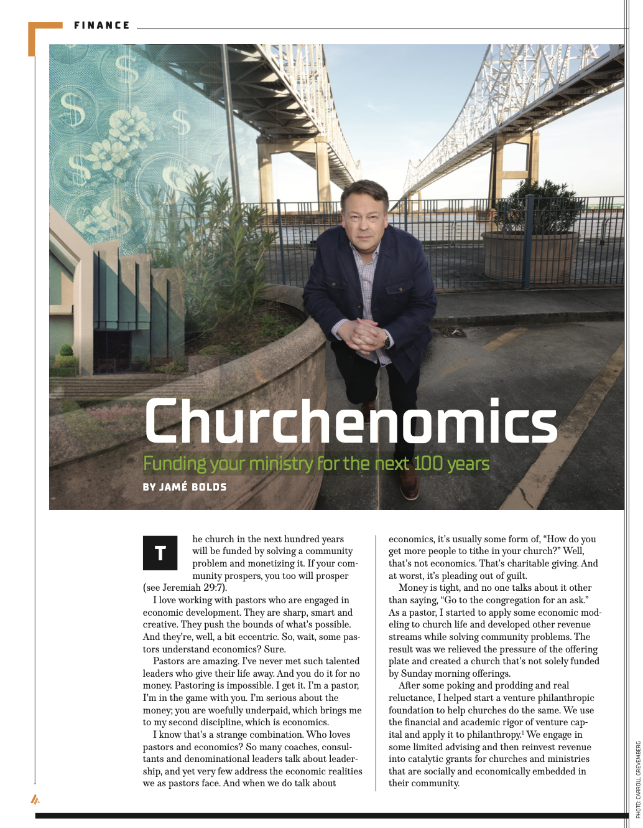
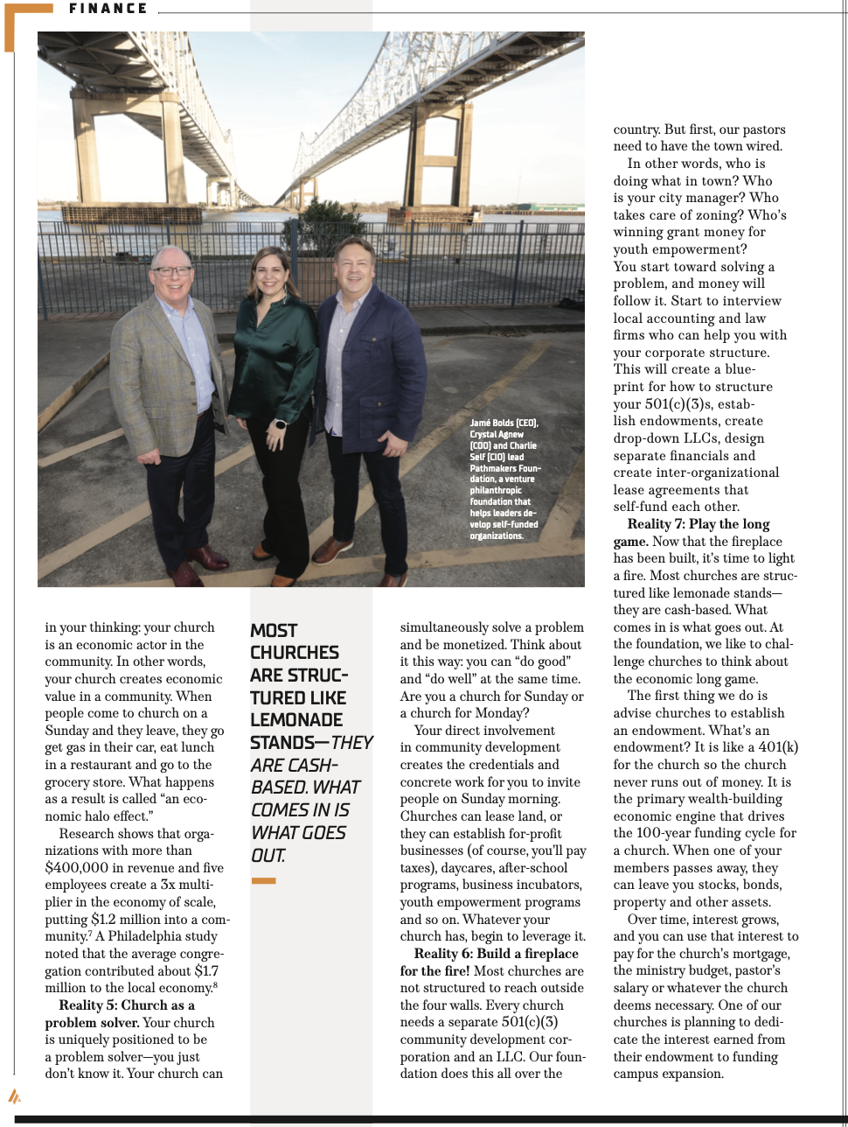
Notes:
Earlier this year we were featured in an article by AVAIL Magazine, which is connected to Sam Chan’s leadership group will be laid out some fundamental economic theology, and some practical insights into how churches can become economically sustainable. And will be more than willing to make this available to you at the end of our time together.

Slide 4
Where the Evidence Led…CGT n=16
The Spirit is generating economic narratives inside local congregations.
Those narratives spill over into the economic life of the neighborhood.
Economists can measure the spillover.
This research explains where it starts.
The sermon becomes a food pantry.
Notes:
[About 1 minute.]
State the thesis plainly so the room can test it for the next 28 minutes. Grounded theory is inductive in the data. I report it point first so you can hold me to it.
Land the line: "The sermon becomes a food pantry." Then move.

Slide 5
Operational Research Question
Question: What are the theological motivations that inspire Pentecostal churches to engage in community economic development?
Operational questions for this session:
1. How does a pneumatological conviction become an economic narrative?
2. How does that narrative travel from the pulpit to the ZIP code?
3. Does the story match what the ministry does?
SOURCE: Bolds, PhD in Practical Theology (in progress), Stellenbosch University. Supervisor: Prof. N. Bowers Du Toit. SU ethics clearance ref. 31455.
Notes:
[About 1 minute.]
The dissertation question asks about motivation. For a room of economists, ethicists, and bishops, I break it into three questions you can check: conviction to narrative, narrative to neighborhood, and whether the story matches the books.
Question 3 is artifact verification: I compared what leaders said against financial and governance documents where ministries provided them.

Slide 6
How an Economist Would Ask It
Question: Does Pentecostal faith change a household’s income?
Cross-country data: Belief in heaven and hell tracks faster growth; church attendance, holding belief constant, tracks slower growth (Barro & McCleary 2003).
Natural experiment: Prussia’s Protestant economic advantage came from literacy, not a work ethic (Becker & Woessmann 2009).
Randomized trial: an evangelical values program in the Philippines raised religiosity and income six months later (Bryan, Choi & Karlan 2021).
Each tool measures the outcome. None asks what moved the pastor first.
SOURCE: Barro, R.J. & McCleary, R.M. 2003. American Sociological Review, 68(5). Becker, S.O. & Woessmann, L. 2009. Quarterly Journal of Economics, 124(2). Bryan, G., Choi, J.J. & Karlan, D. 2021. Quarterly Journal of Economics, 136(1).
Notes:
[About 1 minute 15 seconds.]
Before I show my method, I want to show this room how a development economist would approach the same question. The economist asks a causal question: does Pentecostal belief or practice change income, savings, or enterprise?
Three tools do most of the work. Barro and McCleary ran cross-country regressions and found that growth rises with belief in heaven and hell and falls with church attendance once belief is held constant. Becker and Woessmann used Prussian county data and traced the Protestant advantage to literacy: Luther wanted every believer reading scripture, and reading paid off in the labor market. Bryan, Choi, and Karlan randomized an evangelical Protestant values program among extremely poor households in the Philippines. Six months later, treated households were more religious and had higher income. Labor supply and consumption did not move.
Every one of these studies faces the same problem, and the economists name it themselves: selection. Do aspirational people join Pentecostal churches, or does the church make them aspirational?
Land the line: each tool measures the outcome. None asks what moved the pastor first. That is the gap my grounded theory fills, and at the end of the talk I show how my findings become a model an economist can test.

Slide 7
The Nature of the Problem
Pentecostal economic activity is visible worldwide.
In Africa it has been surveyed and is now being tested. In Latin America it has been debated.
In North America, congregations have been valued in dollars. The Pentecostal motivation behind that value has not been explained.
Secular economic theory cannot account for a pastor who stakes his credibility on “God Said.”
The prosperity-gospel caricature cannot either.
Notes:
[About 1 minute.]
This is the bridge to the global evidence. The problem is uneven knowledge: measured in one place, argued in another, counted but unexplained here.
The last bullet previews Finding 1. Do not explain it yet.

Slide 8
The Scale of the Movement
229 million
Pentecostal and charismatic adherents in Sub-Saharan Africa, 2020.
The fastest-growing religious group in the region.
This is a mainstream movement in the Global South, not a fringe one.
SOURCE: Johnson & Grim (2023), as cited in AEA RCT Registry, trial 13373.
Notes:
[About 1 minute.]
Scale first, so the room knows why economists have started paying attention.
VERIFY before presenting: the 229 million figure comes from the registry entry citing Johnson and Grim (2023). Check the primary source (World Christian Database / Johnson and Grim) and cite it directly in the paper.

Slide 9
Miller and Yamamori: Twenty Countries in Four Years
They visited churches, interviewed leaders, and observed social ministries, mostly in developing nations.
They called what they found Progressive Pentecostalism: believers who say the Holy Spirit and the life of Jesus send them to meet the spiritual, physical, and social needs of their communities.
Their argument: Spirit-filled worship sits at the root of the social concern.
Dissertation begins from their sixth category of social ministry: economic development.
SOURCE: Miller, D.E. & Yamamori, T. 2007. Global Pentecostalism: The New Face of Christian Social Engagement. Berkeley: University of California Press.
Notes:
[About 1 minute 15 seconds.]
This is my launching point, and the closest earlier answer to the colloquy question. Miller and Yamamori placed the Spirit at the root of Pentecostal social engagement. They did not trace how that conviction becomes an economic decision in a North American congregation. That is where my work picks up.

Slide 10
South Africa: Under the Radar
In 2008 the Centre for Development and Enterprise studied post-apartheid Pentecostal growth, advised by Peter Berger and James Hunter.
CDE’s director judged the most significant finding to be “untapped social capital available for development and economic growth.”
A national think tank had missed a social movement growing under its own nose.
SOURCE: CDE. 2008. Dormant Capital: Pentecostalism in South Africa and its Potential Social and Economic Role. Johannesburg: CDE. Bernstein & Rule (2010).
Notes:
[About 1 minute.]
Stellenbosch connection: this is the South African conversation my degree sits inside.
The title of the report says it: the capital was dormant, and the experts had not seen it.

Slide 11
The Critique: Stated Up Front
Gifford and Nogueira-Godsey tested the CDE report against one church, Winners’ Chapel.
Its “victorious living” theology does not fit Weber’s Protestant ethic.
The global evidence is contested. That is why the motivation has to be traced, not assumed.
SOURCE: Gifford, P. & Nogueira-Godsey, T. 2011. The Protestant ethic and African Pentecostalism: A case study. Journal for the Study of Religion, 24(1).
Notes:
[About 45 seconds.]
Name the strongest critique before anyone in the room has to. This shows I know the prosperity-gospel objection and am not hiding from it.

Slide 12
Africa: Testing It in the Field
A registered field experiment proposes the first randomized evidence on the economic outcomes of Pentecostal messages, including the prosperity gospel.
Yong and Knoetze review the literature on African Pentecostalism and economic development.
Freeman places Pentecostalism inside the development literature for Sub-Saharan Africa.
SOURCE: AEA RCT Registry, trial 13373. Yong, A. & Knoetze, J. 2024. Religions, 15(7):832. Freeman, D. 2015. In Tomalin, E. (ed.), Routledge Handbook of Religions and Global Development.
Notes:
[About 45 seconds.]
Africa is getting experimental economics on this question. North America is not. That sentence is the hinge into Part III.

Slide 13
Africa: Testing It in the Field
“Pentecostal churches are often rather more effective change agents than are development NGOs.”
Secular development agencies fail because they try to implement macro-scale economic fixes from the outside. Pentecostalism, by contrast, succeeds because it initiates "transformational development” meaning it changes a person's inner subjectivity, values, and social relations first, which naturally unlocks economic growth later.
SOURCE: Freeman, D. (ed.) 2012. Pentecostalism and Development: Churches, NGOs and Social Change in Africa. Basingstoke: Palgrave Macmillan. Freeman, D. 2013. Pentecostalism in a rural context. PentecoStudies, 12(2):231–249.
Notes:
[About 45 seconds.]
Dena Freeman's edited volume compares Pentecostal churches and development NGOs in Africa. Her argument: NGOs bring programs from outside, while Pentecostal churches change a person's values, relationships, and sense of self first, and economic change follows.
VERIFY the page number for the Freeman quote in the 2012 volume before publication. Do not attribute the stronger line, "more for development than all NGOs combined," to Freeman. That wording comes from a Christian Post summary of her book, not from her.
Africa is getting experimental economics and serious anthropology on this question. North America is not. That sentence is the hinge into the North American gap.

Slide 14
The Halo Has Been Measured in North America
Philadelphia, 12 congregations: $52 million in annual economic value, an average of $4.3 million each.
Three U.S. cities, 90 congregations: $1.27 to $2.51 million per congregation each year.
Urban historic sacred places: over $1.7 million a year on average.
Rural North Carolina churches: about $735,000 a year each.
SOURCE: Cnaan, Forrest, Carlsmith & Pelletier (2013); Cnaan & An (2018); Partners for Sacred Places (2016); Partners for Sacred Places & UNC Charlotte (2023).
Notes:
[About 1 minute 15 seconds. This is an energy point: slow down on the numbers.]
Ram Cnaan and Partners for Sacred Places gave the phrase "halo effect" to congregational studies. They priced what congregations add to their neighborhoods: payroll, day care, counseling, volunteer hours, space below market rate.
Other quantitative work points the same way. U.S. counties with more congregations show more small-business activity (Deller, Conroy & Markeson, 2018). Counties with higher church membership recovered productivity faster after the 2005 hurricanes, an association the authors do not call causation (Hasan, Manfredonia & Noth, 2024).
VERIFY: Philadelphia pilot citation (Cnaan et al. 2013, Journal of Management, Spirituality & Religion 10(1)) and the rural study year.

Slide 15
Valued but Not Explained
The halo studies do not isolate Pentecostal congregations.
They count what a building leaves behind, not the story that started it.
They measure how much. They do not ask why.
The closest U.S. study, of megachurch economic development in Dallas–Fort Worth and Houston, heard from leaders only.
Africa has been measured. Latin America has been debated. North America has been valued but not explained. Ignored.
SOURCES: English, A.E. 2015. Megachurches and Economic Development. PhD diss., University of North Texas (42 surveys, 23 leader interviews).
Notes:
[About 1 minute.]
This is the gap, and it matters most for this room. The congregational halo literature measures what a church leaves behind. It has not asked what a church had to believe, and risk, before there was anything to measure.
Careful wording: I say no study explains the Pentecostal motivation behind the North American halo. I do not say no one has studied Pentecostal economics in North America.

Slide 16
Halo Effect: Three Meanings. One Outcome.
Material Halo: spillovers economists measure, such as jobs, local spending, and property values (Slee 2005; Kline & Moretti 2014).
Perceptual Halo: one visible good deed lifts a reputation in unrelated areas (Smith, Read & López-Rodríguez 2010).
Brusco’s Halo: A converted husband’s wages return to the household, and the change radiates outward (Yong 2010:28).
The halo is not unique to Pentecostals. It is a spillover.
=> My question is what starts it inside a Pentecostal congregation.
SOURCE: The phrase “the Spirit’s Halo Effect” came from a pastor in my study (Ministry F). It is not the dollar valuation of Cnaan and Partners for Sacred Places.
Notes:
[About 1 minute.]
Answer the "isn't this just what congregations do?" objection before it is asked. Yes. The halo is a spillover, a standard idea in quantitative economics. My contribution is the Pentecostal process that starts the spillover.
Brusco's halo is the one closest to mine, because it begins with a changed person and a retold story, upstream of any building or budget.

Slide 17
Research Design
Method: Classical Grounded Theory. The theory is developed from the ground floor, not tested against one already published.
Interpretive partner: Shiller’s Narrative Economics.
Data: Eight Pentecostal ministries, sixteen structured interviews over Zoom.
Round One: eight Lead Pastors. Round Two: one challenge respondent per ministry, chosen to test what the Lead Pastor said.
Glaser & Strauss (1967); Strauss & Corbin (1998); Shiller (2020).
Notes:
[About 1 minute.]
The design choice to stress for this room is the challenge respondent. Every Lead Pastor's account was tested by a second person inside the same ministry: an associate, a board member, a successor, a program officer.
Coding stays inductive at the level of the data. Theoretical saturation is documented in the dissertation.

Slide 18
Eight De-identified Units of Analysis:
A Gulf Coast metro: licensed counseling center; reentry-to-ownership pipeline
B Metro South: workforce development; mixed-use land development
C Coastal New England: property acquisition; teen center; self-funding ventures
D Metro Southeast: food pantry; community center; small-business grants
E Mid-sized Midwest: grocery, laundromat, daycare; “own little, influence everything”
F Mid-Atlantic suburb and a Southeastern public-housing community: coordination
G Pacific Northwest village: cafe ministry and community center
H Metro Northeast: daycare; building tenancy with a Christian academy
SOURCES: Founders (planted the church they lead): A, B, C, D, F. Inheritors (took over an existing church): E, G, H. All names are pseudonyms; locations are regional.
Notes:
[About 1 minute 15 seconds. Energy point: walk the map quickly, one phrase per ministry.]
Urban, suburban, and rural. Both coasts, the South, and the Midwest. Some own their buildings and lease them out. Others own almost nothing on purpose.
The Founder and Inheritor distinction surfaced in the data. It was not part of the design.

Slide 19
Why Narrative Economics?
Stories drive economic behavior.
A narrative spreads through attachment, human interest, and identity, whether or not its details resolve as stated.
A pastor’s public announcement is a narrative in Shiller’s sense.
Its resolution, or its reinterpretation, is the contagion event.
SOURCE: Shiller, R.J. 2020. Narrative Economics, p. 136.
Notes:
[About 45 seconds.]
Shiller gives a secular vocabulary for what Pentecostals call testimony. A testimony does not raise giving only in the week it is told. It keeps working until a newer story replaces it.

Slide 20
From Codes to a Central Category
Open coding: respondents’ own words kept as codes: “buy our way out of it,” “inform, don’t ask.”
Axial coding: each Round One pattern tested against a second respondent.
Selective coding: one central category, the Spirit’s Halo Effect.
Strauss & Corbin (1998:123, 143).
Notes:
[About 45 seconds.]
Some Round One themes split in two under Round Two. Some became spectrums. Two dimensions appeared that Round One could not see. A category is not axial until it has been tried against variation.

Slide 21
Finding 1: Staking Credibility on “God Said”
Present in six of eight Round One interviews.
A Lead Pastor stakes personal, financial, or prophetic credibility on a public statement. The risk resolves. The retold story authorizes the next risk.
Pastor B: “I had told the congregation, God said that we are to buy this building. Well, they sold it to a Fortune 500 company, and my credibility was on the line.”
His resolution was reinterpretation, not retraction: “God told me, I told you to buy it, I didn’t tell you from who.”
Pastor D sold his home and put the equity into the ministry: “Yeah, at the very beginning, absolutely.”
SOURCE: Round One interviews, Ministries B and D (de-identified).
Notes:
[About 1 minute 30 seconds. Let the Pastor B quote get its laugh.]
This is the heart of the theory. The stake can be prophetic (B), financial (D), or relational. What recurs is the sequence: stake, resolution, retelling, next project.
Pastor B called this the single largest risk in his ministry, larger than any financial exposure.

Slide 22
Finding 2: Watched in Real Time
Associate B, a board member, watched a second publicly announced property purchase fail to close.
The ministry secured another property. She reads it as God still providing, in a different form.
Two incidents, two observers: one who staked the risk and one who watched it land.
The halo is a habit of this ministry, not a one-time rescue.
SOURCE: Round Two interview, Ministry B.
Notes:
[About 1 minute.]
Answer the obvious objection: a pastor retelling his own success story has had time to polish it. Round Two removes that weakness for Ministry B. Someone other than the person who made the announcement watched it resolve from inside, and she read it the same way he did.

Slide 23
Finding 3: The Nomenclature of the ZIP Code
Five ministries describe proclamation and service as one act, each by its own theological path:
Associate D: “It’s staff-held, not just his … it’s part of our character, it’s who we are.”
Associate A: “Because we love Jesus, and Jesus loves these people.”
Associate E: the neighborhood is “our garden,” not a mission field, grounded in common grace.
Disconfirming case: Ministry H gave a one-sentence rationale, “the godly thing to do.”
The Spirit’s language is how these congregations name economic action.
Notes:
[About 1 minute 15 seconds.]
This answers "is the Spirit language decorative?" No. In these ministries the Spirit's language is the nomenclature of the ZIP code: the vocabulary communities use for the economic work they do.
Associate D adds a distinction. In practice there is no line between preaching and doing. In theological purpose, a line remains: "Anyone can advocate for justice ... The specific point of evangelism is leading people to Jesus."
Report Ministry H as data, not noise. It is also the governance outlier.

Slide 24
Finding 4: From the Ground Floor
These ministries answer the prosperity gospel through practice, not from the pulpit.
Two poles inside one tradition: Ministry B runs outreach as a membership funnel by design. Ministries C and E decline to, on principle.
Pastor H: “The necessity for it was just the reality that we need to have other streams of income.”
Associate C: “More is not the goal. Greater impact is.”
Associate E wants “a new scorecard”: would the neighborhood notice if the church closed?
Notes:
[About 1 minute 15 seconds.]
The theory came up from practice. None of these pastors preaches personal enrichment as the point. Stewardship and community transformation are argued out in budgets, leases, and grant reports.
Pastor B defends the funnel as an honest mixture of motives: "Everything has an ulterior motive." Associate C and Associate E reject the funnel, one with an impact ethic, one with common grace. Hold both poles; the tradition does not settle it.

Slide 25
Finding 5: What Survives Succession
Ministry G: the founder’s personal relationships did not outlast his retirement. The cafe’s did. The mayor stayed a regular customer.
Institutional Adhesive: trust attached to a place or an ongoing practice, not to one person.
Ministry E: transfer that worked, transfer that failed, and one reversal. The successor was “the same person,” with less standing once he held the title.
=> Weber’s routinization of charisma fits both cases.
SOURCE: Round Two interviews, Ministries G and E. Weber, M. 1968. Economy and Society.
Notes:
[About 1 minute.]
Program Officer G on her father's vision: "I believe it did match." On the mayor: "a genuine friendship in its own right."
What a founder builds into a role does not automatically transfer. What he builds into a place can.
VERIFY the Weber edition and pagination before publication.

Slide 26
The Spirit’s Halo Effect
Pneumatological conviction generates an economic narrative that radiates from the church into the community and spreads by contagion.
Conviction → public stake → resolution → retold story → next project → neighborhood spillover
Boundary condition: capital tied to the Lead Pastor’s personal narrative travels with him. Capital embedded in an institution survives a change in part.
Open question: one process with a boundary condition, or two processes sharing one name?
Notes:
[About 1 minute 15 seconds.]
This is the central category. It is a defensible finding, not a finished theory.
Put the open question to the room directly. Personal narrative capital and institutionally embedded conviction: one process or two? This is the question Chapter 7 has to settle, and this room can help.

Slide 27
Limits and the Next Phase
N = 16 is designed for theoretical generalization, not statistical generalization.
North America is the test case, not the world.
How an economist would test the halo:
Interaction: Y = β₀ + β₁X₁ + β₂X₂ + β₃(X₁ × X₂) + ε
Carryover: Adstockₜ = Xₜ + λ · Adstockₜ₋₁
Control: difference-in-differences
My fieldwork supplies the specification a regression needs.
SOURCE: Wooldridge (2020); Koyck (1954); Broadbent (1979); Angrist & Pischke (2009); Bolds (Forthcoming).
Notes:
[About 1 minute 15 seconds.]
Say what the study cannot do before the room says it. There is no control group, no panel, and no fixed treatment date, so I have not run these models.
beta-3 is the synergy term: two things acting together produce more than each alone. Lambda is the decay rate: how long a testimony keeps working after it is told. Difference-in-differences separates the ministry's effect from a rising local economy.
Before anyone writes X1, X2, or lambda into an equation, someone has to say what the treatment is and whose behavior it changes. That is what sixteen interviews supply.
Bolds (Forthcoming), "Spirit Economics," Brill's Encyclopedia of Global Pentecostalism Supplements, is where I began this economic argument.

Slide 28
Is the Spirit’s halo the same in Accra, Kampala, Chennai, and Manila?
I offer a North American finding.
I am asking this room whether it holds in your ZIP code…
Notes:
[About 1 minute, then open the 15-minute conversation.]
Invite the respondents you arranged in advance by name (for example, colleagues working in India, the Philippines, and Black Pentecostal contexts in the U.S.). Ask each for one confirming case or one counter-case.
Prompt questions if the room is slow:
1. Where have you seen a pastor stake credibility on "God said," and what happened next?
2. In your context, does the economic work survive the founder?
3. One process or two?

Slide 29
References (1 of 2)
Angrist, J.D. & Pischke, J.-S. 2009. Mostly Harmless Econometrics. Princeton: Princeton University Press.
Barro, R.J. & McCleary, R.M. 2003. Religion and economic growth across countries. American Sociological Review, 68(5):760–781.
Becker, S.O. & Woessmann, L. 2009. Was Weber wrong? A human capital theory of Protestant economic history. Quarterly Journal of Economics, 124(2):531–596.
Bolds, J. Forthcoming. Spirit economics: Pentecostal utility in collectivism, liberalism and praxis. In M. Wilkinson (ed.), Brill’s Encyclopedia of Global Pentecostalism Supplements. Leiden: Brill.
Broadbent, S. 1979. One way TV advertisements work. Journal of the Market Research Society, 21(3):139–166.
Brusco, E.E. 1995. The Reformation of Machismo. Austin: University of Texas Press.
Bryan, G., Choi, J.J. & Karlan, D. 2021. Randomizing religion: The impact of Protestant evangelism on economic outcomes. Quarterly Journal of Economics, 136(1):293–380.
Centre for Development and Enterprise (CDE). 2008. Dormant Capital: Pentecostalism in South Africa and its Potential Social and Economic Role. Johannesburg: CDE.
Cnaan, R.A. & An, S. 2018. Even priceless has to have a number: Congregational halo effect. Journal of Management, Spirituality & Religion, 15(1):64–81.
Cnaan, R.A., Forrest, T., Carlsmith, J. & Pelletier, K. 2013. If you do not count it, it does not count: A pilot study of valuing urban congregations. Journal of Management, Spirituality & Religion, 10(1):3–36.
Deller, S.C., Conroy, T. & Markeson, B. 2018. Social capital, religion and small business activity. Journal of Economic Behavior & Organization, 155.
English, A.E. 2015. Megachurches and economic development. PhD dissertation. University of North Texas.
Freeman, D. (ed.) 2012. Pentecostalism and Development: Churches, NGOs and Social Change in Africa. Basingstoke: Palgrave Macmillan.
Freeman, D. 2013. Pentecostalism in a rural context: Dynamics of religion and development in Southwest Ethiopia. PentecoStudies, 12(2):231–249.
Freeman, D. 2015. Pentecostalism and economic development in Sub-Saharan Africa. In E. Tomalin (ed.), The Routledge Handbook of Religions and Global Development. London: Routledge.
Gifford, P. & Nogueira-Godsey, T. 2011. The Protestant ethic and African Pentecostalism: A case study. Journal for the Study of Religion, 24(1).
Glaser, B.G. & Strauss, A.L. 1967. The Discovery of Grounded Theory. Piscataway: Transaction.
Notes:
Reference list in Harvard Stellenbosch style. Items marked VERIFY in earlier notes need checking against primary sources before publication.

Slide 30
References (2 of 2)
Hasan, I., Manfredonia, S. & Noth, F. 2024. Church membership and economic recovery: Evidence from the 2005 hurricane season. Economic Journal.
Kline, P. & Moretti, E. 2014. People, places, and public policy. Annual Review of Economics, 6.
Koyck, L.M. 1954. Distributed Lags and Investment Analysis. Amsterdam: North-Holland.
Miller, D.E. & Yamamori, T. 2007. Global Pentecostalism: The New Face of Christian Social Engagement. Berkeley: University of California Press.
Partners for Sacred Places. 2016. The Economic Halo Effect of Historic Sacred Places. Philadelphia: Partners for Sacred Places.
Partners for Sacred Places & UNC Charlotte. 2023. The Economic Halo Effect of Rural United Methodist Churches of North Carolina.
Shiller, R.J. 2020. Narrative Economics: How Stories Go Viral and Drive Major Economic Events. Princeton: Princeton University Press.
Slee, B. 2005. The halo effect: A widened perspective on the relationship between forestry and the rural economy.
Smith, N.C., Read, D. & López-Rodríguez, S. 2010. Consumer perceptions of corporate social responsibility: The CSR halo effect. SSRN.
Strauss, A. & Corbin, J. 1998. Basics of Qualitative Research. 2nd ed. Thousand Oaks: Sage.
Weber, M. 1968. Economy and Society. Berkeley: University of California Press.
Wooldridge, J.M. 2020. Introductory Econometrics: A Modern Approach. 7th ed. Boston: Cengage.
Yong, A. 2010. In the Days of Caesar: Pentecostalism and Political Theology. Grand Rapids: Eerdmans.
Yong, A. & Knoetze, J. 2024. Many tongues, many economic practices: Socio-economic opportunities and challenges for African Pentecostal Christianity. Religions, 15(7):832.
AEA RCT Registry. Trial 13373: Pentecostal messages and economic outcomes in Sub-Saharan Africa (registered field experiment; citing Johnson & Grim 2023).
Notes:
Johnson & Grim (2023): locate the primary source for the 229 million figure and replace the registry citation in the paper.

