Slide 1


SAHAM TONEY NEIGHBOURHOOD PLAN
PRESENTATION
7th DECEMBER 2018

Slide 2


NEIGHBOURHOOD PLAN UPDATE
George Freeman MP
Work since August presentation
SITE ALLOCATIONS
Village character assessment
Key views
Village design guide
Next steps
Your requests
Q&A

Slide 3
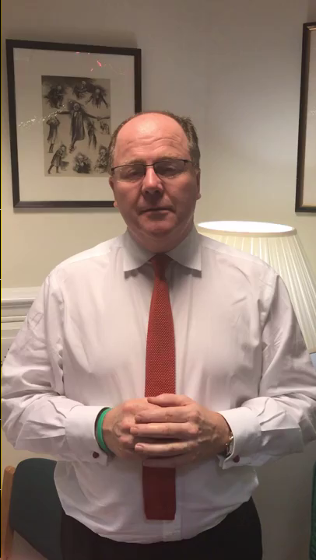
GEORGE FREEMAN MP
THE MAN WHO PUTS THE BRECKS
INTO BREXIT
CKSIT

Slide 4


NEIGHBOURHOOD PLAN UPDATE
IN AUGUST WE TOLD YOU WHAT WE PLANNED TO DO NEXT:
New grant to fund a village character study: ✓☺ September
Technical support pack for site assessments: ✓☺ November
Participate in additional Local Plan hearings: ✓☺ September
Have a biodiversity map of the parish prepared: Ongoing
Have a village character assessment done: Ongoing
Have a village design guide produced: Ongoing
Site allocations – call for sites: ✓☺ Aug-Oct
History of the village’s development ✓☺ September
Guidelines for reviewing planning applications ✓☺ August
Review of planning applications: ✓☺ Ongoing
Meetings and dialogue with Breckland Council: ✓☺ Ongoing
Reflect revised Planning rules (NPPF2) in the Plan: Ongoing
Repeat Reg. 14 consultation: Not due yet - pending new work

Slide 5
SITE ALLOCATIONS – WHY WE’RE DOING THIS
Certainty
The Local Plan is non-specific about where homes can be built
Decision making vagaries
Sustainability
Sites tested objectively
Robust & meaningful assessments
Control
Protection
NP will set total number of houses
NP policies with site specific criteria
Saham Toney will be subject to a 3 year housing land supply rule instead of the current 5 year rule
NP will phase development
The RIGHT homes
In the RIGHT places
At the RIGHT time

Slide 6


SITE ALLOCATIONS PROCESS
1. Sites PROPOSED
2. Sites ASSESSED
3. Sites SELECTED

Slide 7

SITE ALLOCATIONS – WHAT’S BEEN DONE SO FAR
We ran a call for sites from 17th August till 18th October
16 sites were put forward, all from villagers or people with village connection
We’ve met all landowners at least once to discuss their plans and ours
Formal approval for the independent assessments (by AECOM) was granted on 6th November
AECOM have confirmed the assessment criteria they will use
AECOM have started their assessments and expect to finish by 27 March 2019
In parallel we may also ask our landscape consultant to separately assess the sites

Slide 8



SITE ALLOCATIONS – WHAT’S BEEN PROPOSED
FIRST SOME NUMBERS TO BE THINKING ABOUT…
33: Houses allocated to Saham in the draft Local Plan
48: Houses proposed in the Neighbourhood Plan March 2018
81: Houses approved by Breckland Council since 2011
149-226: Houses allocated to Saham when we were a Local Service Centre
450+: Houses built in the village between 1970 and 1995
1010: The number of houses proposed for Breckland assessment
16,630: Number of new homes required in Breckland by 2036
300,000: Number of new homes needed in England every year
16 sites with the potential for a total of…
180 – 222 new homes

Slide 9
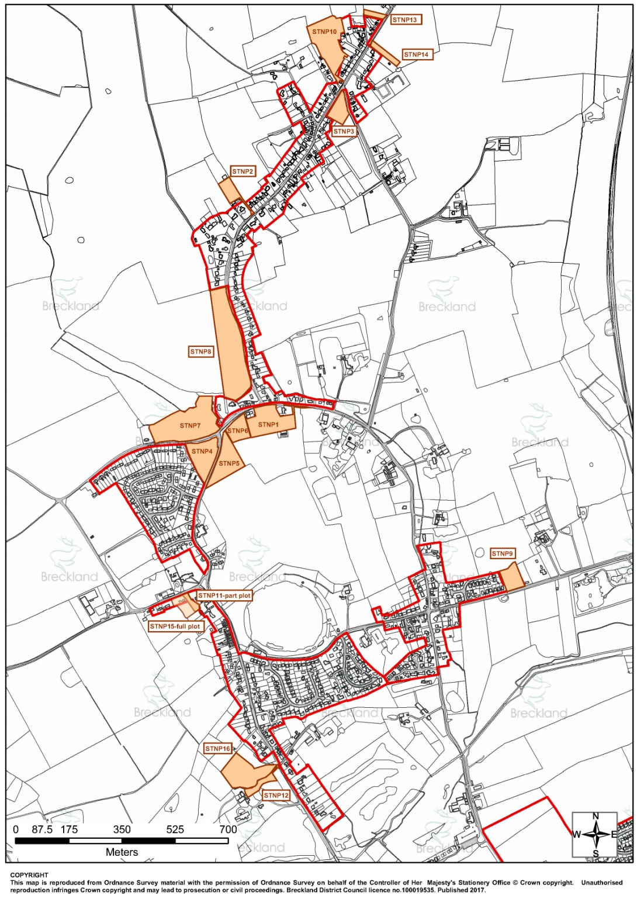

WHERE ARE THE SITES PROPOSED?

Slide 10
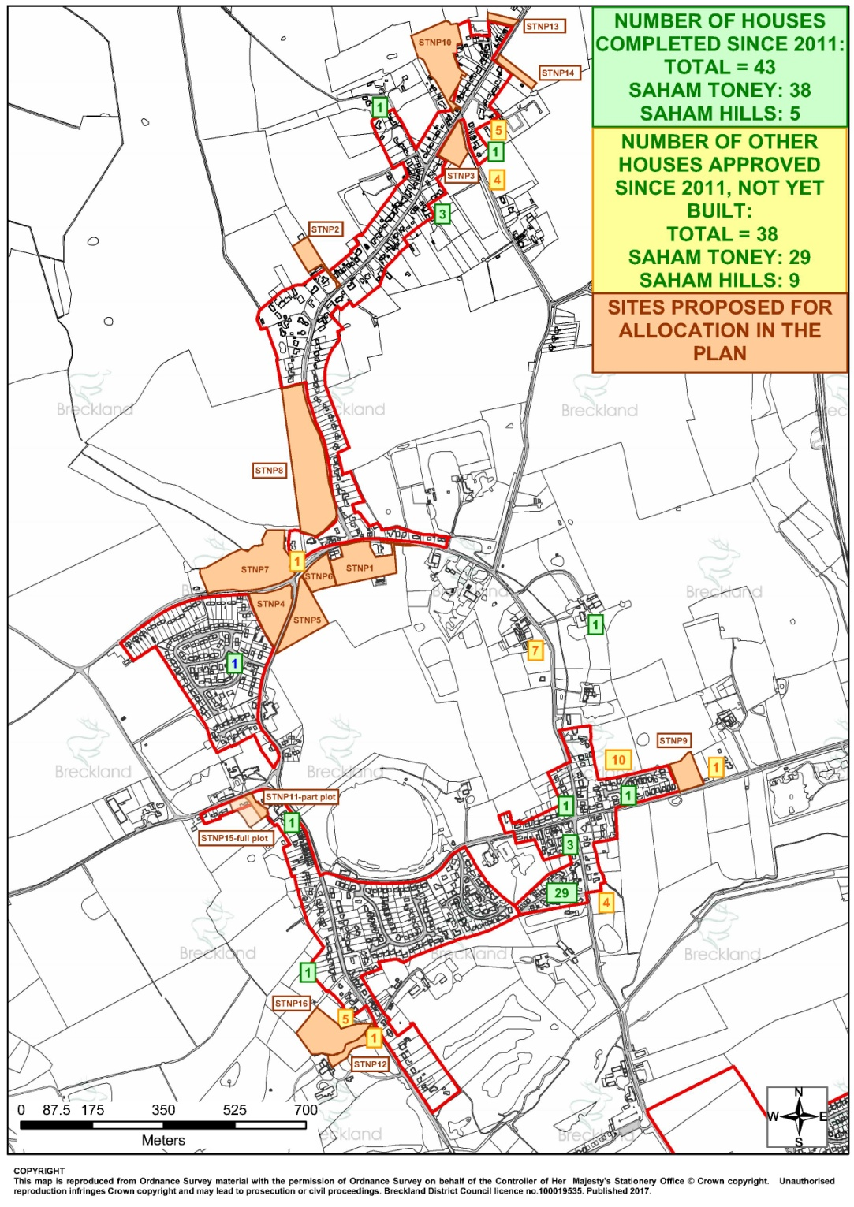
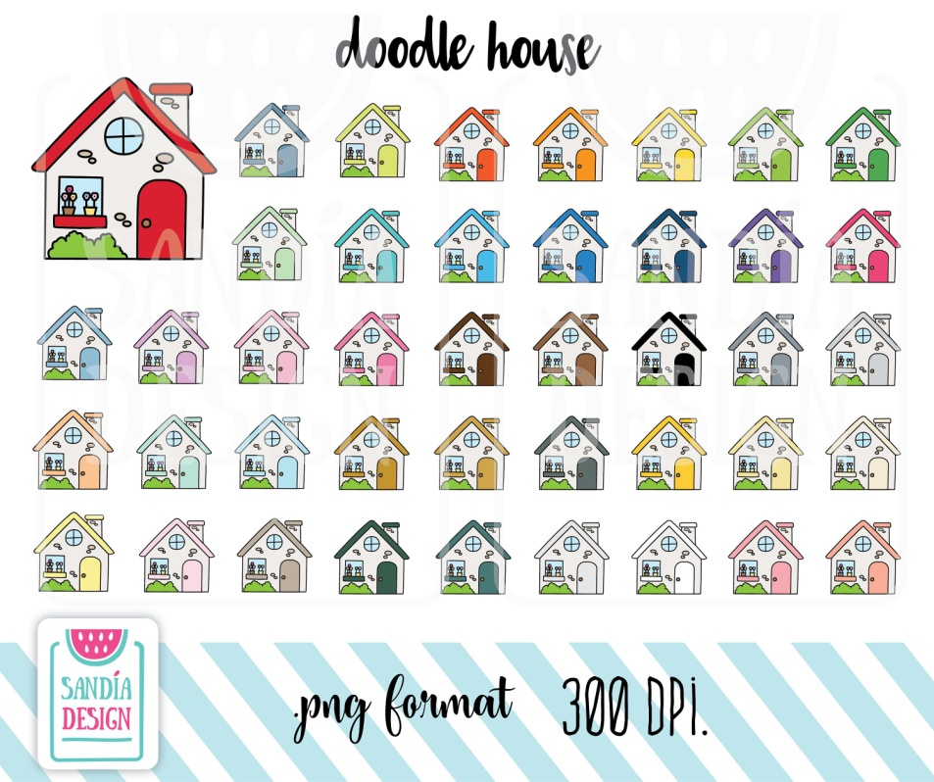



PROPOSALS IN CONTEXT: NUMBER OF NEW HOMES COMPLETED OR APPROVED
LOCAL PLAN
43
NEW HOMES BUILT
+ 38
Reg. 14 Neighbourhood Plan
Since
HOMES APPROVED

Slide 11
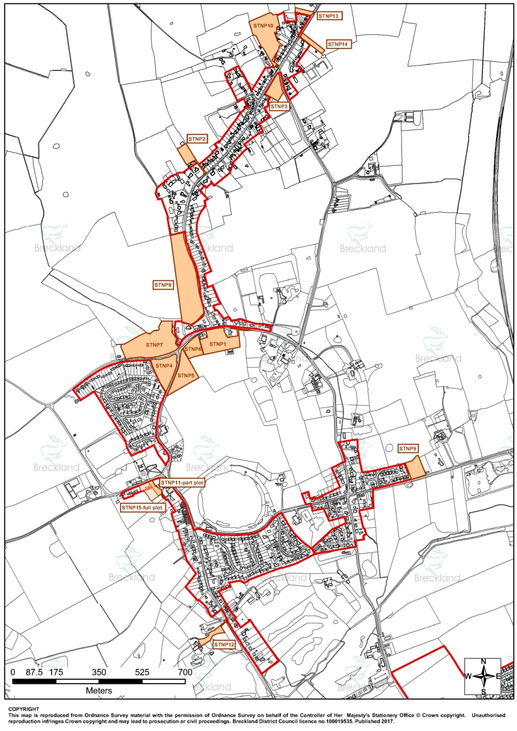
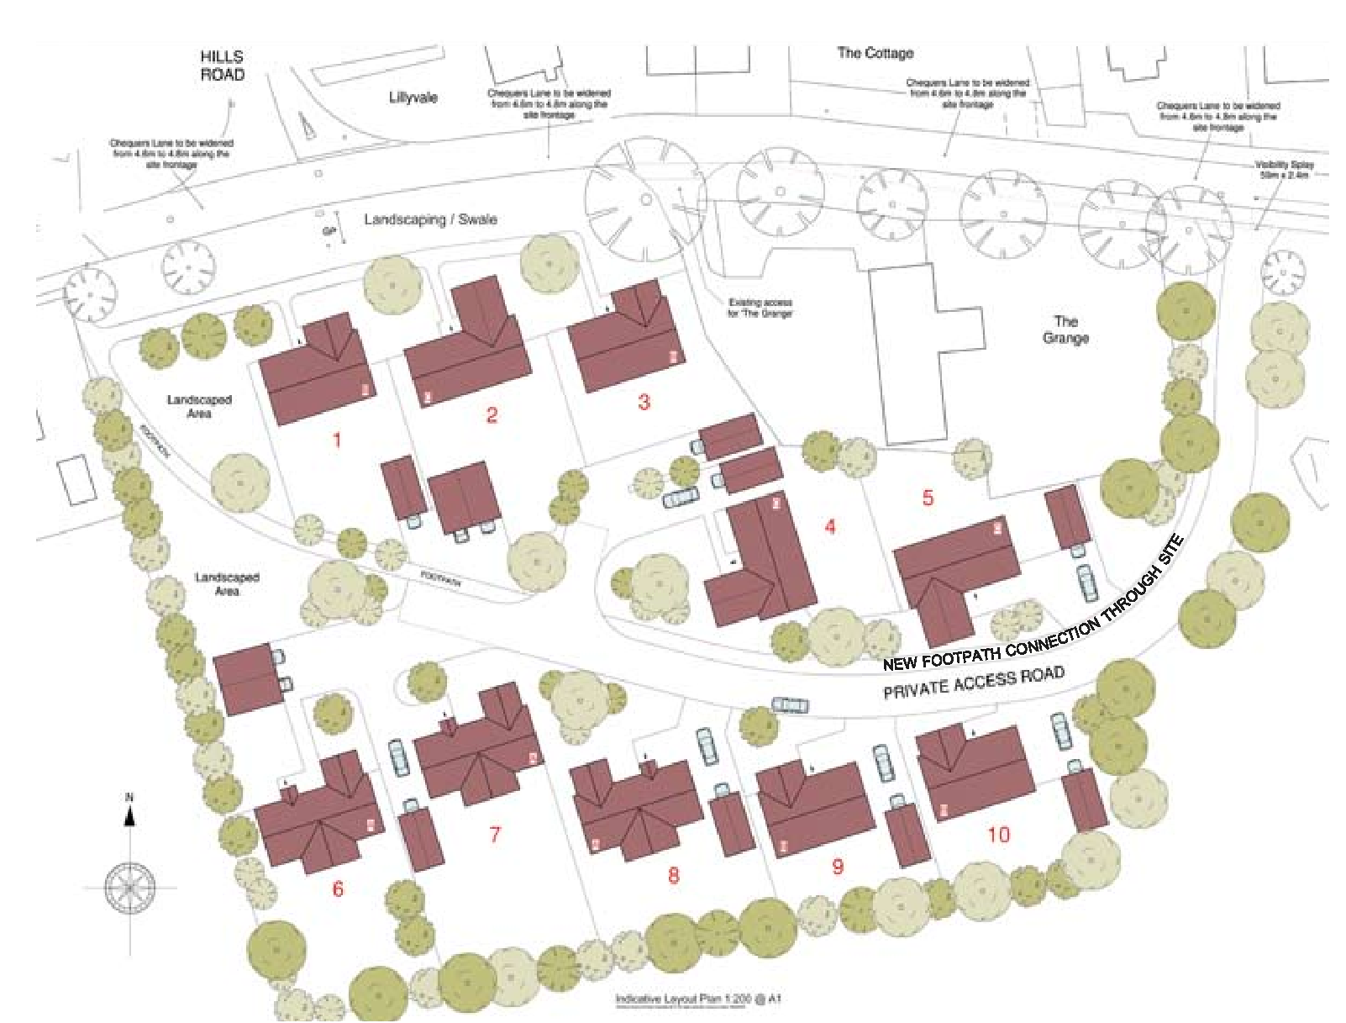
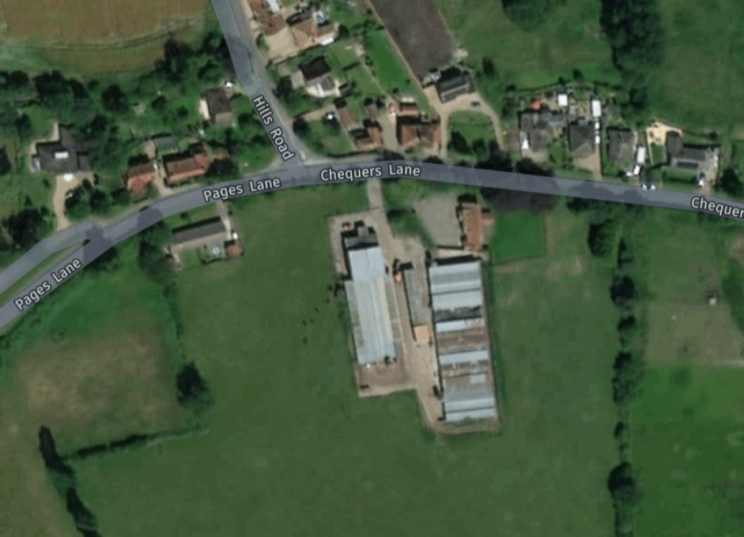
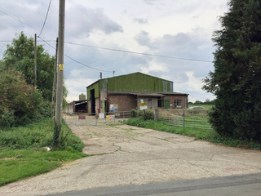


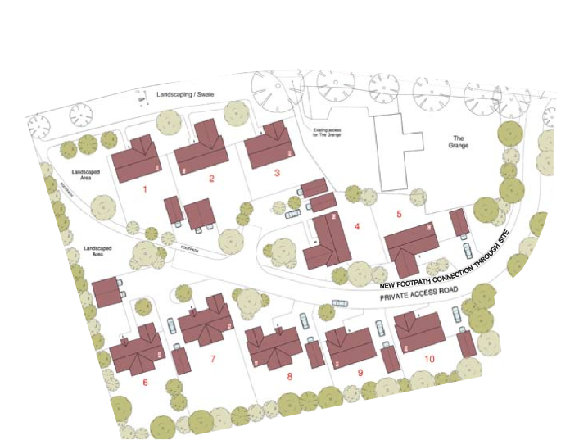

STNP1: THE PIGGERIES, CHEQUERS LANE
0.98 ha
10
3-bed bungalows

Slide 12
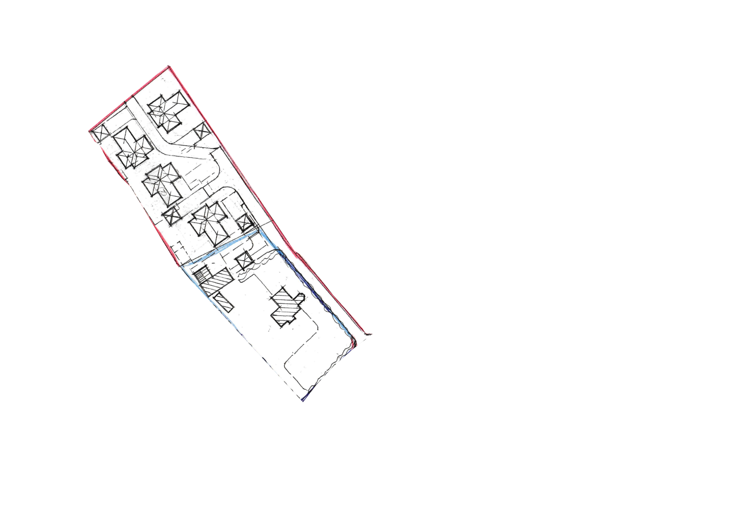
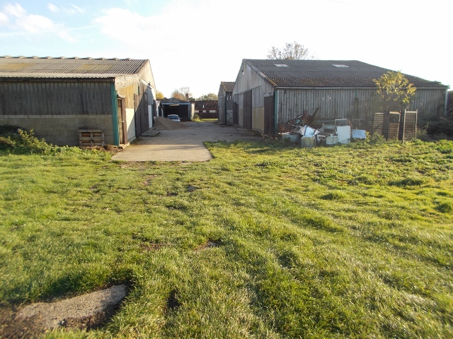
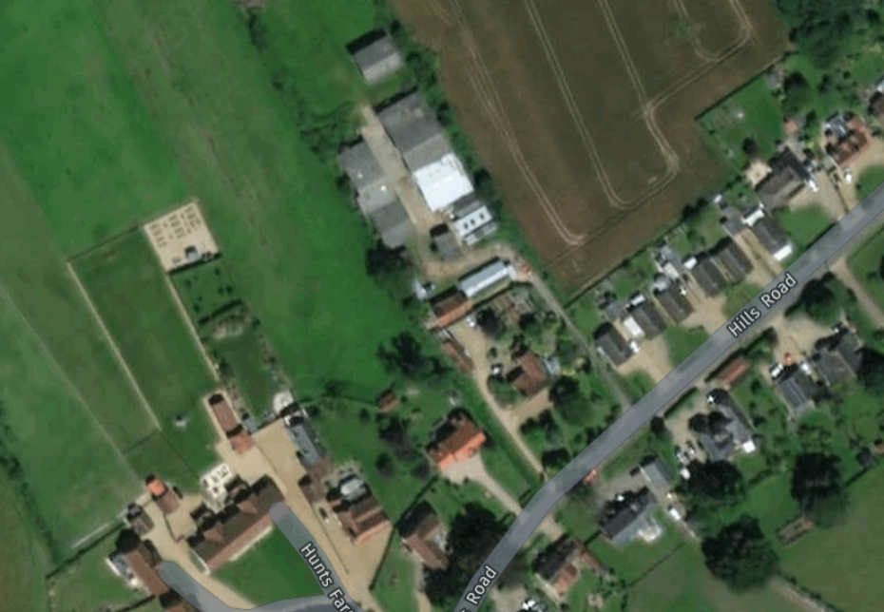
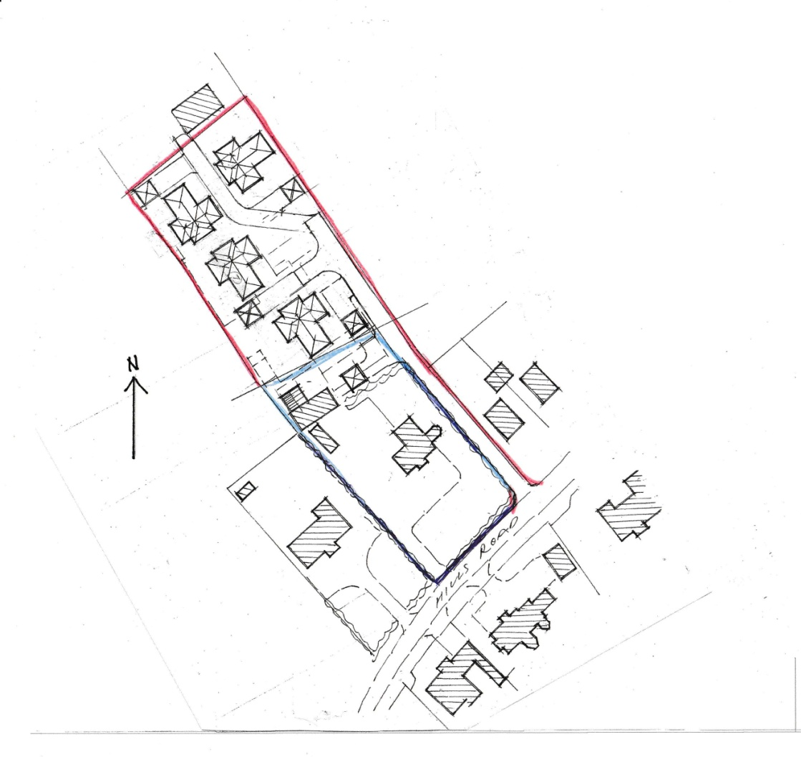
STNP2: DISUSED PIGGERY, HILLS ROAD
0.50 ha
4
3-bed bungalows

Slide 13
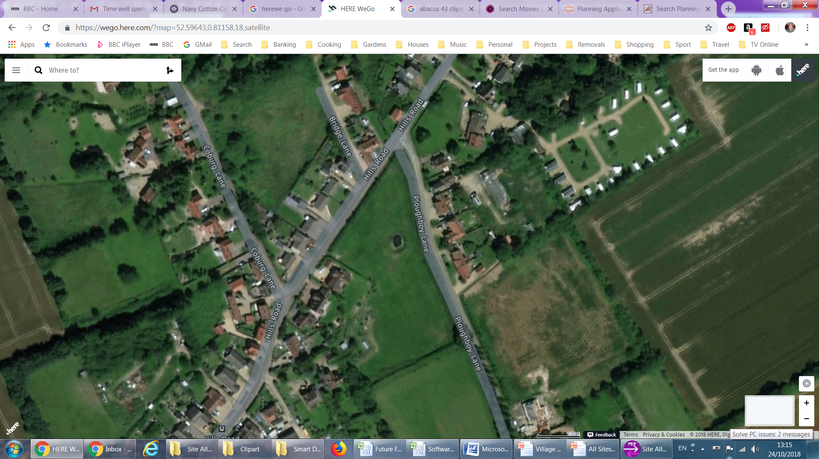
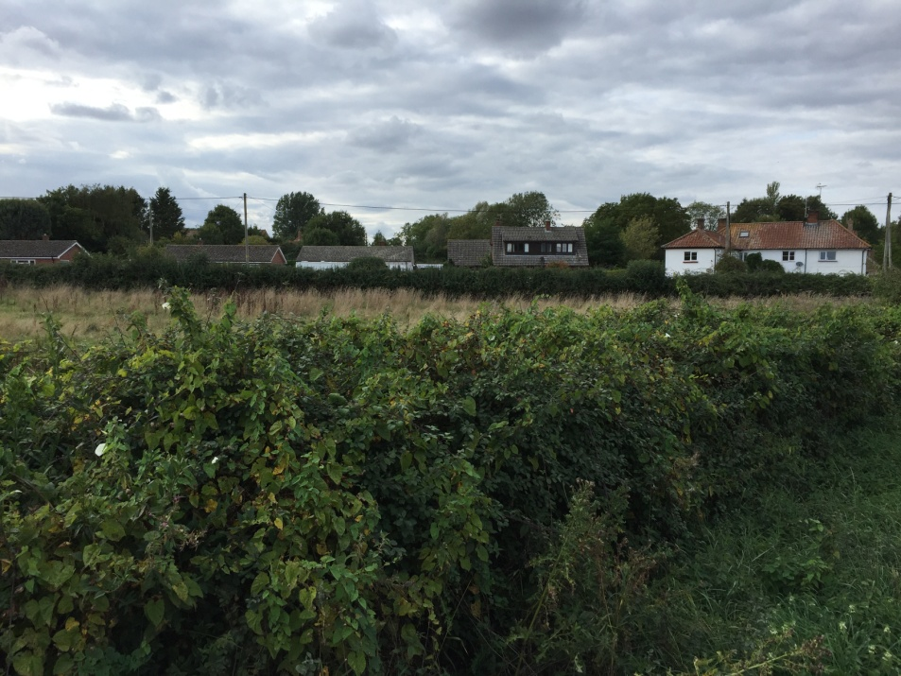
STNP3: HILLS ROAD / PLOUGHBOY LANE JCN
0.25 ha
4
3-bed homes

Slide 14
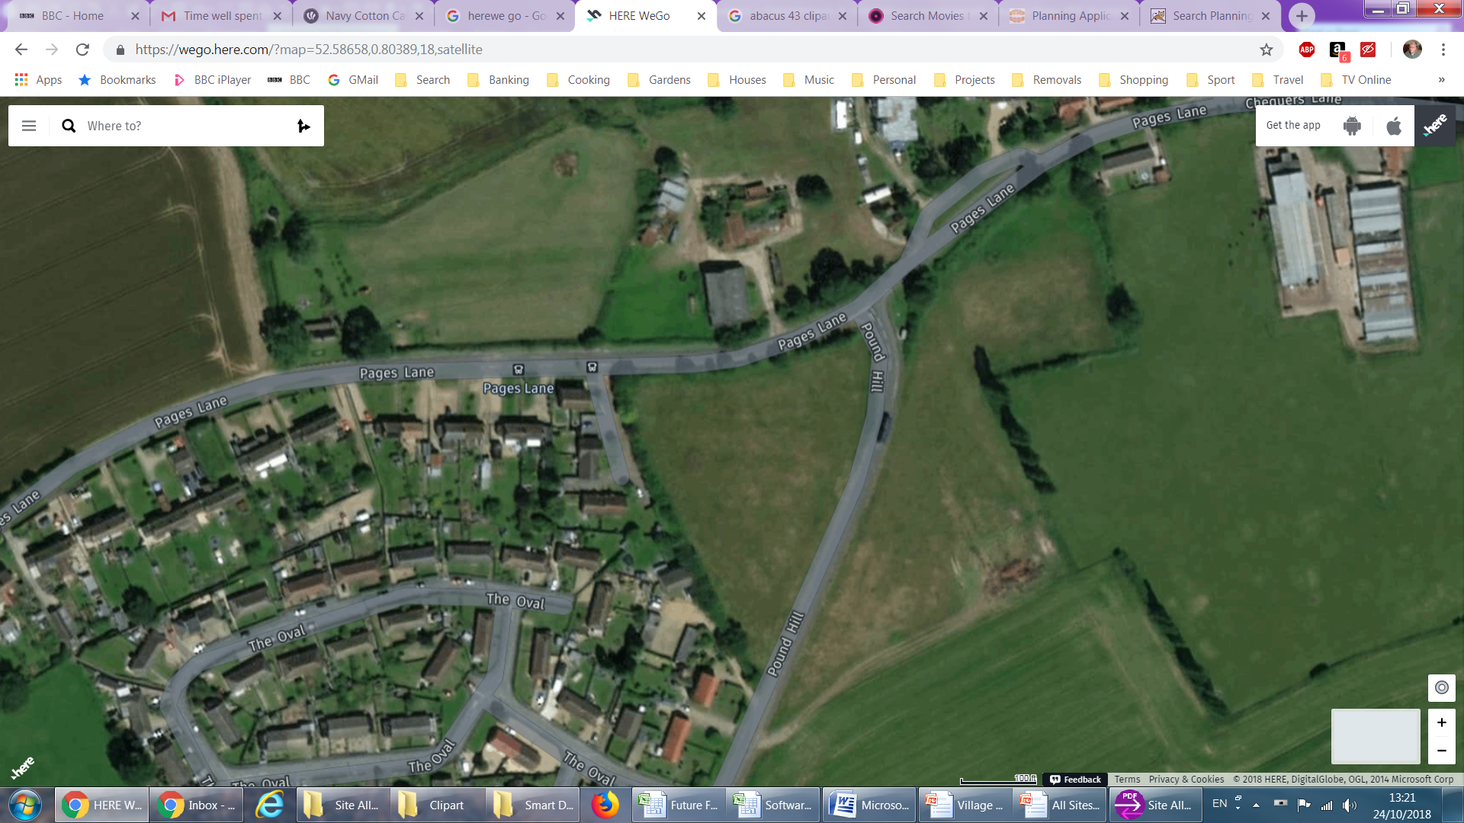
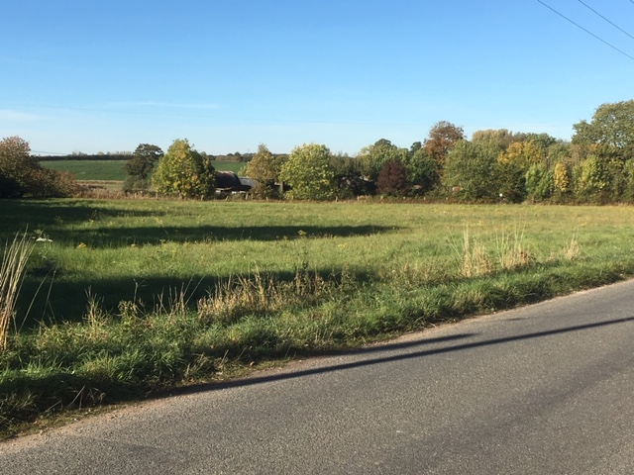
STNP4: POUND HILL / PAGE’S LANE JCN
0.813 ha
12-15
1-3 bed homes

Slide 15
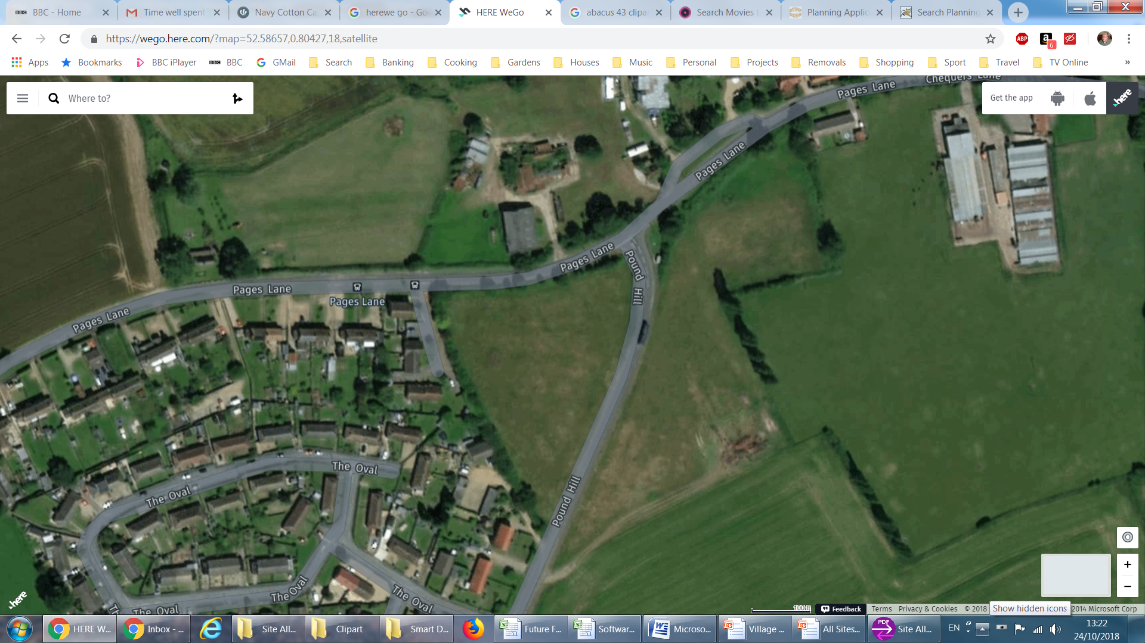
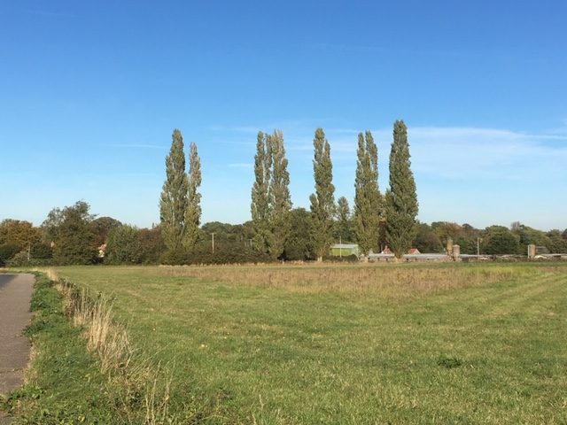
STNP5: POUND HILL EAST
1.014 ha
12-15
1-3 bed homes

Slide 16
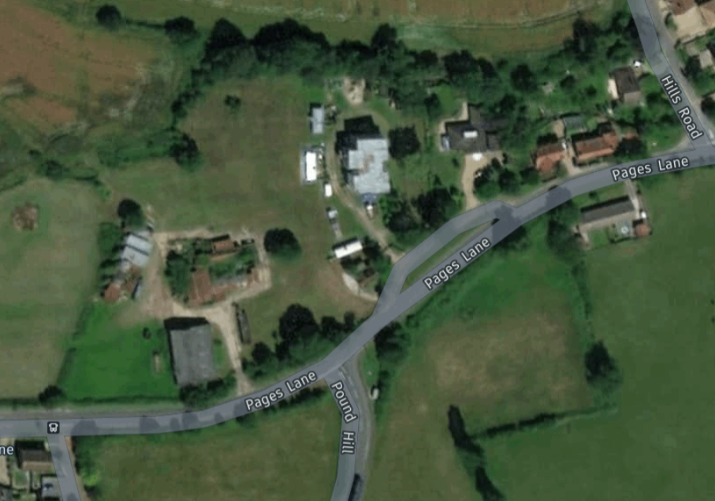
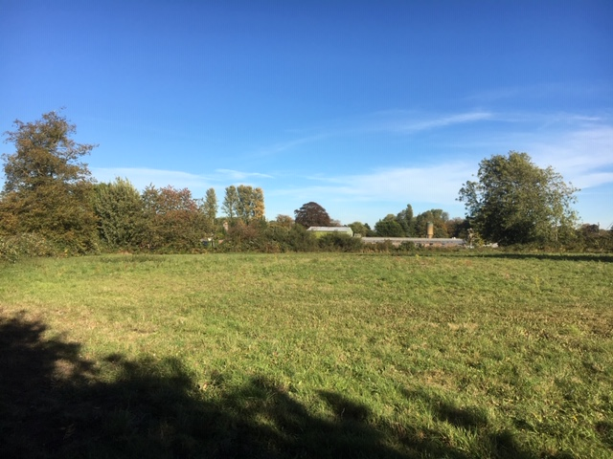
STNP6: PAGE’S LANE EAST
0.46 ha
5-6
To be decided

Slide 17
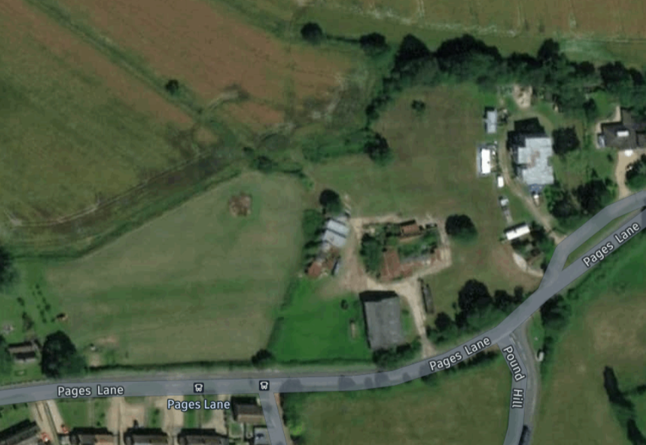
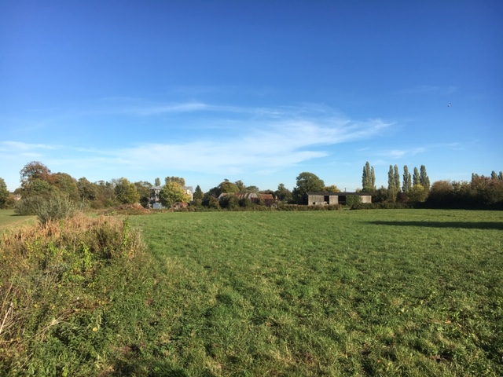
STNP7: PAGE’S LANE FARM
1.86 ha
30-35
1-4 bed homes

Slide 18
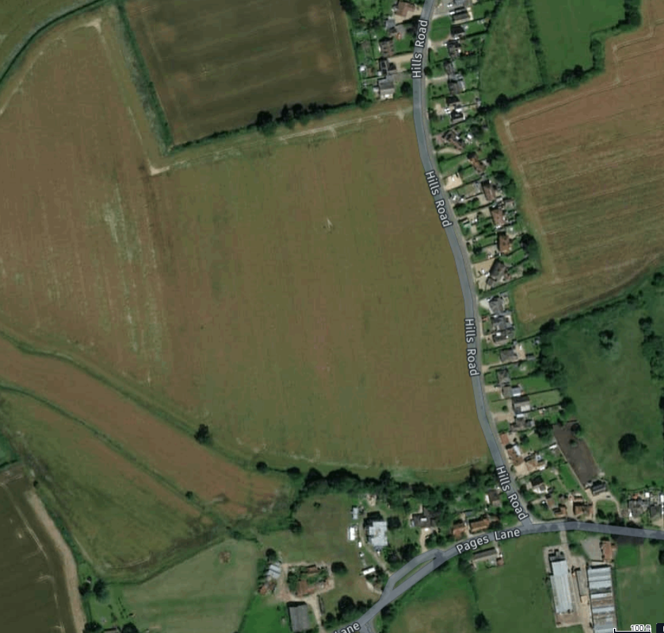
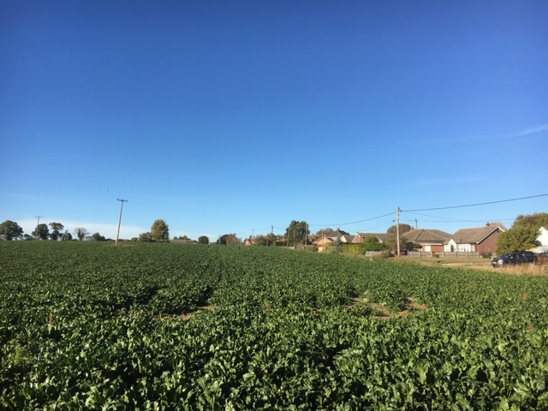
STNP8: HILL’S ROAD SOUTH-WEST
2.59 ha
40-50
1-4 bed homes

Slide 19
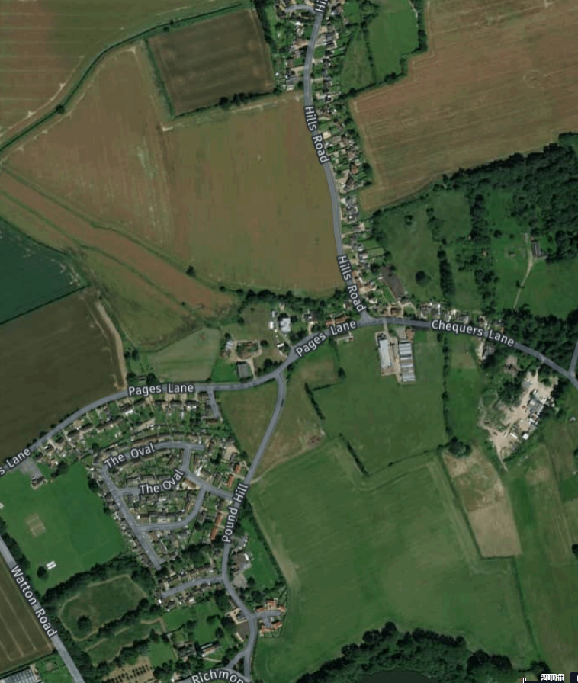
OVERALL – CENTRAL AREA
700 m diameter

Slide 20

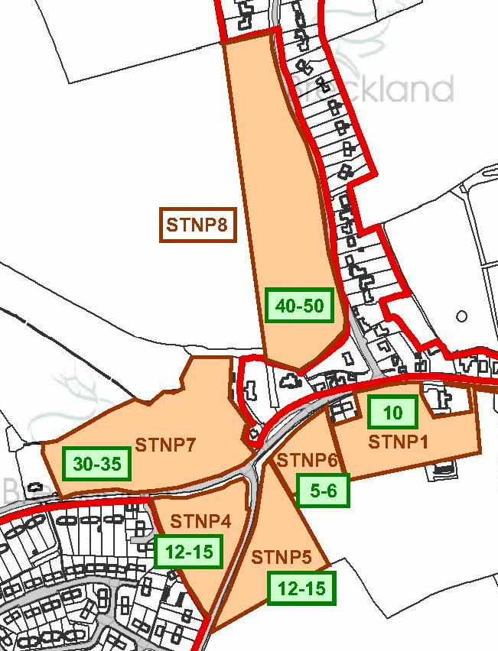
CENTRAL AREA - POTENTIAL HOUSES
109-131

Slide 21

CENTRAL AREA – THREATS & OPPORTUNITIES
INCREASED TRAFFIC
CENTRAL!
ACCESS PROBLEMS
NEW VILLAGE HUB
PRESSURE ON SERVICES
HOMES AFFORDABLE
NEW AMENITIES
LANDSCAPE CHANGED
GOOD LANDSCAPING
YEARS OF DISRUPTION
INFLUX OF YOUNG
VILLAGE THRIVES

Slide 22
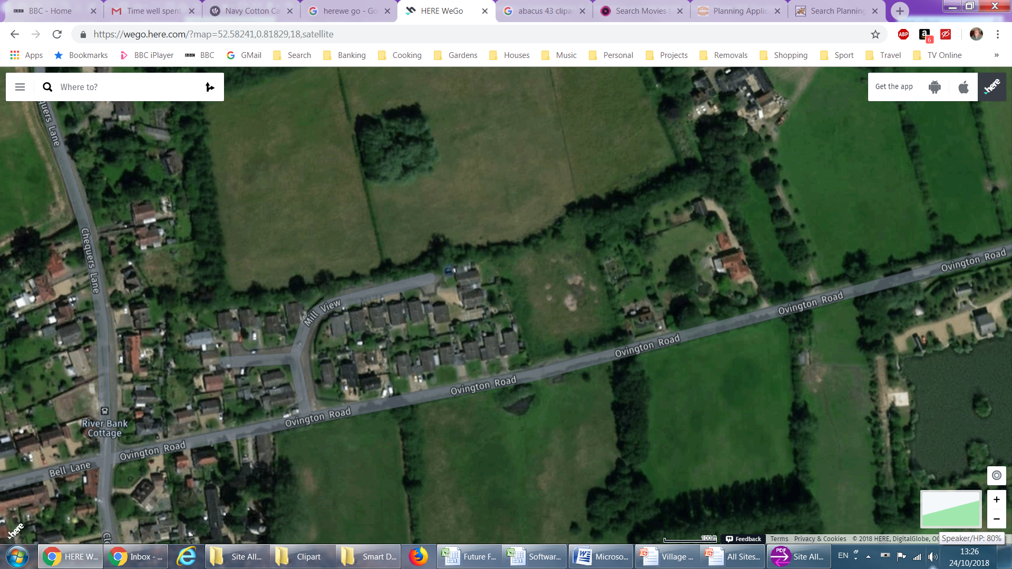
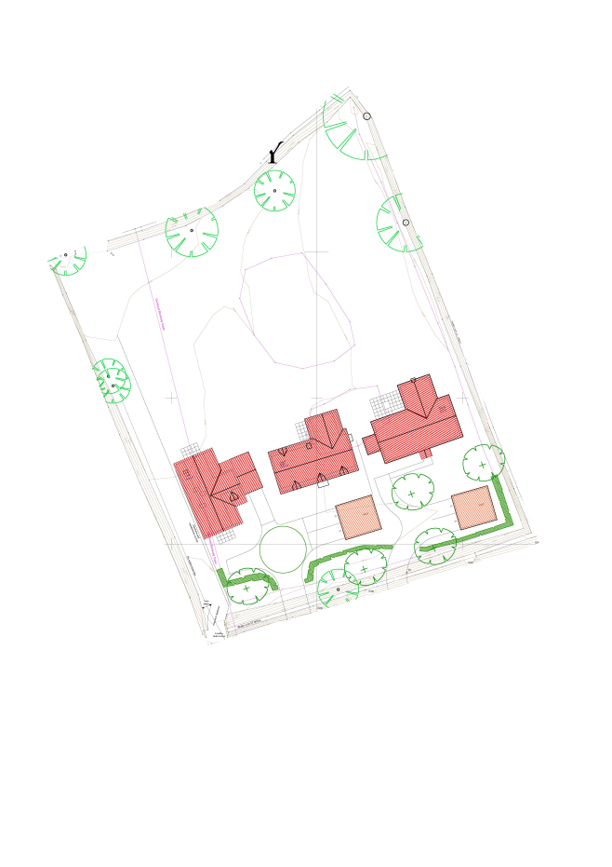
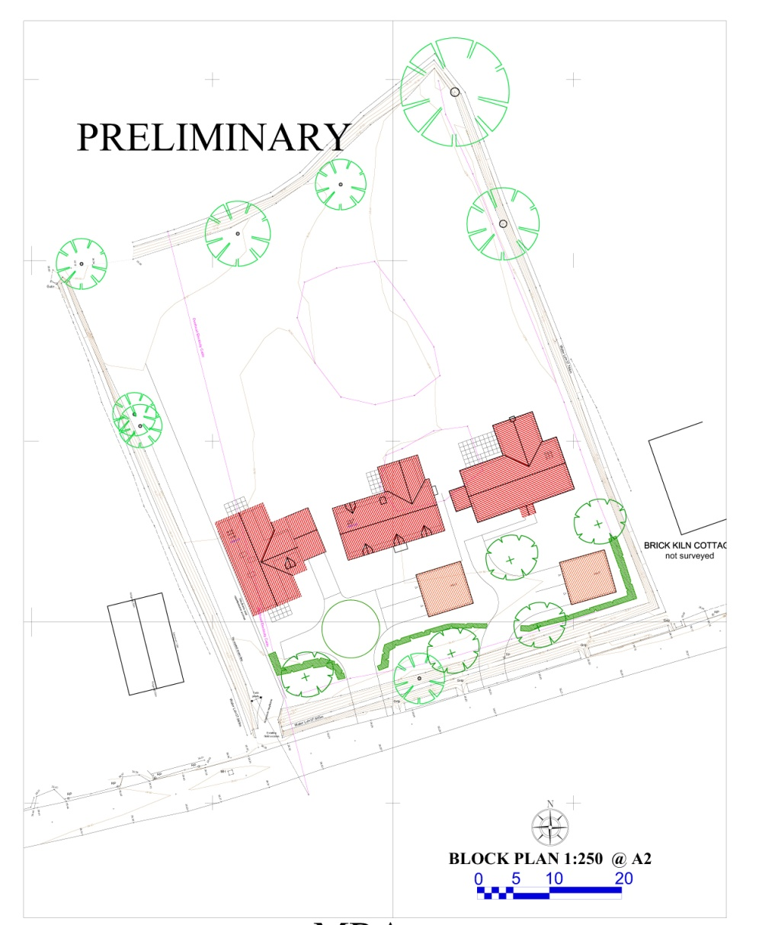
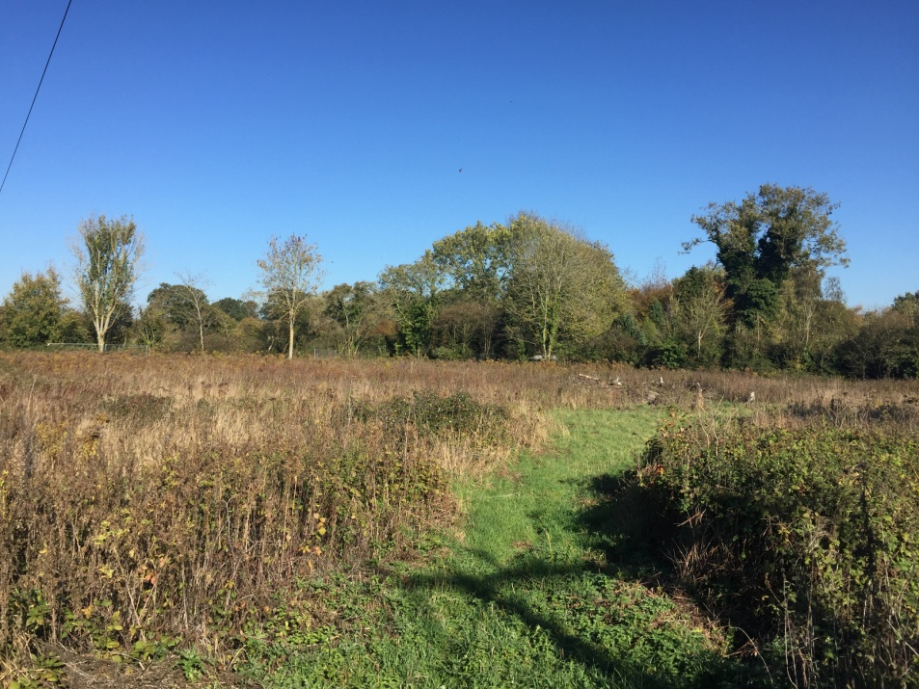
STNP9: OVINGTON ROAD
0.445 ha
3
2, 3 & 4 bed homes

Slide 23
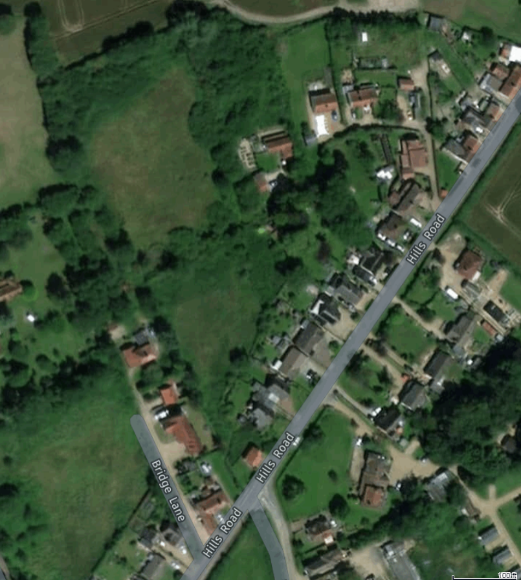
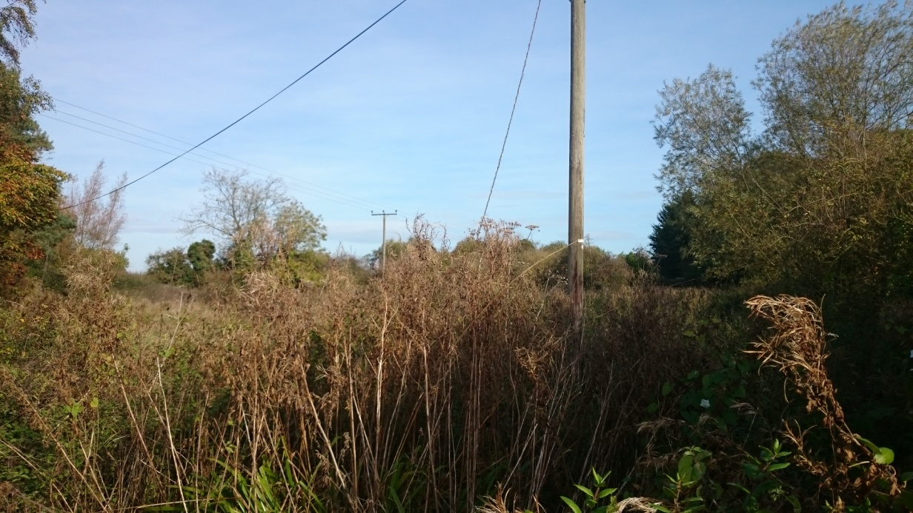
STNP10: BEHIND 129/131 HILLS ROAD
1.6 ha
20
2 & 3 bed homes

Slide 24
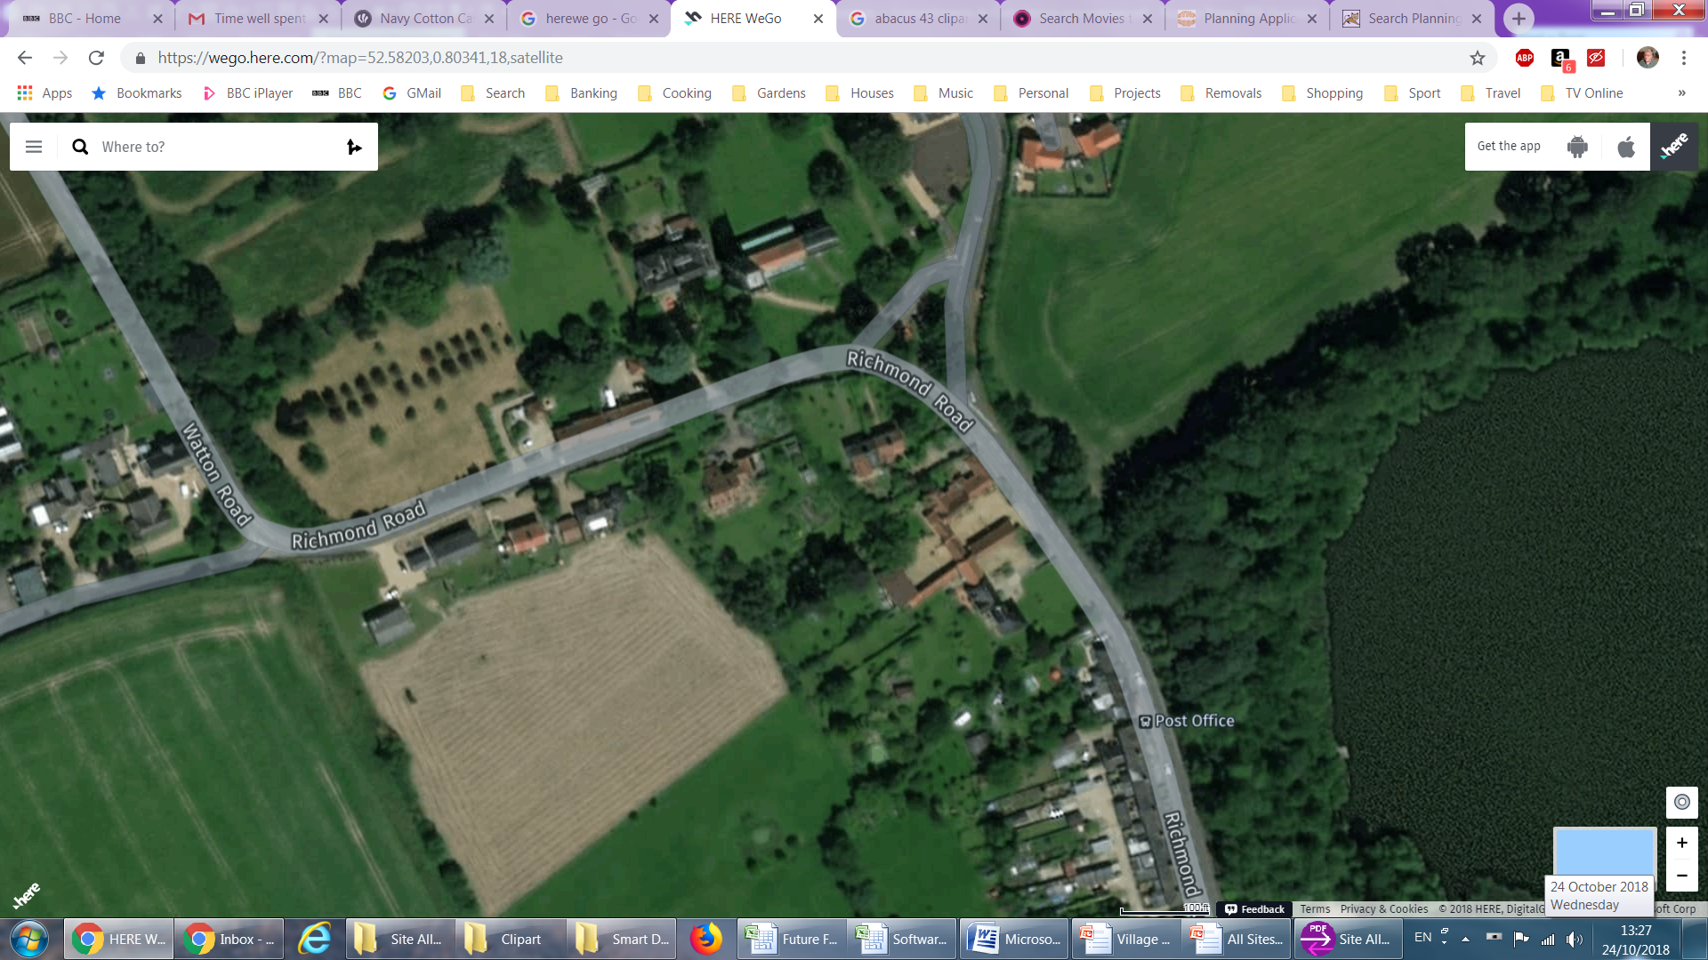
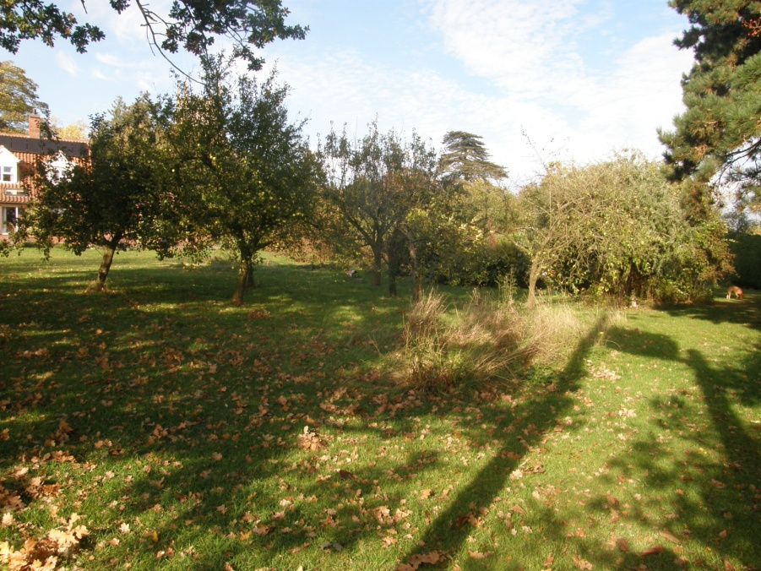
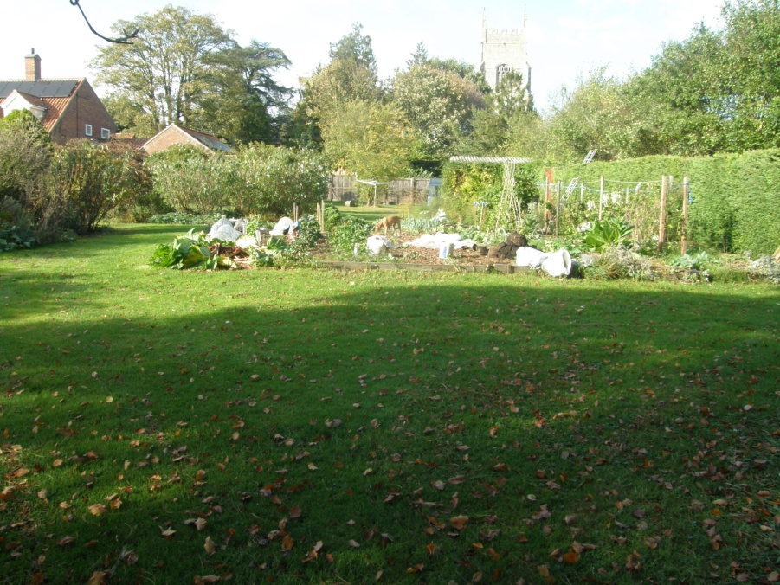
STNP11 / STNP15: RICHMOND ROAD OPTIONS
0.15 ha / 0.40 ha
2 / 4-8
3 bed / To be decided

Slide 25
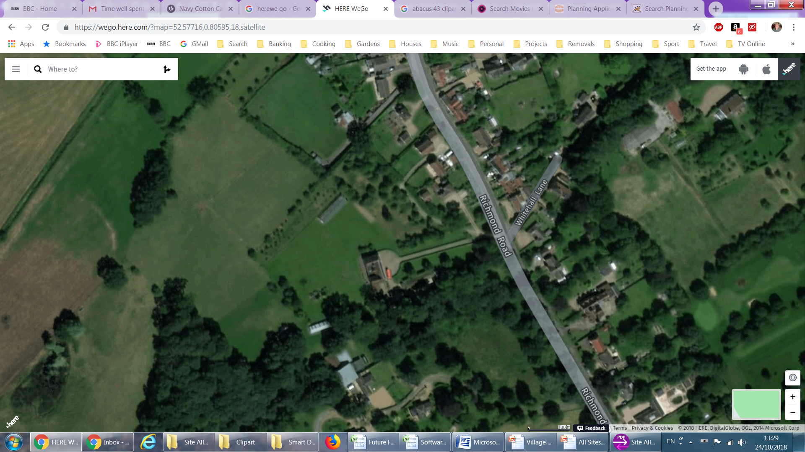
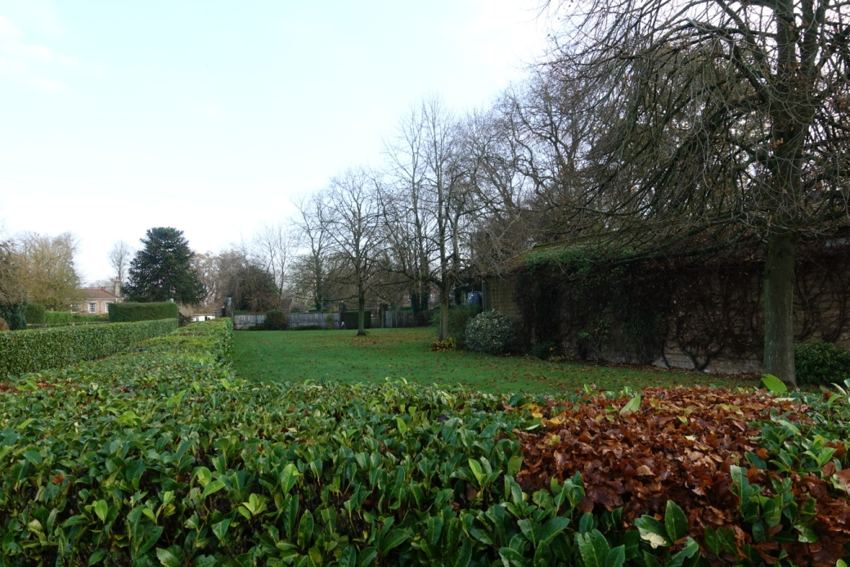
STNP12: RICHMOND HALL
0.24 ha
5
1-4 bed homes

Slide 26
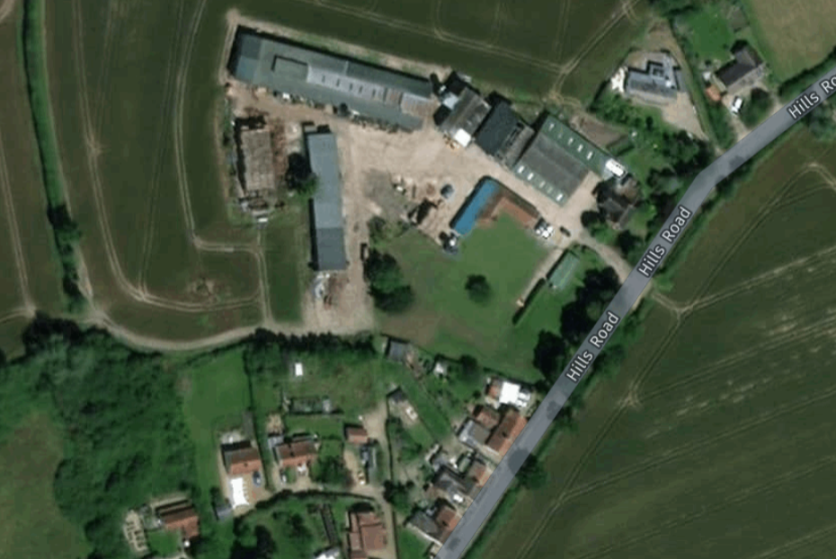
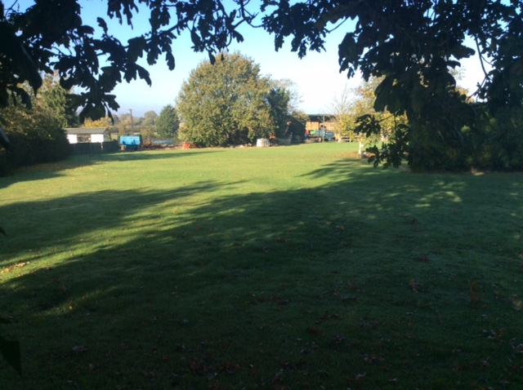
STNP13: HILL FARM
0.2 ha
4-5
To be decided

Slide 27
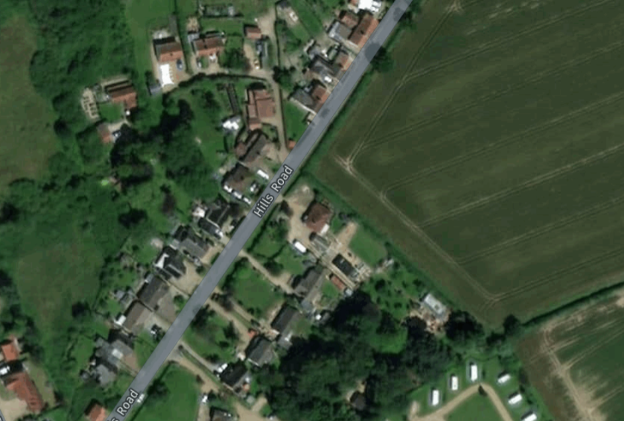
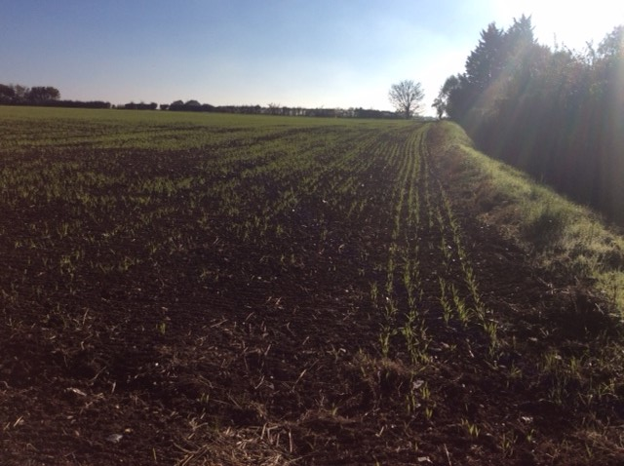
STNP14: CROFT FIELD
0.3 ha
5
To be decided

Slide 28
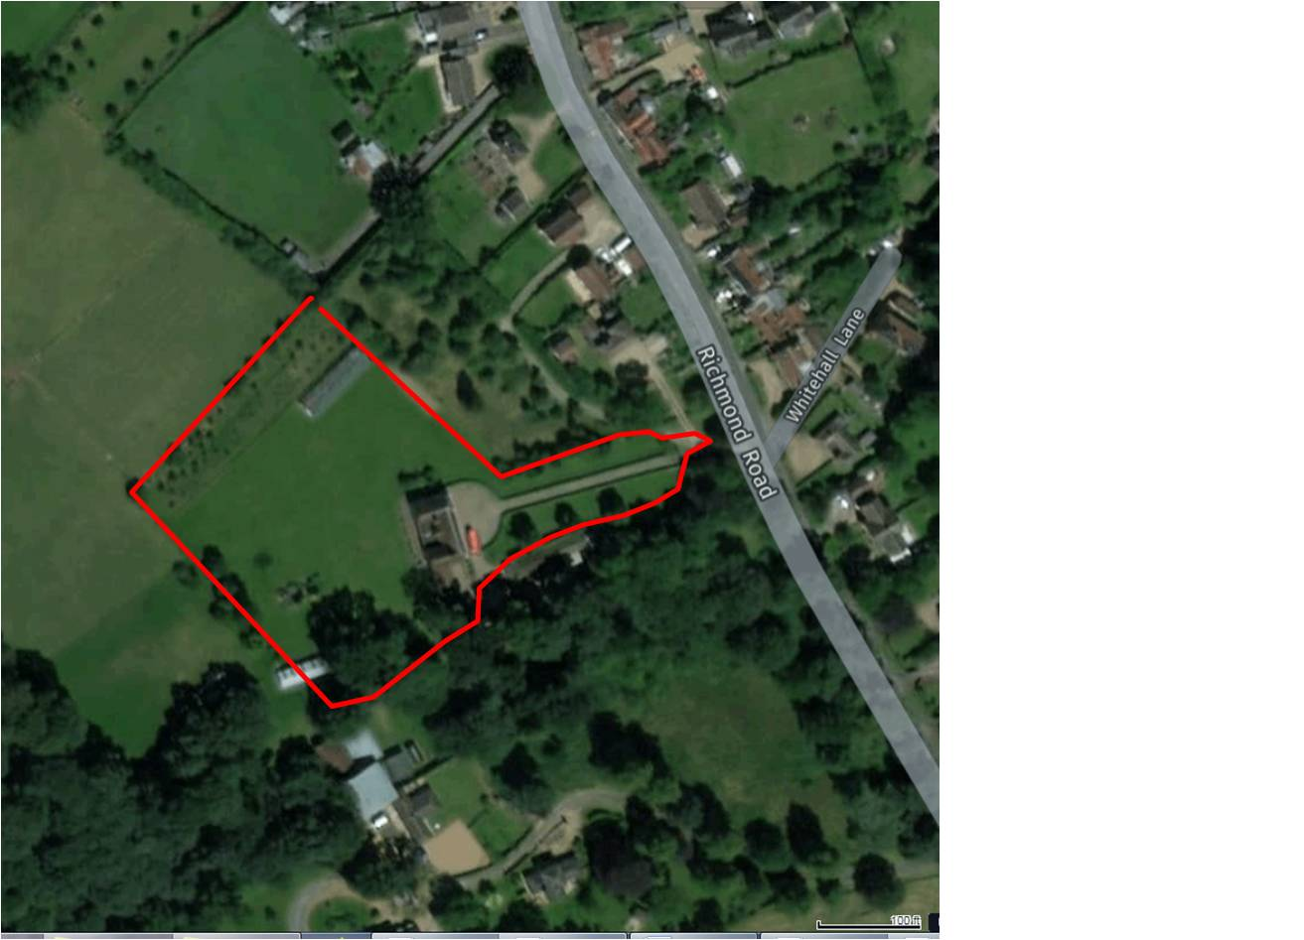

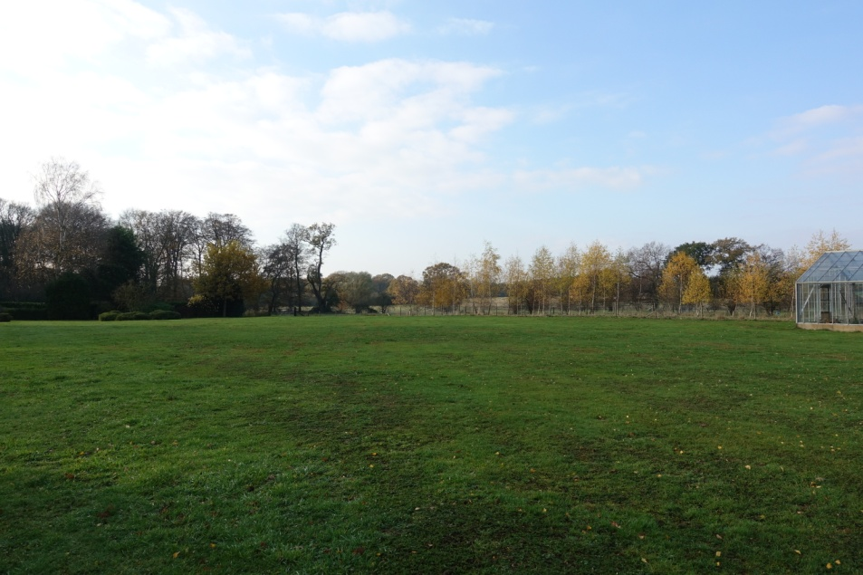
STNP16: RICHMOND HALL PLOT 2
3.48 ha
20-35
To be decided

Slide 29






COMMUNITY BENEFITS FROM ALLOCATED SITES
11+ homes: 20% “affordable”
25+ homes: on-site open space
Earlier unspecified “benefit” deleted
What’s on your wishlist?
We’ll work with owners

Slide 30
POTENTIAL DEVELOPMENT TIMESCALES
SITE ID | HOUSES PROPOSED | TIMESCALE |  | SITE ID | HOUSES PROPOSED | TIMESCALE
STNP1 | 10 | 2019-2024 |  | STNP9 | 3 | 2019-20
STNP2 | 4 | 2019-2024 |  | STNP10 | 20 | t.b.c.
STNP3 | 4 | 2019-2024 |  | STNP11 | 2 | 2025-2036
STNP4 | 12-15 | 2019-2024 |  | STNP12 | 5 | 2019-2024
STNP5 | 12-15 | 2019-2024 |  | STNP13 | 5 | 2019-2024
STNP6 | 5-6 | 2019-2024 |  | STNP14 | 5 | 2019-2024
STNP7 | 30-35 | 2019-2032 |  | STNP15 | 4-8 | 2025-2036
STNP8 | 40-50 | 2019-2036 |  | STNP16 | 20-35 | 2025-2036

Slide 31


SITE ALLOCATIONS Q&A
Any questions or comments?

Slide 32
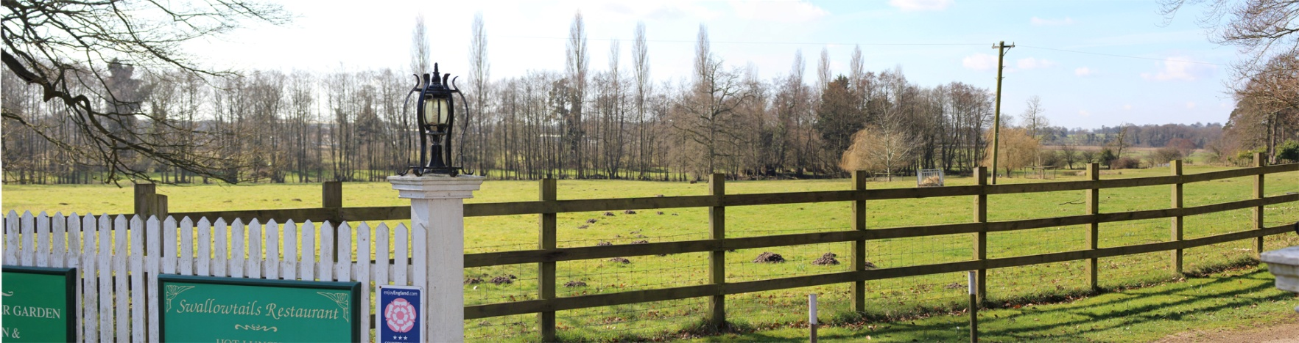
VILLAGE CHARACTER ASSESSMENT
Done by Lucy, our landscape consultant, to ensure village landscape is a key focus in the Plan
How was it done?
Two main threads – character areas and landscape sensitivity
Parish divided into 5 “rural” and 4 “settlement” areas (now 6)
Characteristics of each described
Where rural areas adjoin settlement they termed “settlement fringes”
There were initially 10 such areas – now 8
The sensitivity of each fringe area (to development) defined
Gap to Watton likely to be enlarged
Key views redefined
Village vernacular established
Design guide draft version provided
CHARACTER & SENSITIVITY WILL BE DEALT WITH BY A NEW POLICY

Slide 33
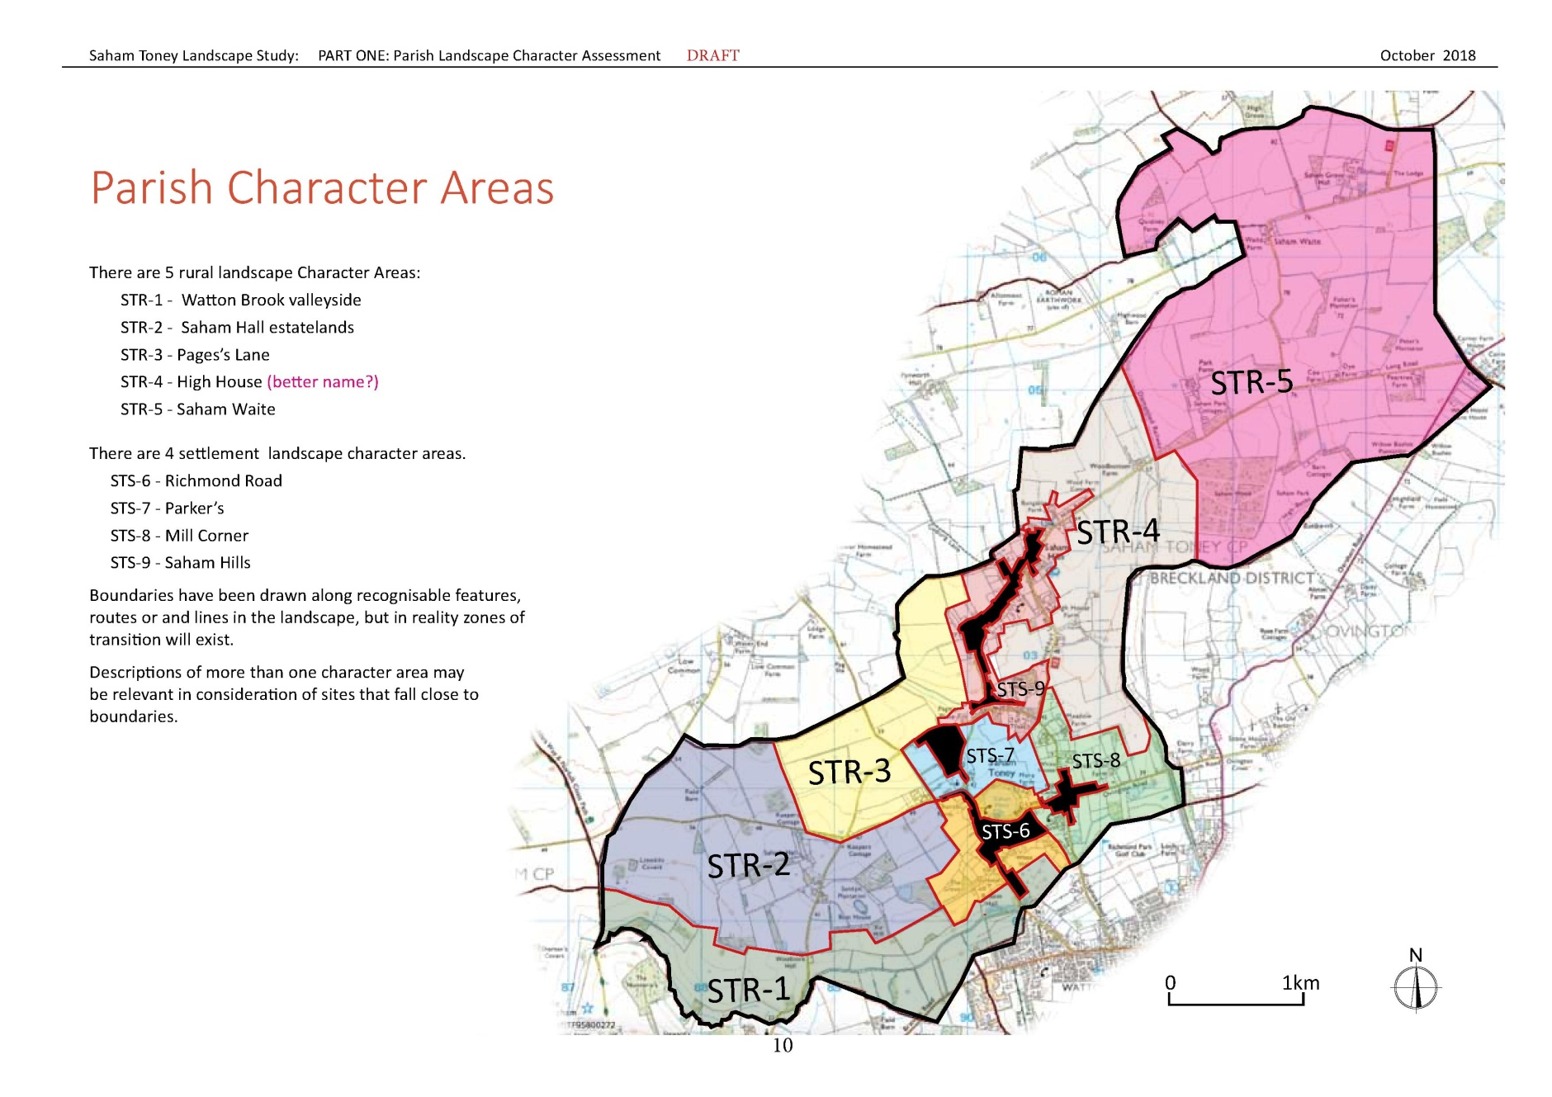
VILLAGE CHARACTER AREA MAPS: 1

Slide 34
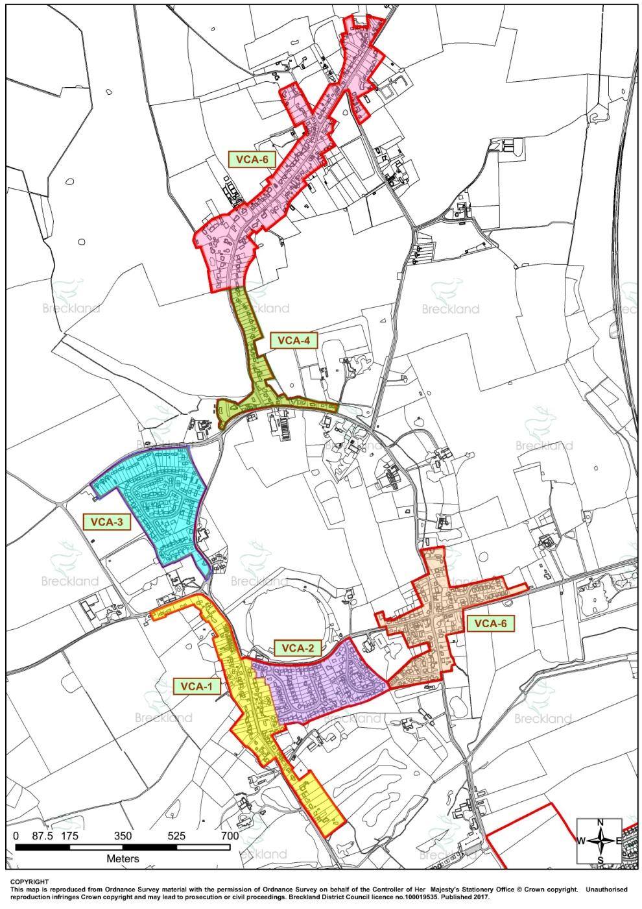
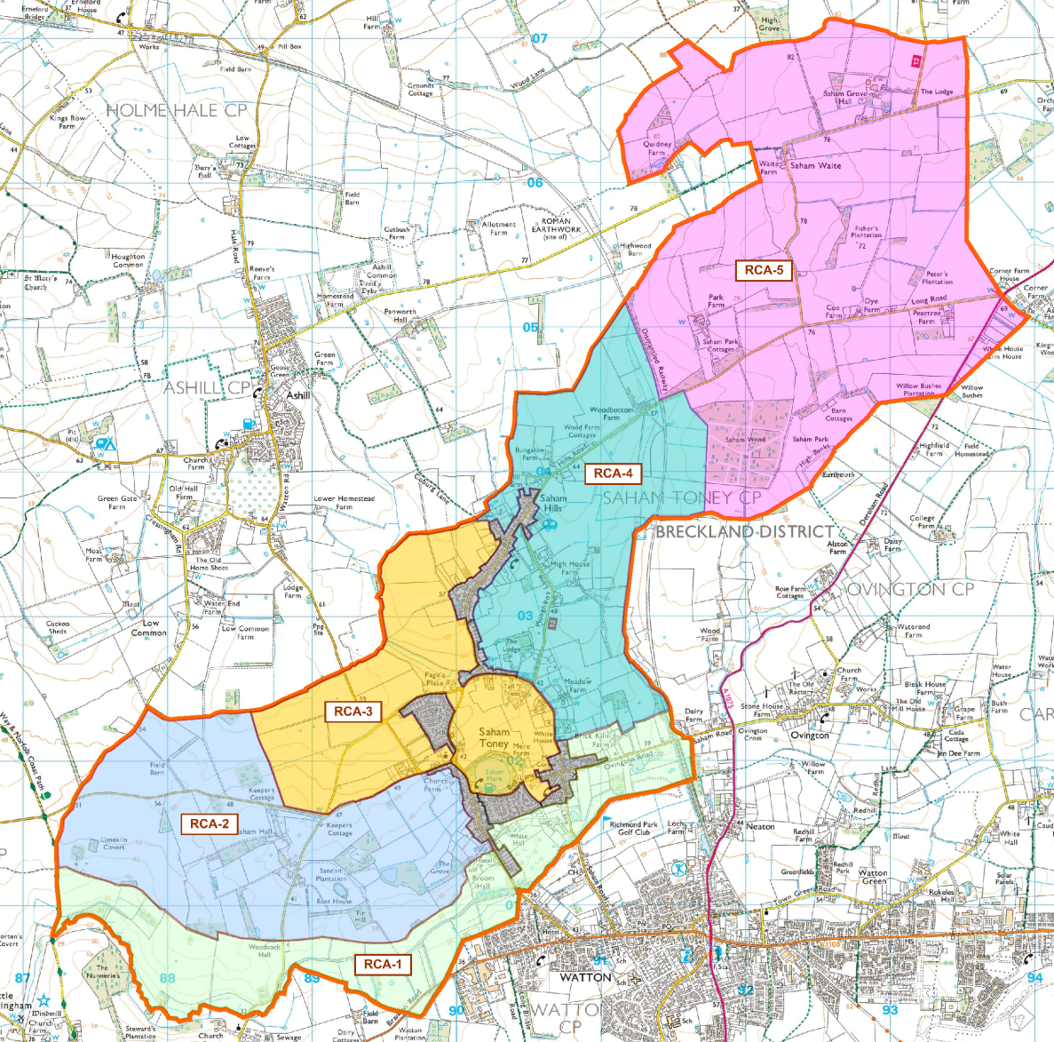
VILLAGE CHARACTER AREA MAPS: 2

Slide 35
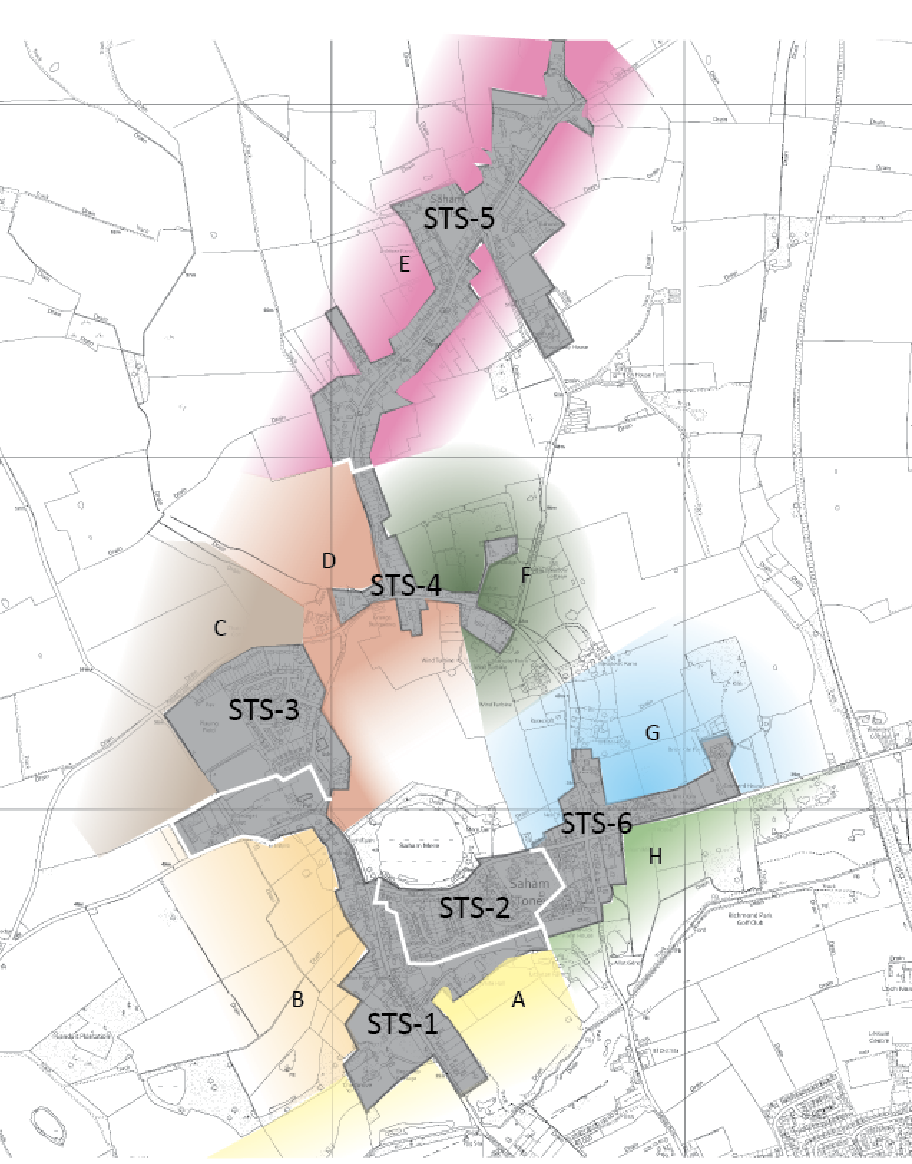
VILLAGE CHARACTER AREA MAPS: 3

Slide 36
VILLAGE AREA MAIN FEATURES
VCA-1 RICHMOND ROAD
Generally linear pattern along busy road;
Historical dwellings scattered amongst more modern infills;
Older buildings add to character;
No single style;
No public open space;
Views of church tower an important feature;
Not many distant views
VCA-2 POUND HILL & VCA-6 BELL LANE
Small 1970’s – 1990’s estates;
Views to church along Pound Hill and Mere across Bell Lane
Well assimilated over time and maintain a rural feel;
Not easily seen from the wider area;
Parker’s Close a starker landscape intrusion
VCA-3 MILL CORNER
Linear pattern in which older buildings sit side by side with more recent infills;
Hedge and tree enclosures provide a sense of intimacy;
Mill tower is a landmark but not widely seen
Ladybird Lane introduced dwellings of a larger scale, but blends well;
Quiet, rural feel;
Older cottages add character

Slide 37
VILLAGE AREA MAIN FEATURES
VCA-4 CHEQUERS
More scattered dwellings, many set back and screened from the road by trees and hedges;
Older cottages have attractive mix of red brick and flint;
Blend of housing and farmland
VCA-5 HILLS ROAD
Strongly linear pattern;
Older cottages and farmsteads scattered among more recent infill
No public open space;
Methodist Chapel notable;
Generally contained views, but they widen out at both ends of the area;
Gently rolling, elevated farmland;
Rural village feel prevails
OVERALL CHARACTER
Very much defined by extensive distribution and multi-focal pattern;
Open spaces between areas important for retaining their individual characters;
Distinctiveness strongest where the historic buildings and farmsteads remain dominant features, and where there is interaction with open space;
Preventing coalescence and further loss of the historic pattern is desirable;
Preservation of open spaces, historic buildings and their settings of primary importance;
Dictates a need for development to be managed and sympathetic
VERNACULAR MATERIALS
Traditional Norfolk combination of red brick and flint
Grey brick quoin decoration adds detail
Some ornate chimneys
Pantile roofing, often red; some black
Diluted by late 20th century development

Slide 38
RURAL AREA MAIN FEATURES
STR-1 WATTON BROOK
Low lying, gently rolling valley bottom;
Meadows for hay and grazing;
Lack of public access;
Forms a gap to Watton;
Poplar, alder and willow trees common;
Scenic, long, open views
Remote, quiet feel
Development would be inappropriate in this area
STR-2 WESTERN ESTATES
Gently sloping arable farmland;
Wooded feel from frequent woodlands;
Sense of scenic, well-managed countryside;
Very lightly scattered settlement
Quiet and tranquil;
Some long views;
Some capacity for development if it blends in
STR-3 PAGE’S MANOR
Flat or gently sloping land;
Open arable farmland dominates;
Views back to the village edge;
Relatively quiet;
Hedge-lined roads provide intimacy

Slide 39
RURAL AREA MAIN FEATURES
STR-4 PLOUGHBOY FARMLANDS
Gently sloping valley;
Pasture in lower parts, arable on higher land;
Smaller field sizes than elsewhere;
Disused rail embankment a strong feature;
Some longer views west to Hills Road;
Strong wooded horizons to the east
STR-5 SAHAM WAITE
Elevated plateau farmland;
Well-managed arable farmland;
Estate feel;
Saham Wood prominent in views south
Regular geometric feel;
Little settlement;
Scenic and tranquil;
Only permissive footpaths in the parish
SETTLEMENT FRINGES
Land where rural and settlement areas meet;
Where future development is most likely to happen;
Hence main focus for sensitivity assessment;
Looks at blocks of land of similar type – not intended to assess individual sites;
No hard boundaries; blend softly with rural areas

Slide 40
LANDSCAPE SENSITIVITY ASSESSMENT
Aims to establish how sensitive an area is to development;
Not a simple black and white issue;
Factors that indicate sensitivity and value
PHYSICAL / LANDSCAPE FACTORS
Designated features & planning policies;
Landform;
Pattern, enclosure and condition;
Settlement edges and village gateways;
Uniqueness and replaceability
VISUAL / PERCEPTUAL FACTORS
Visual prominence;
Vulnerability of views;
Groups of people experiencing change;
Tranquillity and activity
Aesthetic perception
Many of these factors are further sub-divided;
Results in a total of 31 different aspects to be considered;
For each factor guidelines indicate rating on sliding scale from low to high sensitivity;
No area scores uniquely high, moderate or low on that scale;
Need to understand relative importance of individual factors;
Professional judgement leads to an area’s rating against the two overall factors
Still trying to understand how this can be best reflected in the plan and used to assess individual sites

Slide 41
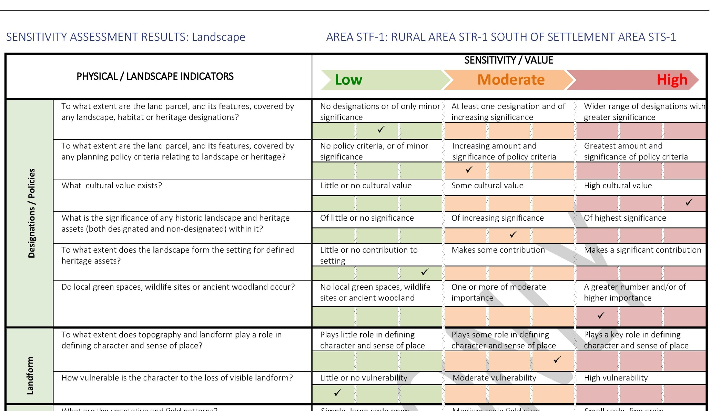
SENSITIVITY ASSESSMENT FORM

Slide 42

LANDSCAPE SENSITIVITY RESULTS
AREA | LOW | MODERATE | HIGH
STF-1
STF-2
STF-3
STF-4
STF-5
STF-6
STF-7
STF-8
STF-9
STF-10
Landscape
Visual

Slide 43
USING THE RESULTS
New landscape policy
Part of site assessments
When reviewing future planning applications
Decide mitigations for landscape impacts
STF-1: Helps justify Watton gap
STF-10: To protect view towards the Mere from Pound Hill
Meeting with Lucy and our main consultant 10th December
To help get the right homes in the right places

Slide 44


GAP TO WATTON
Lucy will recommend increasing the size of the protected gap
We’ll accept that if the evidence she gives is strong enough

Slide 45
KEY VIEWS – HOW SELECTED?
BACKGROUND
There were 11 protected views in the Reg. 14 Plan
Breckland Council said we hadn’t justified the views
Villagers suggested others
Lucy’s suggested we change the definition and criteria for key views
Asked Lucy to make a professional assessment of village views
ASSESSMENT CRITERIA
How prominent is a view and how vulnerable to change?
Number and type of people seeing a view?
Do a view’s aesthetic qualities make it notably scenic?
Does a view include a landmark in people’s “mental map” of an area?
Is it a vista people might stop to take in?
What doe it contribute to the landscape?
Is it indicative of an area’s distinctiveness?

Slide 46

KEY VIEWS - WHERE?

Slide 47





KEY VIEW PHOTOS

Slide 48




DESIGN GUIDE HIGHLIGHTS
Disappointed with Lucy’s draft report
Possible we will take the document over and complete it, but first will work with Lucy to improve it
Village vernacular is defined
Red brick and flint
Grey quoin brick detailing
Red or dark pantiles
Some ornate chimneys
Diluted by 20th century development
Important as it will be an annexe to the Plan

Slide 49
VILLAGE CHARACTER Q&A
Any questions or comments?

Slide 50


WHAT’S COMING NEXT?
AECOM will complete site assessments + landscape consultant may also review sites
Discussions with landowners
Site allocation policies
Landscape and design policies
Other policy updates
Incorporate requirements of the new national planning rules (NPPF2) and anything new in the Local Plan
Continued dialogue with villagers & Breckland Council

Slide 51

LATEST TIMETABLE
Hope to repeat Reg. 14 consultation mid-June to early August 2019
Then perhaps 4 weeks to update things based on comments
In parallel assess final version of Local Plan (end May 2019?) for any changes
Submit final version to Breckland Council early September
Council organises another 6 week consultation till around mid-October
Independent examination by say end-December
Village referendum – perhaps a month to organise > end-January 2020
If vote is “Yes” Plan approved (Made) – perhaps another month
SO PERHAPS …. END FEBRUARY 2020
Overall 2 months slippage from what I told you in August
BUT QUALITY IS MORE IMPORTANT THAN TIMETABLE!

Slide 52
Any overall questions or comments?
stnp2036@gmail.com

Slide 53



Thanks for coming!
Merry Christmas and Happy New Year!
www.stnp2036.org

