Slide 1



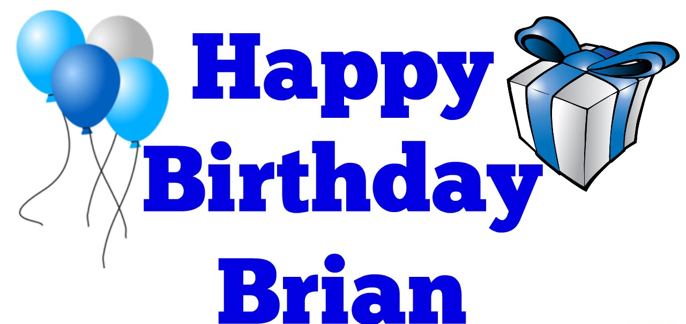
SAHAM TONEY NEIGHBOURHOOD PLAN
PRESENTATION TO VILLAGERS
14th AUGUST 2018

Slide 2






NEIGHBOURHOOD PLAN UPDATE
WHAT I’M GOING TO TELL YOU ABOUT
A: What’s happened since the consultation in March / April
Consultation responses
The health check
Consultant’s review of views
Local Plan hearings
Meeting with George Freeman
Comments on draft NPPF revision
New relations with Breckland planning
Our involvement with planning applications
B: What’s coming next
Further grant application
More Local Plan hearings
Biodiversity mapping
A village character assessment
A design guide
Site allocations
Repeat Reg. 14 consultation
Continued involvement with planning applications
Meetings with Breckland Council
Revised Planning rules (NPPF)
Further into the future

Slide 3



CONSULTATION RESPONSES - 1
Breckland Council had 77 comments:
Want unspecified start date for allocation (Policy 1)
Dislike our approach to community benefit and engagement (Policies 1, 2A & 2B)
Propose more onerous conditions for us than their own Plan (Policy 2A)
Reject most of the strategic gap to Watton (Policy 5)
Don’t accept protection of the Mere (Policy 7A)
Seek to relax the protection of communal views (Policy 7B)
7 NOT AGREED - REJECTED
34 TO BE DISCUSSED
15 WE NEED TO DO MORE WORK
21 AGREED
Read the Breckland comments in full on our website:
www.stnp2036.org

Slide 4

CONSULTATION RESPONSES - 2
How did villagers rate the Plan?
The137 responses were overwhelmingly in favour:
☺ ☺ ☺ ☺ ☺ ☺ ☺ ☺ ☺ ☹
The policies – overall 93% agreed
The protected views – overall 95% agreed
The Parish action points – overall 93% agreed
Principal objections were to the flood risk maps and some of the wildlife routes
Both will be updated
Additionally some useful individual points were submitted
See all the facts and figures and read the full responses on our website at:
www.stnp2036.org

Slide 6





CONSULTATION RESPONSES - 3
Others
Of 128 organisations and local landowners we contacted, 9 made comments:
Anglian Water supported our drainage policy;
Historic England made comments that will help us improve the heritage policy;
Both the Norfolk Wildlife Trust and the Woodland Trust supported our wildlife policy and gave some ideas to improve nature conservation;
Several Norfolk County Council specialists commented on the policies for heritage, drainage and wildlife;
The Ramblers suggested designating an official footpath off Coburg Lane;
The Norfolk Crime Prevention Officer advised us to include the police advice “Secured by Design”
Sport England provided their standard information on open spaces; and
The Bowes estate put forward a site at The Piggeries for consideration
Read the full responses on our website at:
www.stnp2036.org

Slide 7


CONSULTATION RESPONSES Q&A
Any questions or comments?

Slide 8




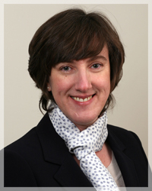
THE HEALTH CHECK
What is a health check?
Essentially it’s a dry run of the sort of formal independent examination the Plan will go through later, prior to a village referendum being allowed
Who did it for us?
We engaged a well-respected independent examiner, Ann Skippers, to review the Plan and all of its supporting documents
What were the results? Ann highlighted both strengths and weaknesses:
Issues well explained
Vision & objectives clear
Proposed consultation with PC
Community benefit approach
Policy implementation text
Housing needs assessment
Housing density approach
Heritage policy
Local green space policy
Presentation of communal views
Presentation could be improved
Restructure policies & evidence
Better justify prescriptive policies
Relationship to Local Plan
Evidence for strategic gap
Justification for communal views
Some confusion in drainage policy
Overall policy map hard to read

Slide 9
HEALTH CHECK Q&A
Any questions or comments?

Slide 10



LOCAL PLAN HEARINGS - 1
What was their purpose and how were they organised?
Plan submitted to Inspector Nov. ’17
He made initial review and posed questions
Council wrote provisional answers
Anyone could comment on those
At public hearings the examiner questioned the Council and those who applied to do so had chance to contribute to the discussions.
17 hearings took place from April to June, some of which extended to several days
How were we involved?
I participated in all the 8 hearing sessions relating to our plan – a total of 8
Others from our work group attended to listen
I was able to ask questions and make comments
During the process I made useful contacts within the Council, and with other village groups writing neighbourhood plans

Slide 11
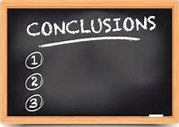

LOCAL PLAN HEARINGS - 2
What were the results?
Note: Just our interpretation at this stage
The total number of new houses in Breckland will increase somewhat
The Government’s new affordability factor will not be applied to housing allocation numbers
Saham Toney’s minimum allocation will be 32-33 new homes
The site size limit of 5 houses may be deleted
Breckland’s site allocation studies of 2014 & 2015 are no longer applicable
40% affordable housing is not viable
Heritage and ecology policies will be clarified and improved
More emphasis will be given to neighbourhood plans
Our settlement boundary will include Warwick Farm
Things we learned from informal discussions with others attending
Swanton Morley’s approach to housing for locals
Dereham Council buying up land to create a unified string or green spaces

Slide 12
LOCAL PLAN HEARINGS Q&A
Any questions or comments?

Slide 13
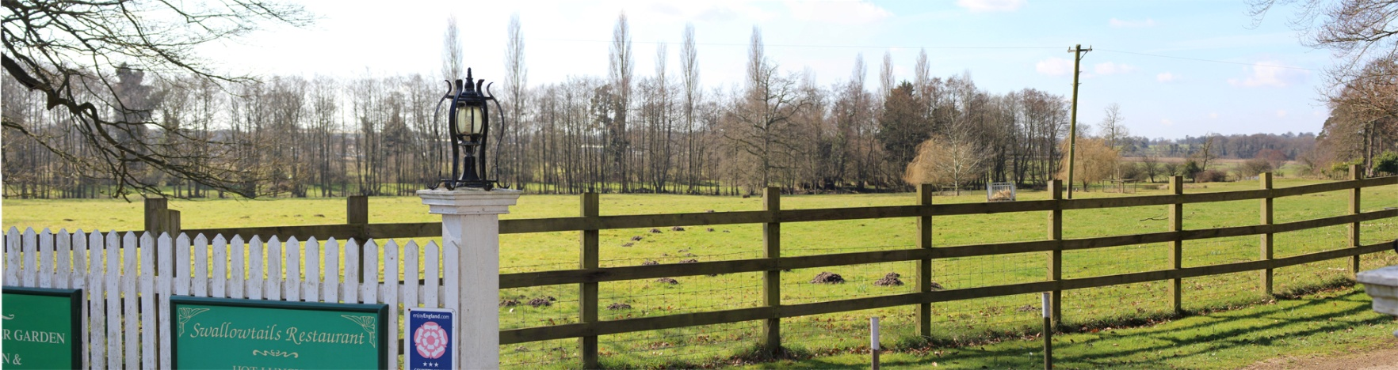
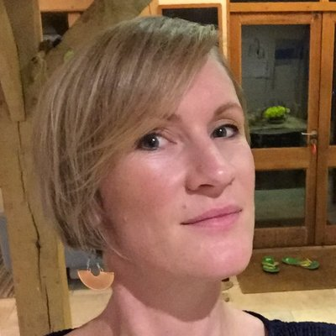


CONSULTANT’S REVIEW OF VIEWS
Why was it done and by who?
We hired a landscape architect to make a professional assessment of the public views we proposed
What did it involve?
Each viewpoint was visited and photographed, and a report was written
What were the results?
We lacked a definition of what constituted a communal – or key – view and need to expand our criteria in order to assess them properly
Landscape is too complex to assess by “tick boxes” and hence the views we’d chosen lacked evidence for their choice
Views exclusively of countryside – no buildings included
Views can change over time without being spoilt
Most important is landscape sensitivity vs capacity for development
Recommendation to widen the strategic gap in places
Recommendation to justify the gap using landscape sensitivity
Landscape is a much wider issue than just views
AS A RESULT WE WILL MAKE LANDSCAPE THE KEY FOCUS OF THE PLAN

Slide 14



PROPOSED DEFINITION OF A KEY VIEW
A Key View is one with a publicly accessible viewpoint that reflects the most distinct and unique characteristics of the Neighbourhood Area. It is memorable and appreciated, and evokes positive emotions. It encompasses an important feature of the village's settlement history and the way its landscape has been shaped by those who have lived and worked in it, and by nature. It may be said to be worthy of being illustrated in a photo, postcard or painting and as such would best represent a special element of the village's identity.

Slide 15
REVIEW OF COMMUNAL VIEWS Q&A
Any questions or comments?

Slide 16
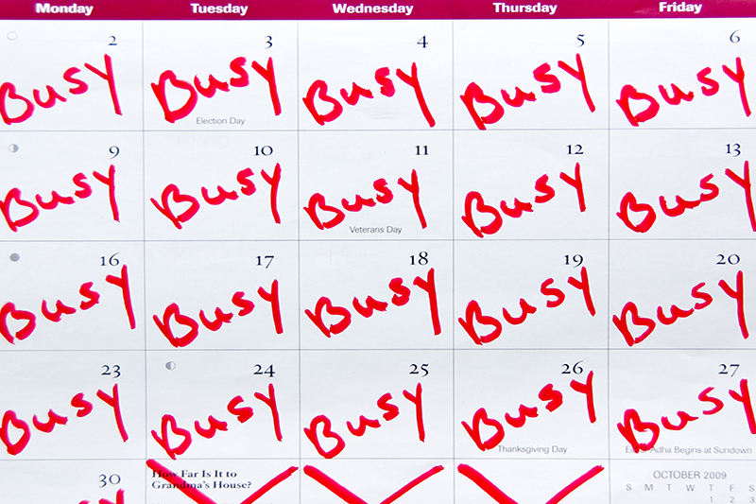
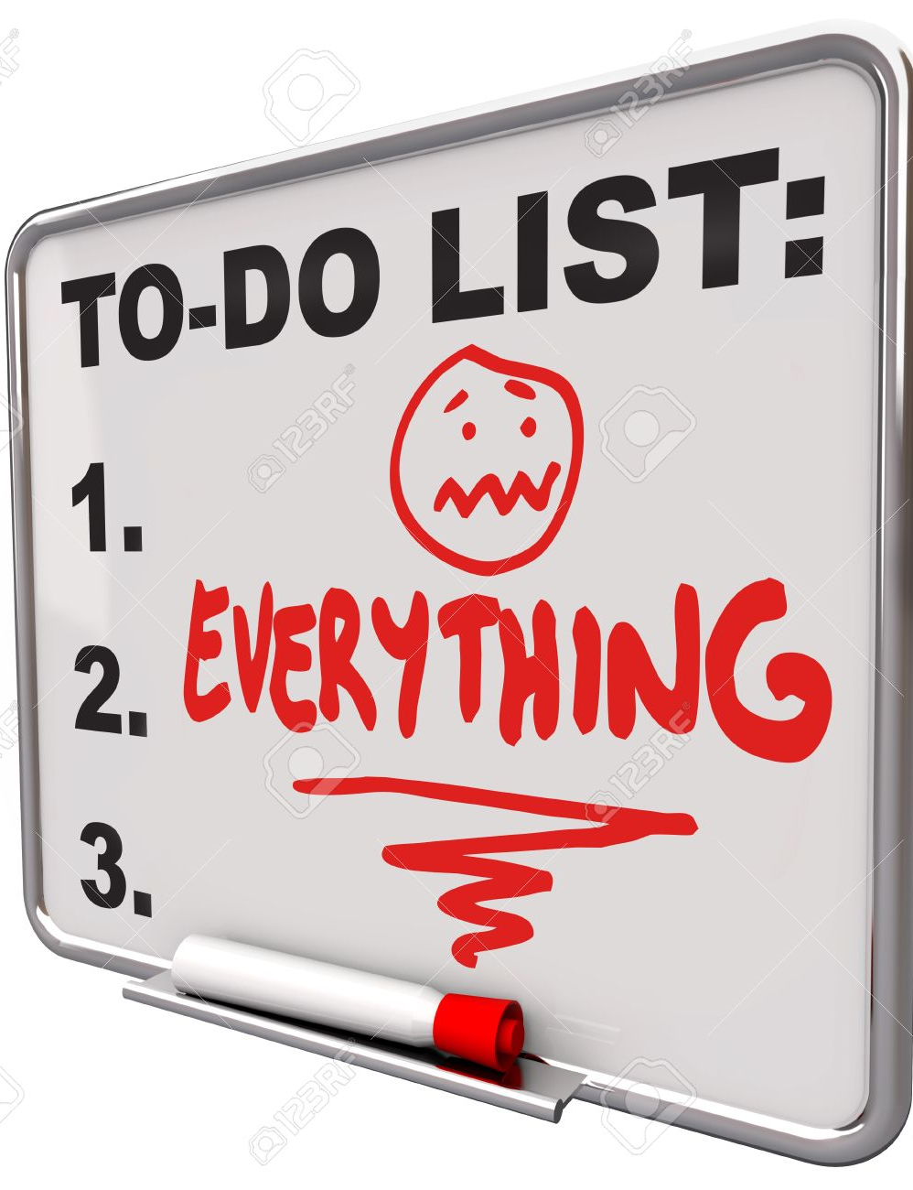


OTHER WORK & EVENTS
Meeting with George Freeman MP and parliamentary debates on neighbourhood planning
Involvement with planning applications and informal consultation with landowners
Submitted comments on the draft revision to the National Planning Policy Framework
New and improved relationship with Breckland planners

Slide 17
WORK SINCE CONSULTATION Q&A
Any questions or comments?

Slide 18
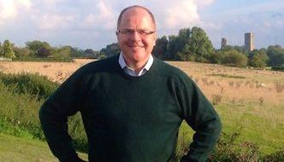

MESSAGE FROM GEORGE FREEMAN MP

Slide 19


WHAT’S COMING NEXT

Slide 20


FURTHER GRANT APPLICATION
Why is this needed and who is it from?
Reminder - we take no money from Parish Council funds.
To date we’ve had 3 grants totalling £9,000 from Locality (a Government body) and another of £4,500 from Breckland Council.
Up to end of July 2018 we have spent close to £8,000 of this, the bulk of it on consultants (review of the entire plan; health check and communal views assessments) and village events.
We estimate we need to spend close to £13,000 more to complete the Plan, including two important new pieces of work I’m going to explain shortly
(£8,000 + £13,000) > (£9,000 + £4,500) hence we need another grant
The grant will be from Locality, which was set up by the Government to support and fund neighbourhood plans

Slide 21



MORE LOCAL PLAN HEARINGS
Why are they needed and when will they be?
During the original hearings there were a number of issues the Inspector felt Breckland Council had not addressed in sufficient detail or had provided confusing information
Realising those issues could not be quickly dealt with, he gave the Council time to do additional work
That work has been made available for consultation from 16 July – 28 August
Following consultation new hearings will run from 18th to 20th September
Of the 6 sessions, 4 are of interest to us – 3 on housing and 1 on the environment, and I will participate in those

Slide 22
GRANTS & THE LOCAL PLAN Q&A
Any questions or comments?

Slide 23

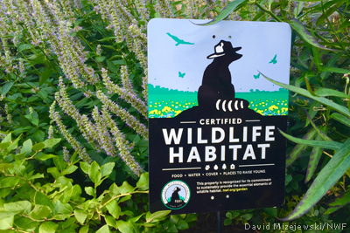

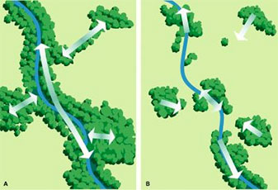
BIODIVERSITY MAPPING
Why is this needed; who will do it and when?
The current plan includes a wildlife protection policy and a map showing where various species have been sighted
A few people commented that the map was inaccurate in places, although that’s disputed
We continue to collect data – AND WELCOME MORE FROM YOU – but feel having maps made by specialists should overcome any disagreements
We have agreed with the Norfolk Biodiversity Information Service they will do this
They have an extensive database of information
They are currently completing wildlife mapping for the whole of Norfolk
By waiting, we get the benefit of that work
Hopefully they’ll start around the end of August
They always welcome more data – remember the 4 “W’s” if you send them some

Slide 24
BIODIVERSITY MAPPING Q&A
Any questions or comments?
Or information?

Slide 25
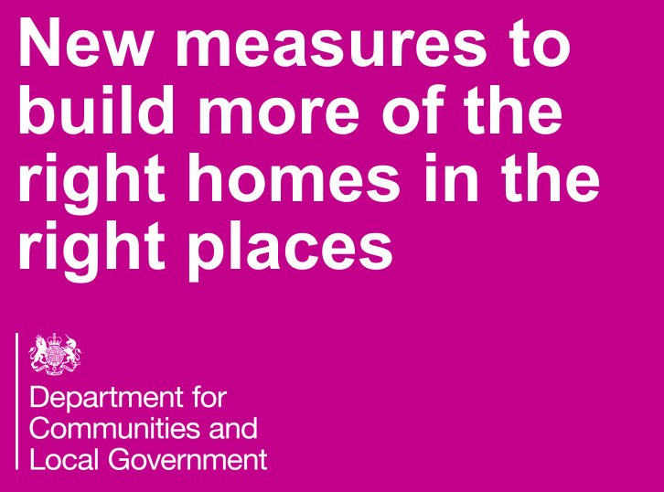

VILLAGE CHARACTER ASSESSMENT - 1
What is it and why are we doing it?
A number of our policies have not been fully accepted:
Strategic gap / Local green spaces / Communal views / Design
We’ve understood that landscape is more than just the countryside; it includes the village’s history and buildings, and the three interact
We aim for the “right homes in the right places” but have struggled to define what that really means
Consultant explained the importance of understanding landscape sensitivity
Although village character is inherent to the Plan it’s not fully defined, nor used to dictate policies that conserve and safeguard it – how to do that?
Every planning decision should be made based on impact to the village’s character
This will all come together in a village character assessment
Landscape Character Assessment
Village History
Townscape Character Assessment

Slide 26
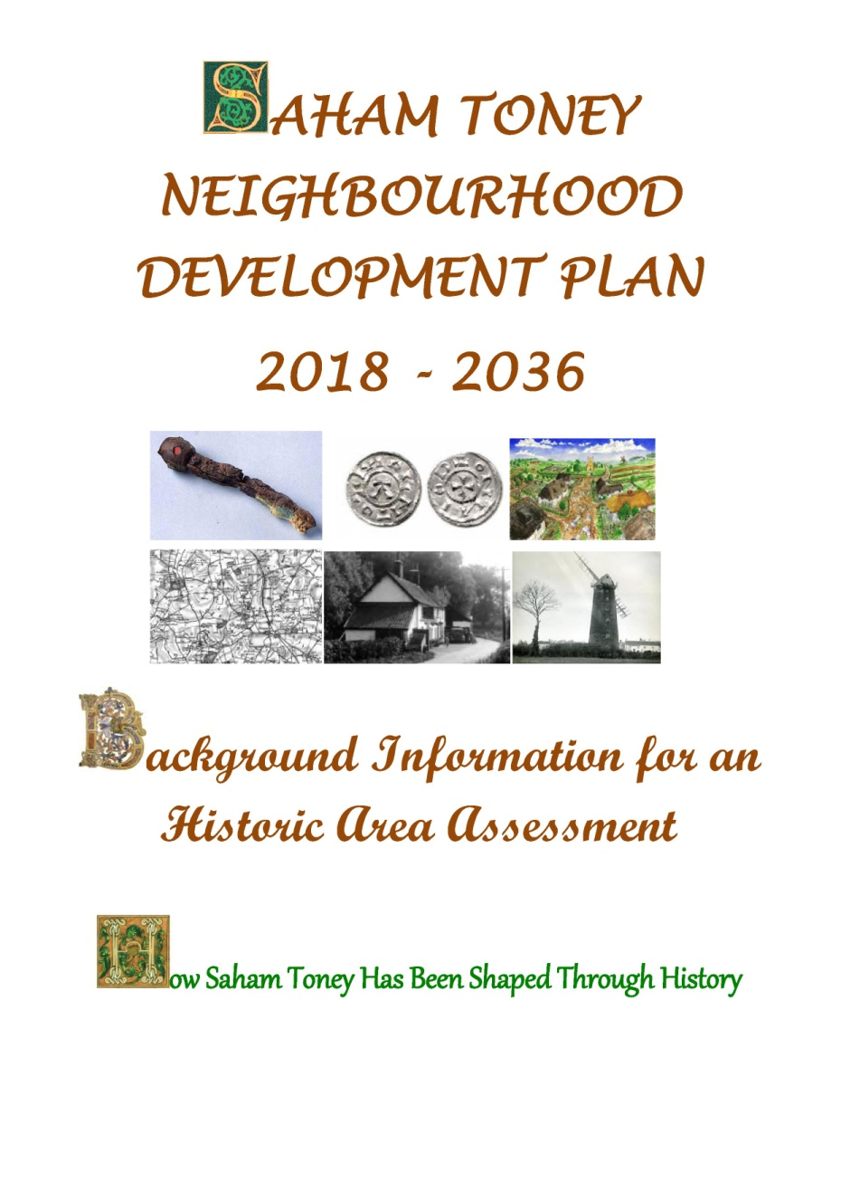
VILLAGE CHARACTER ASSESSMENT - 2
Village Development History Highlights
Farmers here 6,000 years ago
An important settlement for both the Icenis and the Romans, who built 2 forts here
In the past Watton Brook was much larger, and navigable by boats.
The layout of our roads can mostly be traced back at least 2,000 years
For many years Saham was once more important than Watton
Our church evolved from earlier Saxon buildings dating back to the 7th century
In 1612 we had the first village school in Norfolk
Till the mid-20th century roads were gravel tracks
No gas, electricity, running water or mains drainage till 30’s and 40’s
Greatest amount of development came between late sixties and late nineties

Slide 28



VILLAGE CHARACTER ASSESSMENT - 3
Who will be doing it and when?
It will be done by our landscape consultant, Lucy Batchelor-Wylam
Following PC approval of the work, we have just submitted the grant application
Exact timing depends on us receiving a new grant to pay for the work, but we hope Lucy can start in mid-September
Including preparation of reports and recommendations, the work is expected to take about 6 weeks

Slide 29



A VILLAGE CHARACTER ASSESSMENT - 4
What will it involve and how will we use the information?
We will provide historical background information
The parish will be assessed and divided into landscape character areas
The sensitivity of each area to housing development will be defined
Sensitivity will show how each area could accommodate change without undue detrimental effect, by evaluating visual sensitivity and landscape value
An analysis of village character will lead to a comprehensive design guide for future developments that will include both desirable and non-desirable features
Key views will be reassessed and justified
Stronger justification for the strategic gap will be provided
Recommendations for new policy criteria to better conserve our landscape will be made
Landscape sensitivity will be a key factor in site allocations

Slide 30
VILLAGE CHARACTER ASSESSMENT Q&A
Any questions or comments?

Slide 31



SITE ALLOCATIONS - 1
Why are we doing it?
The Plan’s basic aim is to ensure the right homes are built in the right places at the right times – and not to allow the reverse
But at present we don’t have full control over this
The Local Plan dictates in general where houses can be built, but without any firm basis for that
Planners / the Breckland planning committee have the final decision
While Breckland Council want to limit new housing to a precise maximum we’ve been advised they will find that almost impossible to do
Lack of a 5 year supply of housing land in Breckland weakens our policies
We can address these problems by allocating sites in our Plan.
The Parish Council has approved that, and we will start the process in a few days time

Slide 32

SITE ALLOCATIONS - 2
Advantages of allocating sites
Certainty for all about where new housing will – and will not be allowed
Objective process will overcome the emotion that applications attract
Conservation of the best features of village character will be a key criteria
Unlikely a site not allocated would later get permission
Allocated sites will get permission more easily
Instead of the 5 year land supply rule, for the first 2 years of the Plan we will be subject to a 3 year supply rule – so less loopholes for developers
Developments can be phased over time, rather than all in the early years
All three of our consultants support our approach
The only way to ensure the right houses in the right places at the right times

Slide 33
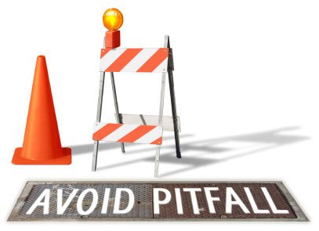

SITE ALLOCATIONS - 3
Potential pitfalls of allocating sites
Can be a contentious or divisive topic within a community
Developers may challenge the process in court and get policies thrown out
Ensuring all those who wish to propose sites are aware
Making sure the whole process is fair and transparent
Sites previously proposed to Breckland will need reassessment if put forward again
Possible delay to finalising the Plan
Missing any individual or group in consultation

Slide 34

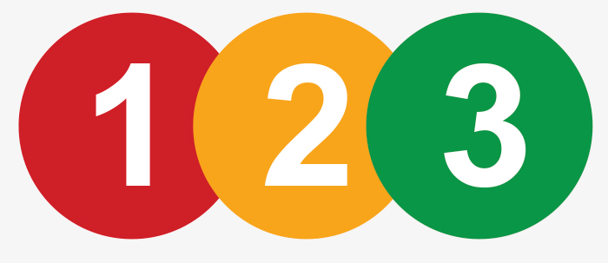
SITE ALLOCATIONS - 4
What will it involve?
Issue a call for sites: this will be open for two months
Publicise it on our website (and hopefully BC’s), in Saga, at PC meetings, on posters, and by writing to landowners / developers who are based outside the village
Collate all information received and clarify proposals
In parallel get approval for a “technical support package” from Locality for an independent group (AECOM) to assess each site proposed
Agree with AECOM local assessment criteria to be added to their standard form
AECOM assess all sites for suitability independently of us and send us a report
Establish the most preferred sites to meet our housing allocation
Define criteria for the granting of future planning permission to each site
Add new site allocation policies to the Plan
CONSULT WITH EVERYONE AT ALL STAGES

Slide 35
SITE ALLOCATIONS Q&A
Any questions or comments?

Slide 36


Repeat of the Reg. 14 consultation
Regulation 14 denoted the first official submission of the Plan for public consultation
Why is this needed?
When will it be?
When we update the Plan it will adhere to the principles we have followed throughout
But it will include new material on village character and site allocations
Both are major issues and quite complex
We consider everyone should have another chance to comment on the changes
As always, comments will help improve what we do
Very approximately we think:
Village character assessment by end October
Site assessments by end November
Plan updated by end December
Repeat consultation mid-January – end February

Slide 37

What else will we be doing?
Incorporating comments from first consultation, where agreed
Informal meetings with Breckland planners
Reviewing planning applications
Keeping you informed
Ever more research
Addressing requirements of the new national planning rules (NPPF)
Drafting new documents needed for the final submission
Consultation Statement
Basic Conditions Statement

Slide 38


IS THE END IN SIGHT?
We’ve decided it’s best not to finalise our Plan before the Local Plan is approved
The latest information we have is that might be in April 2019
Aim to repeat our consultation by end February
Then perhaps 6-8 weeks to update things based on comments
Assess final version of Local Plan for any changes – say a month
Submit final version to Breckland Council end May
Council organises another 6 week consultation till around end-July
Independent examination by say end-September
Village referendum – perhaps a month to organise
If vote is “Yes” Plan approved (Made) – perhaps another month
SO PERHAPS …. NOVEMBER 2019
Alternate: Don’t undertake new work: don’t wait for Local Plan
Then perhaps complete 6 -7 months earlier
BUT WE THINK QUALITY IS MORE IMPORTANT THAN THE FINISH DATE

Slide 39
Any overall questions or comments?
How would you like to be informed / involved?

Slide 40

Thanks for coming!
See you again on 7th December
www.stnp2036.org

