Slide 2
Strategies for Promoting Equity in Clean Energy Deployment
June 27th 2016
Tracy Babbidge, Bureau Chief
Energy Policy

Slide 3



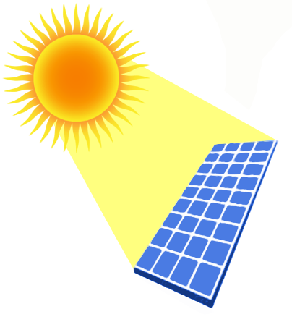


Equitable Distribution: Energy Efficiency and Renewable Energy for All
Notes:
We are trying to build a market, but this market is somewhat unique in that we need every demographic, income class, geographic location to have access to it. Right now, it’s about paying in to develop energy efficiency and renewable energy demand, and we need to ensure that what get’s paid in is spread equally across income levels and the state geographically.

Slide 4
Overview of Equitable Distribution: CGS 16-245ee
Notes:
Requires DEEP to determine if deployment of funds among small load, low-income customers in distressed census tracts is equitable (max., average, monthly peak demand of <100kW in census tracts where the median income does not exceed 60% of the state median income)
CT primarily funds energy efficiency programs through a charge, known as a Conservation Adjustment Mechanism, on all ratepayers’ bills.
In 2014, the charge was increased to support an increased investment in energy efficiency statewide.
DEEP is statutorily required by CGS 16-245ee to assess how these funds are disbursed across the state to ratepayers. Specifically, we look to ensure that distressed census tracts are receiving their equitable shares.
We do this on a utility basis, evaluating Eversource and UI’s performances separately as they both have their own territories.

Slide 5
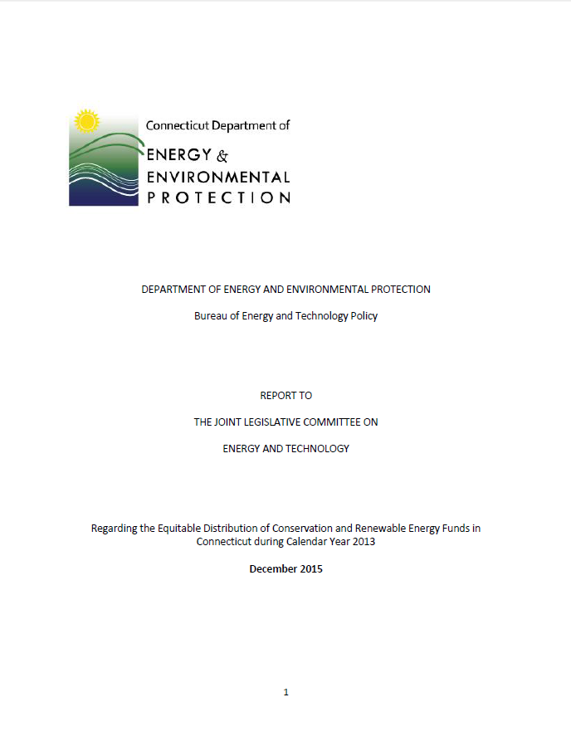
2013 Equitable Distribution Report
2013 Equitable Distribution Report
Currently preparing a joint 2014-2015 report (est. completion December 2016)
Notes:
-Completed December 2013 and filed this spring
-Now evaluating 2014 and 2015

Slide 6
2013 Equitable Distribution Report
First time census tract-based data available
  Eversource: 25% of distressed tracts equitable
  UI: 66% of distressed tracts equitable
  CT Green Bank: 10% of distressed tracts equitable
DEEP has identified several improvements needed for future reports
  Evaluation methods
  Data submission processes
  Census tract identification processes
Notes:
The 2010, and 2011-2012 reports, though statutorily required to report on a census-tract-basis, used municipal data and the DECD’s distressed community list due to technological barriers.
2013 was the first year that the companies were able to report on a census tract basis and the first time the Department was able to evaluate on those parameters.
The Department found that when assessing each company’s data for the equitable distribution to small load customers in distressed tracts, as required statutorily, only UI achieved ED (2/3 of distressed census tracts).
Overall, each utility had achieved equitable distribution but since we must assess them on a census-tract-by-census tract basis, Eversource did not achieve equitable distribution in 75% of its distressed tracts.
The Green Bank only records census tracts in which a project was installed because, unlike utility companies, the Green Bank only serves customers that seek them out (on the other hand, everyone needs energy from the utilities).
Therefore, understandably, the census tract data was more limited.
DEEP cross referenced the Green Bank’s “distressed census tracts” with those identified by the utilities in order to maintain a more consistent evaluation.
With this, DEEP found that of the total 77 distressed census tracts identified by the companies, only 18 had renewable projects and of that, only 8 received incentives greater than their 1 Mill contributions.
DEEP acknowledges that the amount of incentives allocated to a given census tract is largely driven by the level of customer participation in a given census tract.
DEEP is also mindful that the EDCs have energy efficiency programs that specifically target income-eligible customers, whereas the Green Bank’s programs are more geared towards advancing the deployment of renewable energy technology, which require considerable investment by participants.
Accordingly, ratepayers of more limited financial means are far less likely to participate in the Green Bank’s standard programs.
DEEP recognizes that there are many improvements that have been made in following submissions and evaluation processes and therefore has not held this report against any of the companies, and will likely do the same with the ‘14-’15 evaluation.
But, the Department has encouraged them going forward to continue to make ED a priority in their program planning.

Slide 7
Equitable Distribution Funding in New Haven
Ratepayer Collections & Incentives In Distressed Census Tracts
Year | 3 Mill | Incentives
2013 | $537,937 | $1,625,606
2014 | $3,267,810 | $3,755,487
2015 | $2,775,283 | $3,099,072
Energy Efficiency
Ratepayer Collections & Incentives In Distressed Census Tracts*
Year | 1 Mill | Incentives
2013 | $179,312 | $118,488
2014 | $1,089,370 | $210,114
2015 | $925,094 | (n/a)**
Renewable Energy
*Estimates
**Not available at this time
Notes:
Energy Efficiency
Specifically in New Haven, where roughly 19/32 census tracts qualify as “distressed”
Overall, census tracts in New Haven are receiving greater % of total statewide incentives than their % contributions
However, on a census-tract by census-tract basis, DEEP has found that of the 19 distressed tracts, only 6 were receiving equitable shares of incentives
Renewable Energy
18 projects total across all of New haven ( mostly residential solar)
DEEP acknowledges that the amount of incentives allocated to a given census tract is largely driven by the level of customer participation in a given census tract.
DEEP is also mindful that the EDCs have energy efficiency programs that specifically target income-eligible customers, whereas the Green Bank’s programs are more geared towards advancing the deployment of renewable energy technology, which require considerable investment by participants.
Accordingly, ratepayers of more limited financial means are far less likely to participate in the Green Bank’s standard programs.
This is why we need to find other methods to scale up renewable energy access to low-income and distressed communities. An example was given at the EEB Board meeting this Wednesday that for some low-income residents, the money is not the only barrier but things like their roof is literally about to cave in.
….transition to community solar and maybe some support and cheering-on of Posigen/ CGB Solar for All program……………

Slide 8
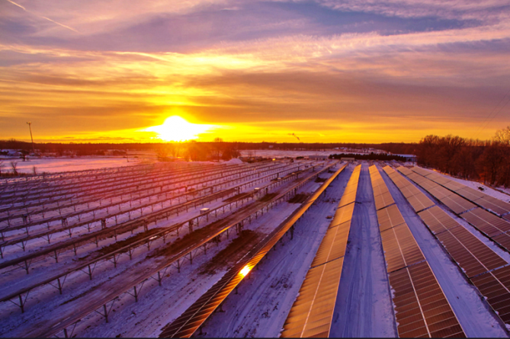
Shared Clean Energy Facilities
Alternative access to clean energy for electric ratepayers
  Suited for customers without access to rooftop solar (i.e. renters, shady roof)
  Potential to reduce energy costs for low income customers
Customers subscribe to a clean energy facility
  Receive credits for their share of the facility output
Notes:
Photo from EERE website

Slide 9
Pilot Program: Public Act 15-113
DEEP authorized to implement 6 MW pilot program (4 MW in Eversource; 2 MW in UI)
  Facility selection through a competitive RFP process
Status:
  May 20: Draft RFP released for comment
  June 20: Comments received
  July 1: Final RFP for bid
  July 7: Bidders’ conference
  September 1: Bids due
  Fall 2016: DEEP selection and PURA approval
Notes:
Photo from EnergizeCT

Slide 10
Questions?
Tracy.Babbidge@ct.gov

