Slide 1

The Grant Making Ecosystem
Bridget’s bio
Born in Invercargill
Bcom Hns at Otago
Wellington in banking and energy for 17 years
Christchurch Recover Canterbury and Rata Foundation
Founder of Delfi.co.nz
On board of two NFPs
Partnership Manager at Space Craft Systems
Reluctant Netball coach
Lunch co-ordinator at school
Chauffeur, Tutor, Cleaner, Cook and Counsellor to three girls
Notes:
Hello and welcome. I’m Bridget Frame. Bio up on screen. Putting a label on me: I guess I’m just a concerned citizen.
When I first started looking at this, there was no information about the complete picture of grantmaking in Canterbury. So I used publicly available information, and pulled together a database of Canterbury grants from 20 different funders. This is the culmination of hundreds of hours work.

Slide 2
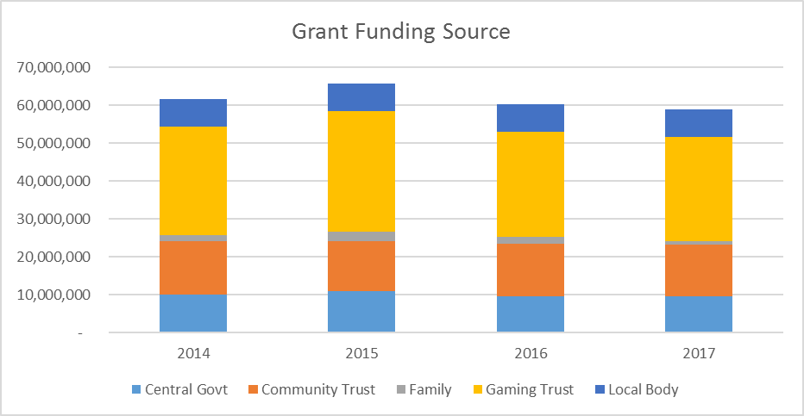
Supply - Where the money comes from
Delfi work from publically available sources
Excluding earthquake funds
2014 DIA data not correct but assumptions made
Notes:
Over the last four years, Canterbury organisations have received at least $239m. If we assume that Canterbury is representative of the rest of New Zealand, that’s at least $700m per annum going into the community from funders.
Each year over 4500 grants go into the Canterbury community, at an average amount of $12,400.
There are a bunch of supply issues: just under half of this funding comes from gaming trusts. And if we add in Central Government funding, both from Creative New Zealand and DIA, then almost 2/3 of community funding comes from gambling.
Disclosure is another. I want open transparent systems. This is where the gaming trusts shine: their disclosure is awesome(ish). Disturbingly, family trusts are moving away from openness, so the data is no longer available.

Slide 3
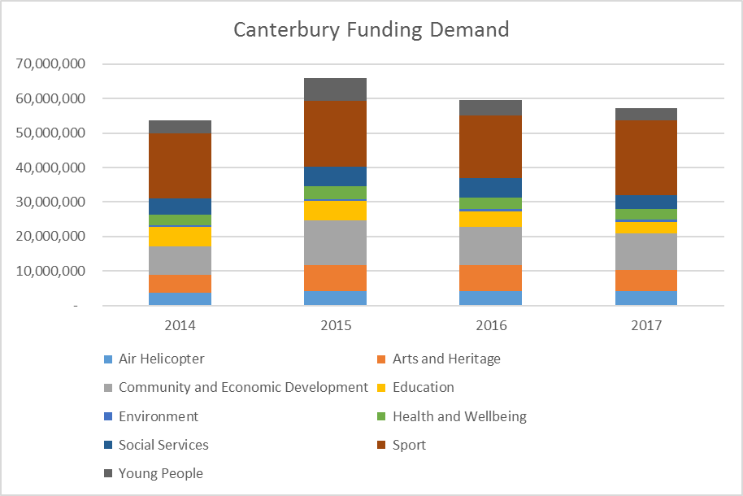
Demand. Where the money goes
2014 DIA assumptions removed
Grant recipients tagged using old Rata classifications
Notes:
Now lets look at demand. In Canterbury, the Sport sector receives the largest piece of the pie, with a third of funds going there. The next largest recipient is Community at 18%, followed by Arts on 11% and Education, Young People and Social Services all sit on 8%.
What do you think … the sports slice. Too much? Too little? Rugby Union gets the most with an average of just over $3.0 million dollars going into Canterbury rugby a year: over $200 per registered player.
The first female dominant sport to get any funding is Netball. It’s 13th on the list. and it gets $569k.
Now, there are a myriad of issues around demand for grant money. I’d like to touch on a few.

Slide 4
Demand: issues
Middle Class capture
  59% to “middle class” groups
  32% to the wider community
  Balance to poorer communities
  Public vs private benefit
Money eroding community aspects
Charitable Purpose
Benchmarking
Growth in demand
Notes:
Middle Class capture - which I guess means that the folks who actually don’t need stuff get stuff. I looked at 2015 Lion data. Some 59% of money is going to those “middle class” organisations such as choirs, sports clubs such as Bowls, Marching (and of course rugby and cricket), and high decile schools, 32% to the wider community (ie, anyone) and the balance to poorer communities. Us middle class are perfectly entitled to ask for support, but this entitlement can sometimes mean that what is to all intents and purposes a hobby can become a leech on the grant making dollar. Now, I have no basis for the categorisation other than my own bias. But regardless of the numbers: it’s an important conversation for us to have.
I also think money can get the way of the community elements of some organisations. I have recently stepped down as president of a $30k per annum social enterprise where we used fund raising events as a catalyst to bring families together – I am of course referring to the school PTA. We all know that it takes a village to raise a child: creating that strong village must override any demands for iPads or what ever the school wants.
Now charitable purpose is another wee issue. Our legislation is based on 400 year old thinking around what charity is. Yet as citizens we decided some time ago that universal education was a right for all Kiwi kids. Our fastest growing belief set is atheism. Yet these two elements, religion and education, are specifically covered by current legislation.
Benchmarking is rather fascinating, and is really only possible with good information. I had a look at rescue helicopters, and was surprised to see government funding ranging from 80% of total costs in Otago, down to 30% of total cost in Canterbury. Preschools can be interesting too, with some NFPs costing $16k per child per year, while others sit at $9k.
When supply increases then so does demand. I compared the accounts of one rugby club in 1999 and in 2016. Expenses were largely the same: except for wages which has grown from 0 to $135k. This is a great example of how demand for funds has grown to meet supply. Its symptomatic of the grant making ecosystem.

Slide 5
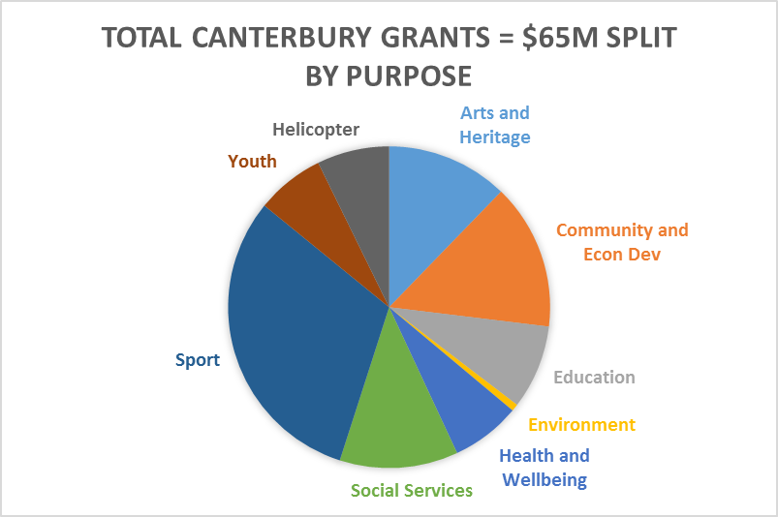
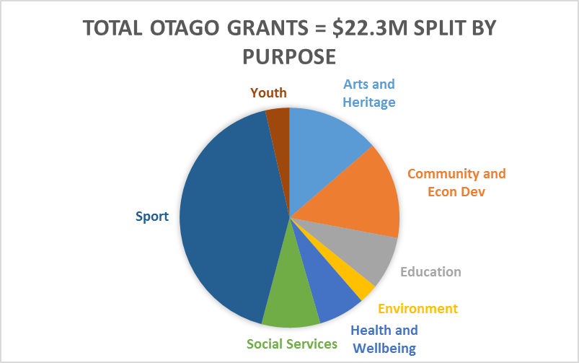
Demand Issues: Provincial Ecosystem
Notes:
Now where this can get fun is comparing different regions with each other. Often funders are regionally based, which leads them to their own view of how the system works. The good folk at Otago Community Trust were kind enough to pay me to look at Otago. Youth is quite interesting to drill down into. Canterbury youth organisations got $4.4m - $75 per head, while Otago groups got $800k or $25 per head. Are Cantab youth more needy than Otagos? Or is Otago underserviced in this space? I have no answers here, but interesting don’t you think?
The other tricky to talk about aspect is around religion. In Canterbury we have a number of particularly evangelical organisations engaged in this work: some employing only congregation members. Indeed, by my reckoning they get around half of youth community funding in Canterbury. And if they make the community a better place then good luck to them. But how do you ensure you walk the line between recruitment, supporting a flagging revenue model and community benefit?

Slide 6
Systematic Failures: Things to think about
Cost to Serve: $260m per annum
Government funding:
  Levels to specific groups
  % funding to sectors
Corporate funding:
  Virtue Laundering
  Cost to serve
Whose voice do we hear?
  The issues are defined by the gatekeepers
Notes:
Some of my earlier work suggests that the cost of this process to NZ Inc is around $260m per annum, and that a grant costs around $4k to get into the community. We need to do some thinking about cost to serve. A 20% improvement is worth $52m per annum. If we can make this process more EFFICIENT, we can give more money to groups that are EFFECTIVE.
There are some scary metrics out there: I met with a funder whose grants cost over $6 to get $1 into the community. Or the group charged with community building in a low income area with many young families, attracting over $150k per annum in grants, with 150 Facebook likes.
The Air Rescue Gaming Trust is a perfect example of system failure, yet what they do is completely legit. They’re a special purpose Class 4 trust, set up to fund the Canterbury rescue helicopter. Last year the gaming trust generated more than $8m which they gave away in grants. The rescue helicopter operation received some $4.2m of that, and got another $1.8m from the community. I reckon the gaming trust could have funded all of the helicopter deficit, saved around $900k in costs, which in turn could have increased the amount they gave away.
The focus here is on Grants. I’d love to have government funding numbers in this… but there seems no simple data source for this. Secondly – have we had a decent discussion lately about the levels of government funding to NGOs. If NGOs are delivering stuff, particularly social services, on behalf of the taxpayer to the community AND they are doing a great job, then why do they have to rattle the tin for grants and philanthropy?
Corporate giving. We are familiar with green wash, but it strikes me that many of our businesses engage in what I am calling Virtue Laundering. Z’s Good in the Hood is a great example of this: giving away $1m to local charities. Sounds lovely… but if we look at the numbers it boils down to around $1k per charity. And selection is effectively a popularity contest. How much of their $36m marketing budget goes on telling us all about the programme? Christchurch Airports gave away $45k in 2016… at an estimated gross cost of $36k.
Voices. There are a bunch of reasons we struggle to have these discussions. Like it or not, there is a power relationship between grant makers and NFPs which reduces the ability for candid conversation. Jacqui Blue the other day said a wee gem which I have paraphrased: issues around this are defined by the gate keepers. Or to paraphrase slightly more crudely, turkeys don’t vote for Christmas.
And lastly, do the gaming trusts actually see themselves as grant makers? Last year they put over $340m into the community, so they certainly are. Yet none are members of Philanthropy NZ.

Slide 7
Imagine: Trip Advisor for Charities
Purpose
  Helping to ensure that well managed, best practice NFPs are able to sustainably deliver on their objectives by casting sunlight onto the Not for Profit sector.
Solution
  One stop shop for NFP evaluation leveraging best practice assessment and using crowd sourcing
  Grant data free and available
  Development of Effective NFP tick
High Level Concept
  All NFPs listed on site
  Best practice assessment criteria
  Socially aware citizens complete assessments
  Considerable data around grants made, declined, benchmarking and strategic overviews
Impact
  Better organisations receiving the funds they need to carry out their operations
  Evaluators connected to communities
  More money going into community groups through more efficient assessment processes
Notes:
I’m keen to throw away the current grants system and start again. We should take process away from the discussion. So, rather than a grant maker centric model we have now, how can we create a community centric one. One where the citizen sector get to decide which groups actually deliver worthwhile stuff within their communities. I personally am fed up with children being killed and hurt by those who are supposed to care. These are failures of our community. We deserve a strong NFP sector, and healthy constructive critique beyond brand and into substantive delivery, is one way to help achieve this.
My wee idea here is around a Trip Advisor for Charities sort of thing. Evaluation using an open transparent system, over factors such as governance, impact, learning and sharing. This would strip some of the dark art around the process, and has the potential to considerably reduce cost to serve, and have more informed citizens participating within the ecosystem.

Slide 8
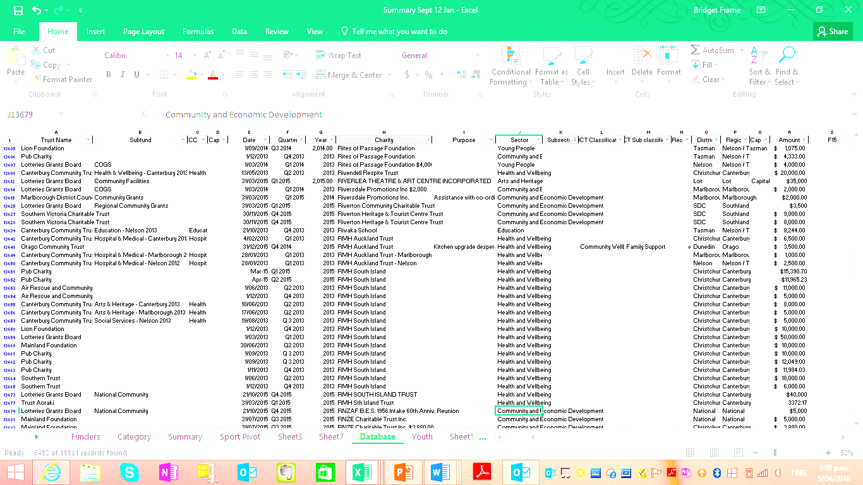
Bridget Frame
www.delfi.co.nz
027 226 0562
bridget@delfi.co.nz
Check out my blog at www.delfi.co.nz
Notes:
I’ve started Delfi because I believe that if we want to get our philanthropic ecosystem back into balance, the first thing we need to do is understand it: where the money comes from, where it goes, and how it gets there. If we have some greater analysis of the overall ecosystem, we can make better decisions and have stronger communities. Thanks, and I’d love to chat.

