Slide 1
Robbin L. Marcus
www.robbinlmarcus.com
Alexander Technique
for Musicians and Educators
Making Music with Ease
Presented
September 2, 2025
For the Berry College Music Department

Slide 2
The Alexander Principles
1) Awareness
2) Inhibition (pause)
3) Directions

Slide 3
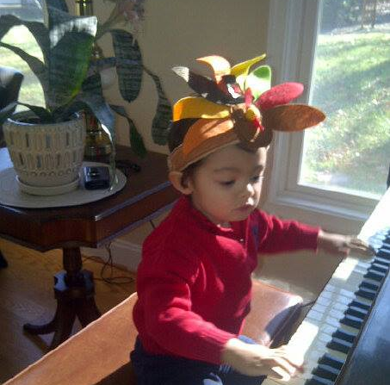
Natural poise and grace
When we begin, we all look like this.

Slide 4
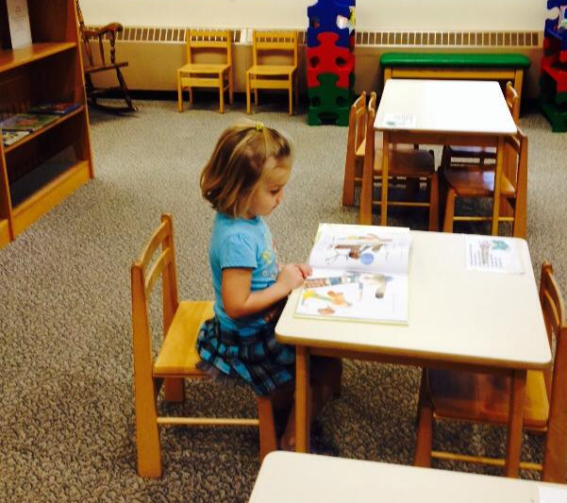
Head balanced on top of spine

Slide 5
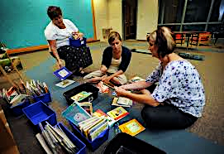
Adults Sitting

Slide 6
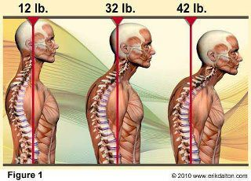
Spine Health = 10 lbs of pressure per inch

Slide 7
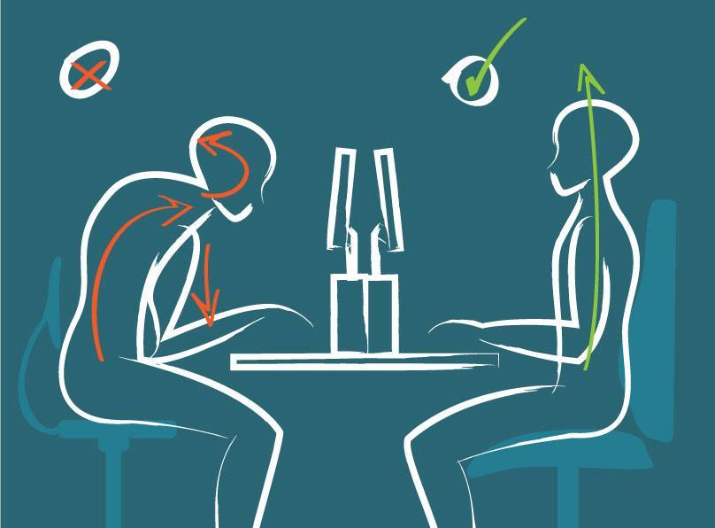
Where and how we spend our time
Head forward posture Properly aligned use

Slide 8
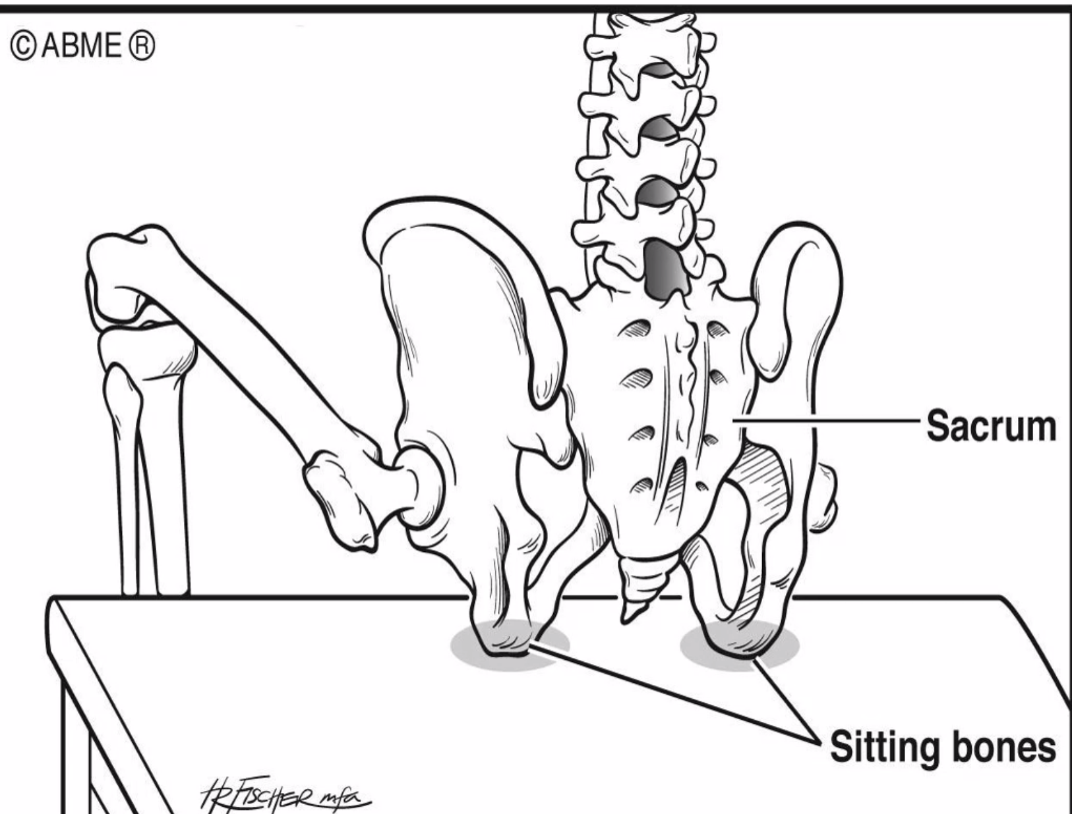
Where are my sit bones?

Slide 9
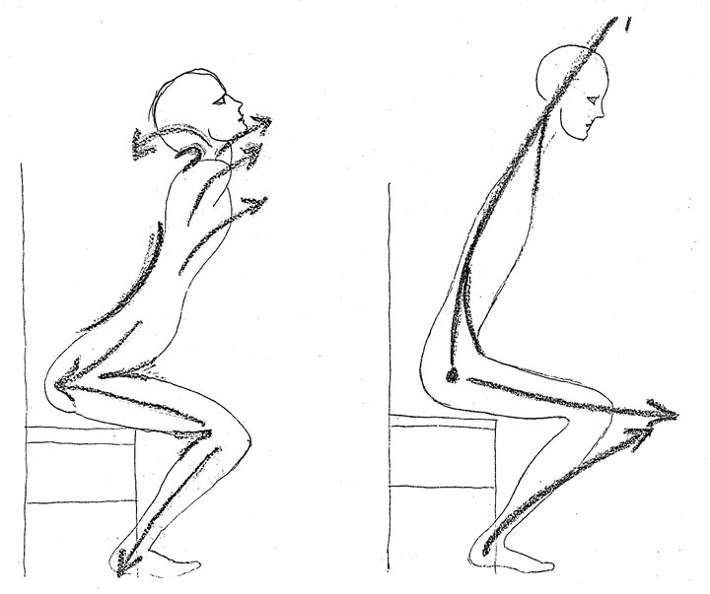
Getting up with ease from a seat

Slide 10
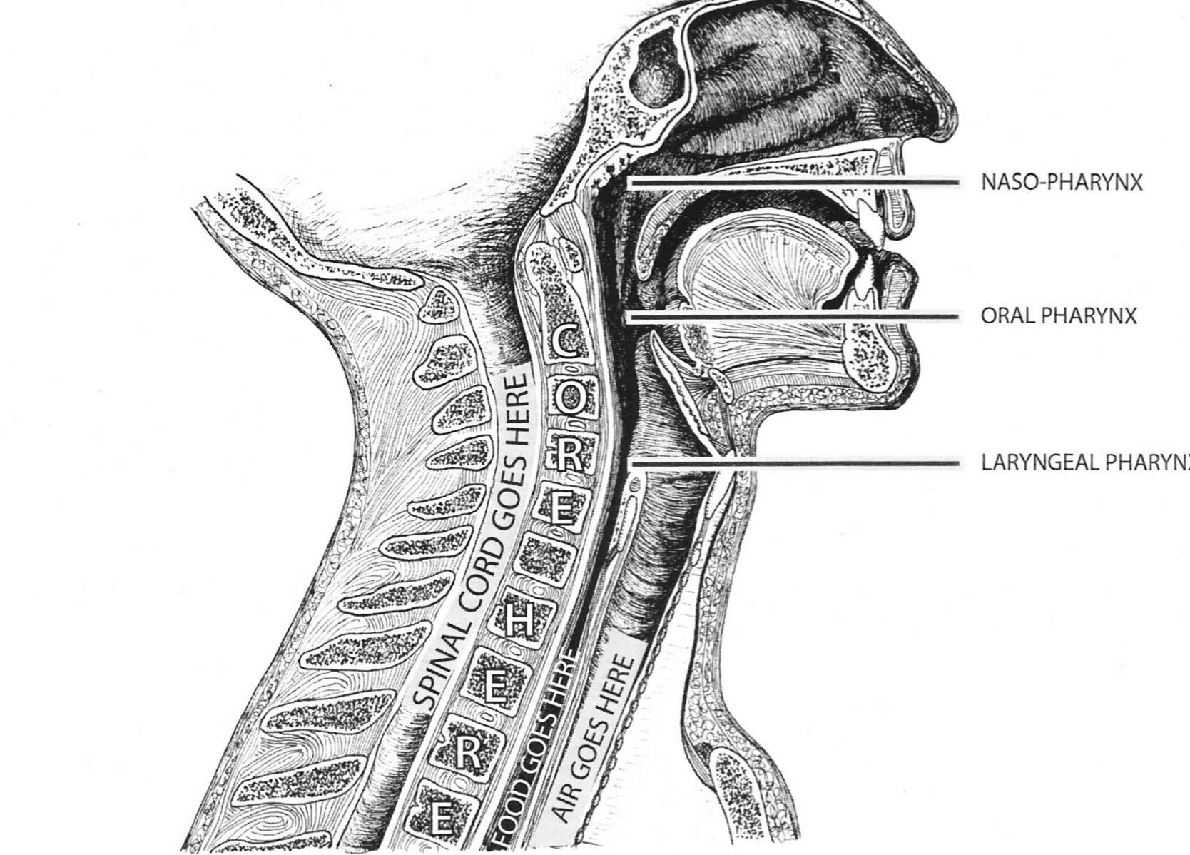
Cross section of neck and head

Slide 11
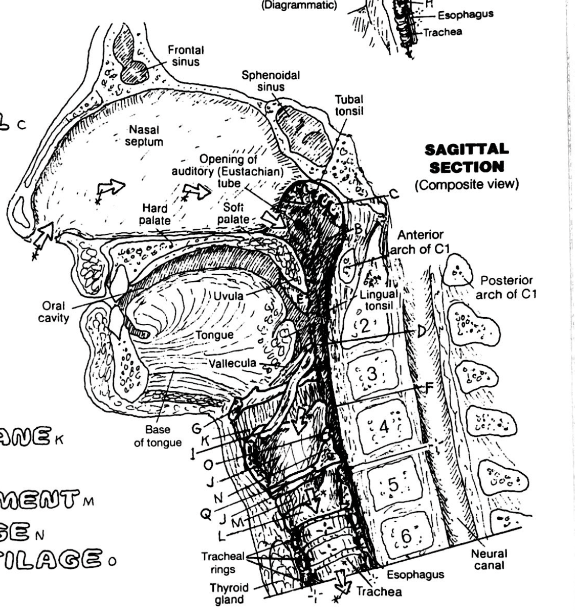




Where is my larynx?
The larynx hangs on the hyoid bone for support, which allows it to move up and down freely as we talk, swallow or sing.

Slide 12
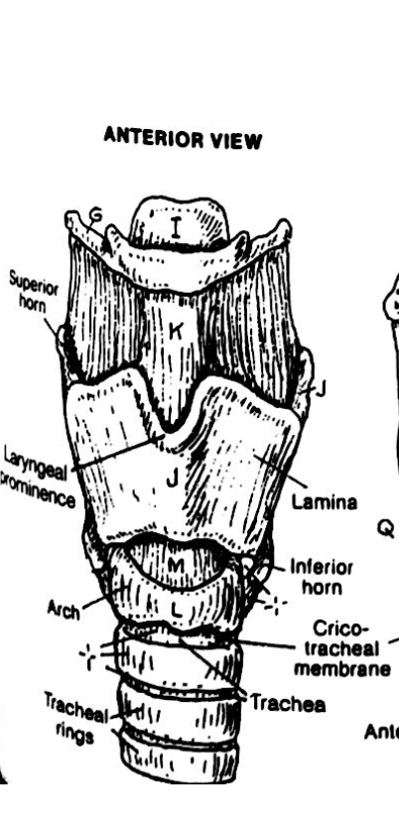
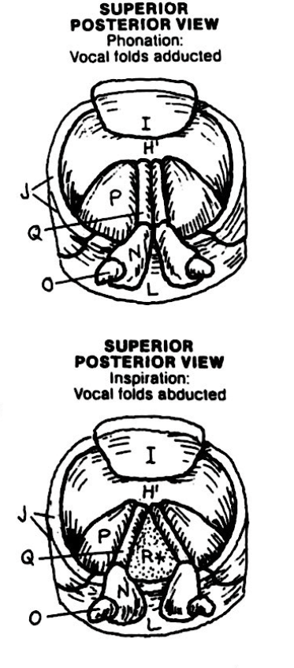












Larynx views: front and from above
Hyoid bone
Lamina
Tracheal rings
Vocal folds
Phonation
Inspiration

Slide 13




The Soft Palate in Singing
Sound from the vocal folds in the larynx vibrates in the soft palate.
The soft palate is the cupola and star of our resonator system.
Other resonators are the hard palate and the sinus cavities.

Slide 14
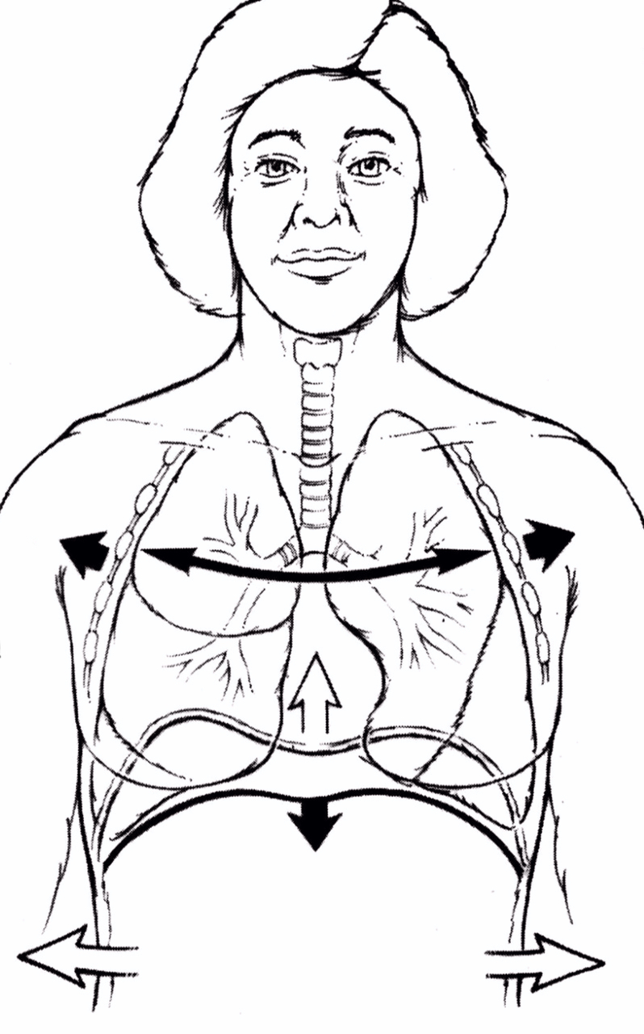
How we breathe
On the inhale, the diaphragm descends towards the pelvic floor, our lungs and torso widen.
On the exhale, the air leaves the lungs as the diaphragm ascends.
Notes:
The Art of Breathing video – 18 minutes – go through with them again to answer questions. Slides 13-14 on breath and the motion of the diaphragm.

Slide 15
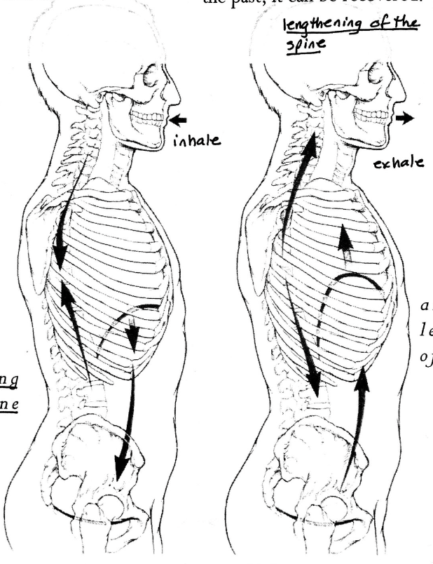
How we are breathed.
The spine alternates between
lengthening and gathering
when we breathe.
On the inhale (left) the spine
gathers as we widen with the breath.
On the exhale, (right) the spine
lengthens as the air leaves the body.
These motions occur because of the movement of the diaphragm.
The diaphragm initiates breathing.

Slide 16
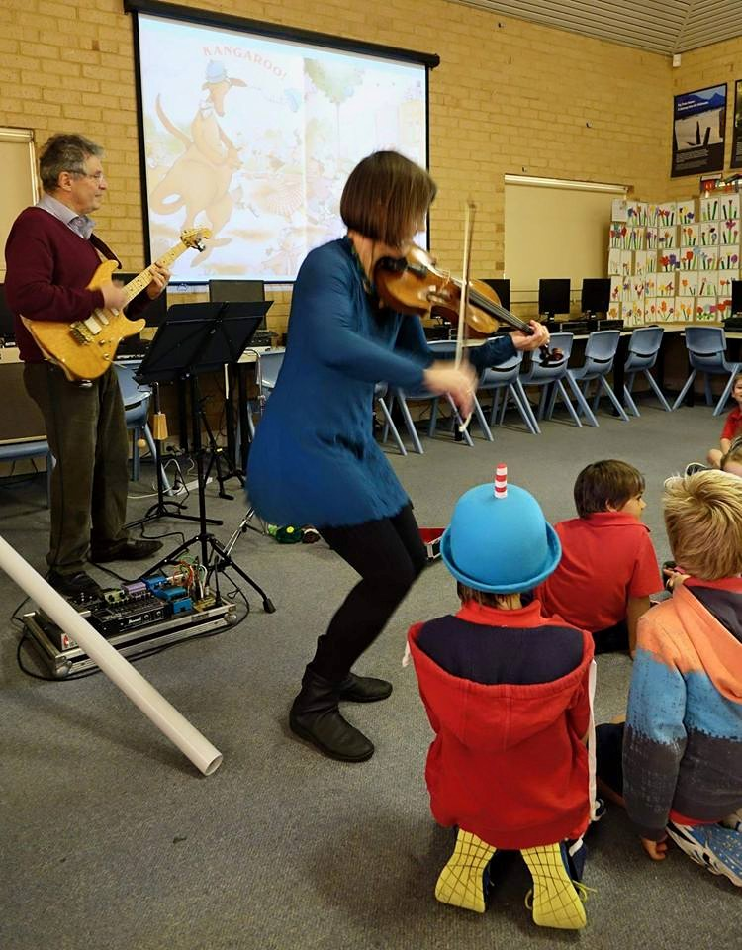
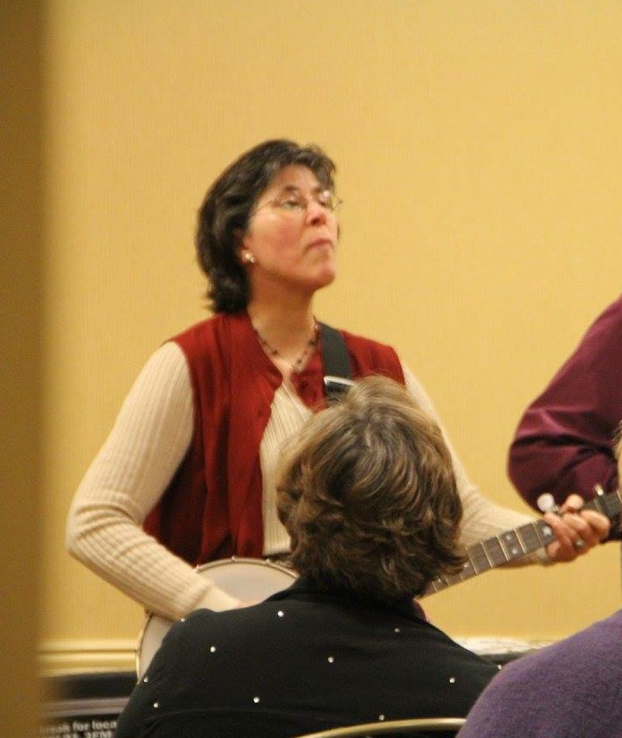
Contrasts in poise and ease

Slide 17
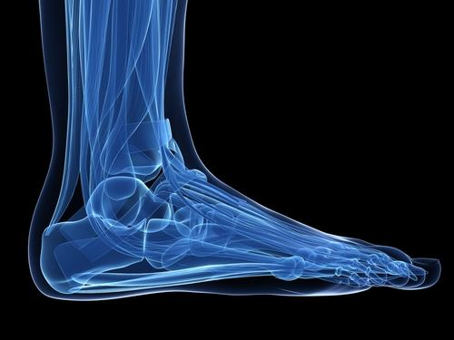


The outside of the foot

Slide 18
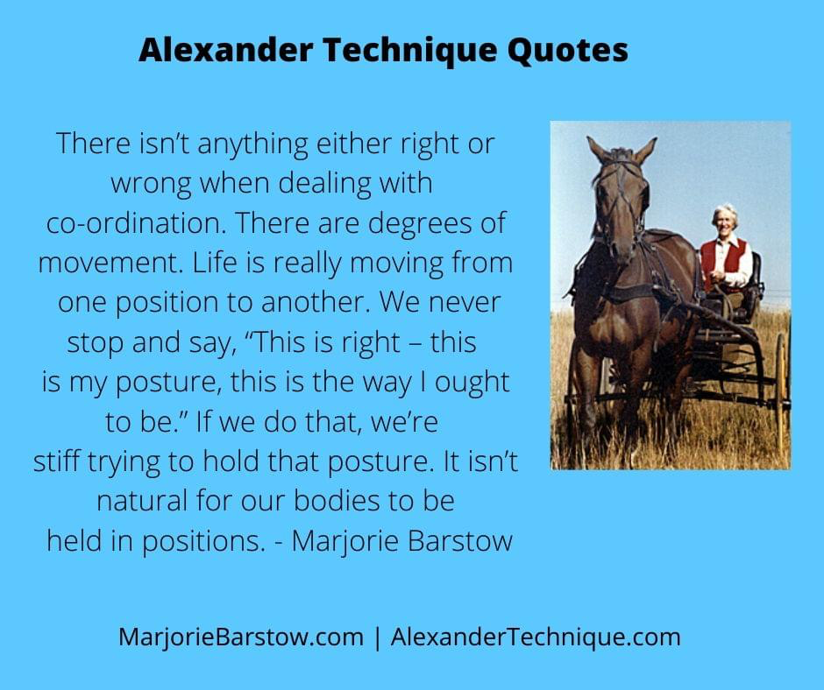
We are designed for movement

Slide 19
The Alexander Principles
1) Awareness
2) Inhibition (pause)
3) Directions

Slide 20
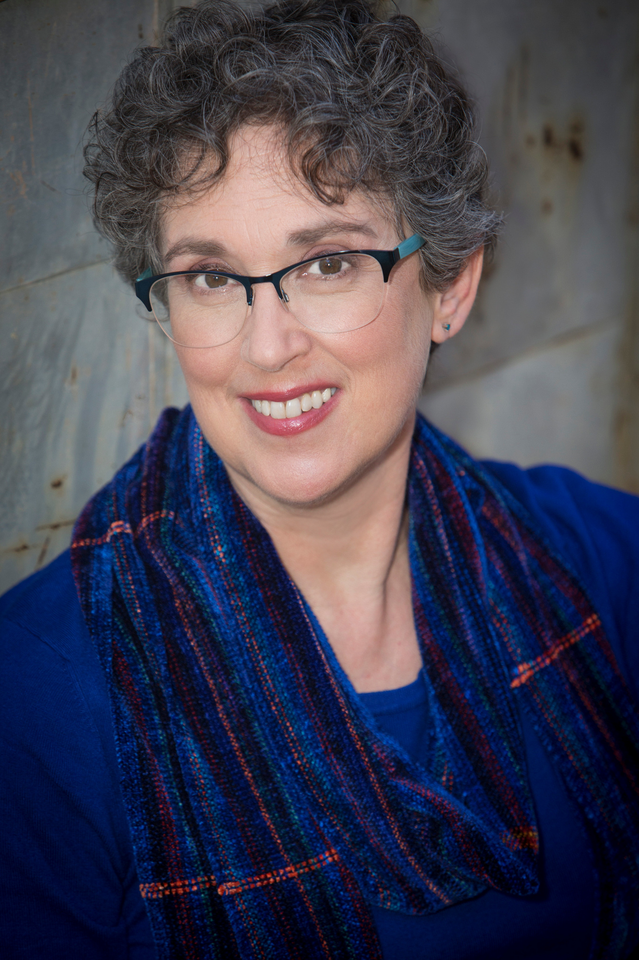
About
Robbin Marcus
Robbin Marcus is an ATI Certified Alexander Technique Teacher with a studio in Decatur, GA.
Robbin teaches private Alexander lessons at the First Christian Church of Decatur, 601 W Ponce de Leon Ave, Decatur GA.
Contact information:
Phone: 410-428-6841
Email: robbin@robbinmarcusmusic.com
Website: https://www.robbinlmarcus.com/alexander-technique.html
Facebook: www.facebook.com/AlexanderTDecatur
Robbin also teaches piano lessons to students of all ages. She is the Founding Director of the George Mason University Summer Kodály Program.

Slide 21
Robbin L Marcus
www.RobbinLMarcus.com
RobbinLMarcus@gmail.com
More Alexander Technique Information
Alexander Technique Informational Websites:
www.alexandertechnique.com
www.robbinlmarcus.com/alexander-technique.html
Robbin on Facebook: www.facebook.com/AlexanderTDecatur
Alexander Technique International
www. https://www.ati-net.com/index.php

